Slide 1
Sample Analysis Methodology for Telluric Purification
2023/08/18
James Smith
Co-op Summer ‘23

Slide 2

The SNO+ Detector

Slide 3
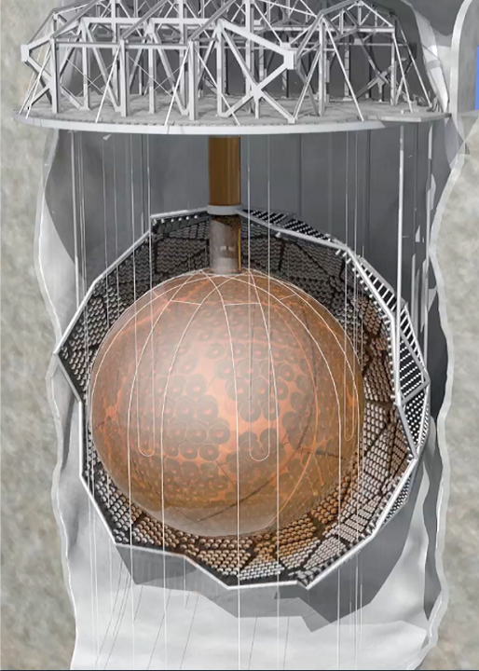
SNO+ Detector
Located at SNOLAB
780 tonnes of liquid scintillator
Scintillation light is detected by ~10,000 PMTs
Extremely sensitive to low-energy particle interactions
AV
PMTs

Slide 4
Neutrinoless Double Beta Decay (0νββ)

Slide 5
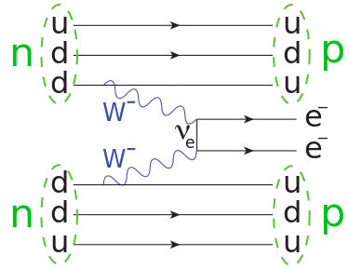
Neutrinoless Double Beta Decay (0νββ)
Conventional double beta decay has been observed
For 0νββ to occur, neutrinos must be “majorana” in nature
Observation of 0νββ would be a groundbreaking discovery in particle physics
  Matter/Antimatter asymmetry
Theorized to occur in many different isotopes

Slide 6
Backgrounds

Slide 7
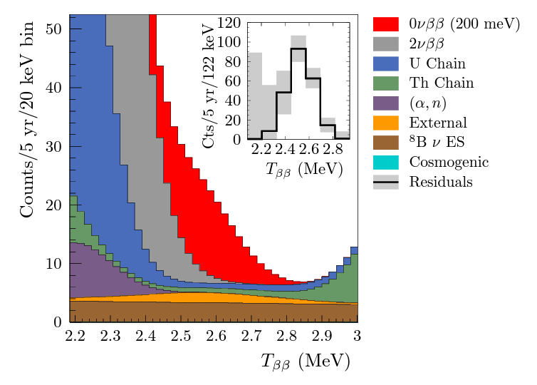
Backgrounds in SNO+
Since SNO+ is very sensitive to low-energy interactions, it must be isolated from high-energy particles such as:
  Muons from cosmogenic sources
  Alpha and beta decays from radioactive isotopes
Contamination from radioactive isotopes can exist in:
  Materials used to construct the detector
  Cavity water
  Cover gas system
  Liquid scintillator cocktail

Slide 8
Overview of the TeA Plant

Slide 9
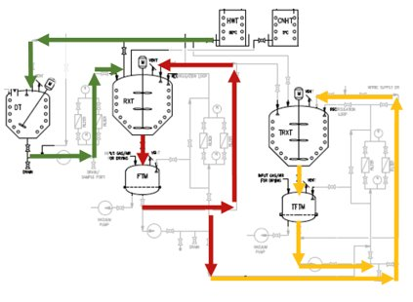
Telluric Acid Purification
Telluric acid crystals are dissolved in water
Particulates are filtered out
TeA is recrystallized and rinsed with nitric acid
TeA is thermally recrystallized and rinsed with UPW
Final product is dried with filtered air
Synthesized with butanediol before being added to the scintillator cocktail

Slide 10
First TeA “Test” Batch

Slide 11
First TeA “Test” Batch
Planned to take place during the fall of 2023
Will provide insight into the physical and chemical processes
Verify the procedures and plant operations
Samples will be taken at different steps along the way in order to:
  Analyze the chemical processes
  Precisely determine the levels of radioactive isotopes
    Uranium and Thorium

Slide 12
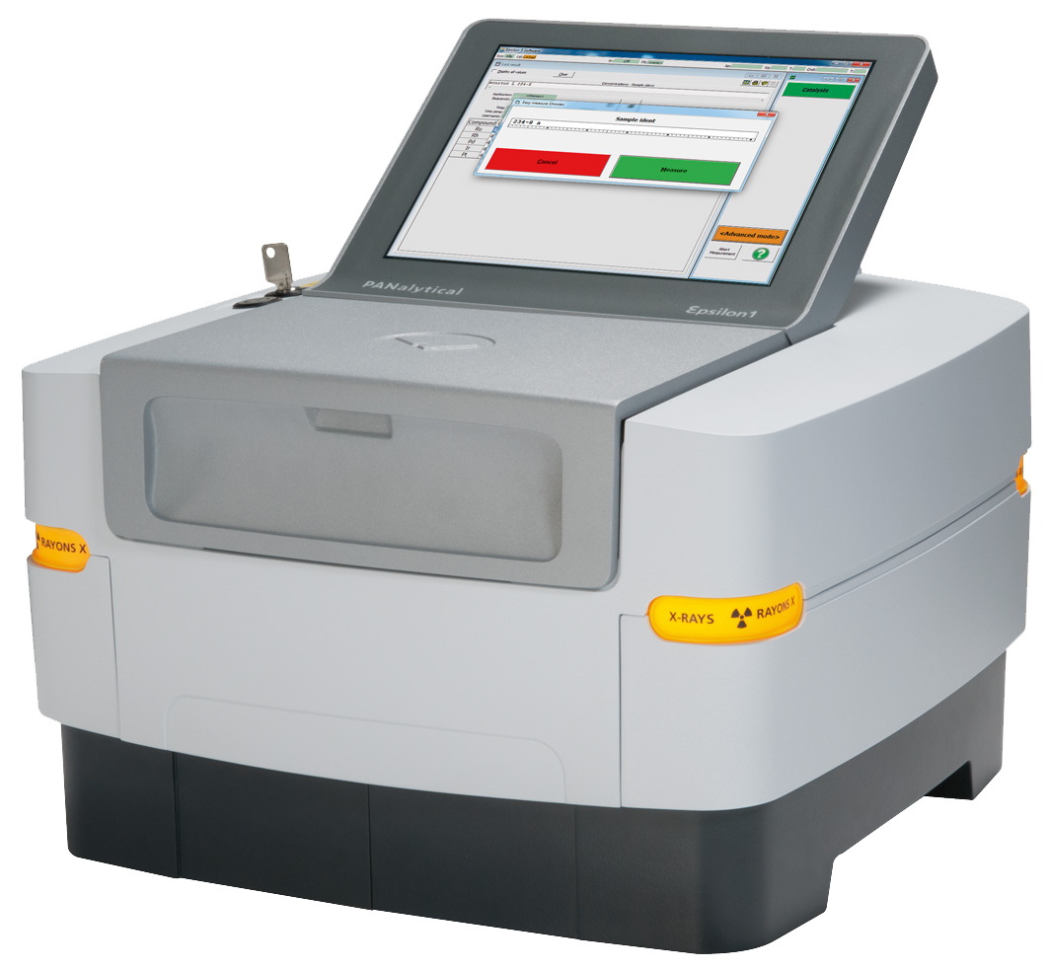
Process Analysis: XRF for TeA Concentration
X-Ray Fluorescence Spectroscopy (XRF) will be used to determine the concentration of Telluric Acid
Will be performed in the U/G chem lab by a trained operator

Slide 13

X-Ray Fluorescence Spectroscopy
An x-ray beam is directed at a sample causing core electrons to be excited from the ground state for a brief moment
When the electrons relax, they emit a photon
The energies from these photons can be used to determine the elemental makeup of the sample
The amount of tellurium present in the sample will reveal the concentration

Slide 14
Process Analysis: UV/Vis for Nitric Acid Concentration
Ultraviolet-visible Spectroscopy (UV/Vis) will be used to determine the concentration of Nitric Acid
Will be performed in the U/G chem lab by a trained operator

Slide 15
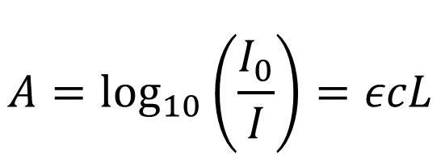
Ultraviolet-Visible Spectroscopy
Uses lower energy UV/Visible light to analyze a sample
Relies on the absorption of light rather than emmision
Can determine the concentration of a sample using the Beer-Lambert law:
$$A=\log_{10}\left(\frac{I_{0}}{I}\right)=εcL$$

Slide 16
Contamination Analysis: ICP-MS for TeA
Inductively Coupled Plasma Mass Spectrometry (ICP-MS) will be used to determine the concentration of Uranium and Thorium in the TeA
ICP-MS will be done on the TeA prior to purification and after
  To determine the effectiveness of the plant
  Ensure the product meets the strict backgrounds budget
    10⁻¹⁵ g of ²³⁸U/g of TeLS
While SNOLAB does have an ICP-MS, this analysis will be conducted off site

Slide 17
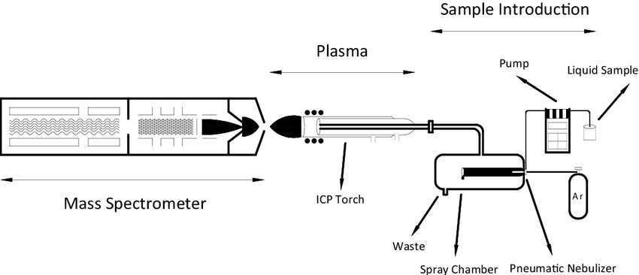
Inductively Coupled Plasma Mass Spectrometry
A high energy plasma is used to ionize a sample
Lenses and vacuum systems focus the ions into a beam
Mass spectrometer filters the ions by their mass to charge ratio
Allows for extremely precise measurements of the concentrations of elements

Slide 18
Thank you for Listening

