Slide 1
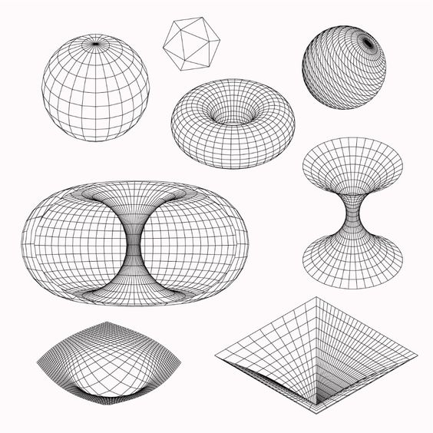


Spinning Massive Amplitudes from
The Flat limit of CFT correlators
Raffaele Marotta
INFN Naples
Based on:
Kostas Skenderis, Mritunjay Verma and R. M., Momentum space CFT correlators of non-conserved spinning operators, JHEP 03 (2023) 196.
Kostas Skenderis, Mritunjay Verma and R. M., Flat space spinning massive amplitudes from momentum space CFT, JHEP 08 (2024) 226.
.

Slide 2
Plan of the Talk
Motivations
Momentum space CFT correlators of non-conserved spinning operators
Bulk 3-point functions.
Flat limit of the three points.
Conclusions
Momentum Space n
SPINNING MASSIVE AMPLITUDES FROM THE FLAT LIMIT OF CFT CORRELATORS

Slide 3
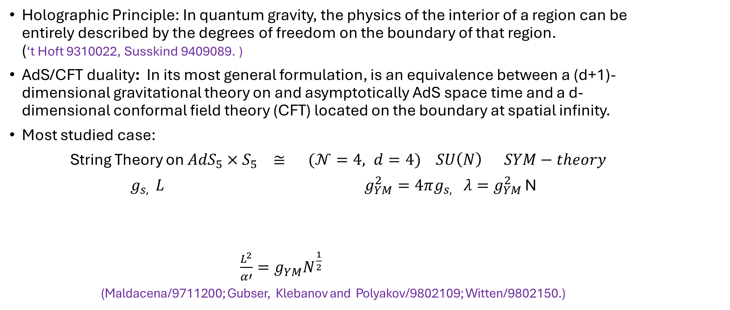
Motivations
Holographic Principle: In quantum gravity, the physics of the interior of a region can be entirely described by the degrees of freedom on the boundary of that region. (‘t Hoft 9310022, Susskind 9409089. )
AdS/CFT duality: In its most general formulation, is an equivalence between a (d+1)-dimensional gravitational theory on and asymptotically AdS space time and a d-dimensional conformal field theory (CFT) located on the boundary at spatial infinity.
Most studied case:
String Theory on ${AdS}_{5}×S_{5} ≅ (𝒩=4, d=4) SU\left(N\right) SYM−theory$
$g_{s, } L$ $g_{YM}^{2}=4πg_{s,} λ=g_{YM}^{2}$ N
$\frac{L^{2}}{α′}=g_{YM}^{}N^{\frac{1}{2}}$
(Maldacena/9711200; Gubser, Klebanov and Polyakov/9802109; Witten/9802150.)
String Coupling
AdS-Radius
Yang-Mills Coupling
‘t Hooft Coupling
SPINNING MASSIVE AMPLITUDES FROM THE FLAT LIMIT OF CFT CORRELATORS

Slide 4
Motivations
In the very large N limit, the curvature of the dual geometry vanishes, and string theory in flat space should be recovered. (Polchinski/991076, Susskind/9901079 ).
As the AdS radius approaches infinity, flat space geometry should be recovered. In principle, this could provide insights into quantum gravity in flat space by exploring the flat limit of the AdS/CFT correspondence.
The flat space limit establishes a connection between the coefficients of the effective action in AdS and those in flat space. This relationship could potentially determine the electromagnetic form factors in AdS based on their established values in flat space.
SPINNING MASSIVE AMPLITUDES FROM THE FLAT LIMIT OF CFT CORRELATORS

Slide 5
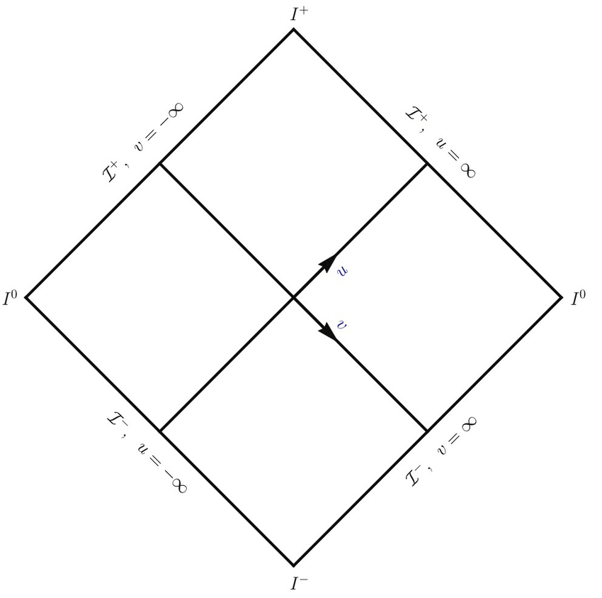
Motivations
The flat-space limit also provides a link to flat-space holography: the duality between (d+1)-dimensional gravity in asymptotically flat spacetime and lower-dimensional (d or d-1) field theory located at infinity. (Alday, Nocchy, Ruzziconi and Srikant/2406.19343.)
For massive particles, there are proposal suggesting
that the dual theory may be located at either timelike
infinity or spacelike infinity.
To further explore this connection for massive particles,
a detailed understanding of the flat limit of massive
particles is essential.
SPINNING MASSIVE AMPLITUDES FROM THE FLAT LIMIT OF CFT CORRELATORS

Slide 6
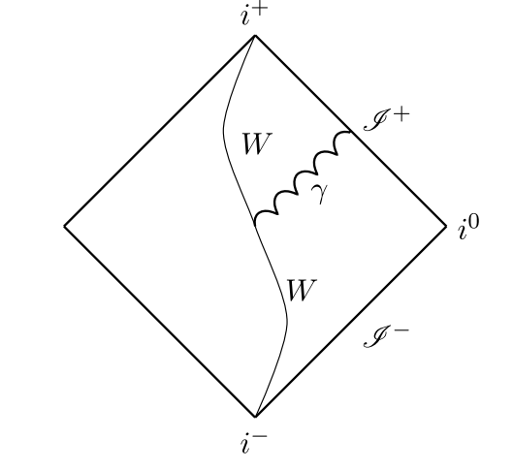
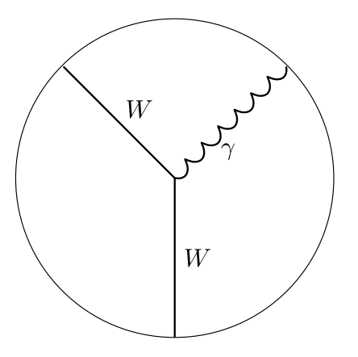
Motivations
We describe the flat limit as a simple yet physically interesting setup.
3-point CFT correlator involving a conserved current and two spin-1 operators in momentum space.
3-point function of an abelian gauge field with a massive spin-1 complex Proca field.
Our goal is to derive the scattering process of a photon with a massive particle from flat limit CFT correlators.
In momentum space, both sides of the duality need to be determined.
SPINNING MASSIVE AMPLITUDES FROM THE FLAT LIMIT OF CFT CORRELATORS

Slide 7
Momentum Space non Conserved Spinning Operators
The CFT 3-point involving a conserved current $𝒥_{μ}\left(p\right)$ and two non conserved spin-1 fields of conformal dimension $Δ, 𝒪_{Δ}$(p) can be expressed as:
The current is decomposed in its longitudinal and transverce components
The form factors of the CFT- correlator are obtained by solving the momentum space CFT-Ward identities.
Generator of the Dilatations
Generator of special conformal transformations
SPINNING MASSIVE AMPLITUDES FROM THE FLAT LIMIT OF CFT CORRELATORS

Slide 8
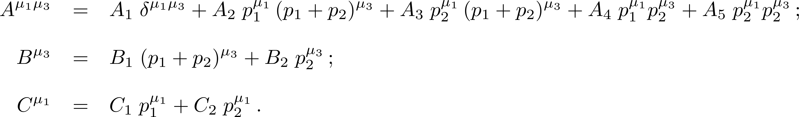
Momentum Space non Conserved Spinning Operators
Focusing on the transverse part:
The form factors $A_{i}, i=1,..5, { B}_{i }$and $C_{i}, i=1,2$ depend on the magnitude of the momenta.
SPINNING MASSIVE AMPLITUDES FROM THE FLAT LIMIT OF CFT CORRELATORS

Slide 9
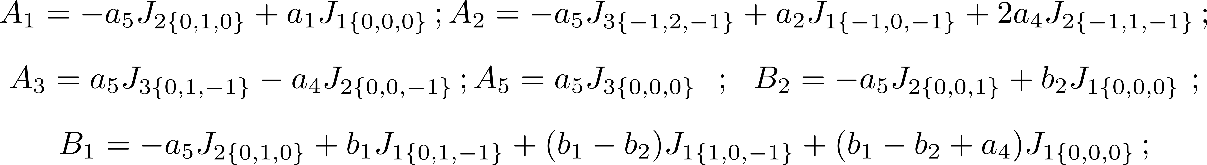
Momentum Space non Conserved Spinning Operators
Focusing on the transverse part
The form factors $A_{i}, i=1,..5, { B}_{i }$and $C_{i}, i=1,2$ depend on the magnitude of the momenta
and are antisymmetric in the exchange of$(μ_{1},p_{1})$ and $\left(μ_{3},p_{3}\right)$ ${ A}_{3}=A_{4}, B_{1}=C_{1}, B_{2}=−C_{2}$.
Triple K Integrals
Modified Bessel function of second Kind
SPINNING MASSIVE AMPLITUDES FROM THE FLAT LIMIT OF CFT CORRELATORS

Slide 10
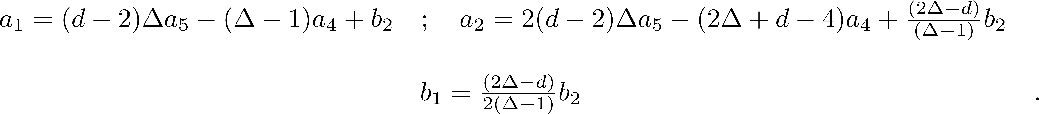
Momentum Space non Conserved Spinning Operators
Only three parameters are independents
SPINNING MASSIVE AMPLITUDES FROM THE FLAT LIMIT OF CFT CORRELATORS

Slide 11
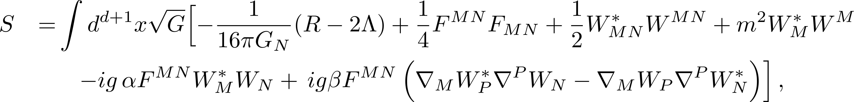
BULK Theory 3-Point Function
The most general Euclidean bulk action linear in the gauge field $A_{M}$, (M=1,…d+1) and quadratic in the Proca fields, in d+1 AdS-spacetime and up to 3 derivative terms is:
Λ-Cosmological constant
We Fourier transform the boundary coordinates ${(x, x}^{μ})\overset{→}{}\left(z,k^{μ}\right)$, ($μ=1,…d)$and choose the axial gauge ${ A}_{0}(z,k)$=0.
SPINNING MASSIVE AMPLITUDES FROM THE FLAT LIMIT OF CFT CORRELATORS

Slide 12
BULK Theory 3-Point Function
For the three-points we need the perturbative solution of the gauge field up to the first order in the gauge coupling.
Bulk-to boundary propagator
Boundary value of gauge field
Bulk to bulk propagator
For the 3-point function we only need the free classical solution for the massive fields since it is determined through the back reaction of the massive fields to $A_{μ}$.
Bulk to boundary propagator
SPINNING MASSIVE AMPLITUDES FROM THE FLAT LIMIT OF CFT CORRELATORS

Slide 13
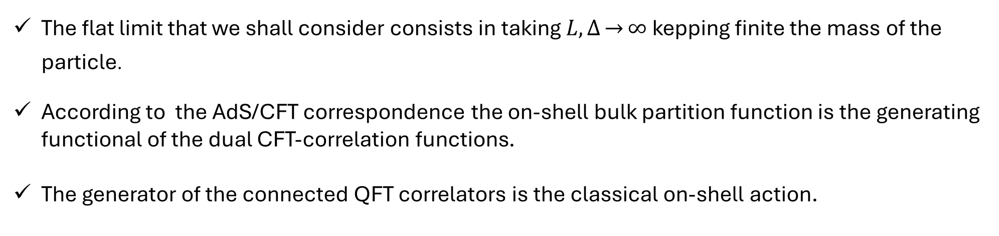
BULK Theory 3-Point Function
The Proca fields are dual to the boundary operators $𝒪_{Δ}$, their mass is related to the conformal dimension Δ by :
The flat limit that we shall consider consists in taking $L, Δ\overset{→}{}∞$ kepping finite the mass of the particle.
According to the AdS/CFT correspondence the on-shell bulk partition function is the generating functional of the dual CFT-correlation functions.
The generator of the connected QFT correlators is the classical on-shell action.
SPINNING MASSIVE AMPLITUDES FROM THE FLAT LIMIT OF CFT CORRELATORS

Slide 14
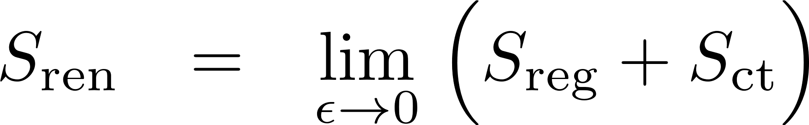
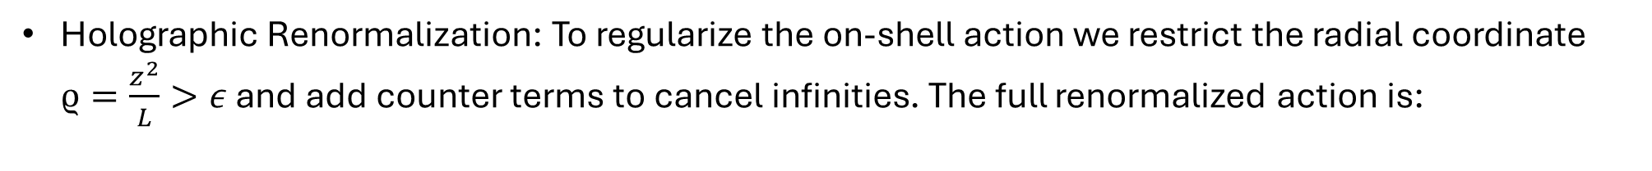
BULK Theory 3-Point Function
Holographic Renormalization: To regularize the on-shell action we restrict the radial coordinate $ϱ=\frac{z^{2}}{L}>ε$ and add counter terms to cancel infinities. The full renormalized action is:
From the renormalized action one gets the exact renormalized 1-point function
The CFT 3-point function of a conserved current and two spin-1 operators is obtained by differentiating with respect to the sources
SPINNING MASSIVE AMPLITUDES FROM THE FLAT LIMIT OF CFT CORRELATORS

Slide 15
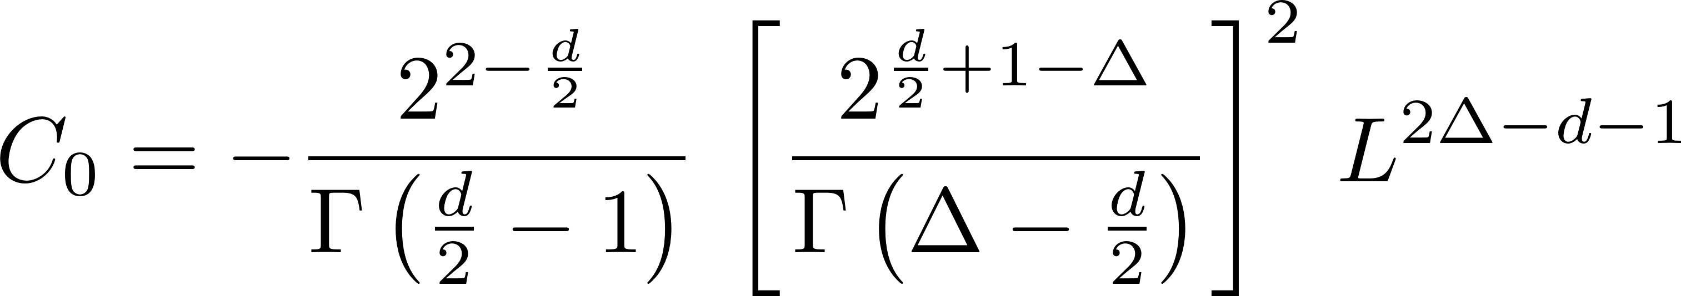
BULK Theory 3-Point Function
The CF The CFT 3-point function obtained from the bulk dual theory exactly matches the boundary CFT result after identifying the bulk parameters with the three independent CFT coefficients:
The number of the bulk parameter coincides with those of the CFT and we spann the full 3-dimensional CFT space.
Each coupling in the bulk, whether minimal, gyromagnetic, or quadrupole, is consistent with the CFT 3-point function on its own, because the bulk action remains AdS-invariant for any value of the coupling
SPINNING MASSIVE AMPLITUDES FROM THE FLAT LIMIT OF CFT CORRELATORS

Slide 16
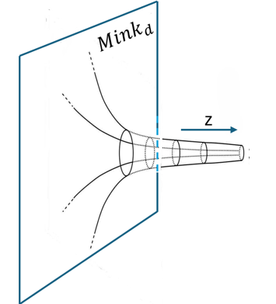
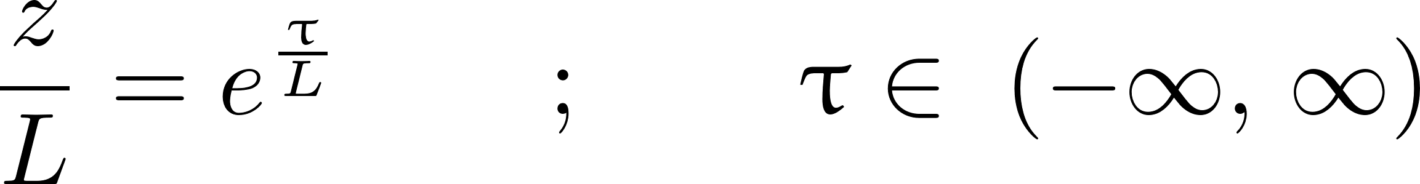
Flat Space Limit of AdS Metric and Isometries
AdS- metric in the Poincaré coordinates
In the limit $L\overset{→}{}∞$the Riemann, Ricci and scalar curvatutes vanishes getting the flat geometry.
To analyse the flat limit, it is convenient to parametrize the radial coordinate as:
Gubser,Klebanov Polyakov/9802109
Yue-Zhou Li/2106.04606
In the large L limit, τ becomes the ${(d+1)}^{th}$ flat (euclidean) time direction and the AdS-metric reduces to Minkowsky one:
SPINNING MASSIVE AMPLITUDES FROM THE FLAT LIMIT OF CFT CORRELATORS

Slide 17
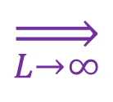
Flat Space Limit of AdS Metric and Isometries
The isometry algebra of Euclidead ${AdS}_{d+1}$ is $𝔰𝔬(d+1,1)$
Inӧn$\ddot{u}$-Wigner contraction: Upon splitting the ${(d+2)}^{th}$ component of the algebra and writing $M_{a,d+2}=L P_{a}$
$$\overset{⇒}{L\overset{→}{}∞}$$
(d+1)-dimensional Euclidean group
In the flat limit, the (Euclidean) AdS isometry algebra reduces to the algebra of the Euclidean group. Upon Wick rotation this becomes the Poincaré group.
SPINNING MASSIVE AMPLITUDES FROM THE FLAT LIMIT OF CFT CORRELATORS

Slide 18
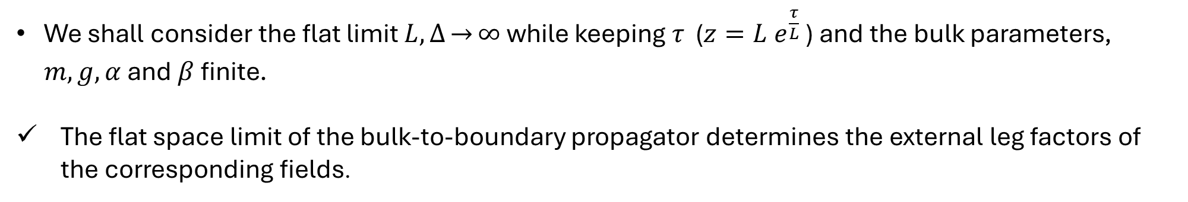
Flat Limit of the Three-point
We shall consider the flat limit $L, Δ\overset{→}{}∞$ while keeping $τ$ ($z=L e^{\frac{τ}{L}}$ ) and the bulk parameters, $m,g, α$ and $β$ finite.
The flat space limit of the bulk-to-boundary propagator determines the external leg factors of the corresponding fields.
The flat limit of the bulk to boundary propagator of thre Proca-field requires uniform expansion of the modified Bessel function:
SPINNING MASSIVE AMPLITUDES FROM THE FLAT LIMIT OF CFT CORRELATORS

Slide 19
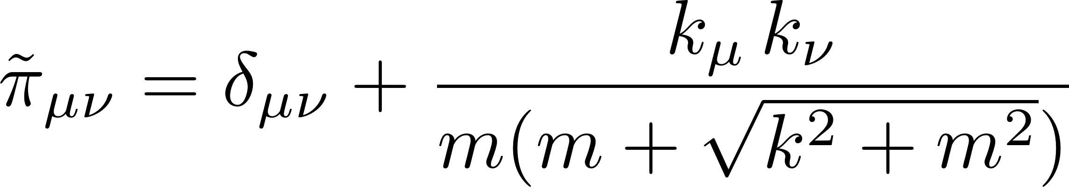
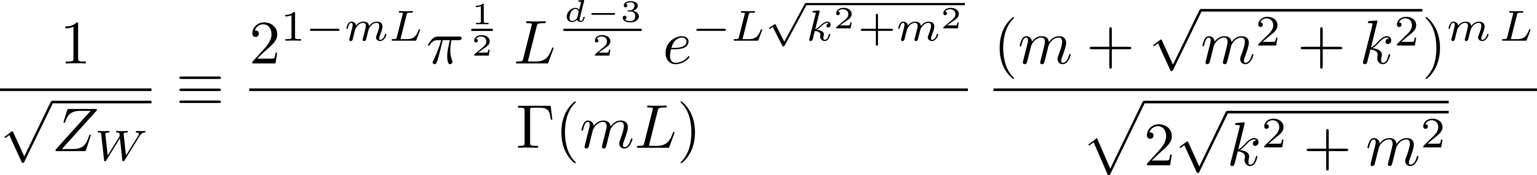
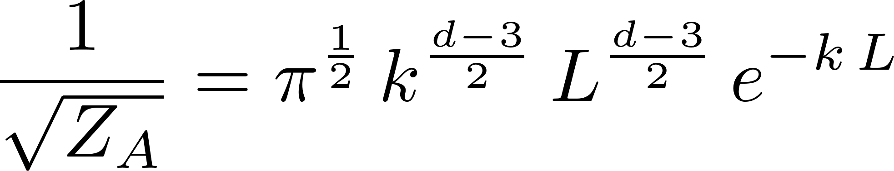
Flat Limit of the Three-point
In the limit, the Proca field turns out to be:
The uplifted (d+1)-dimensional Euclidean momenta:
The gauge field in the flat limit becomes:
The (d+1)-dimensional null momenta is defined as:
SPINNING MASSIVE AMPLITUDES FROM THE FLAT LIMIT OF CFT CORRELATORS

Slide 20
Flat Limit of the Three-point
The 3-point CFT d-dimensional correlator in momentum space are expressed in terms of triple-K integrals. Their flat limit reads:
Emerging delta-function over the energies
At the leading order in the AdS-radius L the correlator becomes:
SPINNING MASSIVE AMPLITUDES FROM THE FLAT LIMIT OF CFT CORRELATORS

Slide 21
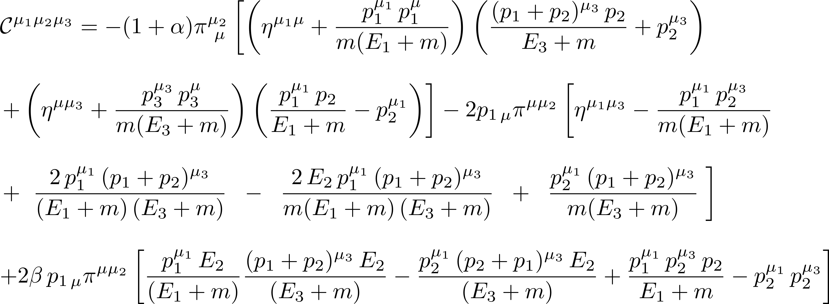
Flat Limit of the Three-point
with
SPINNING MASSIVE AMPLITUDES FROM THE FLAT LIMIT OF CFT CORRELATORS

Slide 22
Flat Limit of the Three-point
By using the polarizations suggested by the flat limit of the Btb-propagators
In the flat limit, the d-dimensional correlator dressed by the (d+1)-dimensional polarization vectors:
This is exactly the (d+1) dimensional three- point amplitude,${ ℳ}_{3}^{μ_{1}μ_{2}μ_{3}},$ stripped by the delta over the momenta, of a photon in interaction with two complex Proca fields.
SPINNING MASSIVE AMPLITUDES FROM THE FLAT LIMIT OF CFT CORRELATORS

Slide 23
Conclusions
We have solved the CFT Ward identities defining the 3-point function involving a conserved current and two non-conserved operators.
Using the holographic renormalization approach, we have computed the dual “Witten diagram”.
We have shown that the AdS calculation is in agreement with the CFT result, providing a new test of the AdS/CFT correspondence.
The matching is valid for each bulk coupling separately.
We have computed the flat limit of the d-dimensional CFT correlator, keeping the mass and gauge coupling of the dual theory fixed, reproducing the (d+1)-dimensional flat amplitude with two complex Proca fields interacting with a U(1) gauge field.
In the flat limit, the Euclidean time coordinate and the corresponding delta function on the energies are emerging quantities.
From the CFT perspective, one zooms into the IR region while sending the conformal dimension of the operator dual to the massive fields to infinity.
The flat limit transforms the AdS isometries into Poincaré isometries.
SPINNING MASSIVE AMPLITUDES FROM THE FLAT LIMIT OF CFT CORRELATORS

Slide 24
Conclusions
We expect that our analysis will extend to higher-point functions.
As we have seen, holography allows for the construction of flat space couplings from CFT correlators, which are completely fixed by the CFT Ward identities. This approach appears promising for constructing massive higher-spin couplings in flat space.
Gain insights into flat space holography through the flat limit of the AdS/CFT duality
SPINNING MASSIVE AMPLITUDES FROM THE FLAT LIMIT OF CFT CORRELATORS

Slide 25
Conclusions
We expect that our analysis will extend to higher-point functions.
As we have seen, holography allows for the construction of flat space couplings from CFT correlators, which are completely fixed by the CFT Ward identities. This approach appears promising for constructing massive higher-spin couplings in flat space.
Gain insights into flat space holography through the flat limit of the AdS/CFT duality
Thank you!
SPINNING MASSIVE AMPLITUDES FROM THE FLAT LIMIT OF CFT CORRELATORS

