Slide 1


Eurostrings 2024
Strong coupling expansion of determinant observables in supersymmetric gauge theories
Zoltan Bajnok¹
Bercel Boldis^{1,2}
Gregory P. Korchemsky³
¹HUN-REN Wigner Research Centre for Physics
² Department of Theoretical Physics, Budapest University of Technology and Economics
³Université Paris Saclay
2024

Slide 2



The project supported by the Doctoral Excellence Fellowship Programme (DCEP) is funded by the National Research Development and Innovation Fund of the Ministry of Culture and the Budapest University of Technology and Economics, under a grant agreement with the National Research, Development and Innovation Office.
EuroStrings
2024
Southampton

Slide 3

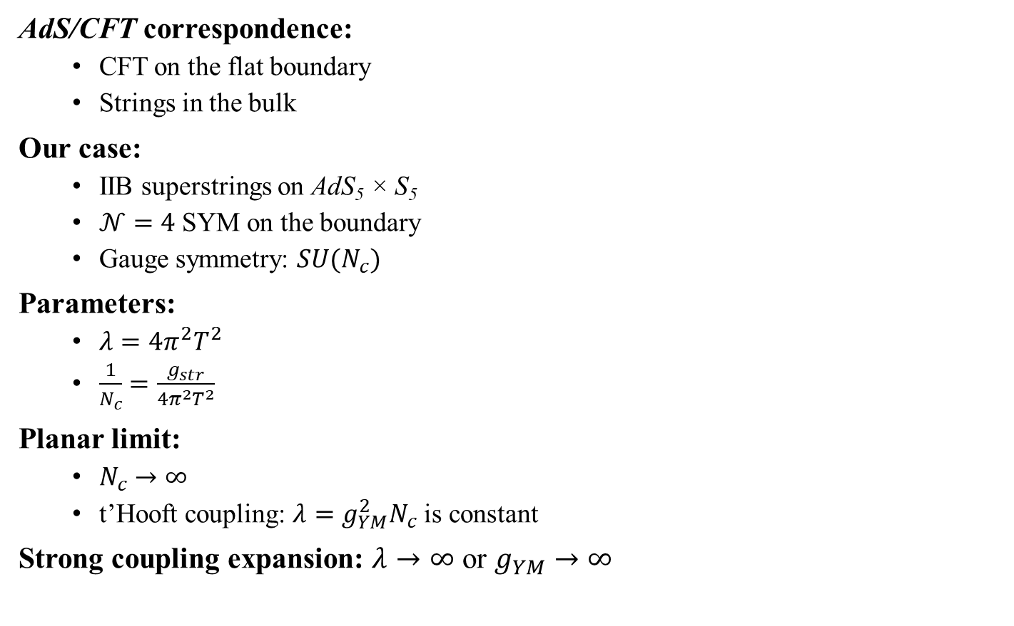

AdS/CFT correspondence
AdS/CFT correspondence:
  CFT on the flat boundary
  Strings in the bulk
Our case:
  IIB superstrings on AdS₅ × S₅
  $𝒩=4$ SYM on the boundary
  Gauge symmetry: $SU(N_{c})$
Parameters:
  $λ=4π^{2}T^{2}$
  $\frac{1}{N_{c}}=\frac{g_{str}}{4π^{2}T^{2}}$
Planar limit:
  $N_{c}→∞$
  t’Hooft coupling: $λ=g_{YM}^{2}N_{c}$ is constant
Strong coupling expansion: $λ→∞$ or $g_{YM}→∞$
$$Z_{str}\left[Φ{\left.​\right|}_{∂AdS}=J\right]=Z_{CFT}\left[J\right]$$
String observables
CFT_{d} observables
Planar limit ($N_{c}→∞$)
↕
Weakly coupled strings ($g_{st}→0$)

Slide 4






AdS/CFT correspondence
1012.3982
$$∞$$
$$1/N_{c}$$
Classical strings
Classical gauge theory
Planar limit
$$0$$
$$0$$
$$λ$$
$$∞$$

Slide 5



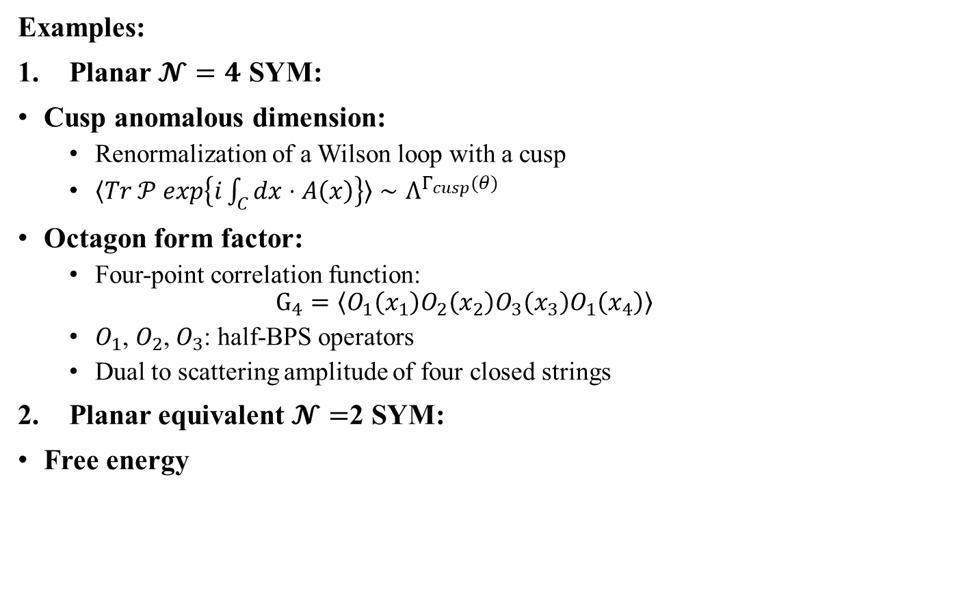





Determinant observables
Examples:
Planar $𝓝=4$ SYM:
Cusp anomalous dimension:
  Renormalization of a Wilson loop with a cusp
  $〈Tr 𝒫 exp\left\{i\int_{C}{dx⋅A\left(x\right)}\right\}〉∼Λ^{Γ_{cusp}(θ)}$
Octagon form factor:
  Four-point correlation function:
  $G_{4}=〈O_{1}\left(x_{1}\right)O_{2}\left(x_{2}\right)O_{3}\left(x_{3}\right)O_{1}\left(x_{4}\right)〉$
  $O_{1}$, $O_{2}$, $O_{3}$: half-BPS operators
  Dual to scattering amplitude of four closed strings
Planar equivalent $𝓝=$2 SYM:
Free energy
$$θ$$
$$C=$$
[Polyakov’80]
$$O_{3}(x_{3})$$
[Coronado’18]
$$O_{1}(x_{1})$$
$$O_{1}(x_{4})$$
$$O_{2}(x_{2})$$
$$≡$$
[Pestun’12]
$$2$$
What is common?

Slide 6
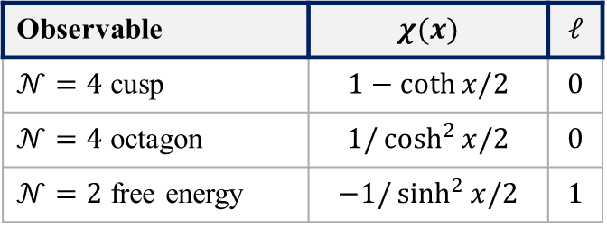
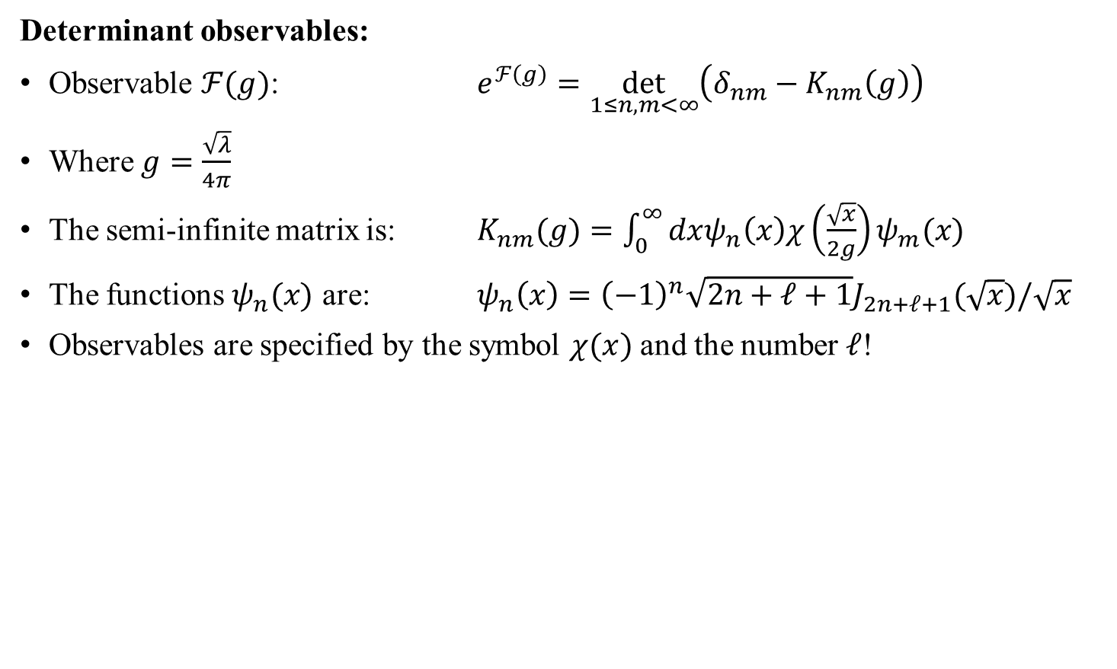
Determinant observables
Determinant observables:
Observable $ℱ(g)$: $e^{ℱ\left(g\right)}=\det_{1≤n,m<∞}\left(δ_{nm}−K_{nm}\left(g\right)\right)$
Where $g=\frac{\sqrt{λ}}{4π}$
The semi-infinite matrix is: $K_{nm}(g)=\int_{0}^{∞}{dxψ_{n}\left(x\right)χ\left(\frac{\sqrt{x}}{2g}\right)ψ_{m}(x)}$
The functions $ψ_{n}(x)$ are: $ψ_{n}\left(x\right)={\left(−1\right)}^{n}\sqrt{2n+ℓ+1}J_{2n+ℓ+1}(\sqrt{x})/\sqrt{x}$
Observables are specified by the symbol $χ(x)$ and the number $ℓ$!
Observable | $$χ(x)$$ | $$ℓ$$
$𝒩=4$ cusp | $$1−\coth{x/2}$$ | $$0$$
$𝒩=4$ octagon | $$1/\cosh^{2}{x/2}$$ | $$0$$
$𝒩=2$ free energy | $$−1/\sinh^{2}{x/2}$$ | $$1$$

Slide 7
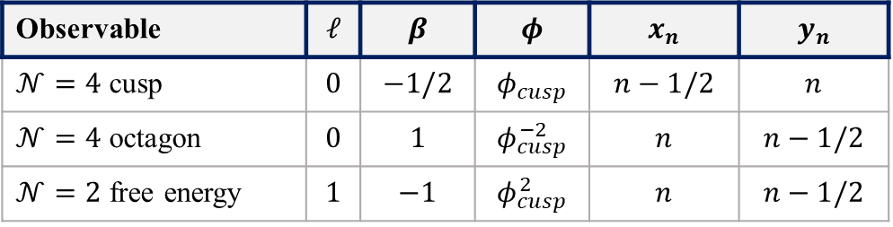
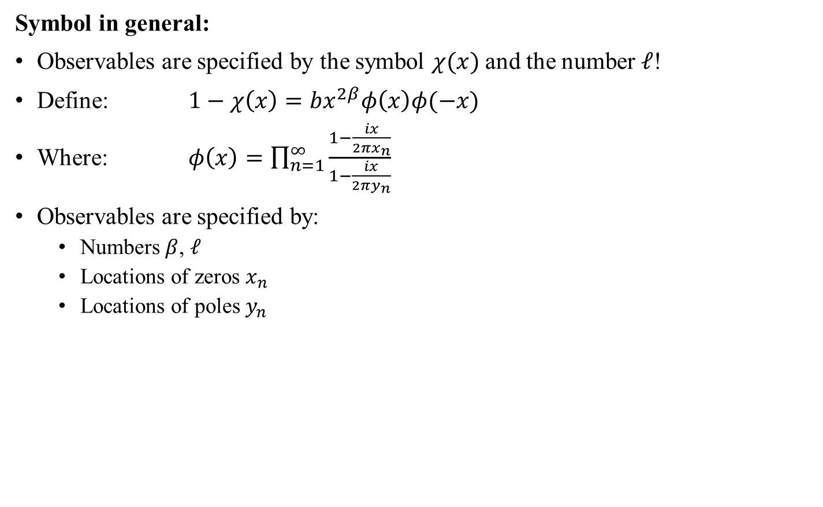

Determinant observables
Symbol in general:
Observables are specified by the symbol $χ(x)$ and the number $ℓ$!
Define: $1−χ\left(x\right)=bx^{2β}φ\left(x\right)φ(−x)$
Where: $φ\left(x\right)=\prod_{n=1}^{∞}{\frac{1−\frac{ix}{2πx_{n}}}{1−\frac{ix}{2πy_{n}}}}$
Observables are specified by:
  Numbers $β$, $ℓ$
  Locations of zeros $x_{n}$
  Locations of poles $y_{n}$
$$φ_{cusp}\left(x\right)=\sqrt{π}\frac{Γ\left(1−\frac{ix}{2π}\right)}{Γ\left(\frac{1}{2}−\frac{ix}{2π}\right)}$$
Observable | $$ℓ$$ | $$β$$ | $$φ$$ | $$x_{n}$$ | $$y_{n}$$
$𝒩=4$ cusp | $$0$$ | $$−1/2$$ | $$φ_{cusp}$$ | $$n−1/2$$ | $$n$$
$𝒩=4$ octagon | $$0$$ | $$1$$ | $$φ_{cusp}^{−2}$$ | $$n$$ | $$n−1/2$$
$𝒩=2$ free energy | $$1$$ | $$−1$$ | $$φ_{cusp}^{2}$$ | $$n$$ | $$n−1/2$$

Slide 8
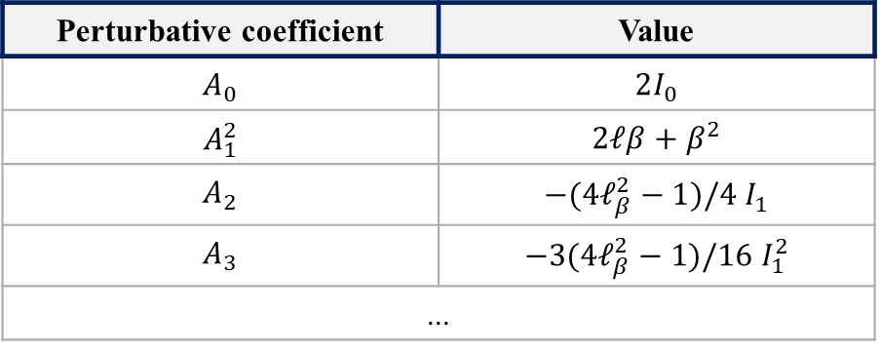



Strong coupling expansion
Perturbative coefficients:
$ℱ\left(g\right)=−gA_{0}+\frac{1}{2}A_{1}^{2}\log{g}+B+\sum_{k=1}^{∞}{\frac{A_{k+1}}{2k\left(k+1\right)}}g^{−k}+Δf(g)$ , as $g→∞$
Perturbative coefficients:
Moments: $I_{n}=\int_{0}^{∞}{\frac{dx}{π}\frac{{\left(x^{−1}∂_{x}\right)}^{n}}{\left(2n−1\right)‼}x∂_{x}\log\left(1−χ\left(x\right)\right)}$
$A_{n}$ grow factorially at large $n$!
$Δf\left(g\right)=\sum_{n≥1}{{\left(ge^{−8πgx_{1}}\right)}^{n}\left(A_{1}^{\left(n\right)}+\sum_{k≥1}{\frac{A_{k+1}^{\left(n\right)}}{2k(k+1)}g^{−k}}\right)}$
[Belitsky,Korchemsky’20]
Perturbative coefficient | Value
$$A_{0}$$ | $$2I_{0}$$
$$A_{1}^{2}$$ | $$2ℓβ+β^{2}$$
$$A_{2}$$ | $$−(4ℓ_{β}^{2}−1)/4{ I}_{1}$$
$$A_{3}$$ | $$−3(4ℓ_{β}^{2}−1)/16{ I}_{1}^{2}$$
...
$$ℓ_{β}=ℓ+β$$
→ Non-perturbative terms ($Δf(g)$)!

Slide 9
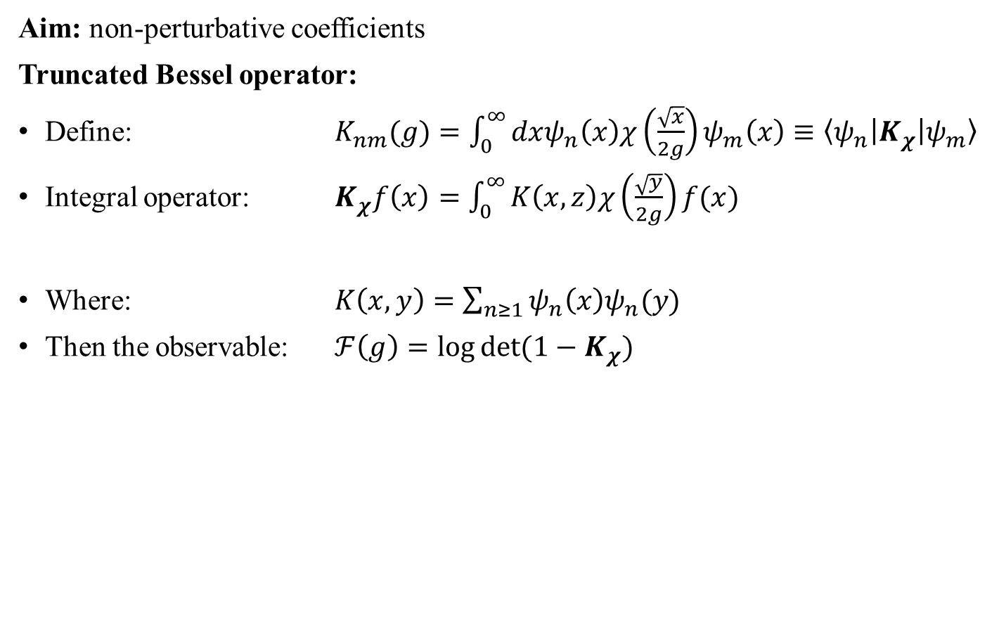
Non-perturbative corrections
Aim: non-perturbative coefficients
Truncated Bessel operator:
Define: $K_{nm}(g)=\int_{0}^{∞}{dxψ_{n}\left(x\right)χ\left(\frac{\sqrt{x}}{2g}\right)ψ_{m}\left(x\right)}≡〈ψ_{n}|K_{χ}|ψ_{m}〉$
Integral operator: $K_{χ}f\left(x\right)=\int_{0}^{∞}{K\left(x,z\right)χ\left(\frac{\sqrt{y}}{2g}\right)f(x)}$
Where: $K\left(x,y\right)=\sum_{n≥1}{ψ_{n}\left(x\right)ψ_{n}(y)}$
Then the observable: $ℱ\left(g\right)=\log{\det{(1−K_{χ})}}$
Truncated Bessel kernel
Fredholm determinant

Slide 10
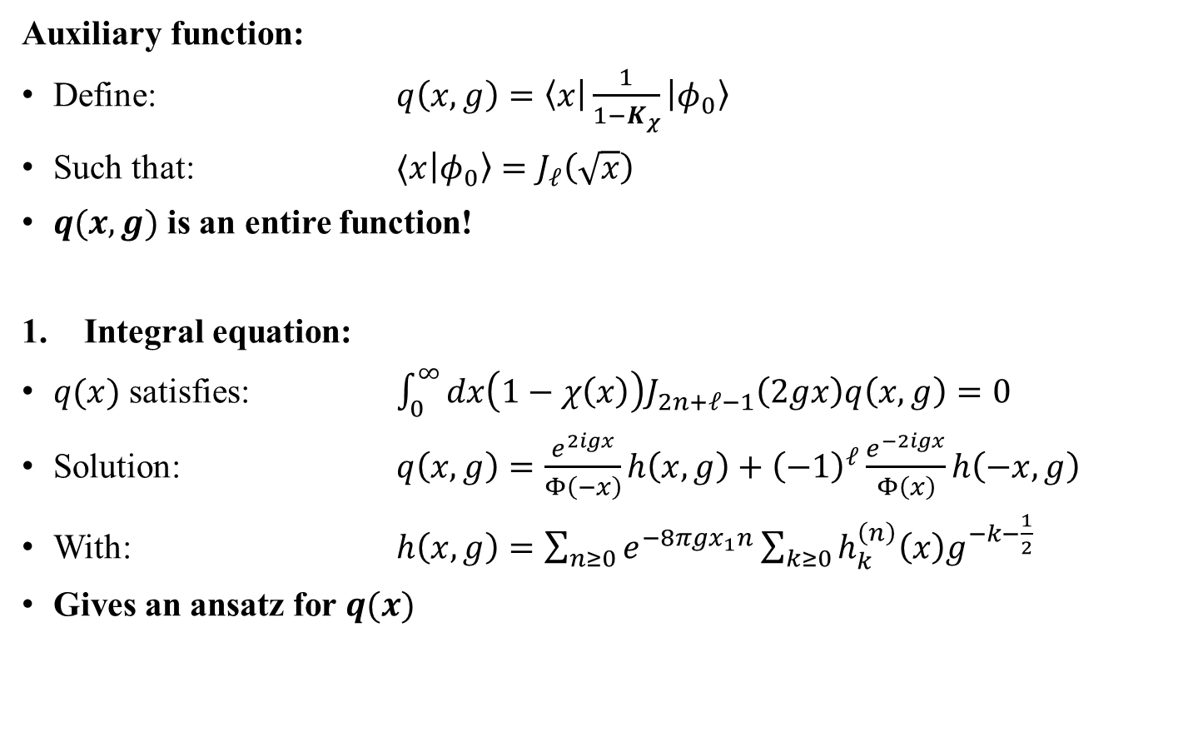
Non-perturbative corrections
Auxiliary function:
Define: $q\left(x,g\right)=〈x|\frac{1}{1−K_{χ}}|φ_{0}〉$
Such that: $〈x|φ_{0}〉=J_{ℓ}\left(\sqrt{x}\right)$
$q(x,g)$ is an entire function!
Integral equation:
$q(x)$ satisfies: $\int_{0}^{∞}{dx\left(1−χ\left(x\right)\right)J_{2n+ℓ−1}\left(2gx\right)q\left(x,g\right)=0}$
Solution: $q\left(x,g\right)=\frac{e^{2igx}}{Φ\left(−x\right)}h\left(x,g\right)+{\left(−1\right)}^{ℓ}\frac{e^{−2igx}}{Φ\left(x\right)}h\left(−x,g\right)$
With: $h\left(x,g\right)=\sum_{n≥0}{e^{−8πgx_{1}n}}\sum_{k≥0}{h_{k}^{\left(n\right)}\left(x\right)g^{−k−\frac{1}{2}}}$
Gives an ansatz for $q(x)$

Slide 11
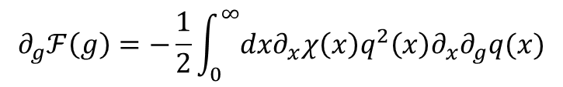
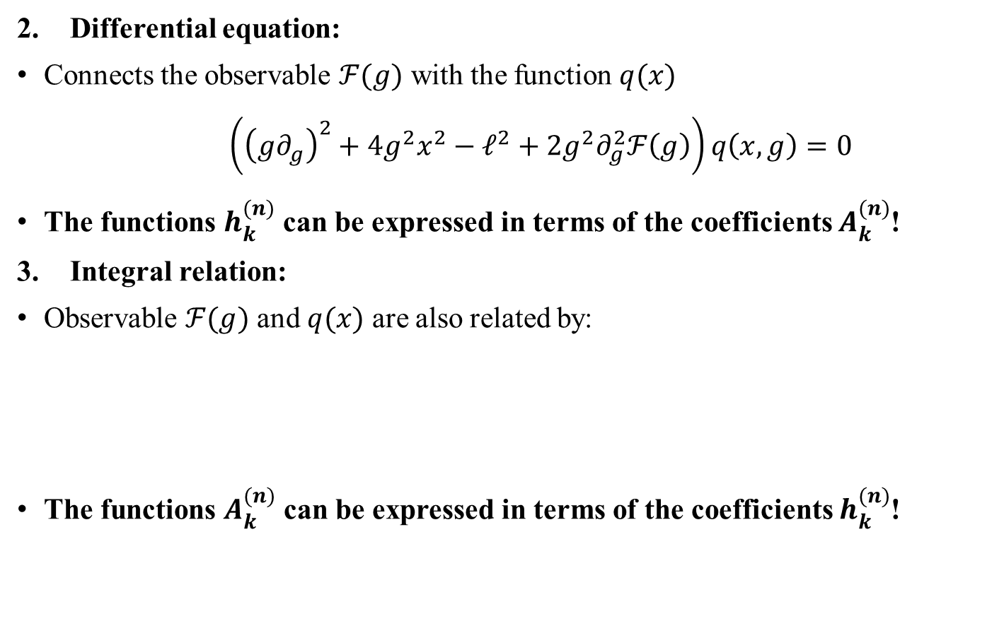
Non-perturbative corrections
Differential equation:
Connects the observable $ℱ(g)$ with the function $q(x)$
$\left({\left(g∂_{g}\right)}^{2}+4g^{2}x^{2}−ℓ^{2}+2g^{2}∂_{g}^{2}ℱ\left(g\right)\right)q\left(x,g\right)=0$
The functions $h_{k}^{(n)}$ can be expressed in terms of the coefficients $A_{k}^{(n)}$!
Integral relation:
Observable $ℱ(g)$ and $q(x)$ are also related by:
The functions $A_{k}^{(n)}$ can be expressed in terms of the coefficients $h_{k}^{(n)}$!
$$∂_{g}ℱ\left(g\right)=−\frac{1}{2}\int_{0}^{∞}{dx∂_{x}χ\left(x\right)q^{2}\left(x\right)∂_{x}∂_{g}q(x)}$$

Slide 12

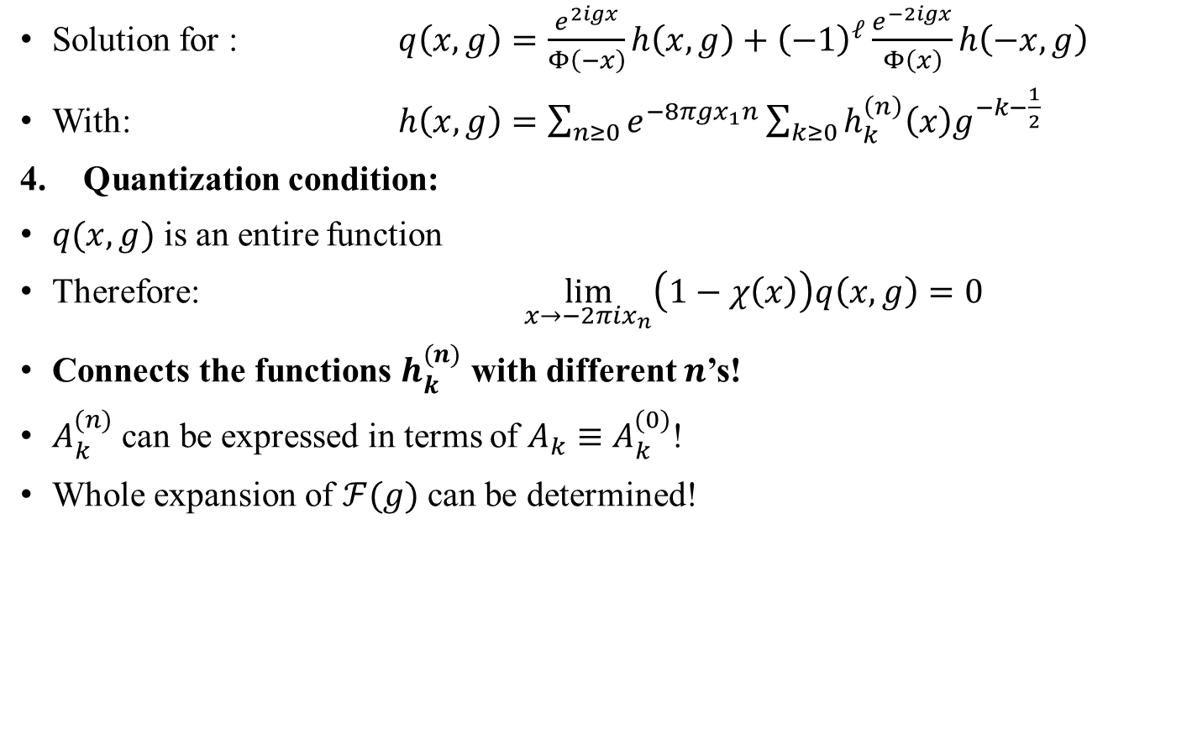



Non-perturbative corrections
Solution for : $q\left(x,g\right)=\frac{e^{2igx}}{Φ\left(−x\right)}h\left(x,g\right)+{\left(−1\right)}^{ℓ}\frac{e^{−2igx}}{Φ\left(x\right)}h\left(−x,g\right)$
With: $h\left(x,g\right)=\sum_{n≥0}{e^{−8πgx_{1}n}}\sum_{k≥0}{h_{k}^{\left(n\right)}\left(x\right)g^{−k−\frac{1}{2}}}$
Quantization condition:
$q(x,g)$ is an entire function
Therefore: $\lim_{x→−2πix_{n}}\left(1−χ\left(x\right)\right)q\left(x,g\right)=0$
Connects the functions $h_{k}^{(n)}$ with different $n$’s!
$A_{k}^{(n)}$ can be expressed in terms of $A_{k}≡A_{k}^{(0)}$!
Whole expansion of $ℱ(g)$ can be determined!
Quantization condition
$$ℱ(g)$$
$$q(x,g)$$
$$⋯ \\ A_{k}^{(n) } \\ ⋯ \\ A_{k}^{(0)}$$
$$⋯ \\ h_{k}^{(n) } \\ ⋯ \\ h_{k}^{(0)}$$
Int. rel.
Quant.
cond.
Diff. eq.

Slide 13
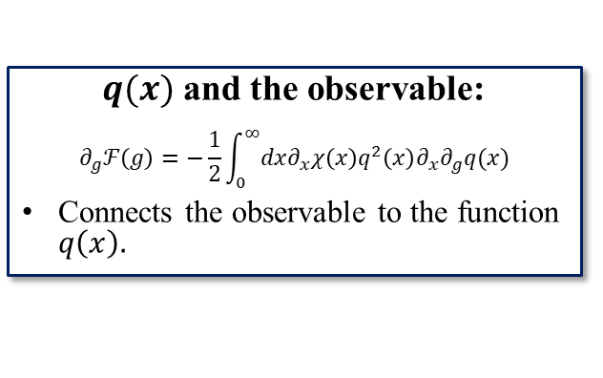
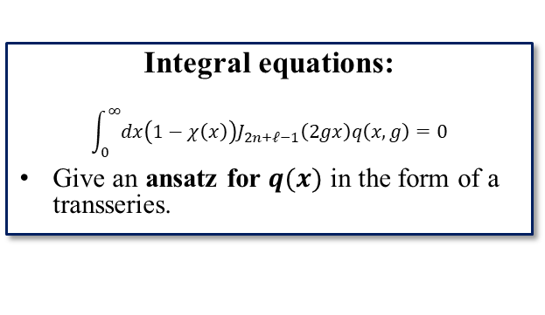
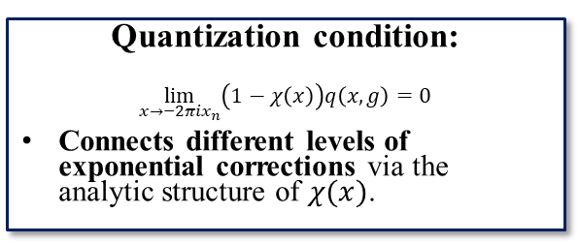
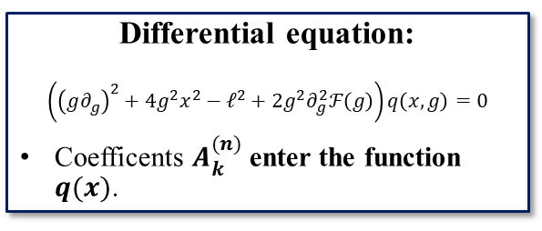
Method
Integral equations:
$$\int_{0}^{∞}{dx\left(1−χ\left(x\right)\right)J_{2n+ℓ−1}\left(2gx\right)q\left(x,g\right)=0}$$
Give an ansatz for $q(x)$ in the form of a transseries.
$q(x)$ and the observable:
$$∂_{g}ℱ\left(g\right)=−\frac{1}{2}\int_{0}^{∞}{dx∂_{x}χ\left(x\right)q^{2}\left(x\right)∂_{x}∂_{g}q(x)}$$
Connects the observable to the function $q\left(x\right).$
Differential equation:
$$\left({\left(g∂_{g}\right)}^{2}+4g^{2}x^{2}−ℓ^{2}+2g^{2}∂_{g}^{2}ℱ\left(g\right)\right)q\left(x,g\right)=0$$
Coefficents $A_{k}^{(n)}$ enter the function $q(x)$.
Quantization condition:
$$\lim_{x→−2πix_{n}}\left(1−χ\left(x\right)\right)q\left(x,g\right)=0$$
Connects different levels of exponential corrections via the analytic structure of $χ(x)$.
Whole transseries of $𝓕(g)$ can be determined in an efficient way!

Slide 14

Results
Cusp anomalous dimension:
$ℱ\left(g\right)=\frac{3}{8}\log{\cosh{2πg}}−\frac{1}{8}\log{\frac{\sinh{2πg}}{2πg}}$
Agrees with the known result
Octagon form factor:
$Δf\left(g\right)=\frac{iπg′}{4}e^{−8πg}\left(1−\frac{7}{4\left(4πg^{′}\right)}−\frac{63}{32{\left(4πg^{′}\right)}^{2}}+…\right)+$
$+\frac{{\left(πg^{′}\right)}^{2}}{32}e^{−16πg}\left(1+\frac{81i−14}{4(4πg′)}+\frac{−1431i−24}{32{\left(4πg^{′}\right)}^{2}}+…\right)$
Where $g^{′}=g+\log{2}/π$
$𝓝=$2 SYM:
$Δf\left(g\right)=2iπg′′e^{−4πg}\left(1+\frac{16\log{2}+1}{2\left(4πg^{′′}\right)}+\frac{96\log{2}−15 }{8{\left(4πg^{′′}\right)}^{2}}+…\right)+$
$+2{\left(πg^{′′}\right)}^{2}e^{−8πg}\left(1+\frac{16\log{2}+1}{(4πg′′)}+\frac{64\log^{2}{2}+32\log{2}−3}{{\left(4πg^{′′}\right)}^{2}}+…\right)$
Where $g^{′′}=g−\log{2}/π$
[Beccaria,Korchemsky,Tseytlin’23]

Slide 15

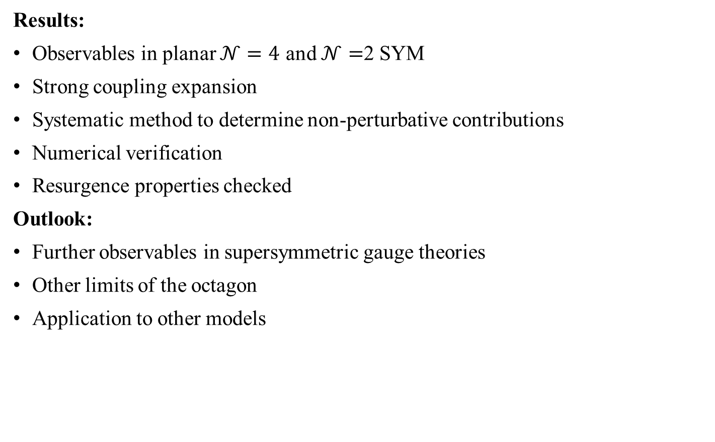
Summary
Results:
Observables in planar $𝒩=4$ and $𝒩=$2 SYM
Strong coupling expansion
Systematic method to determine non-perturbative contributions
Numerical verification
Resurgence properties checked
Outlook:
Further observables in supersymmetric gauge theories
Other limits of the octagon
Application to other models
[Bajnok,Boldis,Korchemsky’24]

Slide 16
Thank you
for your attention!
EuroStrings
2024
Southampton

Slide 17
Summary
Results:
Observables in planar $𝒩=4$ and $𝒩=$2 SYM
Strong coupling expansion
Systematic method to determine non-perturbative contributions
Numerical verification
Resurgence properties checked
Outlook:
Further observables in supersymmetric gauge theories
Other limits of the octagon
Application to other models
[Bajnok,Boldis,Korchemsky’24]

