Slide 1
The nEXO Search for 0νββ
Thomas Brunner (thomas.brunner@mcgill.ca)
nEXO Canada Spokesperson
For the nEXO Collaboration
0νββ International Summit at SNOLAB, April 27, 2023

Slide 2
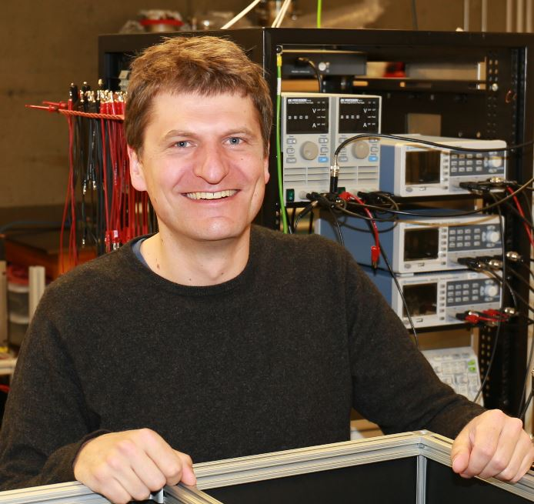
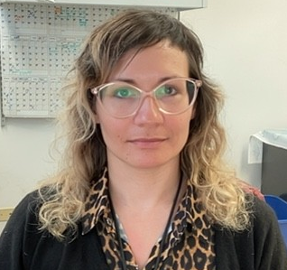
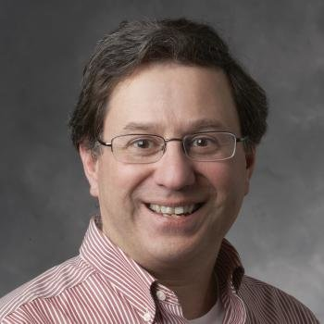
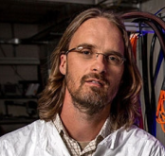
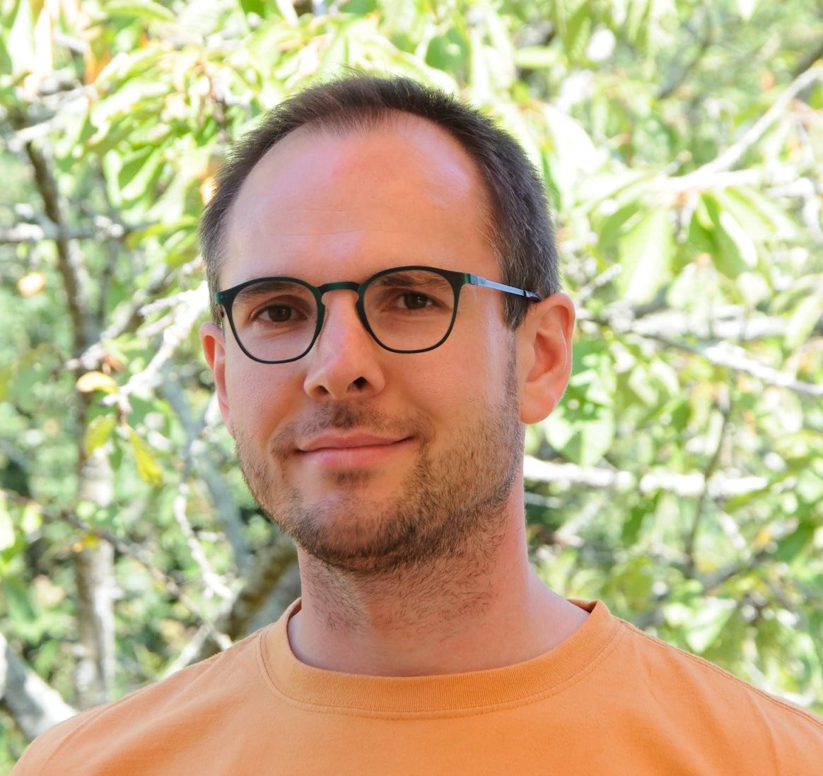
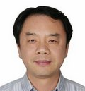
nEXO Delegation at this Summit
Dr. Thomas Brunner
McGill University
Canada
CFI co-lead
Dr. Beatrice Franke
TRIUMF
Canada
CFI co-lead
Dr. Giorgio Gratta
Stanford University
USA
Spokesperson
Dr. Mike Heffner
Lawrence Livermore
National Laboratory
USA
Project Director
Dr. Julien Masbou
SUBATECH
France
LXe detector expert
Dr. Yifang Wang
Director, Institute of High Energy Physics of the Chinese Academy of Sciences (IHEP)
China (unexpectedly unable to travel)
Please approach us with any questions you may have concerning our experiment.

Slide 3
nEXO Subsystems
Charge Readout Electronics (SLAC)
Subsystem Scientist:
L. Yang (UCSD)
Subsystem Manager:
A. Dragone (SLAC)
Photon Readout Electronics (BNL)
Subsystem Scientist:
M. Chiu (BNL)
Subsystem Manager:
L. DeMino (BNL)
TPC (PNNL)
Subsystem Scientist:
J. Orrell (PNNL)
Subsystem Manager:
A. Gorham (PNNL)
Photon Detector (BNL)
Subsystem Scientist:
D. Moore (Yale)
Subsystem Manager:
M. Worcester (BNL)
Computing, Control
and Software (LLNL)
Subsystem Scientist:
S. Sangiorgio (LLNL)
Subsystem Manager:
F. Nekogar (LLNL)
Radioactive Background Control (SLAC)
Subsystem Scientist:
A. Piepke (UA)
Subsystem Manager:
D. Seiner (PNNL)
TPC Support Systems (LLNL)
Subsystem Scientist:
A. Pocar (UMass)
Subsystem Manager:
A. House (LLNL)
Xenon (LLNL)
Subsystem Scientist:
G. Gratta (Stanford)
System Manager:
TBD
Facility (SNOLAB)
Subsystem Scientist:
E. Caden
Subsystem Manager:
D. Hawkins
Outer Detector (SNOLAB)
Subsystem Scientist:
T. Brunner
Subsystem Manager:
D. Hawkins

Slide 4
nEXO Subsystems and Canadian Contributions
WBS with Canadian Contributions
WBS with Canadian Leadership
Charge Readout Electronics (SLAC)
Subsystem Scientist:
L. Yang (UCSD)
Subsystem Manager:
A. Dragone (SLAC)
Photon Readout Electronics (BNL)
Subsystem Scientist:
M. Chiu (BNL)
Subsystem Manager:
L. DeMino (BNL)
TPC (PNNL)
Subsystem Scientist:
J. Orrell (PNNL)
Subsystem Manager:
A. Gorham (PNNL)
Photon Detector (BNL)
Subsystem Scientist:
D. Moore (Yale)
Subsystem Manager:
M. Worcester (BNL)
Two subsystems are Canada-led.
Canadian groups are contributing to 5 other subsystems.
Significant engineering and project management support from SNOLAB
Computing, Control
and Software (LLNL)
Subsystem Scientist:
S. Sangiorgio (LLNL)
Subsystem Manager:
F. Nekogar (LLNL)
Radioactive Background Control (SLAC)
Subsystem Scientist:
A. Piepke (UA)
Subsystem Manager:
D. Seiner (PNNL)
TPC Support Systems (LLNL)
Subsystem Scientist:
A. Pocar (UMass)
Subsystem Manager:
A. House (LLNL)
Xenon (LLNL)
Subsystem Scientist:
G. Gratta (Stanford)
System Manager:
TBD
Facility (SNOLAB)
Subsystem Scientist:
E. Caden
Subsystem Manager:
D. Hawkins
Outer Detector (SNOLAB)
Subsystem Scientist:
T. Brunner
Subsystem Manager:
D. Hawkins

Slide 5
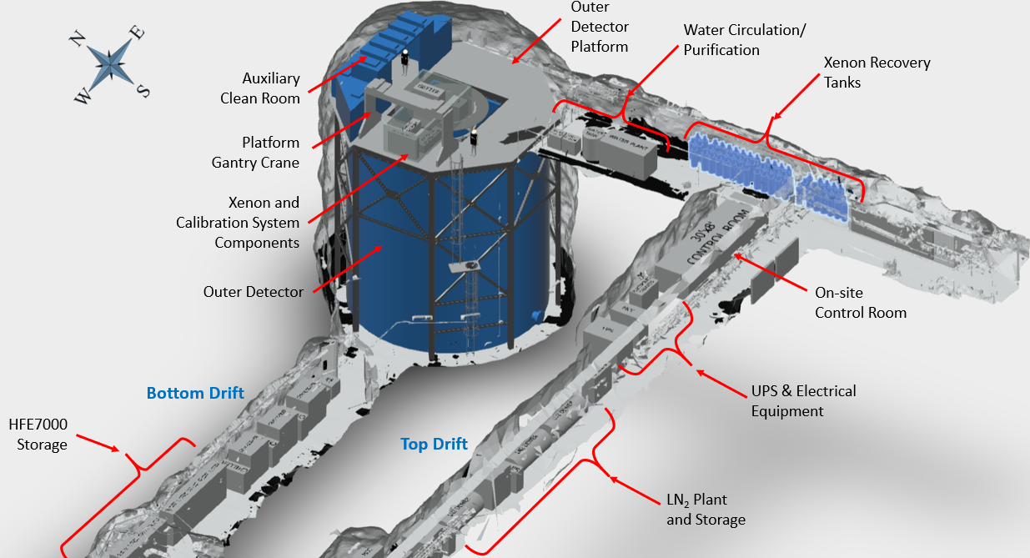

Very substantial engineering done by SNOLAB
Note that the Outer Detector Tank is on a critical path (infrastructure requested in CFI IF 2023), because it is also used as a clean room for constructing the cryostat and assembly of the inner detector components.

Slide 6
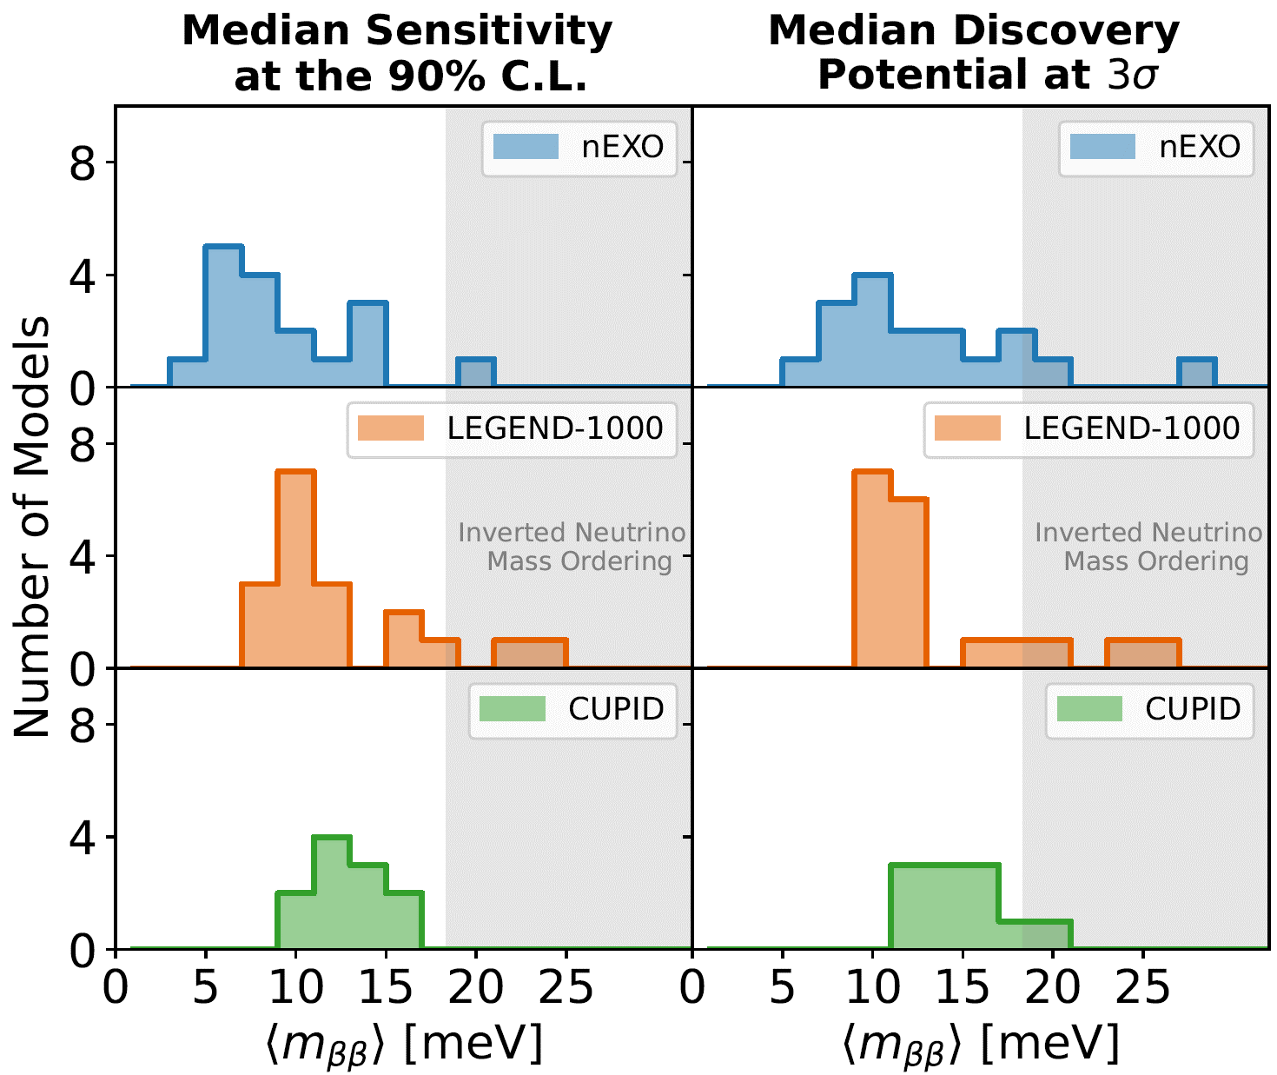
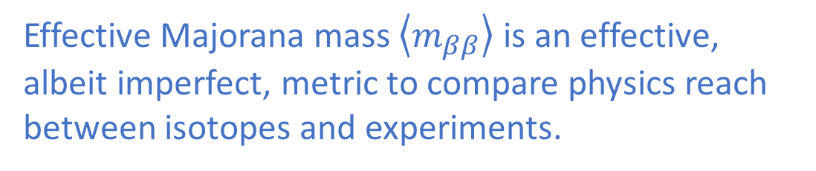
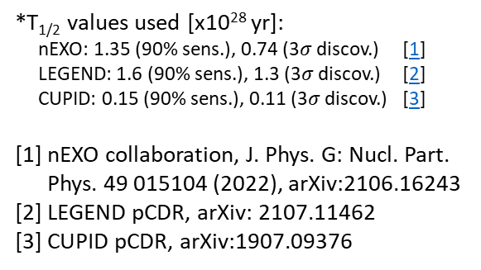
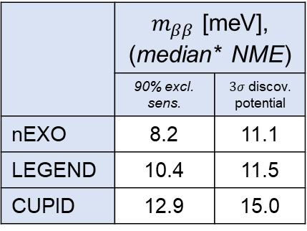

Comparison with other experiments
Effective Majorana mass $\left\langle m_{ββ}\right\rangle$ is an effective, albeit imperfect, metric to compare physics reach between isotopes and experiments.
NME
Phase space factor
Axial coupling, $g_{A}=1.27$
 | $m_{ββ}$ [meV], (median* NME)
 | 90% excl. sens. | $3σ$ discov. potential
nEXO | 8.2 | 11.1
LEGEND | 10.4 | 11.5
CUPID | 12.9 | 15.0
*T_{1/2} values used [x10²⁸ yr]:
nEXO: 1.35 (90% sens.), 0.74 (3$σ$ discov.) [1]
LEGEND: 1.6 (90% sens.), 1.3 (3$σ$ discov.) [2]
CUPID: 0.15 (90% sens.), 0.11 (3$σ$ discov.) [3]
  [1] nEXO collaboration, J. Phys. G: Nucl. Part.
  Phys. 49 015104 (2022), arXiv:2106.16243
  [2] LEGEND pCDR, arXiv: 2107.11462
  [3] CUPID pCDR, arXiv:1907.09376
Deeper Physics Reach
Notes:
nEXO 3$σ$ discovery potential for most NME reaching beyond inverted ordering further into normal ordering
To help understand the impact of the NME and compare across experiments, we show here the exclusion sensitivity and discovery potential for the 3 experiments for the whole set of NMEs. The gray area shows the 15 meV target set by the NSAC, which corresponds to first order to the bottom of the IO region. Keep in mind that this is not a distribution in a statistical sense because in reality at best only one of the NME calculation is correct, and the spread here is not a measure of the uncertainty per se - but, just to guide the eye and provide a comparison, we show with the dashed line the median value of m_bb. We could spend half-hour just discussing all the details embedded in this plot but the main point is that nEXO has a slight advance in the physics reach – indeed for some NMEs, the discovery could be as low as almost 5 meV neutrino mass – but the NME uncertainty is large. We can however say with certainty that nEXO shines in the level of robustness of the estimate – and I will get back to this point in a few slides.
----
Explain plot. Only one NME is possible.
We have NMEs that imply very deep physics reach at 5 meV
Median is just to guide the eye because NME is not a statistical value.
Even if you take all the NMEs from 2000, the general conclusions don’t change
There are less than NMEs for cupid
These are created
*Median shown to guide the eye; NME is not a statistical value → There is only one correct NME.

Slide 7
nEXO Construction Budget
Bottom-up project budget with more than 13,000 entries.
Assumption that nEXO is located at SNOLAB Cryopit.
Assume CD-1 in US DOE FY24 (early CY2024).
Assume data taking start in 2031.
Total cost estimate for nEXO of order US$441M (without contingency).
Source | Amount
US DOE Project | US$311M (US$431M with contingency)
Canada | US$58M-US$77M (MSI + IF + NSERC)
US grants and base funding | US$49M
China | US$4M
Additional opportunities being evaluated
Europe | Under discussion
China | Possible contribution of enriched xenon
7

Slide 8

nEXO’s 0νββ search with a liquid Xe TPC
Liquid-Xe Time Projection Chamber (TPC)
Xe is used both as the source and detection medium.
LXe is continuously recirculated and purified.
LXe TPCs are well understood. As a fully homogeneous detector, it precisely measures backgrounds in situ.
  No internal materials (other than Xe), making nEXO uniquely robust against unknown backgrounds
Multiparameter measurement from scintillation light and ionization signal:
    Energy from combined scintillation/ionization
    Topology, e.g., single-site or multi-site event
    Position distribution from 3D event reconstruction
    Particle identification from scintillation/ionization ratio
Segmented Anode
Scintillation
$$\vec{E}$$
e-
e-
e-
e-
e-
e-
e-
e-
e-
Ionization
e-
e-
e-
e-
Cathode

Slide 9
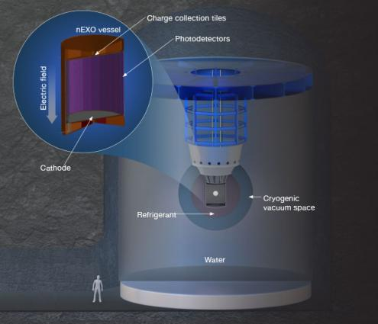

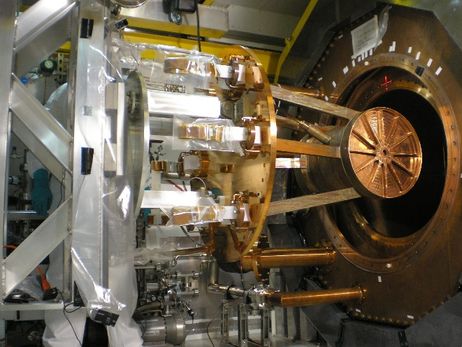

Searching for 0νββ in ¹³⁶Xe – a phased approach
EXO-200 at WIPP (Decommissioned in Dec. 2018):
EXO-200 first 100-kg class ββ experiment
175 kg liquid-Xe TPC with ~80% Xe-136
Discovered 2νββ in Xe-136
Demonstrated excellent background identification through multiplicity and location of event in TPC
→ this is essential for nEXO design
nEXO:
5-tonne liquid Xe TPC
Enriched in Xe-136 at ~90%
SNOLAB cryopit preferred location by collaboration
https://www-project.slac.stanford.edu/exo/
https://nexo.llnl.gov/

Slide 10
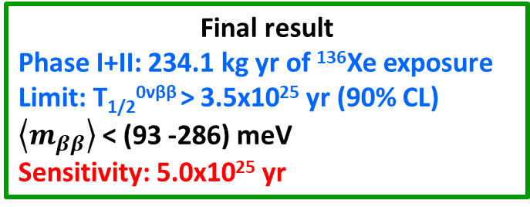
EXO-200 0νββ results
- First 100 kg-class experiment to take data.
- Excellent background, very well predicted by the massive material characterization program
(and the simulation) → This is essential for nEXO design.
- More papers on non-ββ decay physics.
2012: Phys.Rev.Lett. 109 (2012) 032505
2014: Nature 510 (2014) 229-234
2018: Phys. Rev. Lett. 120, 072701 (2018)
2019: Phys. Rev. Lett. 123 (2019) 161802
Final result
Phase I+II: 234.1 kg yr of ¹³⁶Xe exposure
Limit: T_{1/2}^{0νββ} > 3.5x10²⁵ yr (90% CL)
$\left\langle m_{ββ}\right\rangle$ < (93 -286) meV
Sensitivity: 5.0x10²⁵ yr

Slide 11
The power of a monolithic detector
LXe mass (kg) | Diameter or length (cm)
5000 | 130
150 | 40
5 | 13
150kg
2.5 MeV γ-ray
attenuation length in LXe
8.5cm =
5kg
Monolithic/Homogeneous is key because extraneous material is all external (Gamma backgrounds typically originate from the walls )
→ photons Compton scatter on their way into the detector volume.
5000kg
Among the projects selected and funded by DOE for tonne-scale, nEXO is the only Monolithic/Homogeneous detector

Slide 12
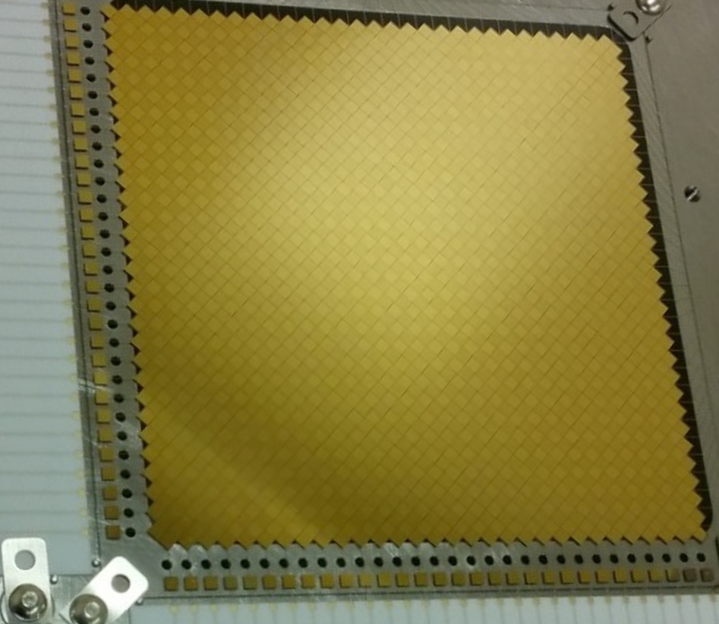
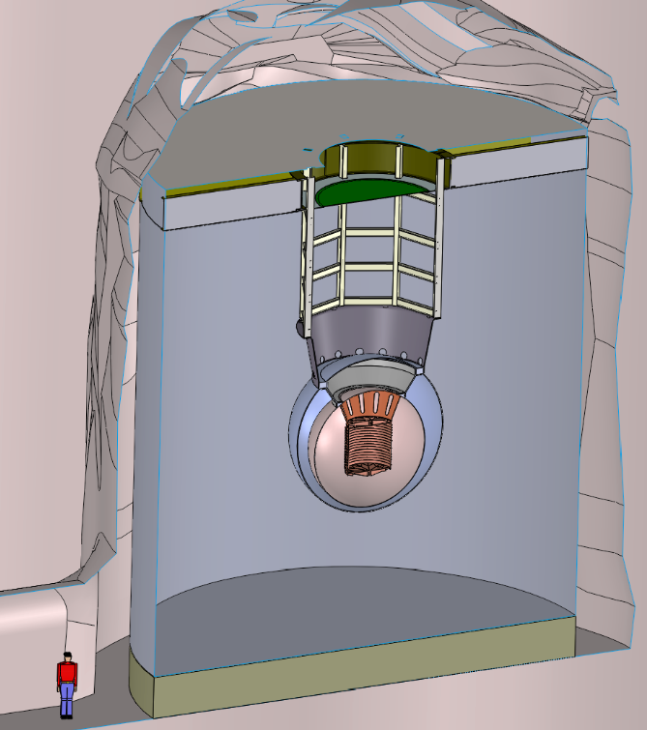
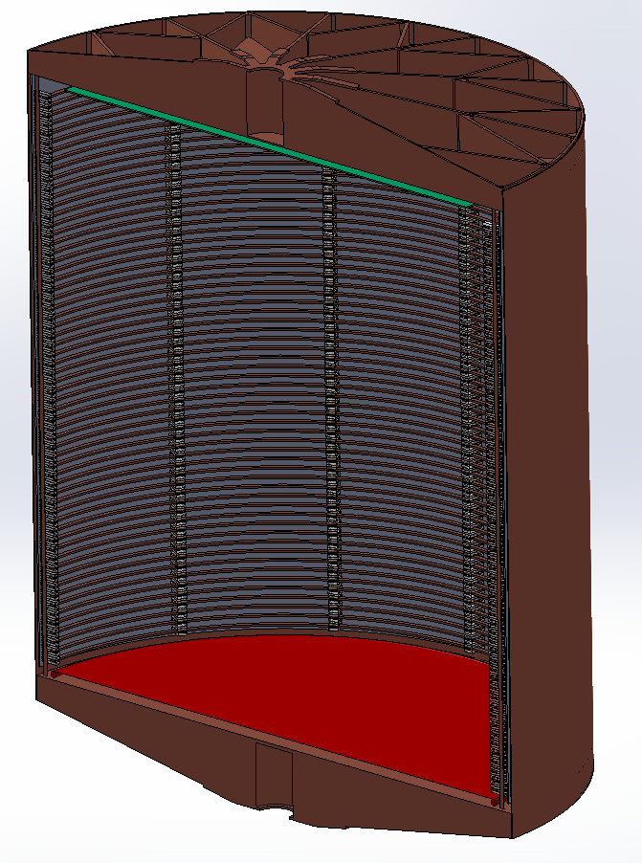
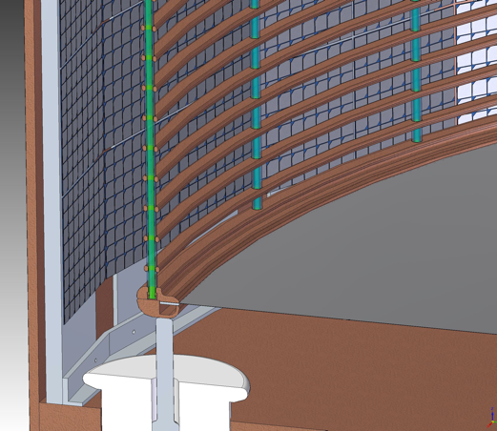
The nEXO detector
5 t liquid xenon TPC similar to EXO-200 (~30x the volume).
SiPM for 175nm scintillation light detection, ~4.5m² SiPM array in LXe.
Tiles for charge read out in LXe.
Cold electronics inside TPC in liquid Xe.
3D event reconstruction.
Combine charge and light readout. Goal → σ/E of <1% at Q-value.
1.5 ktonnes water-Cherenkov detector for muon tagging and shielding.
Picture: 10 x 10 cm² tile prototype
JINST 13, P01006 (2018)
Tile simulation: JINST 14 P09020 (2019)
charge readout pads (anode)
Field shaping rings
Cathode
12.8 m
130
cm
SiPM ‘staves’ covering the barrel
Ø12.3 m
nEXO pre-CDR, arXiv:1805.11142
nEXO TPC
nEXO at the SNOLAB Cryopit
Notes:
Other Xe TPCs have demonstrated better than 1% (look up reference)

Slide 13
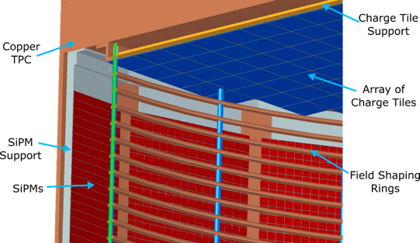
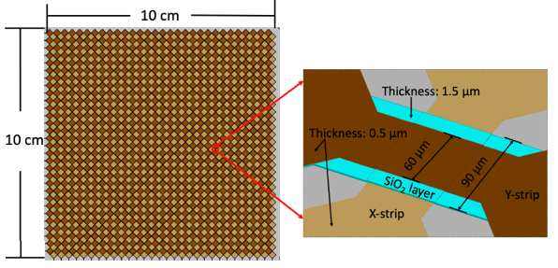
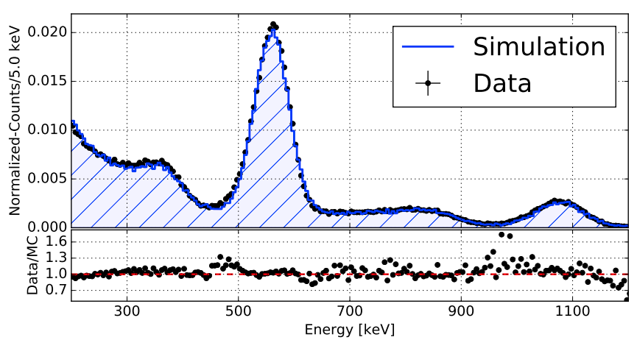
Anode Charge Readout
Zoom in on upper corner of TPC:
Charge collection on tiled anode plane
Full simulation of charge collection in nEXO used to optimize design
  Crossed strips with no shielding grid
  Channel pitch: 6mm
  Tile size: 10 cm x 10 cm
Prototype tiles have been measured in LXe to validate simulation
Zoom in on strip design
Y strip
Z. Li et al. (nEXO Collab) “Simulation of charge readout with segmented tiles in nEXO,” JINST 14 P09020 (2019)
X-Y strip crossing
X strip
Source calibration (²⁰⁷Bi) with prototype tile:
M. Jewell et al. (nEXO Collab) “Characterization of an ionization readout tile for nEXO,” JINST 13 P01006 (2018)

Slide 14
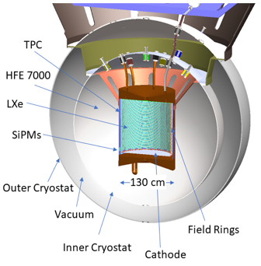
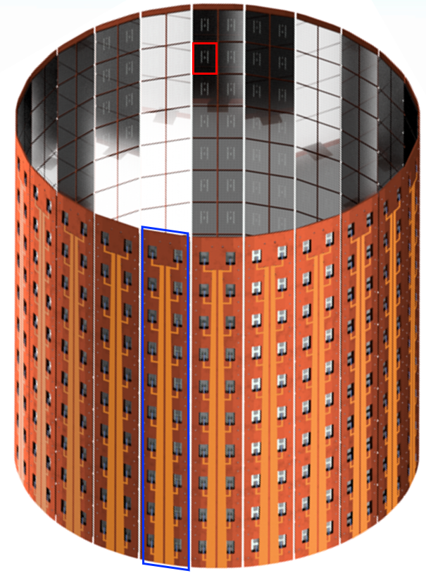
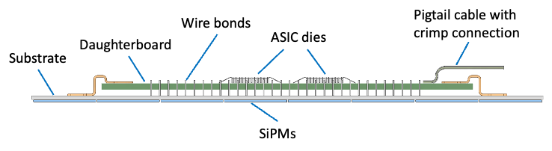
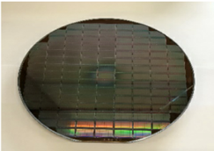
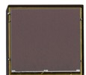
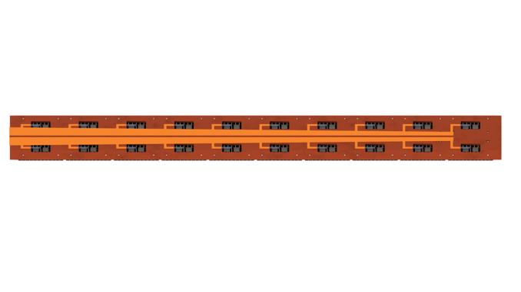
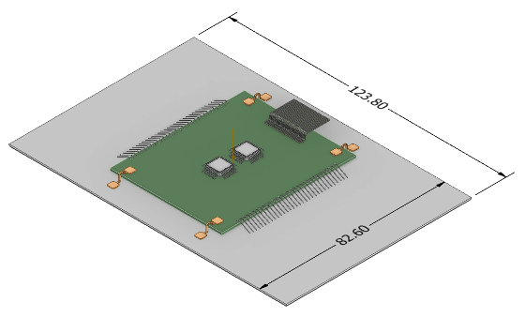

SiPMs for photon detection
  Advantages of SiPMs for photon detection
    Low intrinsic radioactive backgrounds.
    Improved energy resolution (SiPMs high gain).
    Lower bias required for SiPMs (~50 V versus ~1.5 kV).
    Devices from 2 vendors meeting requirements, demonstrated through R&D.
High Voltage
SiPM Devices
Front:
Back:
x 50,000
Stave
x24
1 cm
A. Jamil et al. (nEXO collab.) “VUV-sensitive Silicon Photomultipliers for Xenon Scintillation Light Detection in nEXO,” IEEE Trans. Nucl. Sci. 65, 11 (2018)
1270 mm
G. Gallina et al. (nEXO collab.) “Characterization of the Hamamatsu VUV4 MPPCs for nEXO,” NIM A 940, 371 (2019)
x 24
G. Gallina et al. (nEXO), “Performance of novel VUV-sensitive Silicon Photo-Multipliers for nEXO,” Eur. Phys. J. C 82, 1125 (2022)
Tile module
Photon detector (PD)
x 480
190 mm

Slide 15
nEXO publications
The nEXO collaboration is pursuing a targeted, successful research program.
Most of the studies were led by graduate students and postdocs.
An integrated online radioassay data storage and analytics tool for nEXO, R.H.M. Tsang, et al., submitted to NIM A, arXiv:2304.06180 (2023)
Performance of novel VUV-sensitive Silicon Photo-Multipliers for nEXO, G. Gallina, et al., Eur. Phys. J. C 82, 1125 (2022)
Development of a ¹²⁷Xe calibration source for nEXO, B. G. Lenardo, et al., JINST, 17, 07, P07028 (2022)
nEXO: neutrinoless double beta decay search beyond 10²⁸ year half-life sensitivity, G. Adhikari et al., J. Phys. G: Nucl. Part. Phys. 49 015104 (2022)
Reflectivity of VUV-sensitive silicon photomultipliers in liquid Xenon, M. Wagenpfeil, et al., JINST 16 P08002 (2021),
SNEWS 2.0: A Next-Generation SuperNova Early Warning System for Multi-messenger Astronomy, SNEWS 2 collaboration, New J. Phys. 23 031201 (2021)
Event Reconstruction in a Liquid Xenon Time Projection Chamber with an Optically-Open Field Cage, T. Stiegler, et al, NIMA 1000, 165239 (2021)
Reflectance of Silicon Photomultipliers at Vacuum Ultraviolet Wavelengths, P. Lv, et al, IEEE Trans. Nucl. Sci. 67, 2501 (2020)
Reflectivity and PDE of VUV4 Hamamatsu SiPMs in liquid xenon, P. Nakarim, et al., JINST 15, P01019 (2020)
Measurements of electron transport in liquid and gas Xenon using a laser-driven photocathode, O. Njoya, et al., NIM A 972, 163965 (2020)
Characterization of the Hamamatsu VUV4 MPPCs for nEXO, G. Gallina, et al., NIMA 940, 371 (2019)
Simulation of charge readout with segmented tiles in nEXO, Z. Li, et al., JINST 14, P09020 (2019)
Imaging individual Ba atoms in solid xenon for barium tagging in nEXO, C. Chambers, et al., Nature 569, 203 (2019)
Study of Silicon Photomultiplier Performance in External Electric Fields, X.L. Sun, et al., JINST 13, T09006 (2018)
VUV-sensitive Silicon Photomultipliers for Xenon Scintillation Light Detection in nEXO, IEEE Transactions on Nuclear Science 1 (2018)
nEXO Pre-Conceptual Design Report, arXiv:1805.11142v2
Characterization of an Ionization Readout Tile for nEXO, M. Jewell, et al., JINST 13, P01006 (2018)
Sensitivity and Discovery Potential of nEXO to Neutrinoless Double Beta Decay, J.B. Albert, et al., Physical Review C 97, 065503 (2018)

Slide 16
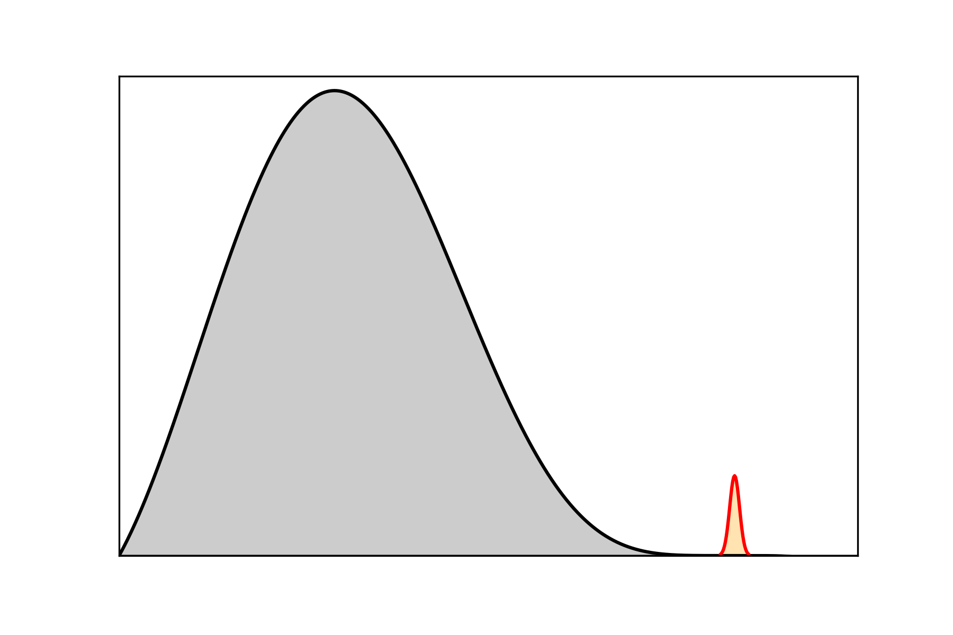
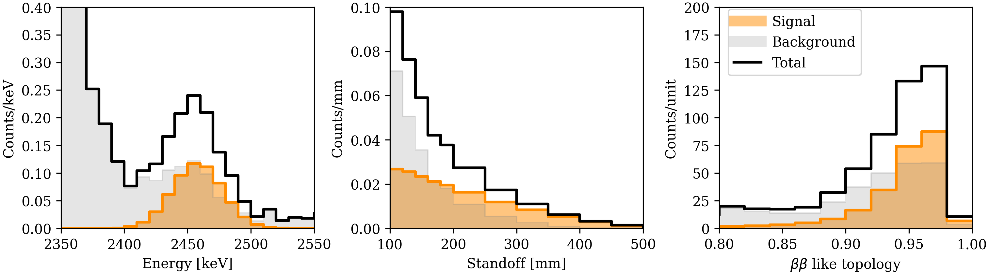

nEXO Signal and Background
Segmented Anode
nEXO measures multiple parameters for each event to be able to robustly identify a 0νββ signal
Signal like
Energy:
Standoff:
Topology:
Bkg. like
Bkg. like
Signal like
Distance from nearest detector surface
Scintillation
Signal like
Bkg. like
~3 mm
$$\vec{E}$$
1D projections of simulated nEXO signal and backgrounds:
e-
e-
e-
e-
e-
e-
T_{1/2} = 7.4 x 10²⁷ yr
nEXO (3$σ$)
e-
e-
e-
Ionization
e-
e-
e-
e-
    Position distribution from 3D event reconstruction
0 ← Background-like
Signal-like → 1
Cathode
    Energy from combined scintillation/ionization
    Topology, e.g., single-site or multi-site

Slide 17
nEXO Signal and Background
Segmented Anode
nEXO measures multiple parameters for each event to be able to robustly identify a 0νββ signal
Signal like
Energy:
Standoff:
Topology:
Bkg. like
Bkg. like
Signal like
Distance from nearest detector surface
Scintillation
Signal like
Bkg. like
~3 mm
$$\vec{E}$$
1D projections of simulated nEXO signal and backgrounds:
e-
e-
e-
e-
e-
e-
T_{1/2} = 7.4 x 10²⁷ yr
nEXO (3$σ$)
e-
e-
e-
3x 1D projections help understanding things but they miss a great deal of information!
Ionization
e-
e-
e-
e-
    Position distribution from 3D event reconstruction
0 ← Background-like
Signal-like → 1
Cathode
    Energy from combined scintillation/ionization
    Topology, e.g., single-site or multi-site

Slide 18
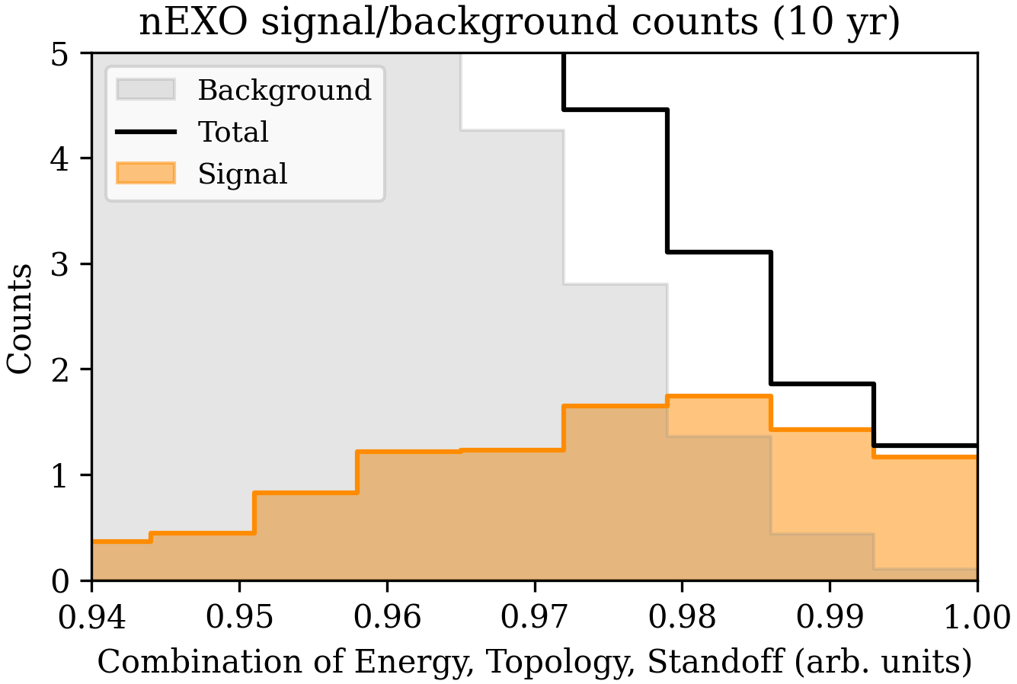

nEXO Signal and Background
Likelihood fit allows optimal weighting between signal and background combining energy, topology, and standoff over full 3D parameter space
For clarity, we arrange the 3D bins into 1D, ordered by signal-to-background ratio.
6.2 tonne yr
exposure with
0.5 bgnd events
T_{1/2} = 7.4 x 10²⁷ yr
nEXO (3$σ$)
➔ nEXO is a “background-free” experiment
Combine energy, topology, and standoff (preserving correlations)
0 ← Background-like
Signal-like → 1
Notes:
The last two bins are 6.2 tonne yr exposure with 0.5 bkg. events

Slide 19
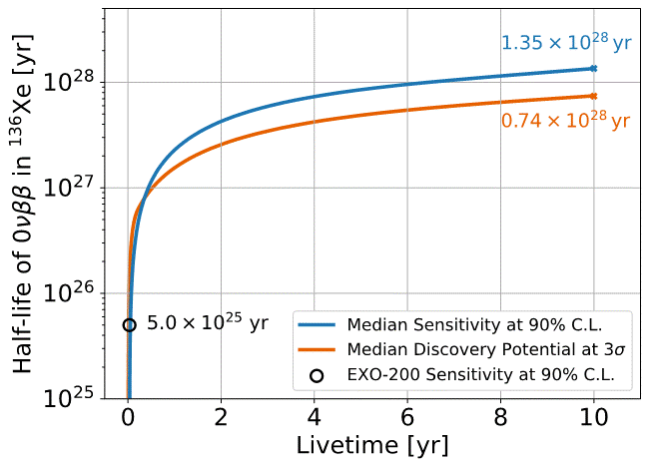
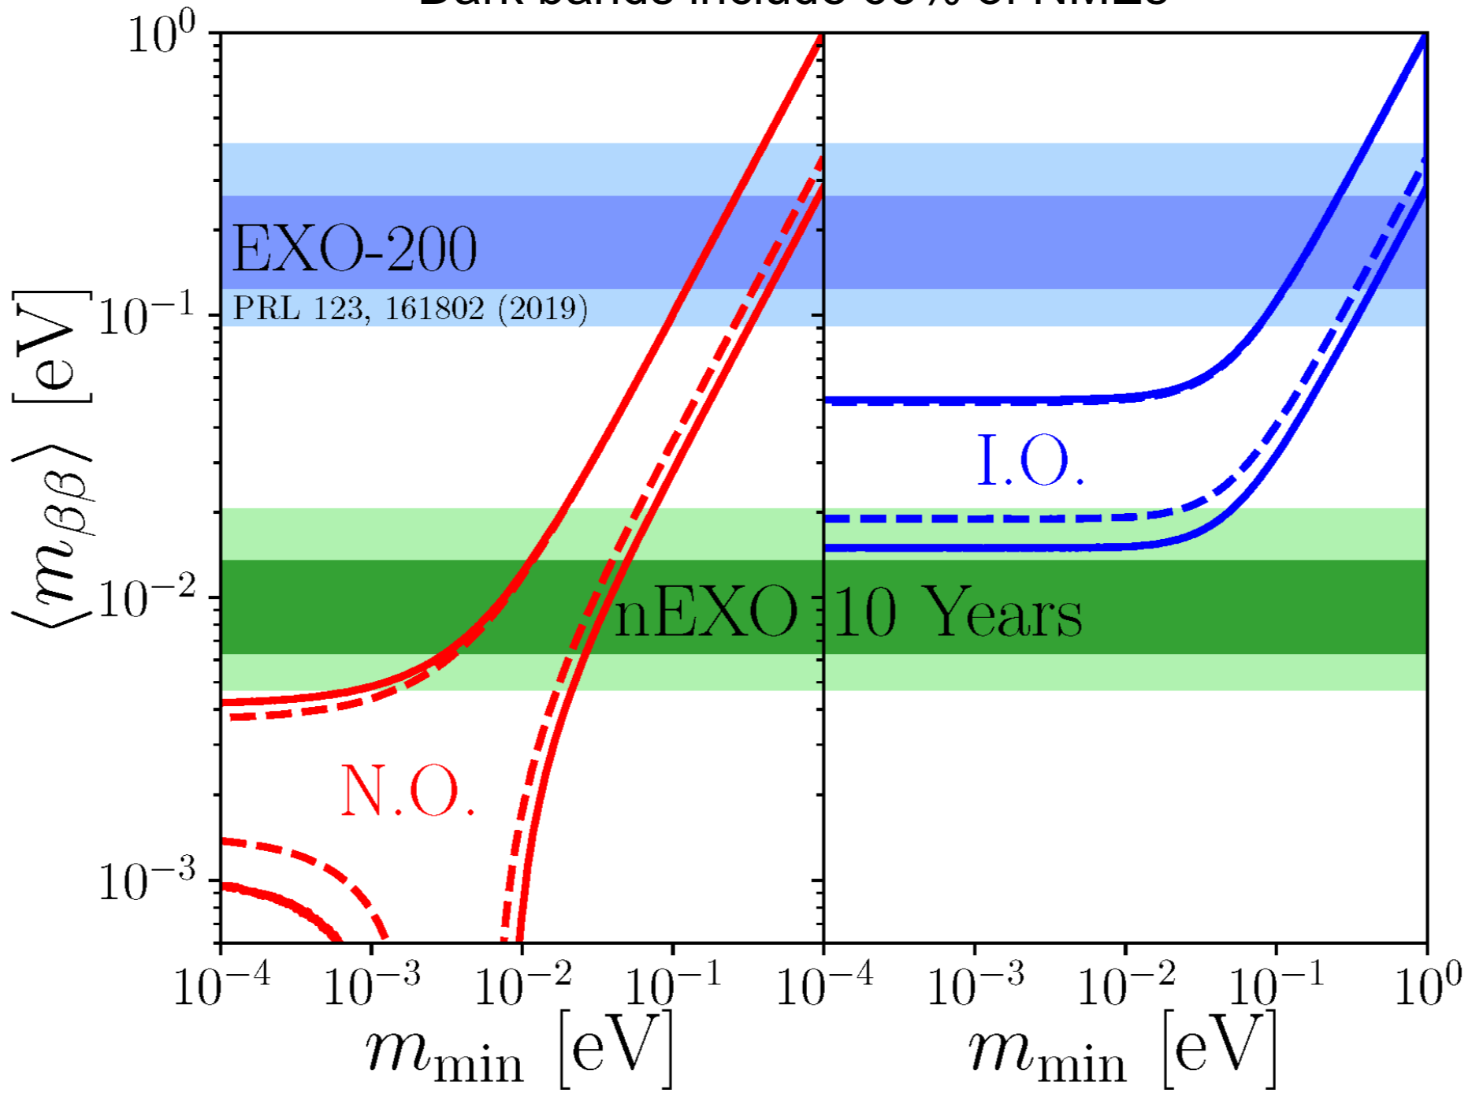
nEXO Projected Sensitivity
Allowed parameter space and nEXO exclusion sensitivity (90% CL):
J. Phys. G: Nucl. Part. Phys. 49, 015104 (2022), arXiv:2106.16243
EXO-200 (2019)
68% of NME models
nEXO sensitivity reaches 10²⁸ yr in 6.5 yr data taking
Projected sensitivity based on background levels measured in samples of all detector materials!

Slide 20
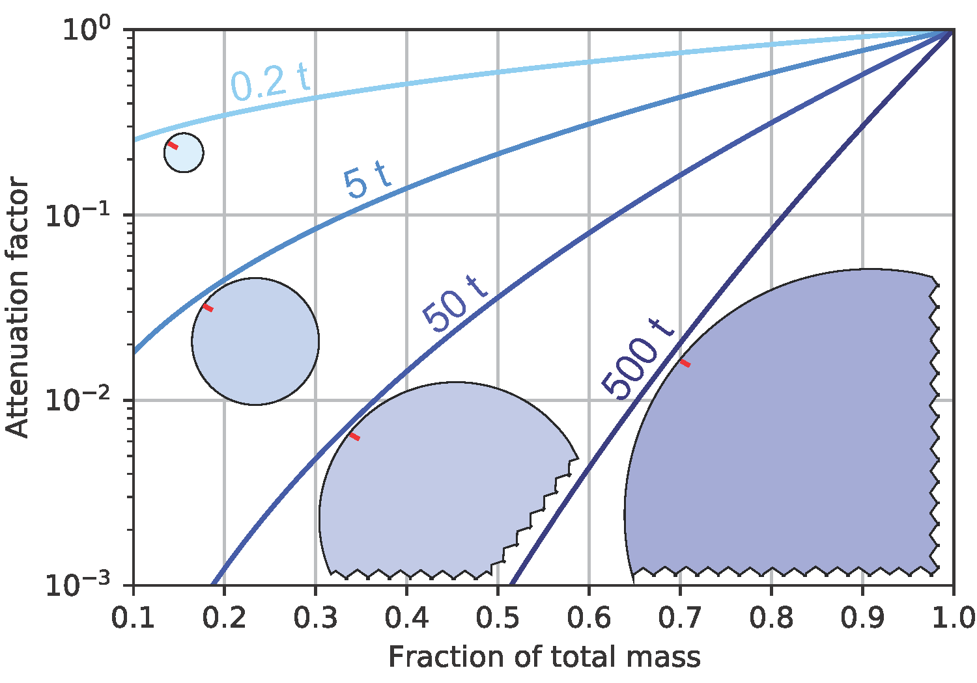
Other Unique Features of nEXO:
LXe reduces risk, as the purification system can be upgraded if unexpected backgrounds are discovered.
If nEXO discovers 0νββ decay:
  nEXO can make a discovery by itself, by repeating the experiment with non-enriched (natural or depleted) xenon to confirm that a signal goes away.
  The enriched xenon is NOT “frozen” in a particular detector. Should 0νββ decay be discovered by nEXO, the xenon could be re-used in a different experimental configuration to investigate the underlying physics.
→ This is particularly important at the tonne scale,
given the cost of the material.
If nEXO does not discover 0νββ decay: The advantages of the homogeneous detector keep improving with size. Should 0νββ decay not be discovered by nEXO, larger detectors using the same technology are possible (A. Avasthi et al, Phys. Rev. D 104, 112007 (2021))
→ The technology needs to be developed with an
eye to the future.

Slide 21
nEXO high-level schedule
CoDR Reviews
PDR Reviews
FDR Reviews
MRR Reviews
Acceptance Reviews
All Needed Xenon in-hand
Operation Readiness Review
      Conceptual
      Design
Preliminary Design
Final Design
Manufacturing Readiness
Assembly and Test
US DOE FY23 (shown): October 2022 – September 2023
Canadian FY23 (not shown): April 2022 – March 2023
Integration & Comm.
First data
CY22
CY23
CY24
CY25
CY26
CY27
CY28
CY29
CY30
CY31
Year 1 – FY22
Year 2-FY23
Year 3-FY24
Year 4-FY25
Year 5-FY26
Year 6-FY27
Year 7-FY28
Year 8-FY29
Year 9-FY30
Year 10-FY31
DOE CD-1 IPR/ICE
DOE CD-3A IPR/ICE
DOE CD-2 IPR/ICE
DOE CD-3 IPR
DOE CD-4 IPR
Now

Slide 22
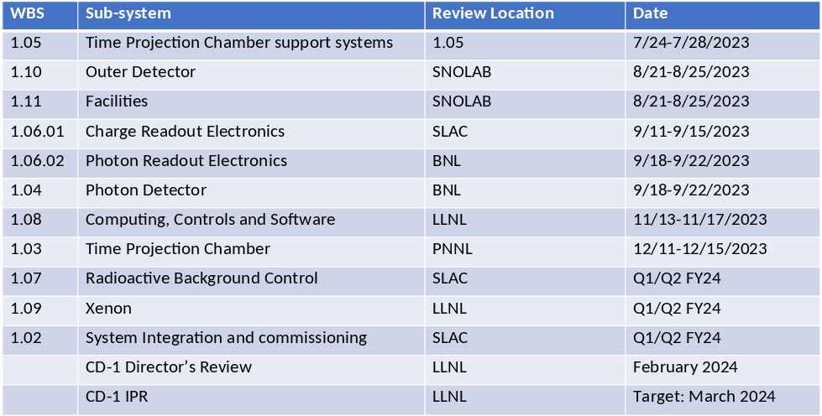
nNEXO Project near term funding:
DOE FY24 Estimates
(CoDRs)
CoDR: Project organized external design review
Estimate complete with DOE FY23 funding in hand
PNNL
Estimate $3.8M of DOE FY24 dollars
CD-1 Independent Project Review
FY24 Funding (US DOE only)
Technically Limited $42M ($57M with contingency).
Of the FY24 dollars, $3.8M is required to complete CD1 (CoDRs shown above + all CD1 deliverables shown on previous slide).
$6.0M in FY24 (constant funding+ inflation) required to avoid reversing ramp up.
April 27, 2023
0νββ International Summit - nEXO
22

Slide 23
nEXO Project Cost Profile
DOE FY | FY22 | FY23 | FY24 | FY25 | FY26 | FY27 | FY28 | FY29 | FY30 | FY31 | TOTAL
US DOE Project [US$k] | 500 | 5,000 | 42,000 | 47,800 | 59,100 | 57,000 | 50,800 | 26,700 | 11,400 | 10,700 | 311,000
CFI Innovation Fund [US$k] |  | 300 | 11,000 | 7,000 | 7,000 | 9,000 | 6,000 | 6,000 | 800 | 800 | 47,900
Notes:
US DOE Project
  40% contingency is NOT included.
  Updated with inflation for 2-year shift from Portfolio Review and suggested escalation model.
Canada CFI Innovation Fund
  CFI IF construction components listed only – R&D specific infrastructure excluded from table.
  Assuming multiple CFI IF awards (2023, 2025, 2027, …)
Funding Status
  $5.5M of DOE funding in hand.
  CFI IF 2020 in hand: CAN$2M towards nEXO construction, CAN$9.2M for nEXO R&D infrastructure.
April 27, 2023
0νββ International Summit - nEXO
23

Slide 24
Analysis of Alternatives (AoA)
In preparation for the next steps, DOE is proceeding with a formal Analysis of Alternatives.
This includes an analysis of the cost and performance at various sites.
For the cost, the analysis is done “differentially” from the case we analyzed with the
most detail (Cryopit).
While the cost at LNGS and SNOLAB is comparable,
due to cosmogenic activation of ¹³⁶Xe → ¹³⁷Xe the physics reach is better at SNOLAB.
Site | Cost to DOE (M$) | Total Cost (M$)
SNOLAB primary | 311 | 441
LNGS primary* | 301** | 462
* Account for some re-design work
** Assumes contributions from Europe that are not as solid as CFI contributions from SNOLAB and Canada. Does not take credit for a possible larger Italian contribution.

Slide 25
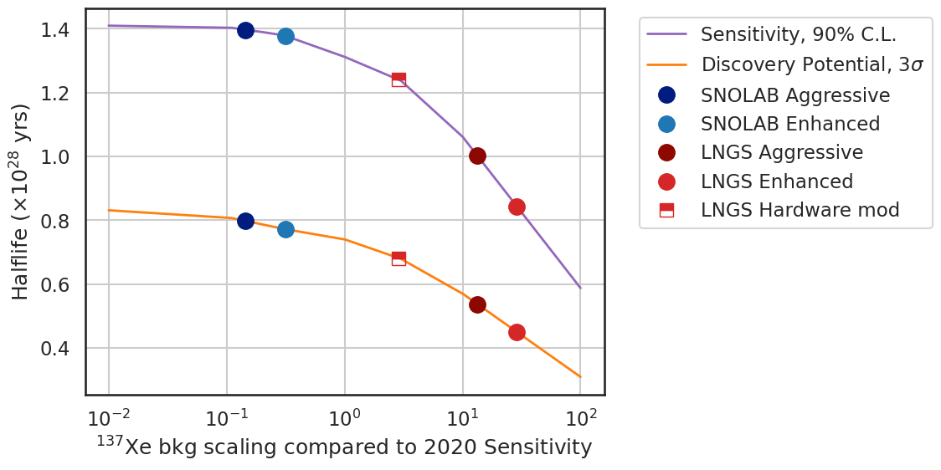
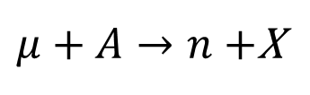
For the two more plausible cases: LNGS and SNOLAB
$μ+A→n+$X
$$n+{}_{}^{136}{\text{Xe}→{}_{}^{137}{\text{Xe}+γ(4.\text{MeV})}}$$
$${}_{}^{137}{\text{Xe}\underset{→}{\text{3.82}\text{min}}{}_{}^{137}{\text{C}s}+β+γ({\text{Q}}_{β}=4.2\text{MeV})}$$
 | Site | ¹³⁷Xe Total Background Fraction [%] | Deadtime [days] (% of 10 yrs) | 90% CL 0νββ Sensitivity [10²⁸ y] | Discovery Potential, 3σ [10²⁸ y]
Enhanced | SNOLAB | 1.1% | 1.6 (0.04%) | 1.38 | 0.77
 | LNGS | 45% | 148 (4%) | 0.84 | 0.45
Aggressive | SNOLAB | 0.7% | 1.9 (0.05%) | 1.39 | 0.80
 | LNGS | 28% | 178 (5%) | 0.99 | 0.53
Hardware Modification | SNOLAB | - | - | - | -
 | LNGS | 7.8% | 15 (0.4%) | 1.24 | 0.68
HIGH LEVEL ASSUMPTIONS
Enhanced – Neutron capture tag eff = 80% (nominal γ threshold)
Aggressive – Neutron capture tag eff = 93% (lower γ threshold) details of dead-time reduction algorithm to be finalized
Hardware Modification - Add neutron capture dopant to HFE volume

Slide 26
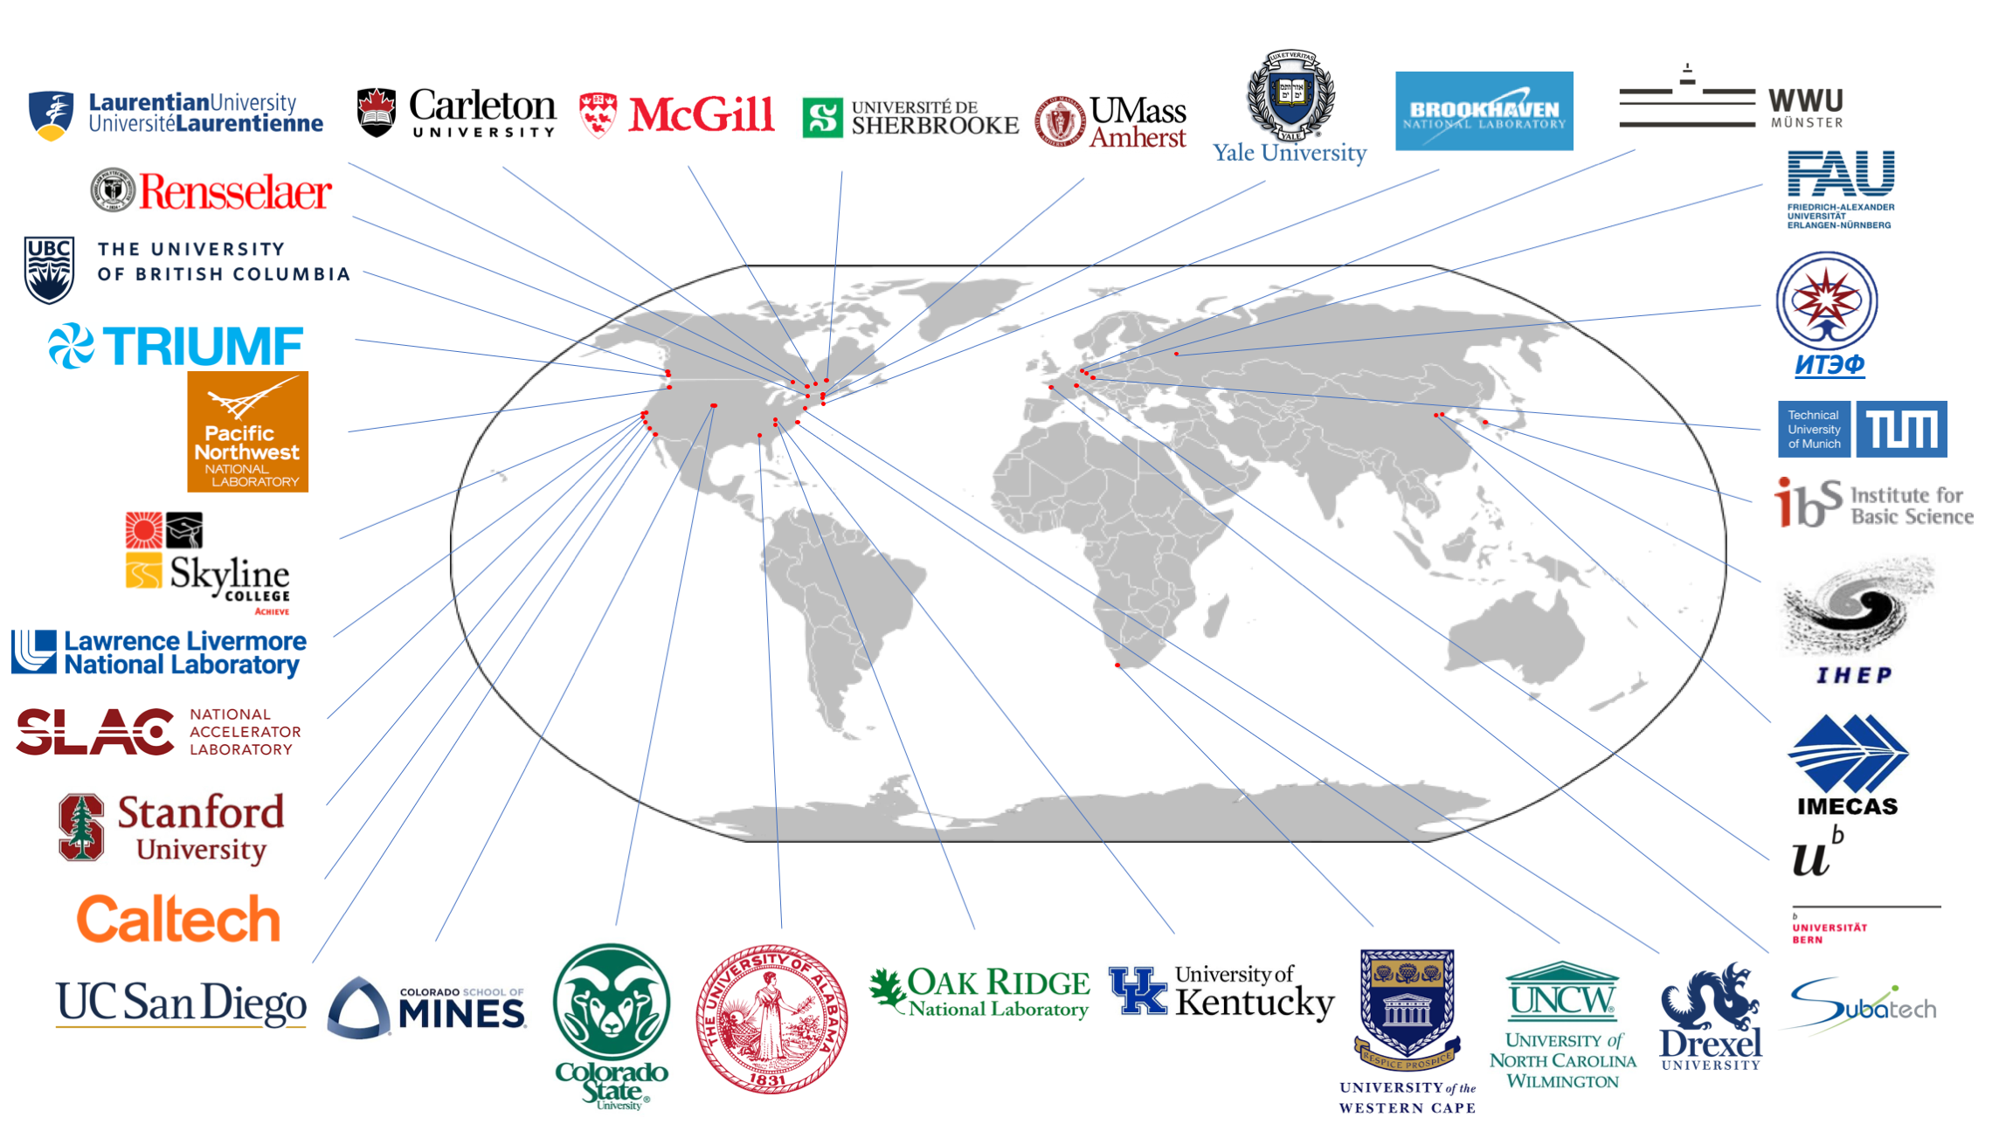
The international nEXO collaboration
Canadian contingent within nEXO
14 PIs members of nEXO
~45 undergraduate and graduate students and postdocs
Canadian groups constitute ~25% of the collaboration, contribute to 5 subsystems, and lead 2 subsystems.
Significant engineering and project management support from SNOLAB
List of collaborators available at https://nexo.llnl.gov/
~200 scientists, 34 institutions in 9 countries on 4 continents

Slide 27
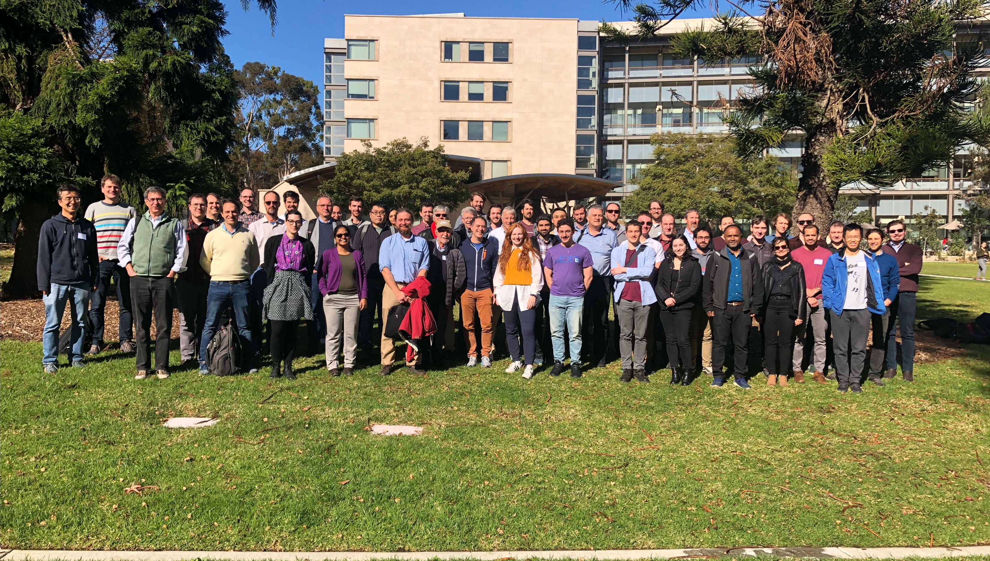

Collaboration Meeting December 2022
We are looking forward to welcome the collaboration in Montreal for the summer 2023 collaboration meeting!

Slide 28
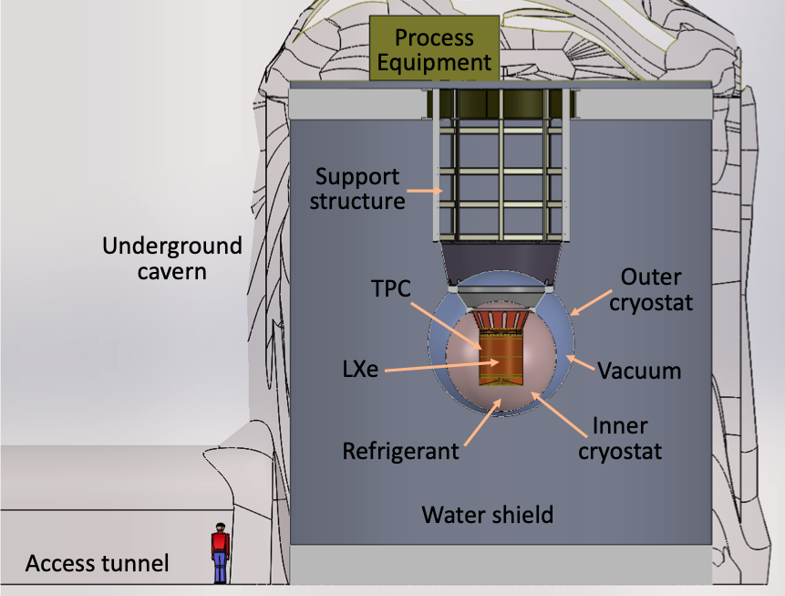
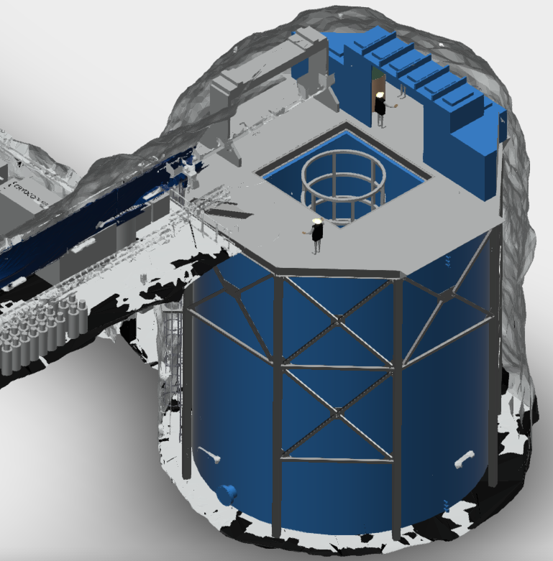
Summary
nEXO at
SNOLAB
nEXO is a discovery focussed 0νββ experiment.
nEXO’s multi parameter signal extraction enables a “background-free” 0νββ search that is particularly robust against unknown backgrounds.
nEXO is being designed to reach a sensitivity beyond ~10²⁸ years and will probe the entire inverted ordering parameter space.
SNOLAB is the location preferred by nEXO.
nEXO design at SNOLAB Cryopit is well advanced.
We hope to engage with international funding agencies to refine our funding strategy.
nEXO at
SNOLAB

Slide 29
IHEP Beijing Status and Interests
Yifang Wang

Slide 30
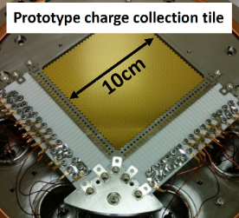
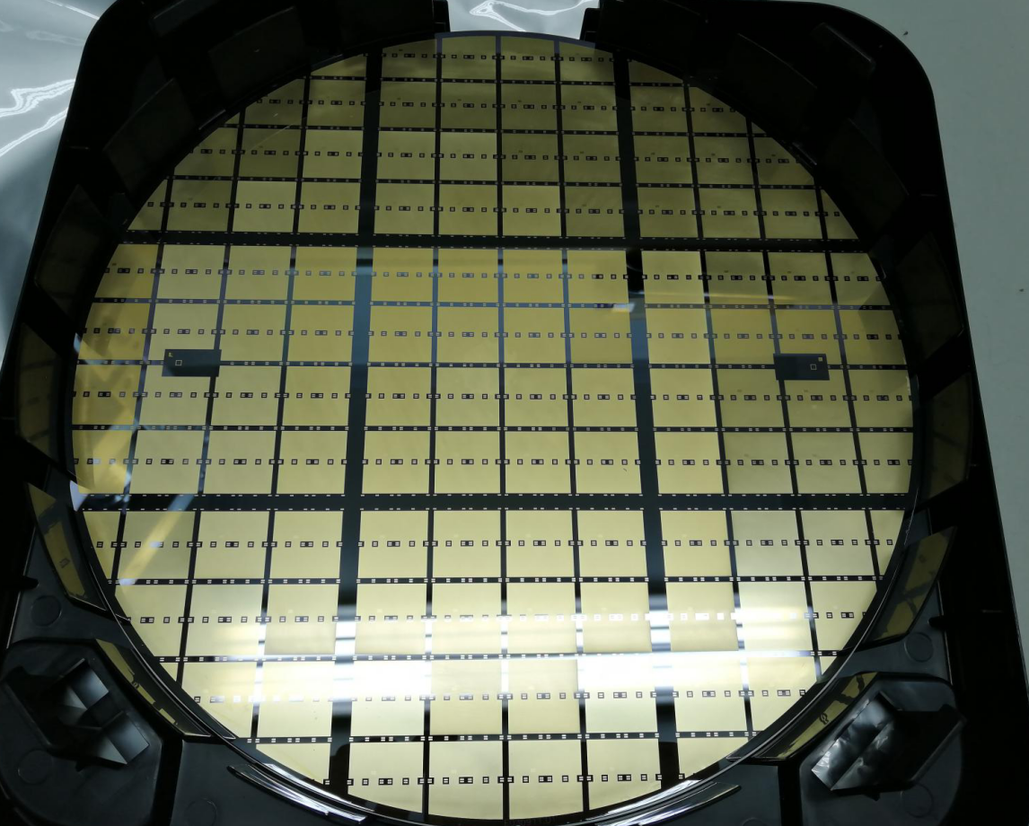

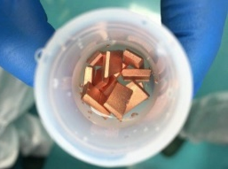
Management Roles in EXO-200/nEXO
  Physics coordinator: Liangjian Wen (2015-2016), Gaosong Li (2017-2022)
  1.04.02 L3 (Photon Detector - photon detector specification) : Guofu Cao
  1.03.04 L3 (TPC - Charge Detection & Anode) : Liangjian Wen
Major activities in nEXO R&D：
Charge readout tiles & ASIC elec.
10 cm
SiPM interposer
Planned Hardware contribution from IHEP, not including manpower & overhead
L2 systems | WBS tasks | M&S Budget
TPC System | Anode charge tiles (full size ~1.3 m²) | $ 2.5 M
Photon Detector | Si-interposer (full size ~ 5 m²) for SiPM readout | $ 3.5 M
 | (Al+MgF₂) coating on cathode & shaping rings to reflect VUV photons | $ 1 M
Electronics (charge readout) | Analog multiplexing ASIC (cold) + under-water FADC electronics based on JUNO experience | $ 1 M
Radioactivity Control | Radio-assay via ICP-MS at IHEP | $ 0.3 M
Veto system | ~500 water-proof 8-in. PMTs (R5912) and readout electronics from Daya Bay | (in-kind, ~ $ 1 M equivalent)
(Al + MgF₂) plating
Radioassay
by ICP-MS
Pursue a domestic solution for Xe-136 enrichment (up to about ~ 1 ton ^{enr}Xe)

Slide 31
IHEP Beijing Status and Interests
We have been a main player of EXO-200 and will continue with nEXO, motivated by physics.
We worked a lot on nEXO R&D and will contribute to electronics, detector, physics, etc.
We have been working with the industry to explore the possibility to provide 1t enriched Xe. Technologically it is feasible but initial investment for equipment has not yet been started, due to uncertainties of nEXO (slow progress in DOE did not help in China).
We plan to start exploring the funding possibilities for Xe enrichment and related equipment investment.
0νββ International Summit - nEXO
Yifang Wang

