Slide 1

Solar neutrino detection with Q-Pix
Guilherme Ruiz
SoLAr meeting 28/06/2023

Slide 2
The simulation
Event generation – Marley (QPixG4)
  Scatters neutrinos in LAr through CC or ES as described previously
  Input: neutrino flux
  Output: scattered electron + daughter nucleus (CC) or neutrino (ES)

Slide 3
The simulation
Event generation – Marley (QPixG4)
  Scatters neutrinos in LAr through CC or ES as described previously
  Input: neutrino flux
  Output: scattered electron + daughter nucleus (CC) or neutrino (ES)
LAr propagation – Geant4 (QPixG4)
  Propagates the scattered electron from Marley’s output through LAr producing “hits”
  Each hit represents an energy deposit at a certain position within the detector
  Only hits from ionization processes contribute to the total deposited energy to be detected

Slide 4
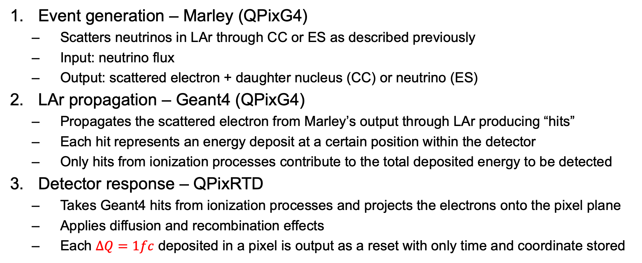
The simulation
Event generation – Marley (QPixG4)
  Scatters neutrinos in LAr through CC or ES as described previously
  Input: neutrino flux
  Output: scattered electron + daughter nucleus (CC) or neutrino (ES)
LAr propagation – Geant4 (QPixG4)
  Propagates the scattered electron from Marley’s output through LAr producing “hits”
  Each hit represents an energy deposit at a certain position within the detector
  Only hits from ionization processes contribute to the total deposited energy to be detected
Detector response – QPixRTD
  Takes Geant4 hits from ionization processes and projects the electrons onto the pixel plane
  Applies diffusion and recombination effects
  Each $∆Q=1fc$ deposited in a pixel is output as a reset with only time and coordinate stored

Slide 5
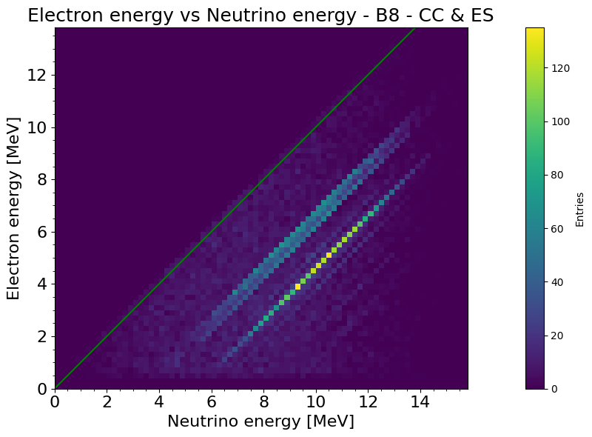
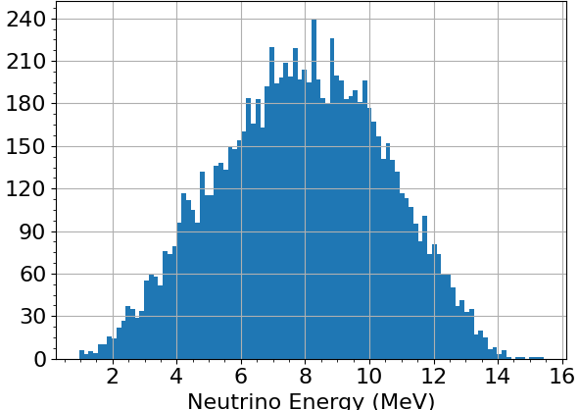
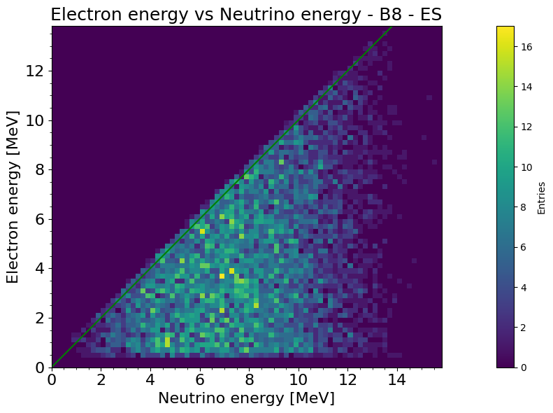


1 – Event generation
Output
Marley
Input
$$ν_{e}+{}_{}^{39}{Ar}→e^{−}+{}_{}^{40}{K^{∗}}$$
CC
ES
$$ν_{e}+e^{−}→ν_{e}+e^{−}$$

Slide 6
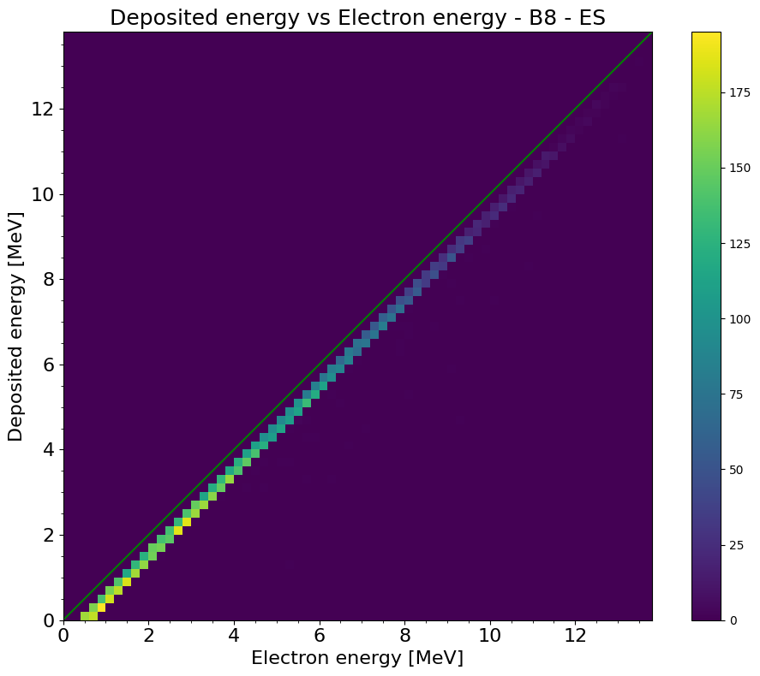
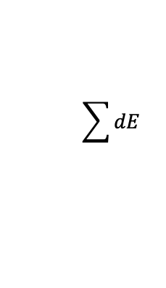




2 – LAr propagation
Geant4
$dE$ per hit
Input
Output
$$t$$
$$\sum{dE}$$
$$e^{−}$$
$$y$$

Slide 7
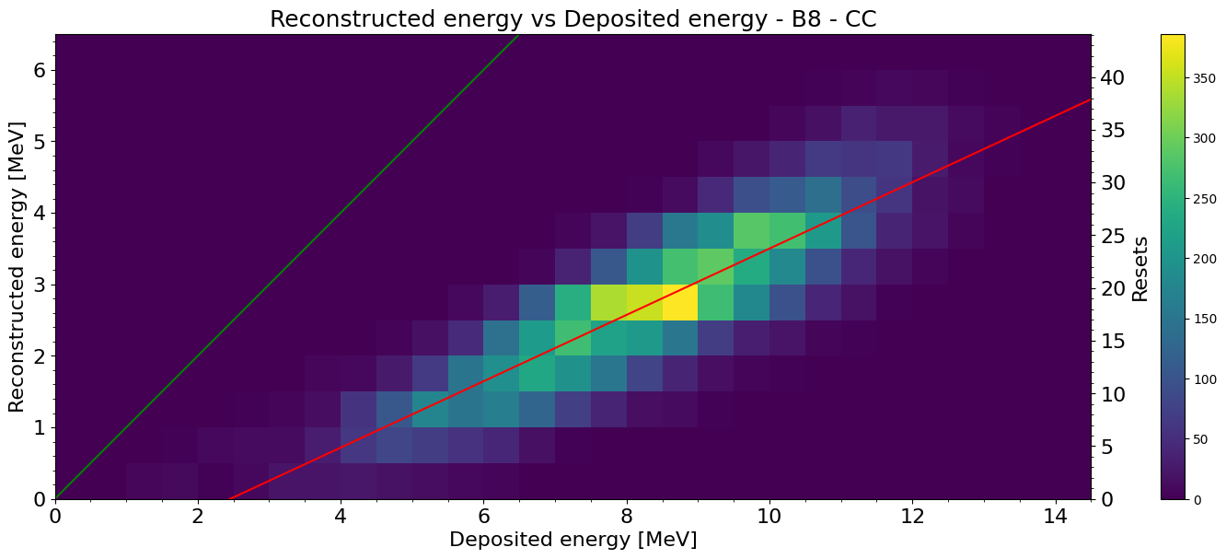
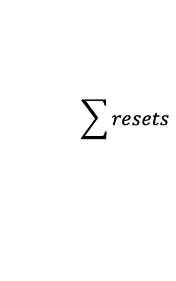

3 – Detector response
QPixRTD
Input
$$t$$
Output
$$t$$
QPix resets
Geant4 hits
$$\sum{resets}$$
$$y$$
3
4
4
2
3
4
5
$$y$$
Resets

Slide 8
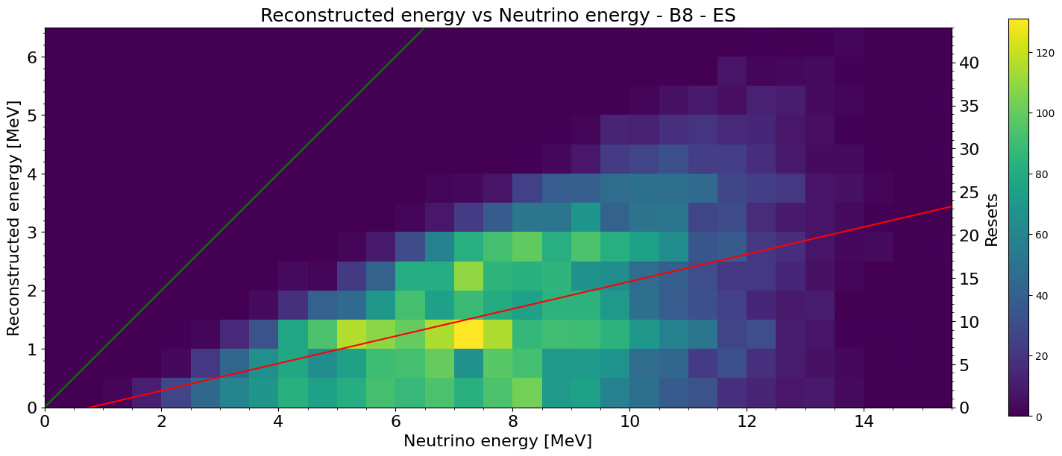
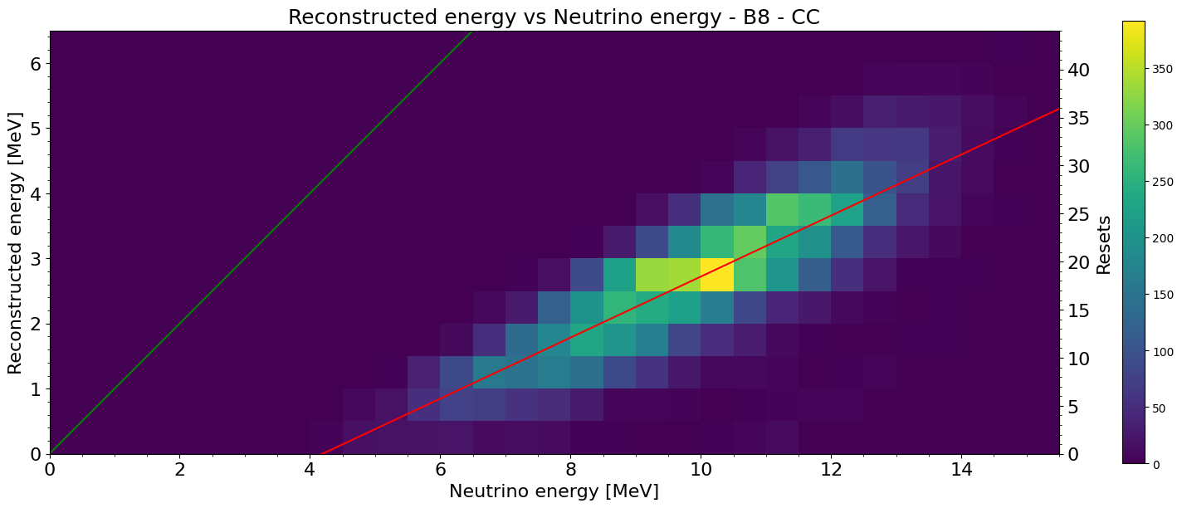
Full simulation
⁸B Reconstructed energy vs Neutrino energy
No Recombination
ES
CC

Slide 9
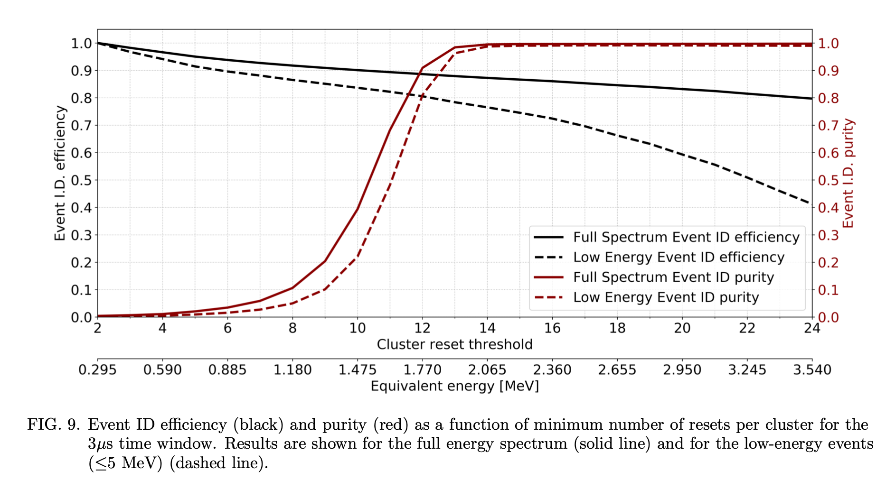
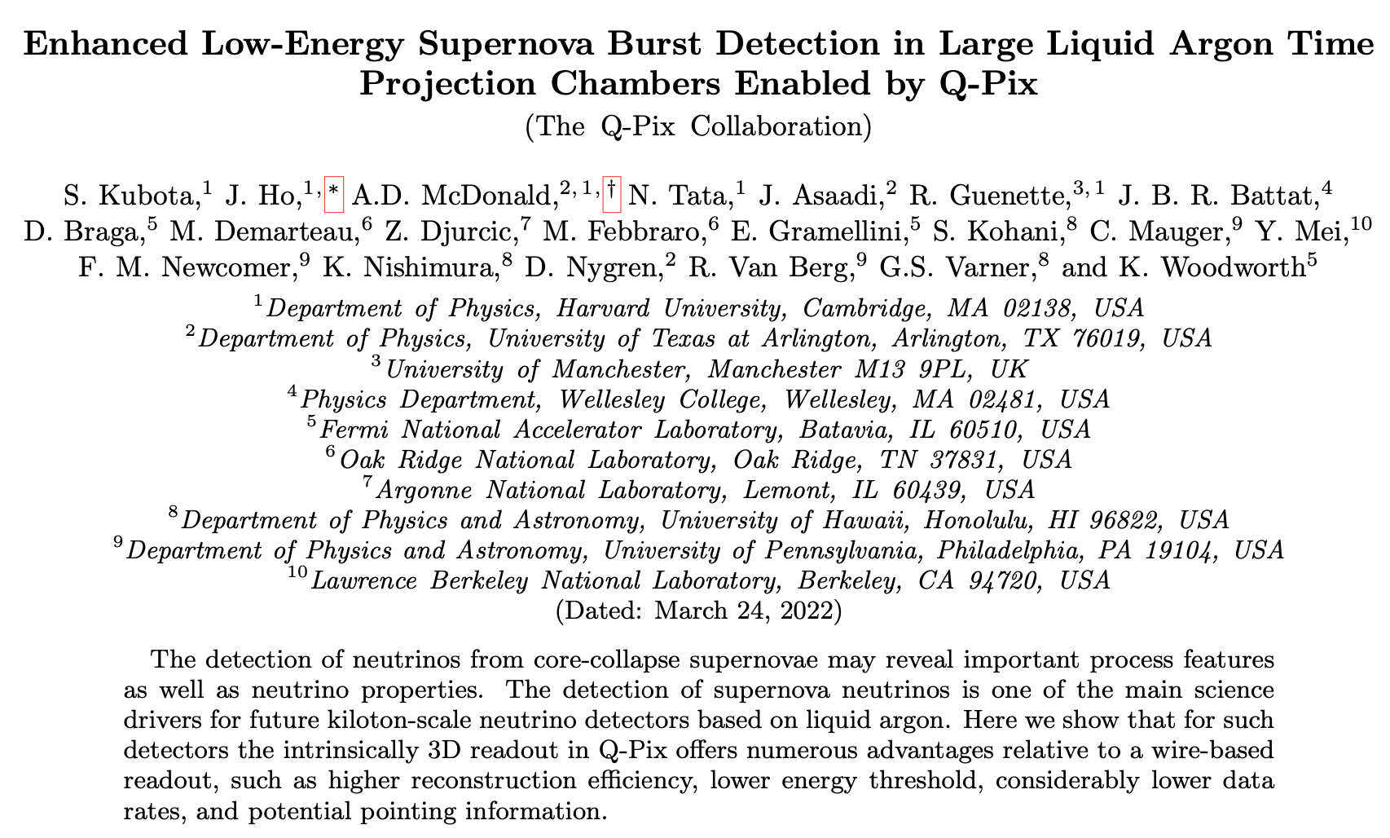
Goal: Detection efficiency and purity
Supernova event detection efficiency and purity
Efficiency and purity depend directly on the number of resets and thus on the reset threshold
1fc may not be optimal for solar neutrinos – depends on signal spectrum and background rates

Slide 10
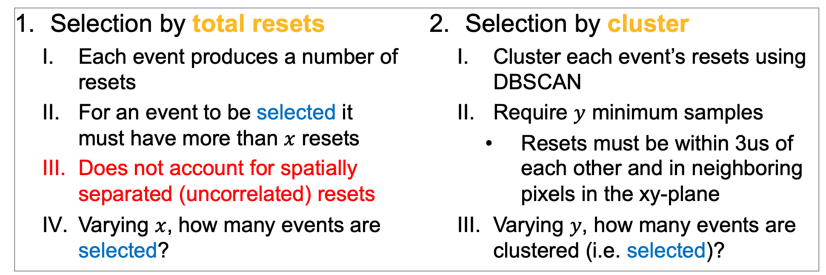
Detection efficiency
Definition: ratio of signal events selected to total number of signal events
Selection by total resets
  Each event produces a number of resets
  For an event to be selected it must have more than $x$ resets
  Does not account for spatially separated (uncorrelated) resets
  Varying $x$, how many events are selected?
Selection by cluster
  Cluster each event’s resets using DBSCAN
  Require $y$ minimum samples
    Resets must be within 3us of each other and in neighboring pixels in the xy-plane
  Varying $y$, how many events are clustered (i.e. selected)?
Efficiency can be increased by lowering the reset threshold –> more resets per MeV

Slide 11
Detection purity*
Definition: ratio of signal events selected to total number of events selected
Selection criteria defined the same as for efficiency
  Either by total resets or clusters
Can be optimized by changing the reset threshold
  Lowering the threshold increases efficiency but decreases purity as more background events satisfy the selection criteria
  Rising the threshold reduces efficiency but also suppresses the background, increasing purity
*Not considered yet. Pending results.

Slide 12
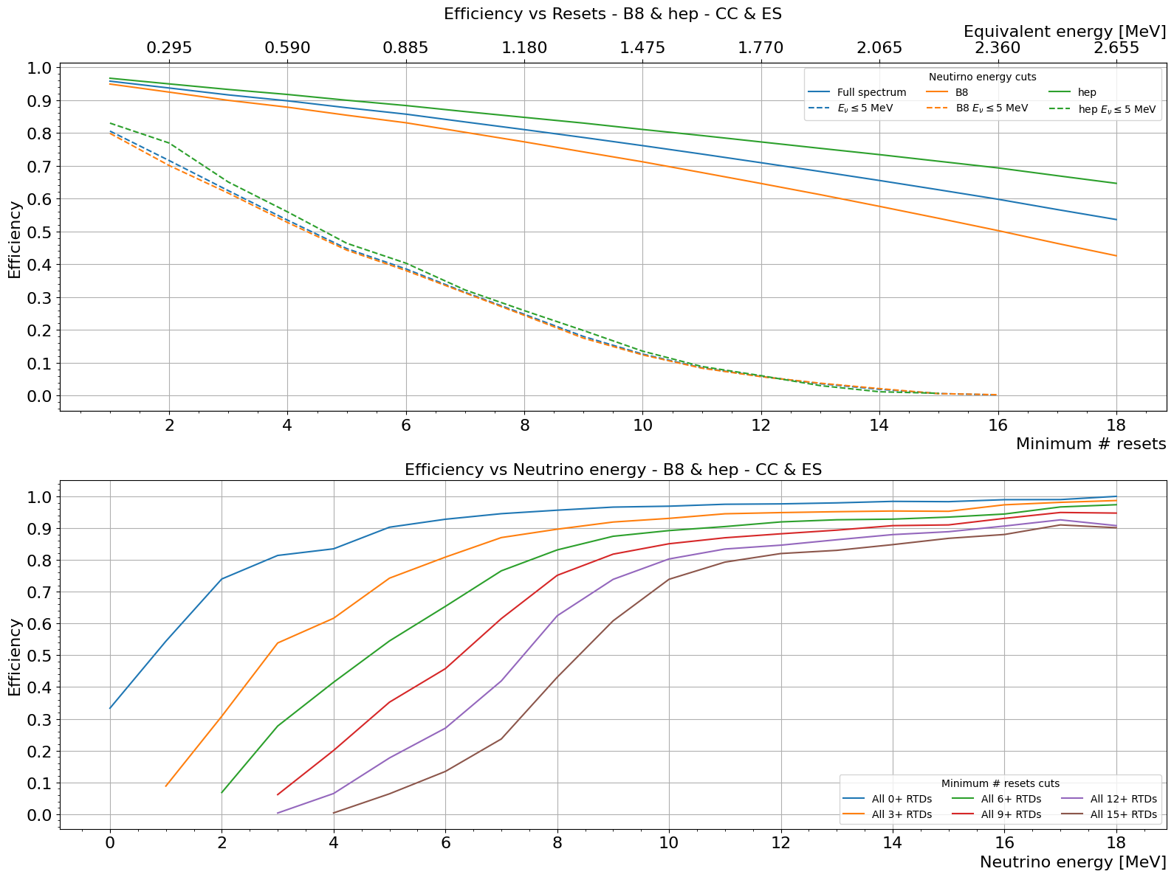
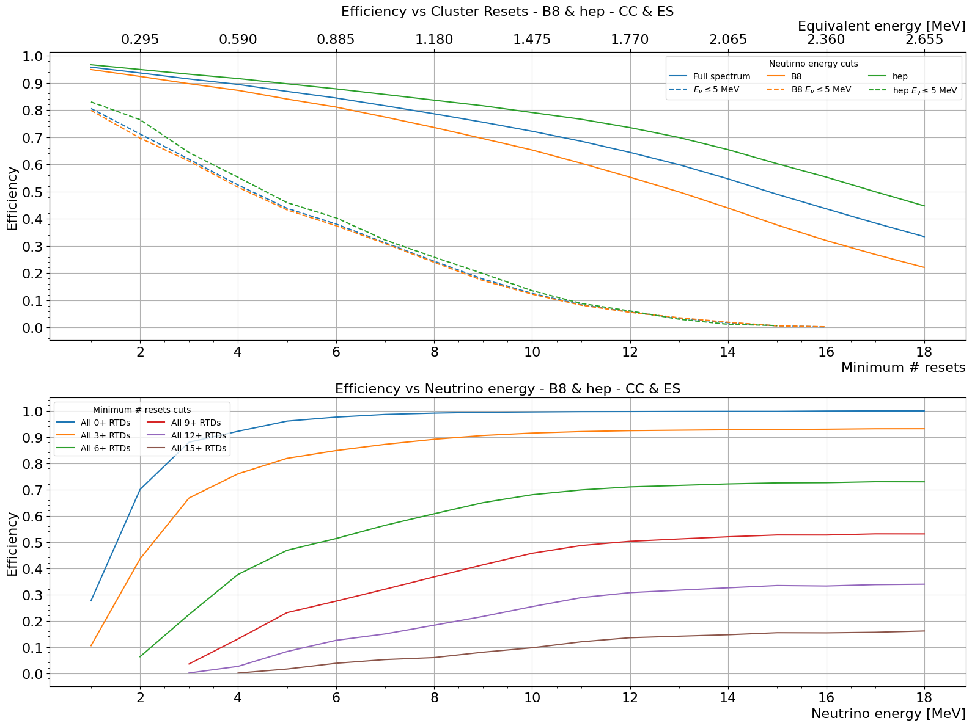
Efficiency vs Resets
⁸B & HEP solar neutrinos
Total resets
Clusters

Slide 13
Conclusions
The simulation results are consistent with the theory
Efficiency and purity can be tuned by changing the reset threshold
A good understanding of the background is needed for optimal solar neutrino detection
Clustering reduces efficiency, but facilitates background discrimination by rejecting unrelated resets
With approximately 8 resets as selection criterion, we can achieve 40% efficiency for 5MeV neutrinos

Slide 14
Thank you

Slide 15
Backup slides

Slide 16
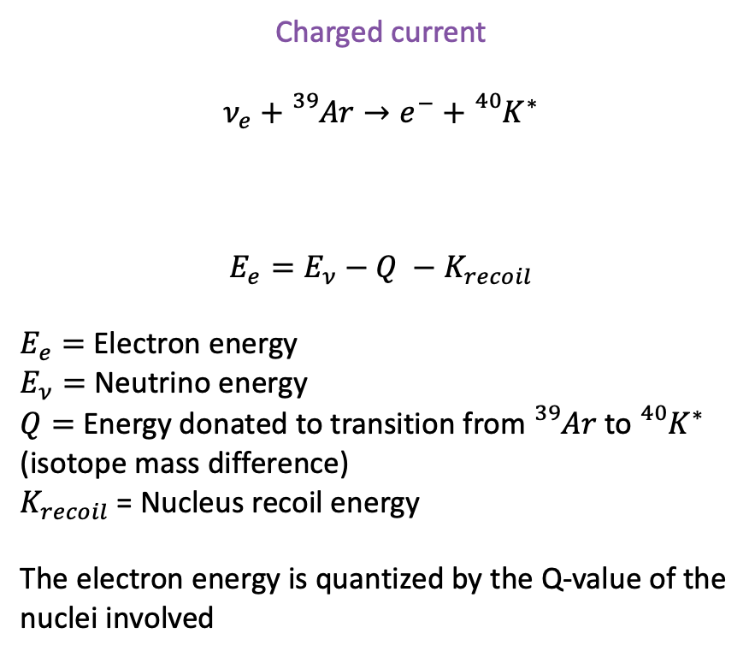
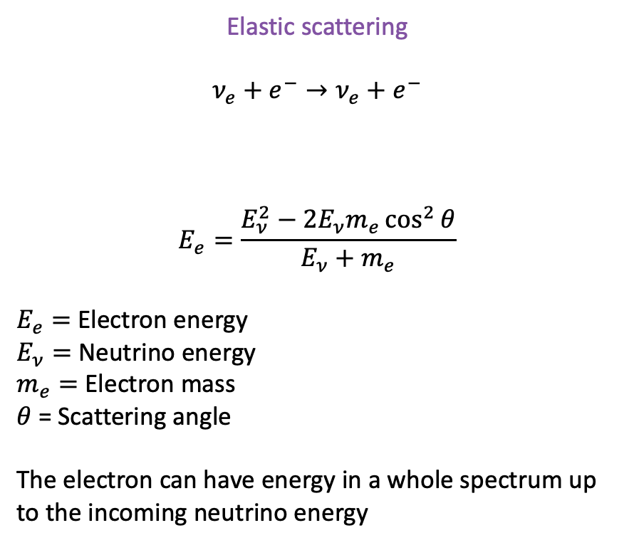
ES vs CC scattering
No Recombination
Elastic scattering
$$ν_{e}+e^{−}→ν_{e}+e^{−}$$
$$E_{e}=\frac{E_{ν}^{2}−2E_{ν}m_{e}\cos^{2}{θ}}{E_{ν}+m_{e}}$$
$E_{e}=$ Electron energy
$E_{ν}=$ Neutrino energy
$m_{e}=$ Electron mass
$θ$ = Scattering angle
The electron can have energy in a whole spectrum up to the incoming neutrino energy
Charged current
$$ν_{e}+{}_{}^{39}{Ar}→e^{−}+{}_{}^{40}{K^{∗}}$$
$$E_{e}=E_{ν}−Q −K_{recoil}$$
$E_{e}=$ Electron energy
$E_{ν}=$ Neutrino energy
$Q=$ Energy donated to transition from ${}_{}^{39}{Ar}$ to ${}_{}^{40}{K^{∗}}$ (isotope mass difference)
$K_{recoil}$ = Nucleus recoil energy
The electron energy is quantized by the Q-value of the nuclei involved
Negligible

Slide 17
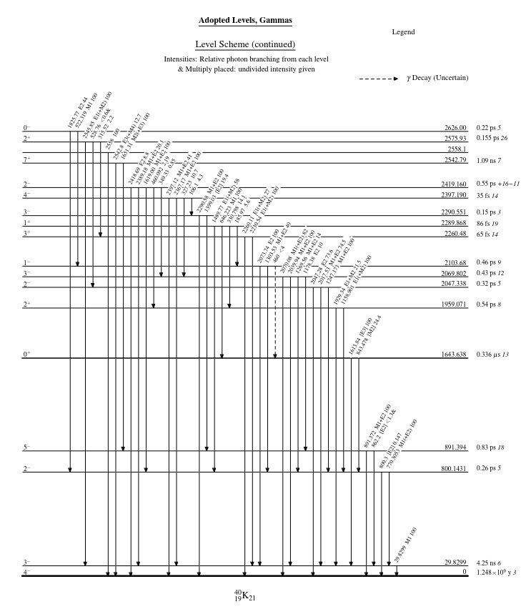
ES vs CC scattering
No Recombination
Elastic scattering
$$ν_{e}+e^{−}→ν_{e}+e^{−}$$
$$E_{e}=\frac{E_{ν}^{2}−2E_{ν}m_{e}\cos^{2}{θ}}{E_{ν}+m_{e}}$$
$E_{e}=$ Electron energy
$E_{ν}=$ Neutrino energy
$m_{e}=$ Electron mass
$θ$ = Scattering angle
The electron can have energy in a whole spectrum up to the incoming neutrino energy

Slide 18
Efficiency vs Resets
8B & HEP solar neutrinos
Total resets

Slide 19
Efficiency vs Resets
8B & HEP solar neutrinos
Clusters

Slide 20
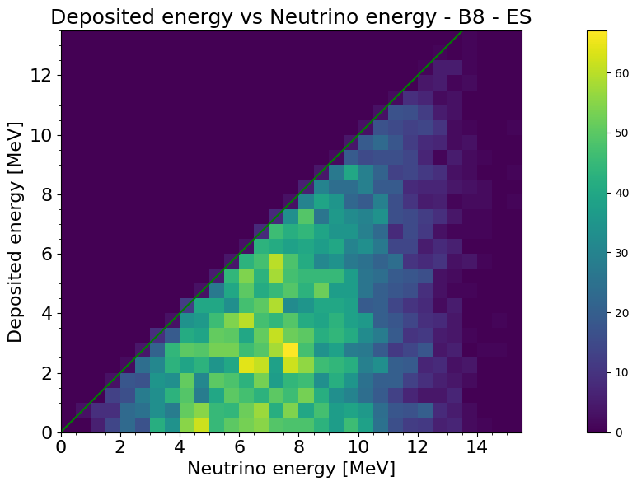
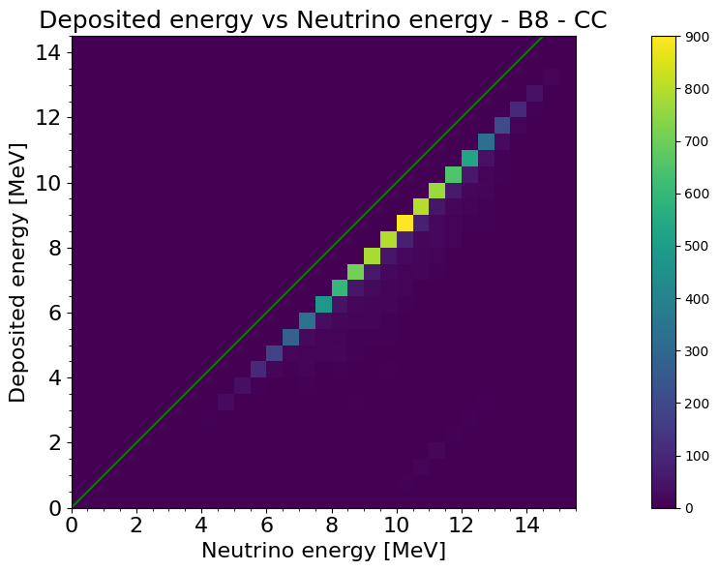
Marley + Geant4 simulation
⁸B Deposited energy vs Neutrino energy
No Recombination

Slide 21
Glossary
No Recombination
Deposited energy:
All energy left within the detector in the form of ionization
The maximum energy we could reconstruct with a perfect detector
Reconstructed energy:
The energy obtained by multiplying the total number of QPix resets by the conversion factor
Conversion factor:
Reset threshold multiplied by the W value for ionization
6250 * 13.6 * 100000 MeV/reset

