Slide 1
Directionality studies on solar neutrinos
Shion Kubota
Harvard University / University of Manchester
Friday 8:15AM- @ CERN

Slide 2
Contents
Background Rejection
  Previously with Supernovae Neutrinos
  Now with Solar Neutrinos
Directionality Method
  Method
  Background
  Elastic Scattering (ES)
  Charged Current events (CC)
hep Discoveries
  Introduction to the general idea
  Directionality reconstruction for hep ES events
Current and Future Work
1)
a.
b.
2)
a.
b.
c.
d.
3)
a.
b.
4)
2
2

Slide 3
Background Rejection
Previously with Supernovae
1)
a.
b.
2)
a.
b.
c.
d.
3)
a.
b.
4)
3

Slide 4
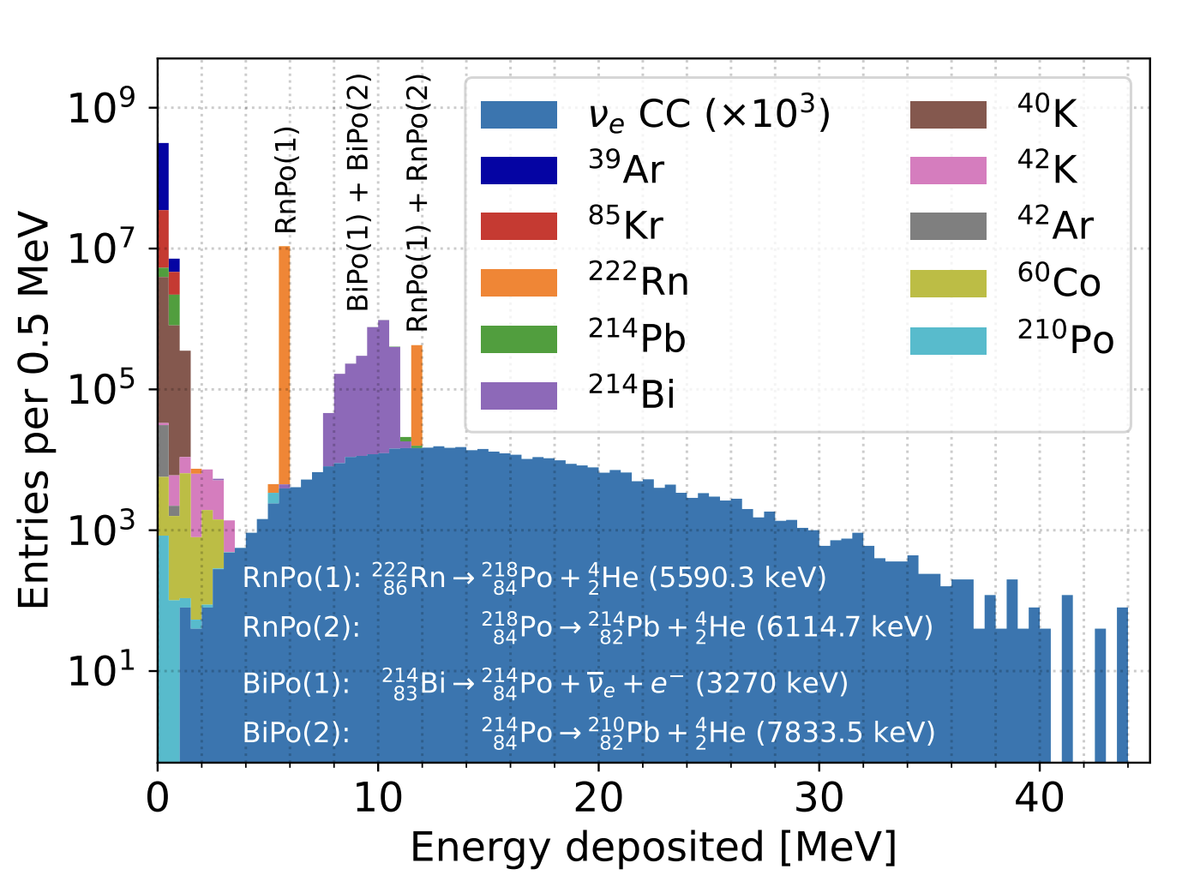
Background Rejection
Previously with Supernovae
1)
a.
b.
2)
a.
b.
c.
d.
3)
a.
b.
4)
4

Slide 5
Background Rejection
Previously with Supernovae
Supernova
1)
a.
b.
2)
a.
b.
c.
d.
3)
a.
b.
4)
5

Slide 6
Background Rejection
Now with Solar
Supernova
1)
a.
b.
2)
a.
b.
c.
d.
3)
a.
b.
4)
Solar
6

Slide 7
Background Rejection
Now with Solar
We need some work done for the background rejection
Supernova
1)
a.
b.
2)
a.
b.
c.
d.
3)
a.
b.
4)
Solar
7

Slide 8
Background Rejection
Now with Solar
Directionality
Event Locations
Pulse Shape Discrimination
Particle ID
1)
a.
b.
2)
a.
b.
c.
d.
3)
a.
b.
4)
8

Slide 9
Background Rejection
Now with Solar
Directionality by Shion
Event Locations by Future Shion
Pulse Shape Discrimination by Nick
Particle ID by Guilherme
1)
a.
b.
2)
a.
b.
c.
d.
3)
a.
b.
4)
9
Notes:
Fiducial volumes / fiducialization

Slide 10

Background Rejection
Now with Solar
Directionality by Shion
Event Locations by Future Shion
Pulse Shape Discrimination by Nick
Particle ID by Guilherme
1)
a.
b.
2)
a.
b.
c.
d.
3)
a.
b.
4)
10

Slide 11
Directionality Method
1)
a.
b.
2)
a.
b.
c.
d.
3)
a.
b.
4)
11

Slide 12
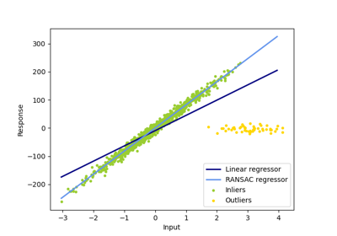
Directionality Studies - RANSAC
RANdom Sample Consensus
Can categorize data into two categories:
Inliers: Data whose distribution can be explained by some set of model parameters, though may be subject to noise
Outliers: Data that do not fit the model
1)
a.
b.
2)
a.
b.
c.
d.
3)
a.
b.
4)
https://scikit-learn.org/stable/modules/generated/sklearn.linear_model.RANSACRegressor.html
12

Slide 13

Directionality Studies - RANSAC
Can categorize data into two categories:
Inliers: Data whose distribution can be explained by some set of model parameters, though may be subject to noise
Outliers: Data that do not fit the model
1)
a.
b.
2)
a.
b.
c.
d.
3)
a.
b.
4)
$$e$$
13

Slide 14
Directionality Studies - RANSAC
Can categorize data into two categories:
Inliers: Data whose distribution can be explained by some set of model parameters, though may be subject to noise
Outliers: Data that do not fit the model
1)
a.
b.
2)
a.
b.
c.
d.
3)
a.
b.
4)
$$e$$
14

Slide 15
Directionality Studies - RANSAC
Can categorize data into two categories:
Inliers: Data whose distribution can be explained by some set of model parameters, though may be subject to noise
Outliers: Data that do not fit the model
1)
a.
b.
2)
a.
b.
c.
d.
3)
a.
b.
4)
$$e$$
15

Slide 16
Directionality Studies - RANSAC
Can categorize data into two categories:
Inliers: Data whose distribution can be explained by some set of model parameters, though may be subject to noise
Outliers: Data that do not fit the model
1)
a.
b.
2)
a.
b.
c.
d.
3)
a.
b.
4)
$$e$$
16

Slide 17
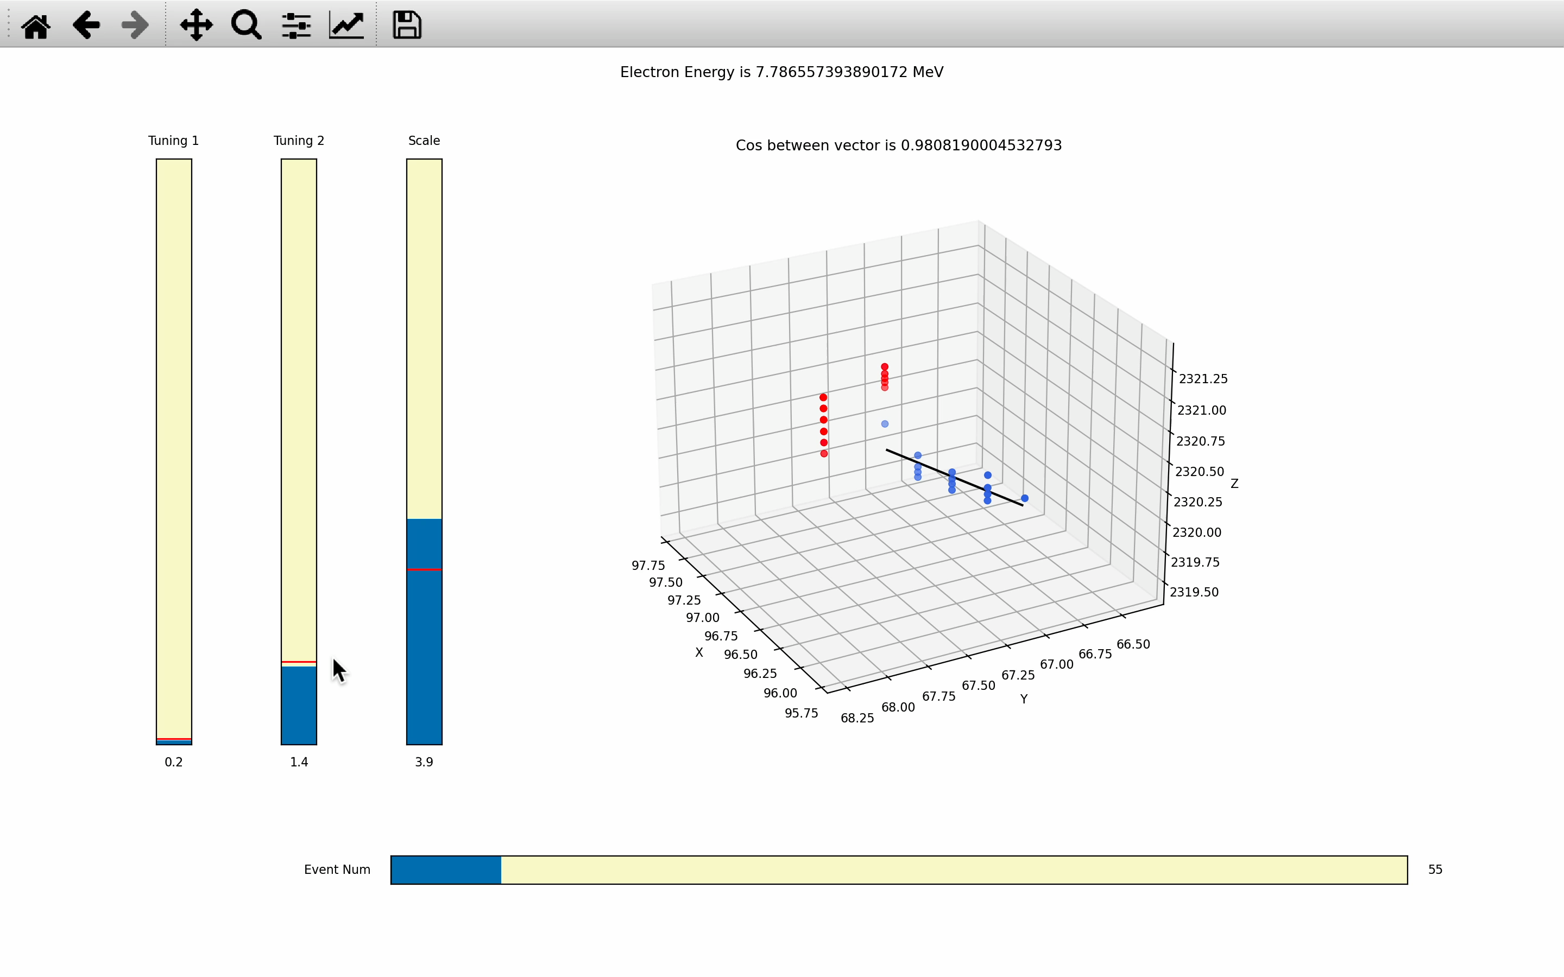

Slide 18
Directionality Studies - RANSAC
Let’s see how we can apply this to
Radiogenic Background Rejections!
Can categorize data into two categories:
Inliers: Data whose distribution can be explained by some set of model parameters, though may be subject to noise
Outliers: Data that do not fit the model
1)
a.
b.
2)
a.
b.
c.
d.
3)
a.
b.
4)
$$e$$
18

Slide 19
Background Rejection with Directionality
Backgrounds
Elastic Scattering
Charged Current Interactions
1)
a.
b.
2)
a.
b.
c.
d.
3)
a.
b.
4)
19

Slide 20
Background Rejection with Directionality
Backgrounds
Elastic Scattering
Charged Current Interactions
1)
a.
b.
2)
a.
b.
c.
d.
3)
a.
b.
4)
20

Slide 21
Background Rejection with Directionality
Backgrounds
Elastic Scattering
Charged Current Interactions
1)
a.
b.
2)
a.
b.
c.
d.
3)
a.
b.
4)
21

Slide 22
Background Rejection with Directionality
Backgrounds
Elastic Scattering
Charged Current Interactions
Uniform distribution!
1)
a.
b.
2)
a.
b.
c.
d.
3)
a.
b.
4)
22

Slide 23
Background Rejection with Directionality
Backgrounds
Elastic Scattering
Charged Current Interactions
1)
a.
b.
2)
a.
b.
c.
d.
3)
a.
b.
4)
23

Slide 24
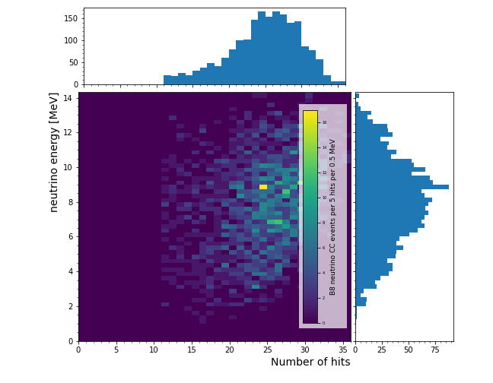
Background Rejection with Directionality
Backgrounds
Elastic Scattering
Charged Current Interactions
1)
a.
b.
2)
a.
b.
c.
d.
3)
a.
b.
4)
Neutrino Energy [MeV]
Number of hits
24
Notes:
Survival rate = 95.7%

Slide 25
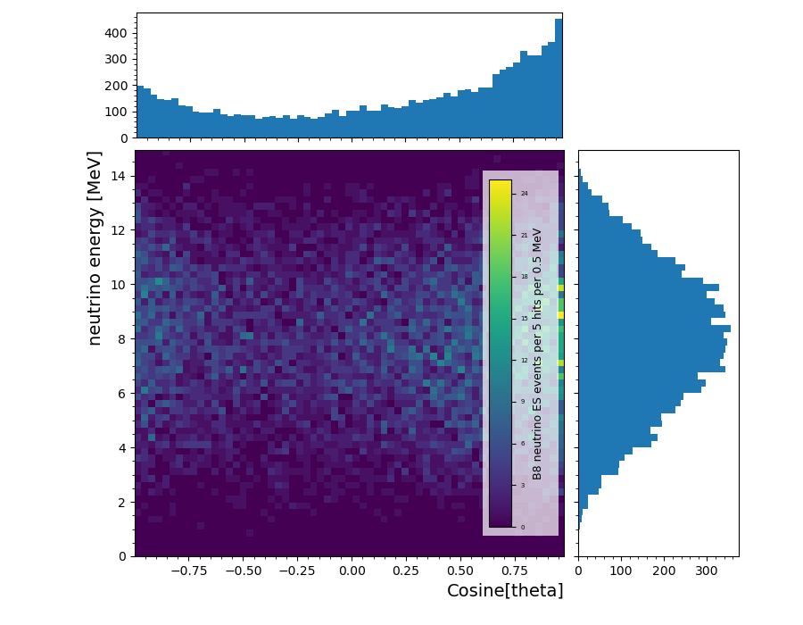
Background Rejection with Directionality
Peak!
Backgrounds
Elastic Scattering
Charged Current Interactions
1)
a.
b.
2)
a.
b.
c.
d.
3)
a.
b.
4)
Neutrino Energy [MeV]
Angle (cosine[theta])
Threshold = 10 hits
25

Slide 26
Background Rejection with Directionality
Peak!
Neutrino directionality can be inferred from the reconstructed ES electron direction!
Backgrounds
Elastic Scattering
Charged Current Interactions
1)
a.
b.
2)
a.
b.
c.
d.
3)
a.
b.
4)
26

Slide 27
Background Rejection with Directionality
Backgrounds
Elastic Scattering
Charged Current Interactions
1)
a.
b.
2)
a.
b.
c.
d.
3)
a.
b.
4)
27

Slide 28
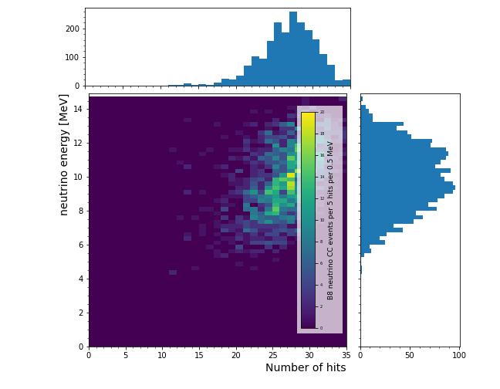
Background Rejection with Directionality
Backgrounds
Elastic Scattering
Charged Current Interactions
1)
a.
b.
2)
a.
b.
c.
d.
3)
a.
b.
4)
28
Notes:
Survival rate = 99.85%

Slide 29
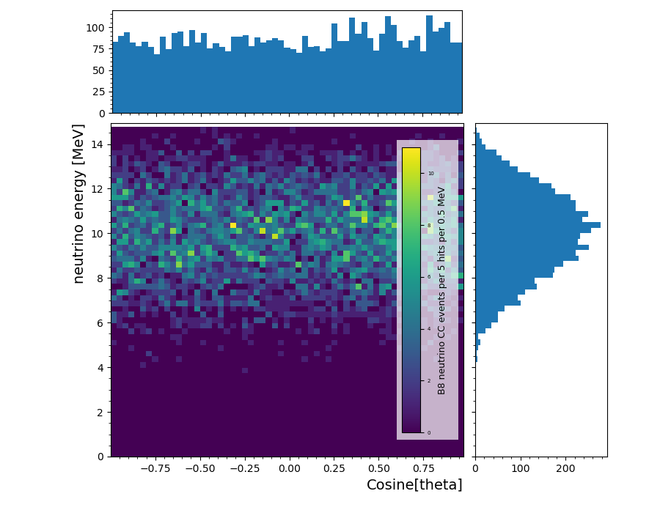
Background Rejection with Directionality
Backgrounds
Elastic Scattering
Charged Current Interactions
1)
a.
b.
2)
a.
b.
c.
d.
3)
a.
b.
4)
Neutrino Energy [MeV]
Angle (cosine[theta])
Threshold = 10 hits
29
Notes:
Survival rate = 95.7%

Slide 30
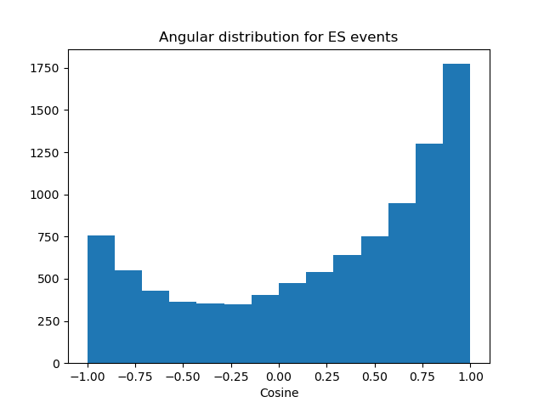
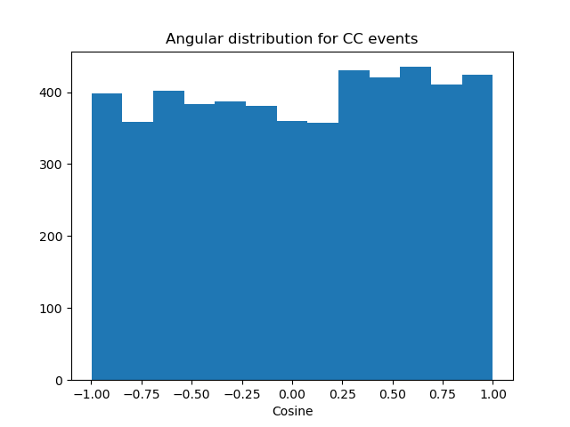
Background Rejection with Directionality
Backgrounds
Elastic Scattering
Charged Current Interactions
1)
a.
b.
2)
a.
b.
c.
d.
3)
a.
b.
4)
30

Slide 31
1)
a.
b.
2)
a.
b.
c.
d.
3)
a.
b.
4)
What else can we do with directionality?
31

Slide 32
hep Discoveries?
1)
a.
b.
2)
a.
b.
c.
d.
3)
a.
b.
4)
What else can we do with directionality?
32

Slide 33
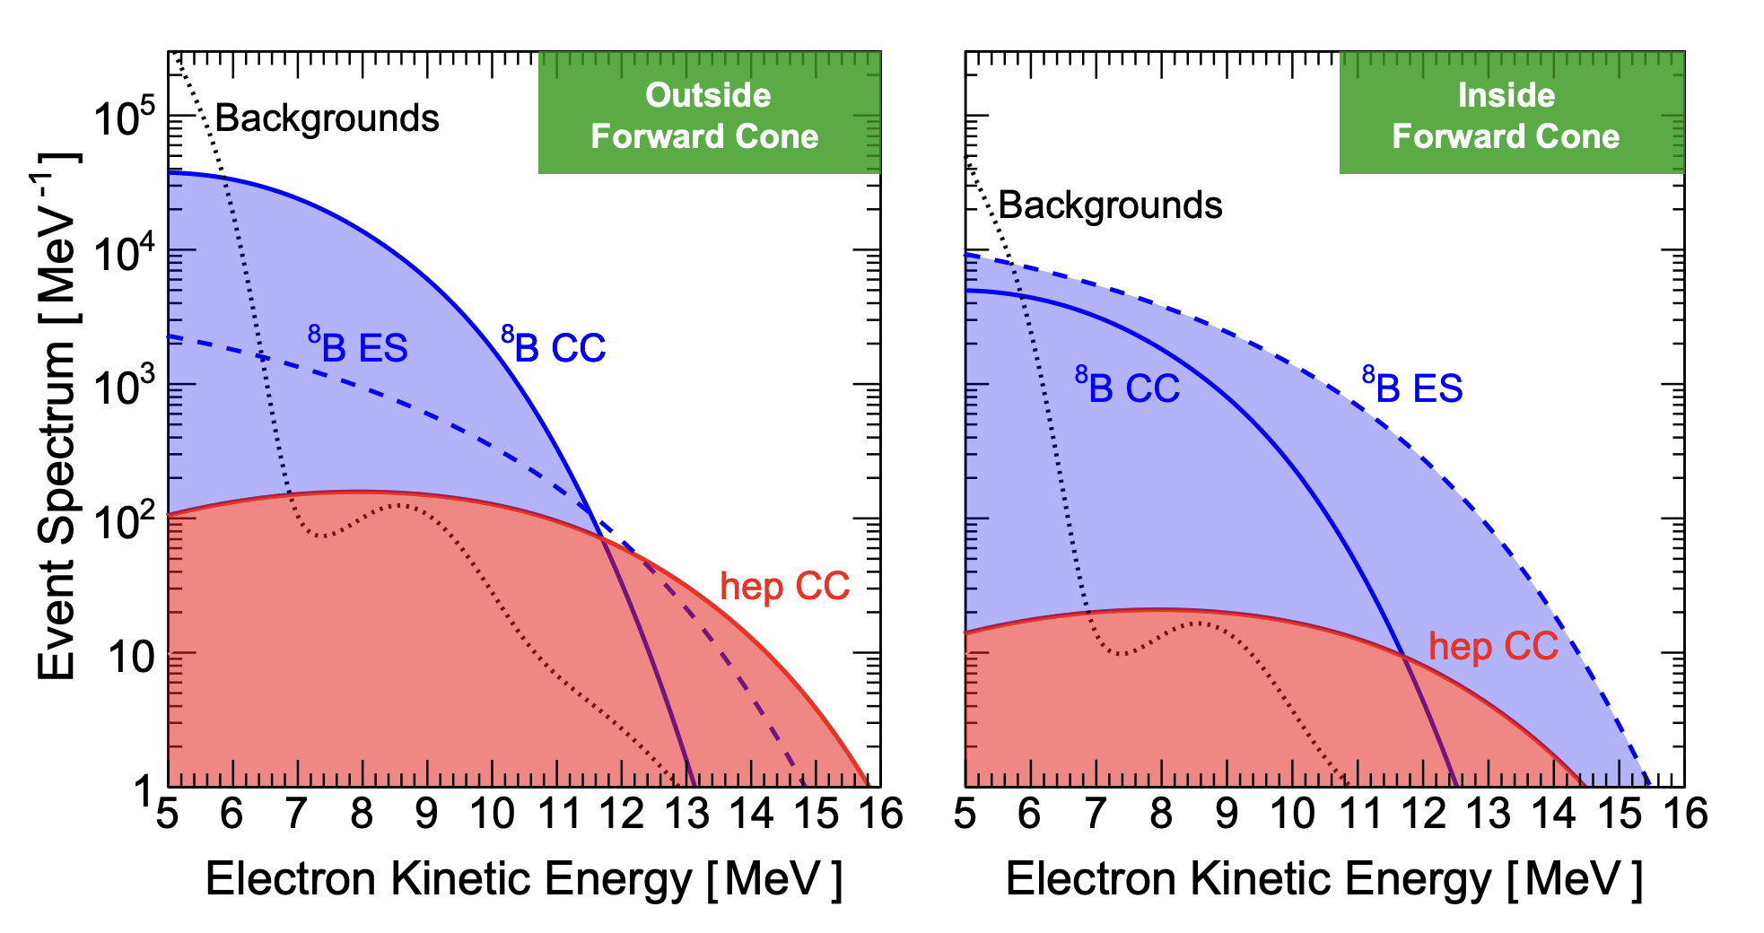
Directionality reconstruction for hep events
1)
a.
b.
2)
a.
b.
c.
d.
3)
a.
b.
4)

Slide 34
Directionality reconstruction for ES events
1)
a.
b.
2)
a.
b.
c.
d.
3)
a.
b.
4)
34

Slide 35
Directionality reconstruction for ES events
Promising indication that
we can select neutrino events that:
Came from the sun
Are hep (provided we have good E resolution) maybe
1)
a.
b.
2)
a.
b.
c.
d.
3)
a.
b.
4)
35

Slide 36
Current and Future Work
Further investigation on radiogenics
Getting the flux/cross section of hep and B8 CC vs ES
Radiogenic rejections with event positions
Improvements on directionality method
1)
a.
b.
2)
a.
b.
c.
d.
3)
a.
b.
4)

Slide 37
Thank you!

Slide 38
Backup

Slide 39
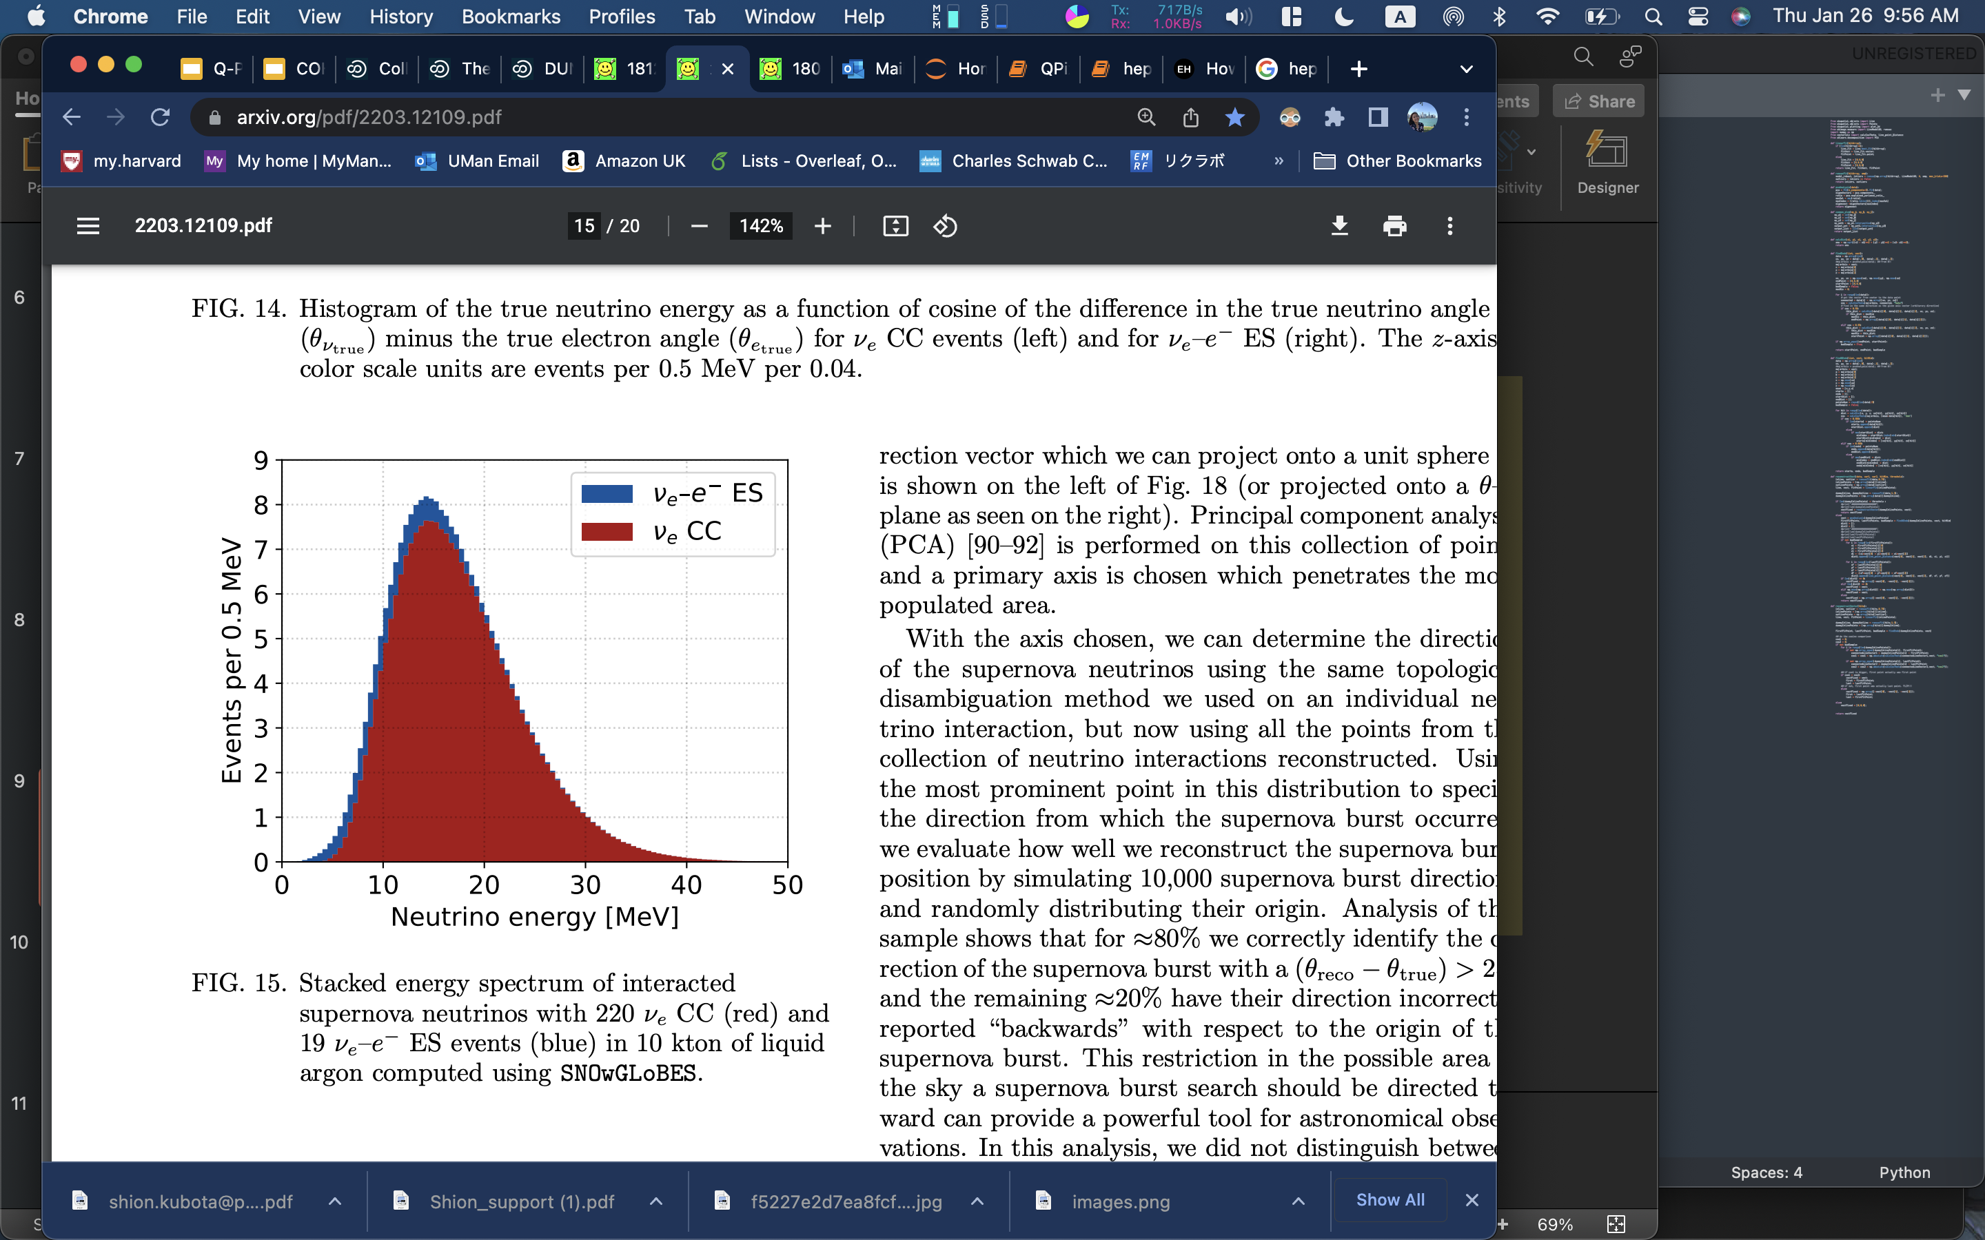
Background Rejection
Previously with Supernovae
1)
a.
b.
2)
a.
b.
c.
d.
3)
a.
b.
4)
39

Slide 40
Background Rejection
Previously with Supernovae
1)
a.
b.
2)
a.
b.
c.
d.
3)
a.
b.
4)
40

Slide 41
Background Rejection
Previously with Supernovae
1)
a.
b.
2)
a.
b.
c.
d.
3)
a.
b.
4)
>>
Signal peak is farther away from
radiogenic backgrounds’ energy range
41

Slide 42
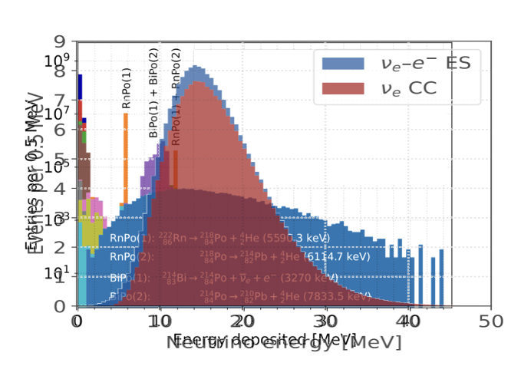
Background Rejection
Now with Solar
1)
a.
b.
2)
a.
b.
c.
d.
3)
a.
b.
4)
Digitization extracted from
DUNE as the Next-Generation Solar Neutrino Experiment
42

Slide 43
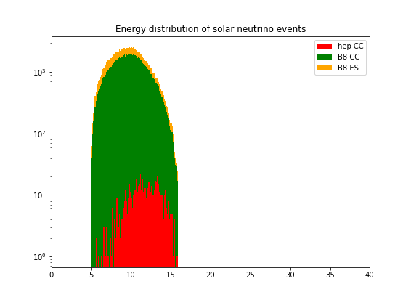
Background Rejection
Now with Solar
1)
a.
b.
2)
a.
b.
c.
d.
3)
a.
b.
4)
Digitization extracted from
DUNE as the Next-Generation Solar Neutrino Experiment
43

Slide 44
Background Rejection
Now with Solar
1)
a.
b.
2)
a.
b.
c.
d.
3)
a.
b.
4)
44
Notes:
No normalization

Slide 45
Background Rejection
Now with Solar
1)
a.
b.
2)
a.
b.
c.
d.
3)
a.
b.
4)
>>
Signal peak overlaps with the backgrounds
45
Notes:
No normalization

Slide 46
Background Rejection
Now with Solar
We need some work done for the background rejection
1)
a.
b.
2)
a.
b.
c.
d.
3)
a.
b.
4)
>>
Signal peak overlaps with the backgrounds
46
Notes:
No normalization

