Slide 1

Energy reconstruction with Q-Pix readout
Guilherme Ruiz
University of Manchester
Notes:
Far Detector 2 on Wednesday

Slide 2
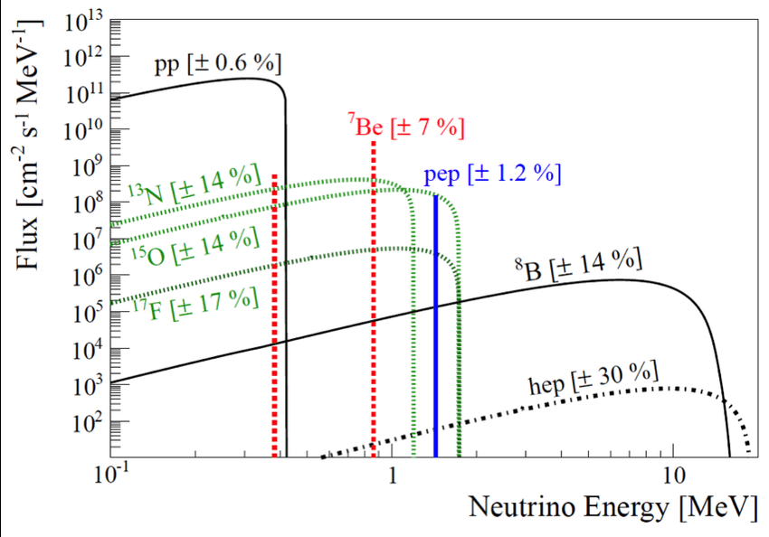
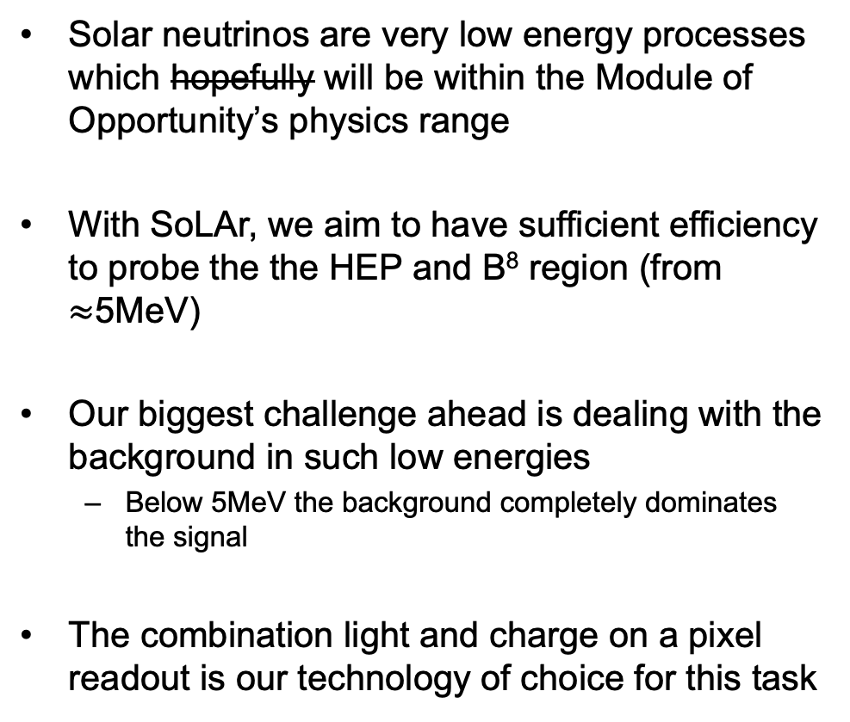
Solar neutrinos
Solar neutrinos are very low energy processes which hopefully will be within the Module of Opportunity’s physics range
With SoLAr, we aim to have sufficient efficiency to probe the the HEP and B⁸ region (from $≈$5MeV)
Our biggest challenge ahead is dealing with the background in such low energies
  Below 5MeV the background completely dominates the signal
The combination light and charge on a pixel readout is our technology of choice for this task

Slide 3
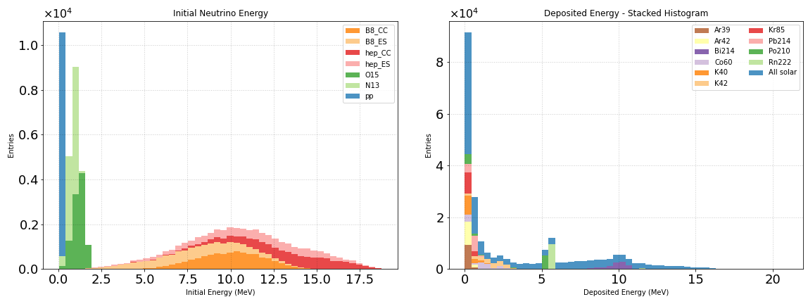
Solar neutrinos vs. Radiogenic background
10000 events per process
10000 events per process
Left: incoming energy from solar neutrinos
Right: deposited energy from solar neutrinos and radiogenic background in the detector

Slide 4
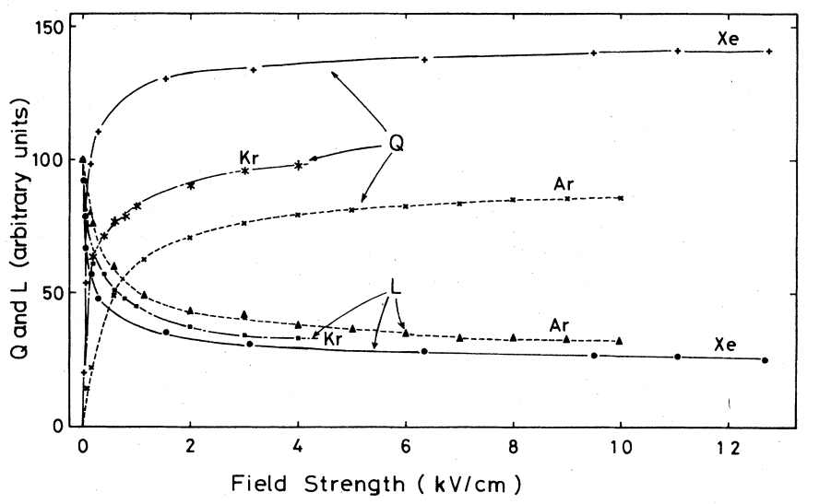
Background discrimination
Scintillation light (L) and ionization charge (Q) yield are anticorrelated and thus complimentary in Lar (see graph).
Both come with properties we can use for background discrimination.
Our group is currently working on discrimination methods using
Pulse shape discrimination from L (Nicholas Lane)
Track directionality reconstruction from Q (Shion Kubota)
Particle identification from Q (Me)
https://journals-aps-org.manchester.idm.oclc.org/prb/pdf/10.1103/PhysRevB.20.3486

Slide 5
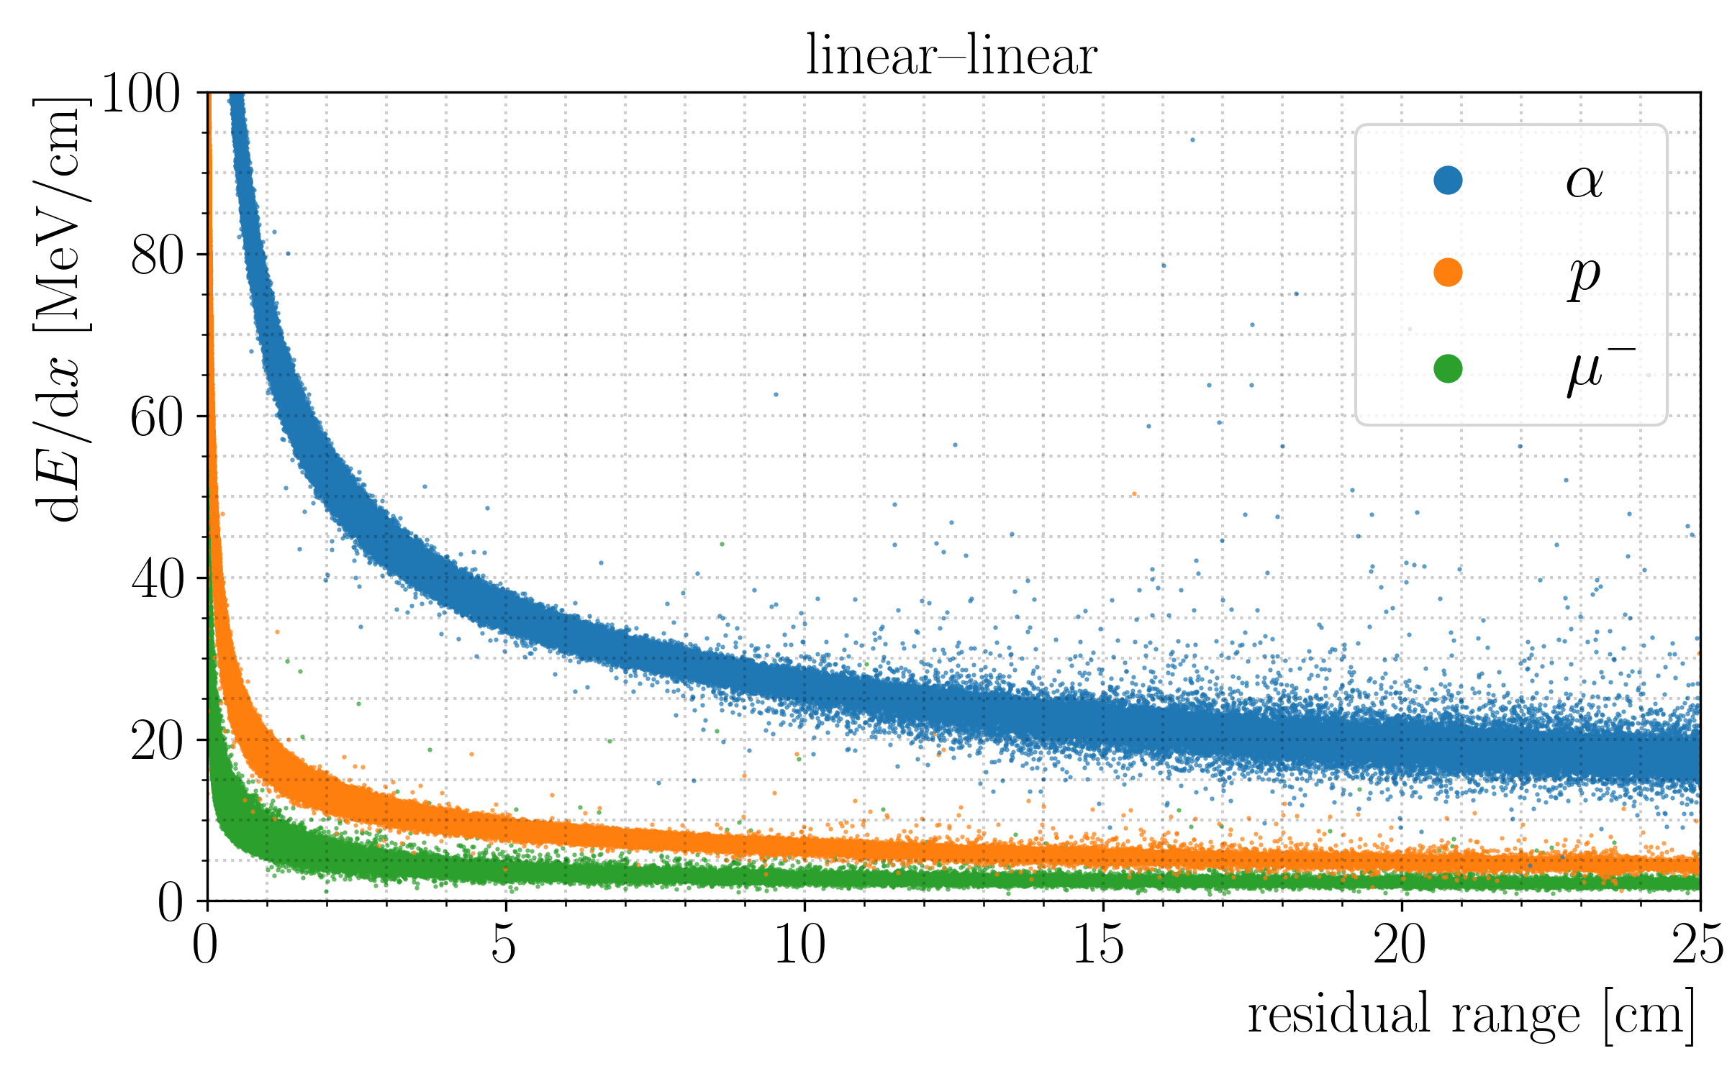
Particle identification (PID) - $dE/dr$ method
Each particle has a particular energy deposit curve in LAr
We can associate a track to its primary particle by looking at its $dE/dx$profile
We can associate a track to its primary particle by looking at its 𝑑𝐸/𝑑𝑥 profile
Protons, muons and pions are particularly easy to identify via $dE/dx$
Protons, muons and pions are particularly easy to identify via 𝑑𝐸/𝑑𝑥

Slide 6
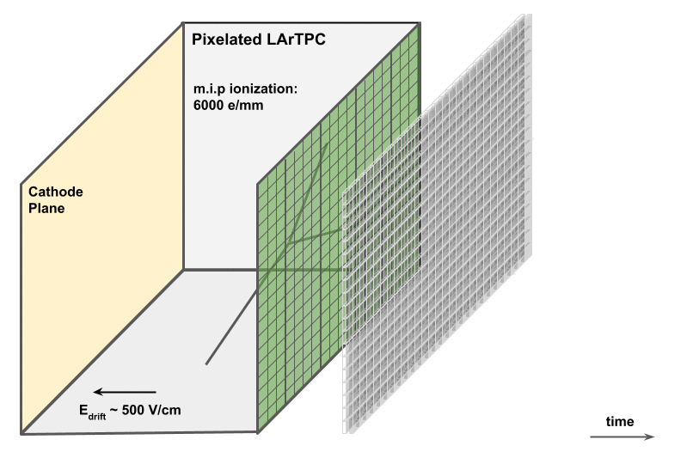
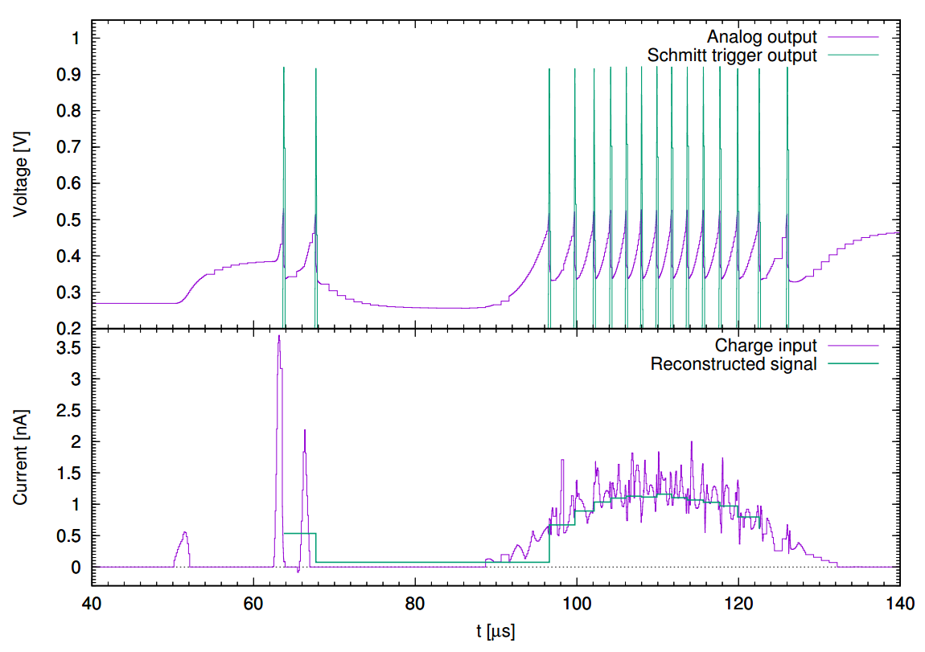

Energy reconstruction from Q-Pix resets
$$∆Q=1 \text{fC}$$
Each reset corresponds to 0.1475MeV of deposited energy
Each reset corresponds to 1fC of deposited charge
Each electron corresponds to 23.6eV of deposited energy
(LAr $W$ function for ionization)
Each electron corresponds to 23.6eV of deposited energy
(LAr 𝑾 function for ionization)

Slide 7
$dE/dr$ reconstruction from Q-Pix resets
*No diffusion or recombination
Generate single proton, muon and pion Geant4 simulations* with energies 200, 300, 400 and 500 MeV along the y coordinate
Compute the energy deposited per pixel by summing resets.
Average the reset times in each pixel to get the mean z coordinate
Sort pixels by x, y and t respectively to obtain tracks
Compute $dE$ and $dr=√\left(dx^{2}+dy^{2}+dz^{2}\right)$ by taking the difference of deposited energy and $x, y, z$coordinates of the sorted pixels
Compute 𝑑𝐸 and 𝑑𝑟=√(𝑑𝑥^2+𝑑𝑦^2+𝑑𝑧^2 ) by taking the difference of deposited energy and 𝑥, 𝑦, 𝑧 coordinates of the sorted pixels
“I’ve got to start somewhere”
Every result presented here is for 200MeV protons only

Slide 8
$dE/dr$ reconstruction - Finding tracks
Event 0
Good track
Event 1
Bad track
Event 4074
No track

Slide 9
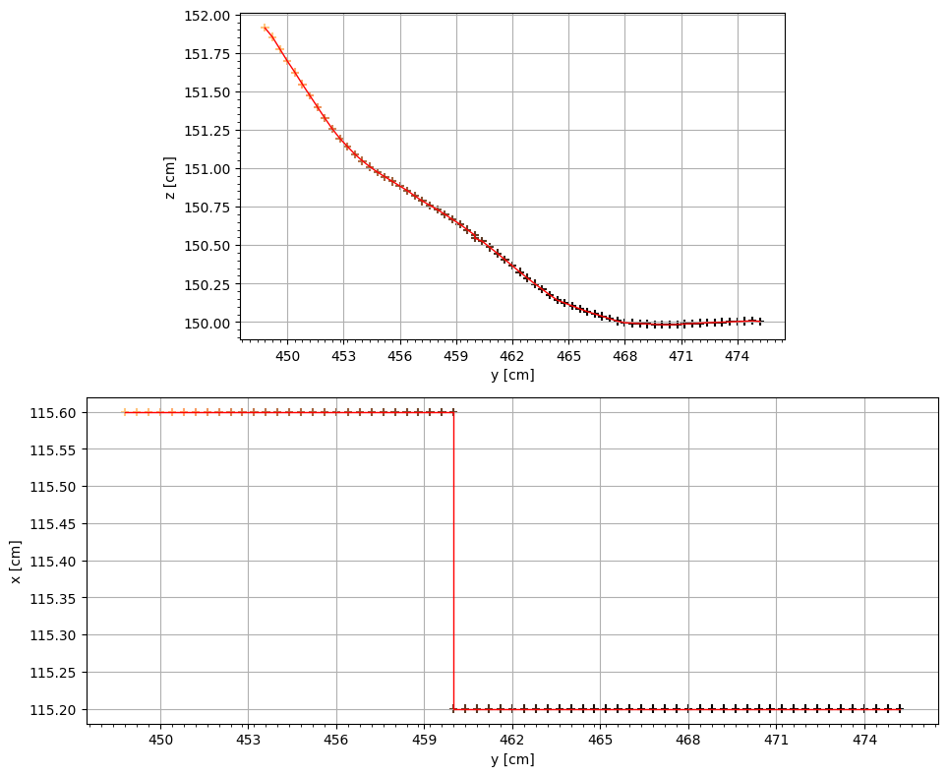
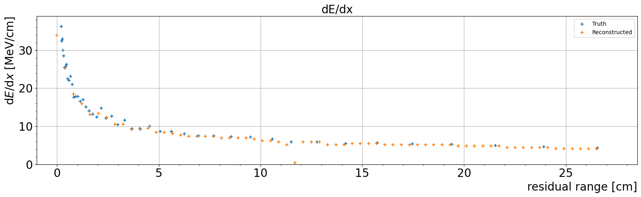
$dE/dr$ reconstruction - Finding tracks
200MeV single proton events
No Recombination
No Diffusion
Good track

Slide 10
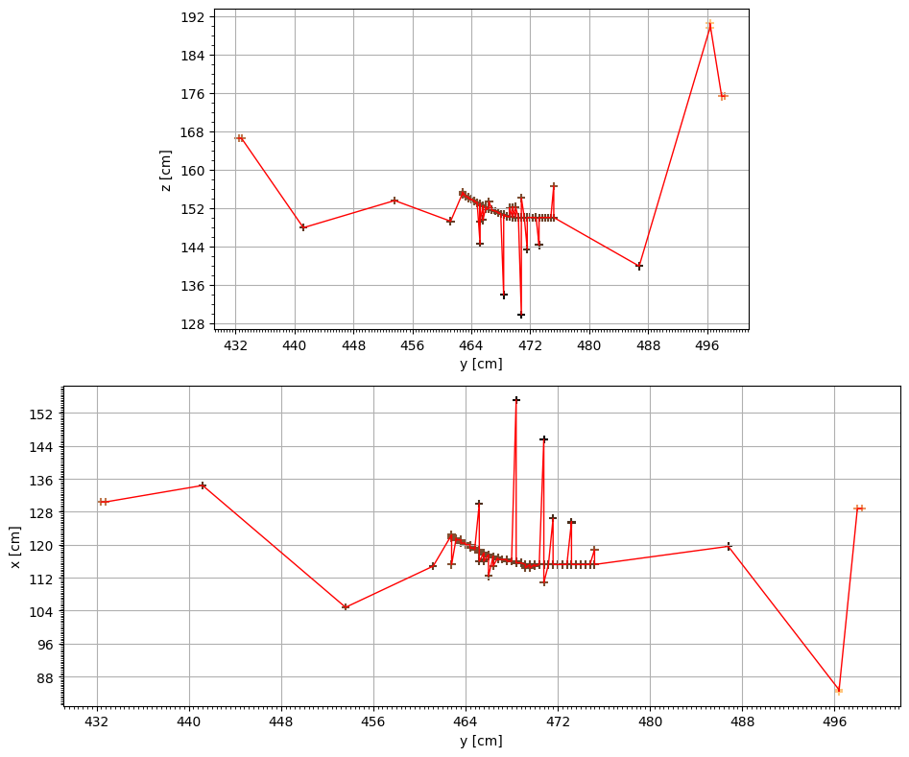
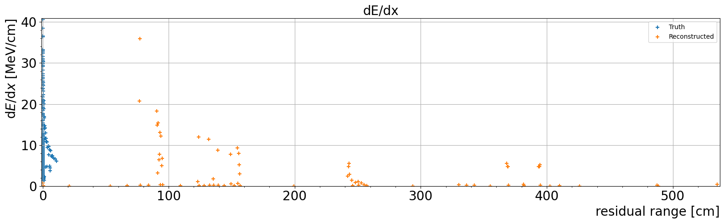

$dE/dr$ reconstruction - Finding tracks
200MeV single proton events
No Recombination
No Diffusion
The $dE/dr$ reconstruction obviously fails
Bad track

Slide 11
$dE/dr$ reconstruction - Finding tracks
Processing ”bad tracks”
DBSCAN
Original event
Processed event
Use DBSCAN to exclude resets that do not form a track and small clusters off-track
DBSCAN parameters:
Min samples = 3
Epsilon = 1.5 x pixel size

Slide 12
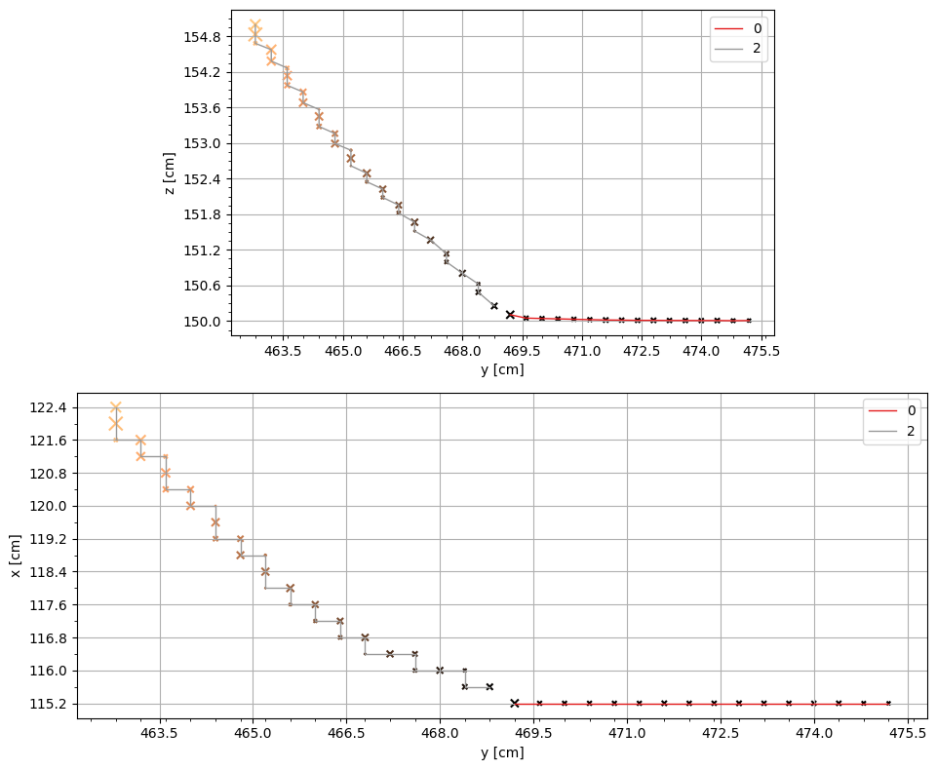
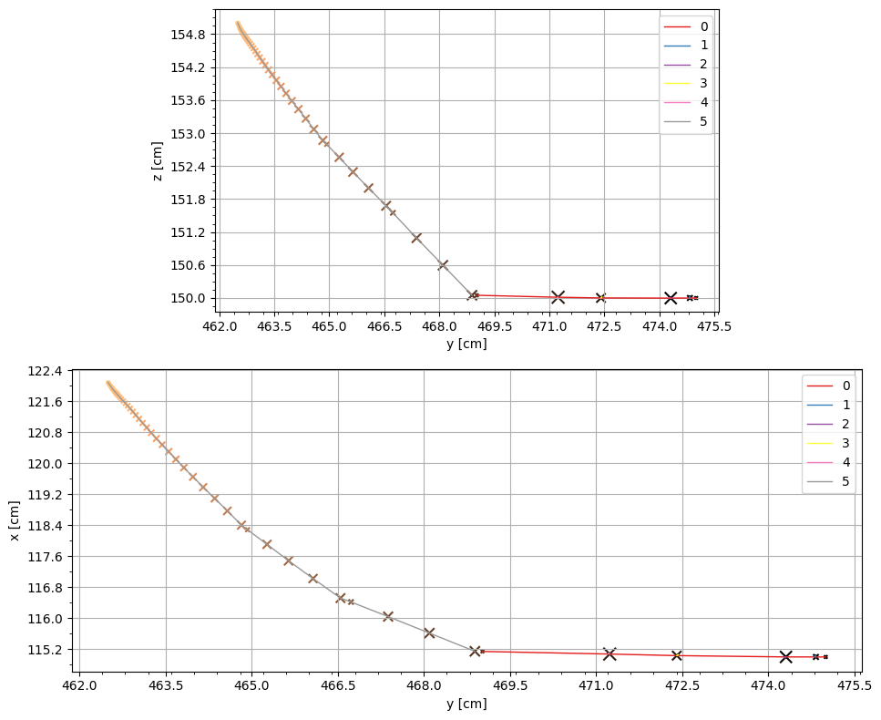
$dE/dr$ reconstruction - Finding tracks
Processed event
Geant4 truth
What is the Geant4 truth?
Particle index
Cluster #2
One track or two tracks?
Track #2
Cluster #0
Track #0

Slide 13
$dE/dr$ reconstruction - Finding tracks
Processed event
Geant4 truth
What is the Geant4 truth?
Particle index
Luck or consistent with other events?
Cluster #2
One track or two tracks?
Track #2
Cluster #0
Track #0

Slide 14
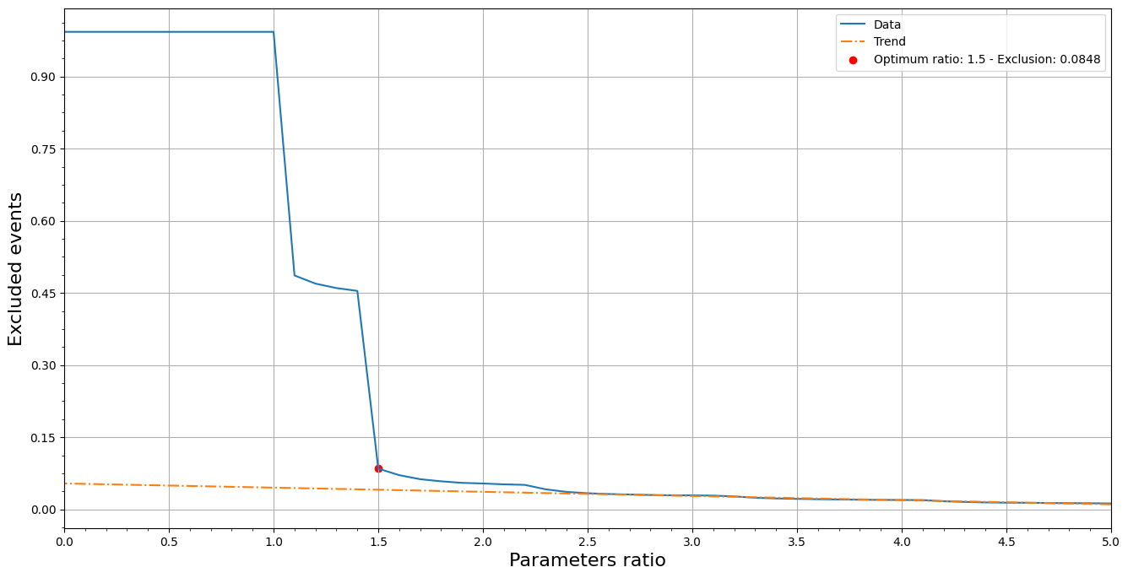
$dE/dr$ reconstruction – Filtering “bad tracks”
Filtering bad events
Experimental method:
Use pixel size – no G4 truth
Exclude events with a maximum reconstructed $dr$value larger than a certain ratio of the pixel size
Exclude events with a maximum reconstructed 𝑑𝑟 value larger than a certain ratio of the pixel size
Above $\sim 1.5$, the number of events excluded becomes “approximately constant” at $≈8\%$
This corresponds to maximum $dr≤\text{0.}\text{6 }\text{cm}$ (the pixel diagonal pitch $0.4 √2$)

Slide 15
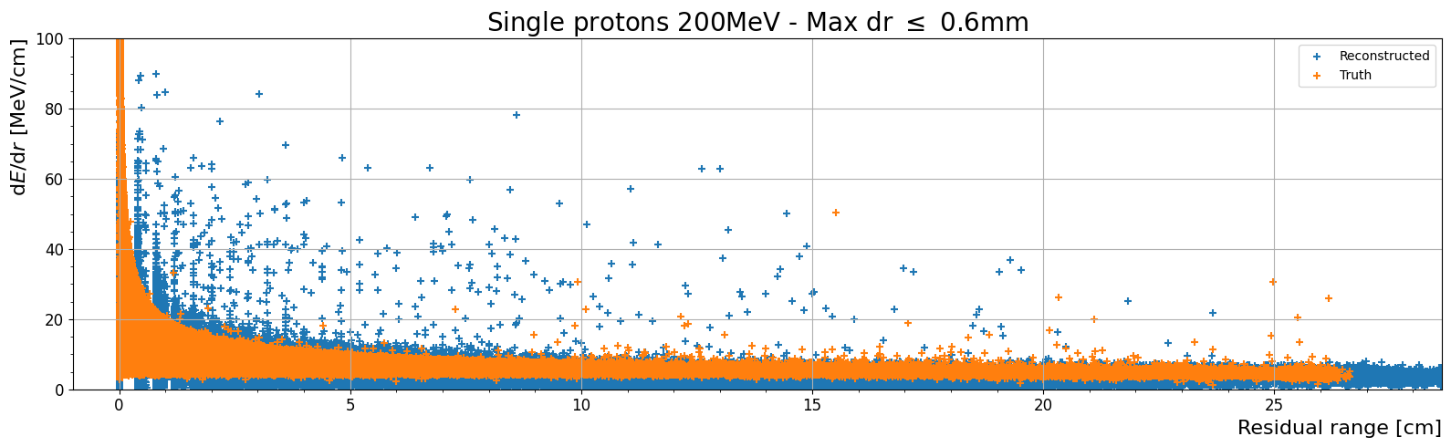
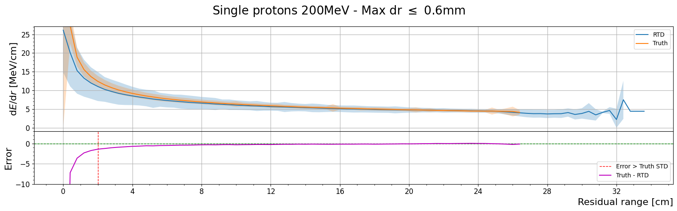
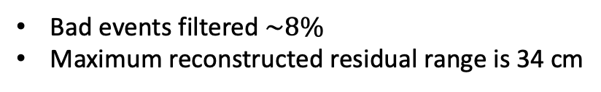
$dE/dr$ reconstruction – “good tracks” after DBSCAN
200MeV single proton events
Processed events
Bad events filtered $\sim 8\%$
Maximum reconstructed residual range is 34 cm

Slide 16
200MeV single proton events
$dE/dr$ reconstruction – “good tracks” after DBSCAN
No Recombination
No Diffusion
Event 0
Good track
Event 1
Bad track
Event 4074
No track
How many of the originally “bad tracks” are “now good” tracks?

Slide 17
Summary
The 𝑑𝐸/𝑑𝑟 reconstruction works remarkably well for “Good tracks”
“Bad tracks” can be usable after some processing with clustering algorithms but still produce “noise”
Using a value slightly above the pixel pitch as maximum 𝑑𝑟 to filter events is the simplest way to optimize the reconstruction
It is expected that at higher energies we will see less “good tracks”. Lower energy events may be easier to reconstruct
This method only works for tracks. Neutrinos and electrons will be considerably more challenging
Some events are impossible (?) to be used for this study regardless of clustering algorithms

Slide 18
Thank you!

Slide 19
Backup slides

Slide 20
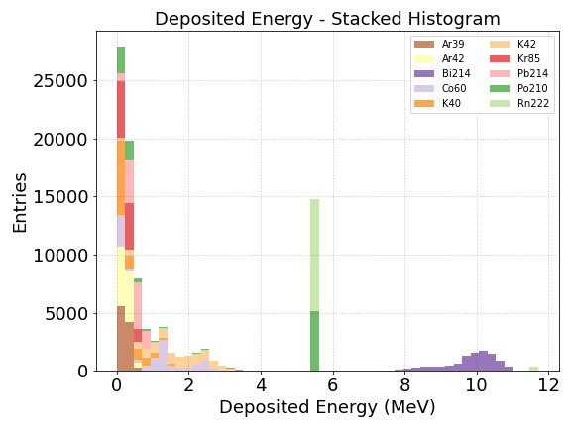
Radiogenic background

Slide 21
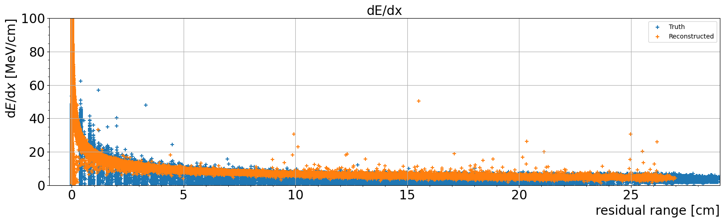
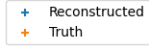
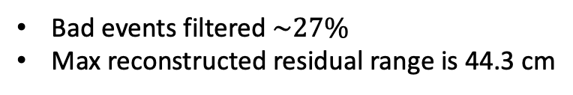
$dE/dx$ reconstruction – Originally “good tracks”
200MeV single proton events
Only “good” events
Bad events filtered $\sim 27\%$
Max reconstructed residual range is 44.3 cm

Slide 22
200MeV single proton events
No Recombination
No Diffusion
Event 0
Good track
Event 1
Bad track
Event 4074
No track

Slide 23
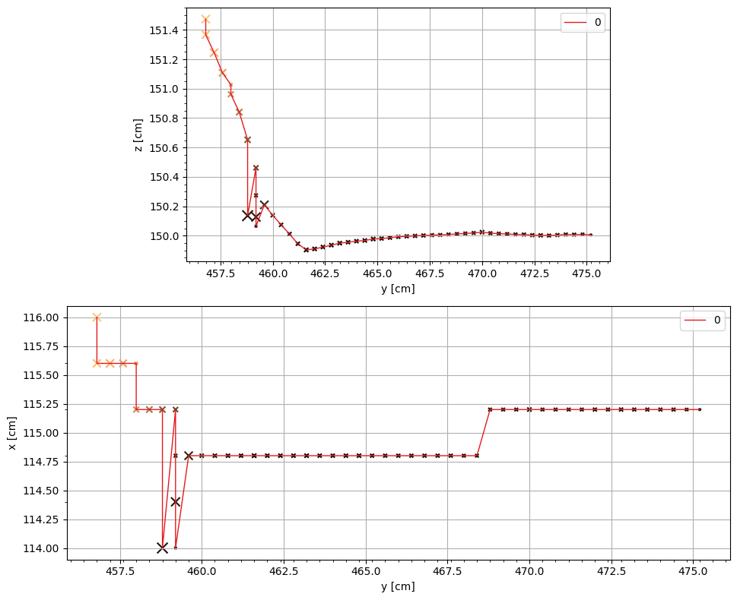
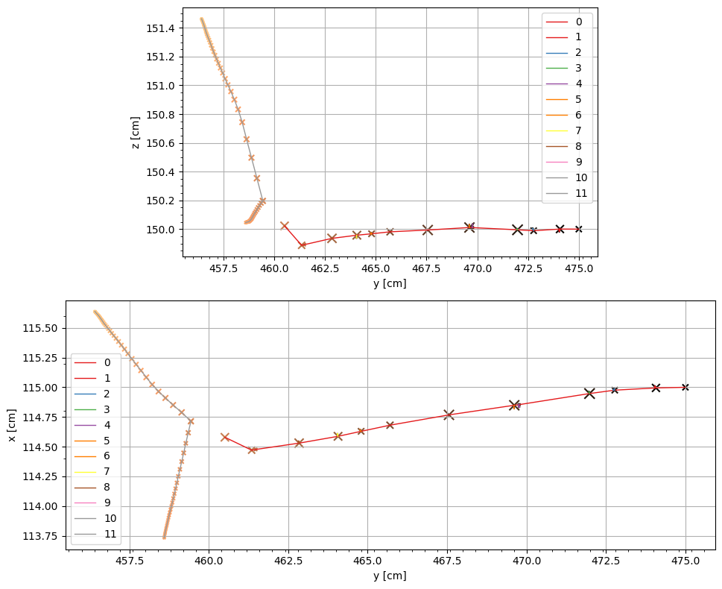
$dE/dx$ reconstruction – Impossible tracks
”Worse tracks”
Impossible to use (?)
Processed RTDs
Geant4 truth

Slide 24
Diffusion study
Generate 10 MeV single electron Geant4 simulations with drift distances 1mm, 5mm, 1cm, 2cm, 5cm, 10cm, 20cm, 50cm, 1.0m, 1.5m, 2.0m, 2.5m, 3.0m and 3.5m
Compute the energy reconstruction efficiency from RTDs with and without recombination
Plot the mean of the distribution for each drift distance with binomial error as error bars

Slide 25
10 MeV single electrons – No recombination
No Recombination

Slide 26
10MeV single electron events
10 MeV single electrons – No recombination
No Recombination

Slide 27
10MeV single electron events
10 MeV single electrons – With recombination
With Recombination

Slide 28
10MeV single electron events
10 MeV single electrons – With recombination
With Recombination

Slide 29
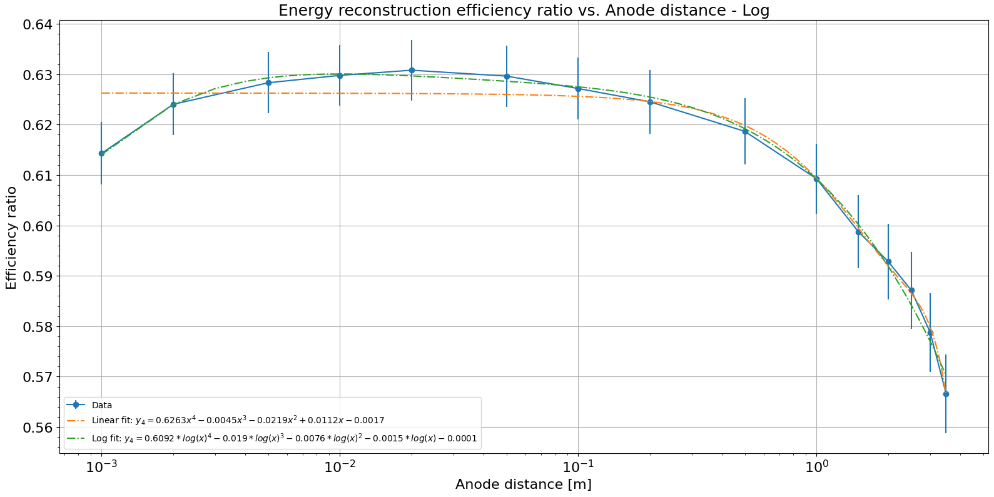
10MeV single electron events
With Recombination
X
No Recombination
10 MeV single electrons – Recombination ratio

