Slide 1
Solar Neutrinos
Patrick Worrell and Ben Leadbetter

Slide 2
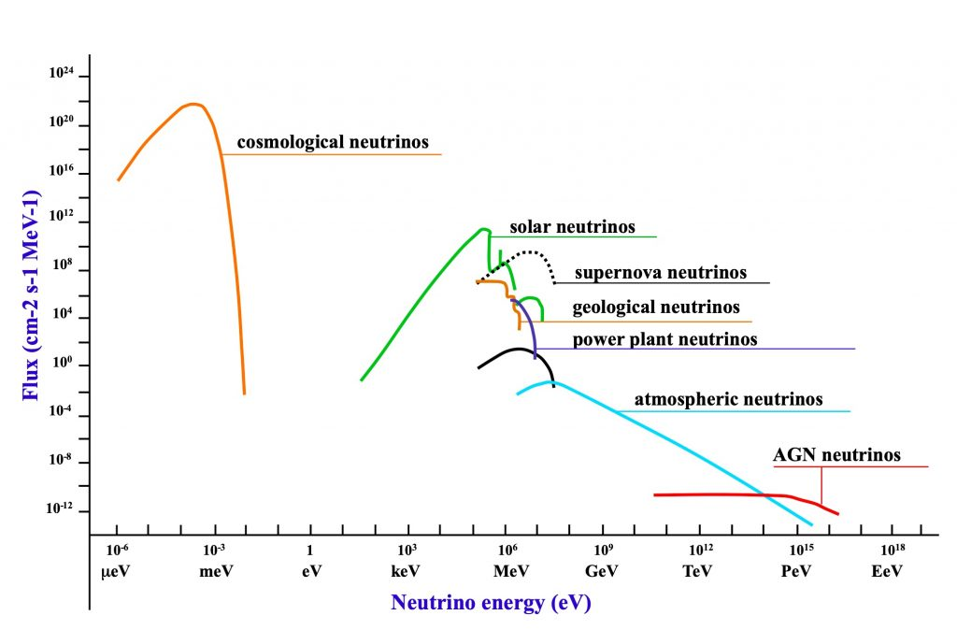
“Inspiration”
Initially working with supernova neutrino simulations -> approx. 0 - 50 MeV spectrum

Slide 3
“Inspiration”
Recently have access to data for solar neutrinos -> approx. 0-19 MeV spectrum

Slide 4


Interaction Processes
There are two main processes for neutrino interactions within liquid argon (this will be important for later results)
Charged current
Electron Scattering
$$ν_{e}+{}_{ }^{40}{Ar}→ e^{−}+{}_{ }^{40}{K^{∗}}$$
$$ν_{e,μ,τ}+e^{−}→ ν_{e,μ,τ}+e^{−}$$

Slide 5
Motivation for reconstructing tracks
Electrons released during interactions will ionize orbital electrons surrounding argon atoms creating a ‘track’ in the detector
While GEANT4 stores the true information of all the particles involved in an interaction, we obviously do not have this in reality
Reconstructing the direction of a track gives us some information about the direction of the electron immediately after a neutrino interaction – something particularly useful for the electron scattering process
Identifying background interactions also requires reconstructing tracks

Slide 6
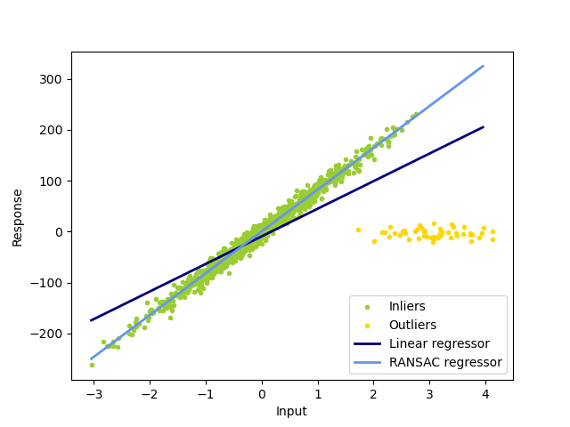
How do we accomplish this?
We use RANdom SAmple Consensus (RANSAC) to identify the cloud of electrons – an idea inspired by the supernova group at Harvard
NB: the RANSAC algorithm has no indication of the beginning of a track, so there is a near equal probability of being in the aligned to the ‘correct’ direction, or anti aligned (this will be shown later)

Slide 7
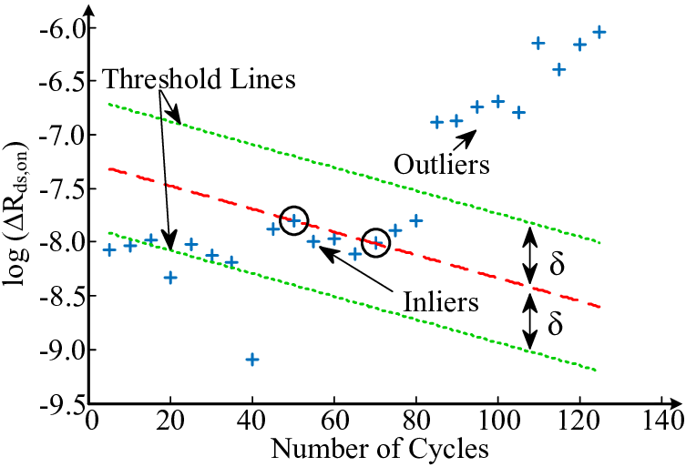
RANSAC

Slide 8
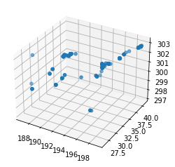
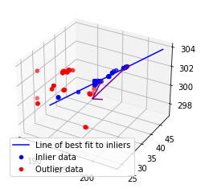
Example from supernova neutrinos
Before and after a RANSAC algorithm fit
Purple arrow is the true electron direction immediately after an interaction

Slide 9
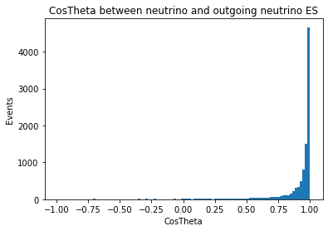
Use of the track reconstruction
We want to check the quality of the track reconstruction, compared with the true electron direction in GEANT4.
This directionality becomes particularly important for identifying ES events in the DUNE detector, as there is a high correlation between the direction of the electron released and the direction of the incoming neutrino.
This is done by comparing the difference in angle between the true direction of the electron and the reconstructed track direction

Slide 10
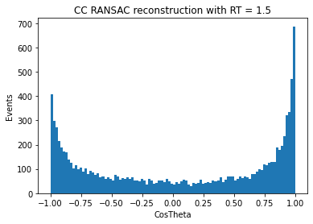
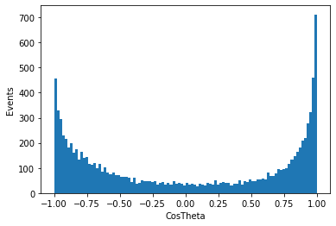
Supernova results
ES RANSAC reconstruction with RT = 1.5
Generally a ‘good’ fit across an entire cloud (like those seen on slide 7)

Slide 11
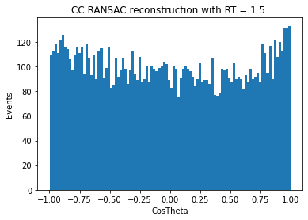
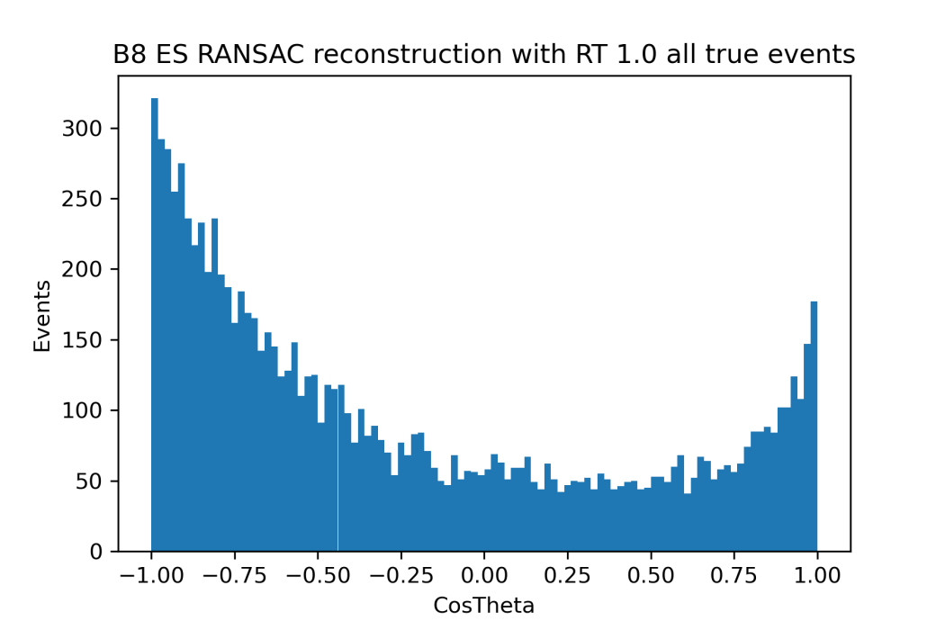
Solar results (for boron-8 flux)
Immediately obvious that our fitting method is not as accurate for the solar neutrino data

Slide 12
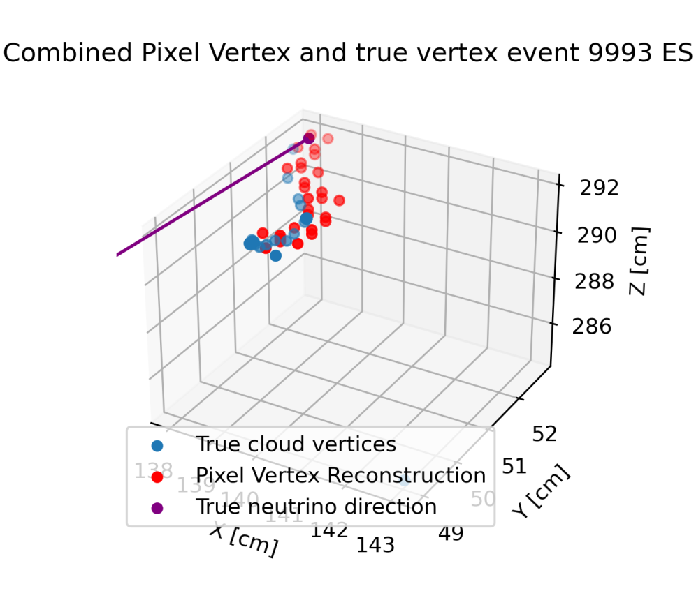
Example of an ES event
Electrons released as a result of solar neutrino interactions have lower energy than supernova neutrinos
They experience larger straggling effects
Need to focus on sections of the track, not the entirety of it
K.E of electron = 7.54 MeV

Slide 13
# of pixels | track vs true init electron | track vs true init neutrino # | ArcCos t vs e | ArcCos t vs n
7 | -0.870141 | -0.935847 | 29.52497126 | 20.63458269
14 | 0.816471 | 0.859168 | 35.26692823 | 30.77670606
21 | -0.777698 | -0.82704 | 38.949713 | 34.20413571
28 | -0.723846 | -0.78335 | 43.62706689 | 38.43167007
This method presents problems for lower energy neutrinos as they do not trigger as many pixels -> more unreliable to reconstruct

Slide 14
