Slide 1





SoLAr V2
Monte Carlo
Guilherme Ruiz Ferreira
University of Manchester
05 June 2024

Slide 2
Recent Corrections
Problem: Data coordinate system is not right-handed and is defined as viewed from behind the anode plane.
  Solution: Analysis now has the option (enabled by default) to flip the x-axis, turning the coordinate system right-handed and displaying the events as viewed from inside the TPC.
Problem: Bug found in hit clustering logic which would error out if there are no dead areas – problem for Monte Carlo files.
  Solution: Modified the logic to properly handle the empty arrays of dead areas.
All SoLAr V2 Reco files on LXPLUS have been regenerated since corrections were applied.

Slide 3
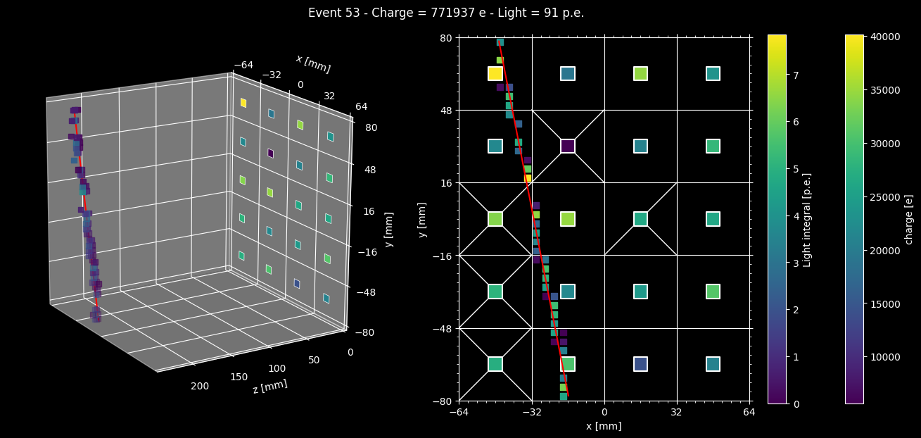
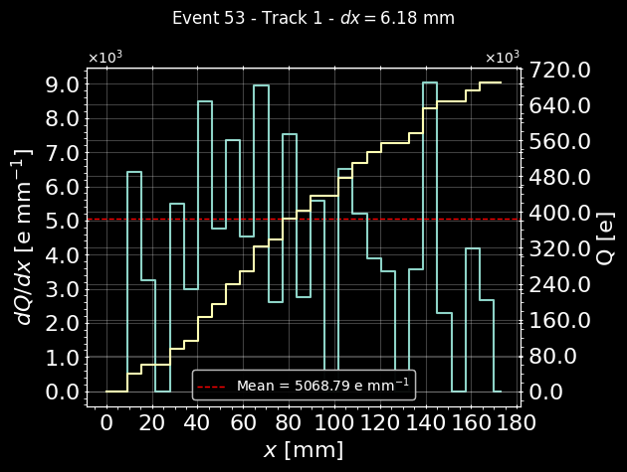
Corrected Event Display
Real cosmic track
Crosses indicate quadrants with dead chips. 1 chip = 1 quadrant with 60 pixels

Slide 4
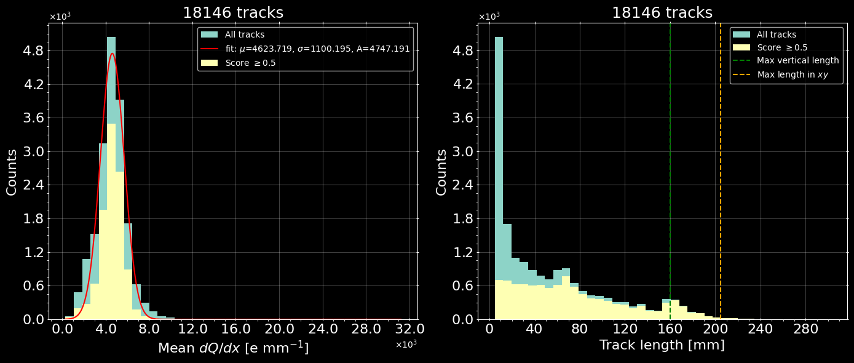





Prototype run data
All single-track events – $\sim 80$minutes of cosmic rays
Track mean $dQ/dx$
Track length
$$\sim 64$$
$$\sim 160$$
Mean $\frac{dQ}{dx}≈4.6 ke^{−}$

Slide 5
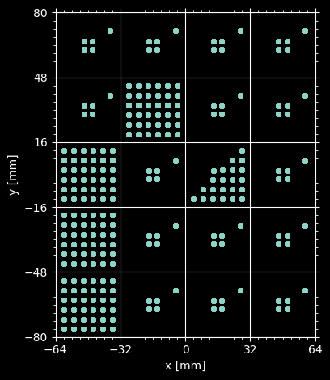
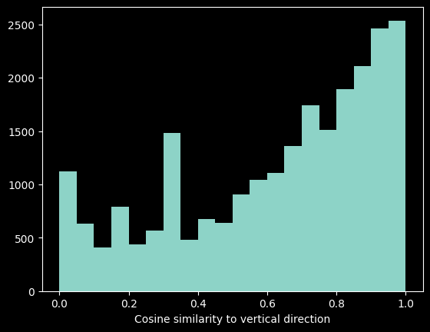
Dead area map
Real data aligned with y-axis
64 mm
160 mm
The principal component of the tracks are mostly aligned with the y-axis
Peaks in track length are due to dead areas in the anode plane
Short tracks could be due to tracks that cross only a corner of the live area (?)
96 mm

Slide 6
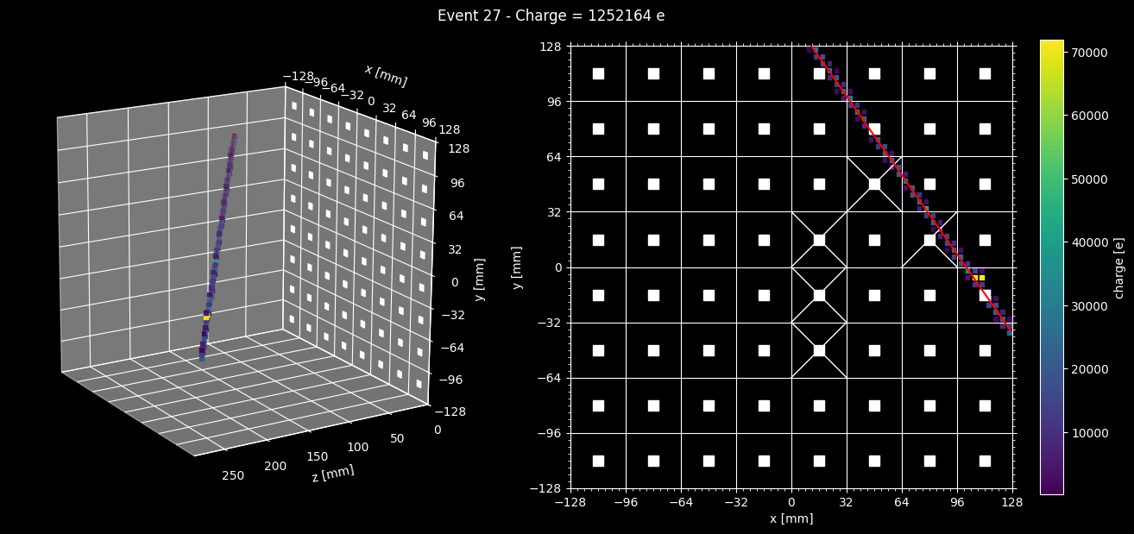
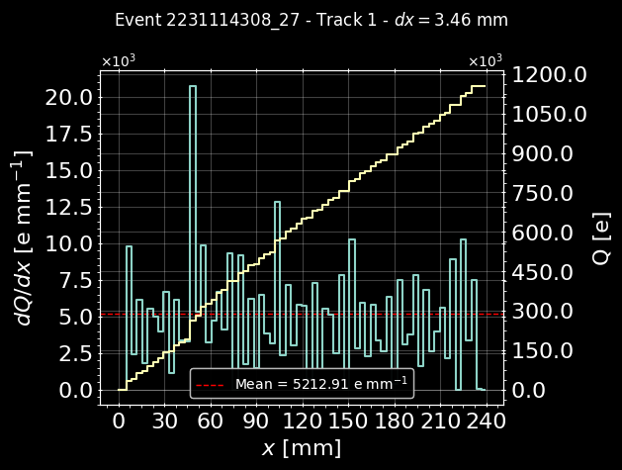
Monte Carlo Event Display
No dead areas
Crosses left to indicate quadrants with dead chips in real data.

Slide 7
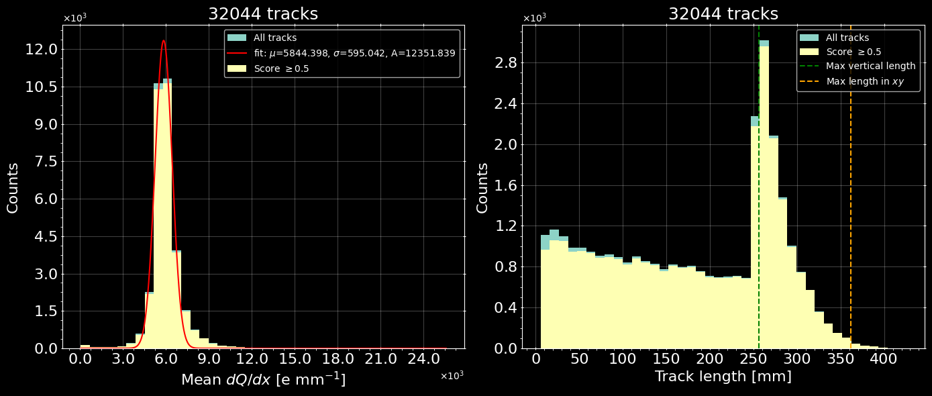

Monte Carlo
All single-track events – No dead areas
Track mean $dQ/dx$
Track length
Mean $\frac{dQ}{dx}≈5.8 ke^{−}$
Single peak in track length at maximum length along y-axis

Slide 8
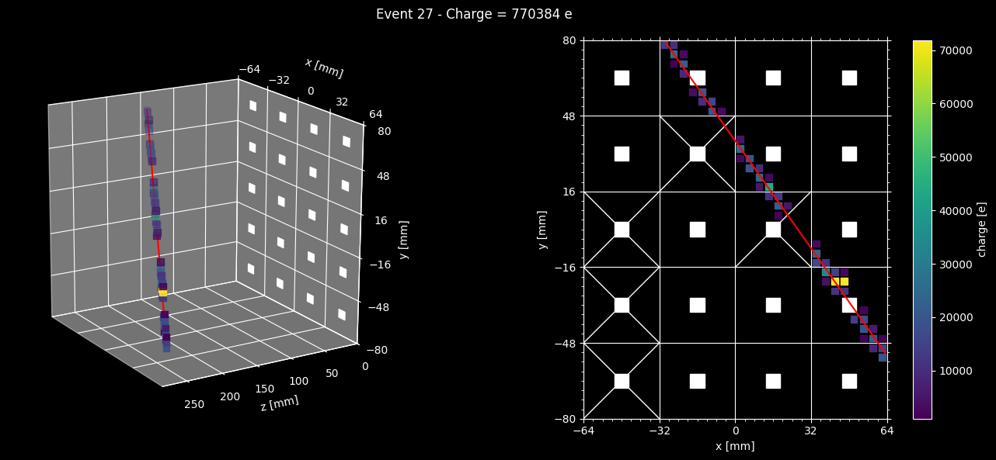
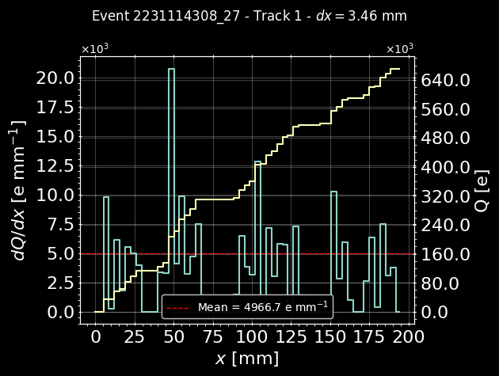
Monte Carlo Event Display
Simulated dead areas
Crosses indicate quadrants with hits removed to simulate dead chips.

Slide 9
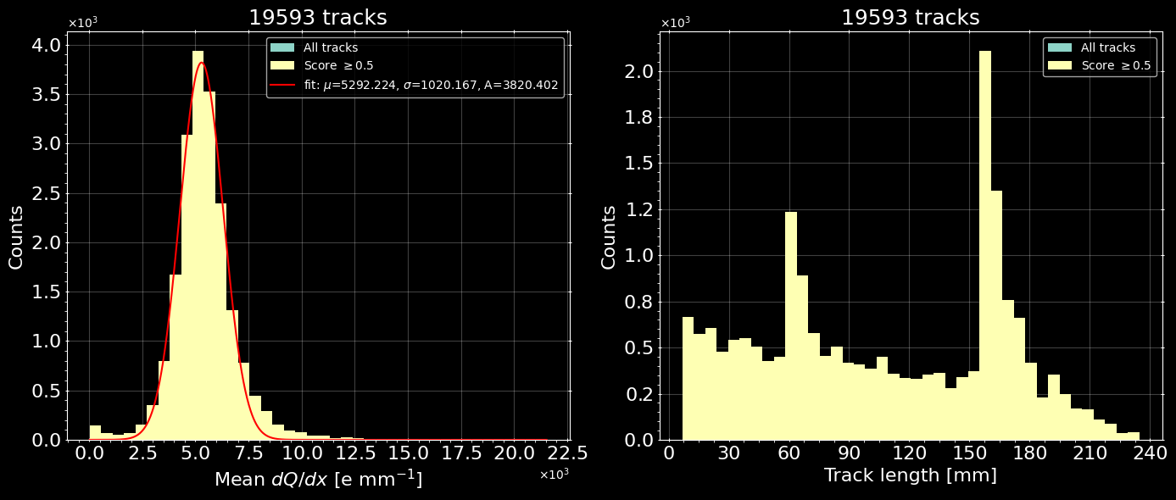



Monte Carlo
All single-track events – Simulated dead areas
Track mean $dQ/dx$
Track length
$$\sim 160$$
$$\sim 64$$
Mean $\frac{dQ}{dx}≈5.3 ke^{−}$
Peak locations in track length similar to run data.

Slide 10
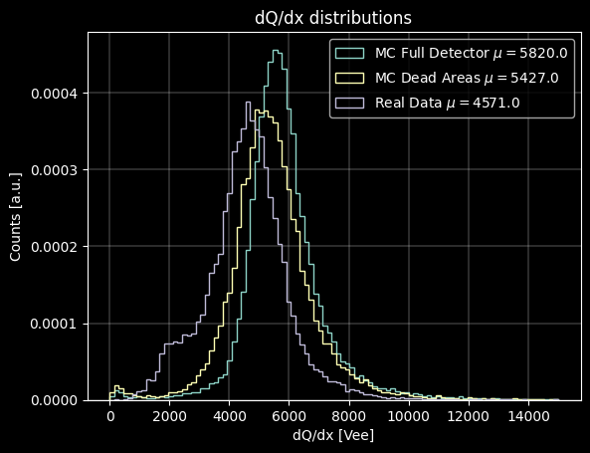
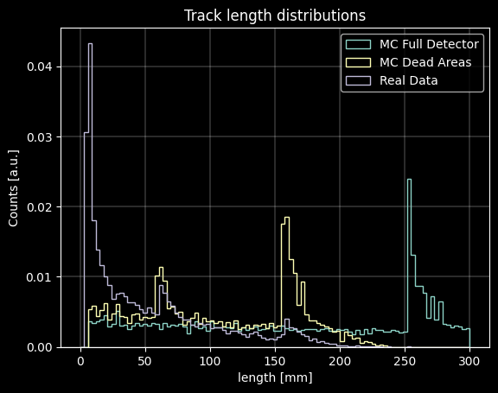

Data vs. Monte Carlo comparison
All single-track events
First peak only appears in real data
Full detector MC distribution is narrower as $dQ$ is better reconstructed without dead areas
First peak not likely to be from cosmic rays
Noisy pixels?
Notes:
“similar to module 2 results” according to Richie

Slide 11
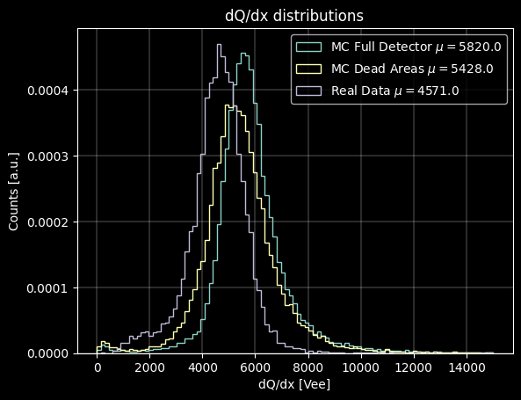
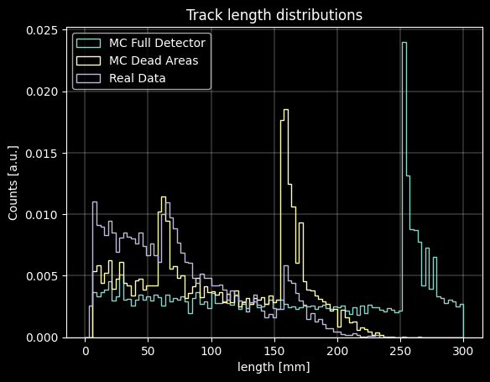
Data vs. Monte Carlo comparison
All single-track events with score > 0.5
Data distribution is narrowed down as very short tracks are removed
Monte Carlo favours longer tracks while data favours short tracks
Notes:
“similar to module 2 results” according to Richie

Slide 12
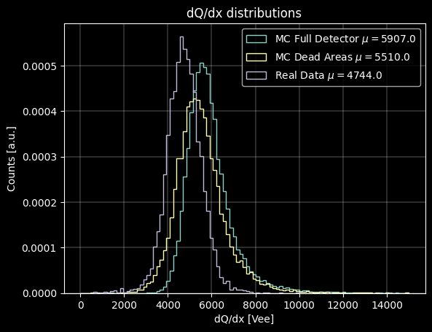
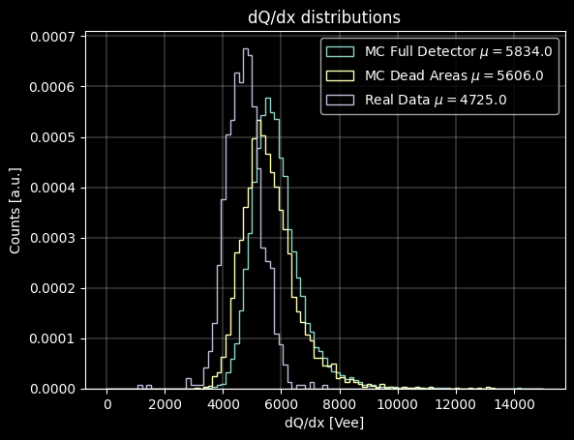
Comparison
All single-track events with score > 0.5
Track Length > 64 mm
Track Length > 160 mm
Run data distribution keeps getting narrower as cut in track length increases. MC is affected only at a very large cut.
Notes:
“similar to module 2 results” according to Richie

Slide 13

Summary
Peaks in track length are due to dead areas in the anode plane
  Simulating dead areas in Monte Carlo reconstruction reproduces peak positions
Monte Carlo indicates that there is more happening in the run data than just cosmic rays
  Very large number of short tracks (blips)
  Noisy pixels? Other low energy events?
Difference in $dQ/dx$between Monte Carlo and run data higher than expected
  Due to DAQ? i.e. LArPix pedestal subtraction in data
  Due to physics? i.e. Larger proportion of short tracks in data
Notes:
“similar to module 2 results” according to Richie

Slide 14
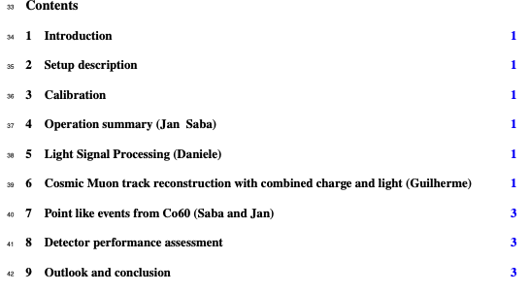

Wish list
Addition of light to Monte Carlo simulation – Danielle
More information on LArPix operation to understand $dQ/dx$– Bern
Understanding the geometric dependency of light signal for the light vs. “charge distance to anode” analysis – Danielle & Guilherme
Conversion of Co60 run files – Danielle & Guilherme
Writing the SoLAr V2 paper – Everybody
Notes:
“similar to module 2 results” according to Richie

Slide 15
Thank you!

Slide 16
Backup slides

Slide 17
FAQ
DBSCAN parameters:
  xy_epsilon = 8 mm (2 pixels)
  Z_epsilon = 8 mm
RANSAC parameters:
  Residual_threshold = 6
  Max_trials = 1000
RANSAC has random component and may not always return the same fit
Cylinder parameters are determined dynamically but bound by DBSCAN parameters

Slide 18
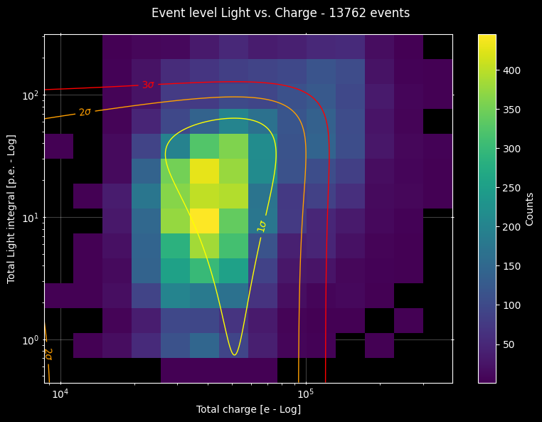
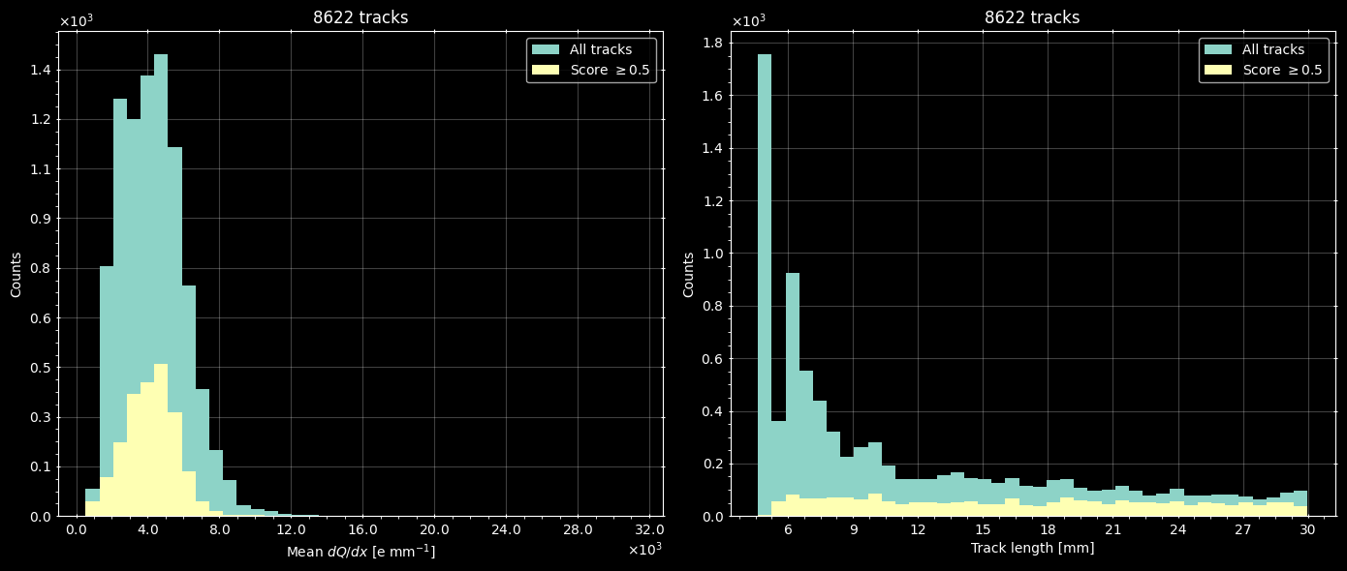
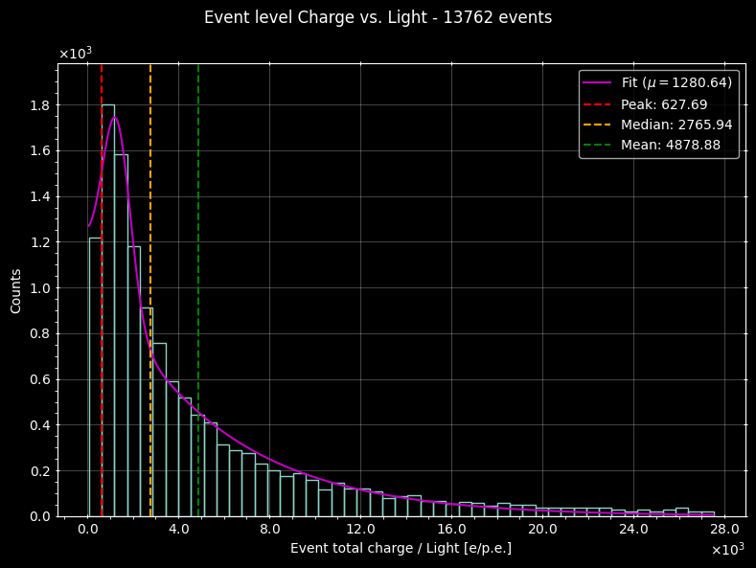



Analysis
Single tracks shorter than $30$mm
2D event charge vs. light
Both axis in log scale
Track mean $dQ/dx$
Track length
Event charge to light ratio
Mean $\frac{dQ}{dx}≈4.2 ke mm^{−1}$
Would be interesting to see the how the ⁶⁰Co events behave

Slide 19








Cylinder parameters
$dh$ estimation
$$\hat{z}$$
z_epsilon
$$\hat{v}$$
$$\hat{u}$$
$$dl \hat{u}=\text{[ }\text{xy}\text{_}\text{epsilon} \left(\hat{x}+\hat{y}\right)+\text{z}\text{_}\text{epsilon} \hat{z} ]$$
$$dh =dl (\hat{u} ∙ \hat{v})$$
$$dh$$
$$dl$$
xy_epsilon
$\hat{x} (\hat{y})$

Slide 20





Cylinder parameters
$dr$ estimation
$$\hat{z}$$
z_epsilon
$$p_{i}$$
$$dr=\sqrt{\frac{1}{N−1} \sum_{i=1}^{N}{{{(x}_{i}−p_{i})}^{2}}}$$
$$x_{i}$$
Minimum $dr$ is bound to $\frac{dl}{4}$
xy_epsilon
$\hat{x} (\hat{y})$

Slide 21
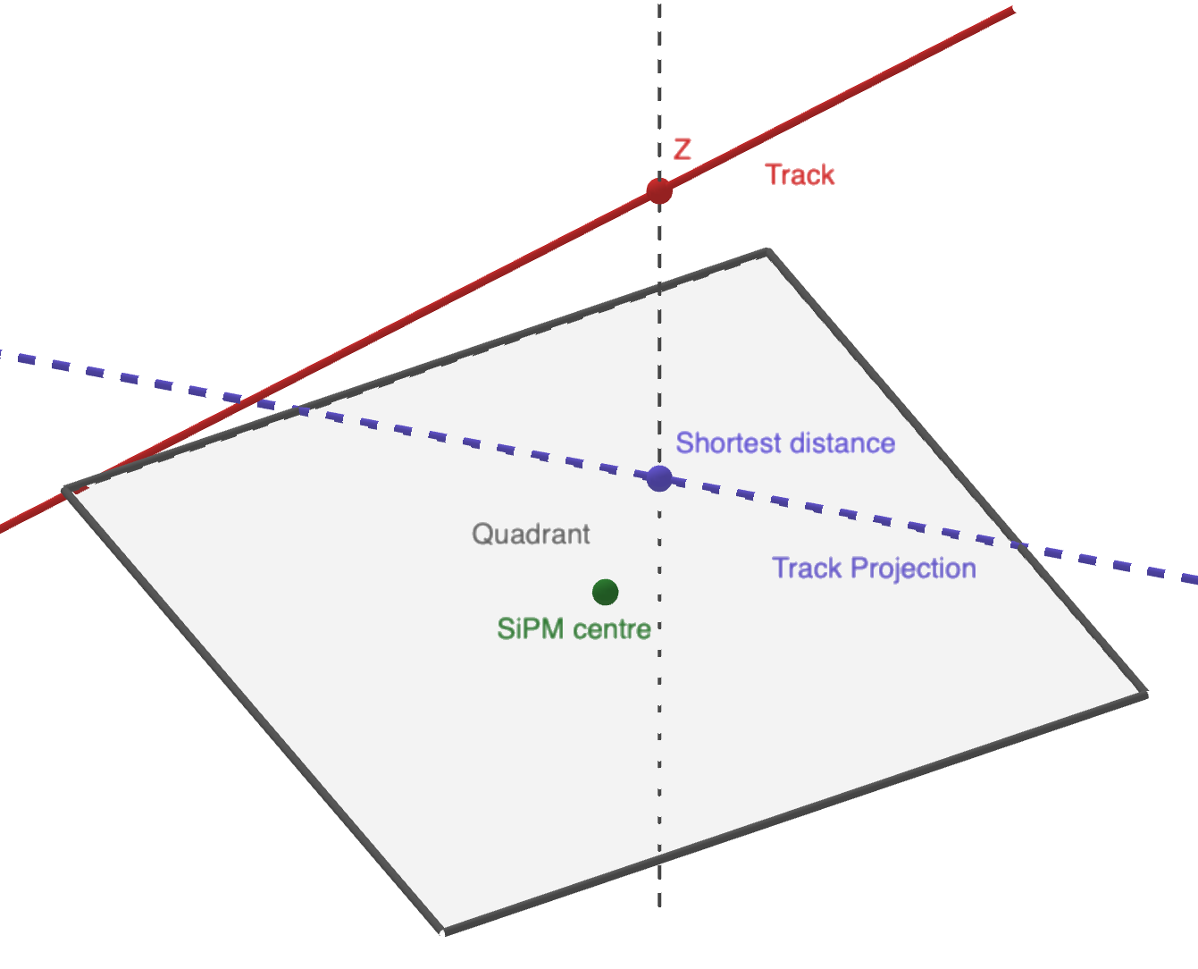
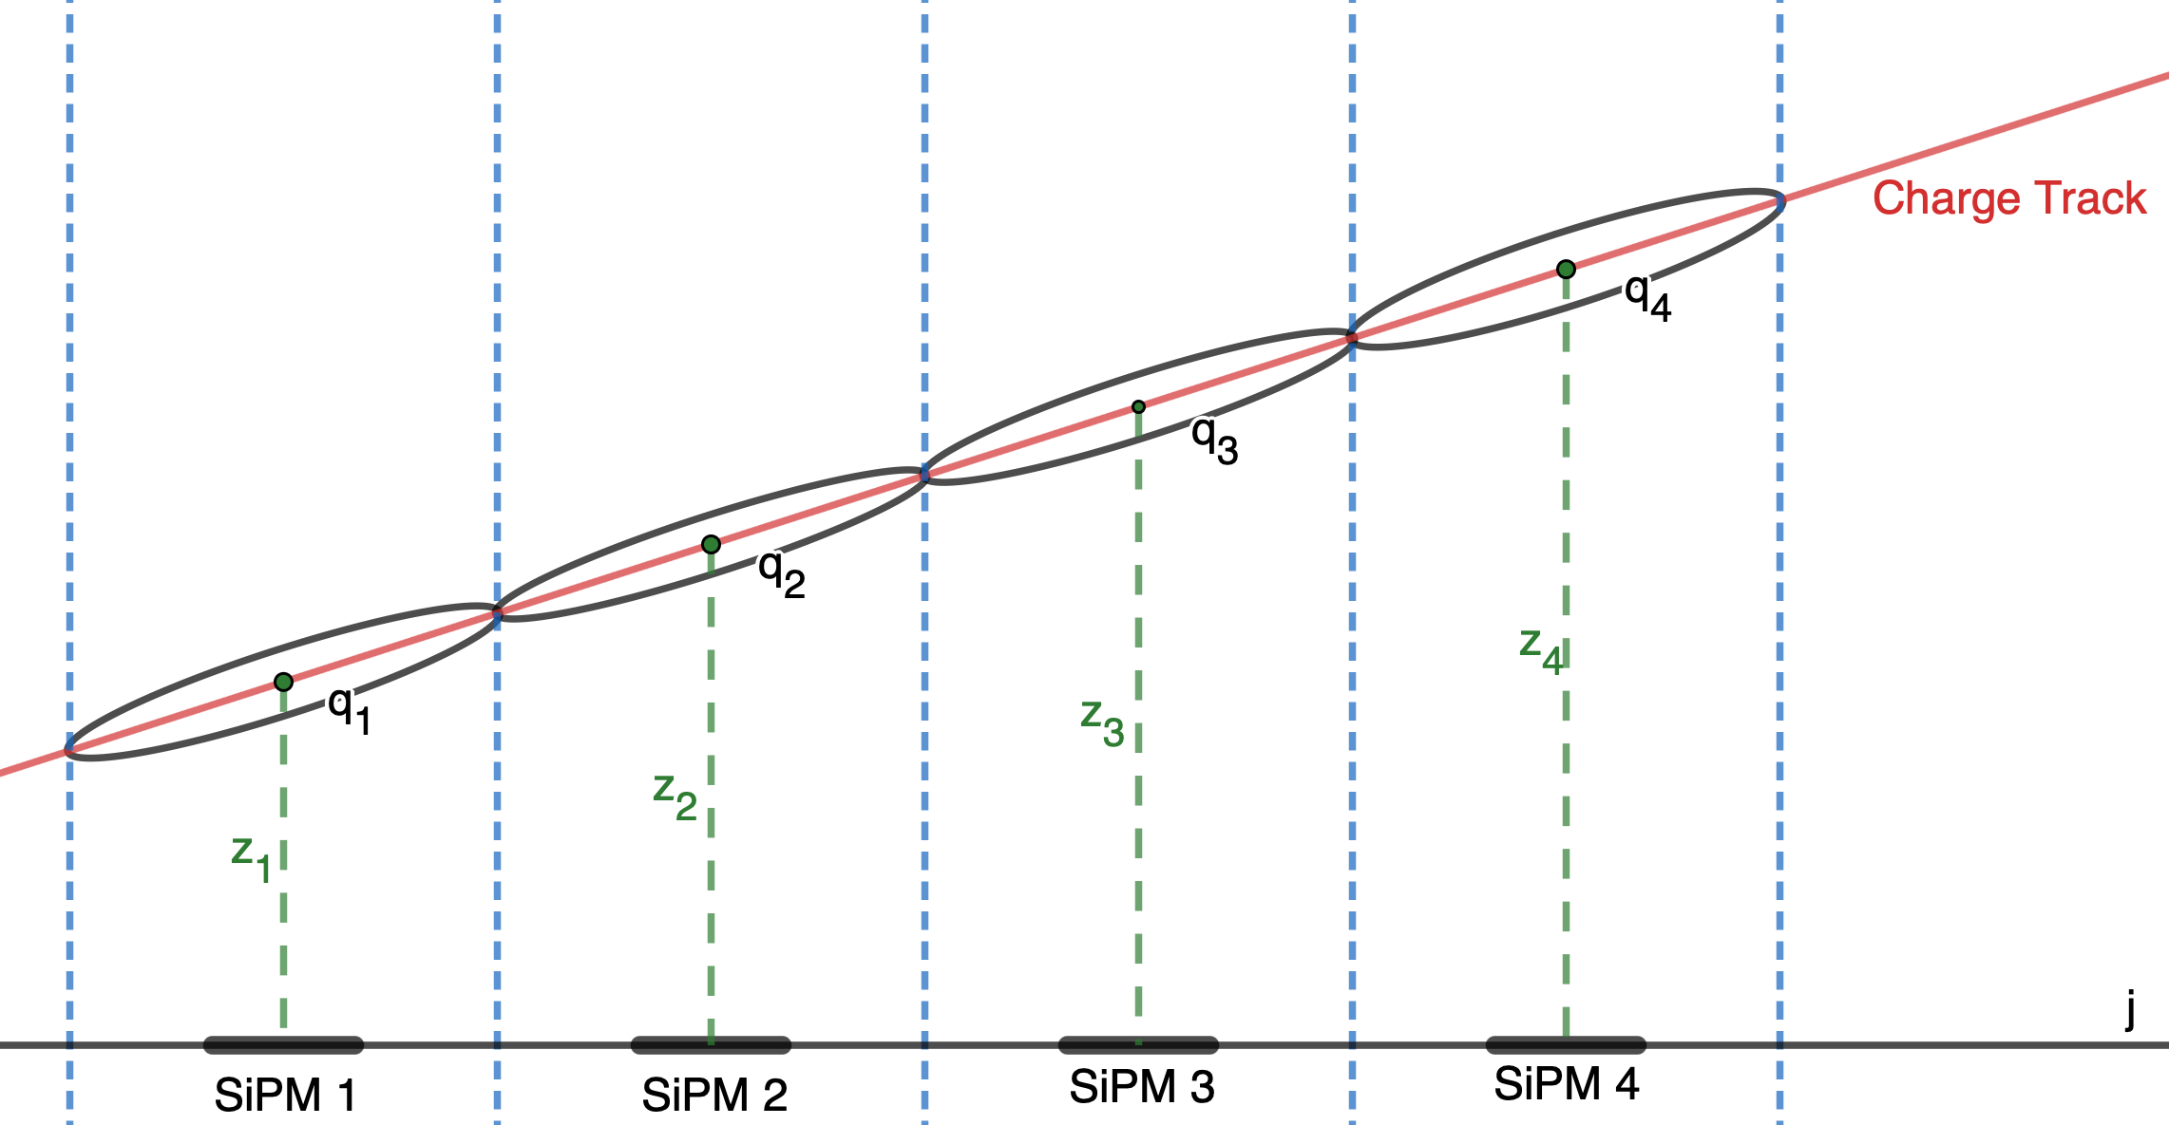
Light to charge z-coordinate estimation

