Slide 1





SoLAr V2
Data Analysis
Guilherme Ruiz Ferreira
University of Manchester
27 March 2024

Slide 2


Data Processing
Scripts
SoLAr_Reco.ipynb
Reconstructs events using light and charge data
Inputs
  Deconvolved light ROOT file
    Daniele’s DecoWave
  Charge ROOT file
    LHEP conversion script)
  SiPMs map JSON
    Manually created to map SiPM channel to $xy$-coordinates
Outputs
  Event display for selected events
  Reconstructed track fit data
  Reconstructed light fit data
  Total light and charge
  Voxelized light and charge
  Etc…
SoLAr_Ana.ipynb
Produces plots and statistics from metrics file obtained through SoLAr_Reco.ipynb
Track fit statistics
  $dQ/dx$versus track length, anode distance, residual range
  Etc…
Light fit statistics
  Light fit cosine similarity to charge fit
Light versus Charge
  Total light versus charge
  Voxelized light versus charge
  Light versus distance to anode
  Etc…
Notes:
Several hard coded parameters that can be overridden

Slide 3
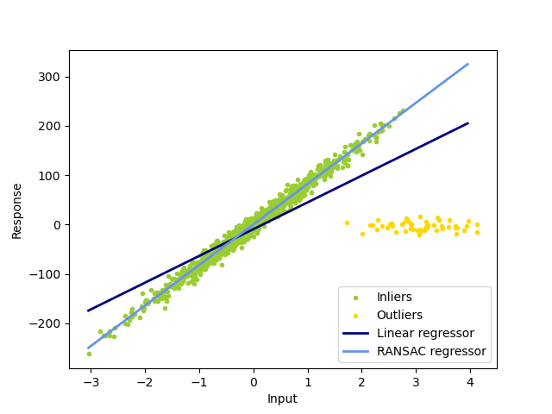
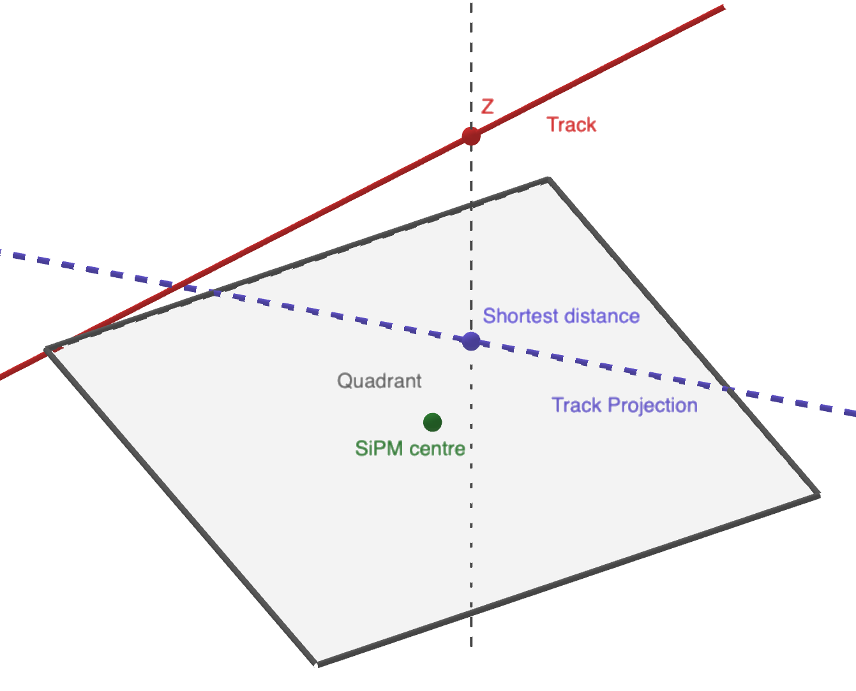

Data Processing
Reconstruction methods
Charge tracks fitting
DBSCAN clustering
  Cluster hits in the 𝑥𝑦-plane
  Determine the intervals in 𝑧 between clusters
  Generate fake data filling dead areas withing the 𝑧 intervals
  Cluster hits + fake data in the 𝑥𝑦-plane
  Cluster hit labels from first stage with hit 𝑧-coordinates
  Remove fake data
RANSAC regression
  Fit line to clustered hits
  Use hit charge as weight for line fit
  Optionally re-cluster and fit outliers to find secondary tracks
Light track fitting
Select top 5 SiPMs with largest light signal
  Must be non-zero
  Minimum of 3 SiPMs
  $x$ and $y$ are determined by SiPM’s coordinates
Estimate light signal $z$-coordinate
  Average the $z$-coordinate of the charge hits within the SiPM’s quadrant
  Use total average z-coordinate if no hits in the SiPM’s quadrant
  Average is weighted by hits charge
RANSAC regression
  Fit line to light coordinates
  Fit quality depends strongly on the track angle of incidence to anode
Handling dead areas due to disabled pixels

Slide 4
Data Processing
Technical details
Output file structure
Event #
Track #
Track labels mask
Fit line
(point & vector)
Fit length
Fit score
SiPM #
dQ list
dx
Etc…
Total charge
Total light
Angle
Distance
Light
SiPM data
SiPM #
Light fit line
Fit threshold
Average z
Charge
Light
Etc...
Run time benchmark
Data formats
Load charge file
Filter events
$\sim 30$seconds
~ 30 seconds
Load light file
Filter SiPMs
$\sim 7$ Minutes
~ 7 Minutes
Match events
$\sim 30$ Seconds
~ 30 Seconds
Fit tracks
$\sim 40$ Minutes
~ 40 Minutes
Light and Charge data frames are saved to bz2 files (compressed CSV)
Dictionary of light to charge matches is saved to JSON file
Analysis output file is saved to pickle file to preserve non-JSON-serializable objects
Saved data can be loaded instead of reloading ROOT files to speed up processing
SoLAr_Ana.ipynb has a method to filter metrics based on a set of parameters.
The parameters used are saved in a JSON file named with the same label (number) as the plots produced

Slide 5
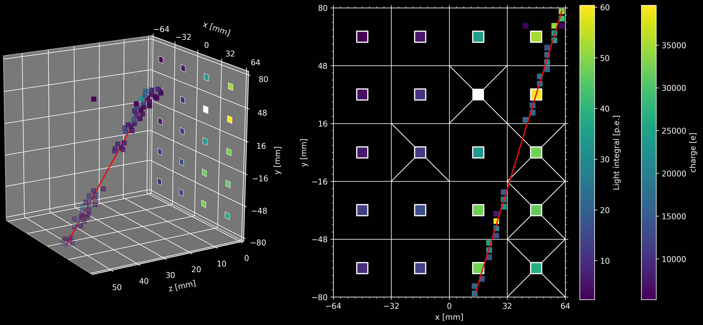
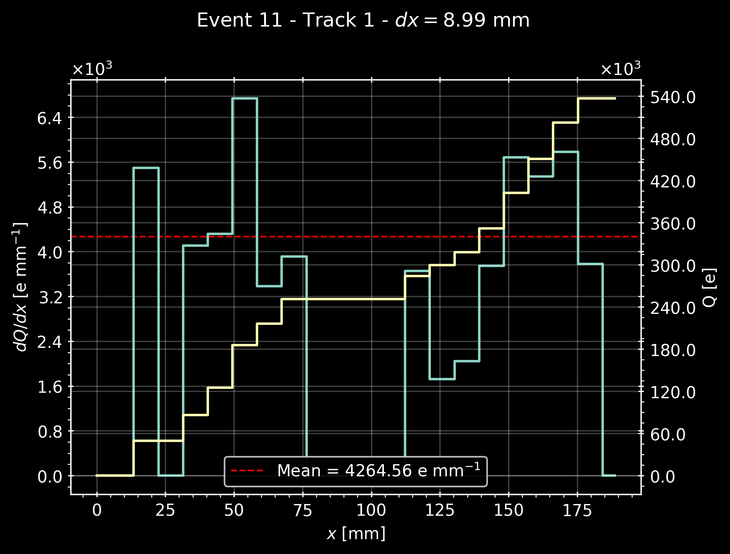
Event Display
Integrated charge and light event display
Single track $dQ/dx$plot showing gap in dead area
Crosses indicate quadrants with dead chips. 1 chip = 1 quadrant with 60 pixels

Slide 6
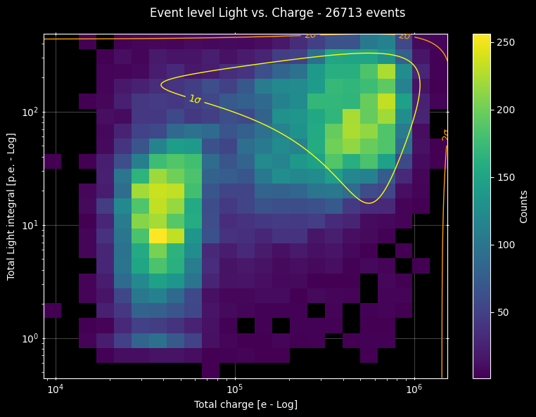
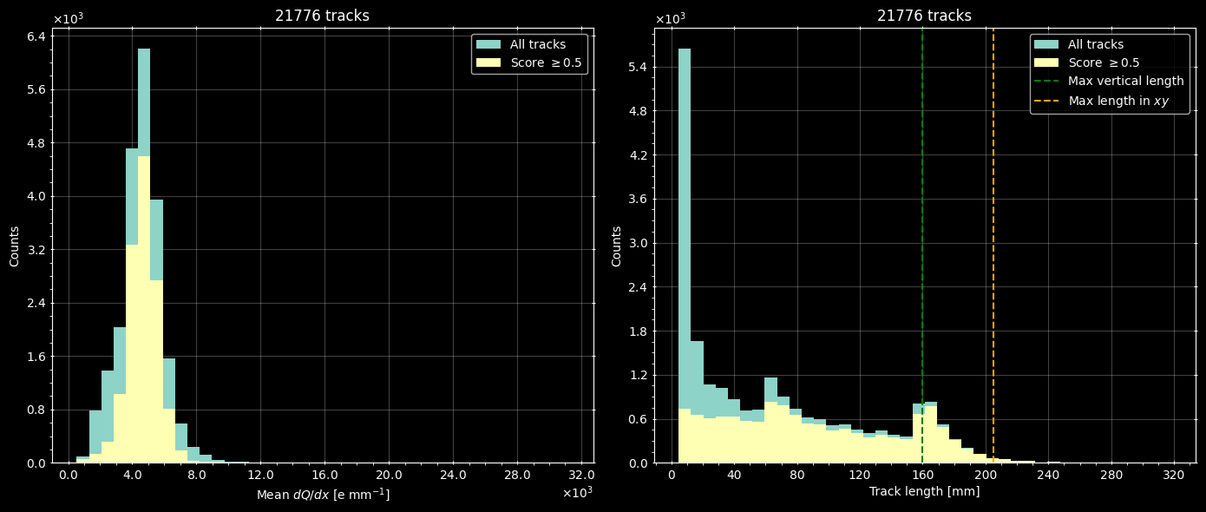
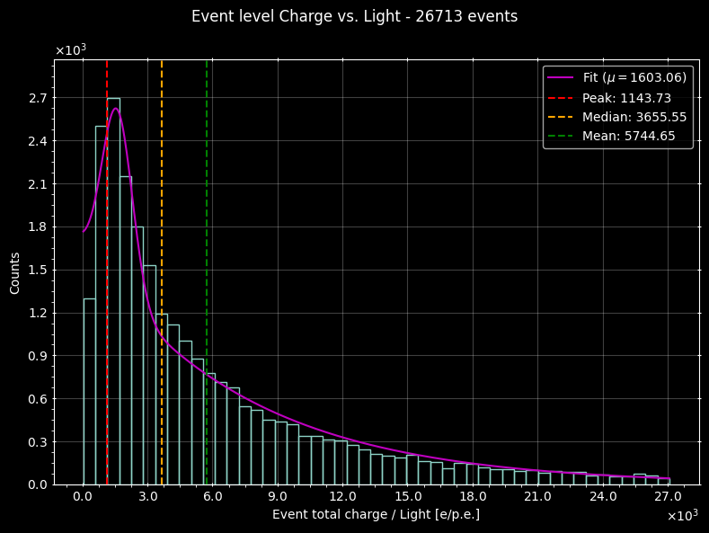


Analysis
All single-track events – $\sim 80$minutes of cosmics
2D event charge vs. light
Both axis in log scale
Track mean $dQ/dx$
Track length
Two populations visible
Event charge to light ratio
Score indicates “goodness of fit”. Shorter tracks are not well fit
Fit quality doesn’t affect total event light and charge

Slide 7
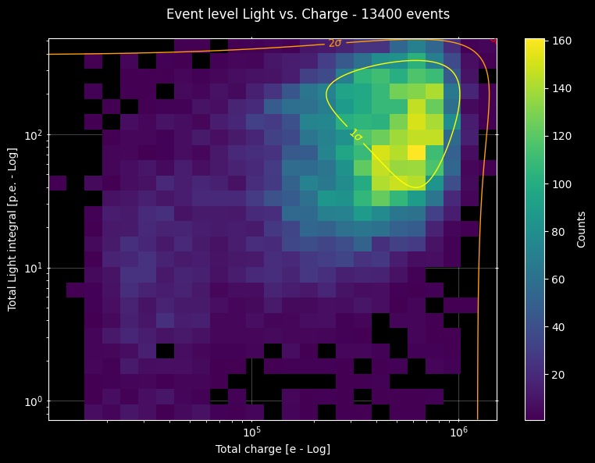
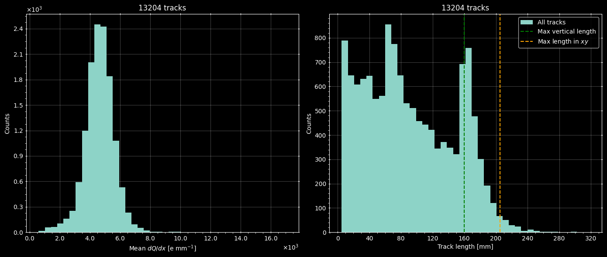
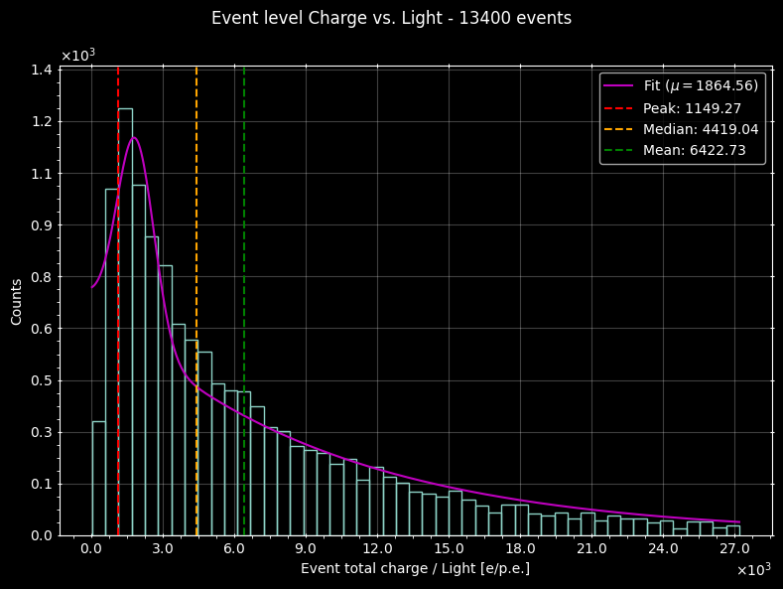
Analysis
Single-track events with score > 0.5
2D event charge vs. light
Both axis in log scale
Track mean $dQ/dx$
Track length
Second population still present
Event charge to light ratio
Removing badly reconstructed tracks reduces the peak at small track lengths but doesn’t fully eliminate events in that region

Slide 8
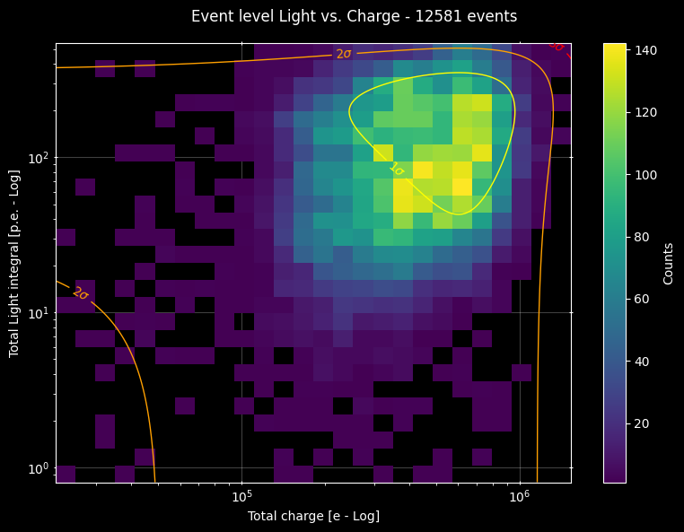
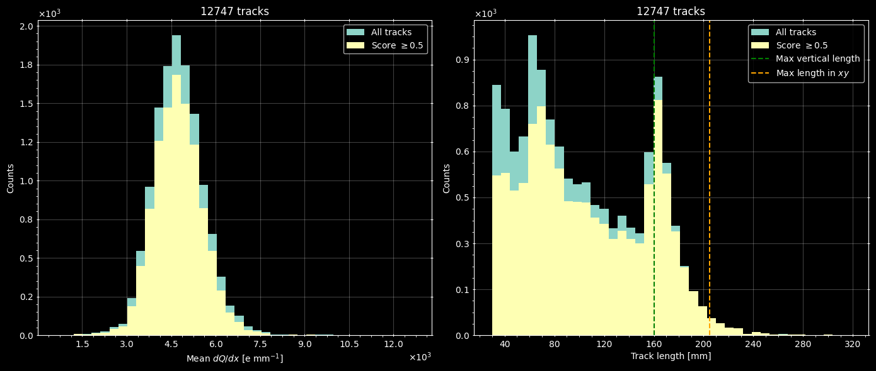
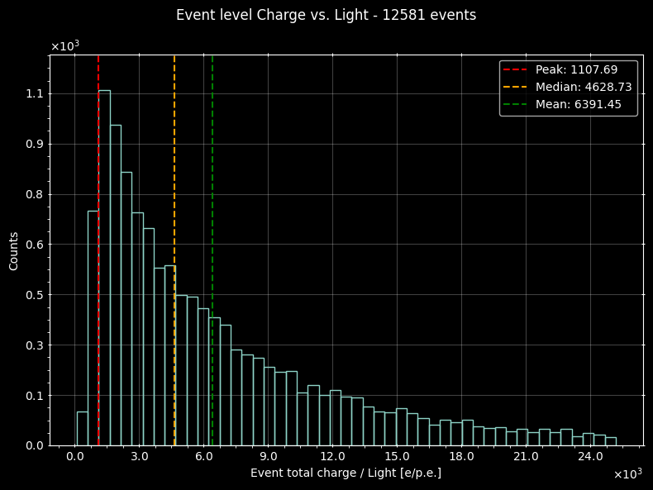
Analysis
Single tracks longer than 30mm
2D event charge vs. light
Both axis in log scale
Track mean $dQ/dx$
Track length
Second populations greatly reduced
Event charge to light ratio
Removing small tracks with less than 30mm eliminates most events in that region
Regardless of fit quality, short tracks are responsible for the second population

Slide 9
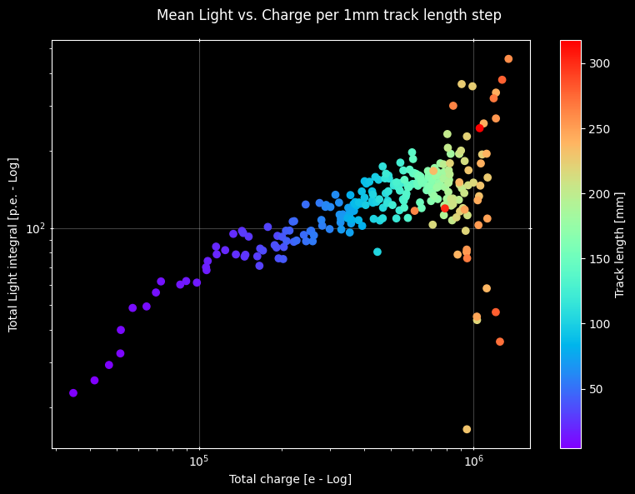
Analysis
All single-track events – $\sim 80$minutes of cosmics
Error bars not shown but STD much larger on light axis
Scattering of large tracks probably due to low statistics
Notes:
Less dead areas in light than charge readout -> light better reconstructed

Slide 10
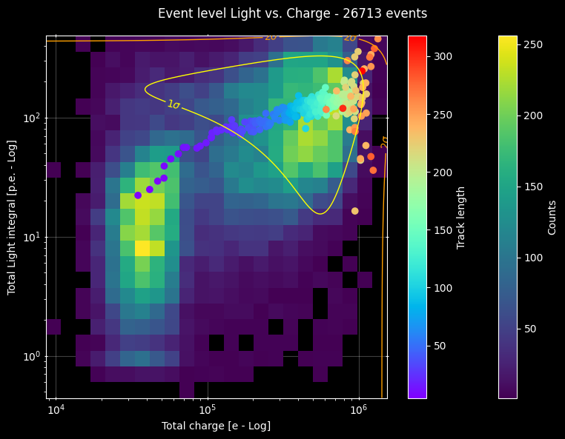
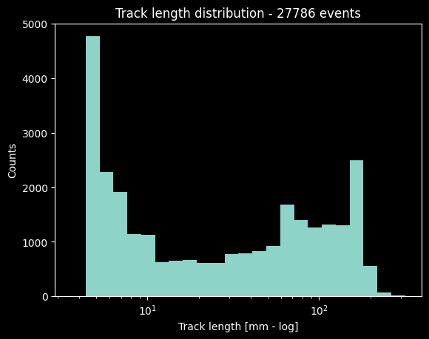
Analysis
All single-track events – $\sim 80$minutes of cosmics
Two populations

Slide 11
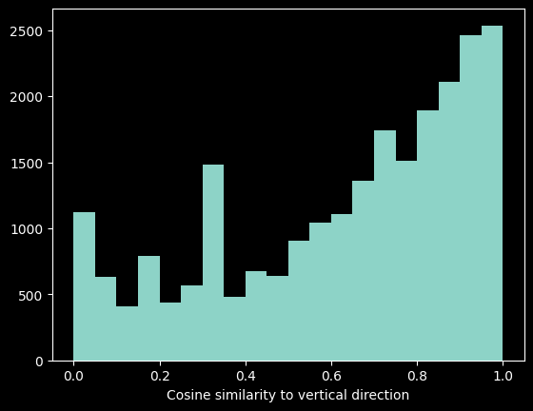


Analysis
Dead area map
64 mm
160 mm
The principal component of the tracks are mostly aligned with the y-axis
Peaks in track length appear to be due to dead areas in the anode plane
Short tracks could be due to tracks that cross only a corner of the live area
$$\sim 65$$
$$\sim 160$$
96 mm

Slide 12
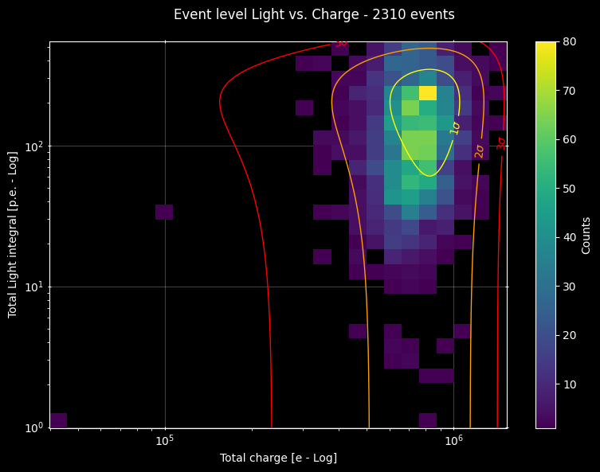
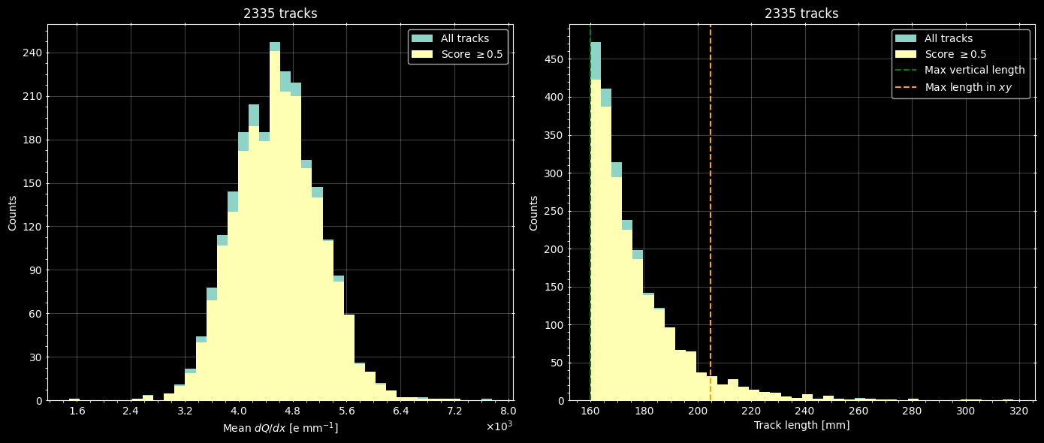
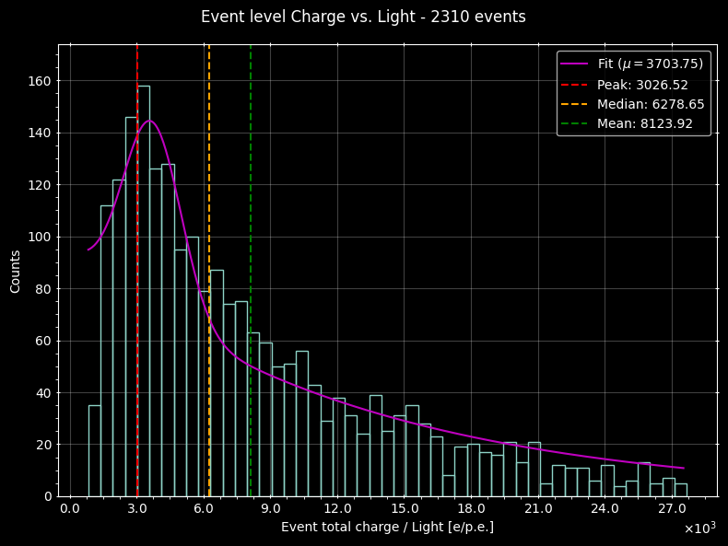


Analysis
Single tracks longer than $160$mm
2D event charge vs. light
Both axis in log scale
Track mean $dQ/dx$
Track length
Second populations eliminated
Event charge to light ratio
Mean $\frac{dQ}{dx}≈4.6 ke mm^{−1}$

Slide 13
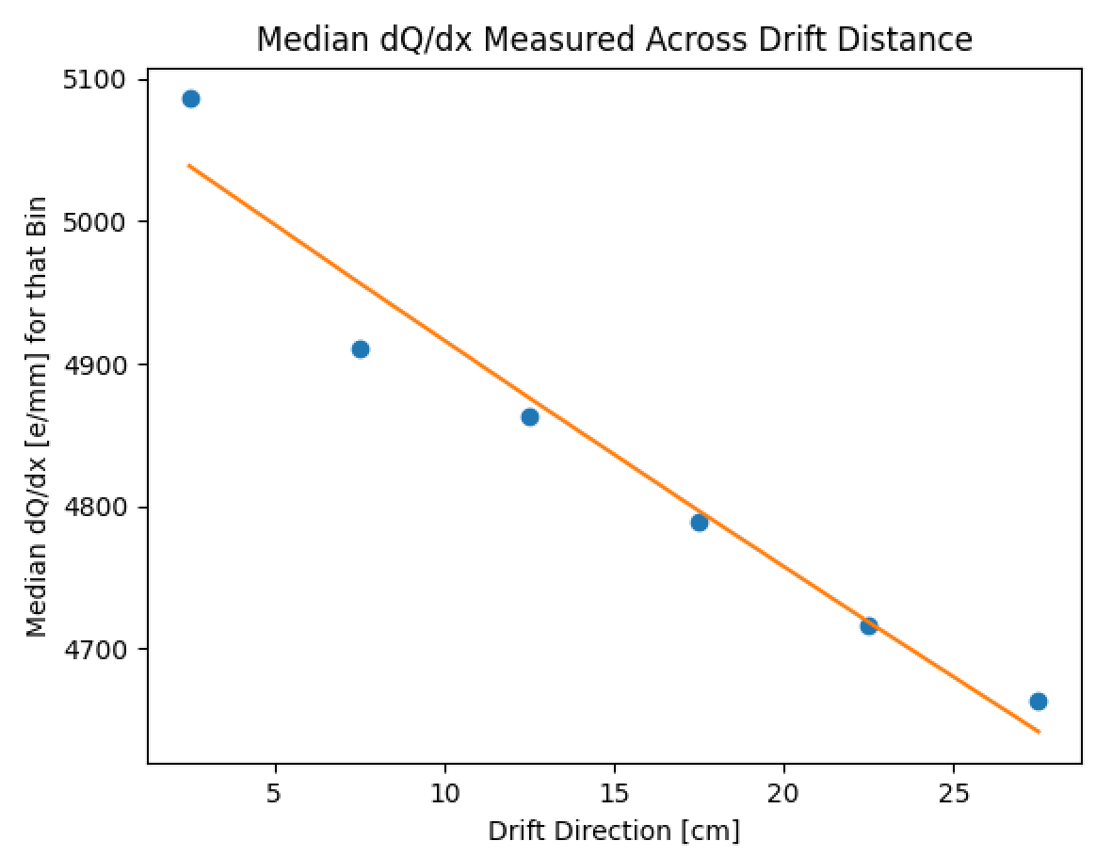
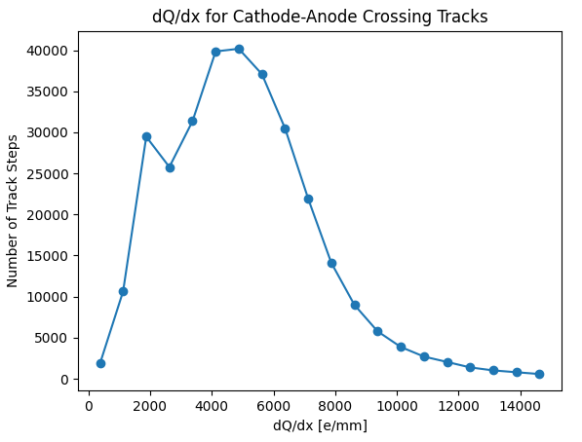


Analysis
Electron Lifetime – Richie’s script
Measured electron Lifetime: $1.828ms$
Similar $dQ/dx$

Slide 14
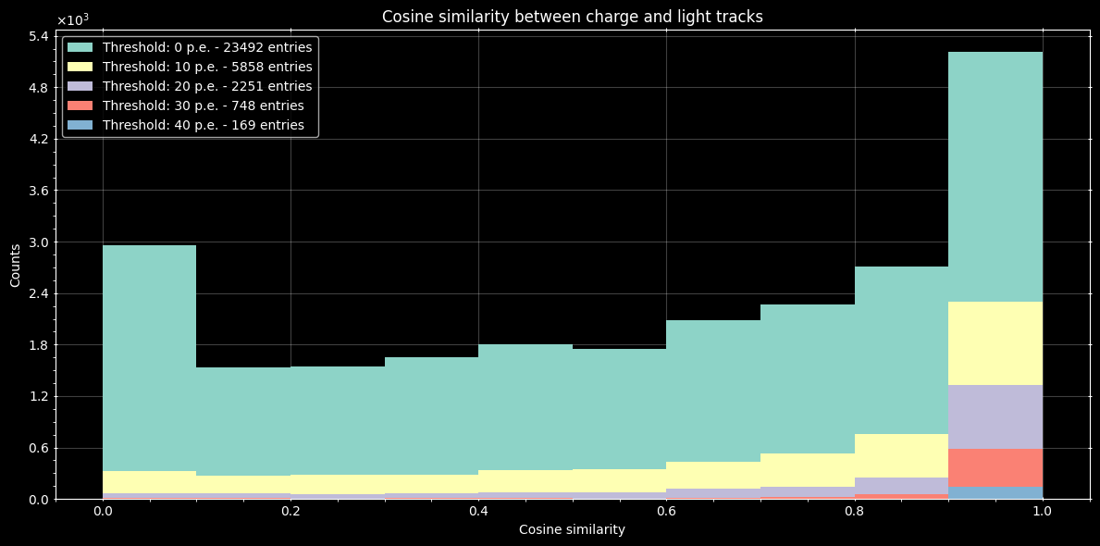
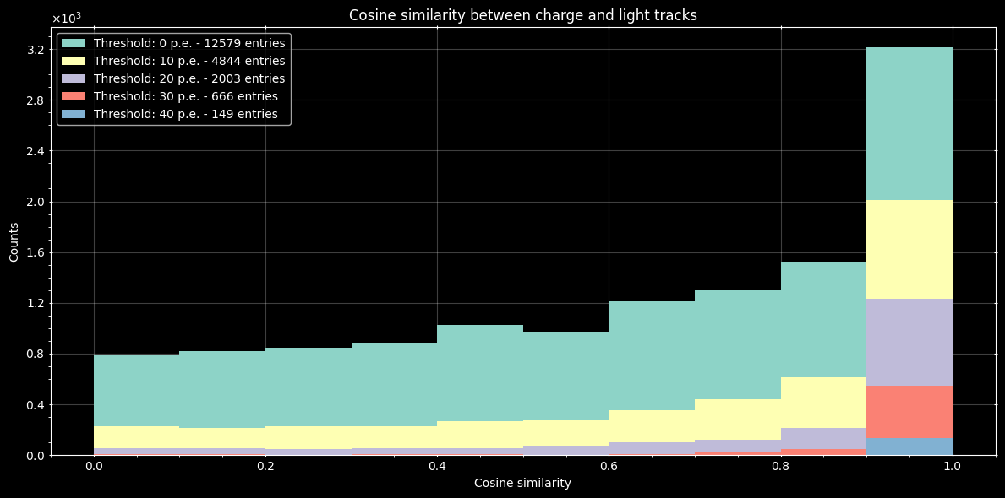
Analysis
Track reconstruction from light
All tracks
Tracks > 30mm
Light fit performs well with a strong enough signal and 𝑧-coordinate obtained from charge

Slide 15
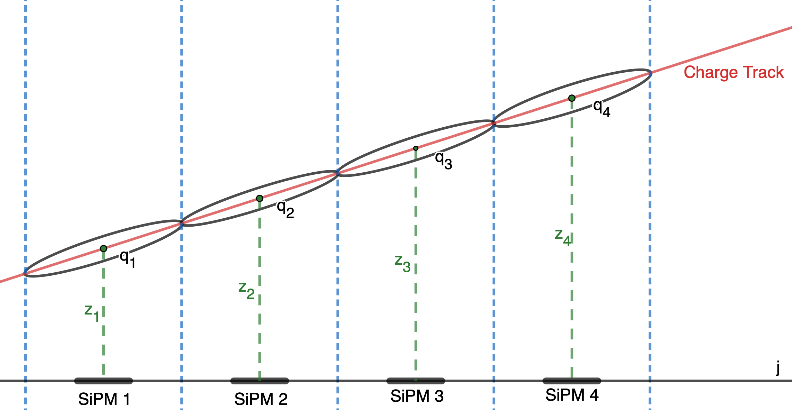
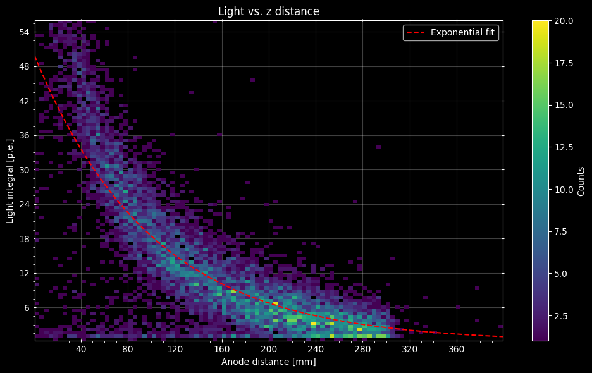
Analysis
Light dependency with distance to anode
Light vs. Charge distance to anode per voxel
Light signal decreases with charge distance to anode
Decrease is faster than exponential (?)
Charge signal versus distance to anode decrease in a much slower rate (almost linear)

Slide 16

Summary
Second population in Charge vs. Light plot due to short tracks ($<\sim 5$cm)
Peaks in track length appear to be due to dead areas in the anode plane
Measured electron lifetime seems a bit high but similar to module 2 results
Light “tracks” are in good agreement with their respective charge counterparts
Light signal decreases fast with hit distance from anode plane
Notes:
“similar to module 2 results” according to Richie

Slide 17
Thank you!

Slide 18
Backup slides

Slide 19
FAQ
DBSCAN parameters:
  xy_epsilon = 8 mm (2 pixels)
  Z_epsilon = 8 mm
RANSAC parameters:
  Residual_threshold = 6
  Max_trials = 1000
RANSAC has random component and may not always return the same fit
Cylinder parameters are determined dynamically but bound by DBSCAN parameters

Slide 20
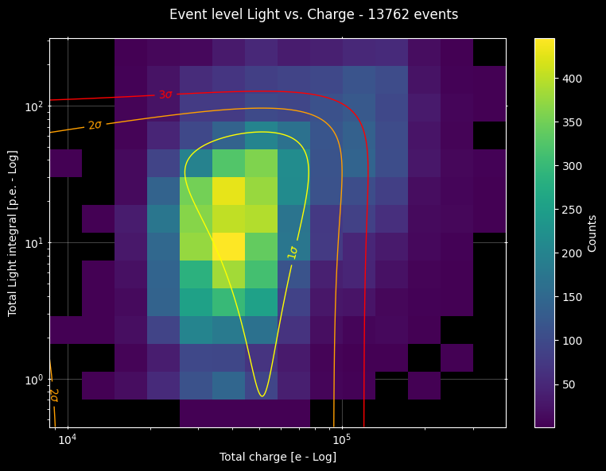
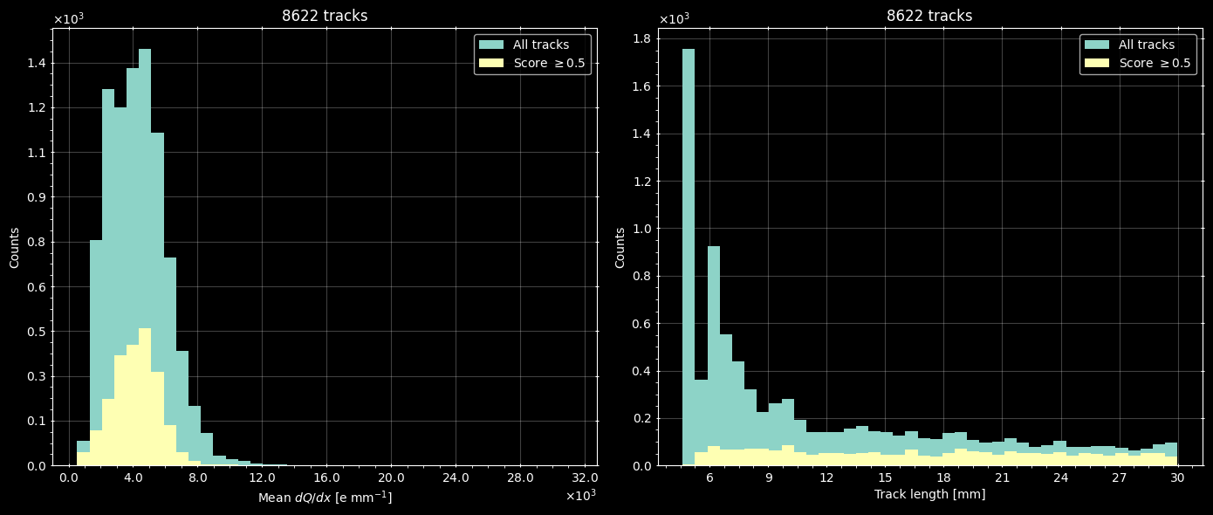
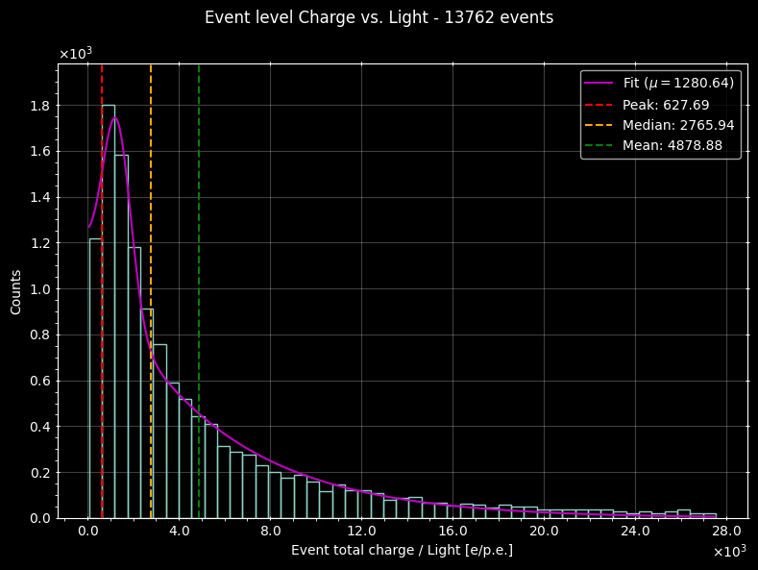


Analysis
Single tracks shorter than $30$mm
2D event charge vs. light
Both axis in log scale
Track mean $dQ/dx$
Track length
Event charge to light ratio
Mean $\frac{dQ}{dx}≈4.2 ke mm^{−1}$
Would be interesting to see the how the ⁶⁰Co events behave

Slide 21








Cylinder parameters
$dh$ estimation
$$\hat{z}$$
z_epsilon
$$\hat{v}$$
$$\hat{u}$$
$$dl \hat{u}=\text{[ }\text{xy}\text{_}\text{epsilon} \left(\hat{x}+\hat{y}\right)+\text{z}\text{_}\text{epsilon} \hat{z} ]$$
$$dh =dl (\hat{u} ∙ \hat{v})$$
$$dh$$
$$dl$$
xy_epsilon
$\hat{x} (\hat{y})$

Slide 22





Cylinder parameters
$dr$ estimation
$$\hat{z}$$
z_epsilon
$$p_{i}$$
$$dr=\sqrt{\frac{1}{N−1} \sum_{i=1}^{N}{{{(x}_{i}−p_{i})}^{2}}}$$
$$x_{i}$$
Minimum $dr$ is bound to $\frac{dl}{4}$
xy_epsilon
$\hat{x} (\hat{y})$

Slide 23
Light to charge z-coordinate estimation

