Slide 1


SoLAr V2
Track Reconstruction
Guilherme Ruiz - 22/11/2023

Slide 2

Charge - Track reconstruction
Apply DBSCAN clustering
  Cluster hits in the $xy$-plane
  Determine the intervals in $z$ between clusters
  Generate fake data filling dead areas withing the $z$ intervals
  Cluster hits + fake data in the $xy$-plane
  Cluster hit labels from first stage with hit $z$-coordinates
  Remove fake data
Fit line to clusters with RANSAC regression
  Use hit charge as weight for fit
  Optionally re-cluster and fit outliers to find secondary tracks
Define same sized stacked cylinders centered around fitted line
  Two parameters are needed: the radius and height of the cylinders
  Apply buffer regions at the extremities of the tracks
  Discard points already accounted for in previous cylinders when iterating over all cylinders

Slide 3

$dQ$ per cylinder translates into $dQ/dx$!
With dead area
Interpolating dead area with mean

Slide 4

$dQ/dx$statistics
P-value: Probability of RANSAC fit being “random”

Slide 5
Light – Correlating events
~68% of the charge events have external trigger and survive pre-processing
~97% of the surviving charge events find a matching light event
~65% of the charge events survive → 1+ light events per charge event

Slide 6
Correlated charge and light event display
“Ooh!” - Stefan

Slide 7
Light and Charge – Event level correlation
All events
Non-zero gaussian peak plus exponential decay in ratio plot
Two populations in 2D histogram

Slide 8
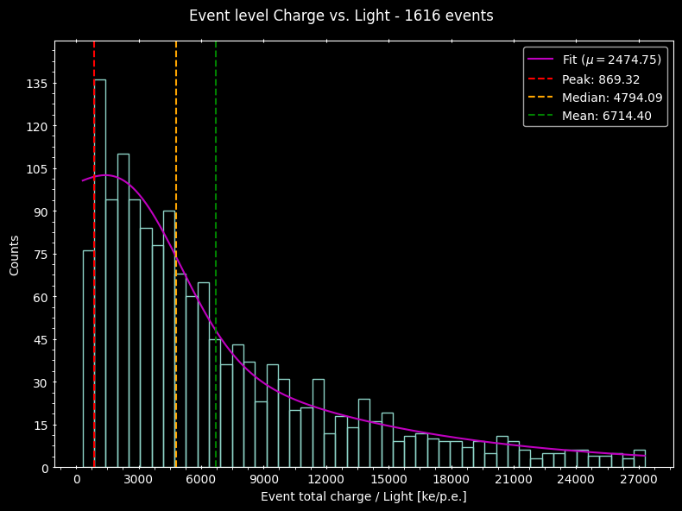
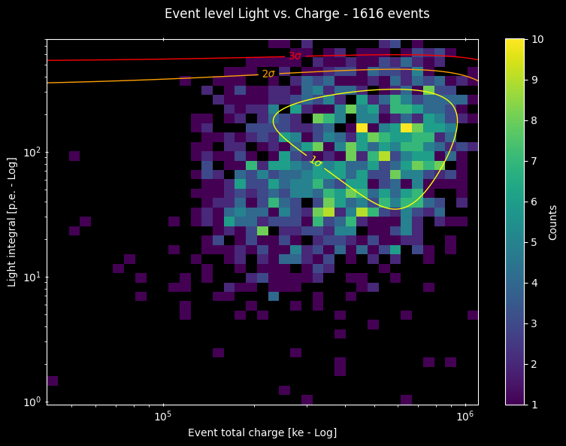
Light and Charge – Event level correlation
Only single tracks larger than 30cm
Fit peak farther from 0
Single populations in 2D histogram

Slide 9
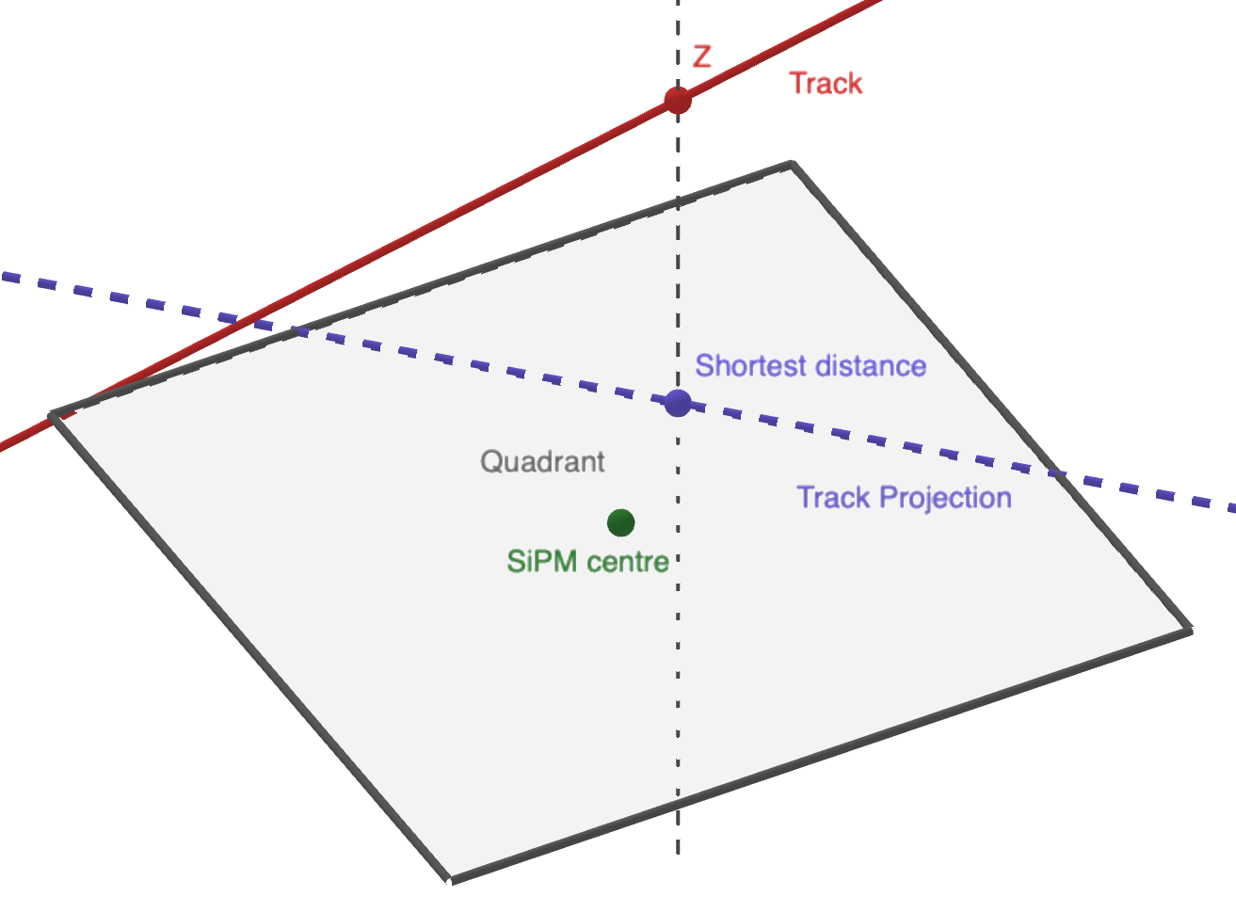
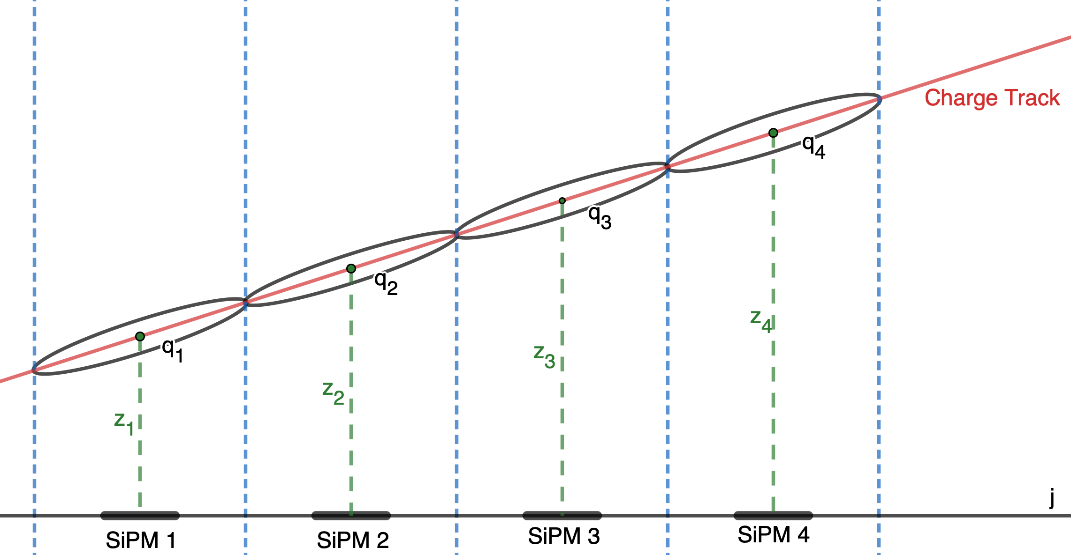

Light track – Fit method
Select top 5 SiPMs with largest light signal
  Must be non-zero
  Minimum of 3 SiPMs
  $x$ and $y$ are determined by SiPM coordinates
$z$ is calculated by averaging the $z$-coordinate of the charge hits within that SiPM’s quadrant weighted by their charge
  If there is no charge data (i.e. dead chip), $z$ is the $z$-coordinate of the closest point in the fitted charge track to the SiPM in $xy$, provided that the track crosses the SiPM’s quadrant
  If no track crosses the SiPM’s quadrant, $z$ is the average z from all hits in the event
Apply RANSAC fit to resulting points

Slide 10
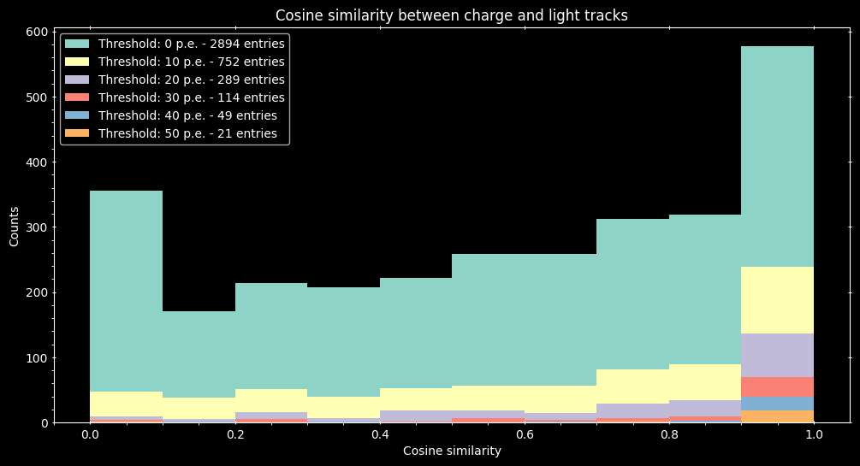
Light track versus Charge track

Slide 11
Analysis code overview
Output file structure
Event #
Track #
Track labels mask
Fit line
(point & vector)
Fit length
Fit p-value
SiPM #
dQ list
dx
Etc…
Total charge
Total light
Angle
Distance
Light
SiPM data
SiPM #
Light fit line
Fit threshold
Average z
Charge
Light
Etc...
Run time
Load charge file
Filter events
$\sim 30$seconds
~ 30 seconds
Load light file
Filter SiPMs
$\sim 7$ Minutes
~ 7 Minutes
Match events
$\sim 30$ Seconds
~ 30 Seconds
Fit tracks
$\sim 4$ Minutes
~ 4 Minutes
Light and Charge data frames are saved to bz2 files (compressed CSV)
Dictionary of light to charge matches is saved to JSON file
Analysis output file is saved to pickle file to preserve non-JSON-serializable objects
Saved data can be loaded instead of reloading root files to speed up processing

Slide 12
Summary
Reconstructing events required refined methods due to the large areas without charge pixel coverage
Track reconstruction is performing remarkably well by combining DBSCAN with RANSAC algorithms
Most charge events find a matching light counterparts
There is a visible correlation between track position and the light detected, but still not fully understood
Light “tracks” are in reasonable agreement with their respective charge counterparts
The analysis is being coded with scalability and ease of usage in mind

Slide 13
Thank you!

Slide 14
Backup slides

Slide 15
Dead area map

Slide 16
FAQ
DBSCAN parameters:
  xy_epsilon = 8 mm (2 pixels)
  Z_epsilon = 8 mm
RANSAC parameters:
  Residual_threshold = 6
  Max_trials = 1000
RANSAC has random component and may not always return the same fit
Cylinder parameters are determined dynamically but bound by DBSCAN parameters

Slide 17








Cylinder parameters - $dh$ estimation
$$\hat{z}$$
z_epsilon
$$\hat{v}$$
$$\hat{u}$$
$$dl \hat{u}=\text{[ }\text{xy}\text{_}\text{epsilon} \left(\hat{x}+\hat{y}\right)+\text{z}\text{_}\text{epsilon} \hat{z} ]$$
$$dh =dl (\hat{u} ∙ \hat{v})$$
$$dh$$
$$dl$$
xy_epsilon
$\hat{x} (\hat{y})$

Slide 18





Cylinder parameters - $dr$ estimation
$$\hat{z}$$
z_epsilon
$$p_{i}$$
$$dr=\sqrt{\frac{1}{N−1} \sum_{i=1}^{N}{{{(x}_{i}−p_{i})}^{2}}}$$
$$x_{i}$$
Minimum $dr$ is bound to $\frac{dl}{4}$
xy_epsilon
$\hat{x} (\hat{y})$

