Slide 1
Solar neutrinos and SoLAr V2
A compilation of methods and results

Slide 2
Solar neutrinos efficiency and purity
Efficiency: ratio of signal events selected to total number of signal events
Purity: ratio of signal events selected to total number of events selected
Clustering time window is 3us
Rates in events per second per kiloton
Background | Rate
Po210 | 4.93e-02
Co60 | 4.09e-01
Ar42 | 6.44e-01
K42 | 6.44e-01
K40 | 1.26e+02
Bi214 | 7.00e+01
Pb214 | 7.00e+01
Rn222 | 2.80e+02
Kr85 | 8.04e+02
Ar39 | 7.07e+03
Rates | ⁸B | hep
CC | 2.71e-04 | 1.04e-06
ES | 5.96e-01 | 1.05e-03

Slide 3
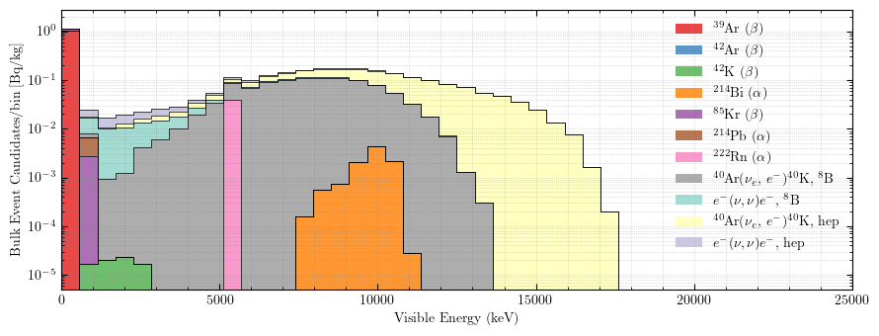

Efficiency & Purity
Energy variable is deposited energy
CC and ES treated equally
Hep has higher efficiency because it has higher energy
⁸B has higher purity with less resets because its rate is ${10}^{3}$ larger than hep and deposited energy is lower
Between 6 and 12 MeV, purity dips due to the presence of ²¹⁴Bi

Slide 4
To do
Make Efficiency vs. Purity plot
Improve background model (Decay0?)
Start writing the paper

Slide 5
FAQ

Slide 6

SoLAr V2 analysis
Apply DBSCAN clustering
  in two stages ($x$ and $y$ then $z$)
Fit line to clusters with RANSAC regression
  Use hit charge as weight for fit

Slide 7
Without fake data

Slide 8

SoLAr V2 analysis - Dealing with dead areas
Apply DBSCAN clustering
  Cluster hits in $x$ and $y$ coordinates
  Determine the intervals in the $z$ coordinate between clusters
  Generate fake data filling dead areas withing the $z$ intervals
  Cluster hits + fake data in two stages ($x$ and $y$ then $z$)
  Remove fake data
Fit line to clusters with RANSAC regression
  Use hit charge as weight for fit
  Optionally re-cluster and fit outliers to find secondary tracks

Slide 9
With fake data

Slide 10

SoLAr V2 analysis - Dealing with dead areas
Apply DBSCAN clustering
  Cluster hits in $x$ and $y$ coordinates
  Determine the intervals in the $z$ coordinate between clusters
  Generate fake data filling dead areas withing the $z$ intervals
  Cluster hits + fake data in two stages ($x$ and $y$ then $z$)
  Remove fake data
Fit line to clusters with RANSAC regression
  Use hit charge as weight for fit
  Optionally re-cluster and fit outliers to find secondary tracks
Define same sized stacked cylinders centered around fitted line
  Two parameters are needed: the radius and height of the cylinders
  Apply buffer regions at the end of the tracks
  Discard points already accounted for in previous cylinders when iterating over all cylinders

Slide 11
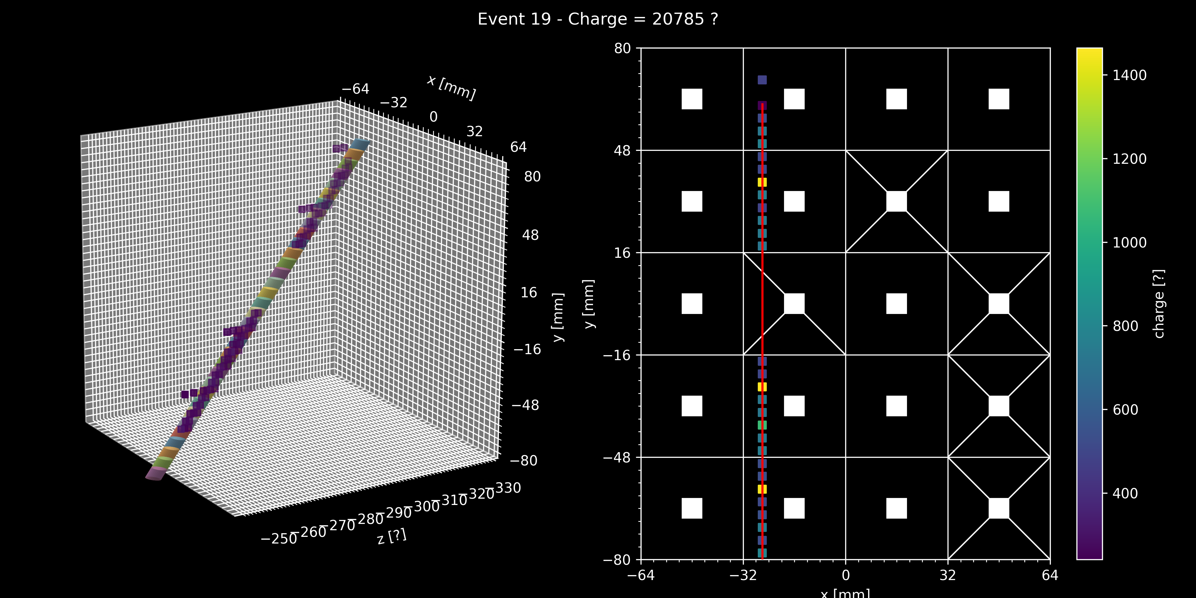
Stacked Cylinders

Slide 12

SoLAr V2 analysis - Dealing with dead areas
Apply DBSCAN clustering
  Cluster hits in $x$ and $y$ coordinates
  Determine the intervals in the $z$ coordinate between clusters
  Generate fake data filling dead areas withing the $z$ intervals
  Cluster hits + fake data in two stages ($x$ and $y$ then $z$)
  Remove fake data
Fit line to clusters with RANSAC regression
  Use hit charge as weight for fit
  Optionally re-cluster and fit outliers to find secondary tracks
Define same sized stacked cylinders centered around the line
  Two parameters are needed: the radius $dr$ and height $dh$ of the cylinders
  Apply buffer regions at the end of the tracks
  Discard points already accounted for in previous cylinders when iterating over all cylinders
Sum charge within each cylinder to determine $dQ/dx$

Slide 13

$dQ$ per cylinder translates into $dQ/dx$!

Slide 14
Complex events

Slide 15

$dQ/dx$ works well on complex events!
Consistent with benchmark track!

Slide 16
FAQ
DBSCAN parameters:
  xy_epsilon = 8 mm (2 pixels)
  Z_epsilon = 8 mm
RANSAC parameters:
  Residual_threshold = 6
  Max_trials = 1000
RANSAC has random component and may not always return the same fit
Cylinder parameters are determined dynamically but bound by DBSCAN parameters

Slide 17
SoLAr V1 COMSOL simulation
SiPM bias: -46V
Cathode bias: -2500V
E_{field}: 500V/cm
Ceramic electric permittivity: 25

Slide 18
SoLAr V2 COMSOL simulation
SiPM bias: -46V
Cathode bias: -2500V
E_{field}: 500V/cm

Slide 19
Thank you

Slide 20
FAQ

Slide 21
Backup slides

Slide 22








Cylinder parameters - $dh$ estimation
$$\hat{z}$$
z_epsilon
$$\hat{v}$$
$$\hat{u}$$
$$dl \hat{u}=\text{[ }\text{xy}\text{_}\text{epsilon} \left(\hat{x}+\hat{y}\right)+\text{z}\text{_}\text{epsilon} \hat{z} ]$$
$$dh =dl (\hat{u} ∙ \hat{v})$$
$$dh$$
$$dl$$
xy_epsilon
$\hat{x} (\hat{y})$

Slide 23





Cylinder parameters - $dr$ estimation
$$\hat{z}$$
z_epsilon
$$p_{i}$$
$$dr=\sqrt{\frac{1}{N−1} \sum_{i=1}^{N}{{{(x}_{i}−p_{i})}^{2}}}$$
$$x_{i}$$
Minimum $dr$ is bound to $\frac{dl}{4}$
xy_epsilon
$\hat{x} (\hat{y})$

