Slide 1

Pointing with preSupernova neutrinos
Cecilia Lunardini
Arizona State University
M. Mukhopadhyay, C. Lunardini, F. X. Timmes and K. Zuber, arXiv:2004.02045, accepted in ApJ.
Notes:
Talk is total of 20 minutes, so plan 15+5 or so.

Slide 2
Introduction
See Chinami Kato’s talk at Neutrino2020

Slide 3
Presupernova → collapse → explosion
Neutrinos from advanced stages of nuclear burning
  Thermal (pair production)
  Beta processes (capture, decay)
0.1-5 MeV energy
  Need low threshold detector
Detectable hours (days?) before collapse neutrinos
  For near-earth stars (D<1 kpc)
Patton, Lunardini, Farmer & Timmes, 2017, ApJ, 851, 6

Slide 4
Why localization?
Rough pointing + list of nearby stars = potential for progenitor identification
Motivation 1: early alert of collapse
  observe a star before and during collapse to test stellar evolution
  Prepare GW detectors
  Prepare to observe exotic physics during collapse (e.g., point axion detectors)
Li, Li, Wen, & Zhou, 2020, arXiv:2003.03982

Slide 5
Motivation 2: very early alert of supernova explosion (or black hole formation)
  precedes the neutrino burst by hours: useful for decision-making (esp. when human intervention is needed)
  Can be the only useful alert for fast-exploding stars (less than 1 hour from collapse to explosion)

Slide 6
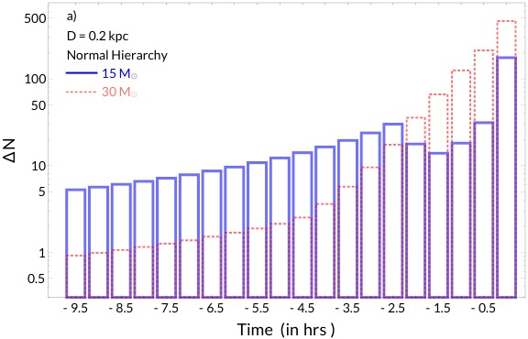
Signal at liquid scintillator detector
Silicon-burning bump
Patton, Lunardini, Farmer & Timmes, 2017, ApJ, 851, 6
JUNO-like detector (17 kt), inverse beta decay (IBD):
  E > 1.8 MeV threshold
  Background: 2.6 events/hour in reactor-on phase
An, An, An, et al. 2016, Journal of Physics G Nuclear Physics, 43, 030401

Slide 7
Nearby stars
31 supernova-ready stars at D<1 kpc
  Known distance, mass and type

Slide 8
The method

Slide 9
Directionality of IBD
X^{(i)}_{pn} : vector from e⁺ annihilation point to n capture point

Slide 10
Experimental sensitivity
ideal
actual
LS : Linear AlkylBenzene (SNO+, JUNO)
  Directionality limited by neutron thermalizing before capture
  Resolution of e⁺ annihilation also important
LS-Li : LS with Lithium salts for faster n capture:
  Enhanced directionality by shortening neutron capture range
Tanaka & Watanabe, 2014, Scientific Reports, 4, 4708
Notes:
Complete…..

Slide 11
Key quantities
N_{S} : IBD signal events from point source
N_{Bkg} : background events ; assumed isotropic
Signal-to-background ratio:
Forward (θ < π/2)-Backward (θ > π/2 ) asymmetry:
Directional IBD signal
Isotropic background

Slide 12
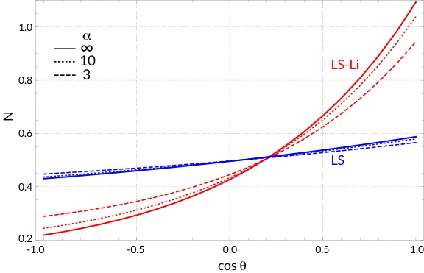
Directionality: low-to-moderate
Forward-Backward
asymmetry
LS-Li
Tanaka & Watanabe, 2014, Scientific Reports, 4, 4708
For geoneutrinos (similar spectrum as pre-SN)

Slide 13
Localization - estimating signal direction
Apollonio, Baldini, Bemporad, et al. 2000, PhRvD, 61, 012001
Best estimate of arrival direction: average of unit vectors
Set direction of p-vector as new z-axis:
y
Detector
star
z
x

Slide 14
Localization – find uncertainty angle β
Use linearized distribution for cos θ:
Study statistical behavior of p-vector:
  Mean:
  Standard deviation: take distribution of X_{pn} and apply Central Limit theorem to the components of p-vector
(Note: minor dependence of 𝜎_{z} on a is neglected here )

Slide 15
  Take 3D Gaussian distribution and find cone that contains a given probability:
( I = 0.68, 0.90,0.99, … )
Solve for β, cone half-width

Slide 16
Results – localization prospects

Slide 17
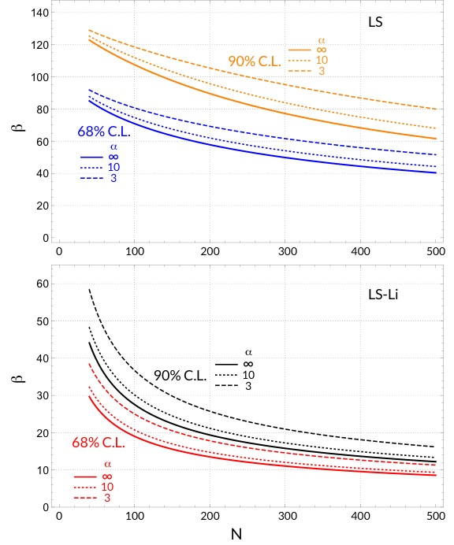
Results: localization angle vs statistics
For Betelgeuse-like star (N ~ 200), 68% C.L. :
  LS : β ~ 60 degrees
  LS-Li : β ~ 15 degrees

Slide 18
Progenitor identification?
Goal: reduce the list of candidates for astronomy follow-ups
  A 4-5 candidates shortlist would be extremely useful to allocate telescope resources
Idea: combine localization information with:
  Distance cut (from number of events, model-dependent)
  signals from multiple detectors (improve distance cut and/or triangulation)
  Clues of stellar type from neutrino time profile (Silicon burning “bump”)
  Possible unusual stellar activity in days/months prior (dimming, etc.)

Slide 19
Examples: Betelgeuse, Sigma Canis Majoris
Betelgeuse, D=0.222 kpc, M=15 M_{sun}
Sigma Canis Majoris, D=0.513 kpc, M=15 M_{sun}

Slide 20
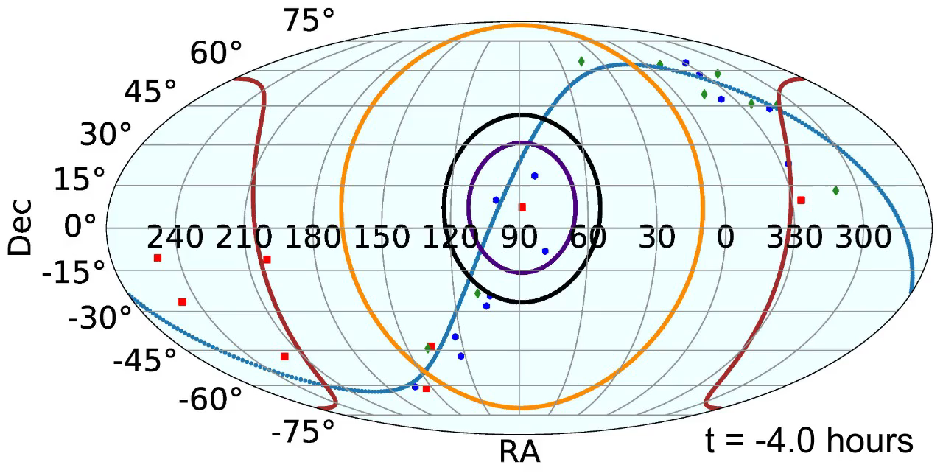
Betelgeuse
Inner contours: LS-Li, 68%,90% CL
Outer contours : LS, 68%,90% CL
D=0.222 kpc, M=15 M_{sun}

Slide 21
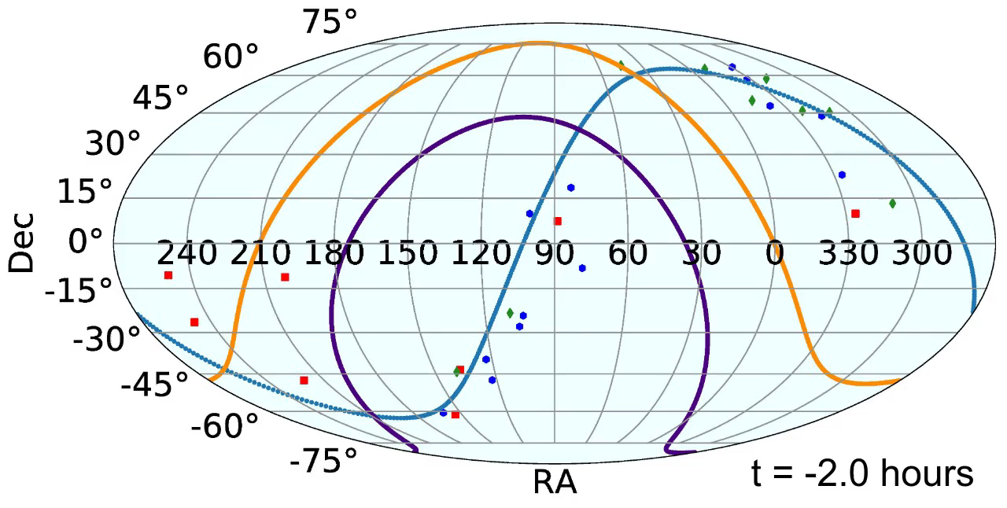
Sigma Canis Majoris
Inner contour: LS-Li, 68% CL
Outer contour : LS, 68% CL
D=0.513 kpc, M=15 M_{sun}

Slide 22
Discussion

Slide 23
Pointing at 10-kt scale LS detectors
Sensitivity up to 1 kpc; angular error ~70°
  Can provide shortlist of 4-10 candidates, about 1 hour prior to collapse
Possible long term improvements:
  ~30° with THEIA (100 kt)
  ~10° with LS-Li

Slide 24
Questions
When to issue localization information?
  Publish as soon as possible and keep updating…
  Best compromise between accumulating statistics and have enough time before collapse? Roughly, when you reach 100 events.
Protocol to identify a slow-rising (hours/days) signal?
  Use directionality for early identification?
Extremely high potential for public engagement
  Impact on the general public? How to handle?

Slide 25
Thank you!

Slide 26
Backup

Slide 27
New compilation of candidates
Includes red and blue supergiants;
updated distance/mass info

Slide 28
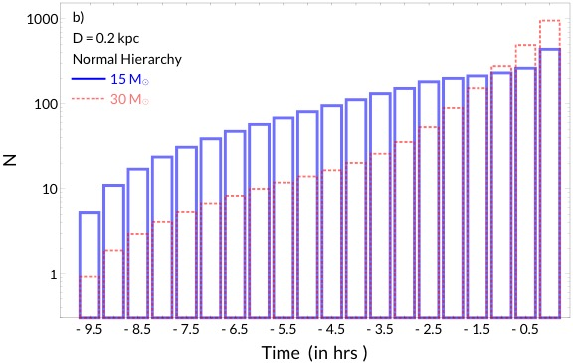

Slide 29
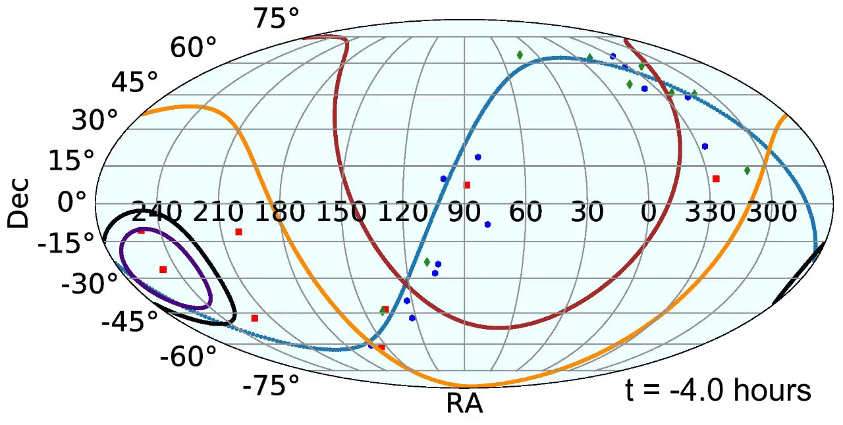
Antares
Inner contours: LS-Li, 68%,90% CL
Outer contours : LS, 68%,90% CL
D=0.169 kpc, M=15 M_{sun}

Slide 30
References
Pre-SN numerical model: Patton, Lunardini, Farmer & Timmes, 2017, ApJ, 851, 6
Zenodo, doi 10.5281/zenodo.2626645 (tables)
Exploratory study of pointing: Li, Li, Wen, & Zhou, 2020, arXiv:2003.03982
Enhancing pointing with LS + Lithium: Tanaka & Watanabe, 2014, Scientific Reports, 4, 4708
Pointing method: Apollonio, Baldini, Bemporad, et al. 2000, PhRvD, 61, 012001
JUNO-specific information: An, An, An, et al. 2016, Journal of Physics G Nuclear Physics, 43, 030401

Slide 31
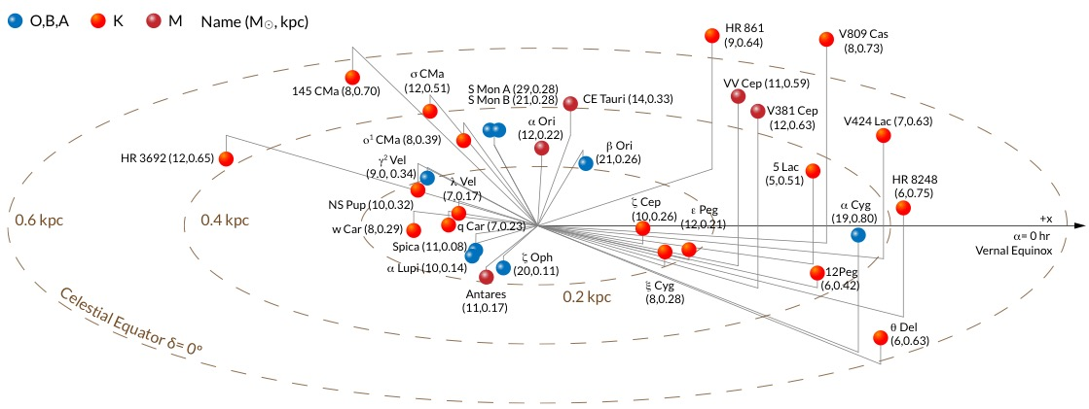

Slide 33
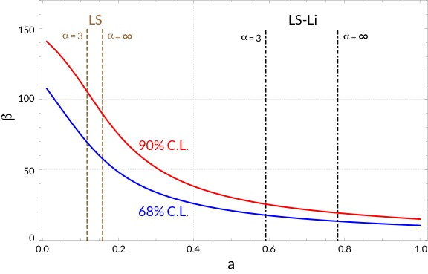

Slide 35
Antares, D=0.169 kpc, M=15 M_{sun}

Slide 36
Sigma Canis Majoris, D=0.513 kpc, M=15 M_{sun}

