Slide 1
Triangulation performance estimation
V. Kulikovskiy on behalf of
Marta Colomer, Damien Dornic, Alexis Coleiro, Massimiliano Lincetto
KM3NeT SN team

Slide 2
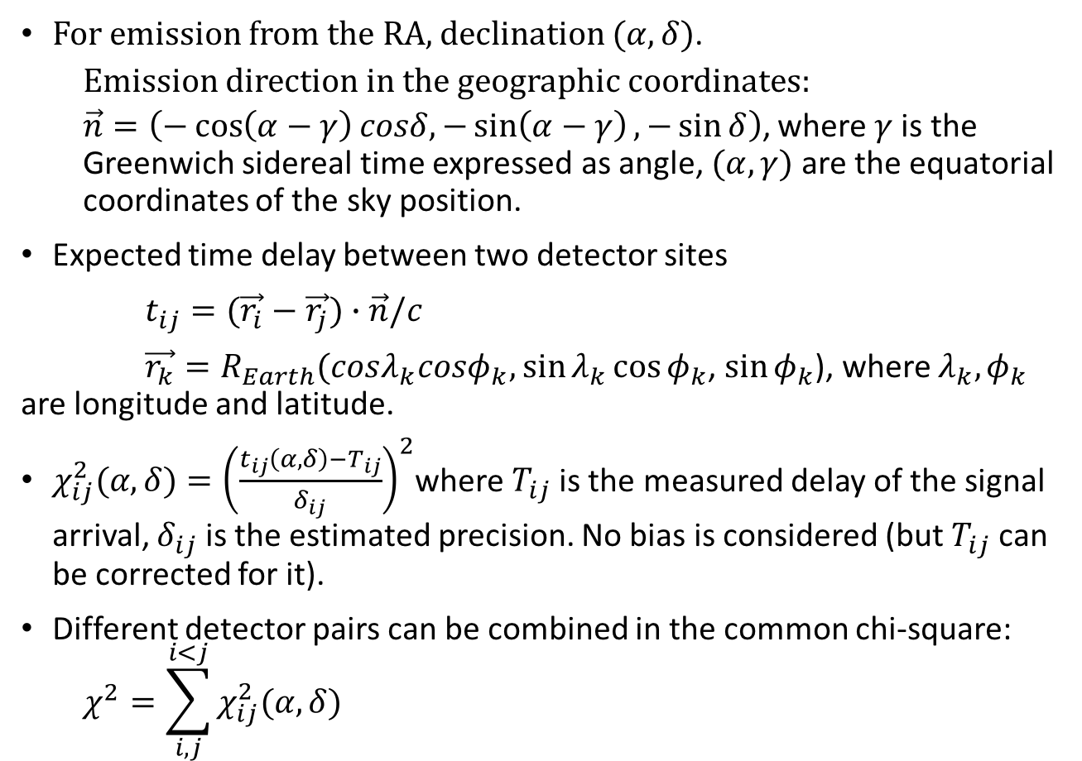
Triangulation method
For emission from the RA, declination $(α,δ)$.
  Emission direction in the geographic coordinates:
  $\vec{n}=\left(−\cos\left(α−γ\right)cosδ,−\sin\left(α−γ\right),−\sin{δ}\right)$, where $γ$ is the Greenwich sidereal time expressed as angle, $(α,γ)$ are the equatorial coordinates of the sky position.
Expected time delay between two detector sites
$t_{ij}=(\vec{r_{i}}−\vec{r_{j}})∙\vec{n}/c$
$\vec{r_{k}}=R_{Earth}(cosλ_{k}cosφ_{k},$ $\sin{λ_{k}}\cos{φ_{k}}$, $\sin{φ_{k}}$), where $λ_{k},φ_{k}$ are longitude and latitude.
$χ_{ij}^{2}(α,δ)={\left(\frac{t_{ij}\left(α,δ\right)−T_{ij}}{δ_{ij}}\right)}^{2}$where $T_{ij}$ is the measured delay of the signal arrival, $δ_{ij}$ is the estimated precision. No bias is considered (but $T_{ij}$ can be corrected for it).
Different detector pairs can be combined in the common chi-square:
  $$χ^{2}=\sum_{i,j}^{i<j}{χ_{ij}^{2}(α,δ)}$$
1
V. Brdar et al. https://arxiv.org/abs/1802.02577

Slide 3
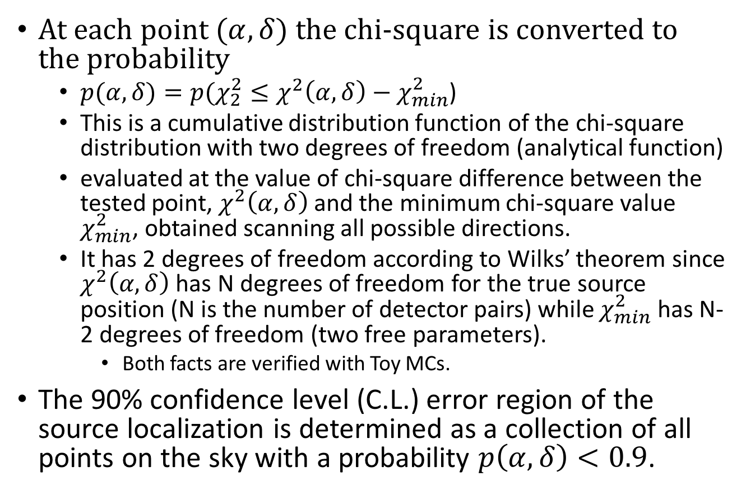
From chi-square to the confidence area
At each point $(α,δ$) the chi-square is converted to the probability
  $p(α,δ)=p(χ_{2}^{2}≤χ^{2}\left(α,δ\right)−χ_{min}^{2}$)
  This is a cumulative distribution function of the chi-square distribution with two degrees of freedom (analytical function)
  evaluated at the value of chi-square difference between the tested point, $χ^{2}\left(α,δ\right)$and the minimum chi-square value $χ_{min}^{2}$, obtained scanning all possible directions.
  It has 2 degrees of freedom according to Wilks’ theorem since $χ^{2}\left(α,δ\right)$ has N degrees of freedom for the true source position (N is the number of detector pairs) while $χ_{min}^{2}$ has N-2 degrees of freedom (two free parameters).
    Both facts are verified with Toy MCs.
The 90% confidence level (C.L.) error region of the source localization is determined as a collection of all points on the sky with a probability $p\left(α,δ\right)<0.9$.
Y. Avni, Astrophys. J 210 , 642-646 (1976)
2

Slide 4
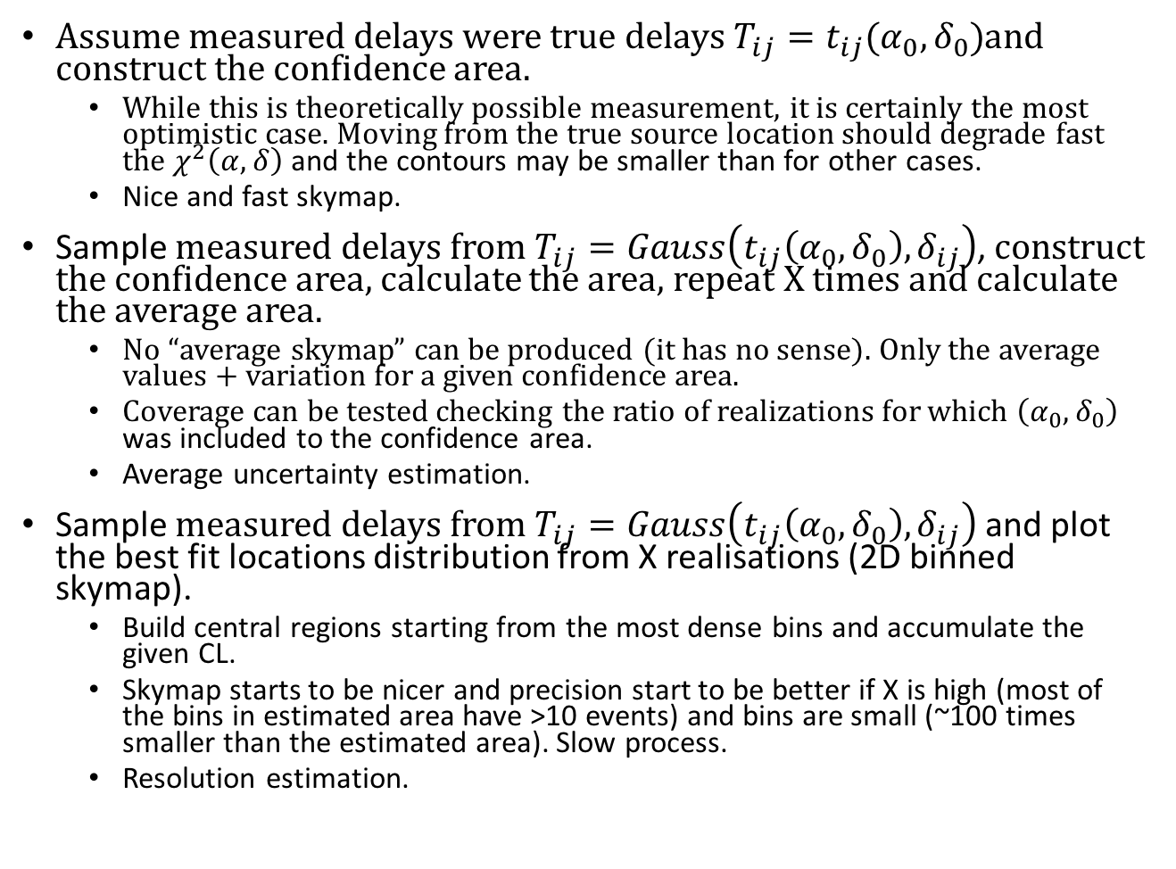
Performance testing
Assume measured delays were true delays $T_{ij}=t_{ij}(α_{0}, δ_{0})$and construct the confidence area.
  While this is theoretically possible measurement, it is certainly the most optimistic case. Moving from the true source location should degrade fast the $χ^{2}\left(α,δ\right)$ and the contours may be smaller than for other cases.
  Nice and fast skymap.
Sample measured delays from $T_{ij}=Gauss\left(t_{ij}\left(α_{0}, δ_{0}\right), δ_{ij}\right)$, construct the confidence area, calculate the area, repeat X times and calculate the average area.
  No “average skymap” can be produced (it has no sense). Only the average values + variation for a given confidence area.
  Coverage can be tested checking the ratio of realizations for which $\left(α_{0}, δ_{0}\right)$ was included to the confidence area.
  Average uncertainty estimation.
Sample measured delays from $T_{ij}=Gauss\left(t_{ij}\left(α_{0}, δ_{0}\right), δ_{ij}\right)$ and plot the best fit locations distribution from X realisations (2D binned skymap).
  Build central regions starting from the most dense bins and accumulate the given CL.
  Skymap starts to be nicer and precision start to be better if X is high (most of the bins in estimated area have >10 events) and bins are small (~100 times smaller than the estimated area). Slow process.
  Resolution estimation.
3

Slide 5
Enough math, show me the skymaps!

Slide 6
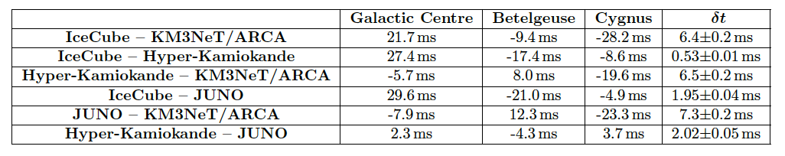
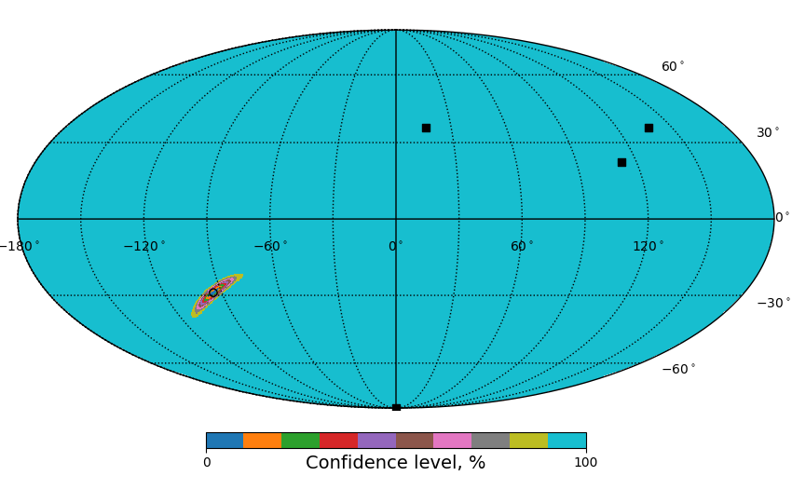
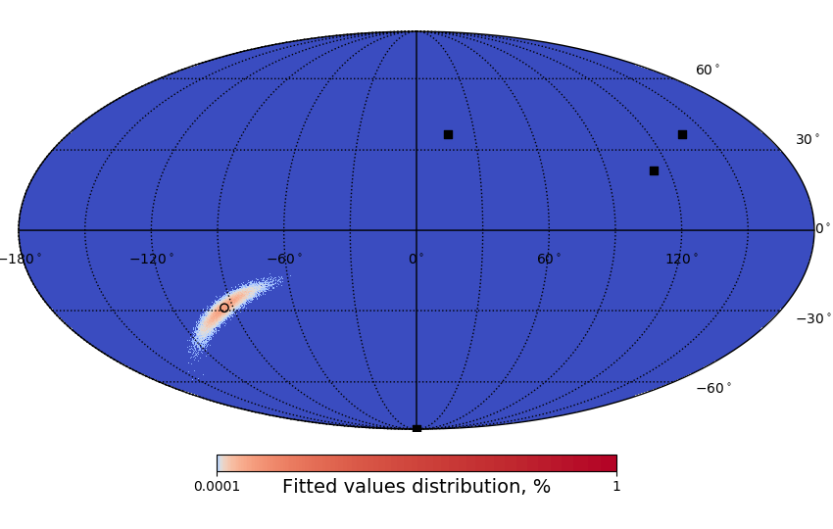
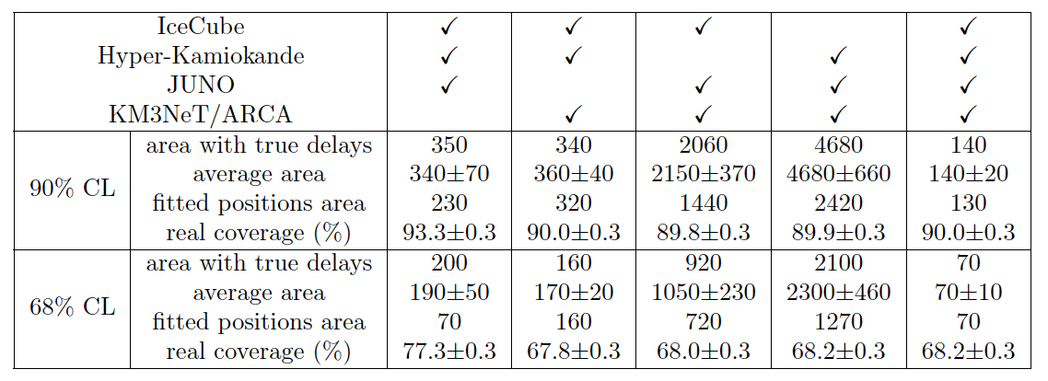
SN with 3e53 ergs @ 10 kpc
direction towards GC
simple model with steady energy.
Energy independent efficiencies.
4

Slide 7
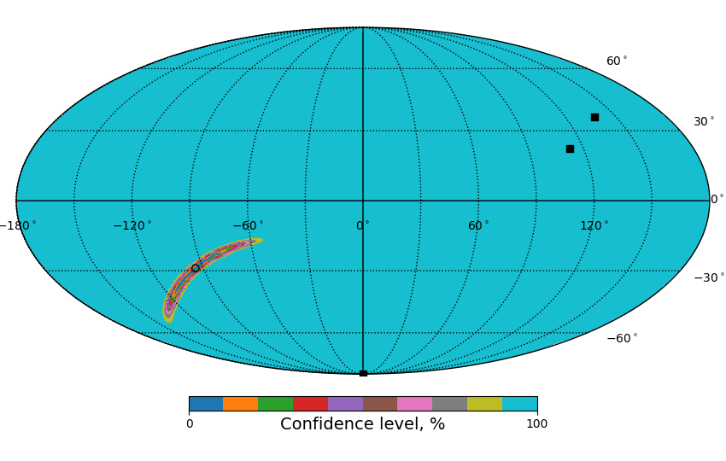
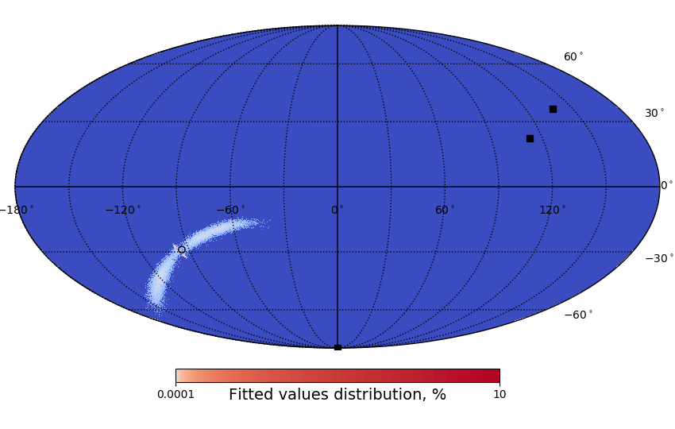
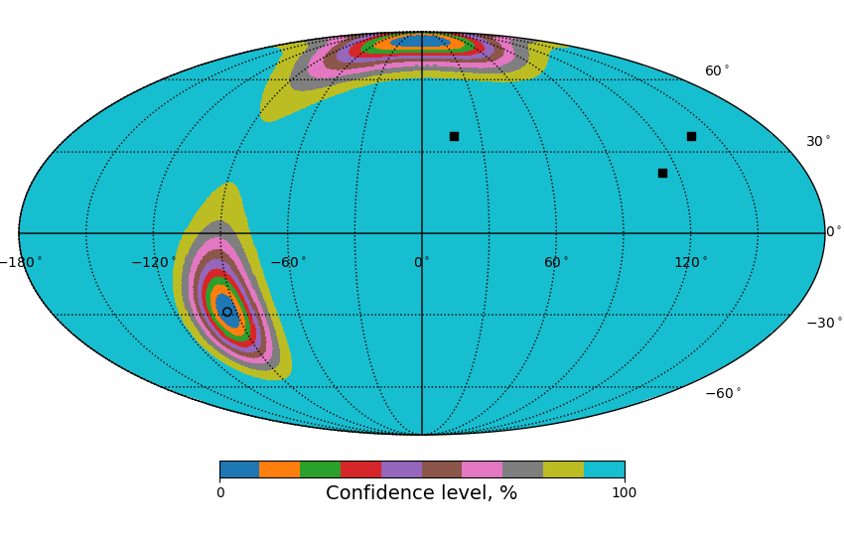
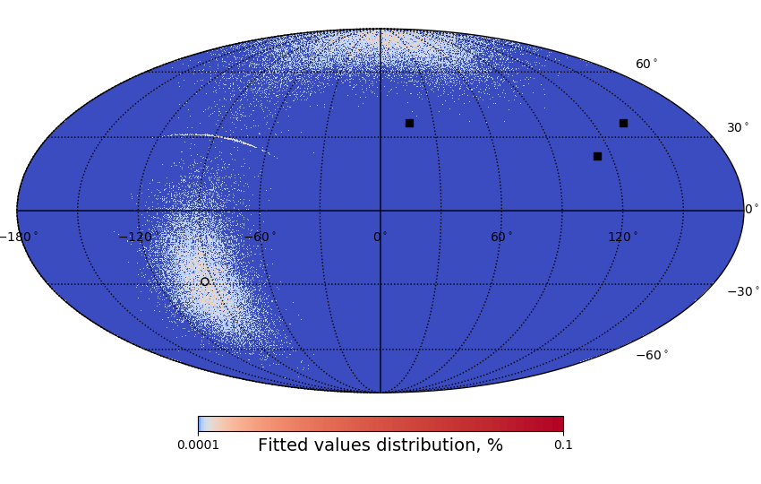
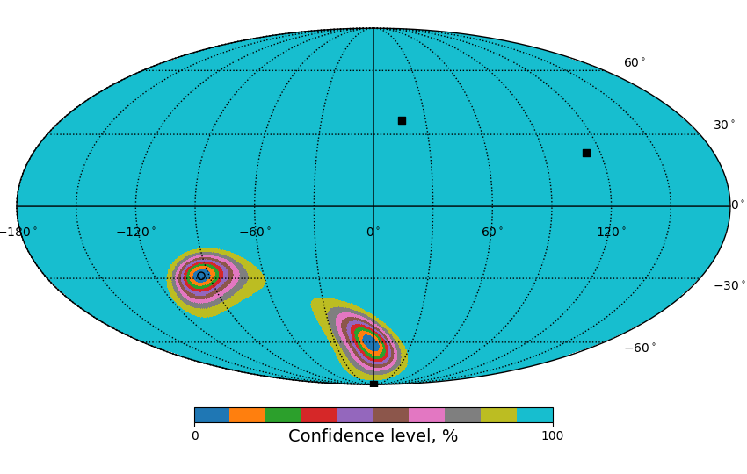
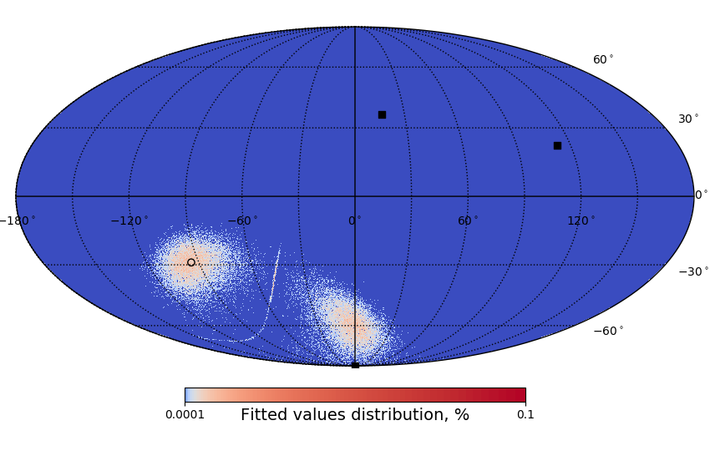
IceCube-HyperK-JUNO
Fake solution in the true values confidence area.
Best fit position often happens in this fake area
or in the middle between the areas.
HK-KM3NeT/ARCA-JUNO
5
IceCube-KM3NeT/ARCA-JUNO

Slide 8
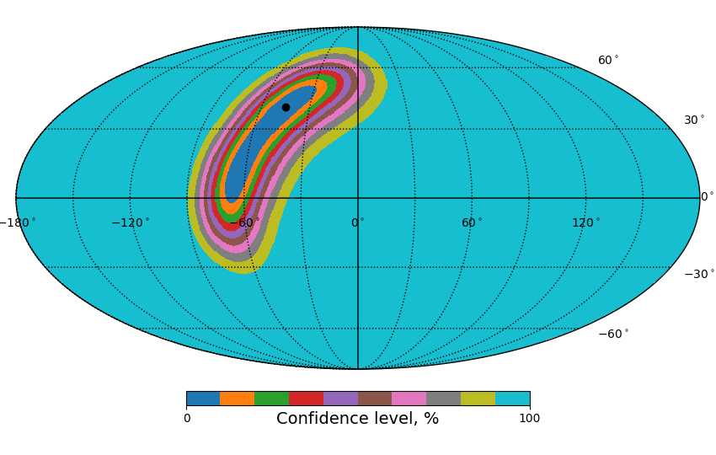
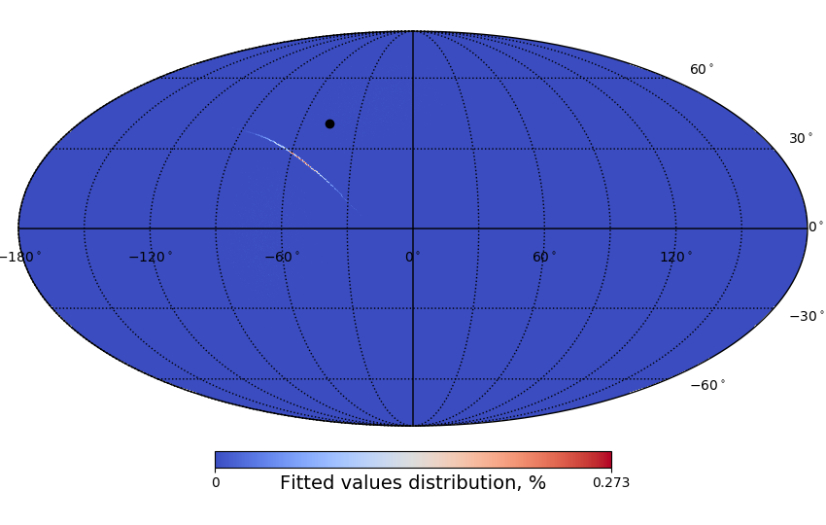
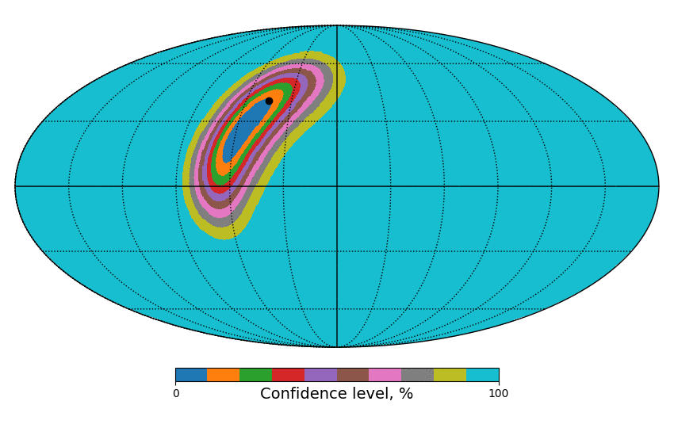
not log scale!
HK-KM3NeT/ARCA-JUNO for Cygnus
6

Slide 9
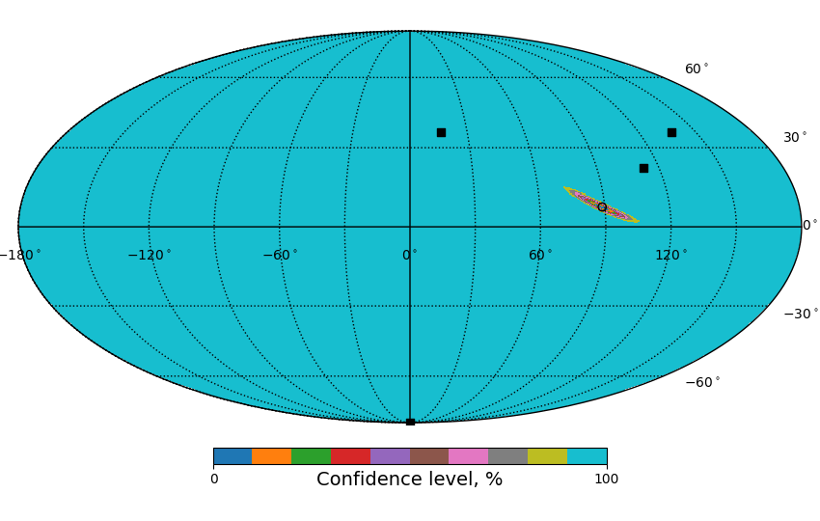
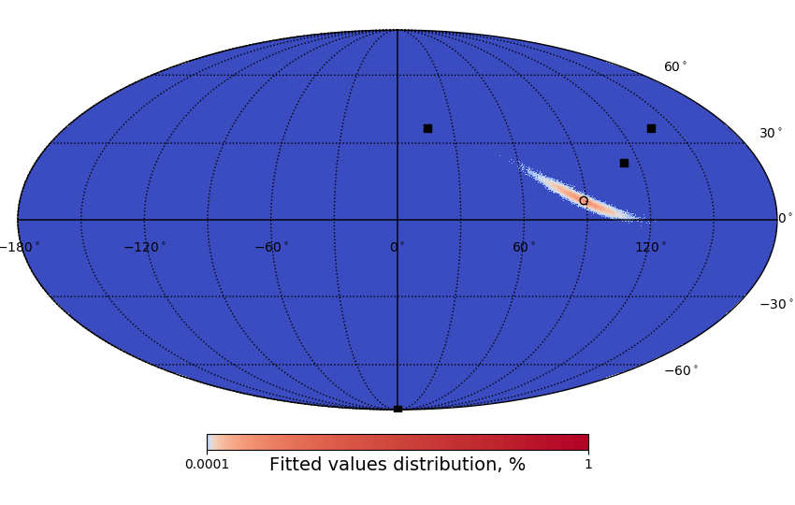
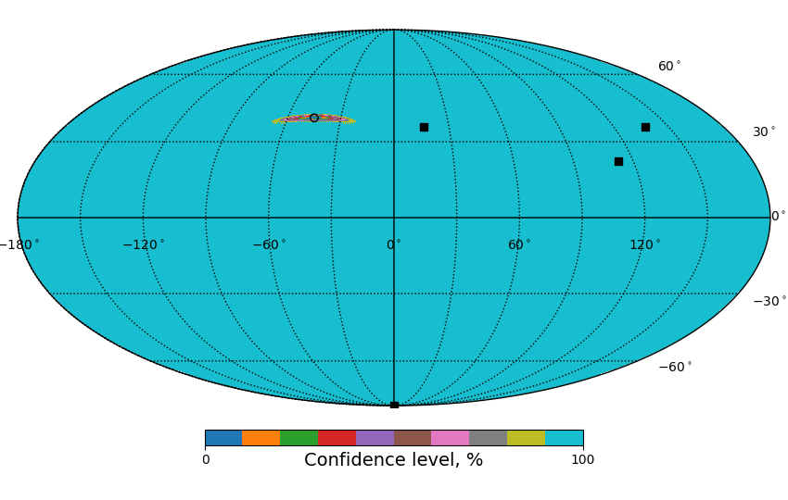
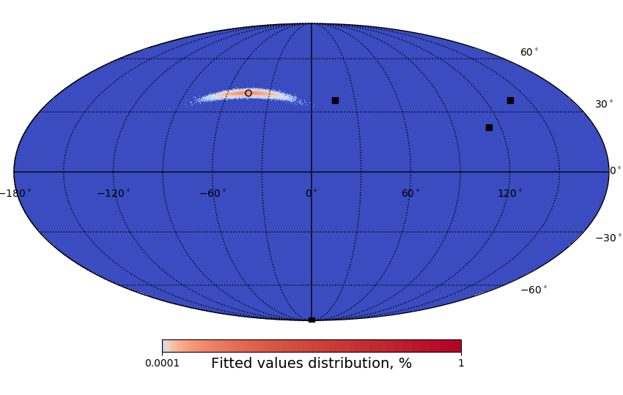
GC
Betelgeuse
4 detectors – consistent shapes for various source positions
Cygnus region
7

Slide 10

Conclusions
Three methods give compatible results for the 4 detectors and elliptic confidence areas independently on the source location (3 candidate sources tested).
  140±20 deg² area is expected from GC location for CCSN @ 10 kpc for IceCube-HyperKamiokande-KM3NeT/ARCA-JUNO.
  It can be further reduced with Galactic Plane prior and other methods combination (light curve matching/first events, SK & JUNO standalone).
The method with true delays gives slightly more optimistic areas in most cases comparing to average areas.
The method with resolution estimation is generally better than the average confidence area estimation (but the problems are really outliers that can form fake solution area and/or appear in between this area and the source).
Confidence areas for toy MC have good coverage, their average value + variation is probably a good conservative estimation of the real case error box (and to what the astronomers should be prepared to use as a search area).
  Using ndof=2 was crucial to have the right coverage.
The code can be found @github.com:SNEWS2/lightcurve_match.git -> skymap.
Updated preprint https://arxiv.org/abs/2003.04864 … resubmission to EPJ C is done.😅
8

