Slide 1

Energy reconstruction with Q-Pix readout
Guilherme Ruiz
SoLAr meeting 05/05/2023

Slide 2
Goal
Determining the energy reconstruction efficiency of the Q-Pix readout as a function of the particle’s energy
  The energy reconstruction efficiency is defined as the ratio of the reconstructed energy to the incoming energy of the simulated particle
Determine the event detection efficiency of the Q-Pix readout as a function of the number of resets (readout trigger)
  The event detection efficiency is defined as the ratio of the events detected to the true number of events
  Background (purity) not currently considered (see Shion’s presentation)

Slide 3
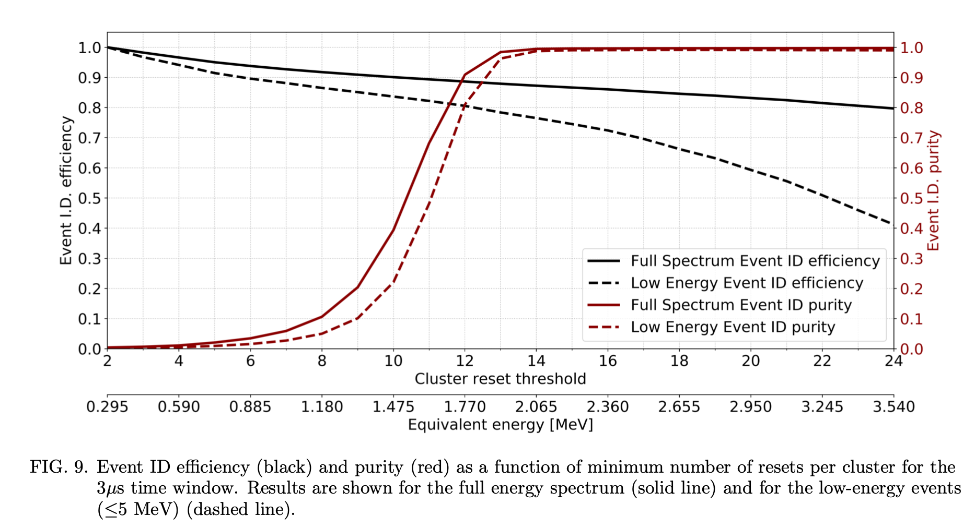
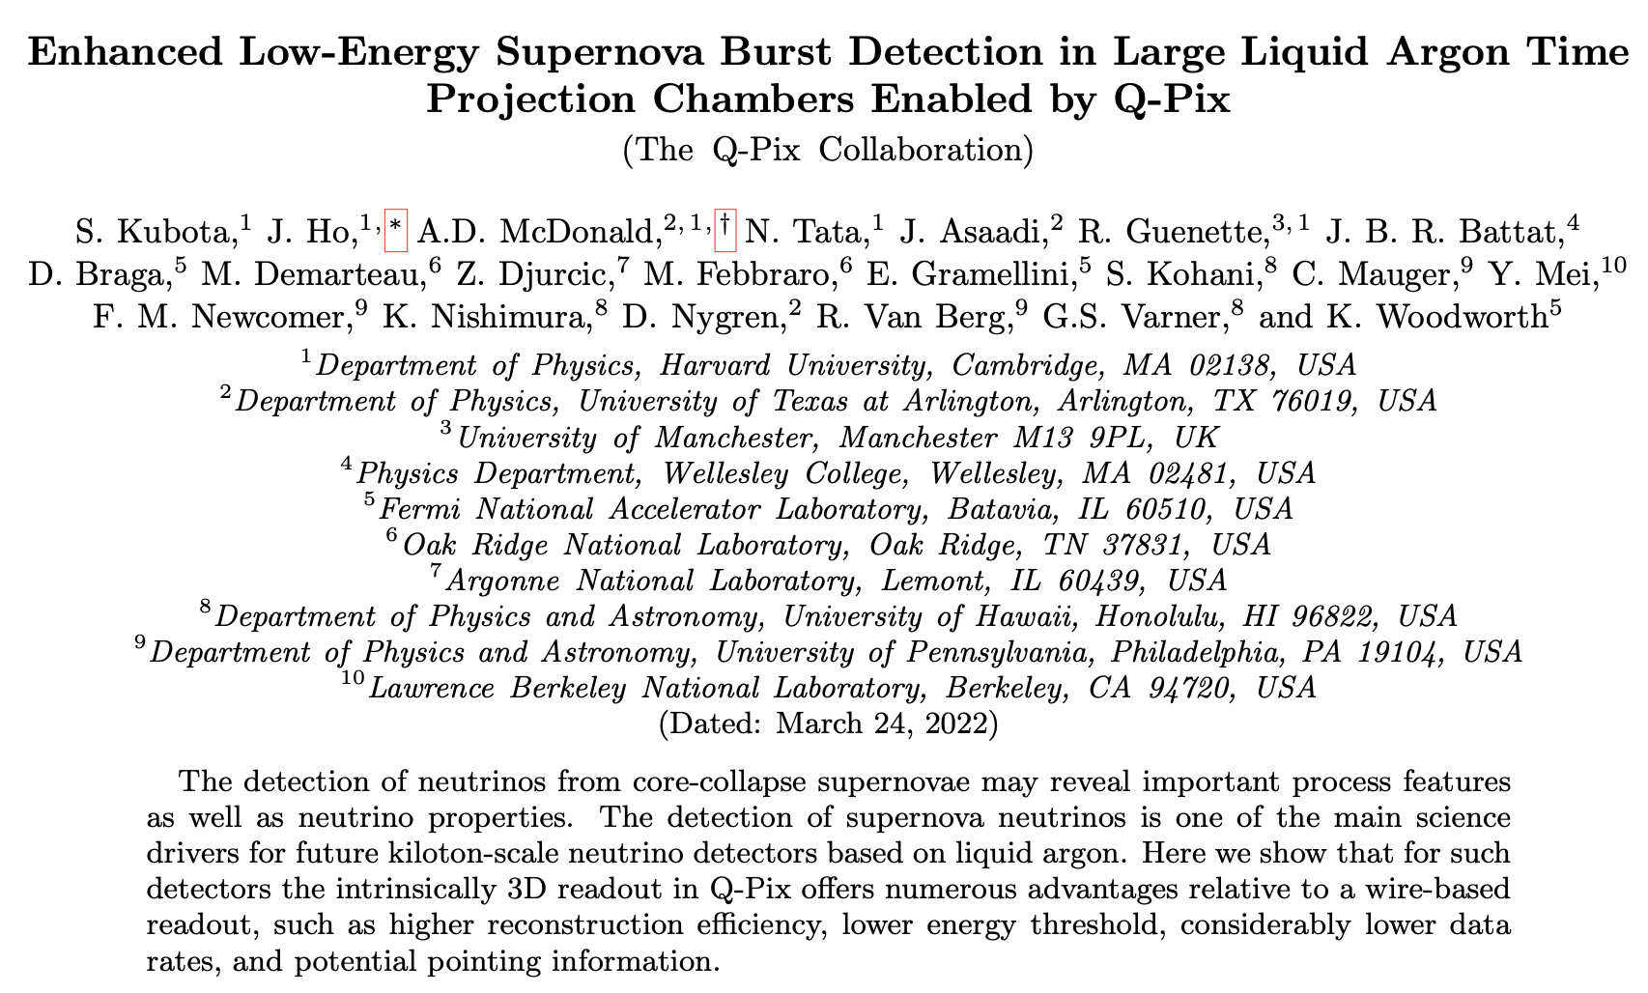
Goal
Event detection efficiency – supernova study
  Background (purity) not currently considered (see Shion’s presentation)

Slide 4
Method
Simulate single electron events from 1 to 30 MeV (neutrinos to follow)
  QPixG4 → QPixRTD
Obtain the number of Q-Pix resets per pixel per event
  QPixRTD → Python script
Reconstruct the deposited energy from resets
  Deposited energy is the total electron energy → No further steps
  For neutrinos, deposited energy ≠ neutrino energy but ∝ electron energy → 4th step needed (future work)

Slide 5
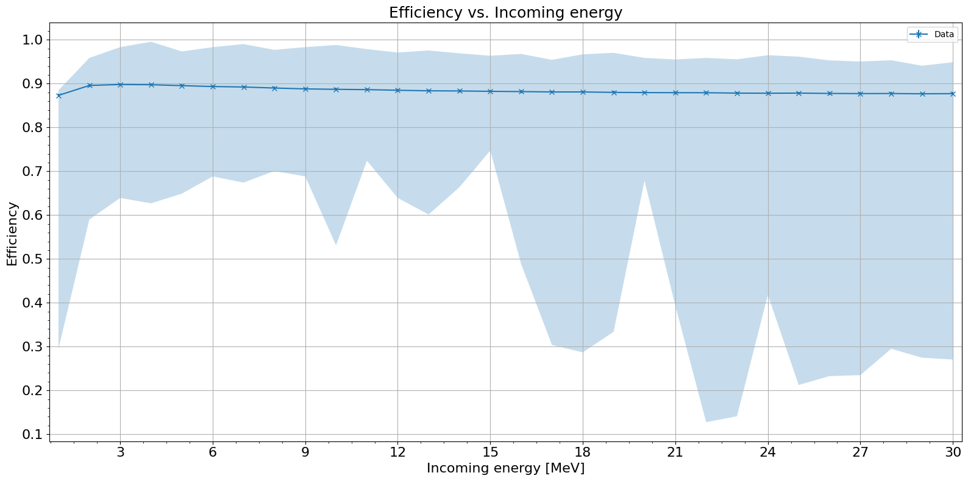
Single electrons
1 to 30 MeV – Energy reconstruction efficiency vs. Incoming energy
The reconstruction efficiency is relatively constant, but a decrease is noticeable towards higher energies as few events with low efficiency bring the average down

Slide 6
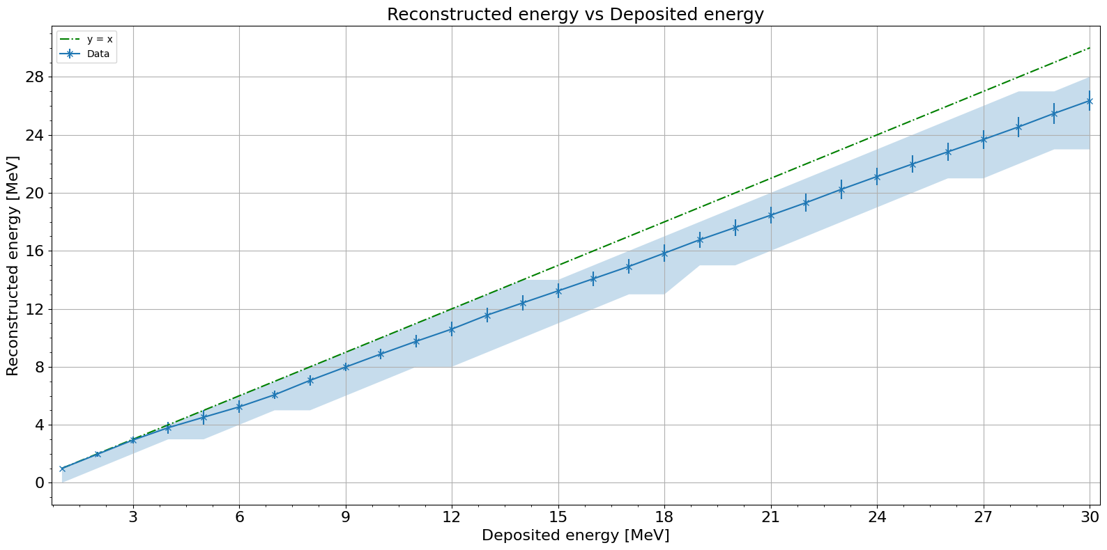
Single electrons
1 to 30 MeV – Reconstructed energy vs. Deposited energy
No Recombination
The reconstructed energy decreases as the energy increases. This is equivalent to the efficiency plot and is likely due to the hits being more scattered at higher energies.

Slide 7
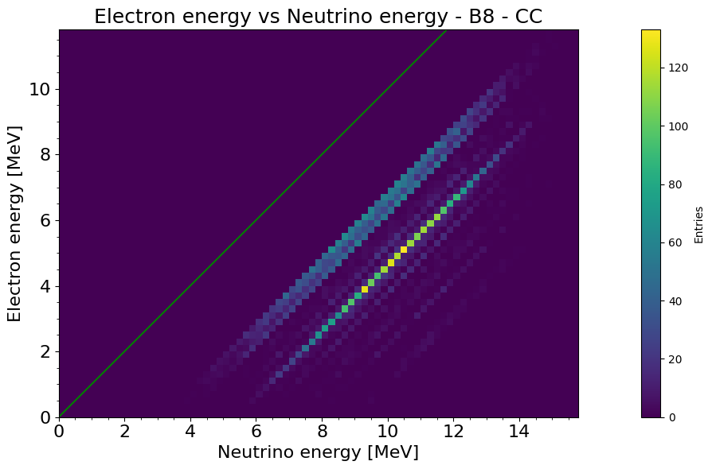
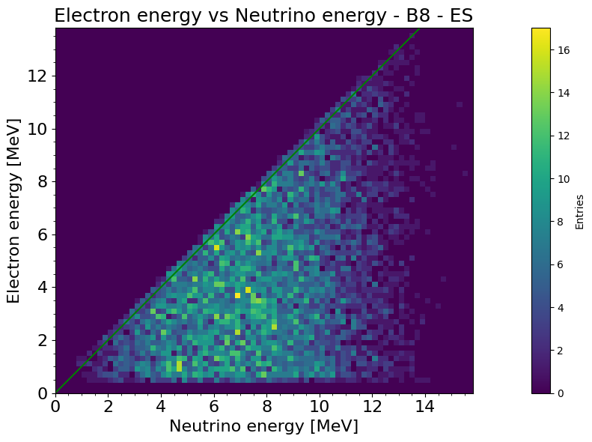



Solar neutrinos
⁸B electron vs neutrino energies
No Recombination
$$E_{e}=E_{ν}−Q −K_{recoil}$$
$$E_{e}=\frac{E_{ν}^{2}−2E_{ν}m_{e}\cos^{2}{θ}}{E_{ν}+m_{e}}$$
Negligible
Multiple energy levels observed
Continuous spectrum ≤ $E_{ν}$

Slide 8
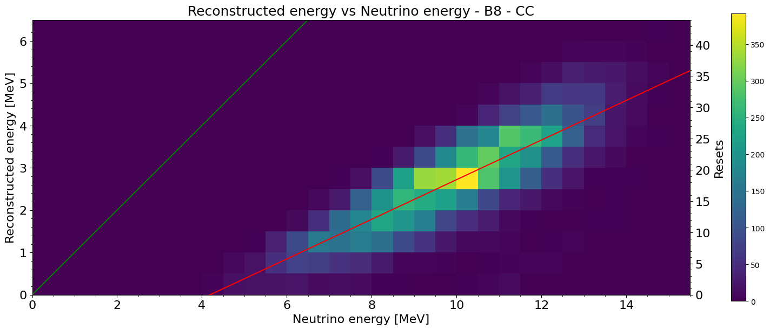
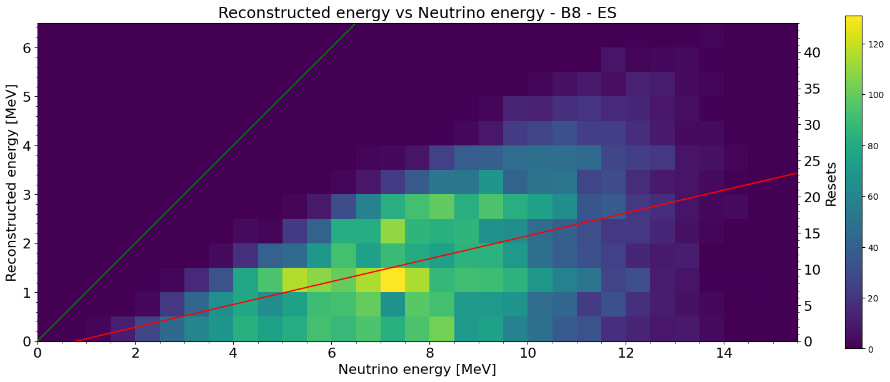
Solar neutrinos
⁸B electron vs neutrino energies
No Recombination
The spectrum of deposited electron vs neutrino energy can be observed again in the ES plot
CC has more energy deposited overall, which facilitates the reconstruction

Slide 9
Conclusions
Efficiency decreases at higher energies due to the hits being scattered across more pixels
The simulation results are consistent with the theory
  Elastic Scattering produces a spectrum of electron energies while Charged Current produces quantized energies
The deposited/reconstructed energy is linear with the electron energy
  For CC, it produces multiple populations due to the energy levels of the daughter isotopes.

Slide 10
Thank you!

Slide 11
Backup slides

Slide 12
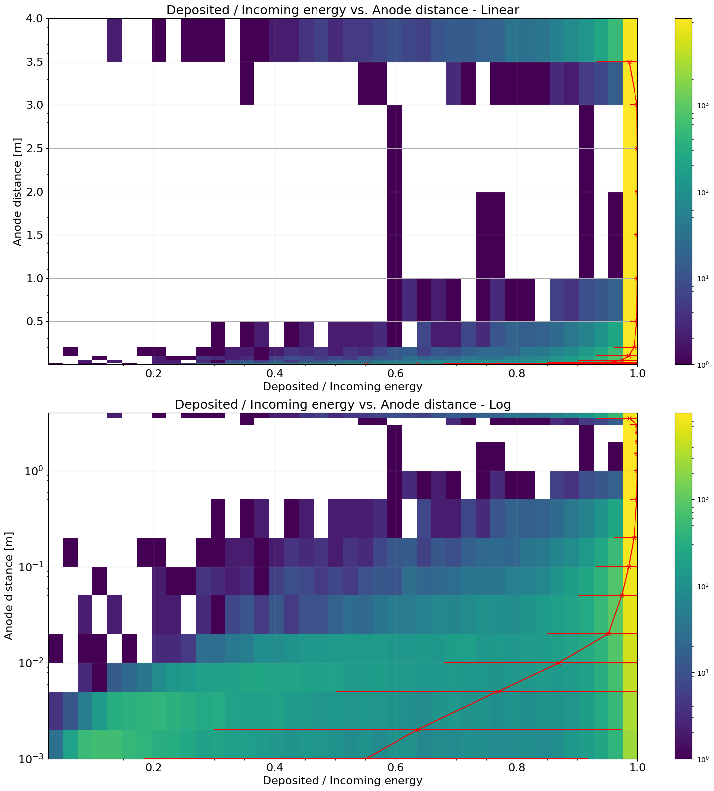
10 MeV single electrons – Track containment
No Recombination
As the event approaches the edge of the TPC, the hits escape resulting in less energy deposited for the same incoming energy

Slide 13
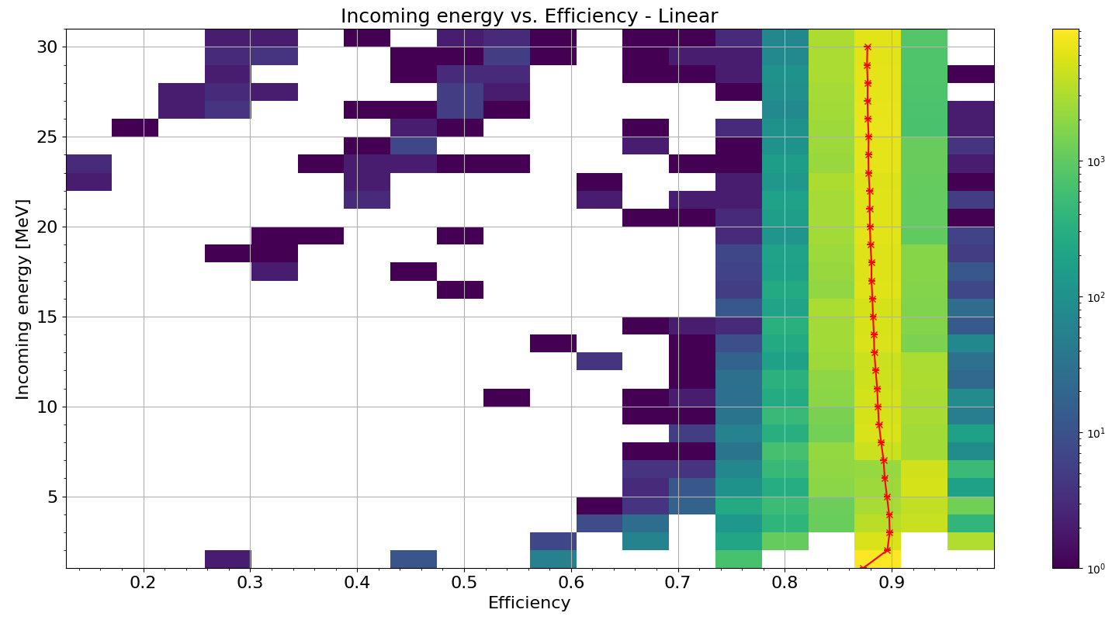
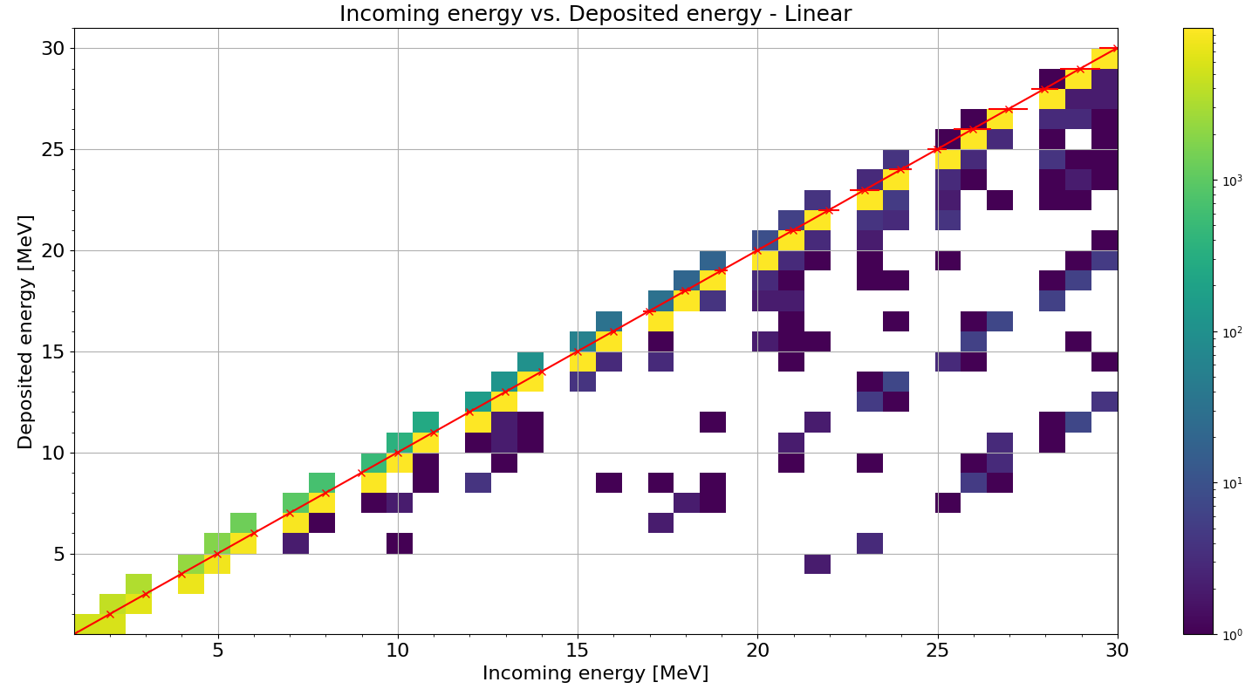
1 to 30 MeV Single electrons – Incoming energy
The ratio of energy deposited for incoming energy is relatively constant, despite some events with low deposited energy
The efficiency is relatively constant, but a decrease is noticeable towards higher energies as few events with low efficiency bring the average down

