Slide 1
The knee of the spectrum of cosmic protons and Helium nuclei below 1 PeV
Zhen Cao
for ARGO-YBJ Collaboration and
LHAASO Collaboration
Institute of High Energy Physics, Beijing, China
TAUP2017, Sudbury, Canada, 24 ~ 28 July 2017

Slide 2
Motivation
Lots of new data in direct CR measurements
  DAMPE and CALET new measurements below 30TeV
  AMS02 confirmed the energy scale and PAMELA results
  CREAM results:
energy spectrum of single element up to 100TeV
Interesting structures
  hardening around 1 TeV
  Small bump around 10TeV?
Attention to the knee

Slide 3
The knee
Many tensions: Where? What? Theories?

Slide 4
Motivated to extend to higher E
Complexes of detector arrays at high altitudes
  TIBET AS
  ARGO-YBJ
  HAWC
  LHAASO
Good opportunity
  Overlap in energy
  Capability of identifying
  prime CRs
  ARGO-YBJ（H+HE）：3TeV-300TeV;
  ARGO-YBJ + C-telescopes: 100 TeV-3 PeV
  LHAASO has much more potential

Slide 5
Outline
A multi-parameter measurement
with WFCTA and ARGO-YBJ
  The method
  The knee at 700 TeV
The prospects
  LHAASO
  Expectations in few years
    Pure composition
    Energy scale
Conclusion

Slide 6
Wide Field of View Cherenkov Telescope (WFCTA)
5m² spherical mirror；
16×16 PMT array
Pixel size 1°；
FOV: 14°× 16°;
Elevation angle: 60°.
One of Cherenkov event
ARGO-YBJ array and Cherenkov telescope
~ 80 m
Strips
Big pad
Full RPC carpet array

Slide 7
Hybrid EAS experiment
proton
iron
  -- ARGO-YBJ:
  lateral distribution
    Precise geo-parameters
    In the core region → mass sensitive
  -- Cherenkov Telescope:
  longitudinal information
    Hillas parameter → mass sensitive
    Good energy resolution
Proton
Iron

Slide 8
Mass-sensitive Parameter
in the Shower Lateral Distribution
Most-hit-RPC at the core of a shower :
~
is the total number of photo-electrons normalized to R_{p} = 0 and α=0°
R_{p}: the impact parameter;
α: the space angle between shower direction and Cherenkov telescope main axis.

Slide 9
Mass-sensitive Parameter
in the Cherenkov Image
Elongation of the shower image : L/W ~ R_{p}/109.9m
Hillas parameters:
Length and Width

Slide 10
Multi-parameter Analysis

Slide 11
Multi-parameter Analysis
H&He selection critiea : p_{L}>-4.53 or p_{C}>0.78

Slide 12
The pure geometrical aperture: 163 m² sr
The aperture for H&He: ~120 m² sr above 300 TeV;
The purity of H&He sample: ~93% below 700 TeV;
The contamination of heavy nuclei increases with energy: 13% @ 1 PeV
and gradually increases to 27% @ 3 PeV;
The contamination of heavy nuclei is model dependent

Slide 13
Energy reconstruction
Using ∑N_{pe} in Cherenkov image
log10(Energy/TeV)
Look-up table by simulatio:
  light component only
Impact parameter (R_{p}): 5m/bin
Log(total N_{pe}) bin: 0.1/bin
Linear interpolation for R_{p}
Linear interpolation for α
Quadratic interpolation for N_{pe}
α

Slide 14
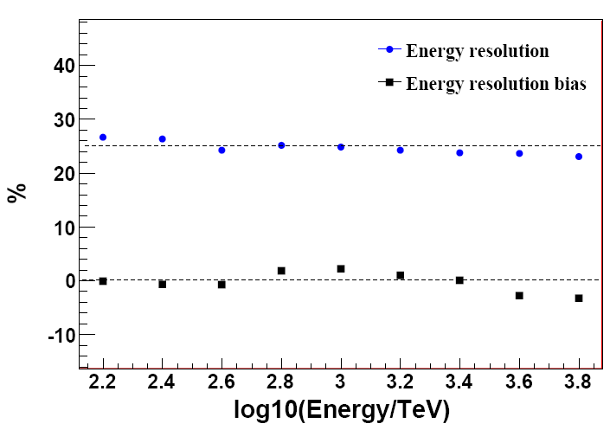
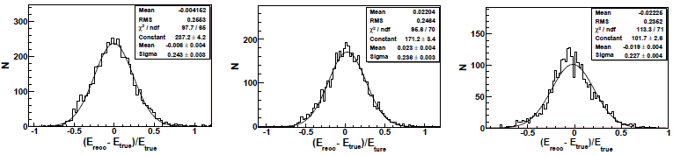
E-reconstruction
Systematic
bias: <3%
Constant resolution: 25%
Gaussian
Energy resolution：~25%
Offset: < 3%
300 TeV 1 PeV 3 PeV

Slide 15
Hybrid Observation and Data Set
Period:
From 2010.12 ~ 2012.02: Coincidence events;
Good weather selection: 7.28×10⁵ sec.
Criteria for well measured events
Showers in the RPC carpet, 1 meter from the edge
>1000 pads registered in the RPC carpet
Shower image is fully contained in the telescope, i.e. shower arrives in 6°or smaller respect to the telescope axis
The number of fired tubes ≥6.
8218 events are well reconstructed above 100 TeV

Slide 16
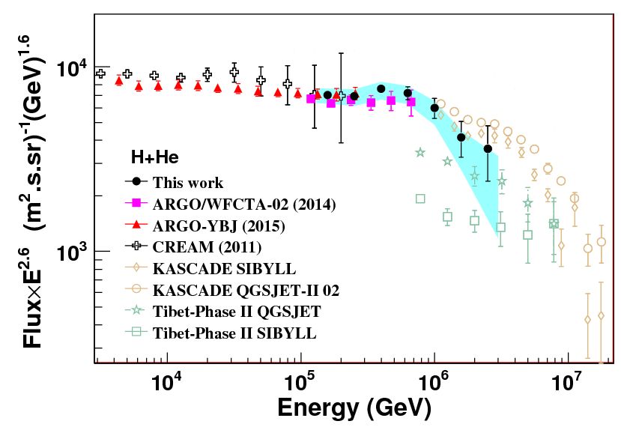
The pectrum
of H & He
with its knee below 1PeV
PHYSICAL REVIEW
D 92, 092005 (2015)
  The knee of H&He spectrum at (700±230) TeV is clearly measured
  Broken power law fits data well with indices
  -2.62 ± 0.05 and -3.58 ± 0.50 below and above the knee
  (with heavy contamination subtracted
  -2.56 ± 0.05 and -3.24 ± 0.36 below and above the knee
  (without heavy contamination subtracted)
  Below the knee, consistent with ARGO-YBJ, which is consistent with CREAM

Slide 17
Systematic Uncertainties
Uncertainties in the energy scale: ~9.7 %
  Photometric calibration: 5.6%;
  Weather/atmosphere conditions：7.6%;
  QGSJET II-03 vs. SIBYLL2.1：<1.0%;
  GHEISHA vs. FLUKA：<2.0%;
  Composition model: 1%.
Systematic uncertainties on the H&He flux:
  Contamination of heavy nuclei is not constant with energy and is dependent on composition models:
  -(1.5~2.5)% @ 158 TeV,
  -(29~51)% @ 2.5 PeV;
  ARGO-YBJ RPC calibration: 7%;
  QGSJET II-03 vs. SIBYLL2.1: <1.0%;
  GHEISHA vs. FLUKA：<3.5 %;
  Boundary effects in the hybrid detector aperture calculation: <3%;
  The difference between proton and Helium selection efficiencies: 3%;
  Saturation of RPCs: <0.03%.

Slide 18
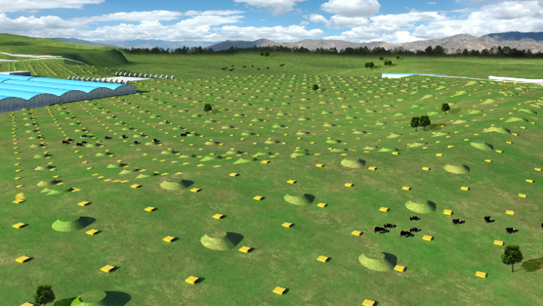
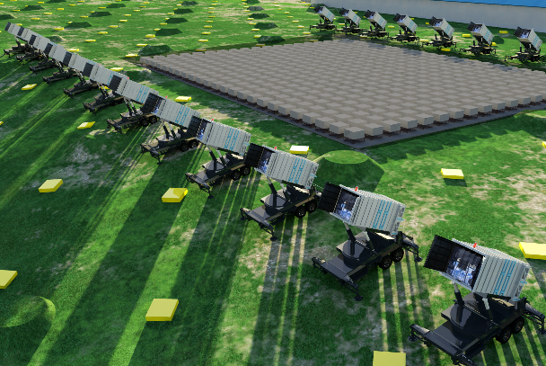
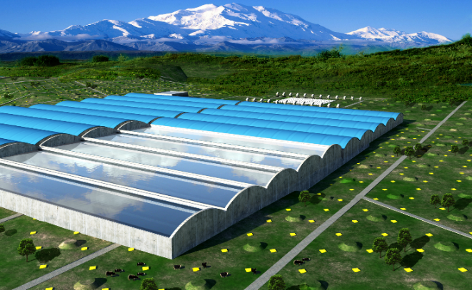
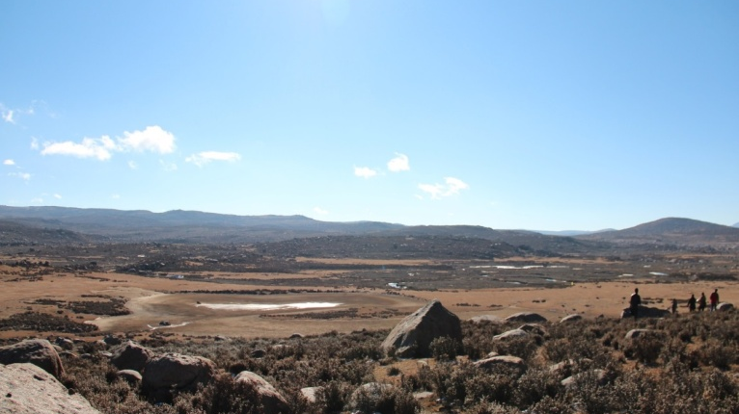
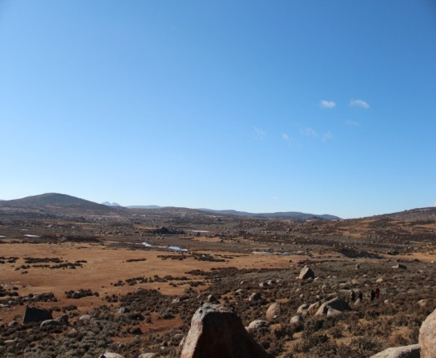
Large High Altitude Air Shower Observatory
LHAASO
KM2A:
5195 Eds: 1 m² each, 15m spacing
1171 MDs: 1146 MDs, 36 m² each, 30m spacing
WFCTA:
18 Cherenkov telescopes (1024 pixels/telescope)
WCDA:
3000 cells (25m²/cell)
Daochen, Sichuan (29º21’ 31” N, 100º08’15” E, 4410 m a.s.l., 600 g/cm)

Slide 19
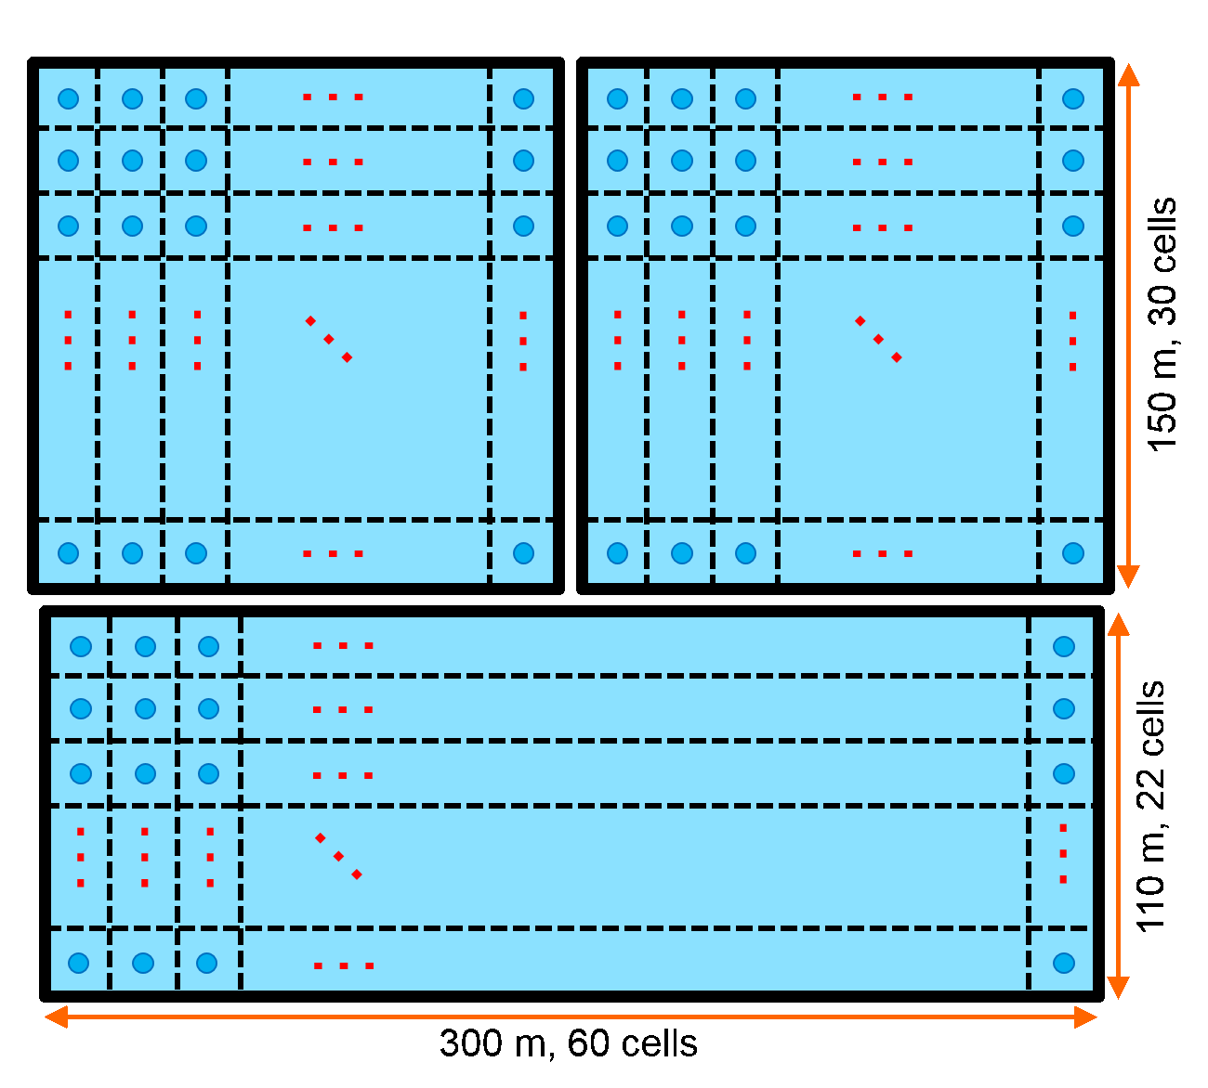
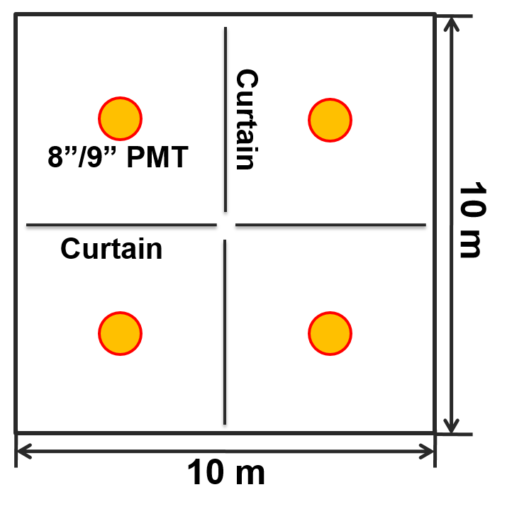
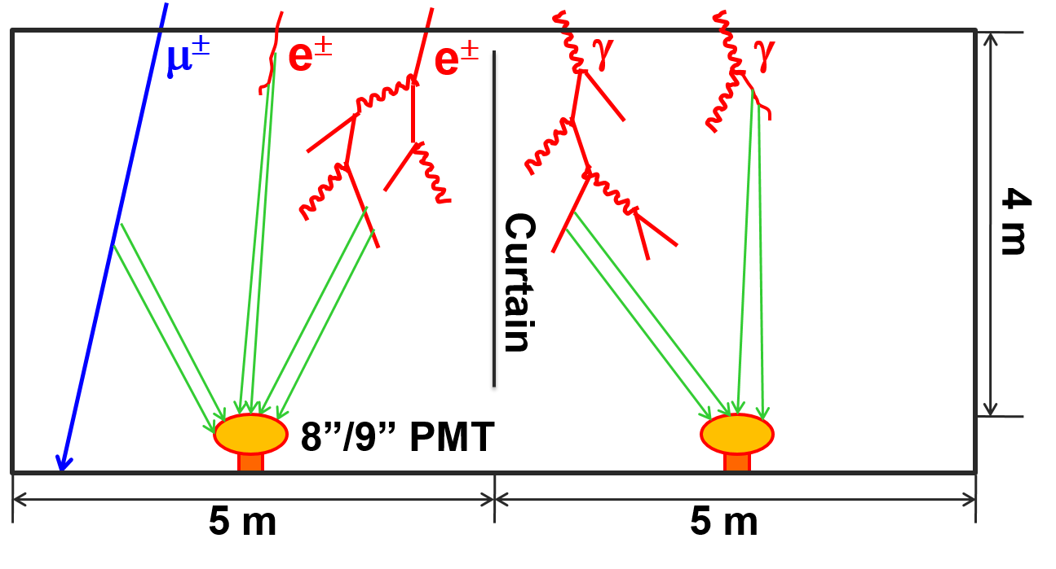
Water Cherenkov
Detector Array
3 water ponds:
  78,000 m² in total;
  4 m effective depth;
  3120 cells, with an 8”/9” PMT in each cell;
  Cells are partitioned with black curtains.
WCDA++: 1”PMTs enhance Dynamic Range

Slide 20
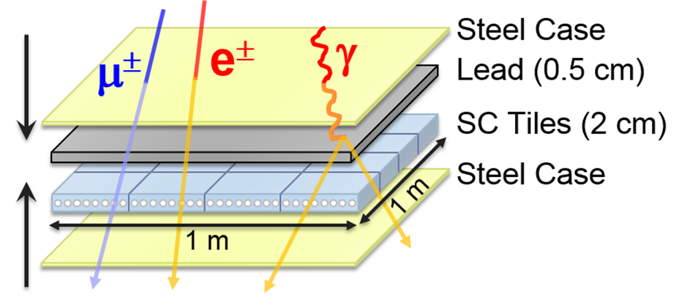
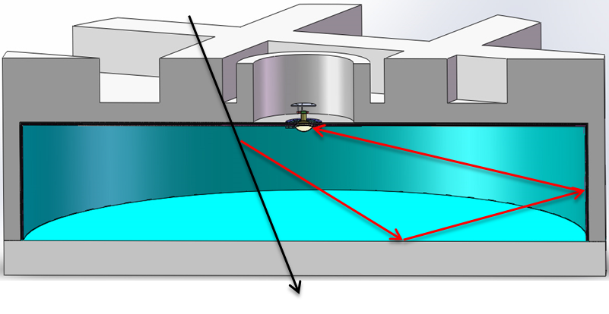
KM² Array (KM2A)
2.8m
1.2m
ED
MD
 | ED | MD
Effective area | 1m² | 36m²
Spacing | 15m | 30m
Total NO. of detectors | 5195 | 1171
Time resolution | 2ns | 10ns

Slide 21
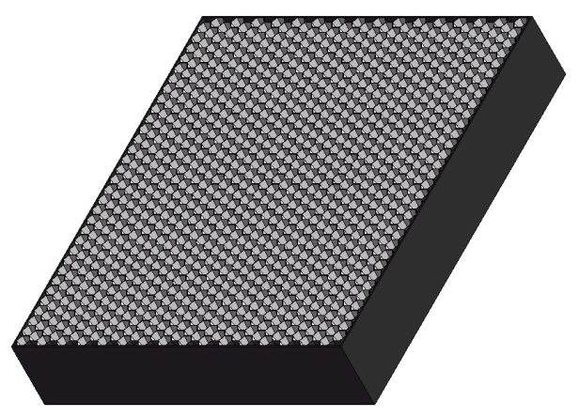
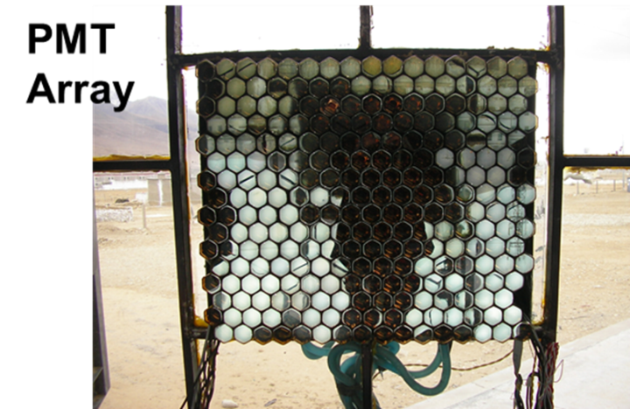
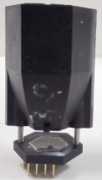
Wide Field of View Cherenkov Telescope (WFCTA)
5m² spherical mirror；
32×32 SiPMs array
Pixel size 0.5°；
FOV: 14°× 16°.
Duty cycle: 30%
Duty cycle: 10%
instead of
SiPM camera
A prototype of WFCTA

Slide 22
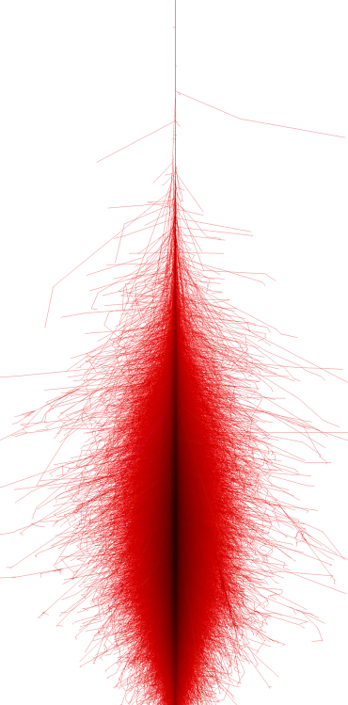
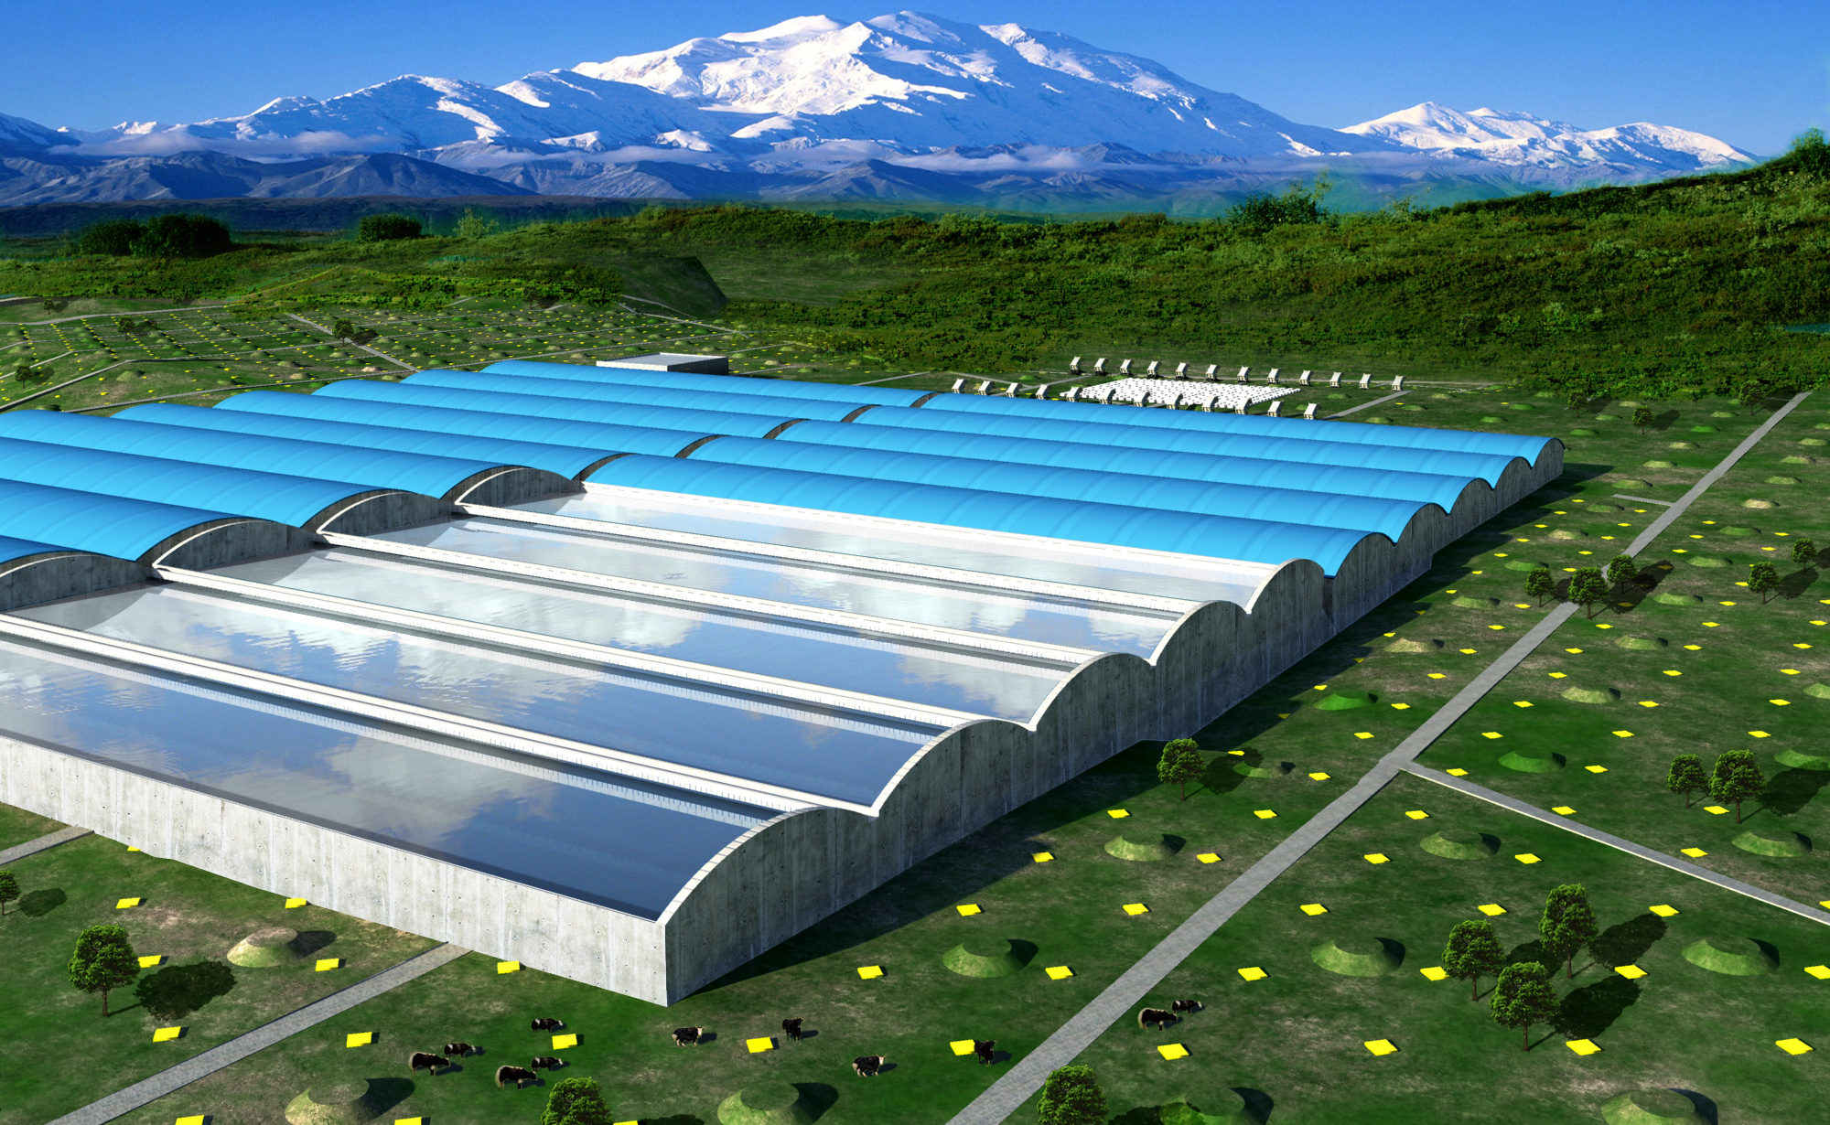
>10TeV

Slide 23
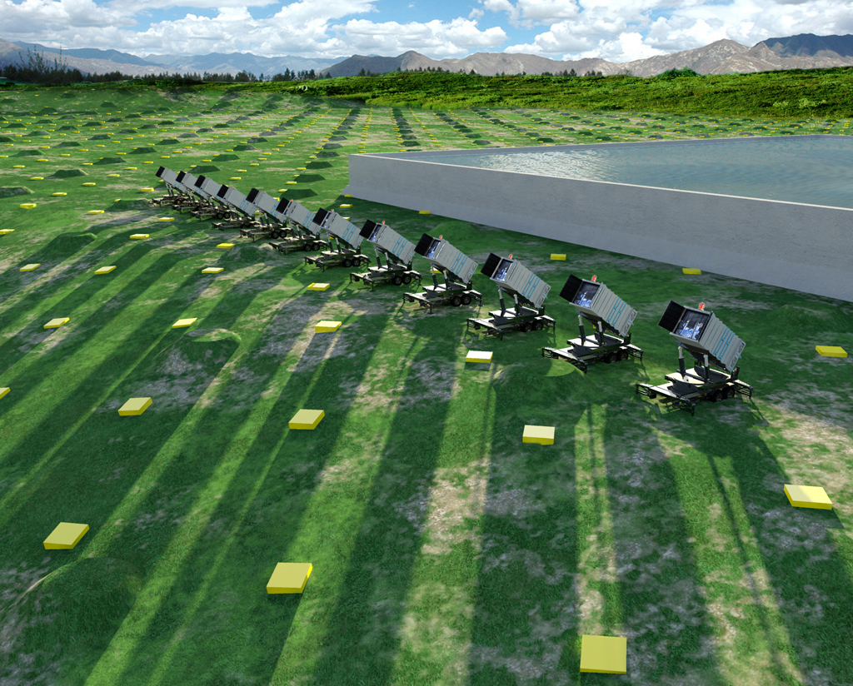
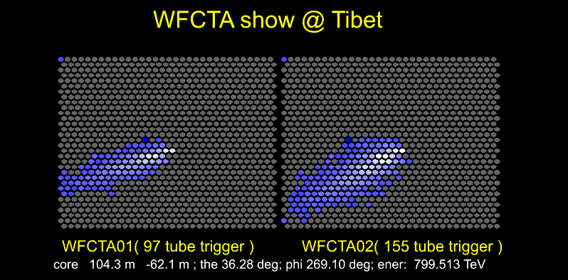
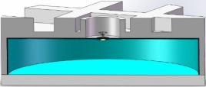
Prospects of P, He knees from 100TeV to 10PeV
WCDA
  Core reconstruction: 3m
  Arrival direction reconstruction: 0.3°
  No. of particles near the core
WFCTA
  SIZE (total PE in image)
  Width, Length
  Distance between arrival directions to the image center
KM2A
  Total Muon number
a
b

Slide 24
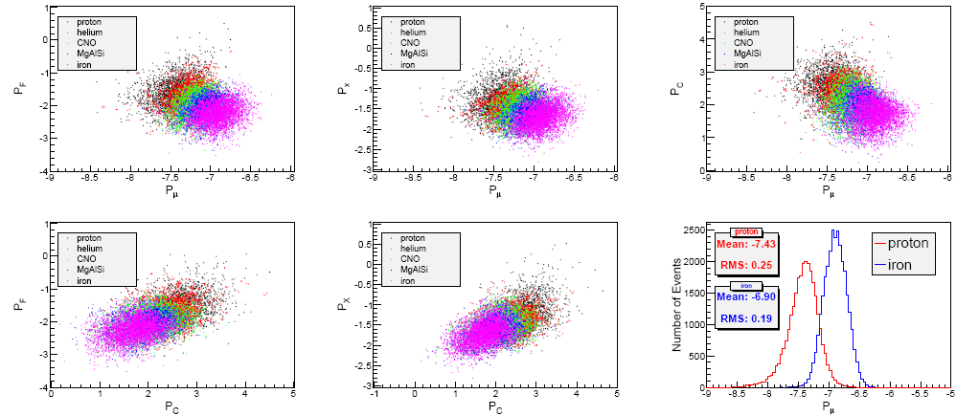
Multi-parameter analysis

Slide 25

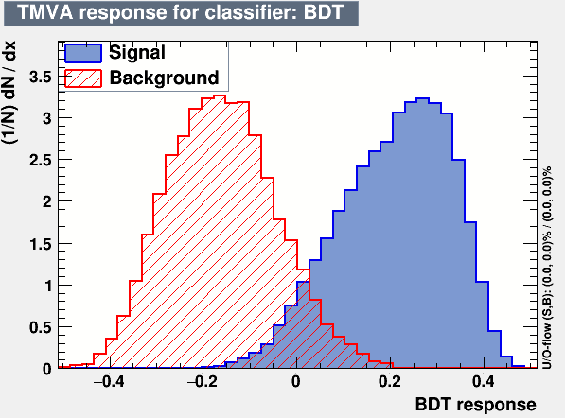
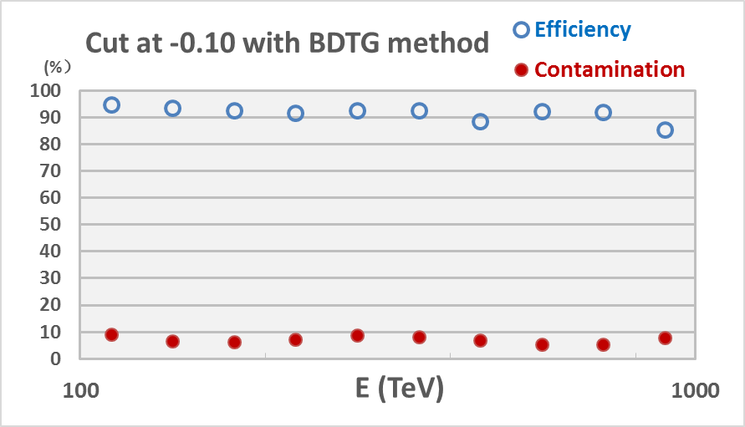


MVA method for p,He / heavy separation
With the Multi-Variate Analysis methods (e.g. neural networks and boosted decision trees), good separations for p/iron and p+He/heavy nuclides identification can be obtained.
Efficiency $\sim 90\%$
p, He
CNO,
MgAlSi,
iron
Contamination $<10\%$
Separation of light (p+He) and heavy nuclei by the BDT (Boost Decision Trees) method.
The contamination is calculated based on the Hörandel model.

Slide 26
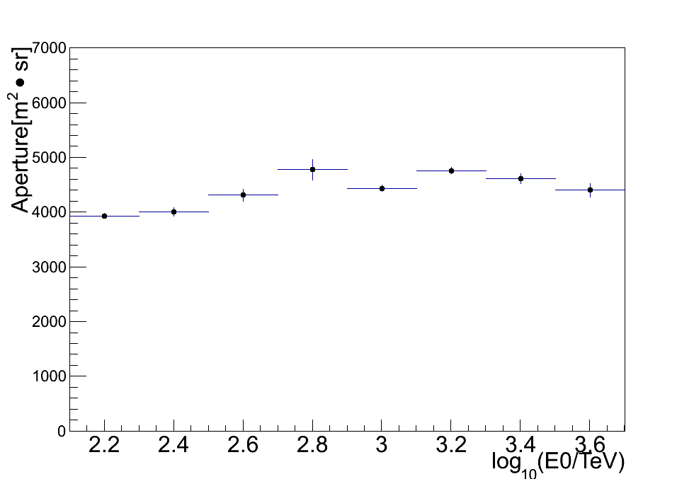
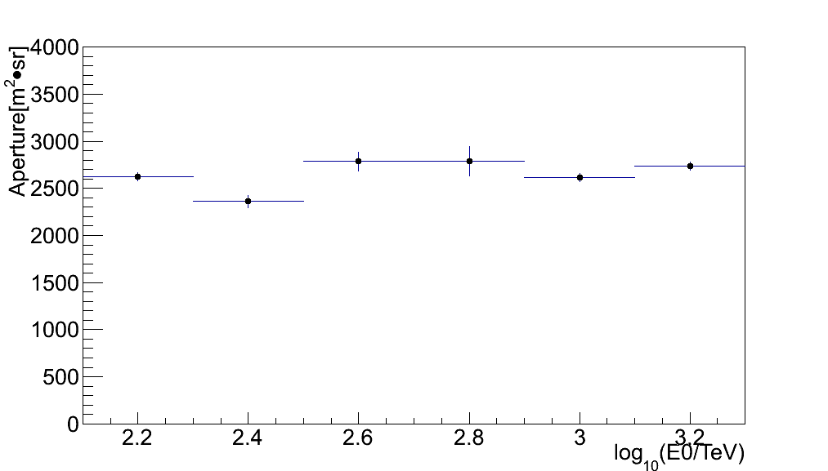
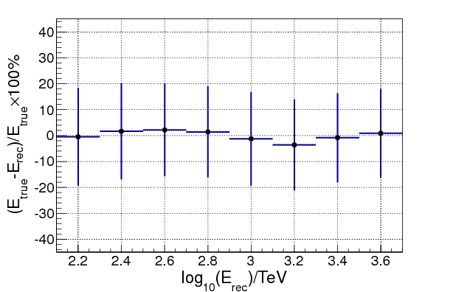
Apertures and
E-resolution
Aperture: ~4000 m².sr
Aperture: ~2500 m².sr
P+He
P

Slide 27
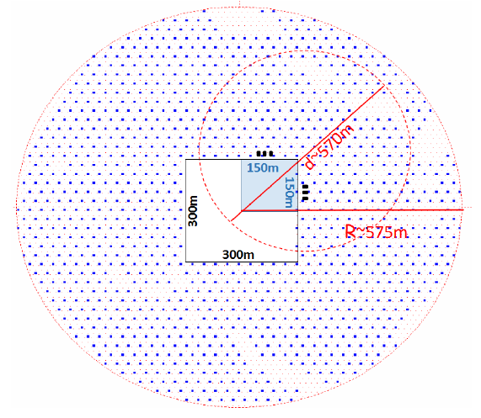
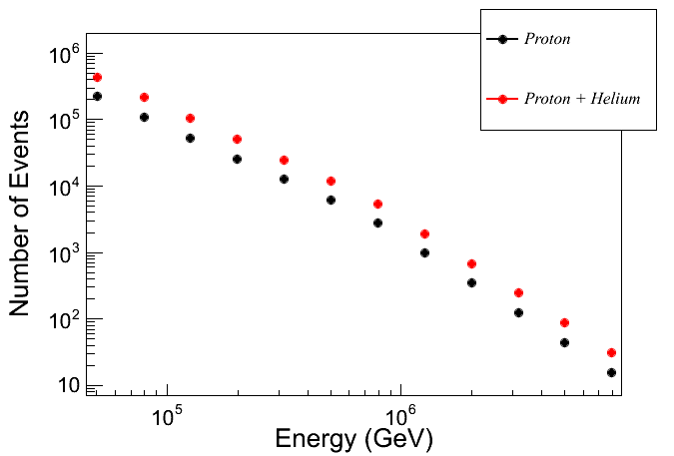
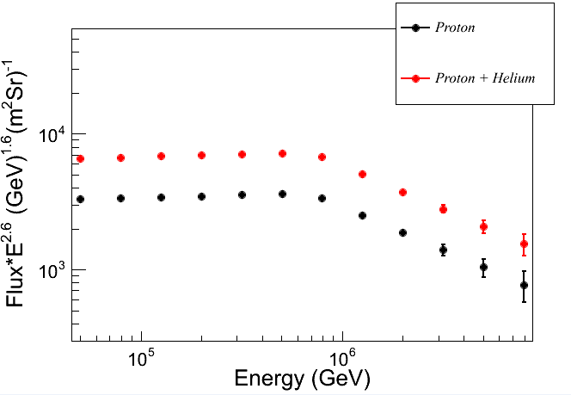
Performance of 1/4 LHAASO array (data taking 2018)
  6 WFCT telescopes
  22,500 m² water Cherenkov detector
  10,000 m² muon detectors covering 250,000 m²

Slide 28
Energy scale in experiment
ARGO-YBJ : Moon Shadow displacement
N ≈ 21 · (E_{TeV}/Z)^{1.5}
1 – 30 (TeV/Z)
55 s.d.
The energy scale uncertainty: smaller than 13%:
T
the assumed primary CR chemical composition (7%)
the uncertainties of different hadronic models (6%)
statistical uncertainty (8%)
An example
Will be improved
below 10%
by LHAASO 1/4

Slide 29
Conclusion
Light component (H&He) energy spectrum from 125 TeV - 3 PeV is measured by the ARGO-YBJ detector with a wide field-of-view imaging Cherenkov telescope together
    Extended the direct measurements by PAMELA, AMS, DAMPE, CALET, CREAM etc. to few PeV
    Constant energy resolution: ~25% with offset <3%；
      The knee of (700±230_{stat.}±70_{sys.}) TeV is found
      Spectral index: β₁=-2.56 ± 0.05 below the knee;
    β₂=-3.24 ± 0.36 above the knee;
    The knee of proton and Helium spectrum below 1 PeV sets a fundamental constraint to galactic cosmic ray acceleration models
    Future LHAASO experiment will greatly improve the measurements in both resolution and systematic uncertainties

