Slide 1
A method to reanalize Dark Matter experimental results in different theoretical scenarios
F. Giuliani
上海交通大学
(Shanghai Jiaotong University)

Slide 2
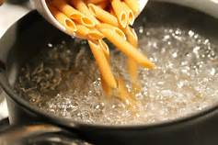
An old joke: are we physicists or mathematicians?
How to cook pasta: fill the pan with water, fire up the stove, add pasta when boiling starts, …
What if the water is already boiling?
Physicist: add pasta.
Mathematician: throw water away and turn stove off, so you’re back to the known case.

Slide 3
How to calculate twists to experimental limits?
Experiments usually publish limits or positive results for standard interpretations (e.g., f_{p} = f_{n}).
Common method: redo calculation from scratch, with simplifying assumptions like constant efficiency. Vary assumed parameters until published result is well approximated, then calculate from scratch new scenario with simplified efficiency, etc.
But the original results include important information like detector efficiencies
So, common method throws away much hard experimental work … like the mathematician! Can we do better?

Slide 4
“Physicist’s” alternative
Just undo the last step(s) of the derivation of the published result
Typically, calculate nucleus zero mom. transfer σs from the nucleon’s
This nucleus σ(s) still contains all the detector info as included by the experiment!
If nuclear form factor doesn’t need change (high A and low E_{nr}), this is sufficient
Then, calculate constraints to “twisted” model from zero mom. transfer σ of the isotopes in the detector
  This retains all the knowledge of the detector response that only the original experiment has, without you actually knowing it.

Slide 5
An example: SI limits with f_{p} ≠ f_{n}
Follow PRL 95 (2005) 101301
Data from http://dmtools.brown.edu
Case of CDMSlite (Phys. Rev. Lett. 116 (2016) 071301)
These data were acquired at low recoil energy, so form factors ≈1

Slide 6
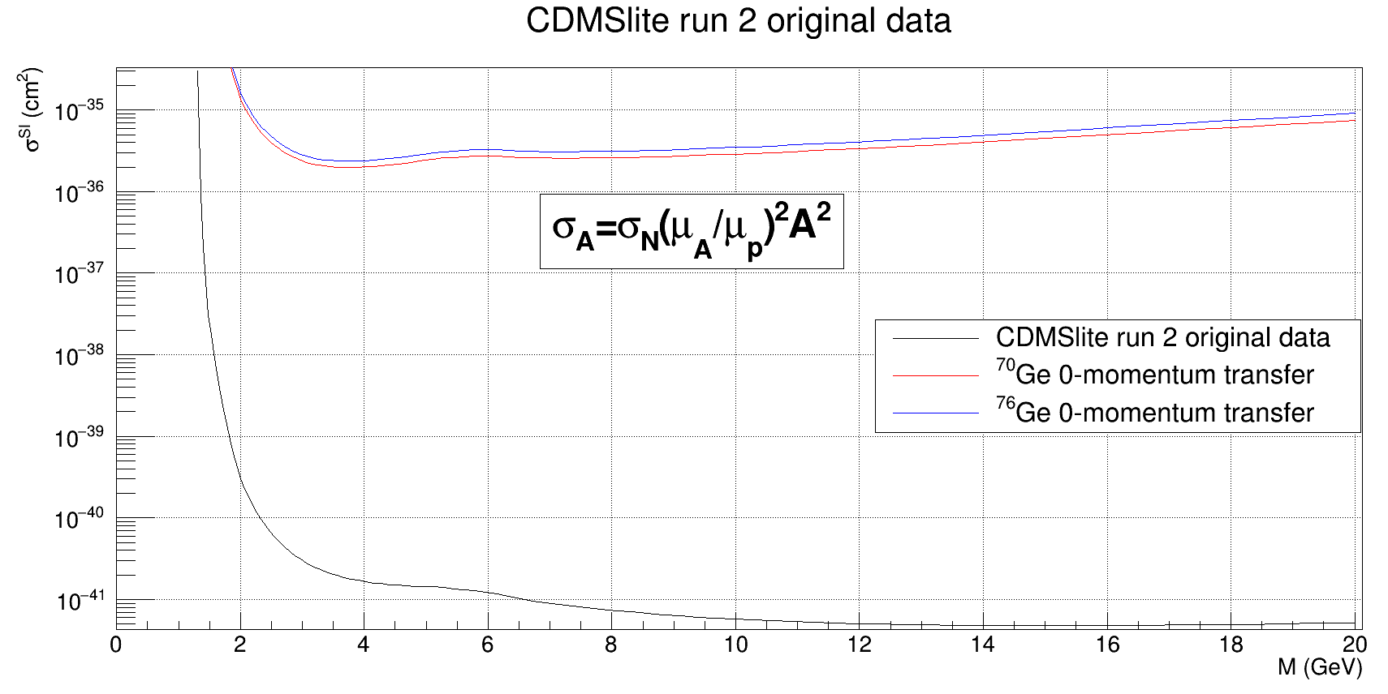
0-mom transfer σ_{A}‘s from published σ_{N}

Slide 7
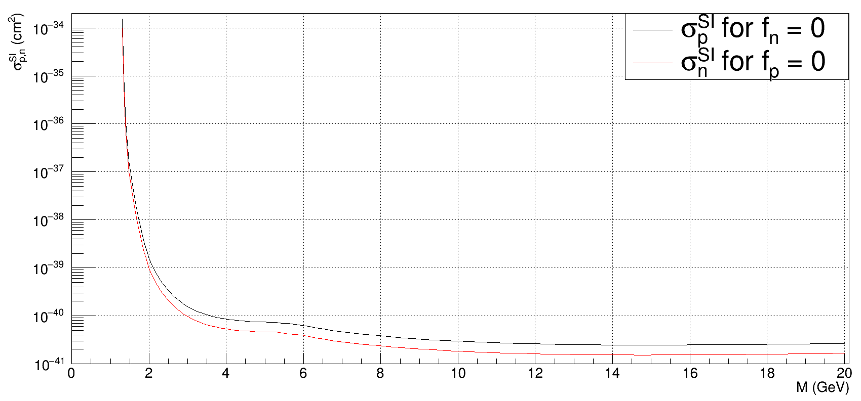
If the DMP coupled to only one type of nucleon…

Slide 8
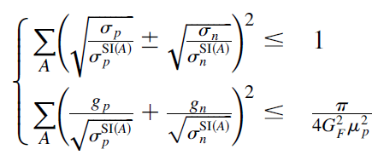
Elliptical inequalities

Slide 9
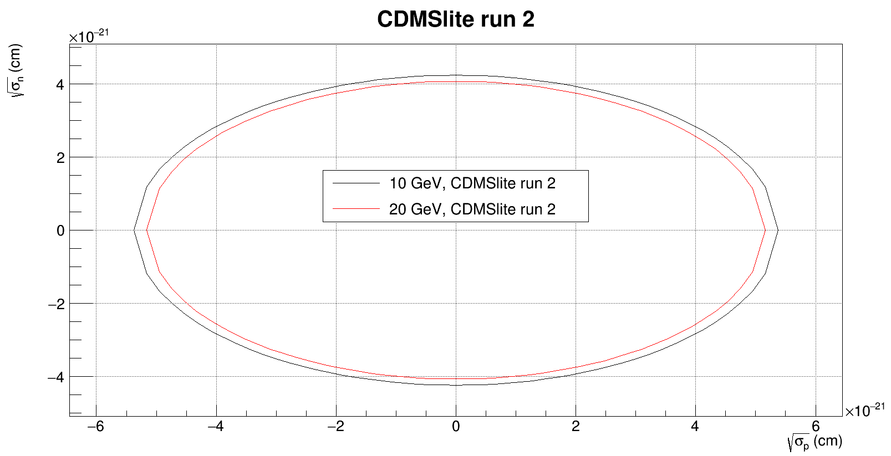
Synopsis of the allowed SI σ_{p,n} for 2 DMP masses

Slide 10
Conclusion
Sometimes it is desirable to use experimental limits or positive results to constrain a scenario not fitting the standard framework the experiments usually employ to deliver their results (e.g., SI interactions with f_{p} ≠ f_{n}).
In these cases, it is possible to convert the published cross sections to a modified framework, retaining all the detector and run information the original experiments used to produce their results
Such an approach does not require any deep knowledge of the experimental details, but simply to avoid throwing away the information originally included in the standard plots by those who best know it.

Slide 11
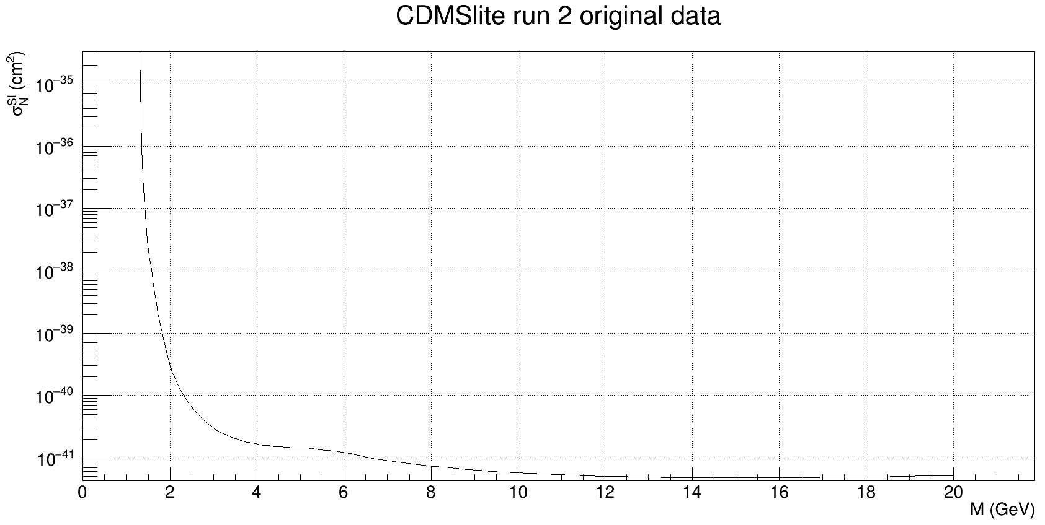
Original CDMSlite plot

