Slide 1

WIMP search from XMASS-I
fiducial volume data with
background prediction
15th International Conference on Topics in Astroparticle
and Underground Physics (TAUP 2017)
Jul. 24–28, 2017,
Sudbury, ON, Canada
26th of Jul. 2017 (14:45–15:00)
A. Takeda for the XMASS Collaboration

Slide 2
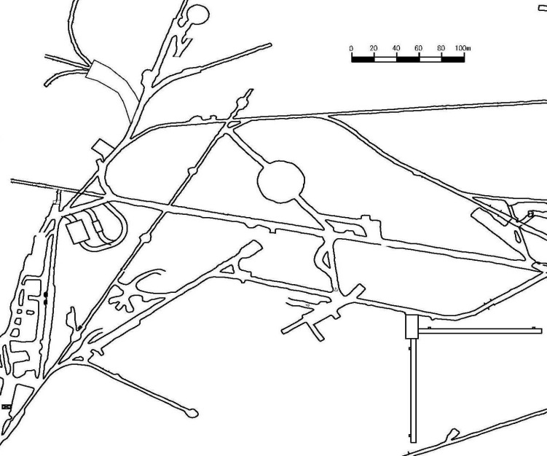
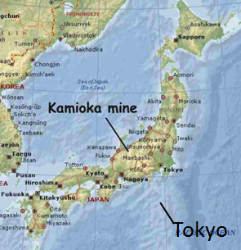
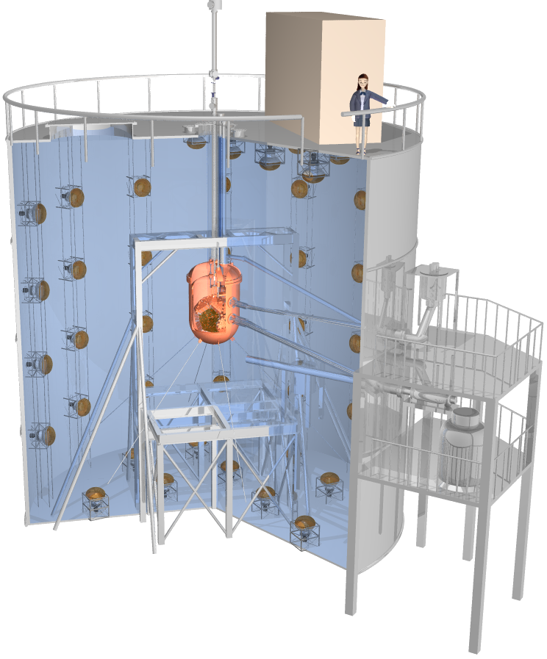
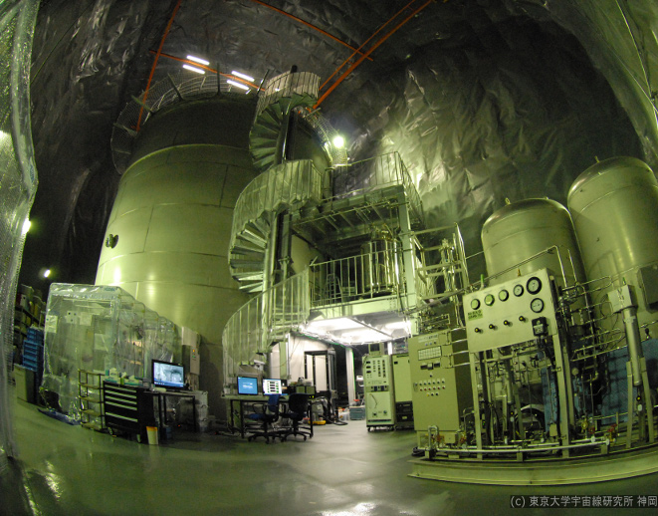
Experimental site
KamLAND
Kamioka Mine
Super-K
~1000m underneath
Mt. Ikenoyama.
(2700 m.w.e.)
Japan
CANDLES
XMASS(Lab-C)
Lab2/EGad
Kamioka Mine
IPMU Labx1
NEWAGE
CLIO
Kamioka mine
Lab-C
10.5 m
Tokyo
Water tank
XMASS I detector
10 m

Slide 3
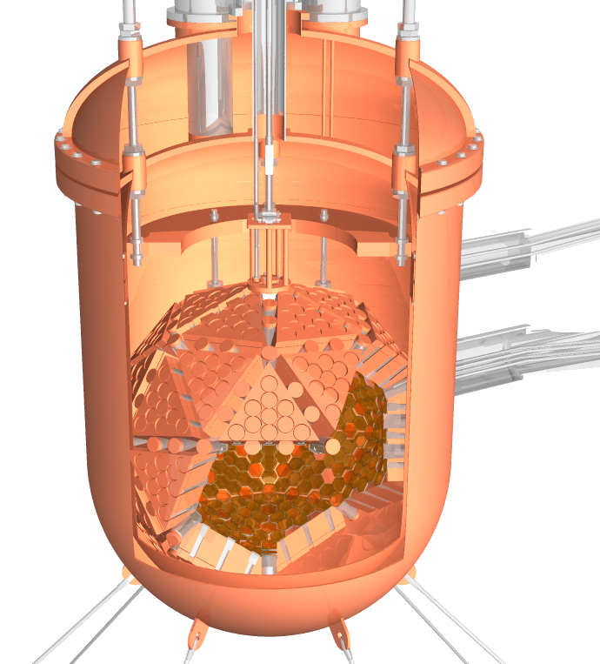
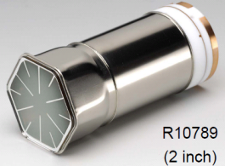
XMASS-I detector
Inner detector
  Single phase liquid xenon detector. (832 kg xenon for sensitive region)
  642 low background PMTs. (2 inch, HAMAMATSU R10789)
  → each PMT signal is recorded by 10-bit 1GS/s waveform digitizers.
  High light yield: ~15 PE/keV.
Outer detector
  10 m x 10.5 m water tank
  with 72 PMTs (20 inch)
  for active muon veto
  and passive radiation
  shield.
Inner detector
Outer detector
10.5 m
642 PMTs
(R10789)
832kg
liquid xenon
72 PMTs
(20 inch)
10 m

Slide 4
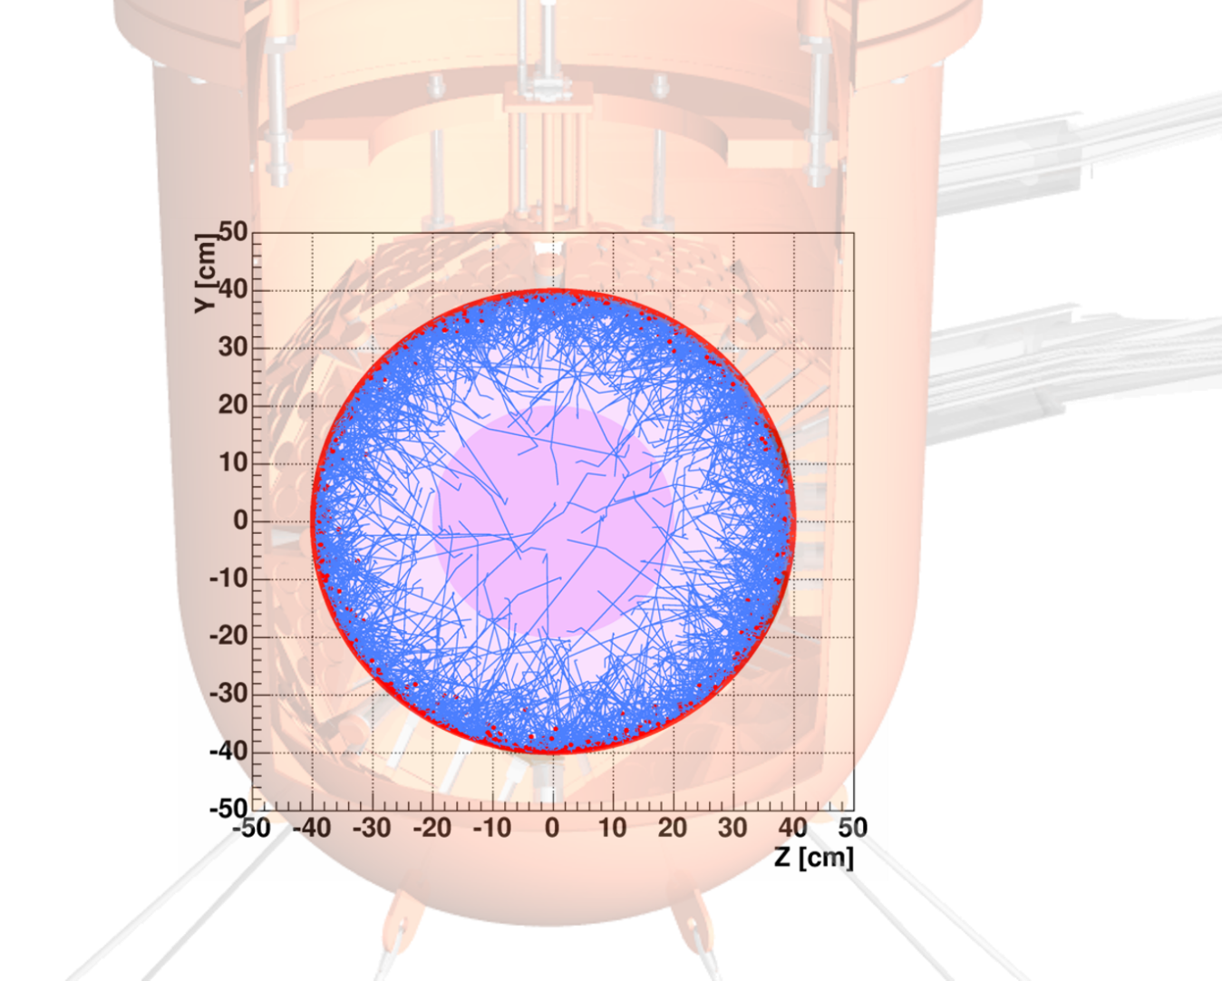
Self-shielding of γ-ray background
Traces of U-chain gamma-rays from PMTs
Owing to high atomic number (Z=54),
external gamma-ray background
(mainly coming from PMTs) can be
shielded by liquid xenon itself.
By selecting events occurred in the
restricted inner volume (fiducial volume)
low background can be achieved.
Fiducial volume

Slide 5
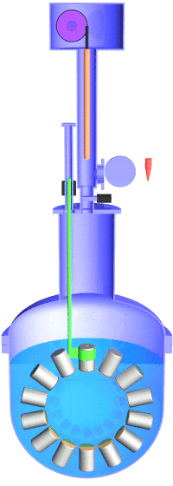
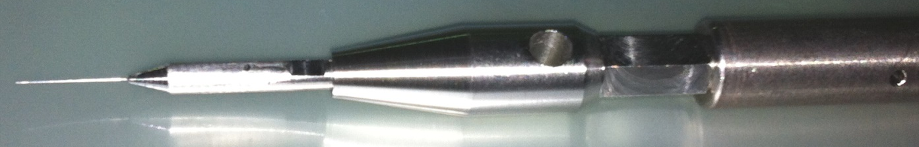
Detector calibration
Various RI sources can be inserted inside the sensitive volume w/o
interrupting detector operation.
Used for light yield monitoring, optical parameter tuning, energy
and timing calibration etc.
Stepping
motor
Magnetic linear and
rotary motion
feed-through
RI | Energy [keV] | diameter [mm] | Geometry
(1) ⁵⁵Fe | 1.65(*1), 5.9 | 10 | 2pi source
(2) ¹⁰⁹Cd | 8, 22, 25, 88 | 5 | 2pi source
(3) ²⁴¹Am | 17.8, 59.5 | 0.17 | 2pi/4pi source
(4) ⁵⁷Co | 59.3(*2), 122 | 0.21 | 4pi source
(5) ¹³⁷Cs | 662 | 5 | cylindrical
Tank top
~5m
Gate valve
Water tank
(*1) 4.2 keV (averaged) L-shell X-ray escape from 5.9 keV K-shell X-ray.
(*2) Tungsten K-shell X-ray used for detector housing.
⁵⁷Co source
N.Y. Kim et al., NIM A 784 (2015) 499–503
Source rod (Ti )
19mm
4mm
0.21mm
Top
PMT
Active region is concentrated on 1.8 mm edge region

Slide 6
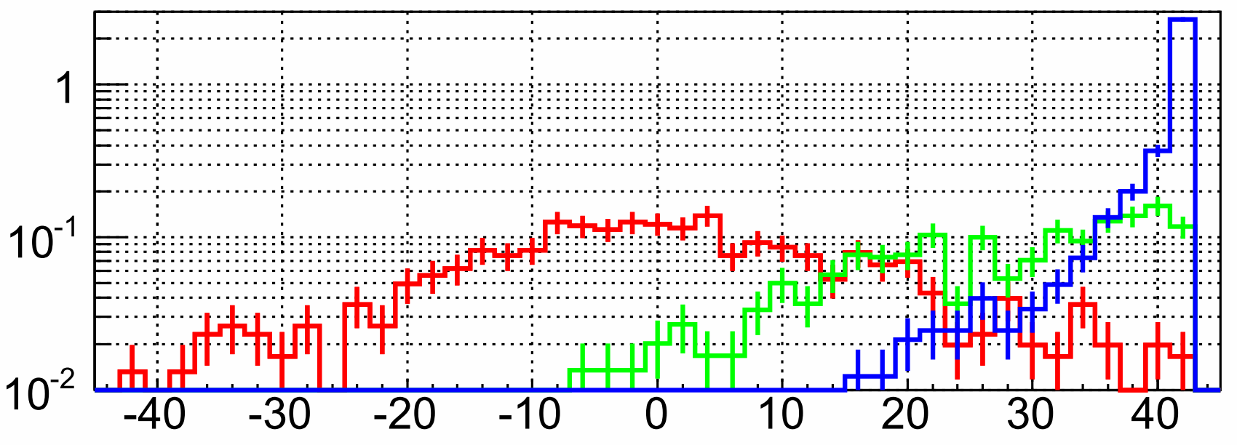
Vertex reconstruction (based on timing, R(T))
Using FADC hit timing of each PMT.
Timing constant for 2–10 keV events: 25±2ns.
Position reconstruction is done by using likelihood method
from probability density function for each PMT.
P(τ) : probability density function
x_{i}, t_{i} : PMT position and hit time
v_{g} : group velocity in Lxe (110mm/ns)
²⁴¹Am calibration data (5–10 keV)
PMTs
z
detector
calibration
z = 0cm
z = 20cm
z = 40cm
z = +40cm
Rate [/sec/cm]
…
z = +20cm
z = 0cm
Source position
along vertical
axis (z-axis)
z = -20cm
z = -40cm
Reconstructed z [cm]
→ Surface events > 38 cm are effectively removed from this distribution.
R(T) < 38 cm selection is used for event reduction.

Slide 7
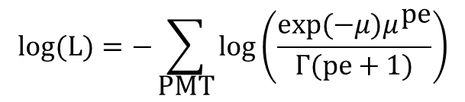
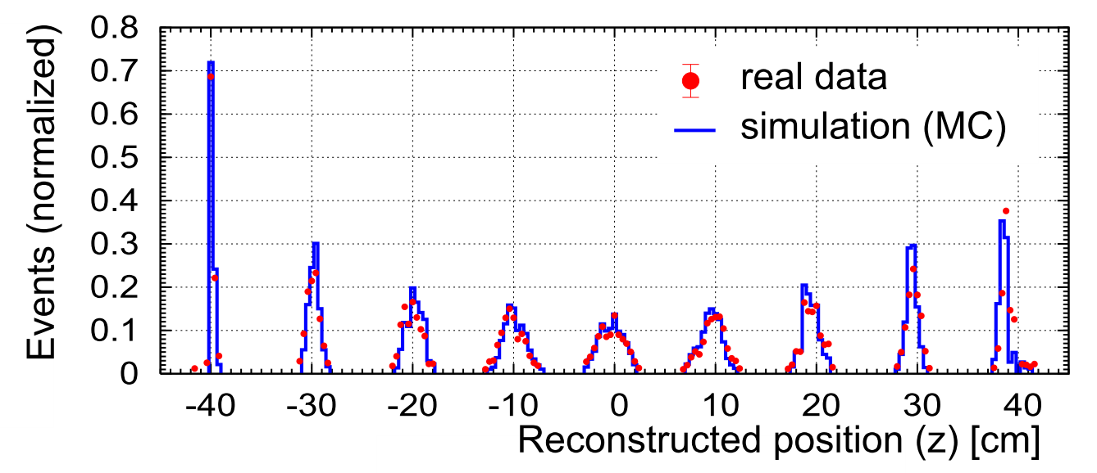
Vertex reconstruction (based on photo electron, R(PE))
Position reconstruction
  Making acceptance map: Many grid points are defined inside whole detector volume including
  detector surface. Events are generated at each grid point and photo-electrons (pe) expected in
  each PMT are calculated by our MC.
  From measured pe and scaled acceptance map (μ) in (1), position is calculated
  where following likelihood is maximum.
Γ(x): Gamma function
(Γ(n) = (n-1)!, n>0)
PMTs
z
Reconstructed position distribution of ⁵⁷Co events (122 keV)
detector
calibration
z = +40cm
…
z = +20cm
z = 0cm
Source position
along vertical
axis (z-axis)
z = -20cm
z = -40cm

Slide 8
Evaluation of RI activities in XMASS-I (1/2)
Based on RI screening for detector materials
mainly with HPGe detector.
RI activities are evaluated by spectrum fitting
for > 400 pe (~30 keV) between data and MC
with constraints from screening results.
ex. RI screening results
for PMT with HPGe detector.
Black line: real data
PMT + base
(whole measurement)
PMT aluminum seal
 | mBq/PMT
²³²Th | 1.80±0.31
²³⁸U | 2.26±0.28
²¹⁰Pb | 200±100
⁶⁰Co | 2.92±0.16
⁴⁰K | 9.10±2.15
MC/data
 | Bq
²³⁸U–²³⁰Th | 1.5±0.4
²¹⁰Pb | 2.85±1.15
²³²Th | 0.096±0.018
²³⁵U–²⁰⁷Pb | ~1.5 x 4.5%
Uncertainty of activity Statistic error

Slide 9
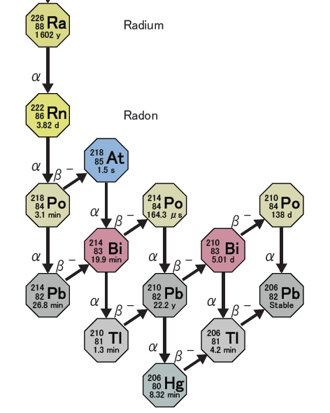
Evaluation of RI activities in XMASS-I (2/2)
²¹⁰Pb in copper surface and bulk
  α events selection from scintillation decay time.
  ²¹⁰Pb in copper surface/bulk were estimated from
  shape of energy spectrum caused by ²¹⁰Po α decay.
  ²¹⁰Pb in the bulk of OFHC copper was also measured
  independently by a low background α-particle counter.
  (XIA Ultra-Lo-1800)
RI in liquid xenon
  Coincidence analysis was used.
    ²²²Rn: ²¹⁴Bi – ²¹⁴Po (164 us)
    ⁸⁵ Kr: β–γ (1.015 us, 0.343%)
  ¹⁴C and ³⁹Ar were estimated from
  spectrum fitting.
²¹⁰Po in copper bulk (continuous)
or on surface (peak)
bulk
surface
1st events (²¹⁴Bi candidates)
2nd events (²¹⁴Po candidates)
Down stream
of ²²²Rn
Events
Events
0 20 40 60 80 100 120
×10³
Number of photo electrons (NPE)
NPE

Slide 10
Data reduction
Main parts of standard cut
w/o Cherenkov cut
Cherenkov cut
R(T) < 38 cm cut
R(PE) < 20 cm cut
10⁷
10⁶
Live time: 705.88 days
2013/Nov. /20 – 2016/Mar./29
Standard cut:
  Reduction of Cherenkov event is effective.
  Main origin of Cherenkov events is
  β-ray in PMT quartz window emitted from
  ⁴⁰K in PMT photo-cathode.
R(T) < 38 cm and R(PE) < 20 cm cuts give
another O(10⁻³) reduction.
Event rate after applying all cuts:
~4×10⁻³ /day/kg/keVee
@5–5.5 keVee
(signal efficiency: ~30%)
10⁵
Events
10⁴
10³
10²
10
1
0 50 100 150 200 250 NPE
Standard cut + R(T)<38cm + R(PE)<20cm
0.005
0.004
0.003
[/day/kg/keVee]
0.002
0.001
0 5 10 15 20 25 30
Reconstruction energy [keVee]

Slide 11
Background prediction with MC
XMASS MC based on Geant4.
  Detail detector geometry and
  responses of PMT and DAQ were included.
  Optical parameters of LXe
  were traced with our periodical
  calibration (⁵⁷Co and ⁶⁰Co).
  RI activities for each material
  were implanted.
  Same live time as that of data.
  Same reduction as that for data
  was applied.
Standard cut + R(T)<38cm + R(PE)<20cm cut
Blue histogram : all MC with statistical error
Pb210 Plate bulk |  | N.R.
Pb210 Ring bulk |  | Internal
PMT Al seal |  | Pb210 Surface
PMT gamma
MC only
0.005
0.004
0.003
[/day/kg/keVee]
0.002
0.001
0 5 10 15 20 25 30
Reconstruction energy [keVee]
  Main BG origin is not internal but detector surface events (miss-reconstructed events).

Slide 12
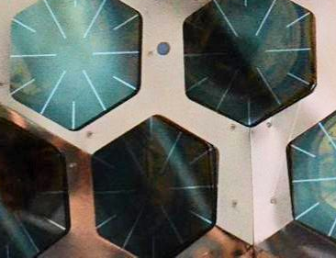

Miss-reconstructed events
Events occurring on surface of copper plate are wrongly
reconstructed to inside of the fiducial volume with some
probabilities because closest PMT has small solid angle
for these events.
Light leakage from a gap around boundary
between plate and plate makes special pattern,
but, sometimes wrongly reconstructed
inside the fiducial volume.
Structure around PMT
Large
miss-recon.
Gap
Small
miss-recon.
Copper plate
PE pattern of gap event
Light leakage from gap
quartz window
Gap
~100 um
PMT
Copper
ring
Position where scintillation happens
Scintillation photons

Slide 13
Systematic error evaluation
All the possible systematic errors were evaluated
Contents | Systematic error
 | 2-15 keVee | 15-30 keVee
(1) Plate gap geometry | +6.2/-22.8% | +1.9/-6.9%
(2) Ring roughness | +6.6/-7.0% | +2.0/-2.1%
(3) Cu ref dependence | +5.2/-0.0% | +2.5/-0.0%
(4) Plate floating | +0.0/-4.6% | +0.0/-1.4%
(5) Al seal dependence | +0.7/-0.7% | +0.0/-0.0%
(6) Reconstruction | +3.0/-6.2% | +0.0/-0.0%
(7) Timing (decay time, TTS) | +4.6/-2.9% | +0.4/-5.3%
(8) Timing (response in detector surface) | +0.0/-8.0% | +0.0/-0.0%
(9) Absorption & scattering | +0.7/-6.7% | +1.5/-1.1%
(10) Dead tube origin | +10.3/-0.0% | +45.2/-0.0%
(11) N.R. | +0.7/-0.7% | +0.0/-0.0%
Related to surface condition: it mainly affects
to miss-reconstruction rate.
  (1) Geometry of gap between plates coming
  from installation accuracy of plates.
  (2) Roughness of ring surface inside the gap.
  (3) Reflection of plate surface.
  (4) Floating of plate coming from
  installation accuracy of each plate.
(5) Geometry and property of aluminum seal
(6) Related to reconstruction:
grid dependency and rate of miss-reconstruction.
(7,8) Uncertainty for scintillation decay
time and response of PMT.
(9) Optical parameters of LXe.
(10) Effect of dead PMTs (10 dead PMTs exist)
(11) for ²⁰⁶Pb recoil from ²¹⁰Po α decay on
copper surface.

Slide 14
Systematic error evaluation
All the possible systematic errors were evaluated
Contents | Systematic error
 | 2-15 keVee | 15-30 keVee
(1) Plate gap geometry | +6.2/-22.8% | +1.9/-6.9%
(2) Ring roughness | +6.6/-7.0% | +2.0/-2.1%
(3) Cu ref dependence | +5.2/-0.0% | +2.5/-0.0%
(4) Plate floating | +0.0/-4.6% | +0.0/-1.4%
(5) Al seal dependence | +0.7/-0.7% | +0.0/-0.0%
(6) Reconstruction | +3.0/-6.2% | +0.0/-0.0%
(7) Timing (decay time, TTS) | +4.6/-2.9% | +0.4/-5.3%
(8) Timing (response in detector surface) | +0.0/-8.0% | +0.0/-0.0%
(9) Absorption & scattering | +0.7/-6.7% | +1.5/-1.1%
(10) Dead tube origin | +10.3/-0.0% | +45.2/-0.0%
(11) N.R. | +0.7/-0.7% | +0.0/-0.0%
Related to surface condition: it mainly affects
to miss-reconstruction rate.
  (1) Geometry of gap between plates coming
  from installation accuracy of plates.
  (2) Roughness of ring surface inside the gap.
  (3) Reflection of plate surface.
  (4) Floating of plate coming from
  installation accuracy of each plate.
Standard cut + R(T)<38cm + R(PE)<20cm cut
+ Real data
MC
systematic error
RI activity error
statistic error
0.005
0.004
0.003
[/day/kg/keVee]
0.002
0.001
← Real data is well explained with background MC.
0 5 10 15 20 25 30
Reconstruction energy [keVee]

Slide 15
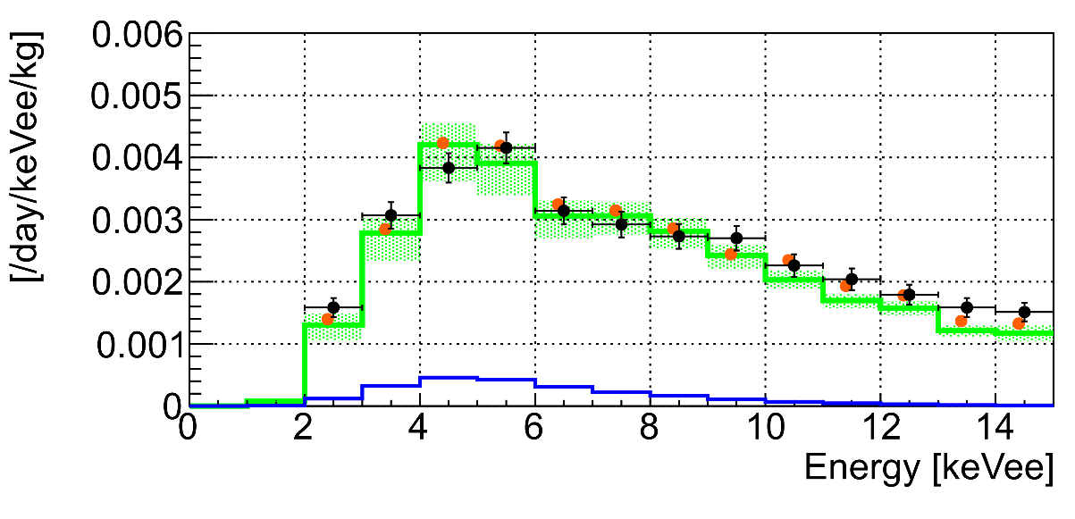
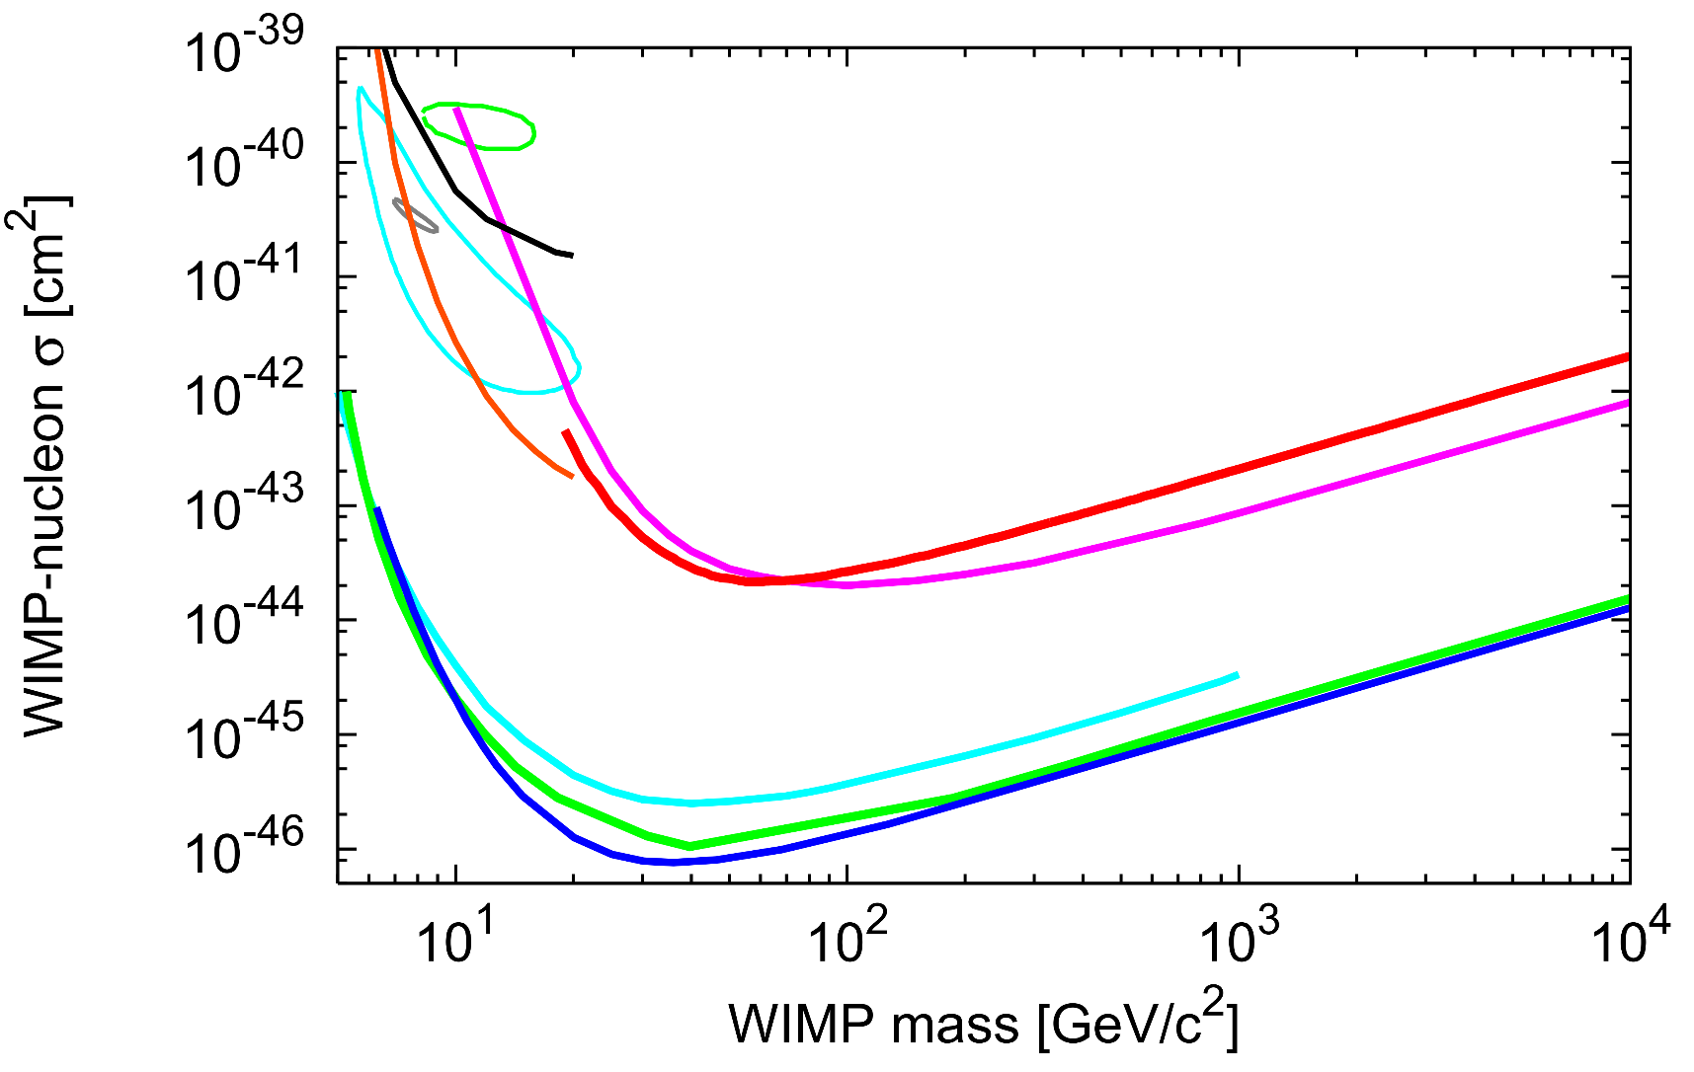
WIMP search with background evaluation in fiducial volume
+ Data
・ BGMC + WIMP(90% C.L.)
■ 1σ error for best fit
705.88 live days data applying fiducial
volume data reduction were used.
(standard + R(T)<38cm + R(PE) < 20cm cut)
Energy spectrum of data was fitted
with background MC and WIMP MC
in the energy range of 2–15 keVee
considering systematic error in both
background and WIMP MC.
Best fit result is consistent with no WIMP
case, then 90% C.L. upper limit on the
WIMP-nucleon cross section was derived.
Our preliminary limit is 2.2×10⁻⁴⁴ cm²
for 60 GeV WIMP mass.
WIMP
60 GeV, 2.2e-44 cm²(90%CL)
DAMA/LIBRA(Na)
XMASS(2013)
CoGeNT
(2013)
CDMS-Si (2014)
This work (FV analysis)
XMASS
(mod. 2017)
DarkSide-50 (2015)
LUX (2017)
PandaX-II (Run8+Run9)
XENON1T (2017)

