Slide 1


Recent results from Daya Bay reactor neutrino Experiment
Haoqi Lu
Institute of High Energy physics, China
On behalf of the Daya Bay collaboration
TAUP 2017, July 24-28, Laurentian University,Sudbury

Slide 2
Outline
Introduction
Recent results from Daya Bay
  Oscillation measurement
  Reactor antineutrino flux and spectrum measurement
  Evolution of the reactor antineutrino flux and spectrum
Summary

Slide 3
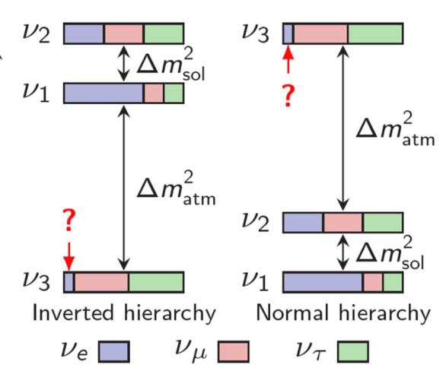
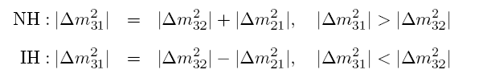
Neutrino Mixing
In a 3-ν framework
θ₂₃ ~ 45°
Atmospheric Accelerator
θ₁₃ :The smallest and the last one to be determined
Reactor
Accelerator
θ₁₂ ~ 34°
Solar
Reactor

Slide 4
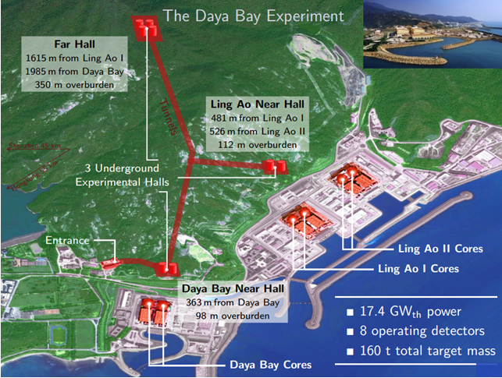
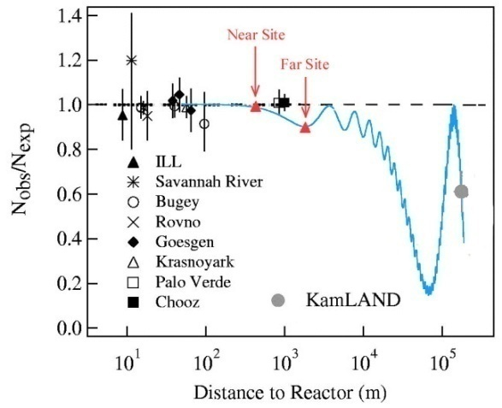

Daya Bay and Reactor Neutrino Oscillation
DayaBay Reactor antineutrino experiment
  In Shenzhen, southern China; ~55km to HK.
  Discovery of disappearance by Inverse-β reaction to determine θ13.
Daya Bay
θ₁₃ revealed by deficit of reactor antineutrinos at ~2 km. Mixing angle θ₁₃ governs overall size of ν_{e} deficit.
Short-baseline reactor experiments insensitive to mass hierarchy can not discriminate 2 frequencies contributing to oscillation:
One effective oscillation frequency is measured:
4

Slide 5
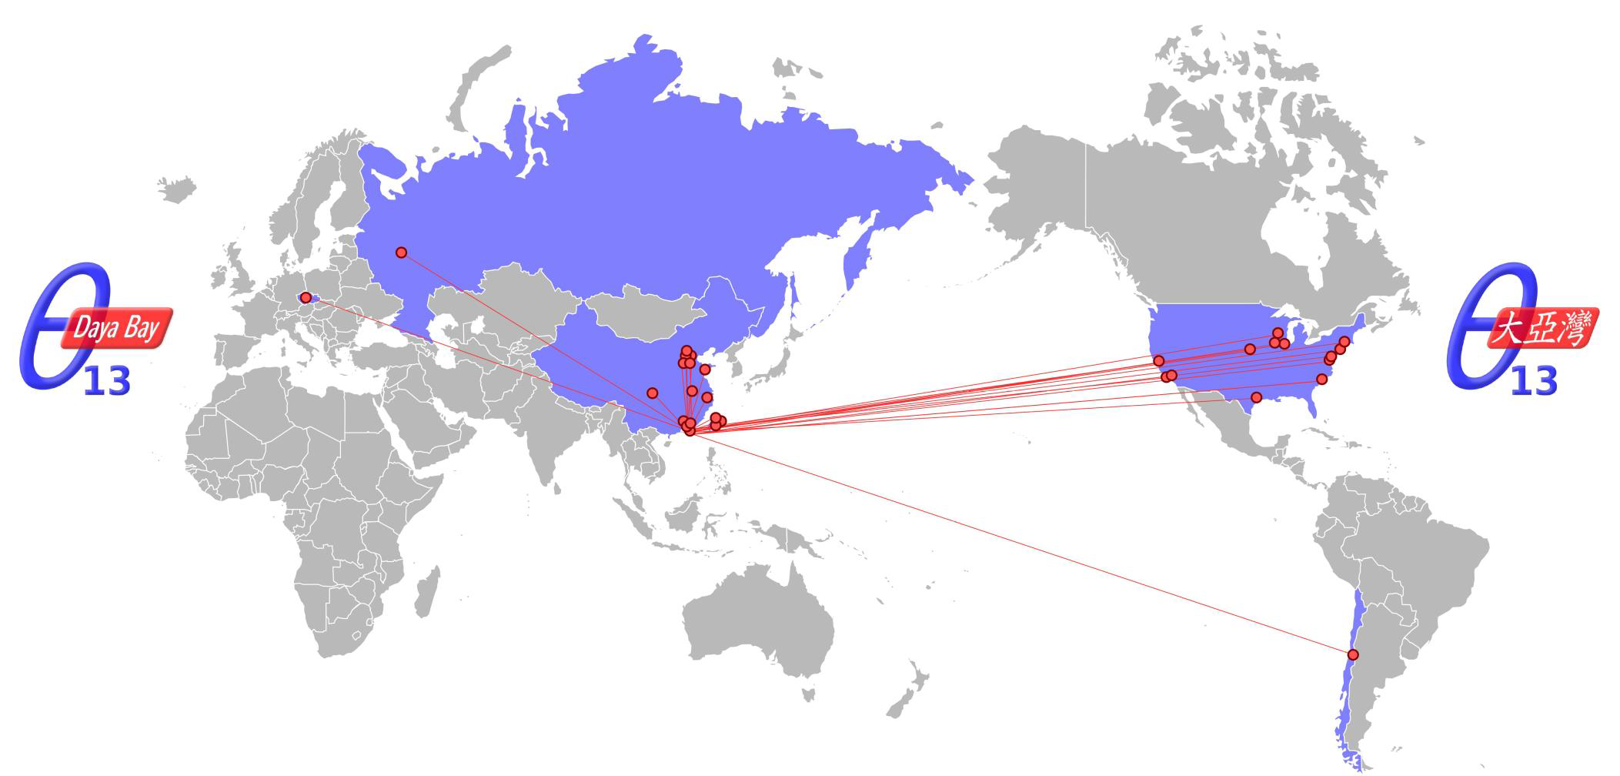
Daya Bay Collaboration
~230 collaborators from 41 institutions:
North America (15)
Brookhaven Nat'l Lab, Illinois Institute of Technology, Iowa State, Lawrence Berkeley Nat’l Lab, Princeton, Siena College, Temple Univ., UC Berkeley, Univ. of Cincinnati, Univ. of Houston, UIUC, Univ. of Wisconsin, Virginia Tech, William & Mary, Yale
Europe (2)
Charles University, JINR Dubna
Asia (23)
Beijing Normal Univ., CNGPG, CIAE, Chongqing Univ., Dongguan Polytechnic, ECUST, IHEP, Nanjing Univ., Nankai Univ., NCEPU, NUDT, Shandong Univ., Shanghai Jiao Tong Univ., Shenzhen Univ., Tsinghua Univ., USTC, Xi’an Jiaotong Univ., Zhongshan Univ., Chinese Univ. of Hong Kong, Univ. of Hong Kong, National Chiao Tung Univ., National Taiwan Univ., National United Univ.
South America (1)
Catholic Univ. of Chile

Slide 6
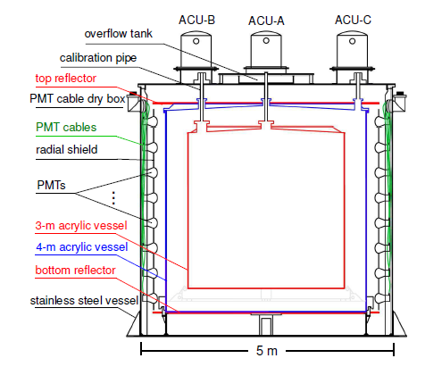
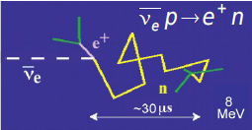
Detector design
Daya Bay Antineutrino Detectors (AD)
8 functionally identical detectors to reduce the detector relative errors
Three zones modular structure
Reflector at top and bottom:
Reflectors improve light collection and uniformity
Inverse beta decay(IBD) in Gd-doped liquid scintillator
Prompt signal
Delayed signal, Capture on Gd (8 MeV), ~30μs

Slide 7
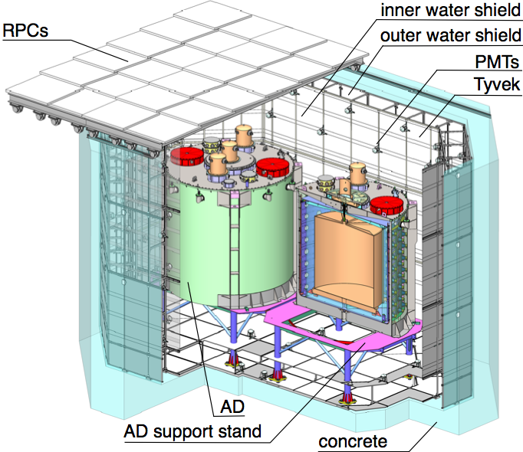
Muon Tagging System
Dual tagging systems: 2.5 meter thick two-section water shield and RPCs
Outer layer of water veto (on sides and bottom) is 1m thick, inner layer >1.5m. Water extends 2.5m above ADs
  288 8” PMTs in each near hall
  384 8” PMTs in Far Hall
4-layer RPC modules above pool
  54 modules in each near hall
  81 modules in Far Hall
Goal efficiency: > 99.5% with uncertainty <0.25%
Two-zone ultrapure water cherenkov detector

Slide 8
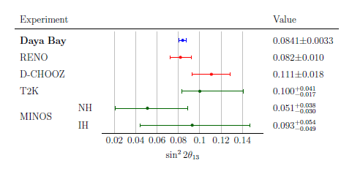
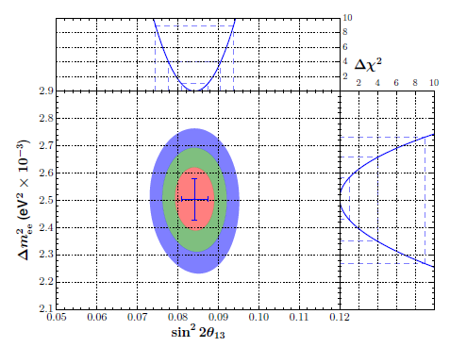
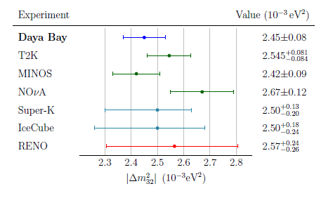
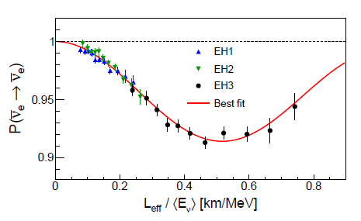
Oscillation measurement(nGd)
1230 days dataset
  217 days x 6AD + 1013 days x 8AD
Strong confirmation of observed anti-neutrino deficit.
Phys. Rev D. 95, 072006 (2017)
Most precise measurement:
• uncertainty: 3.9%
• uncertainty: 3.4%
NH
Consistent results with reactor and accelerator experiments.
Consistent with 3-neutrino oscillation framework.

Slide 9
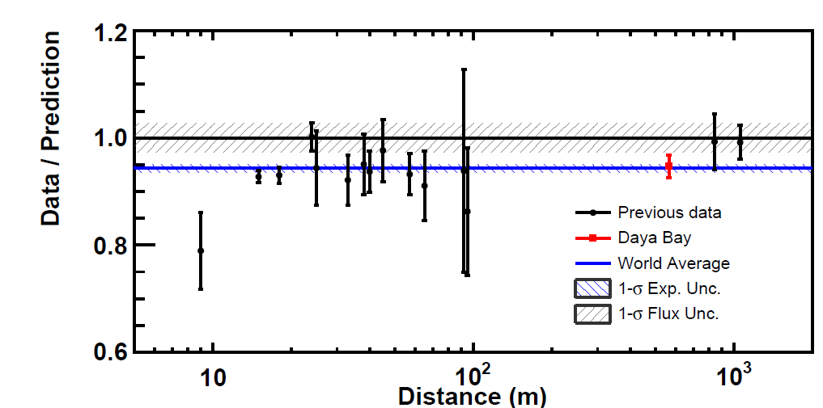
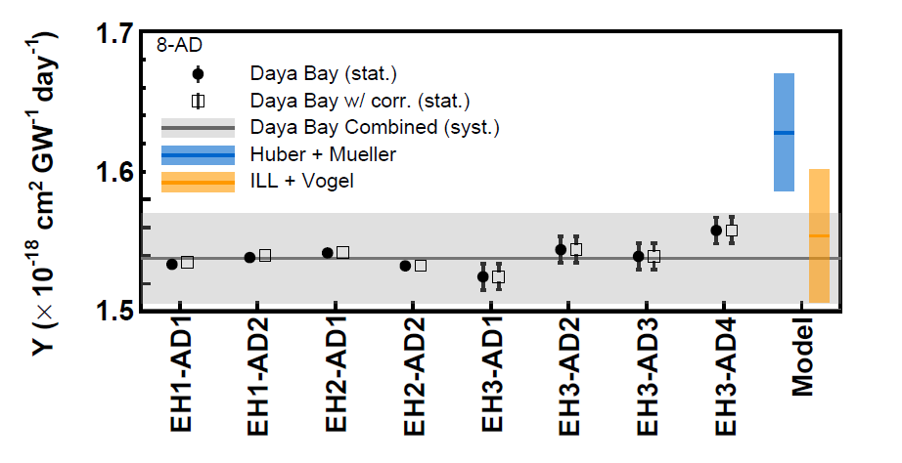
Reactor antineutrino flux measurement
621 days data
  217 days x 6AD + 404 days x 8AD
Chinese Physics C, 2017, 41(1): 13002-013002
IBD yield
Reactor antineutrino flux:
  Data/Prediction (Huber+Mueller) :0.946 ± 0.020
    Reactor antineutrino anomaly
  Data/Prediction (ILL+Vogel): 0.992 ± 0.021
IBD yield measurement consistent among 8 ADs
Measurement consistent with the global average of the previous short baseline experiments
Notes:
Absolute flux and spectrum are measured with the absolute detection efficiency and energy scale. Correlated uncertainties are used, different from θ₁₃ study
Discrepancy with Huber+Mueller model could be due to underestimated uncertainties in the prediction, and/or the existence of a sterile neutrino.

Slide 10
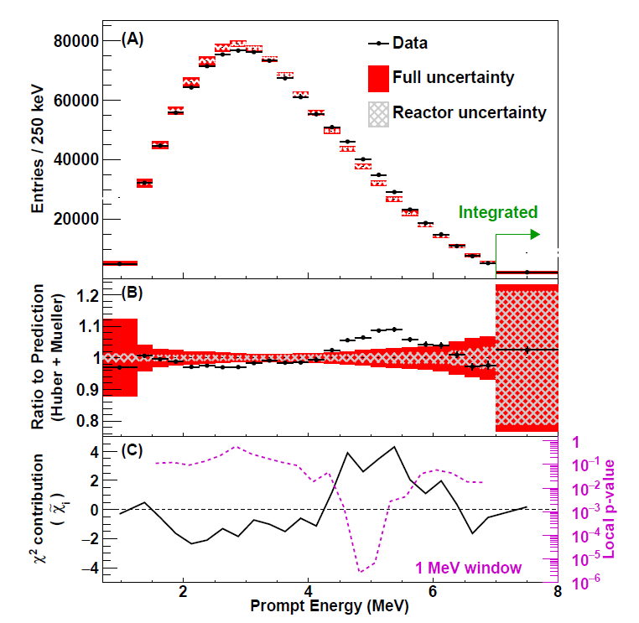
Reactor antineutrino spectrum measurement
621 days data with more than 1.2 million IBD candidates
  high-statistic reactor antineutrino spectrum measurement
A 2.9 σ deviation compared to Huber+Mueller model prediction;
Event excess in 4~6 MeV region(4.4 σ )
  Excess events characteristics are same as IBD events, correlated with reactor power but time independent
  Ruled out detector effects
    There are no event excess for the spallation ¹²B beta spectra at same energy range
Chinese Physics C, 2017, 41(1): 13002-013002

Slide 11

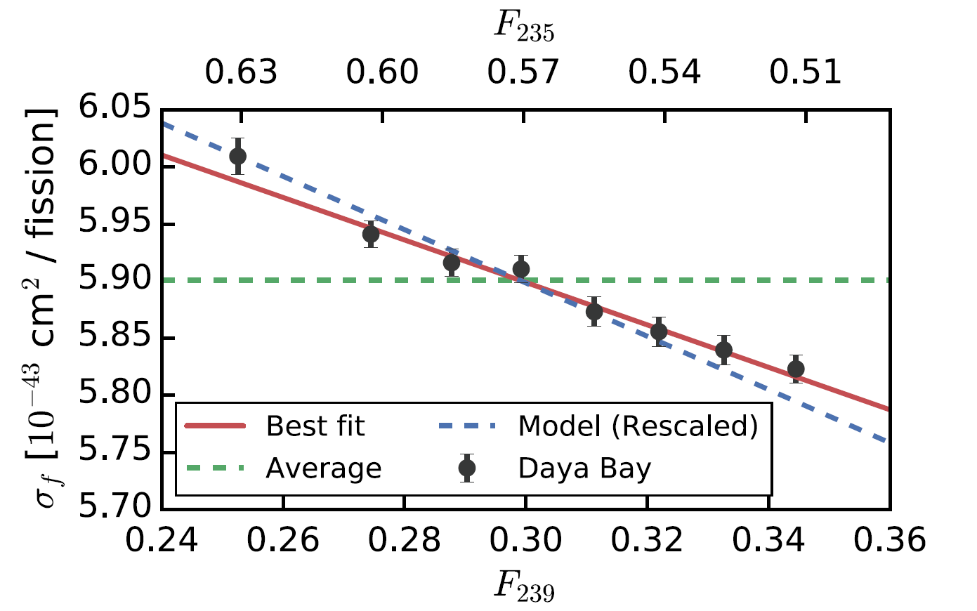
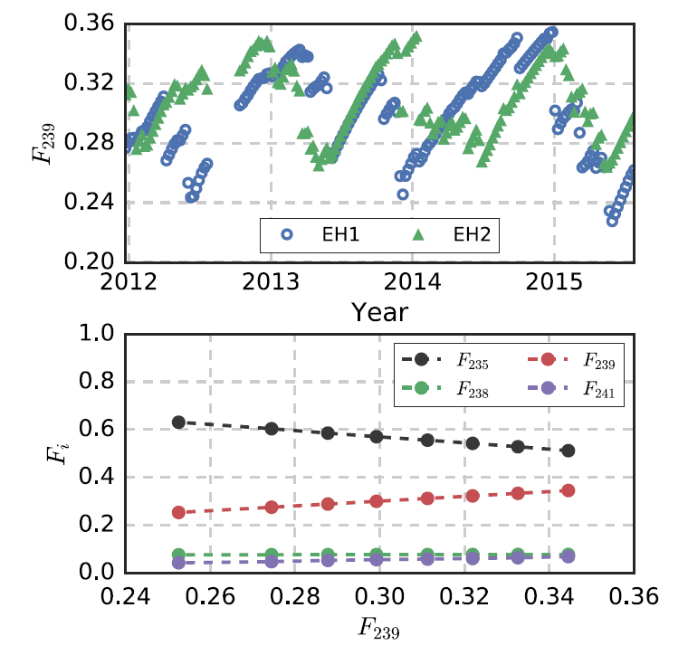
Reactor antineutrino flux evolution
Analysis of dependence of IBD yield/fission σi for each fission isotope (i = ²³⁵U, ²³⁸U, ²³⁹Pu, ²⁴¹Pu ) on effective fission fraction.
Effective fission fraction (Fi): Weighted by power (W), survival, probability (p), baseline (L) over 6 reactor cores
Phys. Rev. Lett. 118.251801
Unit
Daya Bay | 5.90±0.13 | -1.86±0.18
Huber-Mueller Model | 6.22±0.14 | -2.46±0.06
1230 days, near detectors
5.1% difference in predicted and measured in .
Notes:
fission fractions F239 from 0.25 to 0.35

Slide 12
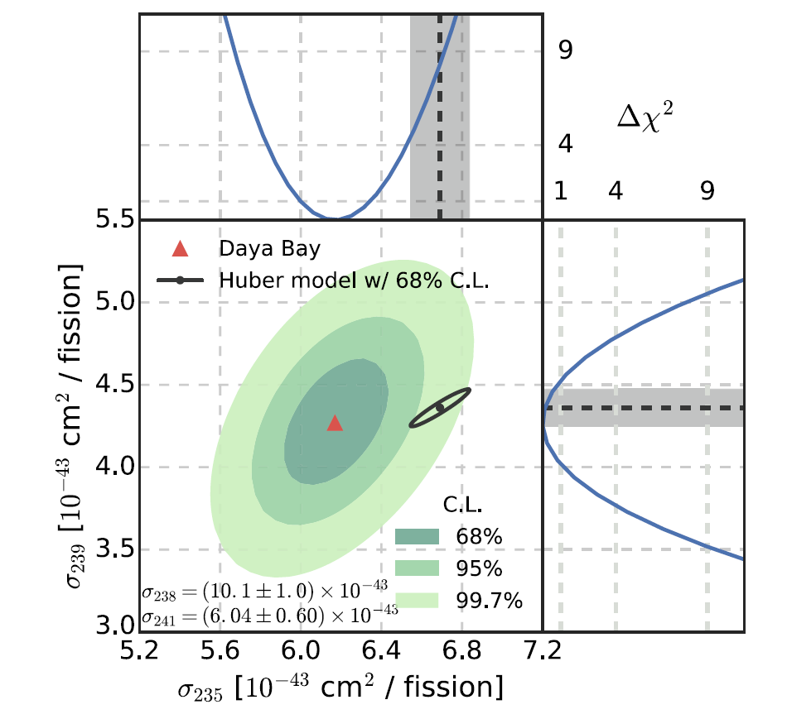
Evolution of reactor antineutrino flux
Fits to Individual Isotopes ²³⁵U & ²³⁹Pu
Assume loose (10%) uncertainties on sub-dominant ²³⁸U & ²⁴¹Pu (central values taken from Huber-Mueller model)
Unit
Daya Bay | 6.17±0.17 | 4.27±0.26
Huber-Mueller Model | 6.69±0.15 | 4.36±0.11
Measurement of ²³⁵U yield is 7.8% lower than predicted.
  Significantly larger than the 2.7% measurement uncertainty
Overestimated contribution from ²³⁵U ?
It may be the primary contributor to the reactor antineutrino anomaly.
Notes:
fission fractions F239 from 0.25 to 0.35

Slide 13
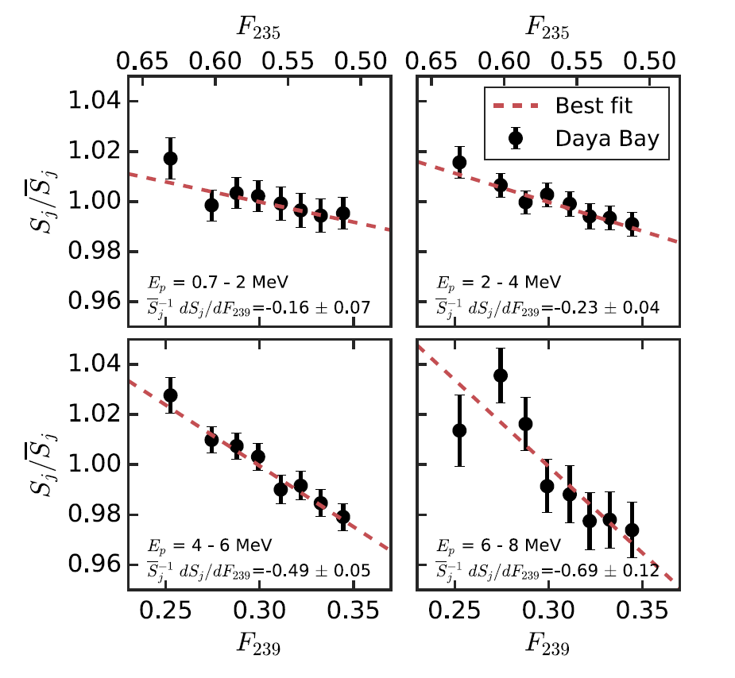
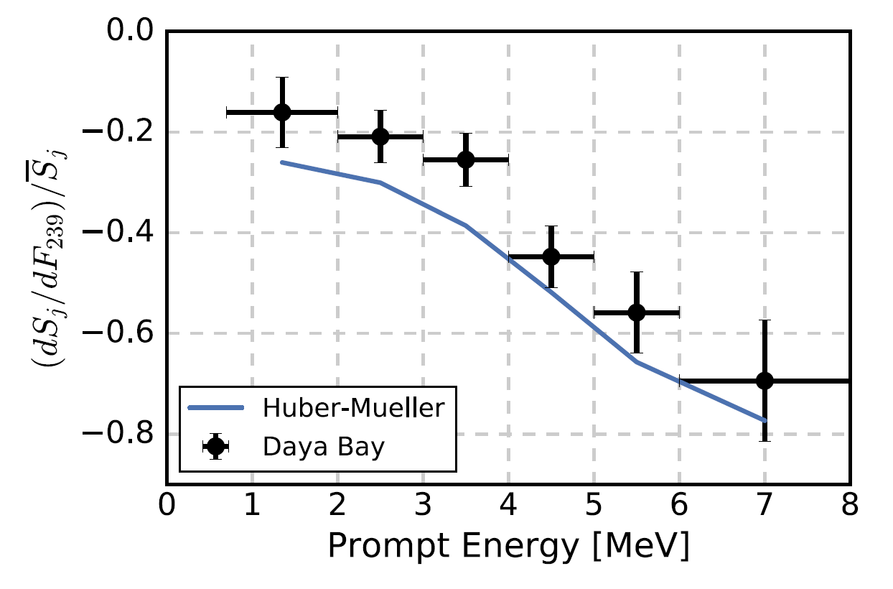
Evolution of the reactor antineutrino Spectrum
Observed IBD spectra per fission, S, the sum of IBD yields in all prompt energy bins.
: F239-averaged IBD yield per fission value.
Y axis is the ratio of .
X axis: fractional variation in IBD yield.
The trend is generally consistent with prediction
4 different energy bins for the analysis
Energy-dependent evolution is observed
Change in spectral shape as fuel composition evolves.
First unambiguous measurements of this Behavior
Notes:
fission fractions F239 from 0.25 to 0.35

Slide 14
Summary
Reactor antineutrino oscillation results:
  nGd, 1230 days’ data
  nH, rate analysis
Reactor antineutrino flux and spectrum
    Flux is consistent with previous short baseline experiments
    Spectrum different from prediction with significance 4.4σ in 4-6 MeV energy region
Evolution of reactor antineutrino flux and spectrum
    IBD yield per fission from individual isotopes (²³⁵U, ²³⁹Pu, ²³⁸U, ²⁴¹Pu) are measured
    IBD yield of ²³⁵U is 7.8% lower than prediction
  Search for light sterile neutrino
  No hint of light sterile neutrino observed. Most stringent limit for
  Excluded parameter space allowed by MiniBooNE& LSND for
The experiment is expected to continue running until 2020.
  Expect to get uncertainty in oscillation parameters to below 3%
(Phys. Rev. D 93, 0720 (2016))
(Phys. Rev. Lett. 117 ,151802(2016); Phys. Rev. Lett. 117, 151801 (2016))

Slide 15
Thanks

Slide 16
Backup

Slide 17
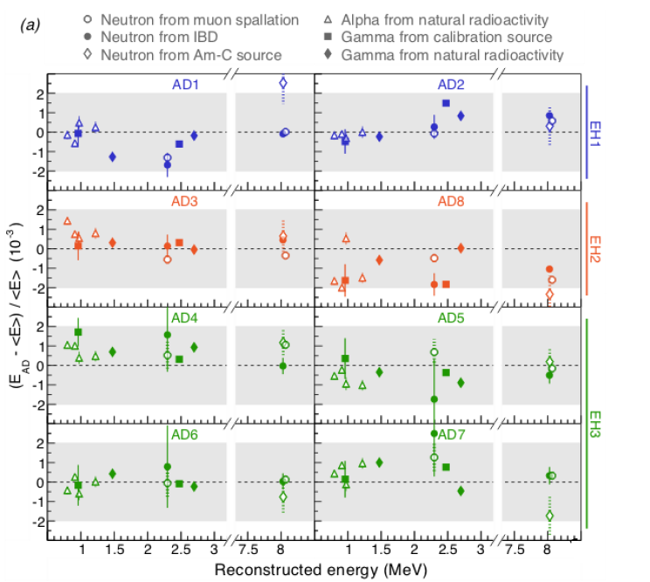
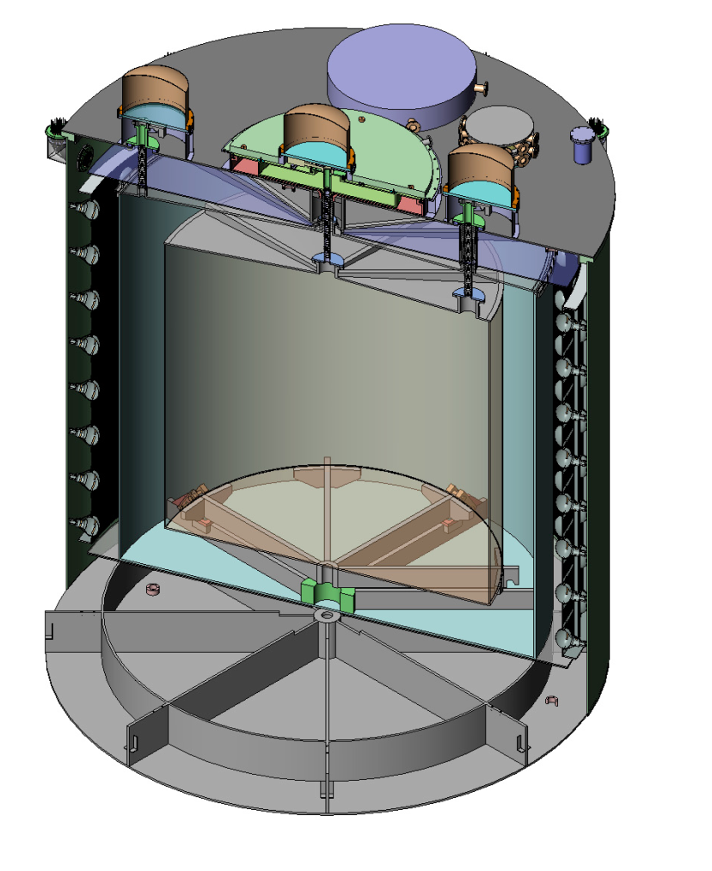
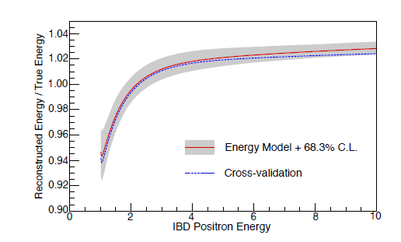
Energy Calibration
3 Automatic calibration units (ACUs) on each detector
Use different sources to calibrate the neutrino detector.
Energy scale, time variation, non-uniformity, non-linearity.
R=1.7725 m
R=0
R=1.35m
Energy non-linearity calibration
Nominal energy model: fit to mono-energetic gamma lines and ¹²B beta-decay spectrum
Cross-validation model: fit to ²⁰⁸Th, ²¹²Bi, ²¹⁴Bi beta-decay spectrum, Michel electron
Use two methods and get the consistent results.
<1% uncertainty in most energy ranges (>2MeV)
Check with various sources from 0.8MeV to 8MeV;
Relative energy scale uncertainty for nGd analysis: 0.2%

Slide 18
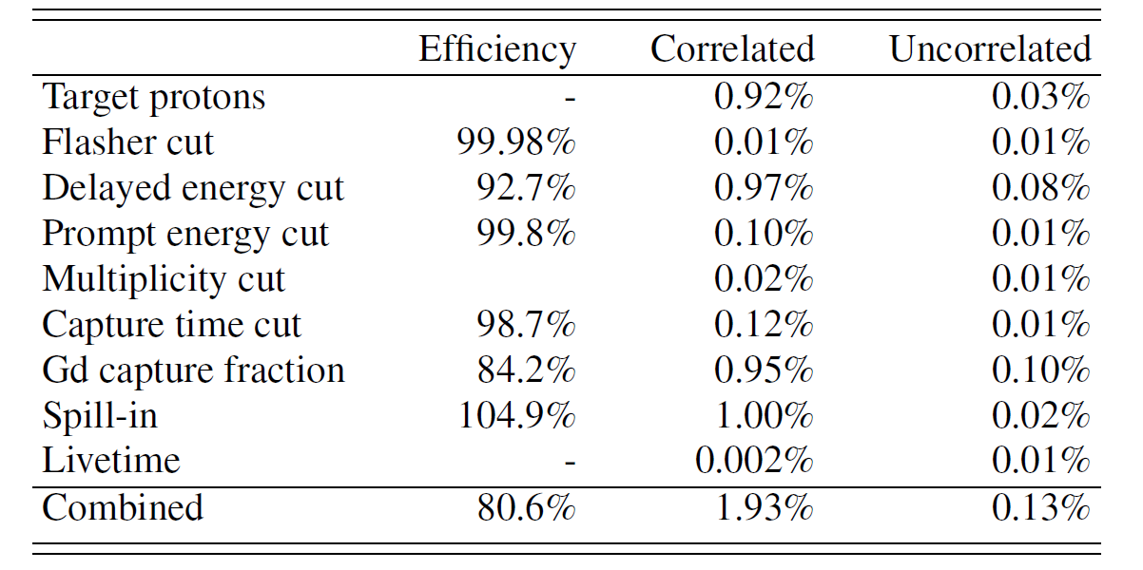
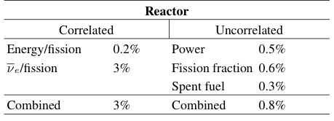
Uncertainty Summary
For near/far oscillation, only
uncorrelated uncertainties
are used.
Influence of uncorrelated reactor systematics reduced by far vs. near measurement.

Slide 19
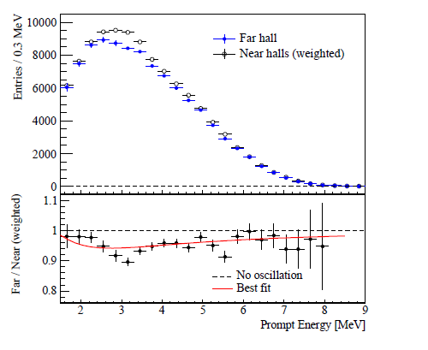
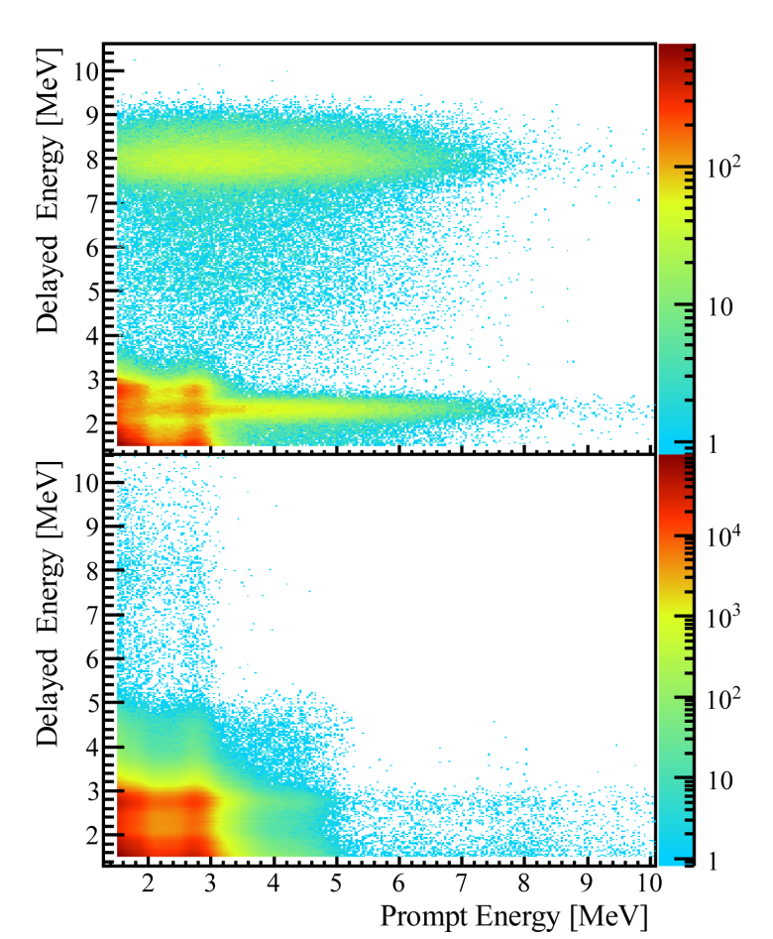
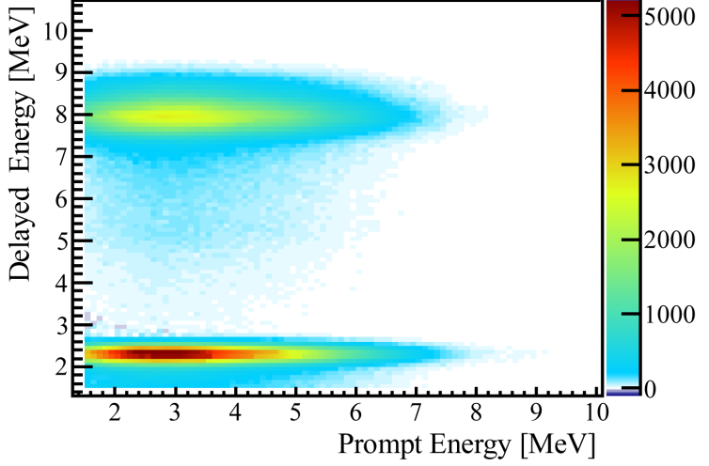
Oscillation measurement(nH)
Phys. Rev. D 93, 0720 (2016)
Double Coincidence
Accidental background prediction
Independent measurement of theta13
Challenge of the analysis
  High accidental background and more energy leakage at the edge of detector
  Increase energy threshold, consider the correlation in space , details study the backgrounds
Rate only results
After accidental background subtraction
Notes:
Version for new nH result
PRD result:
sin^2 2𝜃_13=0.083±0.018
precision 22%, now is 15%

Slide 20
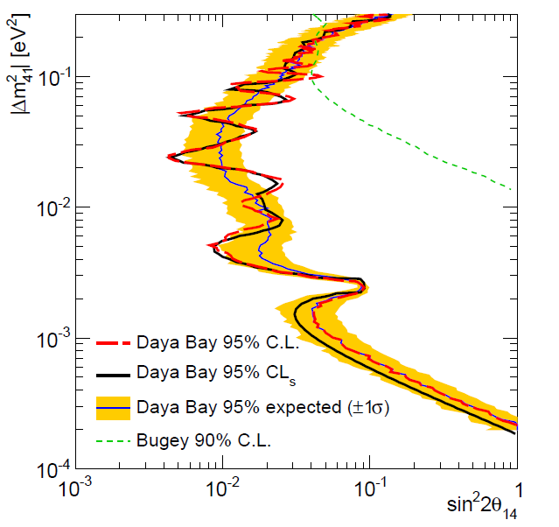
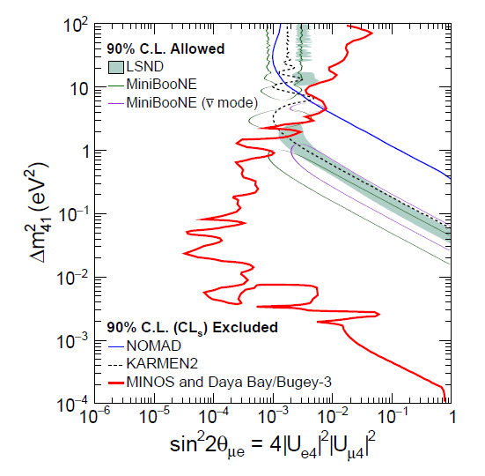
Search for light sterile neutrino
Sterile neutrino(3+1)
Phys. Rev. Lett. 117, 151801 (2016)
Phys. Rev. Lett. 117 ,151802(2016)
DayaBay + MINOS + Bugey-3
Obtain world’s best limits in region spanning more than three orders of magnitude:
No hint of light sterile neutrino observed.
•Most stringent limit for
Excluded parameter space allowed by MiniBooNE& LSND for

