Slide 1

SuperCDMS & Radon
Ray Bunker
Topics in Astroparticle and Underground Physics
July 26, 2017

Slide 2
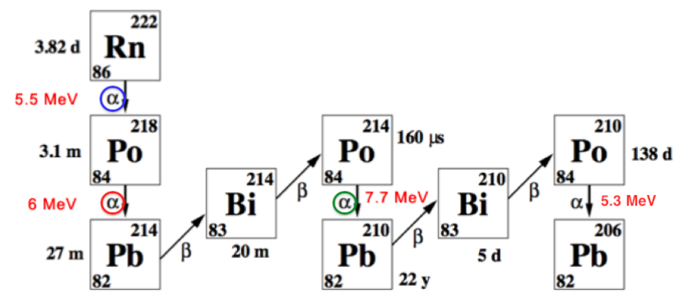
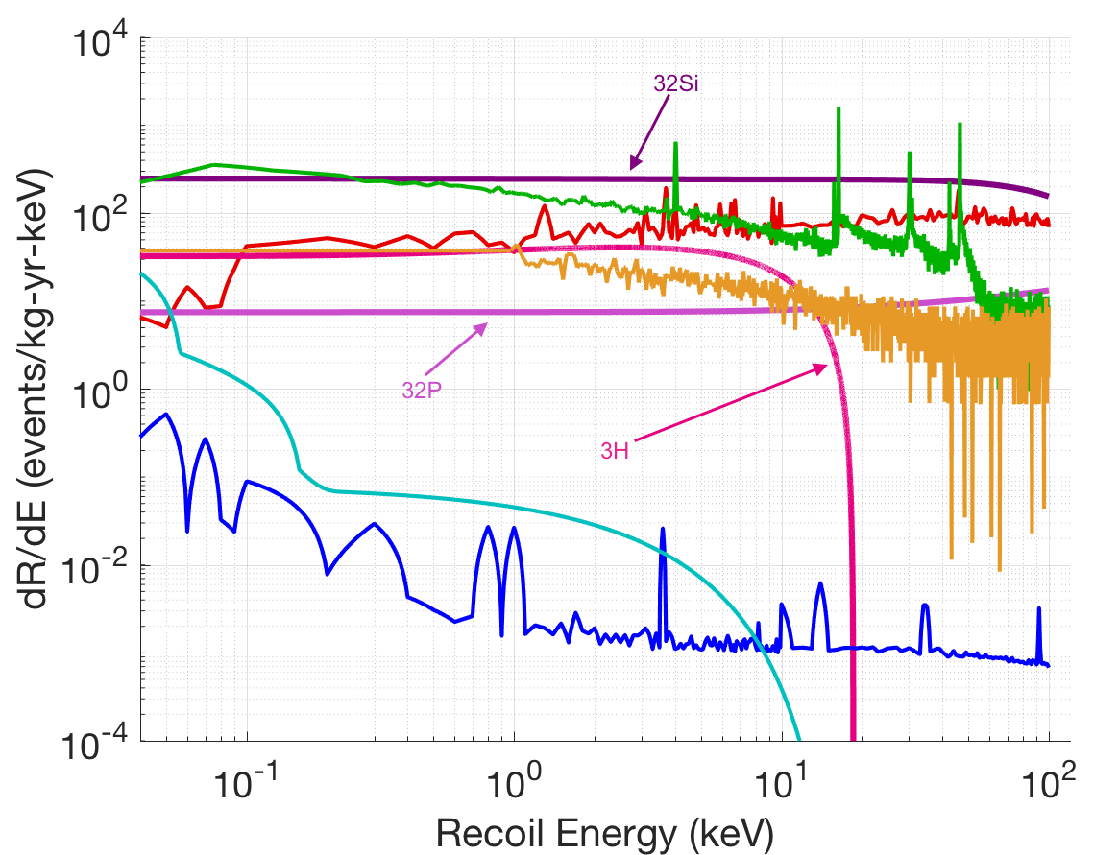
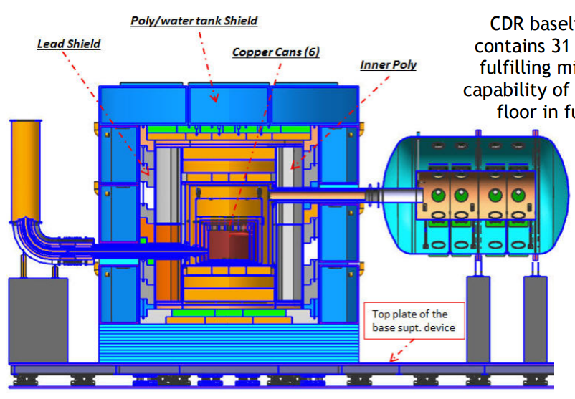
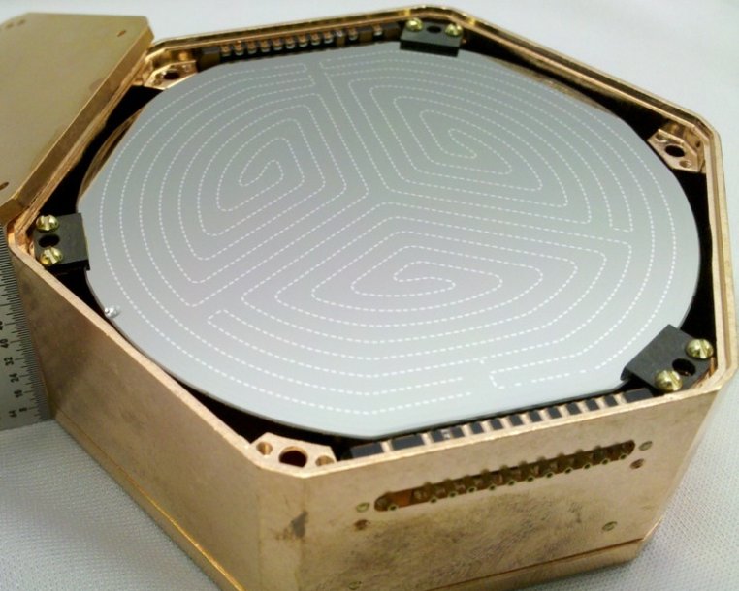
Radon Backgrounds
Radon Decay Chain
α
α
α
Non-line-of-sight (penetrating) Backgrounds:
Electron recoils:
→ ²¹⁰Bi bremsstrahlung
(limit exposure of surfaces to radon)
→ ²¹⁴Pb & ²¹⁴Bi gamma-rays
(purge lead shield with low-Rn gas)
Nuclear Recoils:
→ ²¹⁰Po (α,n) on ¹³C in poly
(limit exposure of surfaces to radon)
SNOLAB Detector Backgrounds
³²Si
Betas
Photons
²⁰⁶Pb
recoils
³²P
³H
Solar neutrinos
Inner surface
of lead shield
Inner poly surfaces & Interstitial air gaps
Neutrons
Cryostat surfaces
Dilution fridge
Non-line-of-sight
Radon Background
<1% of Total Nuclear Recoil
Neutron Background
Non-line-of-sight
Radon Background
≈1% of Total Electron Recoil
Photon Background

Slide 3
Radon Backgrounds
Radon Decay Chain
α
α
α
Line-of-sight (non-penetrating) Backgrounds:
Electron recoils:
→ ²¹⁰Pb & ²¹⁰Bi betas and x-rays
Nuclear Recoils:
→ ²⁰⁶Pb recoils from ²¹⁰Po decays
SNOLAB Detector Backgrounds
³²Si
Betas
Photons
²⁰⁶Pb
recoils
³²P
Potentially dominant backgrounds unless:
Detector/copper surfaces clean at start
And protected from radon thereafter
³H
Solar neutrinos
Neutrons
Detector-surface Backgrounds
²¹⁰Pb
²⁰⁶Pb
recoil
x-ray
Calls for dedicated background controls:
Limit exposure to radon during payload lifecycle
Dedicated low-radon cleanroom at SNOLAB
Validate cleanliness of critical processes
Line-of-sight
Radon Background
≈100% of Detector-surface
Nuclear Recoils
Line-of-sight
Radon Background
≈100% of Detector-surface
Electron Recoils
copper housing
detector
²¹⁰Po
β
²¹⁰Bi
adjacent detector

Slide 4
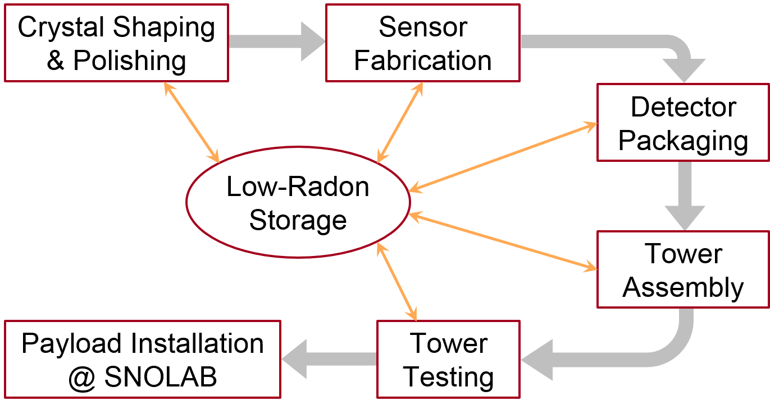
Payload Lifecycle & Radon Exposure
#2
#3
Procedure | ²¹⁰Pb (nBq/cm²)
#1 – storage | <0.1
#2 – polishing | 12–45
#3 – fabrication | 28
#4 – packaging | 4.8
#5 – tower assembly | 0.9
#6 – testing | 1.1
#7 – installation (w/ 1000x Rn mitigation) | <0.1
#7 – installation (w/o Rn mitigation) | 70
#4
#1
#5
#7
#6
²¹⁰Pb from Rn exposure (conservative plate-out tally):
Detector surfaces: 47–80 nBq/cm²
  Assume worst for sidewalls → 80 nBq/cm²
  Sensor fab removes surface area on faces → 50 nBq/cm²
Copper surfaces: <10 nBq/cm²
Plate-out ≈2x larger without low-radon cleanroom

Slide 5
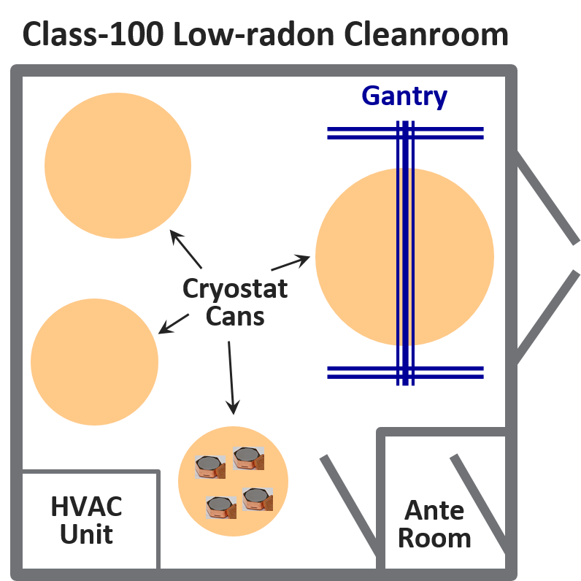
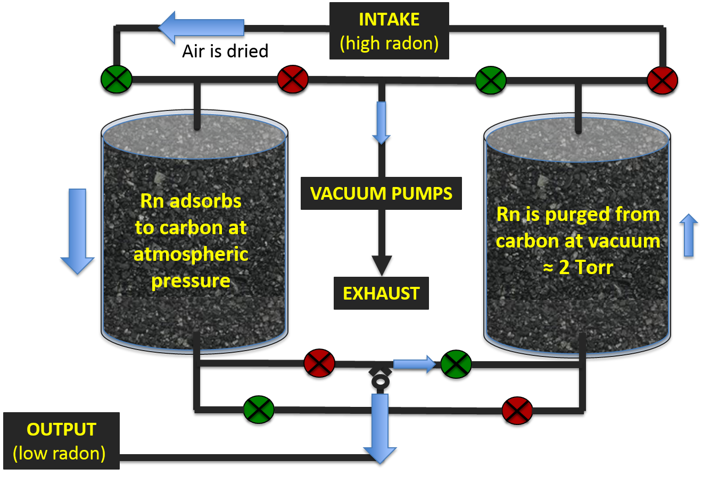
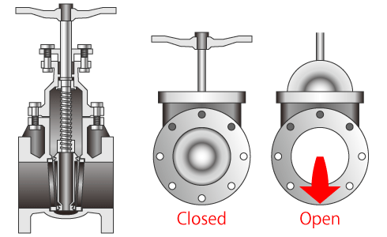
Low-radon Cleanroom @ SNOLAB via Vacuum-Swing Adsorption (VSA)
Custom-built Radon Mitigation System
SNOLAB General
Lab Air ≈130 Bq/m³
Radon-mitigated Air
<0.1 Bq/m³

Slide 6
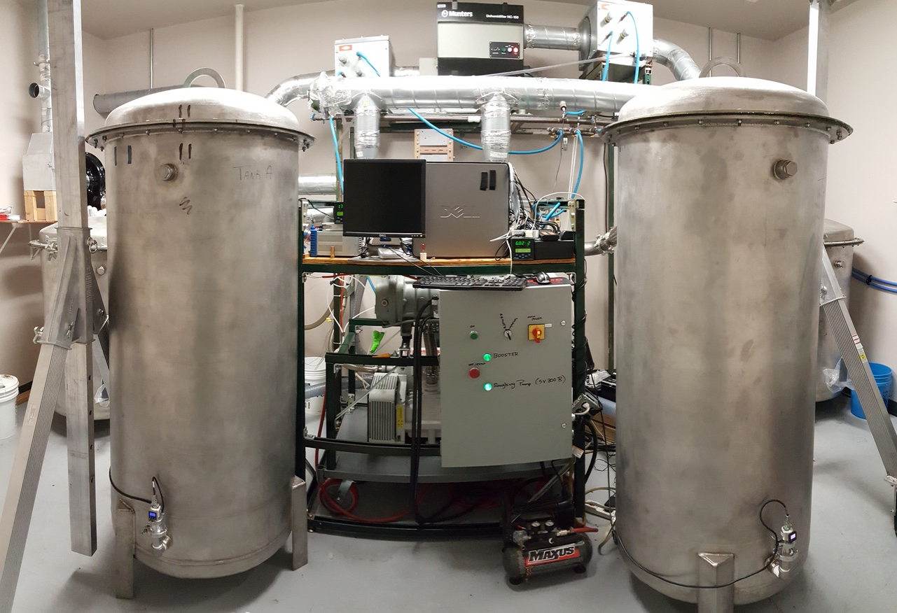
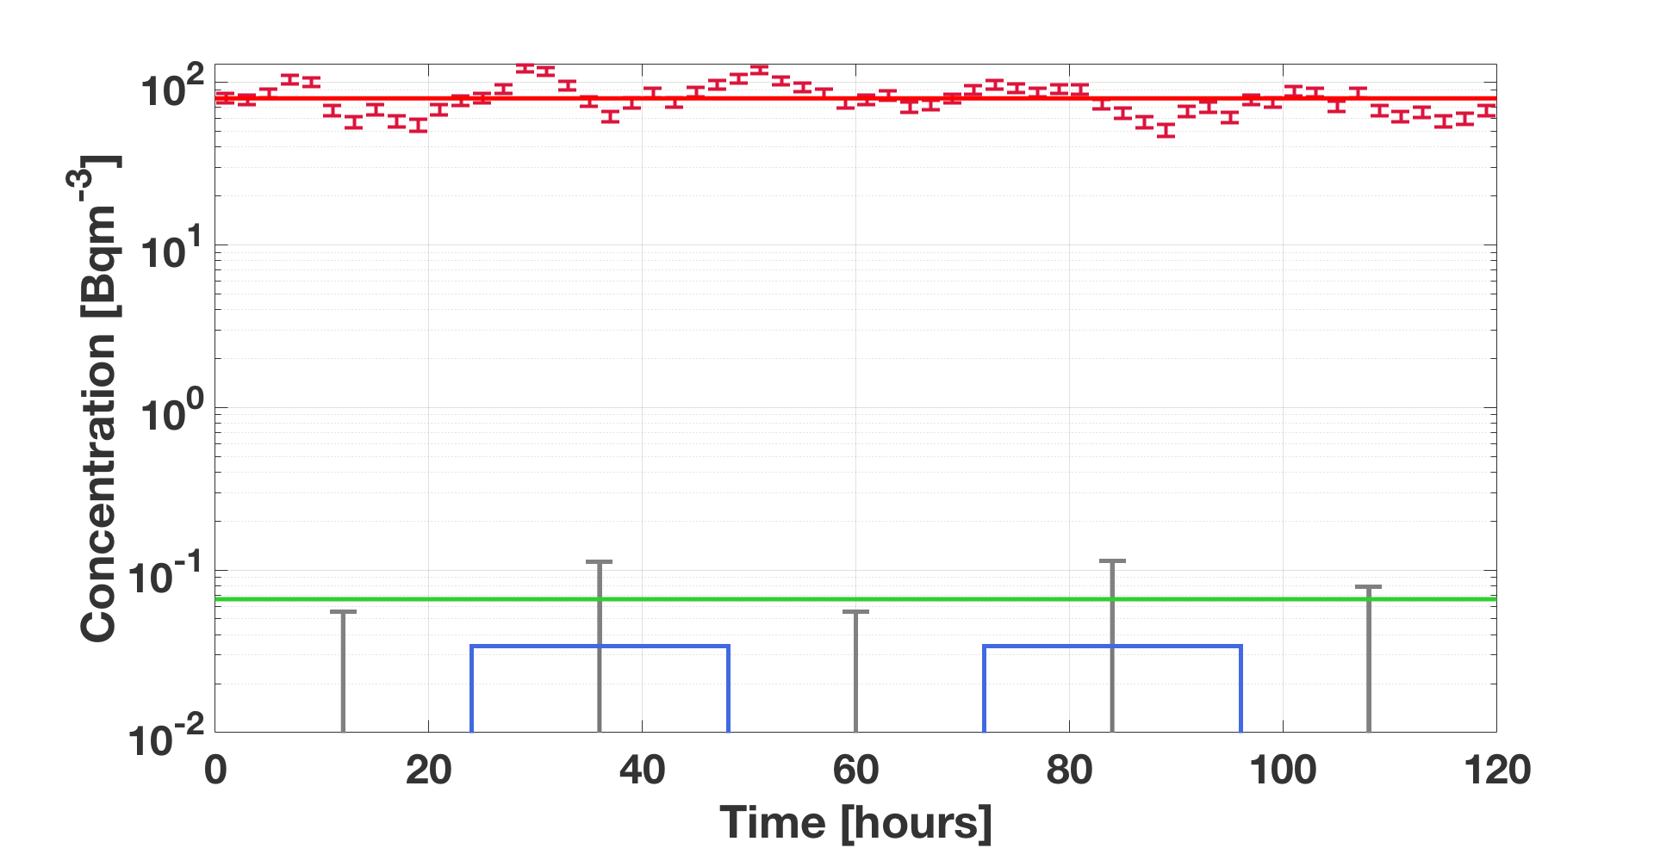
Demonstration VSA @ SDSM&T
Input Air
<Rn> = 80 Bq/m³
Simultaneous RAD7 Readings
Cleanroom Radon
Level <0.07 Bq/m³ → >1000x reduction!

Slide 7
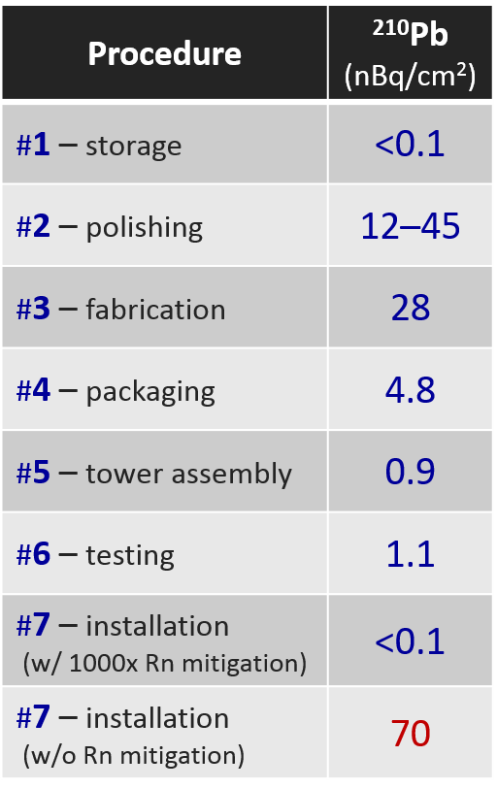




Validation of Critical Processes
Σ
Bottom-up estimate of ²¹⁰Pb plate-out from radon exposure in air:
  Detector surfaces: 50/80 nBq/cm² for faces/sidewalls
  Tower-copper surfaces: <10 nBq/cm²
But doesn’t include:
Initial level of surface contamination
→ do surfaces start clean?
Contamination directly from fabrication processes
(e.g., chemical contact)
R&D tests to validate critical processes:
  Detector surfaces → crystal polishing & sensor fabrication
  Copper surfaces → cleaning method

Slide 8
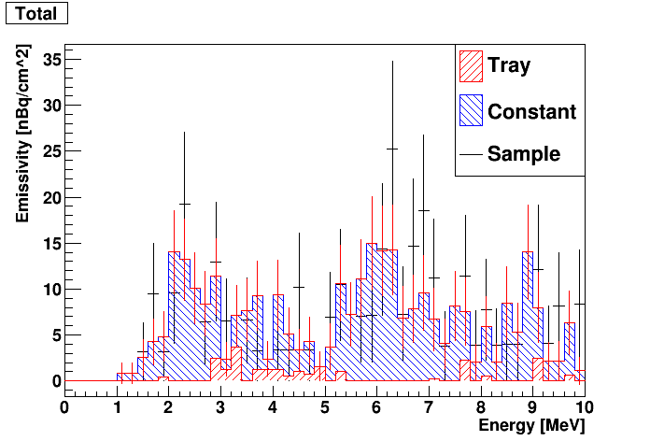
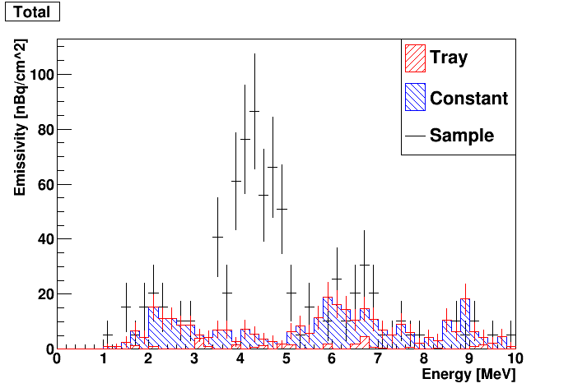
Sensor Fabrication Test
XIA UltraLo-1800 Spectra (SMU)
Goals:
Validate starting level of ²¹⁰Pb on detector surfaces
Validate surface contamination from sensor fabrication
Results:
Broad 4–5 MeV peak suggests upper-chain ²³⁸U alphas
Precedent from DRIFT → Battat et al., NIM A794 (2015)
Background concern → ²³⁴Th daughter beta decay
Follow-up measurements:
  Backsides of wafers → no peak
  ICP-MS of wafers → few Bq/kg of ²³⁸U in aluminum
²¹⁰Po
Background
Sample
Etch wafers
at Stanford
fab facility
Assay in SMU UltraLo-1800
Fab sensor pattern at Stanford
Assay in SMU UltraLo-1800
40 nm pc-Si
40 nm W
600 nm Al (35%)
    Si wafer substrate
²¹⁰Po
uranium
alphas
Background
Sample
Not seen on SuperCDMS Soudan detectors
Working with vendor to pre-screen aluminum

Slide 9
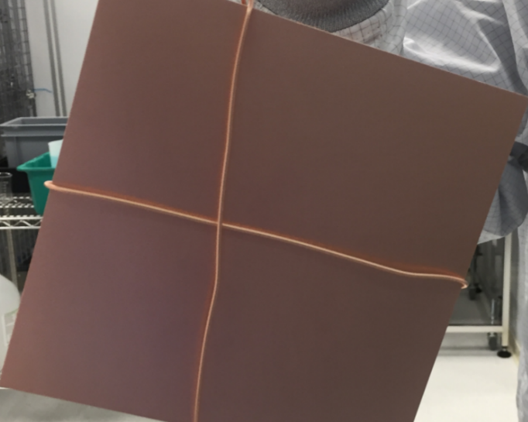
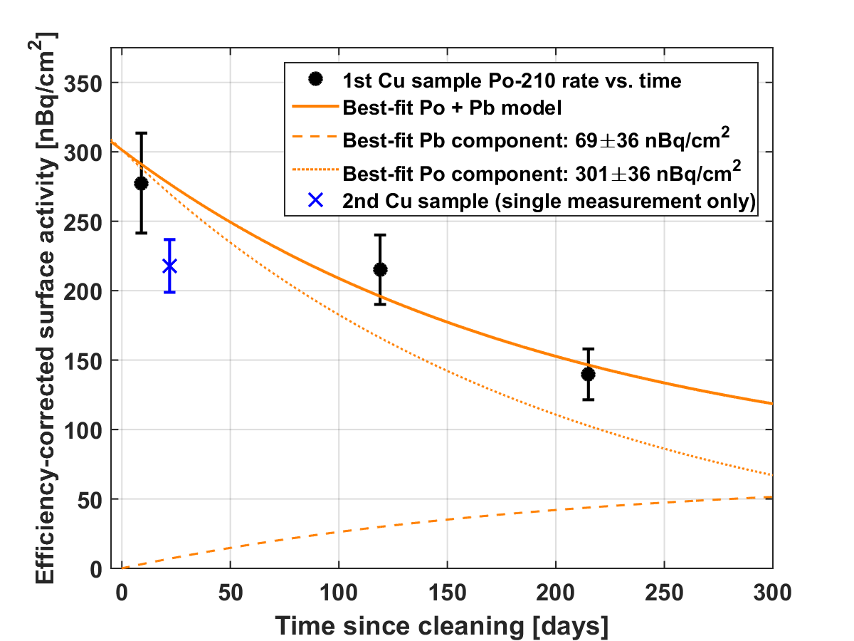
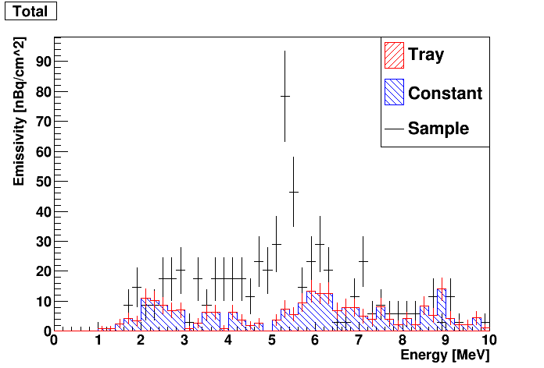
Copper Cleaning Test
1st Test Sample
Goal:
Validate method for cleaning tower copper parts
  And thus starting contamination level for detector housings
Methodology:
Fabricate 2 sets of large-area Cu plates: McMaster & Aurubis OFHC (alloy 101)
Mill off >1 mm from all surfaces to simulate parts fabrication
Clean w/ PNNL acidified-peroxide etching recipe
Use SMU UltraLo-1800 to measure surface alphas
UltraLo-1800 Background not
Subtracted (≈25 nBq/cm² in ²¹⁰Po ROI)
²¹⁰Po
2nd assay of
1st test sample
Background
Sample
Po in Cu bulk
McMaster OFHC
Aurubis OFHC
Anticipate <100 nBq/cm² ²¹⁰Pb (>10x better than Soudan)

Slide 10
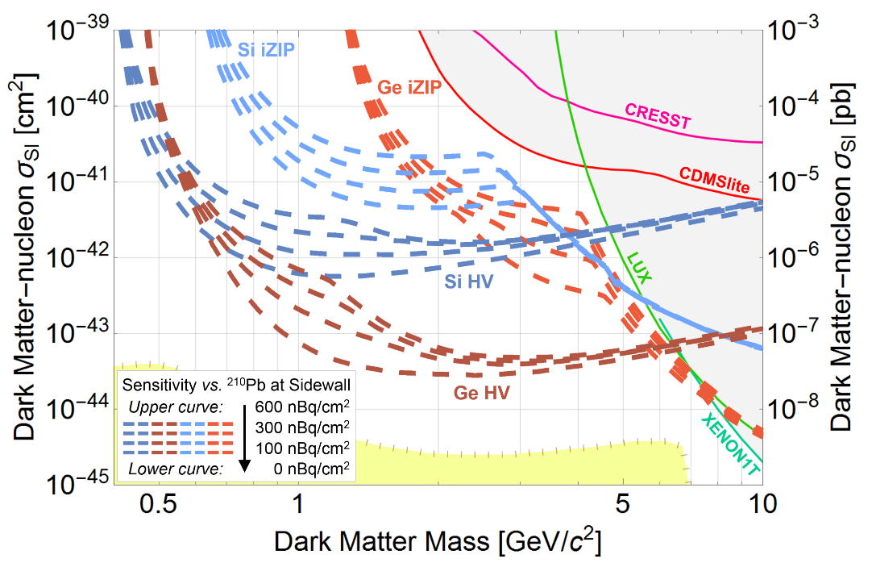
Summary
Radon is an important background
consideration for SuperCDMS SNOLAB
  ²¹⁰Pb within line-of-sight of detectors
  is a potentially dominant background
Estimate of ²¹⁰Pb from plate-out:
  Detector faces/sidewalls: 50/80 nBq/cm²
  Copper housings: <10 nBq/cm²
Low-radon cleanroom for installation
at SNOLAB mitigates plate-out by ≈2x
  SDSM&T VSA demonstrates >1000x radon reduction
Validation of critical processes:
  Contamination during crystal polishing negligible
  Discovered uranium in detector-sensor aluminum → working with vendor to eliminate
  Demonstrated copper surfaces with <100 nBq/cm² ²¹⁰Pb via PNNL acidified-peroxide etch
Demonstrated ²¹⁰Pb at sidewalls:
detector + copper <200 nBq/cm²

Slide 11
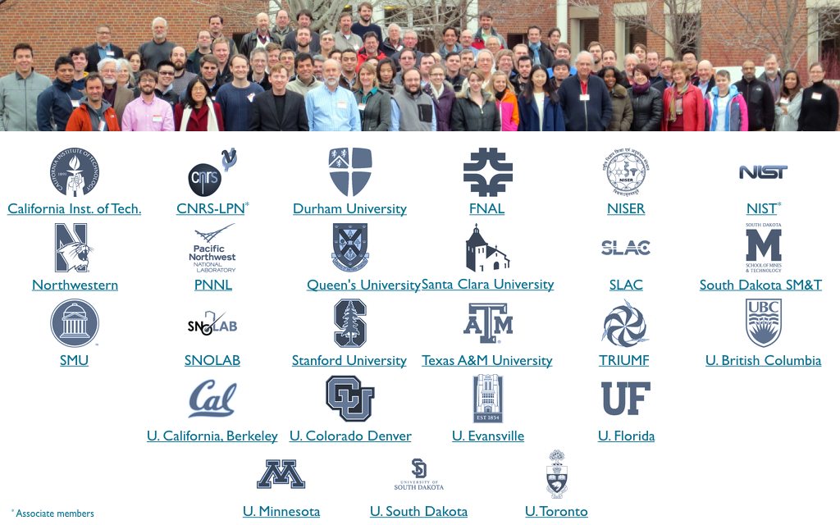
Collaboration

Slide 12
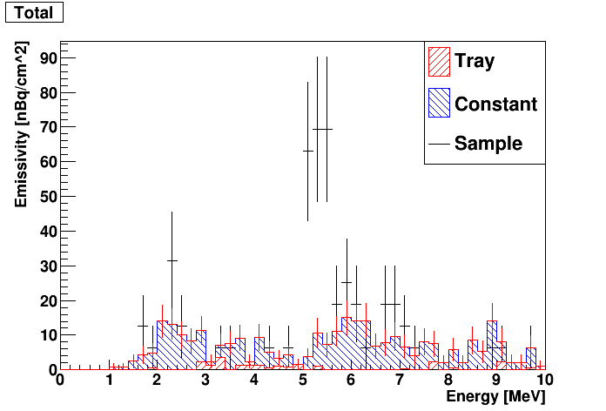
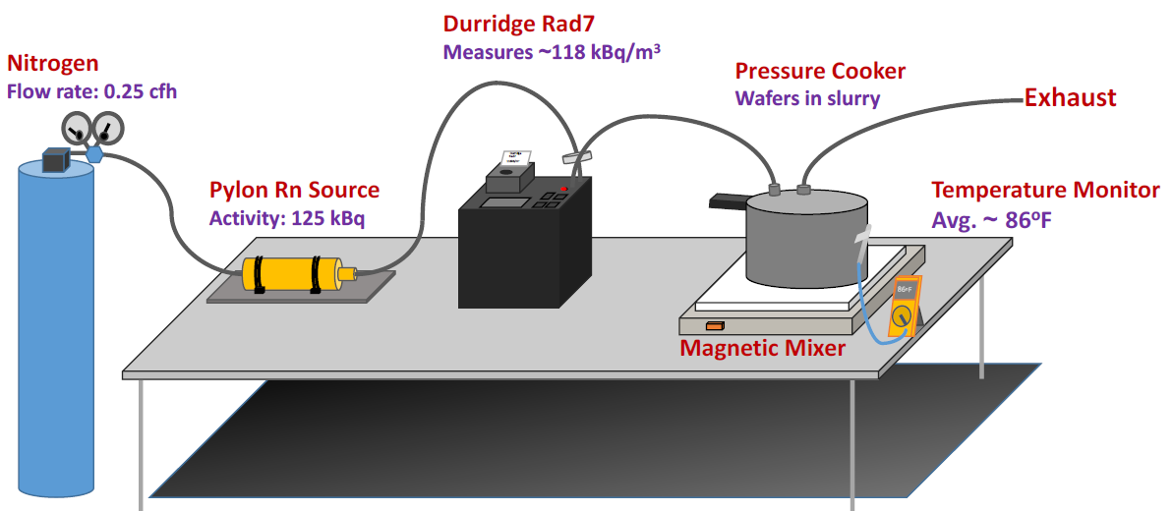
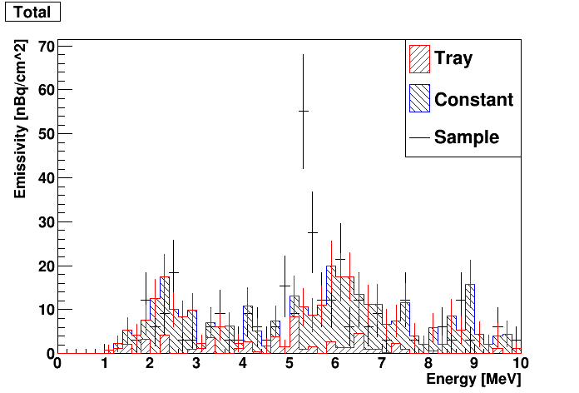
Crystal Polishing Test
Goal:
Validate ²¹⁰Pb contamination rate during polishing
Methodology:
Seven 100 mm Si wafers as proxy for detector surfaces
UltraLo-1800 to measure surface alphas
10,000x radon w/ SDSM&T source to boost sensitivity
XIA UltraLo-1800 Spectra (SMU)
²¹⁰Po
Pre-Process
<200 nBq/cm²
clean enough
for test
Background
Sample
²¹⁰Po
Post-Process
<100 nBq/cm²
Cleaner!
Mild etch from
slurry solution
Background
Sample
²¹⁰Pb surface contamination during
polishing insignificant → <1 nBq/cm²

