Slide 1


SuperCDMS
at SNOLAB
Wolfgang Rau
Queen’s University
for the
SuperCDMS Collaboration

Slide 2
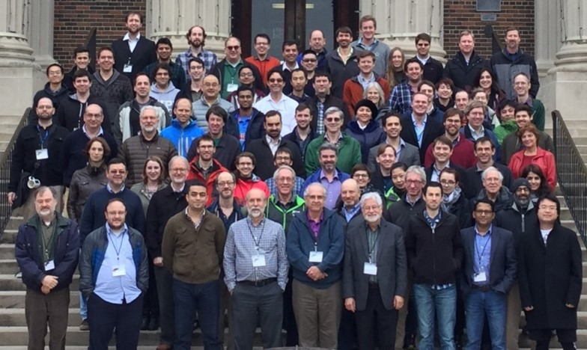
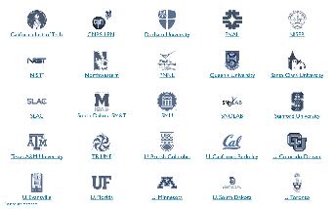

SuperCDMS Collaboration
California Institute of Technology
CNRS/LPN Durham University
Fermi National Accelerator Laboratory
NISER NIST Northwestern University
PNNL Queen’s University
Santa Clara University SLAC/KIPA
South Dakota School of Mines & Technology
SNOLAB/Laurentian University
Southern Methodist University Stanford University
Texas A&M University of British Columbia/TRIUMF
University of California, Berkeley
University of Colorado Denver University of Evansville
University of Florida University of Minnesota
University of South Dakota University of Toronto

Slide 3
SuperCDMS Technology
Implementation at SNOLAB
Status of the Project
Expected Sensitivity
CUTE (time permitting)

Slide 4
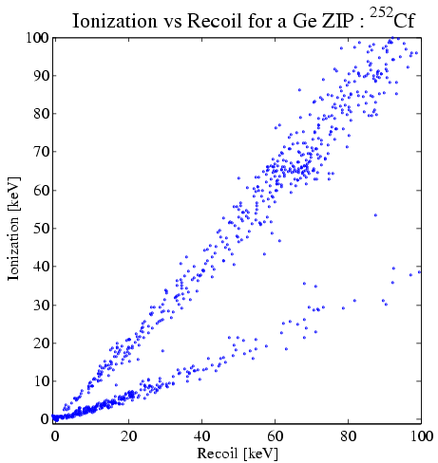
Technology
Detectors
Neganov-Luke Effect
Semiconductor
operated at
few 10s of mK
-
In Vacuum
+
i
HV
ZIP
Electron gains kinetic energy
(E = q · V → 1 eV for 1 V potential)
-
Phonon Readout:
Tungsten TES
-
In Matter
+
Add: high voltage (~70 V)
Phonons from drifting charges
Threshold < 0.1 keV (phonon)
Add: charge readout (few V)
Background discrimination
Threshold < 10 keV
Deposited energy in crystal lattice:
Neganov-Luke phonons
∝ V, # charges
R vs T
-
+
0
0 V
remove surface
background
Electron recoils:
background
large phonon signal from
charges
–
+
Charge signal
–
0
– 70 V
Luke phonons mix charge and phonon signal → reduced discrimination
Apply high voltage → large final phonon signal, measures charge!!
ER much more amplified than NR
→ gain in threshold; dilute background from ER
< 1 background event for
whole exposure
Nuclear recoils:
signal
effective threshold:
few hundred eV (NR)
Phonon signal

Slide 5
Technology
Detectors
SuperCDMS
SNOLAB
Ge / Si
100 mm ∅ x 33 mm
Operated at 30 mK
iZIP
HV
Phonon Readout:
Tungsten TES
Add: charge readout (few V)
Background discrimination
Threshold < 1 keV
Add: high voltage (~100 V)
Phonons from drifting charges
Threshold < 0.1 keV (phonon)
R vs T
+
0
+ 50 V
remove surface
background
Electron recoils:
background
large phonon signal from
charges
–
+
Charge signal
–
0
– 50 V
< 1 background event for
whole exposure
Nuclear recoils:
signal
effective threshold: few
(or one) electron-hole pairs
Phonon signal

Slide 6
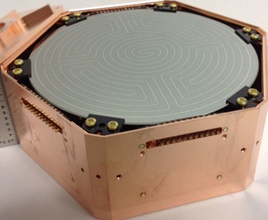
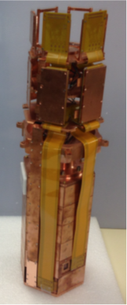
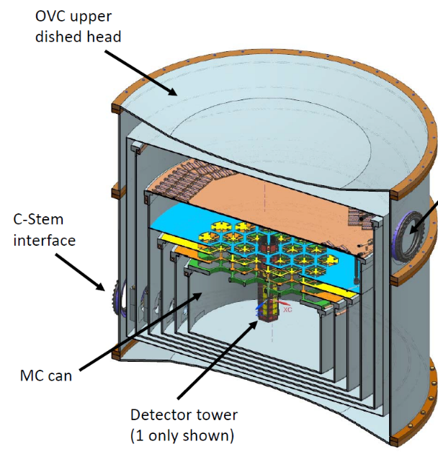
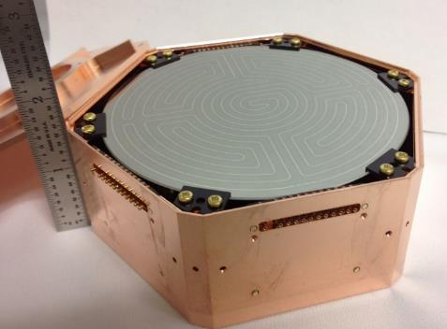

Implementation
Implementation (SNOLAB setup)
6 detectors
→ 1 tower
iZIP

Slide 7
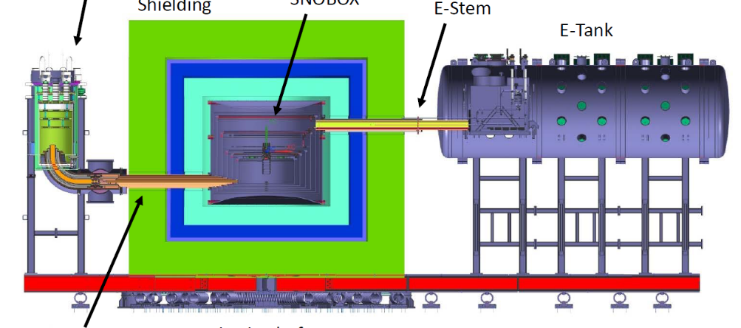
Implementation
Implementation (SNOLAB setup)
Fridge to provide
<15 mK at the detector
Signal vacuum
feedthroughs
Detector volume
(space for up to 31 “towers”)
6 detectors
→ 1 tower
30 cm HDPE
20 cm Pb
60 cm HDPE base / water
Initial Payload:
1 Ge iZIP tower (6 Ge)
1 Ge/Si iZIP tower
(4 Ge/2 Si)
2 HV towers
(4 Ge/2 Si each)
Cold finger
Additional cooling
(70 K/4 K)
Mounted on spring-loaded
platform (seismic isolation)

Slide 8
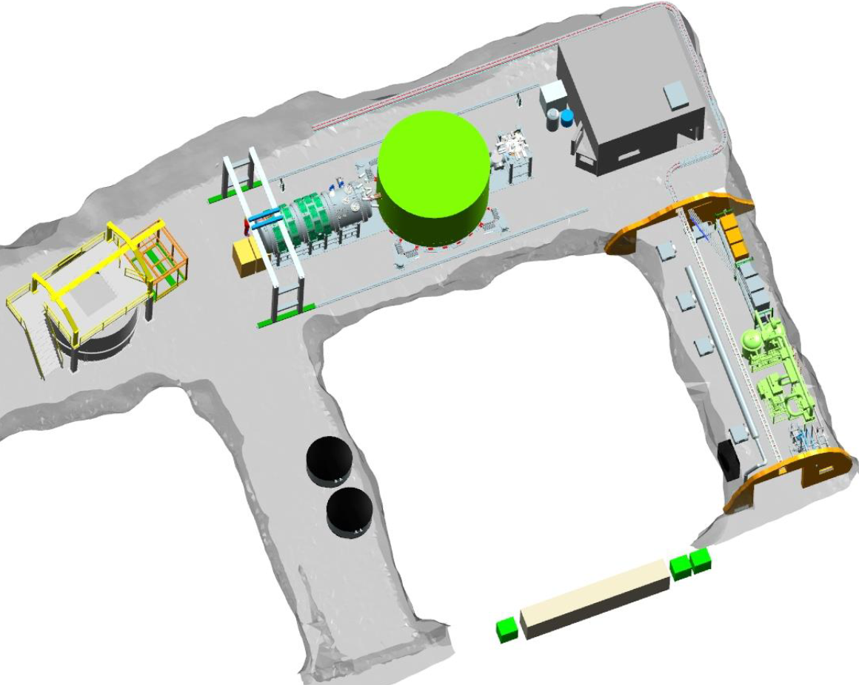
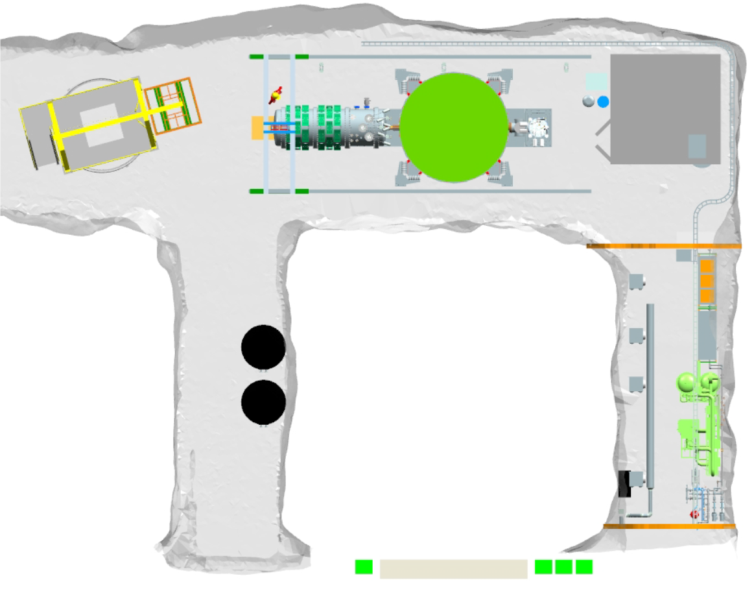
Implementation
SNOLAB
Clean
room
Experimental area
Cryo
CUTE
Backup
cooling
(ice)
Cryogenics
and radon
filter plant
Radon
filter
Access
drift

Slide 9
Status
Schedule and Funding
2013
2014
2015
2016
2017
2018
2019
CFI approved
GW 2a
Main construction phase
US G2 decision
CD 1
CFI application
CD 2/3
CD 4
Start of
operation
DOE/NSF proposals
GW 1
CAP 17
Queen’s
GW 2
Funding approved (CFI: 2012, DOE/NSF: 2014)
DOE/NSF review process:
First step passed (CD 1: conceptual design review)
Next step end of 2017: technical design review/ construction readiness (CD 2/3)
Reviews at SNOLAB:
passed Gateway 1 (space allocation) in fall 2015 / GW2a (early construction) in December 2016; upcoming: GW2 (construction) fall 2017
Total project costs ~$30M

Slide 10
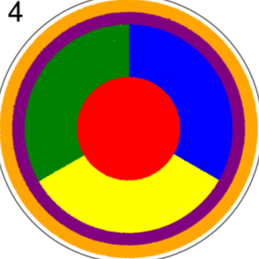
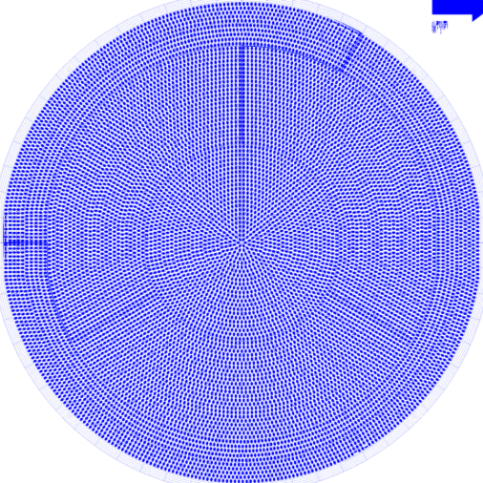
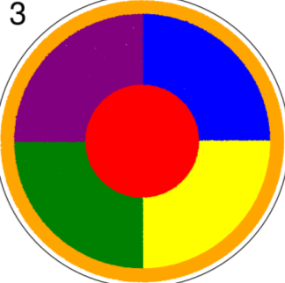
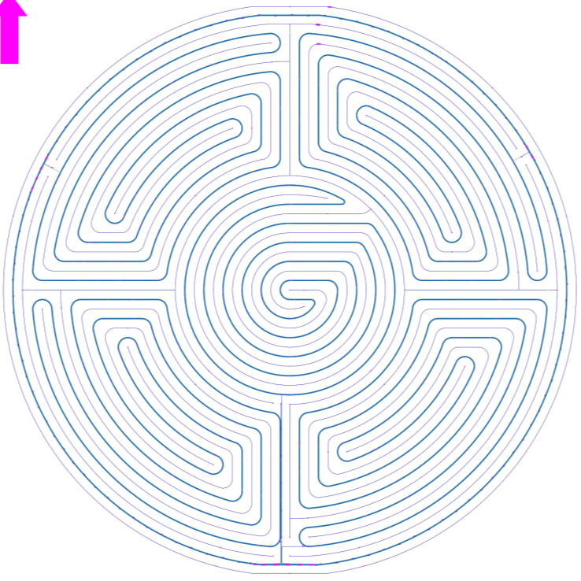
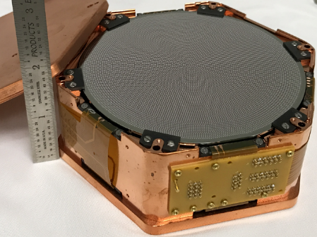
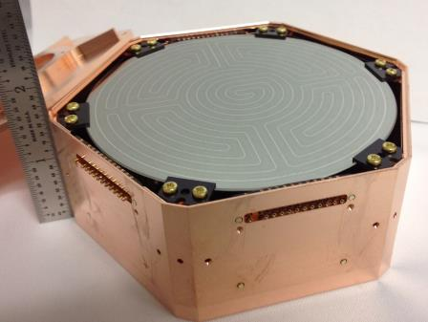
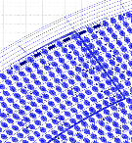

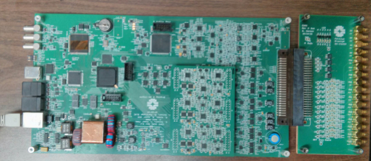
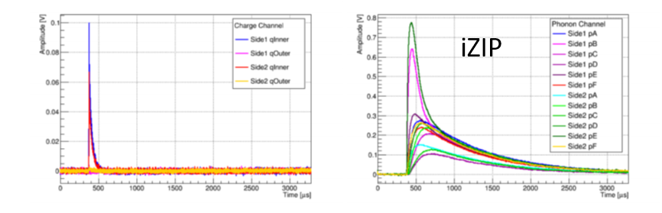
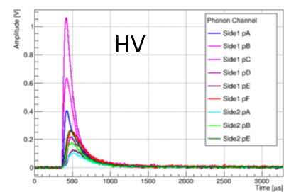
Status
Developments (selection of activities)
Detectors: larger crystals; sensor layout optimized individually for iZIP and HV
prototypes for both types been tested (using old electronics): performance meets or exceeds expectation
Detector tower (mechanical structure, wiring): design ready, mechanical prototype exists; wiring prototype exists – final version expected soon
HV
iZIP
HV
iZIP

Slide 11
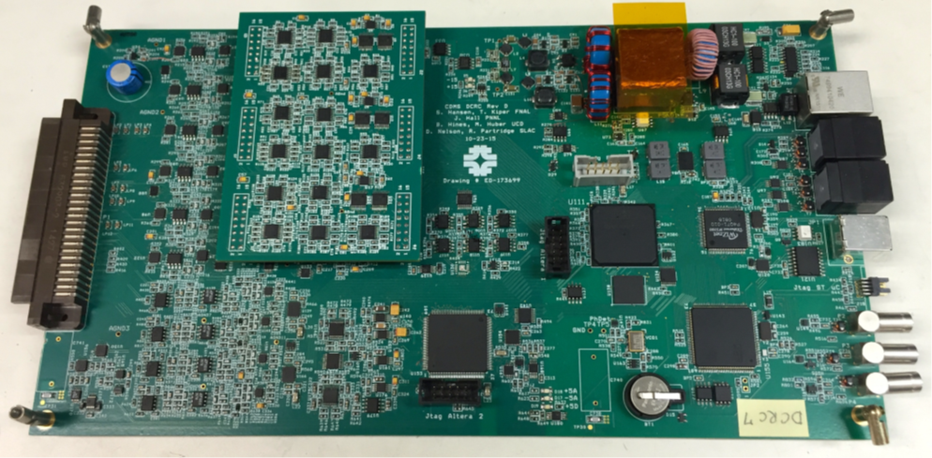
Status
Developments (selection of activities)
Detectors: larger crystals; sensor layout optimized individually for iZIP and HV
prototypes for both types been tested (using old electronics): performance meets or exceeds expectation
Detector tower (mechanical structure, wiring): design ready, mechanical prototype exists; wiring prototype exists – final version expected soon.
Readout electronics:
Preamp: thermal readout design ready; charge readout: circuits are being tested
“Warm electronics” (outside cryostat): prototype exists, tests underway

Slide 12
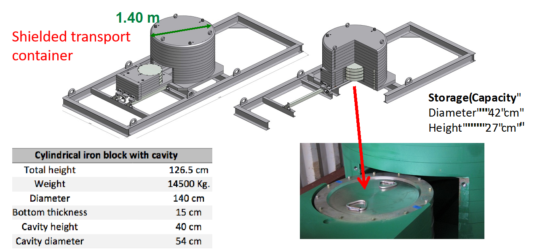
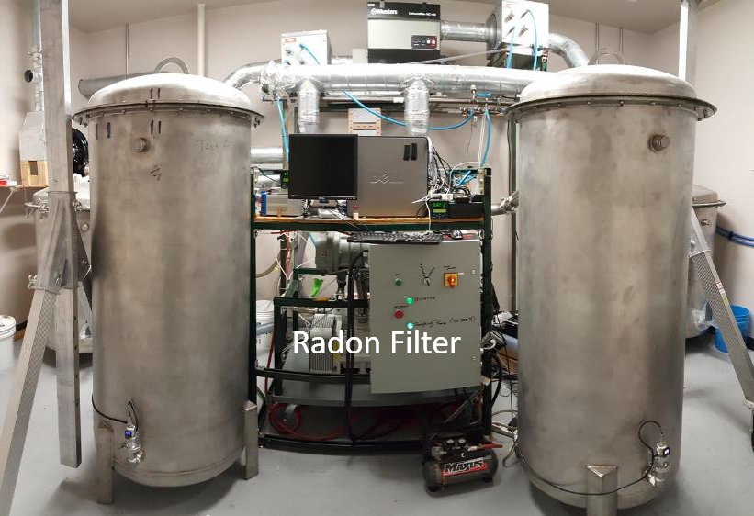
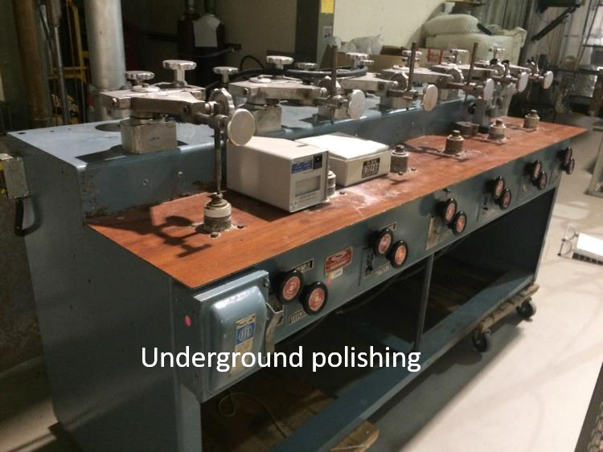
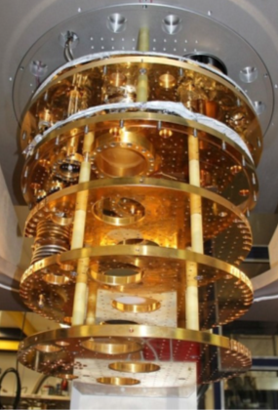
Status
Developments (selection of activities)
Detectors: larger crystals; sensor layout optimized individually for iZIP and HV
prototypes for both types been tested (using old electronics): performance meets or exceeds expectation
Detector tower (mechanical structure, wiring): design ready, mechanical prototype exists; wiring prototype exists – final version expected soon.
Readout electronics:
Preamp: thermal readout design ready; charge readout: circuits are being tested
“Warm electronics” (outside cryostat): prototype exists, tests underway
DAQ: MIDAS based, being developed at UBC with help from
TRIUMF, UofT and others
Cryogenics design completed; Dilution refrigerator is procured;
shielding: design close to complete
Backgrounds: extensive material screening; tracking and
monitoring; minimizing cosmogenic exposure; radon filter to be
installed for detector assembly cleanroom at SNOLAB
Shielded transport container
Radon Filter

Slide 13
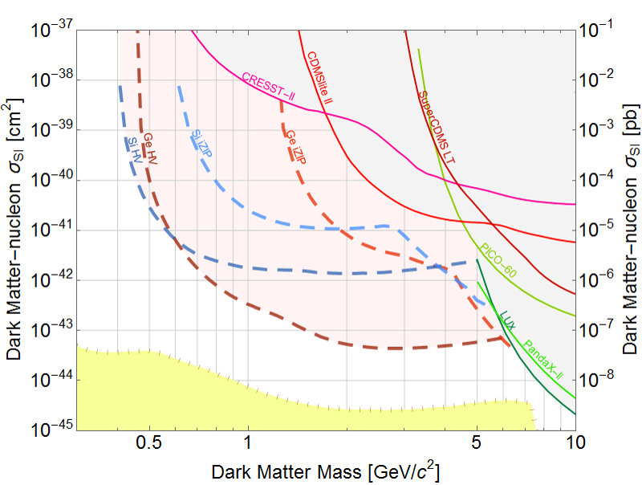
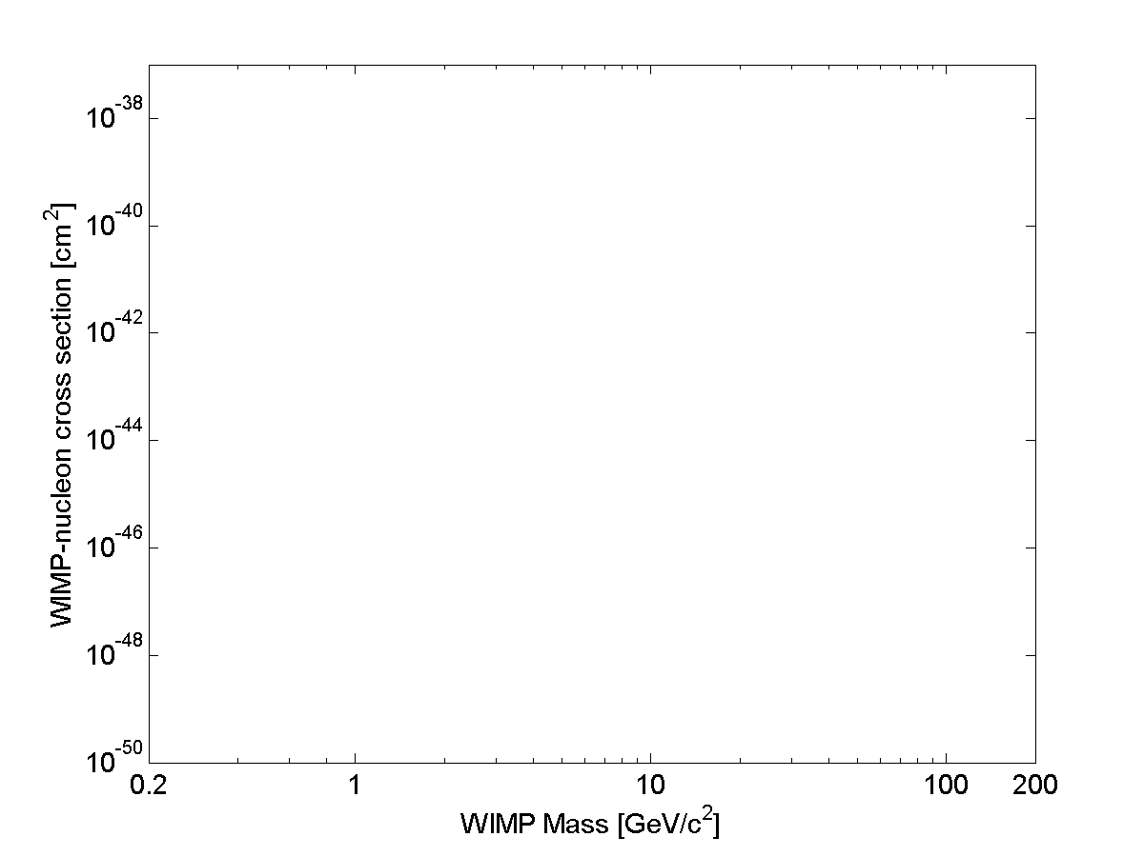
Sensitivity
Goal
CRESST
2015
DAMIC 2016
Si iZIP
Ge iZIP
CDMSlite
2015
DAMA
Si HV
CDMS Si
Ge HV
DAMA
SuperCDMS LT 2014
CDMS II 2015
LUX 2013
Solar Neutrinos
XENON1T 2017
DEAP
Longterm goal
LZ
Atmospheric Neutrinos

Slide 14

CUTE
Cryogenic Underground TEst facility (CUTE) – a Queen’s Project
Motivation
Detector performance:
Detector integrity after transportation
Background discrimination
Noise performance (impact of background)
Background studies
Confirm that screening program and
handling procedures are appropriate
Study cosmogenic backgrounds (³H, ³²Si)
Available for testing of other cryogenic detectors
for rare event searches (e.g. EURECA detectors
for integration with SuperCDMS)
Opportunity for early science! (BG O (few evt/keV/kg/d below 10 keV))
Schedule
Cryostat ordered, to arrive at Queen’s this summer
Infrastructure (water tank, platform, crane): ordered, installation starts in July
Sept/Oct: test cryostat at Queen’s; installation underground end of 2017/early 2018
Commissioning: winter/spring 2018 (~2-3 years ahead of SuperCDMS)
Vibration
damping
Fridge: <10 mK
Pb
Water Shield

Slide 15
Conclusions
SuperCDMS SNOLAB aims at detecting dark matter WIMPs
Main focus are low-mass WIMPs (< 10 GeV/c²)
Project planning well under way
R&D is completed, full technical design close to completion
Start of operation expected in 2020
Initial payload: ~30 kg, significant push in threshold and sensitivity
Upgrades (e.g. improved HV detectors, EURECA detectors, …) will allow us to reach the neutrino floor at low mass and/or check discovery claims at high mass
CUTE: Queen’s initiative for an underground test facility, operational in early 2018
(detector performance studies, background checks, early dark matter science)

