Slide 1
The R&D progress of the Jinping Neutrino Experiment
Shaomin Chen (陈少敏)
(for the Jinping Neutrino Experiment research group)
Department of Engineering Physics
Tsinghua University
July 27, 2017@TAUP2017, Laurentian University

Slide 2
Outline
Jinping neutrino experiment proposal (arXiv:1602.01733, arXiv:1607.01671, arXiv:1612.00133 )
Detector concept: liquid scintillator Cherenkov (arXiv:1511.09339)
Assay of stainless steel by smelting process (arXiv:1706.04506)
Wide field-of-view and high-efficiency light concentrator (arXiv:1703.07527)
One-ton prototype at Jinping (NIMA 855 (2017) 81-87 )

Slide 3
China JinPing underground Lab
Two 17-km long road tunnels below Jinping mountain with an overburden: ~2400 m.
Totally evacuated space > 100k m³ with possible expansion.
Far away from nuclear power plants > 1000 km.
Least radioactivity contamination.

Slide 4
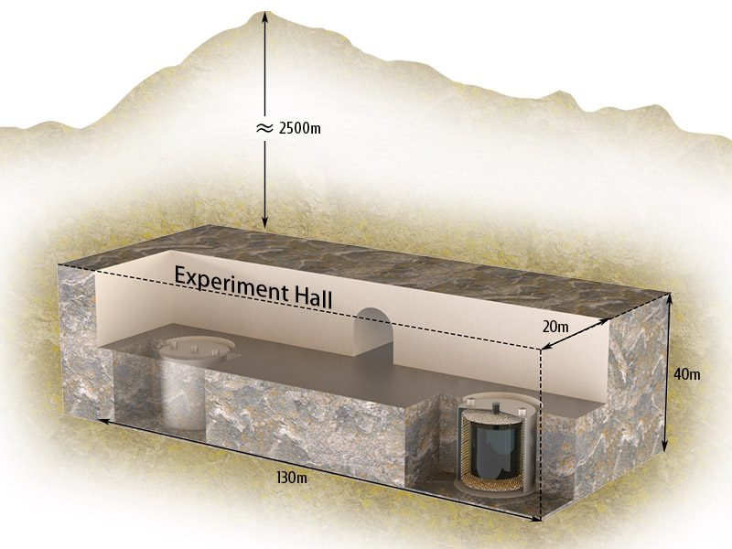
Detector concept
Two detectors with total fiducial mass 2000 tons (solar), 3000 tons (geo, supernova).
LS or LSC (slow LS with directional info.).
With similar low background level as Borexino.
Light Yield > 500 pe/MeV.
7 MeV electron
C light
LS light

Slide 5
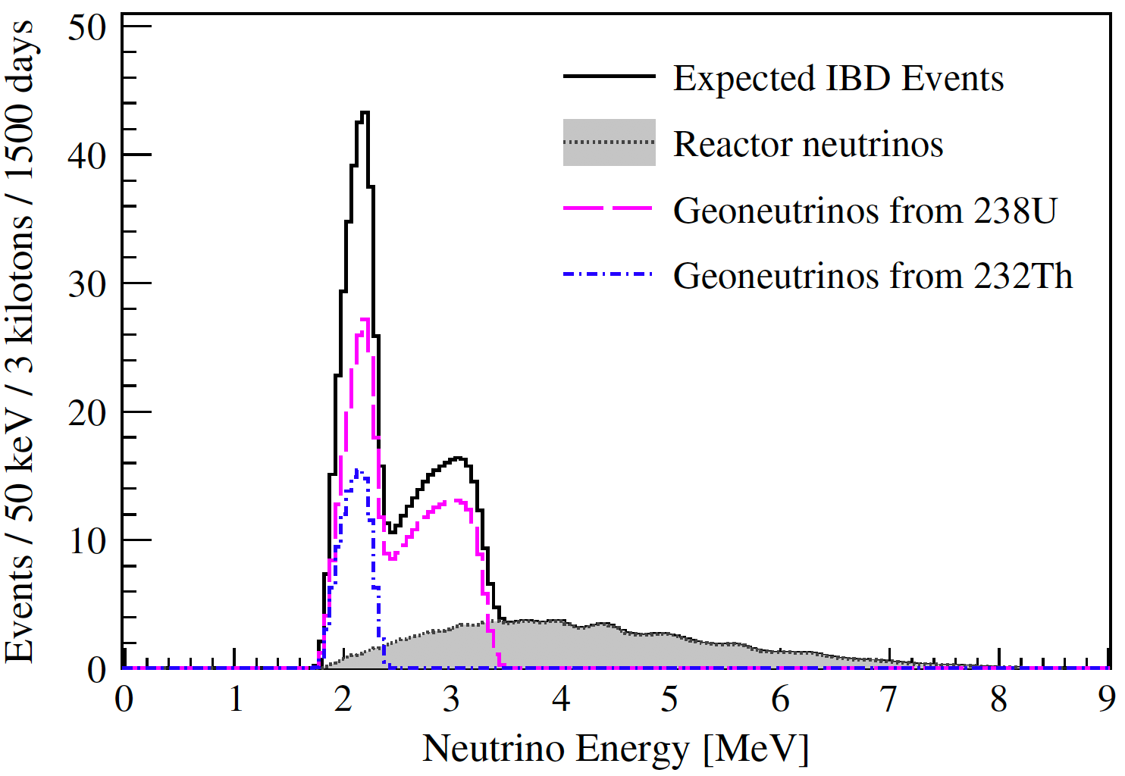
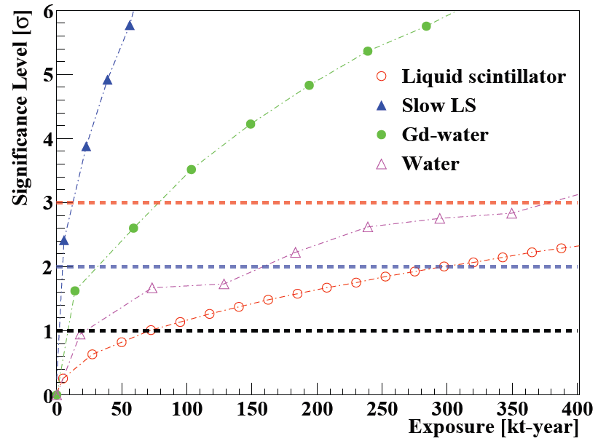
Jinping neutrino experiment
Physics motivations:
Geo-neutrinos
Solar neutrinos
Supernova neutrinos
Dark matter
…
Geo-neutrinos
Sensitivities
Flux: 4.6%
U/Th: 26.3%
Solar neutrinos
Supernova
relic neutrinos

Slide 6
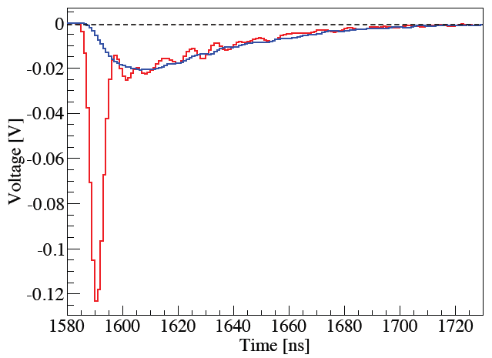
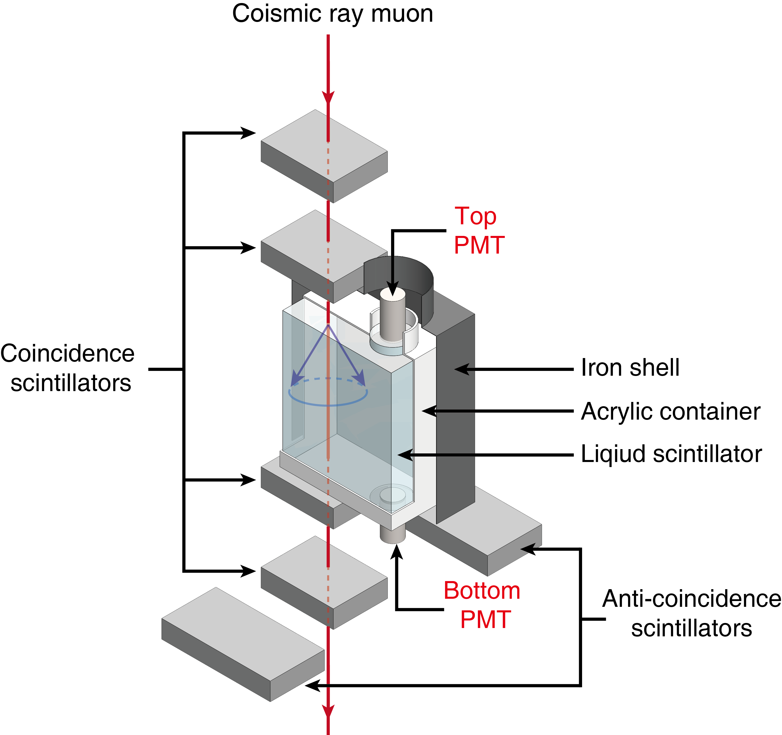
Liquid scintillator Cherenkov
Test with down-going cosmic rays
Check the waveforms of top and bottom PMTs in pure Linear Alkyl Benzene
Top: S only
Bottom: C+S

Slide 7
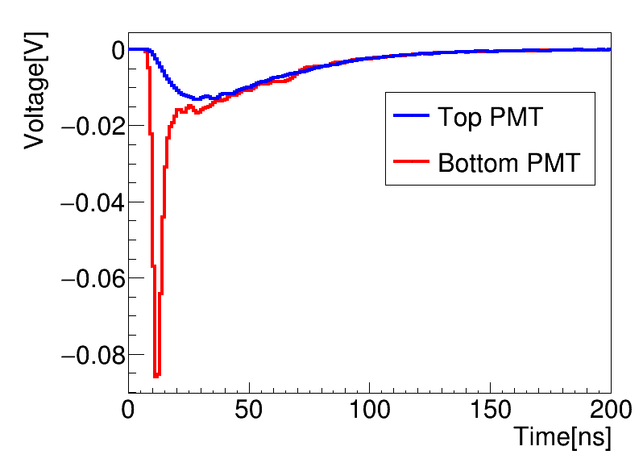
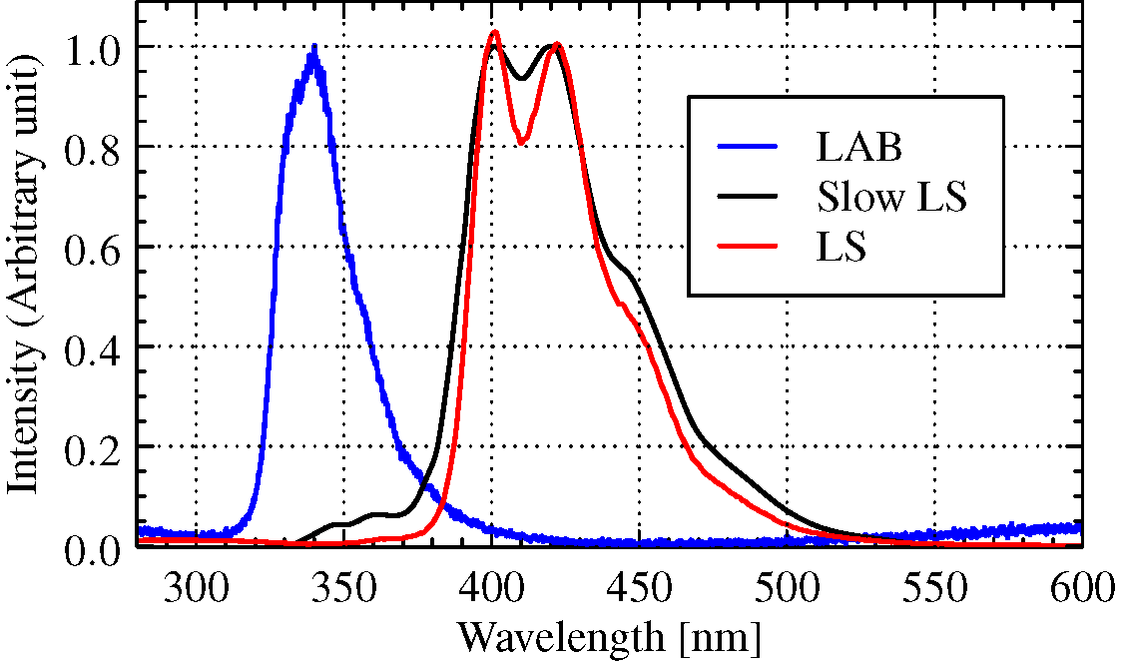
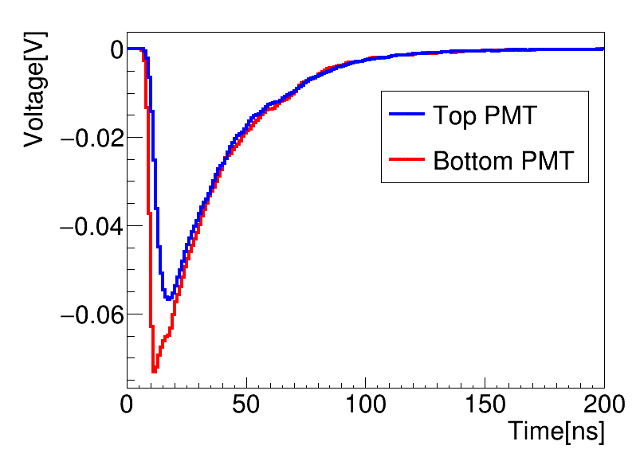
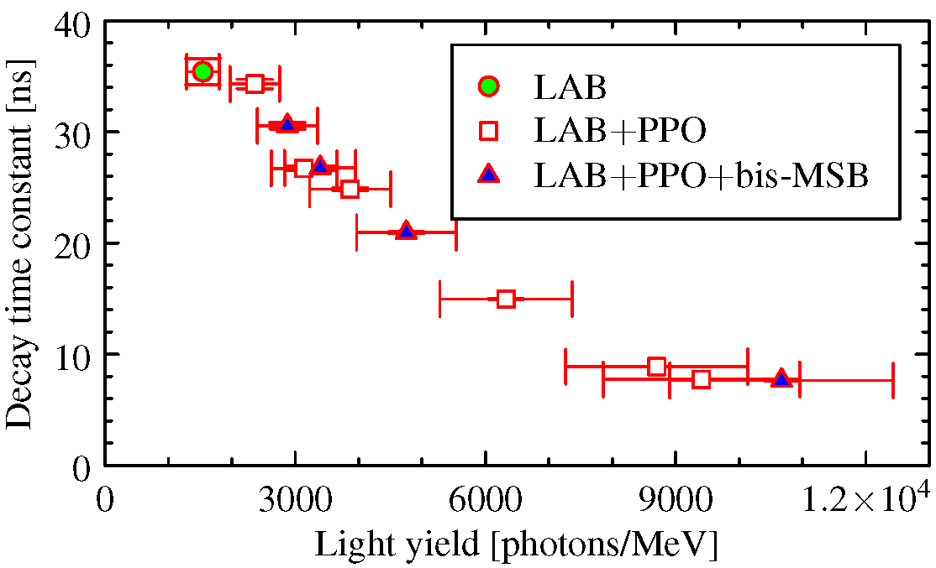
With PPO and bis-MSB
Pure LAB
LAB with ppo+bis-MSB

Slide 8
LSC parameters
Time constants
Light yield
𝛕_{r} (ns) rise time
𝛕_{d} (ns) decay time
# of scintillation PEs
 | 𝛕_{r} (ns) | 𝛕_{d} (ns) | L (×10³ photon/MeV) | Attenuation length (m)
Pure LAB | 7.7 ± 3.0 | 36.6 ± 2.4 | 1.01±0.12 | 19.52±0.39
LAB with ppo + bis-MSB | 1.7 ± 0.1 | 26.6 ± 0.2 | 3.39±0.44 | 9.37±0.44

Slide 9
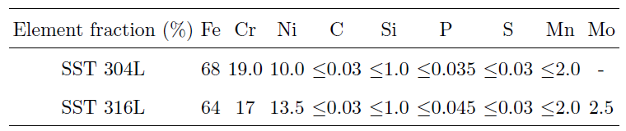
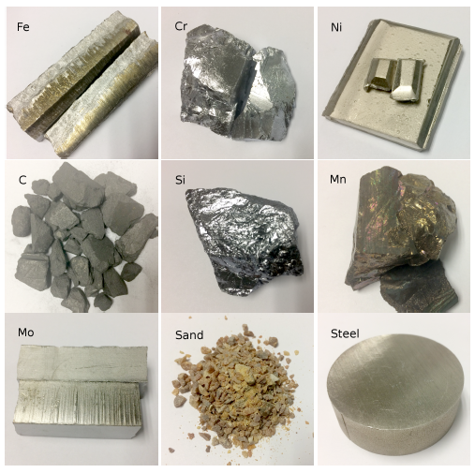
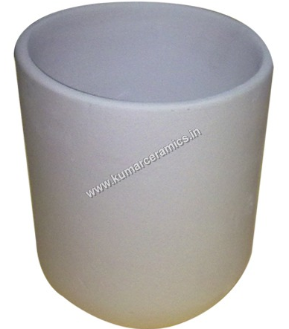
Assay of stainless steel by smelting process
The process uses 99.7% - 99.9% materials.
Fe
Cr
Ni
MgO crucible

Slide 10
Samples and procedure test results
Analyzed by GDMS (1E-9 g/g), HPGe-groud (Bq/Kg), HPGe-Jinping (mBq/Kg)
  C, Si, MgO sand: with significant radioactivity
  S, P: harmful to SST
  Mn is not 100% necessary
  Small impact from MgO crucible
mBq/kg | 316-L | Borexino | NEXT
U-238 | <5.4 | 4.6±0.9 | 32±9
Th-232 | <2.0 | 11.4±1.2 | 1.9±0.2
K-40 | <12.9 | <14 | 3.2±0.7
Co-60 | 1.4±0.4 | 6±1 | 1.8±0.1

Slide 11
Light concentrator
Proposed a light concentrator with hexagonal opening to improve PMT coverage.
Coverage: ~100%.
Collection efficiency: > 97%.
Save nPMT: ~20%.
Time spread: ~ 2ns.

Slide 12
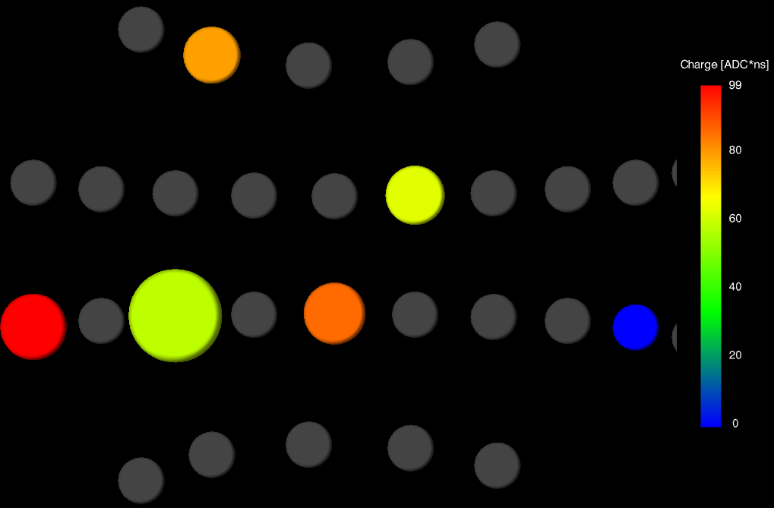
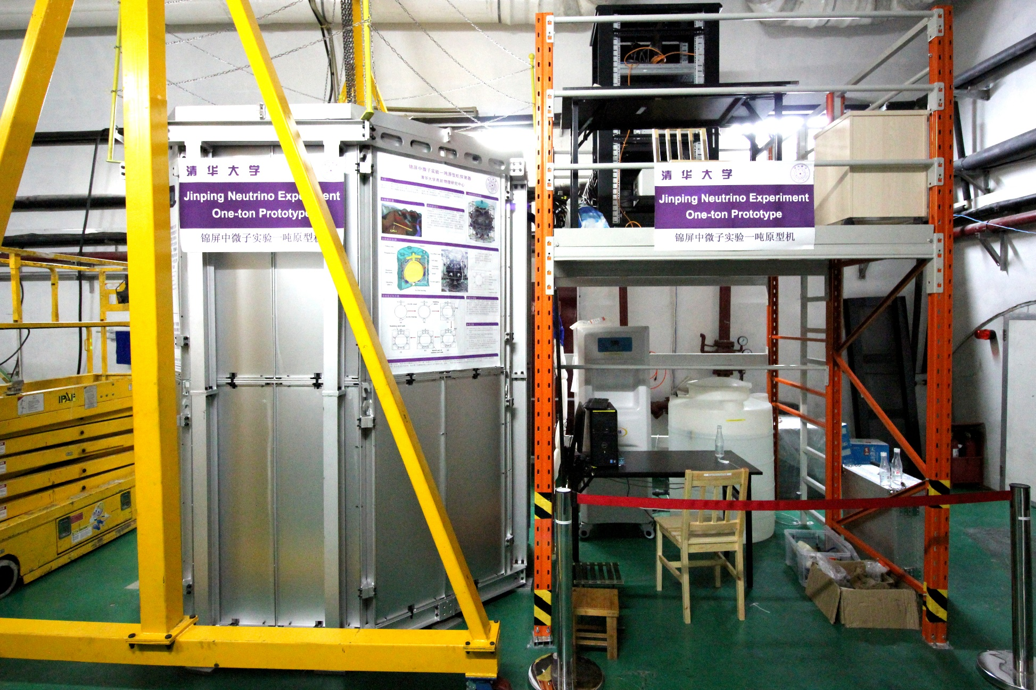
One-ton prototype at CJPL
Motivations:
  Test the idea of LSC
  Study PMT background
  Measure neutron background
Status:
  Started with pure water mode in May
  Will have a replacement of LSC this month

Slide 13
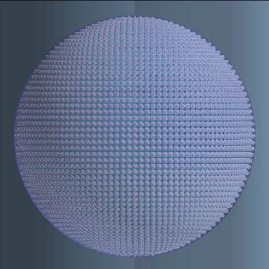
Jinping simulation & analysis package
JSAP
Comprehensive optical simulation
Flexible to different geometry setup
Waveform simulation
Flow style simulation
G4->PMT->Elec-> Trigger
Doing Slow LS study
Doing Detector Optimization

Slide 14
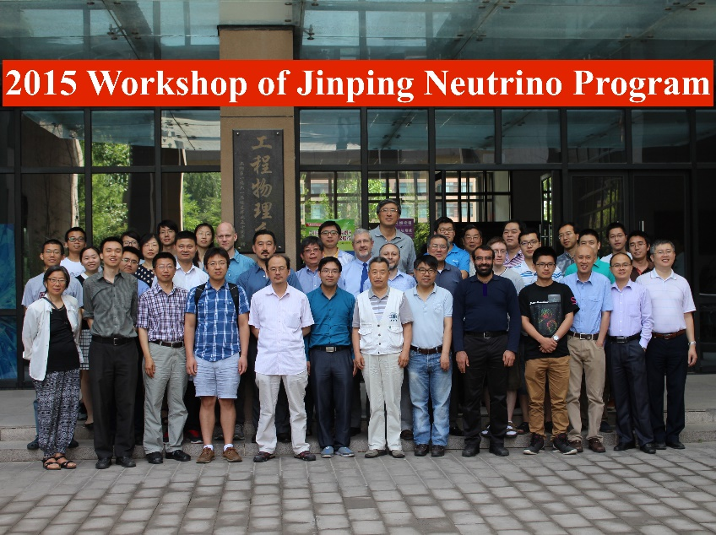
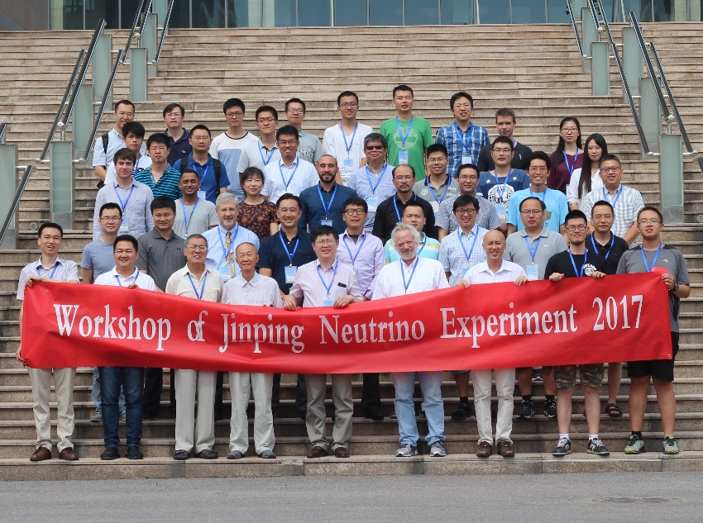
Workshop for Jinping 𝛎 experiment
2015, 2017 two international workshops
Participants from:
Tsinghua, SYSU, Queen’s University, UCAS, Guangxi University, Shandong University, BNL, University of Maryland, Technische Universität Dresden, Mainz University, Charles University, University of Michigan, Tohoku University, Nanjing University, Wuhan University

Slide 15
CJPL-II goes far ahead of us

Slide 17
Summary
CJPL is ideal for the studies on geo, solar, and supernova relic neutrinos
Significant progress of civic construction has been achieved.
Many R&D efforts for Jinping neutrino experiment are on-going:
liquid scintillator Cherenkov
Assay of stainless steel by smelting process
Light concentrator with hexagonal opening
One-ton prototype is now running
…

Slide 18
Thanks!

Slide 19
Backup slides

Slide 20
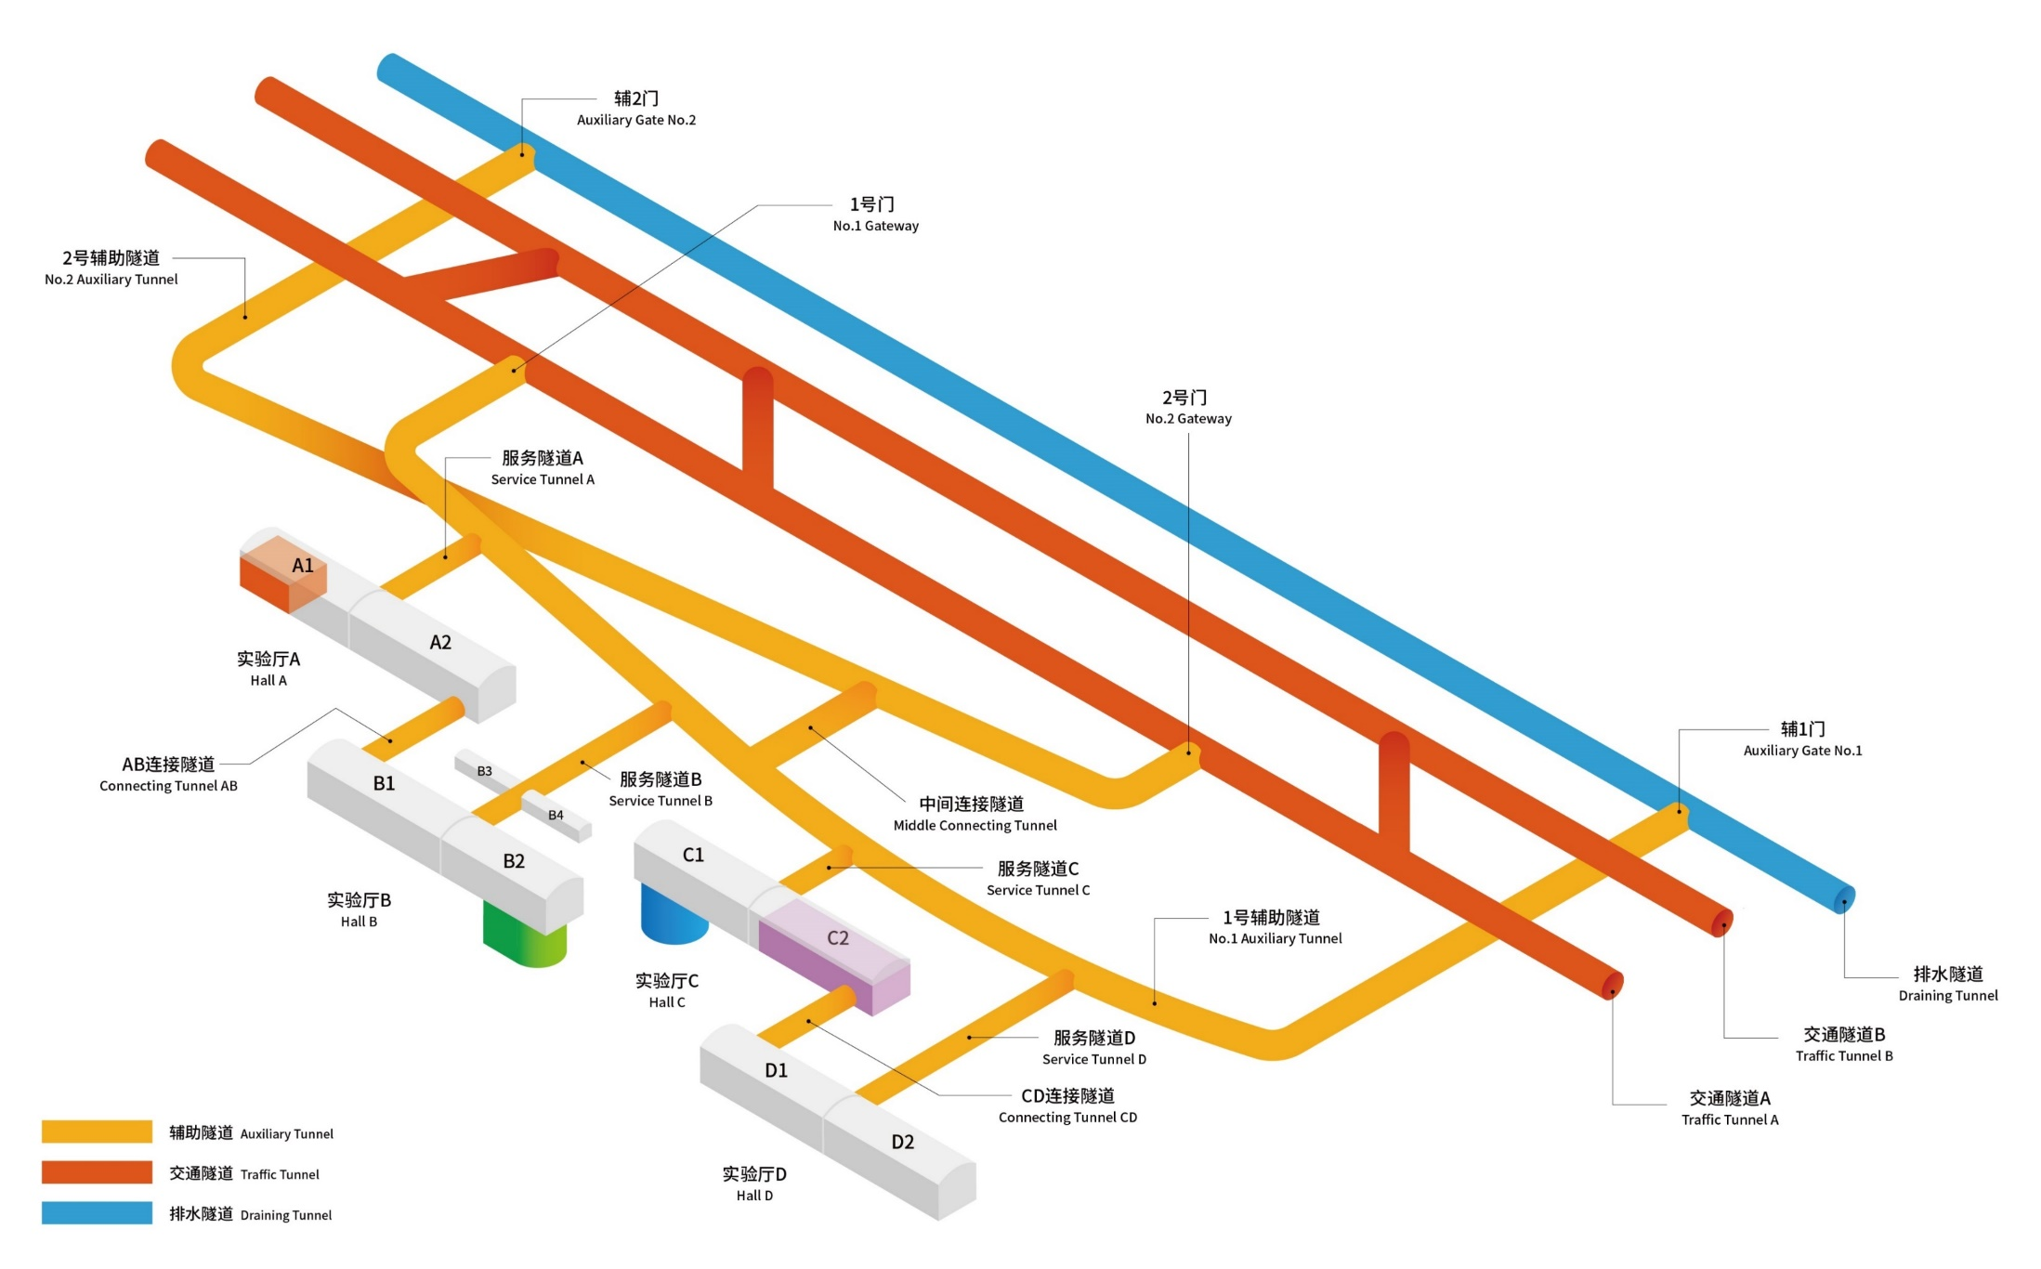
CJPL-II Layout
 | CJPL-I | CJPL-II
Rock Work | 4000 m³ | 210000+131000m³
Electric Power | 70x2 kVA | 10000x2 kVA
Fresh Air | 2400 m³/h | 15000x3 m³/h
Notes:
La

Slide 22
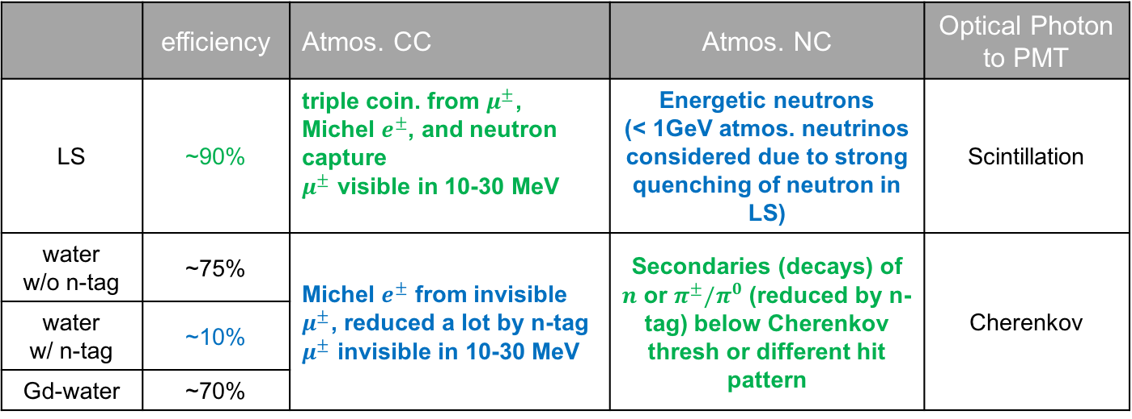
Key issues in SRN detection
Ignore the backgrounds induced by cosmic muons and reactor neutrinos, which are basically negligible at Jinping
 | efficiency | Atmos. CC | Atmos. NC | Optical Photon to PMT
LS | ~90% | triple coin. from $μ^{±}$, Michel $e^{±}$, and neutron capture $μ^{±}$ visible in 10-30 MeV | Energetic neutrons (< 1GeV atmos. neutrinos considered due to strong quenching of neutron in LS) | Scintillation
water w/o n-tag | ~75% | Michel $e^{±}$ from invisible $μ^{±}$, reduced a lot by n-tag $μ^{±}$ invisible in 10-30 MeV | Secondaries (decays) of $n$ or $π^{±}/π^{0}$ (reduced by n-tag) below Cherenkov thresh or different hit pattern | Cherenkov
water w/ n-tag | ~10%
Gd-water | ~70%
Green: advantage / Blue: disadvantage Invisible muon: below Cherenkov threshold
Solution: Cherenkov light + Scintillation light
respective advantages + further suppress due to Cherenkov to Scintillation ratio

