Slide 1
DEAP-50T Dark Matter with Liquid Argon
DEAP-3600 Overview and Status
Scientific Merit of DEAP-50T
Argon and xenon for DM searches
Backgrounds
Ultimate reach
Future Plans / R&D
Mark Boulay
Carleton University
(& Queen’s University)
SNOLAB Future Projects, Aug 24, 2015

Slide 2










DEAP Collaboration: over 60 researchers in Canada, UK, and Mexico

Slide 3

Liquid argon as a dark matter target
Scattered nucleus (with several 10’s of keV)
is detected via scintillation in liquid argon.
⁴⁰Ar
χ
⁴⁰Ar
χ
Well-separated singlet and triplet lifetimes in argon allow for good
pulse-shape discrimination (PSD) of β/γ’s using only scintillation time
information, projected to 10⁻¹⁰ at 15 keV_{ee}
(see Astroparticle Physics 25, 179 (2006) and arxiv/0904.2930)
Very large target masses possible, since no absorption of UV scintillation photons in argon, and no e-drift requirements.
1000 kg argon target allows 10⁻⁴⁶ cm² sensitivity (SI) with ~15 keV_{ee}
(60 keVr) threshold, 3-year run

Slide 4
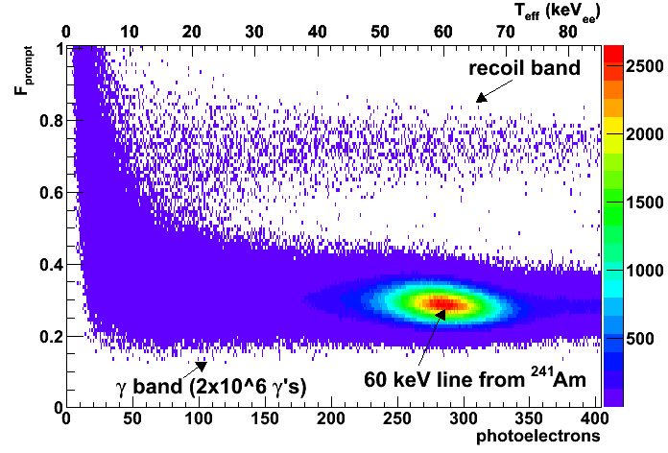
Calibration of DEAP-1 with AmBe neutron source

Slide 5
β/γ backgrounds
³⁹Ar is the most dominant β/γ background
(~1 Bq/kg in natural argon)
Expect ~10⁹ events in 3 years in (15-30) keVee
Pulse-shape discrimination in DEAP-1 extrapolates to sufficient PSD
PSD sufficient for operation of DEAP-3600 (one tonne fiducial), larger detector requires low-radioactivity argon (LRA)

Slide 6
α Βackgrounds in Liquid Argon
Decay in bulk argon tagged
by α-particle energy
α
Decay from TPB surface releases untagged recoiling nucleus in argon and α in TPB
(see both with low energy)
α
Decay from TPB surface releases α in argon and recoil nucleus in TPB
(see mostly α-particle, high energy)
Decay from inside TPB or acrylic releases α which may also enter LAr.
Could see
(a) Light from TPB only (prompt) or
(b) Light from LAr (range of energies)
²¹⁰Po on surface
both TPB and LAr scintillate
PTFE
Acrylic
TPB
Position reconstruction ~5 cm resolution
removes “surface” events
LAr
DEAP-1 and DEAP-3600 surface profile

Slide 7
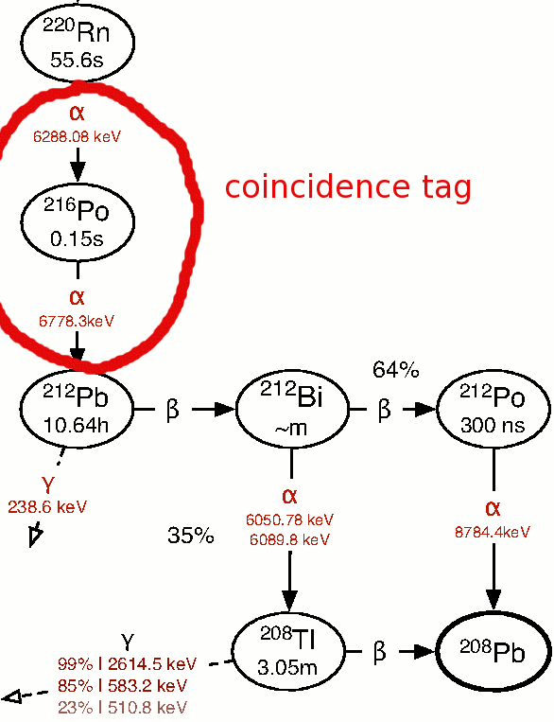
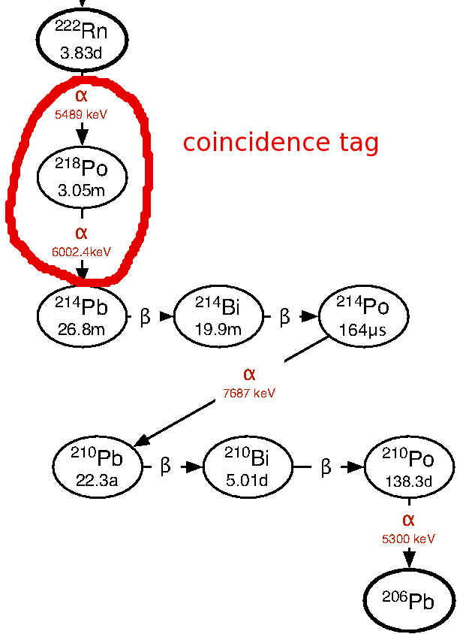
α Backgrounds in LAr (DEAP-1)
²¹⁰Po
June 2010
²³²Th chain
PTFE
Acrylic
TPB
LAr
²³⁸U chain
DEAP-1 data
Events/100 keV
In DEAP-1:
100 μBq ²²²Rn
20 μBq ²²⁰Rn
DEAP-3600 target:
5 μBq ²²²Rn
²²²Rn+²²⁰Rn

Slide 8
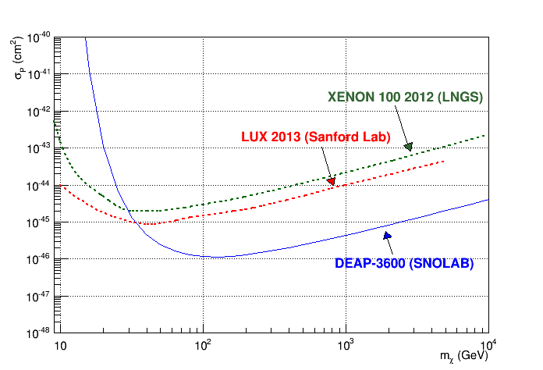
DEAP-3600 Projected Physics Sensitivity
Current best sensitivity

Slide 9
DEAP-3600 Detector
3600 kg argon target
(1000 kg fiducial)
in sealed ultraclean
Acrylic Vessel
Vessel is “resurfaced”
in-situ to remove
deposited Rn daughters
after construction
255 Hamamatsu
R5912 HQE PMTs 8-inch
(32% QE, 75% coverage)
50 cm light guides +
PE shielding provide neutron moderation
Steel Shell immersed in 8 m water shield at SNOLAB

Slide 10
DEAP-3600 Background Budget (3 year run)
Background | Raw No. Events in Energy ROI | Fiducial No. Events in Energy ROI
Neutrons | 30 | <0.2
Surface α’s | 150 | <0.2
³⁹Ar β’s (natural argon) | 1.6x10⁹ | <0.2
³⁹Ar β’s (depleted argon) | 8.0x10⁷ | <0.01
Acr+H₂O shield
Resurfacer
PSD
Need to resurface inner vessel and ensure purity of acrylic.
removal of order 1/2 mm acrylic
²¹⁰Pb < 1.1x10⁻¹⁹ g/g for 0.1 events/3 years
(strict control of Rn exposure)

Slide 11
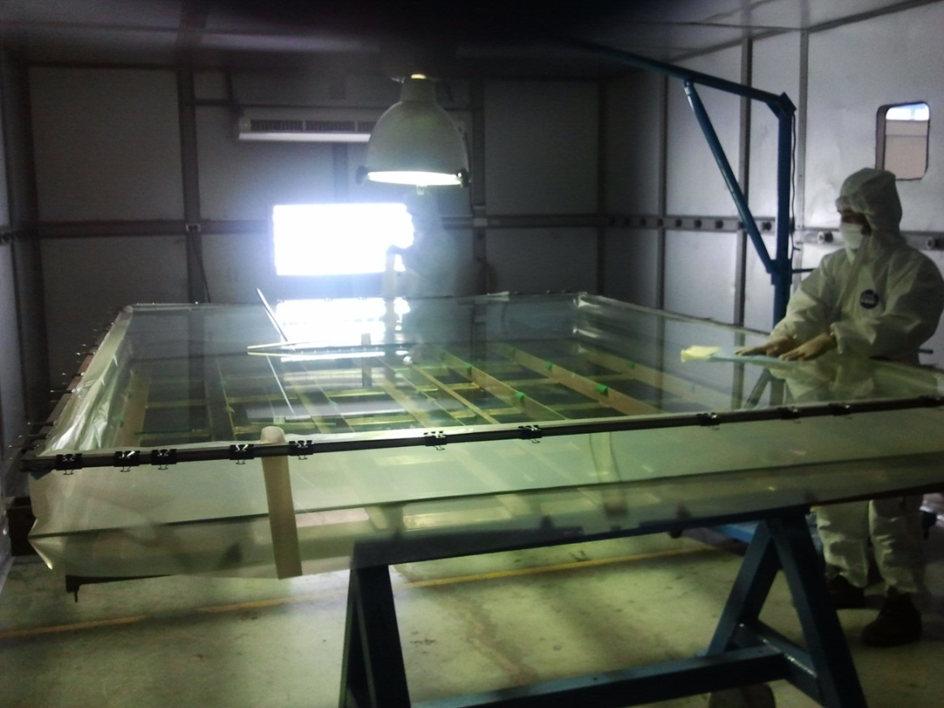
Fabrication of DEAP Acrylic
Fabrication from MMA monomer, strict control of radon exposure for all steps
Moulds were prepped in a HEPA-filtered clean room made especially for DEAP (RPT Asia)
DEAP Collaborators present during fabrication
Control to < 10⁻²⁰ g/g ²¹⁰Pb from radon exposure
DEAP Acrylic Panels
at RPT Asia in 2010

Slide 12
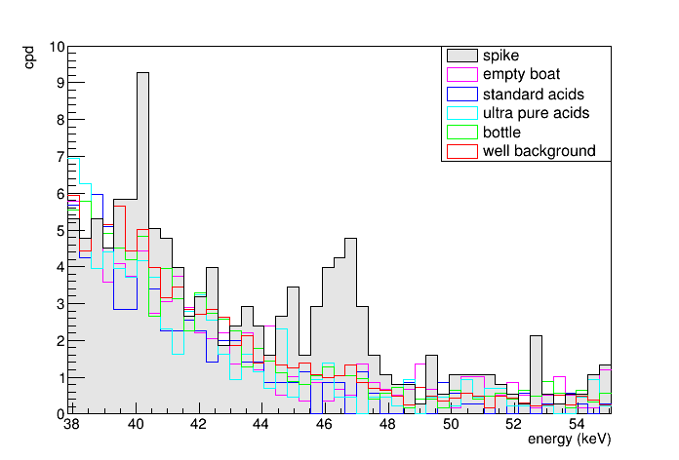
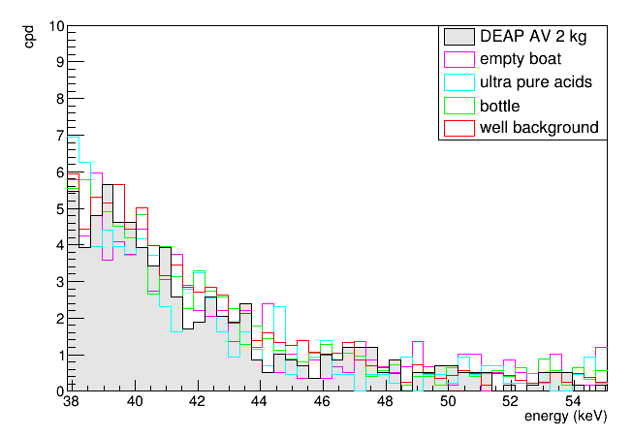
²¹⁰Pb assay of acrylic (vaporization of acrylic followed by γ and α-counting)
Spike with ²²²Rn into
acrylic cylinder
DEAP AV acrylic assay
and backgrounds
Nantais M.Sc. Thesis result (Queen’s, 2014):
²¹⁰Pb : < 2.2 x 10⁻¹⁹ g/g
( <0.2 bkd events in 3 years )

Slide 13
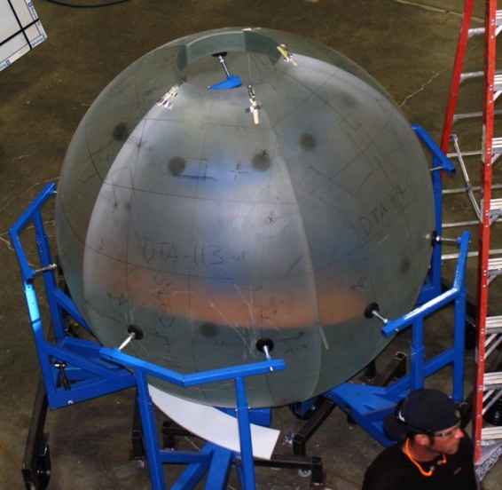
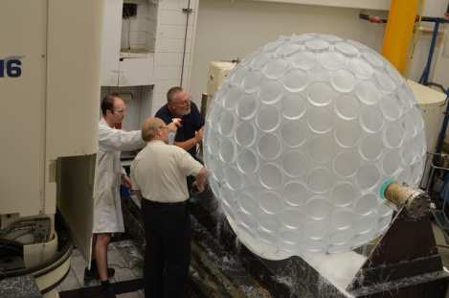
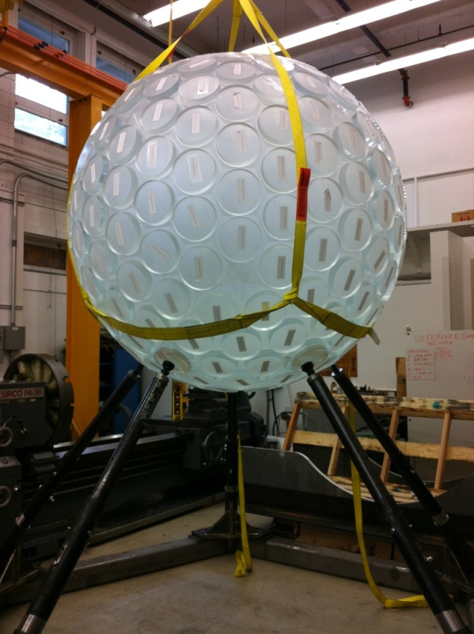
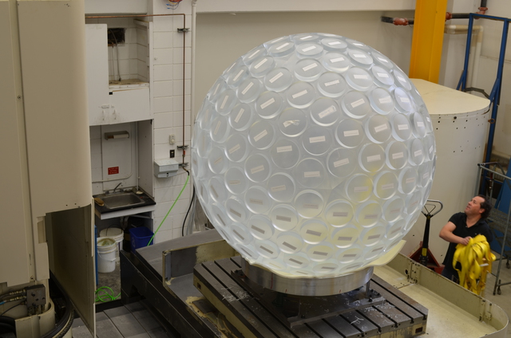
AV Fabrication (RPT Colorado and U of A)

Slide 14
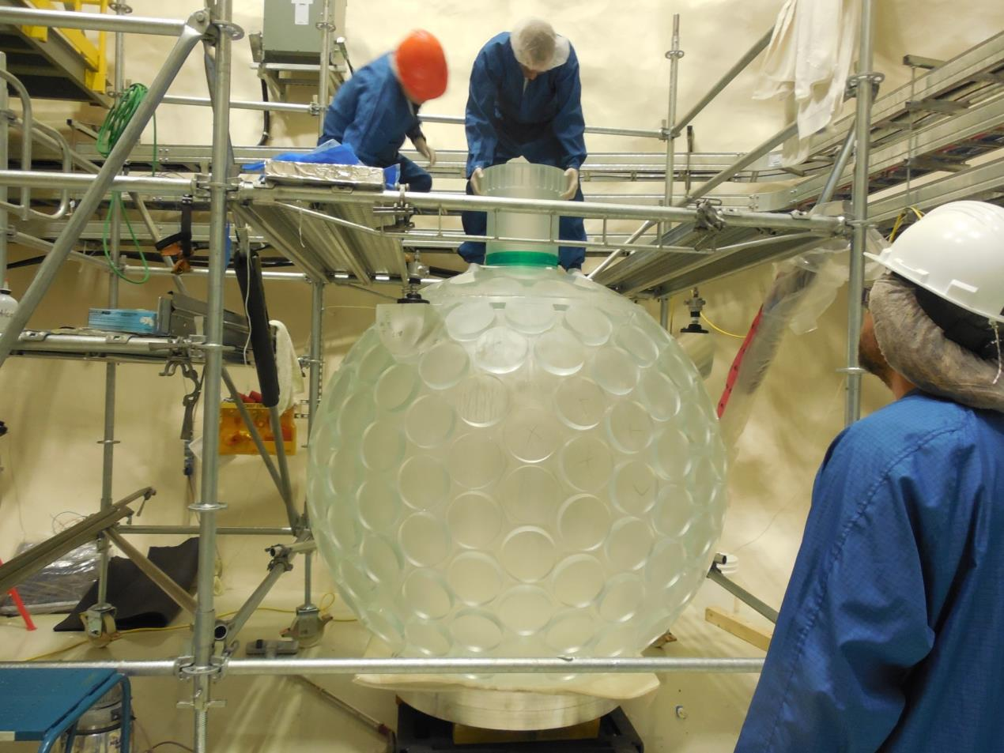
AV neck bonding underground (December 2012-January 2013)

Slide 15
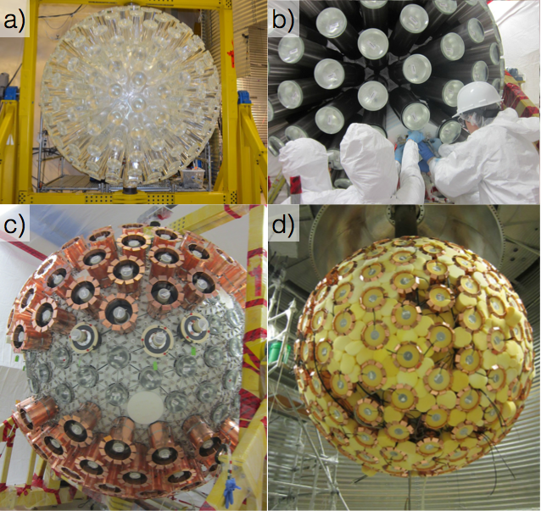
Light guides on AV
Reflectors on light guides
PMT installation Oct 2014

Slide 16
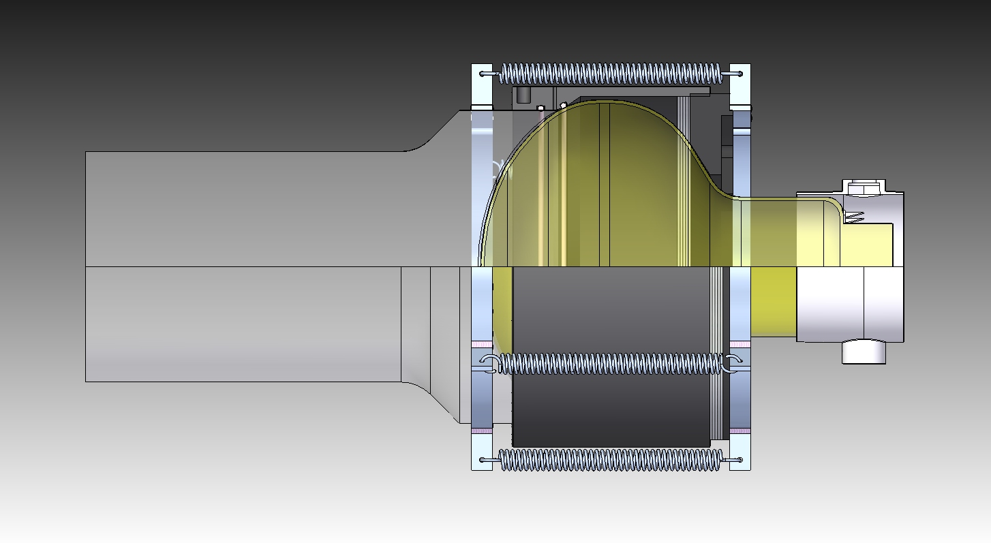
R5912 HQE PMTs on DEAP-1 (Feb. 2010)
silicone oil optical coupling
identical to DEAP-3600 design

Slide 17
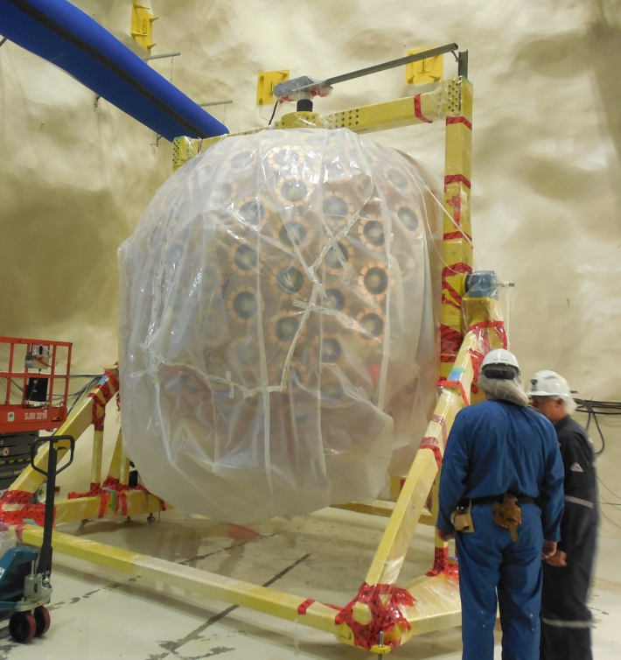
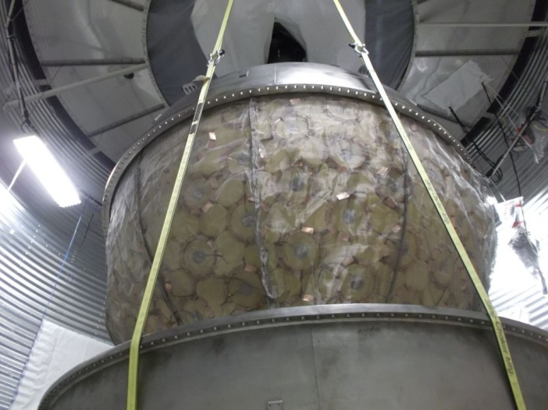
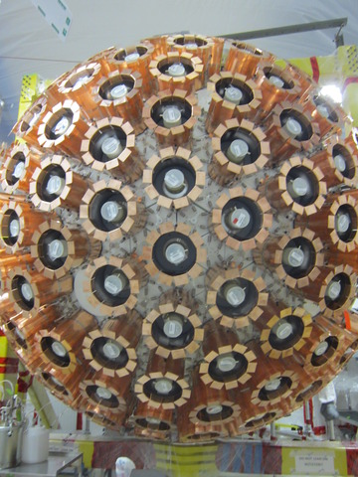
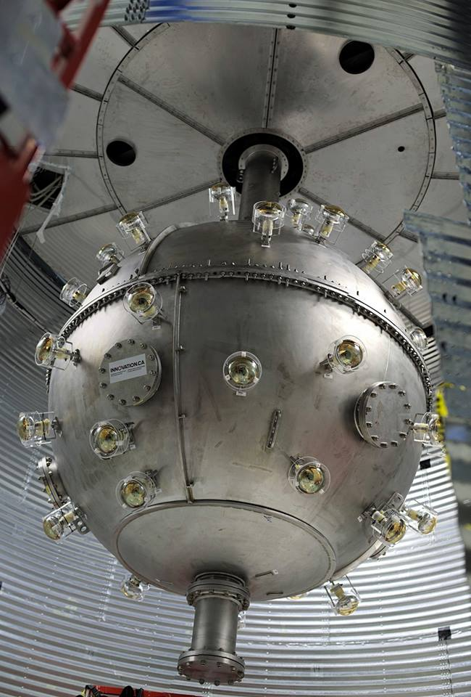
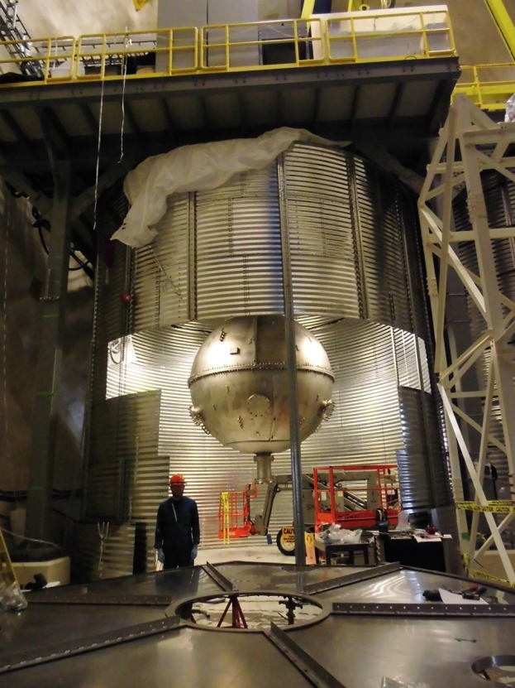
Steel Shell closing Dec 2014
Detector ready for Final Lift onto Neck
Completed inner detector
Steel Shell in shield tank
Veto PMTs installed Mar 2015

Slide 18
DEAP-3600 resurfacer (removal of adsorbed and diffused Rn daughters)

Slide 20
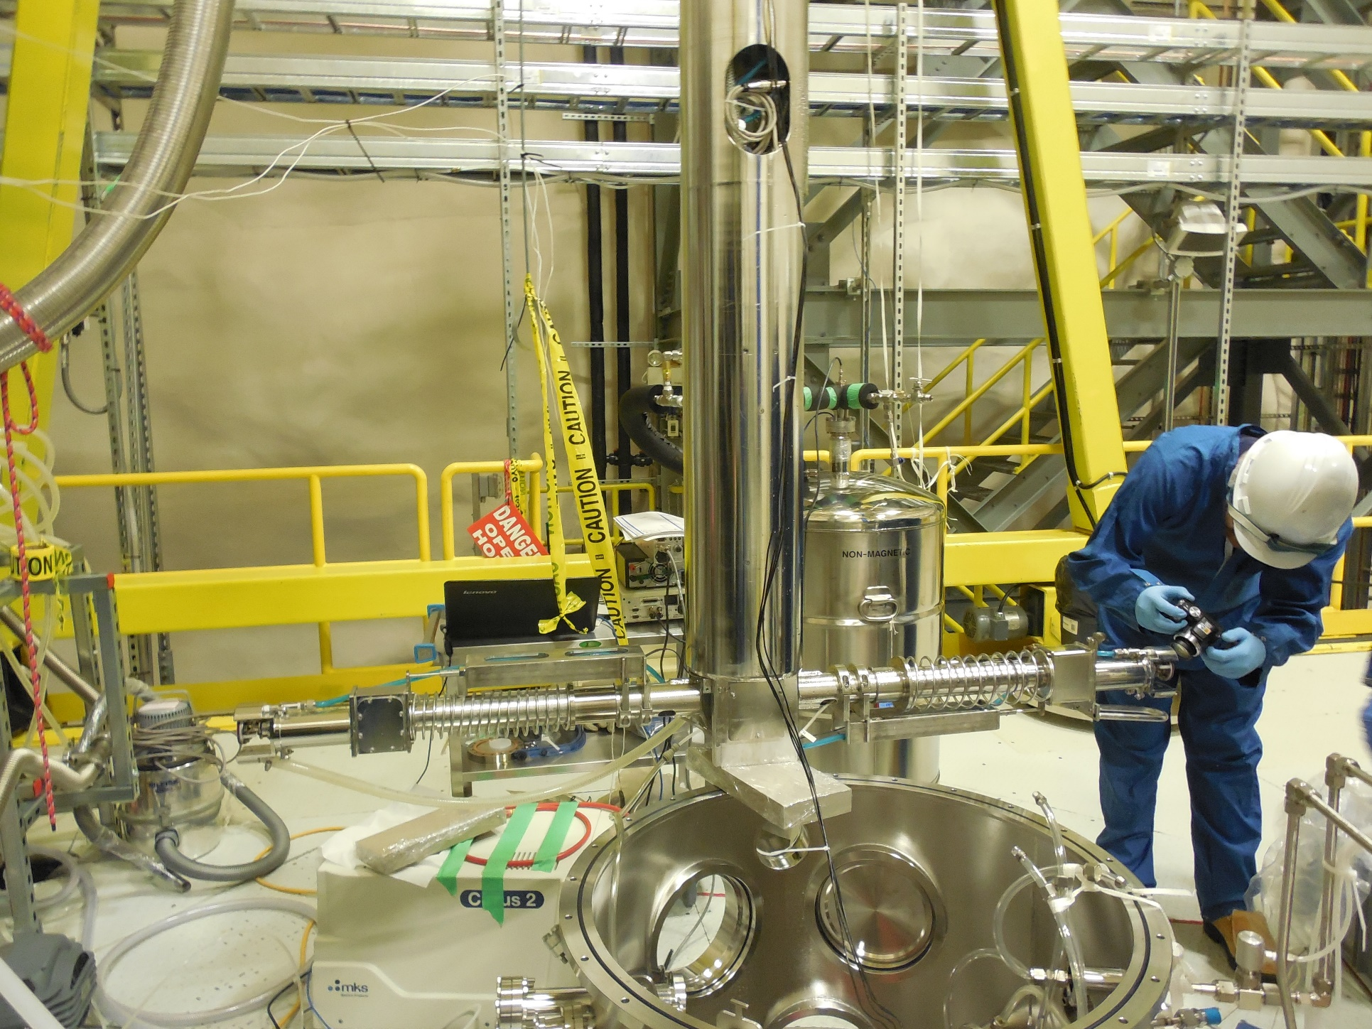

Slide 21
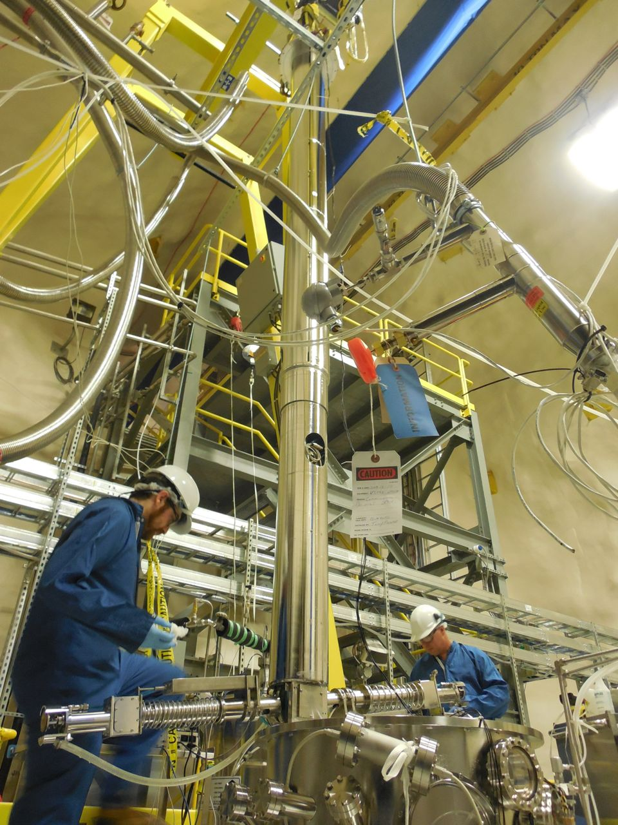
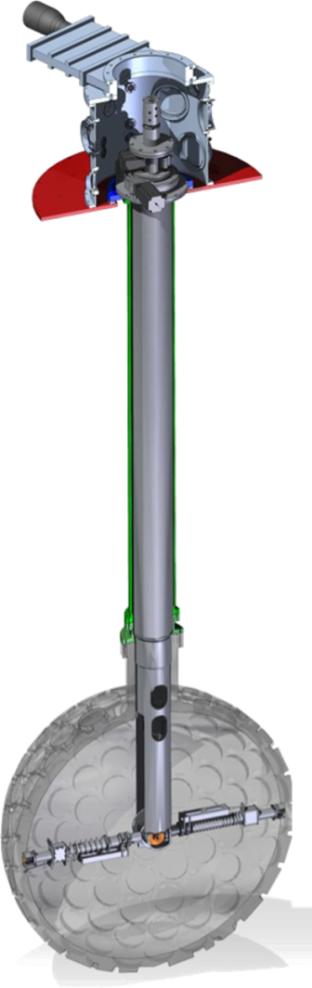
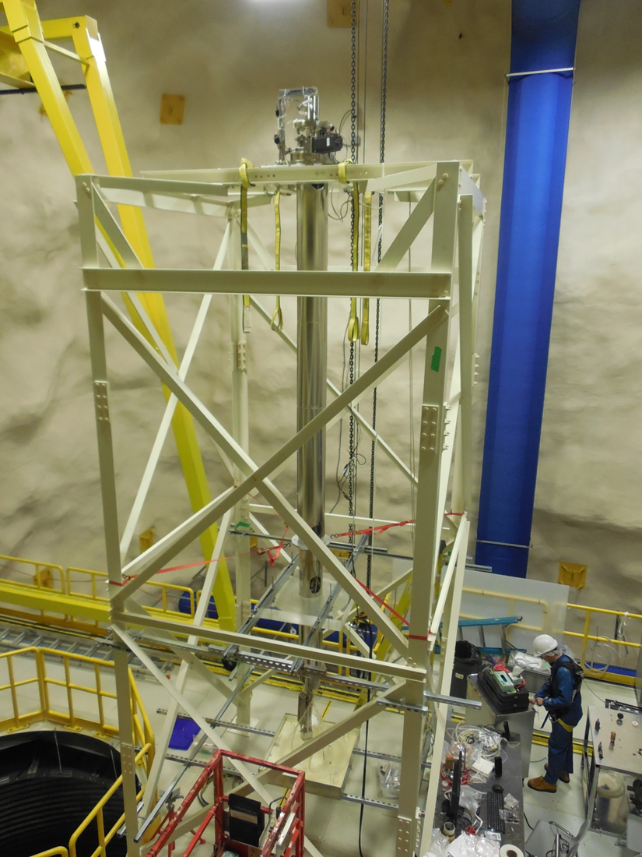
The Resurfacer
Low-radon emanation
Removes acrylic surface
in-situ after construction
Completed Dec. 2014

Slide 22
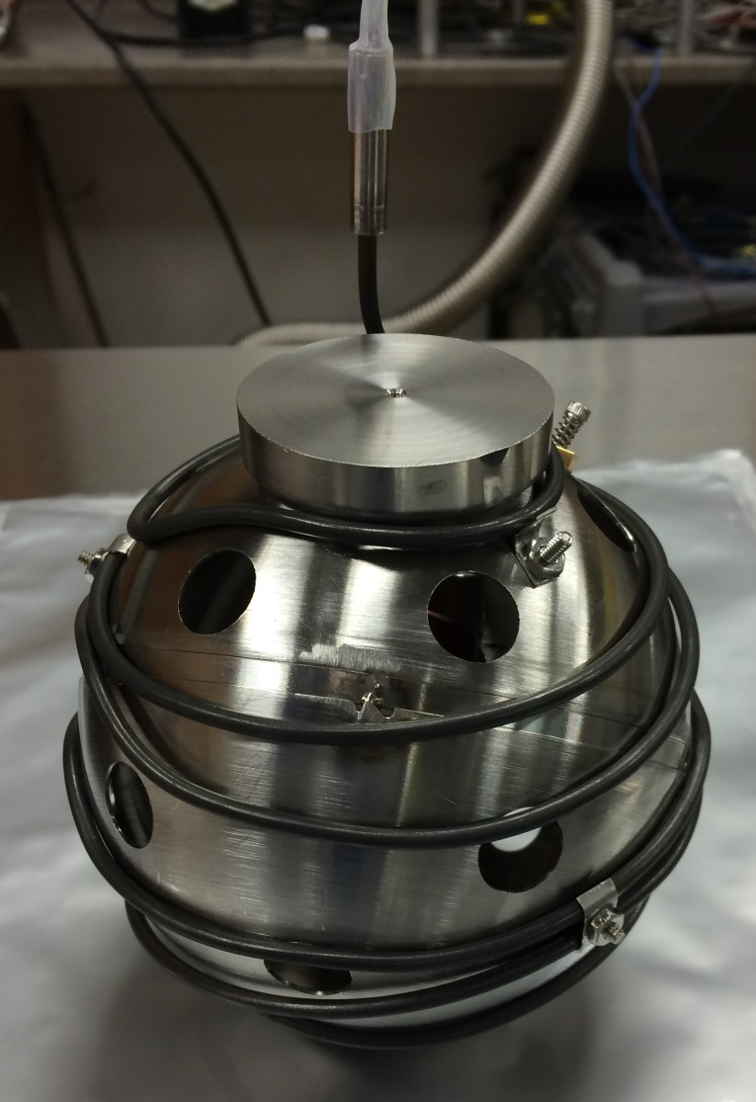
TPB wavelength shifter deposition
Deposition into 20-inch test Acrylic Vessel
Vacuum-baked DEAP-3600 AV to reduce outgassing prior to TPB deposition
(spring/summer 2015)

Slide 23
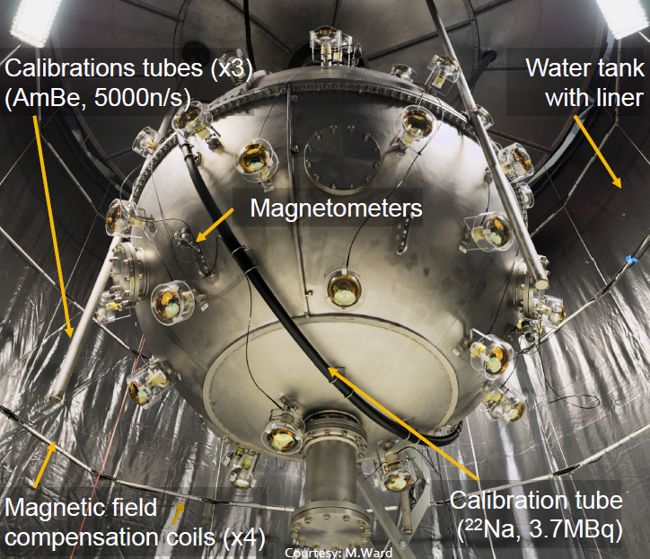
Completed Detector in Shield Tank

Slide 24
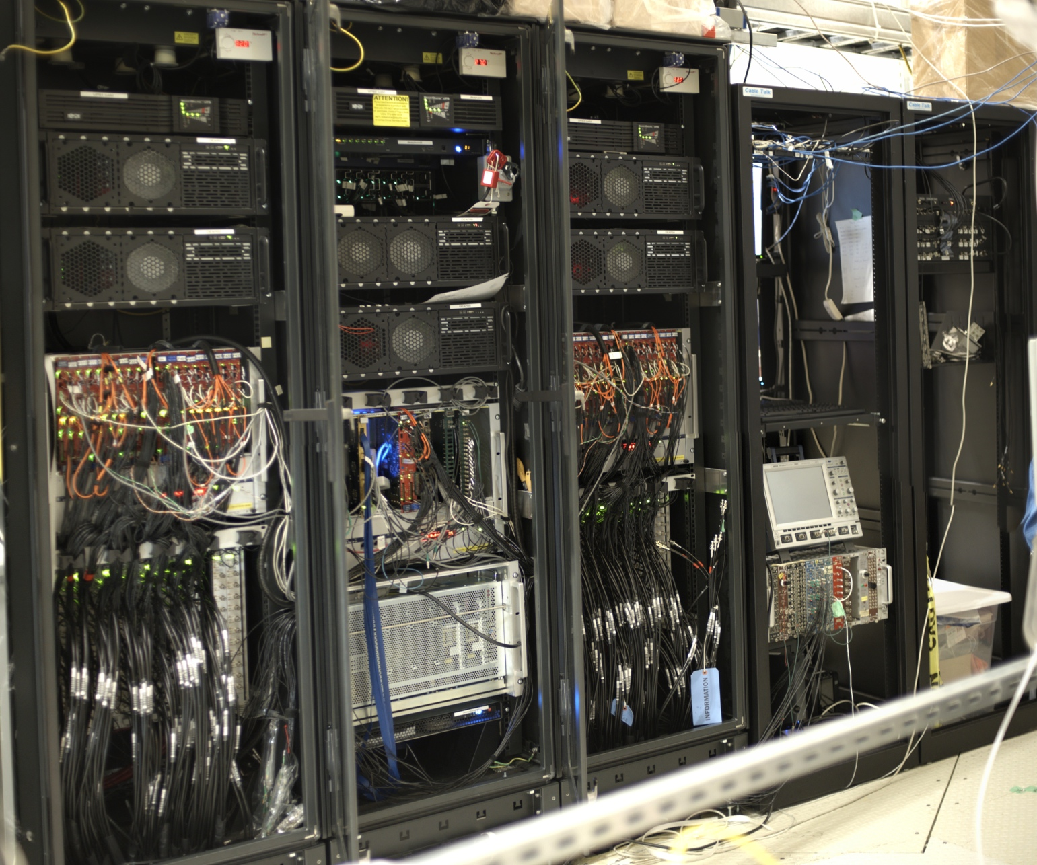
Data acquisition system
LED
driver
CAEN
V1720
Neck veto
cables
Digitizer & trigger module
PMT cables
PMT cables

Slide 25
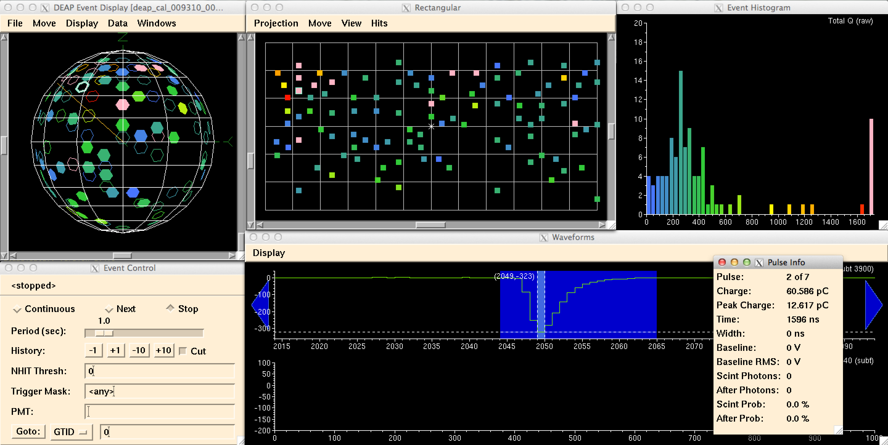
Light injection through fibers (Commissioning Data Spring 2015)
Notes:
Light injection though fiber. Here high intensity with PMT saturation to study the matching low amplification/high amplification branches of the detector

Slide 26
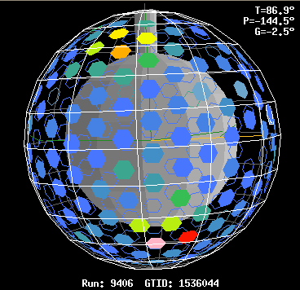
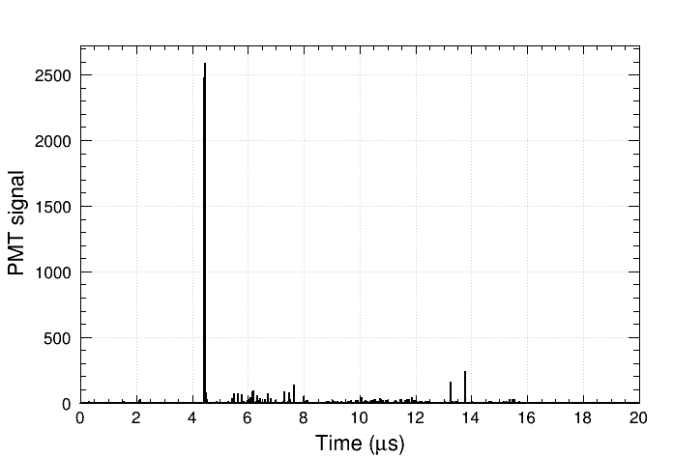
A high energy event (Commissioning running, Spring 2015)
Run: 9406 Subrun: 3 Event: 300460
Total energy: 1520 PE
High event rate: ~1 event/day
Expected muon rate: 1.6 muons/day
preliminary

Slide 27
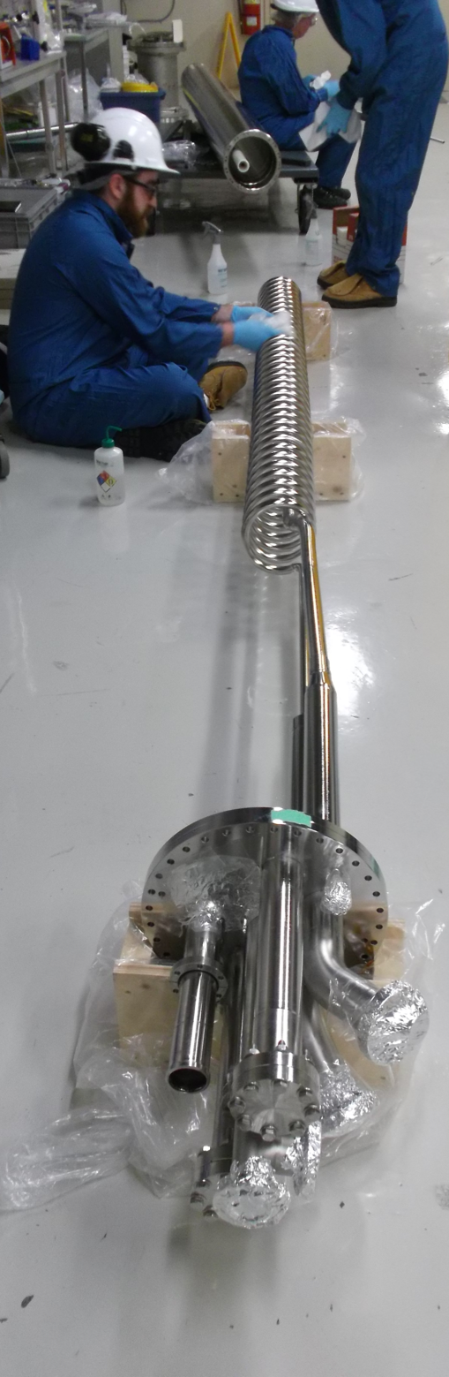
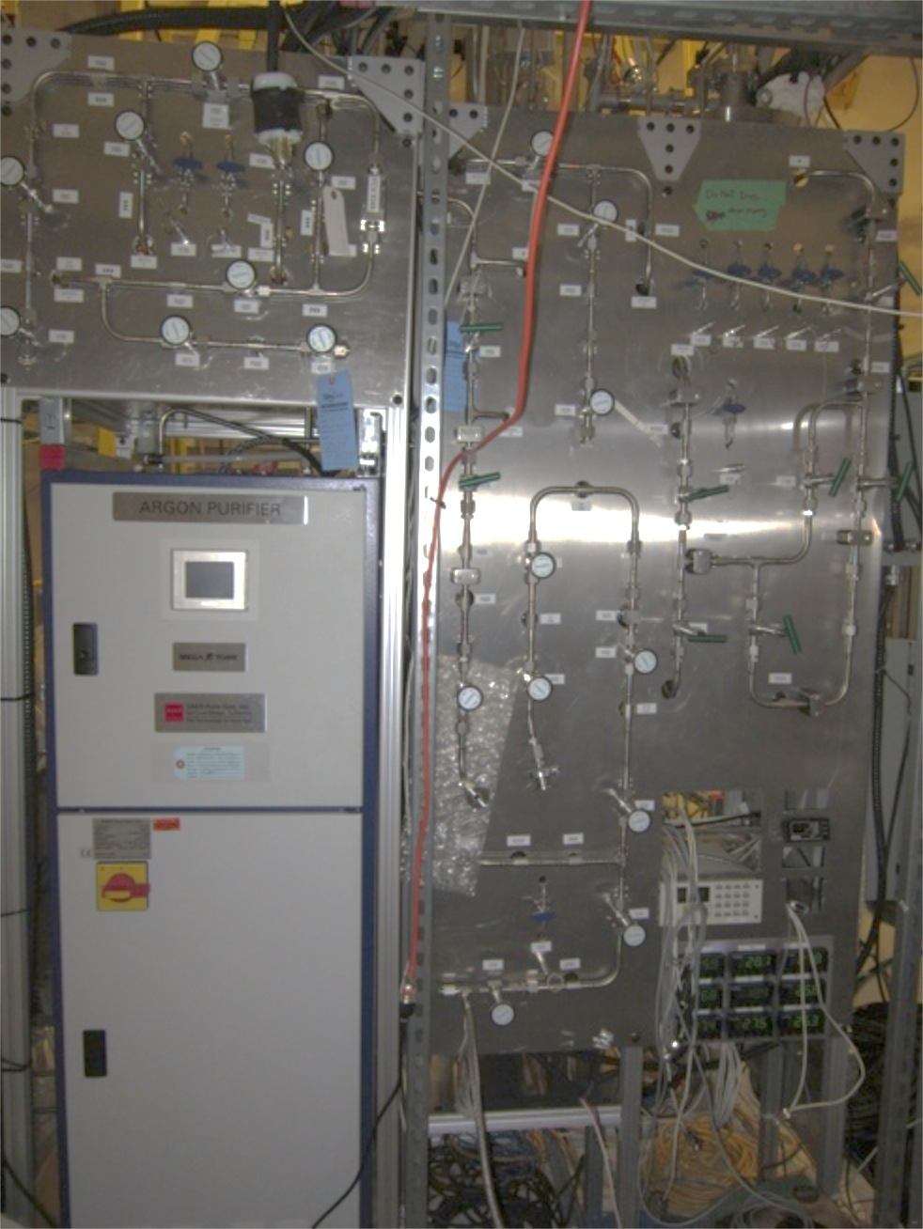
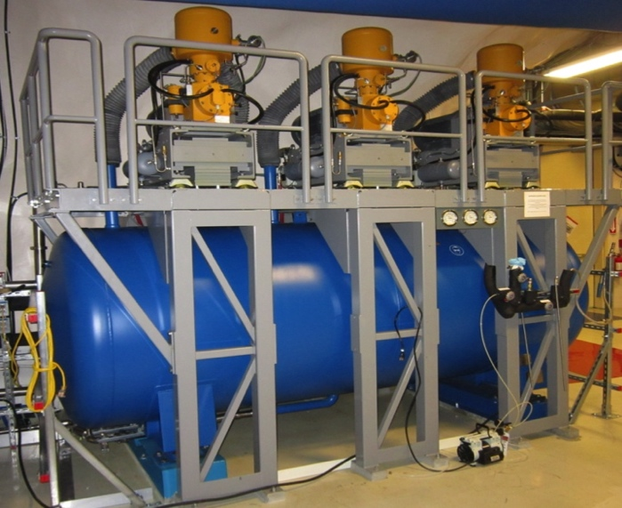
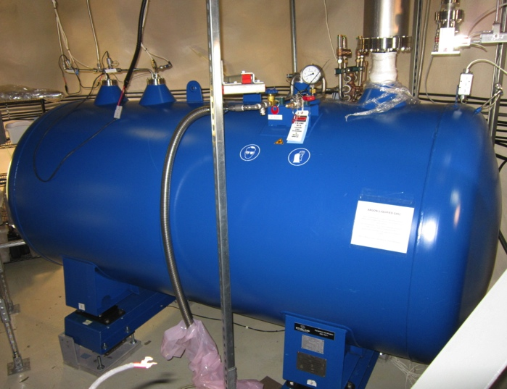
Process system
Cryocoolers and LN2 dewar
Cooling coils being prepared for final acid bath
Ar purification getter and charcoal trap
Ar dewar
Notes:
Like for instance the process systems. Still with the idea of decreasing background and optimizing the PSD, the Argon is purified with a SAES getter and a Charcoal trap. The cooling coil (which is a thermosyphon) is getting ready for the last citric acid bath before being deployed, which will happen as soon as the TPB deposition is done.

Slide 28
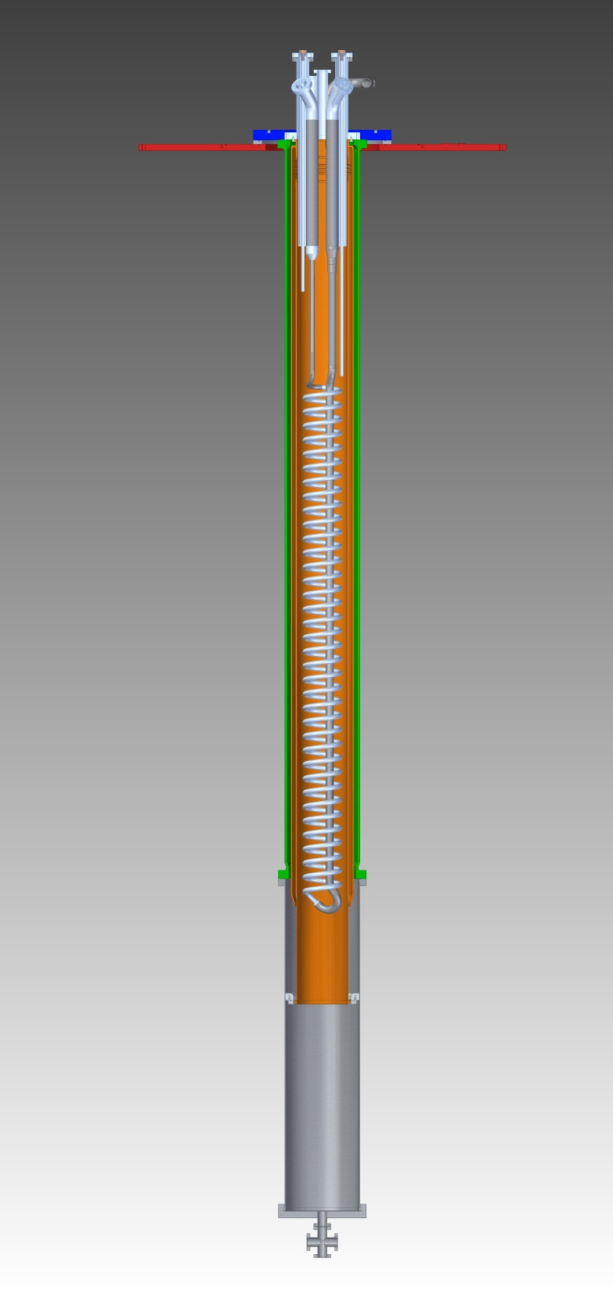
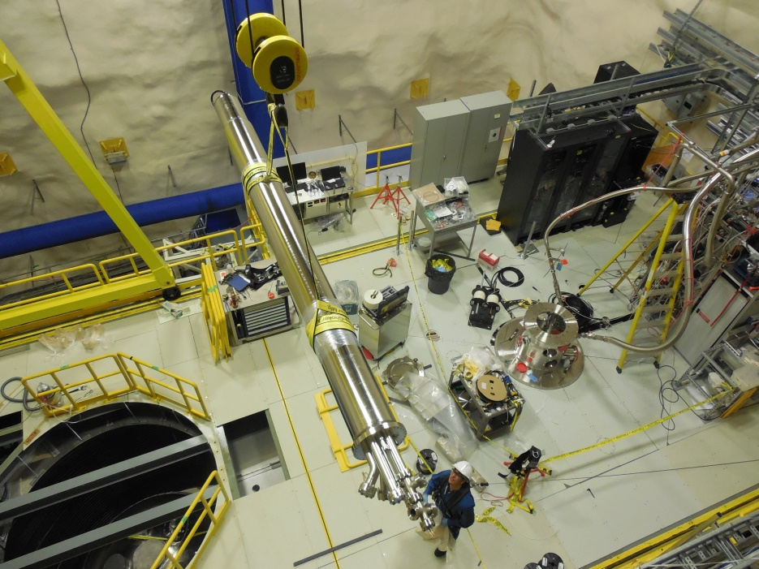
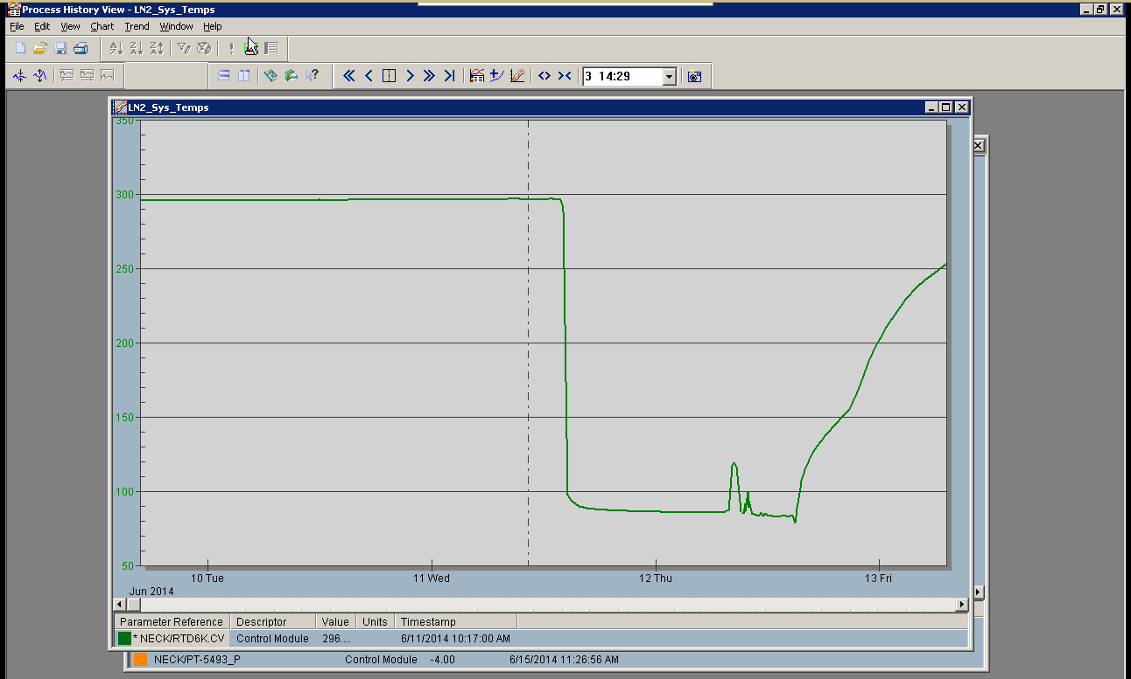
DEAP-3600 Argon Cooling System
Commissioning at 86 K, June 11 2014

Slide 29
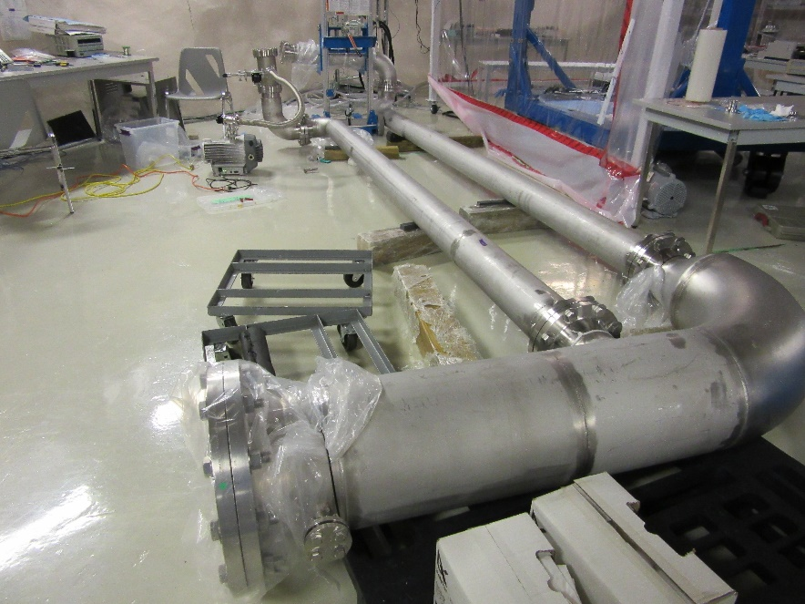
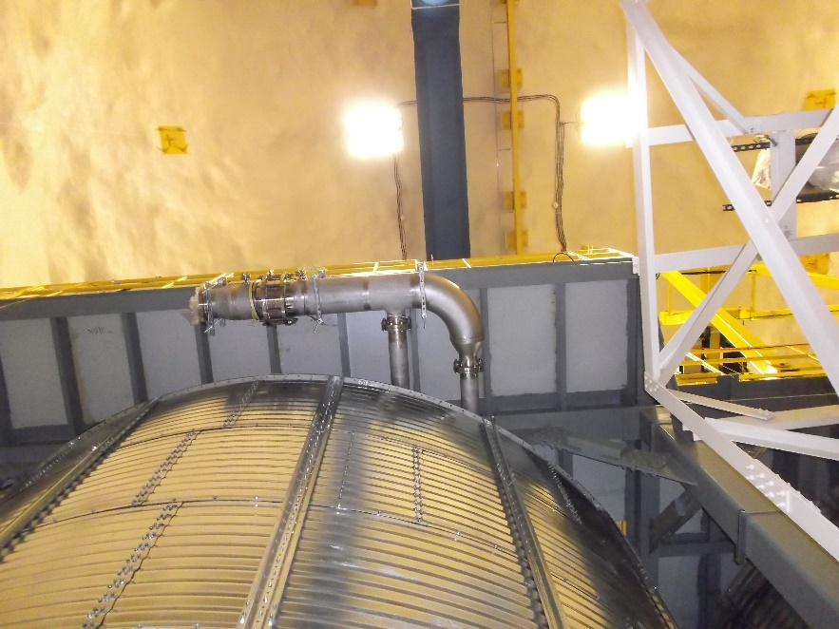
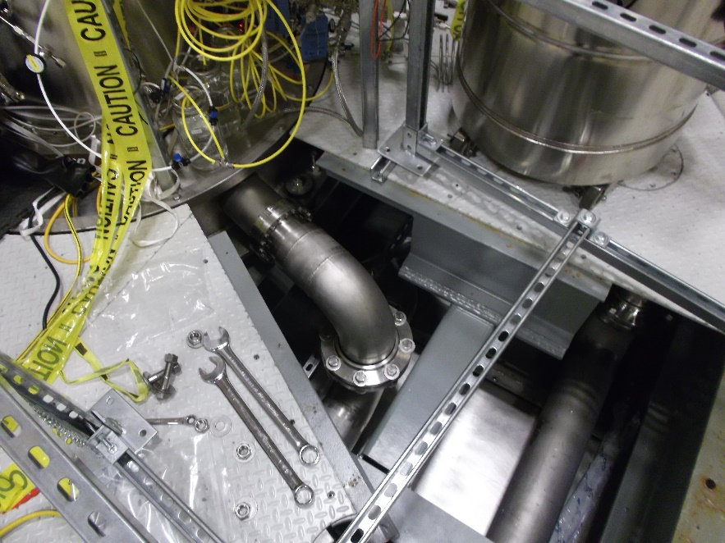
Installation of emergency vent line (~1100’ to Vale Air Raise)
~30 kg/sec argon flow
in case of failure of AV

Slide 30
Current Status of DEAP-3600
Acrylic vessel resurfacing was completed at the end of 2014
Detector optical calibration, PMT and electronics commissioning ongoing (winter 2014/spring 2015)
Commissioning cryogenic system (winter 2014/spring 2015)
Vacuum-baked acrylic vessel, prep. for WLS (spring 2015)
Completion of shield tank components, calibration hardware, veto PMT system (late spring 2015)
Inner wavelength shifter deposited on AV June 2015
Optical calibration runs June/July 2015
Currently completing installation of cooling coil into AV neck, planning for start of cooldown early fall

Slide 31
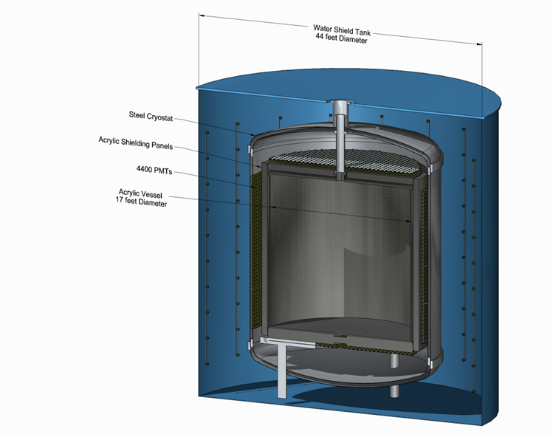
50-Tonne liquid argon detector (conceptual only)
“Conventional”
ultra-clean acrylic
vessel,
constructed UG
Sanded over ~months
to remove deposited
daughters, meets
requirement
(can tolerate higher
surface backgrounds
in larger detector!)
150-tonnes DAr in AV
50-tonne fiducial
Requires UG storage
of argon target
Will investigate PMTs
versus SiPMs

Slide 32
Backgrounds in xenon and argon
All the “regular” radioactive backgrounds
neutrons, internal, μ-induced
β/γ leakage
surface events, α-emitting Rn daughters
Beyond 10⁻⁴⁶ cm², need to consider neutrinos…

Slide 33
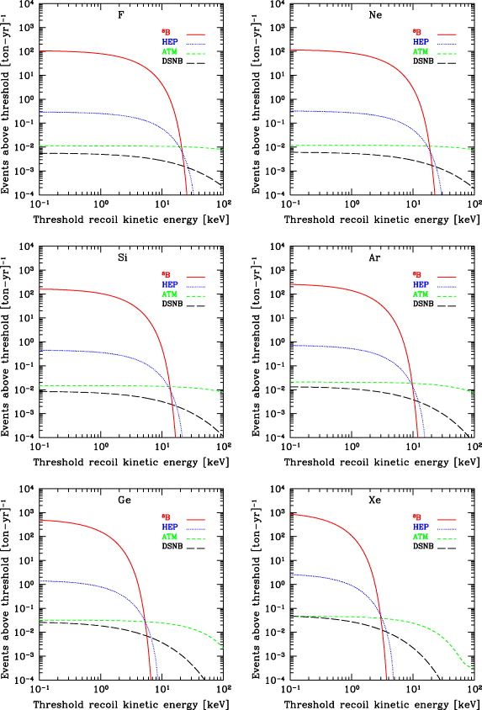
Neutrino backgrounds in xenon and argon
thresh
thresh
pp ES
Coherent scattering from Strigari, New J. Phys. 11 (2009) 105011
pp elastic scattering, Boulay
0.5 event/tonne-year pp background in xenon, after 0.995 discrimination

Slide 34
Depleted argon
³⁹Ar maintained in the atmosphere through cosmogenic production ⁴⁰Ar (n,2n) ³⁹Ar
and similar reactions
Pioneering work by Galbiati, Calaprice (Princeton, DarkSIDE) demonstrated the
possibility of obtaining low-radioactivity argon from underground sources
Underground argon activity varies depending on geology, depth due to production
underground:
(α,n) neutrons from U/Th underground
³⁹K(n,p)³⁹Ar
Site in Colorado developed for extraction, in support of both DarkSIDE and
DEAP-3600 (4 tonnes to be produced for DEAP-3600)
Several tonnes of low-radioactivity argon per day are being extracted along with
CO₂; Princeton has separated on the order of kg/day from the stream
Would need to scale up to order 100 kg/day or greater for proposed detector
(significant challenge for large detector is production/storage of Depleted Argon)

Slide 35
The downside: ³⁹Ar in Ar at 1 Bq/kg
Need argon depleted in ³⁹Ar beyond ~few tonnes

Slide 36
Sensitivity with 50-tonnes argon

Slide 37
Summary
DEAP Collaboration focused on exploiting DEAP-3600 detector in short term
DEAP-3600 sensitive to SI DM interactions at 10⁻⁴⁶ cm²; factor of >20X improvement at high WIMP mass over current LUX leading result
Construction completed, detector being commissioned, planned for liquid filling starting shortly
50T follow-up program builds on DEAP-3600 developments, physics reach approaches ultimate sensitivity of neutrino backgrounds

Slide 38
DEAP-50T Comments
Plan to inform design from DEAP-3600 performance, in particular achieved light yield, surface backgrounds and radon loads
Large single-phase argon detector has good potential to push DM sensitivity, complementary to xenon or good alternative if background-subtraction of pp neutrino signal required in xenon
Currently conceptual design only ! project may fit in Cube Hall or Cryopit
Significant effort needs to be placed on engineering, in particular
-Seismic requirements at SNOLAB
-Failure analysis, overpressure and venting
(above two required several years of effort for DEAP-3600, much more
effort than initially anticipated, even for “tiny” 3.6 Tonne detector)
-Storage and logistics for ~several hundred tonnes of argon
In addition to R&D for
-Light readout (potential for overlap with other next-gen projects)
-Backgrounds, esp. radon and Pb/Po contamination/migration and control
-Simulations for detector performance, design, etc.
(Plans to start some of the above R&D towards DEAP-50T, in particular Boulay at Carleton)

Slide 39
END

