Slide 1
Crosschecking on radiogenic studies
Shion Kubota

Slide 2
Background Rejection
Previously with Supernovae

Slide 3
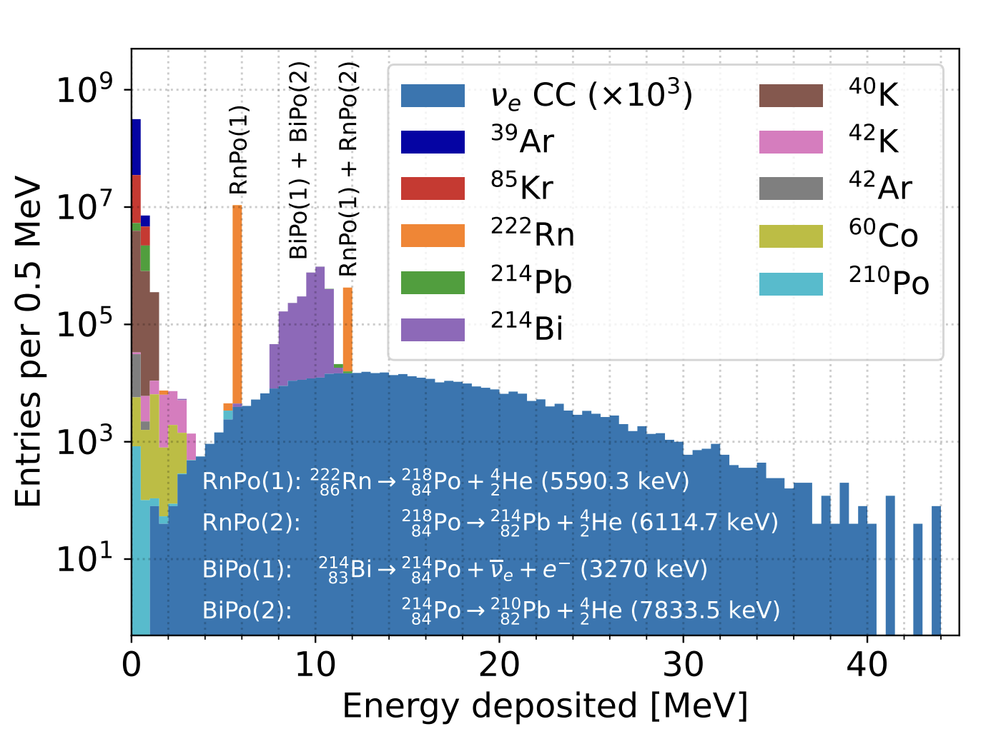
Background Rejection
Previously with Supernovae

Slide 4
Background Rejection
Previously with Supernovae
Supernova

Slide 5
Background Rejection
Now with Solar
Supernova
Solar

Slide 6
Background Rejection
Now with Solar
We need some work done to understand
how the radiogenic bkg might affect our studies
Supernova
Solar

Slide 7
Background Rejection
Now with Solar
We need some work done to understand
how the radiogenic bkg might affect our studies
→ Make analogous plot for solar events
And also make sure those are properly simulated!
Supernova
Solar

Slide 8
BKG Simulation Setups
Simulated with qpixg4
  Used for Supernova paper
  Time window: 10s
  Different decay chain simulation method from bxdecay0 (used in SOLAr-sim)

Slide 9

BKG Simulation Setups
Simulated with qpixg4
  Used for Supernova paper
  Time window: 10s
  Different decay chain simulation method from bxdecay0 (used in SOLAr-sim)
check if long-lived decays get affected by this – future work!
This would give us more complete simulation - future work!

Slide 10
BKG Simulation Setups
This should still give us a good first order approximation !
Simulated with qpixg4
  Used for Supernova paper
  Time window: 10s
  Different decay chain simulation method from bxdecay0 (used in SOLAr-sim)
check if long-lived decays get affected by this – future work!
This would give us more complete simulation - future work!

Slide 11
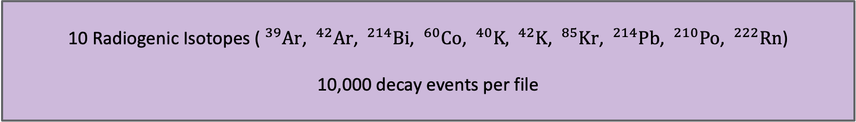
BKG Simulation Setups
This should still give us a good first order approximation !
Simulated with qpixg4
  Used for Supernova paper
  Time window: 10s
  Different decay chain simulation method from bxdecay0 (used in SOLAr-sim)
check if long-lived decays get affected by this – future work!
This would give us more complete simulation - future work!
10 Radiogenic Isotopes ($^{39}\text{Ar}$, $^{42}\text{Ar}$, $^{214}\text{Bi}$, $^{60}\text{Co}$, $^{40}\text{K}\text{,}{ }^{42}\text{K}$, $^{85}\text{Kr}$, $^{214}\text{Pb}$, $^{210}\text{Po}$, $^{222}\text{Rn}$)
10,000 decay events per file

Slide 12
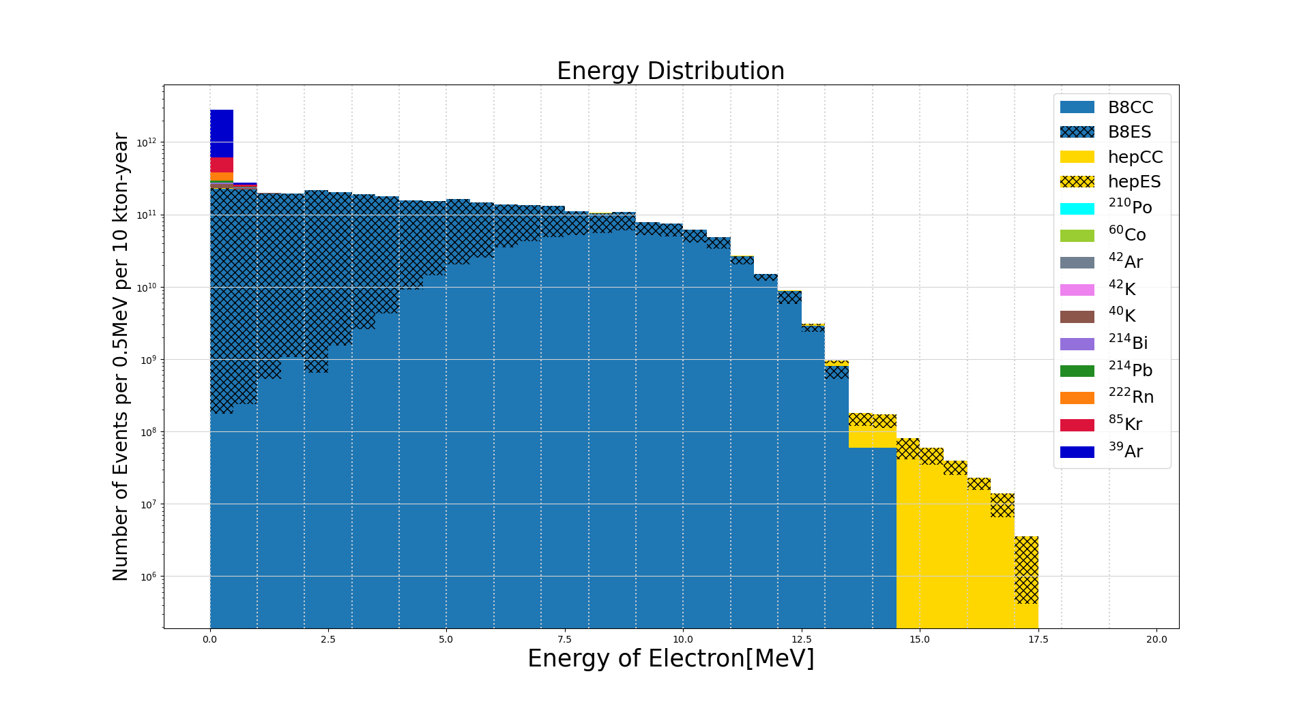
Deposited energy (BKG vs solar events)
Radiogenic Backgrounds
Energy deposited from
electrons or alphas
Scaled to 10 kton-year based on
the radiogenic background studies by Jingyuan Shi

Slide 13
Deposited energy (BKG vs solar events)
Radiogenic Backgrounds
Energy deposited from
electrons or alphas
Scaled to 10 kton-year based on
the radiogenic background studies by Jingyuan Shi

Slide 14
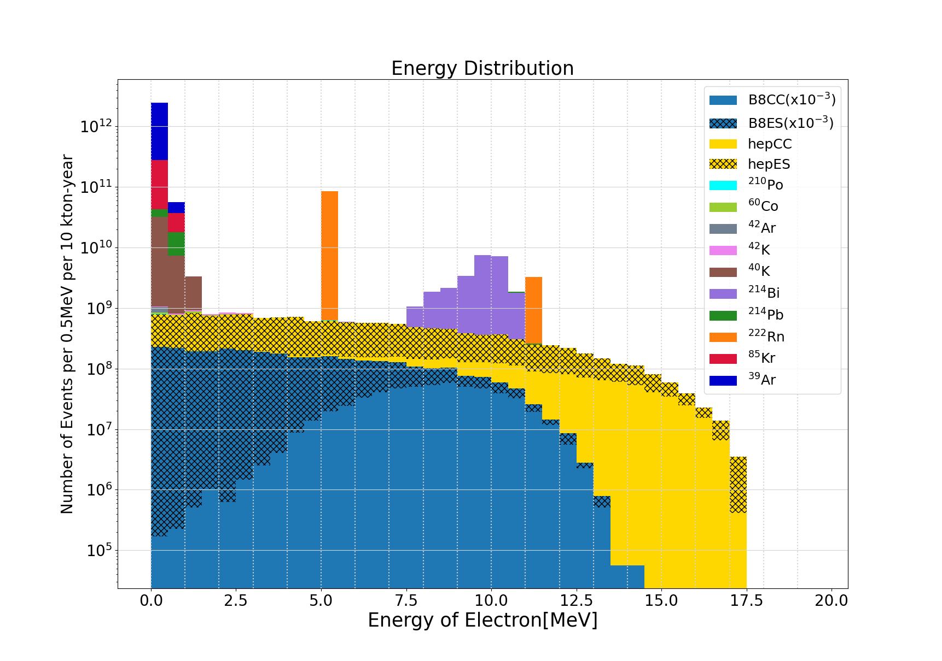
Deposited energy (BKG vs solar events)
Radiogenic Backgrounds
Energy deposited from
electrons or alphas
Scaled to 10 kton-year based on
the radiogenic background studies by Jingyuan Shi

Slide 15
Deposited energy (BKG vs solar events)
Radiogenic Backgrounds
Energy deposited from
electrons or alphas
Scaled to 10 kton-year based on
the radiogenic background studies by Jingyuan Shi

Slide 16
Deposited energy (BKG vs solar events)
Radiogenic Backgrounds
Energy deposited from
electrons or alphas
Scaled to 10 kton-year based on
the radiogenic background studies by Jingyuan Shi
Solar Events
Back-of-the-envelope calculation checks
done with cross section (Marley)
and solar neutrino flux
Agrees with the number in
Cappozzi paper!

Slide 17
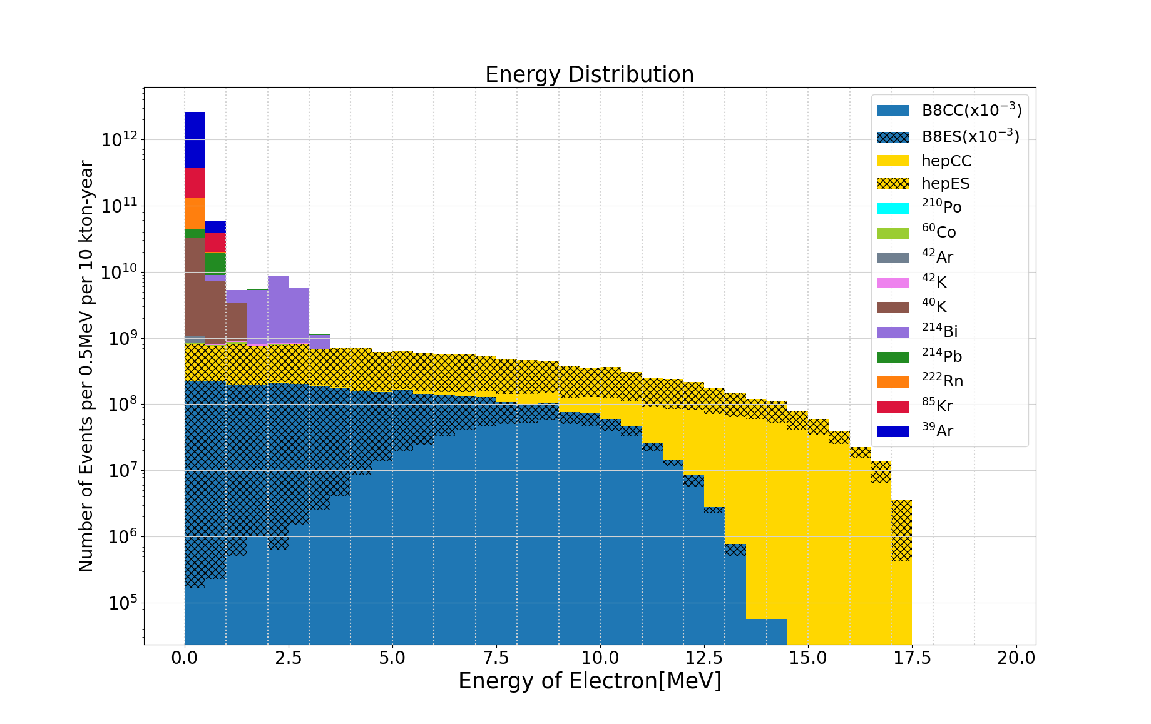
Deposited energy (BKG vs solar events)
Investigate if the physics list used in geant4 propergate all those decays properly -> decay0?
Radiogenic Backgrounds
Energy deposited from
just electrons
Scaled to 10 kton-year based on
the radiogenic background studies by Jingyuan Shi
Solar Events
Back-of-the-envelope calculations
done with cross section (Marley)
and solar neutrino flux
Agrees with the number in
Cappozzi paper!

Slide 18
Future work
Tweaking of the time window. (10s → ??s)
Simulate with SOLAr-sim. (more complete decay simulation)
Study the effect from alpha particles.

Slide 19
Back Up

Slide 20
Deposited energy (BKG vs solar events)
Radiogenic Backgrounds
Energy deposited from
electrons or alphas
Scaled to 10 kton-year based on
the radiogenic background studies by Jingyuan Shi
Solar Events
Back-of-the-envelope calculations
done with cross section (Marley)
and solar neutrino flux
Agrees with the number in
Cappozzi paper!

Slide 21
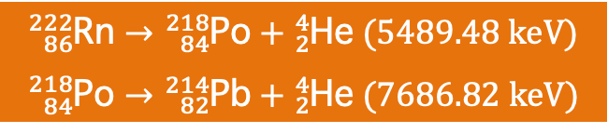

Deposited energy (BKG vs solar events)
Radiogenic Backgrounds
$${}_{86}^{222}{\text{Rn}}→{}_{84}^{218}{\text{Po}}+{}_{2}^{4}{\text{He}} (5489.48 keV)$$
Energy deposited from
electrons or alphas
Scaled to 10 kton-year based on
the radiogenic background studies by Jingyuan Shi
Solar Events
Back-of-the-envelope calculations
done with cross section (Marley)
and solar neutrino flux
Agrees with the number in
Cappozzi paper!
$${}_{86}^{222}{\text{Rn}}→{}_{84}^{218}{\text{Po}}+{}_{2}^{4}{\text{He}} (5489.48 keV)$$
$${}_{84}^{218}{\text{Po}}→{}_{82}^{214}{\text{Pb}}+{}_{2}^{4}{\text{He}} (7686.82 keV)$$

Slide 22
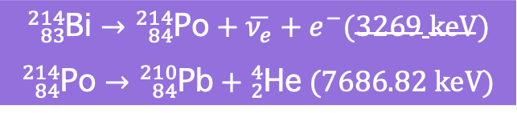
Deposited energy (BKG vs solar events)
Radiogenic Backgrounds
$${}_{86}^{222}{\text{Rn}}→{}_{84}^{218}{\text{Po}}+{}_{2}^{4}{\text{He}} (5489.48 keV)$$
Energy deposited from
electrons or alphas
Scaled to 10 kton-year based on
the radiogenic background studies by Jingyuan Shi
$${}_{83}^{214}{\text{Bi}}→{}_{84}^{214}{\text{Po}}+\overline{ν_{e}}+e^{−}(3269 keV)$$
$${}_{84}^{214}{\text{Po}}→{}_{84}^{210}{\text{Pb}}+{}_{2}^{4}{\text{He}} (7686.82 keV)$$
Solar Events
Back-of-the-envelope calculations
done with cross section (Marley)
and solar neutrino flux
Agrees with the number in
Cappozzi paper!
$${}_{86}^{222}{\text{Rn}}→{}_{84}^{218}{\text{Po}}+{}_{2}^{4}{\text{He}} (5489.48 keV)$$
$${}_{84}^{218}{\text{Po}}→{}_{82}^{214}{\text{Pb}}+{}_{2}^{4}{\text{He}} (7686.82 keV)$$

Slide 23
Deposited energy (BKG vs solar events)
Radiogenic Backgrounds
Energy deposited from
just electrons
Scaled to 10 kton-year based on
the radiogenic background studies by Jingyuan Shi
Solar Events
Back-of-the-envelope calculations
done with cross section (Marley)
and solar neutrino flux
Agrees with the number in
Cappozzi paper!

Slide 24
Deposited energy (BKG vs solar events)
Radiogenic Backgrounds
Energy deposited from
just electrons
Scaled to 10 kton-year based on
the radiogenic background studies by Jingyuan Shi
Solar Events
Back-of-the-envelope calculations
done with cross section (Marley)
and solar neutrino flux
Agrees with the number in
Cappozzi paper!

Slide 25
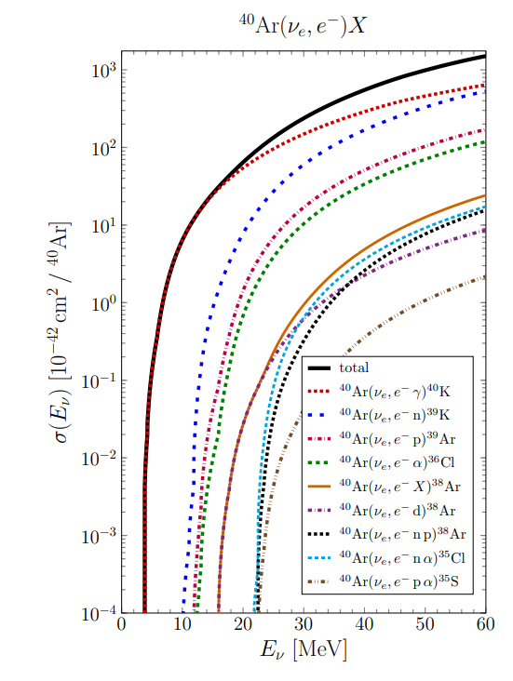
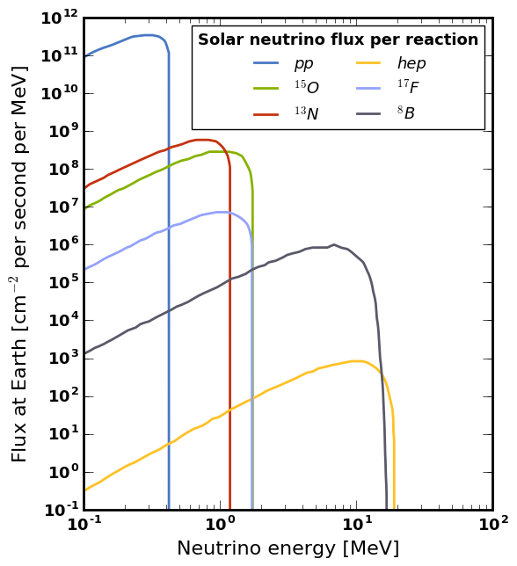
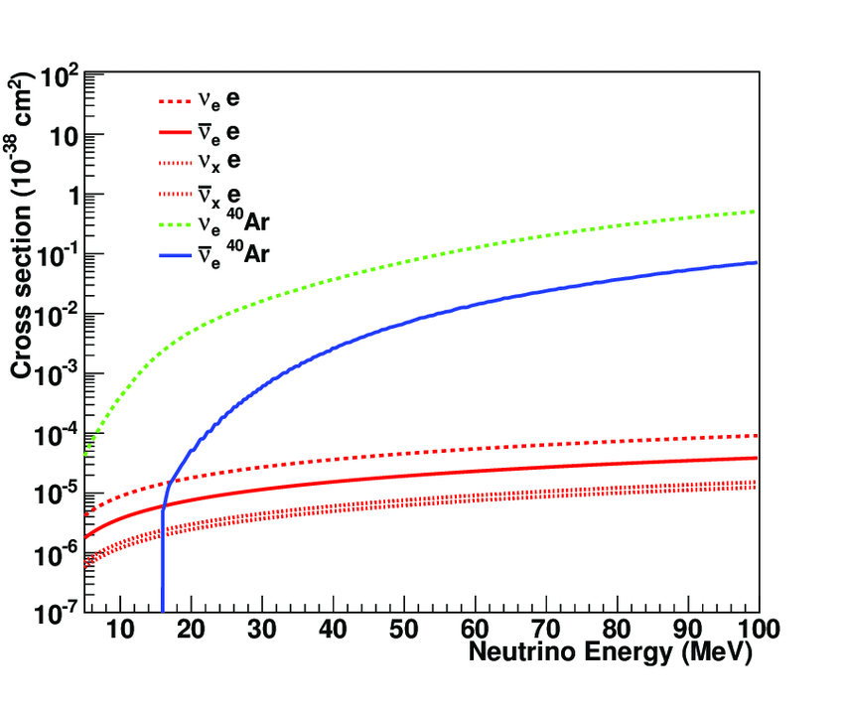
Back of the envelope check
CC Events
ES Events

