Slide 1

Energy reconstruction with Q-Pix readout
Guilherme Ruiz
SoLAr meeting 26/04/2023

Slide 2
Goal
Determining the reconstruction efficiency of the Q-Pix readout as a function of the particle’s energy
  The reconstruction efficiency is defined as the ratio of the reconstructed energy to the initial energy of the simulated particle
Method
Simulate single electron events from 1 to 30 MeV
Obtain the number of Q-Pix resets per event
Reconstruct the deposited energy from resets

Slide 3
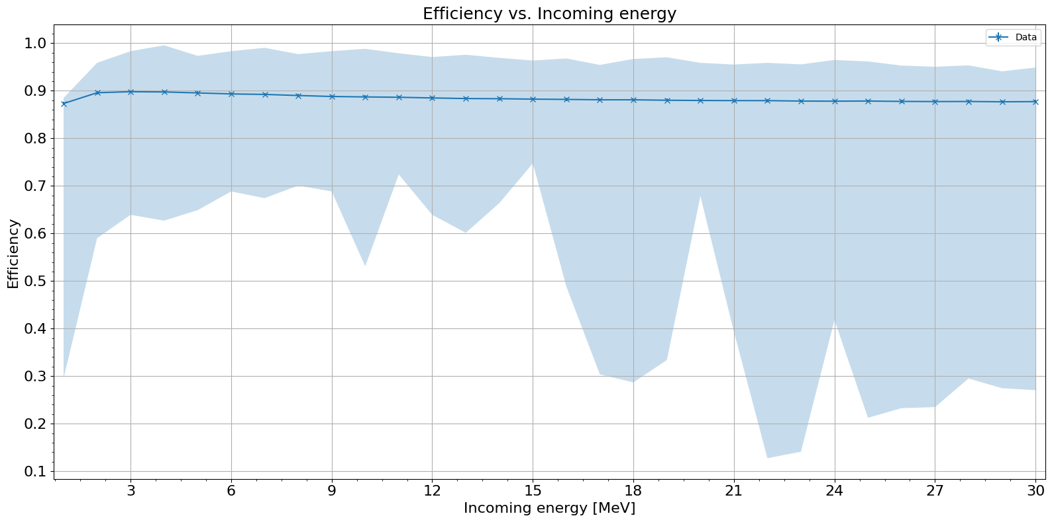
Single electrons
1 to 30 MeV – Reconstruction efficiency vs. Incoming energy
The efficiency is relatively constant, but a decrease is noticeable towards higher energies as few events with low efficiency bring the average down

Slide 4
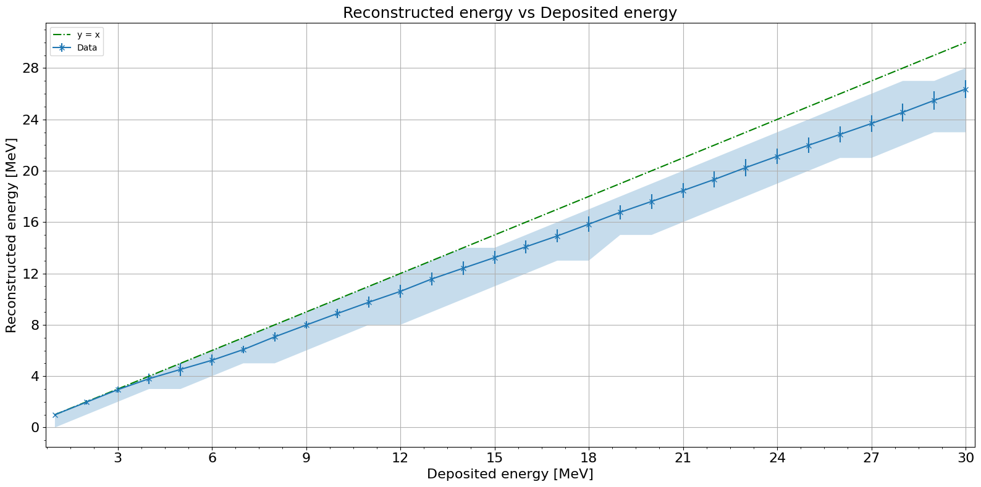
Single electrons
1 to 30 MeV – Reconstructed energy vs. Deposited energy
No Recombination
The reconstructed energy decreases as the energy increases. This is equivalent to the efficiency plot and is likely due to the hits being more scattered at higher energies.

Slide 5
Conclusions
Efficiency decreases at higher energies due to the hits being scattered across more pixels
Low deposited energy is a result of tracks escaping containment at the TPC edges
The deposited energy to incoming energy ratio is mostly constant but there are outliers not related to containment issues

Slide 6
Thank you!

Slide 7
Backup slides

Slide 8
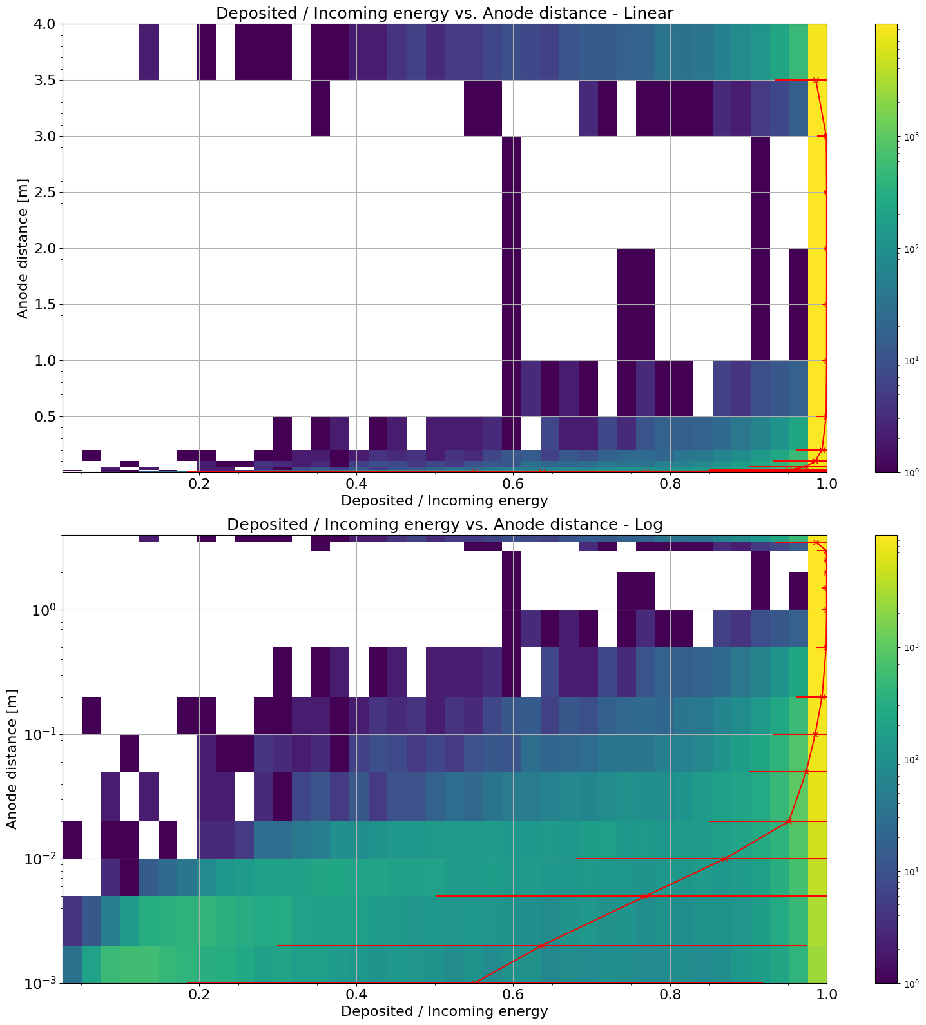
10 MeV single electrons – Track containment
No Recombination
As the event approaches the edge of the TPC, the hits escape resulting in less energy deposited for the same incoming energy

Slide 9
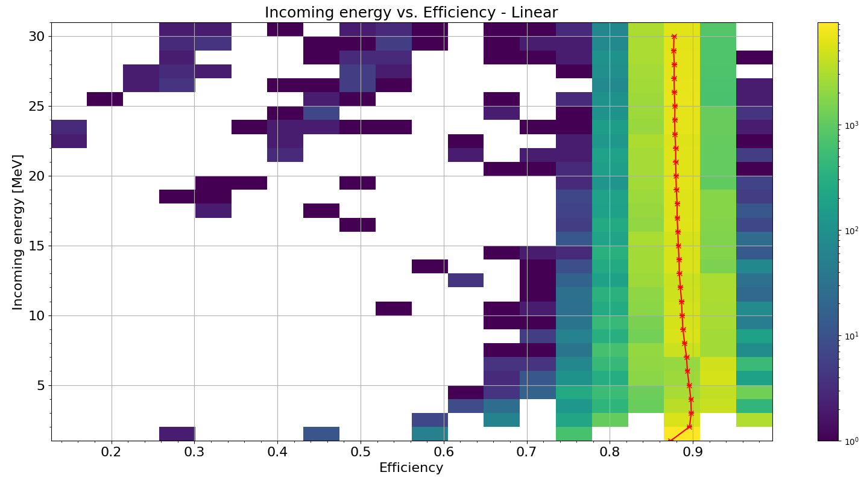
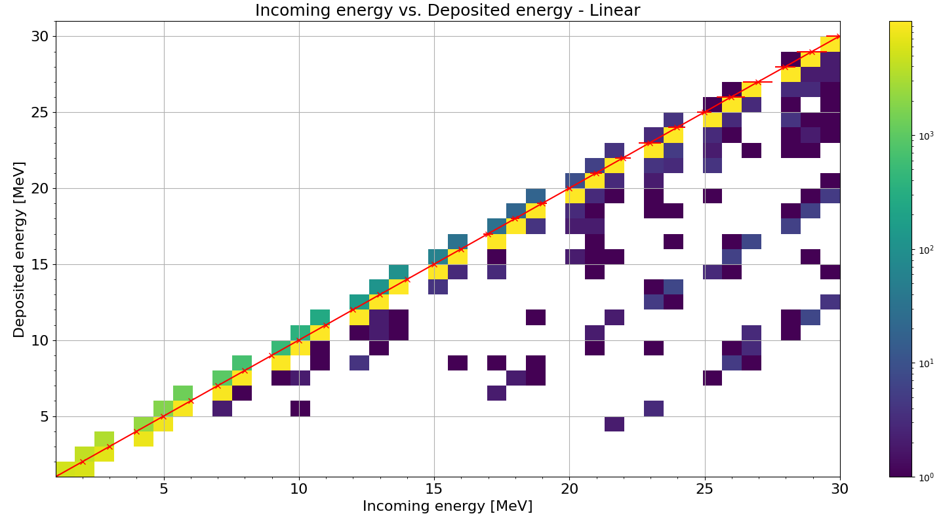
1 to 30 MeV Single electrons – Incoming energy
The ratio of energy deposited for incoming energy is relatively constant, despite some events with low deposited energy
The efficiency is relatively constant, but a decrease is noticeable towards higher energies as few events with low efficiency bring the average down

