Slide 1

Energy reconstruction with Q-Pix readout
Guilherme Ruiz
University of Manchester
Notes:
Far Detector 2 on Wednesday

Slide 2
$dE/dr$ reconstruction - Finding tracks
Event 0
Good track
Event 1
Bad track
Event 4074
No track

Slide 3
$dE/dr$ reconstruction - Finding tracks
Processing ”bad tracks”
DBSCAN
Original event
Processed event
Use DBSCAN to exclude resets that do not form a track and small clusters (less than 7 resets) off-track
DBSCAN parameters:
Min samples = 3
Epsilon = 1.5 x pixel size

Slide 4
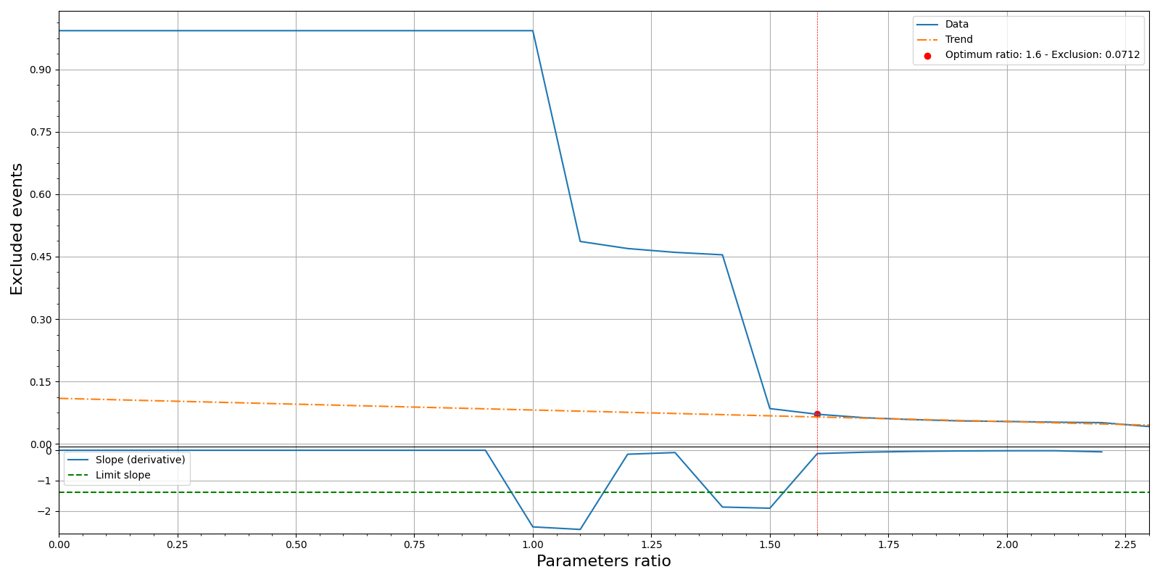
$dE/dr$ reconstruction – Filtering “bad tracks”
Filtering bad events
Experimental method:
Use pixel size – no G4 truth
Exclude events with a maximum reconstructed $dr$value larger than a certain ratio of the pixel size
Exclude events with a maximum reconstructed 𝑑𝑟 value larger than a certain ratio of the pixel size

Slide 5
Filtering “bad tracks” – Defining optimum ratio
Filtering bad events
Calculate the number of events excluded per pixel size ratio until reaching 5% of exclusions
Fit a line to the last 20% of the excluded vs ratio values
Obtain the derivative of the exclusions curve and apply a moving average filter¹ to obtain the curve’s slope
Compare the slope of the exclusions curve to that of the fitted line
Define a multiple of the fitted line slope² as the limit slope
Find the maximum ratio for which the derivative of the exclusions curve is lower than the limit slope
The window size increases linearly with the particle energy
The default is currently set to 50

Slide 6
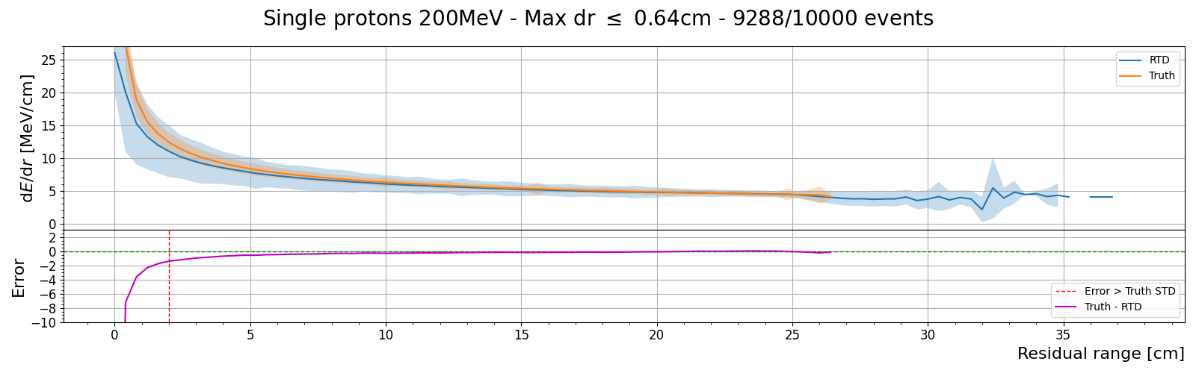
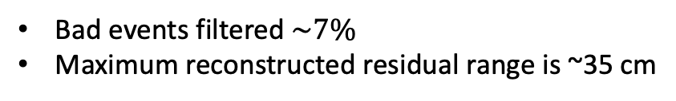
$dE/dr$ reconstruction – “good tracks” after DBSCAN
200MeV single proton events
Processed events
Bad events filtered $\sim 7\%$
Maximum reconstructed residual range is ~35 cm

Slide 7
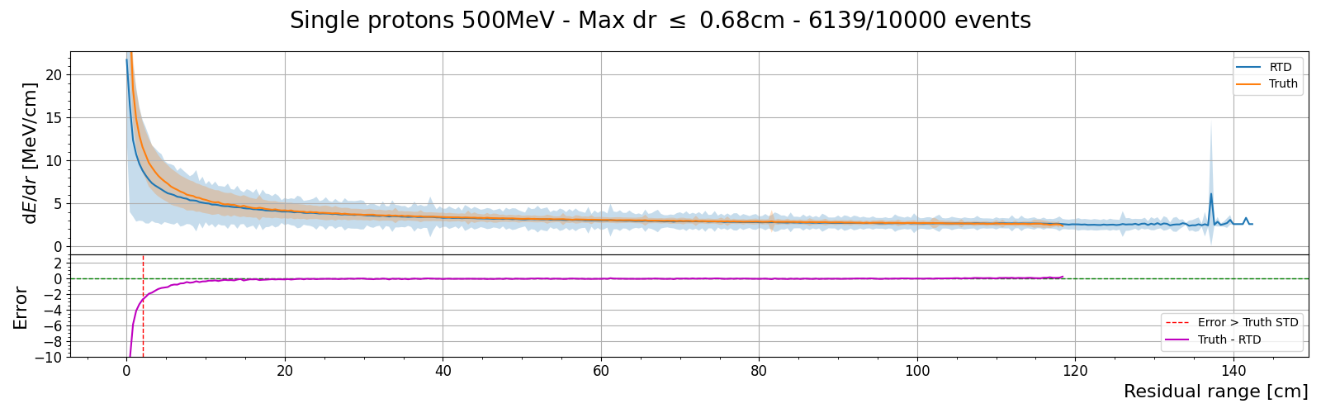
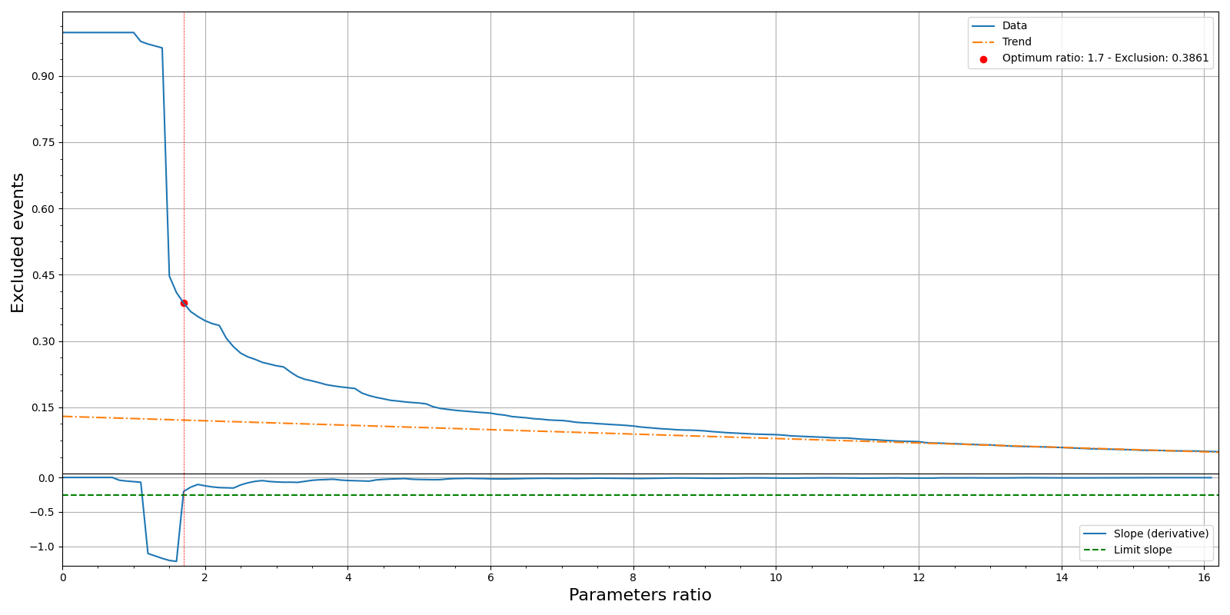
$dE/dr$ reconstruction – Proton metrics
200MeV single proton events
Processed events
DBSCAN
Energy | Excluded | Ratio
200 | 0.0712 | 1.6
300 | 0.1715 | 1.6
400 | 0.2538 | 1.7
500 | 0.3861 | 1.7

Slide 8
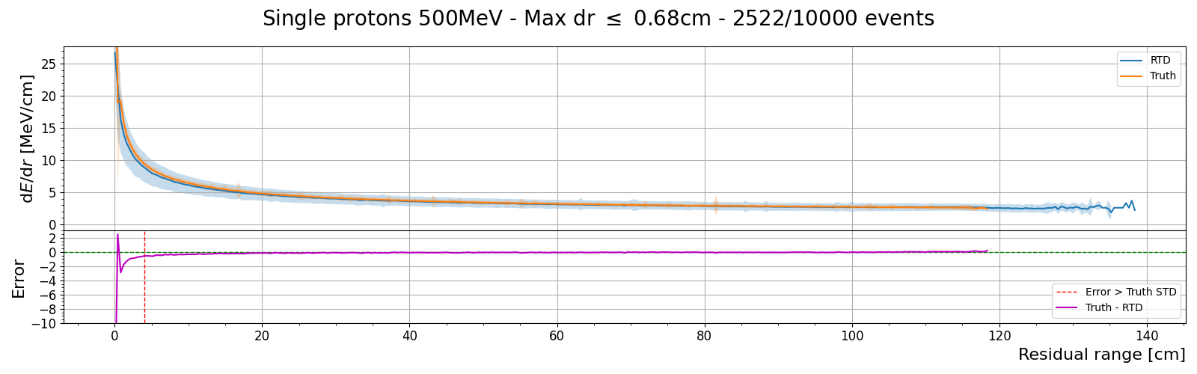
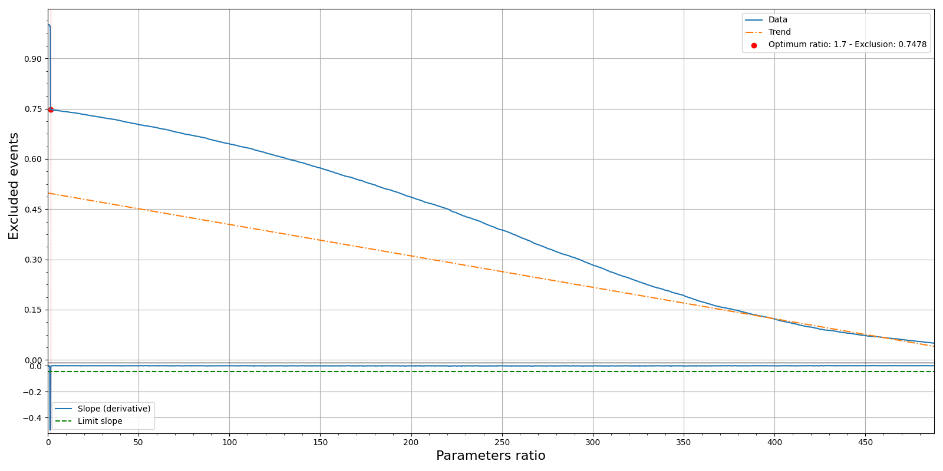
$dE/dr$ reconstruction – Proton metrics
200MeV single proton events
Processed events
No DBSCAN
DBSCAN
No DBSCAN
Energy | Excluded | Ratio
200 | 0.0712 | 1.6
300 | 0.1715 | 1.6
400 | 0.2538 | 1.7
500 | 0.3861 | 1.7
Energy | excluded | ratio
200 | 0.2716 | 1.6
300 | 0.4528 | 1.6
400 | 0.6043 | 1.7
500 | 0.7478 | 1.7
No DBSCAN

Slide 9
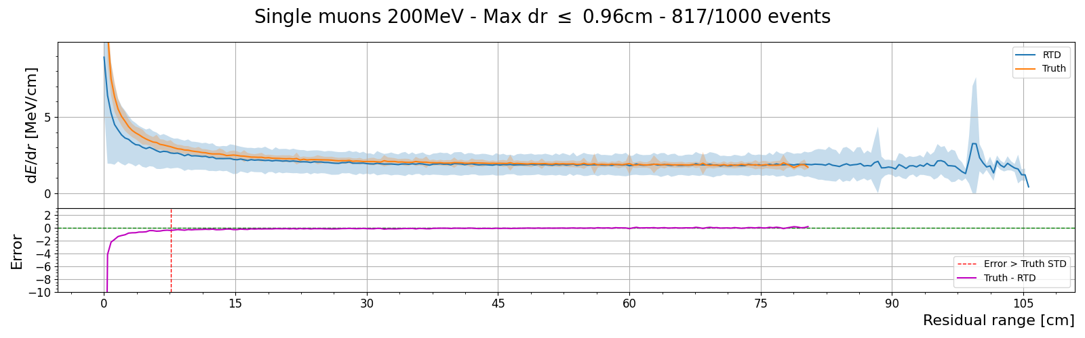
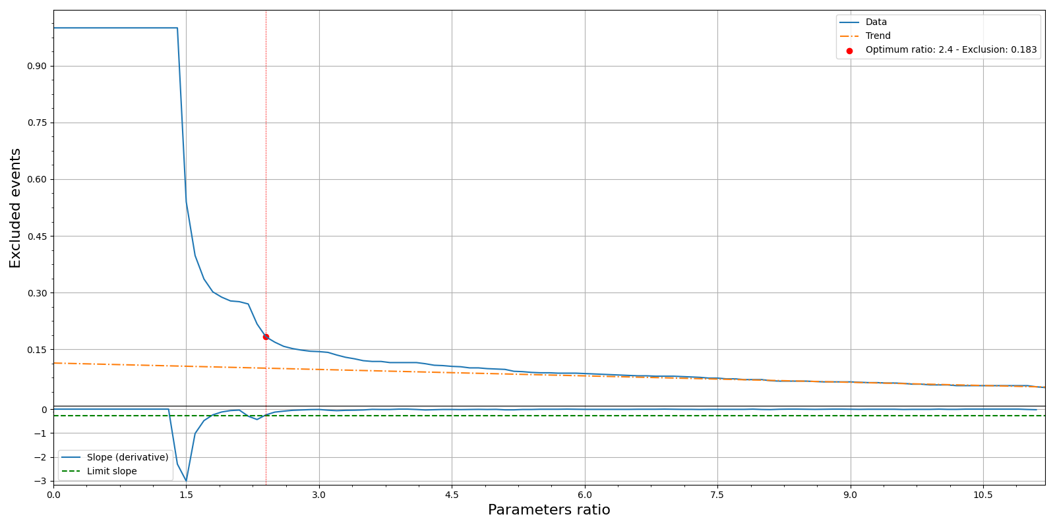
$dE/dr$ reconstruction – Muon metrics
200MeV single proton events
Processed events
DBSCAN
No DBSCAN
Energy | Excluded | Ratio
200 | 0.183 | 2.4
300 | 0.269 | 2.5
400 | 0.357 | 2.5
500 | 0.445 | 2.6
Energy | excluded | ratio
200 | 0.106 | 324.2
300 | 0.122 | 322.7
400 | 0.049 | 698.8
500 | 0.420 | 188.9

Slide 10
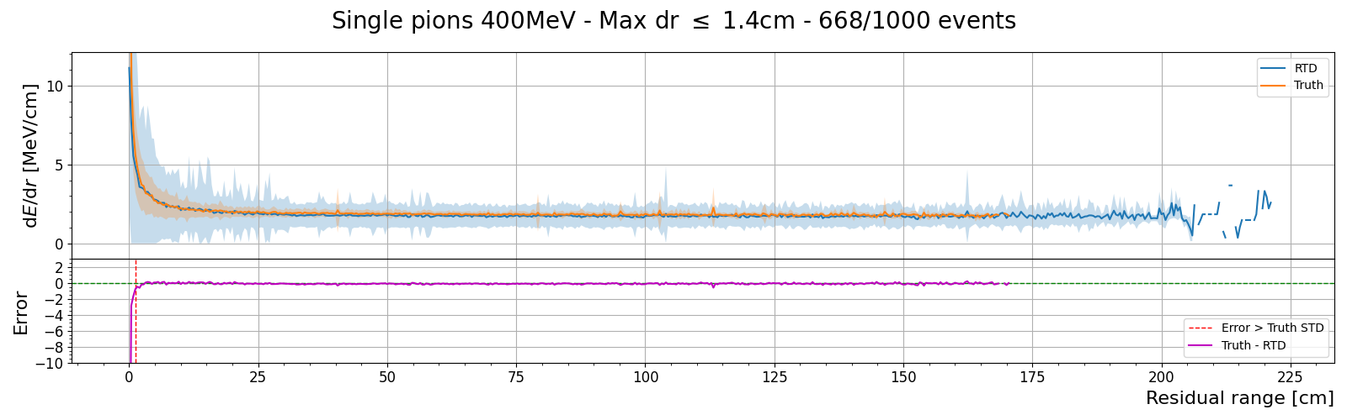
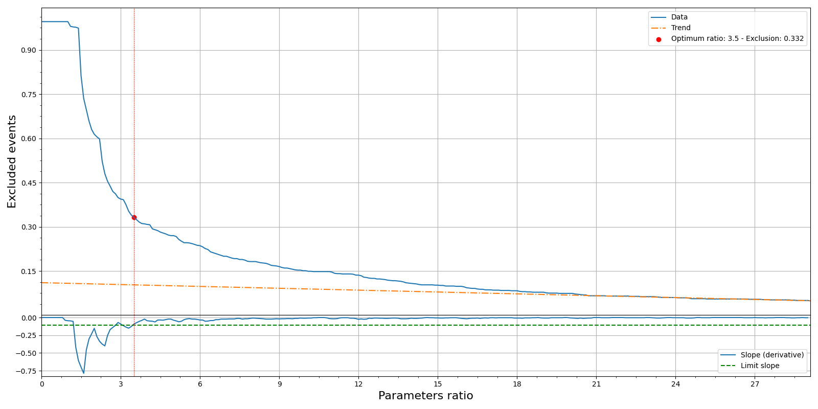
$dE/dr$ reconstruction – Pion metrics
200MeV single proton events
Processed events
DBSCAN
No DBSCAN
Energy | Excluded | Ratio
200 | 0.415 | 1.7
300 | 0.577 | 1.7
400 | 0.332 | 3.5
500 | 0.555 | 2.5
Energy | excluded | ratio
200 | 0.049 | 1059.1
300 | 0.078 | 701.9
400 | 0.264 | 476.3
500 | 0.056 | 999.0

Slide 11
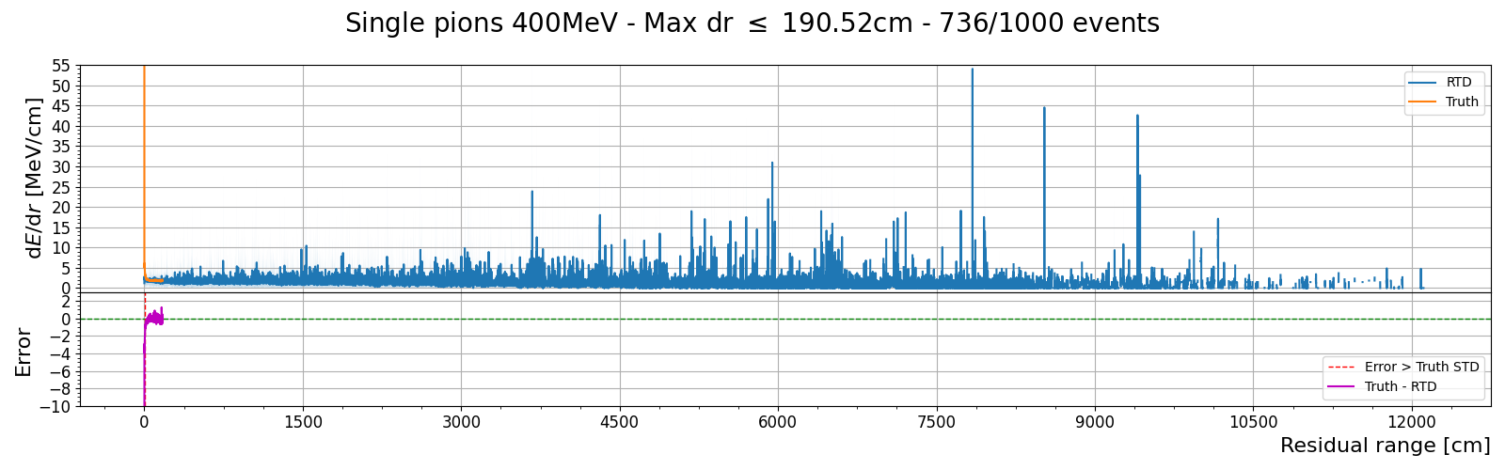
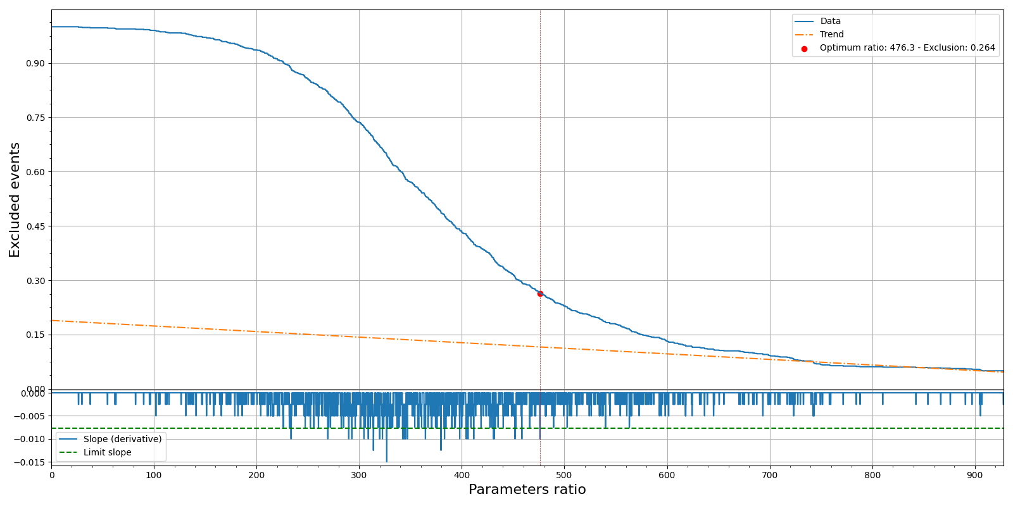
$dE/dr$ reconstruction – Pion metrics
200MeV single proton events
Processed events
DBSCAN
No DBSCAN
Energy | Excluded | Ratio
200 | 0.415 | 1.7
300 | 0.577 | 1.7
400 | 0.332 | 3.5
500 | 0.555 | 2.5
Energy | excluded | ratio
200 | 0.049 | 1059.1
300 | 0.078 | 701.9
400 | 0.264 | 476.3
500 | 0.056 | 999.0

Slide 12
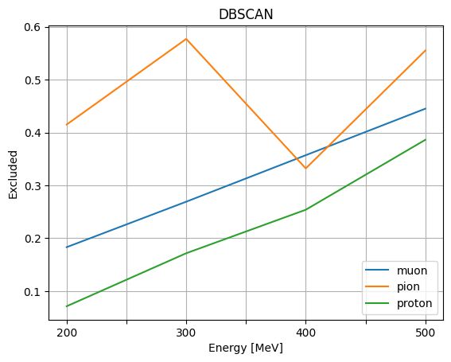
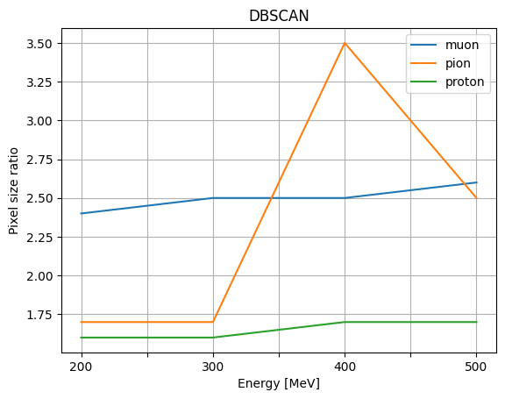
$dE/dr$ reconstruction – Metric plots
200MeV single proton events
Processed events

Slide 13
Conclusions
DBSCAN helps cleaning up events to reconstruct only tracks
  DBSCAN greatly reduces the amount of “bad events” for Protons but is an optimization choice
  DBSCAN is unavoidable for Pions and Muons
The DBSCAN algorithm is fine tuned for Protons but can be improved for Pions and Muons
  Minimum of 7 resets per cluster may be still a loose constraint for Pions and Muons
At 400MeV the default limit slope in the optimization is too large
  Either lower the limit slope or change the moving average filter to ensure the ratio optimization works equally for all energies and particles

Slide 14
Thank you!

Slide 15
Backup slides

Slide 16
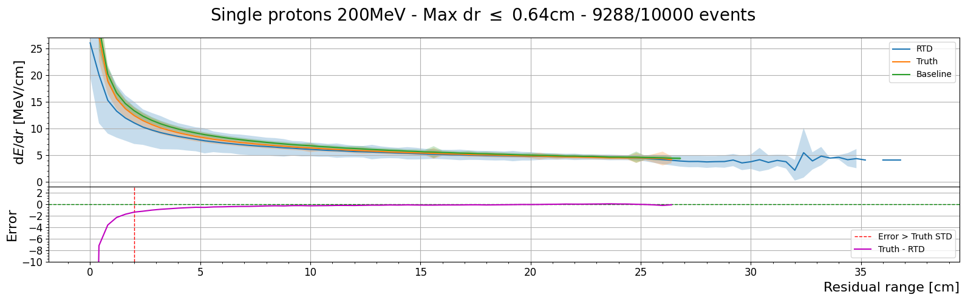
$dE/dr$ reconstruction – “good tracks” after DBSCAN
200MeV single proton events
Processed events
Bad events filtered $\sim 7\%$
Maximum reconstructed residual range is ~35 cm

Slide 17
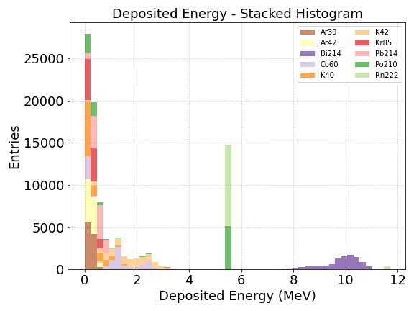
Radiogenic background

Slide 18
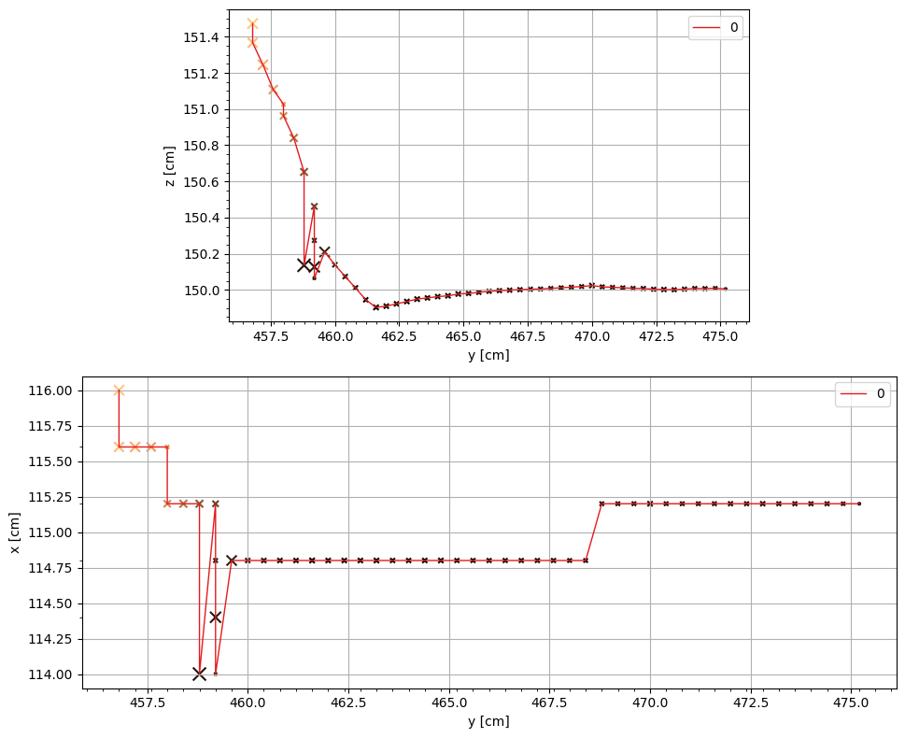
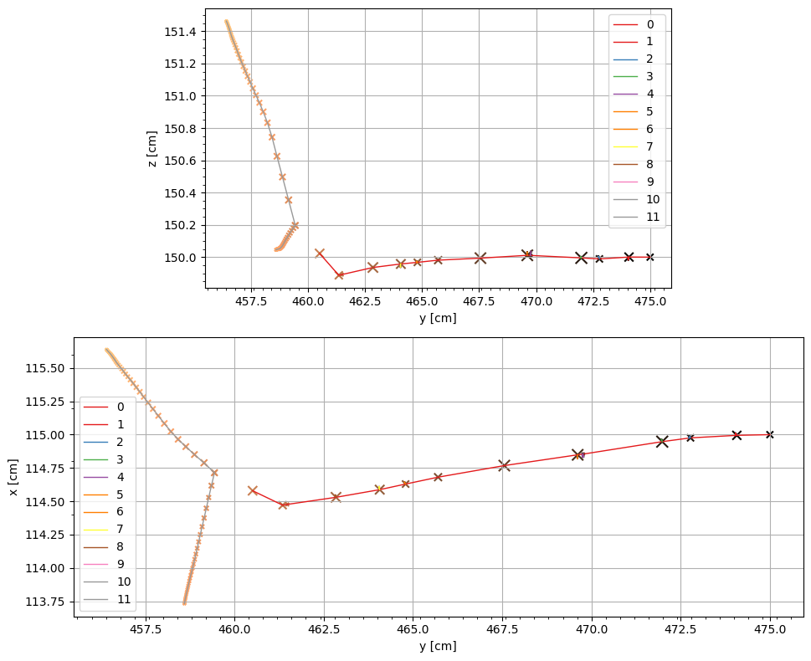
$dE/dx$ reconstruction – Impossible tracks
”Worse tracks”
Impossible to use (?)
Processed RTDs
Geant4 truth

Slide 19
Diffusion study
Generate 10 MeV single electron Geant4 simulations with drift distances 1mm, 5mm, 1cm, 2cm, 5cm, 10cm, 20cm, 50cm, 1.0m, 1.5m, 2.0m, 2.5m, 3.0m and 3.5m
Compute the energy reconstruction efficiency from RTDs with and without recombination
Plot the mean of the distribution for each drift distance with binomial error as error bars

Slide 20
10 MeV single electrons – No recombination
No Recombination

Slide 21
10MeV single electron events
10 MeV single electrons – No recombination
No Recombination

Slide 22
10MeV single electron events
10 MeV single electrons – With recombination
With Recombination

Slide 23
10MeV single electron events
10 MeV single electrons – With recombination
With Recombination

Slide 24
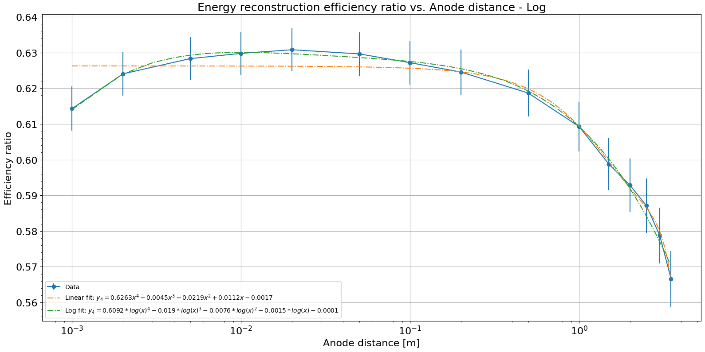
10MeV single electron events
With Recombination
X
No Recombination
10 MeV single electrons – Recombination ratio

