Slide 1


Electric Dipole moment Measurements using Molecules in a Matrix
(EDM³)
Eric Hessels
Supported by:
Canada Foundation for Innovation
Ontario Research Fund
Gordon and Betty Moore Foundation
Alfred P. Sloan Foundation
Templeton Foundation
York University
NSERC Subatomic Project Grants
(2022-2025) $6.7M equipment funding
}
(2018-2023) $2.6M seed funding
(2019-2027) $1.1M continuing funding

Slide 2
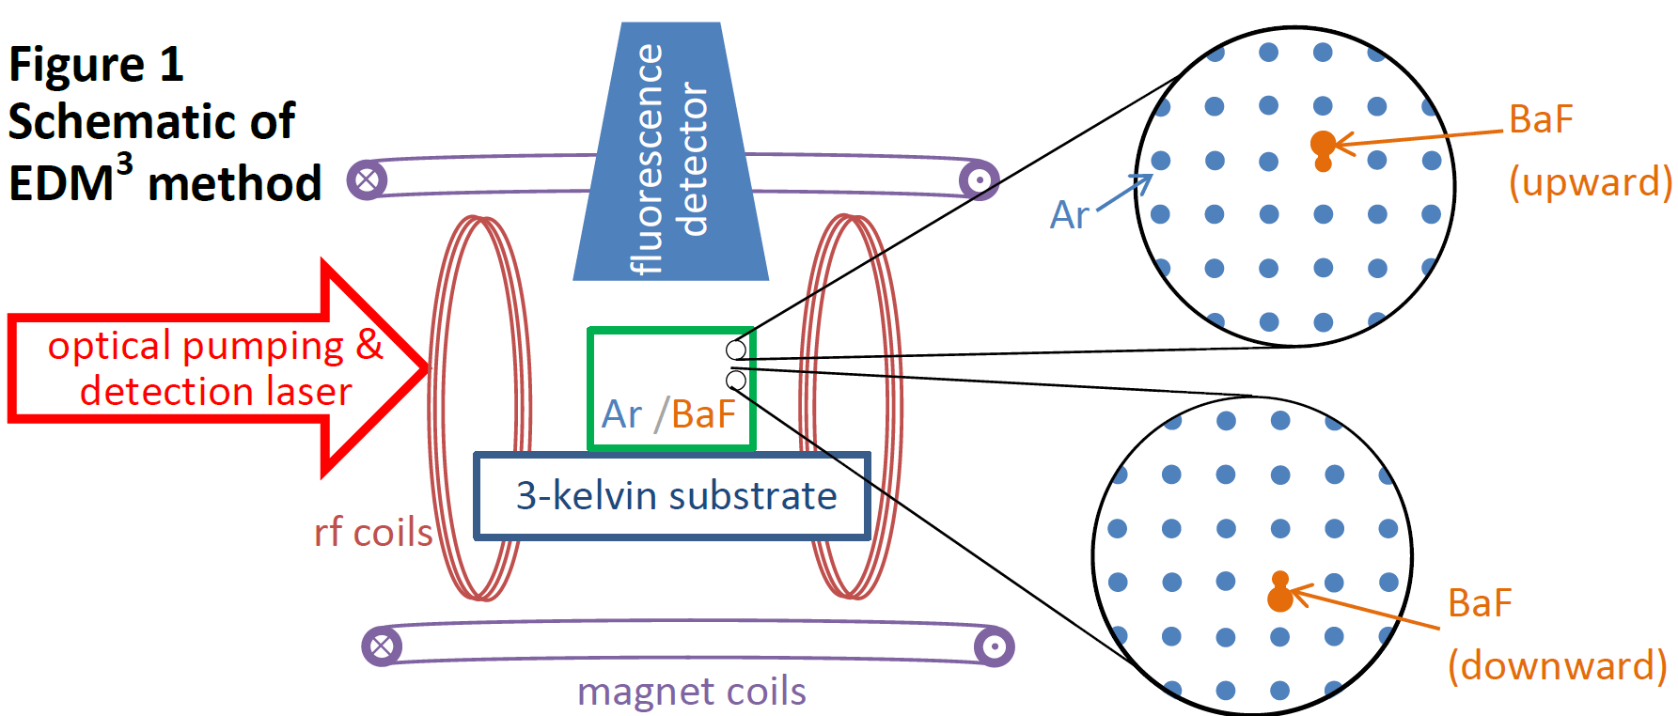
Our Goal
EDM³ aims to make electron electric dipole moment (d_{e}) measurements using BaF molecules embedded in cryogenic solid argon
Use a large number of (~1ppb BaF:Ar, ~1mm³, ~10¹¹ BaF)
Molecular orientation fixed by matrix – no need for external E field
Systematic effects for d_{e} measurement are expected to be favorable:
small volume, cold, stationary
Has the potential to improve d_{e} limit by 3 orders of magnitude (or more)

Slide 3
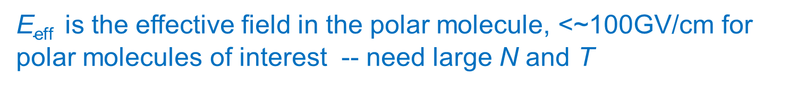
Some Numbers
The statistically accuracy of d_{e} is limited to: $\text{d}\text{d}\text{e}=\frac{\text{ħ}}{\text{2 }\text{E}\text{eff} \sqrt{\text{N} }\text{T}}$
A total (integrated) N electrons that precess for a time T
$\text{E}\text{eff}$ is the effective field in the polar molecule, <~100GV/cm for polar molecules of interest -- need large N and T
N ~ 10⁸ ; T ~ 1 s
|d_{e}|< 4.1x10⁻³⁰ e cm
Current limit: JILA (HfF⁺):
We are using BaF: $\text{E}\text{eff}$= 6.5 GV/cm
10¹¹ BaF used 10⁸ times (every 30 ms for 1 month): N of up to 10¹⁹
Precession time of T=10 ms, could lead to $\text{d}\text{d}\text{e}$<10⁻³² e cm
Potential for a very precise measurement
Even higher precision imaginable for larger numbers of molecules,
a molecule with higher E_{eff} and more months of data collection
$\text{Can} \text{dream} \text{of} \text{limits} \text{as} \text{low} \text{as}$10⁻³⁵ e cm (SM prediction)

Slide 4
Motivation (why measure an electron EDM?)
Test physics beyond the Standard Model
Most extension to the SM predict a d_{e}>> 10⁻³⁵ e cm (due to CP violation needed to explain matter/antimatter asymmetry)
More precise measurement of d_{e} would guide SM extensions
Current limit on d_{e} already tests physics at >10-TeV level
A 10³ improvement would test physics at 30 times higher energies – approaching PeV energies

Slide 5
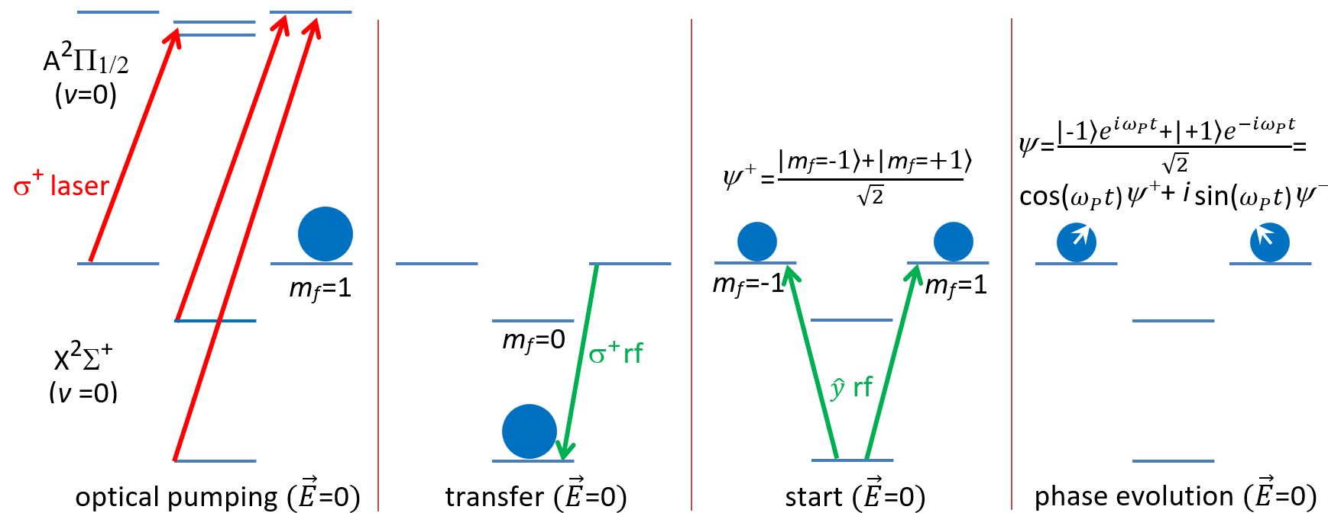
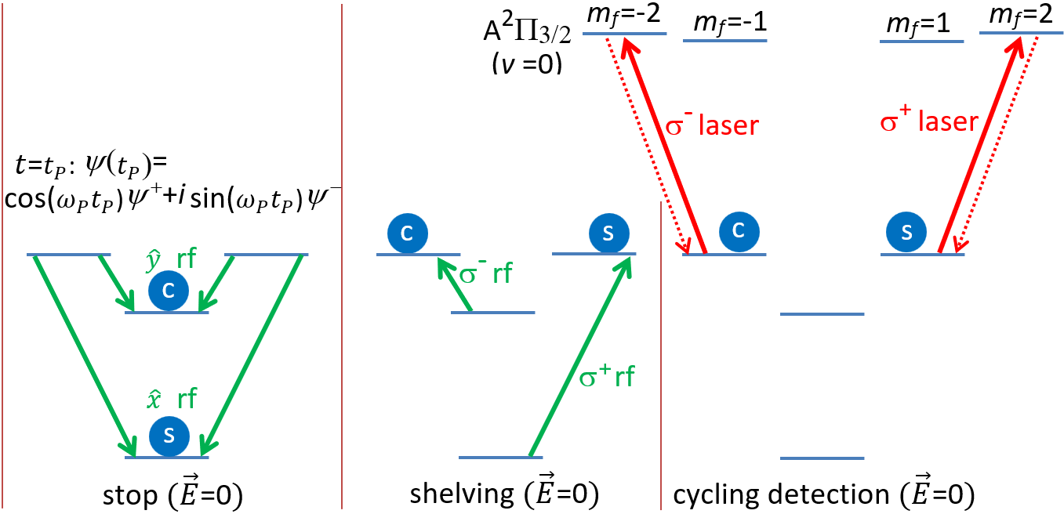
Measurement Scheme
Similar to other d_{e} measurements – except with molecules frozen into an argon solid
Use lasers to optically pump molecules into one hyperfine state and to detect with laser-induced fluorescence
Use rf to transfer populations between hyperfine states

Slide 6

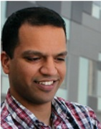


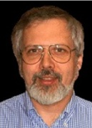
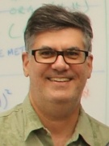


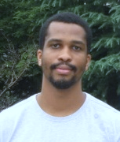


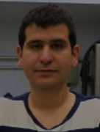








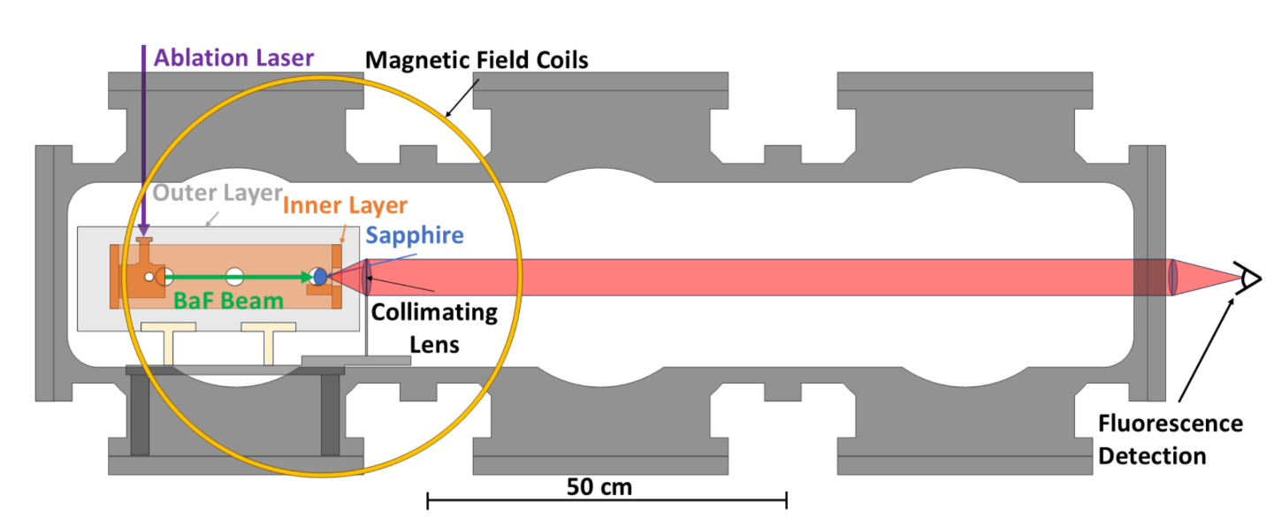
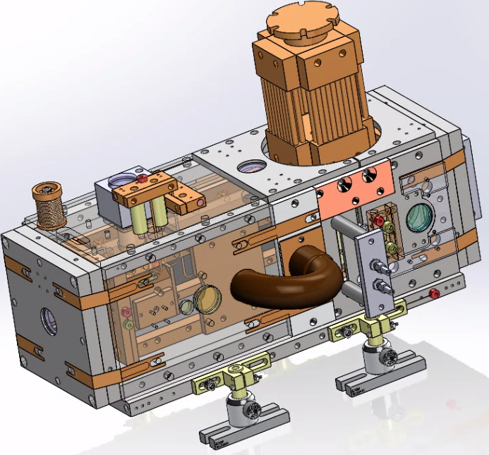
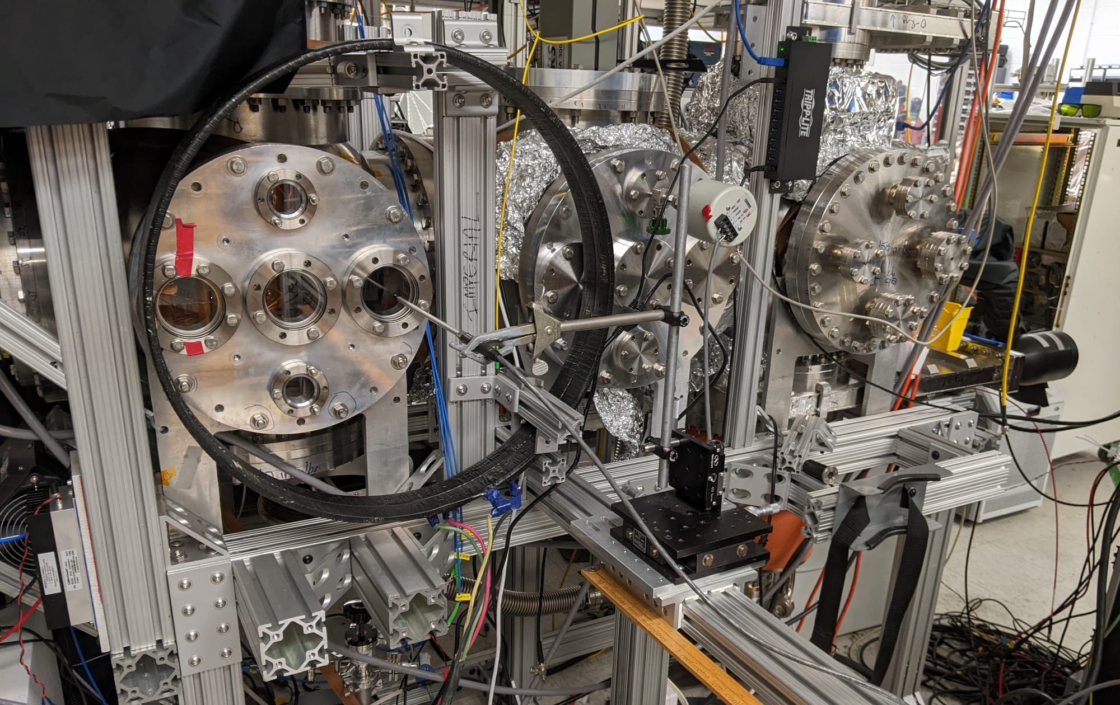
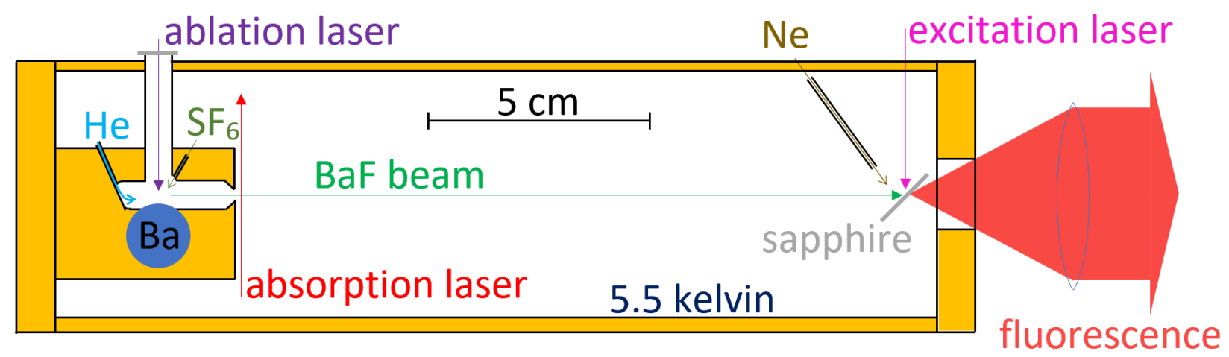
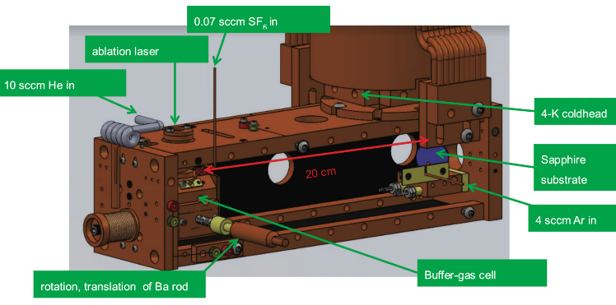
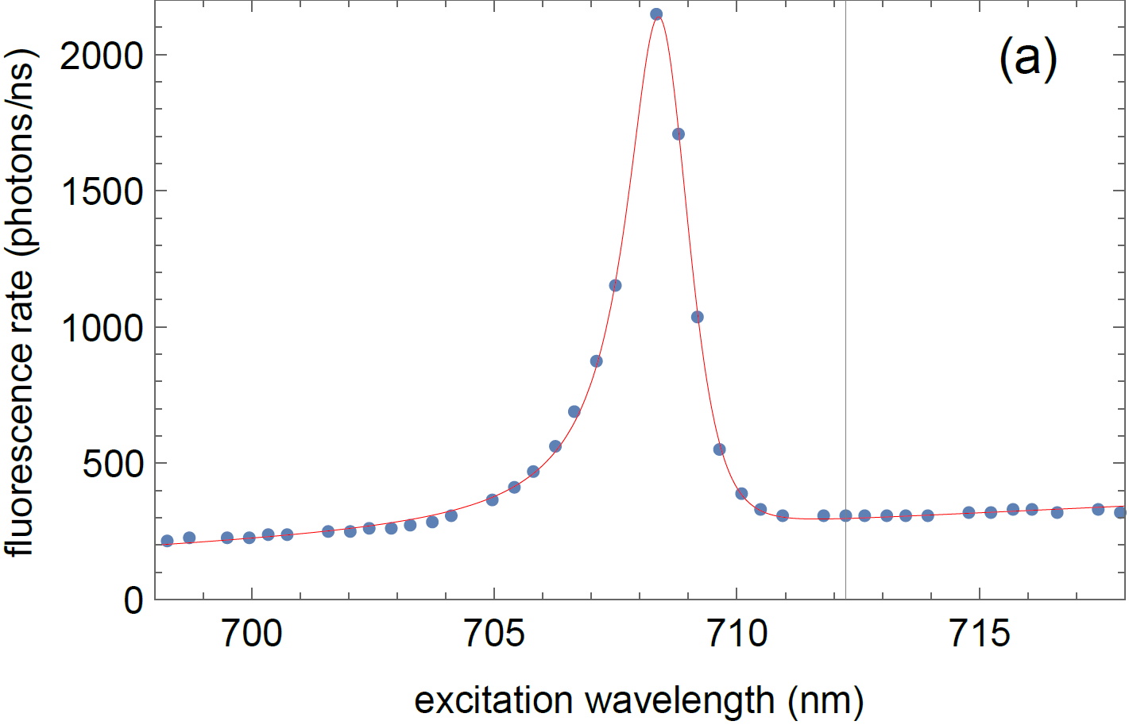
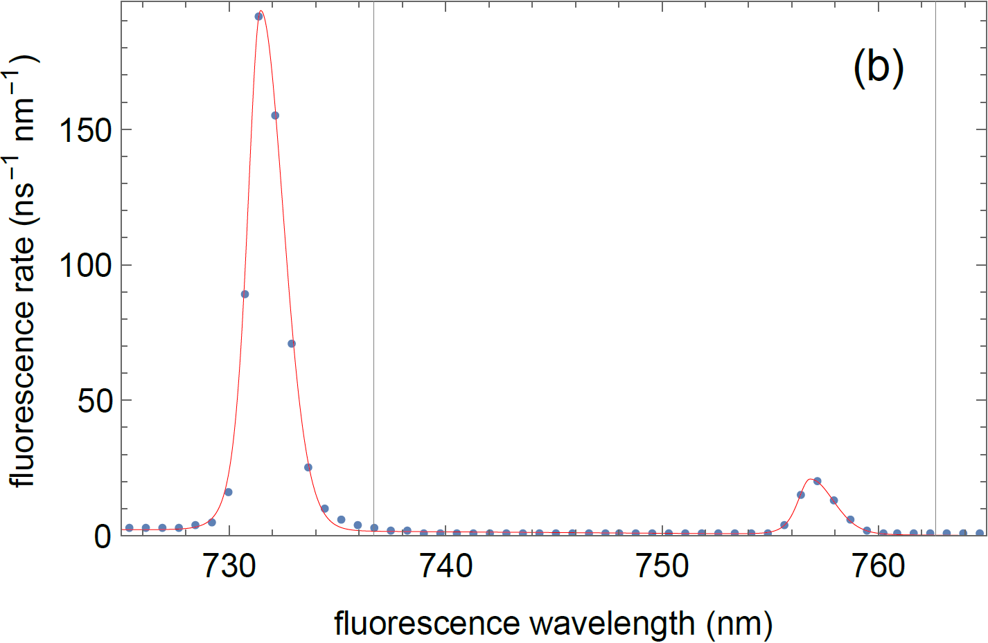
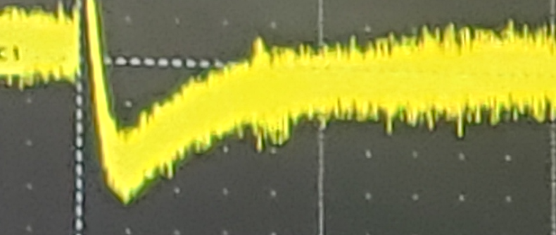
What Has Been Accomplished to Date?
Assembled a team
Physics/Chemistry
Expt/Theory
We are looking for graduate students and postdocs to join us
Assembled 1st generation apparatus
Assembled cryogenic solids with 1ppb BaF
(and SrF)

Slide 7
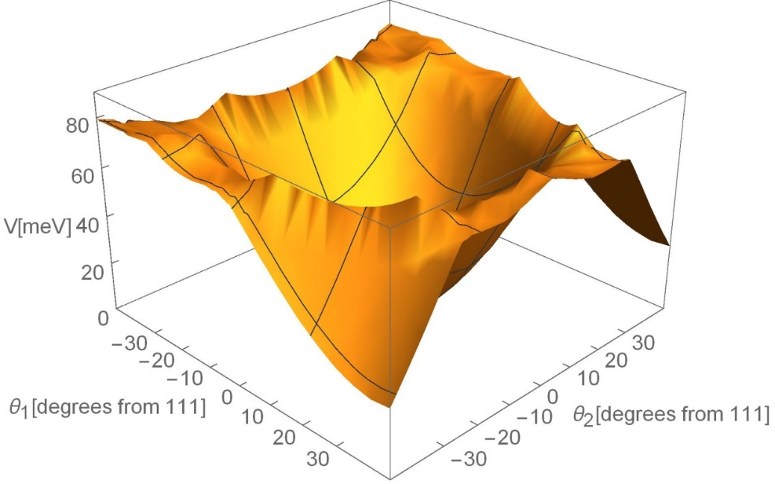
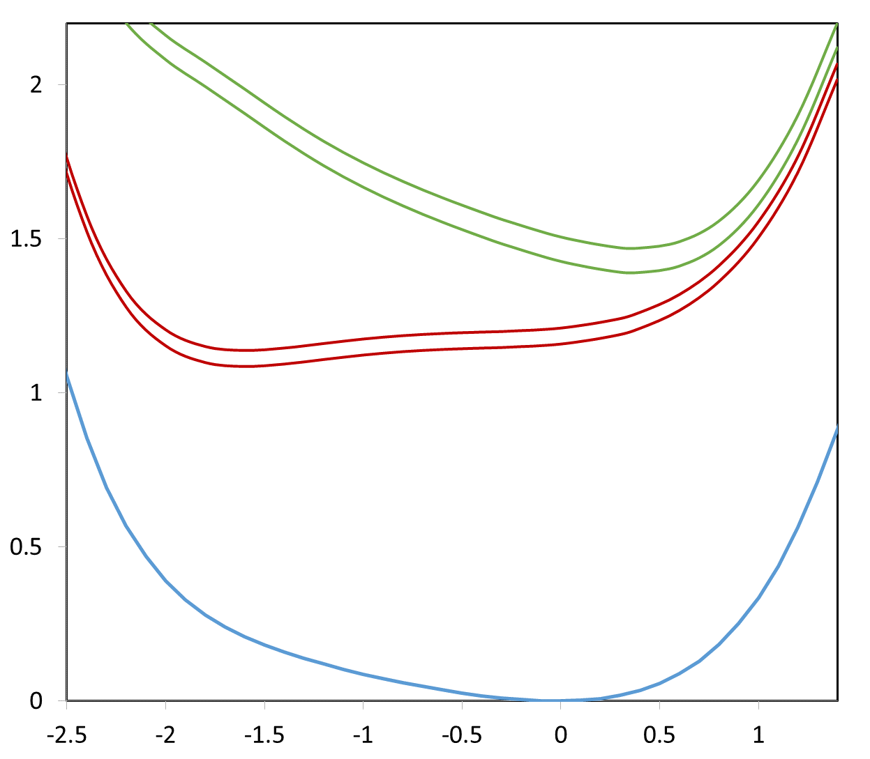
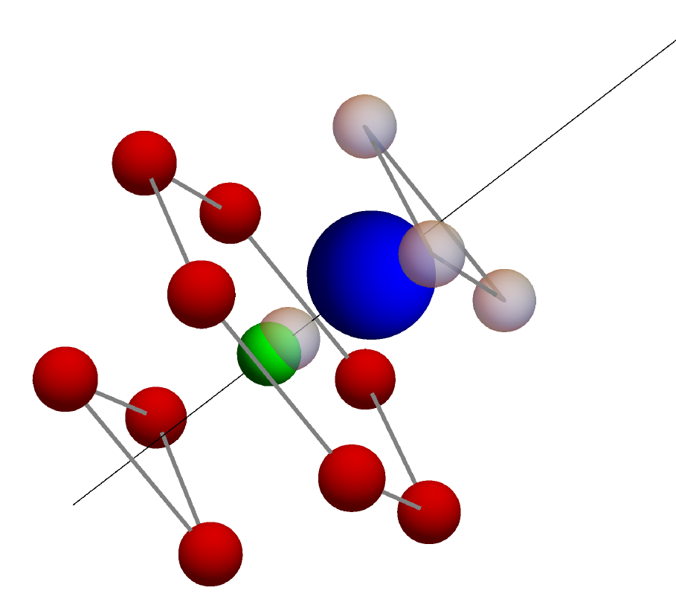
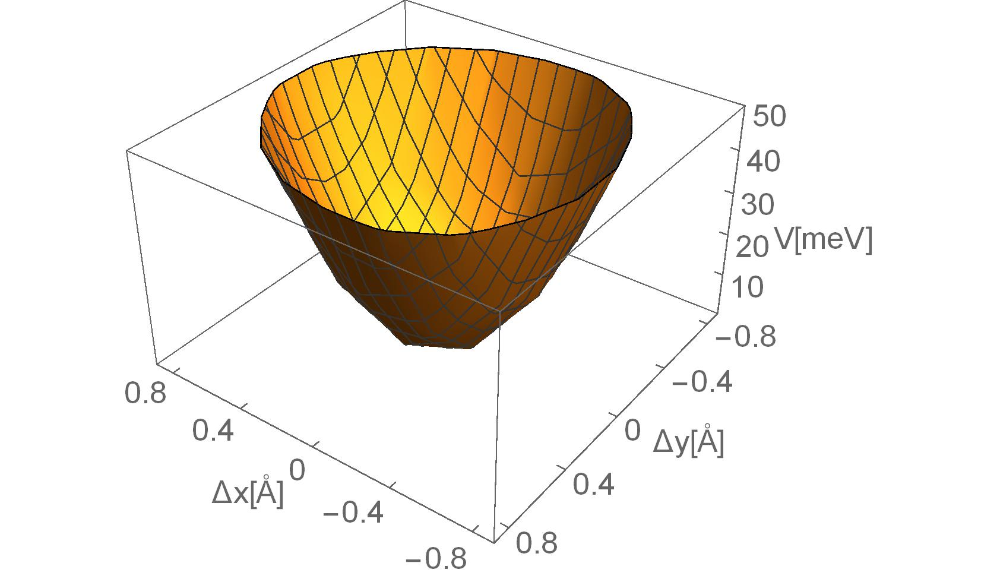
What Has Been Accomplished to Date?
Large theoretical efforts: BaF substitutes for 4 Ar atoms, is oriented along the Ar crystal’s 111 axis, is strongly restrained from rotating or migrating, and fluoresces further into the infrared
Large theoretical efforts: BaF substitutes for 4 Ar atoms
Large theoretical efforts: BaF substitutes for 4 Ar atoms, is oriented along the Ar crystal’s 111 axis
Large theoretical efforts
Large theoretical efforts: BaF substitutes for 4 Ar atoms, is oriented along the Ar crystal’s 111 axis, is strongly restrained from rotating or migrating
A² Π_{3/2}
BaF:Ar
A ²Π_{1/2}
A’ ²Δ_{5/2}
A’ ²Δ_{3/2}
Energy (eV)
~0.5 eV to KE
X ²Σ_{1/2}
τ ~600ns
displacement of molecular c.m. in 111 direction (A)
Energy (eV)
X ²Σ_{1/2}

Slide 8
What Has Been Accomplished to Date?
Efficient optical pumping demonstrated. Unexpected bonus: depends on orientation of molecule -- useful for our measurement.
rf transitions demonstrated
Efficient detection using laser-induced fluorescence demonstrated
For the precession (phase evolution) step, the environment of the molecules has to be exquisitely controlled: colder, fewer impurities in solid and magnetic fields controlled at the μgauss level.

Slide 9
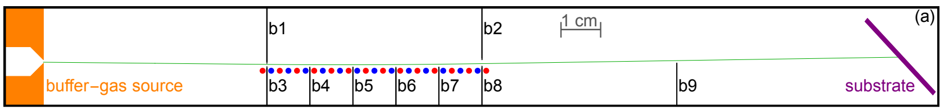
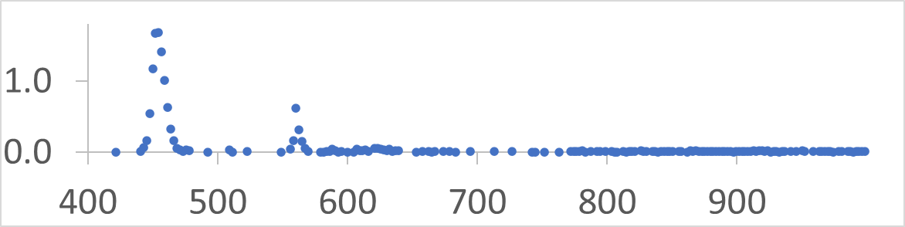
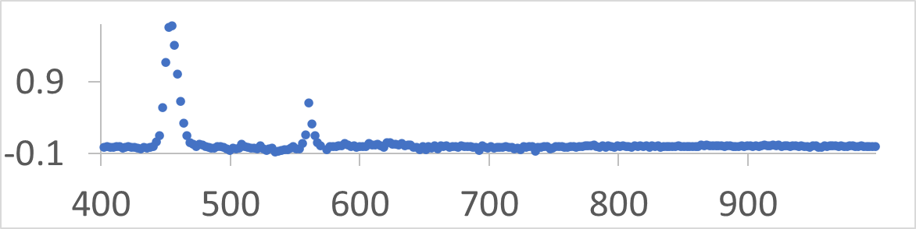
What Remains to be accomplished
Temperature:
We have recently reduced temperature to 3K
Are designing a system that will get us to 1K.
Purity:
We have a getter system for purifying our Ar
We have designed an electrostatic deflector to remove impurities from our molecular beam
We are using x-ray-induced fluorescence to measure purity
counts/s
Ar solid doped with 8 ppb O₂
Magnetic field:
We are designing a superconducting magnetic shield
wavelength (nm)

Slide 10
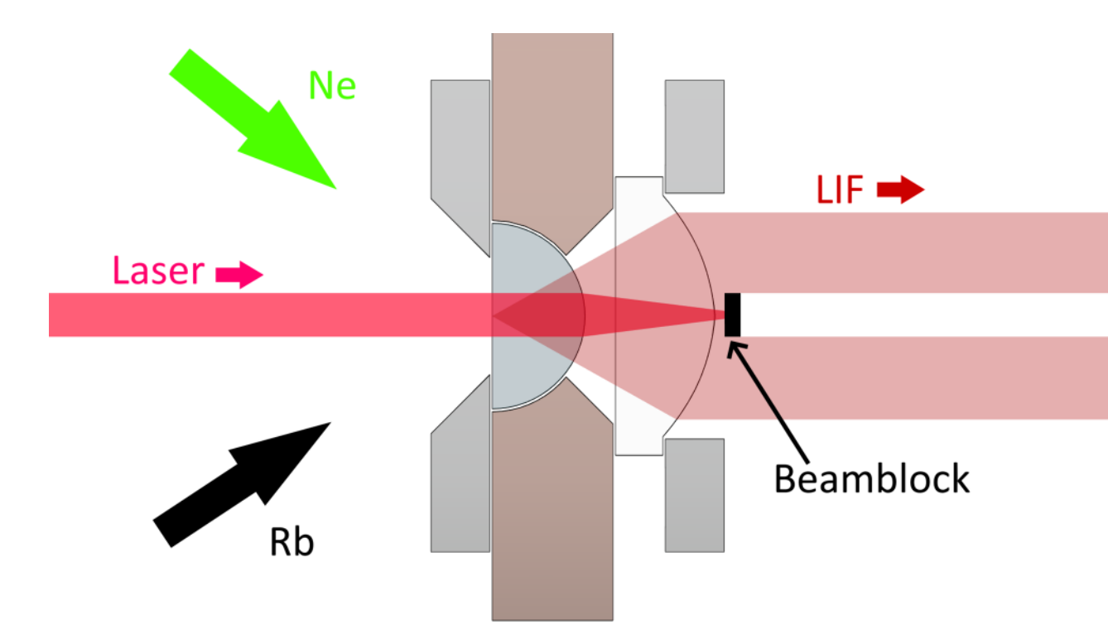
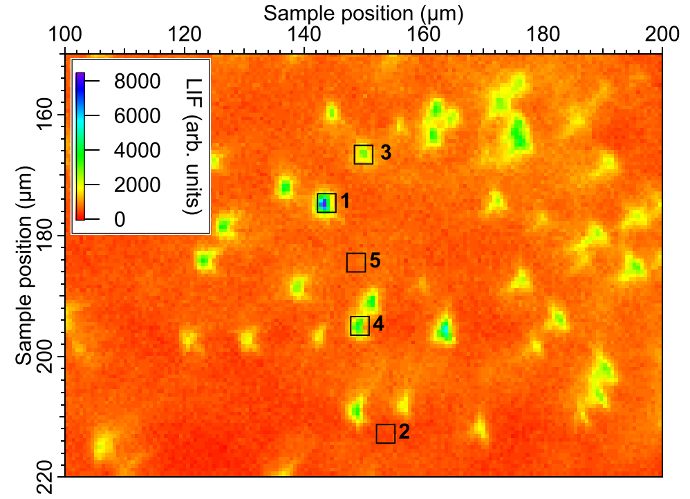
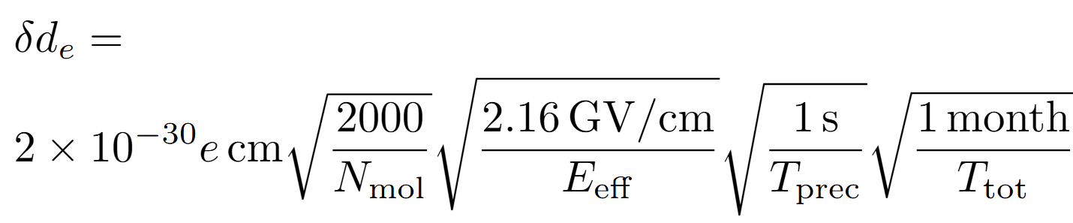
Next Step
Perform full experiment on individually imaged molecules (following the scheme used recently by Weinstein, et al)
Allows for study of orientation and environment of each molecule
May already allow for a competitive d_{e} measurement

Slide 11
Timeline
2 years: individual molecule imaging studies
5 years: full implementation of technique and d_{e} measurement
continuing: measurements of increasing precision
goal: measure CP violation responsible for matter/antimatter asymmetry in the universe
PRA 98 032513 (2018)
J Mol Spectr 391 111736 (2023)
Mol Phys 121 e2198044 (2023)
PRA 107 032811 (2023)
Mol Phys 121 e2232051 (2023)
PRA 108 012811 (2023)
arXiv:2410.04591 (2024)
arXiv:2410.04598 (2024)
arXiv:2410.04605 (2024)

