Slide 1
CINP townhall
Education, , Training, EDI
Ruben Sandapen
Acadia University
June 13, 2025

Slide 2
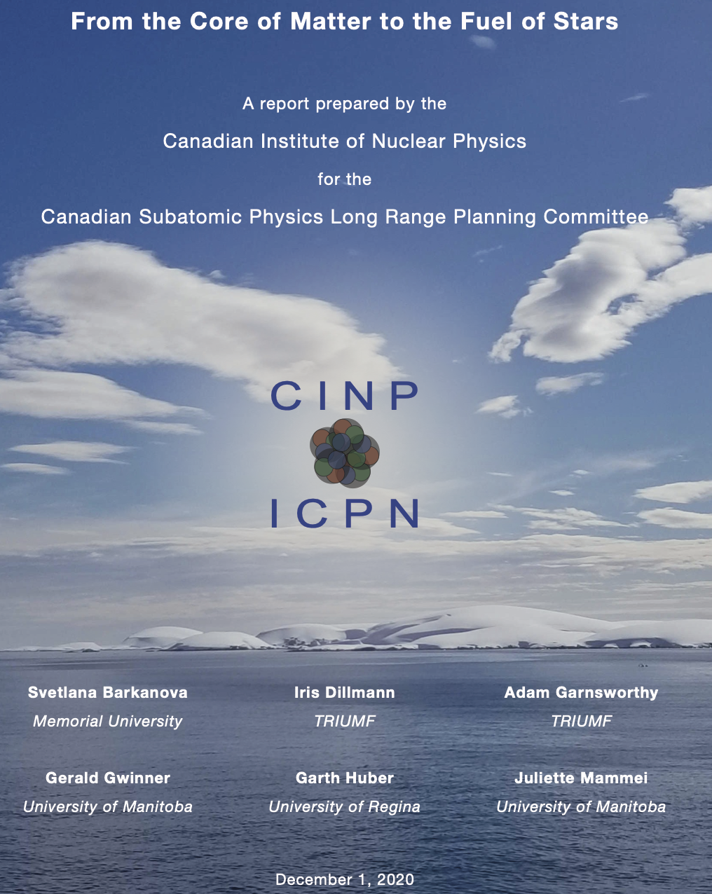
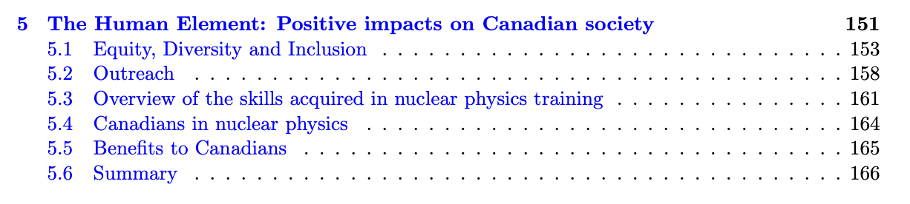
Last CINP brief

Slide 3
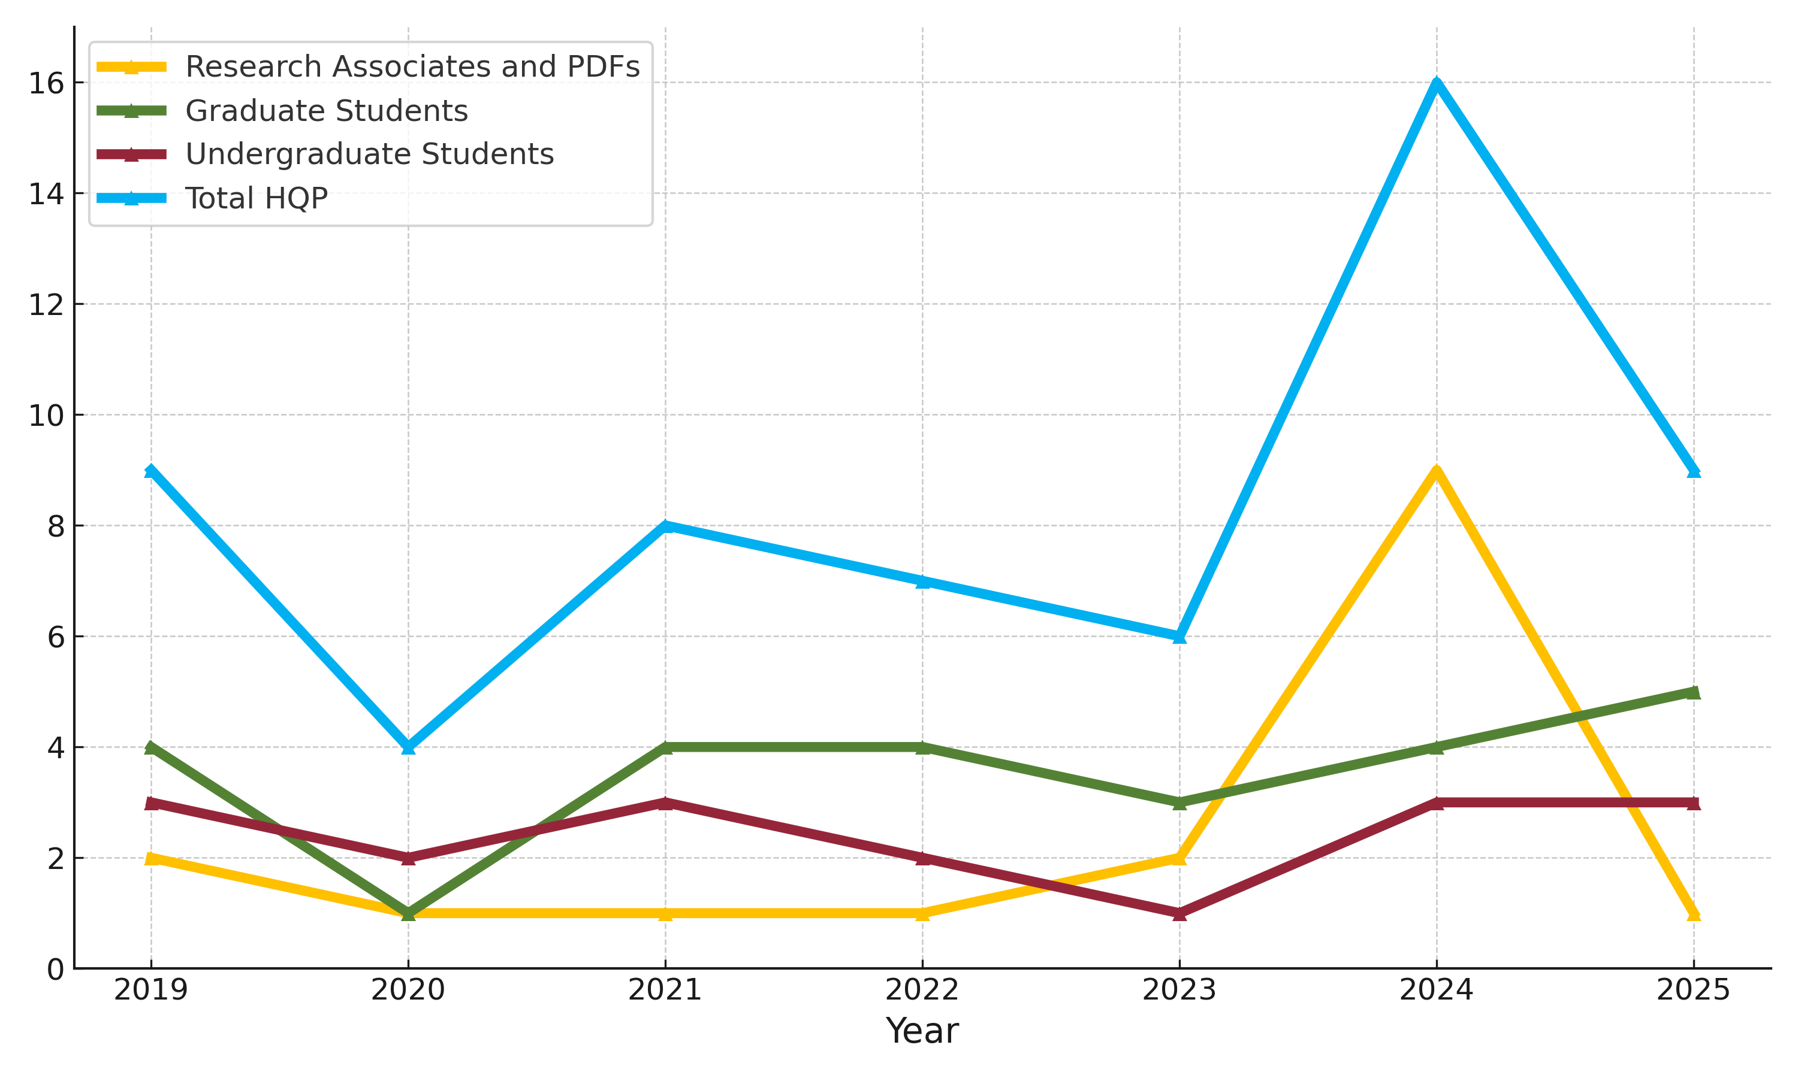
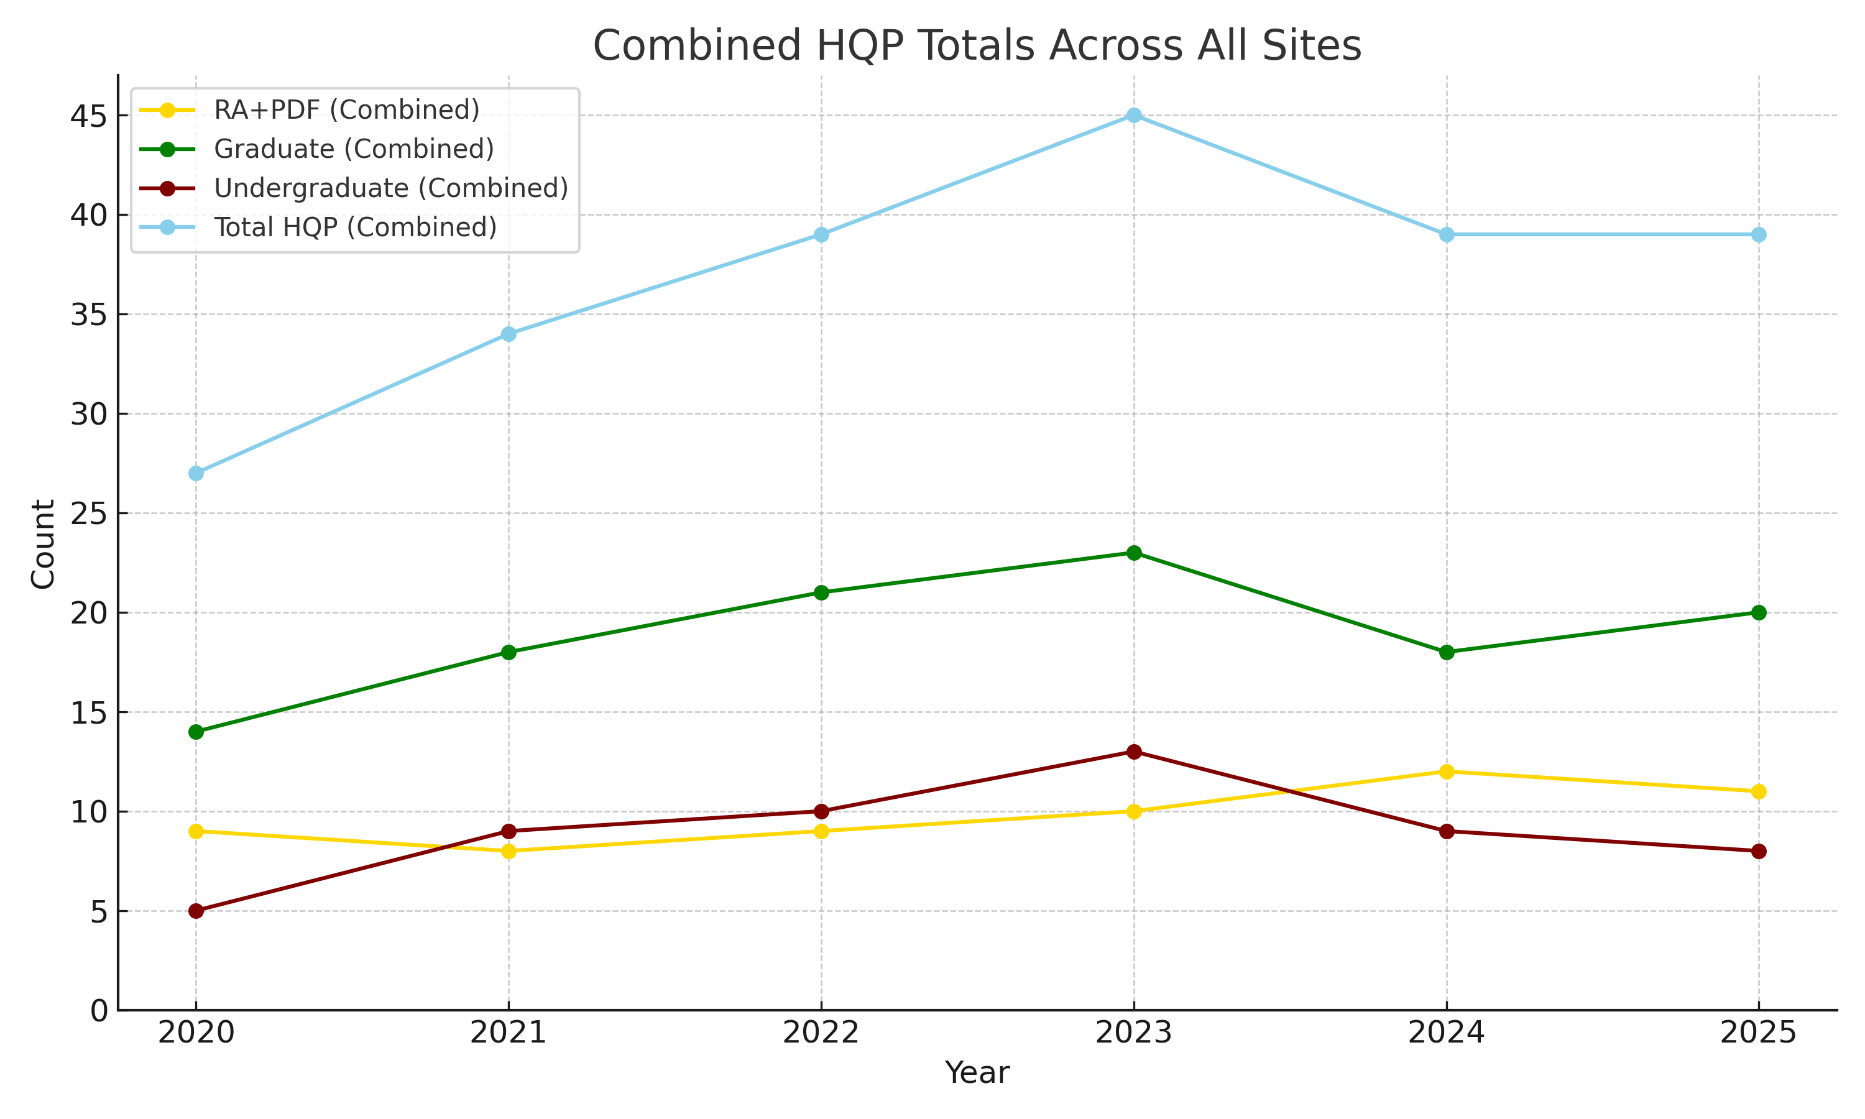
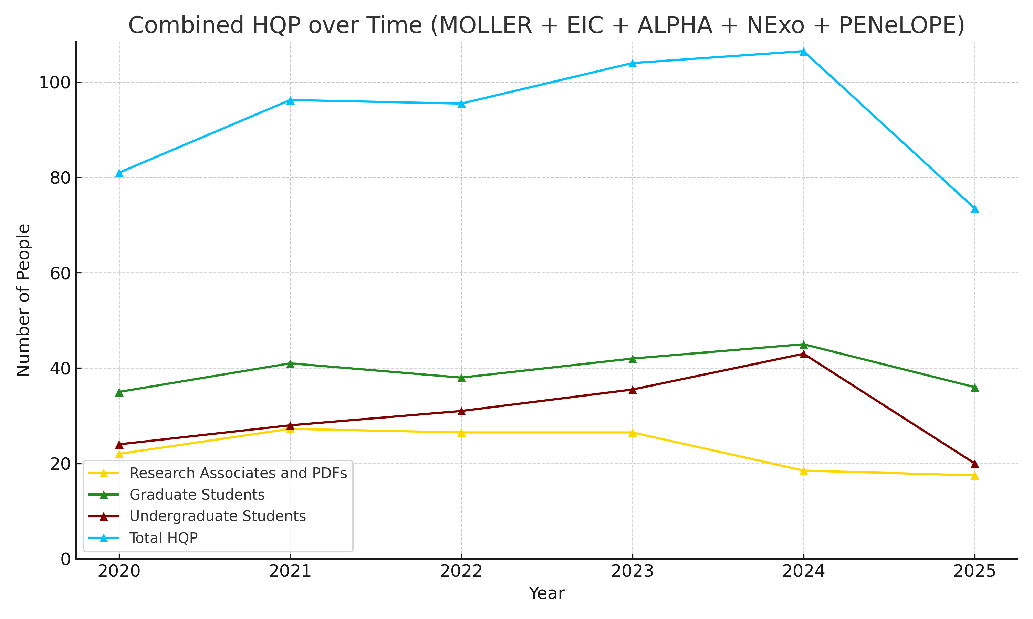
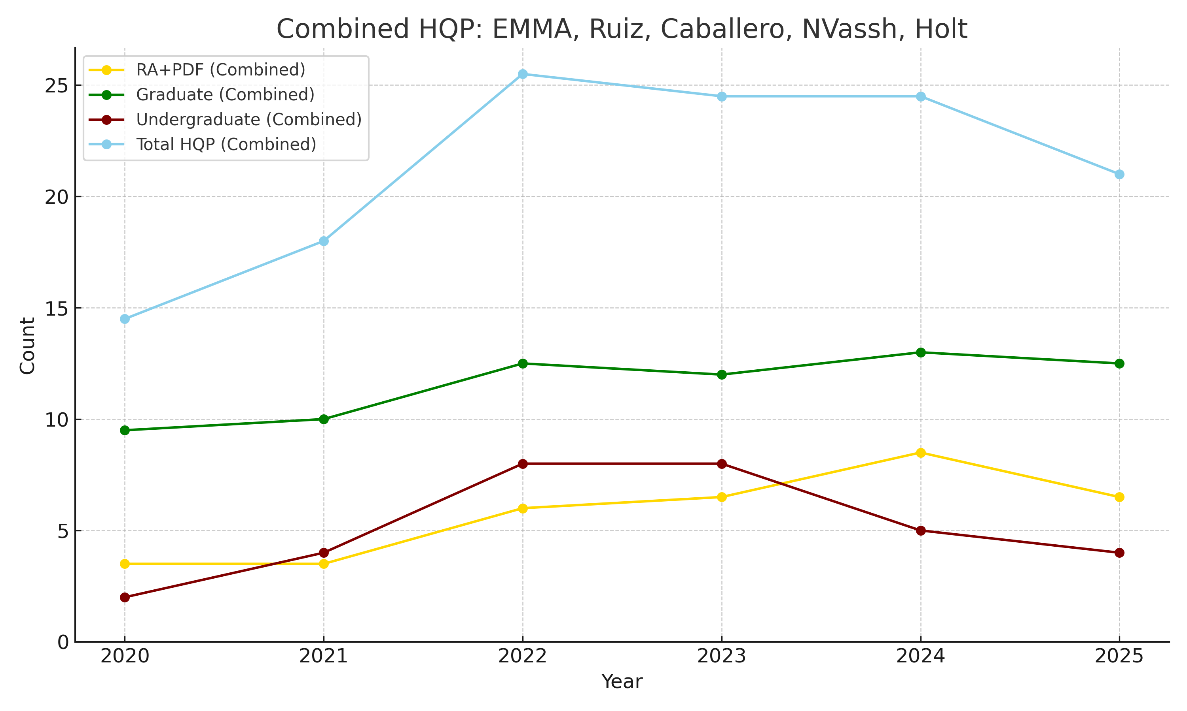
HQP data
Hadrons/QCD: Experiment: Jlab, EIC. Theory: Ahmady-Sandapen, Gojko
Nuclear Structure: Experiment: RIB in flight, Nab, NSL-SFU, PUMA, IRIS. Theory: Holt, Vassh, Navratil
Fundamental symmetries: MOLLER, EIC, ALPHA, NExo, PENeLOPE, TRINAT
Nuclear Astrophysics: Experiment: EMMA, ARIEL. Theory: Holt, Caballero, Vassh

Slide 4
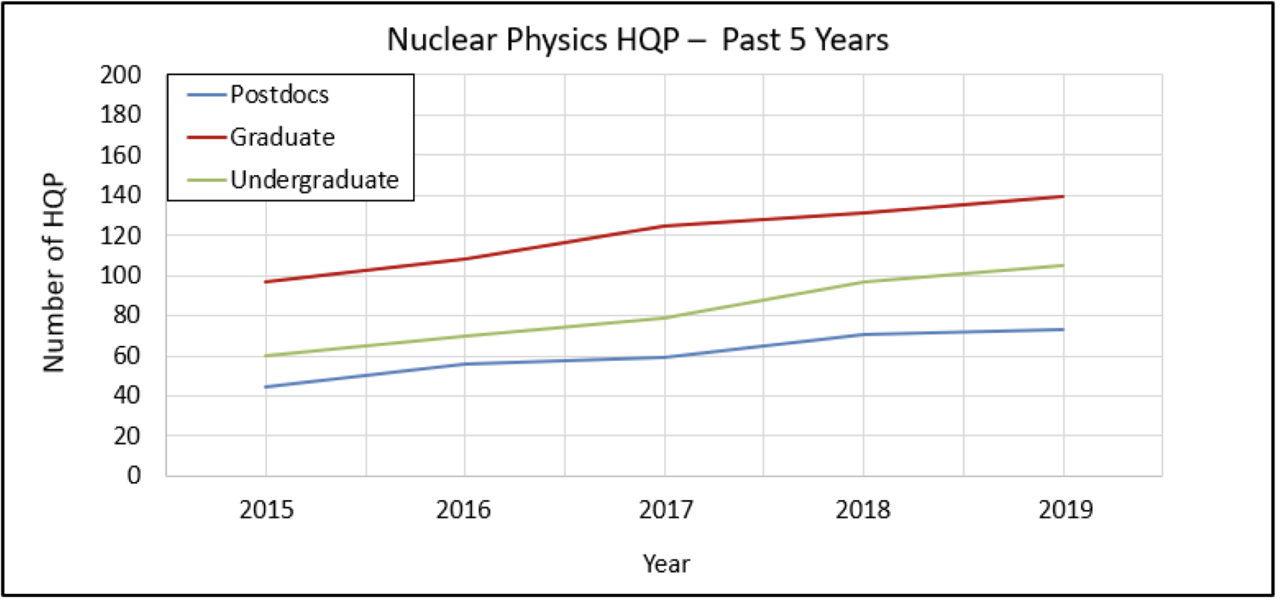
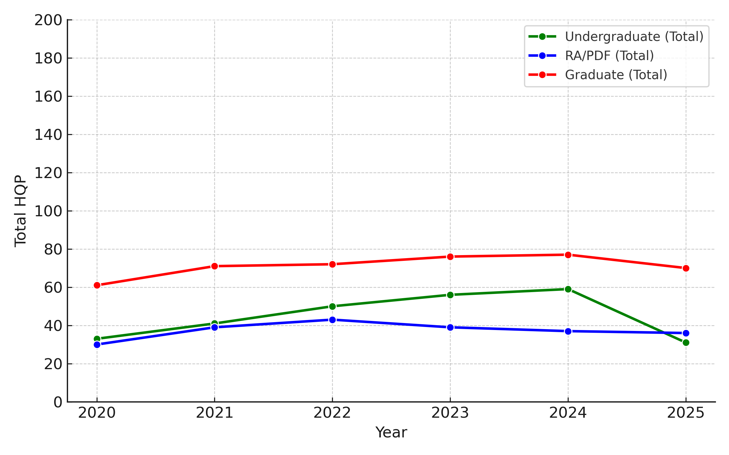
Comparing to last CINP brief
Based on final briefs
Based on briefs received so far

Slide 5
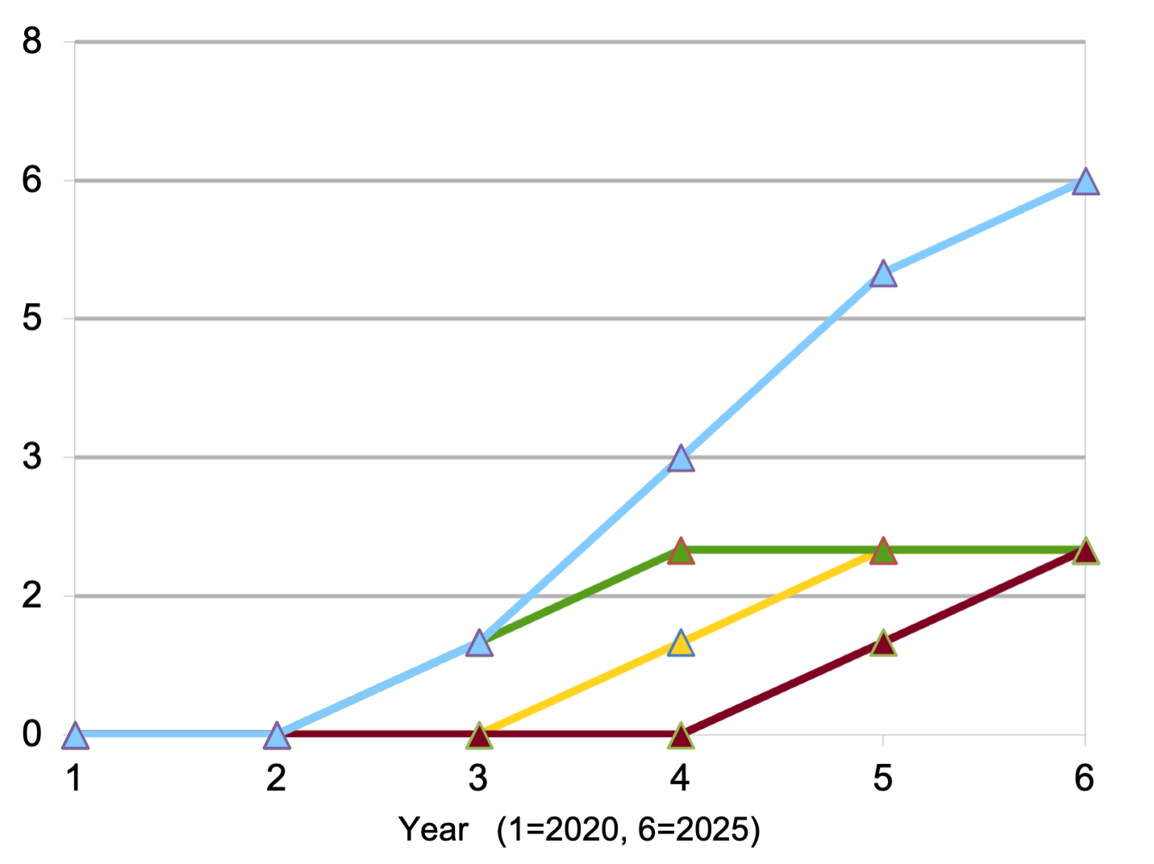
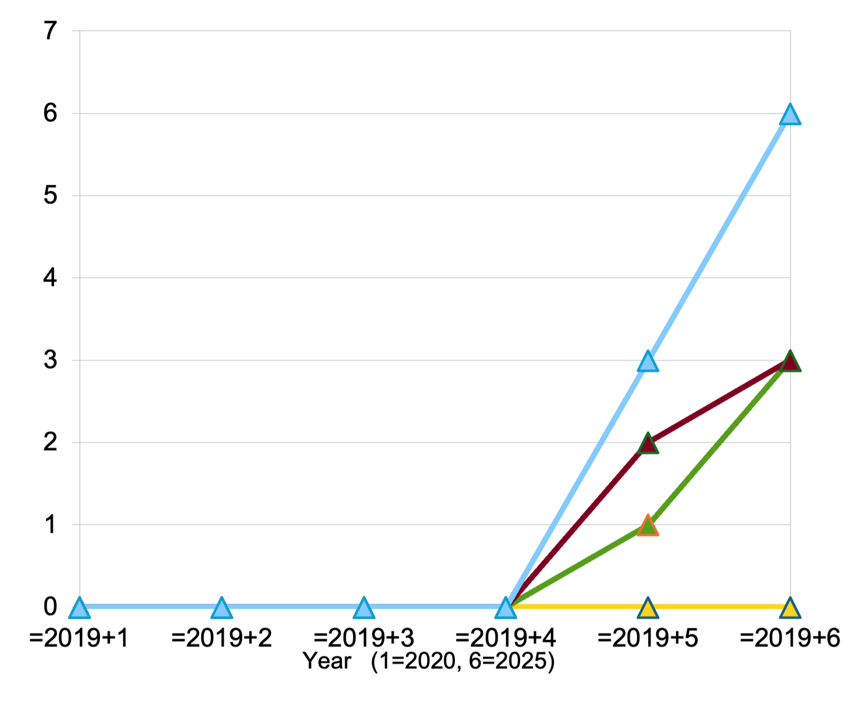
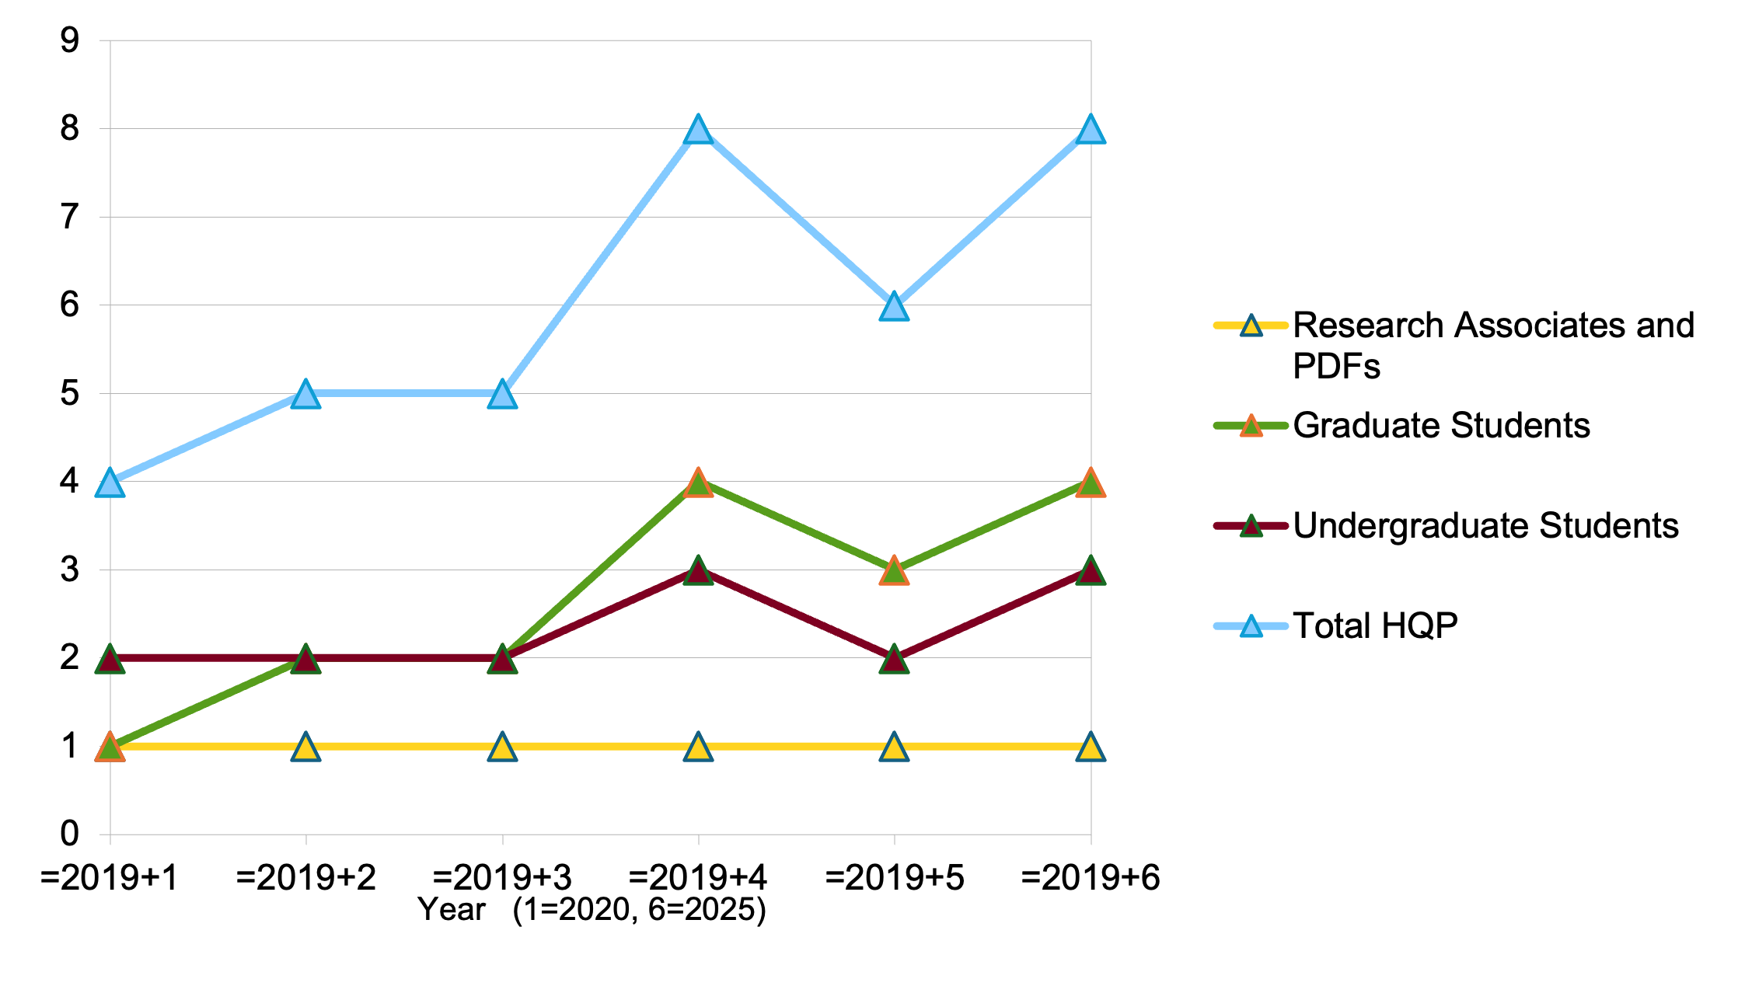
New experiments
RAD-MOL
BeEST & SALYER
High-T magnets

Slide 6
HQP data
Call for additional data: some briefs (those not quoted here) did not include the excel sheet or HQP graph
How to present HQP data? Total? Experiment/Theory? Major facilities?

Slide 7
Noteworthy HQP
We need noteworthy HQP at both graduate and undergraduate levels.
For example:
Antoine Belley, UBC, PhD 2024. Carl H. Westeoff (first ever to a theorist) + numerous other awards.
Adam Powell, U Calgary, PhD 2024. Thesis selected for publication in Springer “Best of the best”.
Karthik Suresh, U Regina, PhD 2023. Prestigious Jefferson Science Associates Thesis Prize.
Call for suggestions !

Slide 8
Career paths
We need to highlight also non-academic career paths:
Nathan Evetts, UBC PhD 2021, Senior Quantum Engineer at Photonics Inc.
Ali Kavaki, York PhD student, now research scientist at 1QBit Information Technologies Inc.
MSc student U. Rizwan was a Data Scientist in the City of Edmonton and currently works in the same capacity for Shopify Inc. MSc T.

Slide 9
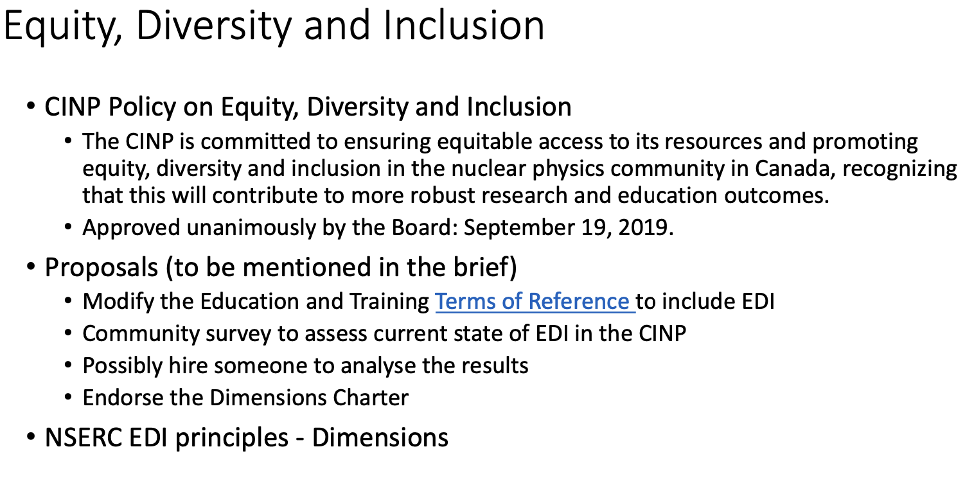
EDI: from last Town Hall
No rigorous EDI statistics available; qualitative so far
Last brief used US data. Should we do that?

Slide 10
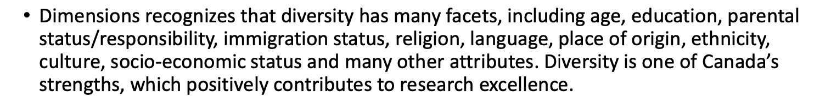
Dimensions-NSERC EDI principles
In briefs received so far: women, gender, ethnicity, place of origin, socio-economic status, immigration status, age
Should it remain qualitative?

Slide 11
EDI at TRIUMF
From Accelerator science brief:
TRIUMF recognizes that persons identifying as black, Indigenous, people of colour (BIPOC), women, and members of the 2SLGBTQI+ community have long navigated systemic marginalization, under-representation, and discrimination in science.
Recent scapegoating and rollbacks of equity, diversity, and inclusion (EDI) initiatives in North America and elsewhere illustrates the all- too-easy recurrence of injustices that historically thrived in academia for persons who are “different or not of the right kind”.
A recent arms-length EDI survey sampled over 80% of our community in 2024, showing us our strengths and our deeper structural biases at TRIUMF including representation in leadership and scientific positions, career advancement, and concerns on interpersonal behaviors.
And a new EDI Special Advisor hire at the senior-management level will soon reformulate our policies and best practices on how to engage underrepresented persons and communities in physics from a grassroots level.

Slide 12
EDI: Individuals
Women. Nicole Vassh focused on helping young women develop not only their problem- solving abilities and communication skills, but also their confidence and awareness for strategies related to professional development. Petr Navratil hired and supervised three female postdocs in the past few years, one of which has now a staff position at a US DOE lab and another a prestige fellowship in Germany.
Place of origin, ethnicity. Jason Holt: to increase the presence of African HQP, I participate in the Tastes of Nuclear Physics Conference aimed at enthusing students from disadvantaged regions in Sub-Saharan Africa. Ruben Sandapen is a 2025 Carnegie African Diaspora Fellow in Mauritius doing workshops and outreach to attract HQP to Atlantic Canada.
Socio-economic status, culture, indigenous. Svetlana Barkanova: One of the Chairs for Inclusion in Science and Engineering (CISE) program with activities in rural Atlantic Canada and with Indigenous students.
Age/parental status/place of origin. Alex Gezerlis has recruited two Syrians, 3 refugees, a mature student who is a parent of three, as well as a person with a physical disability over past 5 years.

Slide 13
Highlighted in last CINP brief
MOLLER: University of Manitoba (Mammei and Longo) run the Verna J. Kirkness summer program, working with indigenous students. Memorial University (Barkanova) runs a recruitment program featuring female and Indigenous role models.
W. Deconinck (University of Manitoba): extensive work for LGBTQ+ physicists.
These EDI activities are ongoing and are reported in current briefs.
Need highlights for this brief

Slide 14
EDI: Collaborations
ALPHA-Canada formed an EDI committee to serve as a forum to identify issues and implement new practices to improve EDI. Three consecutive Richard Azuma Fellowships awarded to self-identified equity-deserving students
nEXO-Canada has implemented a Code of Conduct and elected ombudspersons to address concerns impartially. The collaboration is international, and the Canadian team includes a mix of early-career researchers and minority-identifying scientists.
TUCAN: Development of a Code of Conduct to encode the Collaboration’s support of EDI principles (an effort spearheaded by Canadians in the international collaboration)
EDM3: An aggressive set of EDI measures are being used to encourage larger representation in the collaboration from groups that are currently underrepresented in experimental physics.
High-T superconducting magnets: Regarding EDI, each partner will involve its own EDI officers at all steps of a recruitment process (advertisement, interview and selection).

Slide 15
Outreach
TRIUMF: Science Rendezvous (∼3000 people), (b) “Cosmic Night” events with the H.R. MacMillan Space Centre (∼400 people) 2-3 times/year, (c) many local community festivals and celebrations (∼2000 people or more), (d) science events for Indigenous and unrepresented youth and communities, (e) smaller local school or community events.
ALPHA-Canada: extensive media engagement with both national and international outlets, including CBC, Radio-Canada, The Globe and Mail, Maclean’s, The New York Times, and BBC. ALPHA’s demonstration of laser cooling of antihydrogen was featured on the cover of Nature and as one of the Top 10 Breakthroughs of the Year in 2021 by Physics World magazine. The gravity experiment was selected as one of Physics World’s Top 10 Breakthroughs of 2023, and as #2 most significant science story of 2023 by CBC.
Individuals: many !
  Last CINP brief tied Outreach with EDI. Do we separate them?

