Slide 1
Fundamental Symmetries
Jeff Martin

Slide 2
Overview of submissions
Fundamental Symmetries had 22 submissions
  20 experimental, 2 theoretical (Holt & Navratil)
nEXO | Nab | MOLLER | TUCAN | PENeLOPE | TRINAT | BeEST/SALER
Francium | ALPHA/HAICU | TRIUMF accel. | SC magnets | Gamma spec | Detailed struct. | Rad. Mol.
EDM³ | EIC | 2-step RIB | TITAN | Quantum | Boland accel.

Slide 3
What did they lead with?
Dominantly FunSym:
  nEXO
  Nab
  MOLLER
  TUCAN
  PENeLOPE
  TRINAT
  BeEST/SALER
  Francium
  ALPHA/HAICU
  Rad. Mol.
  EDM³
Partly FunSym
  Gamma spec
  Detail nucl. struct.
  EIC
  TITAN
Theory
  Holt, Navratil
Accelerator & new capabilities
  TRIUMF, Boland, 2-step RIB
Other technology
  SC Magnet, Quantum

Slide 4
Looking back: the 2020 brief (20 pages)

Slide 5
2020 | 2025 (?)
T/CP TUCAN RadMol FrEDM | T/CP TUCAN RadMol EDM³ (also TRINAT)
Z0 MOLLER Fr EIC | Z0 MOLLER Fr EIC
CPT ALPHA/HAICU | CPT ALPHA/HAICU
Nuclear decay 0+ -> 0+ (TITAN, GRIFFIN) BL3 | “Vud” (“precision β-decay”?) 0+ -> 0+ (GRIFFIN, TITAN) Nab
β-ν correlations TRINAT Nab, NPDGamma, N3He | TRINAT SALER PENeLOPE
ν nEXO BeEST | ν nEXO BeEST Detailed nucl. struct. (0νββ)
Possible outline
Comparing 2020 to 2025
combine (?)

Slide 6
Contact: J. Martin
Winnipeg, Manitoba, UBC, UNBC, TRIUMF; Japan, USA, Mexico
TUCAN
Goal
Neutron EDM measurement to 1e-27 ecm, factor of ten better than present world’s best
Next seven years
Past five years
Run nEDM experiment
Upgrade helium liquefier, also UCN source and EDM experiment (CFI IF 2025)
UCN source upgrade nearing completion
Source cryogenic systems tested extensively
Magnetically shielded room completed construction and characterization
First commissioning with beam
  It happened on Wednesday, June 11, and we observed our first ultracold neutrons with the new source
Beyond
Other neutron experiments
Upgrades to facility and nEDM experiment, if compelling to do so.

Slide 7
Contact: S. Malbrunot-Ettenauer
UBC, TRIUMF, Toronto, Manitoba, Waterloo, McGill, Ottawa; USA, UK, NL, Germany
RadMol
Goal
Next seven years
EDMs of octupole-deformed nuclei with trapped molecules (1e7 improvement over ¹⁹⁹Hg EDM)
Complete the laboratory
Complete EDM experiment (?)
Past five years
Opportunities paper (2023)
Preparation of laboratory
Would profit from ARIEL
Beyond
Going beyond EDM searches, e.g. nuclear anapole moments

Slide 8
Contact: E. Hessels
York, Toronto; USA
NEW to CINP/LRP
EDM³
Goal
Next seven years
eEDM improvement by 2-4 orders of magnitude, using polar molecules in cryogenic inert-gas solids
Need to improve purity of sample
Improved purity eEDM measurement planned to take place by 2030
Past five years
Demonstration of implantation and addressing BaF (2024)
Calculation that molecules can have their orientation fixed in the matrix (2023)
Laser-induced fluorescence and optical pumping characterized (2024)
Preparation of molecular beam (2023, 2024)
Beyond
Continued improvement of purity, lowering temperature of solid, systematic effects to increase accuracy from 2030-2040.
Final accuracy 2-4 orders of magnitude improv’t

Slide 9
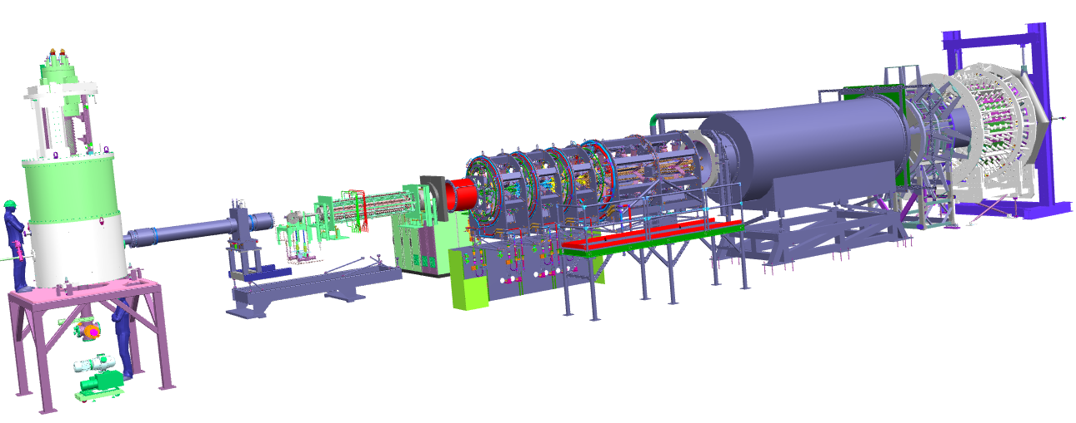
Contact: J. Mammei
Manitoba, Winnipeg, Memorial, UNBC; USA, Italy, Germany
MOLLER
Goal
Most precise measurement of sin²θ_{W} at low energy, with similar precision as Z-pole meas’ts
Next seven years
Past five years
Will run in Hall A at JLab from 2026-2030 in three major runs.
Analysis continuing until 2032.
Preparing the MOLLER apparatus
Major Canadian contributions:
  Spectrometer magnet design
  Main detectors, install Fall 2026
Building on important previous work of Qweak experiment (Nature, 2018)
Beyond
Likely decommissioned before 2034-2041 timeframe

Slide 10
Contact: G. Gwinner
Manitoba, TRIUMF, …
FrPNC
Goal
Not submitted, yet
Next seven years
Past five years
Not submitted, yet
Not submitted, yet
Beyond
Not submitted, yet

Slide 11
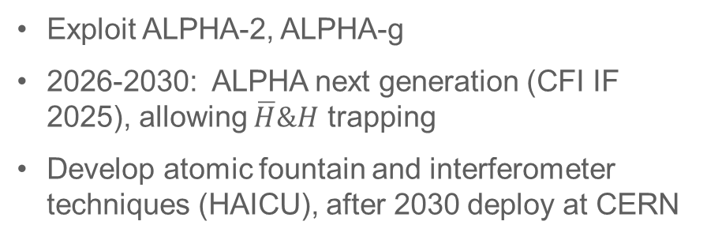
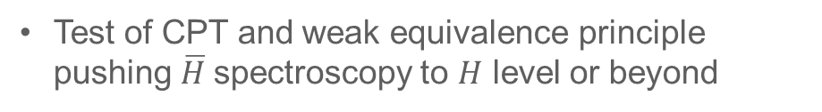
Contact: M. Fujiwara
TRIUMF, York, Calgary, SFU, BCIT, UBC, Uvic; Denmark, UK, US, Brazil, Sweden, Israel.
ALPHA/HAICU
Goal
Next seven years
Test of CPT and weak equivalence principle pushing $\overline{H}$spectroscopy to $H$ level or beyond
Exploit ALPHA-2, ALPHA-g
2026-2030: ALPHA next generation (CFI IF 2025), allowing $\overline{H}\&H$ trapping
Develop atomic fountain and interferometer techniques (HAICU), after 2030 deploy at CERN
Past five years
Nature articles on hyperfine spectroscopy (g.s. and 1S-2S), fine structure and Lamb shift (1S-2P), laser cooling, and free fall under gravity.
Canadians are 1/3 of ALPHA and lead ALPHA-g and HAICU
Beyond
Develop antihydrogen techniques (quantum sensing)
Antimatter molecules
Other new ideas arising from HAICU

Slide 12
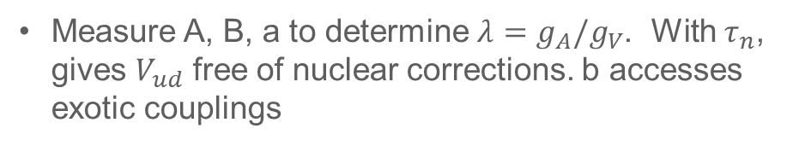
Contact: R. Mammei
Winnipeg, Manitoba; US (?)
Nab, PNab
Goal
Next seven years
Measure A, B, a to determine $λ=g_{A}/g_{V}$. With $τ_{n}$, gives $V_{ud}$ free of nuclear corrections. b accesses exotic couplings
2027: a, b precision data set
2028-2032: PNab measurement of A, B
Past five years
Preparing the apparatus (?)
Beyond
No plans beyond 2032

Slide 13
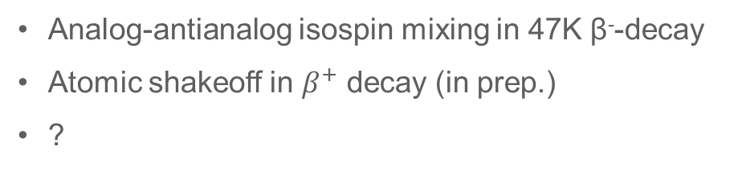
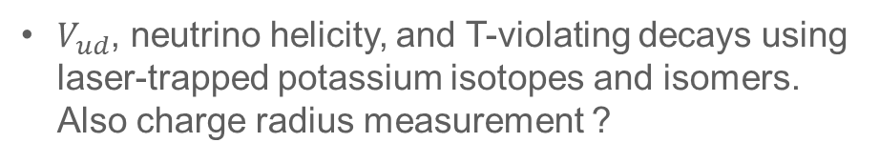
Contact: J. Behr
TRIUMF, Manitoba; US, Israel, India
TRINAT
Goal
Next seven years
$V_{ud}$, neutrino helicity, and T-violating decays using laser-trapped potassium isotopes and isomers. Also charge radius measurement ?
Upgrade electrostatic spectrometer and complete improved β-ν correlation measurements in 37K, 38mK, 38gK, and 47K.
Charge radius of 38mK.
Past five years
Analog-antianalog isospin mixing in 47K β⁻-decay
Atomic shakeoff in $β^{+}$ decay (in prep.)
?
Beyond
Any results breaking the standard model could drive further improvements.

Slide 14
Contact: R. Picker
TRIUMF; Germany
New to CINP/LRP
PENeLOPE
Goal
Precision (0.1 s) measurement of the neutron lifetime, for Vud, BBN, and neutron lifetime puzzle.
Next seven years
Past five years
Will be ready to receive UCNs at TRIUMF in 2027.
By 2030: complete 0.1 s
2030-2032 implement proton detection
Apparatus completed at TUM, 2020.
Moved to TRIUMF, 2024.
First cryogenic testing at TRIUMF completed spring 2025.
Quench testing and
Careful studies of systematic effects; D. Salazar, MSc thesis, SFU 2024
Beyond
If statistically interesting, can try different methods of loading the trap, to push further in statistical precision.

Slide 15
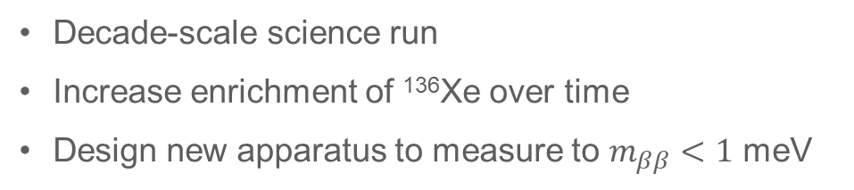
Contact: T. Brunner
McGill, Sherbrooke, TRIUMF, SNOLAB, Laurentian, Carleton, Windsor, McMaster, Queen’s; US, France, Russia, China, Germany, Korea, South Africa, Japan, Switzerland
nEXO
Goal
¹³⁶Xe 0νββ lifetime > 10²⁸ yrs using a 5-tonne single-phase TPC; 15 meV intermediate scale goal
Next seven years
Past five years
Build international collaboration
Site prep at SNOLAB and installation
Commissioning 2033
Canadian led initiatives:
  photodetector R&D, novel digital photosensors (PDC), radiopurity screening, and simulation frameworks
  To be located in the Cryopit at SNOLAB
  CFI IF support 2020 and 2023
  Canada could lead this project (US DOE prioritizes LEGEND)
Summit at Heidelberg, recently
Beyond
Decade-scale science run
Increase enrichment of ¹³⁶Xe over time
Design new apparatus to measure to $m_{ββ}<1$ meV

Slide 16
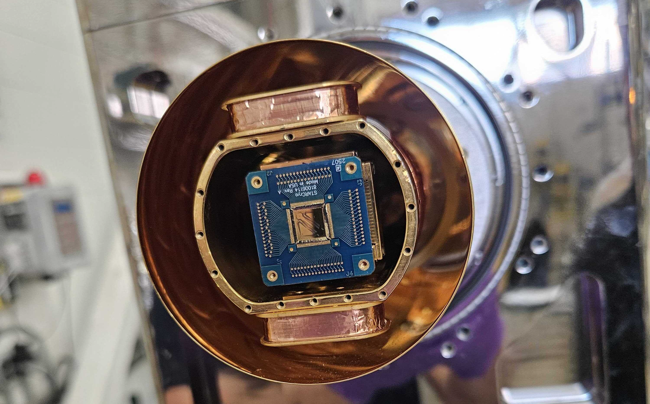
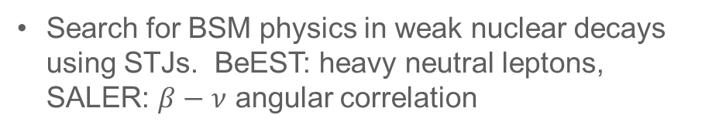
Contact: A. Lennarz
TRIUMF, McGill, McMaster;
US, France, Portugal,
BeEST, SALER
Goal
Search for BSM physics in weak nuclear decays using STJs. BeEST: heavy neutral leptons, SALER: $β−ν$ angular correlation
Next seven years
Analyze BeEST Phase III data
Begin Phase IV with higher activity
Deploy at TRIUMF and FRIB for short-lived β emitters
Past five years
Limits on sub-MeV sterile neutrinos (PRL 2021)
7Be L/K Capture Ratio (PRL 2020)
Spatial extent of a neutrino wavepacket (Nature, 2025)
Excited-State Nuclear Recoil Spectroscopy (arXiv)
Beyond
General-purpose facility for neutrino mass, dark section, nuclear structure research
User platform sustaining Canadian leadership in quantum-enabled nuclear physics

Slide 17
Neutrinoless double beta decay
Garrett et al. (“Detailed Nucl. Struct.”) measurement of matrix elements relevant to 0νββ
Partially FunSym
Vud / Precision beta-decay
Theory
Gamma spec & TITAN to improve precision on 0+ -> 0+ Ft values (Vud), also octupole def. for RadMol
How to disentangle SALER from BeEST?
Only Holt & Navratil checked the FunSym box. Where do they belong?
Barkanova & Aleksejevs are MOLLER collaborators
Should some “particle” theory be included? (e.g. Ritz, Czarnecki, Morrissey, McKeen, …)
Neutral weak currents
EIC to perform precision measurement of sin2thetaW using PVDIS (NC)
  Also: CLFV and charged-current DIS
Techniques
What to do with “quantum”?

Slide 18
What are Canada’s priorities?
Of note:
“Quantum”
Other things we are good at:
“Co-ordinated action”
“Building coalitions with reliable partners”

Slide 19
Recommendations seen in the submissions
CINP, TRIUMF, NSERC, and CFI are important
Dedicated SAP RTI support for new projects, quicker turnaround
Need more HQP (x3)
Need MRS & TRIUMF detector support (x3)
HPC (x2)
Prioritization based, in part, on CFI success
Support for techniques, e.g. quantum sensing
Explicit support for small-scale projects
Link RTI-1 to project grant, at least making expert reviews available
MRS needed at TRIUMF
TRIUMF coop/ugrad support is important
Canada/ISED needs mechanism to fund large-scale projects; CFI helpful but falls short
(SNOLAB) project management important
Need RTI-1 support

Slide 20
Plan
Draft will be prepared based on input from the briefs.
I would like to circulate the draft to the proponents for technical review and wordsmithing.
  Let’s represent your project in the best and most accurate way.

