Slide 1
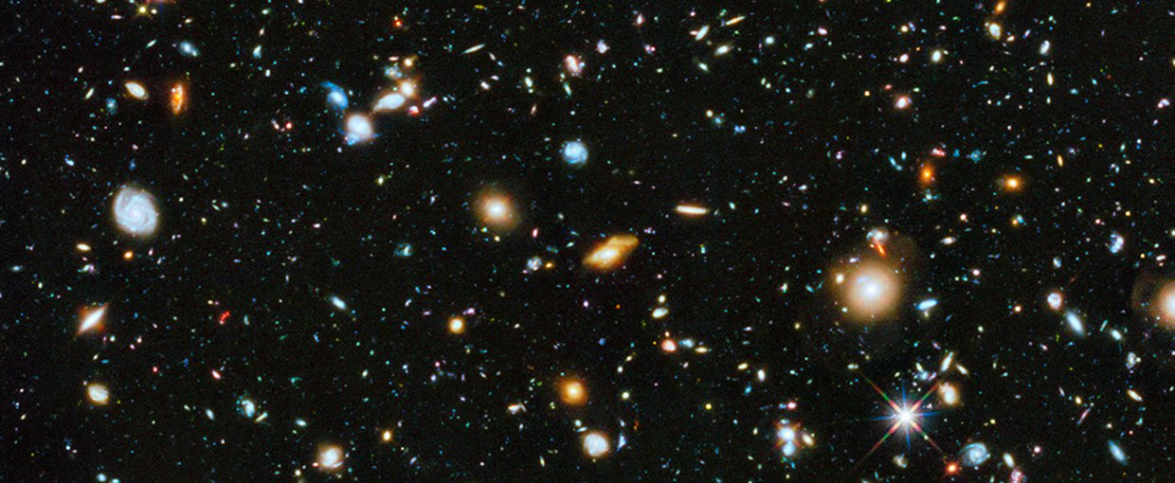
Overview: Nuclear Astrophysics Briefs
Submissions summary
20 briefs submitted which checked the box for astro.
8 identified as “primarily astro” → presented in more detail here
Remaining: 2x fund. sym, 4x structure, 4x theory → less detailed summary w/ emphasis on astro impacts
Also: 2x briefs focus on accelerator technology developments → no additional mention
Short Title | Author | Main SWG
GSI Decay Spec | Iris Dillmann | Astro
DRAGON | Chris Ruiz | Astro
SMU | Greg Christian | Astro
EMMA | Barry Davids | Astro
Storage ring | Iris Dillmann | Astro
TITAN | Ania Kwiatkowski | Astro
Caballero theory | Liliana Caballero | Astro
Vassh Theory | Nicole Vash | Astro
BeEST/SALER | Annika Lennarz | Fund sym
Rad mol | Stephan Malbrunot | Fund sym
Gamma spec | Carl Svensson | Structure
IRIS | Rituparna Kanungo | Structure
2-step RIB | Rituparna Kanungo | Structure
In-flight fragmentation | Rituparna Kanungo | Structure
Short Title | Author | Main SWG
Gazerlis theory | Alex Gezerlis | Theory
Holt theory | Jason Holt | Theory
Ab initio | Petr Navratil | Theory
Gojko Theory | Gojko Vujanovic | Theory
Accel tech | Thomas Planche | Accel.
Supercond. Magnets | Frederic Sirois | Accel.

Slide 2
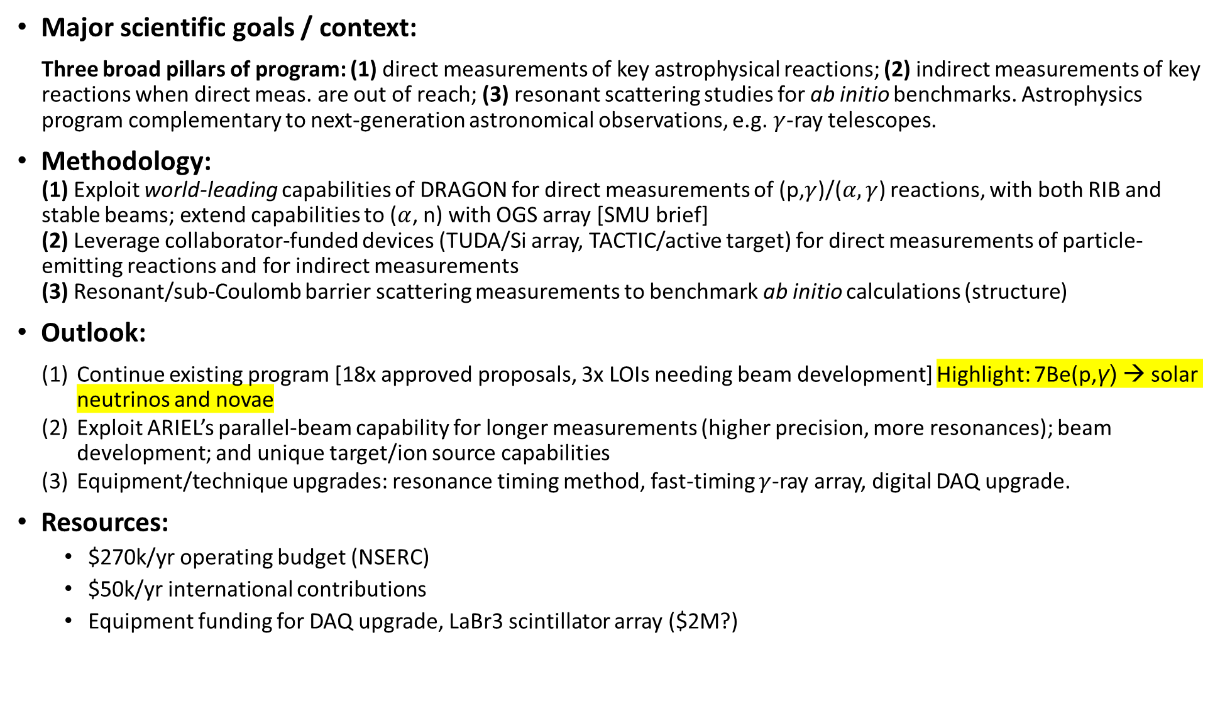
Project: DRAGON/TUDA/TACTIC: Direct & indirect measurements of astrophysical reactions, scattering for ab initio calculations
Major scientific goals / context:
Three broad pillars of program: (1) direct measurements of key astrophysical reactions; (2) indirect measurements of key reactions when direct meas. are out of reach; (3) resonant scattering studies for ab initio benchmarks. Astrophysics program complementary to next-generation astronomical observations, e.g. $γ$-ray telescopes.
Methodology:
(1) Exploit world-leading capabilities of DRAGON for direct measurements of (p,$γ$)/($α,γ$) reactions, with both RIB and stable beams; extend capabilities to ($α$, n) with OGS array [SMU brief]
(2) Leverage collaborator-funded devices (TUDA/Si array, TACTIC/active target) for direct measurements of particle-emitting reactions and for indirect measurements
(3) Resonant/sub-Coulomb barrier scattering measurements to benchmark ab initio calculations (structure)
Outlook:
Continue existing program [18x approved proposals, 3x LOIs needing beam development] Highlight: 7Be(p,γ) → solar neutrinos and novae
Exploit ARIEL’s parallel-beam capability for longer measurements (higher precision, more resonances); beam development; and unique target/ion source capabilities
Equipment/technique upgrades: resonance timing method, fast-timing $γ$-ray array, digital DAQ upgrade.
Resources:
  $270k/yr operating budget (NSERC)
  $50k/yr international contributions
  Equipment funding for DAQ upgrade, LaBr3 scintillator array ($2M?)

Slide 3
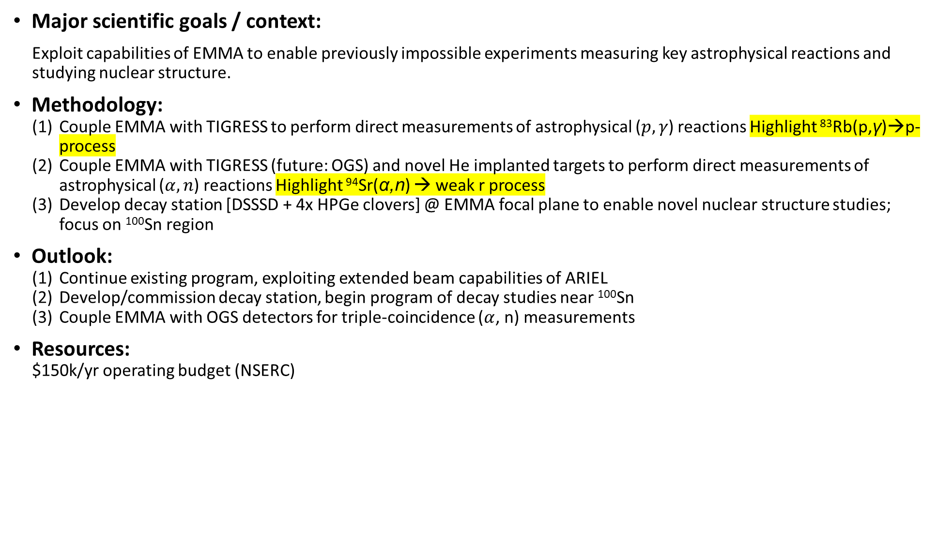
Project: EMMA: recoil separator for astrophysical and structure studies
Major scientific goals / context:
Exploit capabilities of EMMA to enable previously impossible experiments measuring key astrophysical reactions and studying nuclear structure.
Methodology:
Couple EMMA with TIGRESS to perform direct measurements of astrophysical ($p,γ$) reactions Highlight ⁸³Rb(p,γ)→p-process
Couple EMMA with TIGRESS (future: OGS) and novel He implanted targets to perform direct measurements of astrophysical ($α,n$) reactions Highlight ⁹⁴Sr(α,n) → weak r process
Develop decay station [DSSSD + 4x HPGe clovers] @ EMMA focal plane to enable novel nuclear structure studies; focus on ¹⁰⁰Sn region
Outlook:
Continue existing program, exploiting extended beam capabilities of ARIEL
Develop/commission decay station, begin program of decay studies near ¹⁰⁰Sn
Couple EMMA with OGS detectors for triple-coincidence ($α$, n) measurements
Resources:
$150k/yr operating budget (NSERC)

Slide 4
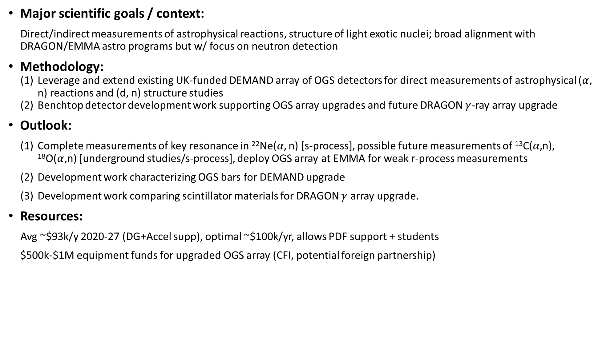
Project: SMU (Christian): OGS neutron detector/Detector development
Major scientific goals / context:
Direct/indirect measurements of astrophysical reactions, structure of light exotic nuclei; broad alignment with DRAGON/EMMA astro programs but w/ focus on neutron detection
Methodology:
Leverage and extend existing UK-funded DEMAND array of OGS detectors for direct measurements of astrophysical ($α$, n) reactions and (d, n) structure studies
Benchtop detector development work supporting OGS array upgrades and future DRAGON $γ$-ray array upgrade
Outlook:
Complete measurements of key resonance in ²²Ne($α,$ n) [s-process], possible future measurements of ¹³C($α,$n), ¹⁸O($α$,n) [underground studies/s-process], deploy OGS array at EMMA for weak r-process measurements
Development work characterizing OGS bars for DEMAND upgrade
Development work comparing scintillator materials for DRAGON $γ$ array upgrade.
Resources:
Avg ~$93k/y 2020-27 (DG+Accel supp), optimal ~$100k/yr, allows PDF support + students
$500k-$1M equipment funds for upgraded OGS array (CFI, potential foreign partnership)

Slide 5
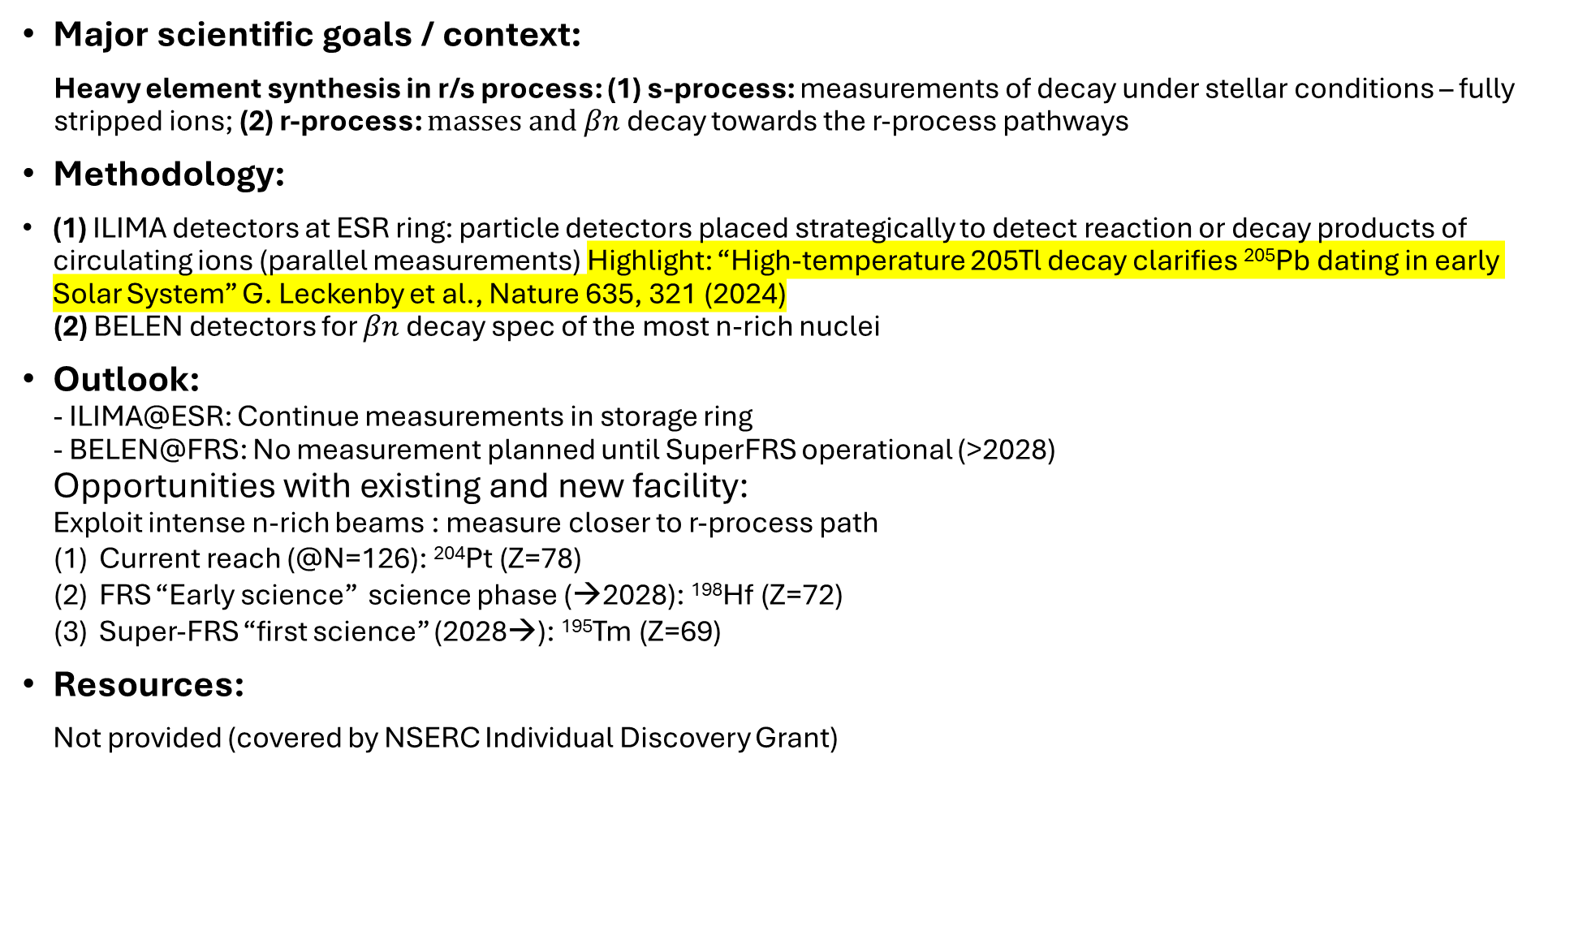
Project: GSI Decay Spec: Decay under astrophysical conditions, $βn$ decay
Major scientific goals / context:
Heavy element synthesis in r/s process: (1) s-process: measurements of decay under stellar conditions – fully stripped ions; (2) r-process: $masses and βn$ decay towards the r-process pathways
Methodology:
(1) ILIMA detectors at ESR ring: particle detectors placed strategically to detect reaction or decay products of circulating ions (parallel measurements) Highlight: “High-temperature 205Tl decay clarifies ²⁰⁵Pb dating in early Solar System” G. Leckenby et al., Nature 635, 321 (2024)
(2) BELEN detectors for $βn$ decay spec of the most n-rich nuclei
Outlook:
- ILIMA@ESR: Continue measurements in storage ring
- BELEN@FRS: No measurement planned until SuperFRS operational (>2028)
Opportunities with existing and new facility:
Exploit intense n-rich beams : measure closer to r-process path
Current reach (@N=126): ²⁰⁴Pt (Z=78)
FRS “Early science” science phase (→2028): ¹⁹⁸Hf (Z=72)
Super-FRS “first science” (2028→): ¹⁹⁵Tm (Z=69)
Resources:
Not provided (covered by NSERC Individual Discovery Grant)

Slide 6
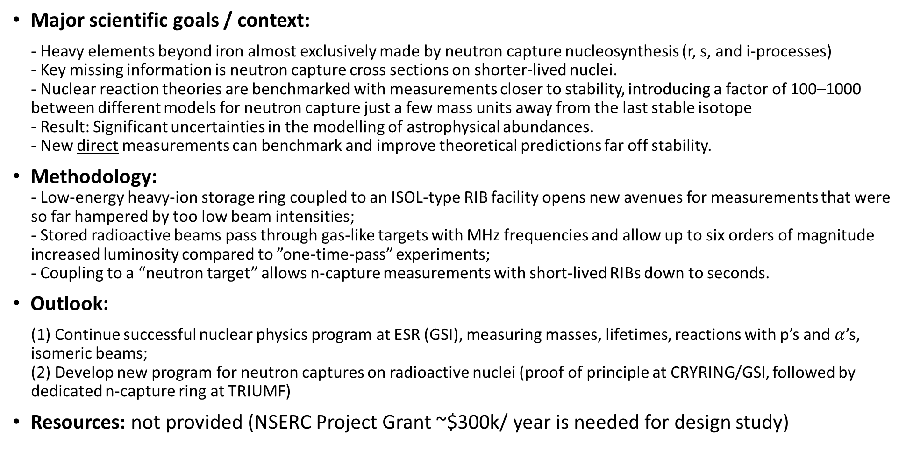
Project: TRISR: a dedicated storage ring for neutron captures on radioactive nuclei
[new]
Major scientific goals / context:
- Heavy elements beyond iron almost exclusively made by neutron capture nucleosynthesis (r, s, and i-processes)
- Key missing information is neutron capture cross sections on shorter-lived nuclei.
- Nuclear reaction theories are benchmarked with measurements closer to stability, introducing a factor of 100–1000 between different models for neutron capture just a few mass units away from the last stable isotope
- Result: Significant uncertainties in the modelling of astrophysical abundances.
- New direct measurements can benchmark and improve theoretical predictions far off stability.
Methodology:
- Low-energy heavy-ion storage ring coupled to an ISOL-type RIB facility opens new avenues for measurements that were so far hampered by too low beam intensities;
- Stored radioactive beams pass through gas-like targets with MHz frequencies and allow up to six orders of magnitude increased luminosity compared to ”one-time-pass” experiments;
- Coupling to a “neutron target” allows n-capture measurements with short-lived RIBs down to seconds.
Outlook:
(1) Continue successful nuclear physics program at ESR (GSI), measuring masses, lifetimes, reactions with p’s and $α$’s, isomeric beams;
(2) Develop new program for neutron captures on radioactive nuclei (proof of principle at CRYRING/GSI, followed by dedicated n-capture ring at TRIUMF)
Resources: not provided (NSERC Project Grant ~$300k/ year is needed for design study)

Slide 7
Project: TITAN: precision measurements for nuc. structure, nuc. astro., and fund. interactions
Major scientific goals / context:
Three broad pillars of program: (1) precision exp. for nuclear structure away from stability to understand nuclear force and emergent many-body physics (e.g. pairing, nuclear shell structure evolution); (2) systematic investigations of nucleosynthesis in astrophysical environments (e.g. s-process, r-process, rp-process); (3) program in fundamental interactions (e.g V_{ud} to test Standard Model via probe of unitarity of CKM quark-mixing matrix).
Methodology:
Obtain measurements with accuracy and precision via ion-trapping techniques; goals (1)-(3) achieved via:
(1) high-accuracy mass spectrometry and charge-radii determinations alongside in-trap nuclear-decay spectroscopy and back-and-forth with ab initio nuclear theory
(2) targeted mass measurements of ground and isomeric states to help to constrain the astrophysical conditions relevant to heavy-element synthesis via back-and-forth with nuclear astrophysics theory as well as half-lives of highly charge ions to study decays as they would occur in astro. environments
(3) very-high precision Q-value determinations of super-allowed and mirror β-decay nuclides as well as novel decays like two-photo emission and bound-state β decay; hunt for time-reversal via permanent EDM (promising avenue for the EDM searches is highly charged radioactive molecule)
Outlook:
ARIEL experiments will advance towards neutron dripline for structural evolution / nucleosynthesis studies and seek stringent limits on fund. symm.; the knowledge gained can also be applied to the sectors of nuclear energy, nuclear security and anti-proliferation, border control, fusion, standards, as well as environmental and biological monitoring.
Resources: $714k/yr 2020-25, $300k/y 2026, optimal $375k/y

Slide 8
Project: Nuclear astrophysics theory programs: Caballero
Caballero (University of Guelph)
Primary working group: Theory
Major scientific goals:
Central goal is to identify and characterize the imprints of subatomic physics—particularly nuclear and neutrino processes—on multi-messenger observations. Their interpretation depends on a deep understanding of nuclear matter, weak interactions, nuclear reactions, and gravitational waves from compact objects. Via analyzing simulations of these systems we generate predictive models of neutrino fluxes, gravitational wave signatures, and nuclear element synthesis.
Impact on nuclear astrophysics:
* Expand our study of nuclear pasta and other exotic phases, using simulations to understand how these complex nuclear geometries influence transport properties, x-ray bursts, neutron star cooling, and the synthesis of heavy elements (heavy-ion collisions offering potential for terrestrial validation)
* Develop a theoretical framework that incorporates long-lived isomeric states into r-process simulations and refine our modeling of nuclear reaction rates involving radioactive and cluster decay
* Explore the potential impact of dark matter interactions on nucleon behavior and neutrino emission in neutron star environments to establish new indirect probes of dark matter properties that complement terrestrial detection efforts
* Uncover connections between relic neutrinos and stochastic gravitational wave backgrounds which carry imprints of the early Universe and cosmic structure formation; investigating how these signals are correlated how they can be leveraged to improve detection strategies (relevant for Hyper-Kamiokande, DUNE, LIGO, LISA and Cosmic Explorer)

Slide 9
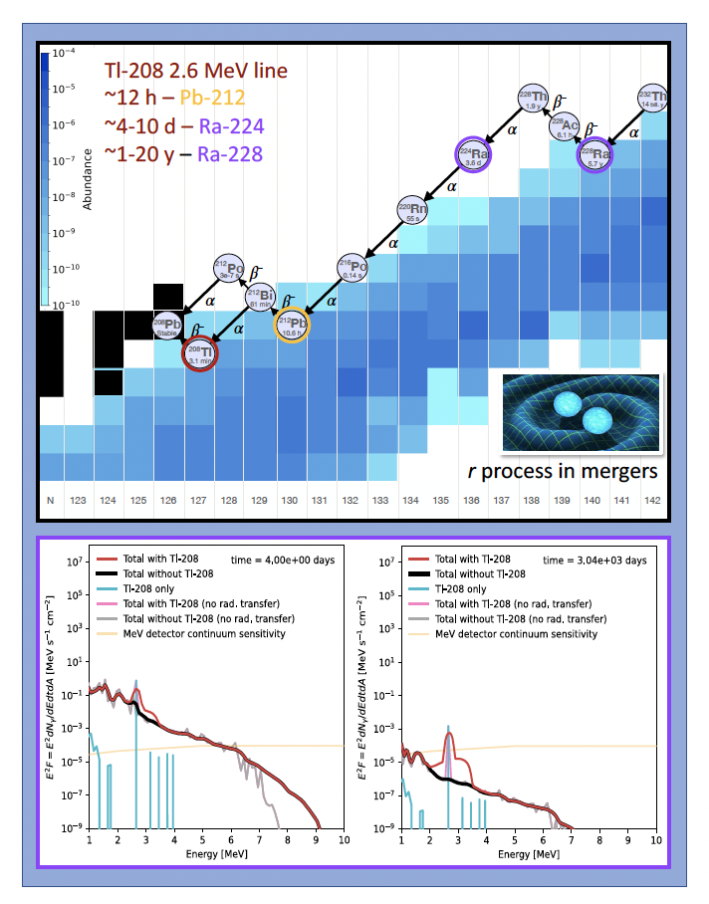
Project: Nuclear astrophysics theory programs: Vassh
Snapshot of a nucleosynthesis calc. populating Tl-208 which produces MeV gamma rays on observable timescales (hours, days, and years) exemplifying opportunities for future detectors such as COSI to detect the nucleosynthesis reach.
Vassh (TRIUMF Theory group) [new]
Primary working group: Theory
Major scientific goals:
Nucleosynthesis analysis pipelines take inputs from both exp. and theory, combined with hydrodynamic simulations of astrophysical events, and provide predictions for observables such as stellar abundances, bolometric light curves, and MeV gamma rays. Such studies leverage the role that nuclear physics has in shaping astrophysical observables in order to gather hints regarding the properties of exotic nuclei that cannot presently be produced on Earth as well as shed light on which sites are responsible for heavy element formation.
Impact on nuclear astrophysics:
* Examining correlations of elements / isotopes in stellar abundances / meteorites can shed light on the site and reach of heavy element production (e.g. correlation between Ag, Eu has suggested an event with fission cycling enriched some stars and places current highest limit of astro. synthesis at A~260)
* Electromagnetic transients such as light curves and gamma-ray lines can point to specific types of nuclei present in real-time multi-messenger events such as the r-process in mergers and the i-process in rapidly accreting white dwarfs (see above figure)
* Statistical methods and ML can discern nuclear properties producing features in observations as well as the astro. environment (e.g. MCMC predictions for rare-earth masses, ML generated global mass models, ML to discern r vs. s vs. i enriched stars)
* Regular back-and-forths with experiments (e.g. at ARIEL and FRIB) as well as state-of-the-art nuclear theory (e.g. ab initio) help to drive the mapping of the nuclear chart; can also facilitate the creation of well-defined `templates' of nucleosynthesis predictions available for comparison with observation

Slide 10
Project: Nuclear theory programs: Navratil / Holt
Navratil (TRIUMF Theory group)
Primary working group: Theory
Major scientific goals:
Develop a predictive ab initio theory of nuclear structure and nuclear reactions for light and medium mass nuclei (only calc. inputs are nucleon-nucleon and three-nucleon interactions derived within chiral Effective Field Theory)
Impact on nuclear astrophysics:
* Reactions important for astrophysics take place in the Cosmos at energies lower than accessible by experiments, so a nuclear theory with predictive power is important
* E.g. fusion and radiative capture reactions important for big bang nucleosynthesis
Holt (TRIUMF Theory group)
Primary working group: Theory
Major scientific goals:
Developing a comprehensive ab initio picture of all atoms and nuclei, with robust uncertainty estimates, to provide reliable predictions to answer questions such as nature of neutrinos and dark matter, the origin of matter over antimatter, neutron stars, and nucleosynthesis
Impact on nuclear astrophysics:
* Structure of exotic nuclei, extending predictions for the nuclear driplines and evolution of magic numbers to the heavy region of nuclei (long term: global calcs)
* First ab initio input (masses, β decay, and neutron capture rates) for use in r-process nucleosynthesis simulations (can now straightforwardly calculate nuclear masses and β decays in the N = 82, 126 regions, critical for understanding the second and third r-process abundance peaks
* Properties of neutron stars, where ab initio calculations of infinite nuclear and neutron matter are essential

Slide 11
Project: Nuclear theory programs: Gezerlis / Vujanovic
Gezerlis (University of Guelph)
Primary working group: Theory
Major scientific goals:
Nuclear many-body theory (ab initio quantum Monte Carlo) to connect microscopic nuclear interactions and strongly interacting nuclear systems appearing in terrestrial laboratories and in astrophysical settings
Impact on nuclear astrophysics:
* Improved formulations of nuclear forces to understand the physics of neutron star crusts and cores / neutron-rich nuclei via highly optimized next-generation nucleon-nucleon and three-nucleon interactions
* Connections to multi-messenger astronomy: matter’s opacity to neutrinos, the effect of pairing and deformation on neutron star cooling and, of relevance to neutron star mergers, and the interplay between equation of state and tidal deformability
Vujanovic (University of Regina) [new]
Primary working group: Theory
Major scientific goals:
Theoretical understanding of nuclear medium dynamics via microscopic effective kinetic theory and QCD-based effective Lagrangians to explore the strong force, quark gluon plasma (QGP), collisions of nuclei at relativistic energies
Impact on nuclear astrophysics:
* QGP exists during the first few microseconds after the Big Bang
* QCD-based effective Lagrangians and hadron properties at finite chemical potential have direct applications to nuclear matter in neutron stars

Slide 12
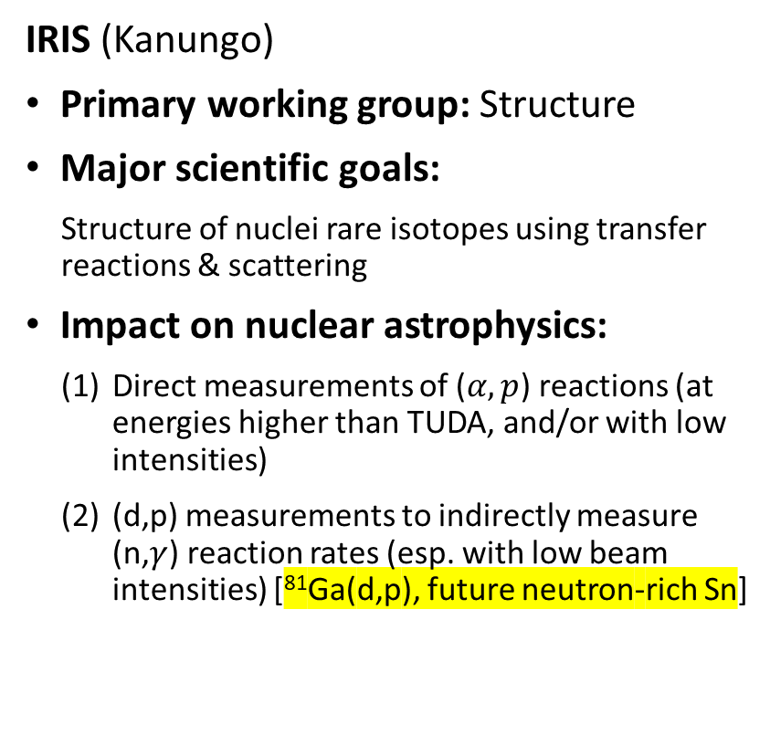
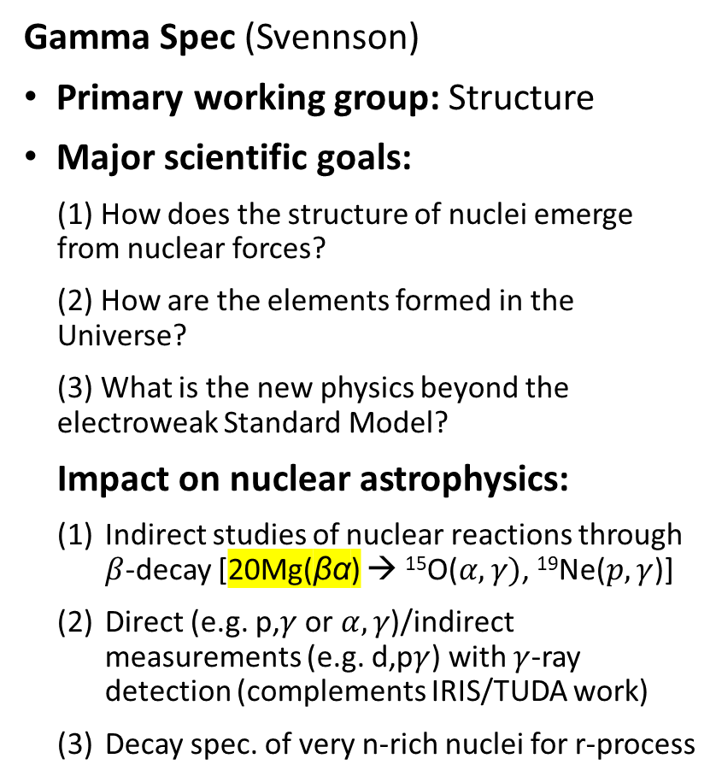
Project: Primarily Structure: IRIS & Gamma spec
IRIS (Kanungo)
Primary working group: Structure
Major scientific goals:
Structure of nuclei rare isotopes using transfer reactions & scattering
Impact on nuclear astrophysics:
Direct measurements of ($α,p$) reactions (at energies higher than TUDA, and/or with low intensities)
(d,p) measurements to indirectly measure (n,$γ$) reaction rates (esp. with low beam intensities) [⁸¹Ga(d,p), future neutron-rich Sn]
Gamma Spec (Svennson)
Primary working group: Structure
Major scientific goals:
(1) How does the structure of nuclei emerge from nuclear forces?
(2) How are the elements formed in the Universe?
(3) What is the new physics beyond the electroweak Standard Model?
Impact on nuclear astrophysics:
Indirect studies of nuclear reactions through $β$-decay [20Mg(βα) → ¹⁵O($α,γ)$, ¹⁹Ne($p,γ$)]
Direct (e.g. p,$γ$ or $α,γ$)/indirect measurements (e.g. d,p$γ$) with $γ$-ray detection (complements IRIS/TUDA work)
Decay spec. of very n-rich nuclei for r-process

Slide 13
Project: Primarily Structure: In-flight RIB stidies & Two-step fragmentation
In flight RIB (Kanungo)
Primary working group: Structure
Major scientific goals:
Study exotic nuclear structures (n-skins, halos, shell evolution) far from stability; focus on nuclear radii measurements using in-flight fragmentation beams from offshore facilities (RIKEN, FRIB, GSI).
Impact on nuclear astrophysics:
Neutron skin measurements constrain the nuclear EOS and have implications for, e.g. neutron stars
Two-step fragmentation (Kanungo) [new]
Primary working group: Structure
Major scientific goals:
Structure of n-rich nuclei; expand beam-delivery capabilities for n-rich nuclides using projectile fragmentation of n-rich ARIEL beams (e.g. ¹³²Sn); focus on N=82 below Sn and N=50 below Kr.
Impact on nuclear astrophysics:
The targeted region for beam production is important for r-process nucleosynthesis

Slide 14
Project: Primarily Fund Sym: BeEST/SALYER & Radioactive Molecules
BeEST/SALYER (Lennarz)
Primary working group: Fund. sym
Major scientific goals:
Search for BSM physics using decays of radioactive isotopes implanted into superconducting quantum sensors.
Impact on nuclear astrophysics:
⁷Be decay → solar neutrinos
Long term vision: “enable high-statistics recoil correlation measurements across the nuclear chart, and provide new input for… nuclear astrophysics…”
Radioactive Molecules (Malbrunot)
Primary working group: Fund. sym
Major scientific goals:
Search for permanent EDMs of nuclei in the form of nuclear Schiff moments → violation of time-reversal symmetry.
Impact on nuclear astrophysics:
The role of radioactive molecules in nuclear astrophysics is being recognized – provide insights into stellar evolution [T. Kaminski et al. Nature Astronomy 2, 778]

