Slide 1




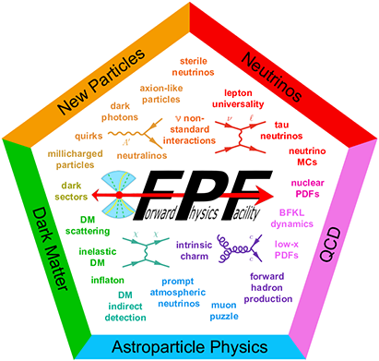
Physics and Project planning for Forward Physics Facility
And many university collaborators from US, Europe, and Asia
Milind V. Diwan (Brookhaven National Laboratory) on behalf of the FPF working group under the PBC/CERN
The 2025 Canadian Association of Physicists Congress (June 9-13, 2025), University of Saskatchewan
Forward Physics Facility (FPF) is for neutral long lived particles emerging in the forward direction from the LHC collisions.
Notes:
Thank you for accepting this contribution. I am talking on behalf of a community that is spread out in US, Europe and Asia.
I am going to talk about physics at the LHC in the far forward region. It is obviously in the spirit of taking maximum advantage out of the High Luminosity LHC upgrade.
And so this project should be considered as part of the exploitation of the current investments.
We have been working on this plan for a couple of years now. It is supported by many collaborators and agencies. I have only made a partial list above.
The FPF is for neutral long lived particles from the LHC in the forward region. However as this diagram suggests it has unique sensitivity for many aspects of particles physics that are relevant for both collider physics, astrophysics and neutrino physics.

Slide 2

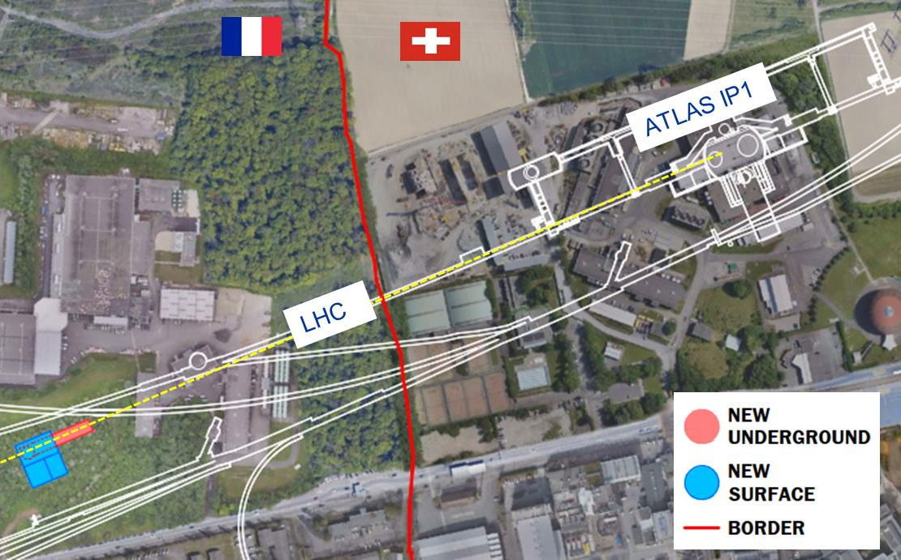
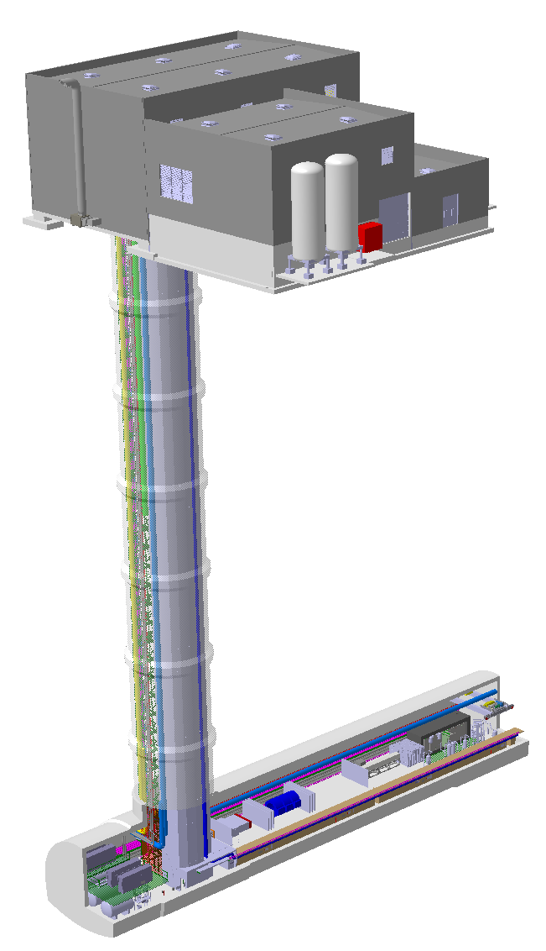
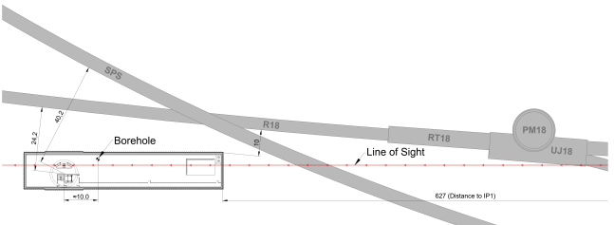
Forward Physics Facility cavern conceptual design
Engineering Department
FPF - Forward Physics Facility:
Final location to respect constraints:
    627 m from ATLAS IP1 on the French side of CERN land
90 m depth; 75 meter long/ 12 meter wide.
10 m away from the LHC tunnel
Suite of 4 experiments have been designed.
Surface building
LHC tunnel
Shaft
FPF
Cavern
Recent detection of neutrinos (FASER/FASERnu) from the LHC has opened a new opportunity for physics. The FPF will allow full exploitation of this opportunity.
Notes:
After a thorough study with CERN technical personnel, we have identified a site that is in the line of sight from ATLAS IP1. It is 627 m and 90 m depth. It is a minimum of 10 meter away from the LHC tunnel.
The hall is designed to be 75 meters long and 12 meters wide. A key reason for the choice is the recent detection of neutrinos from the LHC. This is opened up a new opportunity for physics, and it was felt that a coordinated approach for an experimental program with all detectors in the same single hall will produce the best outcome in the long term.

Slide 3
Community and References
This talk is on behalf of the working group under the Physics Beyond Colliders PBC@CERN
Science and Project Planning for the Forward Physics Facility in Preparation for the 2024-2026 European Particle Physics Strategy Update: https://arxiv.org/abs/2411.04175
Engineering effort supported from CERN and other institutions.
Several workshops have resulted in the design. FPF8 Jan 21-22, 2025
Snowmass white paper has ~ 400 authors and contributors.
Snowmass Energy Frontier Report: Our highest immediate priority accelerator and project is the HL-LHC, the successful completion of the detector upgrades, operations of the detectors at the HL-LHC, data taking and analysis, including the construction of auxiliary experiments that extend the reach of HL-LHC in kinematic regions uncovered by the detector upgrades.
Notes:
This talk is on behalf of a working group that has been functioning under the CERN physics beyond colliders initiative. The web link is in my slides. Along with the talk, a brief white paper has been uploaded to the the indico. The talk can be assumed to be on behalf of the authorship of this white paper.
The technical progress that I will show is due to the excellent engineers and technical people at CERN and other institutions.
The interest in the community can be judged from the 400 contributors to the snowmass white paper. And the statement from the Energy frontier report to include construction of auxiliary experiments to extend the kinematic reach of the HL-LHC experiments. And so this is very much in that spirit.

Slide 4
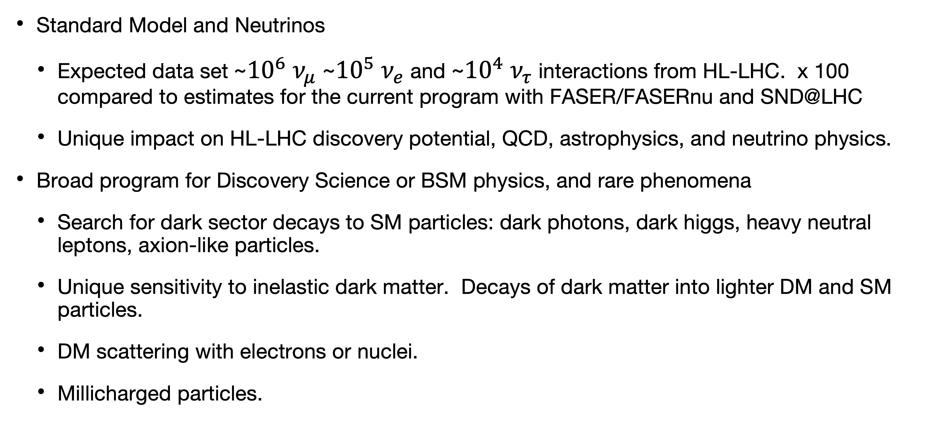
The scientific case for the Forward Physics Facility
Standard Model and Neutrinos
  Expected data set ~${10}^{6}$ $ν_{μ}$ ~${10}^{5}$ $ν_{e}$ and ~${10}^{4}$ $ν_{τ}$ interactions from HL-LHC. x 100 compared to estimates for the current program with FASER/FASERnu and SND@LHC
  Unique impact on HL-LHC discovery potential, QCD, astrophysics, and neutrino physics.
Broad program for Discovery Science or BSM physics, and rare phenomena
  Search for dark sector decays to SM particles: dark photons, dark higgs, heavy neutral leptons, axion-like particles.
  Unique sensitivity to inelastic dark matter. Decays of dark matter into lighter DM and SM particles.
  DM scattering with electrons or nuclei.
  Millicharged particles.
Notes:
The science case for the FPF is two-fold. The neutrino and standard model science case is based on the quite large data set that will be collected in the detectors. It will be about 100 to 200 times the current estimates for the pioneering program from FASER and SND. This data set will be unique and has impact on a number of physics topics.
Given the difficulty of predicting where dark matter signals might arise, we believe it is important to have a broad search strategy. The FPF will have sensivity that overlaps many dedicated projects such as SHIP on dark photons, dark higgs, etc. It has unique sensitivity to inelastic dark matter in which light dark matter decays into SM particles.
The liquid argon and emulsions detectors also have sensitivity to Dm scattering. And finally there will be excellent sensitivity to millicharged particles if they should be present in pp collisions.

Slide 5
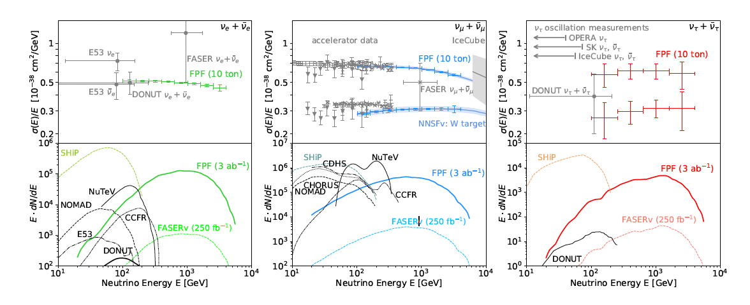

Neutrinos and SM physics
Production
kaons
charm
pions
kaons
charm
FPF experiments detects highest energy laboratory neutrinos. ~${10}^{6}$ $ν_{μ}$ ~${10}^{5}$ $ν_{e}$ and ${10}^{4}$ $ν_{τ}$ from HL-LHC.
Rates ~ 20-50 events/ton/day.
This data allows 1) SM cross sections for astrophysics (e.g. to understand the cosmic ray muon puzzle), 2) Lepton flavor studies with tau, 3) constraints on anomalous neutrino properties. 4) QCD studies to constrain parton distributions down to $x∼{10}^{−7}$
Notes:
The total mass of FPF neutrino detectors is about 30-40 tons including the steel/scintillator hadronic calorimeter for the liquid argon TPC. This allows large statistics.
The breakout of the rates is roughly million numu, hundred k for electron neutrinos, and about 10000 for nutau.
The energy range spans the region between the current best accelerator measurements and astrophysical flux above several TeV.
Knowledge of cross section limits the Utilization of astrophysics neutrino data for fundamental physics. This is something that will be provided by the FPF program. Given that the flux and cross section are entangled, we expect a step by step approach to resolving the cross section. For this reason I have provided a rough sketch of where the production comes from for electron, muon and tau neutrinos.
The data will be the largest data set for tau neutrino interactions. For neutrino physics, such data is completely missing. And will be very valuable to know if there are any anomalous interactions in the tau sector. Finally, the kinematics of these events at very high energy is such that very low x regions are probed. And this is on the next slide.

Slide 6
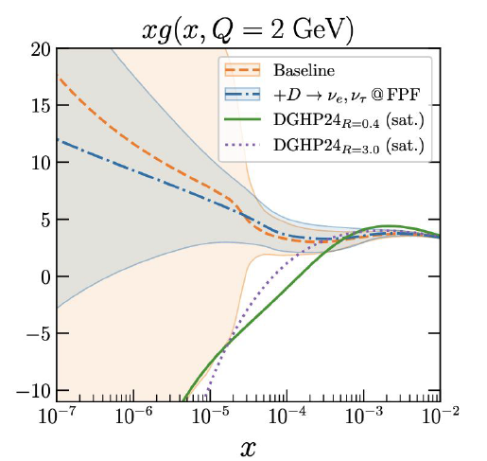
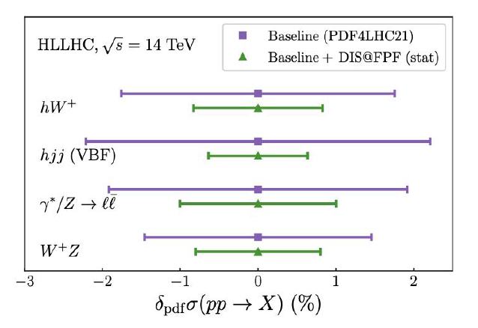
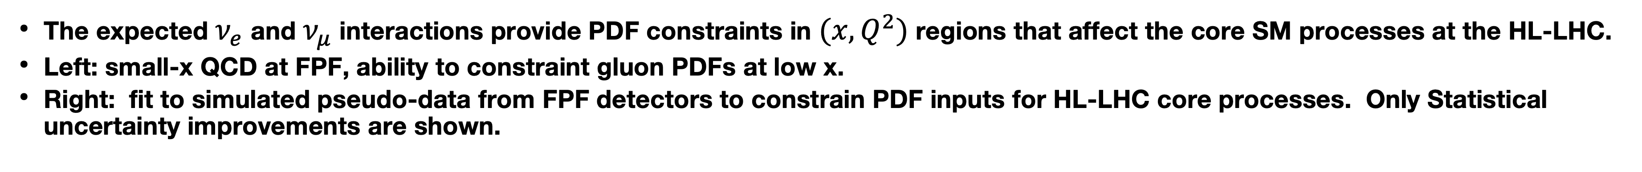
Enhancing the HL-LHC discovery potential
2411.04175
2309.09581
The expected $ν_{e}$ and $ν_{μ}$ interactions provide PDF constraints in $(x,Q^{2})$ regions that affect the core SM processes at the HL-LHC.
Left: small-x QCD at FPF, ability to constraint gluon PDFs at low x.
Right: fit to simulated pseudo-data from FPF detectors to constrain PDF inputs for HL-LHC core processes. Only Statistical uncertainty improvements are shown.
Notes:
In these references, a very valuable study has been performed using pseudo-data from all the FPF detectors. The left side shows the constraints that would come from the electron and muon neutrino data on x at a particular Qsquarded. The gluon PDFs get constrained below 10^-6 in a significant way.
The new PDF information from this pseudo data was fed back into pp cross sections to see the impact on core standard model processes. In this plot 4 processes are illustrated, but the paper has a comprehensive list. The statistical improvement on many of these could be as much as a factor of 2.
This work was done in the spirit that this program is an extension of the HL-LHC physics and must be relevant for the core mission of the LHC eletroweak physics.

Slide 7
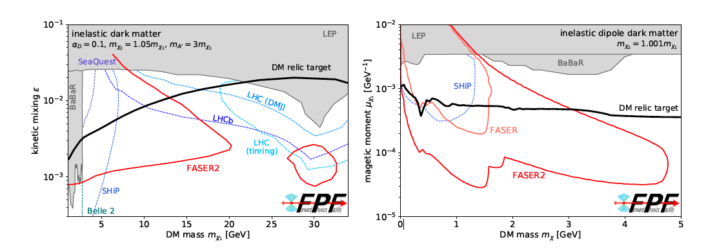
Dark Sector searches (examples from a wide BSM program)
Example for inelastic DM (almost degenerate states with SM emission)
Signature is a pair of SM leptons. Left: for high mass advantage due to high CM energy. Right: low mass advantage due to large boost. https://arxiv.org/pdf/1810.01879
Notes:
The entire system of FPF has broad sensitivity to the dark sector model including dak photons, dark higgs, etc. The sensitivity plots such as the one here have a generic look, the upper limit depends on the minimum lifetime that is needed to reach the FPF detectors, and the lower limit depends largely on the intensity of production and acceptance of the detectors.
Given the almost completely open issue of light dark matter, we have maintained an approach that is as broad as possible. Much of this sensitivity for many models from FPF overlaps which other more specifically designed experiments such as SHIP, however FPF has two advantages that can be utilized. Mainly, the largest CM energy of any approach and also the huge boost to the light particles that would be present in the forehead direction.
This advantage translates to unique sensitivity for the dark sector when the particles tend to be almost denerate that decay with emission of standard model leptons. The boost allows excellent sensitivity in this case which could be a broad class of models. There are two example with masses that range to tens of GeV and also for masses that are in the GeV scale.

Slide 8
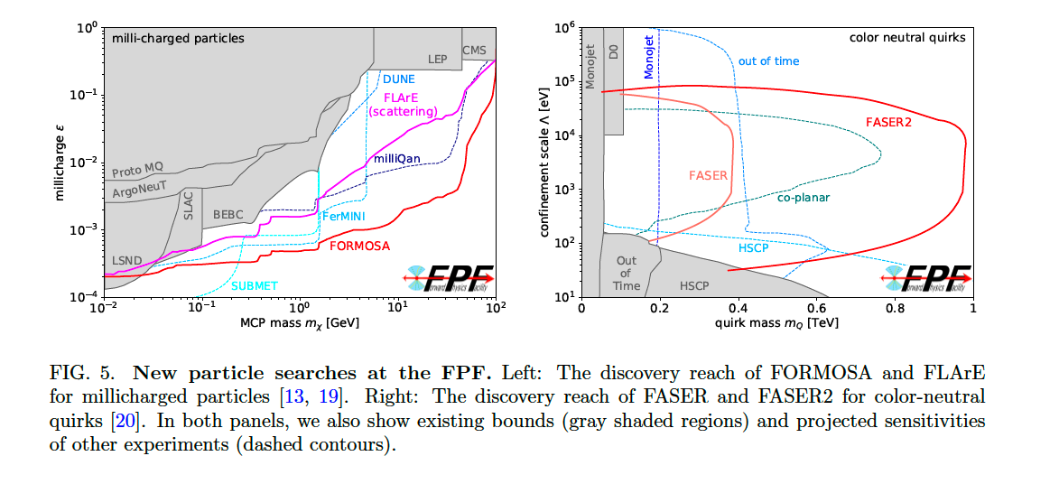
Millicharged particles and Quirks (examples from a wide BSM program)
https://arxiv.org/pdf/2203.05090
Notes:
This slide is a calculation of the sensitivity for millicharged particles from ForMOSA and other experiments. The calculation includes careful consideration of backgrounds using the current experience from running experiment such as mili qan. FLARE would have similar sensitivity to FORMOSA in the dE/dx mode providing an important confirmation or improved combined sensitivity.
On the right is sensitivity to a model of Quirks which are charged particles that also have macroscopic confinement scale. And so they come to the FPF detectors with charge and apparently large mass and are delayed or have large dedx deposits. The sensitivity is unusually dependent on the cross sectional area of the detectors, but the trigger conditions also have to be carefully chosen. We expect the backgrounds to be such searches to be low especially if all the detector systems are utilized in combination.
These are examples of sensitivity to particular models of new physics from the LHC in the forward region. The overall approach is to make it as broad as possible and this is enabled by having a single facility that is flexible enough to host several experiments that work with each other.

Slide 9
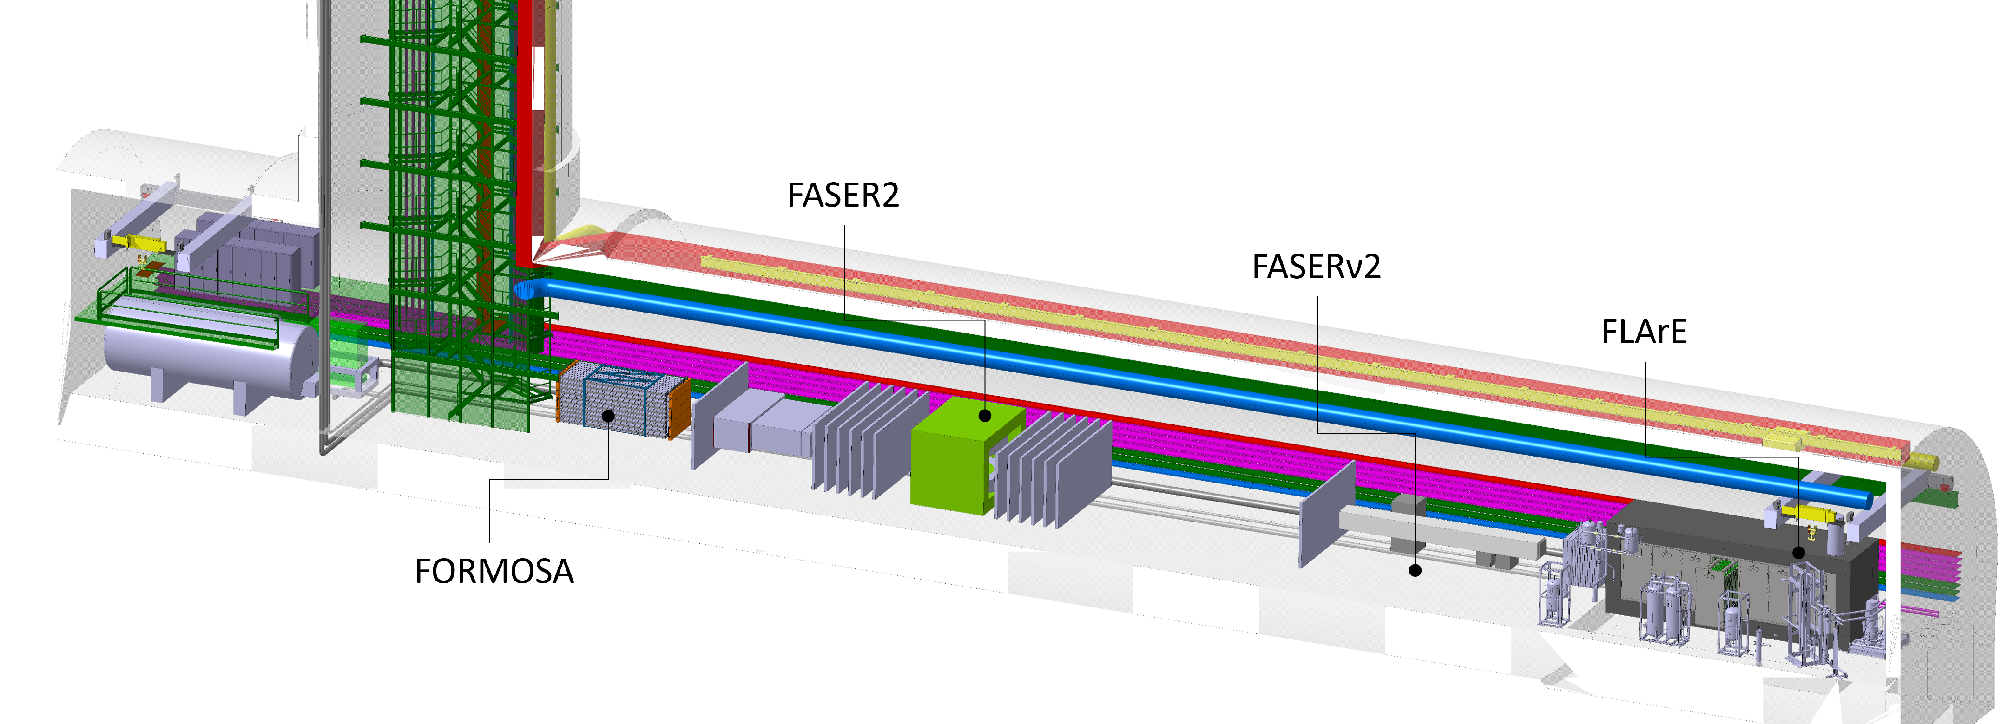
Experiments in Forward Physics Facility
Baseline design
FPF covers η > 5.5, experiments on LOS cover η ≳ 7
Tungsten/Emulsion
High spatial resolution
for tau/charm
Liquid Argon TPC
broad-purpose detector,
wide dynamic range, 10 ton
Service alcove
(Turbo-Brayton, storage, electronics)
Magnetic spectrometer
Scintillator detector
4 ton
Emulsion/tungsten 20 ton
~600m from ATLAS IP
Good energy containment (high density), high spatial resolution (for 𝜏 neutrinos) and low threshold (for DM scattering)
Notes:
This shows the layout of the experiments in the facility and also various services that must be included.
Detailed technical notes for each detector are in draft form.
Starting from the upstream. Flare would be a liquid argon TPC. It is designed to be a broad purpose detector. It would have a high resolution readout, either pixels or optical or both. We have put a lot of effort into conceptual design of the cryogenics and cryostat. The main cryogenics is placed at the other end of the cavern so that it does not create noise or obstruction for the rest of the systems. The detector also has a steel/scintillator hadronic calorimeter to provide excellent containment of events.
Second detector in the line is FASERnu2 which will be a tunsgten/emulsion detector with very high resolution of < 1 micron specifically designed for identification of tau neutrinos.
This is followed by FASER2 which is a large magnetic spectrometer with much larger acceptance than the current FASER2 spectrometer. Overall FASER2 will be many orders of magnitude more sensitive than FASER2.
FASER2 has an electronmagnetic calorimeter and it is followed by FORMOSA which is a high resolution plastic scintillator stack conventional detector. By using plastic with high quantum efficiency PMT readout FORMOSA is able to achieve very high dE/dx resolution.

Slide 10
Detector parameters and physics (summary)
Detector | Design/Parameter | Standard Model Physics | Discovery and Rare Phenomena Physics
FLArE | Liquid argon TPC/10 ton active target/~ns timing/Fe-Scin hadronic calorimeter(40 ton) | High eff. Muon/Electron neutrino spectrum. wider eta coverage, Low purity Tau neutrinos spectrum | LLP interactions with low threshold. Inelastic DM, DM scattering, mCP interactions. Neutrino Tridents
FASERnu2 | Tungsten/emulsion/20 ton/high spatial resolution <1micron. | High eff Tau neutrino detection. Charm detection. Muon/electron neutrino spectra at high eta | DM scattering, Neutrino Tridents
FASER2 | Magnetic Spectrometer/SciFi/~4 T-meter/aperture ~ 3mx1m; dp/p ~ 5% @ TeV | High acceptance Muon spectrometer for FLArE and FASERnu2 | Dark sector decays of neutral LLPs, Inelastic DM, Quirks
FORMOSA | Plastic Scintillator Array/high resolution dE/dx (4 layers, 4 tons) | — | Millicharged particles with sensitivity q~10⁻³ Quirks
Each detector is designed to have unique scientific reach. System of detectors enhance the scientific case for the facility. Simulations are in progress to evaluate acceptances and resolutions.
Notes:
On this slide, I have attempted to summarize the detector technologies and their standard model and beyond standard model targets.
Each detector is designed to have unique scientific impact, but it is also located and designed to support the entire ensemble of experiments. And so together the system should have much broader sensitivities.
FLARE is a broader purpose detector with sensitivity for neutrino physics. It will have high energy resolution and excellent coverage over a broad range of pseudo-rapidity. It has timing and will be able to stay live continuously. For DM, liquid argon has low threshold and due to its completely live nature it has sensitivity to DM and millicharged particle scattering as well as neutrino tridents.
FASERnu2 is specifically designed to have extremely high spatial resolution using emulsion and can select tau events with very low backgrounds using decay kinks. Because of the tungsten heavy target it provides additional constraints of neutrino events apart from argon. Particularly, we are evaluating sensitivity to neutrino tridents with both FLARE and FASERnu2 which is sensitive to the target nucleus.
FASER2 is a high resolution magnetic spectrometer; the nominal design is with a 4 tesla-meter dipole, but we are also examining commercial approaches to magnets. FASER2 will serve as the muon spectrometer for FLARe and FASERnu2. This is a crucial function that requires careful design of the geometry. However, FASER2 is also designed with a minimum 5 meter decay length for excellent sensitivity for Dark sector decays, unique sensitivity to inelastic DM,
And finally FORMOSA is a plastic scintillator array with 4 layers of scintillators.
We have just started examining how to look at the physics in combination of all detectors, but as a first task, the acceptance of the spectrometer has been analyzed and designed to have >50% acceptance for neutrino generated muons.

Slide 11
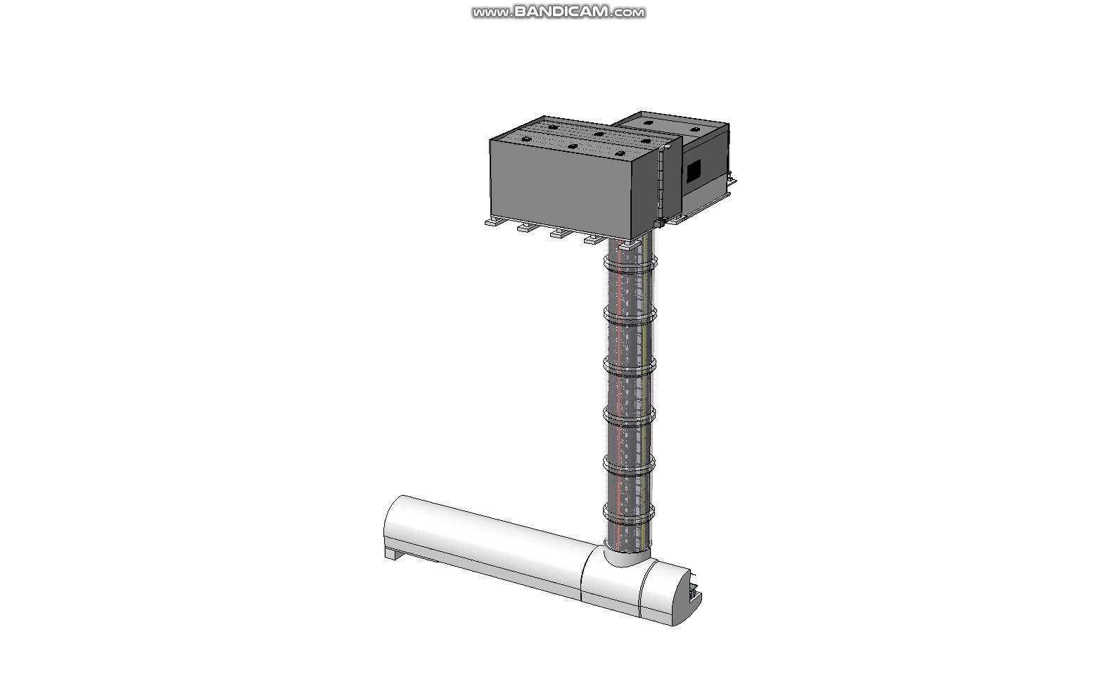
Status of Technical Studies and Integration
CERN beam physics group: Vibration/tunnel movement are not expected to be an issue either during construction or operation.
CERN radioprotection group: Can access cavern for trained personnel during beam operations.
Muon backgrounds: CERN fluke team, muon flux will be < 1 Hz/cm^2 in a region 1 meter around LOS. Generally acceptable for experiments.
CERN site investigation: Geological conditions appear good for proposed excavation.
CERN safety: Addition of over-pressure safety corridor allows a single access point (no physical connection to LHC).
The cryo system to be separated underground; has an industrial cooler(Turbo Brayton), LAr and LN2 storage ; all sized to be installed thru shaft.
Conceptual installation plan for all services and detectors developed at FPF8.
Engineering Department
Notes:
I will play this short video while going through the list of technical studies that have resulted in this design.

Slide 12
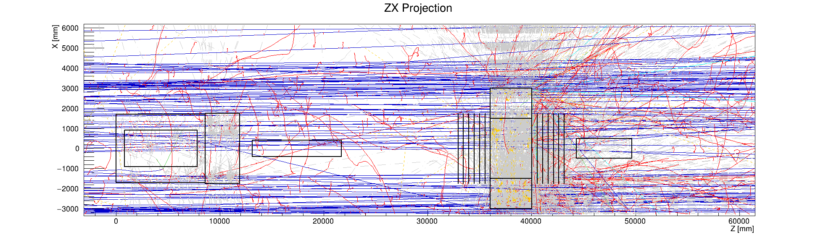
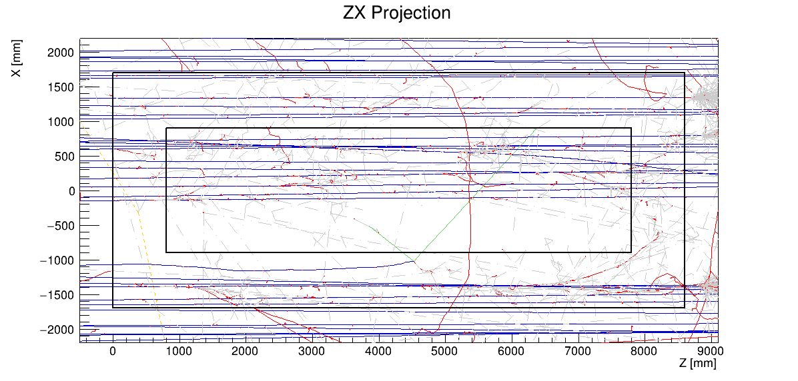
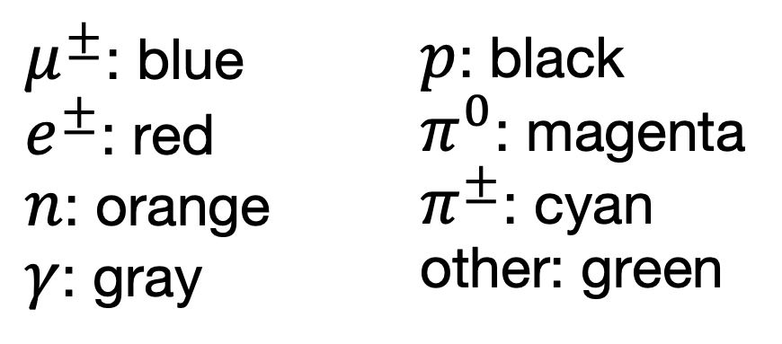


Full simulation of muon backgrounds shows that detector background rates on LOS are manageable
Overlayed background events in 187.5 us (FLArE acquisition window)
Event display from G4 simulations
$$μ^{−}$$
$$μ^{+}$$
Mu- band
from IP
Mu+ band
FLArE
FASERnu2
FASER2
FORMOSA
Zoom on FLArE volume
The muon rates (0.5 Hz/cm^2) and space charge effects are manageable around the line of sight.
$μ^{±}$: blue
$e^{±}$: red
$n$: orange
$γ$: gray
$p$: black
$π^{0}$: magenta
$π^{±}$: cyan
other: green
Notes:
As an experimental note, we have put some effort into making sure the background rates in the FPF detectors are reasonable through excellent FLUKA simulations of the beam interactions. This is a full simulation of the muon rates from the IP. You can see the mu+ and mu- bands, but the rates on the line of sight are quite reasonable around about 0.5 Hz/cm^2. This has been verified. The detector designs have incorporated this information in particular for the any space charge effects in the liquid argon TPC.

Slide 13
Conclusion
A scientific opportunity with Forward Physics Facility is ready with excellent design for a new underground hall and an initial suite of experiments. https://arxiv.org/pdf/2411.04175
  Headline physics interest for FPF experiments is world class.
    Neutrinos in the 1 TeV range: ~200-500 events/ 10 ton/day
    Tau neutrino flux and associated heavy flavor physics: ~1-2 events/10 ton/day
    And discovery science with BSM searches and rare phenomena.
After 8 dedicated workshops and technical meetings, most integration, safety issues are understood and documented.
Unique experimental features: A. There will be no interference to HL-LHC during construction or operation. B. The LHC magnets provide shielding from MUONs, C. location has over 200 meters of rock shielding. D. The boost from LHC energy provides excellent experimental signatures.
A preliminary cost estimate for the facility (from CERN experts) is ~49MCHF and detector core costs of ~40 MCHF. A schedule can be developed rapidly.
This project is for young capable international physicists who are needed for the future.

Slide 14
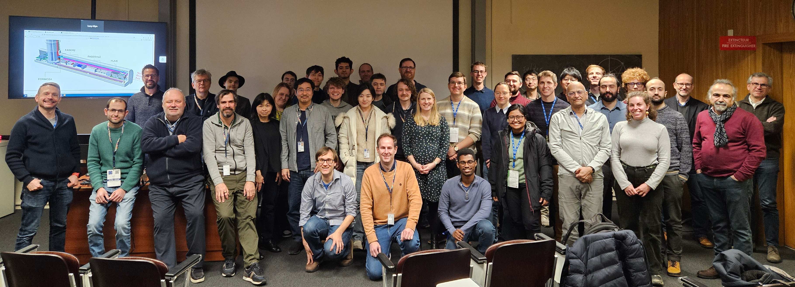
Photograph from FPF8 workshop at CERN Jan 25 (114 registrants)

Slide 15
Information Sheet
Effort Name: Forward Physics Facility and Experiments at the High Luminosity LHC.
Short Abstract: The Forward Physics Facility (FPF) is a proposed new underground cavern at the Large Hadron Collider (LHC) that will host a suite of new experiments during the High-Luminosity LHC (HL-LHC) era. The existing large LHC detectors have un-instrumented regions along the beam line, and so miss the rich physics opportunities provided by the enormous flux of particles produced in the far-forward direction. A diverse set of experiments are planned to detect millions of neutrinos and a wide range of new physics possibilities.
Contact: https://fpf.web.cern.ch/
Useful Link: https://pbc.web.cern.ch/ , https://pbc.web.cern.ch/fpf-resources
White papers: https://arxiv.org/abs/2411.04175

