Slide 1

Shining (Dark)Light on Interactions with the Dark Sector
Gabby Gelinas
On behalf of the DarkLight Collaboration
MSc student at The University of British Columbia
Supervised by Katherine Pachal and Michael Hasinoff

Slide 2
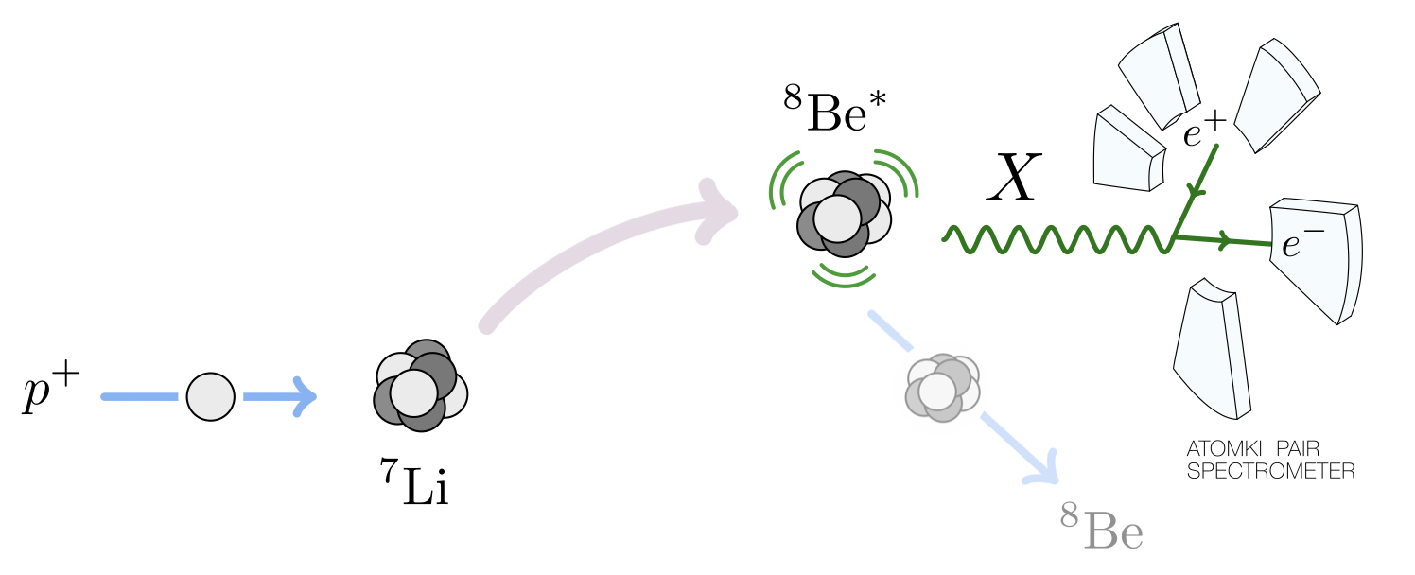
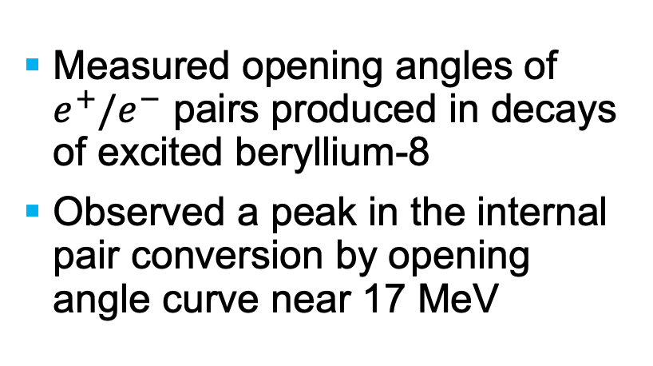
DarkLight Experiment Motivations
Atomki Experiment
Measured opening angles of $e^{+}/e^{−}$ pairs produced in decays of excited beryllium-8
Observed a peak in the internal pair conversion by opening angle curve near 17 MeV
Phys. Rev. D 95, 035017 (2017)
/11
Notes:
DarkLight is a dark boson search at triumf. We are looking for a particle that would mediate interactions between the standard model and dark matter. First, let's look at some reasons we think this particle could exist within our region of interest.
One motivating experiment is the atomki experiment out of Hungary that was studying decays of excite beryllium. When the examined the relationship between internal pair conversion and opening angle, they observed an unexpected peak corresponding to this particle having a mass of 17 MeV. This could be explained by the production and decay of a new particle. This is termed the X17. However, more work is needed since it would also be explained by SM nuclear effects.
If we can confirm a discovery of a dark boson it would be a monumental step in understanding the particle nature of dark matter.

Slide 3
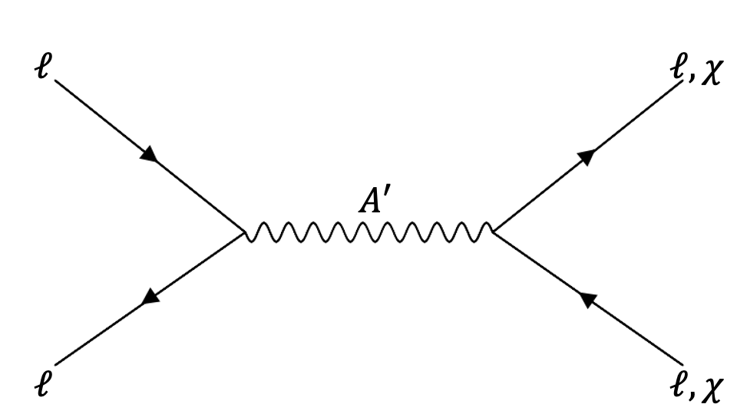
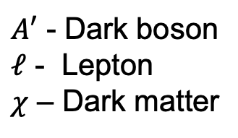

Dark Boson Model of Interest
An X17-like dark boson must be:
Massive
  Massless is not compatible with our universe
An axial vector
  Satisfy conservation of angular momentum in observed decays
Protophobic
  Proton based experiments have already checked!
$A′$ - Dark boson
$ℓ$ - Lepton
$χ$ – Dark matter
/11
Notes:
So, what do these experimental motivators mean for the type of dark boson that darklight is looking for?
DL is looking for an X17-like dark boson: one that aligns with the restrictions introduced by the atomki experiment. The dark boson would mediate interactions between the SM and dark sector by directly interacting with both sectors, being able to be produced by SM particles, and could decay to SM or DM particles.

Slide 4
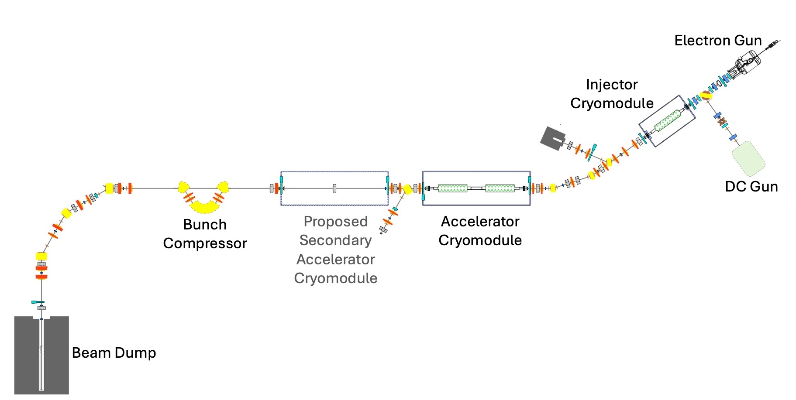
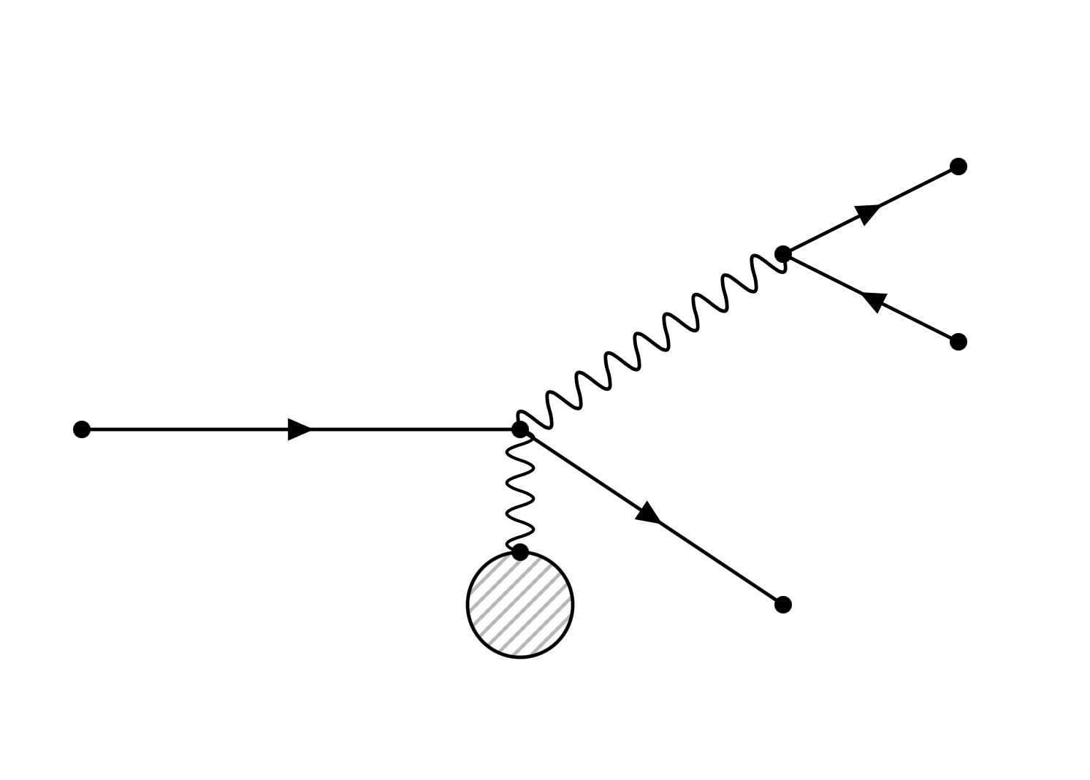


Dark Boson Production
30 MeV beam energy
e-
DarkLight
$$γ$$
e+
e- beam
$$A′$$
Modified from DOI: 10.18429/JACoW-ERL2019-WEPNEC01
Ta
e-
/11
Notes:
1 min

Slide 5
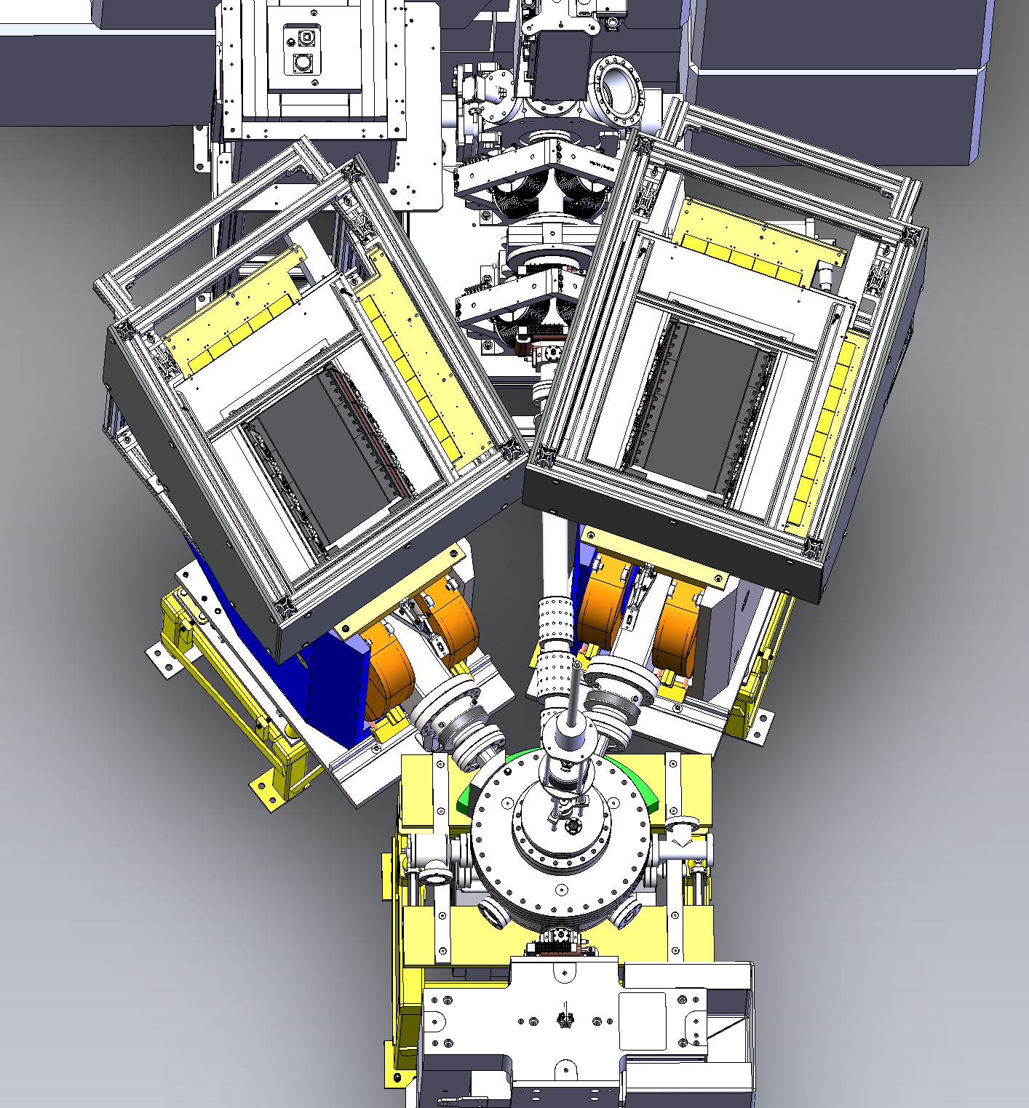
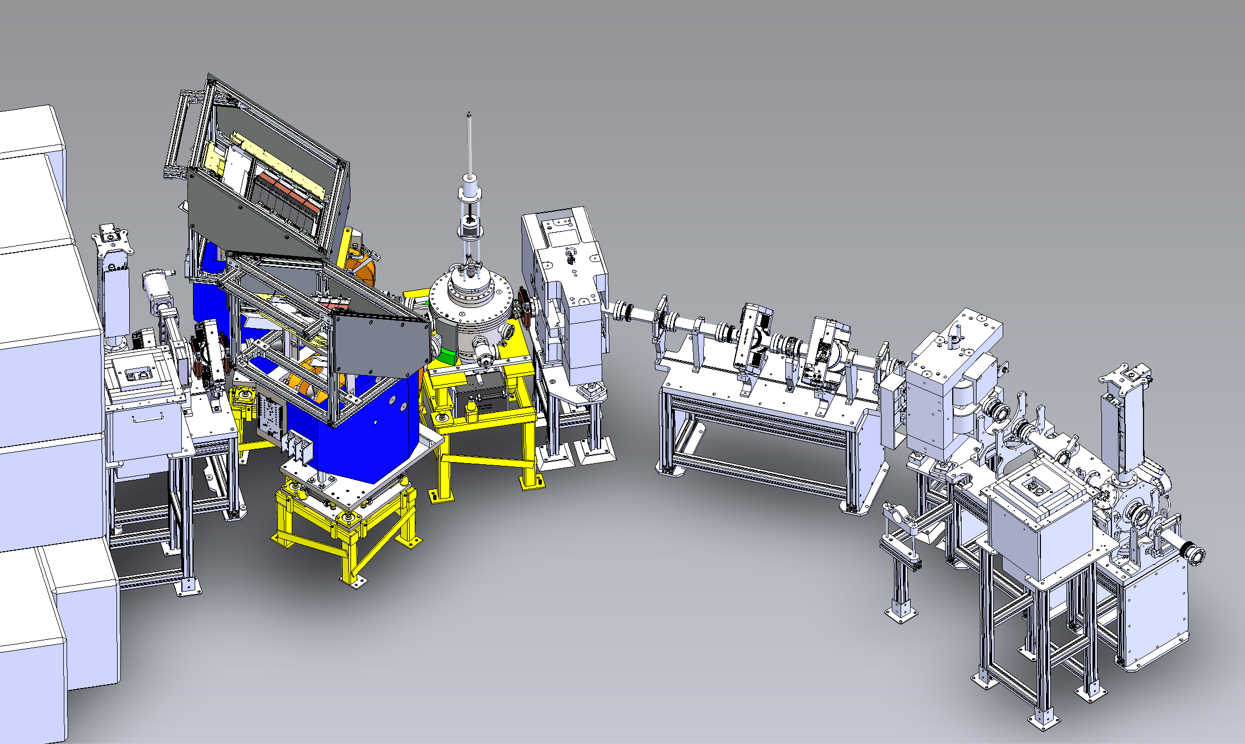
DarkLight Experiment
Trigger system
GEMs
Target
ladder
Target chamber
Dipole magnets
Beam Dump Shielding
/11
Notes:
1.5

Slide 6
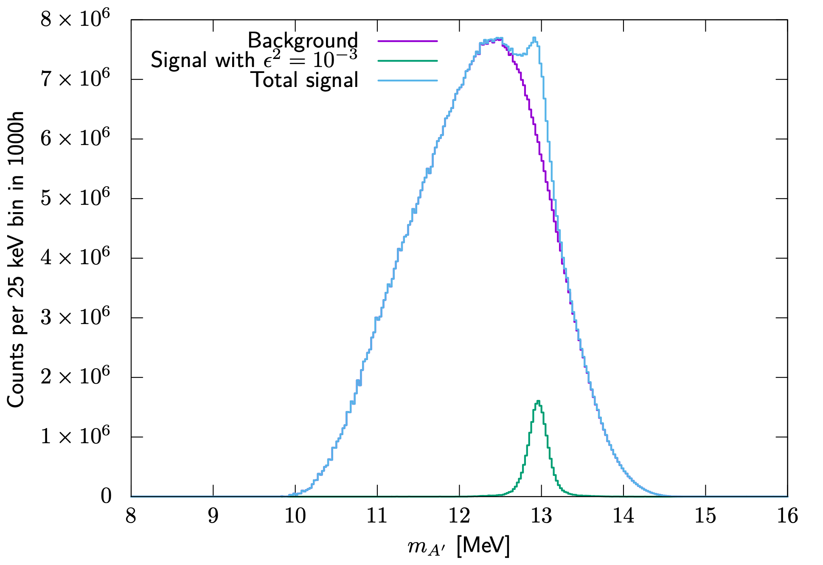
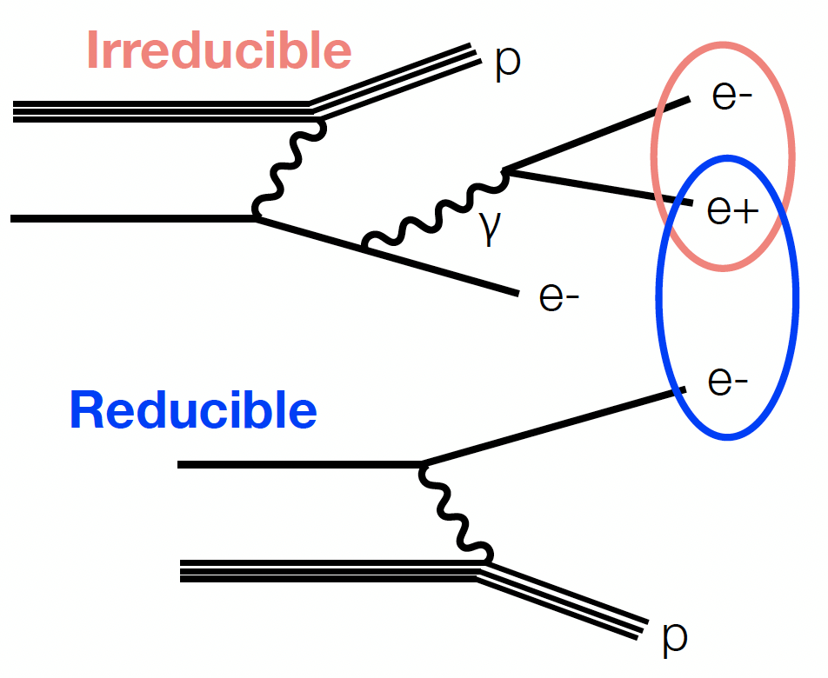
DarkLight Experiment Backgrounds
Exaggerated!
Figure by J. Bernauer
Figure by K. Pachal
/11
Notes:
By examining particles that come from the same decay we can reconstruct the invariant mass of the particle that produced them and produce a histogram of parent particle invariant masses. Correct identification of these pairs of course requires precise knowledge of their arrival times.
This naturally brings us to a discussion about backgrounds
The most obvious background to me is the from the decay process for the dark boson we are interested in occurring from a photon decay. We cannot filter this background further without risking cutting our signal because the electron/positron pair are behaving the exact way we expect those from our signal to, only with a wider range of momenta since the photon could exist with a wider range of energies
The second type of background we face is our reducible background where scattered electrons have the right momenta and angle to pass through the electron spectrometer arm and reach the detector system. This not only introduces concerns of increasing the rate at our detectors, but if the electron arrives at the same time as a positron from the irreducible background, the two could falsely be identified as a coincidence pair and lead to an incorrect invariant mass calculation
As you can see, you backgrounds are predicted to be significant compared to signal, and this is with the coupling strength squared factor being exaggerated by three orders of magnitude so you can see the signal line. So it is important that we are reducing the reducible background wherever possible. In addition to the spectrometer arm filtering and it’s angular placement, we do this by maximizing trigger system precision.

Slide 7
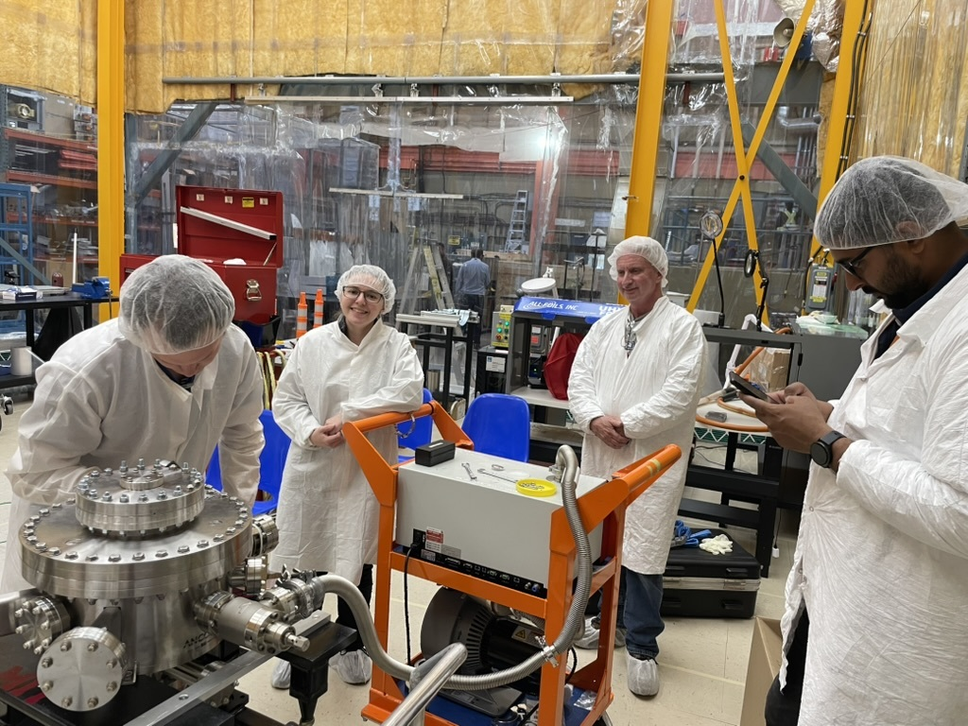
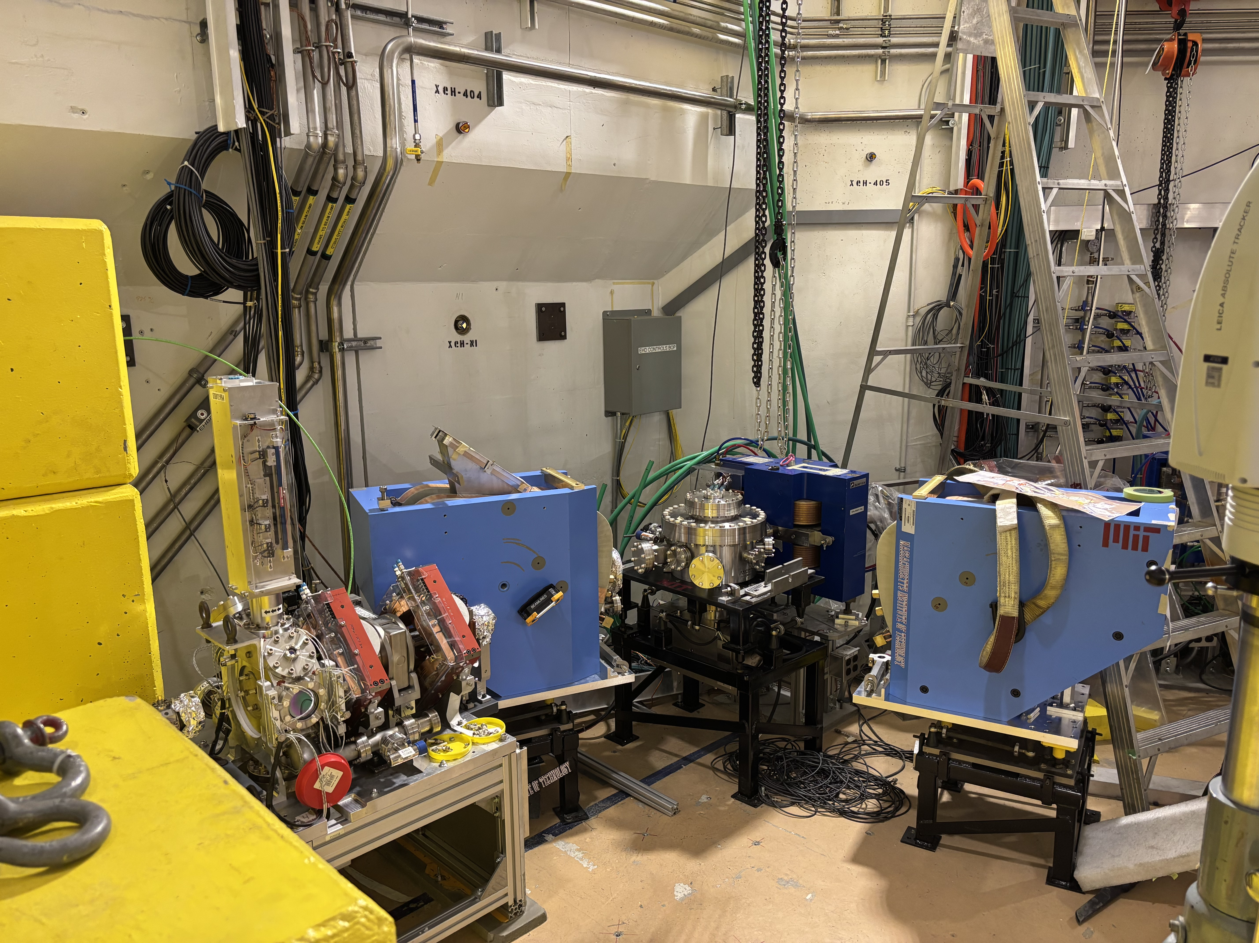
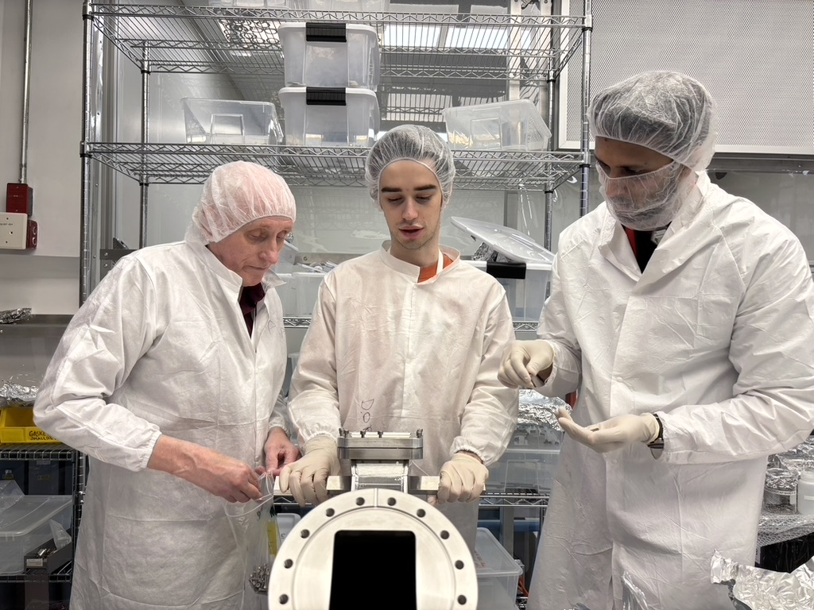
DarkLight’s Timeline
May 2025
June
January 2026+
August
December
Installation
30 MeV Particle search run
30 MeV Analysis and 50 MeV planning
30 MeV Commissioning
/11
Notes:
As we speak, the DarkLight team is at TRIUMF completing installation. We will begin our 30 MeV commissioning run in the next couple weeks which will last for 300 beam hours
In August we will begin our 30 MeV particle search set to collect 1000 hours of data before the TRIUMF long shutdown starting in January
We’ll be spending the shutdown doing analysis from the 30 MeV run and planning for the proposed 50 MeV upgrade
E-linac record up-time is 3 days

Slide 8
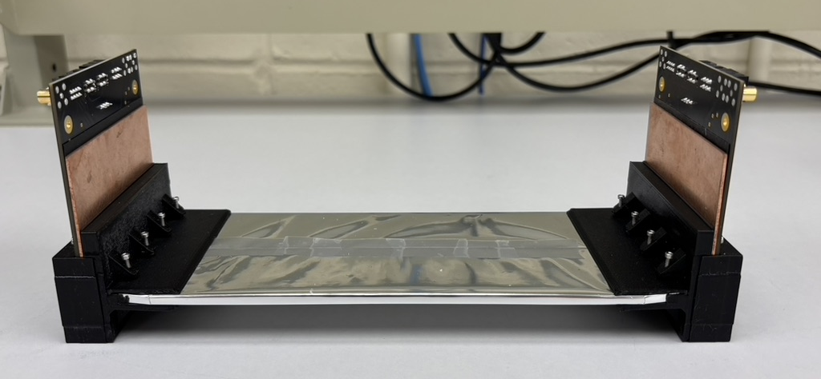
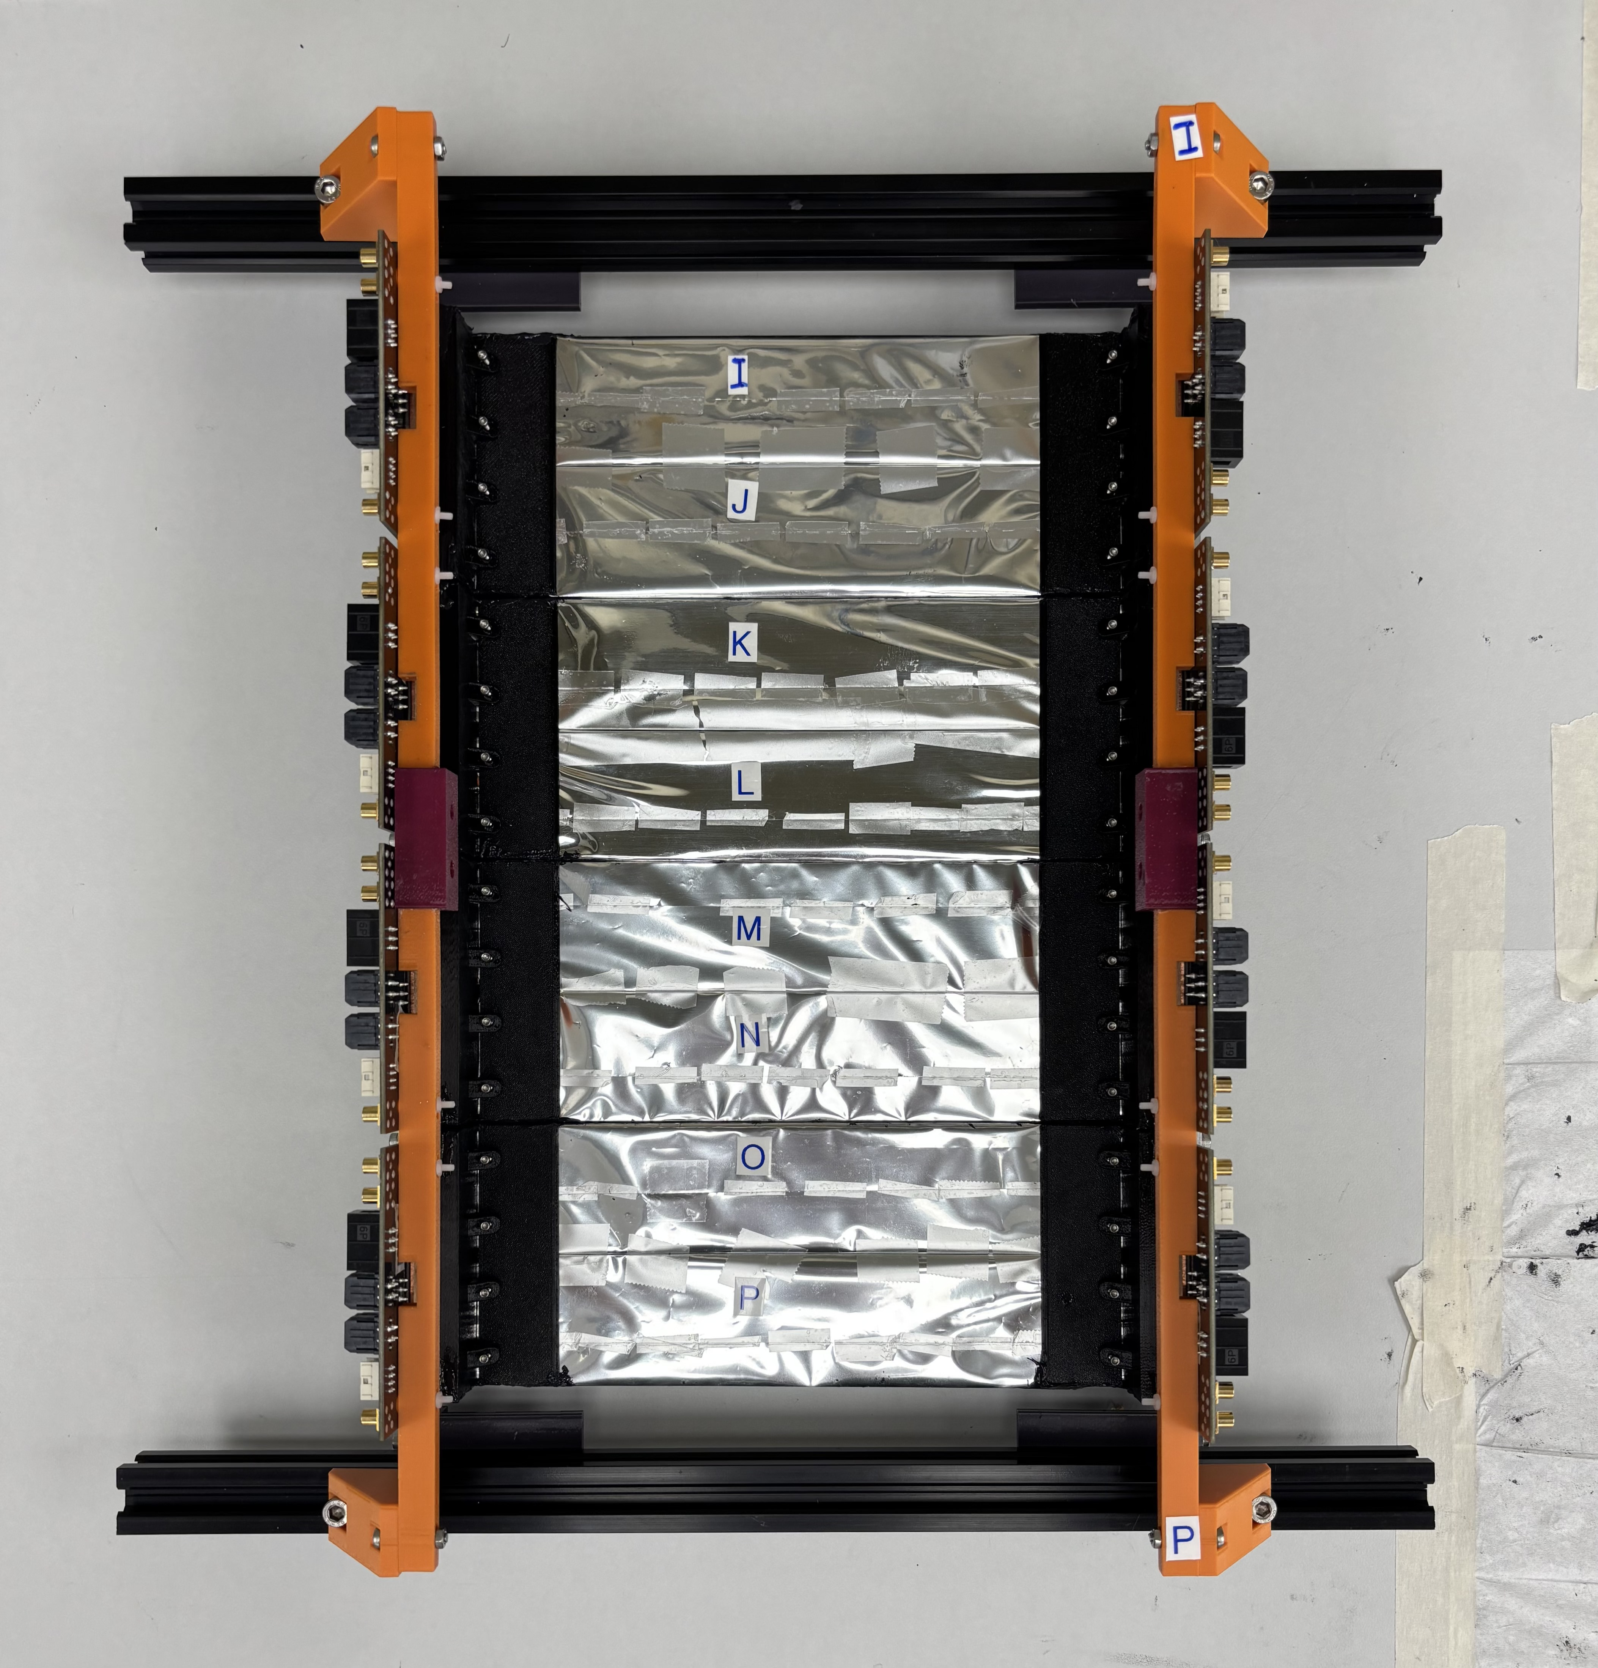
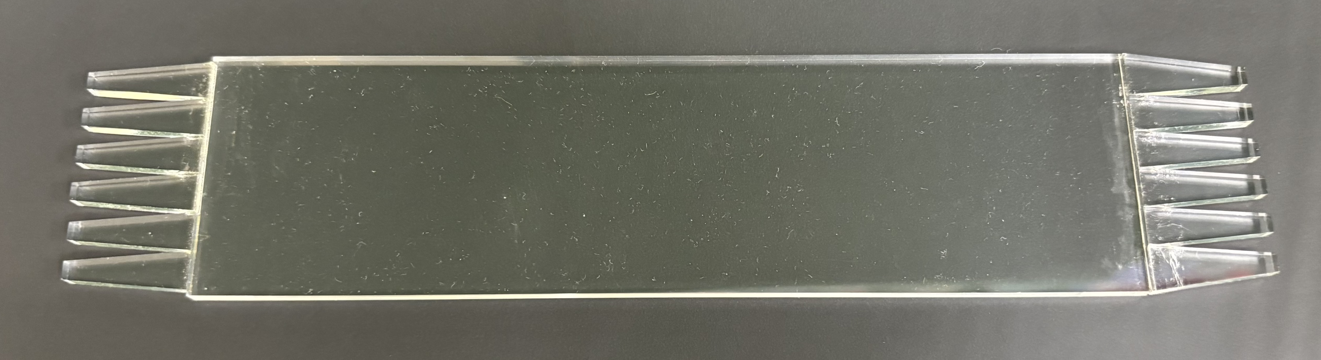
Trigger System: Hardware
/11
Notes:
Starts at 7 minute mark
So, I mentioned how the trigger system is important in reducing our backgrounds and correctly identifying coincident pairs of particles. Understanding this system and maximizing it’s potential is what my work is all about!
Our trigger system is composed of two identical detectors, each made up of eight plastic scintillators. When a charged particle interacts with the scintillator light is produced and directed down the light guides on each end onto a set of six SiPM.
Here, we see the scintillator and an example scintillator pair that we call a paddle. Four of them are mounted together to form our detector, then light sealed which is not shown here.
Another feature you will notice is this copper plate sticking out above the scintillators, this is for cooling since we can’t cool the SiPMs directly due to our light shielding structures.

Slide 9
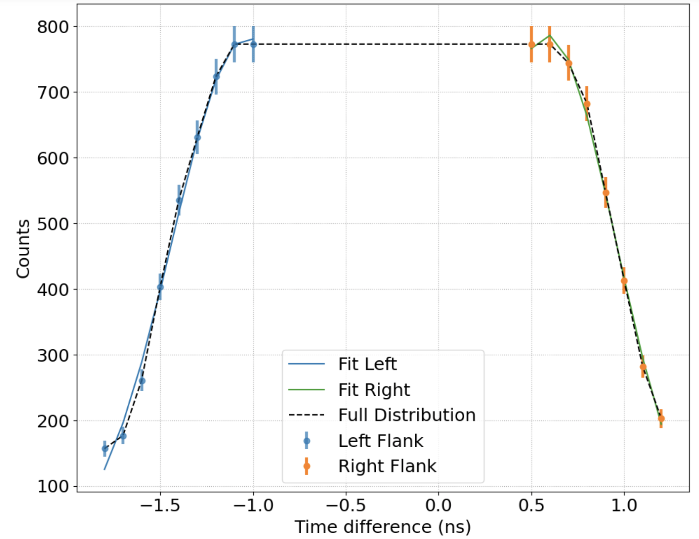
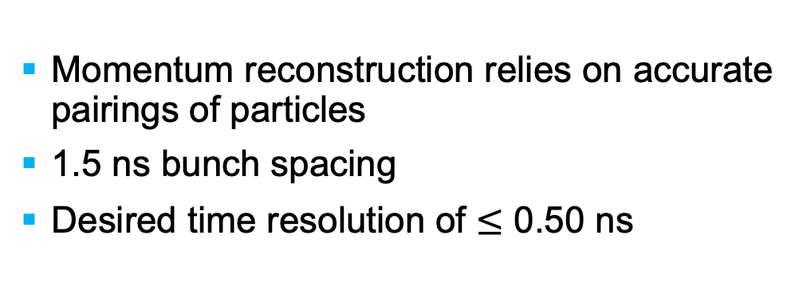
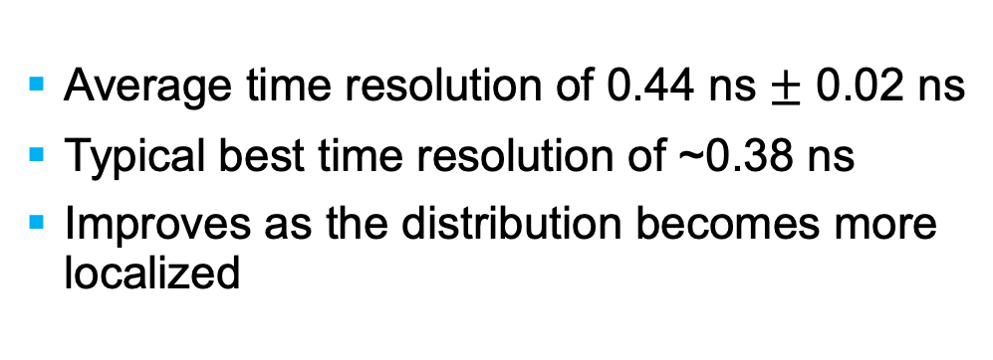
Trigger System: Time Resolution
Momentum reconstruction relies on accurate pairings of particles
1.5 ns bunch spacing
Desired time resolution of $≤$ 0.50 ns
Average time resolution of 0.44 ns $±$ 0.02 ns
Typical best time resolution of ~0.38 ns
Improves as the distribution becomes more localized
/11
Notes:
Positron rate: 10kHz
Election rate: 10 MHz
TDR simulation section. 1.5 ns bunch spacing is the space between the beam electrons. So we want to be able to resolve them to 3 sigma. 500 ps is the highest time resolution we can accept.
The first quantity of interest in trigger characterization is of course of time resolution since momentum reconstruction relies on accurate pairings of particles. Given our bunch spacing we need to be able to achieve a time resolution of better than 0.5 ns.
To determine time resolution, cosmic ray data was taken using a large number of scintillators and we produced a histogram of the time difference along each scintillator. Since we have a constantly running clock inside of our fpga we can’t work in absolute arrival times, so the get rid of the offset we work with the difference in the time each end of a scintillator sees a signal, since one interaction will produce light going out in both directions. Cosmic rays will arrive at the detector uniformly over its length, creating a uniform distribution smeared by the resolution of our detector at the edges. By fitting the edges and averaging over multiple scintillators we received a time resolution that meets darklight’s requirements

Slide 10
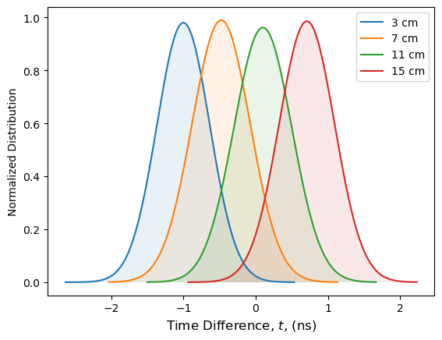
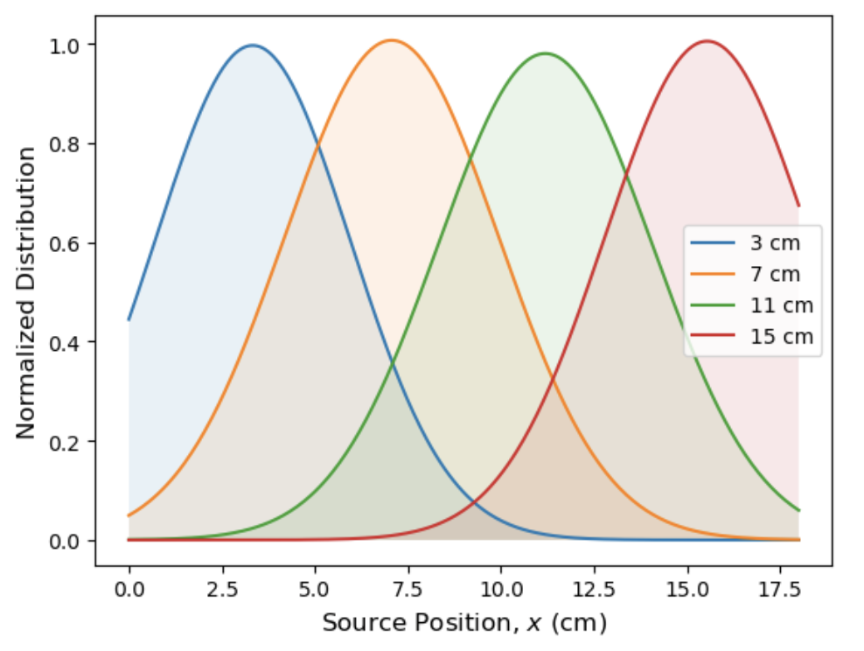

Trigger System: Position Resolution
GEMs are DarkLight’s primary means of hit position determination
What happens when two hits arrive at the GEMs in close succession?
Goal: to use the triggers to identify GEM events of interest
Position resolution of 2.14 cm $±$ 0.08 cm
/11
Notes:
Mention the distinction between position resolution and being able to tell two points apart from each other. A standard reference for telling two thing apart is 3 sigma
The triggers’ role does not stop at precise time measurements. While the GEMs are DarkLight’s primary means of position determination sometimes additional information will be required to determine which hit on the GEMs we will use, like if two hits on the GEMs arrive in close succession. If they triggers have position resolving capabilities, then once they use time information to determine which hit has a coincident match, we can isolate that hit to a region of the GEMs and select the hit that arrived within it.
Since we are looking at time difference along a scintillator data as discussed, a time difference near zero should mean a hit interacted at the center of the bar, with high positives and negatives corresponding to hits at the left and right edges. By using a source to control the position I delivered particles to, I could vary the impact position over the length of the scintillator over multiple runs.
I used the centroid of each distribution and the source position to get a conversion factor between a time and position axis.

Slide 11










Summary
DarkLight is well positioned to provide vital information to the search for an X17-like dark boson.
Experiment installation is well underway, and we are on track to complete 30 MeV data collection by the end of 2025.
The DarkLight trigger system is well suited to DarkLight’s needs. A thorough understanding of this system is key in ensuring data quality.
ggelinas@triumf.ca
/11

Slide 12
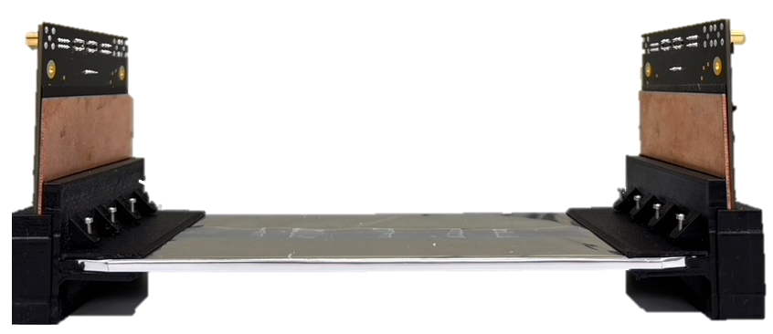

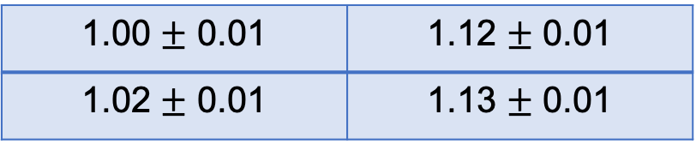
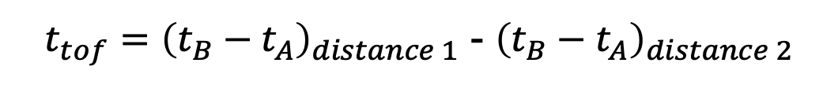
Trigger System: Accuracy Verifications
Goal: verify the time measurement accuracy by measuring the speed of cosmic rays
A
$t_{tof}={\left(t_{B}−t_{A}\right)}_{distance 1}$ - ${\left(t_{B}−t_{A}\right)}_{distance 2}$
Cosmic ray speed as a fraction of $c$ for all scintillator combinations
1.00 $±$ 0.01 | 1.12 $±$ 0.01
1.02 $±$ 0.01 | 1.13 $±$ 0.01
B
Reproducibility concern
Notes:
Talk about when TOF was good and then say, however, we have struggled with the reproducibility of this data then mention how the effect of hardware variations and calibration quality are being examined
- The final point of interest

