Slide 1

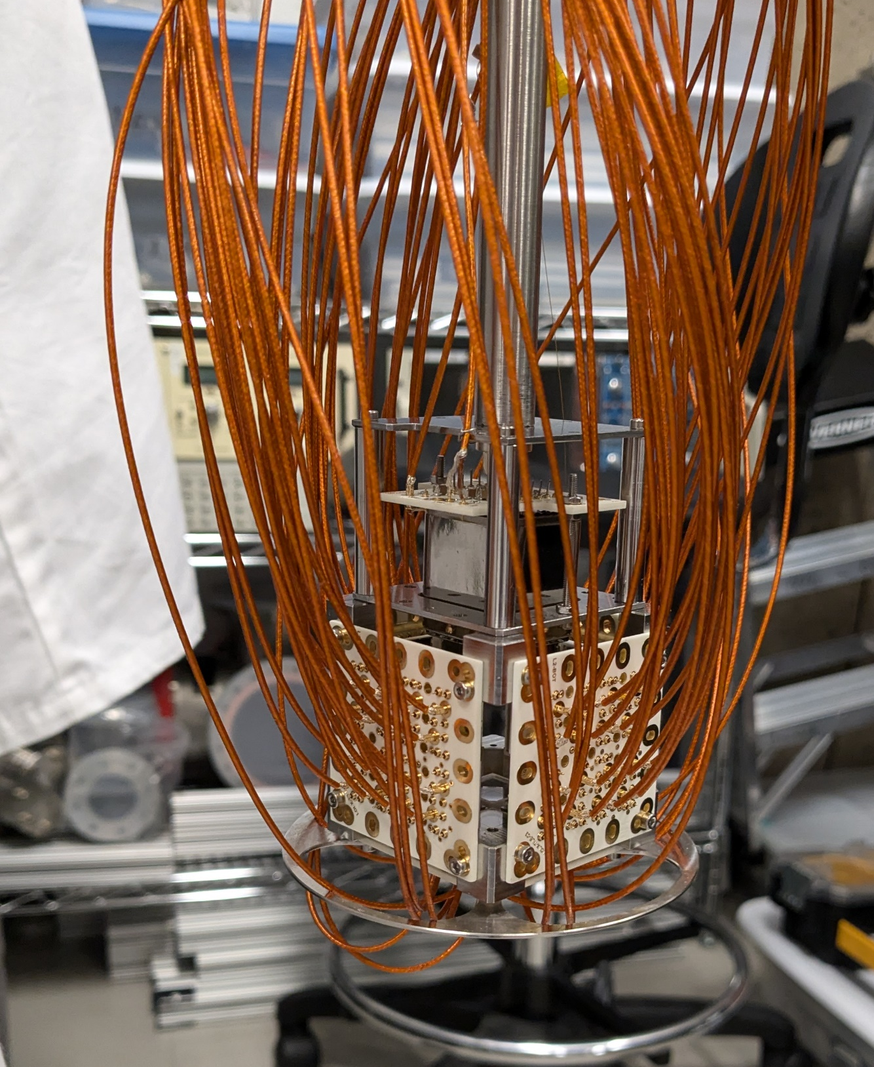



Light-only Liquid Xenon experiment:
Energy and position reconstruction
Xiang (Alex) Li, PhD candidate,
TRIUMF/SFU,
Supervisor: Fabrice Retière
On behalf of LoLX collaboration
CAP Congress
2025.06.09

Slide 2
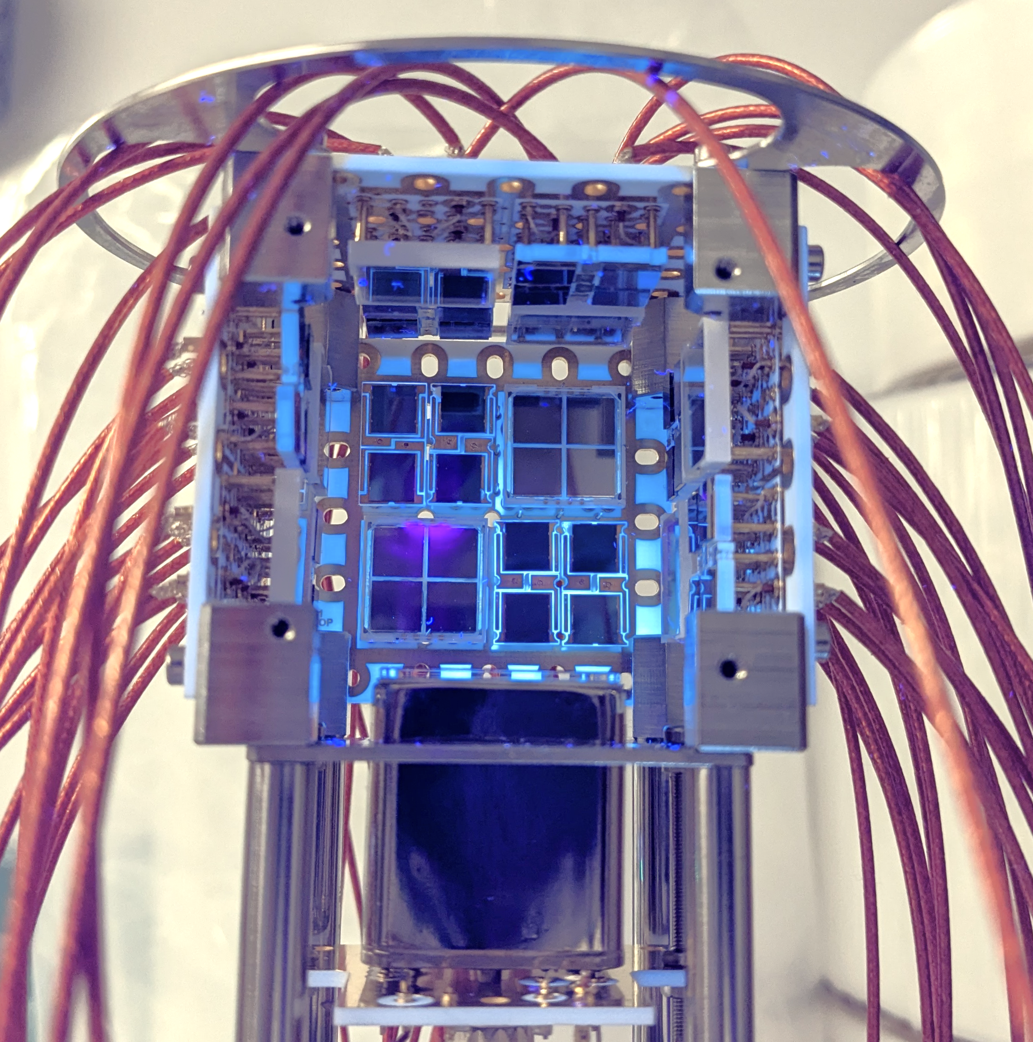
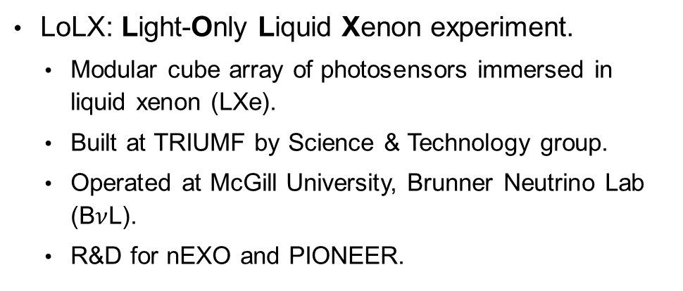
What is LoLX?
LoLX: Light-Only Liquid Xenon experiment.
  Modular cube array of photosensors immersed in liquid xenon (LXe).
  Built at TRIUMF by Science & Technology group.
  Operated at McGill University, Brunner Neutrino Lab (B$ν$L).
  R&D for nEXO and PIONEER.
4 cm
HPK SiPM
FBK SiPM
PMT

Slide 3
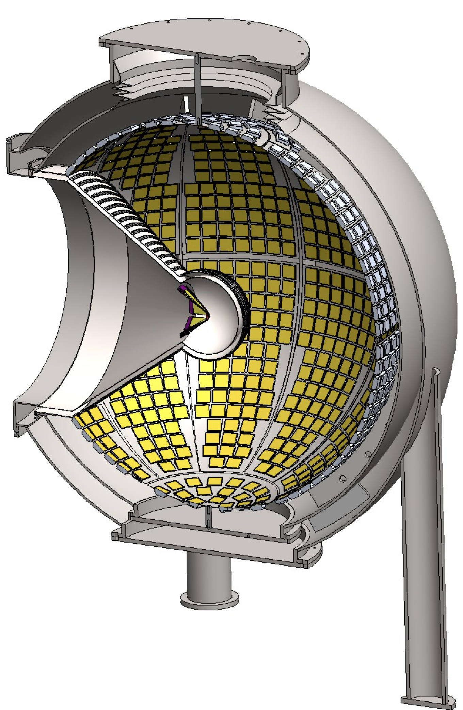
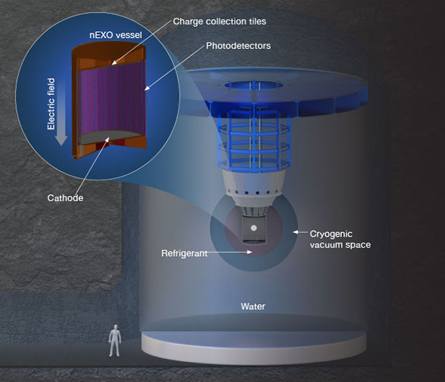
Goals
  Study light production of LXe.
    Study light yield and energy resolution.
    Scintillation and Cherenkov light.
  Develop and validate simulation model. with experimental data.
    Inform future experiments, such as nEXO, and PIONEER.
  SiPMs performance in LXe.
    Photon detection efficiency.
    Long term stability operation.
    Cross-talk study.
      We recently published!
        Available on arXiv: 2502.15991.
        Accepted by EPJ C.
nEXO:
Neutrinoless double beta decay search
PIONEER:
Lepton flavor universality
Notes:
## Remove those figures
## Backup slides

Slide 4
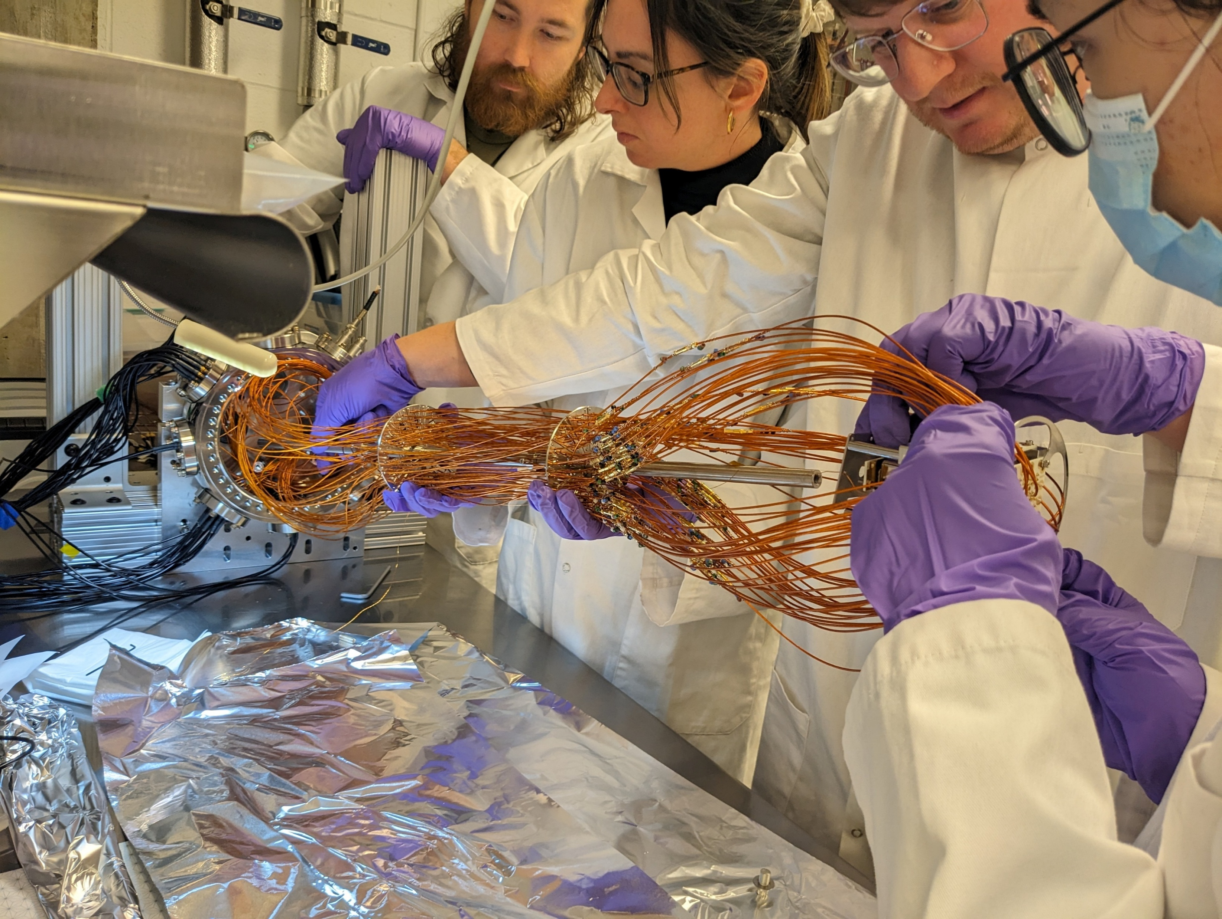
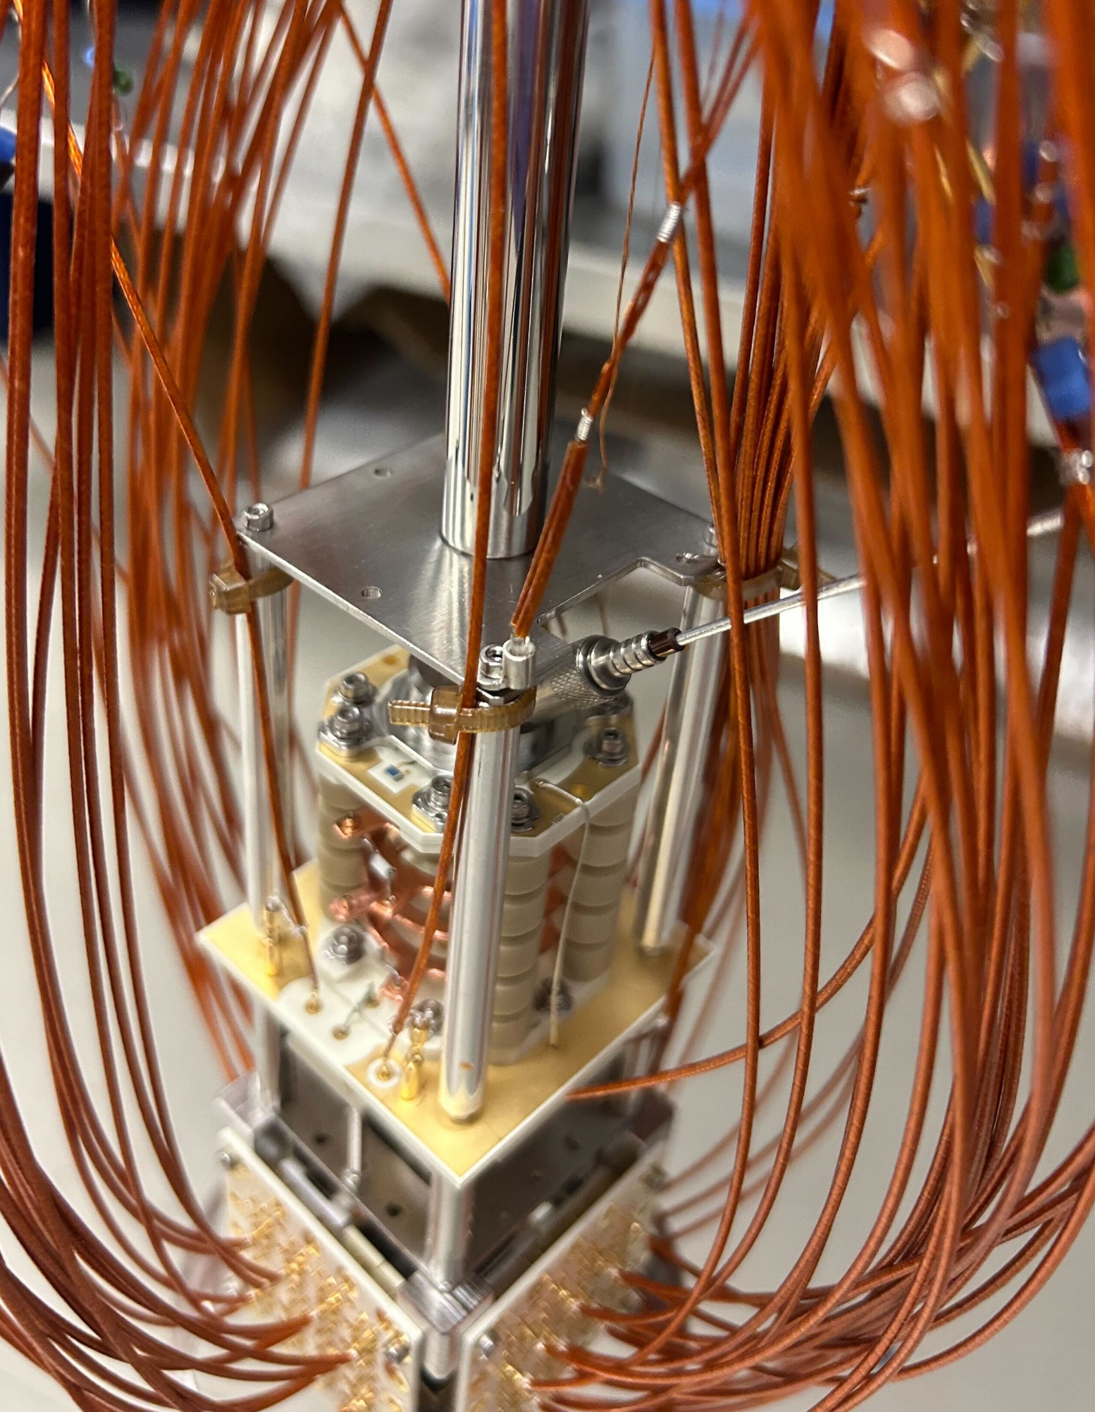
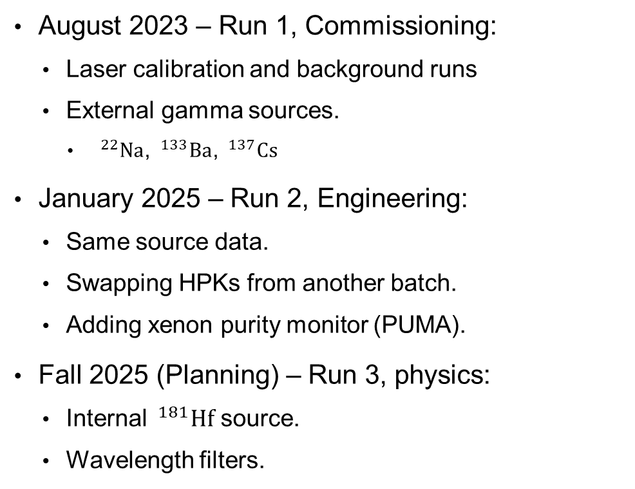
LoLX runs
August 2023 – Run 1, Commissioning:
  Laser calibration and background runs
  External gamma sources.
    $^{22}Na$, $^{133}Ba$, $^{137}Cs$
January 2025 – Run 2, Engineering:
  Same source data.
  Swapping HPKs from another batch.
  Adding xenon purity monitor (PUMA).
Fall 2025 (Planning) – Run 3, physics:
  Internal $^{181}Hf$ source.
  Wavelength filters.

Slide 5
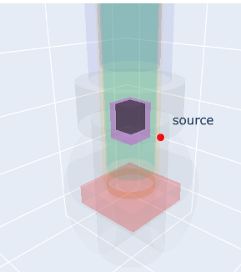
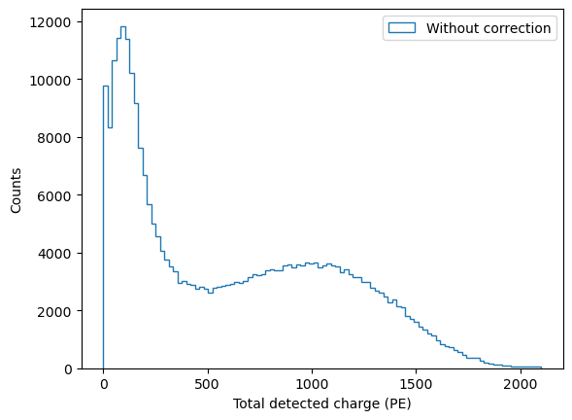
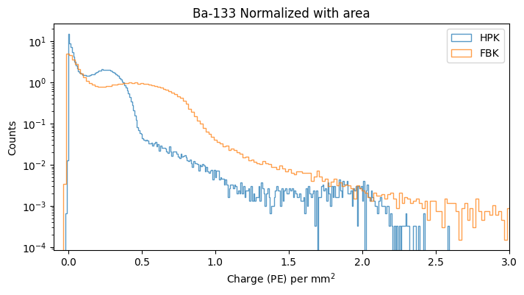



Challenges in LoLX data
We want to study the energy resolution of using SiPMs in xenon.
Position dependent light collection efficiency smears energy resolution.
Photon detection efficiency (PDE) difference three photosensor types (FBK, HPK, PMT).
  SiPMs performance in liquid xenon is one of study goals.
$^{133}$Ba 356keV gamma source
  $^{133}Ba, E_{γ}=356$ keV
~50% Resolution
Total detected charge [PE]
$$PE/mm^{2}$$

Slide 6
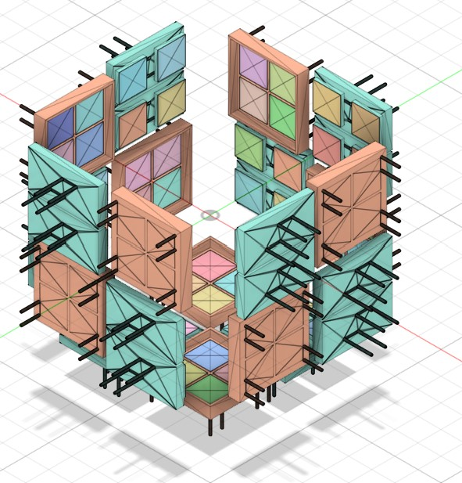
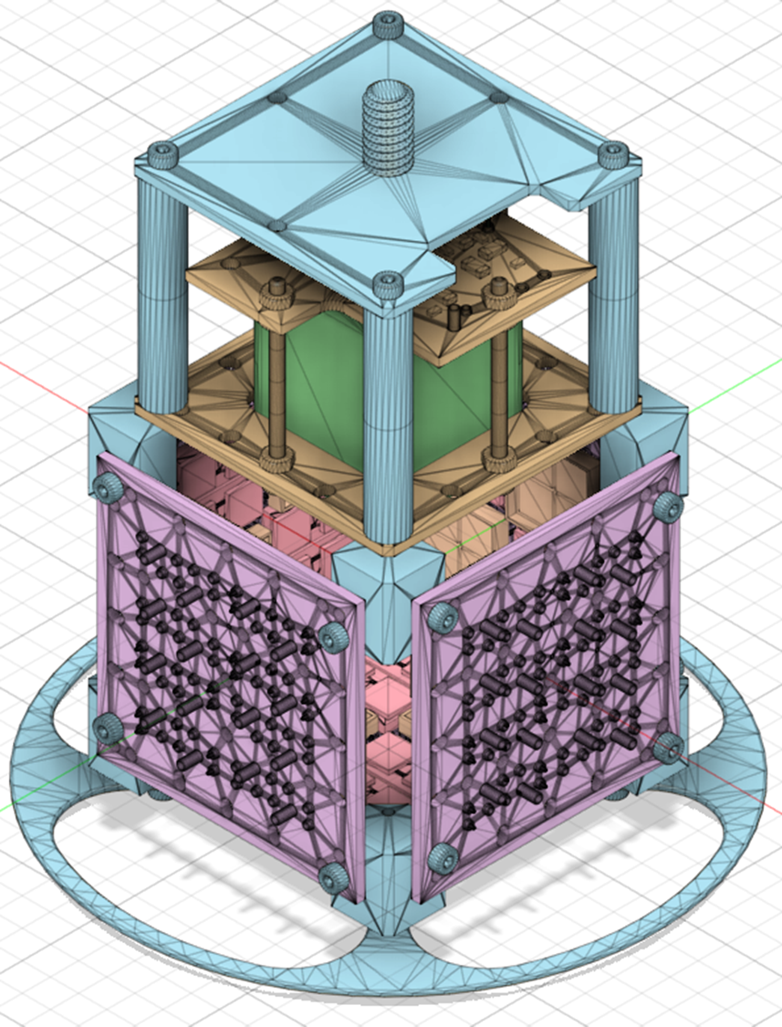
Chroma – GPU Optical Simulation
Chroma is an optical photon simulation for particle physics detectors.
GPU-based photon transport simulation.
  Development in Python (core simulation in CUDA-C).
  ~100 times faster than G4OpticalPhoton.
Does:
  Take the energy deposition in GEANT4 as input.
    Or other user defined photon generators.
  Optical Photon Transport.
    Refractive index, wavelength shifter, scattering, attenuation length…
  Photon Detection.
    Angular and wavelength dependent SiPM photon detection efficiency based on measurement at TRIUMF.
    Fully customized detection logic.

Slide 7
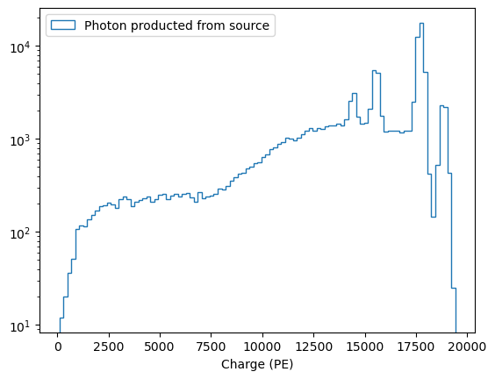
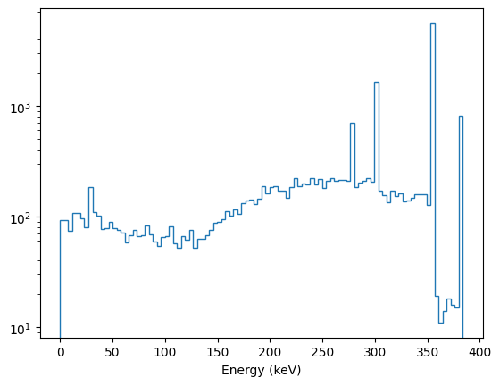
Geant 4 and Chroma
Energy deposition in GEANT4 vs light production in Chroma.
  Light yield base on NEST model.
    NEST: Noble Element Simulation Technique.
Ba-133 source example:
Chroma light production
Geant4 Energy deposition
Number of photon generated
Energy [keV]

Slide 8
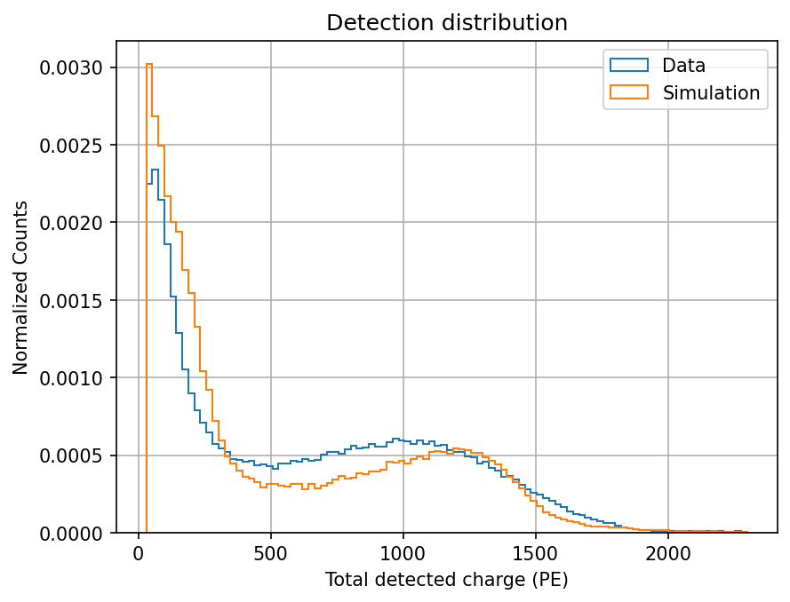
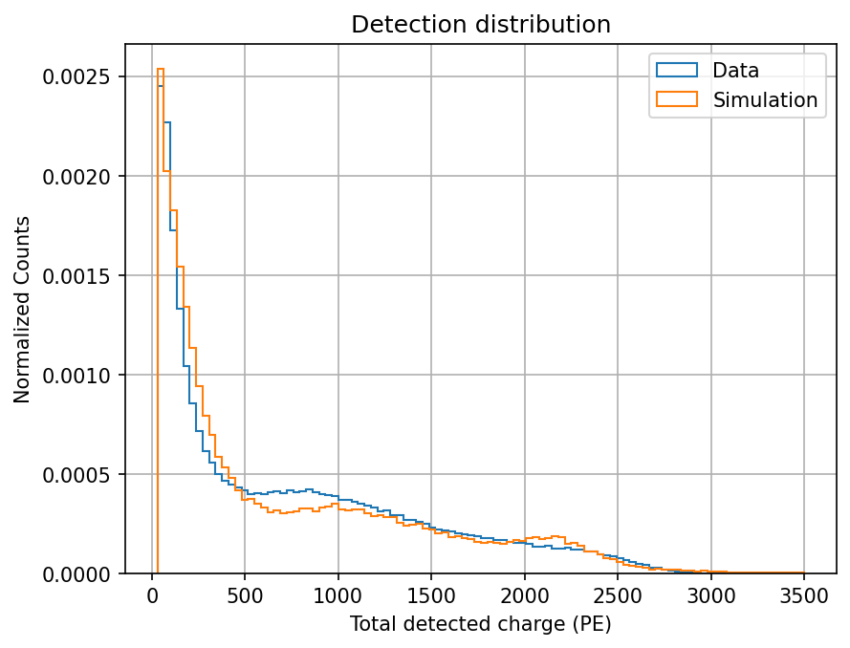


Simulation data compare
Simulation also shows the similar feature with low energy resolution.
Sum all the channels without correction.
  $^{133}Ba, E_{γ}=356$ keV
  $^{137}Cs, E_{γ}=662$ keV
Total detected charge [PE]
Total detected charge [PE]

Slide 9
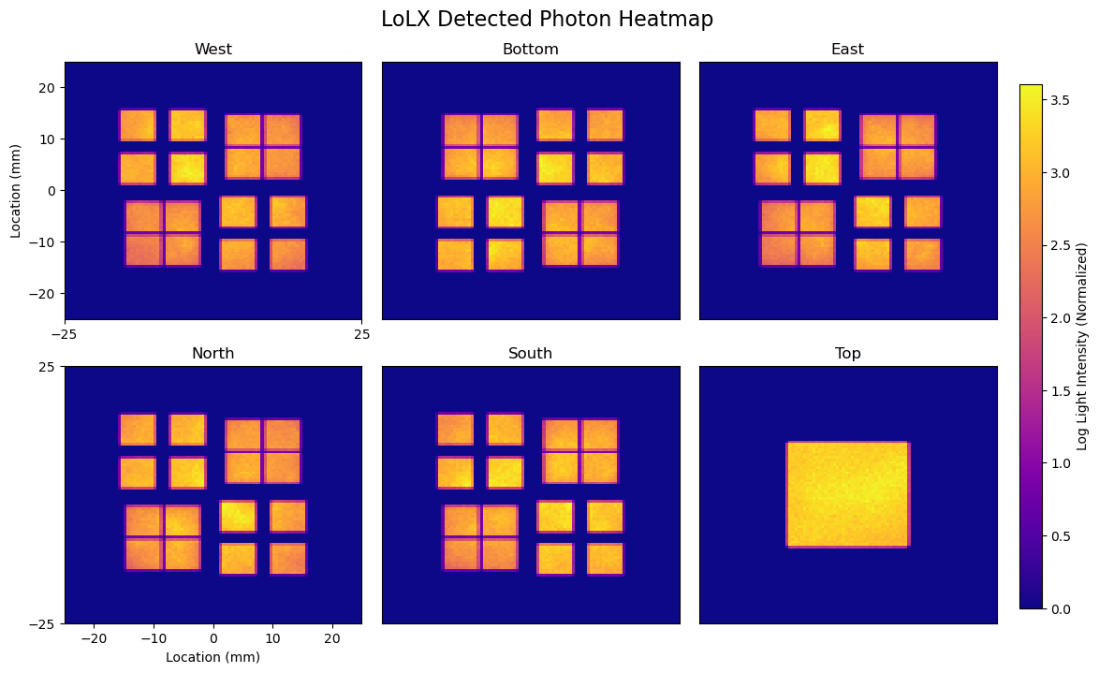
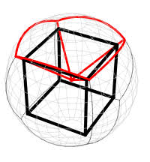


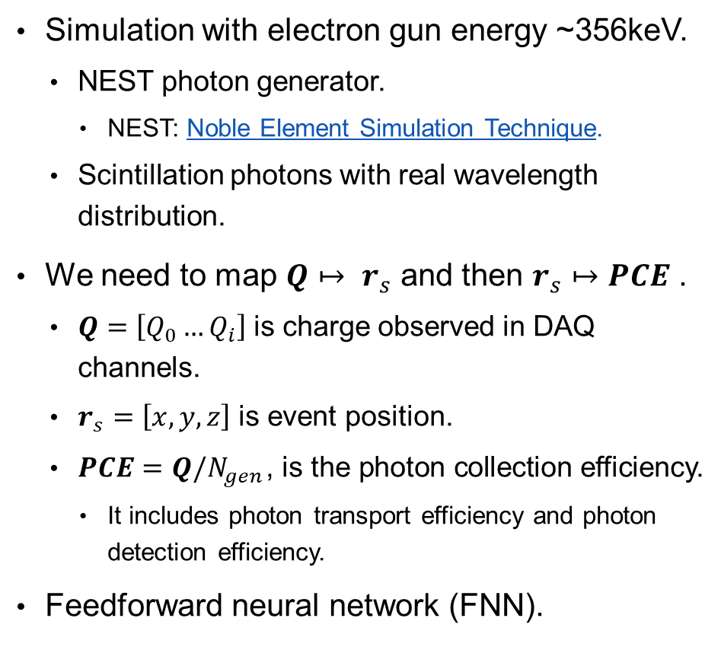

Position and energy reconstruction
Simulation with electron gun energy ~356keV.
  NEST photon generator.
    NEST: Noble Element Simulation Technique.
  Scintillation photons with real wavelength distribution.
We need to map $Q↦ r_{s}$ and then $r_{s}↦PCE$ .
  $Q=\left[Q_{0}…Q_{i}\right]$ is charge observed in DAQ channels.
  $r_{s}=\left[x,y,z\right]$ is event position.
  $PCE=Q/N_{gen}$, is the photon collection efficiency.
    It includes photon transport efficiency and photon detection efficiency.
Feedforward neural network (FNN).
NN1
mapping
$Q$: charge detected in each channels
$r_{s}=\left[x,y,z\right]$
NN 2
mapping
$PCE\left(x, y, z\right)$: photon collection efficiency
Notes:
## simplify the simulation config intro
## Figure intro the mapping?
### Make the figure of the heat map bigger

Slide 10
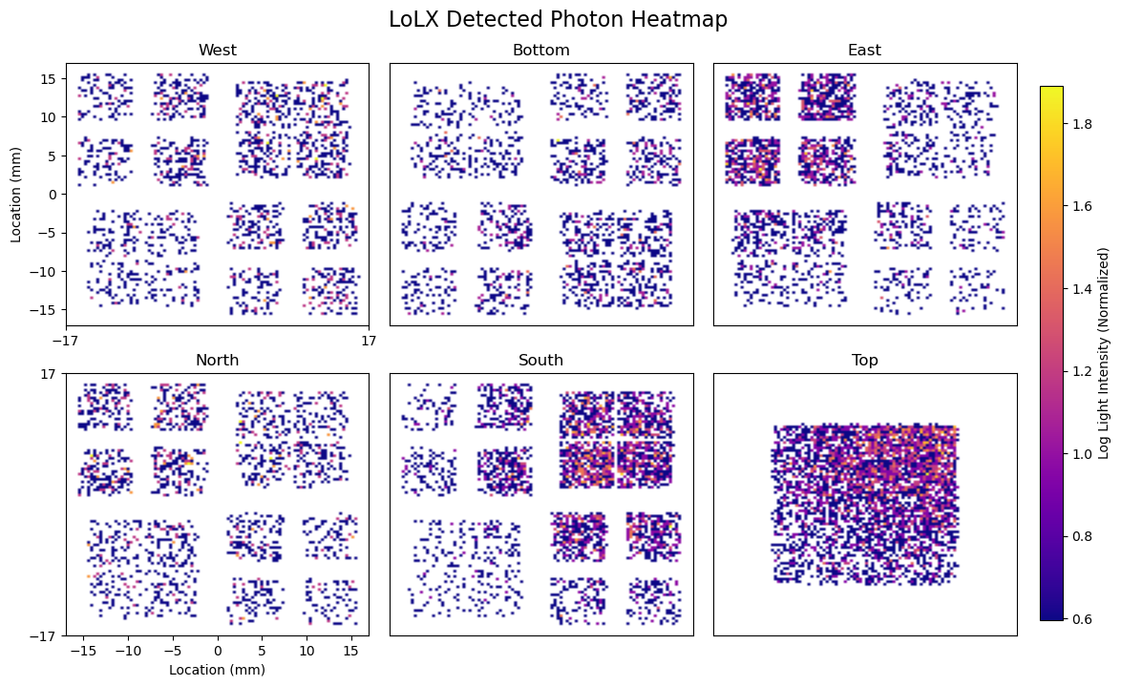
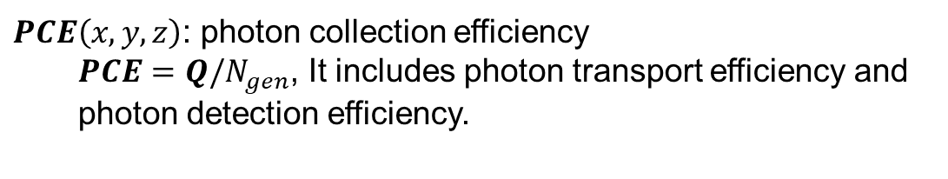

Position and energy reconstruction
Simulation with electron gun energy ~356keV.
  NEST photon generator.
    NEST: Noble Element Simulation Technique.
  Scintillation photons with real wavelength distribution.
Feedforward neural network (FNN).
$Q=\left[Q_{0}…Q_{i}\right]$: charge detection distribution in each channels
NN1
mapping
NN 2
mapping
$r_{s}=\left[x,y,z\right]$
$PCE\left(x, y, z\right)$: photon collection efficiency
  $PCE=Q/N_{gen}$, It includes photon transport efficiency and photon detection efficiency.
Notes:
## simplify the simulation config intro
## Figure intro the mapping?
### Make the figure of the heat map bigger

Slide 11
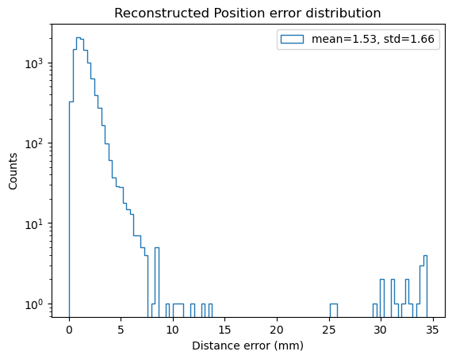
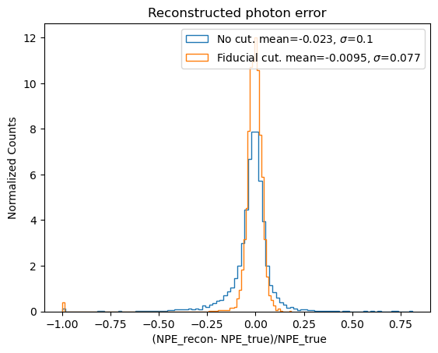
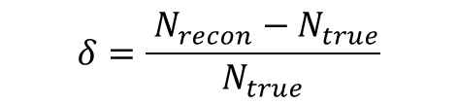
Validation within simulation – Electron gun
Validated simulation with electron gun energy 662 keV using NEST generator.
Fiducial cut events outside of 34mm cube.
$$δ=\frac{ N_{recon}−N_{true}}{N_{true}}$$
Euclidean distance error [mm]

Slide 12
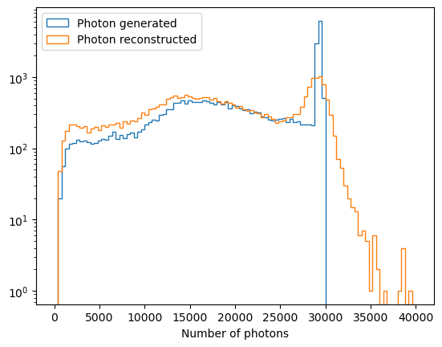
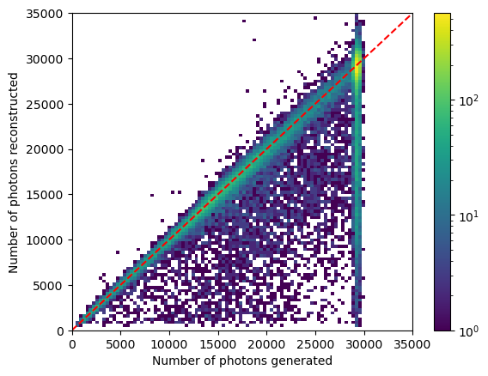
Validation within simulation – Gamma ray
Geant 4 general particle source (GPS) produced Cs-137 decay gamma ray.
Chroma handles optical photons base on the energy deposition.
Number of photons reconstructed
Number of photons
Number of photons generated

Slide 13
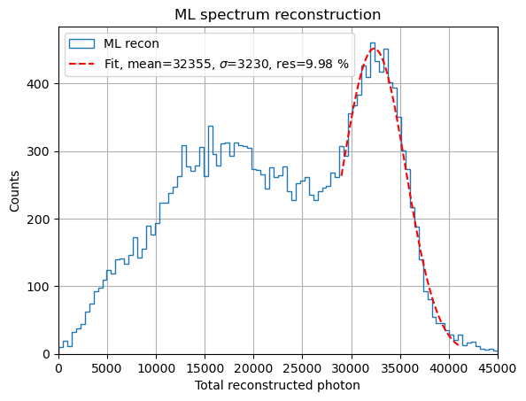

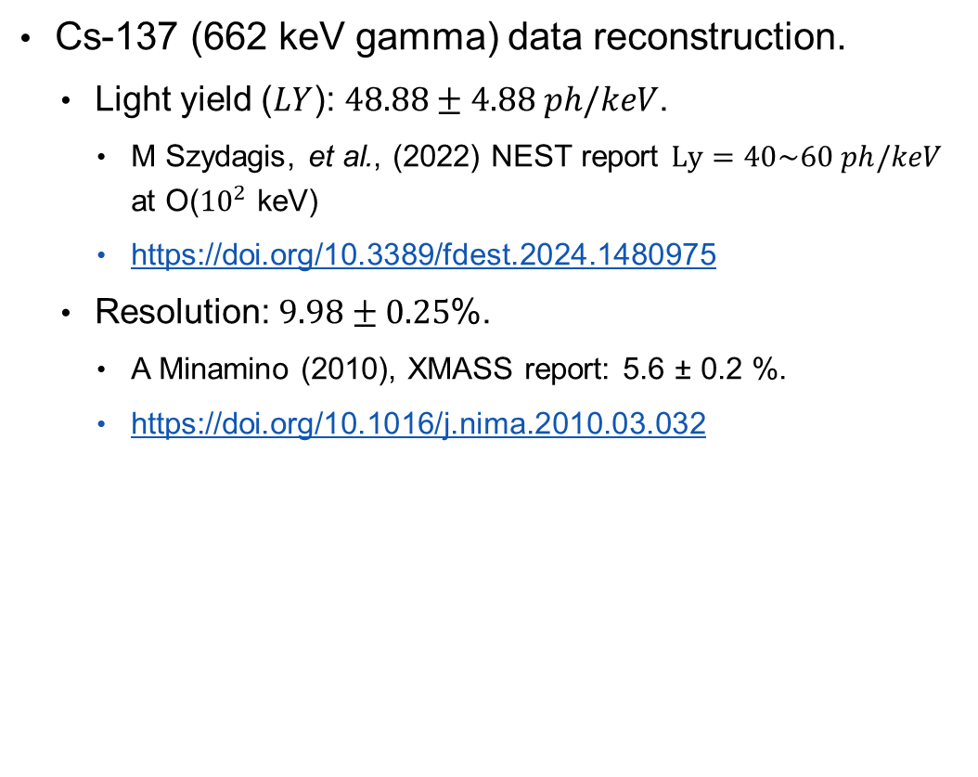
Reconstruction on real data
Cs-137 (662 keV gamma) data reconstruction.
  Light yield ($LY$): $\text{48.88}±4.88 ph/keV$.
    M Szydagis, et al., (2022) NEST report $Ly=40\sim 60 ph/keV$ at O(${10}^{2}$ keV)
    https://doi.org/10.3389/fdest.2024.1480975
  Resolution: $9.98±0.25$%.
    A Minamino (2010), XMASS report: 5.6 ± 0.2 %.
    https://doi.org/10.1016/j.nima.2010.03.032
Preliminary
ML reconstruction
Number of photons reconstructed
    Likelihood and fiducial cut applied:
    Likelihood<0.8, events outside of 34mm cube.

Slide 14
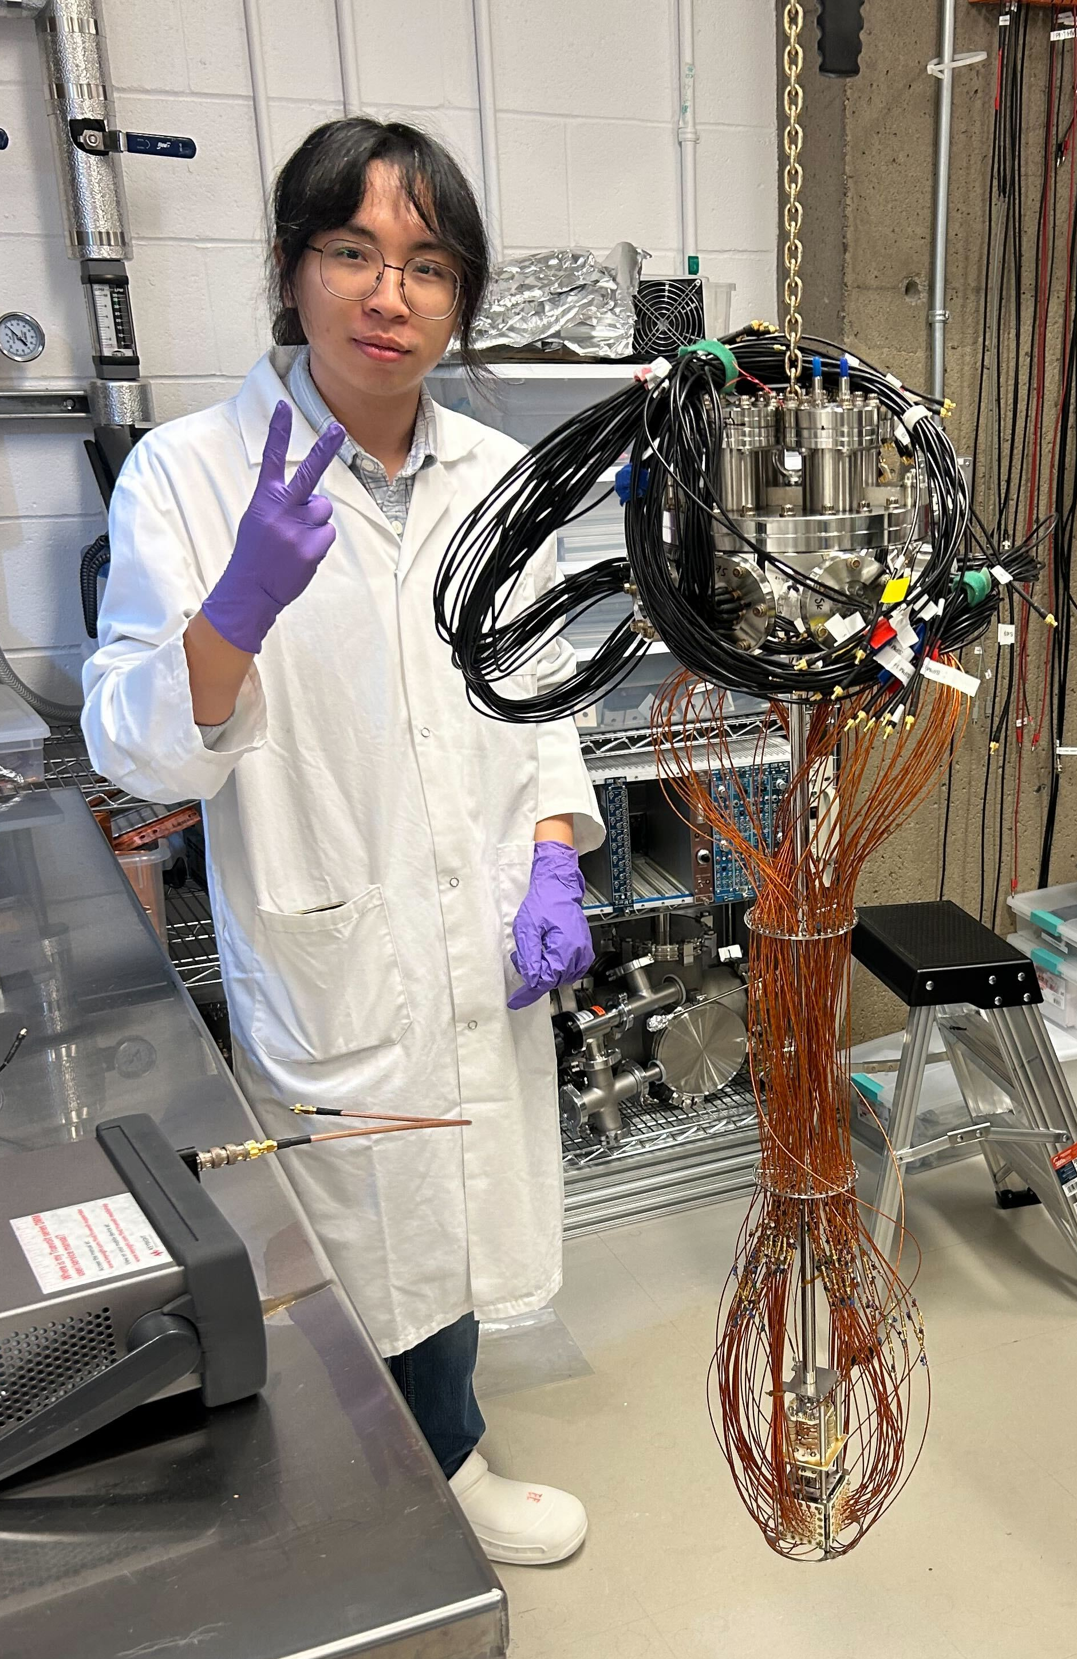
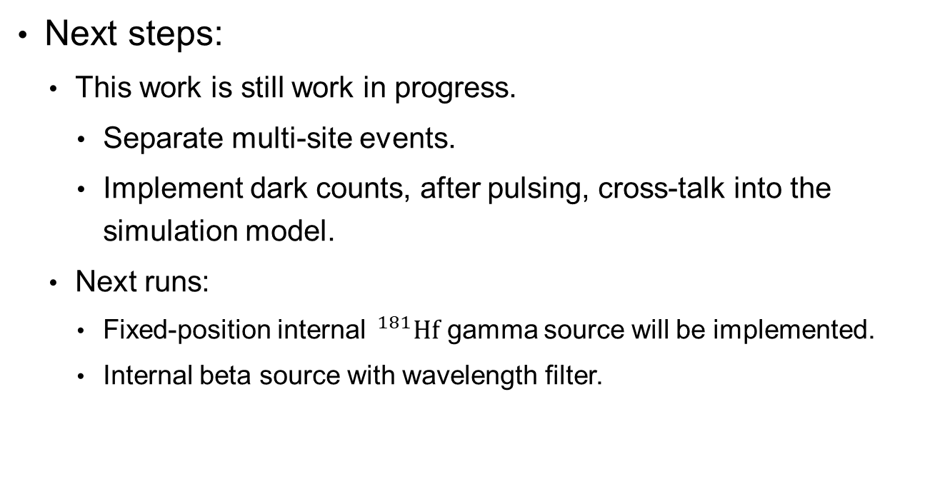
Summary
Conclusion:
  Light yield estimate is consistence with the literatures value.
  The results shows the energy resolution has massively improve.
Next steps:
  This work is still work in progress.
    Separate multi-site events.
    Implement dark counts, after pulsing, cross-talk into the simulation model.
  Next runs:
    Fixed-position internal $^{181}Hf$ gamma source will be implemented.
    Internal beta source with wavelength filter.
Photo by: D. Gallacher. 2024 Oct

Slide 15





Thank you!
Question?
LoLX Collaboration: Canada-US-Italy
This work was supported by the TRIUMF Science and Technology team for engineering assistance, and by the SAP-MRS program through grant funding.
Notes:
Give credit to people here, MRS, TRIUMF SCI-TECH,

Slide 16
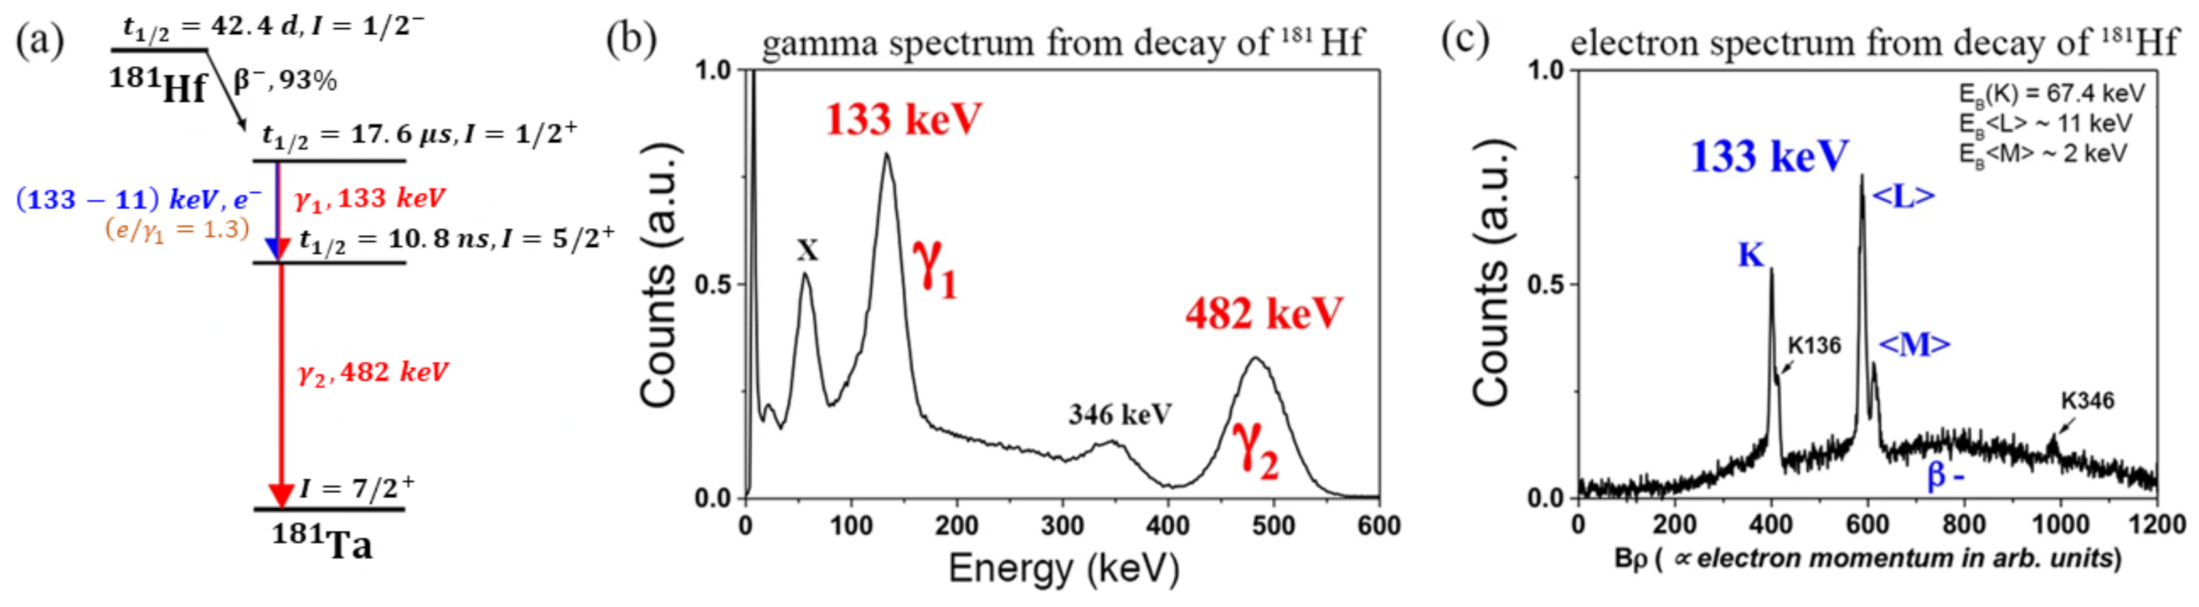

Back up
  $^{181}Hf$ source. Beta decay with end point energy 414 keV, mean energy 120keV.
    Beta decay from Hf181 to Ta181 $I=1/2^{+}$ state.
    133 keV gamma emission with $T_{1/2}=17.6 μs$ after beta, decay from $I=1/2^{+}$ to $I=5/2^{+}$
    482 keV gamma emission with $T_{1/2}=21.1 ns$ from $I=5/2^{+}$ to Ta181 ground state.
Ian Chang Jie Yap (2022): https://doi.org/10.3390/cryst12070946

Slide 17
Multi-sites events
*Not to scale
xxx
Multi-sites energy deposition due to Compton scattering.
LXe volume
LXe sensitive detection
Volume (GEANT output)
LoLX detector size
(Chroma geometry)
40x40x40mm
55x55x55mm
Notes:
## Backup slides

Slide 18
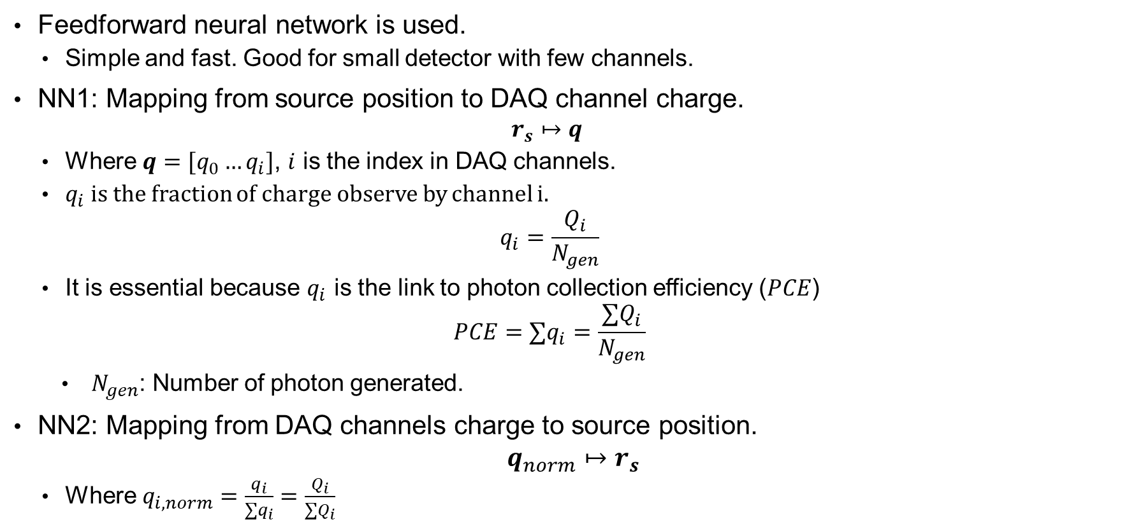
Neural network (NN)
Feedforward neural network is used.
  Simple and fast. Good for small detector with few channels.
NN1: Mapping from source position to DAQ channel charge.
  $$r_{s}↦q_{ }$$
  Where $q=[q_{0}…q_{i}]$, $i$ is the index in DAQ channels.
  $q_{i}$ is the fraction of charge observe by channel i.
  $$q_{i}=\frac{Q_{i}}{N_{gen}}$$
  It is essential because $q_{i}$ is the link to photon collection efficiency ($PCE$)
  $$PCE=∑q_{i}=\frac{∑Q_{i}}{N_{gen}}$$
  $N_{gen}$: Number of photon generated.
NN2: Mapping from DAQ channels charge to source position.
$$q_{norm}↦r_{s}$$
  Where $q_{i, norm}=\frac{q_{i}}{∑q_{i}}=\frac{Q_{i}}{∑Q_{i}}$

Slide 19
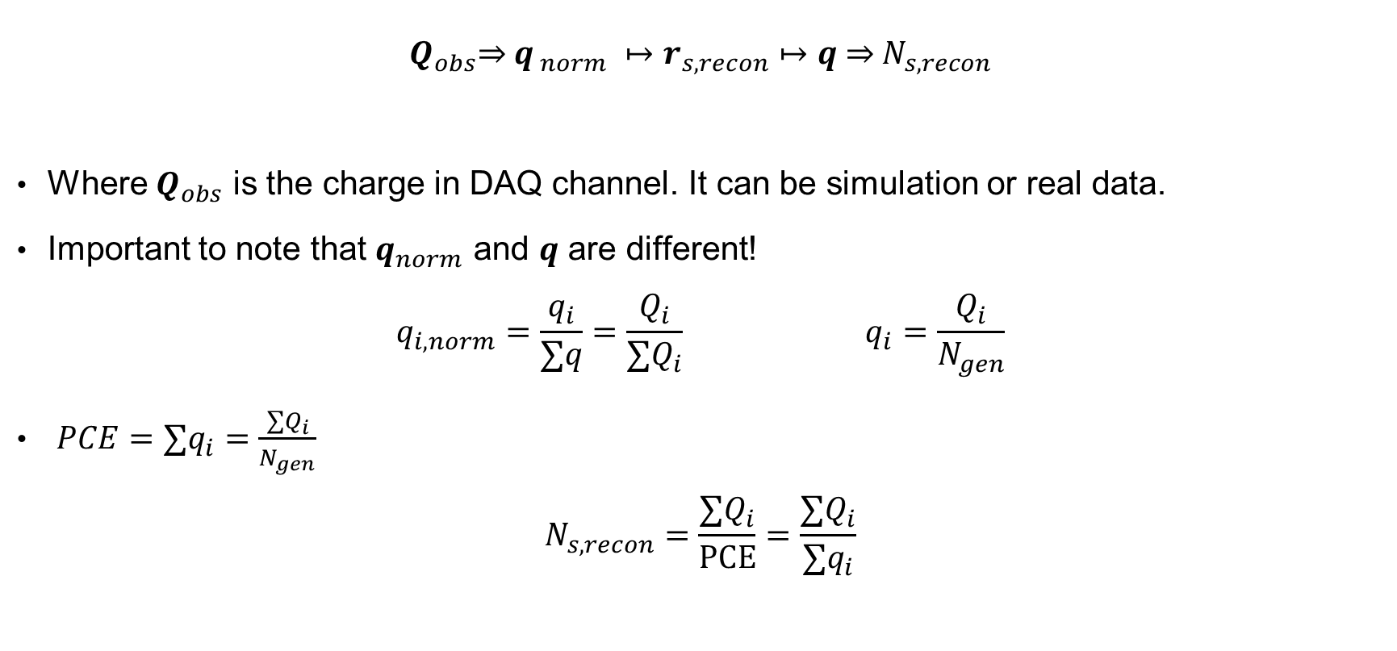
Reconstruction steps
Apply the ML neural network
$$Q_{obs}\underset{⇒}{ } q_{ norm} ↦r_{s, recon}↦q \underset{⇒}{ } N_{s, recon}$$
Where $Q_{obs}$ is the charge in DAQ channel. It can be simulation or real data.
Important to note that $q_{norm}$ and $q$ are different!
$$q_{i, norm}=\frac{q_{i}}{∑q}=\frac{Q_{i}}{∑Q_{i}} q_{i}=\frac{Q_{i}}{N_{gen}}$$
$PCE=∑q_{i}=\frac{∑Q_{i}}{N_{gen}}$
$$N_{s, recon}=\frac{∑Q_{i}}{PCE}=\frac{∑Q_{i}}{∑q_{i}}$$

Slide 20
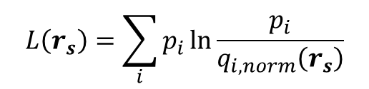
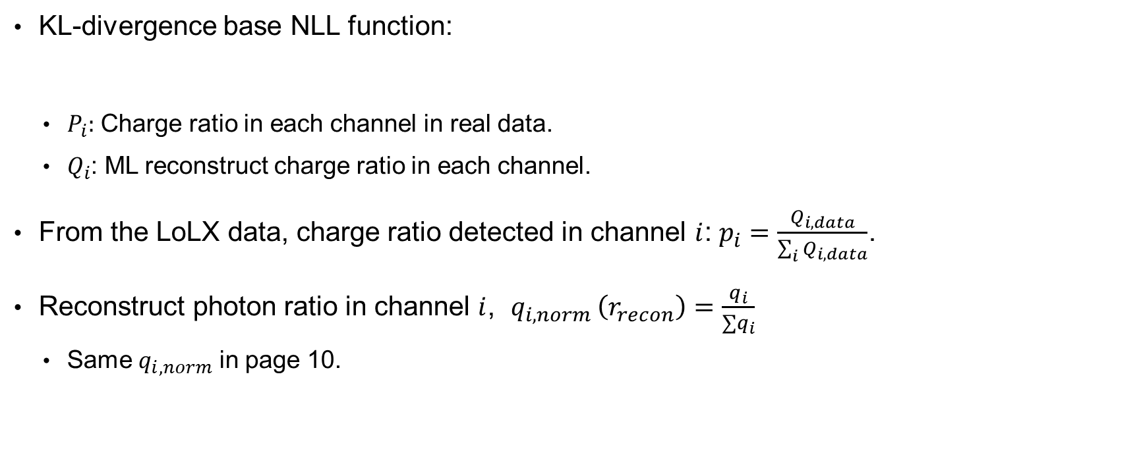
Likelihood function
KL-divergence base NLL function:
  $P_{i}:$ Charge ratio in each channel in real data.
  $Q_{i}$: ML reconstruct charge ratio in each channel.
From the LoLX data, charge ratio detected in channel $i$: $p_{i}=\frac{Q_{i, data}}{\sum_{i}{Q_{i, data}}}$.
Reconstruct photon ratio in channel $i$, $q_{i,norm }\left(r_{recon}\right)=\frac{q_{i}}{∑q_{i}}$
  Same $q_{i, norm}$ in page 10.
$$L\left(r_{s}\right)=\sum_{i}{p_{i}}ln\frac{p_{i}}{q_{i,norm}\left(r_{s}\right)}$$

Slide 21
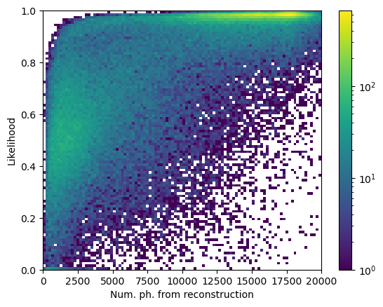
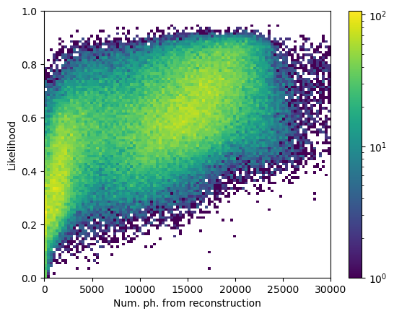
Likelihood vs number of photon
Simulation
Data

Slide 22



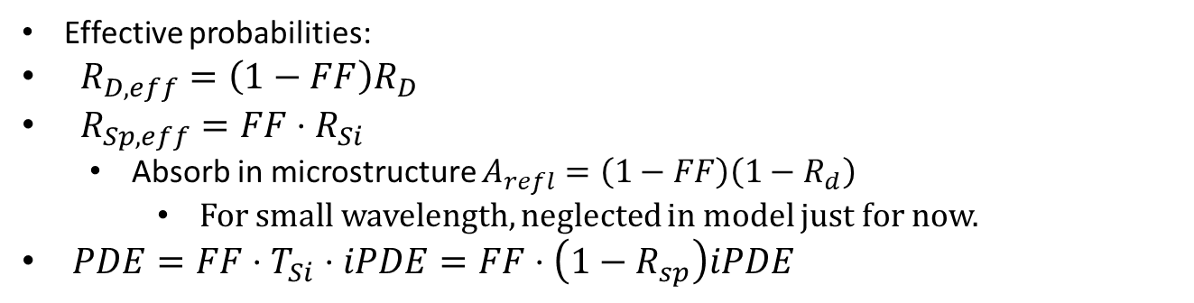



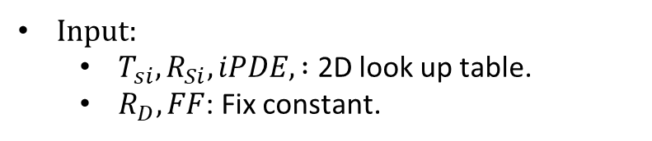







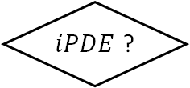


Chroma SiPM
FF?
FF
1-FF
$R_{D}$? $R_{ms}(λ)$?
Else Absorb
$R_{Si}$? $A_{Si}$?
Else $iPDE$
Input:
  $T_{si}, R_{Si}, iPDE, :$ 2D look up table.
  $R_{D}, FF$: Fix constant.
$$1−T_{Si}−R_{Si}$$
$$R_{Si}$$
$$R_{D}$$
$$1−R_{D}$$
$$T_{Si}$$
Absorb
$iPDE$?
Specular Reflect
Diffuse Reflect
Absorb
$$FF(1−T_{Si}−R_{Si})$$
$$FF⋅R_{Si}$$
$$\left(1−FF\right)R_{D}$$
$$\left(1−FF\right)(1−R_{D})$$
$$iPDE$$
$$1−iPDE$$
Detect
Absorb
Probability trial
$$FF⋅T_{Si}⋅iPDE$$
$$FF⋅T_{Si}(1−iPDE)$$
Effective probabilities:
$R_{D,eff}=\left(1−FF\right)R_{D}$
$R_{Sp,eff}=FF⋅R_{Si}$
  Absorb in microstructure $A_{refl}=\left(1−FF\right)\left(1−R_{d}\right)$
    For small wavelength, neglected in model just for now.
$PDE=FF⋅T_{Si}⋅iPDE=FF⋅\left(1−R_{sp}\right)iPDE$
Photon final state
Purple text: probability in the trials.
Blue text: effective probability.

Slide 23
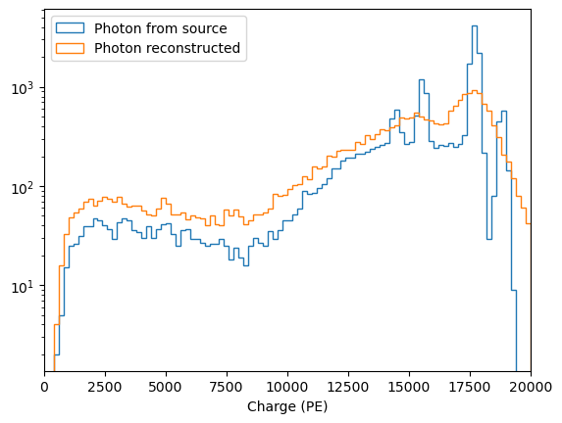
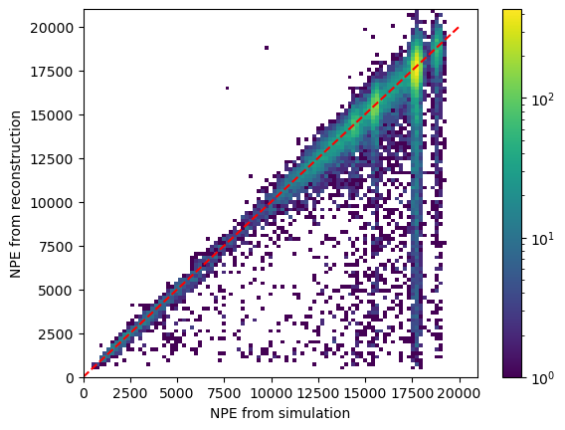
Ba-133 Simulation

Slide 24
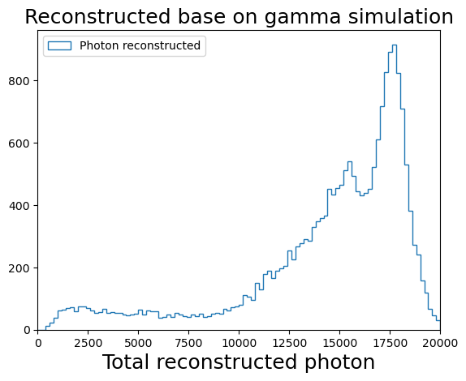
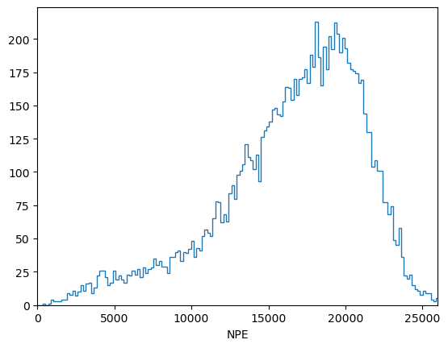
Ba-133 Simulation data compare
Same Cut apply on likelihood and fiducial volume.
Ba-133 Data reconstruction
Total reconstructed photons

Slide 25

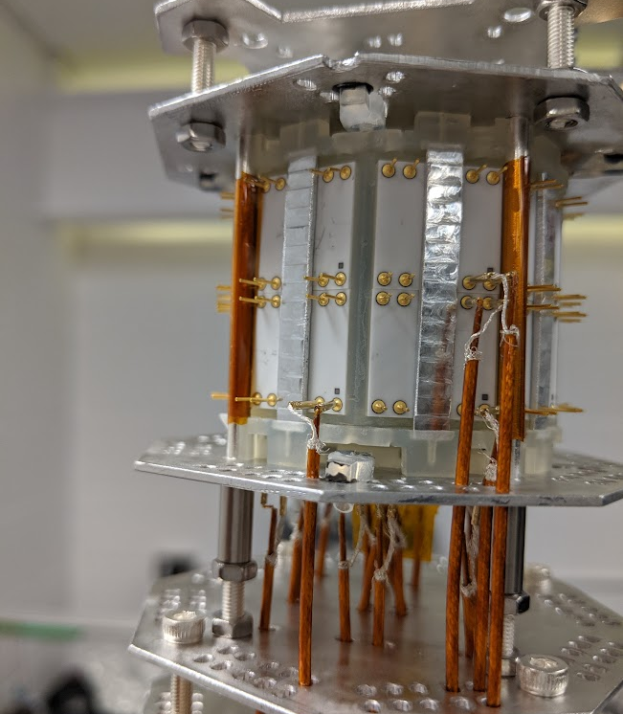
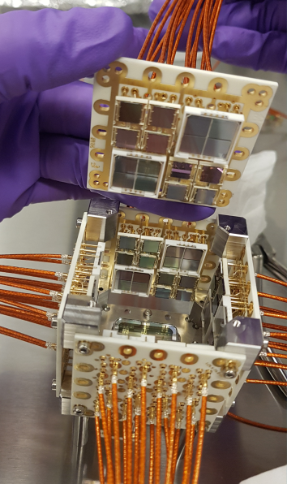
Compare LoLX1 and LoLX2
Problems found in LoLX1:
  Fluorescence from 3D-printed plastic.
  Detector light yield is lower than expected.
    LXe impurity?
    SiPMs have lower efficiency?
Improvements:
  Adding a PMT.
  Benchmarking SiPMs Photon detection efficiency (PDE).
  Comparing FBK and Hamamatsu SiPMs performance.
    Never did it in LXe before, only in vacuum.
  Installing a purity monitor.
  Upgrading to a faster DAQ system.

