Slide 1

Effect of electronegative impurities in NEWS-G's dark matter detector
Jon Clarke (he/him), jon.clarke@queensu.ca
PhD student, Queen’s University, Canada
Supervisor Guillaume Giroux
Globie
CAP Congress, 9 June 2025

Slide 2

Overview
Introduce NEWS-G’s main detector
Excess of low-energy events
Attachment hypothesis
Air injection test
Provisional findings
If this were a detective film, we’re about 10 minutes before all the suspects are herded into a room… https://www.theguardian.com/culture/2017/nov/13/how-we-made-the-original-murder-on-the-orient-express

Slide 3

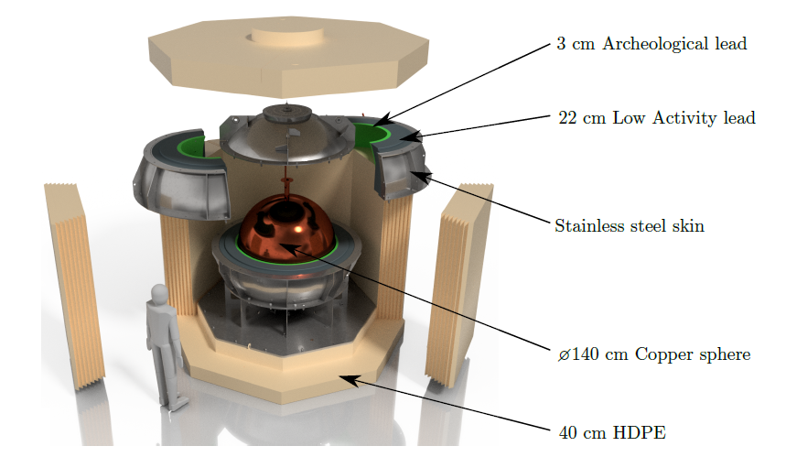
Spherical proportional counters
Grounded metal spheres
Filled with gas, e.g., neon + 2% methane
Central anodes – radial electric field
Single mode – ionization
Signal amplitude ∝ energy deposited
10.1088/1748-0221/18/02/T02005

Slide 4
New Experiments with Spheres–Gas (NEWS-G)
Copper 140 cm diameter spherical proportional counter to search for low-mass dark matter
Operating at SNOLAB, Sudbury, Canada since 2021
Can resolve individual ionization electrons
10.1088/1748-0221/18/02/T02005

Slide 5
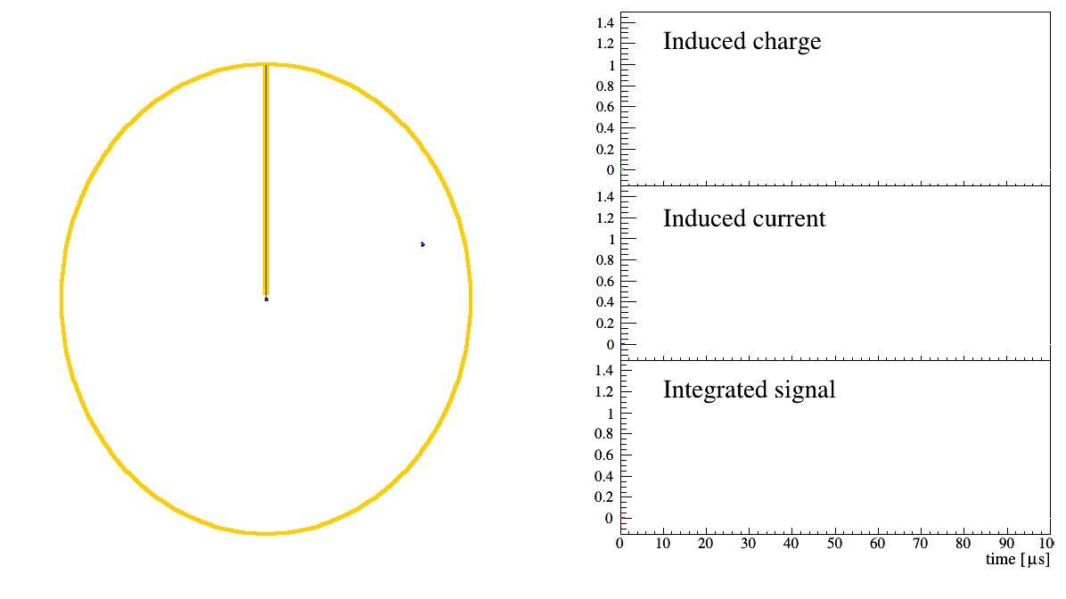
P Gros

Slide 6
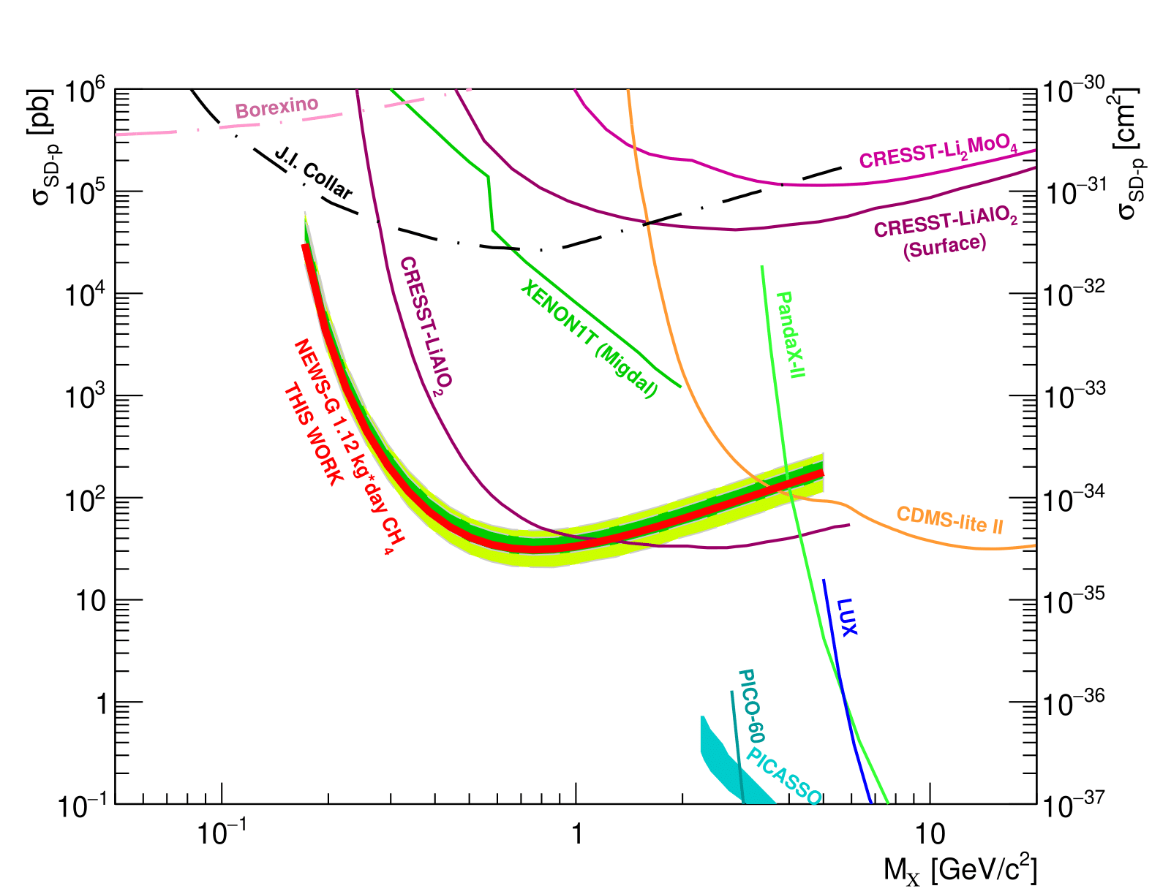
Dark matter exclusion limits
NEWS-G has set world-leading dark matter exclusion limits for spin-independent interactions at 0.5 GeV/c^2 and spin-dependent proton interactions at
0.2-1.0 GeV/c^2
10.1016/j.astropartphys.2017.10.009
10.1103/PhysRevLett.134.141002

Slide 7
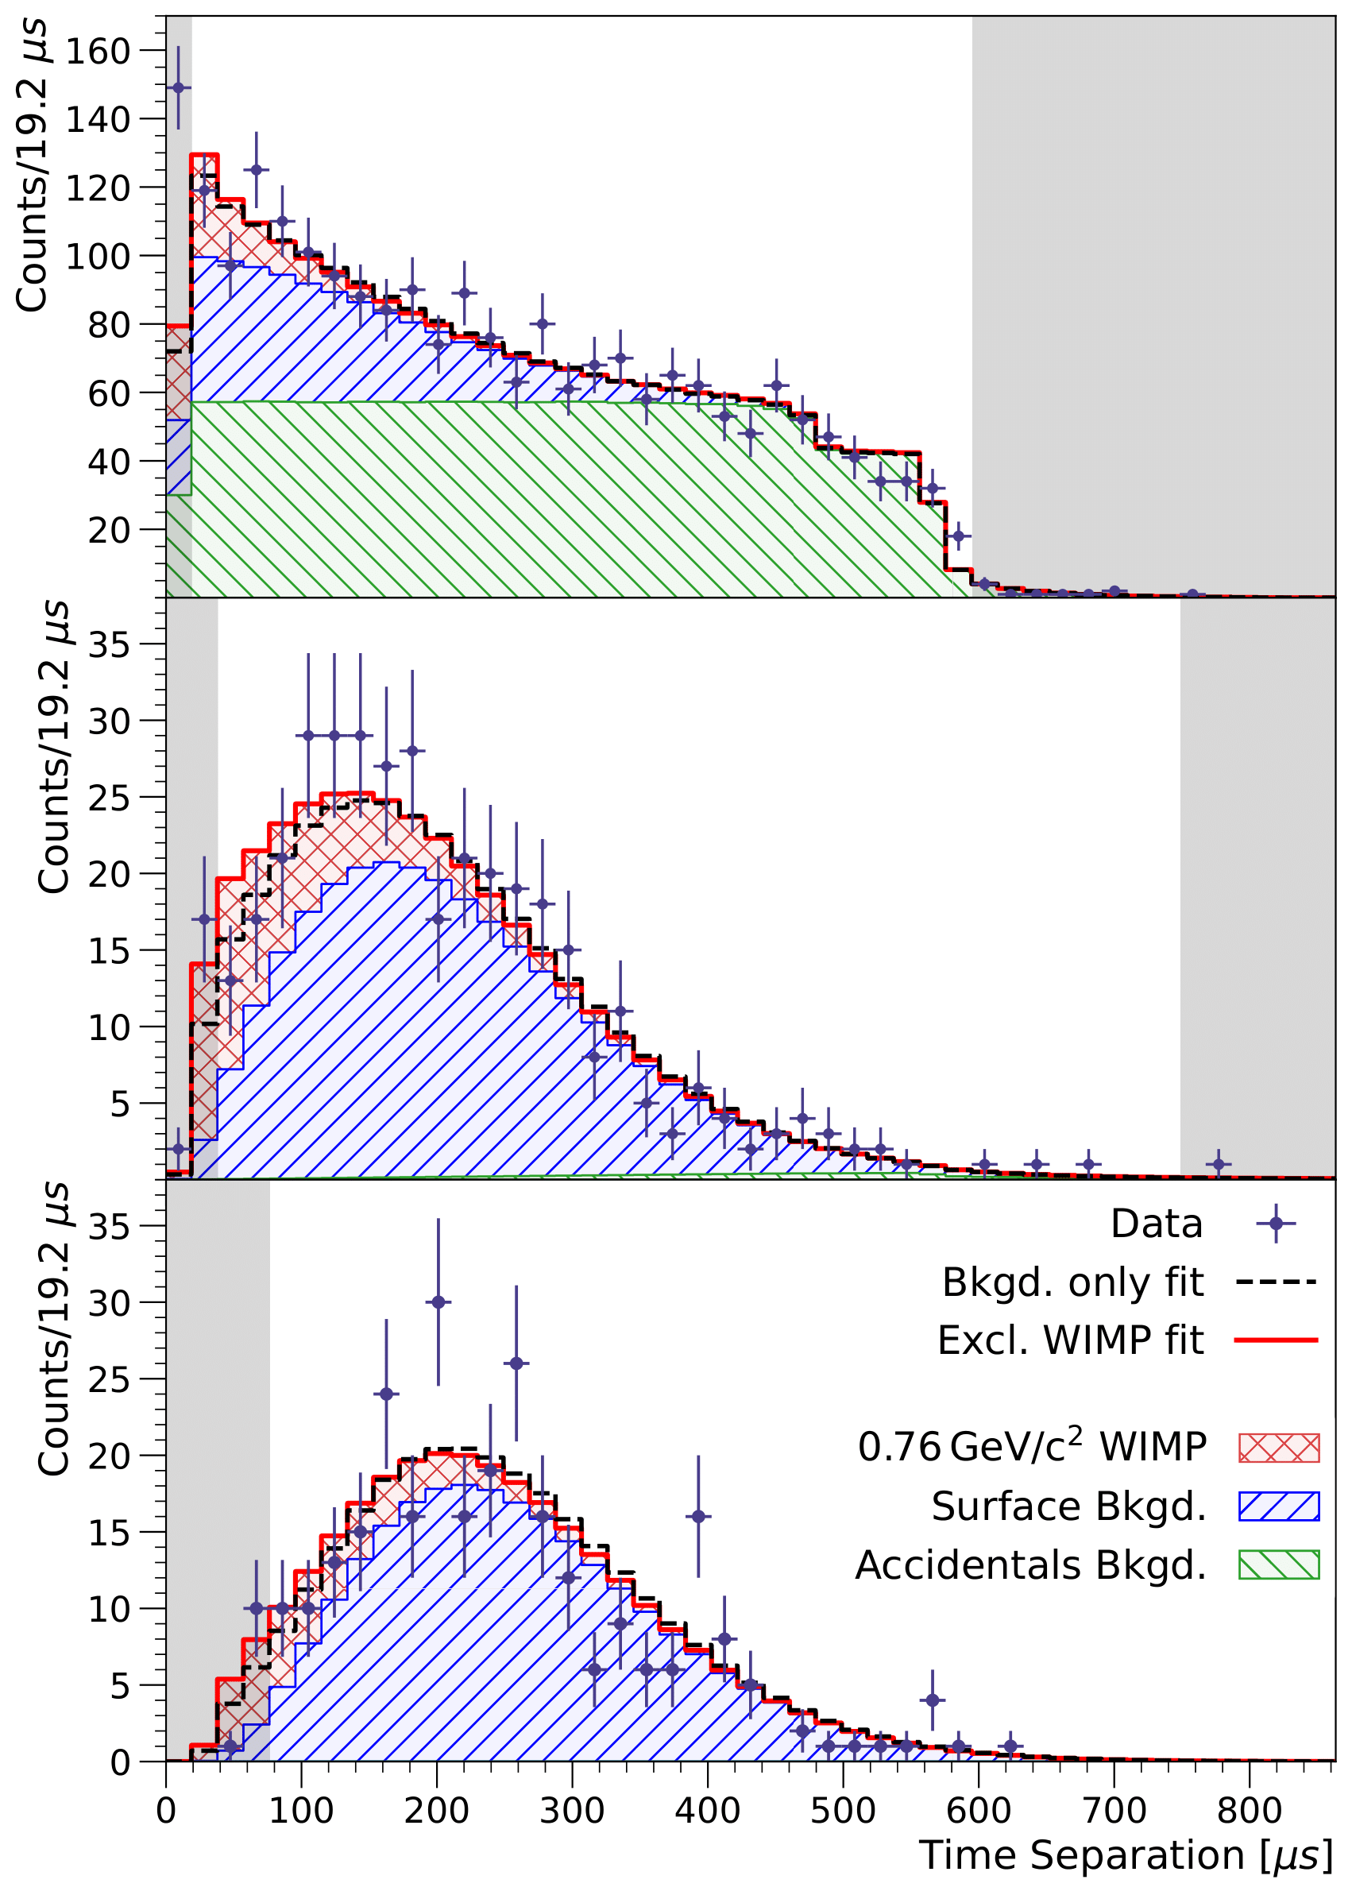
Low-energy excess
Unexplained excess of low-energy events in many dark matter detection experiments, including NEWS-G - 10.21468/SciPostPhysProc.9.001
Coincident pile-up due to unexplained excess of single-electron events is largest constraint on our dark matter exclusion limits
10.1103/PhysRevLett.134.141002

Slide 8
Hypothesis: delayed negative ion signal due to attachment
Attachment of ionization electrons to electronegative species has been reported in gaseous detector for decades - 10.1088/0950-7671/41/2/418, 10.1088/1748-0221/13/04/p04022
Oxygen of particular interest
  Present in air, more electronegative than all elements except fluorine
A typical effect is reduction in signal amplitude because a proportion of electrons have been captured

Slide 9
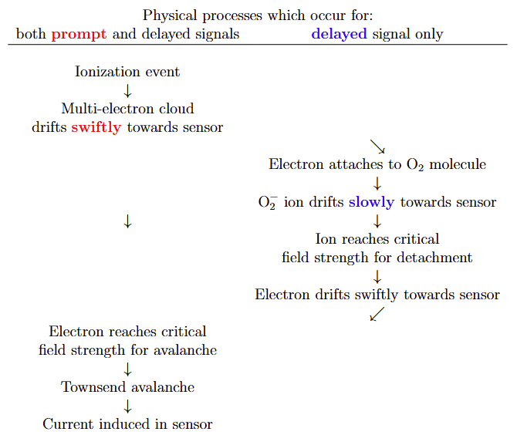
Proposed physical processes that explain why attachment can lead to a delayed signal

Slide 10

Animation for Ne at 1 bar
detachment electric field strength ∝ pressure

Slide 11
Air injections test
Tested hypothesis by twice injecting air into main detector, 8 days apart
  O₂ concentration of 11 ± 1 ppm each in 1400 L
Perhaps due to unexpected behaviour of unquenched UV photons?
  Open to any plausible alternative explanation!

Slide 12
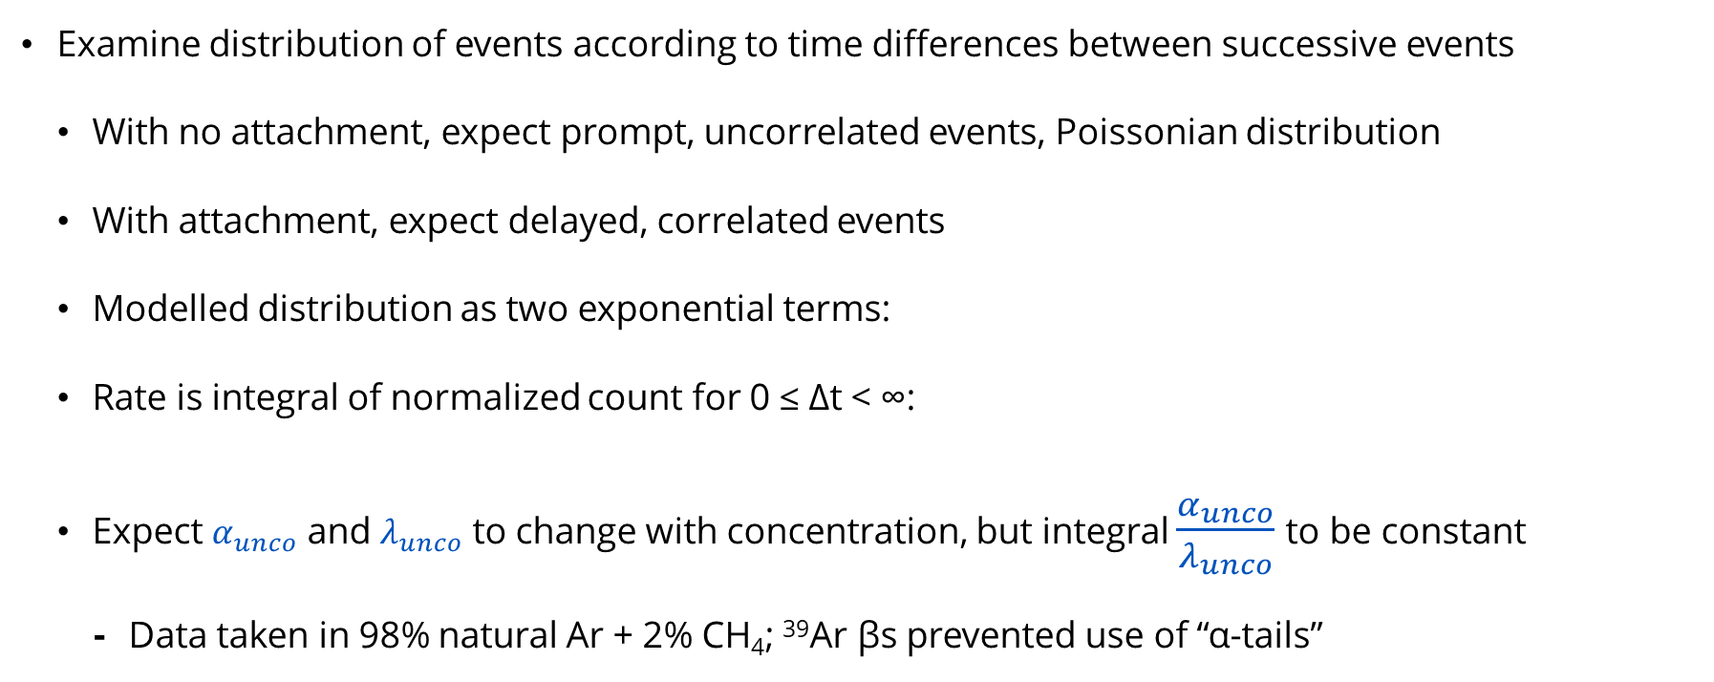
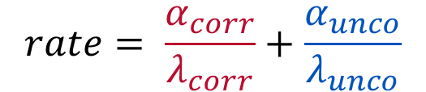
Air injections analysis
Examine distribution of events according to time differences between successive events
  With no attachment, expect prompt, uncorrelated events, Poissonian distribution
  With attachment, expect delayed, correlated events
  Modelled distribution as two exponential terms:
  Rate is integral of normalized count for 0 ≤ Δt < ∞:
  Expect $α_{unco}$ and $λ_{unco}$ to change with concentration, but integral $\frac{α_{unco}}{λ_{unco}}$to be constant
    Data taken in 98% natural Ar + 2% CH₄; ³⁹Ar βs prevented use of “α-tails”
$$count= α_{corr}e^{−λ_{corr}Δt}+α_{unco}e^{−λ_{unco}Δt}$$
$$rate= \frac{α_{corr}}{λ_{corr}}+\frac{α_{unco}}{λ_{unco}}$$

Slide 13
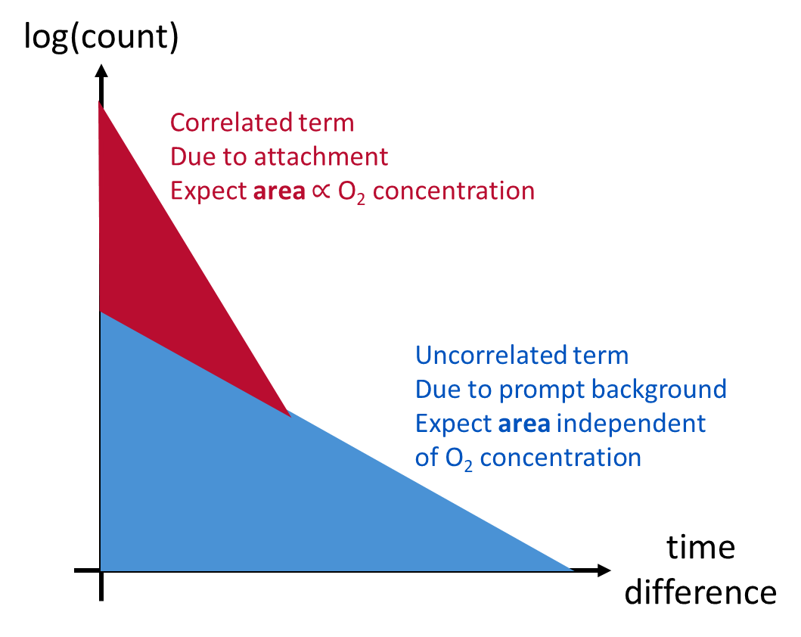
Count histograms

Slide 14
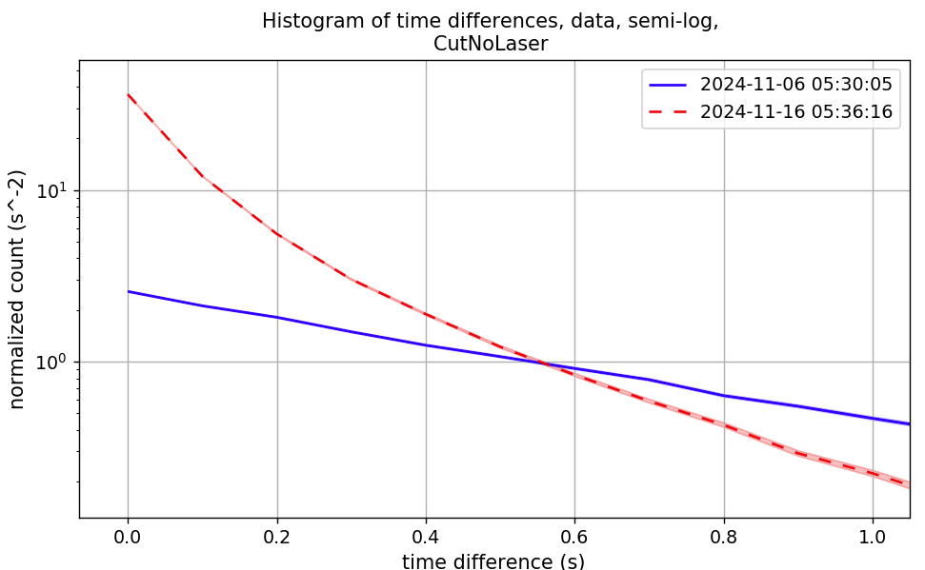
Count histograms
Last run before 1st air injection - zero attachment
  One straight line, as expected
First run after 2nd air injection - maximum attachment
  Sum of two straight lines, as expected

Slide 15
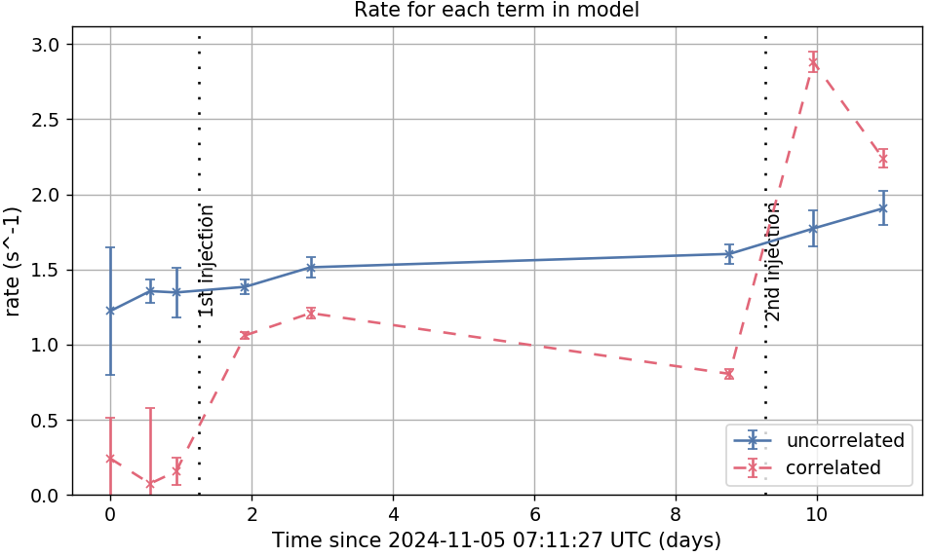
Correlated and uncorrelated rates during air injections
Uncorrelated rate varies little
Correlated rate jumps at each injection

Slide 16
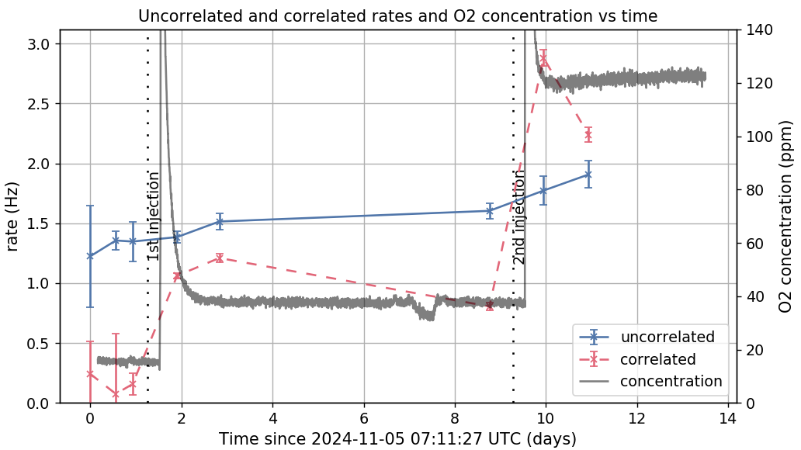
Correlated and uncorrelated rates during air injections
Statistically significant correlation between “correlated” rate and O₂ concentration
Weaker correlation with “uncorrelated” rate
Rate | Correlation coefficient, r | p
“Correlated” | 0.97 | 8 × 10⁻⁵
“Uncorrelated” | 0.90 | 2 × 10⁻³

Slide 17
Conclusions
Results of air injections test has supported our hypothesis
  This time difference analysis agrees with separate line of evidence (results of analyzing “α-tails” during an accidental air leak)
Looking very likely that attachment due to O₂ contamination is a significant contributor to our unexplained excess of single-electron events
Changes attribution: some of what we interpreted as uncorrelated, prompt, single-electron events are probably correlated, delayed, attachment signals from multi-electron events

Slide 18
What’s next?
Complete related analysis, e.g., quantify expected size of effect & gas purity needed so single-electron pile-up would no longer be the leading constraint, test UV photon alternative explanation, simulate processes
Finish technical note for internal NEWS-G discussion and record-keeping
Prepare paper for publication
On other topics, across NEWS-G:
  Use SNOLAB Ne data to calculate new dark matter exclusion limits
  Trying He as detector gas for first time
  G3 project to study coherent elastic neutrino-nucleus scattering

Slide 19


Thank you
Any questions?
https://www.queensu.ca/physics/news-g/teams/collaboration

Slide 20
Extra slides

Slide 21
Outline – technical note, https://www.overleaf.com/project/67802f6999b0e676d56e55c4
overview
NEWS-G
alpha-tails, air leak – if time
single-e excess
attachment
hypothesis
air injection test
delta t air injection analysis
delta t air leak analysis – if time
future work

Slide 22
Submitted abstract
https://indico.global/event/442/abstracts/37290/ - 15 min, including questions
Effect of electronegative impurities in NEWS-G's dark matter detector
The NEWS-G collaboration uses spherical proportional counters to search directly for low-mass dark matter. Each counter is a metallic sphere filled with gas with high-voltage anodes at its centre producing a radial electric field. The interaction between a dark matter particle and a nucleus can ionize the gas, which leads to electron avalanches near the anodes and a detectable signal. The latest NEWS-G detector is a 140 cm diameter copper sphere currently taking data with various gases at SNOLAB.
Like many sensitive detectors of various types, we have found an unexplained excess of low-energy events, which is the main limit on NEWS-G's sensitivity. Our working hypothesis was that this relates to electron attachment to electronegative impurities, such as oxygen, in the detector gas. In fall 2024, we injected two small boluses of air into our detector volume (O_2 concentration of 11 ± 1 ppm each in 1400 L) and found proportionate changes in certain types of event. I will introduce the detector and discuss the issue of attachment, including the results of this injection experiment.

Slide 23
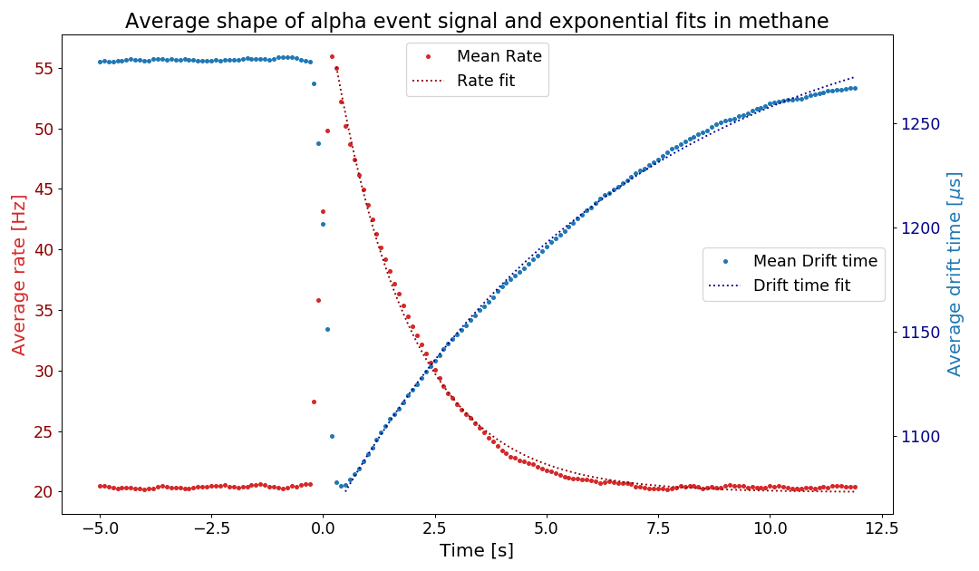
α contamination, “α-tails”
Inner surface of the sphere is contaminated with
Pb-210, which decays to the α-emitter
Po-210, ~25 mHz of α-particles
α-particles ionize a lot of gas and create a space charge that disturbs the electric field; changes the electron drift time
For some still unknown reason, a high rate of low-energy events occur for around 5s after each α; so-called “α-tail”
5 s cut after each α reduces background by ~70% but exposure by only ~12%
Rate increases
Average drift time (μs)
Average rate (Hz)
Methane
135 mbar
1630 V
Drift time decreases
Time (s)

Slide 24
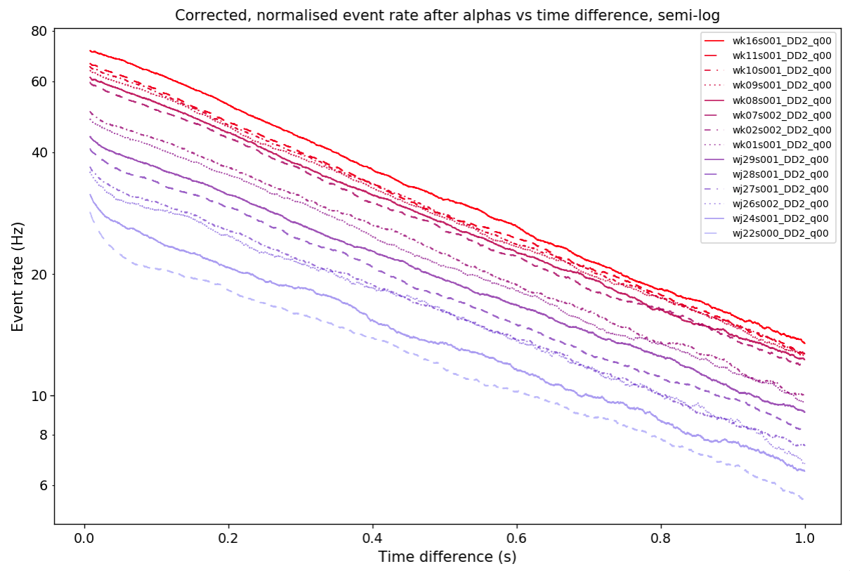
α-tails during accidental air leak
22 Oct (j22) to
16 Nov (k16), 2022, taken in 98% Ne + 2% CH₄
Evidence that the α-tail worsens as gas quality worsens
1st indication that single-e background might relate to gas quality
Event rate (Hz)
Fast, early decay disappears
Event rate increases
(Also, decay constant of exponential fit increases, 1.32 to 1.49 s⁻¹)
Time since alpha event (s)
J Clarke

Slide 25
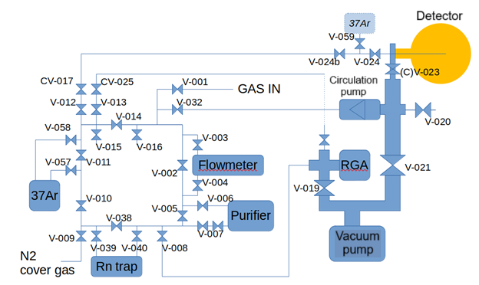
SNOGLOBE gas system

Slide 26
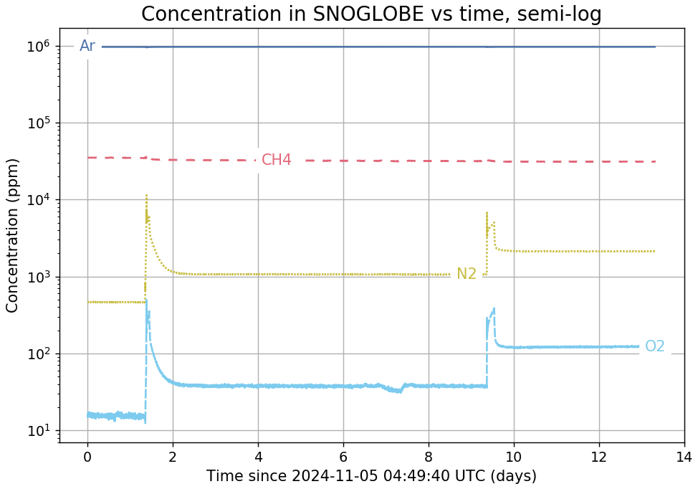
Gas concentrations
Detector contained 98% Ar and 2% CH₄.
Data from our residual gas analyzer shows jumps in concentrations of O₂ and N₂, as expected, during both air injections.

Slide 27
[Original object drawing of this figure]
log(count)
Correlated term
Due to attachment
Expect area ∝ O₂ concentration
Uncorrelated term
Due to prompt background
Expect area independent
of O₂ concentration
time difference

Slide 28
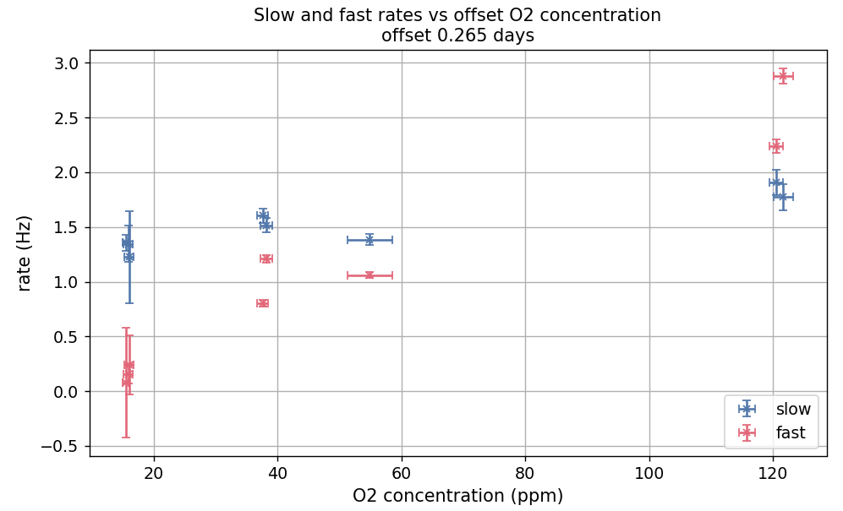

Slide 29
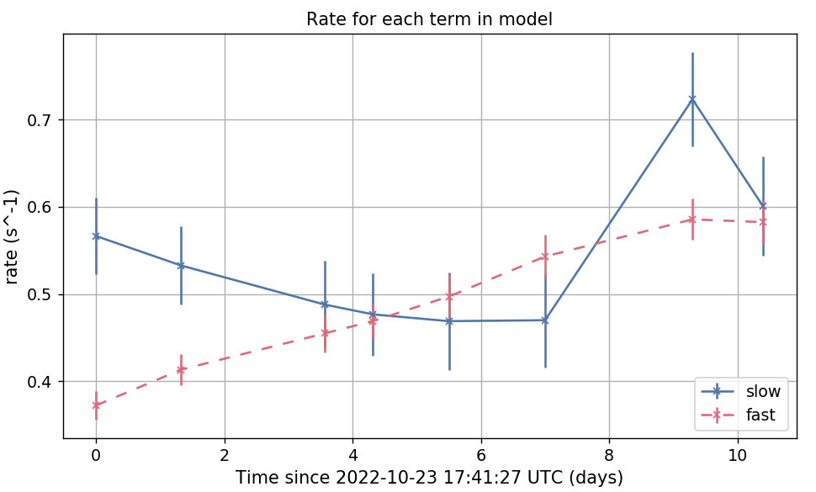
Fast and slow rates during air leak
Returned to earlier air leak data, which showed worsening α-tails, and reran this new analysis.
Similar findings:
no consistent trend in slow rate
fast rate consistently increases

Slide 30
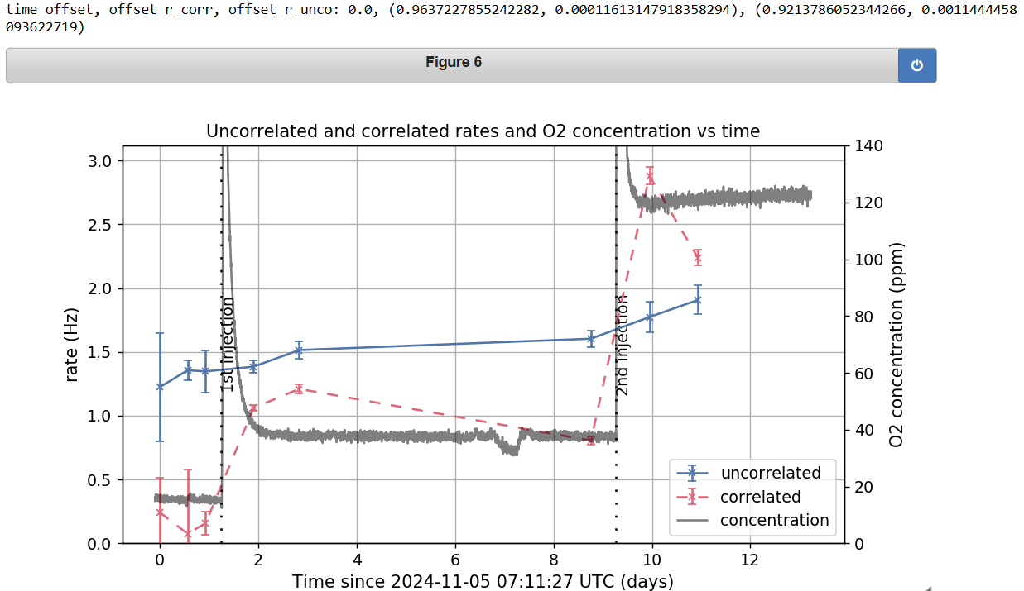

Slide 31
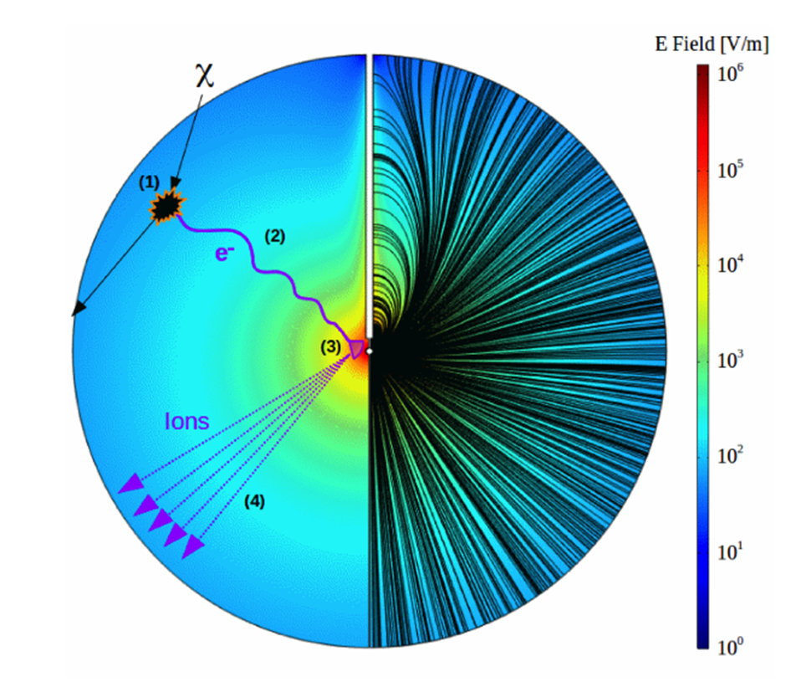
Principle of operation
Gas molecules ionised by incoming particles
Freed primary electrons drift towards central anode
Townsend avalanche close to the anode produces secondary electron-ion pairs, amplifying signal
Current induced in the anode by drifting secondary ions

Slide 32
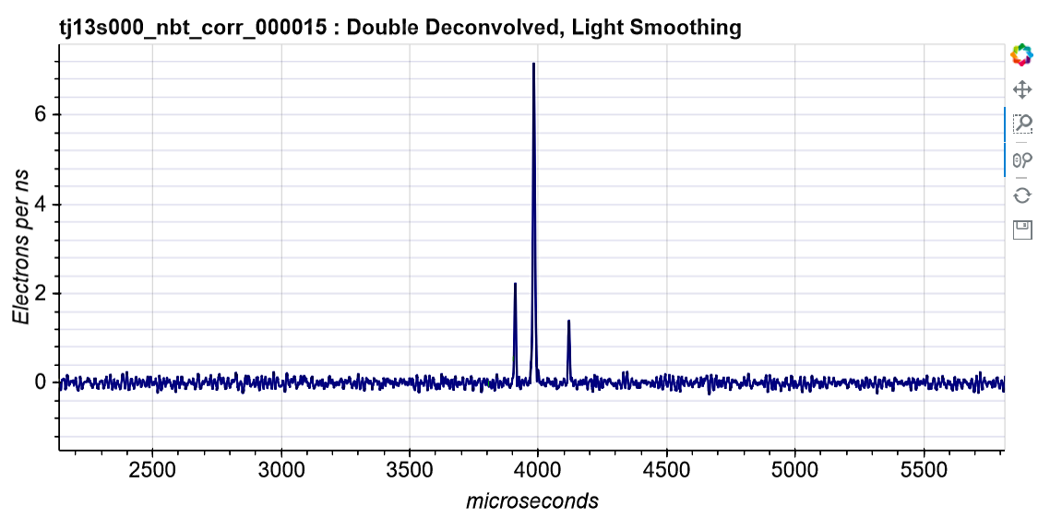
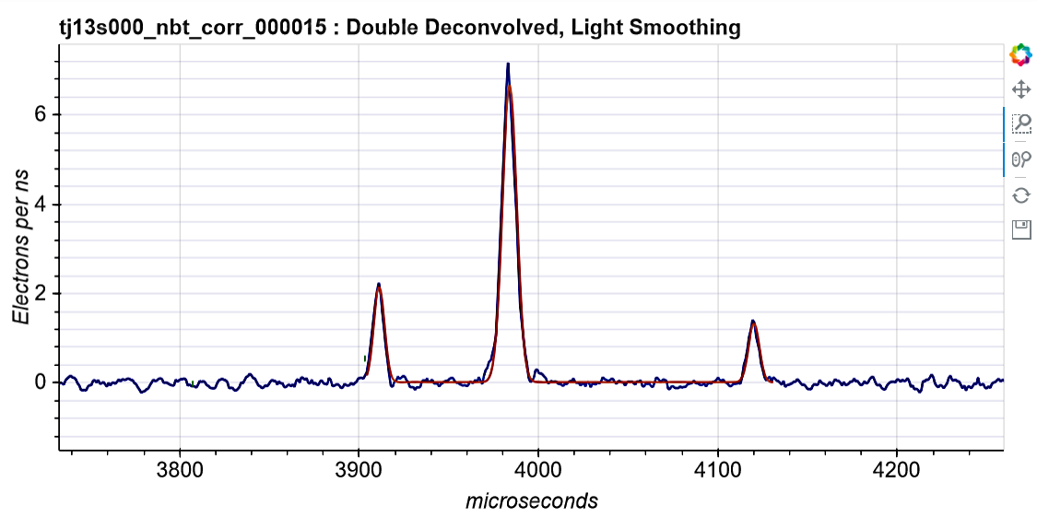
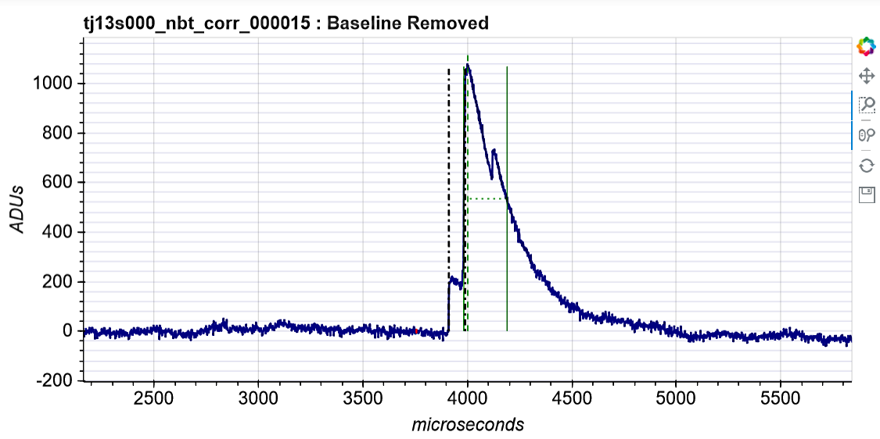
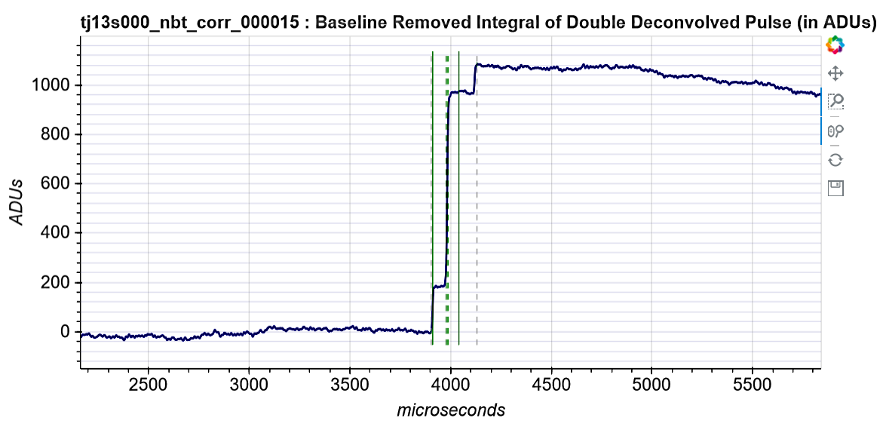
Double deconvolution
Double deconvolution
Voltage (ADUs)
Integration
Time (μs)
Signal amplitude underestimated due to the exponential decay of the preamplifier
Full amplitude (energy) is retrieved by doing a double deconvolution of the raw signal, and then integrating the pulses

Slide 33
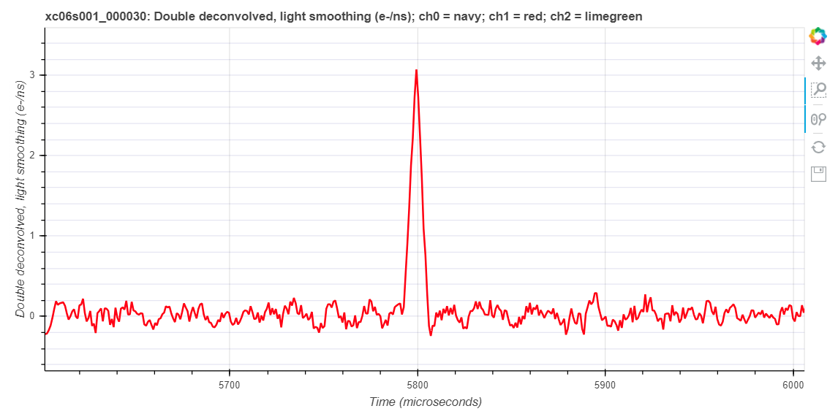
Single-electron background
Limiting factor for our WIMP exclusion limits
Mechanism of this background not known
  Hypothesis: it is similar to that for “alpha tails”, but generated by lower-energy events
Typical double-deconvolved signal from a single primary electron

Slide 34
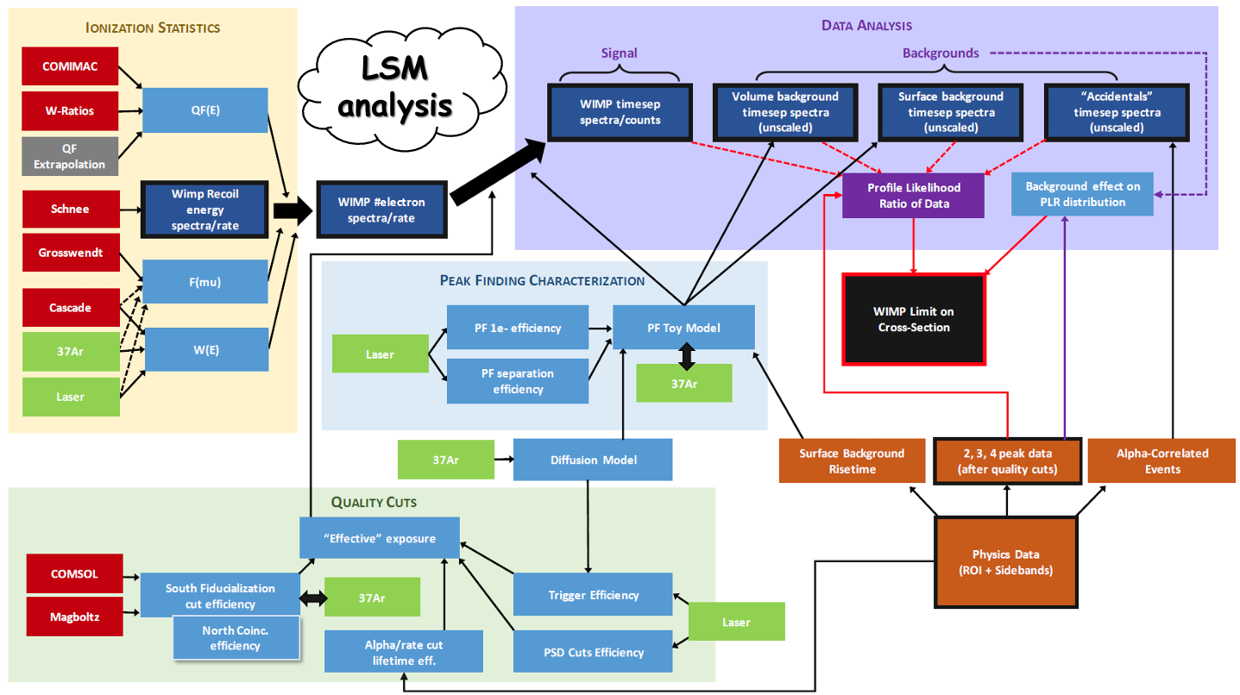
F Vazquez de Sola

