Slide 1
The Keystone Mission: Concept and Objectives
One of four projects selected as a candidate for ESA's Earth Explorer 12
William Ward (on behalf of the Keystone Advisory Group and Keystone PI, Daniel Gerber)
https://www.esa.int/Applications/Observing_the_Earth/FutureEO/Preparing_for_tomorrow/ESA_selects_four_new_Earth_Explorer_mission_ideas
https://www.ralspace.stfc.ac.uk/Pages/keystone-shortlisted-to-be-next-earth-explorer.aspx

Slide 2
Overview
ESA’s Mission Advisory Group for Earth Explorers
Mission overview
Mission objectives and goals
Measurement requirements
Summary

Slide 3
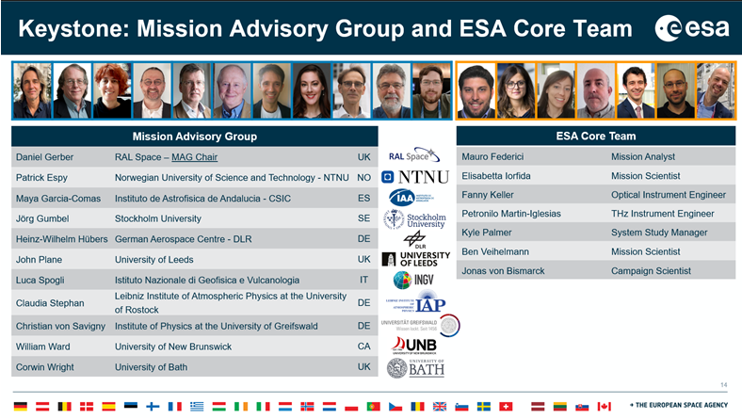

Slide 4
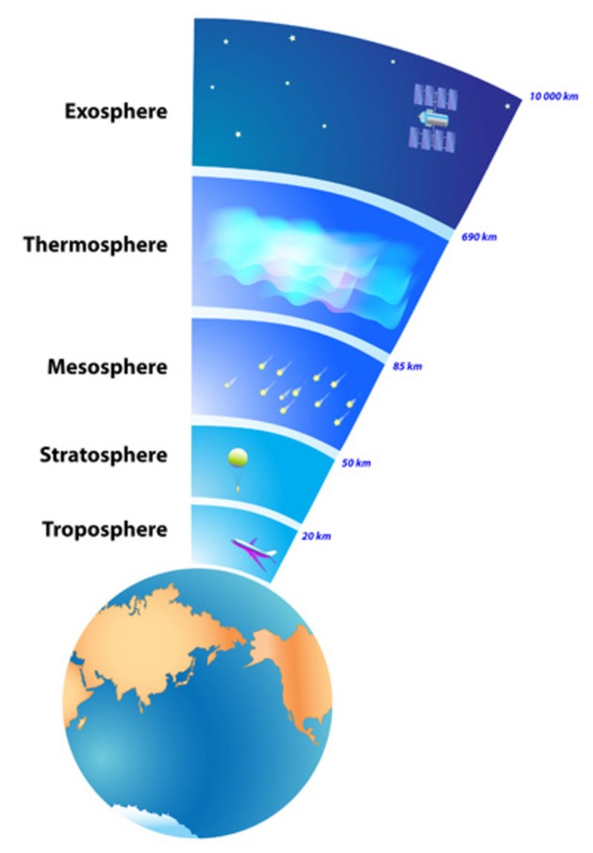
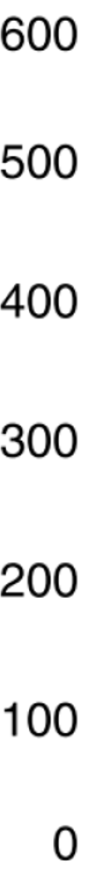
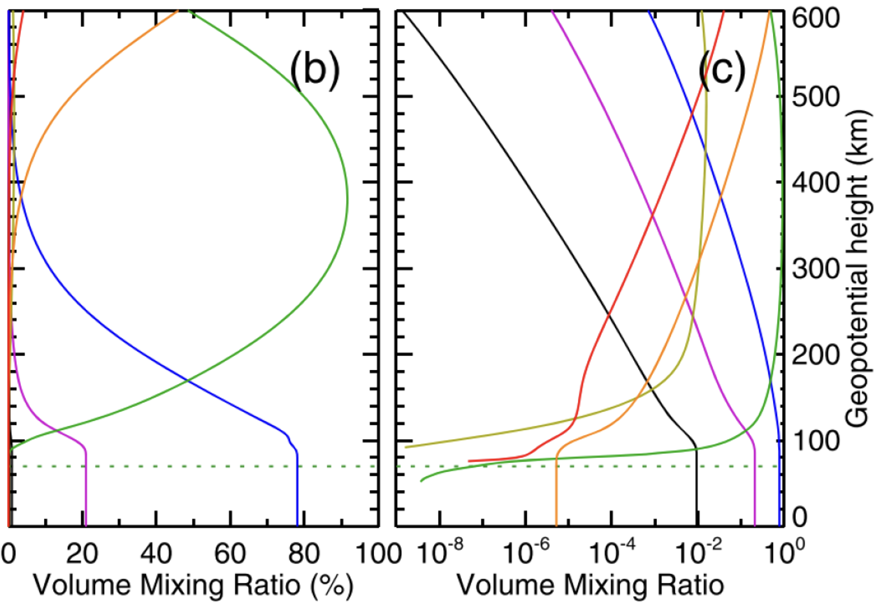
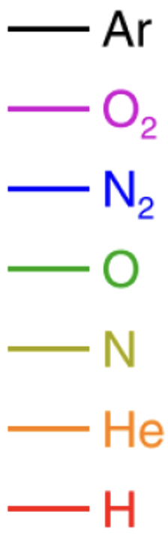
Scientific Motivation and Goals
The Mesosphere—Lower Thermosphere (MLT) is the “No Fly Zone” of the atmosphere. Only Remote Sensing techniques are viable
Atomic oxygen (O) is the dominant reactive species above ~110km, but it can only be observed in the “THz Gap” of the electromagnetic spectrum (1THz – 5THz)
→ MLT is the “Agnostosphere”
O is the “Holy Grail” of the Upper Atmosphere:
  It’s the most abundant species
  It’s involved in almost all reactions
  It drives radiative cooling (direct/indirect)
  It’s the source of all residual drag
  It can give neutral winds up to 150km
Data courtesy of Markus Rapp (DLR)

Slide 5
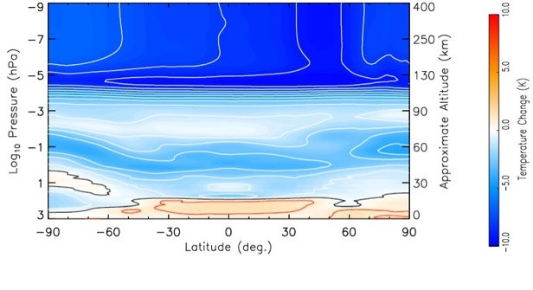
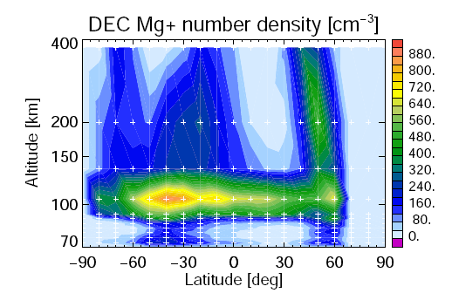

Scientific Motivation and Goals
Infrared Radiances
- Derived T and VMR
UVis Airglow & Scat.
- Derived VMR
e.g. MLT cooling trend indicated by IR radiances, [Solomon 2018]
e.g. Mg+ distribution from UVis (SCIAMACHY) [Scharringhausen 2009]
Indirect info on O relying on
assumptions on quenching rates
Indirect info on O relying on
assumptions on O/O₂ photochemistry

Slide 6

Scientific Motivation and Goals
THz
Retrieved
O & T
Infrared Radiances
- Derived T and VMR
UVis Airglow & Scat.
- Derived VMR
e.g. MLT cooling trend indicated by IR radiances, [Solomon 2018]
e.g. Mg+ distribution from UVis (SCIAMACHY) [Scharringhausen 2009]
Direct retrievals of O and T are the missing links that combine existing science bites, into a complete picture of the upper atmosphere

Slide 7
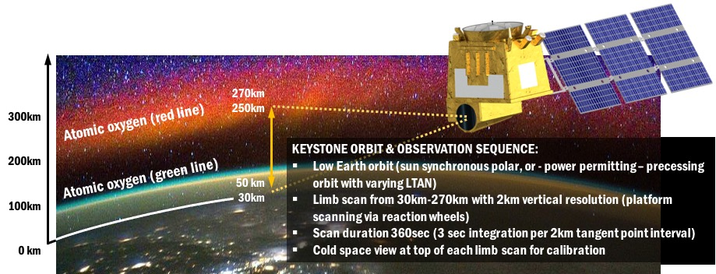

Mission Requirements
Limb-scanning, medium sized, LEO satellite with 3-instrument payload comprising of:
  Supra-THz radiometers for trace gas, temperature, and wind retrievals
  IR radiometer
  UV-Vis spectrometer
Image by ESA astronaut Samantha Cristoforetti, taken from ISS

Slide 8
Science Objectives
1 — “Thermal balance” Measure O, T, IR heat loss, and airglow to understand MLT (photo)chemistry, and thus upper atmospheric cooling rates, and localised thermal contraction/expansion
2 — “Diurnal variations of the whole atmosphere” Measure O, T, O₃ and ozone related species (e.g., HO_{X}, H₂O), and neutral winds to obtain a complete picture of MLT variability and tides
3 — “Upward coupling” Measure Temperature, winds, ion density & gravity waves to unveil the vertical propagation of synoptic-to planetary scale disturbances from the middle atmosphere (non-migrating tides and stratospheric sudden warming events) to the MLT
4 — “Downward coupling” Measuring NO_{X} & HO_{X} to unveil the vertical propagation of Space Weather (particle precipitation and magnetic storms) to the MLT
5 — “Models & applications” — Measure H₂O, O₃, CO (tracer), O (density), T, and neutral winds as assimilation data products for next generation atmospheric models (and orbit trajectory models)

Slide 9
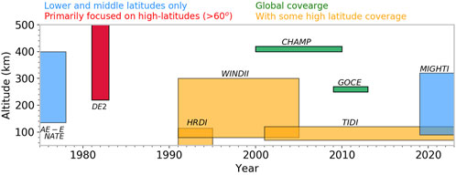
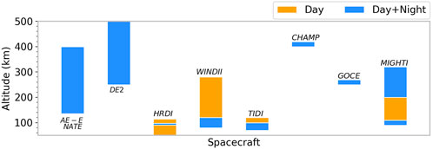
Past Missions (Dhadly et al., (2023), Neutral winds from mesosphere to thermosphere —past, present, and future outlook)
FIGURE 1. The time-line of past ITM missions launched with neutral wind measuring capabilities and their altitudinal coverage. Their latitudinal coverages are indicated with colors on the top.
FIGURE 2. Altitudinal and diurnal coverage of the past ITM missions with neutral wind measuring capabilities.

Slide 10
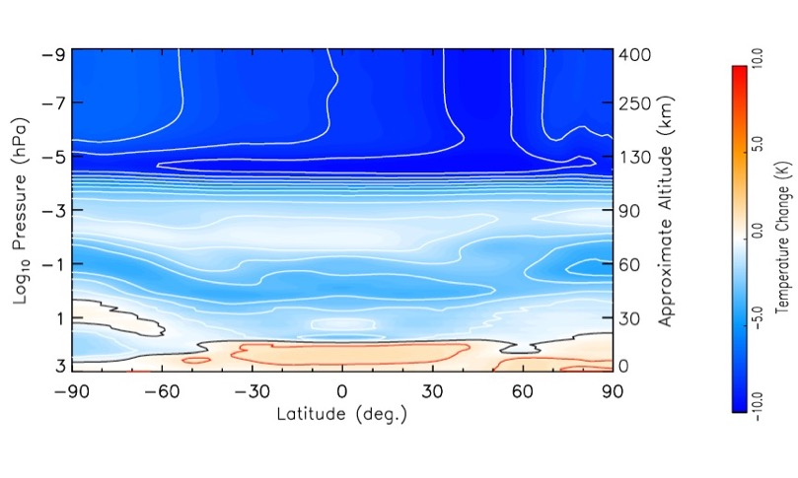
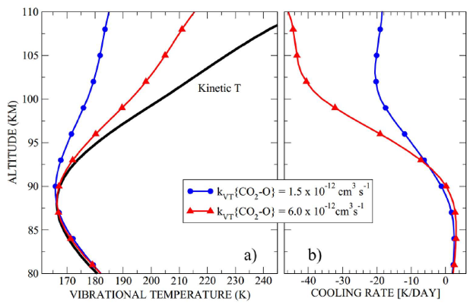
Climatological Trends in the MLT
Upper atmospheric cooling trend is stronger than surface warming
Role of GHG unclear, because quenching rates with [O] are unknown
Factor 4 Uncertainty!
Solomon et al. 2018 Feofilov et al. 2012

Slide 11
Terahertz Gap:
Heterodyne Detection for High Frequency Spectroscopy
The Local Oscillator [LO] needs to match the Radio Frequency [RF]
Space ready LO for very high THz frequencies (1-5THz) = Breakthrough
Quantum Cascade Laser LO could bridge the current “THz Gap”

Slide 12
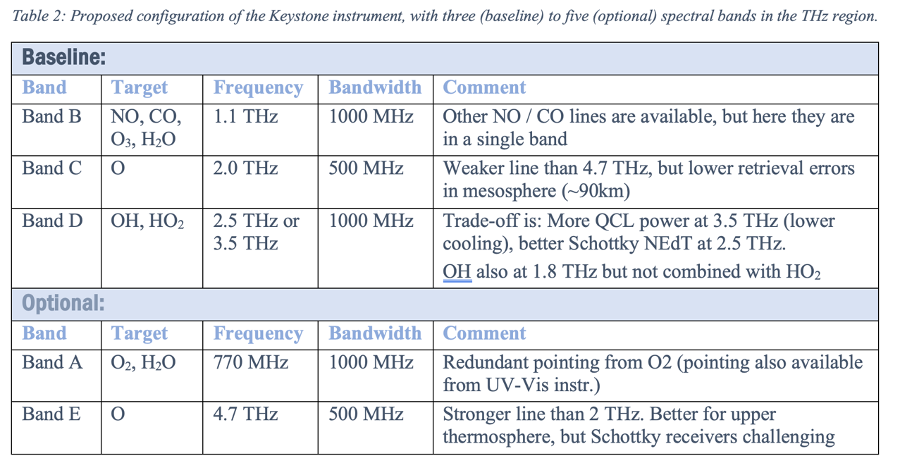
Measurement Requirements: THz
THz Radiometer:
Passive, heterodyne Schottky radiometers (uncooled)
High spectral resolution spectrometers (1-3 MHz)
Key emissions: O, OH, HO₂, H₂O, NO, CO, O₃, O₂
Heritage: MLS (UARS/Aura), SMR (ODIN), MWS / MWI / ICI (MetOp-SG)

Slide 13
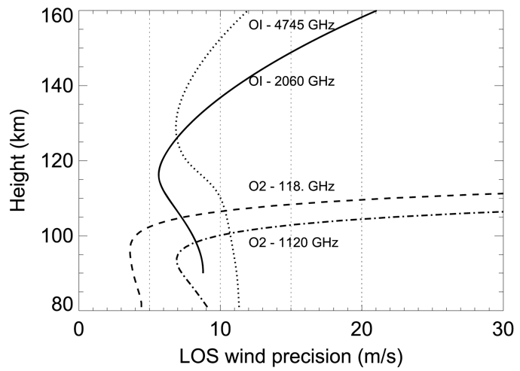
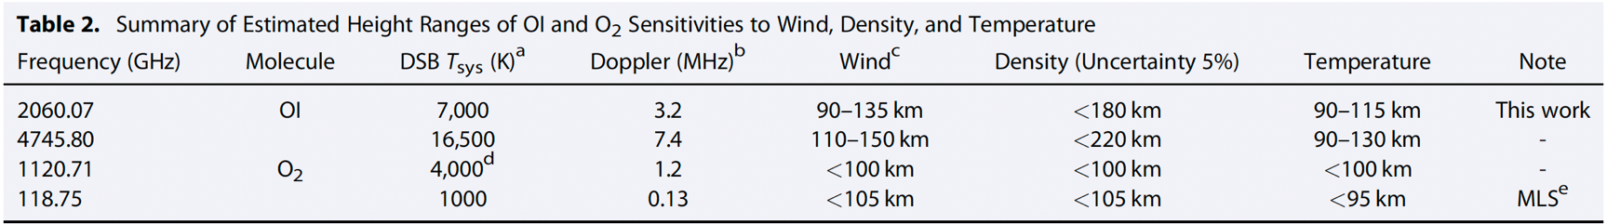
Mission Concept, Challenges, and Trade-offs
Band selection for atomic oxygen and associated Doppler wind retrieval
2 THz (weaker spectral line)
performs better at low tangent altitudes (90-110km)
limited vertical range of density (180km), T (115km), and wind (135km)
4.7 THz (stronger spectral line)
worse lower limit of vertical range (110km)
extended vertical range of density (220km), T (130km), and wind (150km)
technical challenge
Figures/Table: Wu et al. 2016 (JGR)

Slide 14
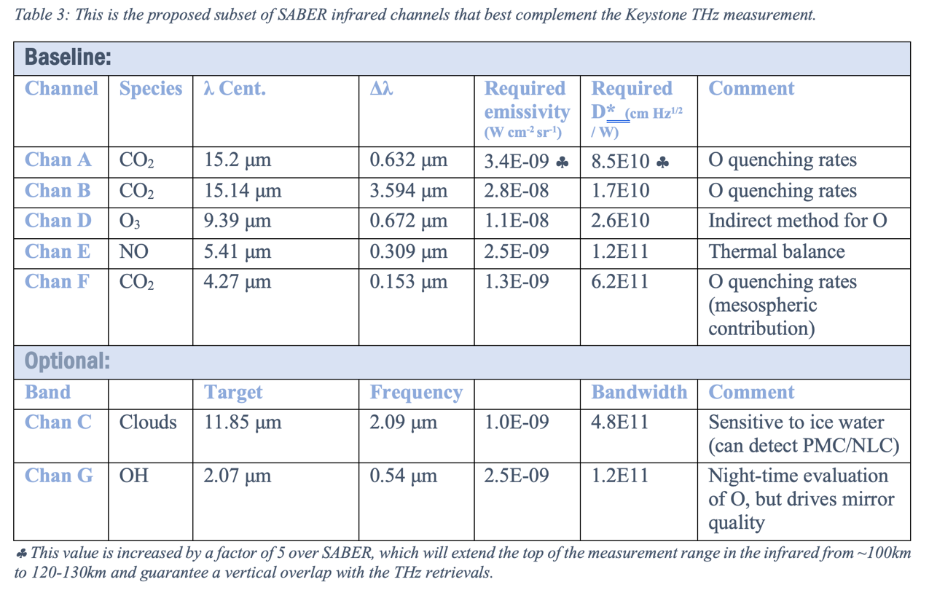
Measurement Requirements: IR
Infrared Radiometer
Single pixel IR detectors
Key emissions: CO₂, NO, OH, O₃
Heritage: SABER (TIMED)

Slide 15
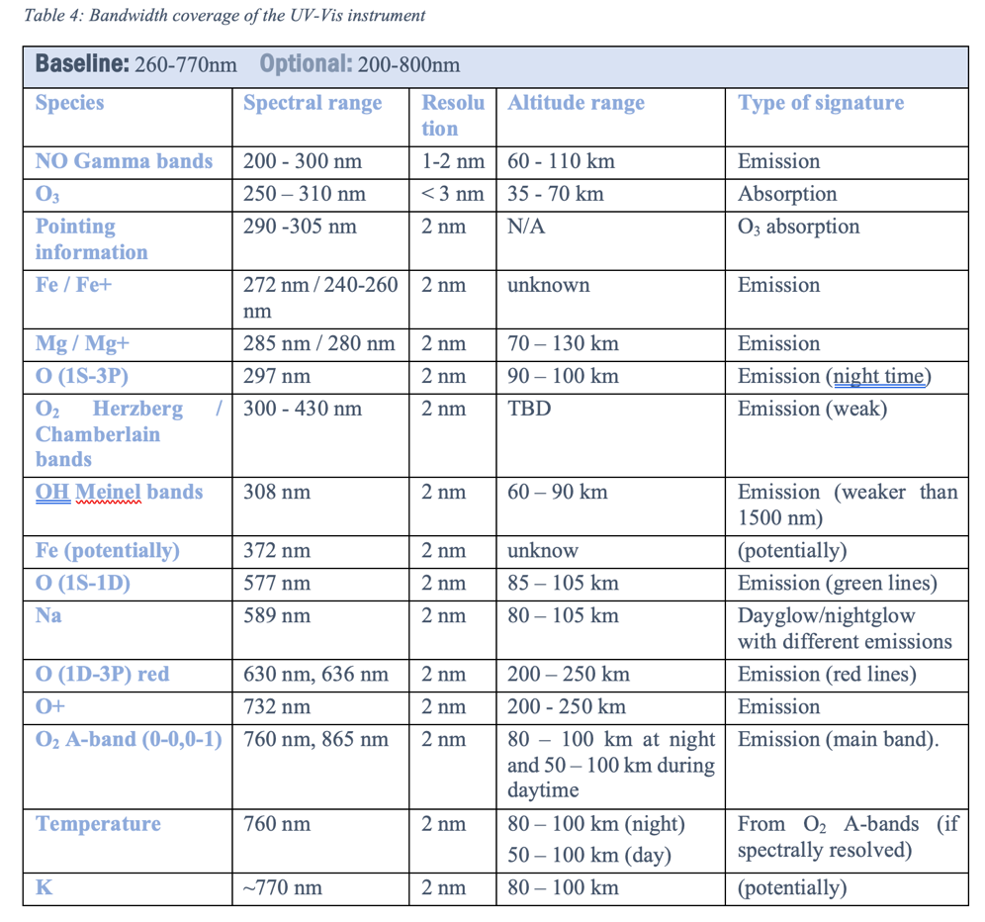
Measurement Requirements: UV-Vis
UV-Vis Spectrometer
Broadband spectrometer: 200nm -~800nm
Spectral resolution: 1nm
Heritage: OSIRIS (ODIN), SCIAMACHY (Envisat), NOMAD (ExoMars)

Slide 16
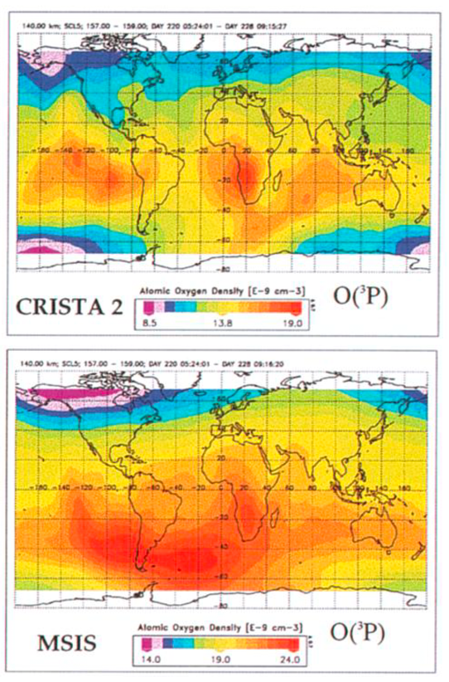
Summary
Atomic oxygen (O) is the missing keystone for our understanding of the upper atmosphere.
The Keystone mission will provide first global and temporally resolved measurements of the key missing MLT trace gas atomic oxygen (O), together with Temperature, neutral winds (Doppler), and other important trace gases
Keystone flies a comprehensive payload suite, comprising of a novel THz radiometer in combination with heritage IR and UV-Vis instruments
The Phase-0 system study will address trade-offs on viewing strategy (wind observations) and temporal sampling of diurnal / seasonal cycles (orbit choice)
Figures: Grossmann et al. 2000 (GRL)

Slide 17
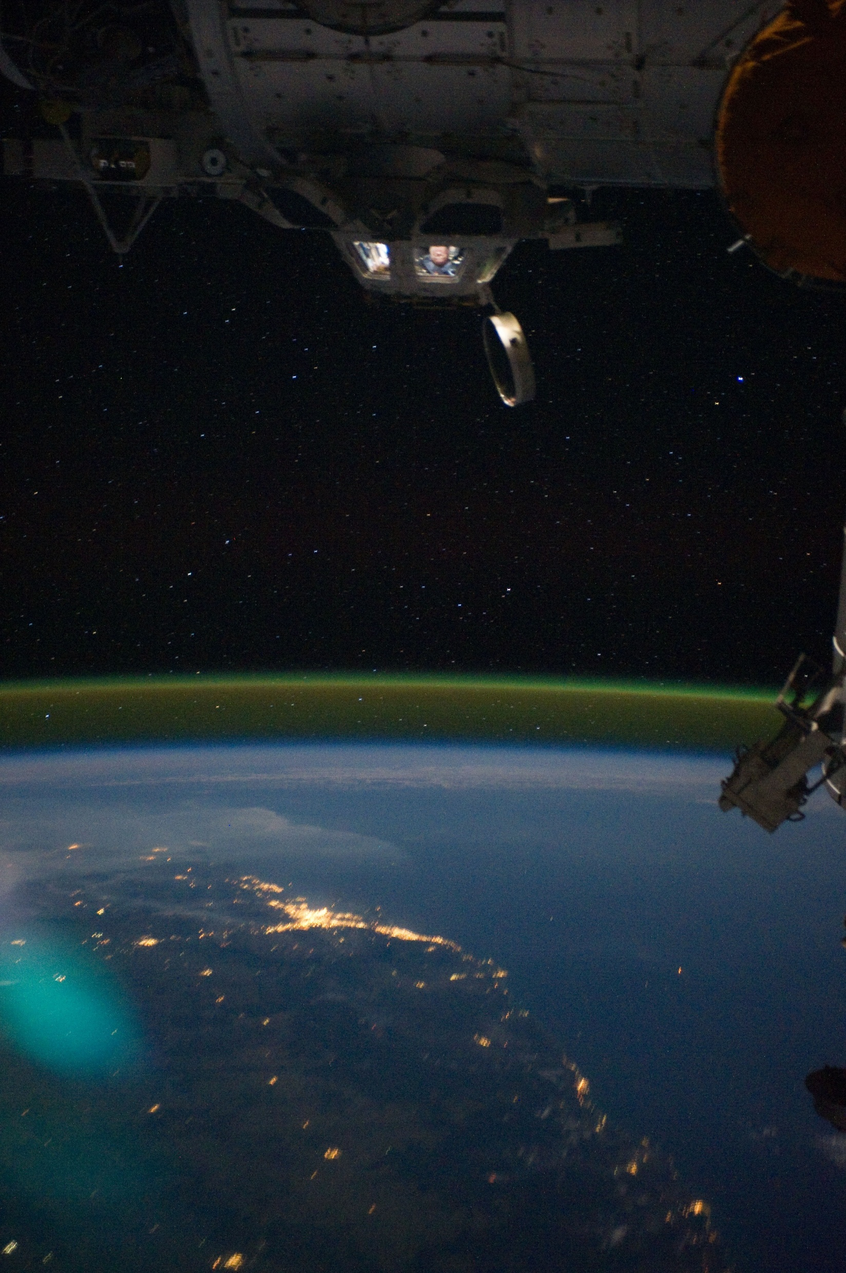
Many Thanks for your attention

