Slide 1
The effect of auroral absorption events on HF propagation links over Canada
R. G. Gillies, E. Spanswick, F. Ghaly, T. Cameron, R. Fiori, and S. Skone
Division of Atmospheric and Space Physics (DASP) annual meeting 2025
University of Saskatchewan, Saskatoon, SK
June 10, 2025

Slide 2
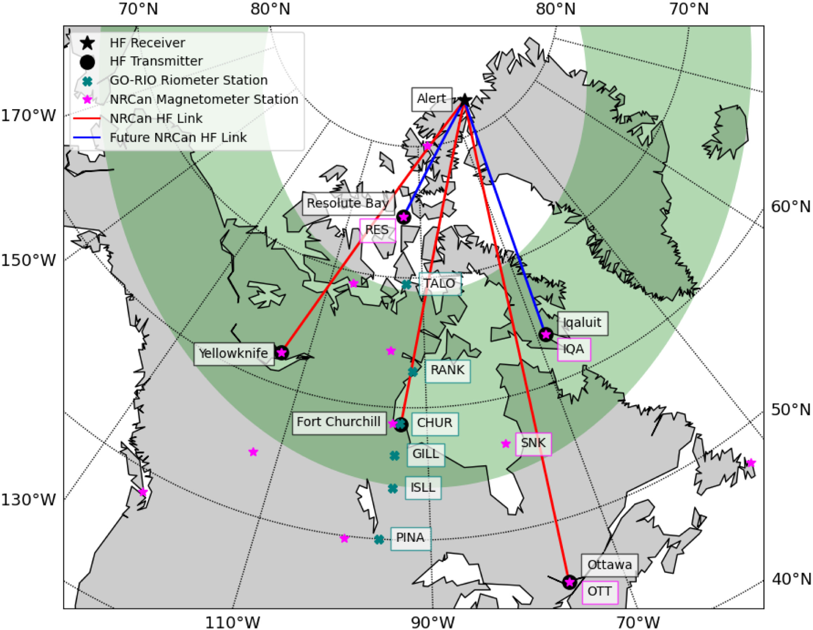
NRCan Ottawa-Alert HF link
Dedicated HF link between Ottawa and Alert operated by NRCan
Reception data from 2013-2019 available (Cameron et al., 2021)
Relationship between absorption from GO-Canada riometers and HF link examined
Riometer chain
HF link
Cameron et al., 2021, Fig 1

Slide 3
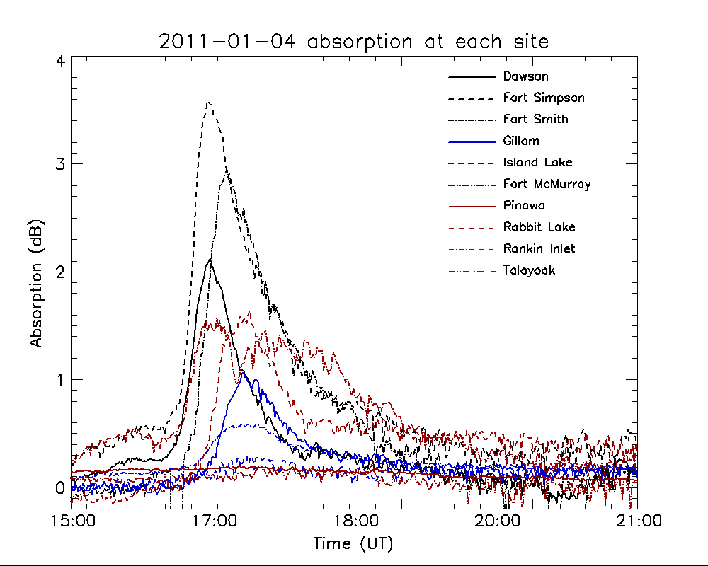
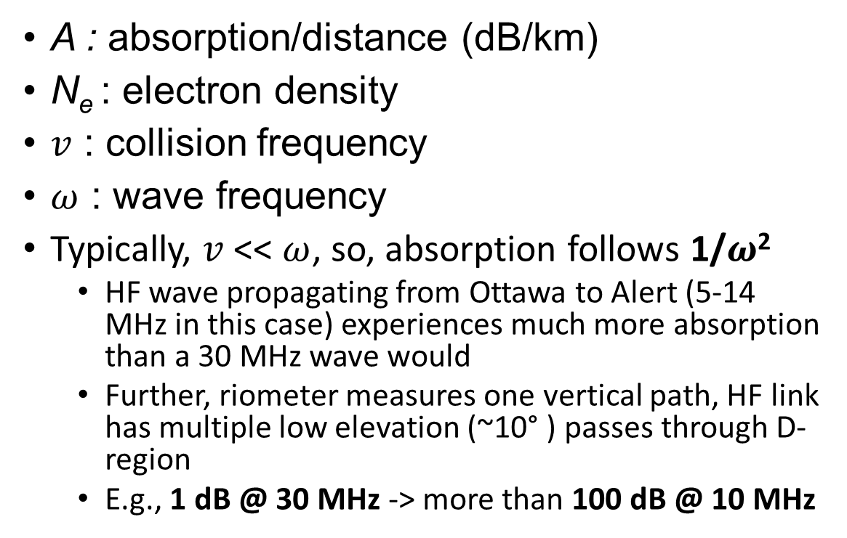
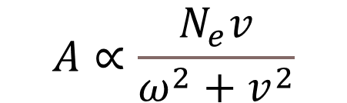
Absorption as a function of radio wave frequency
$$A∝\frac{N_{e}v}{ω^{2}+v^{2}}$$
A : absorption/distance (dB/km)
N_{e} : electron density
$v$ : collision frequency
$ω$ : wave frequency
Typically, $v$ << $ω$, so, absorption follows 1/$ω$²
  HF wave propagating from Ottawa to Alert (5-14 MHz in this case) experiences much more absorption than a 30 MHz wave would
  Further, riometer measures one vertical path, HF link has multiple low elevation (~10° ) passes through D-region
  E.g., 1 dB @ 30 MHz -> more than 100 dB @ 10 MHz
Figure 2: Gillies et al., 2024

Slide 4
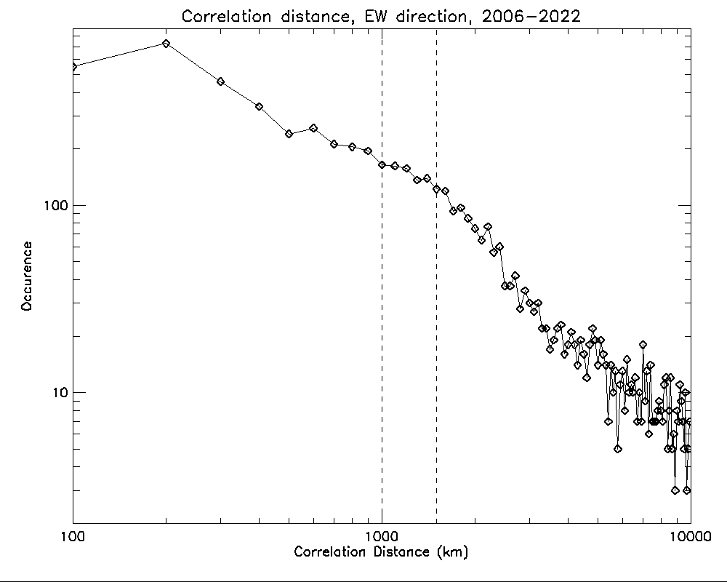
Riometers
GO-Canada sites examined: Rabbit, Gillam, Churchill, and Rankin (from farthest to closest)
  Distance from riometers to HF link ~1000-2000 km
Gillies et al., 2024 examined typical auroral absorption region sizes
  0.5 dB threshold used in that study
  Roughly 30% of events have scale sizes larger than ~1000 km
  Most absorption events measured at riometer sites are not expected to affect HF link
~30% of events
~Riometer to HF link distance
Gillies et al., 2024; absorption region scale size occurrence (magnetic East-West direction)

Slide 5
NRCan HF link
  HF pulses (CW and Barker code) transmitted from Ottawa and received at Alert
  5.4, 6.9, 8.1, 10.4, 11.1, 14.4 MHz transmitted (4 - 24 pulses/hour for each frequency)
  Parameters measured for each pulse (if received/decoded) included:
    Received SNR
    Angle-of-arrival
    Doppler shift
    Time delay
  Signal propagation depends on ionospheric electron density profile:
    F-region -> controls maximum usable frequency (MUF) -> allows sufficient refraction
    D-region -> controls lowest usable frequency (LUF) -> allows minimal absorption

Slide 6
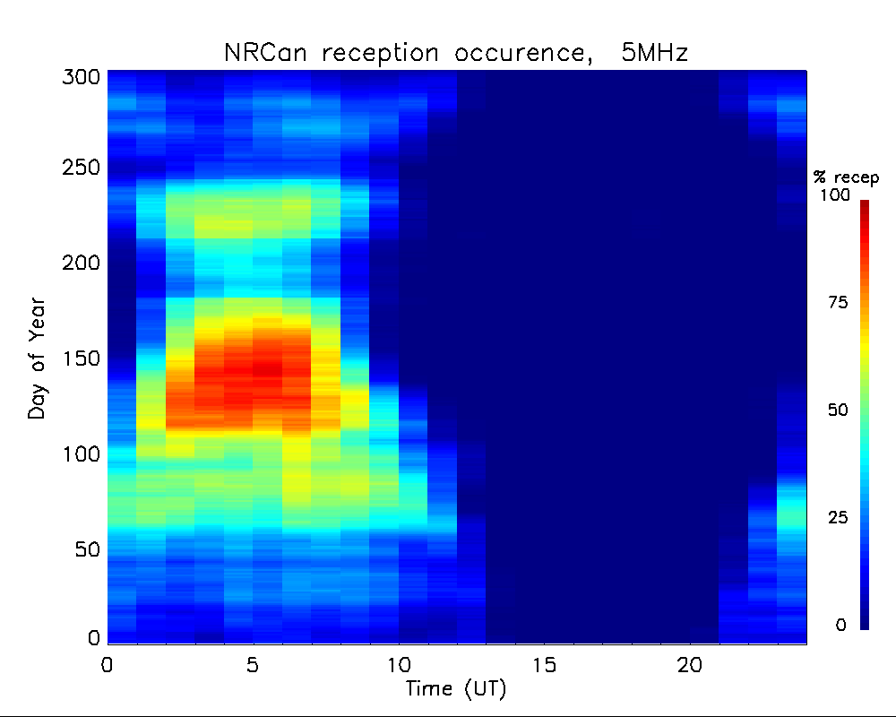
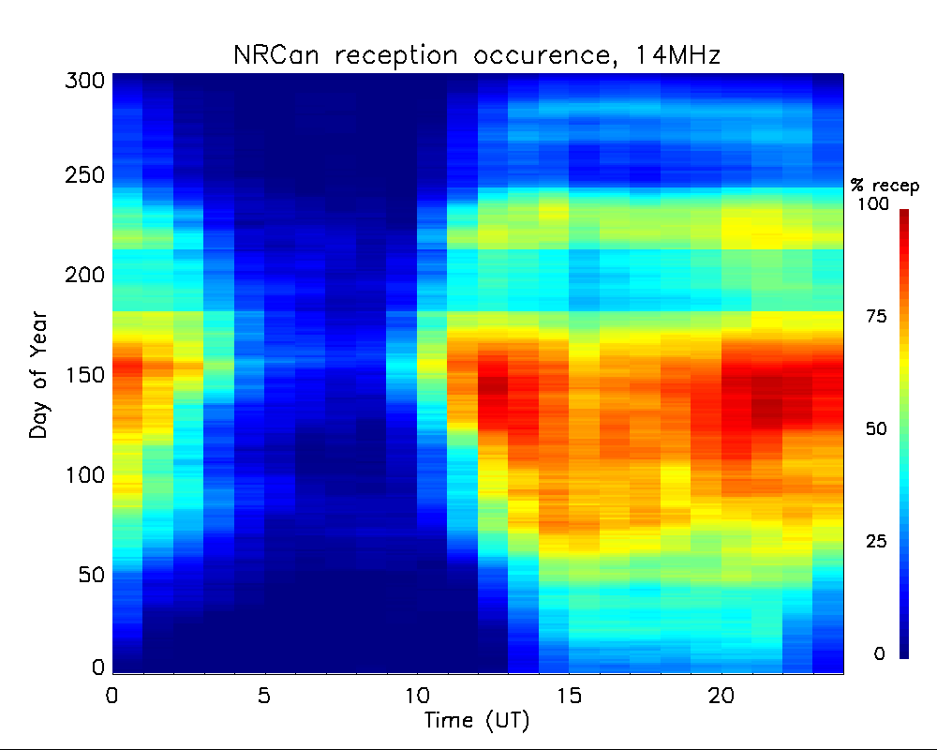
NRCan reception occurrences
5 MHz reception occurrence probability
  Lower absorption during night -> more receptions
14 MHz reception occurrence probability
  Higher density during day -> more receptions

Slide 7
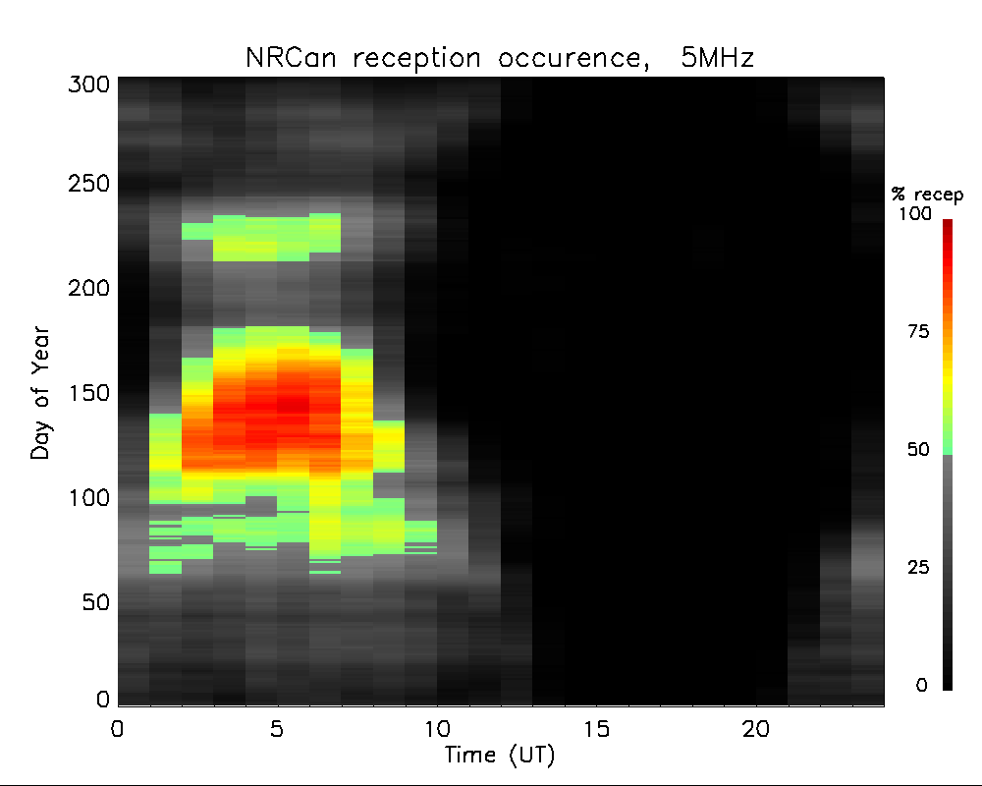
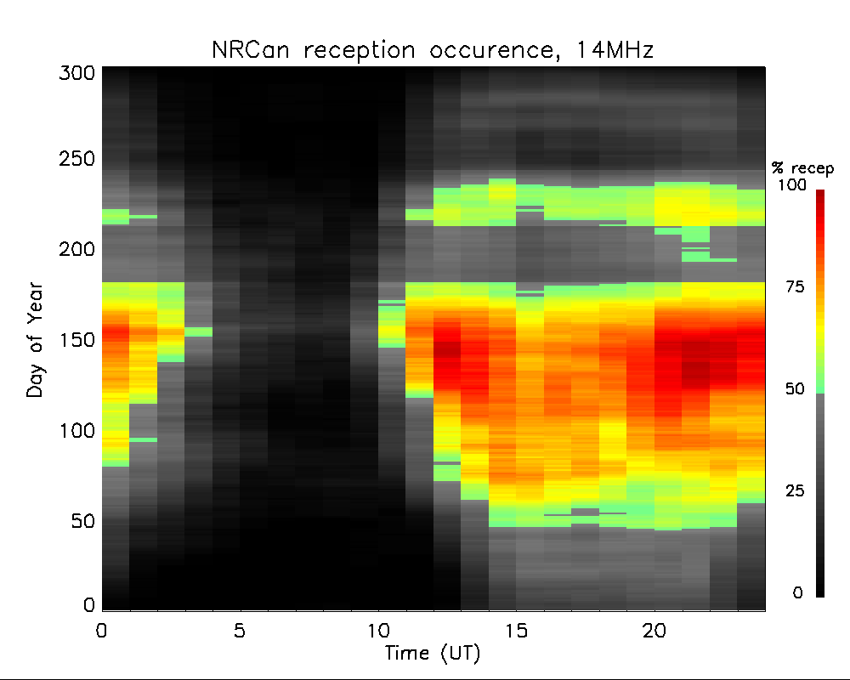
NRCan data selection
Large-scale variation of HF propagation conditions generally predictable
  Local time, season, and solar cycle variation of F-layer
Interested in more sporadic deviations from this occurrence when reception otherwise expected
Consider hour/days when 20-day running average of reception is >50%

Slide 8
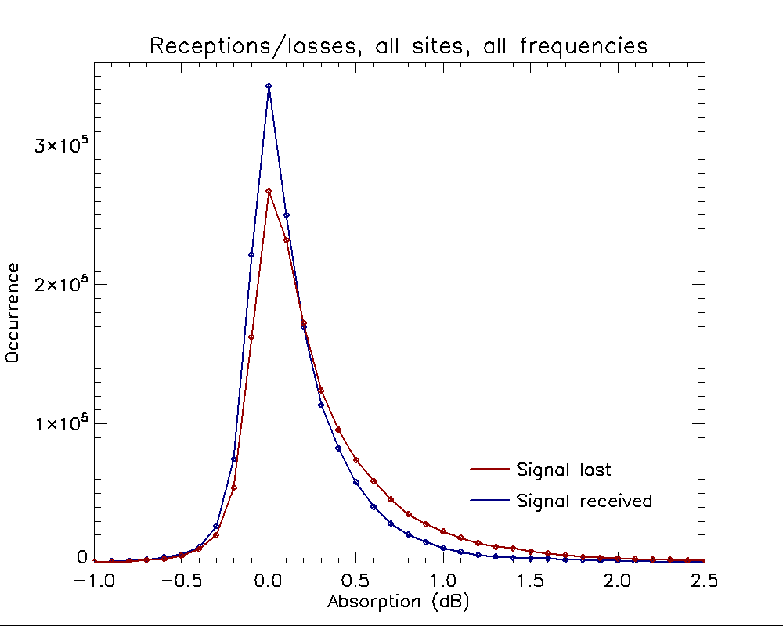
Absorption when signal received vs not
Blue curve: total receptions vs absorption
Red curve: signal losses (signal should be received but was not)
Red curve normalized to area of blue curve
At low absorption (<0.5 dB), signal is received more than lost
At higher absorptions, signal is lost more than received

Slide 9
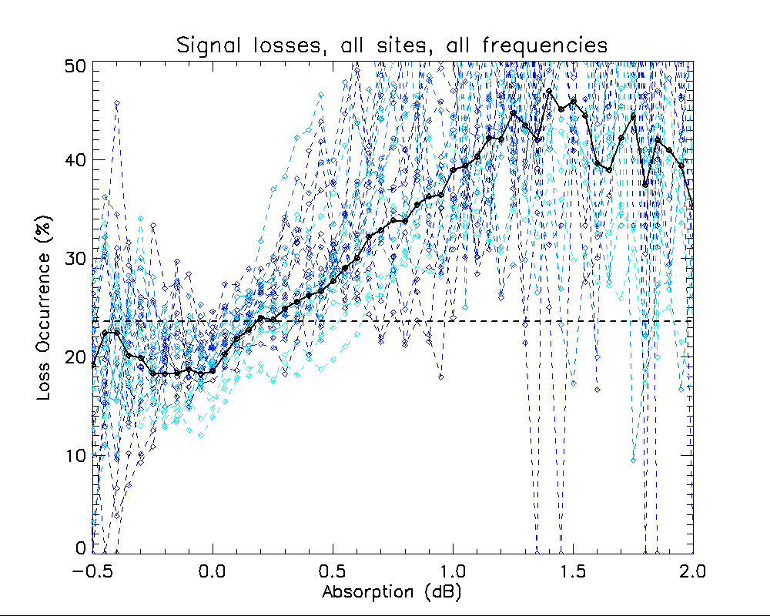
Signal loss vs measured absorption
Number of missed pulses/total expected
Dashed line is overall missed/expected
  Above dashed line: more losses
  Below dashed line: more receptions
Blue curves: separate frequencies/sites
Black curve: overall average (all sites and frequencies)
Overall, higher measured absorption corresponds to more signals being lost

Slide 10
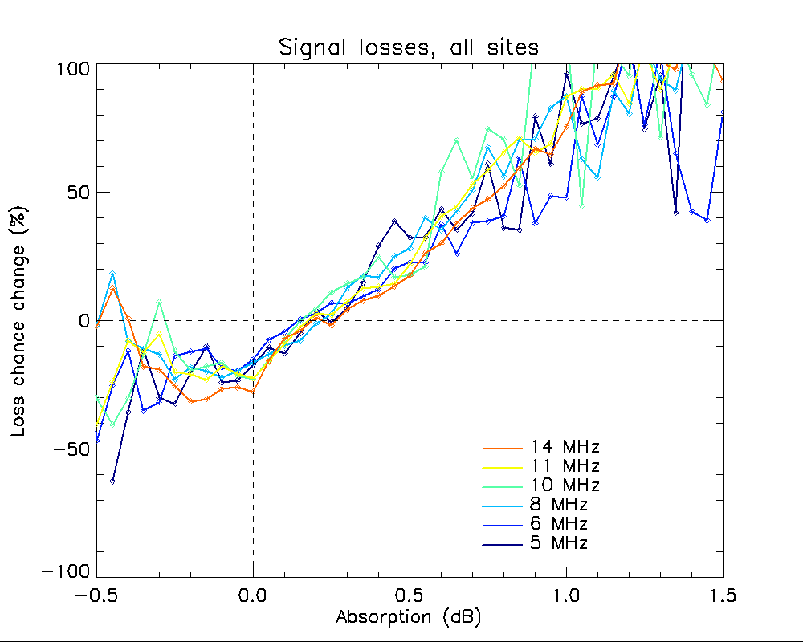
Signal loss vs absorption at different frequencies
Increase of signal losses vs absorption at different frequencies
Little frequency dependence:
  Any absorption (~0.1-0.2 dB) at 30 MHz corresponds to a total blackout at frequencies below 14 MHz
Therefore, signal along the HF link is only lost if measured absorption region is large enough to be detected above both the riometer site and the HF link

Slide 11
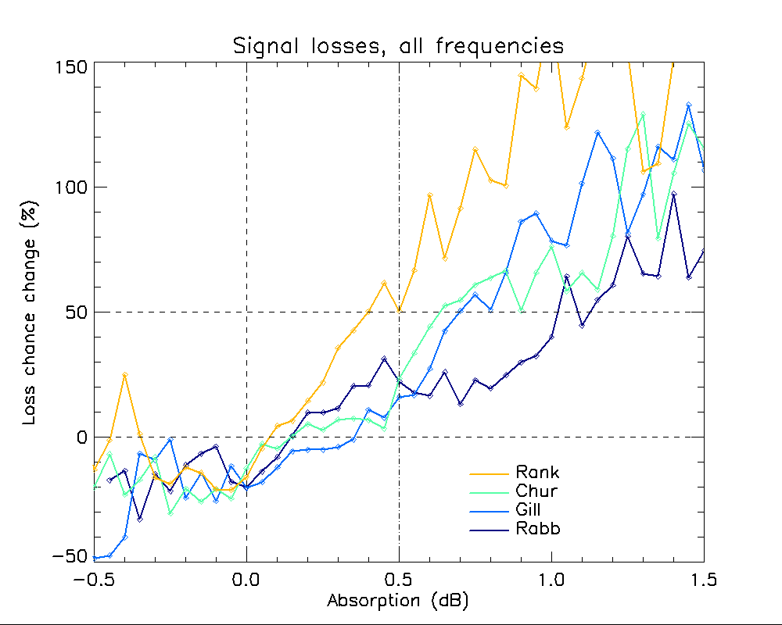
Signal loss vs absorption at different sites
Increase of signal losses vs absorption at different riometer sites
Rankin Inlet (closest site to link) shows most loss vs absorption
  Overall, at 0.5 dB threshold (Gillies et al., 2024), ~20-50% increase in signal losses (broadly in agreement with ~30% of absorption events having appropriate sizes)
Proximity of riometer to HF link/path is very important for predicting useability of link with absorption measurement

Slide 12
Summary
HF link between Ottawa and Alert examined with respect to ionospheric absorption
Signal tends to be lost more often as measured absorption increases
From 5 to 14 MHz, a given level of absorption tends to result in same probability of signal loss
  Any amount of absorption measured at 30-MHz results in total signal loss regardless of frequency if region above riometers is representative of the D-region at the pierce points of HF signal
Sites closer to HF link path correlate better with HF signal losses
Future studies may consider other HF links/transmitters (e.g., SuperDARN) and/or other riometers closer to predicted HF path and D-region intersections

Slide 13
References
Gillies, R. G., Spanswick, E., and Skone, S. (2024). A statistical examination of the spatial correlations of HF ionospheric absorption signatures using the GO‐Canada riometer network. Journal of Geophysical Research: Space Physics, 129, e2023JA032082. https://doi.org/10.1029/2023JA032082
Cameron, T. G., R. A. D. Fiori, E. M. Warrington, A. J. Stocker, T. Thayaparan, & D. W. Danskin (2021). Characterization of high latitude radio wave propagation over Canada, Journal of Atmospheric and Solar-Terrestrial Physics, Volume 219, 2021, 105666, https://doi.org/10.1016/j.jastp.2021.105666

