Slide 1

Doppler shift of transionospheric
HF radio waves
D.W. Danskin¹, R.G. Gilles², E.C. Kalafatoglu Eyiguler¹,
G.C. Hussey¹, and A.W. Yau²
¹Institute of Space and Atmospheric Studies
University of Saskatchewan, Saskatoon
²University of Calgary, Calgary
ddanskinLDS@gmail.com
Canadian Association of Physicist Congress, Saskatoon Jun 8-13, 2025

Slide 2
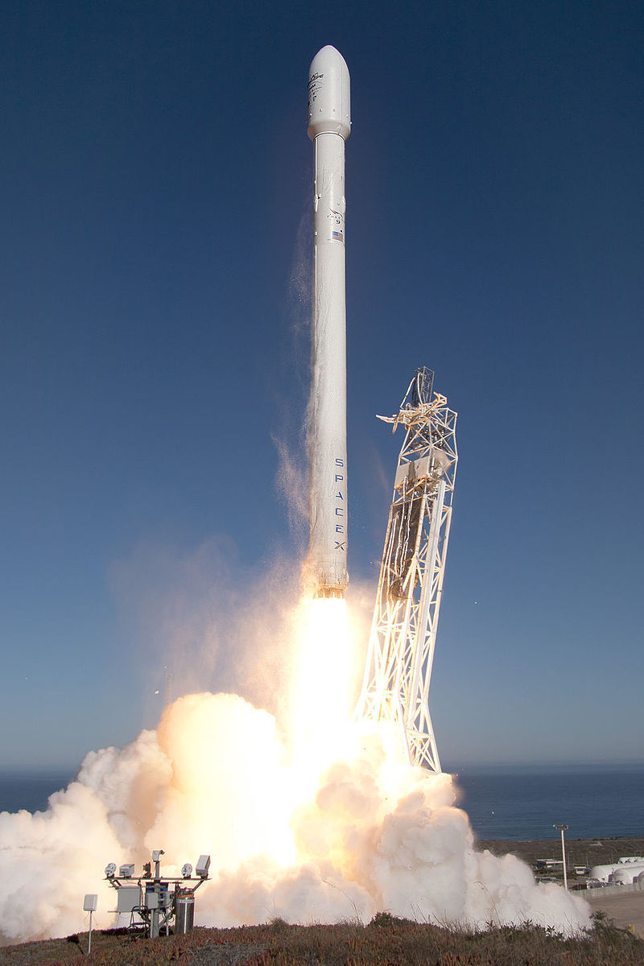
Outline
CASSIOPE launches on a Falcon 9 v1.1
September 29, 2013
Overview of e-POP on Cassiope/Swarm-E
Radio receiver instrument (RRI)
Transmitted waveforms (HF band)
Doppler effect for satellites
Research results
Interpretation
Summary
e-POP first meeting Sep 1997
By SpaceX.com - http://www.spacex.com/media, CC0, https://commons.wikimedia.org/w/index.php?curid=47875078

Slide 3
Overview
RRI on e-POP Cassiope/Swarm-E
GPS Attitude and Profiling Experiment (GAP)
Dipole A
Dipole B
Variable attitude:
Point any axis to a target
Ram orientation
Nadir orientation
Other instruments:
Neutral mass spectrometer (NMS) (demo)
Suprathermal electron imager (SEI)
Imaging and Rapid-Scanning Ion Mass Spectrometer (IRM)
CASCADE high-capacity digital courier (demo)
Radio Receiver instrument has:
crossed dipoles
in-phase and quadrature (I/Q) radio receiver, 4 channel
sampling at ~62.5 ks/s => 30 kHz bandwidth
central frequency is selectable from 15 kHz – 18.5 MHz.
Fixed frequency or sweep modes
3 gain modes
Magnetometers (MGF)
Certo Radio Beacon (CER)
Fast Auroral Imager (FAI)
https://epop.phys.ucalgary.ca/

Slide 4
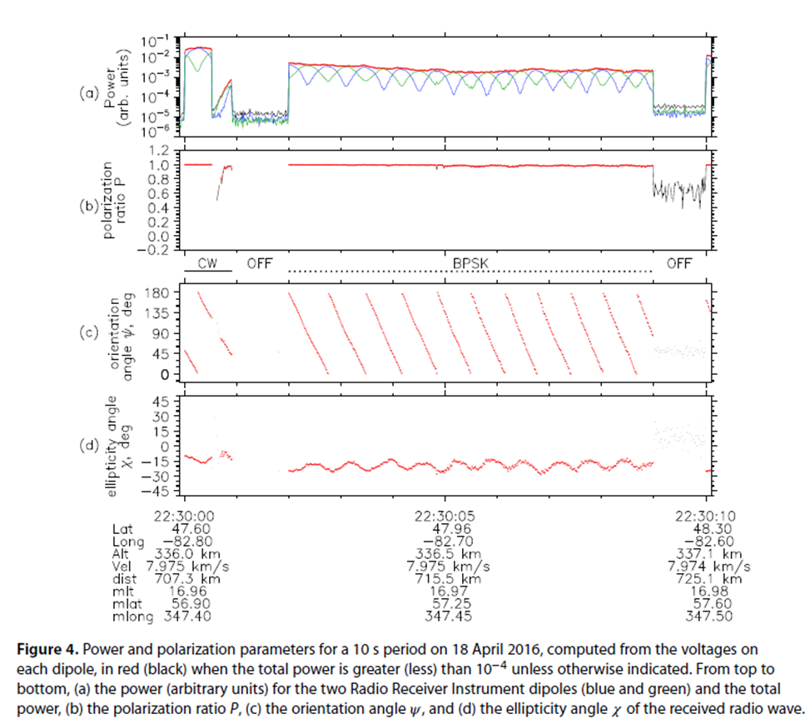
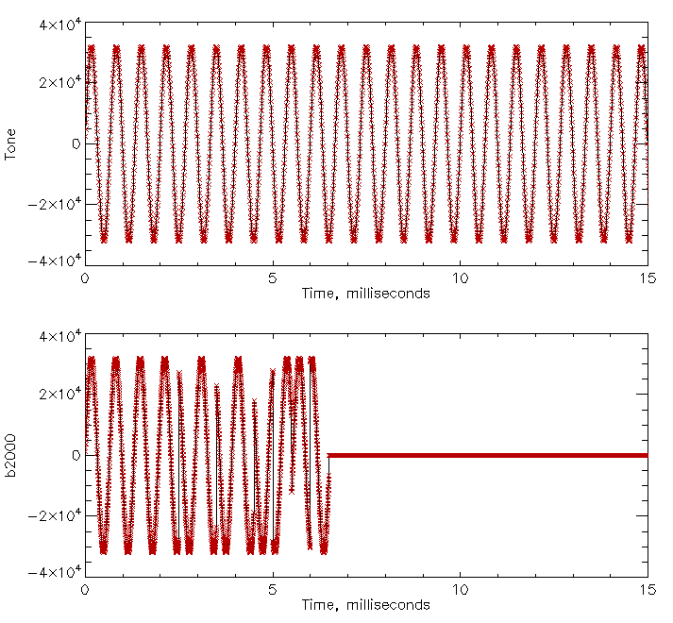
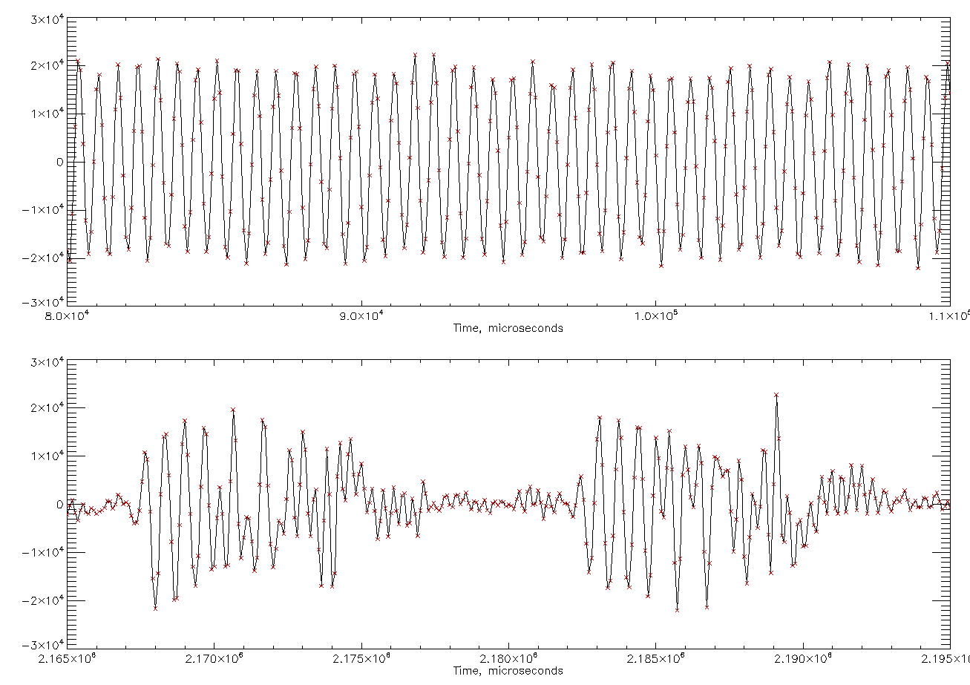
Ottawa HF transmitter waveform
RRI
10.0 s
Transmitted
0.015 s
Received
0.030 s

Slide 5
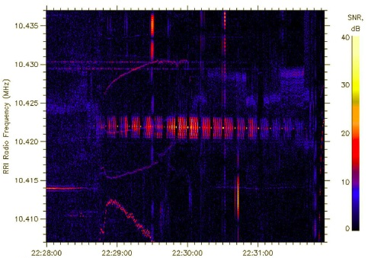
HF transmitter
Five passes of e-POP near Ottawa in April 2016
18 Apr 2016
Transmitter frequency 10.422 MHz
foF2 ~6.262 MHz hmF2 ~260.2 km
Frequency determined using 1s FFT
Spectrogram of signal recorded on one of RRI dipoles

Slide 6
Doppler effect
V
V
θ
V cos θ
n
Ionosphere
Transmitter
Transmitter

Slide 7
Change of Doppler shift
V
V cos θ
90
V cos 90 = 0
V
V
θ
θ
V cos θ
n
Ionosphere
Transmitter

Slide 8
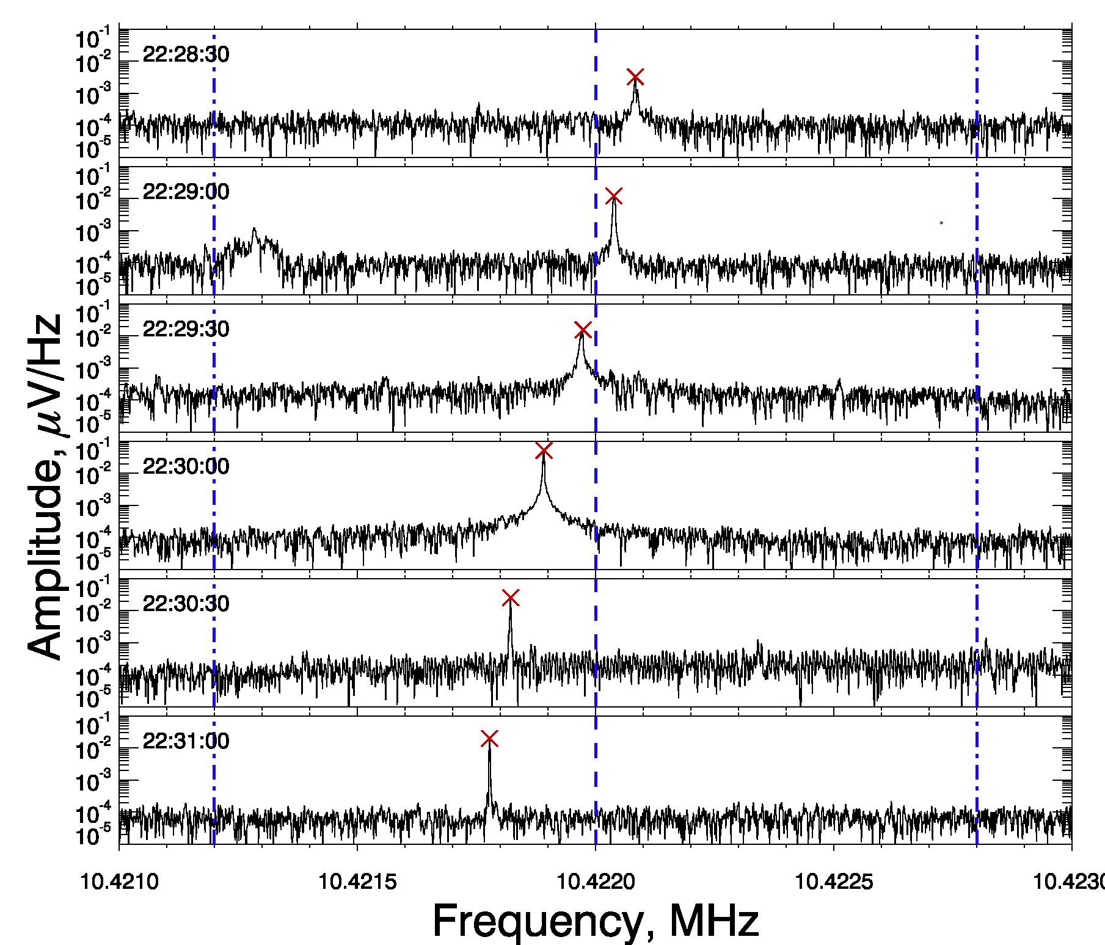
Experimental method: frequency shift analysis
1s FFT -> 1 Hz resolution

Slide 9
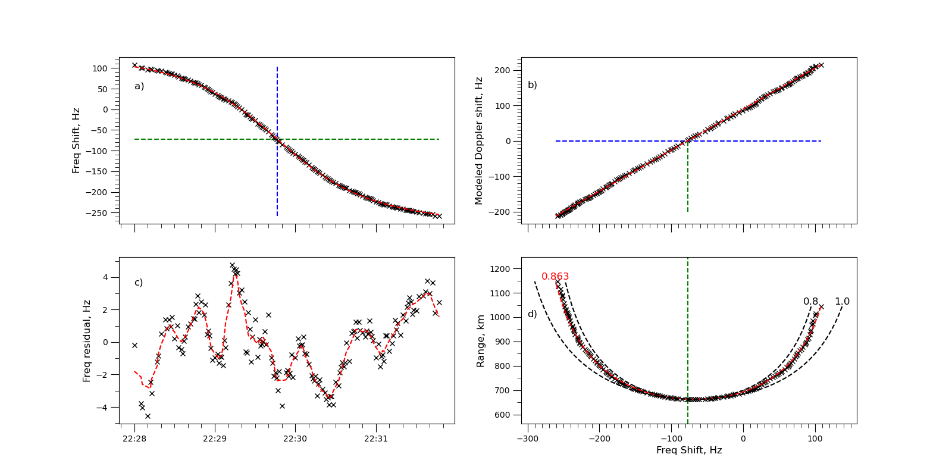
Detected frequency shift analysis
18 Apr 2016
Time, UT

Slide 10
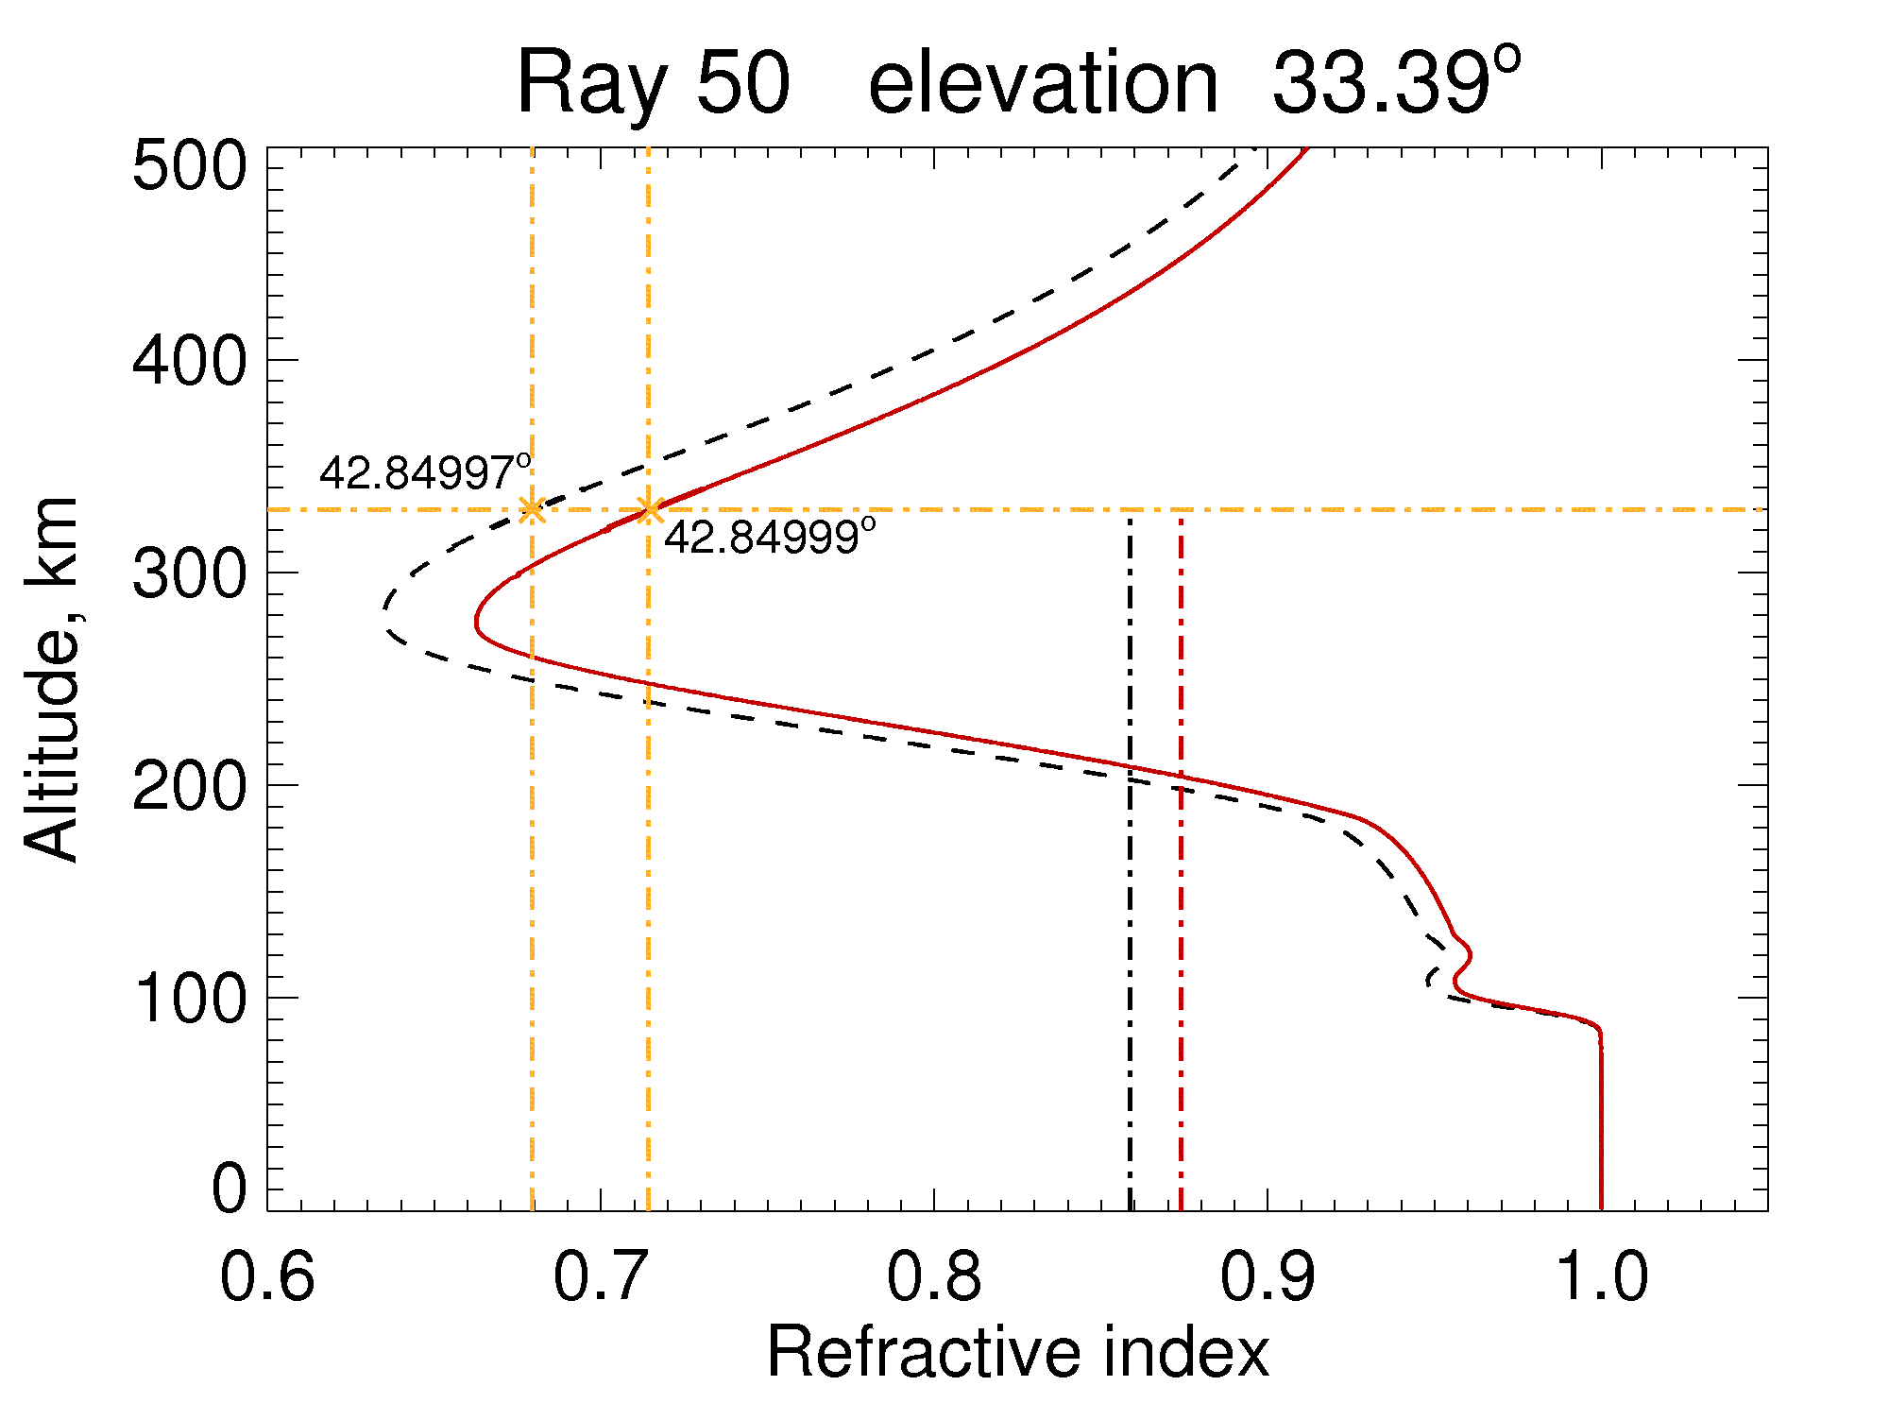
Refractive index profile from ray-tracing model
O-mode
X-mode
.00002º ~ 2.2 m

Slide 11
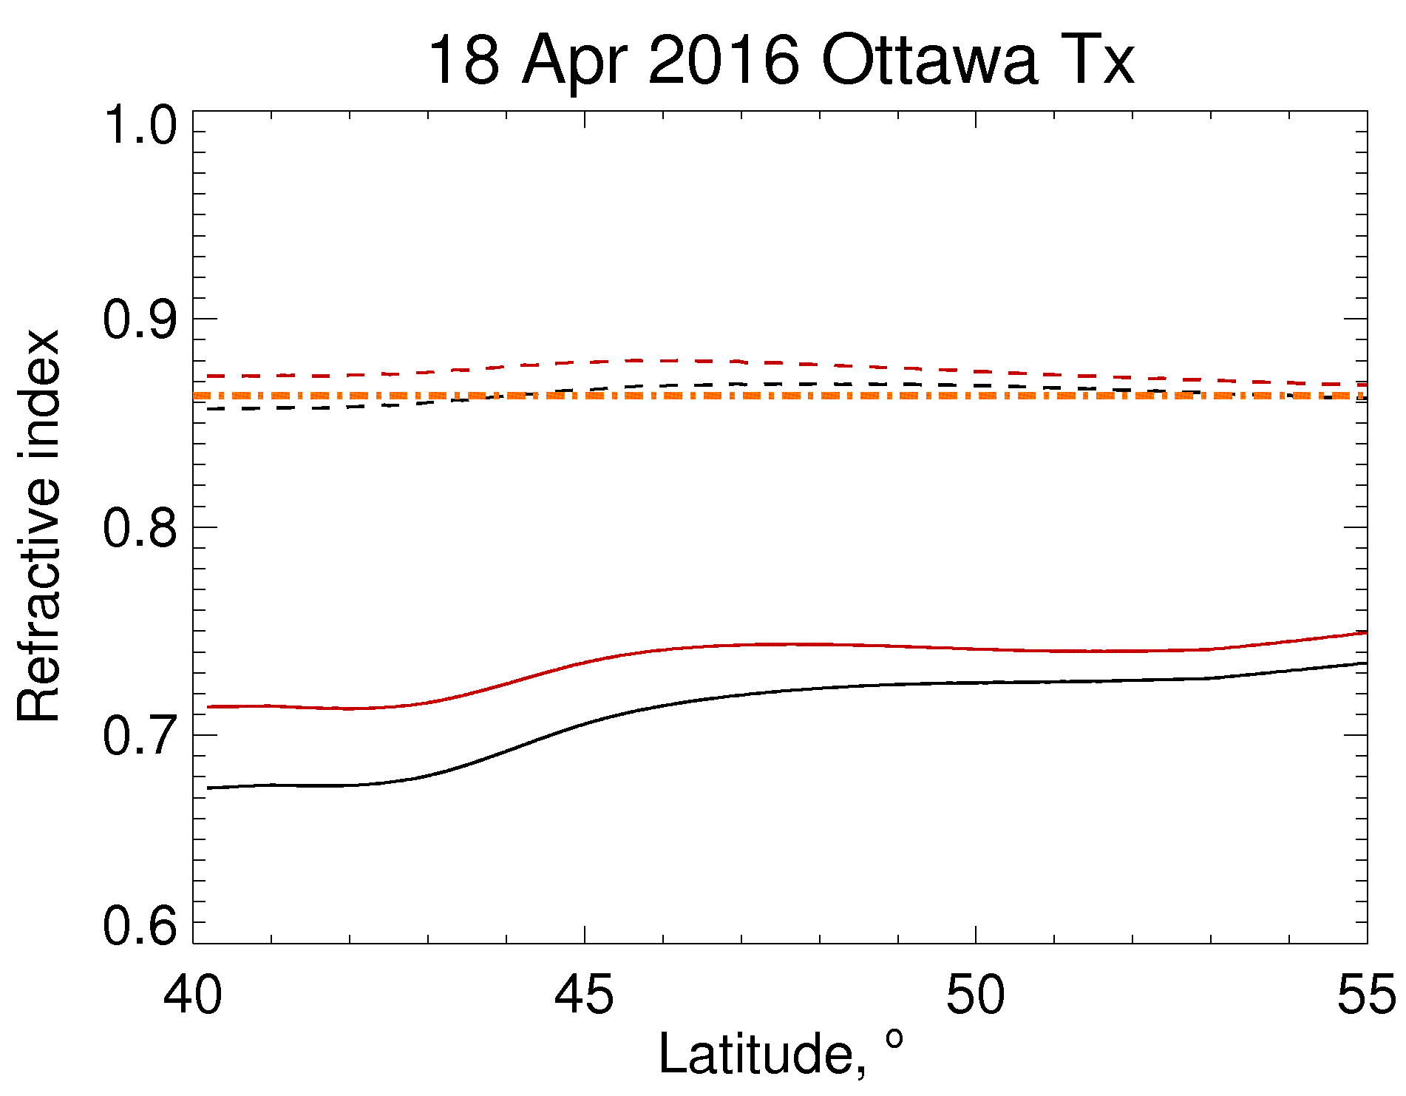
Comparison of refractive index for satellite pass
Refractive index
O-mode sat
O-mode integrated
X-mode sat
X-mode integrated
estimated

Slide 12
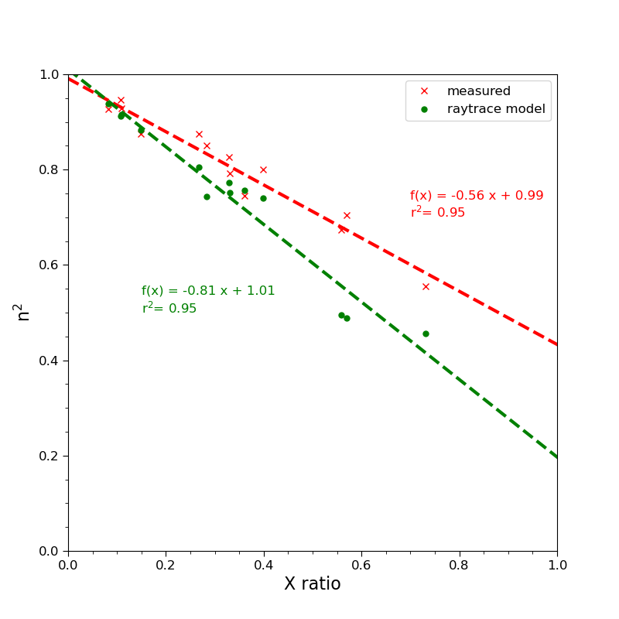
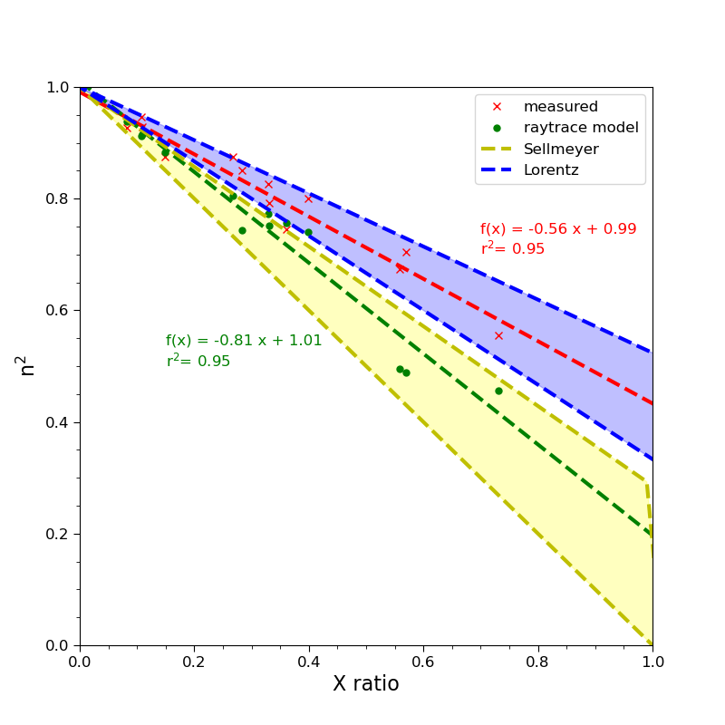
13 satellite passes
X = (foF2/f)²
Strangeways, H. (1992). The Lorentz polarisation term for ionospheric and magnetospheric electromagnetic propagation. JATP.
doi/10.1016/0021-9169(92)90087-2

Slide 13
Summary
Three models were used to estimate the refractive index detected by e-POP RRI on SWARM-E
  Curve fitting of frequency shift v time
  Curve fitting of range v frequency shift
  Slope of expected Doppler shift v frequency shift line
Observationally, the effective refractive index is similar to the height-integrated refractive index rather than the local refractive index at satellite altitude
the radio wave has a memory of the refractive index along the path from the transmitter to the receiver via the ionosphere
Experimentally, Lorentz polarization term of effective Electric field is necessary to explain measured values of refractive index

Slide 14
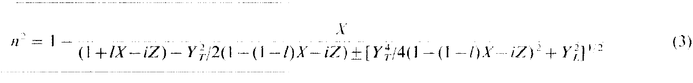
Acknowledgements
Funding provided by the Canadian Space Agency and the European Space Agency
Swarm-E RRI data is available at:
  https://epop-data.phys.ucalgary.ca, (e-POP data portal)
  l = 0 or l = 1/3
Contact: ddanskinLDS@gmail.com

