Slide 1




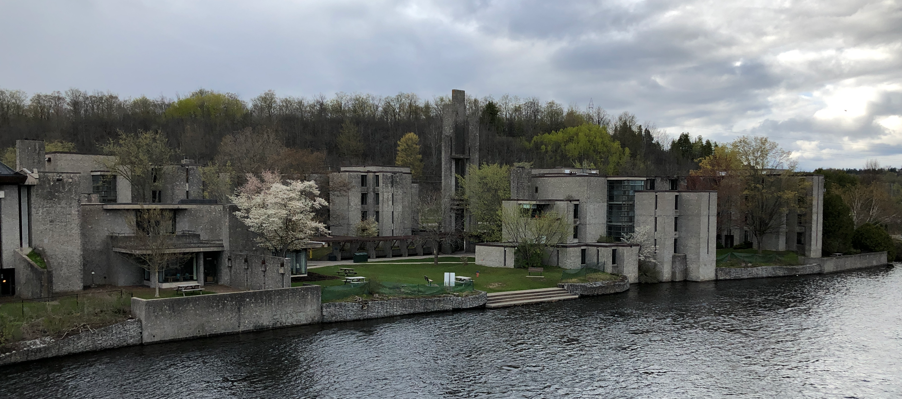

Entanglement growth in the disordered Fermi-Hubbard model
Rachel Wortis
Ahad Nokhostin Helm
Brandon Leipner-Johns

Slide 2
What does disorder do to strongly correlated systems?
What do interactions do to disordered systems?

Slide 3
Outline
equilibrium in closed systems
What is it? How is it reached?
systems which don’t equilibrate
the Fermi Hubbard model with disorder

Slide 4


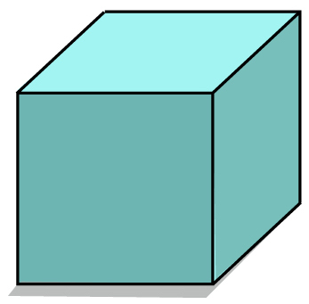
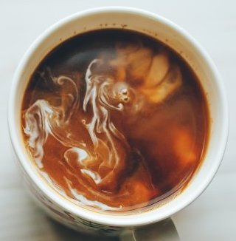
equilibrium, classical
What is it?
time average = ensemble average
properties uniform in space and time

Slide 5
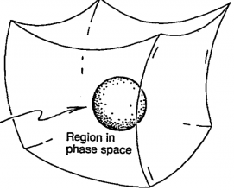
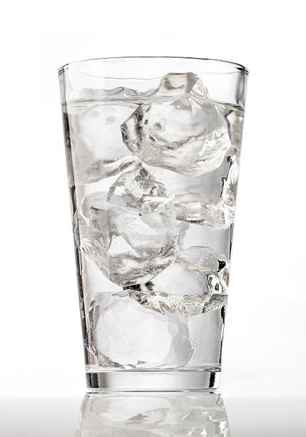
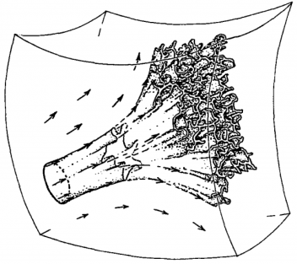
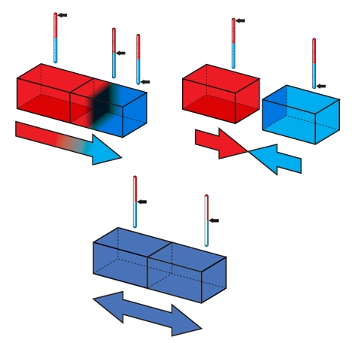
equilibrium, classical
How is it reached?
Hamiltonian dynamics
Liouville’s theorem: phase space volume is conserved
just wait
Liouville equation: in chaotic system, divergence of trajectories such that original volume enters any region of phase space you choose

Slide 6
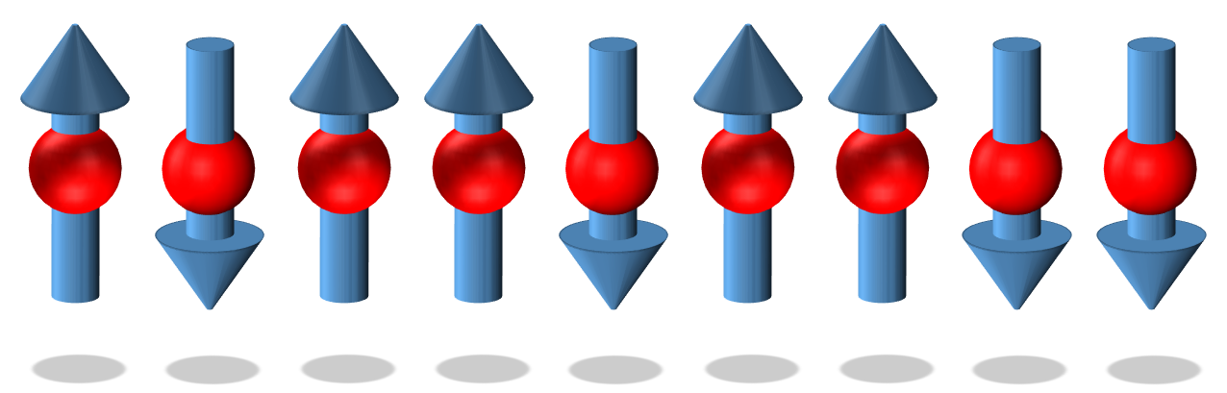
equilibrium, quantum
What is it?
System S is in a single eigenstate with energy
S
A
comes from
If the system were in contact with a thermal bath, what temperature of the bath would make the average energy of S equal to ?
The rest of the system acts as
a thermal bath for the subsystem.

Slide 7
equilibrium, quantum
How is it reached?
If system starts in an eigenstate, there is no time dependence.
If system starts in a superposition of eigenstates, does it evolve toward equilibrium?
eigenstate thermalization hypothesis

Slide 8
Outline
equilibrium in closed systems
systems which don’t equilibrate
classical -> quantum single-ptcle -> quantum many-body
the Fermi Hubbard model with disorder

Slide 9


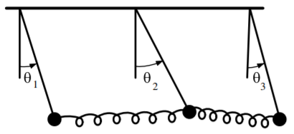
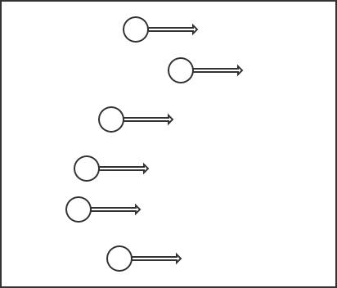
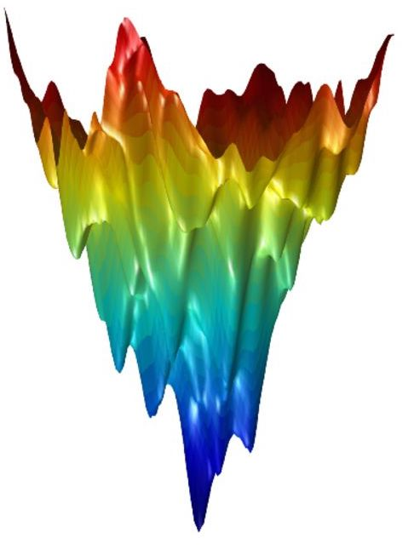
equilibrium, classical
What systems don’t equilibrate?
classical confinement
linearly coupled oscillators:
normal modes
non-ergodicity can persist for sufficiently small nonlinearities!
(KAM theorem)
addition conserved quantities
(macroscopic number)
fine tuning
What about quantum systems?
glassy

Slide 10
blocking equilibration with disorder
non-interacting particles
particle-in-a-box/extended states
increasing disorder strength
amplitudes of sample wavefunctions
Absence of diffusion in certain random lattices
P.W. Anderson, Phys. Rev. 109, 1492 (1958)
Scaling Theory of Localization: Absence of Quantum Diffusion in Two Dimensions
E. Abrahams, P. W. Anderson, D. C. Licciardello, and T. V. Ramakrishnan
Phys. Rev. Lett. 42, 673 (1979)
Anderson localized states
Anderson localization

Slide 11
Anderson localization
cold atoms
Billy, et al, Nature
453 891 (2008)
light
Schwartz, et al, Nature
446 52 (2007)

Slide 12
What does localization mean in an interacting system?
lack of transport
memory of initial conditions
lack of thermalization
macroscopic number of local conserved quantities
Poisson statistics of level spacing
discrete local spectrum
entanglement entropy area law and logarithmic time dependence
not just ground state property
precursers: Fleishman & Anderson (1980); Finkelstein (1983); Giamarchi & Schulz (1988)
early work: Gornyi, Mirlin, & Polyakov (2005); Basko, Aleiner, & Altshuler (2006,2007)
reviews: Nandkishore & Huse, Annual Review of Cond. Matt. Phys. 6, 15 (2015); Abanin, Altman, Bloch, & Serbyn, Rev. Mod. Phys. 91 021001 (2019)
Choi, et al., Science 352 1547 (2016)
Schreiber, et al., Science 349 6250 (2015)

Slide 13

What does localization mean in an interacting system?
Pal & Huse, PRB 82 174411 (2010)
lack of thermalization: many-body localized system does not act as a thermal bath for a subsystem.

Slide 14
What does localization mean in an interacting system?
Hamiltonian in terms of local integrals of motion
Huse, Nandkishore and Oganesyan, PRB 90, 174202 (2014)
local integral of motion

Slide 15
questions
Is many-body localization stable in the thermodynamic limit?
What is the nature of the transition? Is there an intermediate phase? A mobility edge?
Is there localization for d>1?
Can localization persist in the presence of external coupling?
What novel nonequilibrium states might arise?
Can the local memory retention be used in quantum computing?
What new aspects of localization arise in multi-component systems?

Slide 16

Kondov PRL 2015
Fermi-Hubbard model with charge and spin disorder
charge density
magnetization
charge disorder
spin disorder

Slide 17
Outline
equilibrium in closed systems
systems which don’t equilibrate
the Fermi Hubbard model with disorder
How does the entanglement grow with time?
What are the contributions of charge and spin to this growth?
How might disorder in charge and spin be used to control this growth?

Slide 18
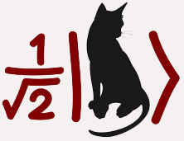
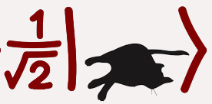
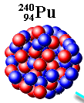
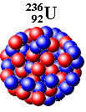

Why study entanglement?
How to quantify entanglement?
entanglement entropy
Identifying distinct phases of matter
Controlling entanglement for quantum computation
Understanding how quantum systems approach thermal equilibrium
A B
next: S(t) in noninteracting system -> S(t) in interacting system
-> understanding charge and spin contributions

Slide 19
Disorder impedes entanglement growth and equilibration
non-interacting tight-binding + disorder
interacting spinless Fermions + disorder
entanglement entropy
time
local integral of motion
Bardarson, Pollmann, & Moore, PRL 109 017202 (2012)
Huse & Oganesyan, PRB 90 174202 (2014)
Serbyn & Abanin, PRL 110 260601 (2013)

Slide 20
Experiments in cold-atom systems
Bose-Hubbard
model
Lukin, Rispoli, Schittko, Tai, Kaufman, Choi, Khemani, Leonard, Greiner
Science 364 256 (2019)

Slide 21
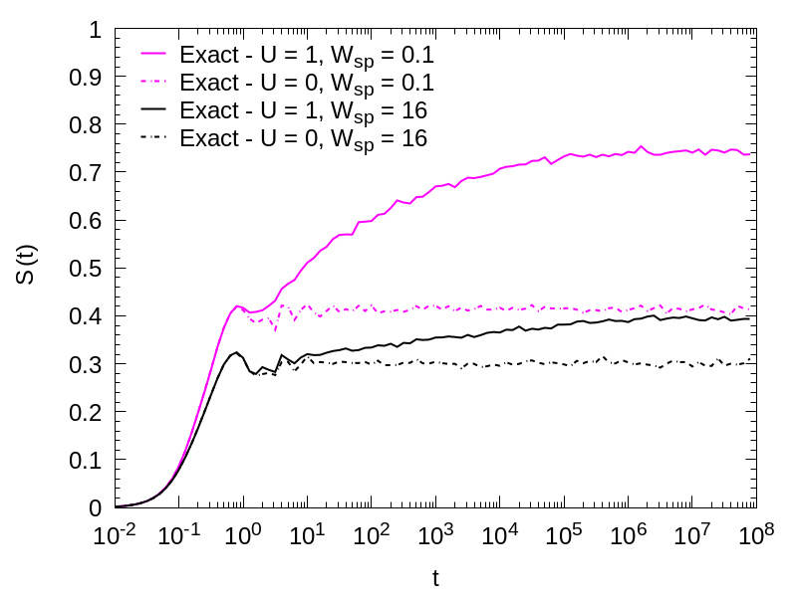
Entanglement growth in disordered Fermi-Hubbard model
comparing W_{ch}=16,W_{sp}=16 with W_{ch}=16,W_{sp}=0.1
entanglement entropy
Lower W_{sp} causes small
increase for U=0
but a large increase for U=1
time

Slide 22
Expressing the disordered Fermi-Hubbard model
in terms of local integrals of motion
Hamiltonian in the usual form:
Originally proposed Hamiltonian in terms of local integrals of motion:
Our version with charge and spin specific local integrals of motion:

Slide 23
Charge and spin-specific local integrals of motion
making integrals of motion
Huse (2014); Chandran (2015)
Eigenstates of H → Q such that Q⁺HQ is diagonal.
If A is diagonal in Fock basis, then QAQ⁺ diagonal in energy basis.
making them local
Leipner-Johns (2019)
Choose local A, e.g.
Choose Q close to the identity
Q = ( )
charge and spin character
Leipner-Johns (2019)
Construct from local charge
and magnetization operators

Slide 24
Locality of integrals of motion
Phys. Rev. B 100, 125132 (2019)
overlap vs distance
Zero spin disorder:
No localization of spin
Very weak spin disorder:
Localization of spin is almost as strong as that of charge

Slide 25
The Hamiltonian written in terms of LIOMs
1st-order terms
2nd-order terms
Next:
Results: distribution of J values → entanglement entropy
(1) Wsp=Wch (2) Wsp<<Wch

Slide 26
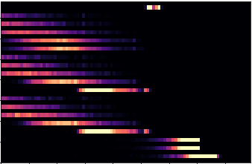
Distribution of coefficients in the LIOM Hamiltonian
Wsp = Wch = 16
Charge and spin values the same
2nd-order coefficients decay with distance
Charge-spin coupling 10x smaller than charge-charge or spin-spin
-6 -4 -2 0 +2
log(J)

Slide 27
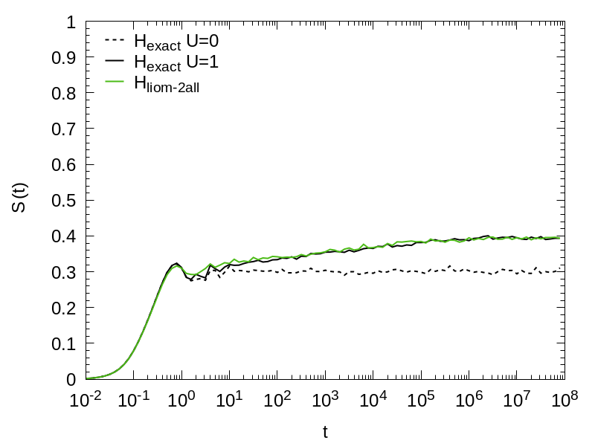
Entanglement growth in disordered Fermi-Hubbard model
comparing exact with up to 2nd-order terms in LIOM Hamiltonian
W_{ch}=16
W_{sp}=16
2nd-order terms in the LIOM Hamiltonian capture most of the physics
log(t) growth same as seen in single-component systems
weak coupling between charge and spin not apparent
entanglement entropy
time

Slide 28
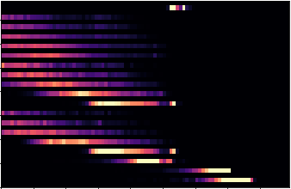
Distribution of coefficients in the LIOM Hamiltonian
Wsp = Wch = 16
Wsp = 0.1 << Wch = 16
-6 -4 -2 0 +2
-4 -2 0 +2
log(J)
log(J)

Slide 29
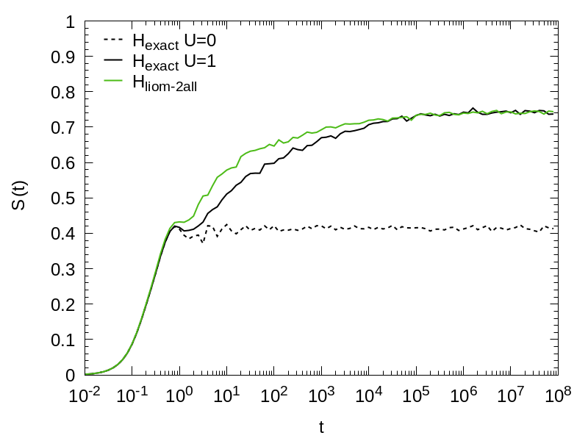
Entanglement growth in disordered Fermi-Hubbard model
comparing exact with up to 2nd-order terms in LIOM Hamiltonian
W_{ch}=16
W_{sp}=16
entanglement entropy
W_{ch}=16
W_{sp}=0.1
time
time
Wsp<< Wch: long-term growth no longer log(t)
2nd-order terms still capture most physics, but not quite as well

Slide 30
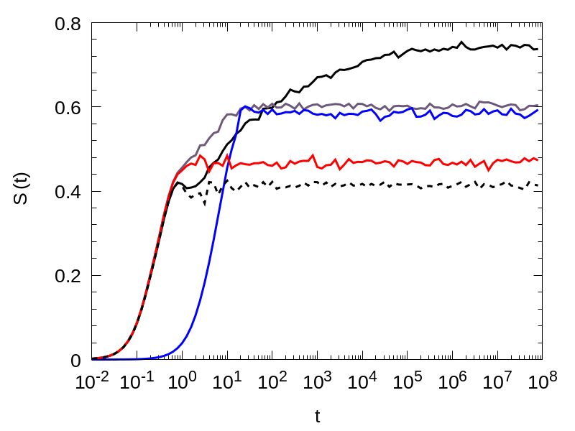
Entanglement growth in disordered Fermi-Hubbard model
separating 1st-order terms into charge and spin
W_{ch}=16
W_{sp}=0.1
exact
all 1st order
1st-order spin only
entanglement entropy
1st-order charge only
origin of two-stage rise:
W_{ch}>W_{sp} →
localization length charge < spin
→ charge entangles faster
to lower saturation value
time

Slide 31
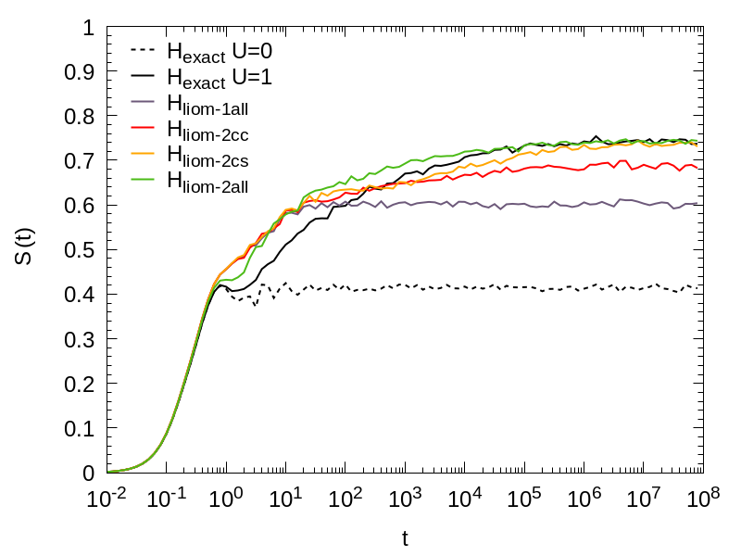
Entanglement growth in disordered Fermi-Hubbard model
contributions of different 2nd-order terms
W_{ch}=16
W_{sp}=0.1
all 2nd-order
1st + charge-spin
1st + charge-charge
1st order only
entanglement entropy
charge-spin coupling contributes at later times than charge-charge and spin-spin
← →
average charge-spin coupling strength is much less than average charge-charge and spin-spin coupling strength
time

Slide 32
Summary
Disorder can prevent equilibration
The Fermi-Hubbard model can have disorder in charge and spin
Localization in spin depends on disorder in both spin and charge
We study entanglement growth, distinguishing the contributions from charge and from spin by expressing the Hamiltonian in terms of optimally local charge and spin integrals of motion
The Hamiltonian truncated at 2nd order captures most of the physics
Charge-charge and spin-spin coefficients decay exponentially with distance
Charge-spin coupling is much weaker than charge-charge or spin-spin
rwortis@trentu.ca

Slide 33
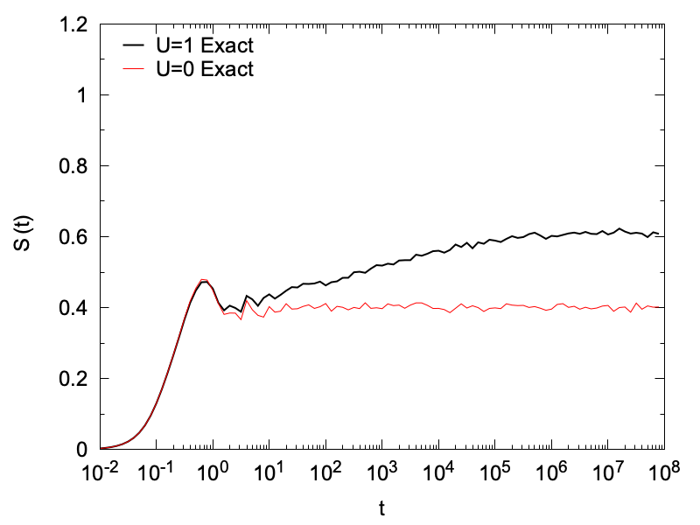
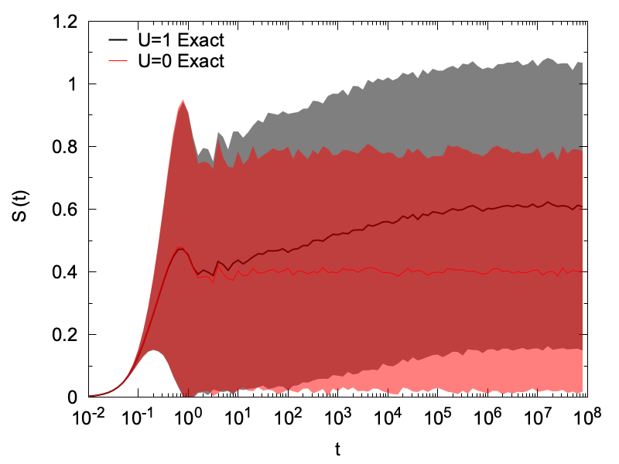
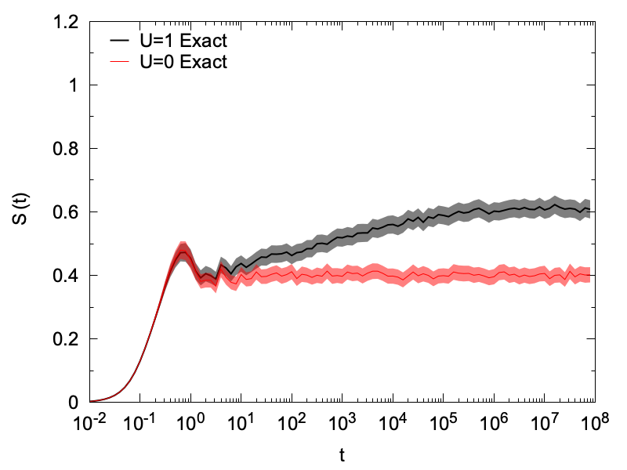
Entanglement growth in disordered Fermi-Hubbard model
strong disorder in both charge and spin
entanglement entropy
standard devation
standard error of the mean
time

Slide 34
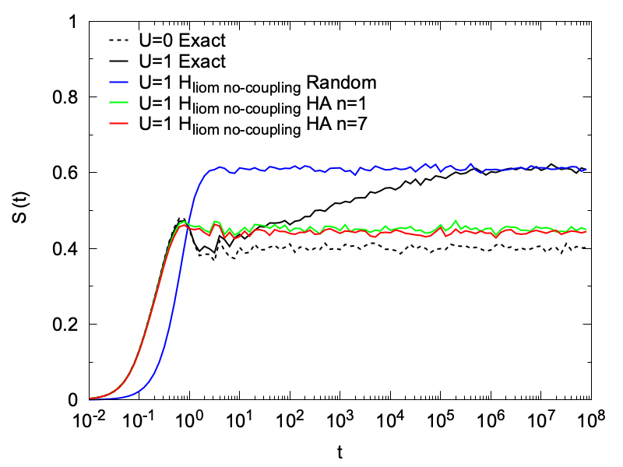
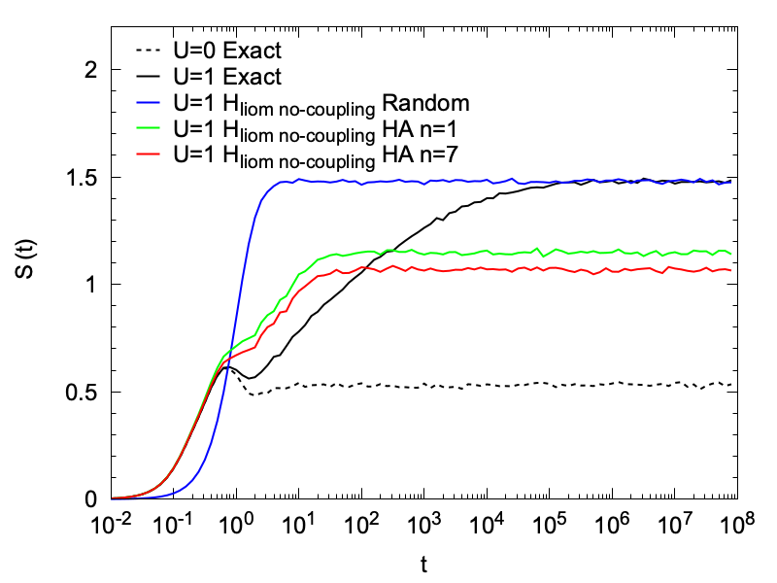
Entanglement growth in disordered Fermi-Hubbard model
Does optimizing locality of integrals of motion make a difference?
W_{ch}=16
W_{sp}=16
W_{ch}=16
W_{sp}=0.1
entanglement entropy
time
time
Optimizing the locality of the LIOMs is making a difference;
but with W_{sp}=0.1 extra entanglement remains

Slide 35
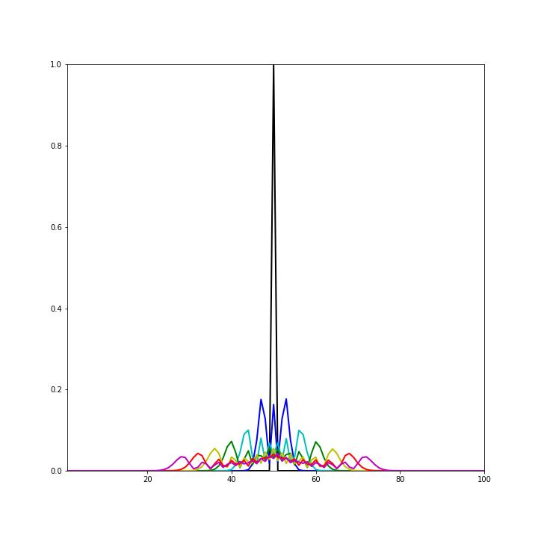
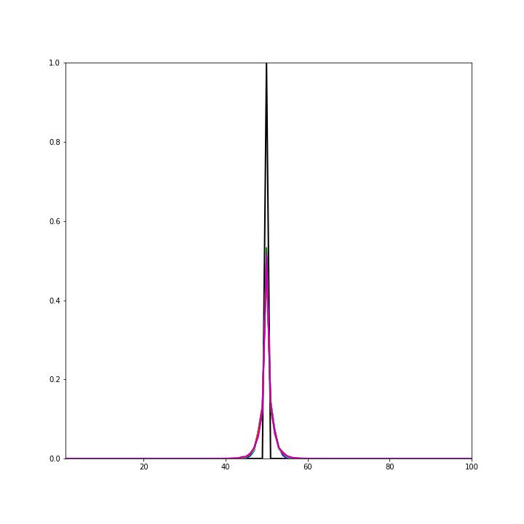

Slide 36


Strong disorder in both channels not required for localization
entanglement entropy
time

