Slide 1





Introducing the Partial Strassen Algorithm for entanglement renormalization
Aaron Dayton (Speaker) – Kiana Gallagher – Dr. Thomas E. Baker
Department of Physics & Astronomy, University of Victoria, Victoria, Canada

Slide 2
Motivation
We require efficient classical methods to compare against quantum computations
  Lattice density functional theory
  Variational quantum eigensolvers
  Entanglement renormalization
Tensor contractions reduce to matrix multiplications

Slide 3
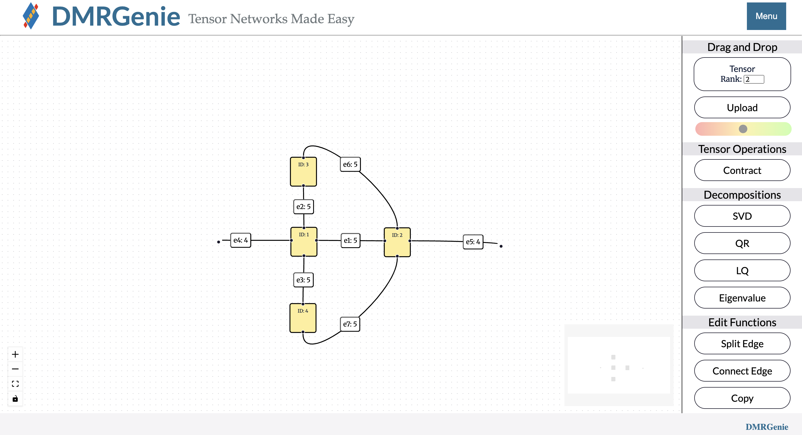
URL: dmrgenie.rs.uvic.ca
GitHub: bakerte/DMRGenie.jl

Slide 4
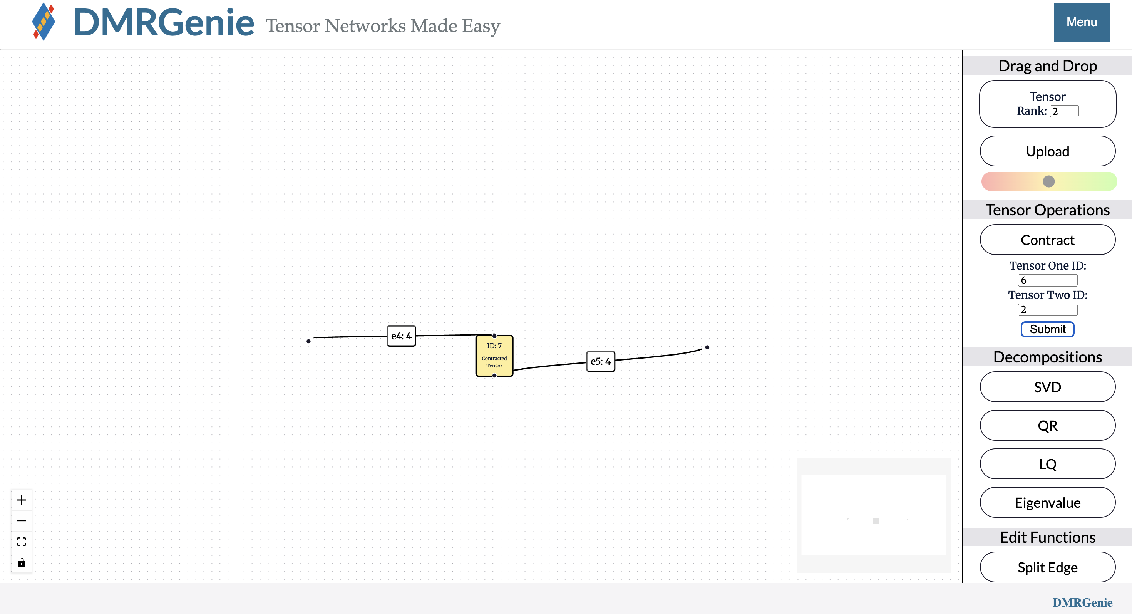
URL: dmrgenie.rs.uvic.ca
GitHub: bakerte/DMRGenie.jl

Slide 5
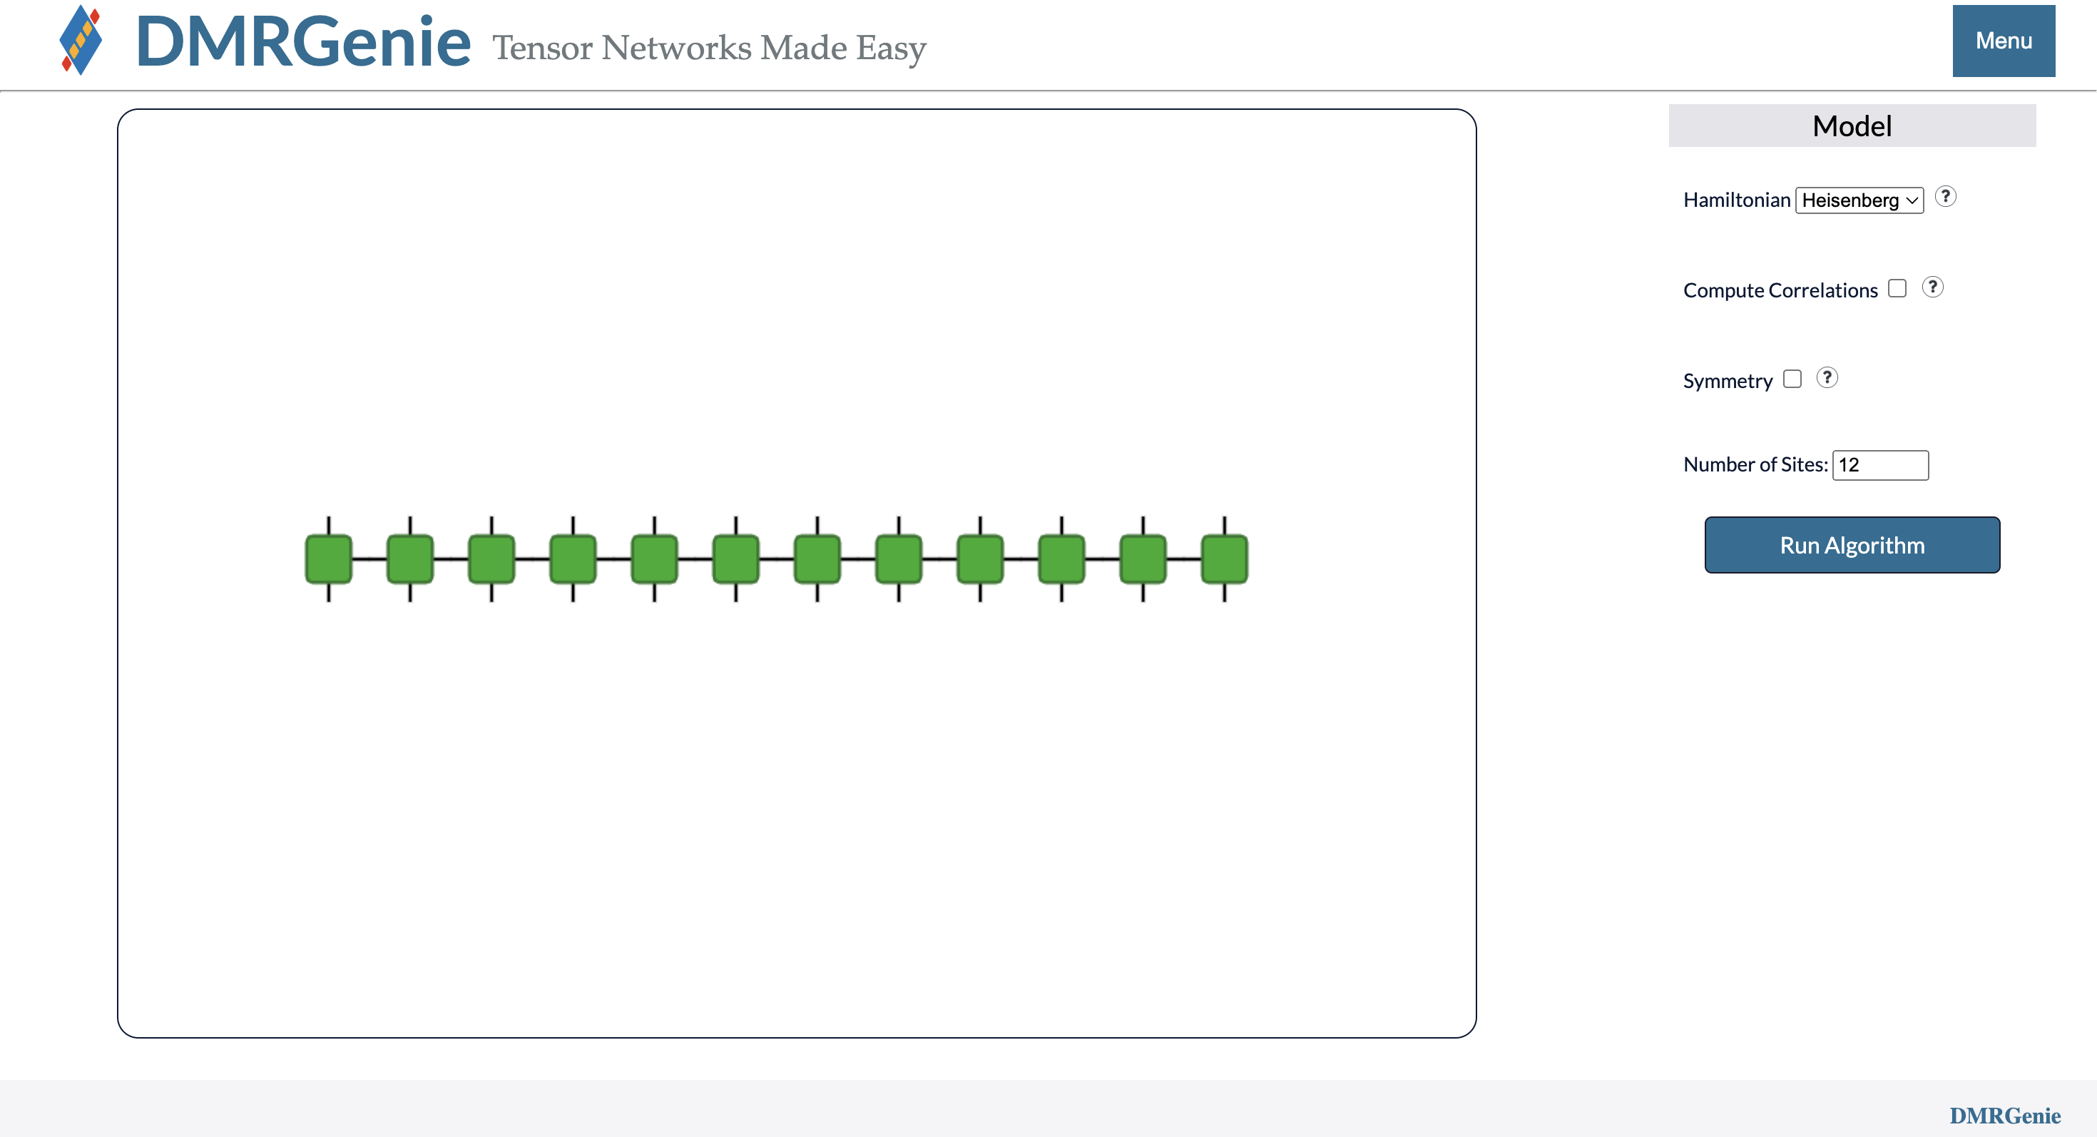
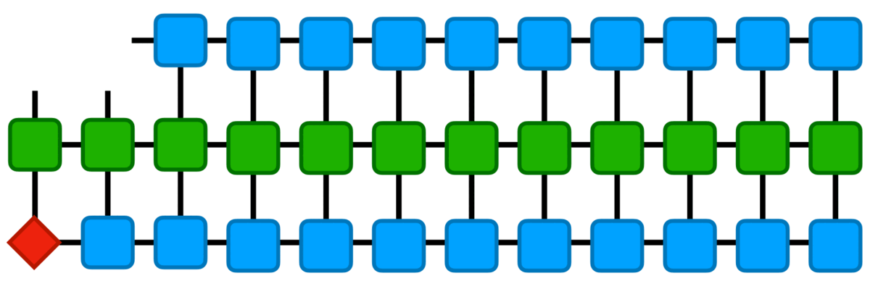
URL: dmrgenie.rs.uvic.ca
GitHub: bakerte/DMRGenie.jl

Slide 6
The Strassen algorithm for matrix multiplication
6

Slide 7
The Strassen algorithm
A
B
C
.
=

Slide 8
The Strassen algorithm
A₁₁
A₁₂
B₁₁
B₁₂
C₁₁
C₁₂
.
=
A₂₁
A₂₂
B₂₁
B₂₂
C₂₁
C₂₂

Slide 9
The Strassen algorithm
Traditional Multiplication
8 Multiplications
4 Additions
Strassen Multiplication
7 Multiplications
18 Additions

Slide 10
The Strassen algorithm
Traditional Multiplication
8 Multiplications
4 Additions
Strassen Multiplication
7 Multiplications
18 Additions
(Single-level vs. Multi-level)

Slide 11
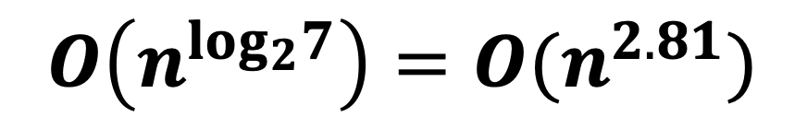
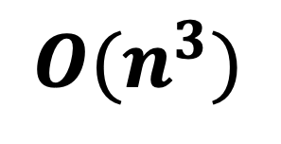
The Strassen algorithm
Traditional Multiplication
8 Multiplications
4 Additions
Strassen Multiplication
7 Multiplications
18 Additions
(Single-level vs. Multi-level)
$$O(n^{3})$$
$$O\left(n^{log_{2}7}\right)=O(n^{2.81})$$

Slide 12
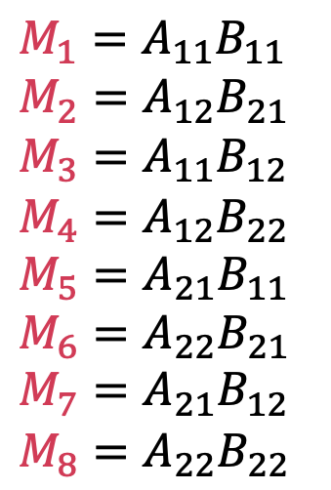
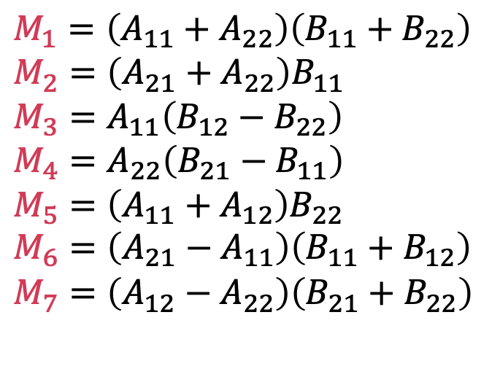
The Strassen algorithm
Traditional
Strassen
$$M_{1}=A_{11}B_{11}$$
$$M_{2}=A_{12}B_{21}$$
$$M_{3}=A_{11}B_{12}$$
$$M_{4}=A_{12}B_{22}$$
$$M_{5}=A_{21}B_{11}$$
$$M_{6}=A_{22}B_{21}$$
$$M_{7}=A_{21}B_{12}$$
$$M_{8}=A_{22}B_{22}$$
$$M_{1}=\left(A_{11}+A_{22}\right)\left(B_{11}+B_{22}\right)$$
$$M_{2}=\left(A_{21}+A_{22}\right)B_{11}$$
$$M_{3}=A_{11}\left(B_{12}−B_{22}\right)$$
$$M_{4}=A_{22}\left(B_{21}−B_{11}\right)$$
$$M_{5}=\left(A_{11}+A_{12}\right)B_{22}$$
$$M_{6}=\left(A_{21}−A_{11}\right)\left(B_{11}+B_{12}\right)$$
$$M_{7}=\left(A_{12}−A_{22}\right)\left(B_{21}+B_{22}\right)$$

Slide 13
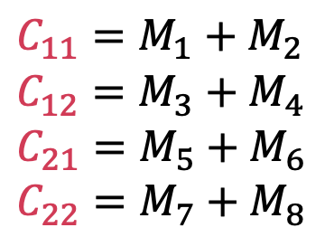
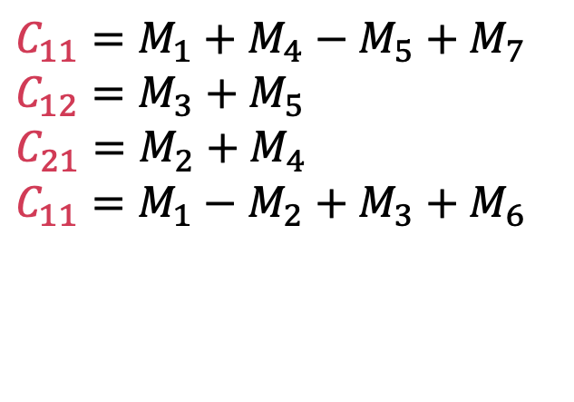
The Strassen algorithm
Traditional
Strassen
$$C_{11}=M_{1}+M_{2}$$
$$C_{12}=M_{3}+M_{4}$$
$$C_{21}=M_{5}+M_{6}$$
$$C_{22}=M_{7}+M_{8}$$
$$C_{11}=M_{1}+M_{4}−M_{5}+M_{7}$$
$$C_{12}=M_{3}+M_{5}$$
$$C_{21}=M_{2}+M_{4}$$
$$C_{11}=M_{1}−M_{2}+M_{3}+M_{6}$$

Slide 14

Our Results
We implemented a general Strassen algorithm in Julia
github.com/bakerte/StrassOPen.jl
14

Slide 15
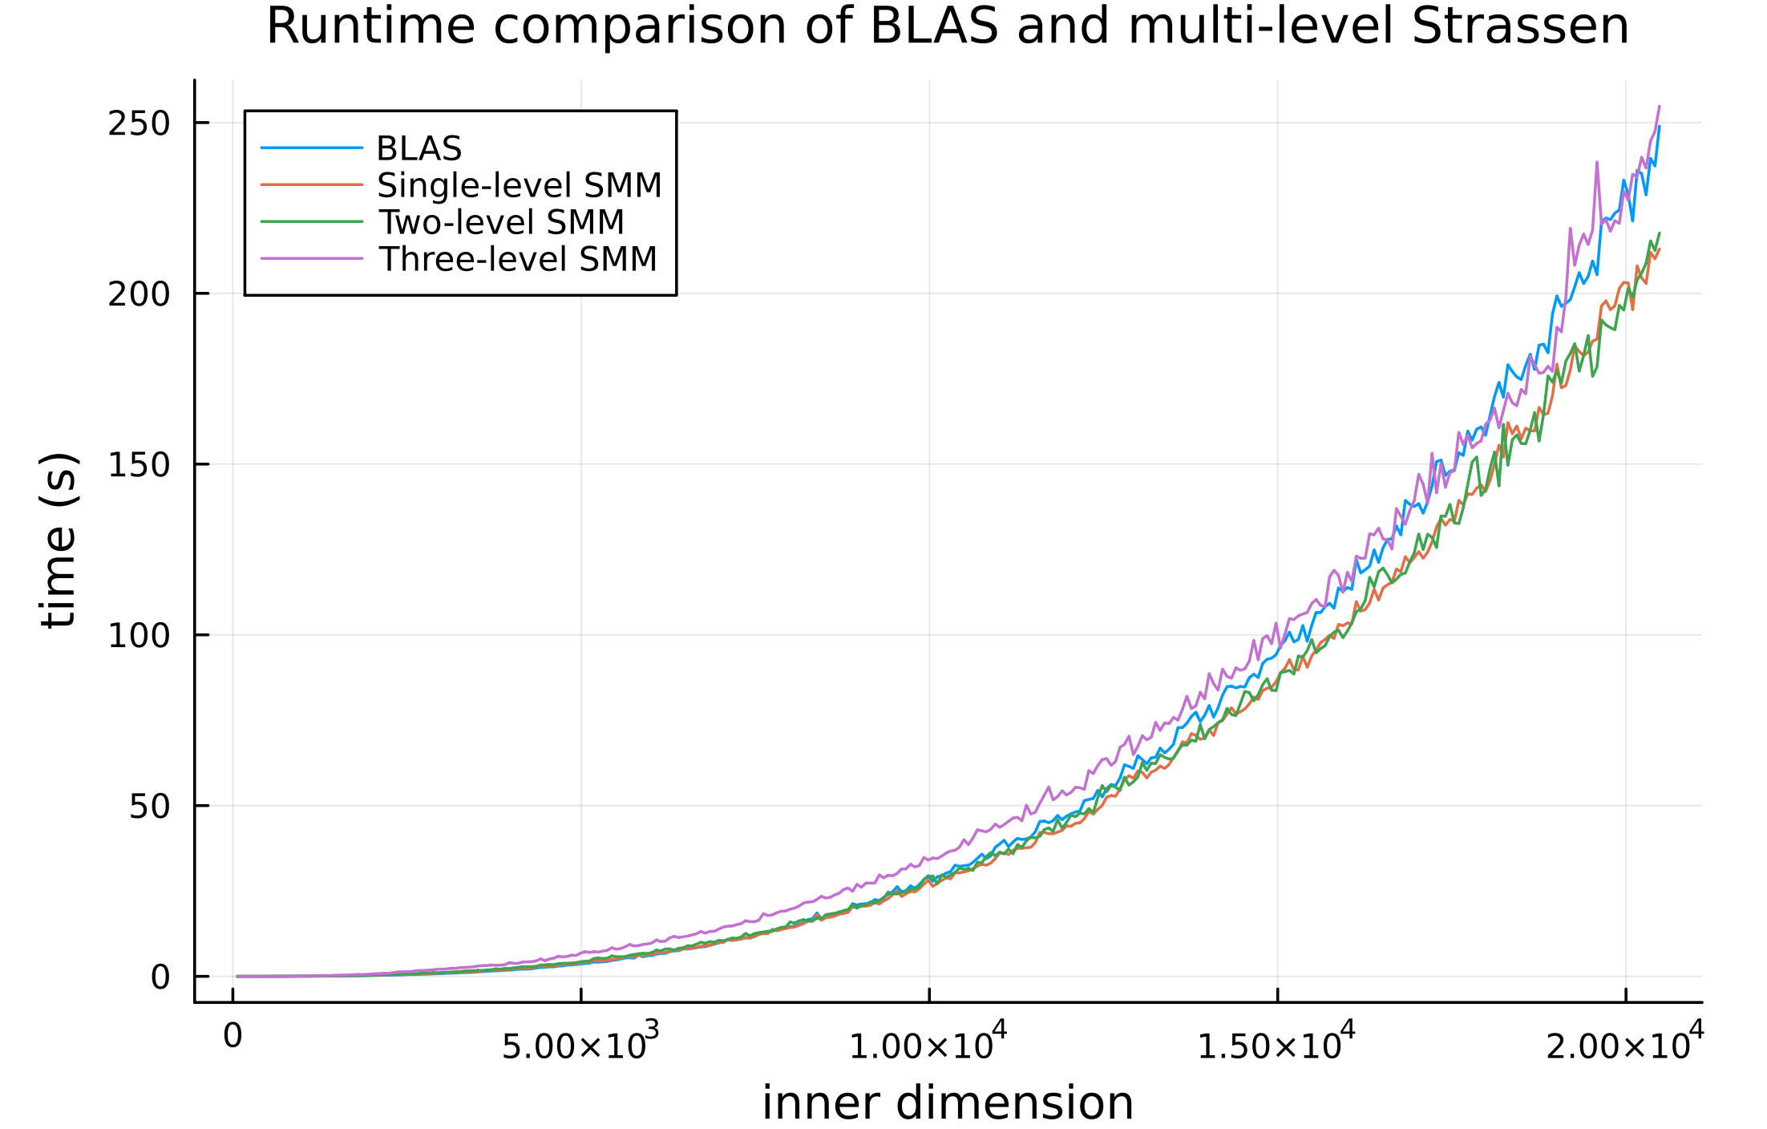

Slide 16
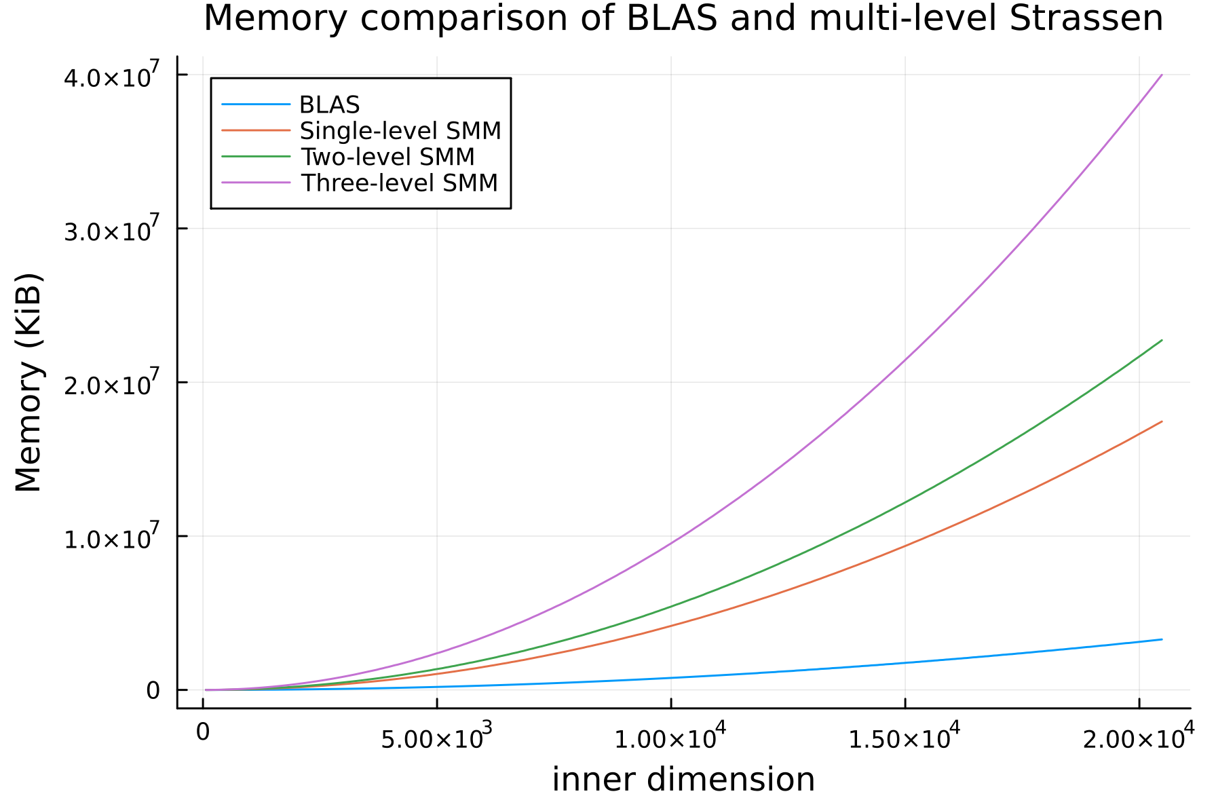

Slide 17
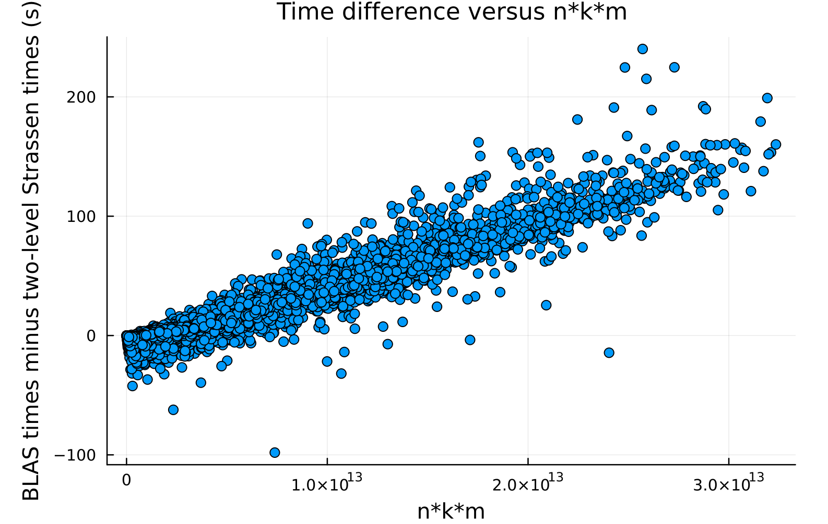

Slide 18
Initial Conclusions
The single and two-level Strassen algorithms are applicable
There is a Goldilocks zone of applicability:
  Matrix size is large enough for speedup
  Matrix size is not too large so that there is sufficient memory (memory ceiling)
18

Slide 19
The partial-Strassen algorithm
A new variant
19

Slide 20
The Partial-Strassen algorithm
Modifications:
Store some M_{i} matrices in C and some in pre-allocated buffers
Subdivide only the M_{i} matrices stored in C

Slide 21
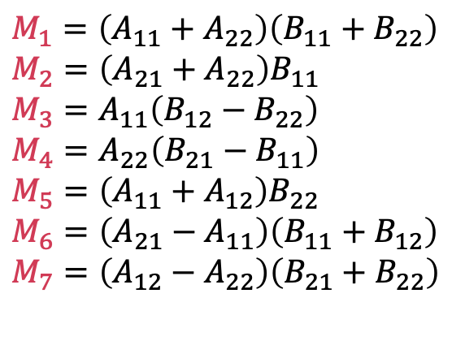
The Partial-Strassen algorithm
Store some M_{i} matrices in C
C
M₄
M₅
$$M_{1}=\left(A_{11}+A_{22}\right)\left(B_{11}+B_{22}\right)$$
$$M_{2}=\left(A_{21}+A_{22}\right)B_{11}$$
$$M_{3}=A_{11}\left(B_{12}−B_{22}\right)$$
$$M_{4}=A_{22}\left(B_{21}−B_{11}\right)$$
$$M_{5}=\left(A_{11}+A_{12}\right)B_{22}$$
$$M_{6}=\left(A_{21}−A_{11}\right)\left(B_{11}+B_{12}\right)$$
$$M_{7}=\left(A_{12}−A_{22}\right)\left(B_{21}+B_{22}\right)$$
M₂
M₃

Slide 22
The Partial-Strassen algorithm
Store remaining M_{i} matrices in a buffer
Buffer
M₁
M₆
$$M_{1}=\left(A_{11}+A_{22}\right)\left(B_{11}+B_{22}\right)$$
$$M_{2}=\left(A_{21}+A_{22}\right)B_{11}$$
$$M_{3}=A_{11}\left(B_{12}−B_{22}\right)$$
$$M_{4}=A_{22}\left(B_{21}−B_{11}\right)$$
$$M_{5}=\left(A_{11}+A_{12}\right)B_{22}$$
$$M_{6}=\left(A_{21}−A_{11}\right)\left(B_{11}+B_{12}\right)$$
$$M_{7}=\left(A_{12}−A_{22}\right)\left(B_{21}+B_{22}\right)$$
M₇

Slide 23
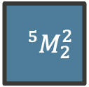
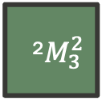
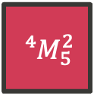
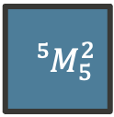
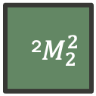
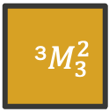
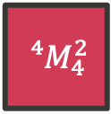
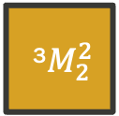
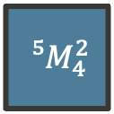
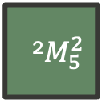
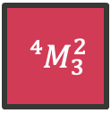
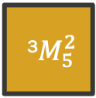
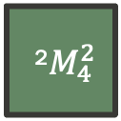
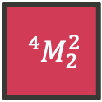
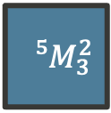
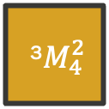
The Partial-Strassen algorithm
Further subdivide matrices which are stored in C
M₄
M₅
⁴$M_{4}^{2}$
⁴$M_{5}^{2}$
⁵$M_{4}^{2}$
⁵$M_{5}^{2}$
⁴$M_{2}^{2}$
⁴$M_{3}^{2}$
⁵$M_{2}^{2}$
⁵$M_{3}^{2}$
M₂
M₃
²$M_{4}^{2}$
²$M_{5}^{2}$
³$M_{4}^{2}$
³$M_{5}^{2}$
²$M_{2}^{2}$
²$M_{3}^{2}$
³$M_{2}^{2}$
³$M_{3}^{2}$

Slide 24
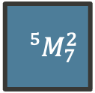
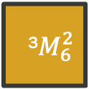

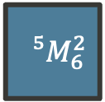
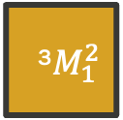

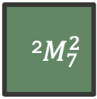
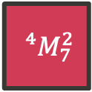
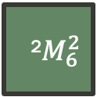
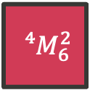
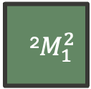
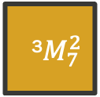
The Partial-Strassen algorithm
Store the ${ʲM}_{i}^{2}$ which don’t fit into C in our buffer (single-thread representation)
M₁
M₆
⁴$M_{1}^{2}$
⁴$M_{6}^{2}$
⁵$M_{1}^{2}$
⁵$M_{6}^{2}$
⁴$M_{7}^{2}$
³$M_{1}^{2}$
³$M_{7}^{2}$
⁵$M_{7}^{2}$
M₇
²$M_{1}^{2}$
³$M_{6}^{2}$
²$M_{7}^{2}$
²$M_{6}^{2}$

Slide 25
The Partial-Strassen algorithm
Repeat all the way down, then build back up
C
Buffer

Slide 26
The Partial-Strassen algorithm
Repeat all the way down, then build back up
C
Buffer

Slide 27
The Partial-Strassen algorithm
Repeat all the way down, then build back up
C
Buffer

Slide 28
The Partial-Strassen algorithm
Repeat all the way down, then build back up
C
Buffer

Slide 29
The Partial-Strassen algorithm
Repeat all the way down, then build back up
C
Buffer

Slide 30
The Partial-Strassen algorithm
Repeat all the way down, then build back up
C
Buffer

Slide 31
The Partial-Strassen algorithm
Repeat all the way down, then build back up
C
Buffer

Slide 32
The Partial-Strassen algorithm
Repeat all the way down, then build back up
C
Buffer

Slide 33
The Partial-Strassen algorithm
Repeat all the way down, then build back up
C
Buffer

Slide 34
The Partial-Strassen algorithm
Repeat all the way down, then build back up
C
Buffer

Slide 35
The Partial-Strassen algorithm
Repeat all the way down, then build back up
C
Buffer

Slide 36
The Partial-Strassen algorithm
Repeat all the way down, then build back up
C
Buffer

Slide 37
The Partial-Strassen algorithm
Repeat all the way down, then build back up
C
Buffer

Slide 38
The Partial-Strassen algorithm
Repeat all the way down, then build back up
C
Buffer

Slide 39
The Partial-Strassen algorithm
Repeat all the way down, then build back up
C
Buffer

Slide 40
The Partial-Strassen algorithm
Repeat all the way down, then build back up
C
Final Result

Slide 41

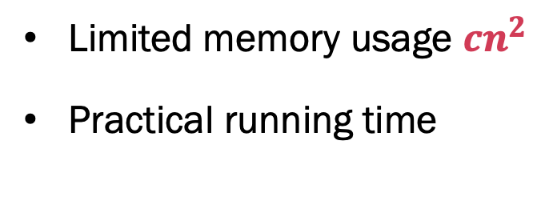
Benefits
Limited memory usage $cn^{2}$
Practical running time
T = Total operations
k = Number of levels
$$T=4^{k}\left[{\left(\frac{n}{2^{k}}\right)}^{2}+{\left(\frac{n}{2^{k}}\right)}^{3}\right]+ \sum_{i=1}^{k}{\left[3∗4^{i−1}\left[2{\left(\frac{n}{2^{i}}\right)}^{2}+{\left(\frac{n}{2^{i}}\right)}^{3}\right]+8{\left(\frac{n}{2^{i}}\right)}^{2}\right]+O(n)}$$

Slide 42
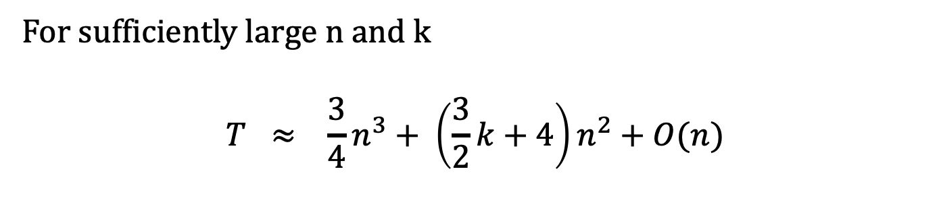
Benefits
Limited memory usage $cn^{2}$
Practical running time
T = Total operations
k = Number of levels
For sufficiently large n and k
$$T ≈ \frac{3}{4}n^{3}+ \left(\frac{3}{2}k+4\right)n^{2}+O(n)$$

Slide 43
Matrix Multiplication in 75% time
(for large matrices)

Slide 44
Implementation
We implemented a single-threaded version of the Partial Strassen Algorithm which can achieve 80% the runtime of BLAS
We have a multi-threaded version in early development which beats BLAS
There is a lot of room for improvement
44

Slide 45
Takeaway
We can speed up large matrix multiplications and tensor contractions with limited memory consumption
45

Slide 46



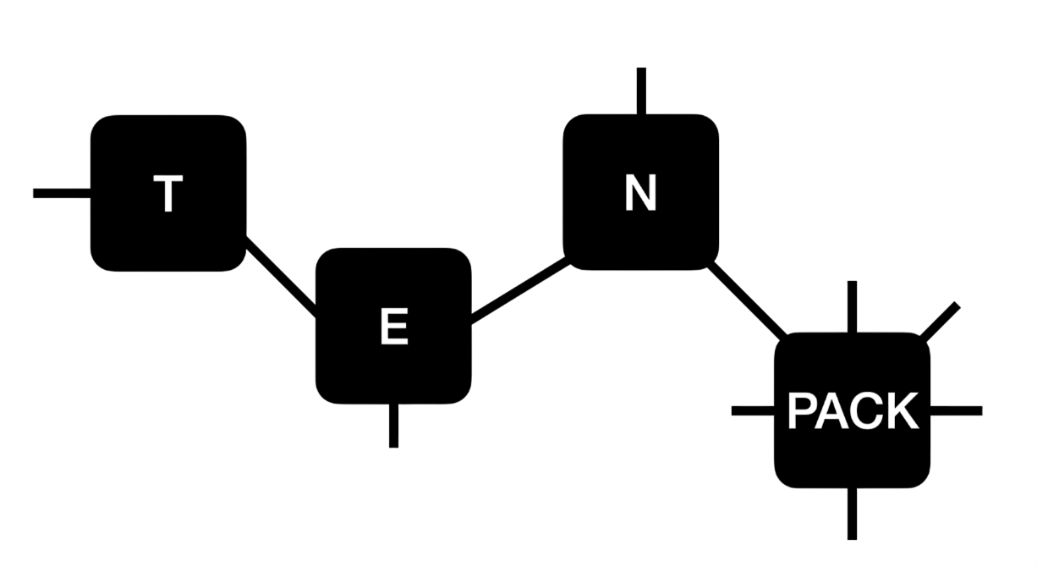
bakerte/DMRGenie.jl
bakerte/DMRJtensor.jl
bakerte/TensorPACK.jl
bakerte/StrassOPen.jl

Slide 47
Thank you
Aaron Dayton (Speaker) – Kiana Gallagher – Dr. Thomas E. Baker
Department of Physics & Astronomy, University of Victoria, Victoria, Canada
47

