Slide 1


Experiences Comparison Between Female and Male Students in Labatorials
Lydie Lachance Djilo Kamdem
Calvin S. Kalman
Mandana Sobhanzedah

Slide 2
Table of Content
Introduction
Goal and Objectives
Definitions and Theoretical Framework
Methodology
Mixed Methods Design
Framework
Challenges
Current Findings
Research Challenges
Conclusion
Pre-Interviews
Observations
State of the Art
Post-Interviews

Slide 3
Introduction

Slide 4
Introduction
Methodology
Expectations and Challenges
Current Findings
Conclusion
State of the Art
Marshman et al. (2018)
Physics self-efficacy in introductory courses – female vs male students
Sokoloff et al. (2007)
Traditional physics labs- unengaging and tedious

Slide 5
Introduction
Methodology
Expectations and Challenges
Current Findings
Conclusion
State of the Art
Kalman et al. (2020)
Labatorials - labs and tutorials vs conceptual understanding and engagement.
Huang & Kalman (2012)
Reflective writing aids in deeper understanding

Slide 6
Introduction
Methodology
Expectations and Challenges
Current Findings
Conclusion
Goal and Objectives
Goal
Objectives
Compare learning experiences of male and female students in labatorials & Identify factors contributing to effective and engaging lab learning.
Explore differences in experiences between male and female students during labatorials in CU and MRU.
CU: Concordia University & MRU: Mount-Royal University

Slide 7


Introduction
Methodology
Expectations and Challenges
Current Findings
Conclusion
Definitions: Labatorials Overview
3 female & 2 male students
Labatorials
Particularities
Reference: https://freerangestock.com/photos/147854/group-of-students-doing-science.html
3 male & 2 female students
Reference:https://www.freepik.com/premium-ai-image/group-students-working-together-science-project-using-lab-equipment-sharing-ideas_318563444.htm

Slide 8
Introduction
Methodology
Expectations and Challenges
Current Findings
Conclusion
Definitions & Theoretical Framework
Labatorials
Benefits
Theoretical Framework
Social Interactionist Theory

Slide 9
Methodology

Slide 10
Introduction
Methodology
Expectations and Challenges
Current Findings
Conclusion
Mixed Methods Design
Classical Physics 1 Lab Sections Students (MRU)
Participants
PHYS 224 Students (CU)
CU: Concordia University, MRU: Mount-Royal University

Slide 11
Introduction
Methodology
Expectations and Challenges
Current Findings
Conclusion
Mixed Methods Design
Qualitative Methods
Semi-structured interviews (students and TAs)
Observations and reflective writing analysis
Coding and content analysis (Nvivo software)
Quantitative Methods
Conceptual quiz, pre- and post-tests
Surveys
Statistical analysis (SPSS)
TA: Teaching Assistant

Slide 12
Introduction
Methodology
Expectations and Challenges
Current Findings
Conclusion
Framework
For Female Vs Male Students:
Social interactions in labatorials vs the learning experience?
Elements of labatorials vs a satisfying experience?
Labatorials vs students' perspectives on physics?
Self-efficacy evolvement vs labatorials?
Labatorials vs conceptual understanding?
T1: -Course design (PHYS 224 & Classical Physics 1 Lab)
-Interview questions & survey design
T: Step
12

Slide 13
Introduction
Methodology
Expectations and Challenges
Current Findings
Conclusion
Framework
For Female Vs Male Students:
Social interactions in labatorials vs the learning experience?
Elements of labatorials vs a satisfying experience?
Labatorials vs students' perspectives on physics?
Self-efficacy evolvement vs labatorials?
Labatorials vs conceptual understanding?
T2: -Pilot study
-Study review
-Main study
T3: -Data analysis
T: Step

Slide 14

Introduction
Methodology
Expectations and Challenges
Current Findings
Conclusion
Framework
Reference: https://www.acs.org/education/policies/middle-and-high-school-chemistry/laboratory/laboratory-experience.html

Slide 15
Challenges

Slide 16
Introduction
Methodology
Expectations and Challenges
Current Findings
Conclusion
Research Challenges
Diverse and balanced student participation
Qualitative and quantitative data collection.

Slide 17
Introduction
Methodology
Expectations and Challenges
Current Findings
Conclusion
Research Challenges
Reliability and validity in coding and analysis.
Logistical challenges in implementation - scheduling and TA involvement.

Slide 18
Current Findings

Slide 19
Introduction
Methodology
Expectations and Challenges
Current Findings
Conclusion
Observations
Female Students
High & early interaction
Apparatus manipulation: interest vs gender-mix groups
High engagement: male vs Female peers
Increasing activity over time

Slide 20
Introduction
Methodology
Expectations and Challenges
Current Findings
Conclusion
Observations
High interest in apparatus manipulation & computations
Tend to take the lead
Increased interaction overtime
Prefer working alone
Male Students

Slide 21
Introduction
Methodology
Expectations and Challenges
Current Findings
Conclusion
Observations
More questions from female students
Female TA
More structured
Probing and direct answers
Provides assistance
More questions from younger vs older male students
TA: Teaching Assistant

Slide 22
Introduction
Methodology
Expectations and Challenges
Current Findings
Conclusion
Observations
Less inquiries from female students
Male TAs
Provide assistance
Probing and direct answers
More questions from male students
TA: Teaching Assistant

Slide 23
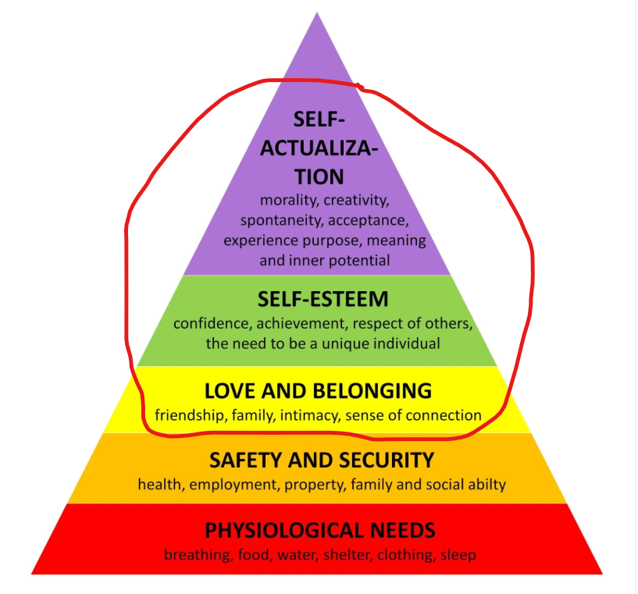
Introduction
Methodology
Expectations and Challenges
Current Findings
Conclusion
Observations
Reference: https://www.simplypsychology.org/maslow.html
Maslow's Pyramid of Needs

Slide 24
Introduction
Methodology
Expectations and Challenges
Current Findings
Conclusion
Pre-Interviews
Female Students
Comfortable - lab female dominated
Follow-up questions: female TA vs male TA
Discrimination and stereotyping - male TA
Male peers - grasp faster and work alone
TA: Teaching Assistant

Slide 25
Introduction
Methodology
Expectations and Challenges
Current Findings
Conclusion
Pre-Interviews
Experience- background & studies vs gender
Male Students
Female peers - more shy
No difference in gender

Slide 26
Introduction
Methodology
Expectations and Challenges
Current Findings
Conclusion
Post-Interviews
Female Students
Interactions - built trust & conceptual understanding
Less rapport/questions - male TA vs female TA
More confidence - more interactions & validation for female students
TA: Teaching Assistant

Slide 27
Introduction
Methodology
Expectations and Challenges
Current Findings
Conclusion
Post-Interviews
Male Students
Increased confidence: gender mix-up vs female peers
Interpersonal chats
Pre-Readings vs deepen understanding

Slide 28
Introduction
Methodology
Expectations and Challenges
Current Findings
Conclusion
Post-Interviews
Female TA
Female students - asked more questions
Group assistance vs 1:1 - male vs female students
Organized RW products: female vs male students
TA: Teaching Assistant, RW: Reflective Writing

Slide 29
Introduction
Methodology
Expectations and Challenges
Current Findings
Conclusion
Post-Interviews
Male TAs
Female students – increased confidence & conceptual understanding
Female students - more follow-up questions
Male students vs teamwork overtime
TA: Teaching Assistant

Slide 30
Conclusion

Slide 31
Introduction
Methodology
Expectations and Challenges
Current Findings
Conclusion
Labatorials enhance engagement and inclusivity.
Address gender-based learning differences.
Research to guide future educational policies.
31

Slide 32
Thank You!
Questions?

