Slide 1

Use of MathMatize for formative assessments in large classes
Brian Wilson & Ania Harlick
Department of Physics, University of Toronto
CAP Congress 2025
Saskatoon, SK

Slide 2

What is MathMatize?
MathMatize is an educational technology for high school/university level math that we are shamelessly exploiting in physics courses.
It offers polling and assessment tools with a content editor built to support formulaic/ scientific syntax.
https://www.mathmatize.com/
Disclaimer: We do not own it, we are not selling it, we have no financial benefits from its use.
We just used it, liked it, and decided more people should know about it.

Slide 3
Use of Mathmatize - outline
Why?
Where?
How?

Slide 4

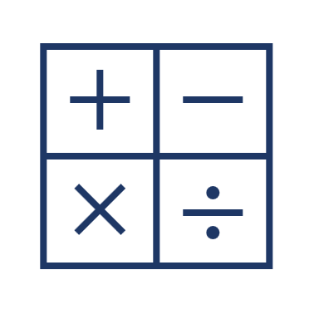










Why we chose MathMatize?
Price tag
Math Equivalence
Simplicity
Accessible Statistics
Versatility
Resource requirements
LaTeX!
Dependability
Notes:
Free to students (department licence)
Reduce number of platforms used by students
Does multiple choice and fill in the blanks
Uses LaTeX
Understands math: log(x/y) = log(x) – log(y)
Can show class guesses on their devices
Does require smart phone and internet
No problems with lag at 200+ students

Slide 5
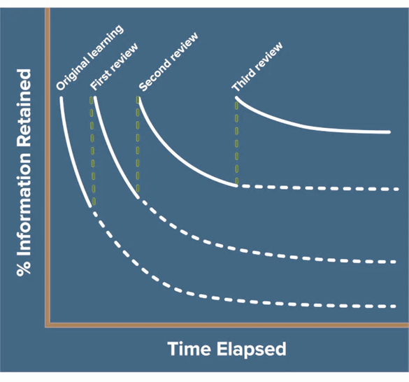
Why post-class assessments?
Reviewing and refreshing information regularly halts the Forgetting Curve.
Murre, J. M. J. and Dros, J., PLoS One, 10, 7, (2015) https://www.ncbi.nlm.nih.gov/pmc/articles/PMC4492928/
"Post-class assessment" is opened after a class and due before the next class.
Designed as purely formative – allows multiple attempts, reviews, encourages collaboration and discussion.
Ebbinghaus’s “Forgetting Curve” – the forgetting starts after each review session, but it’s always slower than before.
https://www.mindtools.com/a9wjrjw/ebbinghauss-forgetting-curve

Slide 6



How we used MathMatize – learning curve
Reliance on question banks
Safe choices,
simple design
Creative mode on

Slide 7
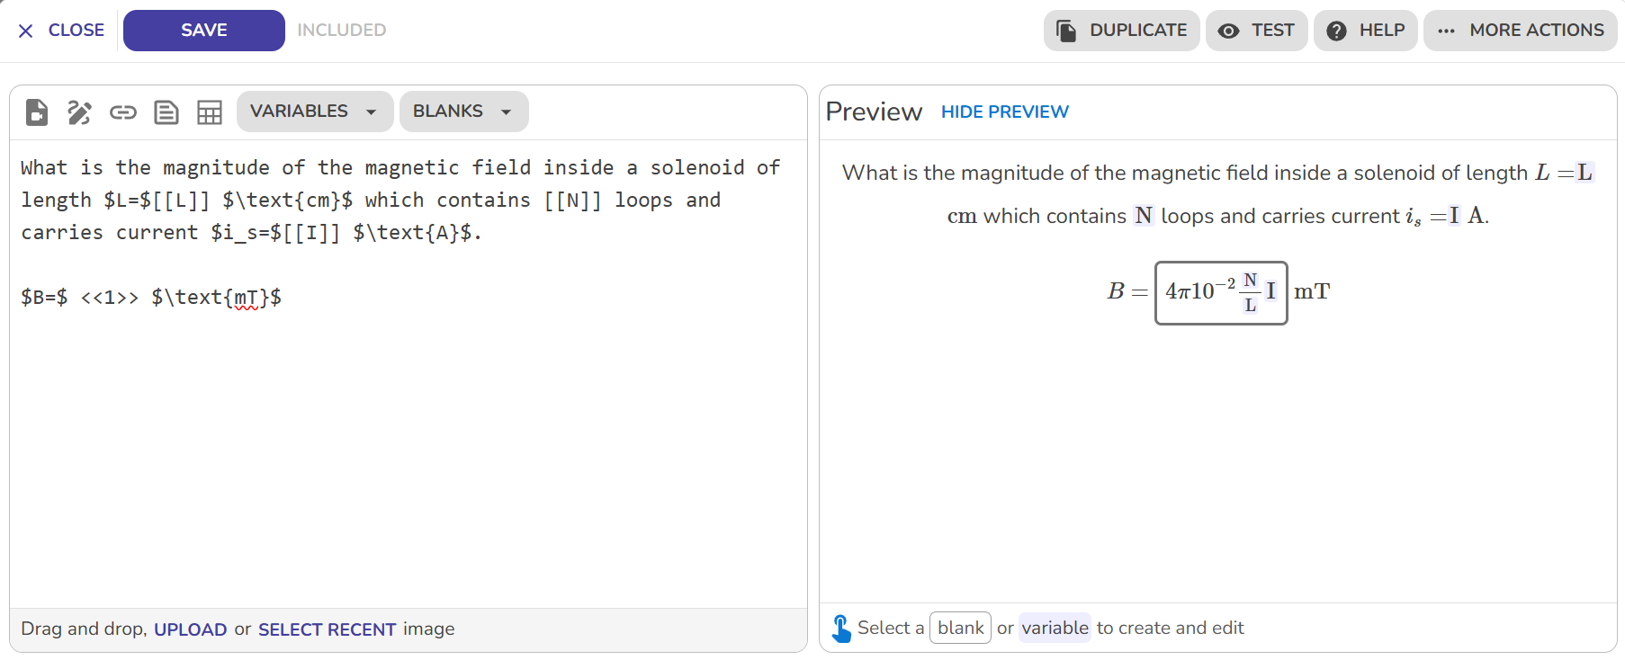
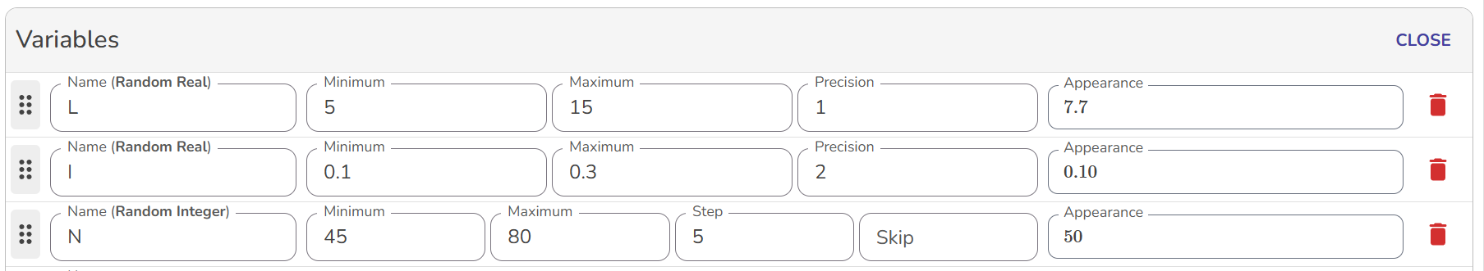
How we used MathMatize – variable problems

Slide 8
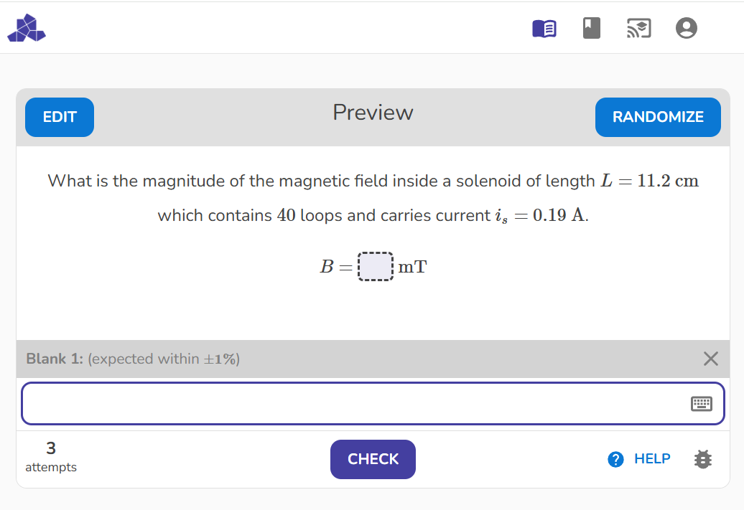
How we used MathMatize – variable problems

Slide 9
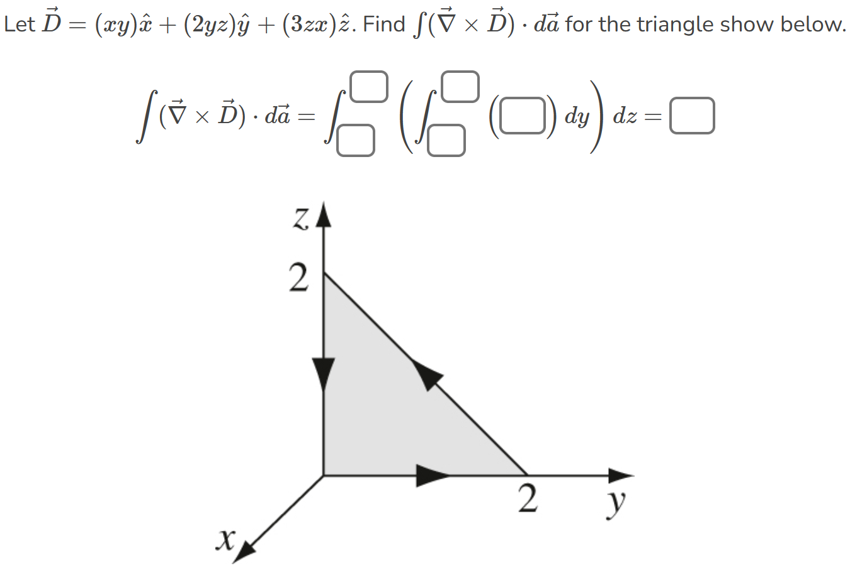
How we used MathMatize – formula problems

Slide 10
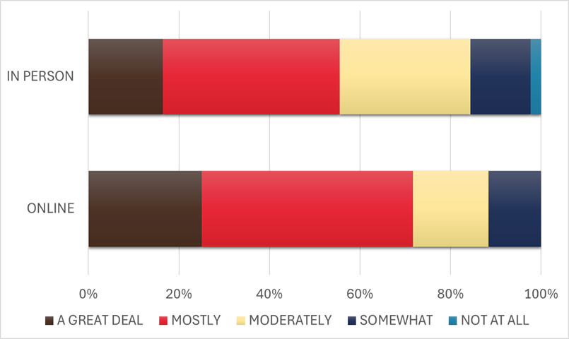
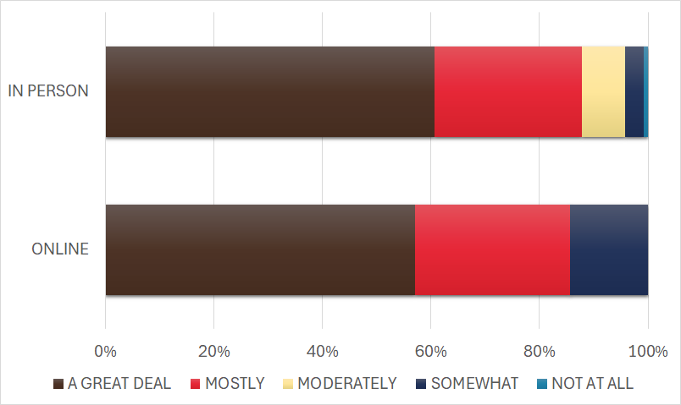
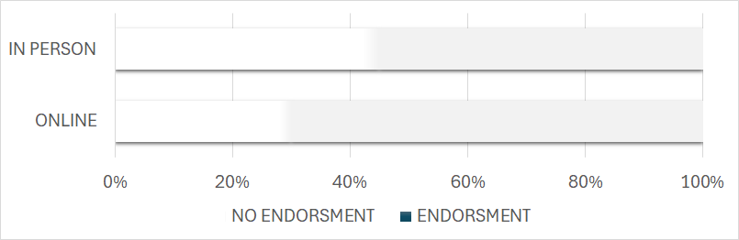
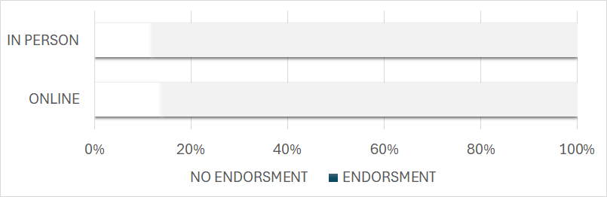
Student Feedback
Responses to the course evaluation question inquiring whether use of educational technology contributed to (PHY2xx, left) or promoted (PHY1xx, right) learning in the course.

Slide 11

Summary
We used MathMatize – educational technology designed with focus on mathematical language – in various junior physics courses.
We liked it – especially the multi-variable and formula questions, flexibility in setting access, transparent design and relative simplicity in downloading grades.
There is a learning curve, and it still has some flaws, but it is fully functional
Try sample questions!

