Slide 1
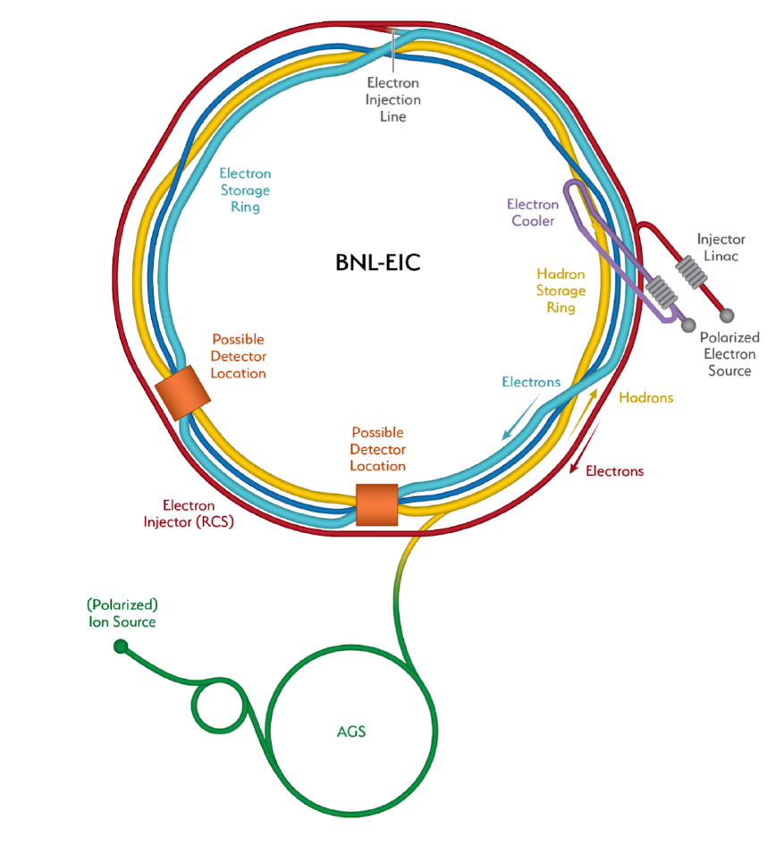

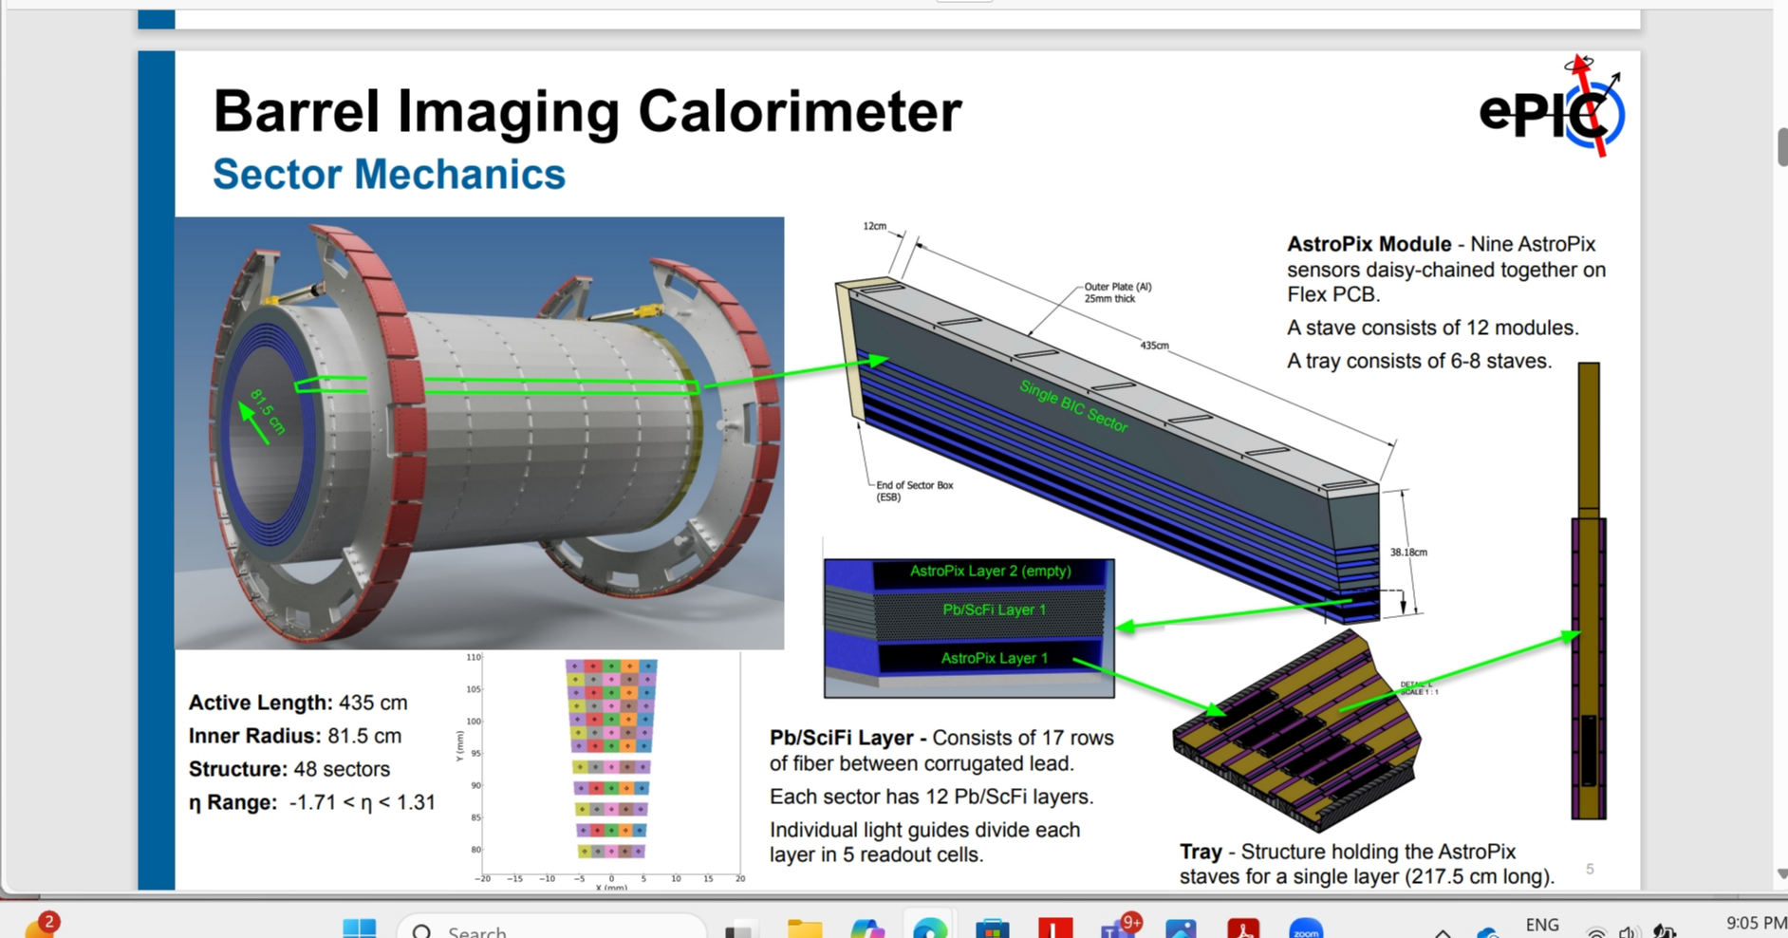
Canada’s Involvement in the Electron Ion Collider
EIC
Bob Laxdal
Deputy Director, Accelerator Division
TRIUMF, Canada
Collaborators:
TRIUMF: O. Kester, P. Kolb, N. Smith, Z. Yao
U. Manitoba: W. Deconinck, M. Gericke, S. Longo, J. Mammei,
U. Regina: G. Huber, Z. Papandreou, A. Teymurazyan
Mt Allison: D. Hornidge
UVic: T. Junginger

Slide 2
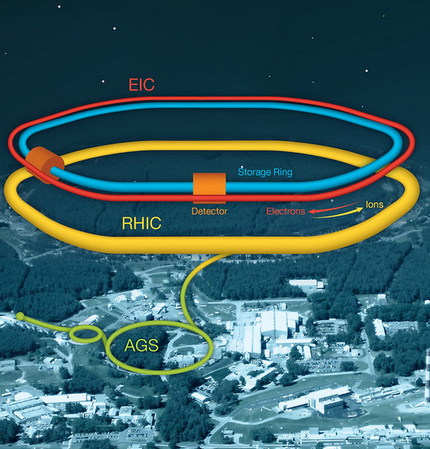
Electron Ion Collider
The EIC at Brookhaven will be the next international discovery machine.
The EIC accelerator design is based on the existing RHIC Complex
Hadron storage ring 40-275 GeV (based on existing RHIC)
New 3 GeV SRF e-Linac
New Electron rapid cycling synchrotron 3 - 18 GeV in RHIC tunnel
New electron storage ring 5 – 18 GeV ring in RHIC tunnel
High luminosity interaction region and new detector ePIC

Slide 3
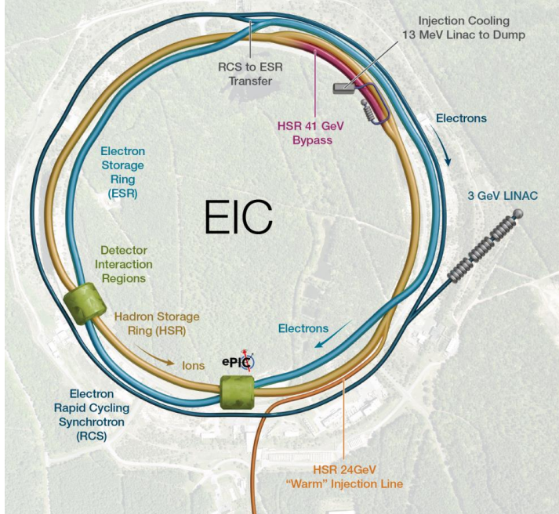
EIC Challenges
The Electron Ion Collider is the most challenging and complex collider project to date
Constrained by existing tunnel, hadron source and infrastructure
Broad energy range, radial off-set of hadrons to match synchronism with electrons
High currents and polarization in both electrons and hadrons
Crab cavities
  Very tight phase and amplitude noise requirements
Hadron cooling

Slide 4


Canada and EIC
The Canadian subatomic physics community is strongly supporting participation in the EIC program. In the 2022–2026 Canadian Subatomic Physics Long Range Plan, the community named the EIC as a “flagship program with broad outcomes.”
A Canadian collaboration with EIC Canada, TRIUMF and University partners is pursuing a CFI proposal in the 2025 IF competition.
The proposal leverages technical know-how at TRIUMF and partnering universities, engages Canadian industry in cutting edge accelerator technology while training next generation HQP.

Slide 5





A Canadian contribution to EIC
  Discussions with EIC have identified two potential deliverables for in kind contributions from Canada
    394 MHz crab cavities for the hadron ring – led by TRIUMF and UVic
    Barrel Imaging Calorimeter subsystem of the ePIC detector – led by the U. of Regina and the U. of Manitoba

Slide 6
Barrel Imaging Calorimeter

Slide 7
The ePIC Detector
Barrel Imaging Calorimeter (BIC)
EIC baseline scope has a single detector at the south collision point – the ePIC detector
BIC is an innovative particle-imaging hybrid calorimeter that interleaves lead-scintillating-fiber calorimetry matrices (for neutral-particle energy measurement) to an advanced silicon-based tracker (for submillimeter charged-particle tracking precision).
5.3 m
9.5 m
Tuesday DNP T1-6 10:15AM `The Barrel Imaging Calorimeter for the ePIC Experiment at EIC’, Tegan Beattie

Slide 8
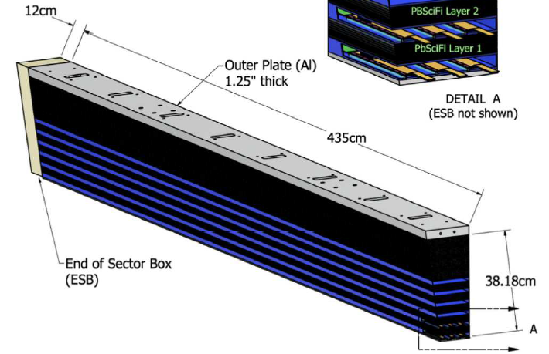
Barrel Imaging Calorimeter
435 cm
Canadian contributions will support the Barrel Imaging Calorimeter (BIC)
BIC is comprised of 48 sectors each sector consisting of 12 Pb/ScFi calorimetry layers and 4 tracking layers (AstroPix)
End of Sector Boxes (ESB) (two per sector) contain light guides and silicon photomultipliers (SiPMs) to convert optical light into electrical signals.
Canadian contributions include:
  Construction of 96 end-of-sector boxes (ESB) each box with 60 optical light guides and SiPMs (5 per Pb/ScFi layer)
  Training towards scintillating fiber and lead sheet sampling calorimeter (Pb/ScFi layers) – 12 per sector
Design faces considerable challenges due to limited available space

Slide 9
HSR 394MHz Crab Cavities

Slide 10
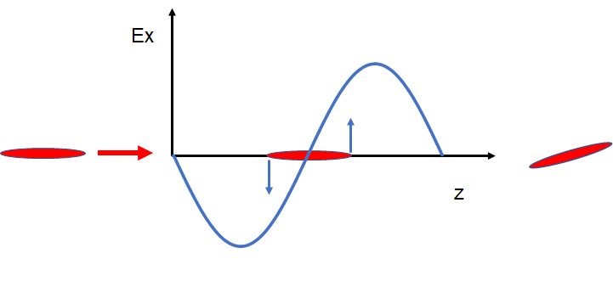
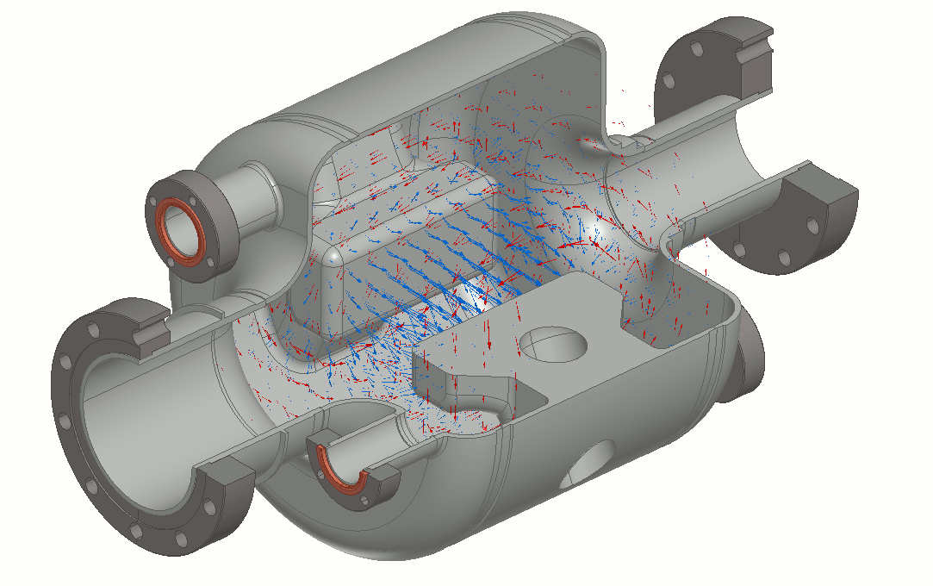
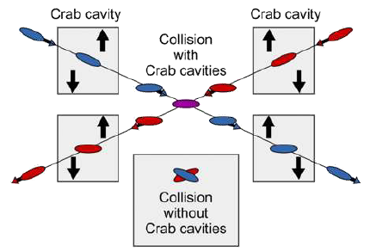
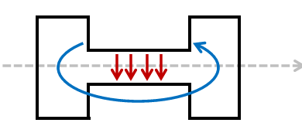
What is a crab cavity?
A crab cavity is designed to produce a deflecting (rather than accelerating) electro-magnetic rf field.
A charged particle bunch passing through the cavity at the zero-crossing will experience a transverse skewing (crabbing)
This skewing compensates for the crossing angle at the collision point and increases the probability of collision (luminosity)

Slide 11
EIC Crab Cavities
The EIC requires crab cavities on both the hadron storage ring (HSR) and the electron storage ring (ESR)
HSR – long bunch, high rigidity
  requires eight 197MHz crab cavities and four 394MHz cavities to linearize the deflection
ESR – short bunch, low rigidity
  requires two 394 MHz cavities
The performance of the crab cavities is critical to the success of EIC – they increase luminosity by a factor of 10
Canadian contribution includes the 394 MHz hadron ring crab cryomodules
 | Voltage/cavity Vt (MV) |  | No. of cavities
System | HSR | ESR | HSR | ESR
197 MHz | 8.5 | - | 8 | -
394 MHz | 2.4 | 2.9 | 4 | 2
25 mrad
394MHz
197MHz

Slide 12
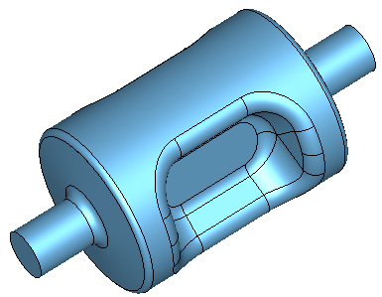
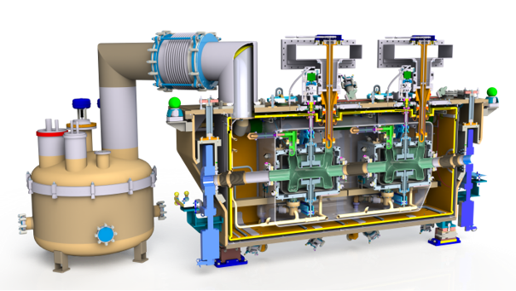
Challenge 1: Large crossing angle -> high voltage -> SRF technology
36 cm
Given the high crossing angle (25mrad) and limited space strong deflecting voltages are required
This precludes the use of normal conducting structures as the dissipated power would be too high (~1 MW for RT vs a few Watts for SRF)
The cavities will be made from Niobium (Tc=9.2K) and operated at 2K
The cavities will be housed in cryomodules for thermal isolation
54 cm

Slide 13
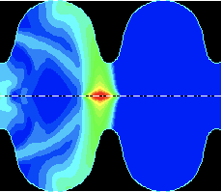
Challenge 2: High beam current and short bunches -> HOM excitation
High intensity charged particles passing through an rf cavity can excite additional rf field modes in addition to the fundamental crabbing mode
In EIC these higher order modes (HOMs) represent considerable power (10s of kW in e-ring) that must be removed from the cavity and delivered to an external load – under study at TRIUMF
394 MHz Crab Cavity with waveguide HOM extraction to damped loads

Slide 14
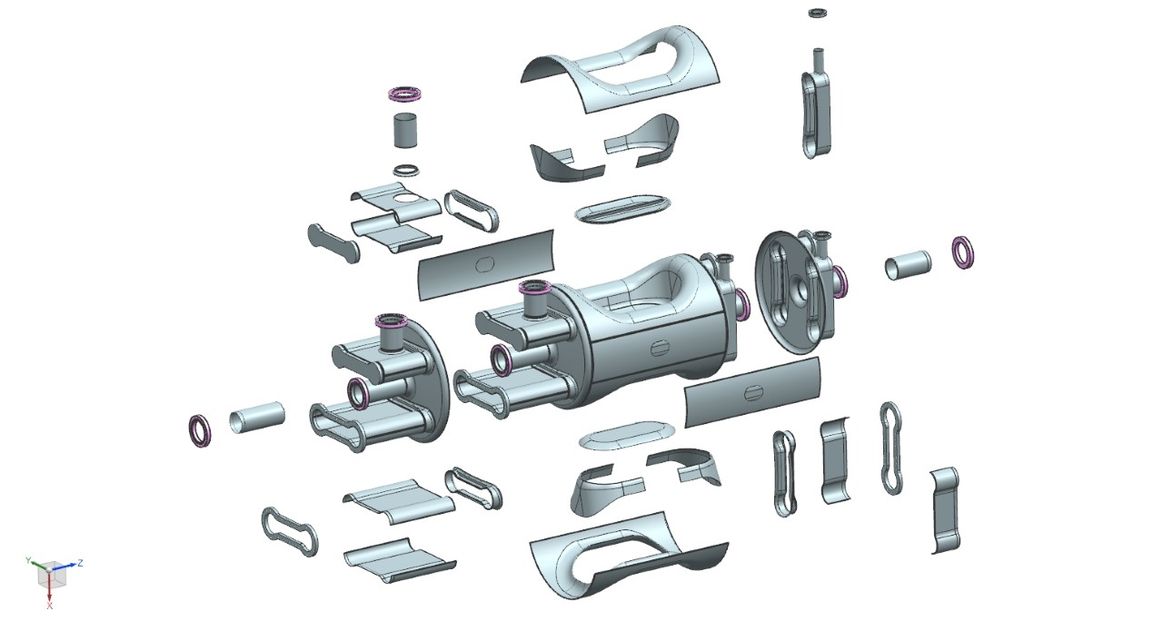
Challenge 3: Complex cavity shape
Crab cavities have complex shapes further complicated by additional ports and waveguides for HOM extraction
Requires many unique forming/machining and electron beam welding steps

Slide 15
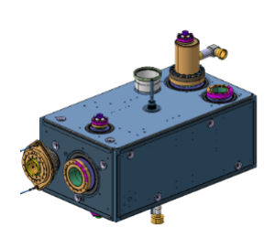
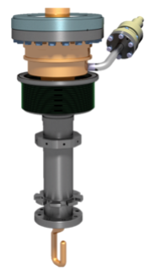
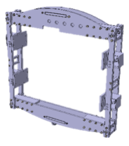
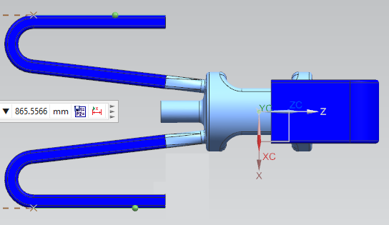
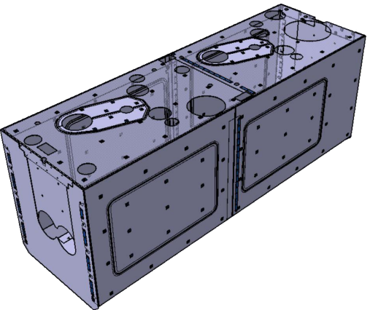
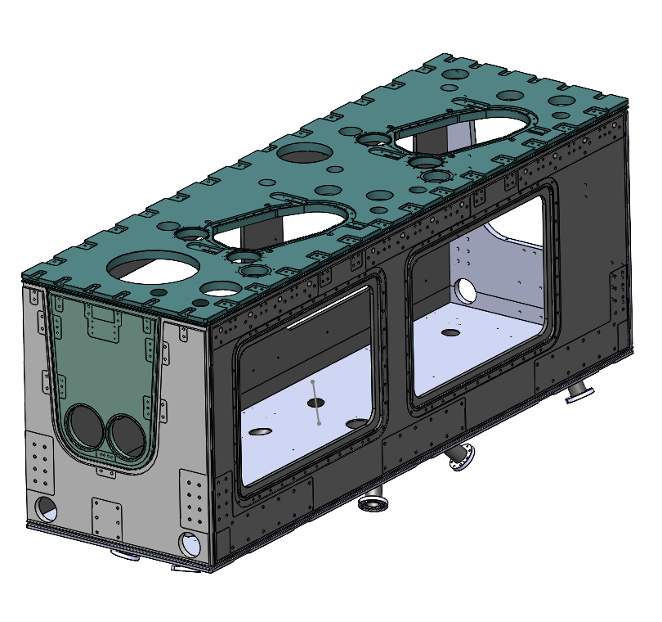
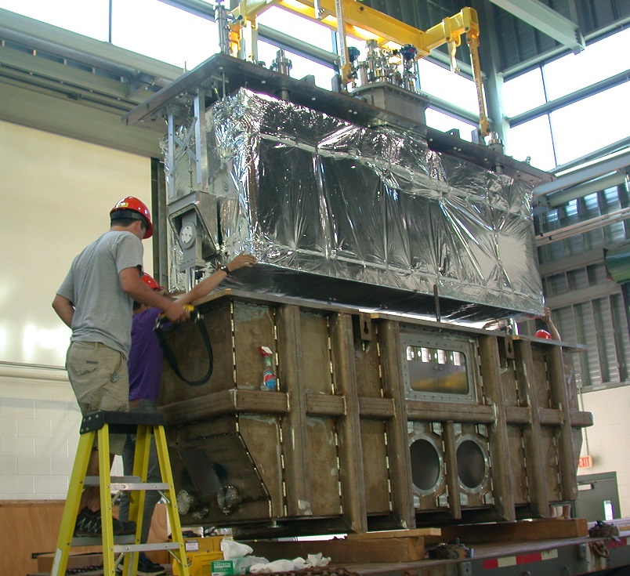
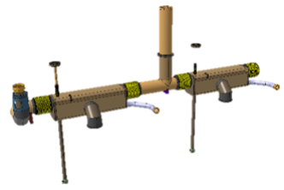
Scope for EIC crab contribution
TRUMF/UVic propose to deliver scope on the 394 MHz crab cavity system for the HSR.
SRF Cavity package: (4)
Cavity design including HOM mitigation schemes
Niobium cavity fabrication plus jacket
Fundamental Power Couplers (FPC) and HOM mitigation schemes (waveguide or coupler).
Rf tuner
Cryomodule package: (2)
Outer vacuum chamber (OVC)
thermal shield, mu-metal
cryogenic piping
fabricated in industry
assembled and qualified at TRIUMF.
Cavity
Jacketing
FPC
Tuner
HOM mitigation
Thermal screen and mu metal
OVC
Cryo-piping
Assembly

Slide 16
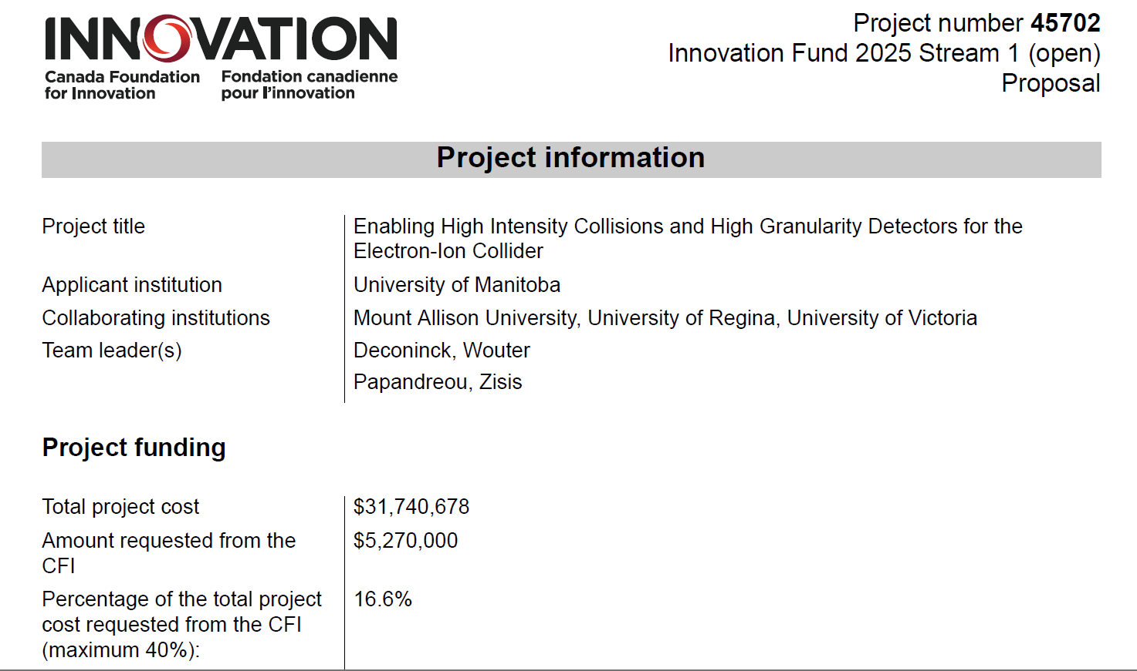
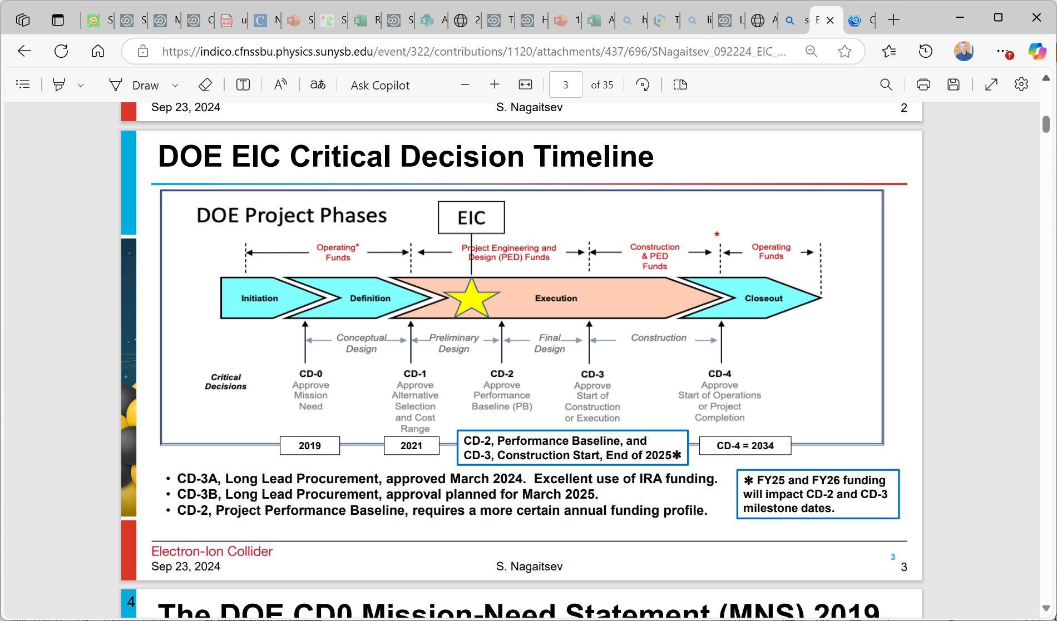
CFI project
Project planning to baseline (CD-2) at end of 2025
CD4-2034

Slide 17
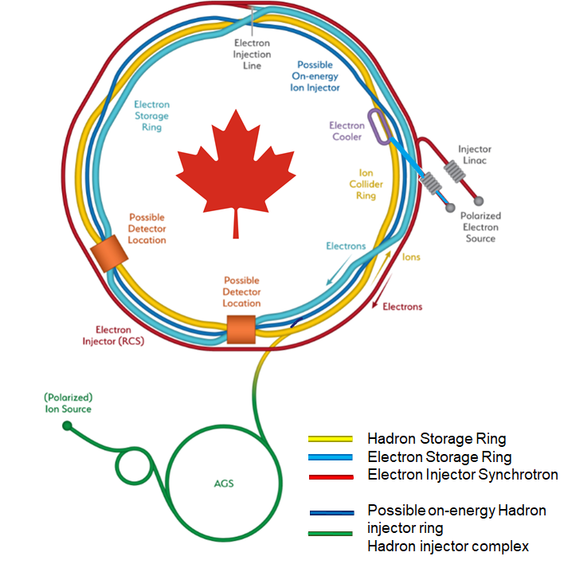
Summary
The proposal will deliver critical elements to the EIC within the accelerator and the detector
The technical scope offers unique challenges in design, fabrication, assembly and testing with excellent opportunities for HQP training
The project supports both the EIC and the CINP community while leveraging and augmenting Canada’s core competence in cutting edge accelerator and detector technology and offering opportunity to Canadian industry
Collaborators and students are welcome!

Slide 18
Thank you!
Merci!

Slide 19
EIC Timeline

Slide 20
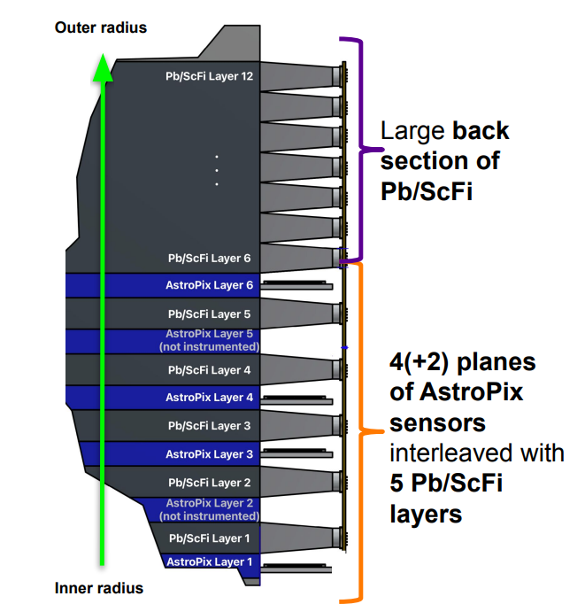
BIC End of Sector (ESB) Boxes
Each of the 96 ESBs contain 60 optical light guides and optical silicon interfaces coupled to silicon photomultipliers (SiPM), AstroPix End-of-Tray Cards (ETCs), field-programmable gate array (FPGA) boards to combine SiPM and ETC signals into streaming readout
ESBs require cooling to stabilize the SiPMs and remove heat from ETCs
All components will be surrounded by a light-tight enclosure
Design faces considerable challenges for installation and future maintenance due to limited space, particularly in the electron-going direction and inner radius of the BIC.

