Slide 1


Nuclear physics detection solution, from double beta decay to forest fires
Fabrice Retiere (TRIUMF)
Work done within the PHoton for Astro-particle and Applied Research (PHORWARD) group at TRIUMF
Collaboration with U.Sherbrooke (QC, Canada) for the Photon to Digital Converter
Support from TRIUMF Sci Tech dept and NSERC MRS

Slide 2
Outline
Searching for neutrinoless double beta decay in nEXO
  By detecting scintillation light
  A journey towards the optimum single photon detector
Measuring the energy of neutrons produced in fusion reaction
  By detecting scintillation light
  In partnership with General Fusion (Richmond, BC)
  Optimizing the optimum single photon detector
Detecting forest fire before they become catastrophic
  Ultra low power, high performance smoke detection
  Optimizing a system relying on the optimum single photon detector

Slide 3
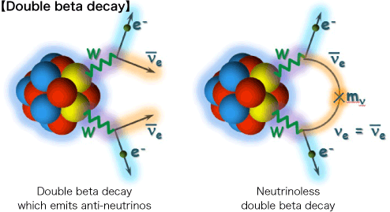
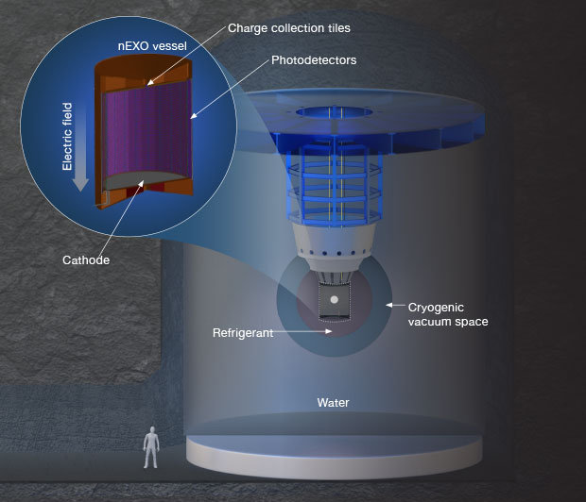
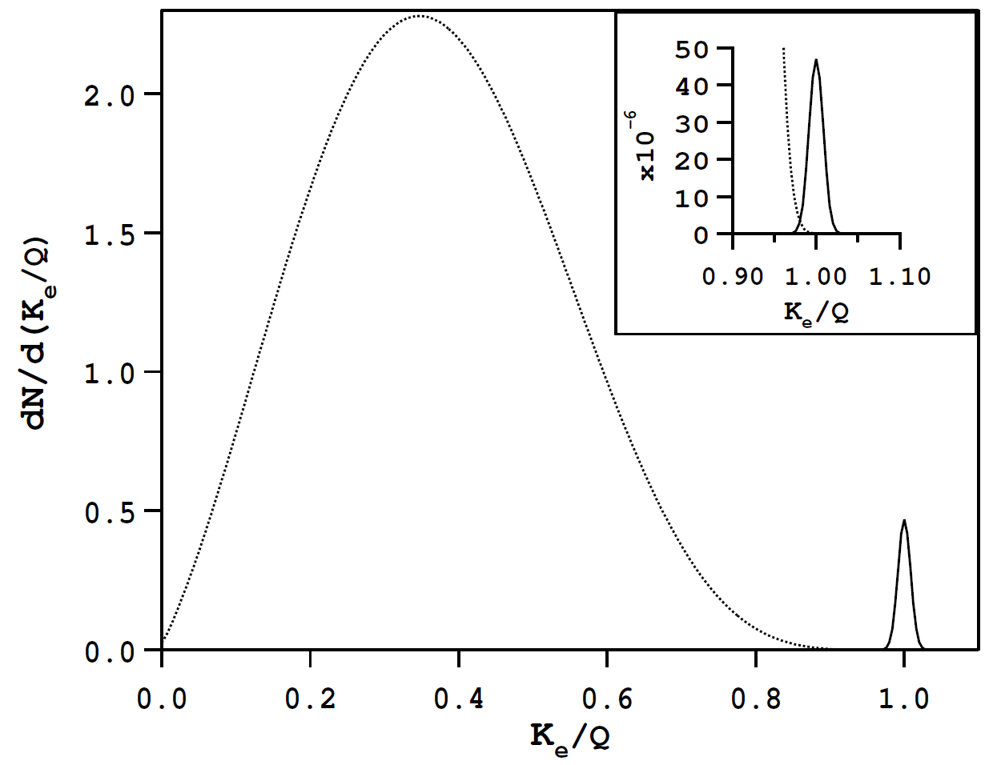
nEXO for 0νββ
2νββ
0νββ
[arXiv:hep-ph/0611243]
See talk by Thomas Brunner on Tuesday afternoon

Slide 4
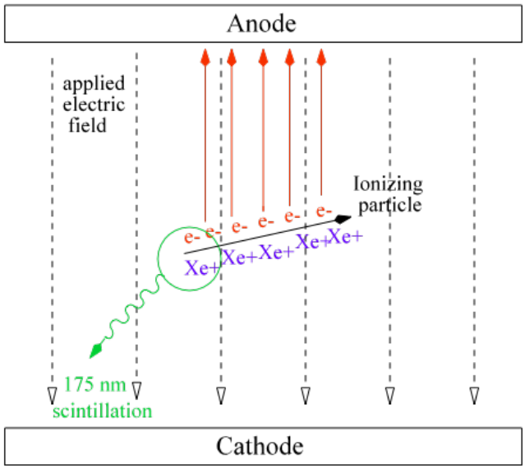
Liquid Xenon time project chamber
Searching for ¹³⁶Xe decay at 2.456 MeV
Collect charge produced in liquid Xenon with an electric field
  Information about position and energy
Detect scintillation photons
  All light emitted within 100ns → time of the event
  Also information about energy

Slide 5
Liquid Xenon scintillation at ~175nm
SiO2
Easiest Noble-gas liquid scintillation to detect
Above SiO2 cut-off
  Can still use standard silicon technology
Bright and short flash
  Number of photons produced ~125,000 at 2.5 MeV
  All photons emitted within 150ns
Alexander Neumeier: Optical Properties of Liquid Noble Gas Scintillators
TUM PhD thesis

Slide 6
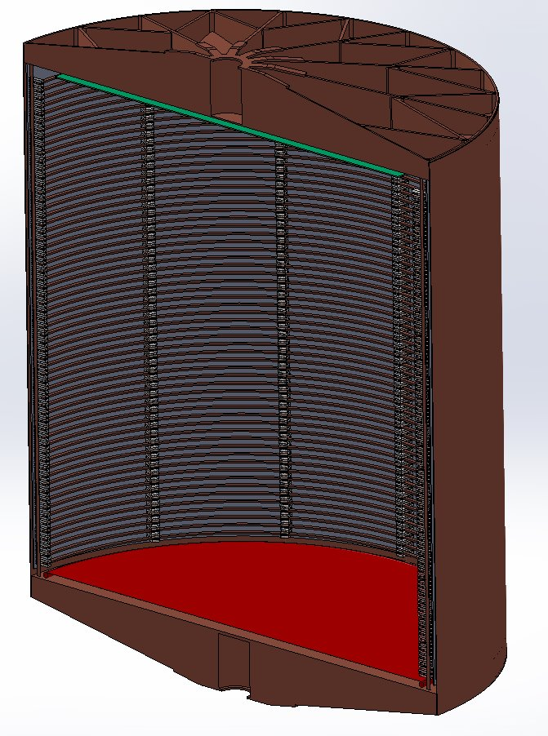
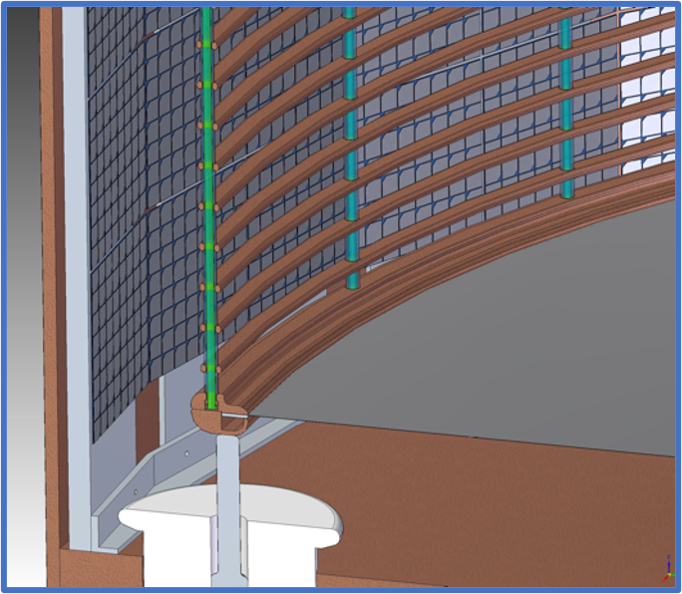
Detecting scintillation light in nEXO
Use 1x1cm² silicon photomultipliers
24 staves - 130 cm long
12 tiles per staves

Slide 7
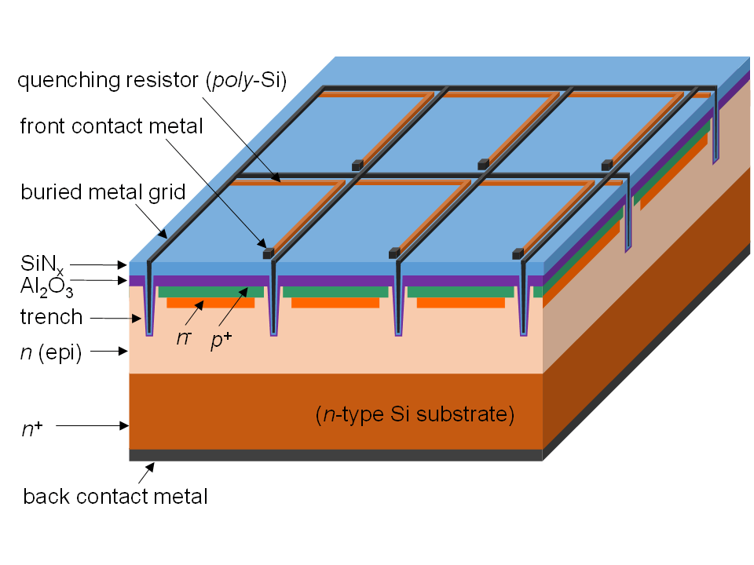
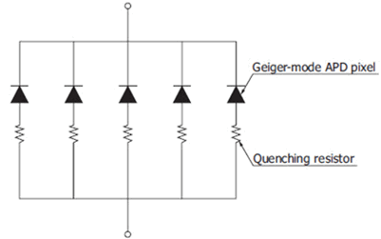
A silicon photo-multiplier – many diodes in parallel isolated by a resistor
https://sites.gatech.edu/lanns/research/silicon-photomultipliers/

Slide 8
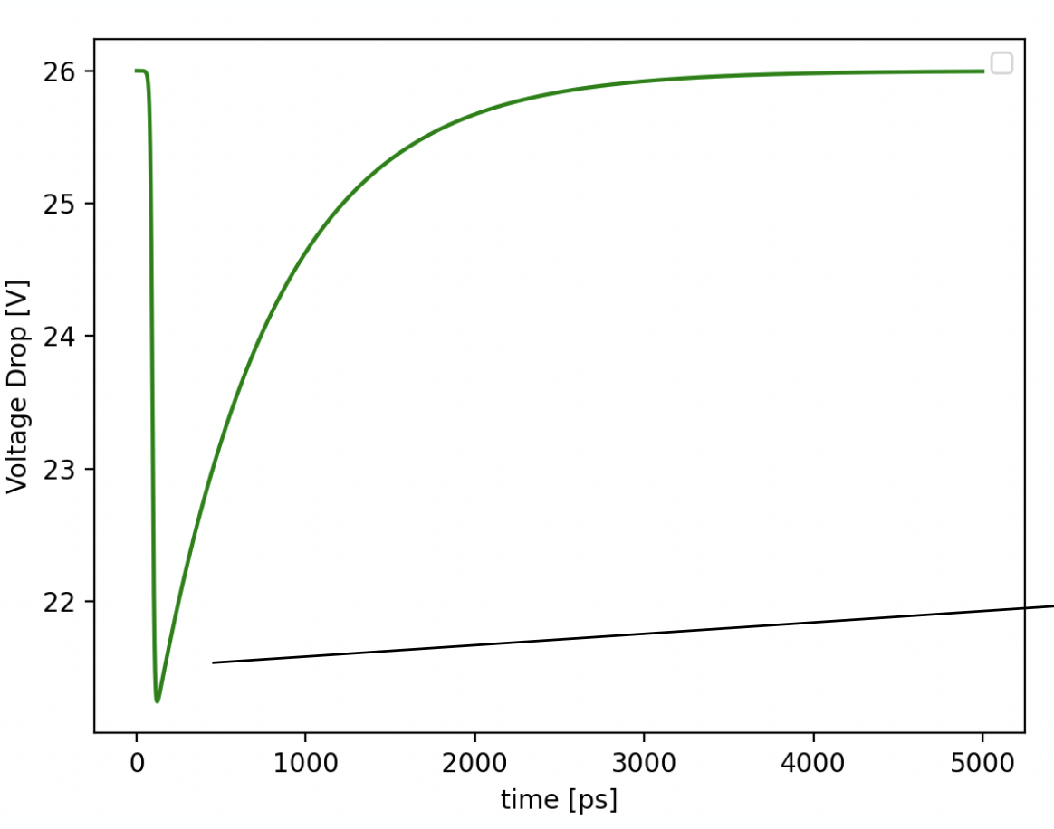
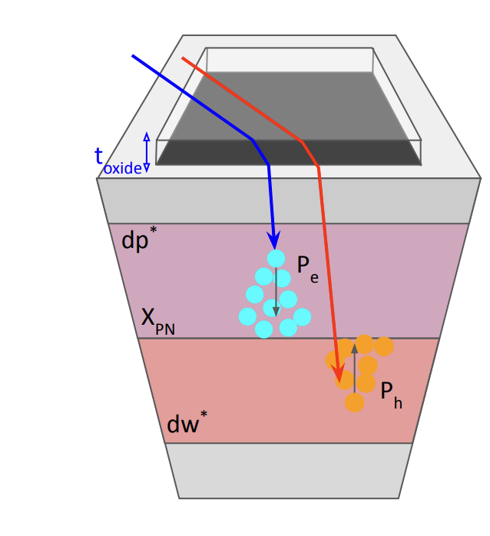
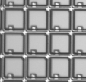
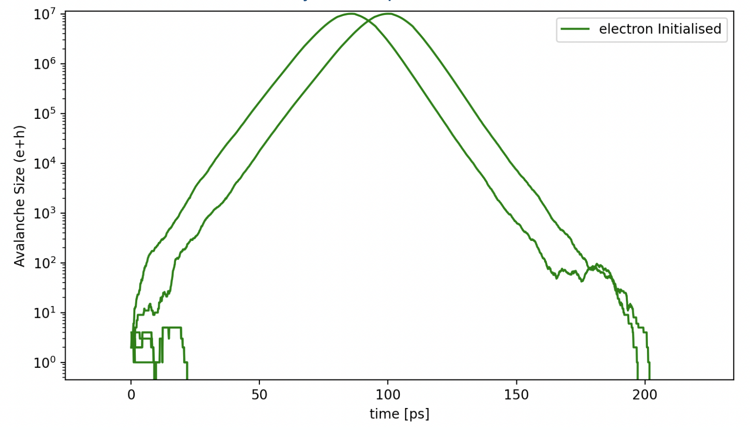
SiPM, Silicon photomultiplier
An array of Single Photon Avalanche Diodes (SPAD)
Cd
recharges
Seed
carrier
Vd drops
Cd empties
Vbias
Avalanche
Rq,
quenching
Rq / n
Cd, diode capacitance
n Spectator SPADs
Vd
Avalanche
Cd x n
Gnd

Slide 9
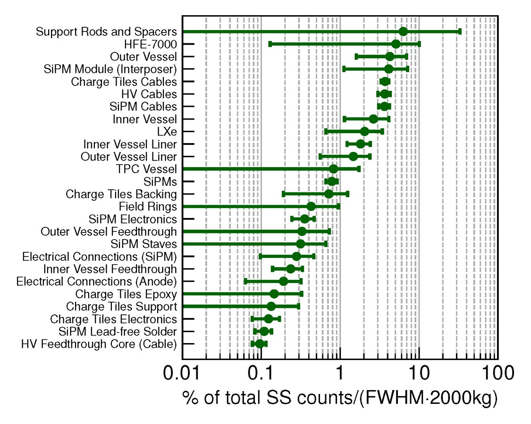
Using Silicon device because of their very low radioactivity
Several orders of magnitude lower radioactivity than PMT
Contribute less than 1% of background

Slide 10
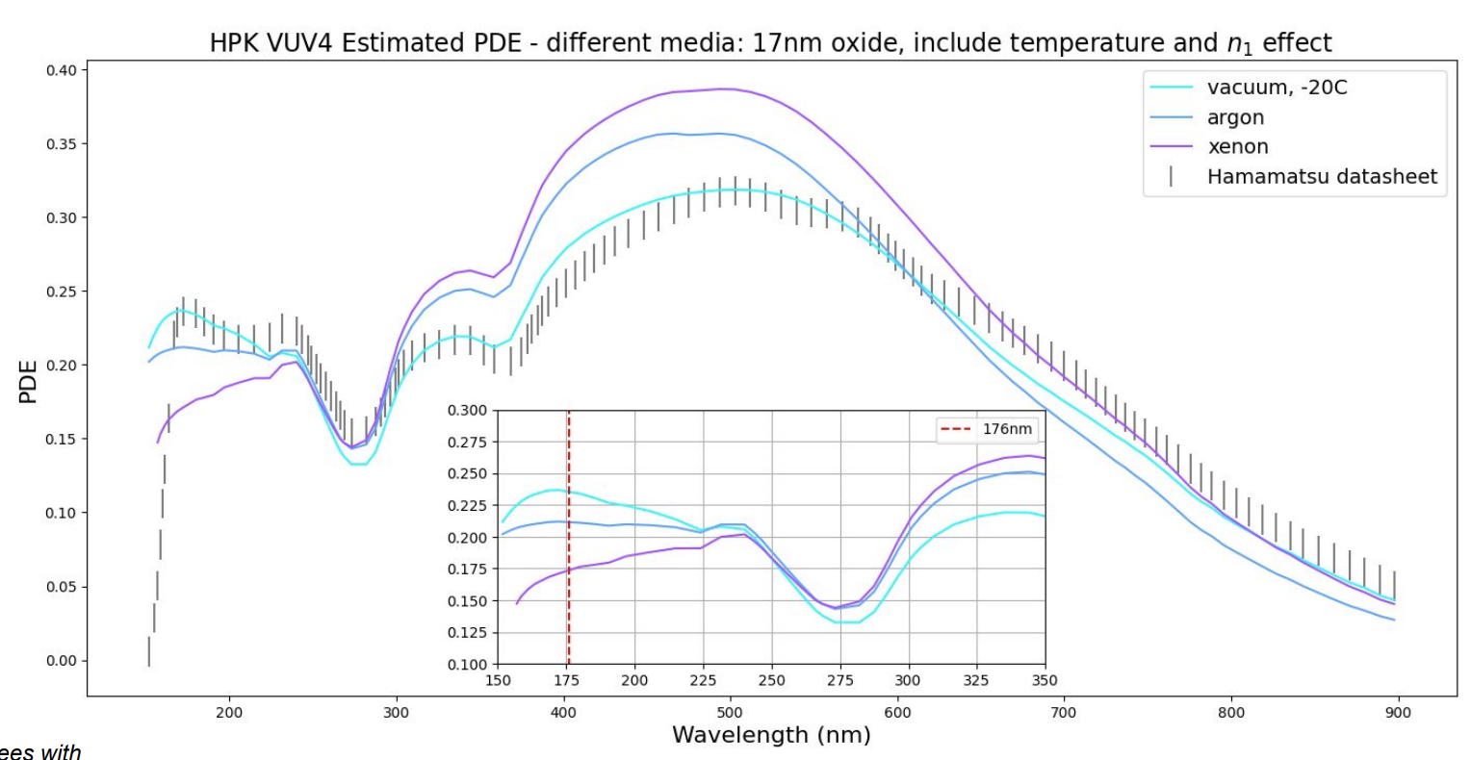
Performances in one slide – almost 10 years of work!
Austin de St. Croix (Queen’s / TRIUMF) – paper on efficiency modeling coming this summer

Slide 11
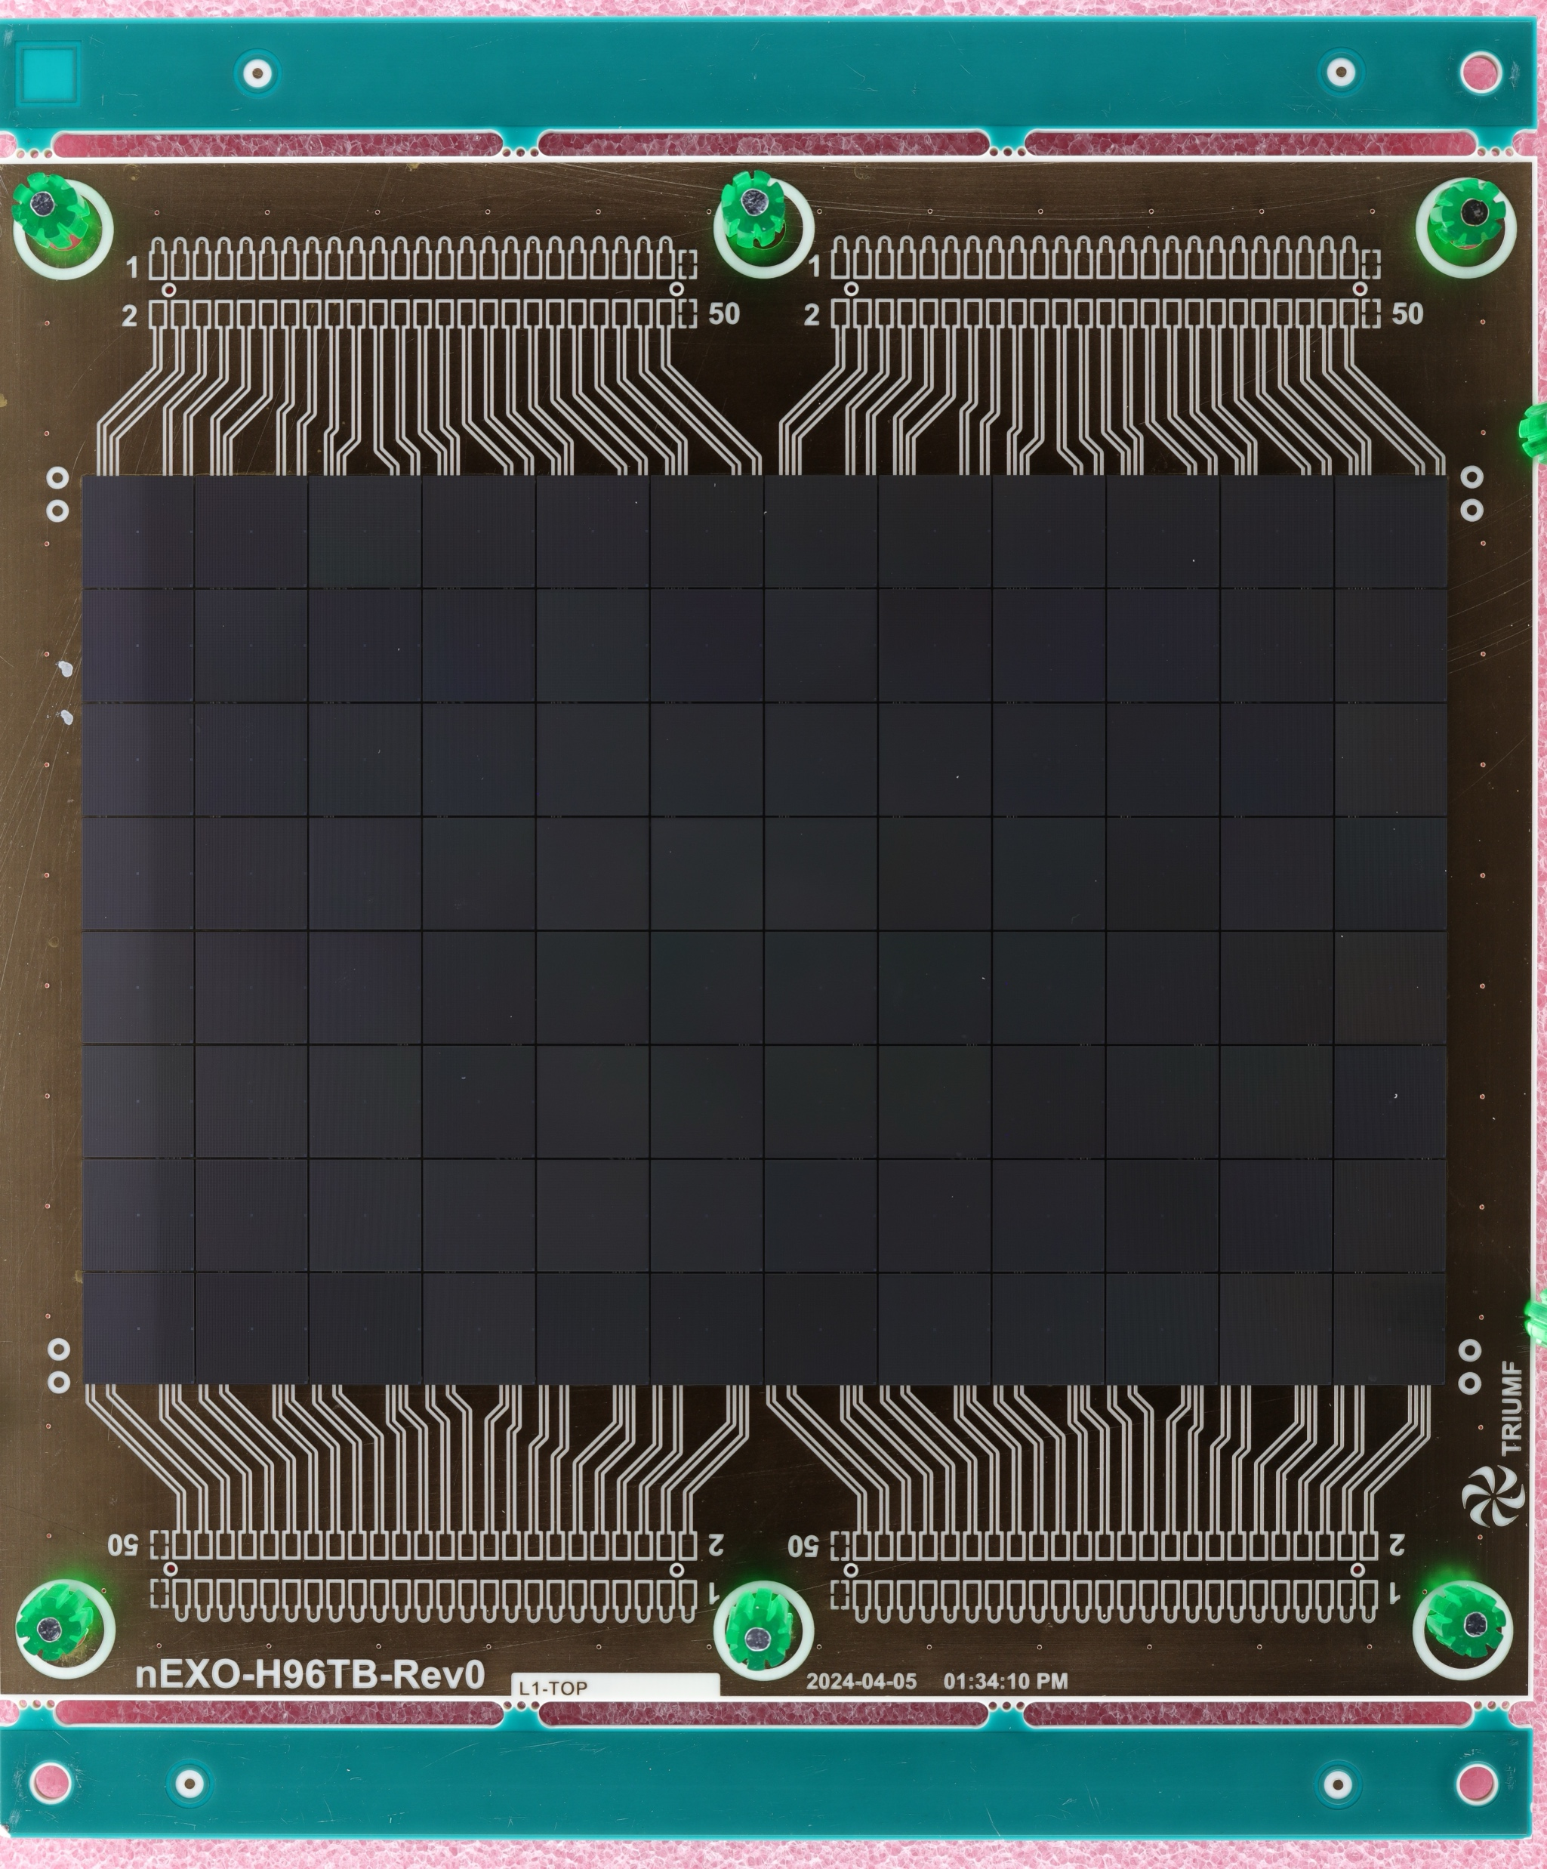
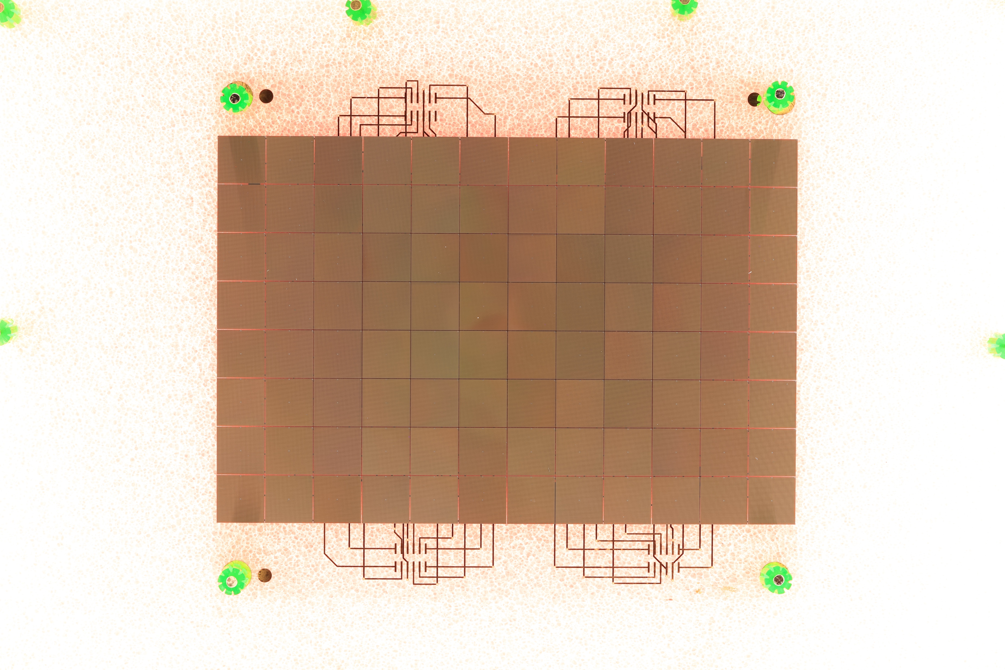
nEXO tiles – 12x8 1cm² Hamamatsu MPPC
PCB for individual MPPC characterization
Quartz – low radioactivity solution

Slide 12
Moving away from SiPM to digital SiPM
SiPM
Vbias
Analog
electronics
Digital electronics
Analog to Digital
Conversion:
comparator or
Waveform digitizer
Software or firmware
In software or firmware
Zq
Zq / n
Photon
1 SPAD Avalanche
Amplifier
Need power
to buffer
capacitance
Photon time stamp
Cd
Cd x n
Gnd
SPAD array
Quench
Detect
Photon
Enable / Disable
1 SPAD Avalanche
Photon time stamp
Cd
Cd x n
Time stamp

Slide 13
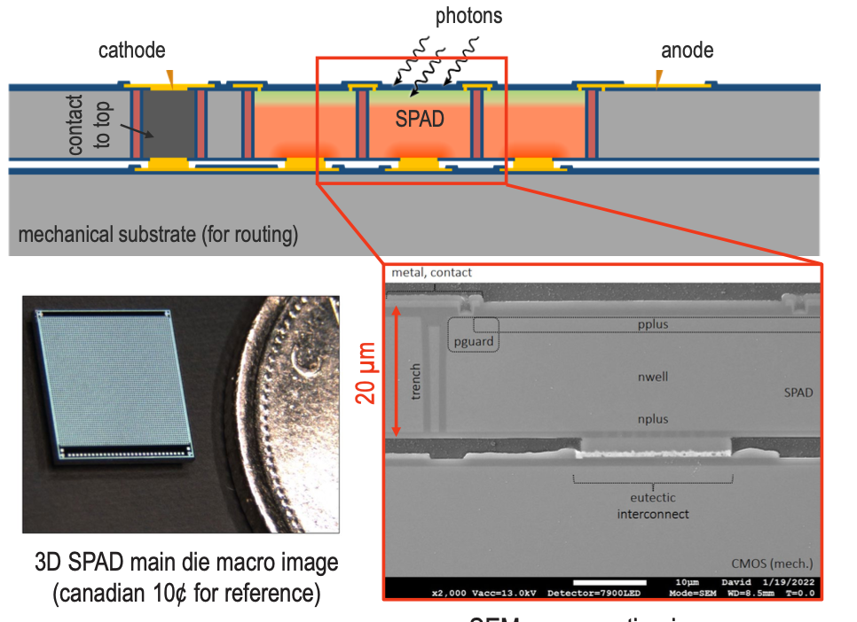
Photon to Digital Converter detour
PDC developed for Astro-particle physics
“Front-side” illuminated single photon detector
Designed at U.Sherbrooke (QC, Canada)
Built at Teledyne-DALSA (QC, Canada)
Parent, Samuel, et al. "Single photon avalanche diodes and vertical integration process for a 3D digital SiPM using industrial semiconductor technologies." 2018 IEEE Nuclear Science Symposium and Medical Imaging Conference Proceedings (NSS/MIC). IEEE, 2018.
Serge Charlebois talk on Tuesday

Slide 14
Why PDC for nEXO
Ability to time stamp every photons with ns scale resolution
  Not achievable with analog due to power dissipation constraints
  Efficient tagging of coincidence such as Bismuth-Polonium
  May use timing for position reconstruction
Ease of use. Only having to deal with digital signals
But a few challenges
  Efficiency at 175nm is low (<20%)
  Dark noise rate to be optimized
  Mass production not achieved yet

Slide 15
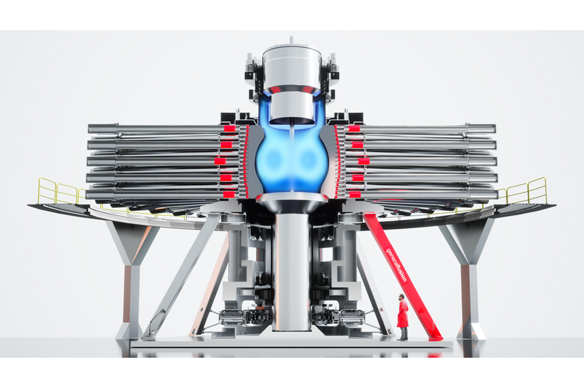
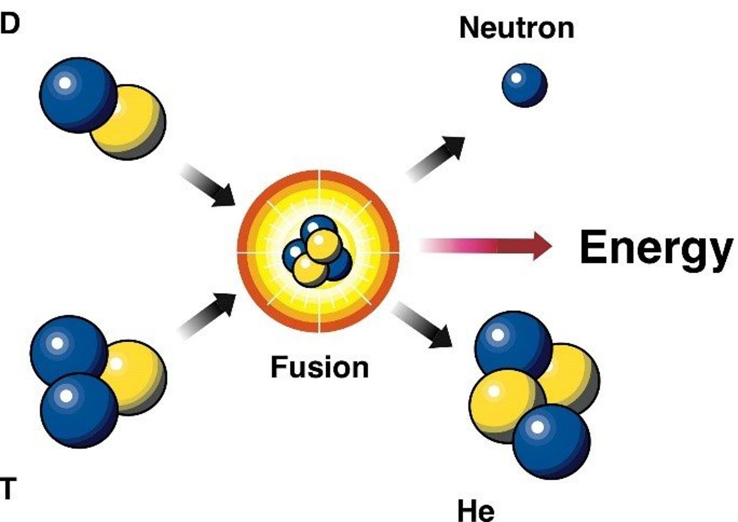
Leveraging our expertise for enabling new technologies
In 2022, General Fusion contacted us regarding a solution for neutron spectrometry
  Need to measure neutron energy
    To demonstrate Fusion condition
  Very high rate of neutrons for a short time
General Fusion Magnetized Target Fusion technology

Slide 16
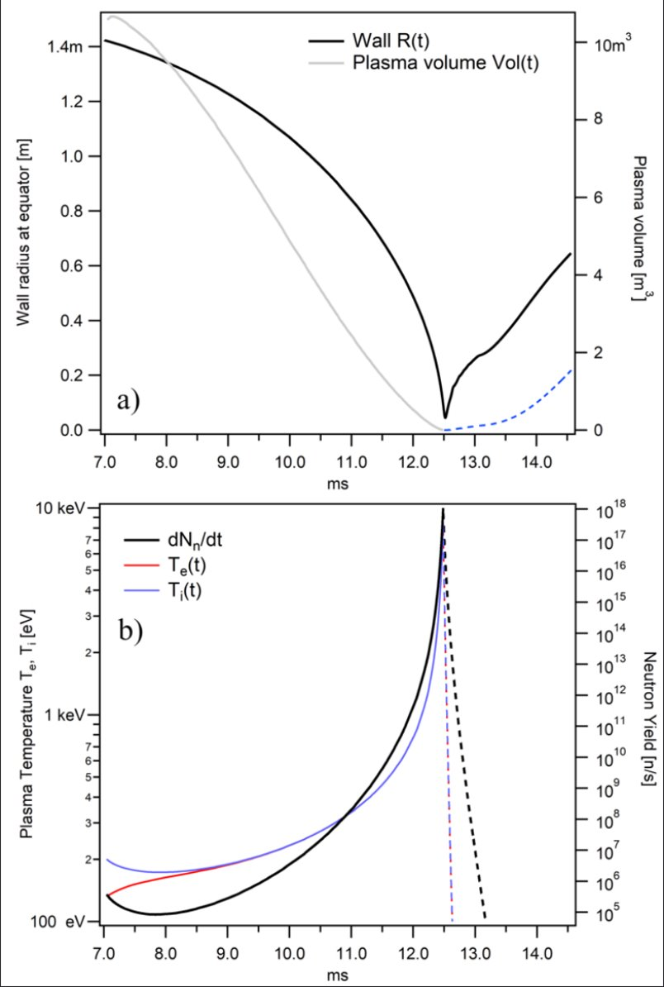
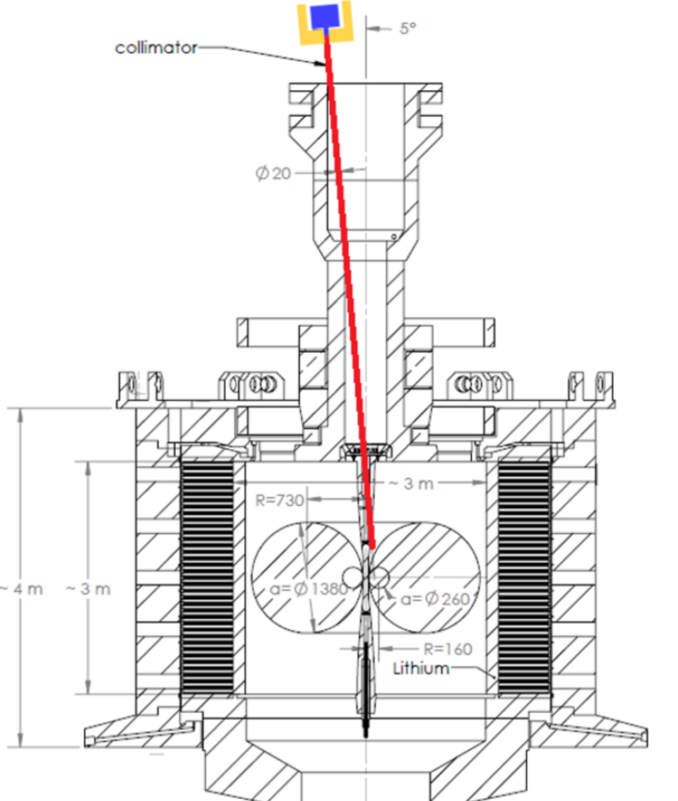
A rather unusual experiment

Slide 17
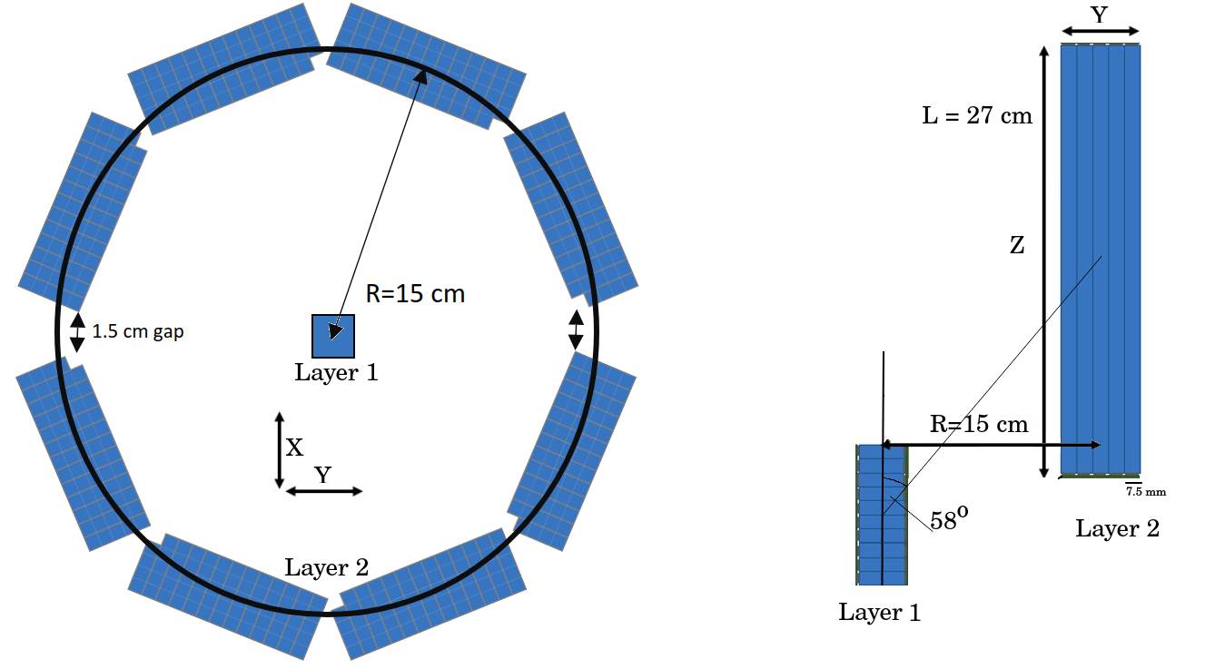
Time of flight spectrometry
A well-known technique using plastic scintillators
  Measure scattering angle
  Measure time difference between first and second scatter
Challenges due to rate
  1 neutron per ns in first layer
    High segmentation
    Fast response
  Ambiguity associating layer 1 and layer 2
    Minimize time of flight – so need outstanding timing resolution
Neutrons

Slide 18
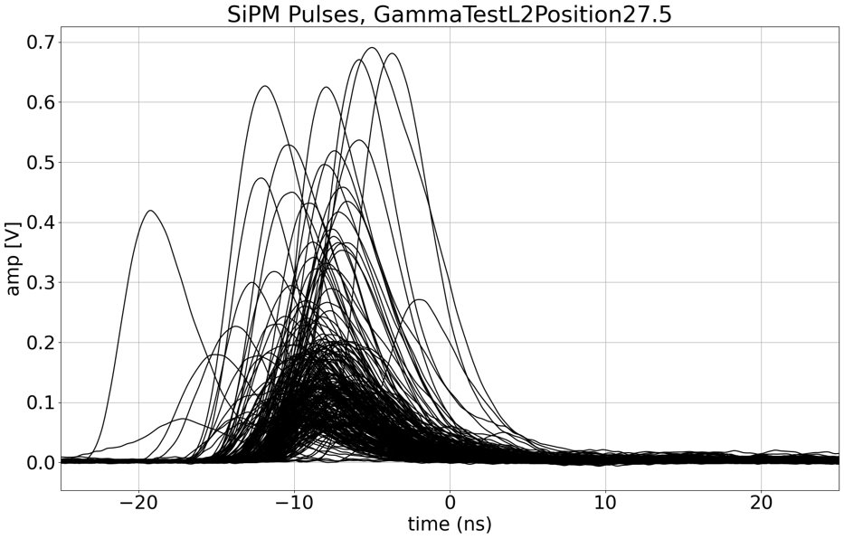
A SiPM-electronics challenge that would be alleviated using PDCs
Extensive tail cutting required without scarifying timing resolution and minimizing power dissipation
  Start with >100ns pulse width. Need <20ns after shaping
Phase 2 will be to used PDC
  Much easier to control SiPM recharge
  Expect to achieve 100 MHz per channel
    I.e. can detect 2 interaction separated by at least 10ns
  With analog SiPM, 20ns is probably as good as it gets
    And we have not found a low power solution. Need 50-100 mW per channel for front end

Slide 19
Towards first experiment early 2027
Complete single channel validation by end of 2025
  Using analog SiPMs + analog electronics
Build the detector system by end of 2026
  128 channels for layer 1
  About 1000 channels for layer 2
In parallel, develop layer 1 readout using PDC in 2026
Start data taking in 2027 if General Fusion can deliver
  Upgrade to PDCs as soon as possible
This is really like a physics experiment
  Made possible by NSERC ALLIANCE with General Fusion

Slide 20
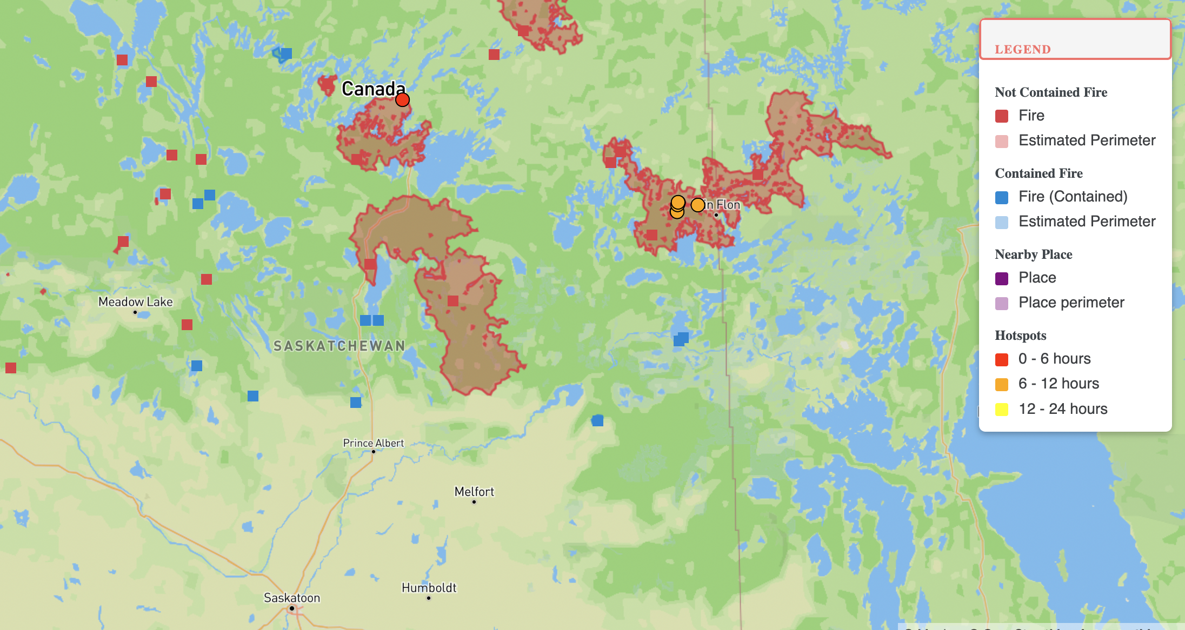
But, can we afford to wait for green energy or is it already too late?
Map copied on June 9 at 1:38pm (Pacific)

Slide 21
Suppressing forest fire before the become catastrophic – A multi-prong challenge
The detection
  What modality? Imaging from space, drone operated, static systems?
    In remote area most fires are started by lightning – somewhat predictable – drone fleet
    Humans start most fires in area they access – hard to predict – static arrays
  Our strategy #1: rely on diffusion + wind to bring the signal to our sensors whether static or drone mounted.
  Our strategy #2: measure smoke because we can use SiPM/SPAD technology
The suppression
  When is it too late? How quickly can a fire be put out vs their size and the environment
The decision
  When to put out a fire vs letting it burn?

Slide 22
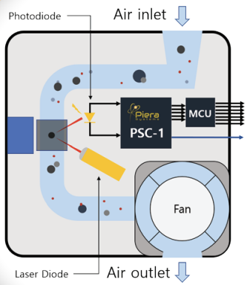
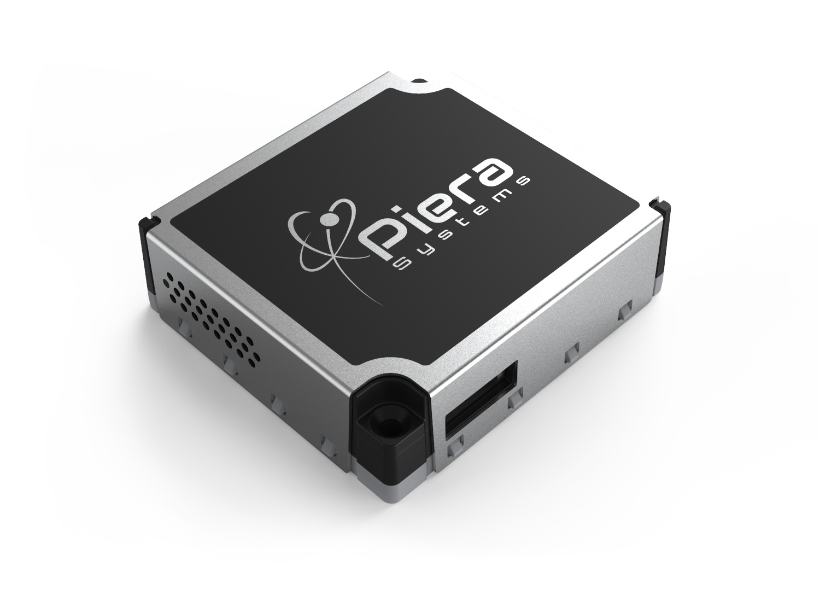
Smoke (particulate) detection technology
Based on Mie scattering detection
Commercial units rely on a single photo-diode
Low noise electronics in an ASIC + AI
Designed primarily in Mississauga, ON
80$/unit

Slide 23

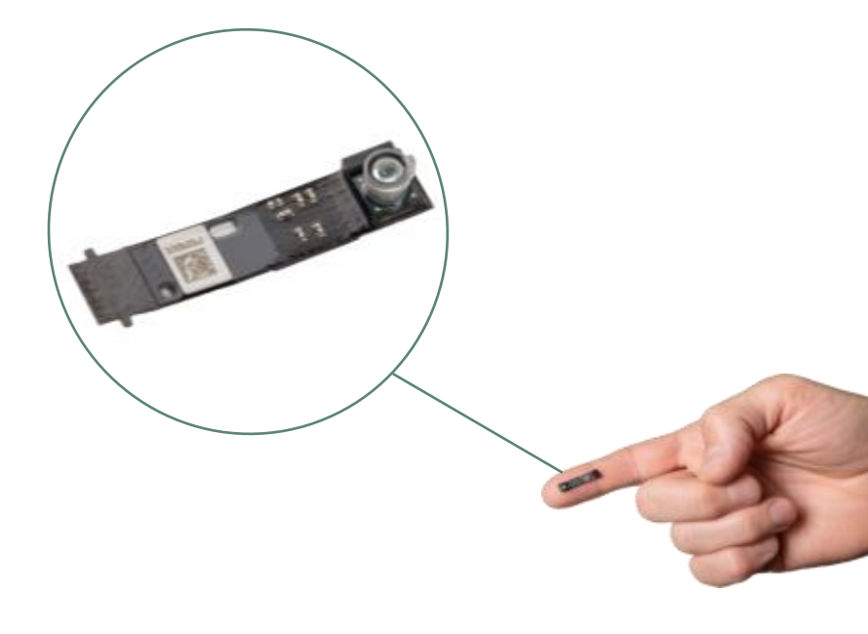
Most recent technology
Measure Mie (back) scattering in free space
  No more enclosure
Still using photo-diode

Slide 24
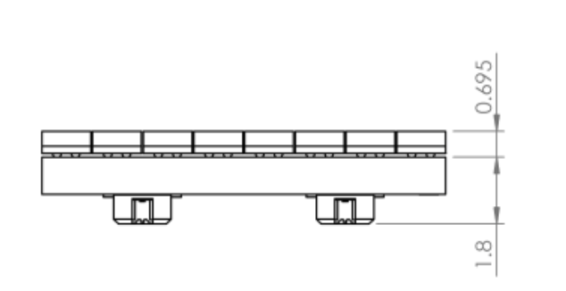
Our concept using SiPMs (2021-2022)
Beam dump
Key idea was that we had deep UV sensitive detector
Able to probe smaller particulate
Optical baffle
SiPM array
Elliptical
mirror
SiPM behind pinhole
Limit stray light
Limit ambient light leakage
Limit dust
Gas jet
Perpendicular to plane
Collimated
Laser

Slide 25
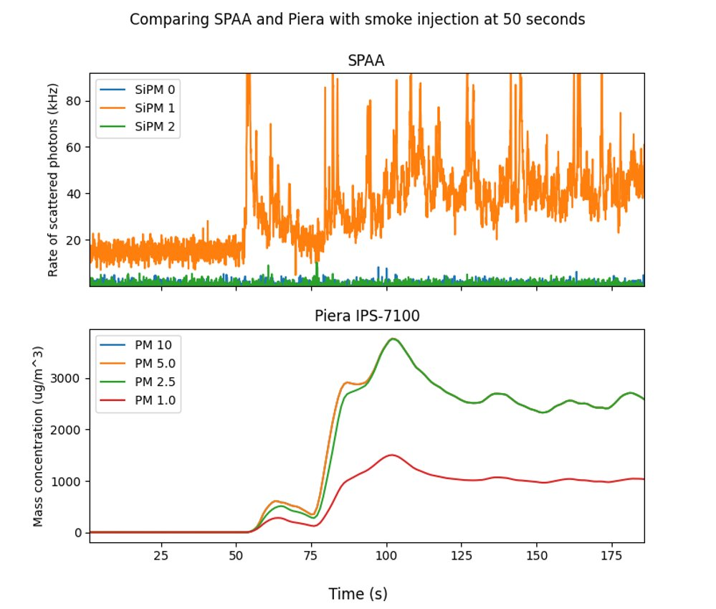
Working concept!
Demonstrated over the summer 2022
Photon counting is compelling
New design coming. Easier to build
Smoke injection

Slide 26
Moving to digital SiPM
Much lower power than photo-diode and much higher performances due to built-in segmentation
Design to enable stand-alone operation for >4 months

Slide 27
Summary and outlook
Long journey from nEXO to General Fusion NES to smoke detection
  We built extensive expertise and capabilities
  Our focus shifted overtime from fundamental physics to tackling pressing issues linked to climate change
Where do we go from there?
  Build a community to address the challenge of managing forest fire in Canada. Global warming is here, mitigation is required.
  Build a sensor network from Vancouver North Shore to Squamish by 2030
    May not make most sense but this is a symbolic example
  Too ambitious for academia alone. We will work with companies (especially SenseNet) and we may create a spin-off
    We want/need to move fast. If you are tired of the snail pace of academia, talk to me!

Slide 28
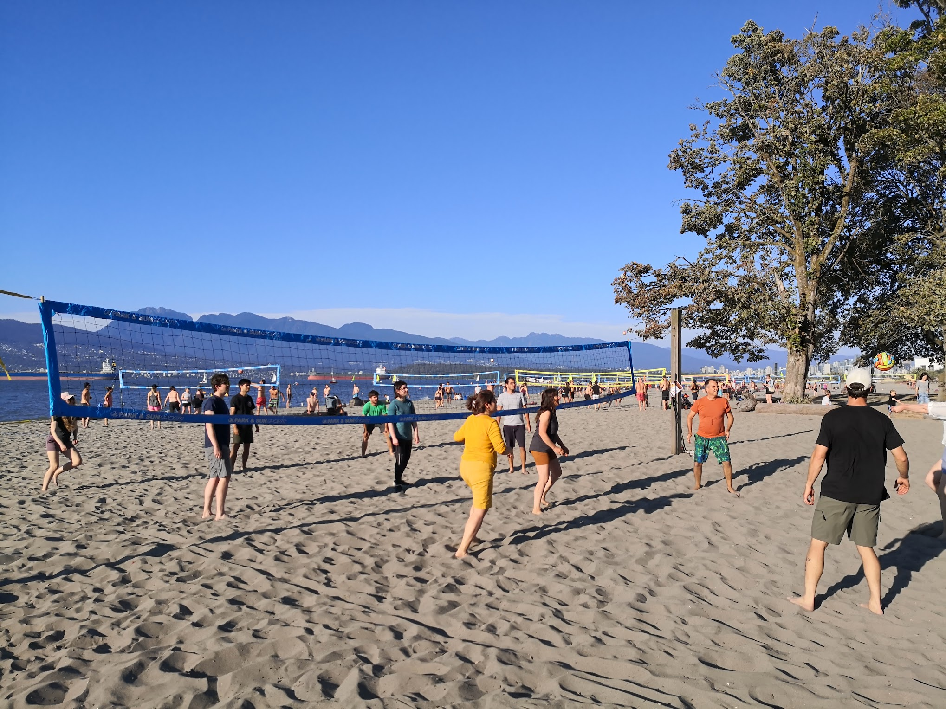
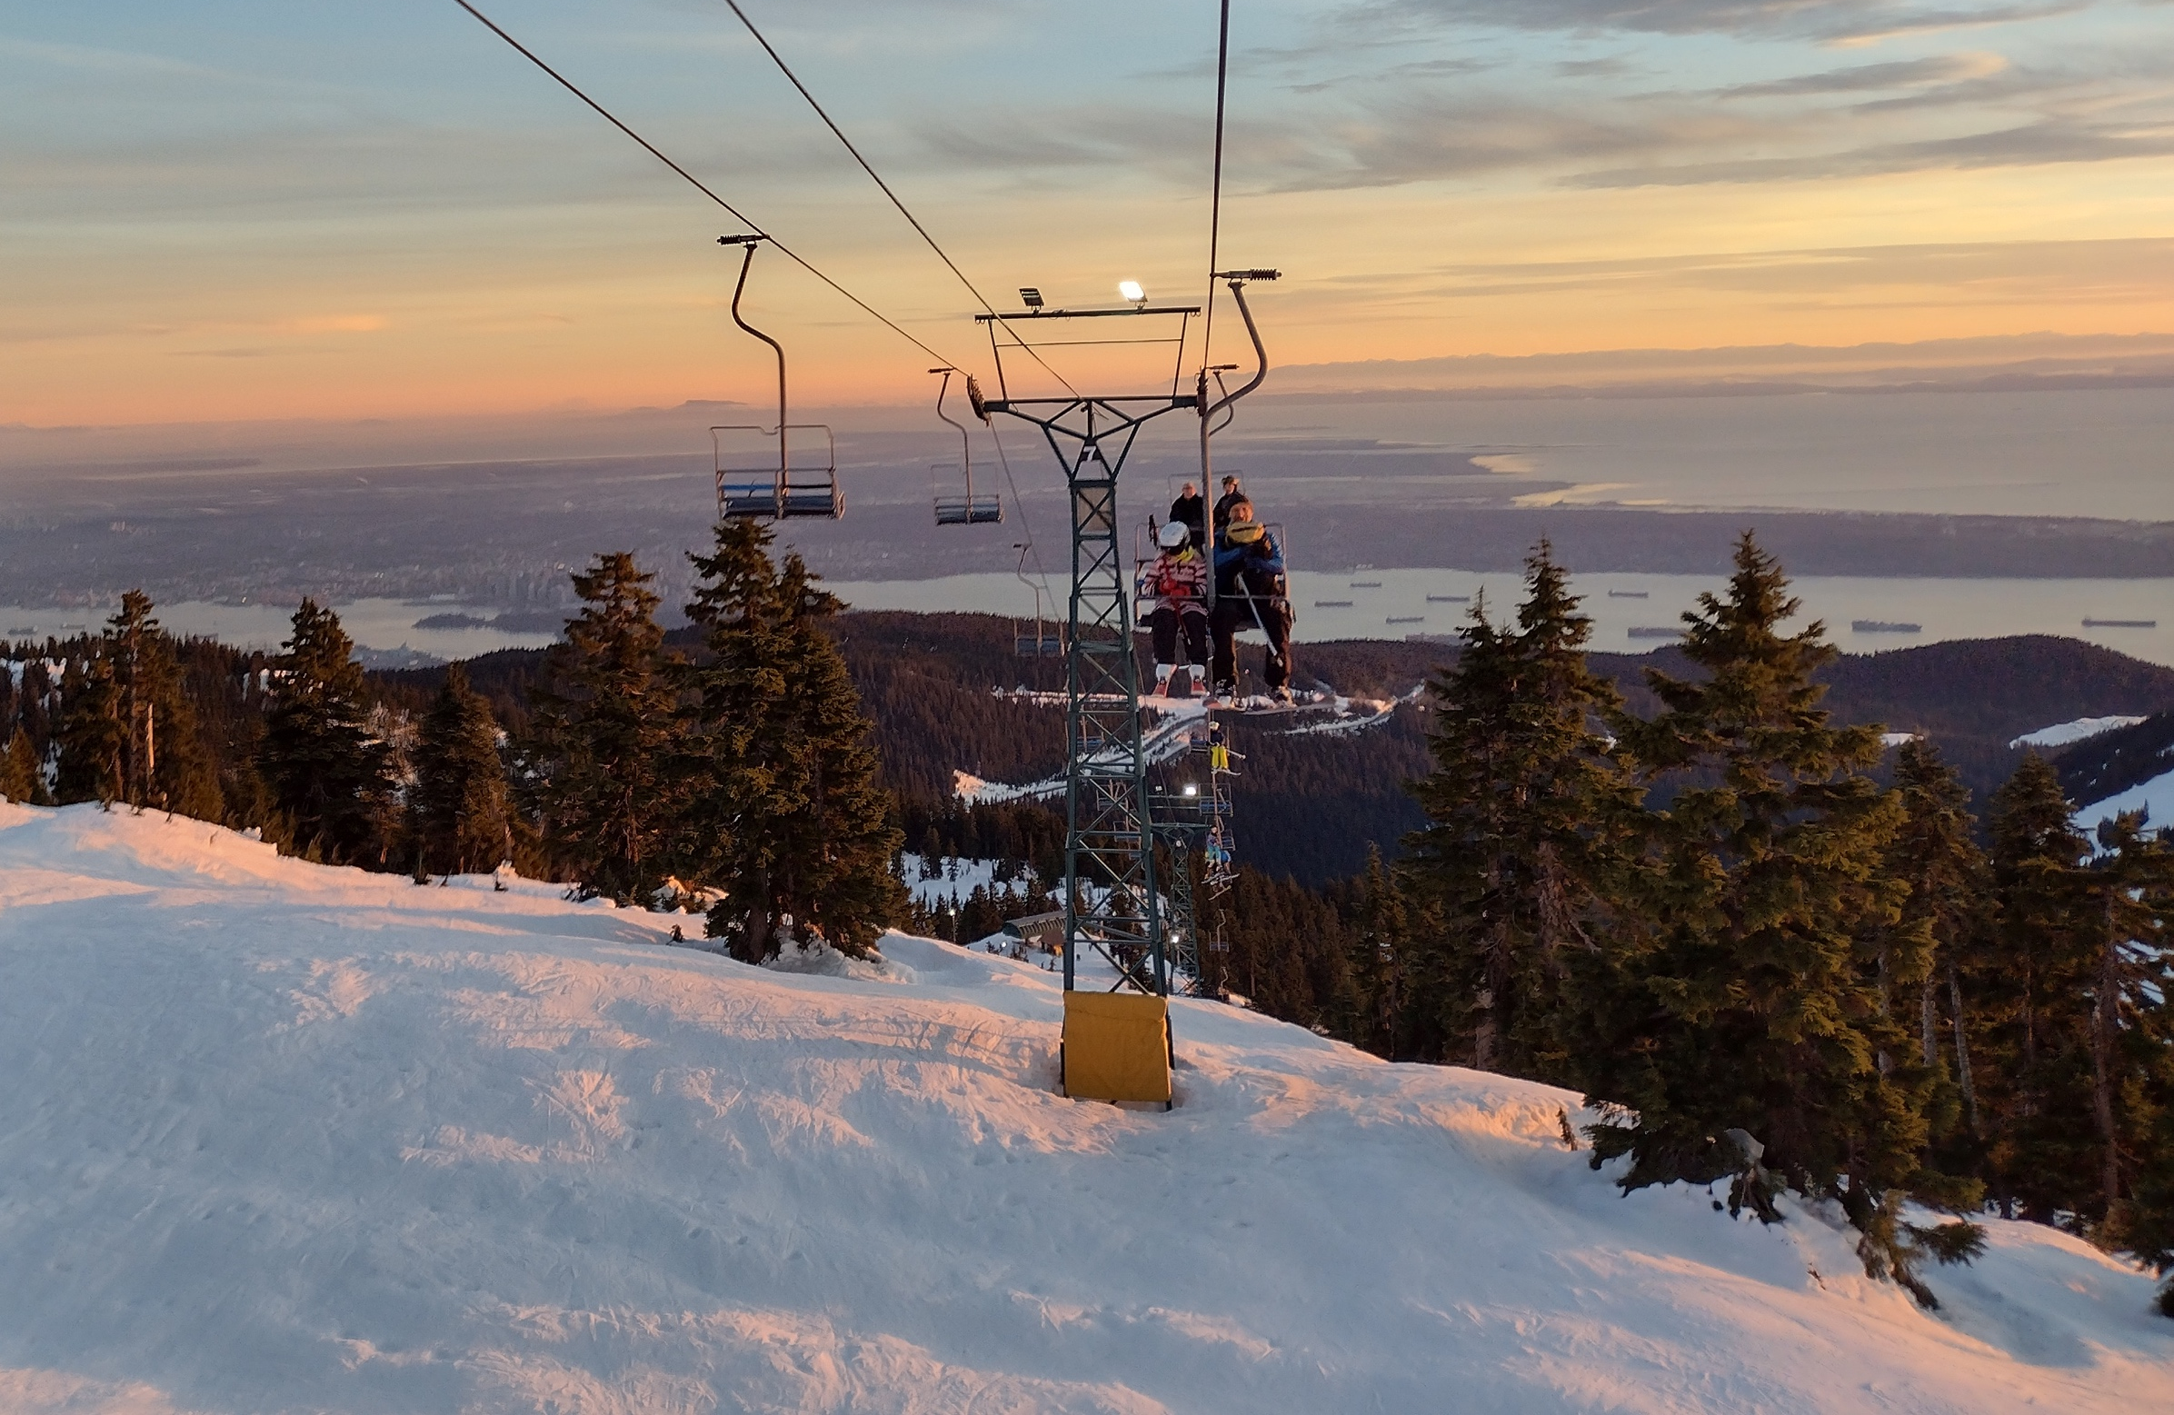
Where work and play meet.
Nuclear physics technologies can rescue our environment

Slide 29
Scintillation detection concept
Diffuse
reflection
Physics process
  Neutrino scattering
  Double beta decay
  … Ionizing particle, gamma ray, neutron
Energy deposited
Scintillation light produced
Light (photons) propagate
Photons are detected
Electronics converts photon signal into digital information
scintillator
Neutrino
elastic
scattering
Specular
reflections
Double
beta
decay
Photon detector
Time of arrival
Photon count

Slide 30
PDC detour
Front Side illumination (ala Sherbrooke)
photon
Thin passivation ~100nm
e⁻
Ultra-thin contact 1-5nm
Low drift field region
h
e⁻
Drift field region
Versatility
  Visible to IR via thickness control
  Deep UV through Back-side surface processing
    Unconventional Anti-reflective coating: black silicon, graphene, 3D structures
  Non-photon detection
    Minimum ionizing
    keV scale electron (hybrid photo-detector)
    Dark matter
Avalanche region
Molecular bonding
CMOS
Aka. electronics
Back side illumination
photon
Thin passivation ~100nm
Ultra-thin contact 1-5nm
Low drift field region
e⁻
e⁻
Drift field region
Avalanche region
Molecular bonding
CMOS (in 2D or 3D)
Aka. electronics
30

Slide 31
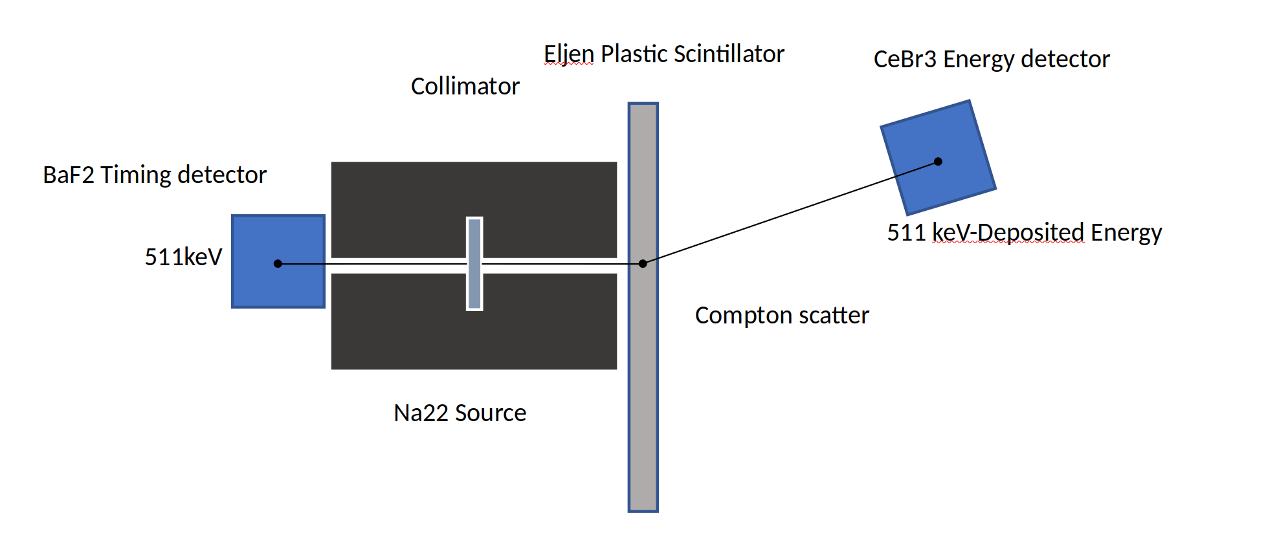
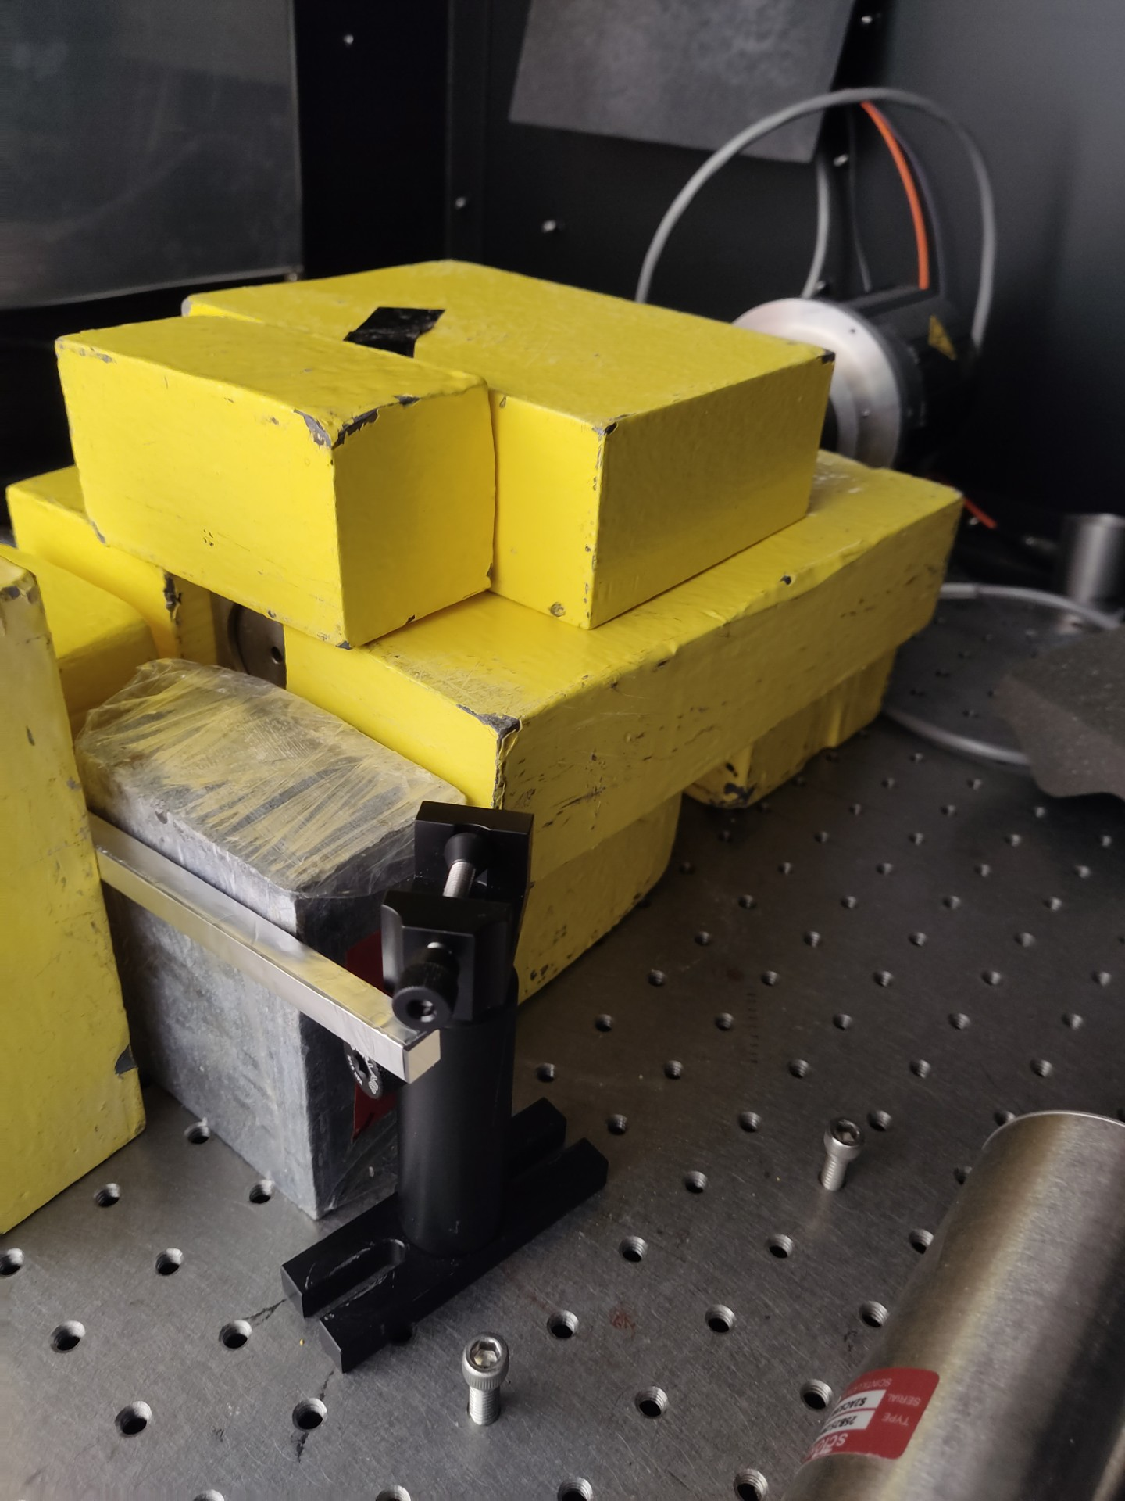
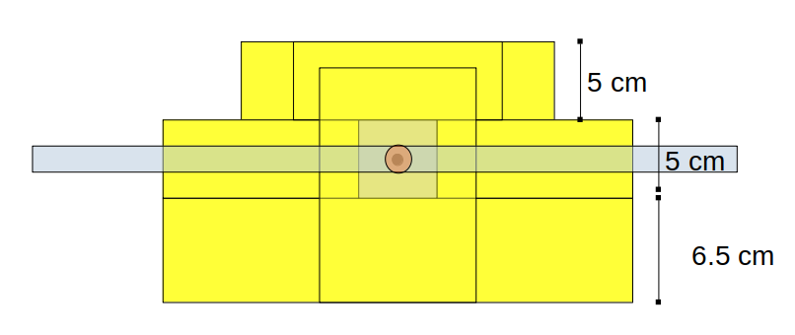
Gamma as neutron proxy
Back-to-back 511 kev gammas
Left side - BaF₂ detector to time stamp interaction time
Right side – Compton scatter in plastic bar
  Gamma produce 8-10 times more scintillation than neutrons
  100 keV Compton scatter ~ 1 MeV neutron scatter
Right side - CeBr₃ to measure energy of scattered gamma

Slide 32
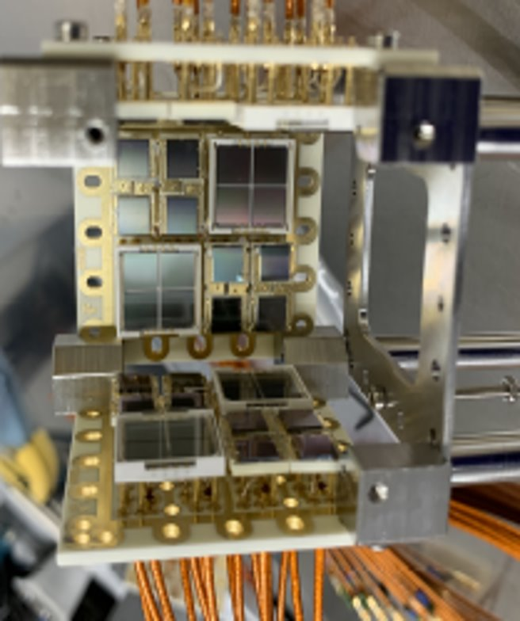
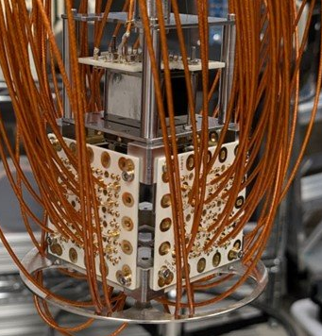
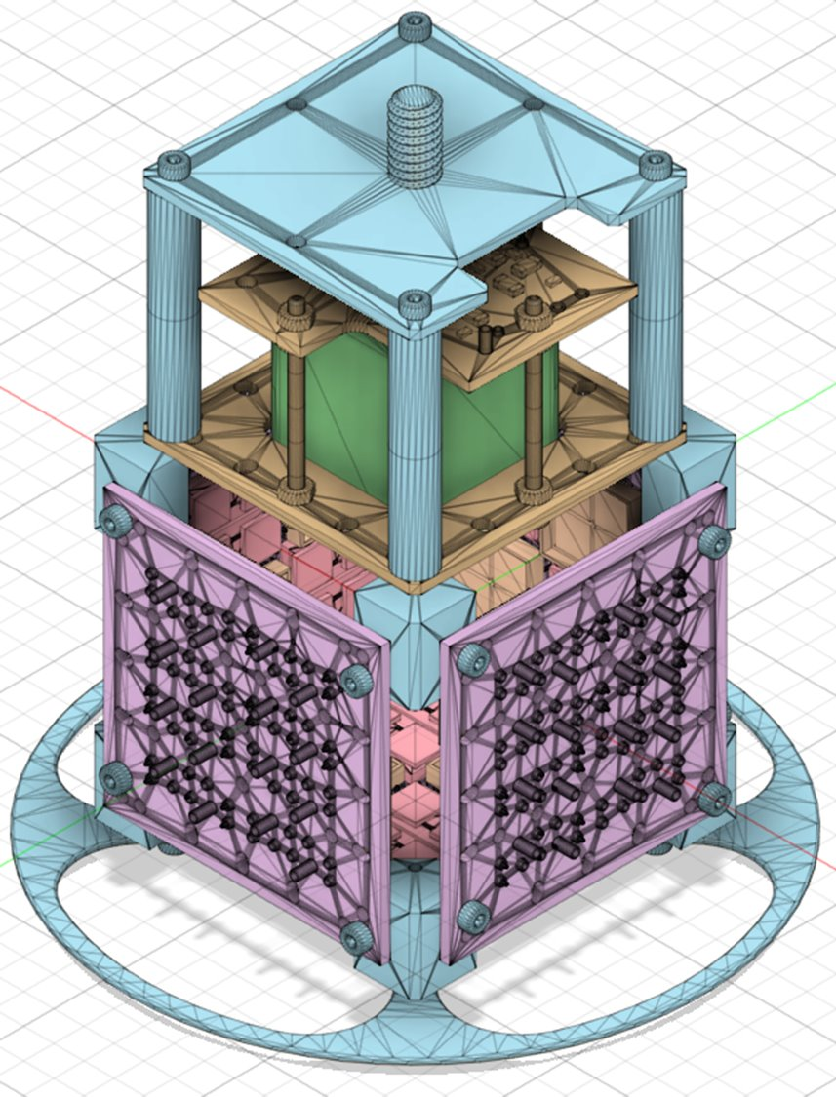
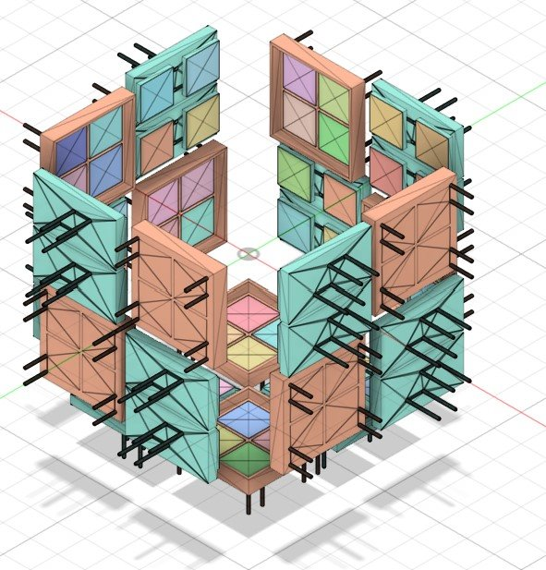
Probing performances in LXe
Reality
Light only Liquid Xenon (LoLX)
  Carleton, McGill, Pisa, Sherbrooke, TRIUMF collaboration
Validating performances of SiPMs in Lxe
Studying light production in Lxe
  Scintillation and Cerenkov
  Energy resolution
See talk by A. Li on Monday
Simulation

Slide 33
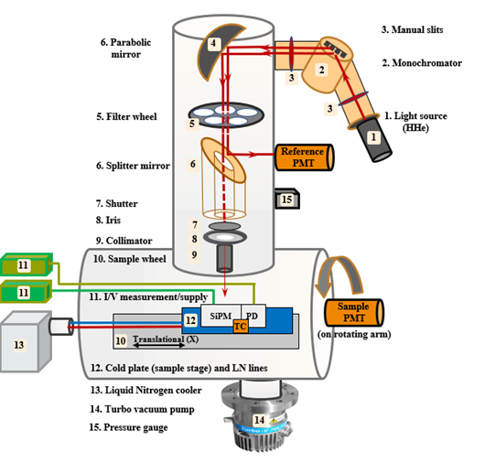
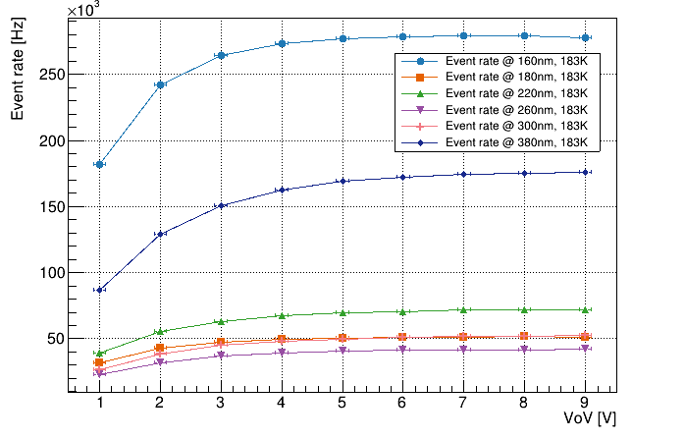
Asset: Vacuum Ultra-Violet Efficiency reflectivity and Absorption setup (VERA)
For example: inferring the number of electrons produced per VUV photon

Slide 34
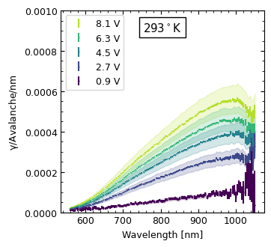
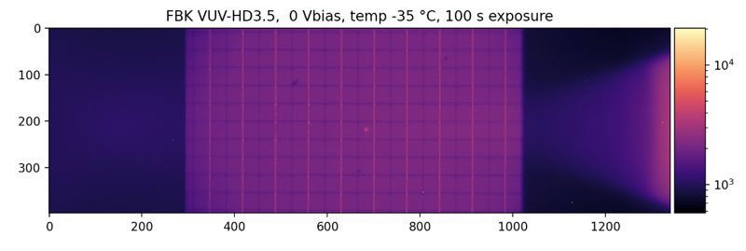
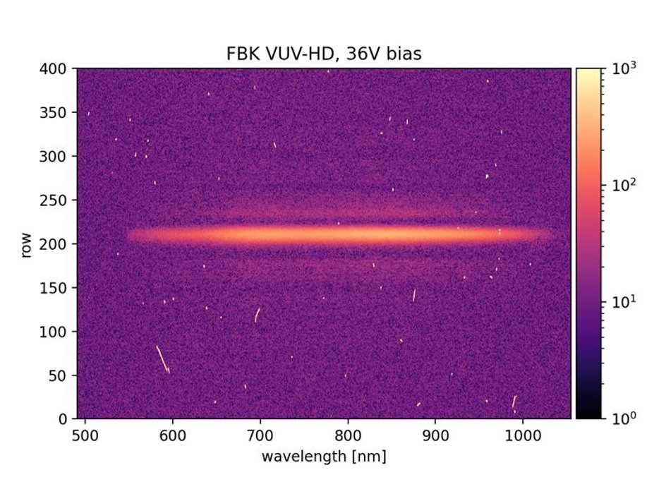
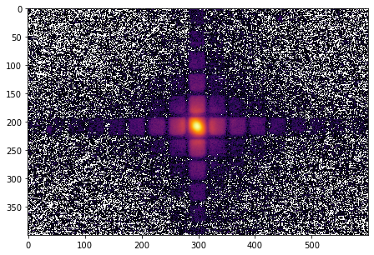
Asset: MIEL
Cooled X-Y Stage
SPAD
Vacuum Window
SiPM Surface
Vacuum Chamber
Objective
FBK Reflected Light and Laser Spot
Dichroic Mirror
Tunable laser
300 - 1500nm
Emission Filter
Emitted Light
IX-83 Microscope
Diffraction
Grating
B)
A)
Spectroscopy
Imaging
Spectrometer and Cryogenically Cooled Camera
2D Emission Map

Slide 35
nEXO - a steppingstone to expanding SiPM expertise
nEXO leveraged earlier work
  T2K Fine Grain Detector 2007-2011. First use of SiPMs in physics experiment
  SiPM for Positron Emission Tomography
    Main deliverable was a PET/MR insert led by U. Manitoba
nEXO provided
  State of the art equipment and personnel
nEXO and LAr DM enabled emergence of digital SiPMs in Canada
  Sherbrooke’s Photon to Digital Converter
  My vision: the next decade will see digital SiPMs eliminate analog ones
  Canada will pave the way – driven by applied projects

Slide 36
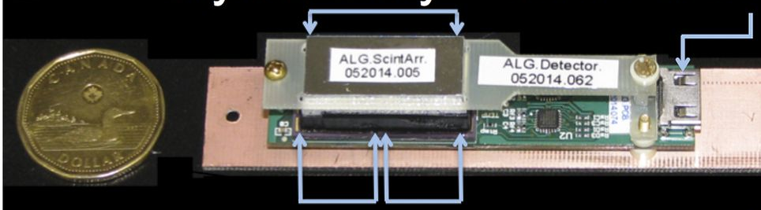
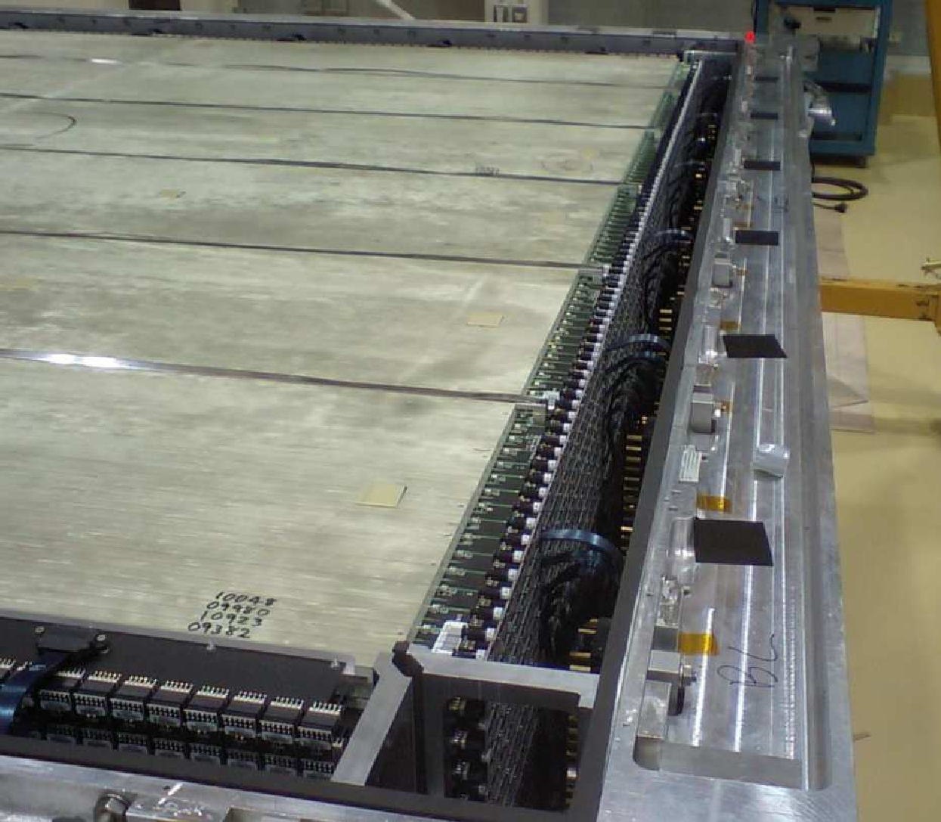
Evolution of SiPM R&D at TRIUMF
Neutron spectrometry
2022-2025
T2K Fine Grain Detector
Positron Emission Tomography
Neutrinoless double beta decay
Neutrino oscillation
Manitoba PET/MR insert
nEXO: 2014-2025

