Slide 1
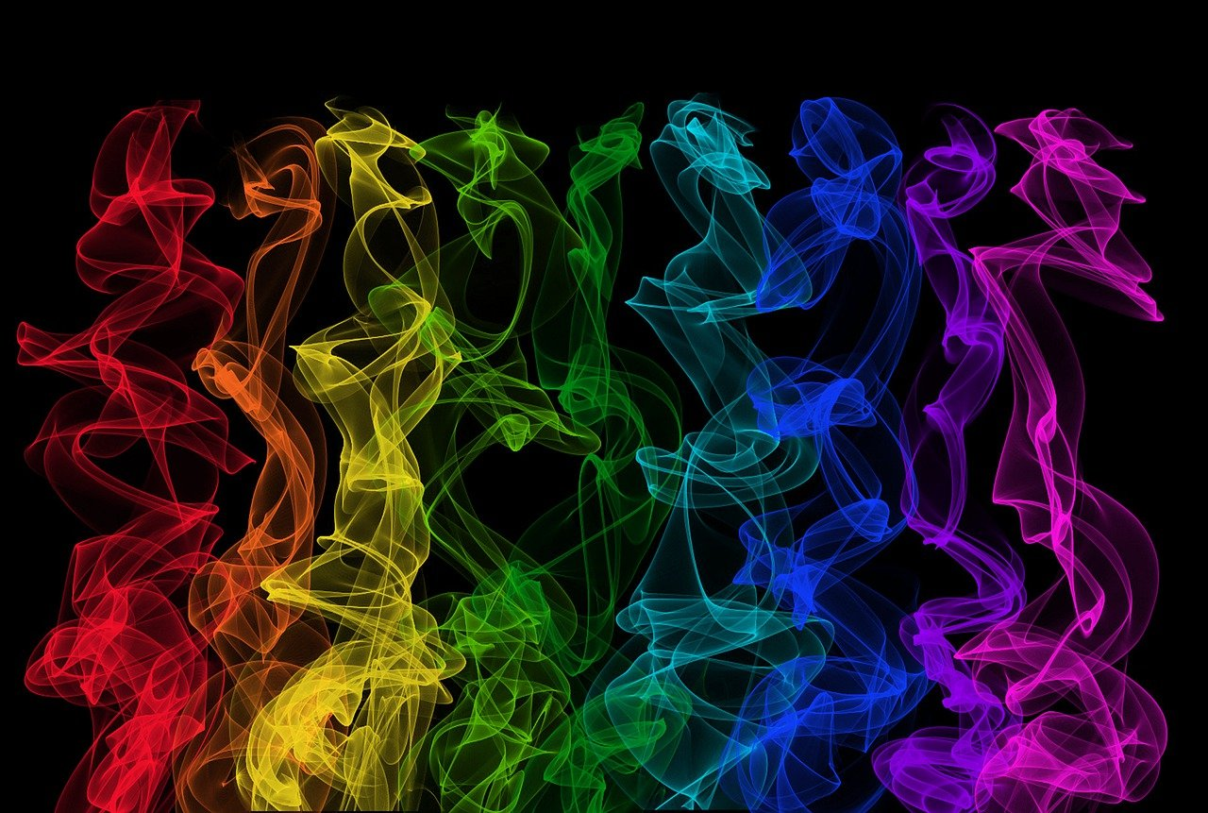




Radioactivity of Rare Isotopes
April 13, 2023
June 9, 2025
Nuclear structure at the limits of stability
Dr. Gwen Grinyer she/her
Department of Physics, University of Regina, Regina, SK S4S 0A2, Canada
Gwen.Grinyer@uregina.ca
@gwendoesscience

Slide 2
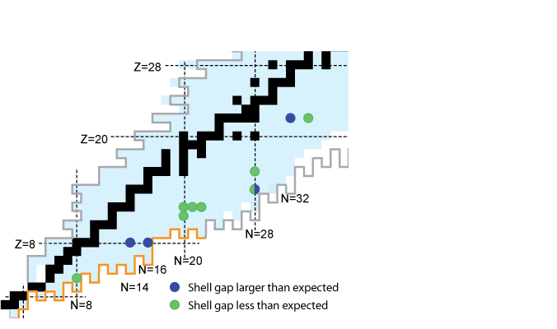
Rare Isotope Research
Rare Isotopes = Short-lived radioactive isotopes not found on Earth
  Often exhibit unique properties compared to well-known stable isotopes
  Essential tests of fundamental symmetries, structure and nuclear astrophysics
Big questions in subatomic physics
What is the nature of physics at the electroweak scale and beyond?
How does the structure of nuclei emerge from the nuclear forces?
How are the elements formed in the universe?
2p radioactivity
Discovered 2002
Symmetry Tests
Shell Evolution
Canadian Subatomic Physics LRP 2022-2026
www.subatomicphysics.ca
Neutron-rich limit?
Halos,
Clusters
Experiments on the most exotic nuclei!

Slide 3
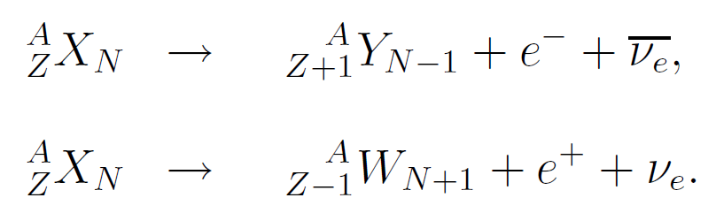
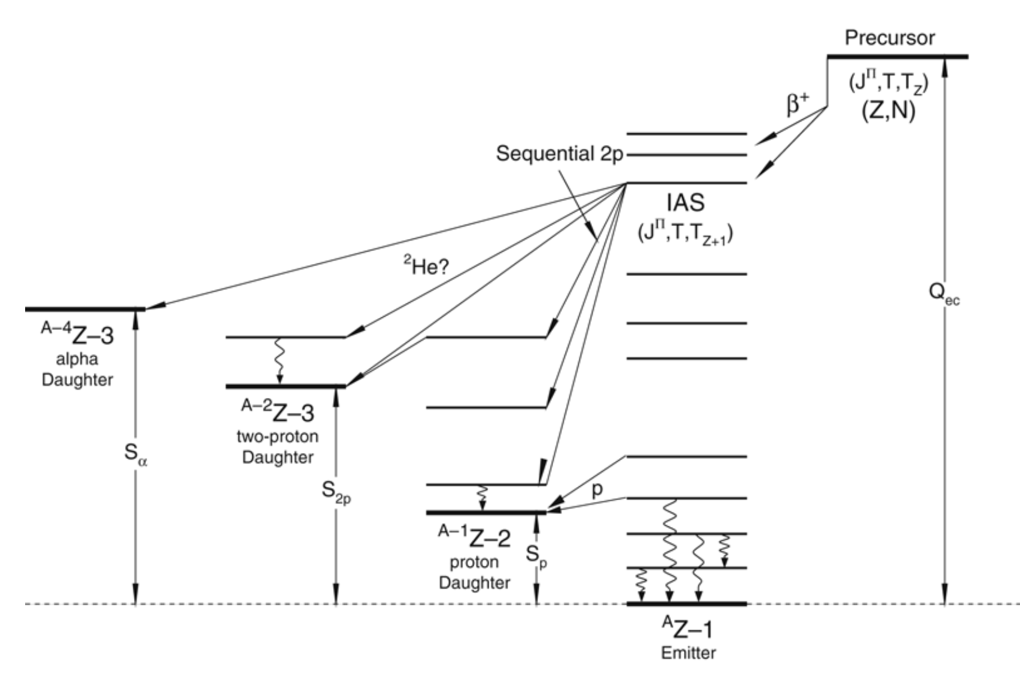
Radioactivity: Nuclear β decay
Powerful technique to study rare isotopes
β⁻
neutron proton
β⁺
proton neutron
Parent
Half-life
T_{1/2}
Q-value
(energy)
Branching
Ratio’s
BR
Daughter
γ-ray emission

Slide 4
Radioactivity: Nuclear β decay
Powerful technique to study rare isotopes
Further from stability
Parent
β⁻
Half-life
T_{1/2}
neutron proton
β⁺
proton neutron
Q-value
(energy)
Branching
Ratio’s
BR
Daughter
γ-ray emission

Slide 5
Radioactivity: Nuclear β decay
Powerful technique to study rare isotopes
Further from stability
  Particle unbound states
  β delayed proton decay (βp)
  β delayed 2 proton decay (β2p)
  2p radioactivity and more!
Parent
β⁻
Half-life
T_{1/2}
neutron proton
β⁺
proton neutron
Isobaric Analogue State
Proton
emission
Q-value
(energy)
Branching
Ratio’s
BR
S_{P}
Separation
Energy
Daughter
γ-ray emission

Slide 6
Radioactivity: Nuclear β decay
Powerful technique to study rare isotopes
Further from stability
  Particle unbound states
  β delayed proton decay (βp)
  β delayed 2 proton decay (β2p)
  2p radioactivity and more!
Measurement principle
  Produce the parent nuclei
  Detect β’s, γ rays & particles
  Decay scheme, T_{1/2}, BR, …
Parent
β⁻
Half-life
T_{1/2}
neutron proton
β⁺
proton neutron
Isobaric Analogue State
Proton
emission
Q-value
(energy)
Branching
Ratio’s
BR
S_{P}
Separation
Energy
Daughter
γ-ray emission

Slide 7

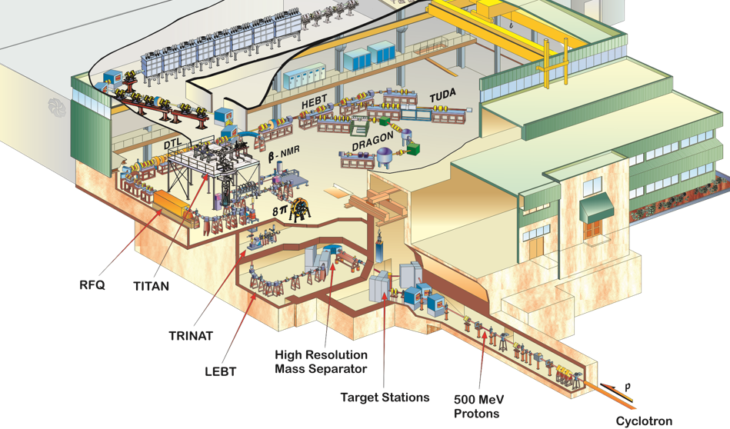
TRIUMF’s ISAC Facility
Isotope Separator and Accelerator (ISAC)
  Canada’s rare-isotope beam factory
TRIUMF 500 MeV
Cyclotron 100 μA
proton beam
production target
ion source
ions + ionized molecules
mass separator
experimental area
~30 keV beam

Slide 8
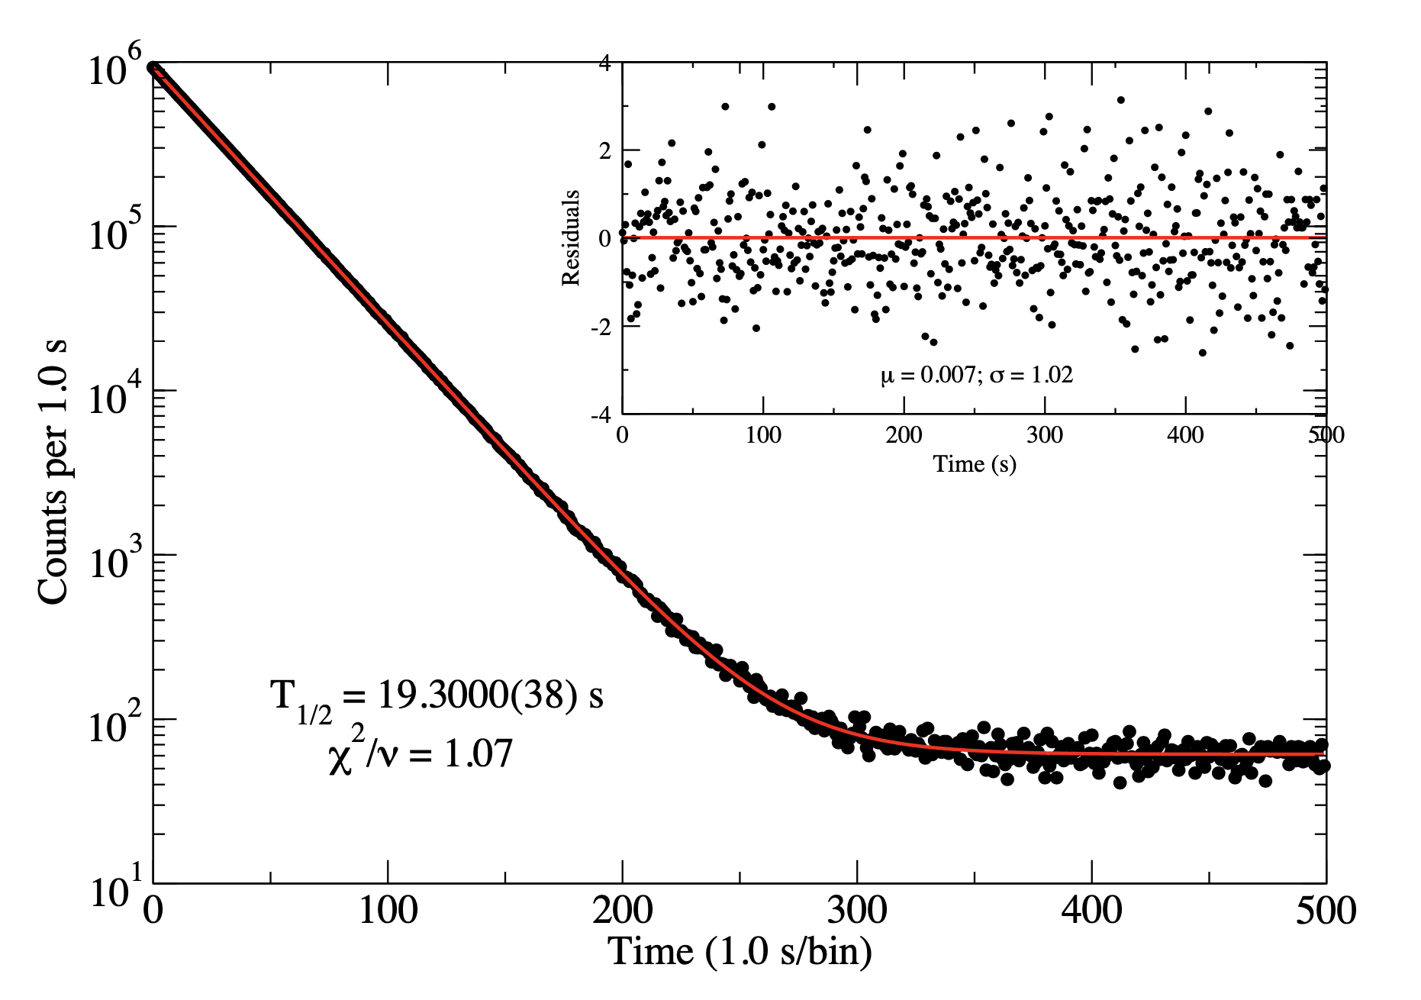
Half-life of ¹⁰C
M.R.Dunlop et al. PRL 116, 172501 (2016)
Beam of radioactive ¹⁰C
  Intensity ~10⁵ ions/s
Data from 1 cycle (~ 8 mins)
  Precision ± 0.07%
Total of 550 cycles (4 days)
  T_{1/2} = 19.3009(17) s
A₀ = initial activity
λ = slope
λ = ln(2)/T_{1/2}
B = background
A(t) = A₀e^{–λt} + B

Slide 9
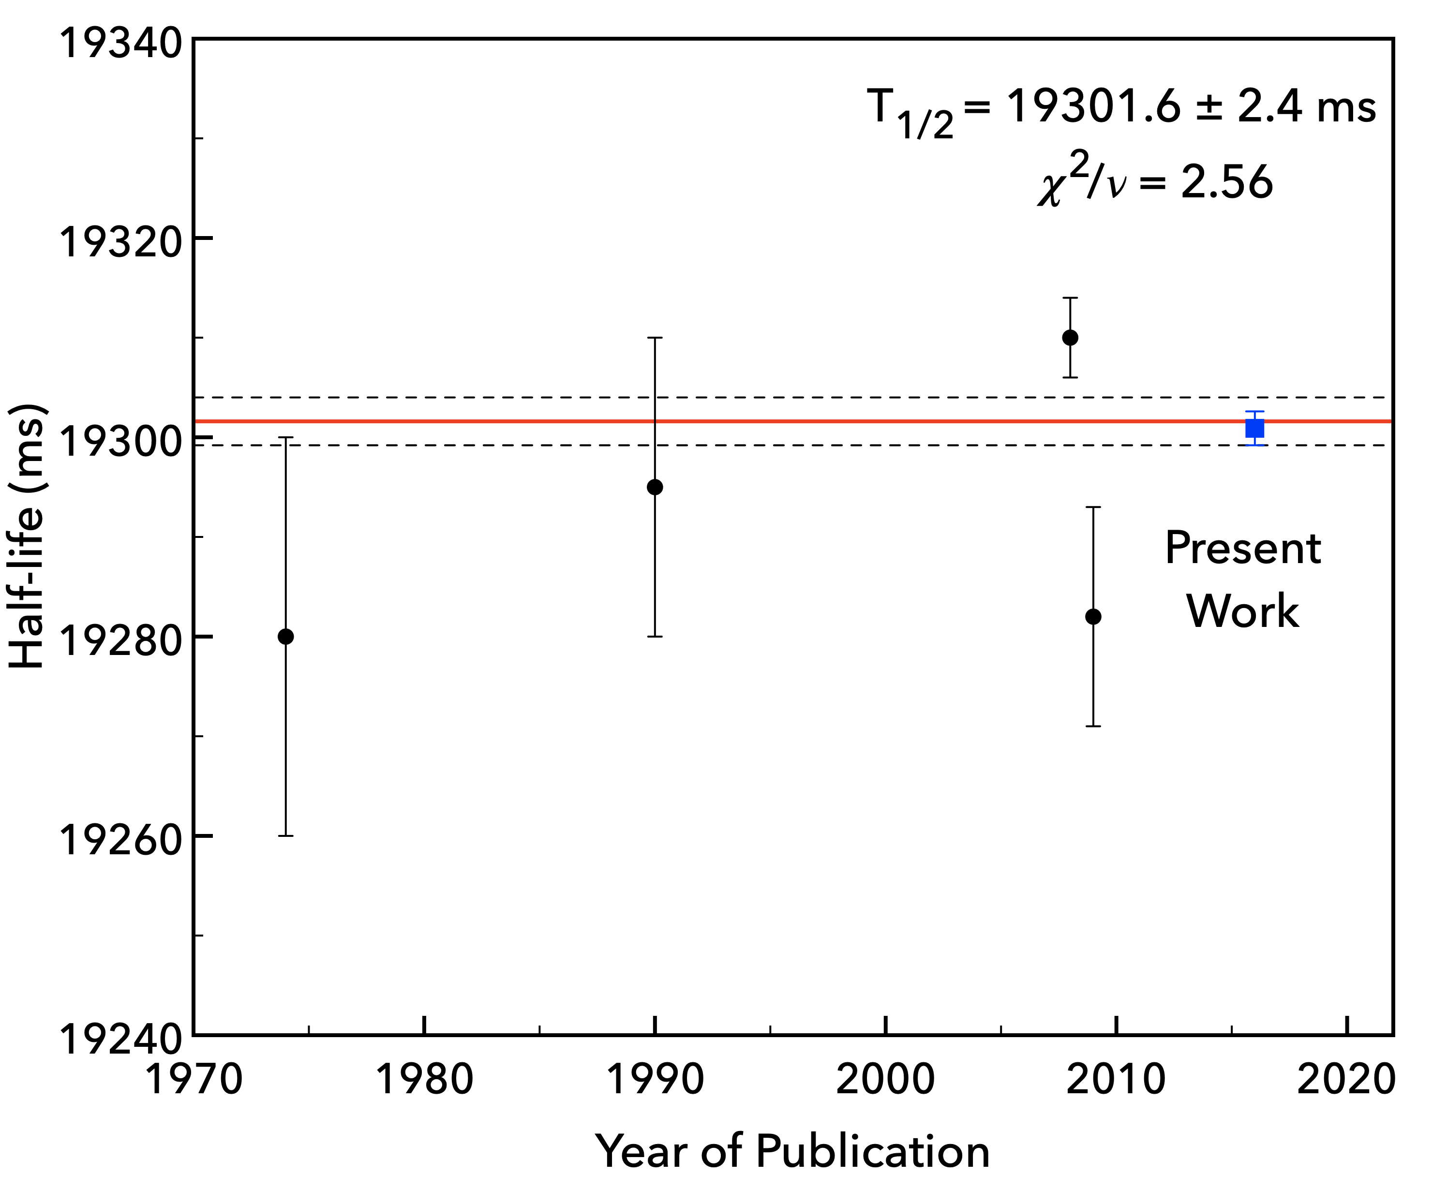
Half-life of ¹⁰C
M.R.Dunlop et al. PRL 116, 172501 (2016)
Beam of radioactive ¹⁰C
  Intensity ~10⁵ ions/s
Data from 1 cycle (~ 8 mins)
  Precision ± 0.07%
Total of 550 cycles (4 days)
  T_{1/2} = 19.3009(17) s
Systematic uncertainties
  The most challenging part
Half-life of ¹⁰C @ TRIUMF
  Overall precision ± 0.009%
  Most precise T_{1/2} ever reported!

Slide 10
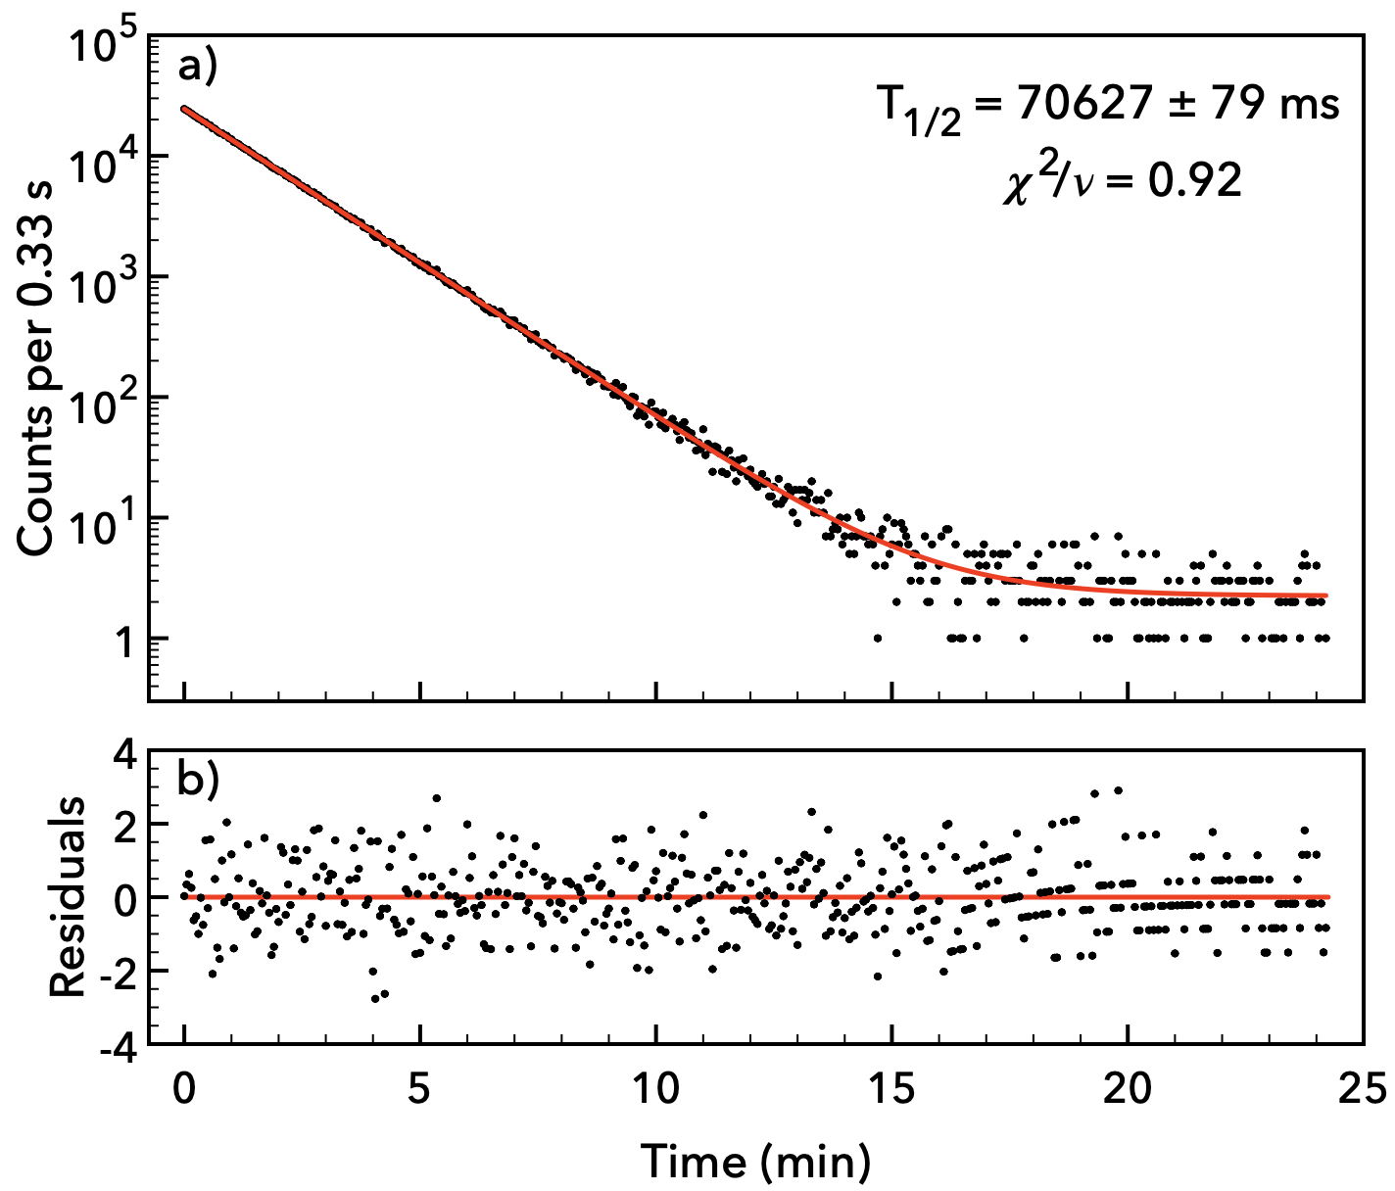
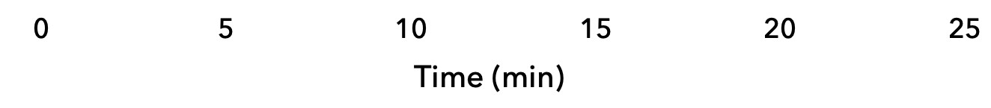
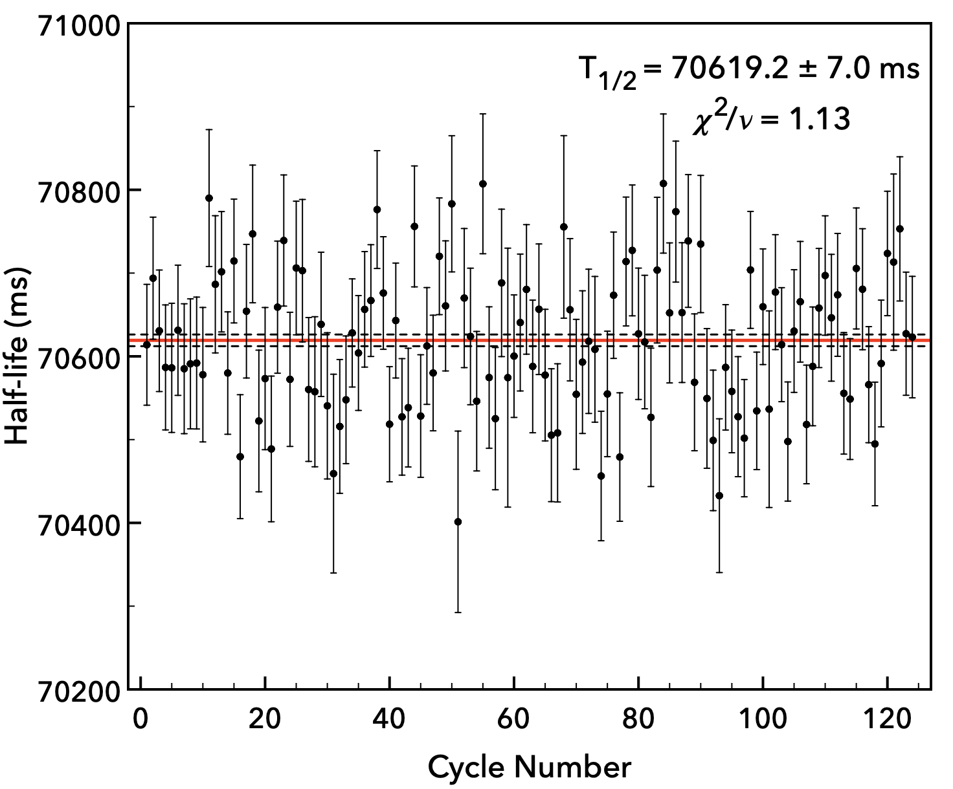
Half-life of ¹⁴O
S.Sharma et al. E. Phys. J. A 58, 83 (2022)
Beam of radioactive ¹⁴O
  Intensity ~10⁵ ions/s
Data from 1 cycle (~ 25 mins)
  Precision ± 0.10%
Total of 124 cycles (3 days)
  T_{1/2} = 70.6192(76) s
Half-life = 70.6 s
25 mins/cycle!

Slide 11
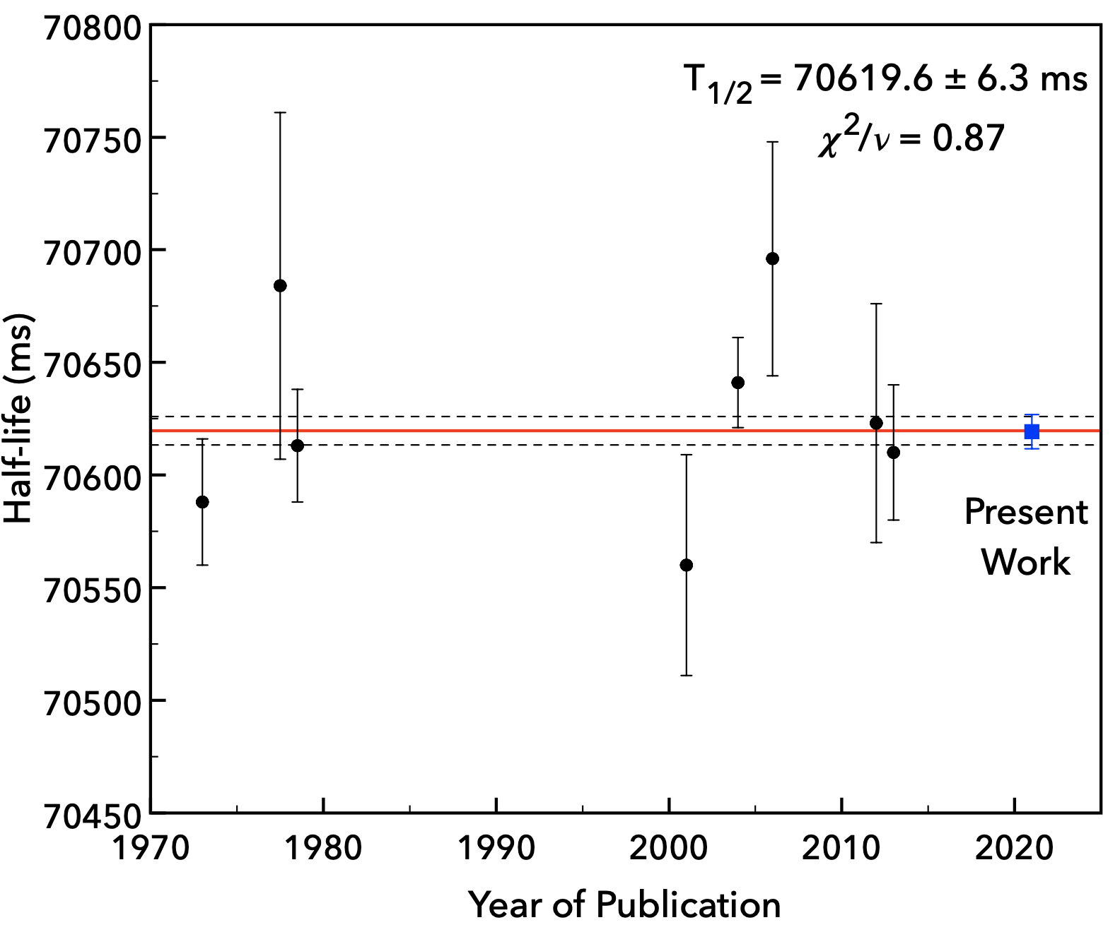
Half-life of ¹⁴O
S.Sharma et al. E. Phys. J. A 58, 83 (2022)
Beam of radioactive ¹⁴O
  Intensity ~10⁵ ions/s
Data from 1 cycle (~ 25 mins)
  Precision ± 0.10%
Total of 124 cycles (3 days)
  T_{1/2} = 70.6192(76) s
Half-life of ¹⁴O @ TRIUMF
  Overall precision ± 0.010%
  Comparable precision to ¹⁰C!
Article published in 2022
  Shivani Sharma, U of R
  PhD Medical Physics @TMU

Slide 12
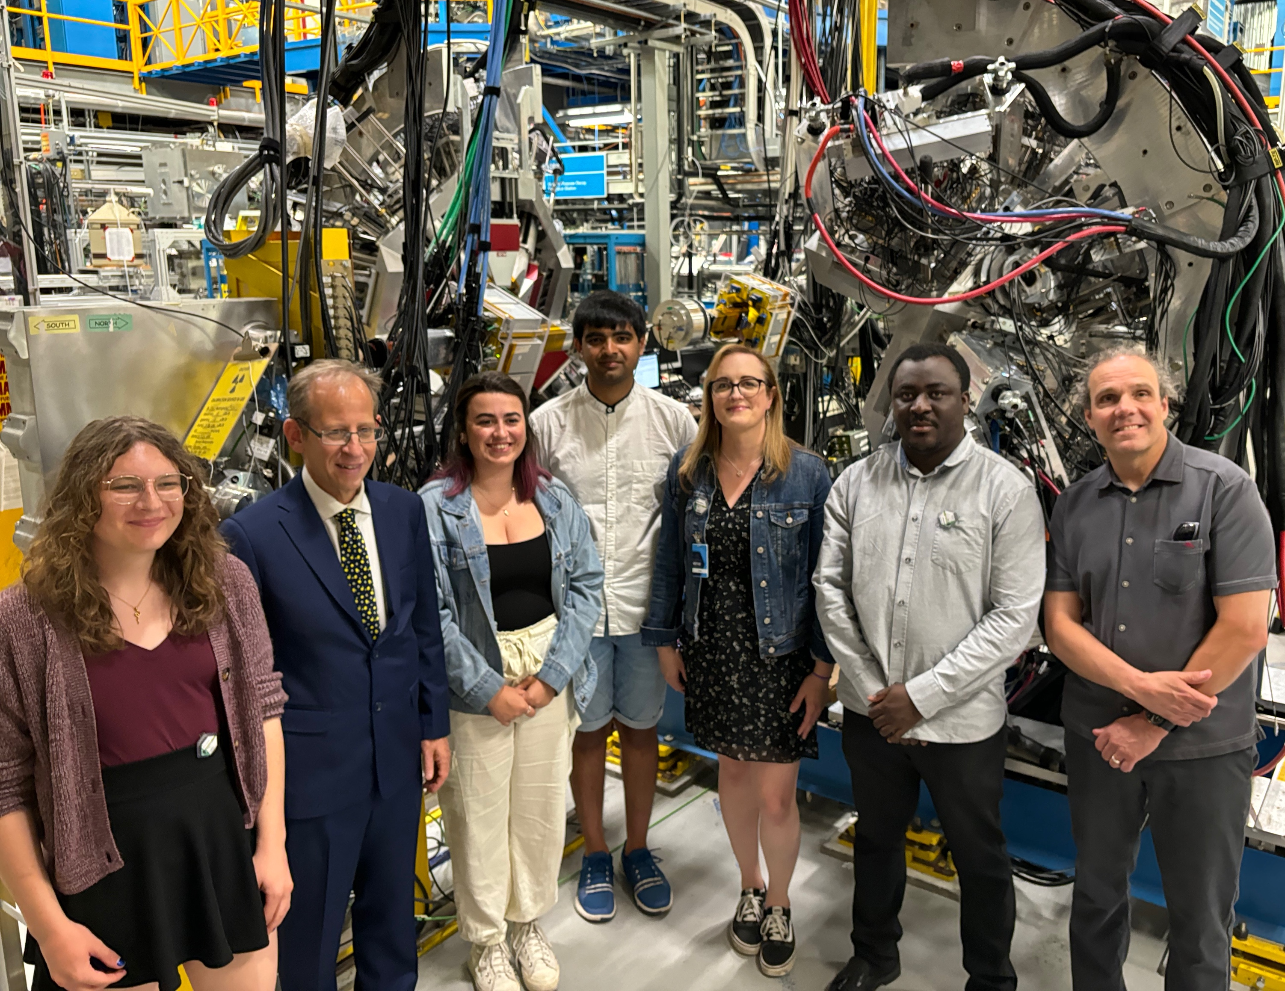
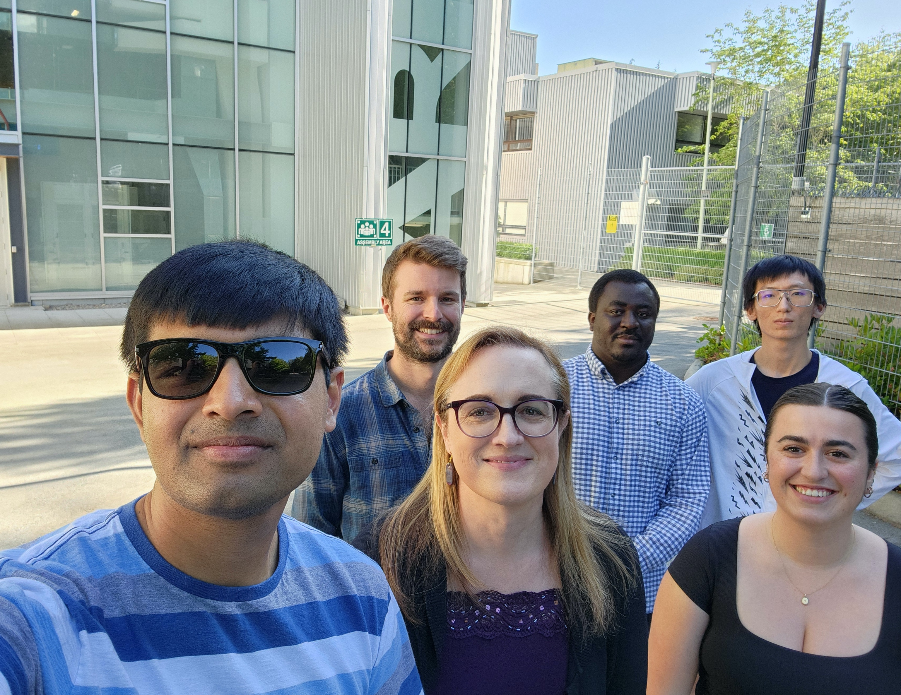
Next generation: GRIFFIN
Efficient HPGe γ-ray spectrometer
  16 large volume “clover” detectors
  Detect γ-rays to study radioactivity
Recent experiments at GRIFFIN
  S1140: Half-life of ¹⁴O
  S1848: Branching ratio of ³⁴Ar
  S2232: Beta decay of ²⁰Mg
Regina students lead the analysis!
  Ugrad Dhruval Shah (alum)
  Ugrad Zach Sullivan
  M.Sc. Fatima Aljarrah
  M.Sc. Jizhong Liu (alum)
  M.Sc. Sydney Plante
  M.Sc. Mira Quinn
  PDF Chris Griffin
July 2024
UofR at GRIFFIN

Slide 13
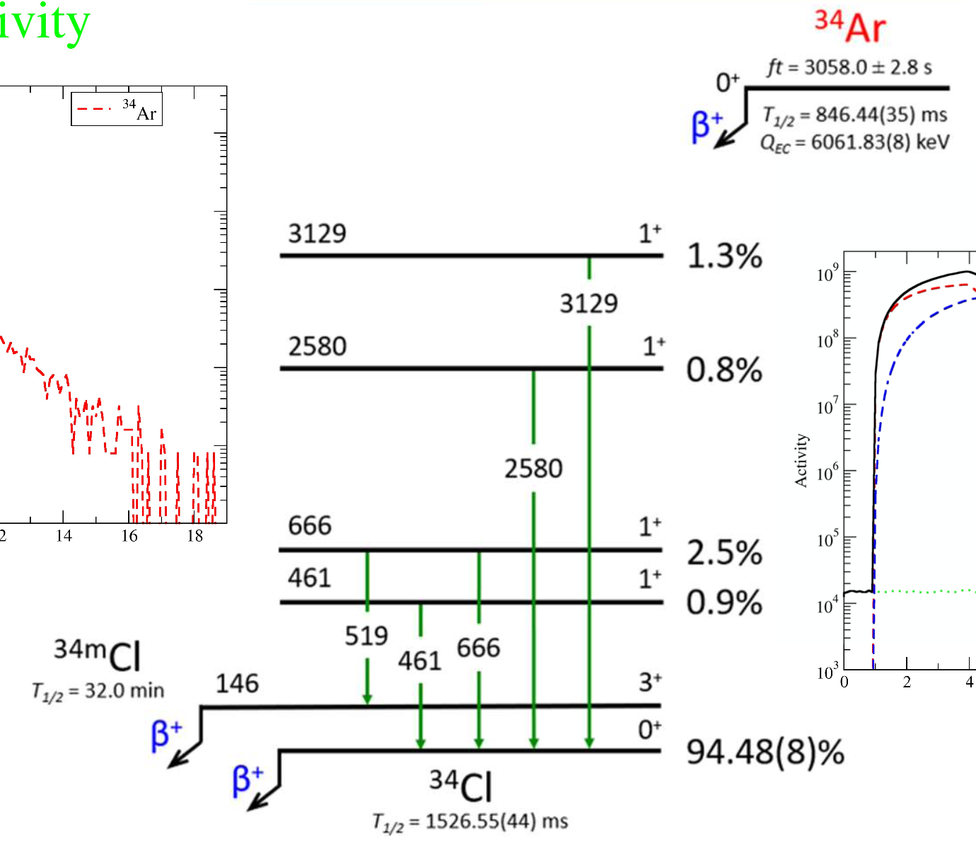
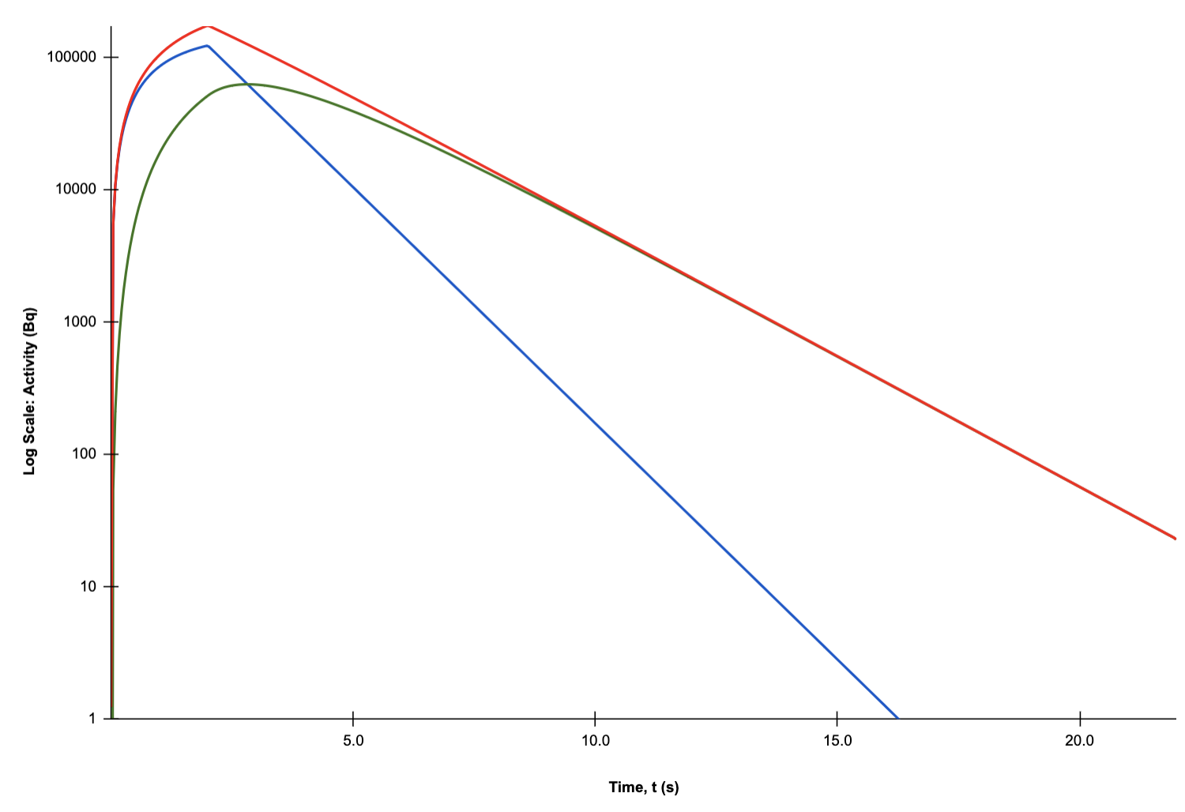
Half-life of ³⁴Ar
V.E. Iacob et al. PRC 101, 015504 (2020)
Very challenging due to ³⁴Cl daughter
  Total activity looks just like daughter!
  Almost no sensitivity to parent (³⁴Ar)
³⁴Cl
Total activity
Log (Activity)
³⁴Ar
Time (s)

Slide 14
Half-life of ³⁴Ar
V.E. Iacob et al. PRC 101, 015504 (2020)
Very challenging due to ³⁴Cl daughter
  Total activity looks just like daughter!
  Almost no sensitivity to parent (³⁴Ar)
Gate on ³⁴Ar decay 𝛄 ray (666 keV)
  Effectively eliminates the ³⁴Cl
³⁴Cl
Total activity
β counting
Log (Activity)
³⁴Ar
γ counting
(666 keV gate)
Time (s)

Slide 15
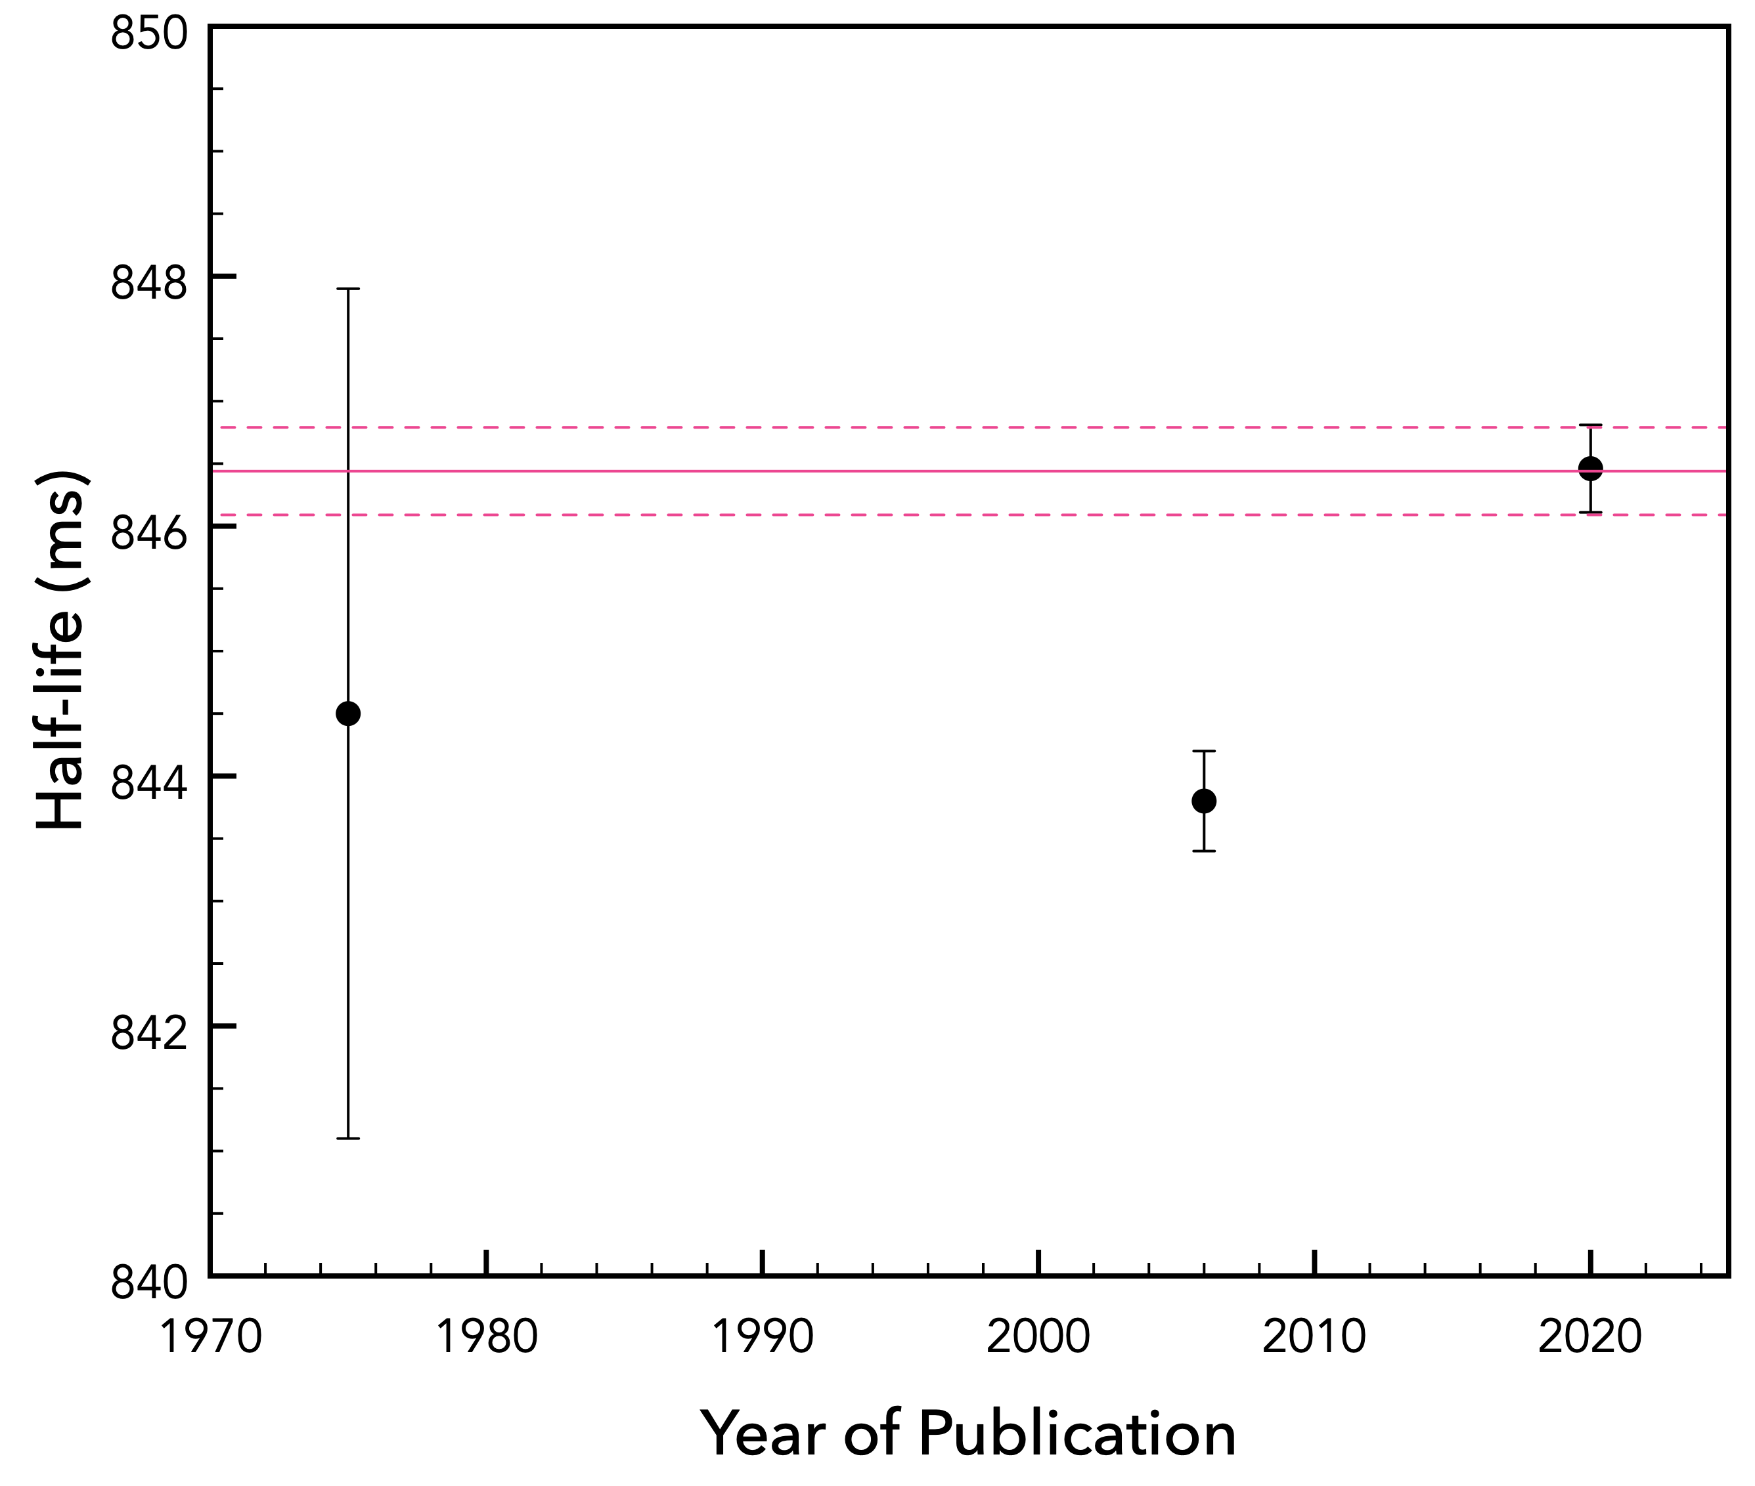
Half-life of ³⁴Ar
V.E. Iacob et al. PRC 101, 015504 (2020)
Very challenging due to ³⁴Cl daughter
  Total activity looks just like daughter!
  Almost no sensitivity to parent (³⁴Ar)
Gate on ³⁴Ar decay 𝛄 ray (666 keV)
  Effectively eliminates the ³⁴Cl
Recent T_{1/2} measurements
  Rely on the total activity curve
  Results differ by nearly 7σ
Hardy
(1974)
Iacob
(2006)
Iacob
(2020)

Slide 16
Half-life of ³⁴Ar
V.E. Iacob et al. PRC 101, 015504 (2020)
Very challenging due to ³⁴Cl daughter
  Total activity looks just like daughter!
  Almost no sensitivity to parent (³⁴Ar)
Gate on ³⁴Ar decay 𝛄 ray (666 keV)
  Effectively eliminates the ³⁴Cl
Recent T_{1/2} measurements
  Rely on the total activity curve
  Results differ by nearly 7σ
Goal of experiment S1848:
  Deduce the ³⁴Ar half-life to ± 0.05%
  Solve discrepancy in past results
  Will also deduce the branching ratio
  MSc.PhD thesis of M. Quinn (UofR)
Hardy
(1974)
Iacob
(2006)
Iacob
(2020)

Slide 17


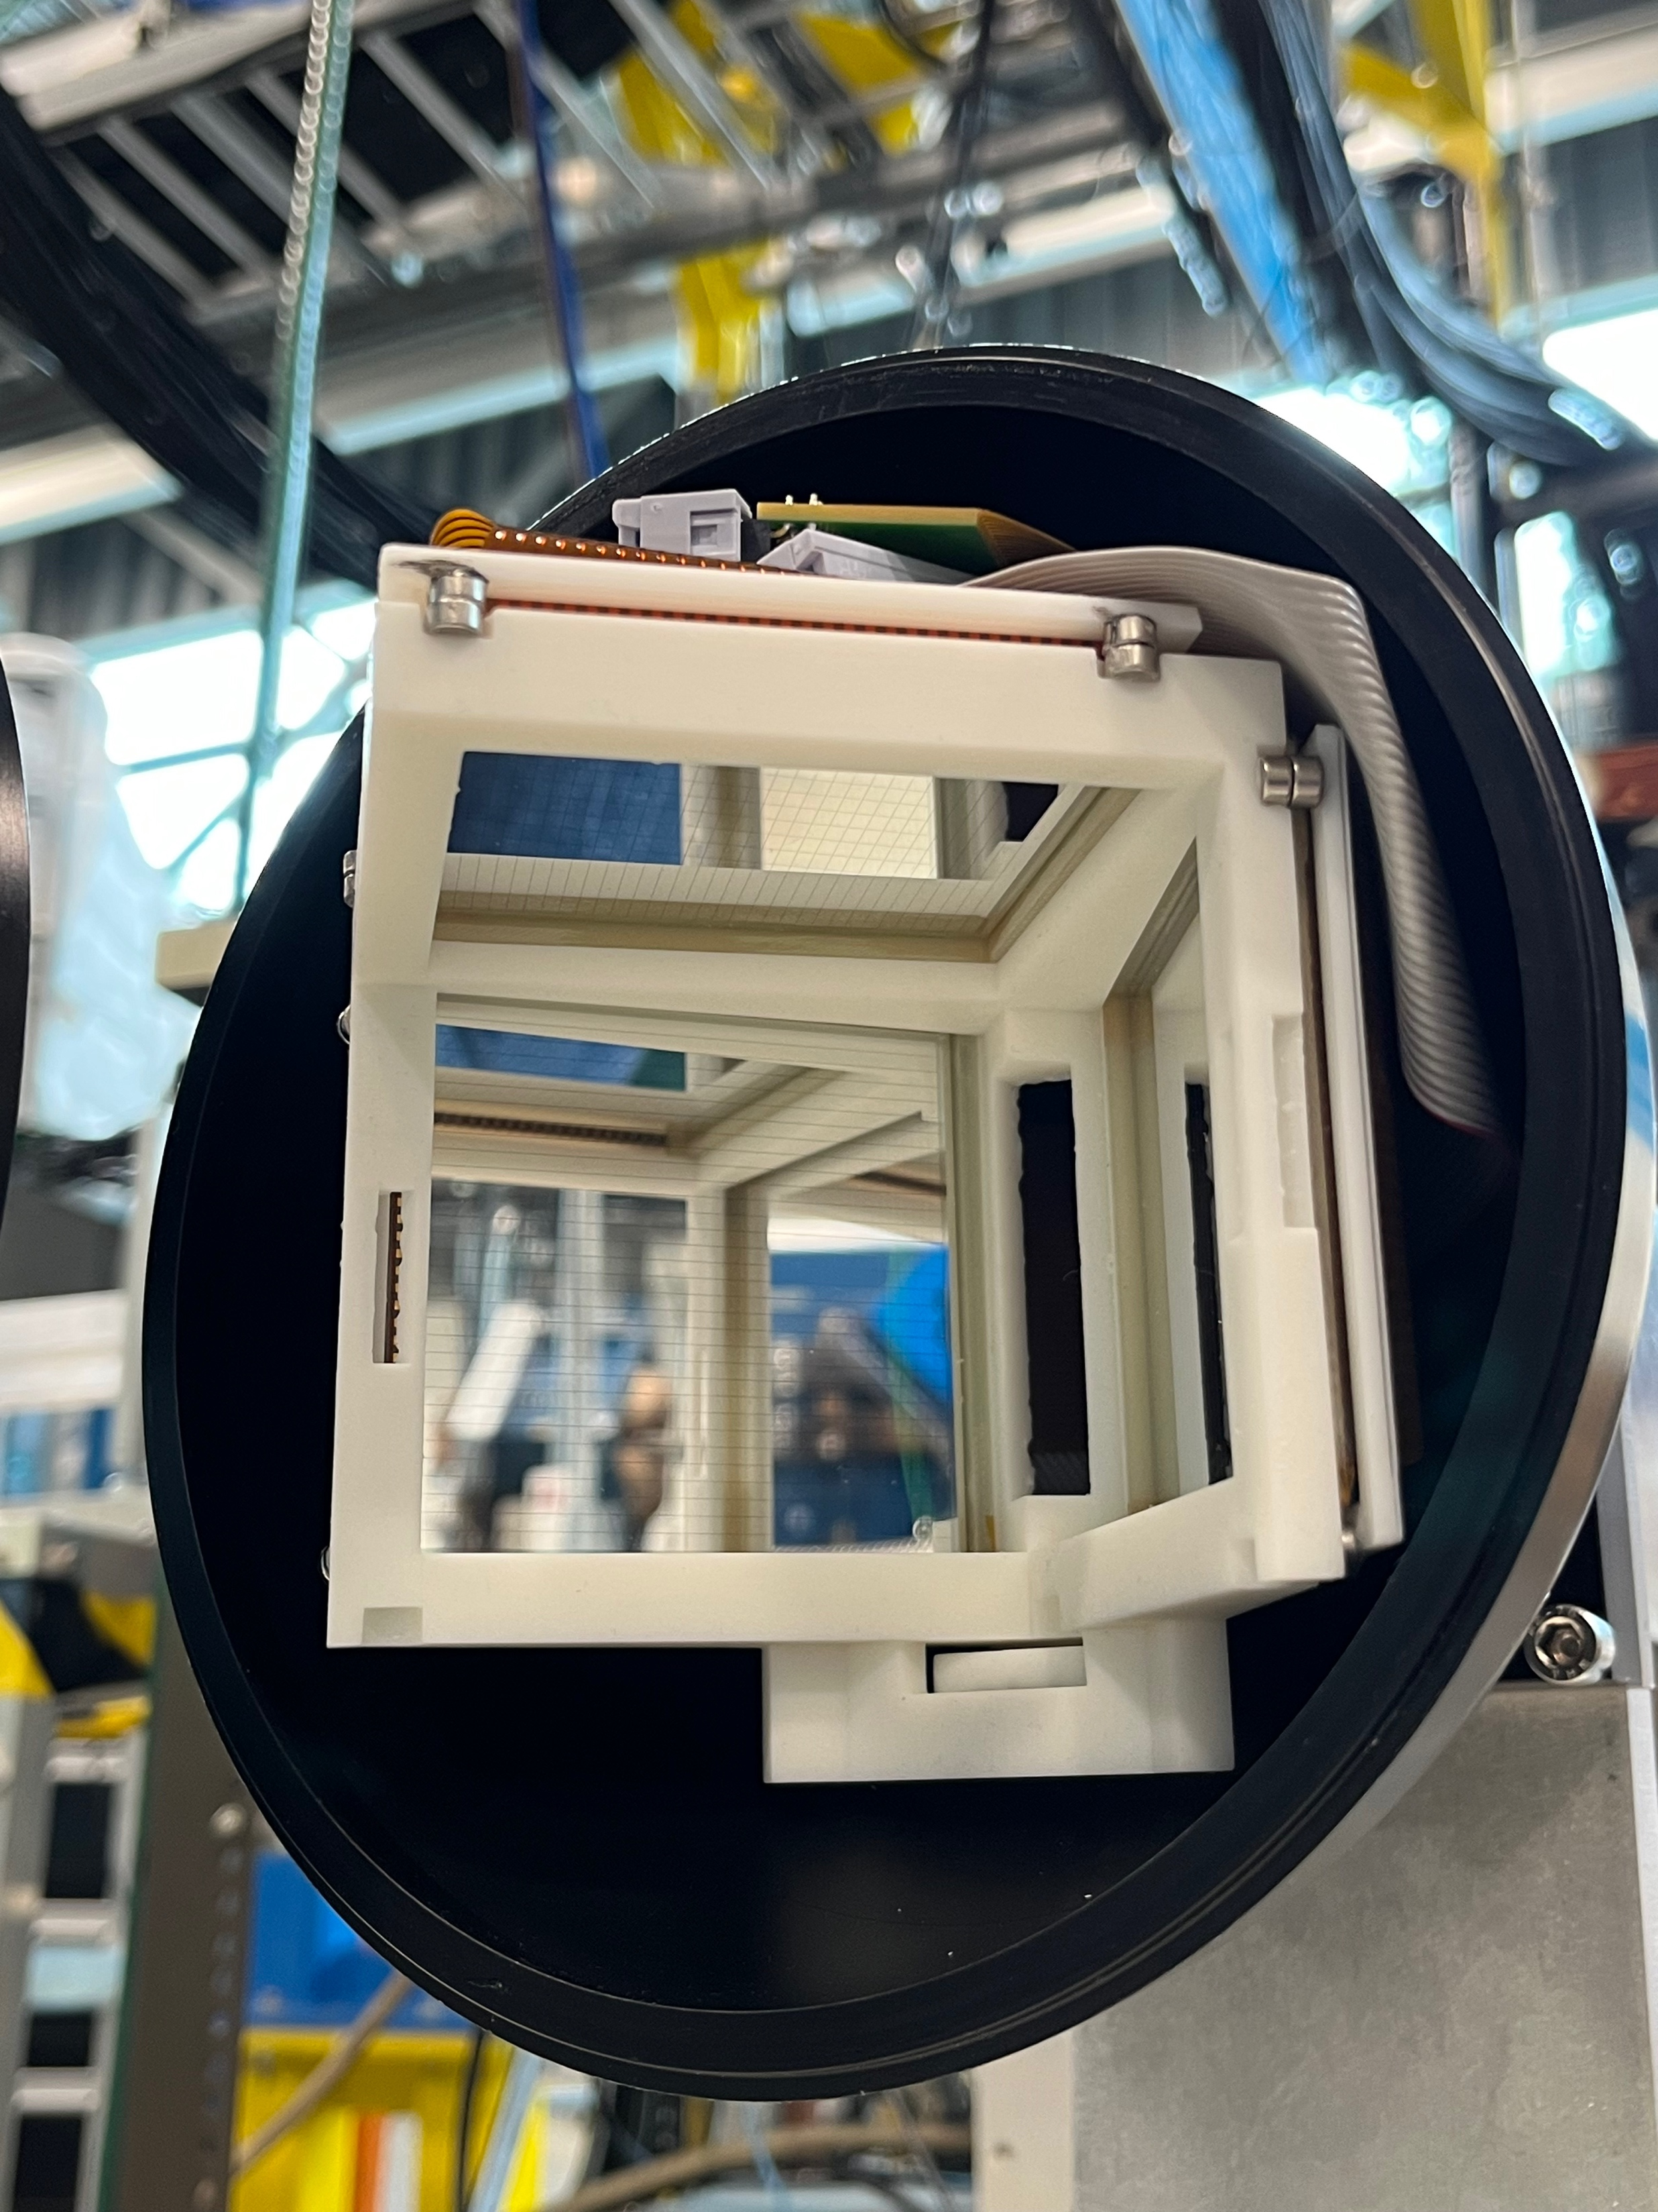
Regina Cube for Multiple Particles
Auxiliary detector for GRIFFIN
  Compact charged particle array
  α decay and β delayed particles
  Multiple particles (β2p, βαp, …)

Slide 18
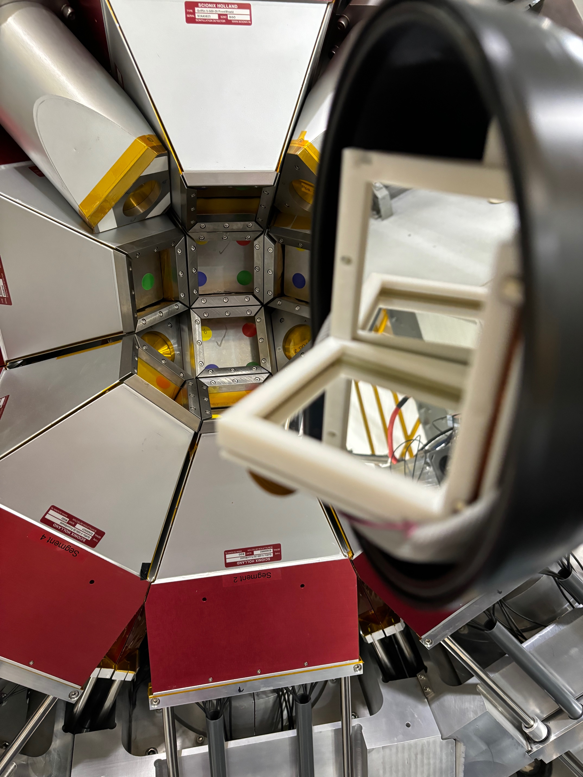
Regina Cube for Multiple Particles
Auxiliary detector for GRIFFIN
  Compact charged particle array
  α decay and β delayed particles
  Multiple particles (β2p, βαp, …)
6 DSSD detectors (micron BB7)
  Active area: 64 x 64 mm²
  6 x (32+32) strips = 384 channels
  Thick: 1 mm (12 MeV protons)
  Strip pitch: 2 mm (0.5° ang. res.)
Funded $147k (2020 – 2023)
  CFI, Innovation SK, NSERC, UofR

Slide 19
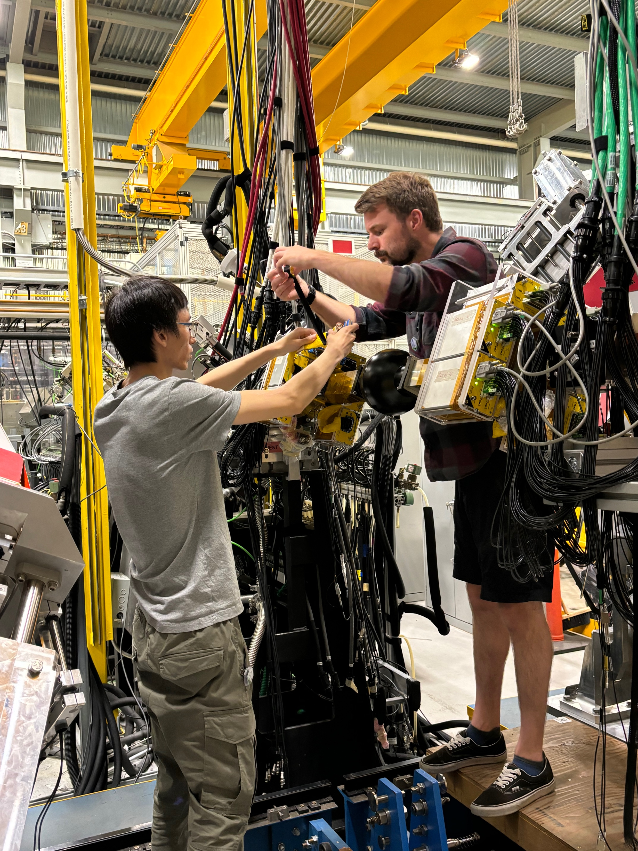
Regina Cube for Multiple Particles
Auxiliary detector for GRIFFIN
  Compact charged particle array
  α decay and β delayed particles
  Multiple particles (β2p, βαp, …)
6 DSSD detectors (micron BB7)
  Active area: 64 x 64 mm²
  6 x (32+32) strips = 384 channels
  Thick: 1 mm (12 MeV protons)
  Strip pitch: 2 mm (0.5° ang. res.)
Funded $147k (2020 – 2023)
  CFI, Innovation SK, NSERC, UofR
Design, construction, tests (UofR)
  Shipped to TRIUMF in 2023
  First experiment summer 2024

Slide 20
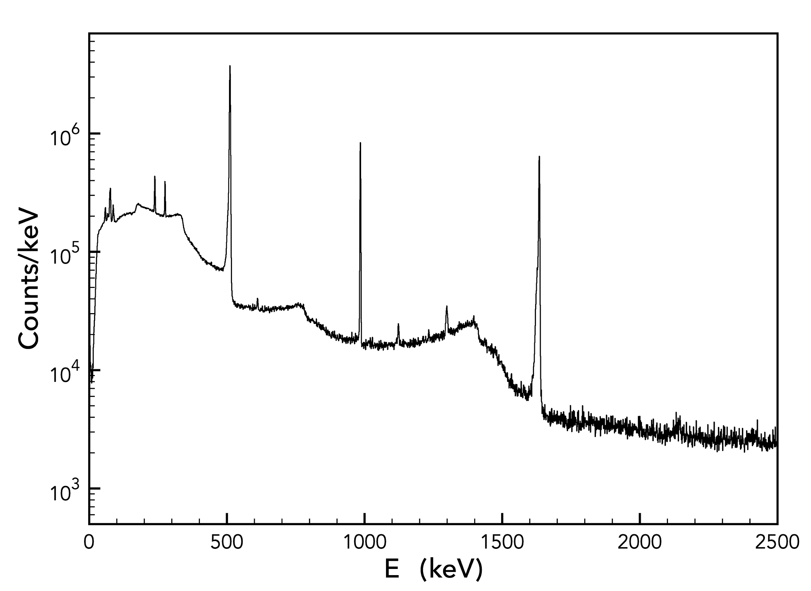
S2232: Online Results
D.Shah, S.Plante (University of Regina)
Beam of ²⁰Mg at 10⁴ ions/s
  From 4 hour subset of data (~10%)
  See all of the expected 𝛾 rays
Coincident proton spectra
  Gate on 238 and 275 keV gamma
  Selected 3 of 6 detectors (upstream)
  Background subtracted
^{511 keV}
^{984 keV}
^{1634 keV}
^{275 keV}
^{238 keV}
¹⁹Ne
(βp)
^{1298 keV}
²⁰Na
(β)
²⁰Ne
(ββ)
^{p}
E_{𝛄} (keV)

Slide 21
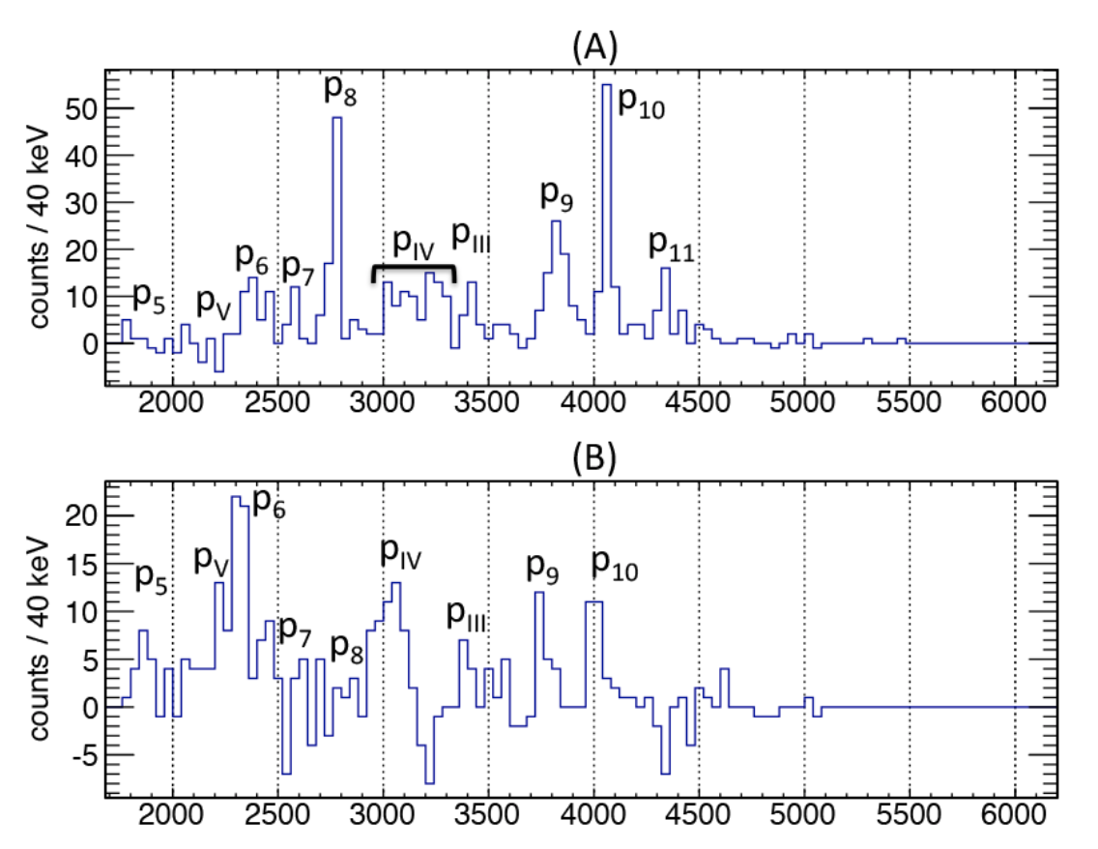
S2232: Online Results
M.V. Lund EPJA 52, 304 (2016)
Beam of ²⁰Mg at 10⁴ ions/s
  From 4 hour subset of data (~10%)
  See all of the expected 𝛾 rays
Coincident proton spectra
  Gate on 238 and 275 keV gamma
  Selected 3 of 6 detectors (upstream)
  Background subtracted
Comparison to ISOLDE
  With this subset ~3x10² more counts
  Total data set ~6x10³ more counts
  Have 𝛾-ray gated p peaks ~10⁵ counts!
Full analysis now underway
  MSc thesis Sydney Plante (UofR)
  Also wrote out waveforms (future work)
p₁₀
p₈
p₆
238 keV
275 keV

Slide 22
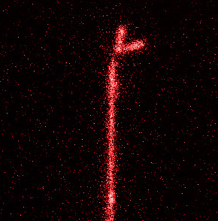
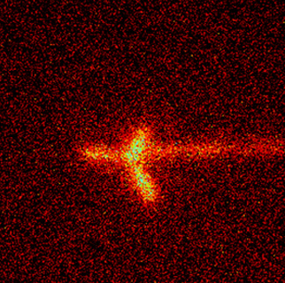
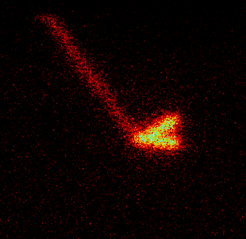
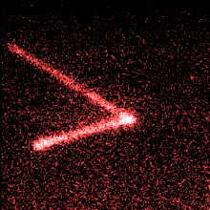
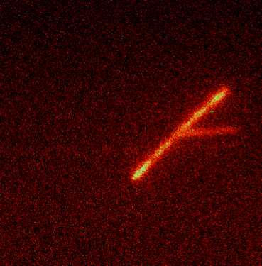
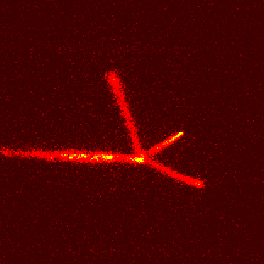
Time Projection Chambers (TPC)
Charged particle decay studies
  Proton and alpha decay spectroscopy
  Beta delayed charged particle emission
Traditional method: Silicon detectors
  Expensive and fragile
  Relatively low efficiency
  Low resolution (β summing)
Solution: Gas detectors!
  Nearly transparent to β particles
  High efficiency and good resolution
Time projection chambers (TPC)
  Event-by-event “images” of radioactivity
  Identify the rarest decays with only 1 event
2p
β3α
2p
β2p
β2α
β3p
M.Pfutzner et al. Optical TPC

Slide 23
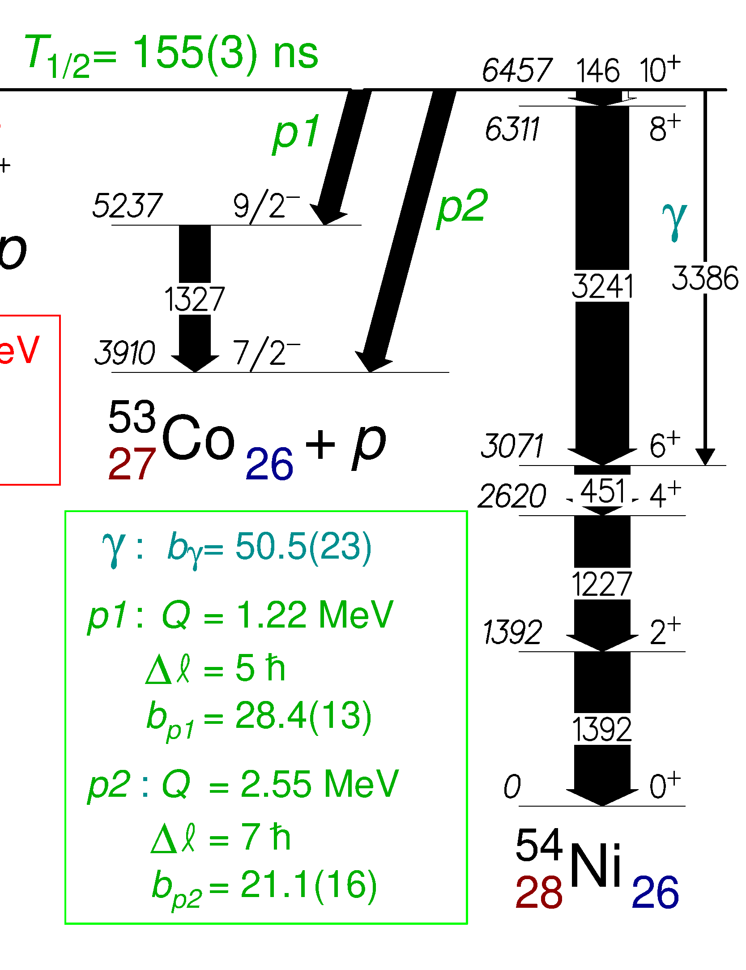
E690: Proton decay of a 10⁺ isomer in ⁵⁴Ni
Proton decay of an excited state!
  Incredibly challenging…
How does it work?
  Produce the radioactive ⁵⁴Ni
  Only a fraction of it is 10⁺ (0.4%)
  Deliver it to the experiment
  Measure the protons
  And do it all in < a few 100 ns!
Experiment performed at GANIL
  LISE3 fragmentation facility
  First decay experiment with TPC
What does this look like in a TPC?
  Movie time!
Excited 10⁺ state
T_{1/2} = 155 ns!
Protons?
Ground State
T_{1/2} = 114 ms

Slide 24
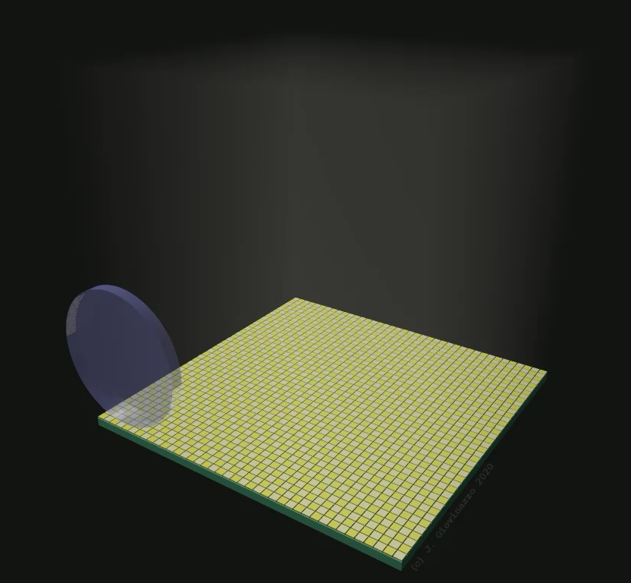
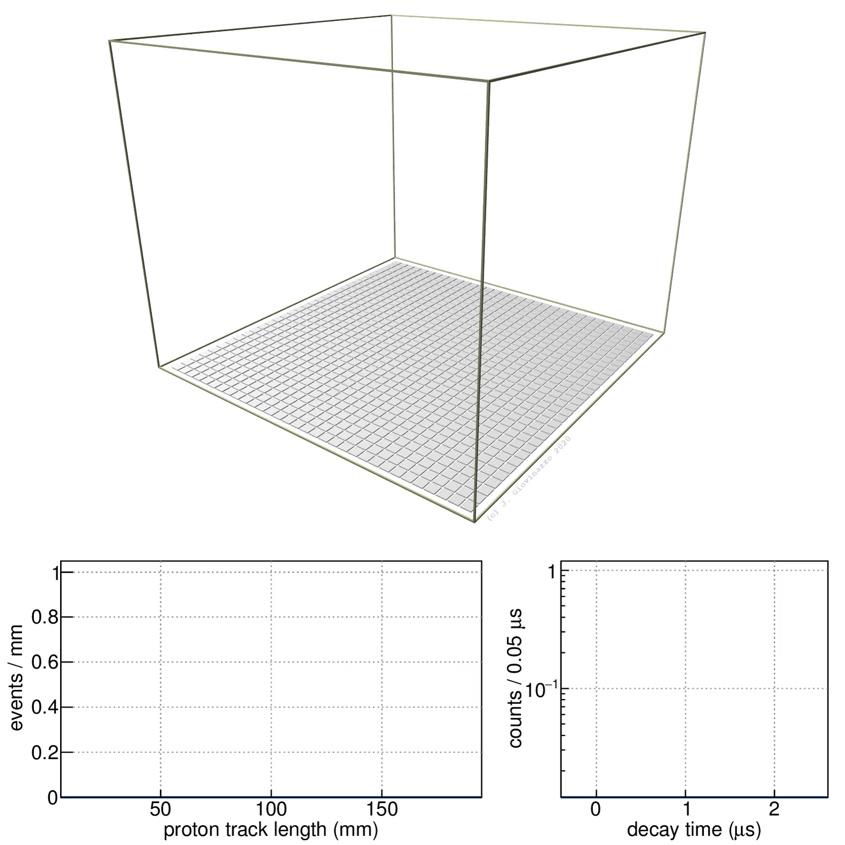
Movie Time: Proton decay in a TPC!
Real Data
Not a simulation!
Full 3D images of exotic radioactivity!
Videos: Jérôme Giovinazzo (CENBG)
J.Giovinazzo et al. Nature Communications 12, 4805 (2021)

Slide 25
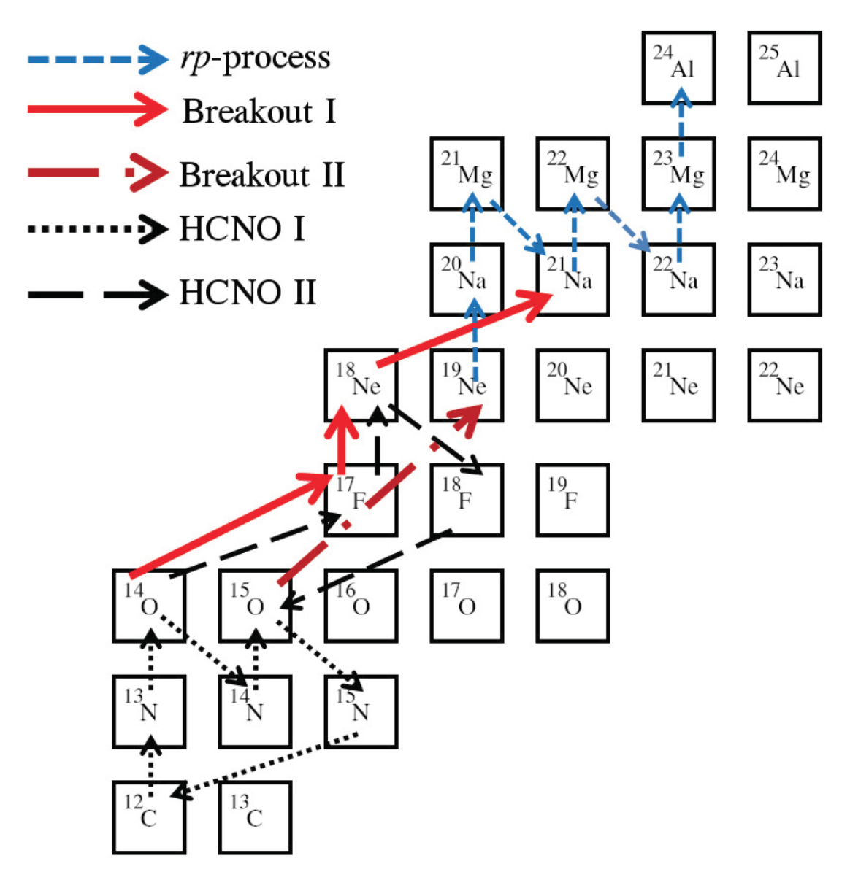
Resonant proton scattering on ¹⁷F
X-ray bursts and novae (T₉ > 0.1)
  Breakout of the HCNO cycle
  One main pathway: ¹⁴O(α,p)¹⁷F
¹⁴O(α,p)¹⁷F
S.Almarez-Calderon et al. PRC 86, 025801 (2012)

Slide 26
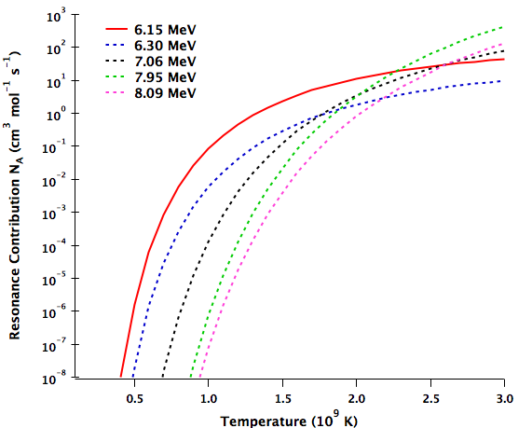
Resonant proton scattering on ¹⁷F
X-ray bursts and novae (T₉ > 0.1)
  Breakout of the HCNO cycle
  One main pathway: ¹⁴O(α,p)¹⁷F
Reaction populates states in ¹⁸Ne
  Dominated by a 1⁻ resonance
  Excitation energy = 6.15 MeV
Log scale!
S.Almarez-Calderon et al. PRC 86, 025801 (2012)

Slide 27
Resonant proton scattering on ¹⁷F
X-ray bursts and novae (T₉ > 0.1)
  Breakout of the HCNO cycle
  One main pathway: ¹⁴O(α,p)¹⁷F
Reaction populates states in ¹⁸Ne
  Dominated by a 1⁻ resonance
  Excitation energy = 6.15 MeV
Rate depends on decay widths
  Dominated by p decay
  Decay by α and 2p unknown
10.1
9.58
8.09
7.62
7.35
7.02
7.06
6.30
α?
6.15
2p?
5.45
5.12
p,p’
5.10
¹⁴O+α
4.53
4.41
4.52
¹⁶O+2p
3.92
¹⁷F+p
0.00
¹⁸Ne

Slide 28
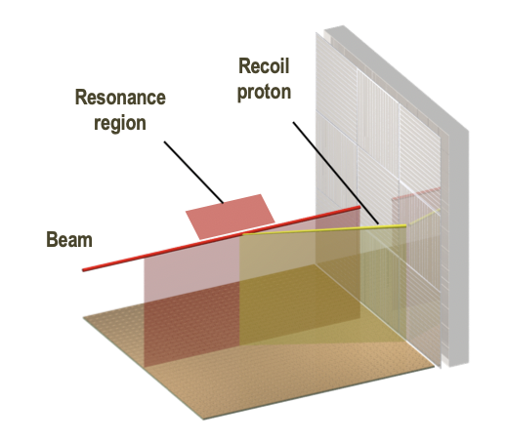
Resonant proton scattering on ¹⁷F
X-ray bursts and novae (T₉ > 0.1)
  Breakout of the HCNO cycle
  One main pathway: ¹⁴O(α,p)¹⁷F
Reaction populates states in ¹⁸Ne
  Dominated by a 1⁻ resonance
  Excitation energy = 6.15 MeV
Rate depends on decay widths
  Dominated by p decay
  Decay by α and 2p unknown
Experiment S2029 @ TRIUMF
  Beam of ¹⁷F at 10⁴ ions/s
  Aim to discover α and 2p decay
  Expected yield ~10 /day
  This is only 1 event in 10⁸
Si + CsI detectors

Slide 29
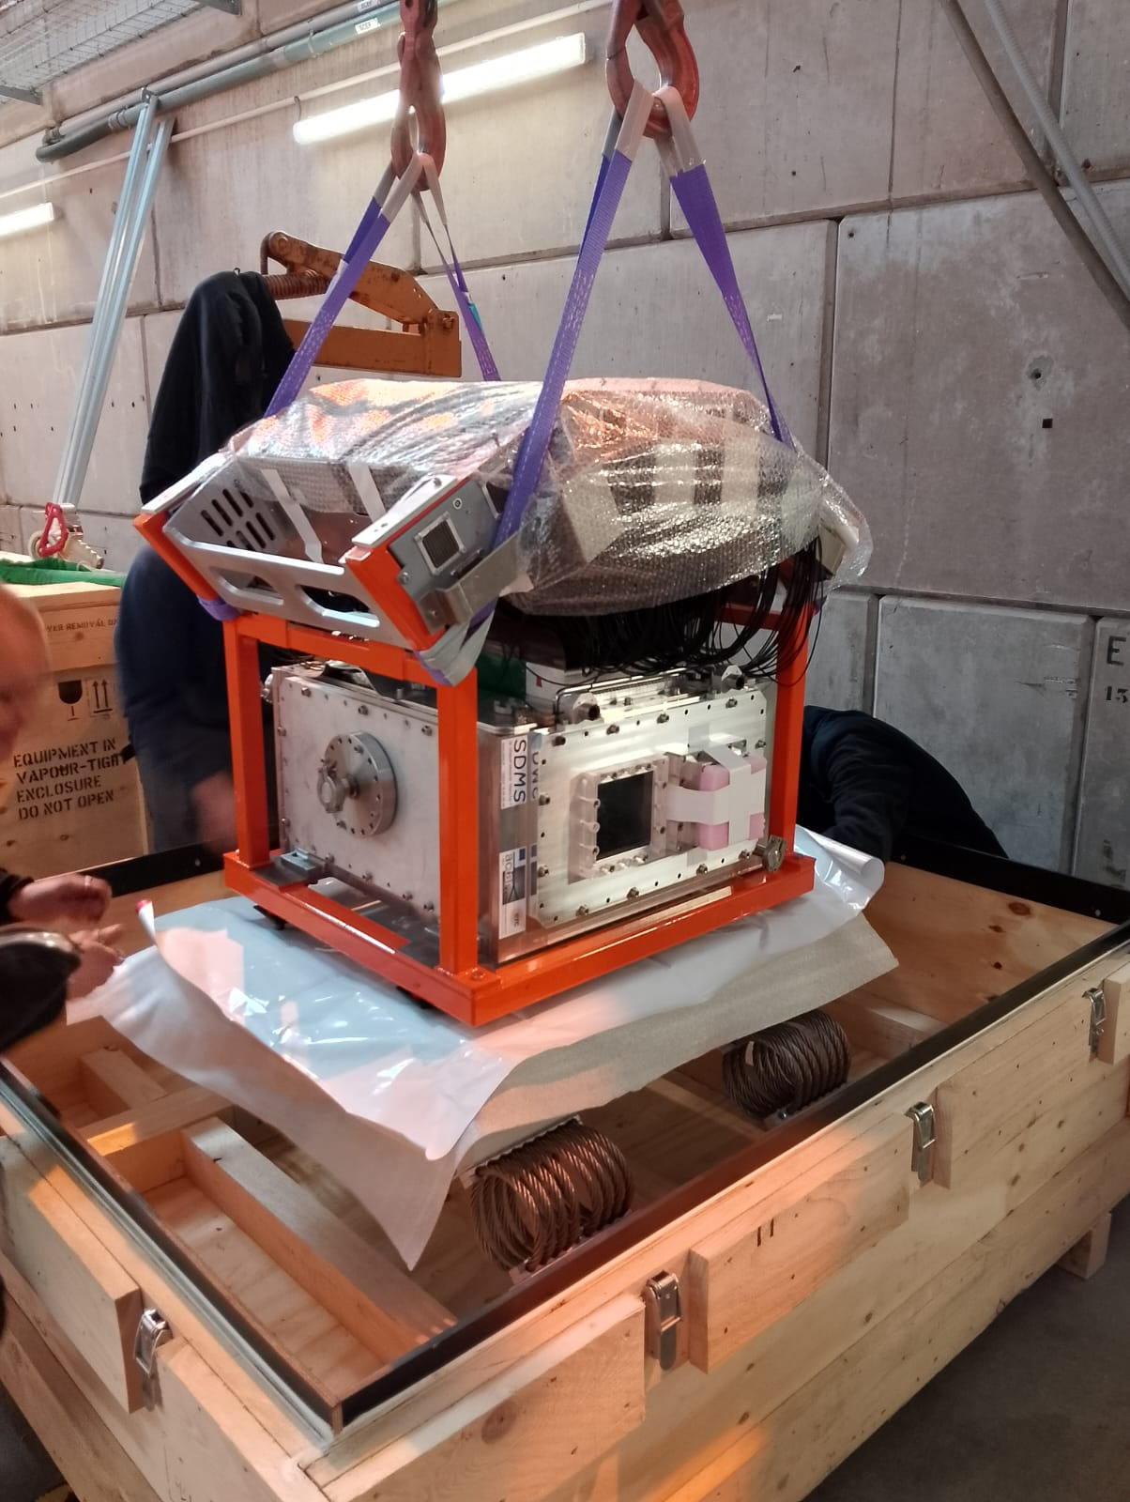
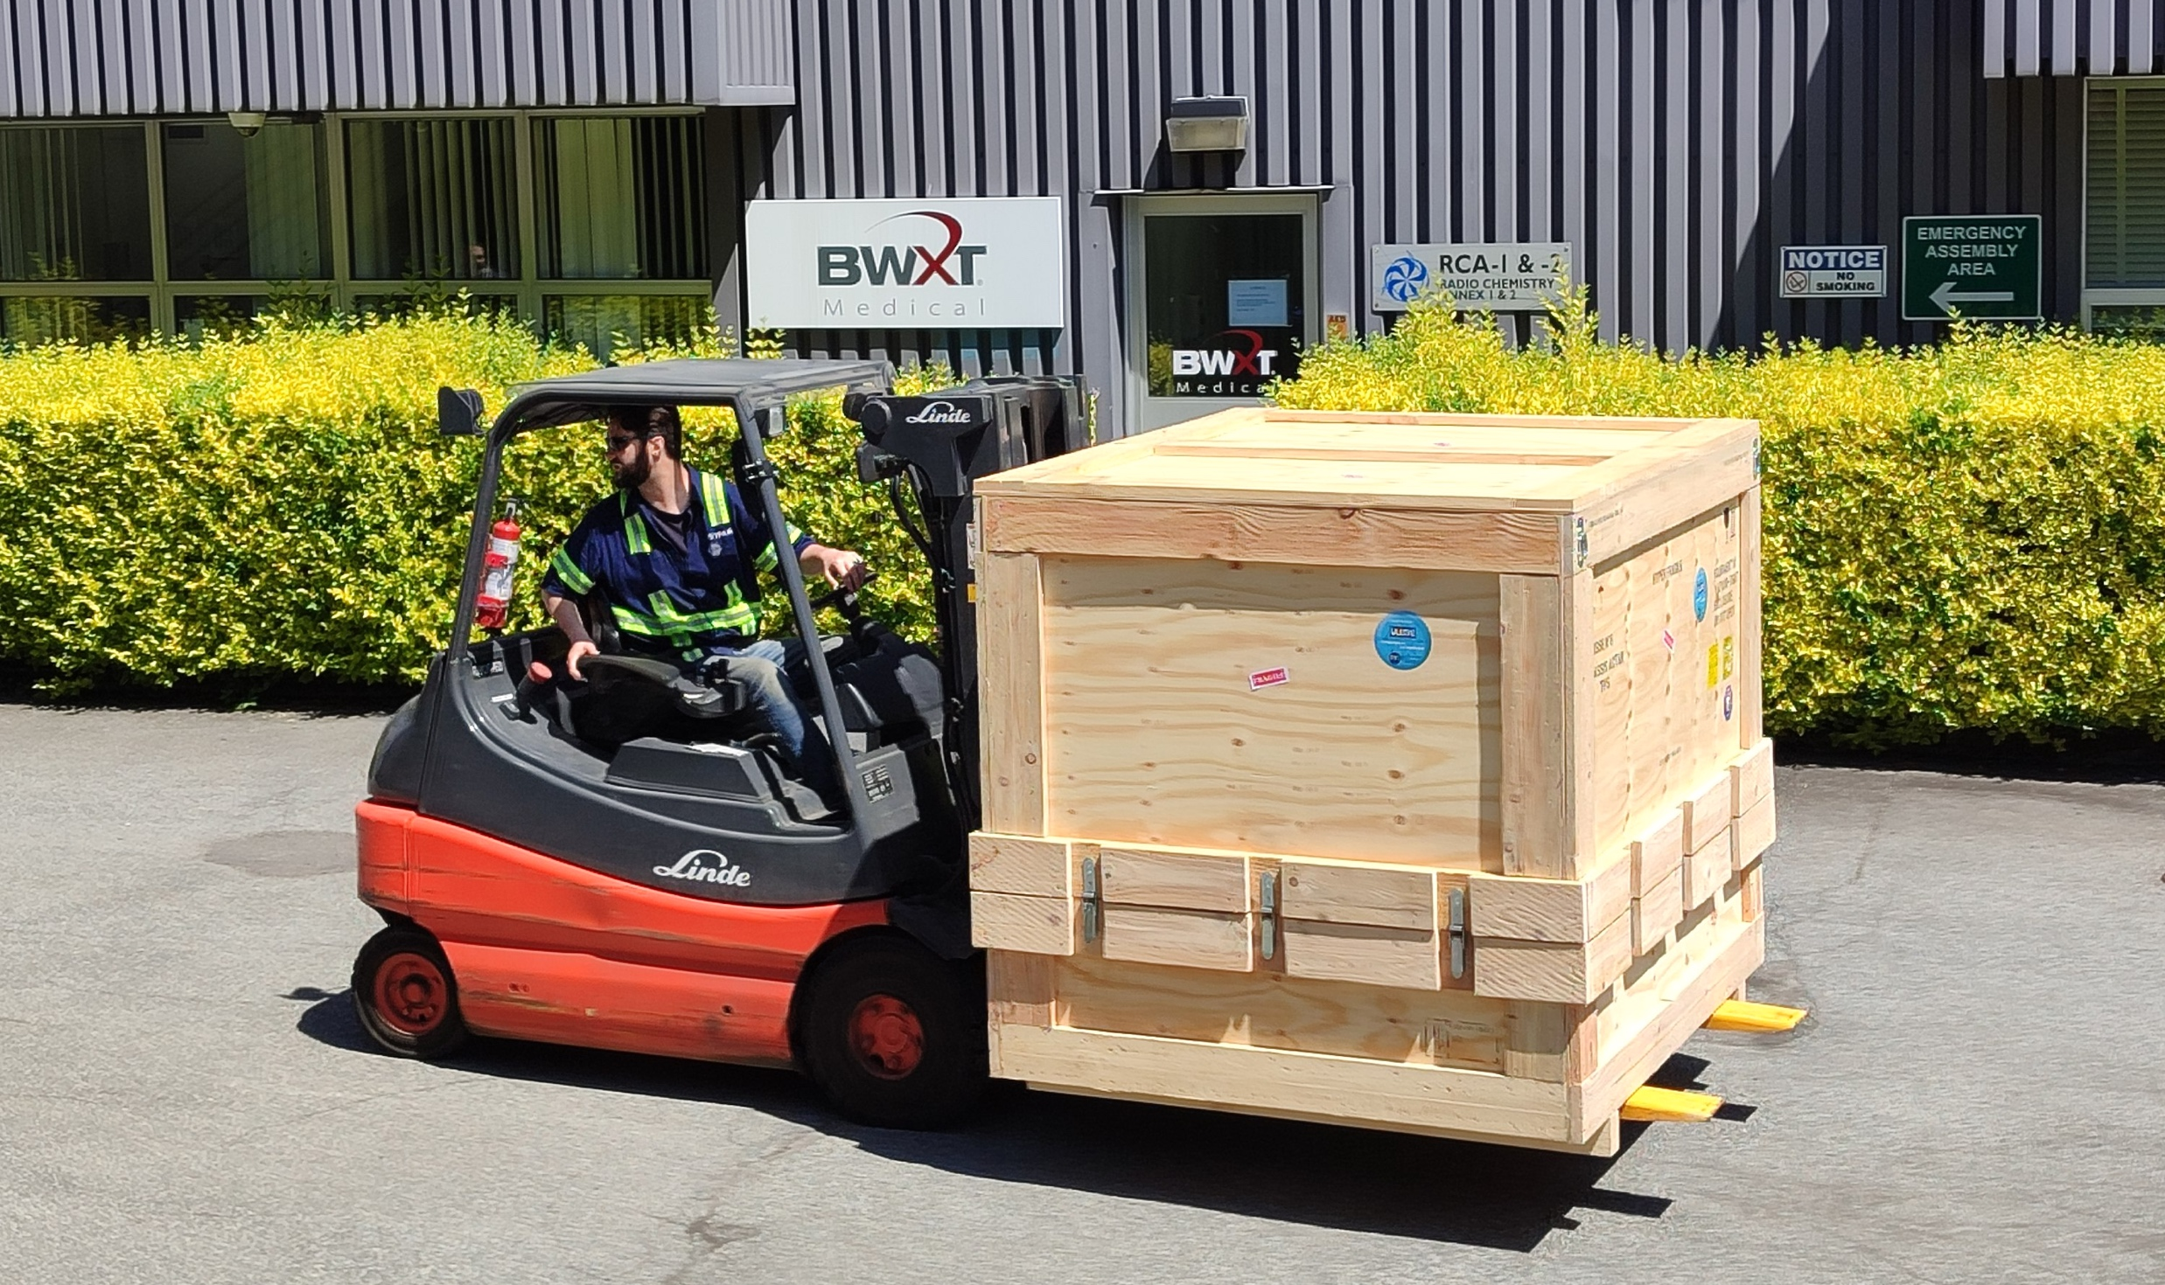
ACTAR TPC at TRIUMF
F.Aljarrah, A.Tsantiri (University of Regina)
Detector was shipped to Canada!
  Departed France in mid-April
  Arrived at TRIUMF in late May!
Will run 3 experiments in 2025
  Collab: France, Spain, Canada
  Beams not available at GANIL
  Can only be done at TRIUMF!

Slide 30
Thank You!!!
April 13, 2023
June 9, 2025
Dr. Gwen Grinyer she/her
Department of Physics, University of Regina, Regina, SK S4S 0A2, Canada
Gwen.Grinyer@uregina.ca
@gwendoesscience

