Slide 1
Microwave spectroscopy of antihydrogen in the ALPHA experiment
CAP2025 – University of Saskatchewan
Tim Friesen (He/Him/His)
on behalf of the ALPHA collaboration
Associate Professor
Department of Physics and Astronomy, University of Calgary
June 12, 2025

Slide 2
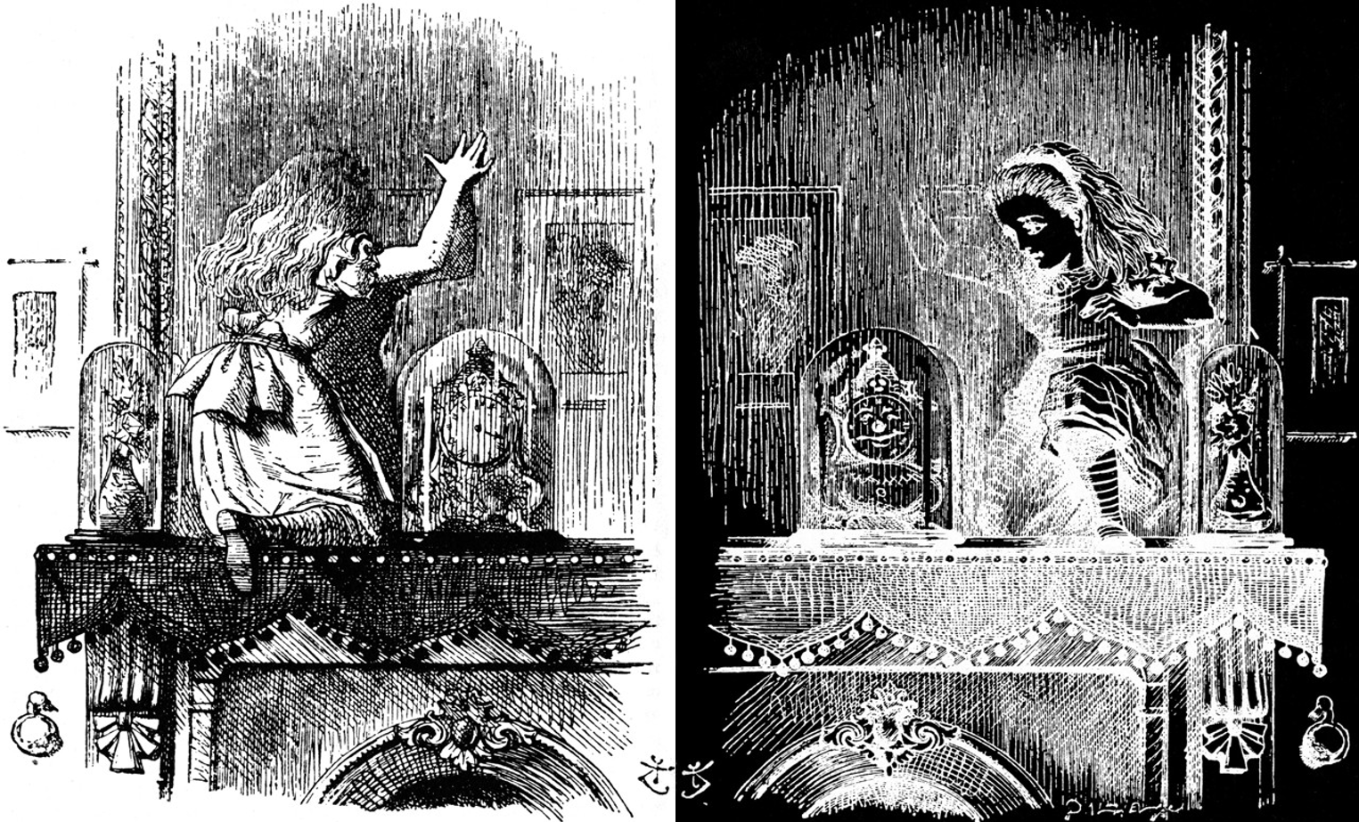
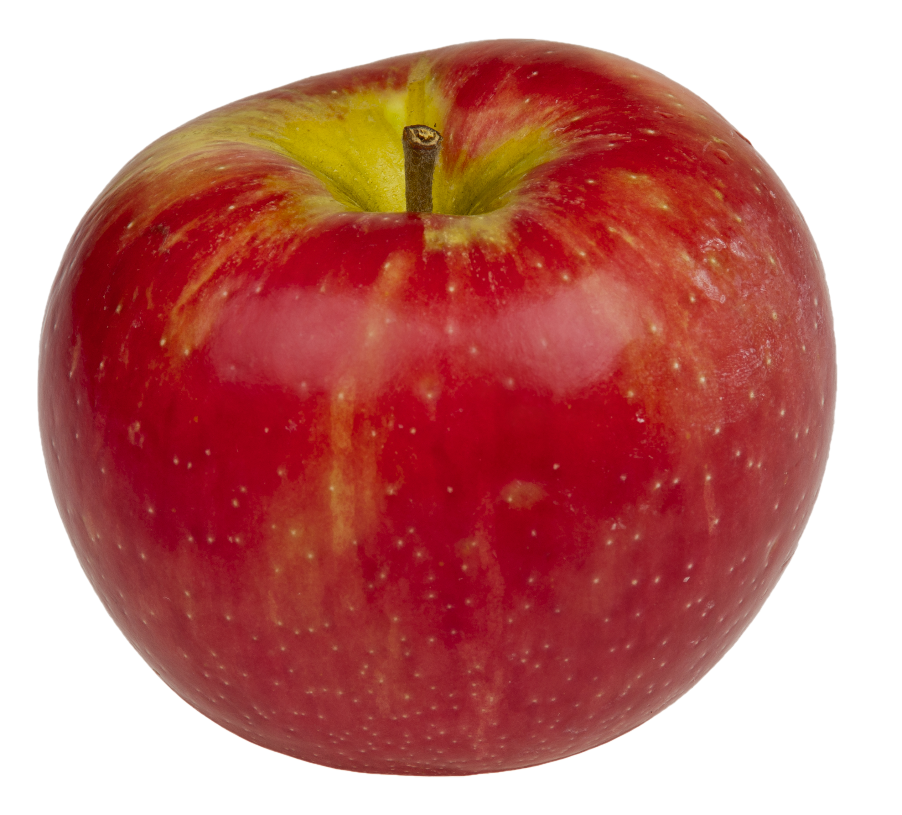
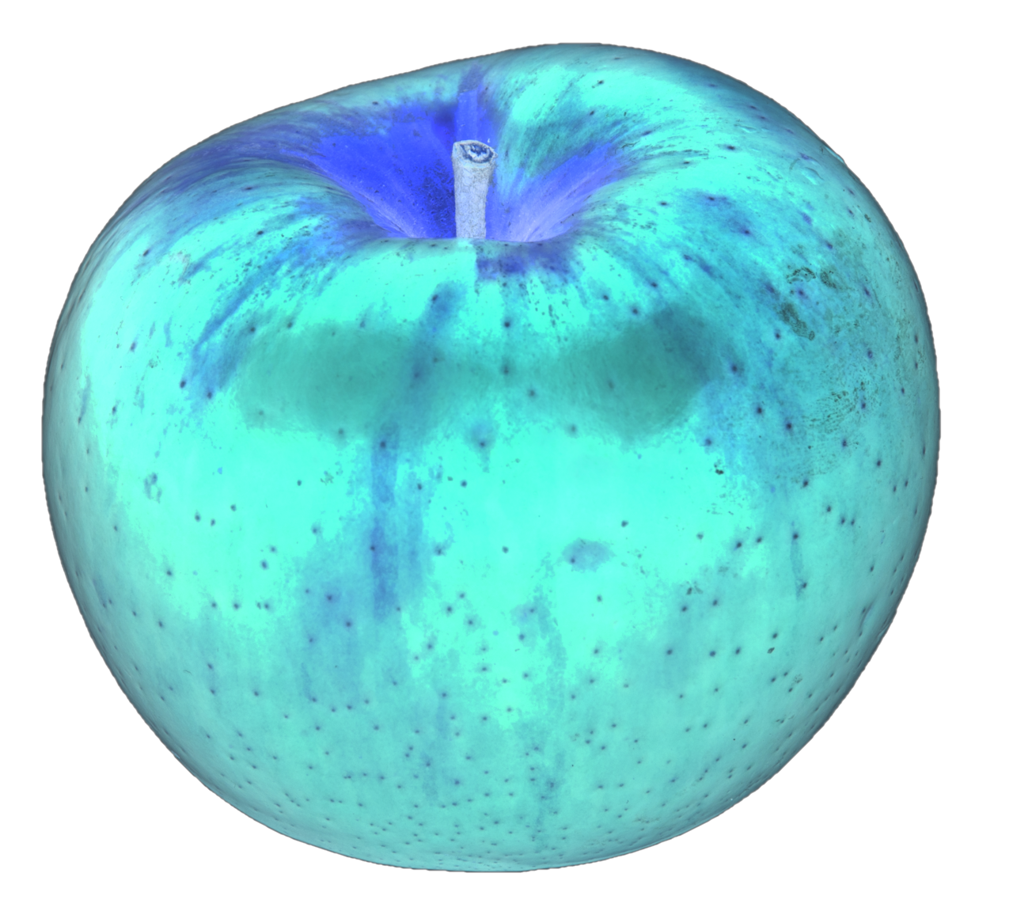

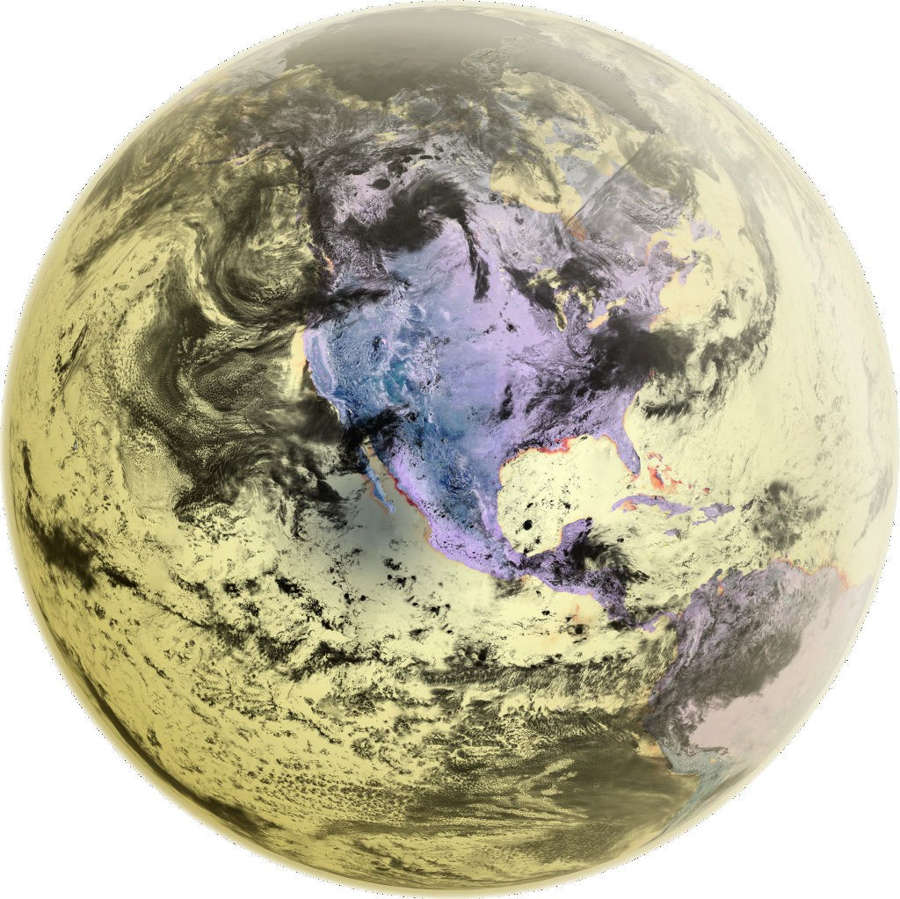
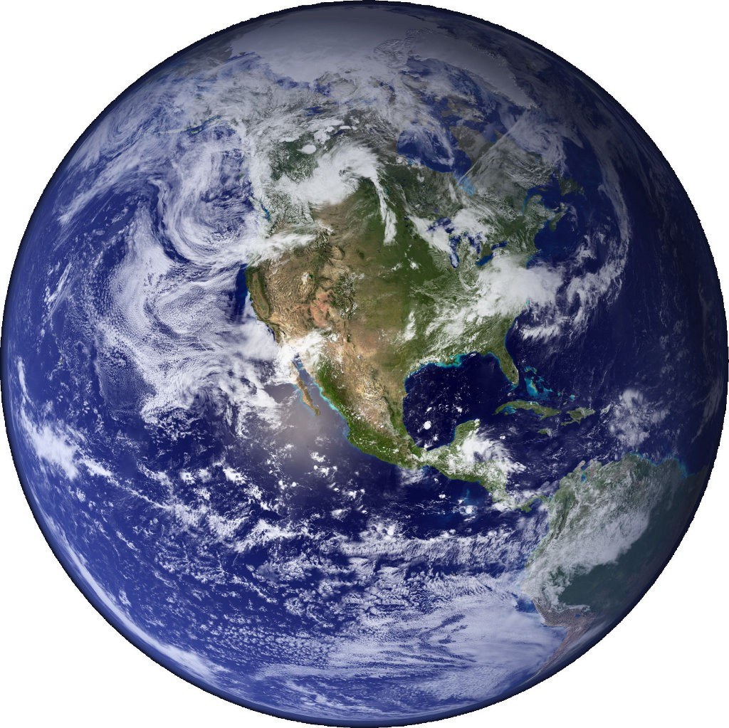
Why study antimatter?
Baryon Asymmetry Problem
Weak equivalence principle
?
Earth
Anti-Earth
Earth
(under CPT)

Slide 3
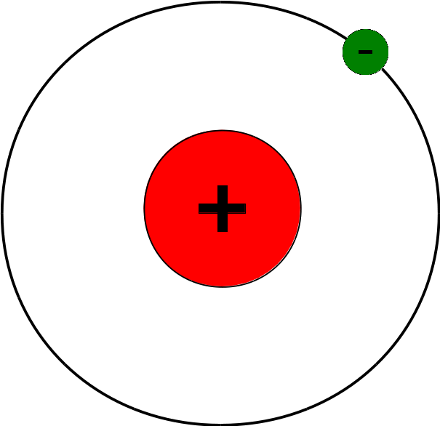
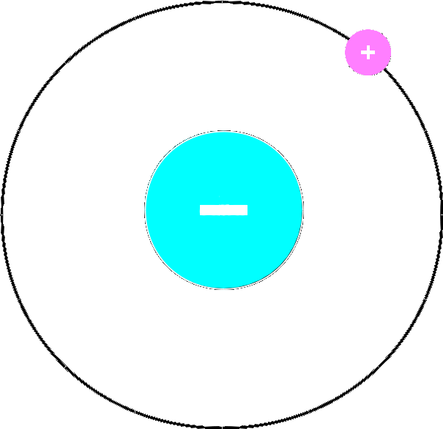
Antihydrogen
Hydrogen
Antihydrogen

Slide 4

ALPHA experiment

Slide 5
ALPHA
Goal: Precision measurements with antihydrogen atoms to test fundamental physics

Slide 6
ALPHA
Goal: Precision measurements with antihydrogen atoms to test fundamental physics
Spectroscopy (CPT tests):
1S – 2S (H: 10 Hz/4 x 10⁻¹⁵)
Ground state HFS (H: 2 mHz/1 x 10⁻¹²)
Lamb shift
1S – 2P (laser cooling)
nS – n’S/P
[C.G. Parthey et al. Phys. Rev. Let. 107, 203001 (2011).]
[H. Hellwig et al. IEEE Trans. on Instr. and Meas. 19, 200 (1970).]

Slide 7
ALPHA
Goal: Precision measurements with antihydrogen atoms to test fundamental physics
Spectroscopy (CPT tests):
1S – 2S (H: 10 Hz/4 x 10⁻¹⁵)
Ground state HFS (H: 2 mHz/1 x 10⁻¹²)
Lamb shift
1S – 2P (laser cooling)
nS – n’S/P
Gravity (WEP test):
Test the Weak Equivalence Principle with free-fall experiments (ALPHA-g)
Approach: Trap antihydrogen in a magnetic minimum neutral atom trap.

Slide 8
ALPHA
Goal: Precision measurements with antihydrogen atoms to test fundamental physics
Spectroscopy (CPT tests):
1S – 2S (H: 10 Hz/4 x 10⁻¹⁵)
Ground state HFS (H: 2 mHz/1 x 10⁻¹²)
Lamb shift
1S – 2P (laser cooling)
nS – n’S/P
Gravity (WEP test):
Test the Weak Equivalence Principle with free-fall experiments (ALPHA-g)
Approach: Trap antihydrogen in a magnetic minimum neutral atom trap.

Slide 9
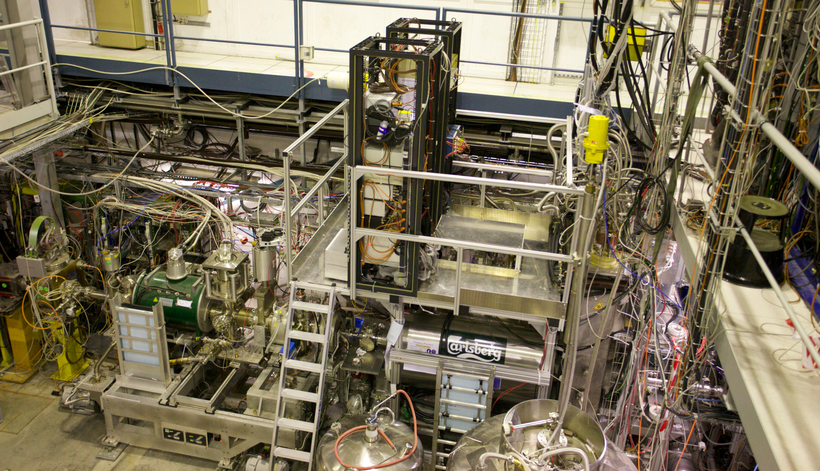
ALPHA-2 Apparatus

Slide 10
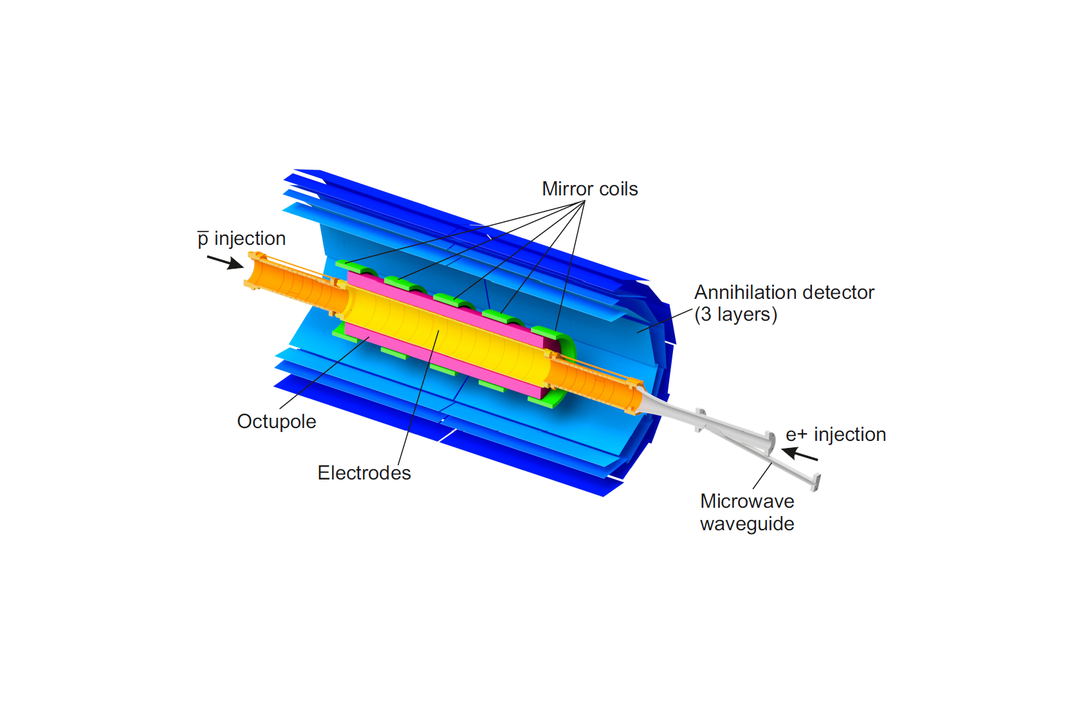
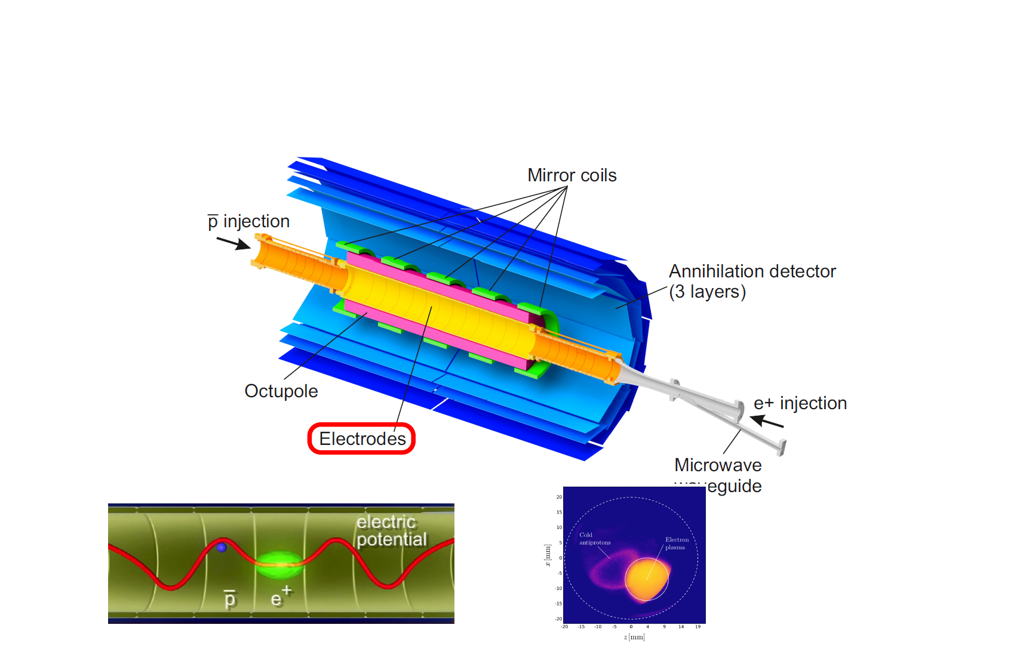
Producing and trapping antihydrogen
B = 1 T

Slide 11
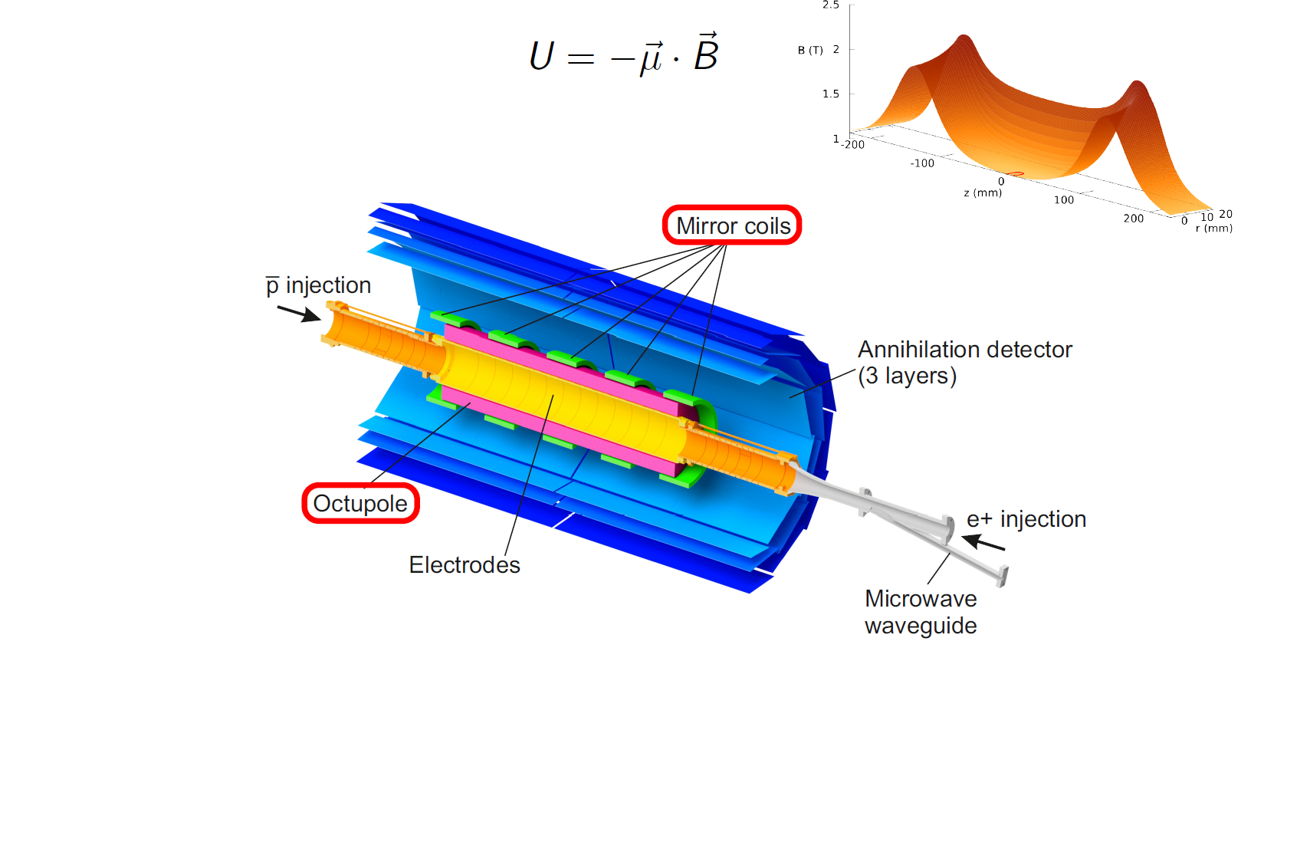
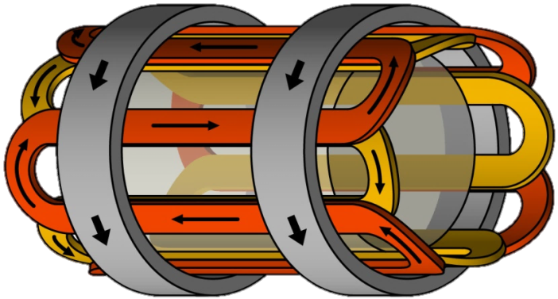

Producing and trapping antihydrogen
$$ΔU≈0.5 K$$
B = 1 T

Slide 12
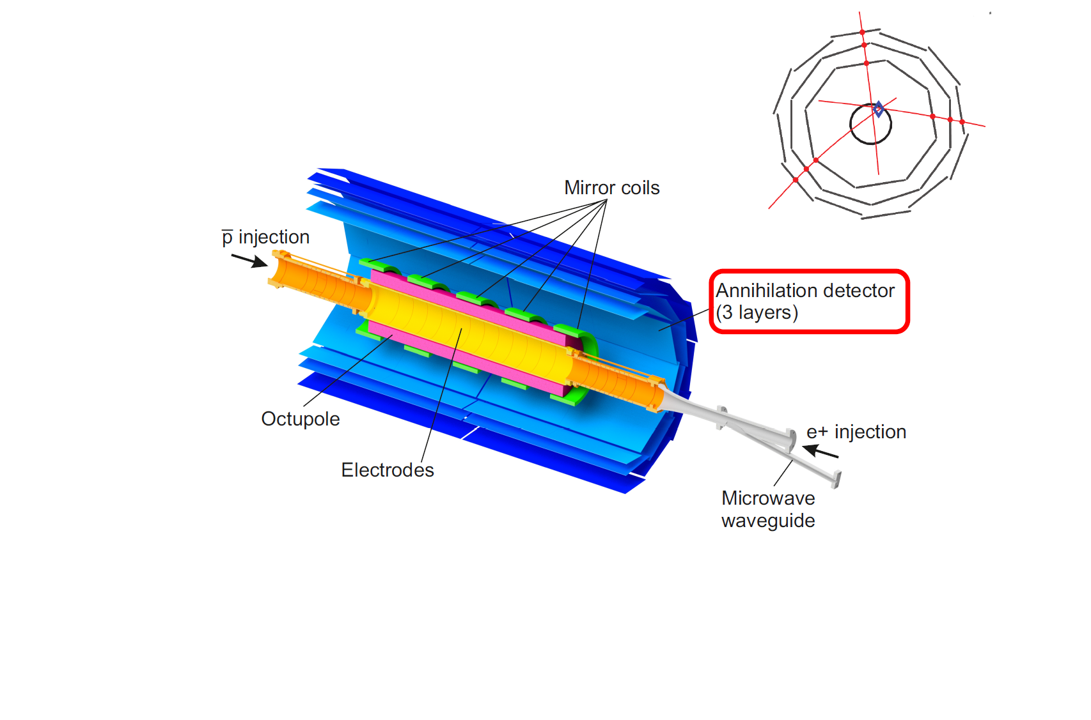
Producing and trapping antihydrogen
B = 1 T

Slide 13
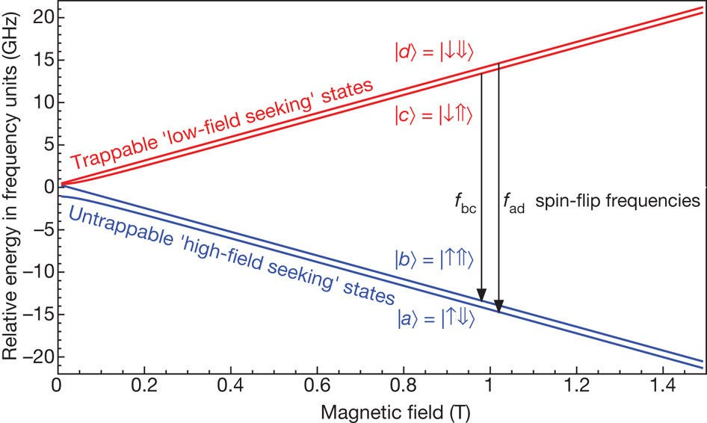
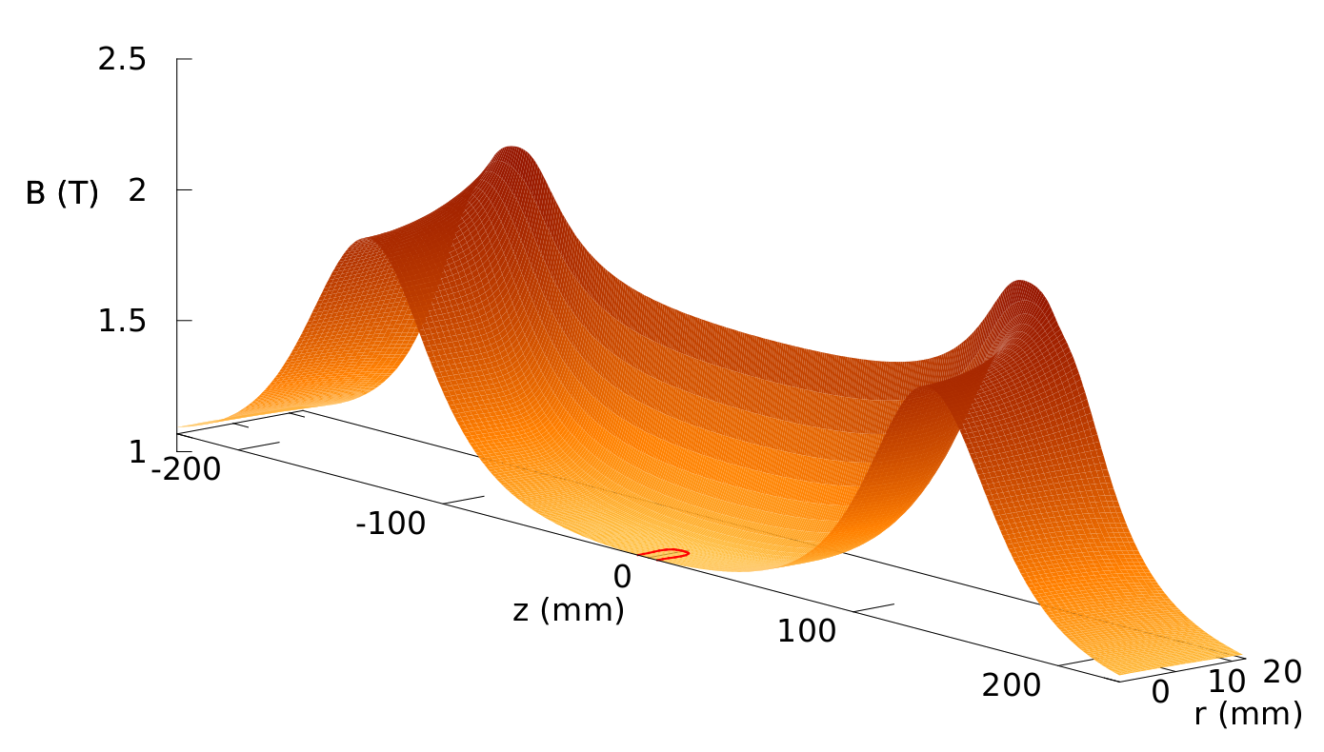
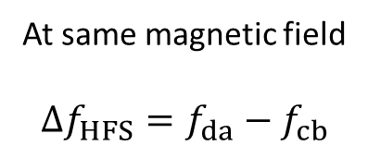

Ground state hyperfine splitting
At same magnetic field
$$Δf_{HFS}=f_{da}−f_{cb}$$
At 1 T:
f_{bc} ≈ 28.0 GHz
f_{ad} ≈ 29.42 GHz
$$0.1 mT⇒2.8 MHz$$

Slide 14

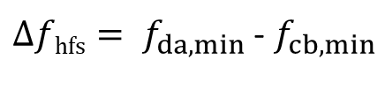

Approach
Find minimum resonance for both transitions
Stepped increasing frequency
Look for appearance of annihilations
$$f_{da}$$
Frequency
$$f_{cb}$$
${Δfhfs= f}_{da,min}$ - $f_{cb,min}$
Position

Slide 15
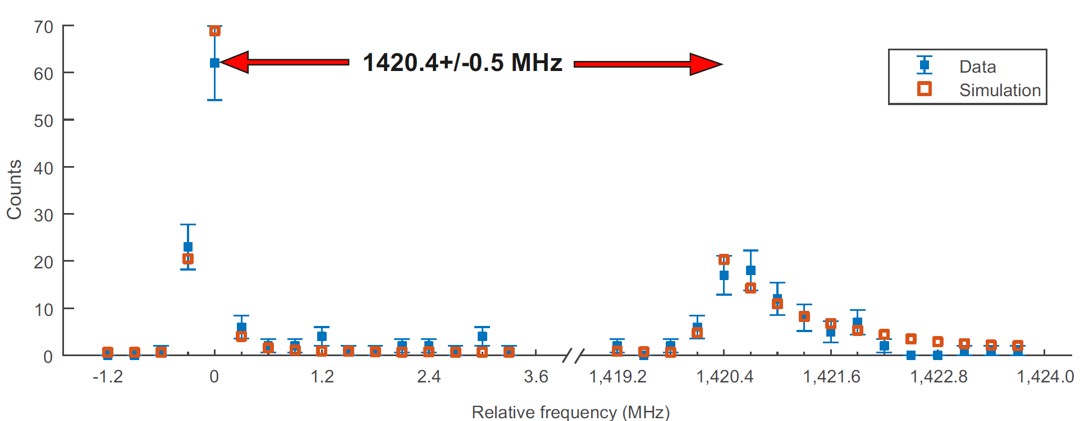
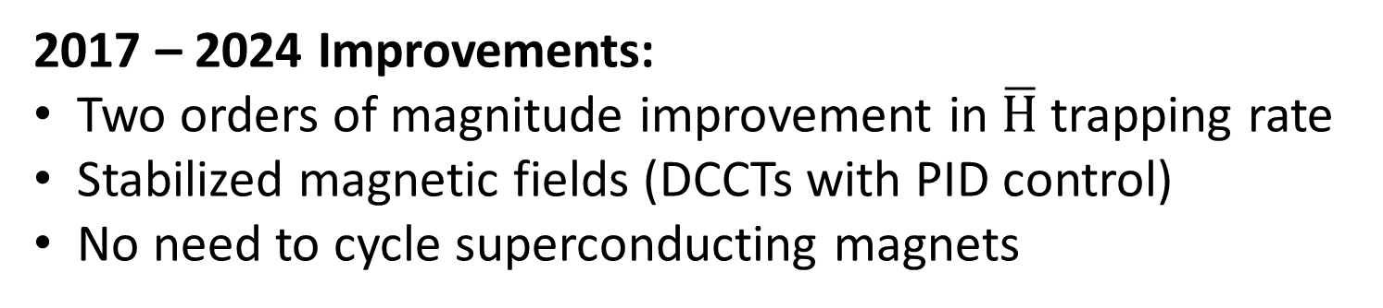
Previous result (2017)
Dataset – 194 annihilations total
Sum of 22 separate “runs” with
magnetic field ramps between each
[ALPHA, Nature 548, 66 (2017)]
2017 – 2024 Improvements:
Two orders of magnitude improvement in $\overline{H}$trapping rate
Stabilized magnetic fields (DCCTs with PID control)
No need to cycle superconducting magnets

Slide 16

2024 HFS Measurement Protocol
Energize trapping magnets
Accumulate ~1500 $\overline{H}$over roughly 1 hour
Let magnetic fields settle
Repeat pairs of resonance scans

Slide 17
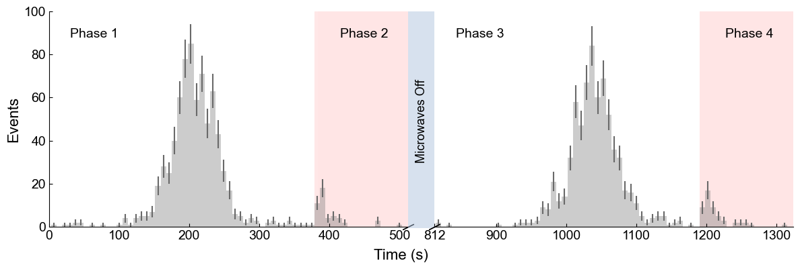
Results
PRELIMINARY

Slide 18
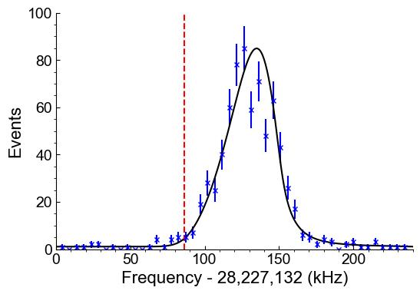
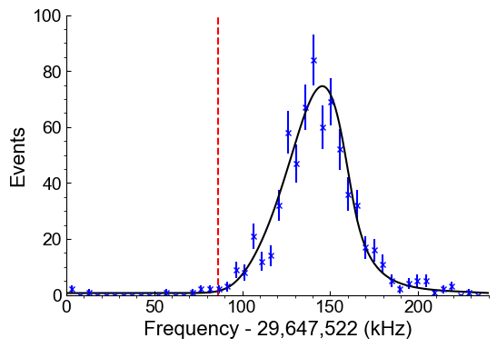


Results
PRELIMINARY
PRELIMINARY
$$\left|c\right\rangle →|b⟩$$
$$\left|d\right\rangle →|a⟩$$

Slide 19
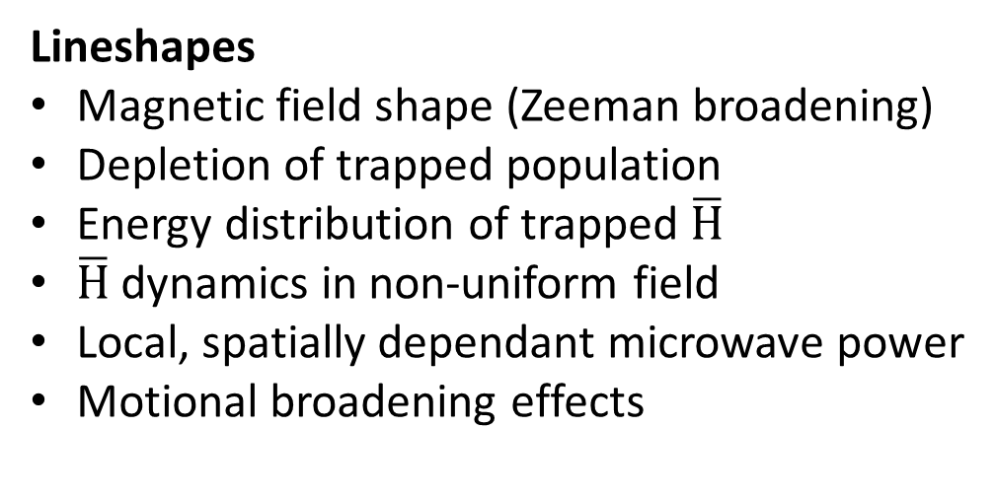


Analysis
$$\left|d\right\rangle →|a⟩$$
Lineshapes
Magnetic field shape (Zeeman broadening)
Depletion of trapped population
Energy distribution of trapped $\overline{H}$
$\overline{H}$ dynamics in non-uniform field
Local, spatially dependant microwave power
Motional broadening effects
PRELIMINARY
$$\left|c\right\rangle →|b⟩$$
PRELIMINARY

Slide 20
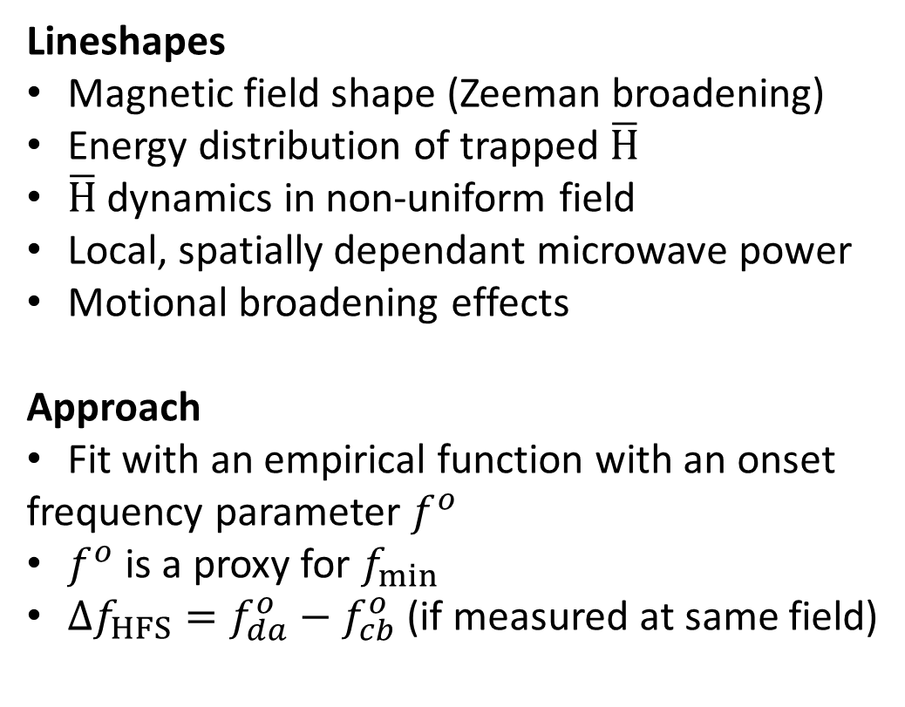
Analysis
$$\left|d\right\rangle →|a⟩$$
Lineshapes
Magnetic field shape (Zeeman broadening)
Energy distribution of trapped $\overline{H}$
$\overline{H}$ dynamics in non-uniform field
Local, spatially dependant microwave power
Motional broadening effects
Approach
Fit with an empirical function with an onset
frequency parameter $f^{o}$
$f^{o}$ is a proxy for $f_{min}$
$Δf_{HFS}={f_{da}^{o}−f}_{cb}^{o}$ (if measured at same field)
PRELIMINARY
$$\left|c\right\rangle →|b⟩$$
PRELIMINARY

Slide 21
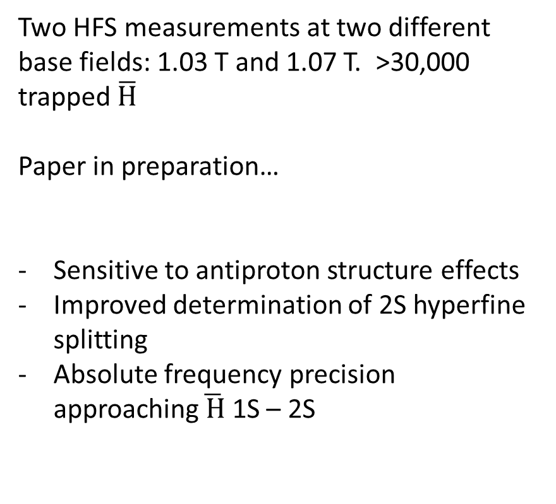
Result
Two HFS measurements at two different base fields: 1.03 T and 1.07 T. >30,000 trapped $\overline{H}$
Paper in preparation…
Sensitive to antiproton structure effects
Improved determination of 2S hyperfine splitting
Absolute frequency precision approaching$\overline{ H}$ 1S – 2S
Systematics:
  Choice of function
  Choice of onset parameter
  Assumption of linear field drift
  Reproducibility of shape between repetitions
  Binning

Slide 22
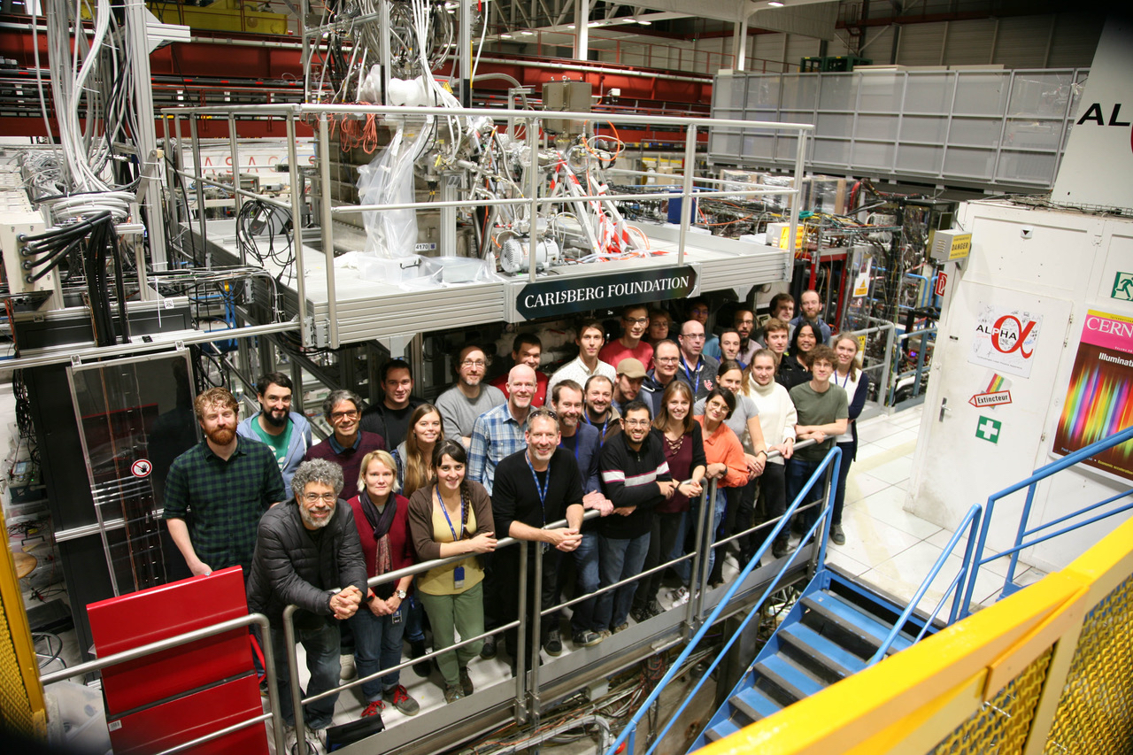
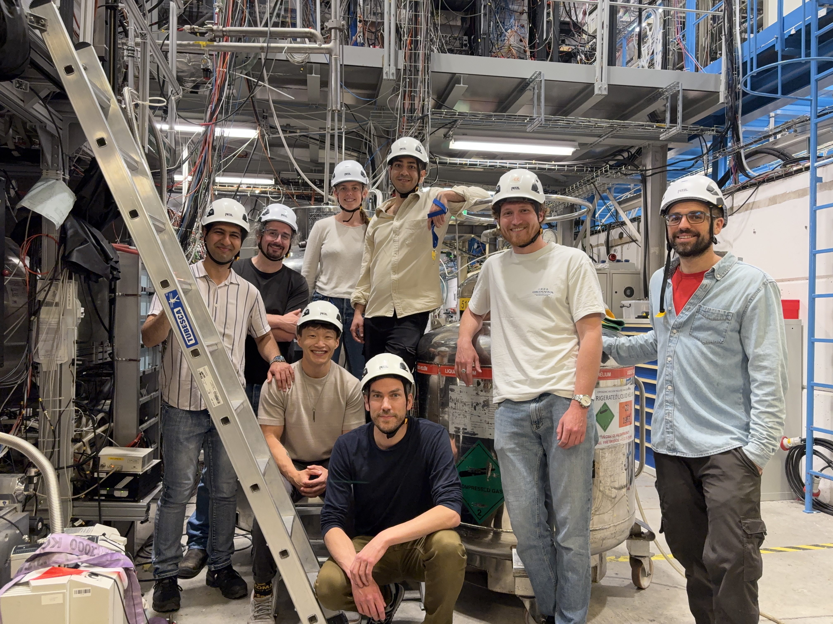




Thanks!
timothy.friesen@ucalgary.ca
ALPHA
https://alpha.web.cern.ch/
UCalgary PSR + NMR:
Jay Suh
Abbygale Swadling
Sean Wilson
Pouya Heidari
Alberto Uribe Jimenez
Reece Stefanyshyn
Modeling:
Simone Stracka (INFN Sezione di Pisa)
Germano Benome (U. Brescia)
Adriano Del Vinicio (U. Brescia)

Slide 23
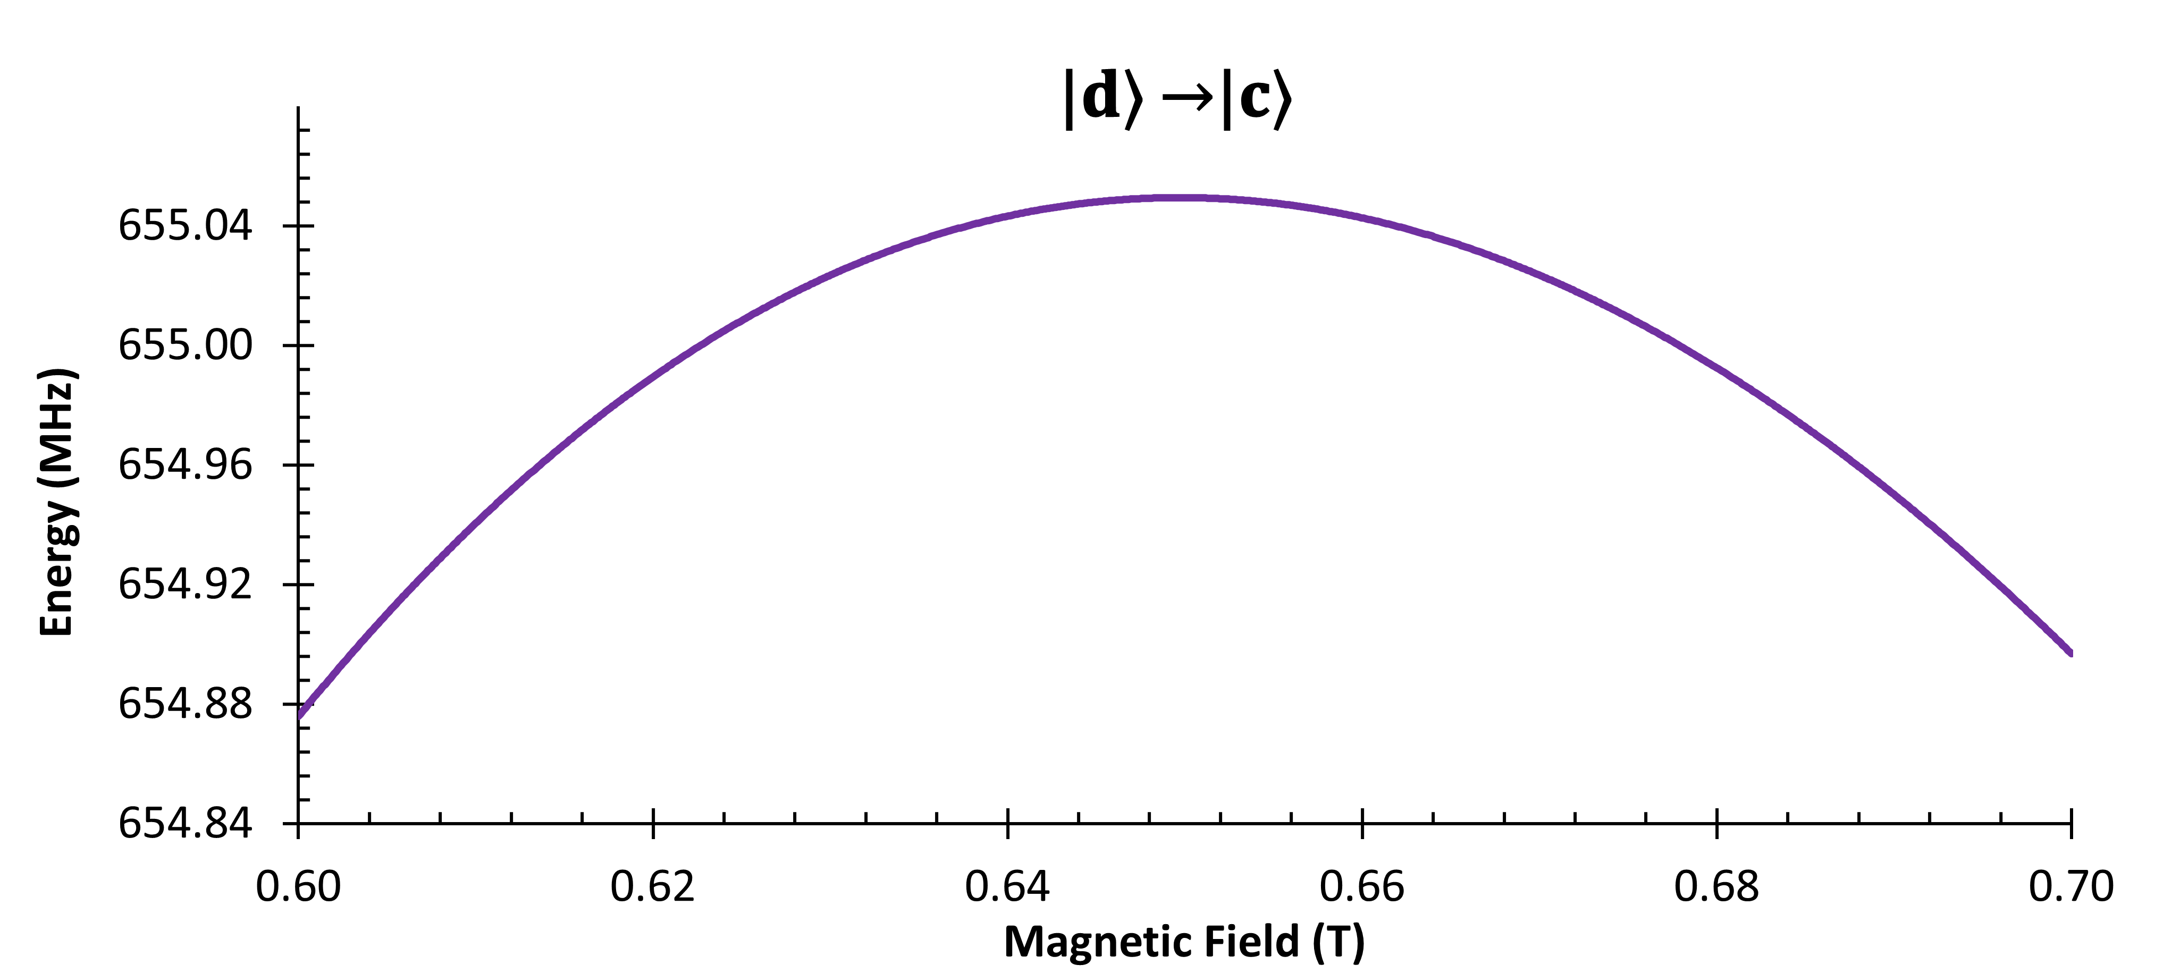





Antiproton NMR
$$c↔d$$
$f_{cd}^{∗}$ = (a/h)([$1/2−\sqrt{η}/(1+η)$], 𝜂 = $γ_{\overline{p}}/γ_{e^{+}}$
$$\frac{a}{h}=HFS$$
Stripline $λ/2$ resonator antenna

Slide 24
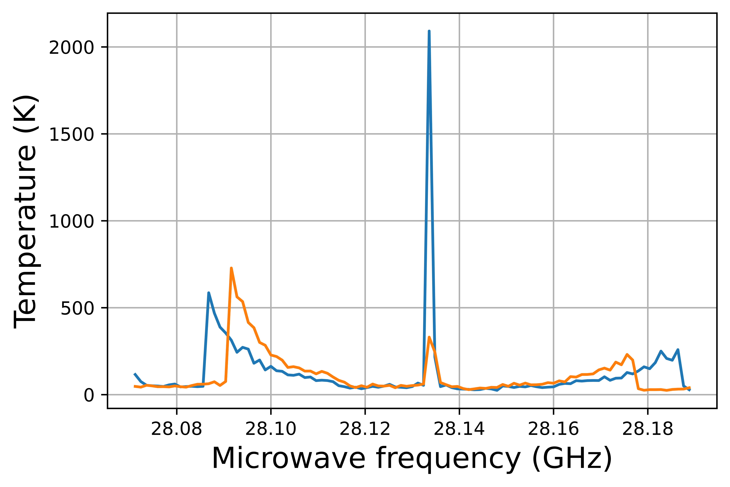
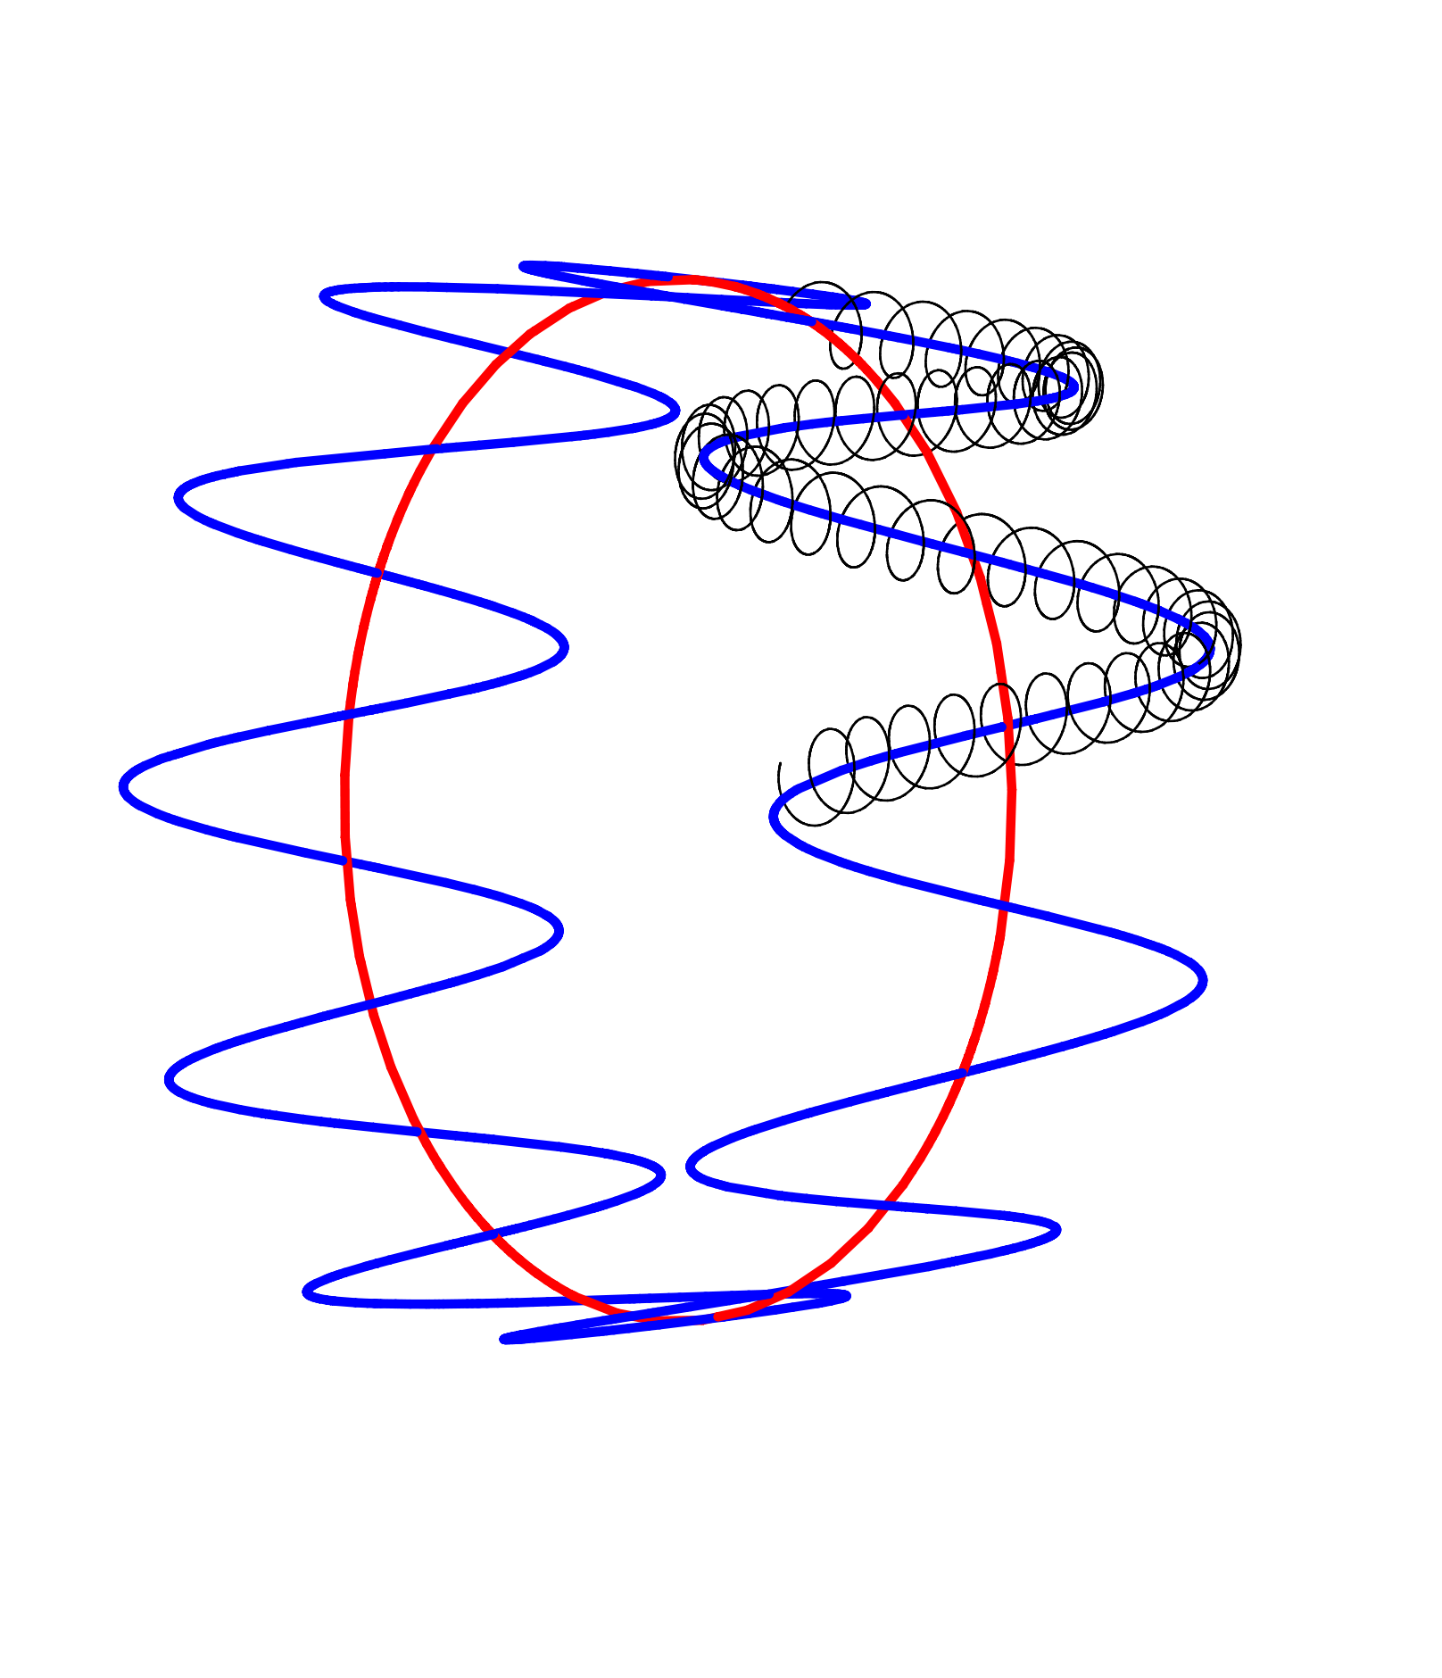
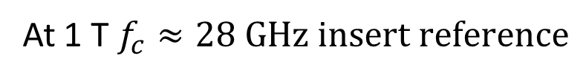
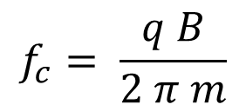

Electron cyclotron resonance magnetometry
MCP
$μ$W
e-
B
$$f_{c}= \frac{q B}{2 π m}$$
1 ppm precision (on-axis)
At 1 T $f_{c}≈28 GHz insert reference$

Slide 25
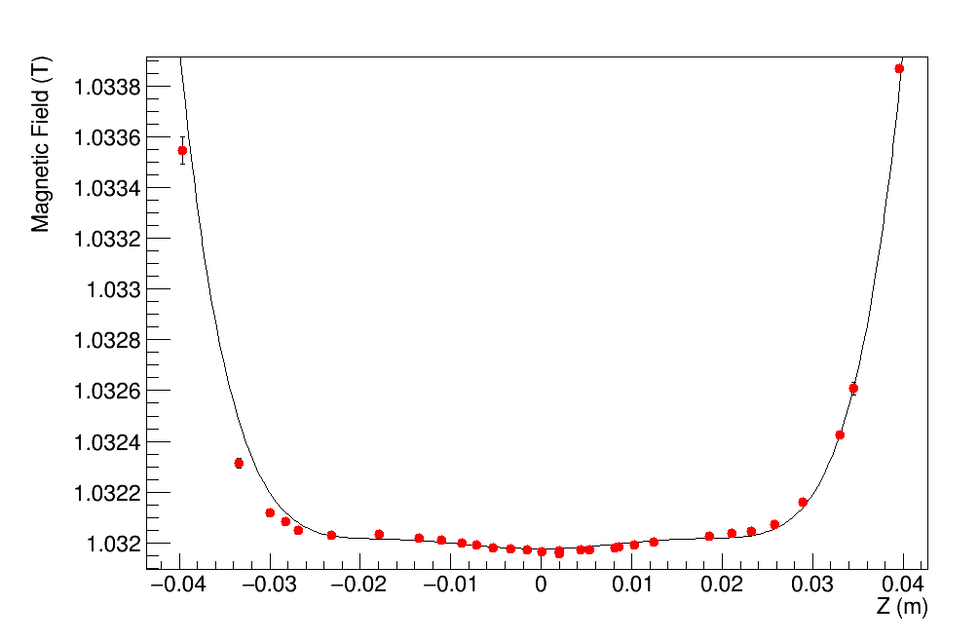
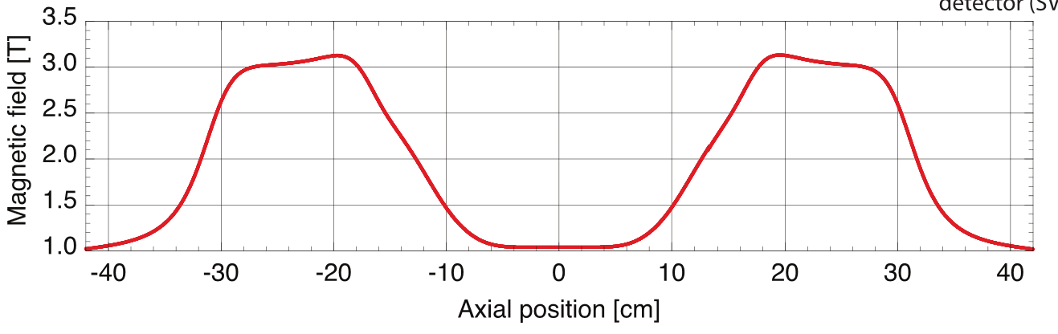
Magnetic field maps
Electron Cyclotron Resonance Measurements
Model
ECR
Magnet model
1 ppm on-axis field measurements
[E.D. Hunter et al. Physics of Plasmas, 27, 032106 (2020)]

Slide 26
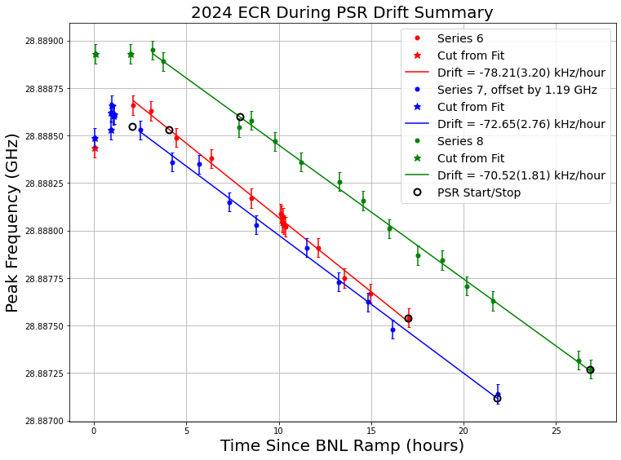
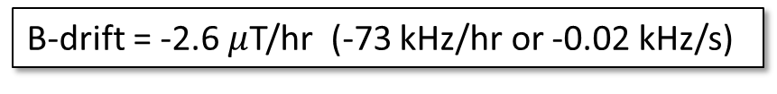
Magnetic field time evolution
2000
1500
Frequency – 28,887,000 (kHz)
B-drift = -2.6 $μ$T/hr (-73 kHz/hr or -0.02 kHz/s)
1000
500
0
0
5
10
15
20
25
Time after trap ramp (h)

Slide 27
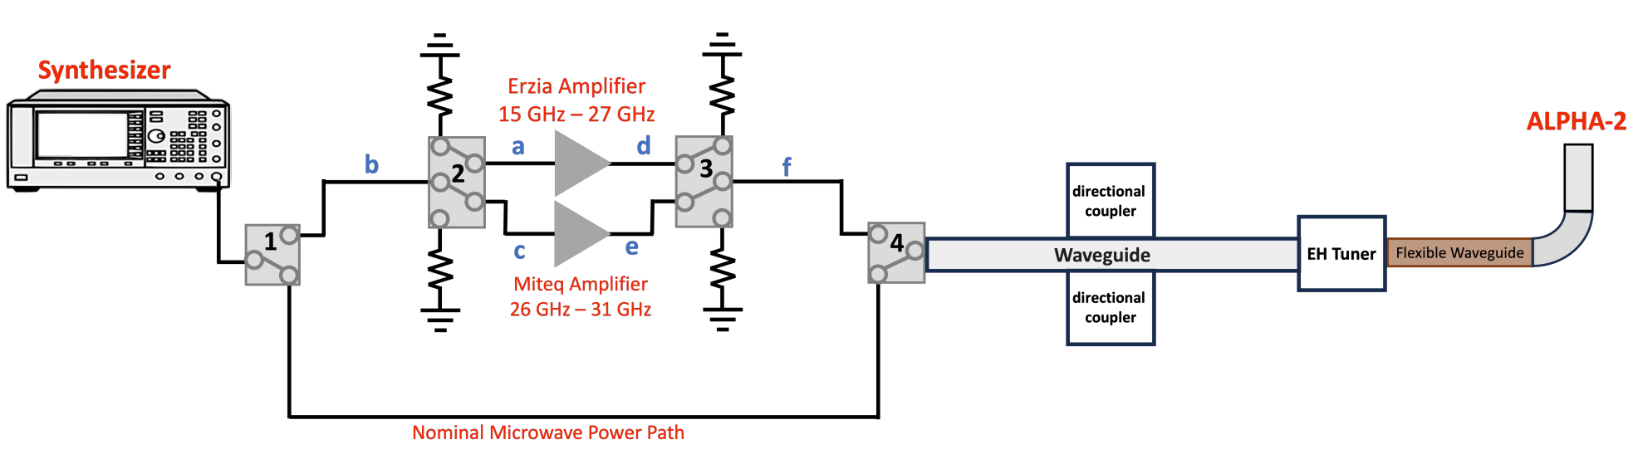

Slide 28
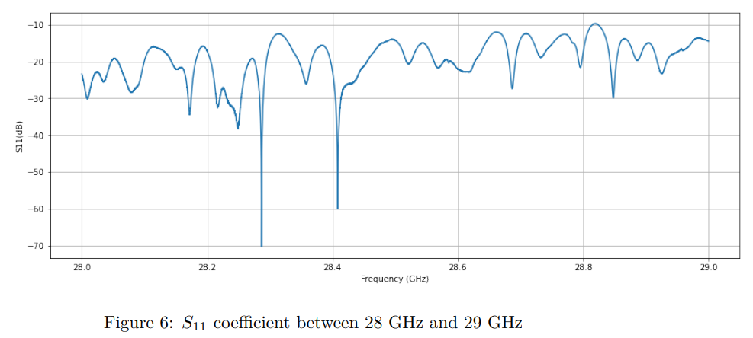
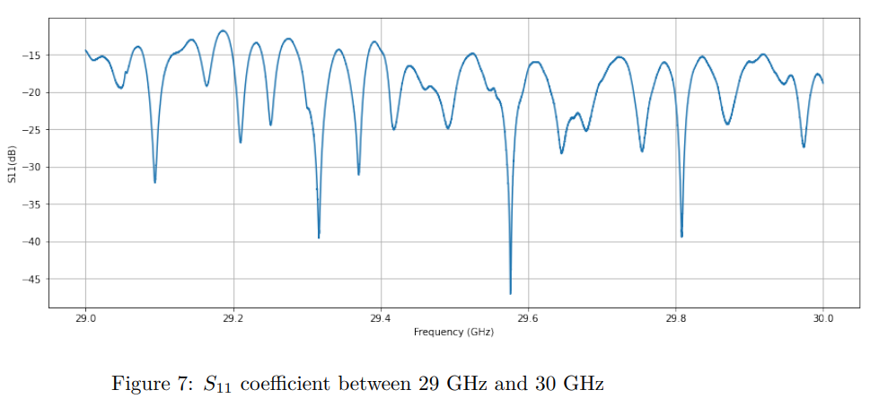

Slide 29
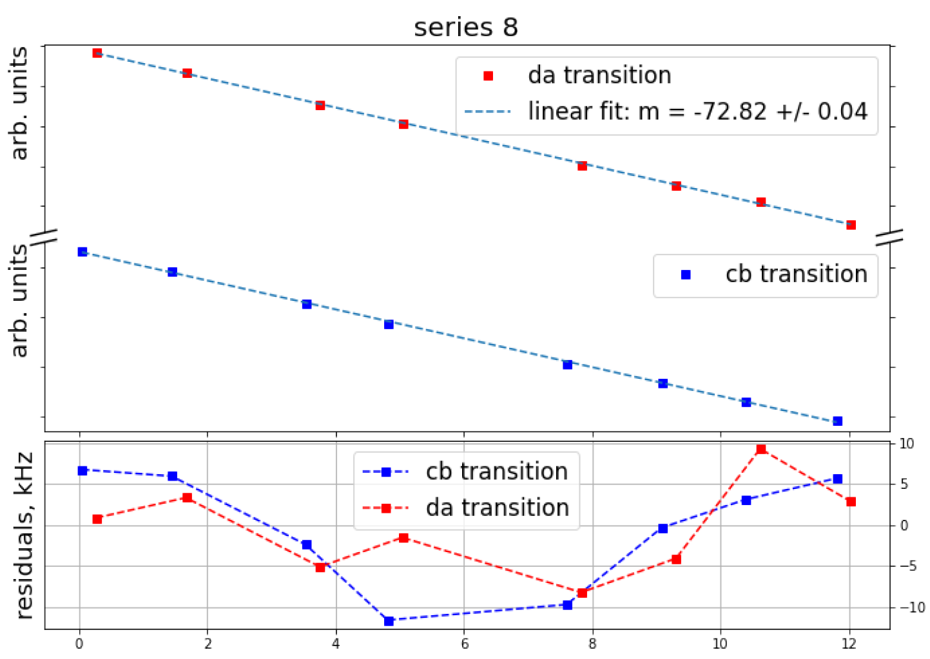
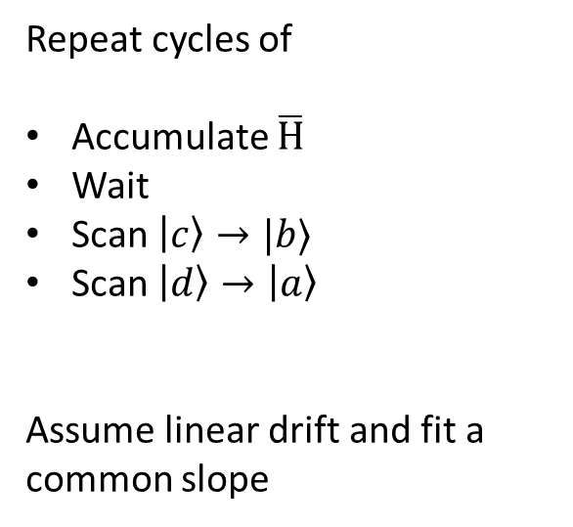

Compensating for B-drift
Repeat cycles of
Accumulate $\overline{H}$
Wait
Scan $\left|c\right\rangle →|b⟩$
Scan $\left|d\right\rangle →\left|a\right\rangle$
Assume linear drift and fit a
common slope
$$Δf_{HFS}$$
PRELIMINARY
Time (h)

Slide 30
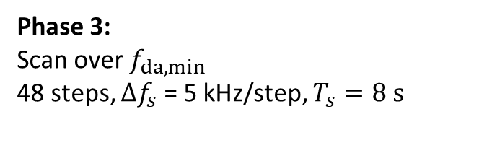
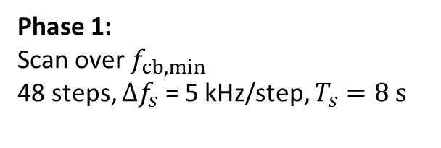
Protocol
Phase 4:
Remove any remaining d-state atoms
$$f_{da}$$
Phase 3:
Scan over $f_{da,min}$
48 steps, $Δf_{s}$ = 5 kHz/step, $T_{s}=8 s$
Frequency
Phase 2:
Remove any remaining c-state atoms
$$f_{cb}$$
Phase 1:
Scan over $f_{cb,min}$
48 steps, $Δf_{s}$ = 5 kHz/step, $T_{s}=8 s$
Position

