Slide 1


Paradoxes & Probabilities
Revisiting quantum nonlocality
in the graphical formalism of causal inference
Elie Wolfe
Western University May 30, 2024

Slide 2
OUTLINE
Review of Bell’s Theorem
Machine learning (causal discovery) and nonlocal correlations
Techniques for Classical Causal Inference
Techniques for Nonclassical Causal Inference
Causal Thinking & Multipartite Resources

Slide 3


Slide 4


Slide 5
Quantum Entanglement and Nonlocal Correlations

Slide 6
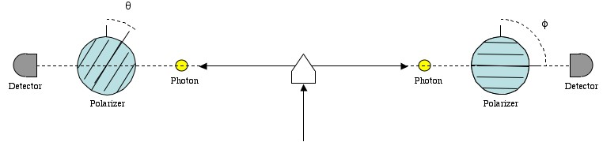
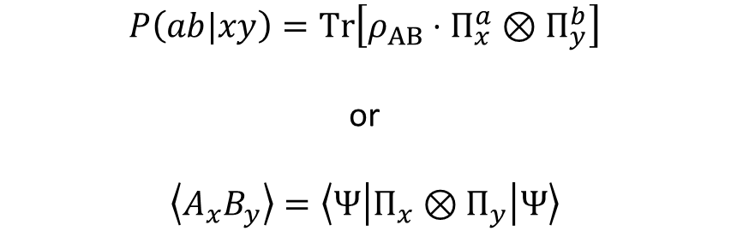
A quantum experiment
$$P\left(ab|xy\right)=\text{Tr}\left[ρ_{AB}⋅Π_{x}^{a}⊗Π_{y}^{b}\right]$$
or
$$\left\langle A_{x}B_{y}\right\rangle =\left\langle Ψ | Π_{x}⊗Π_{y} | Ψ\right\rangle$$

Slide 7


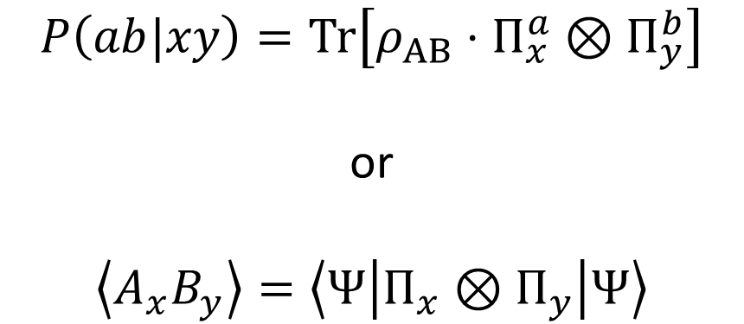
Bell Scenario (circuit model)
A
B
$$P\left(ab|xy\right)=\text{Tr}\left[ρ_{AB}⋅Π_{x}^{a}⊗Π_{y}^{b}\right]$$
or
$$\left\langle A_{x}B_{y}\right\rangle =\left\langle Ψ | Π_{x}⊗Π_{y} | Ψ\right\rangle$$
$$Π_{x}^{a}$$
$$Π_{y}^{b}$$
ρ_{AB}
X
Y

Slide 8
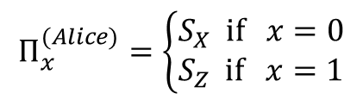


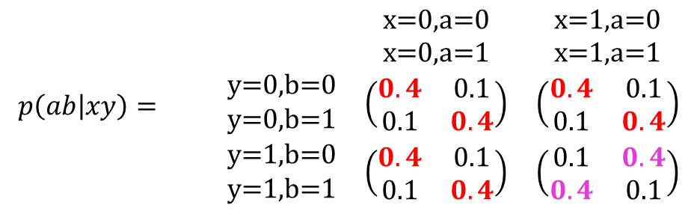
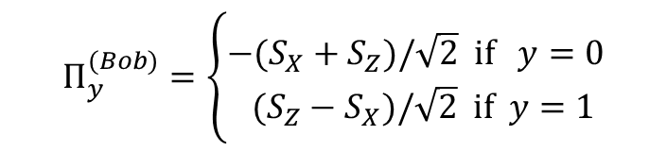
Bell’s Quantum Example
$$Π_{y}^{(Bob)}=\left\{\begin{aligned}−(S_{X}+S_{Z})/\sqrt{2} \text{if} y=0 \\ ({S_{Z}−S}_{X})/\sqrt{2} \text{if} y=1\end{aligned}\right.$$
$$\left.\left|Ψ\right.\right\rangle =\frac{\left.\left|01\right.\right\rangle −\left.\left|1\right.0\right\rangle }{\sqrt{2}}$$
$$Π_{x}^{(Alice)}=\left\{\begin{aligned}S_{X} \text{if} x=0 \\ S_{Z} \text{if} x=1\end{aligned}\right.$$
$$\text{x}\text{=}\text{0,}\text{y}\text{=0 } \overset{⇒}{\text{almost} \text{always}} \text{a}\text{=}\text{b}$$
$$\text{x}\text{=}\text{0,}\text{y}\text{=1 }\overset{⇒}{\text{almost} \text{always}} \text{a}\text{=}\text{b}$$
$$\text{x}\text{=}\text{1}\text{,}\text{y}\text{=0 }\overset{⇒}{\text{almost} \text{always}} \text{a}\text{=}\text{b}$$
$$\text{x}\text{=}\text{1}\text{,}\text{y}\text{=1 }\overset{⇒}{\text{almost} \text{always}} \text{a}≠\text{b}$$
$$p\left(ab | xy\right)= \begin{matrix} & \begin{matrix}\text{x}\text{=}\text{0}\text{,}\text{a}\text{=0} \\ \text{x}\text{=}\text{0}\text{,}\text{a}\text{=1}\end{matrix} & \begin{matrix}\text{x}\text{=1,}\text{a}\text{=0} \\ \text{x}\text{=1,}\text{a}\text{=1}\end{matrix} \\ \begin{matrix}\text{y}\text{=}\text{0}\text{,}\text{b}\text{=0} \\ \text{y}\text{=}\text{0}\text{,}\text{b}\text{=1}\end{matrix} & \left(\begin{matrix}0.4 & 0.1 \\ 0.1 & 0.4\end{matrix}\right) & \left(\begin{matrix}0.4 & 0.1 \\ 0.1 & 0.4\end{matrix}\right) \\ \begin{matrix}\text{y}\text{=}\text{1}\text{,}\text{b}\text{=0} \\ \text{y}\text{=}\text{1}\text{,}\text{b}\text{=}\text{1}\end{matrix} & \left(\begin{matrix}0.4 & 0.1 \\ 0.1 & 0.4\end{matrix}\right) & \left(\begin{matrix}0.1 & 0.4 \\ 0.4 & 0.1\end{matrix}\right)\end{matrix}$$

Slide 9
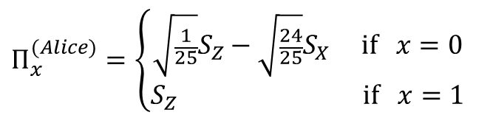
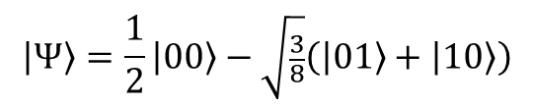

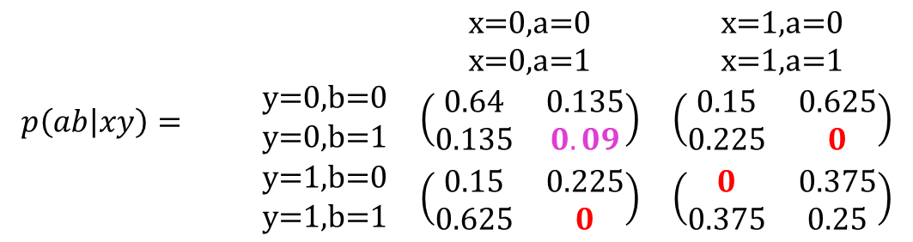

Hardy’s Quantum Example
$$Π_{x}^{(Alice)}=\left\{\begin{aligned}\sqrt{\frac{1}{25}}S_{Z}−\sqrt{\frac{24}{25}}S_{X} \text{if} x=0 \\ S_{Z} \text{if} x=1\end{aligned}\right.$$
$$\left.\left|Ψ\right.\right\rangle =\frac{1}{2}\left.\left|00\right.\right\rangle −\sqrt{\frac{3}{8}}\left(\left.\left|01\right.\right\rangle +\left.\left|1\right.0\right\rangle \right)$$
$$Π_{y}^{(Bob)}=Π_{x→y}^{(Alice)}$$
$$\text{x}\text{=}\text{0,}\text{y}\text{=0 } \overset{⇒}{\text{sometimes}} \text{a}\text{=1,}\text{b}\text{=1}$$
$$\text{x}\text{=}\text{0,}\text{y}\text{=1 } \overset{⇒}{\text{always}} \text{a}\text{=1}⇒\text{b}\text{=0}$$
$$\text{x}\text{=}\text{1}\text{,}\text{y}\text{=0 }\overset{⇒}{\text{always}} \text{b}\text{=1}⇒\text{x}\text{=0}$$
$$\text{x}\text{=}\text{1}\text{,}\text{y}\text{=1 } \overset{⇒}{\text{never}} \text{a}\text{=}\text{b}\text{=0}$$
$$p\left(ab | xy\right)= \begin{matrix} & \begin{matrix}\text{x}\text{=}\text{0}\text{,}\text{a}\text{=0} \\ \text{x}\text{=}\text{0}\text{,}\text{a}\text{=1}\end{matrix} & \begin{matrix}\text{x}\text{=1,}\text{a}\text{=0} \\ \text{x}\text{=1,}\text{a}\text{=1}\end{matrix} \\ \begin{matrix}\text{y}\text{=}\text{0}\text{,}\text{b}\text{=0} \\ \text{y}\text{=}\text{0}\text{,}\text{b}\text{=1}\end{matrix} & \left(\begin{matrix}0.64 & 0.135 \\ 0.135 & 0.09\end{matrix}\right) & \left(\begin{matrix}0.15 & 0.625 \\ 0.225 & 0\end{matrix}\right) \\ \begin{matrix}\text{y}\text{=}\text{1}\text{,}\text{b}\text{=0} \\ \text{y}\text{=}\text{1}\text{,}\text{b}\text{=}\text{1}\end{matrix} & \left(\begin{matrix}0.15 & 0.225 \\ 0.625 & 0\end{matrix}\right) & \left(\begin{matrix}0 & 0.375 \\ 0.375 & 0.25\end{matrix}\right)\end{matrix}$$

Slide 10

Bell’s Theorem
local realism implies that spacelike-separated observers should have statistics matching an ontological model wherein
The prediction of quantum theory are different, however, allowing for
All classical statistics must obey
But quantum theory allows for
$$P\left(ab|xy\right)=\sum_{λ }{P\left(a | xλ\right)P\left(b | yλ\right)P\left(λ\right)}$$
$$P\left(ab|xy\right)=\text{Tr}\left[ρ_{AB}⋅Π_{x}^{a}⊗Π_{y}^{b}\right]$$
$$P_{AB|XY}\left(00 | 00\right)≤P_{AB|XY}\left(01 | 01\right)+P_{AB|XY}\left(10 | 10\right)+P_{AB|XY}\left(00 | 11\right)$$
$$P_{AB|XY}\left(00 | 00\right)=P_{AB|XY}\left(01 | 01\right)+P_{AB|XY}\left(10 | 10\right)+P_{AB|XY}\left(00 | 11\right)+\frac{\sqrt{2}−1}{2}$$

Slide 11
Causal Inference and Machine Learning

Slide 12
Causal Modelling
The causal structure implies constraints on the observed statistics
Both inequality constraints and equality constraints
A
B
double-ring indicates unobserved, single ring indicates observed
Λ
X
Y
Bell inequality
$$P_{AB|XY}\left(00 | 00\right)≤P_{AB|XY}\left(01 | 01\right)+P_{AB|XY}\left(10 | 10\right)+P_{AB|XY}\left(00 | 11\right)$$
$$P_{AB|XY}\left(00 | 00\right)+P_{AB|XY}\left(01 | 00\right)=P_{AB|XY}\left(00 | 01\right)+P_{AB|XY}\left(01 | 01\right)$$
“No signalling”

Slide 13

The Quantum Physicist as Causal Detective
“Draw your assumptions before your conclusions.”
--- Miguel Hernán
Professor of Biostatistics and Epidemiology
Harvard University

Slide 14
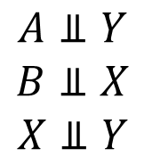
Reichenbach's Common Cause Principle
NO CORRELATION WITHOUT CAUSATION
A pair of random variables are can only be correlated if they share some causal history.
A
B
RCCP Practice:
A
B
A
B
$$A⫫Y$$
$$B⫫X$$
$$X⫫Y$$
A
B
Λ
X
Y
Λ

Slide 15


Inducing Correlation by Postselection
Conditioned on certain information, correlations can be induced between independent random variables
C
$$A⫫B$$
A
B
$$\left.A\text{⧓}B \right| C$$
The correlation induced can be positive or negative
Aptitude and Beauty both contribute to likelihood of Celebrity
∴ Beauty and Aptitude are negatively correlated among Celebrities
The Vernam ciphertext is a function of the plaintext and the secretkey.
∴ ciphertext bit = 1 ⇒ plaintext = secretkey (for that bit)

Slide 16

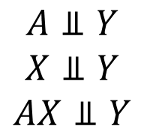
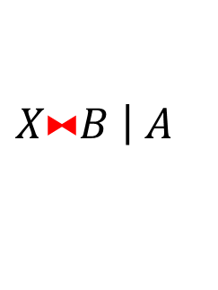
Conditional Independence (d-separation)
Aside from RCCP, we can argue that some correlations are not induced even by conditioning.
This generalizes the sorts of independences that a given causal structure can imply.
Independent despite conditioning:
From RCCP:
A
B
$$A⫫Y | X$$
$$A⫫Y$$
$$X⫫Y$$
$$AX⫫Y$$
Λ
X
Y
Possibly correlated through postselection:
$$\left.X\text{⧓}B \right| A$$

Slide 17

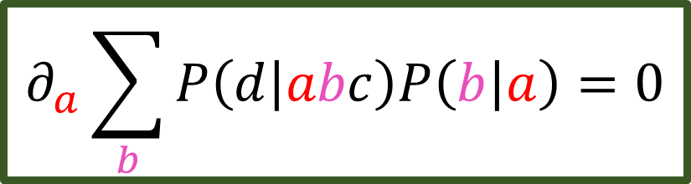
Fancier Equality Constraints: Nested Markov
A
B
C
D
Λ
$$∂_{a}\sum_{b}{P\left(d | abc\right)P\left(b | a\right)}=0$$

Slide 18
Causal Discovery
Check the given observed data for dependencies between the random variables. Also find all dependencies induced by postselection.
Reject any causal explanation that fails to account for the observed correlations. “No Correlation Without Causation”
Check the given observed data for independences between the random variables. Ditto all independences induced by postselection.
Reject any causal explanation that doesn’t necessitate these independences. “No Fine Tuning”
Examine each remaining causal hypothesis for non-conditional-independence constraints it implies, such as inequality constraints.
Reject any causal explanation which implies constraints not satisfied by the observed data.

Slide 19




Example: Cancer, Smoking, & Tar in the lungs
$$S⫫C | T$$
$$S\text{⧓}C$$
$$S\text{⧓}T$$
$$C\text{⧓}T$$
Wood & Spekkens: “The lesson of causal discovery algorithms for quantum correlations:
causal explanations of Bell-inequality violations require fine-tuning” arXiv:1208.4119

Slide 20
Causal Discovery & Bell’s Theorem
If you run quantum Bell-experiment statistics through a causal discovery algorithm, what happens?
Causality Catastrophe: There is no classical causal explanation at all for quantum statistics. (Assuming “No Fine Tuning”)
We don’t just get the wrong answer… we get no answer at all. Spooky!
Retrocausal & Superluminal explanations are causal, but fine tuned.
Wood & Spekkens: “The lesson of causal discovery algorithms for quantum correlations:
causal explanations of Bell-inequality violations require fine-tuning” arXiv:1208.4119

Slide 21
Loopholes used to “explain” Bell’s Theorem
Λ
A
B
A
B
A
B
Λ
Λ
X
Y
X
Y
X
Y
Super-determinism
(setting choices not free)
Retrocausality
(state is updated by choice of measurement)
Superluminal influence
(Bob’s outcome depends on Alice’s setting)

Slide 22
Contrasting classical and quantum unobserved common causes

Slide 23

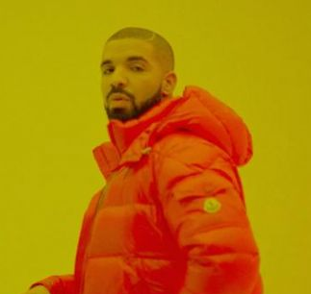
Interpreting Bell’s Theorem: Spooky Action
A
B
A
B
Λ
Λ
X
Y
X
Y

Slide 24
Interpreting Bell’s Theorem: Nonclassical Causes
A
B
A
B
Λ
Ψ
X
Y
X
Y

Slide 25




Looking for a Quantum / Classical Gap
Bell Scenario
A
B
A
B
Λ
Ψ
X
Y
X
Y
$$P\left(a | xy\right)=P\left(a | x\right) \\ P\left(b | xy\right)=P\left(b | y\right)$$
Same Equalities
$$P\left(a | xy\right)=P\left(a | x\right) \\ P\left(b | xy\right)=P\left(b | y\right)$$
$$P_{AB|XY}\left(00 | 00\right)−P_{AB|XY}\left(01 | 01\right)−P_{AB|XY}\left(10 | 10\right)−P_{AB|XY}\left(00 | 11\right)≤0$$
$$P_{AB|XY}\left(00 | 00\right)−P_{AB|XY}\left(01 | 01\right)−P_{AB|XY}\left(10 | 10\right)−P_{AB|XY}\left(00 | 11\right)≤\frac{\sqrt{2}−1}{2}$$
Different Inequalities

Slide 26
Looking for a Quantum / Classical Gap
All the Conditional Independence Relations implied by a classical causal structure are also implied by the analogous quantum (and GPT) causal structure.
All the Equality Constraints (such as Nested Markov) implied by a classical causal structure are also implied by the analogous quantum (and GPT) causal structure.
Henson, Lal, & Pusey: “Theory-independent limits on correlations from generalised Bayesian networks” arXiv:1405.2572
Evans: “Margins of discrete Bayesian networks” arXiv:1501.02103
EW: Unpublished notes.
Only Inequalities Matter

Slide 27
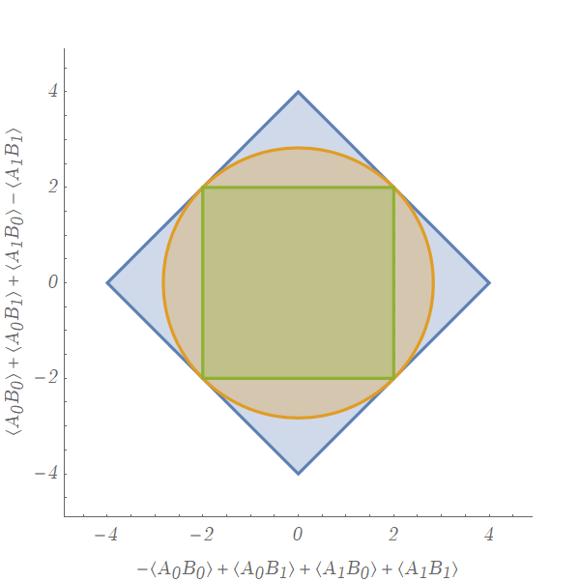
Visualizing Bell Scenario Distributions

Slide 28
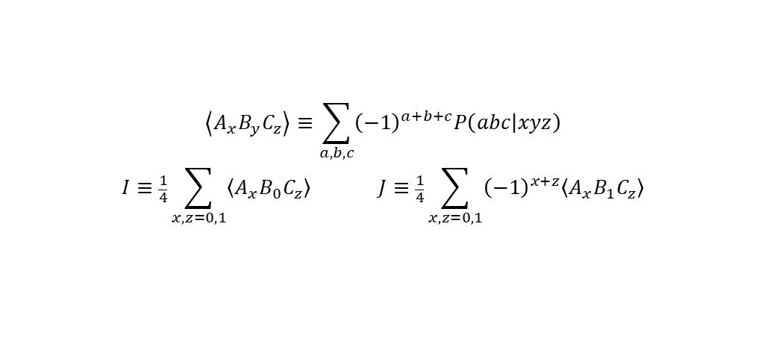
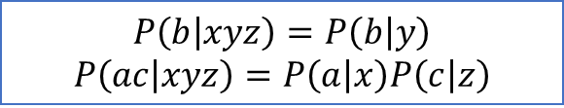
Looking for a Quantum / Classical Gap
Bilocality Scenario
$$\sqrt{I}+\sqrt{J}≤1$$
A
B
C
Λ_{AB}
Classical “Bilocality Inequality”
Λ_{BC}
X
Y
Z
Quantum analog (violated)
$$P\left(b | xyz\right)=P\left(b | y\right)$$
$$P\left(ac | xyz\right)=P\left(a | x\right)P\left(c | z\right)$$
$$\sqrt{I}+\sqrt{J}≤\sqrt{2} but \left|I\right|+\left|J\right|≤1$$
$$\left\langle A_{x}B_{y}C_{z}\right\rangle ≡\sum_{a,b,c}{{\left(−1\right)}^{a+b+c}P\left(abc | xyz\right)}$$
$$I≡\frac{1}{4}\sum_{x,z=0,1}{\left\langle A_{x}B_{0}C_{z}\right\rangle } J≡\frac{1}{4}\sum_{x,z=0,1}{{\left(−1\right)}^{x+z}\left\langle A_{x}B_{1}C_{z}\right\rangle }$$
Branciard, Rosset, Gisin, & Pironio: “Bilocal versus non-bilocal correlations in entanglement swapping experiments arXiv:1112.4502

Slide 29
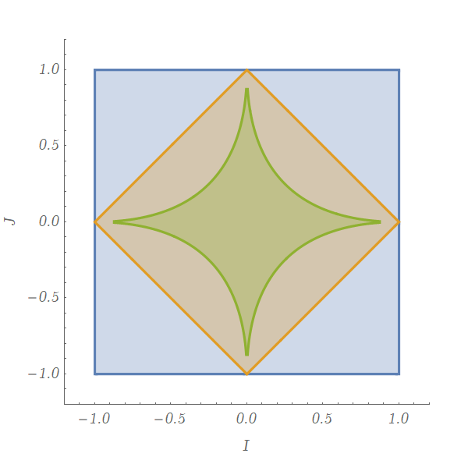
Visualizing Bilocality Scenario Distributions

Slide 30
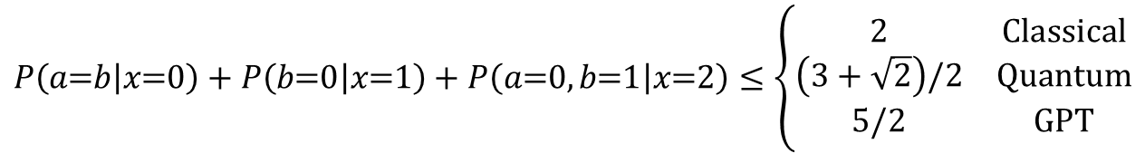
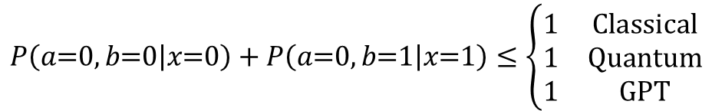
Looking for a Quantum / Classical Gap
Instrumental Scenario
Pearl: “On the Testability of Causal Models with Latent and Instrumental Variables” arXiv:1302.4976
Bonet: “Instrumentality Tests Revisited” arXiv:1301.2258
Henson, Lal, & Pusey: “Theory-independent limits on correlations from generalised Bayesian networks” arXiv:1405.2572
Van Himbeek, et. al.: “Quantum violations in the Instrumental scenario and their relations to the Bell scenario” arXiv:1804.04119
X
A
B
Λ
$$P\left(a\text{=}b | x\text{=}0\right)+P\left(b\text{=}0 | x\text{=}1\right)+P\left(a\text{=}0,b\text{=}1 | x\text{=}2\right)≤\left\{\begin{matrix}2 & \text{Classical} \\ \left(3+\sqrt{2}\right)/2 & \text{Quantum} \\ 5/2 & \text{GPT}\end{matrix}\right.$$
This inequalities witness a gap
$$P\left(a\text{=}0,b\text{=}0 | x\text{=}0\right)+P\left(a\text{=}0,b\text{=}1 | x\text{=}1\right)≤\left\{\begin{matrix}1 & \text{Classical} \\ 1 & \text{Quantum} \\ 1 & \text{GPT}\end{matrix}\right.$$
This inequalities is nonviolable
Notes:
Remark that Pusey conveyed violability of this inequality in personal communication back at Perimeter

Slide 31
Where do inequalities come from?
Many ways to obtain inequalities.
I’ll focus on The Inflation Technique, because
I helped invent it.
It recovers every classical constraint (asymptotically)
EW, Fritz, & Spekkens: “The Inflation Technique for Causal Inference with Latent Variables” arXiv:1609.00672
Navascues & EW: “The Inflation Technique Completely Solves the Classical Inference Problem” arXiv:1707.06476

Slide 32
The inflation technique for correlation scenarios

Slide 33

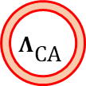




Triangle Scenario
$${ A}_{}^{}$$
$$Λ_{\text{AB}}^{}$$
$$Λ_{\text{CA}}^{}$$
$${ B}_{}^{}$$
$$Λ_{\text{BC}}^{}$$
$${ C}_{}^{}$$
$$P\left(abc\right)=\sum_{λ_{AB}^{},λ_{BC}^{},λ_{CA}^{}}{P\left(a | λ_{CA}^{}, λ_{AB}^{}\right)P\left(b | λ_{AB}^{}, λ_{BC}^{}\right)P\left(c | λ_{BC}^{}, λ_{CA}^{}\right)P\left(λ_{AC}^{}\right)P\left(λ_{BC}^{}\right)P\left(λ_{CA}^{}\right)}$$

Slide 34













“Reuse” causal parameters
Original Graph
Inflation Graph
$${ A}_{}^{2}$$
$$Λ_{\text{CA}}^{2}$$
$${ A}_{}^{}$$
$${ A}_{}^{1}$$
$$Λ_{\text{AB}}^{}$$
$$Λ_{\text{CA}}^{}$$
$$Λ_{\text{AB}}^{}$$
$$Λ_{\text{CA}}^{1}$$
$${ B}_{}^{}$$
$$Λ_{\text{BC}}^{}$$
$${ C}_{}^{}$$
$${ B}_{}^{}$$
$$Λ_{\text{BC}}^{}$$
$${ C}_{}^{}$$
$$P_{ABC}^{Original}\left(abc\right)$$
$$P_{A^{1}A^{2}BC}^{Inflation}\left(a^{1}a^{2}bc\right)$$

Slide 35
Causal Inflation in 60 seconds
IMAGINE your choice of inflation graph
LINK the original graph to the inflation graph via linear equation(s)
CONSTRAIN the set of allowed distributions on the inflation graph using SYMMETRY (also a sort of linear equations)
(it always ends up looking like a linear program)

Slide 36







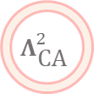



LINK #1
$$P_{ABC}^{Original}\left(abc\right)=P_{A^{1}BC}^{Inflation}\left(abc\right)$$
Original Graph
Inflation Graph
$${ A}_{}^{2}$$
$$Λ_{\text{CA}}^{2}$$
$${ A}_{}^{}$$
$${ A}_{}^{1}$$
$$Λ_{\text{AB}}^{}$$
$$Λ_{\text{CA}}^{}$$
$$Λ_{\text{AB}}^{}$$
$$Λ_{\text{CA}}^{1}$$
$${ B}_{}^{}$$
$$Λ_{\text{BC}}^{}$$
$${ C}_{}^{}$$
$${ B}_{}^{}$$
$$Λ_{\text{BC}}^{}$$
$${ C}_{}^{}$$

Slide 37





LINK #2
$$P_{A}^{Original}\left(a\right)P_{C}^{Original}\left(c\right)=P_{A^{2}C}^{Inflation}\left(ac\right)$$
Original Graph
Inflation Graph
$${ A}_{}^{2}$$
$$Λ_{\text{CA}}^{2}$$
$${ A}_{}^{}$$
$${ A}_{}^{1}$$
$$Λ_{\text{AB}}^{}$$
$$Λ_{\text{CA}}^{}$$
$$Λ_{\text{AB}}^{}$$
$$Λ_{\text{CA}}^{1}$$
$${ B}_{}^{}$$
$$Λ_{\text{BC}}^{}$$
$${ C}_{}^{}$$
$${ B}_{}^{}$$
$$Λ_{\text{BC}}^{}$$
$${ C}_{}^{}$$

Slide 38






SYMMETRY CONSTRAINT
$$P_{A^{1}A^{2}B}^{Inflation}\left(a^{1}a^{2}b\right)=P_{A^{1}A^{2}B}^{Inflation}\left(a^{1}a^{2}b\right)$$
Inflation Graph
Subgraph Automorphism
$${ A}_{}^{2}$$
$$Λ_{\text{CA}}^{2}$$
$${ A}_{}^{1}$$
$$Λ_{\text{CA}}^{1}$$
$${ A}_{}^{1}$$
$${ A}_{}^{2}$$
$$Λ_{\text{AB}}^{}$$
$$Λ_{\text{CA}}^{1}$$
$$Λ_{\text{AB}}^{}$$
$$Λ_{\text{CA}}^{2}$$
$${ B}_{}^{}$$
$$Λ_{\text{BC}}^{}$$
$${ C}_{}^{}$$
$${ B}_{}^{}$$
$$Λ_{\text{BC}}^{}$$

Slide 39
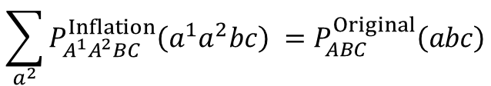

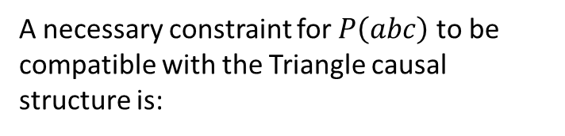
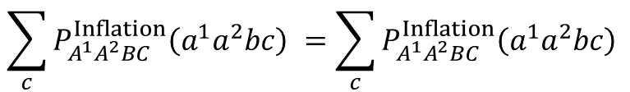
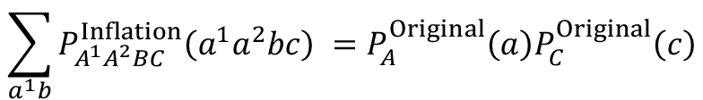
Links + Symmetry = Linear Program
A necessary constraint for $P\left(abc\right)$ to be compatible with the Triangle causal structure is:
$${ A}_{}^{2}$$
$$Λ_{\text{CA}}^{2}$$
${∃ P}_{A^{1}A^{2}BC}^{Inflation}\left(a^{1}a^{2}bc\right)$ such that
$${ A}_{}^{1}$$
1.
$$\sum_{a^{2}}{P_{A^{1}A^{2}BC}^{Inflation}\left(a^{1}a^{2}bc\right) }=P_{ABC}^{Original}\left(abc\right)$$
$$Λ_{\text{AB}}^{}$$
$$Λ_{\text{CA}}^{1}$$
2.
$$\sum_{a^{1}b}{P_{A^{1}A^{2}BC}^{Inflation}\left(a^{1}a^{2}bc\right) }=P_{A}^{Original}\left(a\right)P_{C}^{Original}\left(c\right)$$
$${ B}_{}^{}$$
$$Λ_{\text{BC}}^{}$$
$${ C}_{}^{}$$
3.
$$\sum_{c}{P_{A^{1}A^{2}BC}^{Inflation}\left(a^{1}a^{2}bc\right) }=\sum_{c}{P_{A^{1}A^{2}BC}^{Inflation}\left(a^{1}a^{2}bc\right) }$$

Slide 40

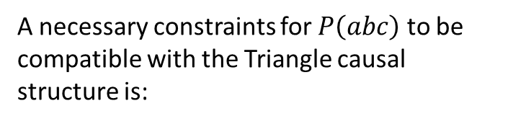

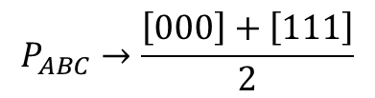

Implied Inequalities…
A necessary constraints for $P\left(abc\right)$ to be compatible with the Triangle causal structure is:
$P_{AB}\left(00\right)+P_{BC}\left(00\right)≤P_{B}\left(0\right)+P_{A}\left(0\right)$ $P_{C}\left(0\right)$
$${ A}_{}^{}$$
$$Λ_{\text{AB}}^{}$$
$$Λ_{\text{CA}}^{}$$
$$P_{ABC}→\frac{\left[000\right]+\left[111\right]}{2}$$
$${ B}_{}^{}$$
$$Λ_{\text{BC}}^{}$$
$${ C}_{}^{}$$
No perfect correlation!

Slide 41
Is it violable?
Does the derivation of the inequality
hold for the triangle scenario with quantum sources?
$P_{AB}\left(00\right)+P_{BC}\left(00\right)≤P_{B}\left(0\right)+P_{A}\left(0\right)$ $P_{C}\left(0\right)$

Slide 42












Is it violable?
QUESTION: Can we repeat the same argument with quantum sources?
Original Graph
?? Inflation Graph
$${ A}_{}^{2}$$
$$Ψ_{\text{CA}}^{2}$$
$${ A}_{}^{}$$
$${ A}_{}^{1}$$
$$Ψ_{\text{AB}}^{}$$
$$Ψ_{\text{CA}}^{}$$
$$Ψ_{\text{AB}}^{}$$
$$Ψ_{\text{CA}}^{1}$$
$${ B}_{}^{}$$
$$Ψ_{\text{BC}}^{}$$
$${ C}_{}^{}$$
$${ B}_{}^{}$$
$$Ψ_{\text{BC}}^{}$$
$${ C}_{}^{}$$

Slide 43
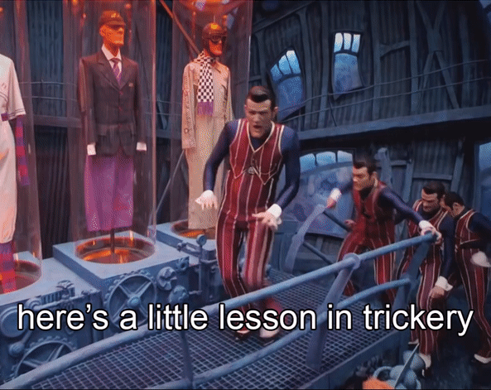

Slide 44
No Broadcasting Theorem
ANSWER: No, because we can’t broadcast a quantum state!
Original Graph
?? Inflation Graph
$${ A}_{}^{2}$$
$$Ψ_{\text{CA}}^{2}$$
$${ A}_{}^{}$$
$${ A}_{}^{1}$$
$$Ψ_{\text{AB}}^{}$$
$$Ψ_{\text{CA}}^{}$$
$$Ψ_{\text{AB}}^{}$$
$$Ψ_{\text{CA}}^{1}$$
$${ B}_{}^{}$$
$$Ψ_{\text{BC}}^{}$$
$${ C}_{}^{}$$
$${ B}_{}^{}$$
$$Ψ_{\text{BC}}^{}$$
$${ C}_{}^{}$$

Slide 45

The inflation method can’t fail…
… if you don’t broadcast any state…

Slide 46









Non-Fanout Inflations = GPT valid arguments
Original Graph
GPT Inflation Graph
$$A$$
$$A$$
$$B$$
$$C$$
$$Ψ_{\text{AB}}^{}$$
$$Ψ_{\text{CA}}^{}$$
$$Ψ_{\text{CA}}^{2}$$
$$Ψ_{\text{AB}}^{}$$
$$Ψ_{\text{BC}}^{}$$
$$Ψ_{\text{CA}}^{1}$$
$$B$$
$$Ψ_{\text{BC}}^{}$$
$$C$$
GPT means “Generalized Probability Theory”; basically, it means any nonclassical physical theory, including quantum theory.

Slide 47








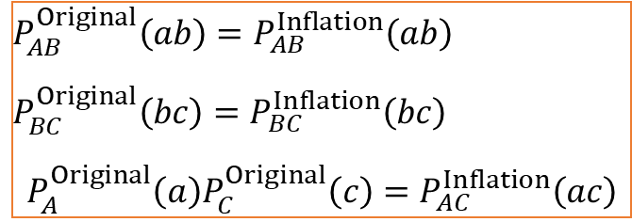
Links w/o symmetry constraints still powerful!
Original Graph
GPT Inflation Graph
$$A$$
$$A$$
$$B$$
$$C$$
$$Ψ_{\text{AB}}^{}$$
$$Ψ_{\text{CA}}^{}$$
$$Ψ_{\text{CA}}^{2}$$
$$Ψ_{\text{AB}}^{}$$
$$Ψ_{\text{BC}}^{}$$
$$Ψ_{\text{CA}}^{1}$$
$$B$$
$$Ψ_{\text{BC}}^{}$$
$$C$$
$$P_{AB}^{Original}\left(ab\right)=P_{AB}^{Inflation}\left(ab\right)$$
$$P_{BC}^{Original}\left(bc\right)=P_{BC}^{Inflation}\left(bc\right)$$
$$P_{A}^{Original}\left(a\right)P_{C}^{Original}\left(c\right)=P_{AC}^{Inflation}\left(ac\right)$$
3 LINKS

Slide 48

Links w/o symmetry constraints still powerful!
Original Graph
GPT Inflation Graph
$$A$$
$$A$$
$$B$$
$$C$$
$$Ψ_{\text{AB}}^{}$$
$$Ψ_{\text{CA}}^{}$$
$$Ψ_{\text{CA}}^{2}$$
$$Ψ_{\text{AB}}^{}$$
$$Ψ_{\text{BC}}^{}$$
$$Ψ_{\text{CA}}^{1}$$
$$B$$
$$Ψ_{\text{BC}}^{}$$
$$C$$
$$P_{AB}^{Original}\left(ab\right)=P_{AB}^{Inflation}\left(ab\right)$$
$$P_{BC}^{Original}\left(bc\right)=P_{BC}^{Inflation}\left(bc\right)$$
$$P_{A}^{Original}\left(a\right)P_{C}^{Original}\left(c\right)=P_{AC}^{Inflation}\left(ac\right)$$
3 LINKS

Slide 49
Links w/o symmetry constraints still powerful!
Original Graph
GPT Inflation Graph
$$A$$
$$A$$
$$B$$
$$C$$
$$Ψ_{\text{AB}}^{}$$
$$Ψ_{\text{CA}}^{}$$
$$Ψ_{\text{CA}}^{2}$$
$$Ψ_{\text{AB}}^{}$$
$$Ψ_{\text{BC}}^{}$$
$$Ψ_{\text{CA}}^{1}$$
$$B$$
$$Ψ_{\text{BC}}^{}$$
$$C$$
$$P_{AB}^{Original}\left(ab\right)=P_{AB}^{Inflation}\left(ab\right)$$
$$P_{BC}^{Original}\left(bc\right)=P_{BC}^{Inflation}\left(bc\right)$$
$$P_{A}^{Original}\left(a\right)P_{C}^{Original}\left(c\right)=P_{AC}^{Inflation}\left(ac\right)$$
3 LINKS
0 SYMMETRY CONSTRAINTS

Slide 50



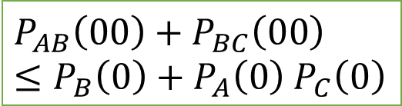



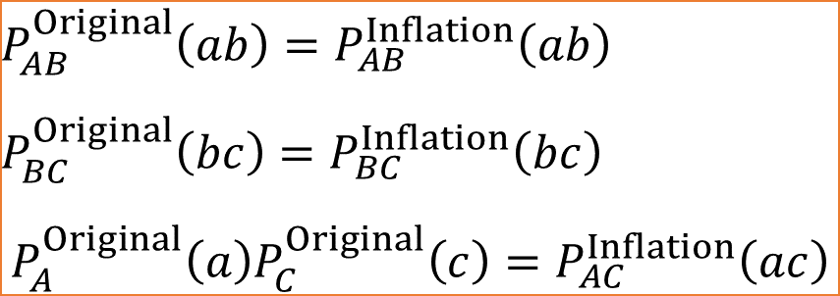
Constraint recovered without broadcasting
Original Graph
GPT Inflation Graph
$${ A}_{}^{}$$
$${ A}_{}^{}$$
$${ B}_{}^{}$$
$${ C}_{}^{}$$
$$Ψ_{\text{AB}}^{}$$
$$Ψ_{\text{CA}}^{}$$
$$Ψ_{\text{CA}}^{2}$$
$$Ψ_{\text{AB}}^{}$$
$$Ψ_{\text{BC}}^{}$$
$$Ψ_{\text{CA}}^{1}$$
$${ B}_{}^{}$$
$$Ψ_{\text{BC}}^{}$$
$${ C}_{}^{}$$
3 LINKS
$$P_{AB}^{Original}\left(ab\right)=P_{AB}^{Inflation}\left(ab\right)$$
$$P_{BC}^{Original}\left(bc\right)=P_{BC}^{Inflation}\left(bc\right)$$
$$P_{A}^{Original}\left(a\right)P_{C}^{Original}\left(c\right)=P_{AC}^{Inflation}\left(ac\right)$$
$$P_{AB}\left(00\right)+P_{BC}\left(00\right)$$
$≤P_{B}\left(0\right)+P_{A}\left(0\right)$ $P_{C}\left(0\right)$

Slide 51
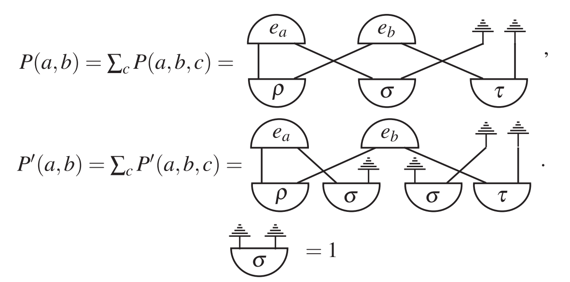
Henson Lal & Pusey arXiv:1405.2572

Slide 52










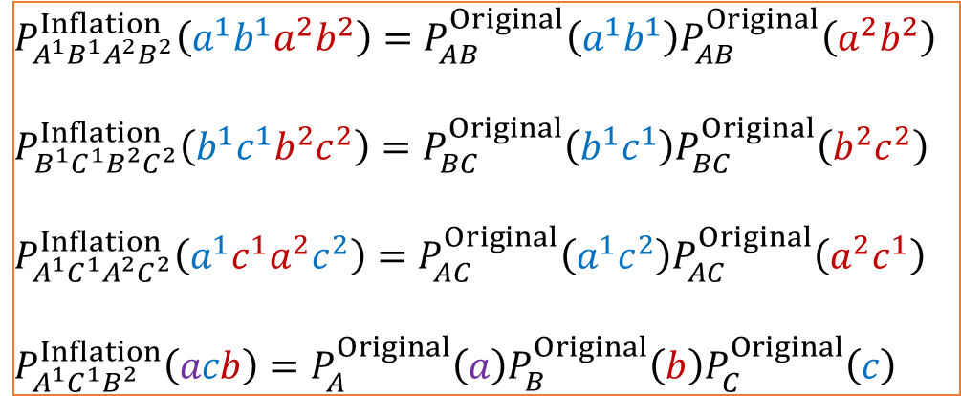
Creative Non-Fanout: The Ring
4 LINKS
$$Ψ_{\text{CA}}^{2}$$
$${ C}_{}^{2}$$
$${ A}_{}^{1}$$
$$P_{A^{1}B^{1}A^{2}B^{2}}^{Inflation}\left(a^{1}b^{1}a^{2}b^{2}\right)=P_{AB}^{Original}\left(a^{1}b^{1}\right)P_{AB}^{Original}\left(a^{2}b^{2}\right)$$
$$P_{B^{1}C^{1}B^{2}C^{2}}^{Inflation}\left(b^{1}c^{1}b^{2}c^{2}\right)=P_{BC}^{Original}\left(b^{1}c^{1}\right)P_{BC}^{Original}\left(b^{2}c^{2}\right)$$
$$P_{A^{1}C^{1}A^{2}C^{2}}^{Inflation}\left(a^{1}c^{1}a^{2}c^{2}\right)=P_{AC}^{Original}\left(a^{1}c^{2}\right)P_{AC}^{Original}\left(a^{2}c^{1}\right)$$
$$P_{A^{1}C^{1}B^{2}}^{Inflation}\left(acb\right)=P_{A}^{Original}\left(a\right)P_{B}^{Original}\left(b\right)P_{C}^{Original}\left(c\right)$$
$$Ψ_{\text{BC}}^{2}$$
$$Ψ_{\text{AB}}^{1}$$
$${ B}_{}^{2}$$
$${ B}_{}^{1}$$
$$Ψ_{\text{AB}}^{2}$$
$$Ψ_{\text{BC}}^{1}$$
$${ A}_{}^{2}$$
$${ C}_{}^{1}$$
$$Ψ_{\text{CA}}^{1}$$
Cyclic symmetry
1 SYMMETRY CONSTRAINT
$$P_{A^{1}B^{1}C^{1}A^{2}B^{2}C^{2}}^{Inflation}\left(a^{1}b^{1}c^{1}a^{2}b^{2}c^{2}\right)=P_{A^{1}B^{1}C^{1}A^{2}B^{2}C^{2}}^{Inflation}\left(a^{2}b^{2}c^{2}a^{1}b^{1}c^{1}\right)$$

Slide 53
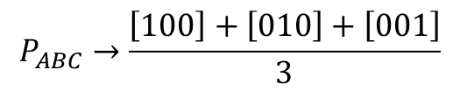
Creative Non-Fanout: The Ring
$$Ψ_{\text{CA}}^{2}$$
$${ C}_{}^{2}$$
$${ A}_{}^{1}$$
$$Ψ_{\text{BC}}^{2}$$
$$Ψ_{\text{AB}}^{1}$$
$$P_{ABC}→\frac{\left[100\right]+\left[010\right]+\left[001\right]}{3}$$
$${ B}_{}^{2}$$
$${ B}_{}^{1}$$
$$Ψ_{\text{AB}}^{2}$$
$$Ψ_{\text{BC}}^{1}$$
$${ A}_{}^{2}$$
$${ C}_{}^{1}$$
No “W”-like distribution!
$$Ψ_{\text{CA}}^{1}$$

Slide 54



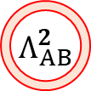
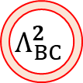






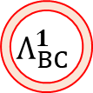






Creative Fanout: The Web
$${ A}_{}^{22}$$
$${ A}_{}^{12}$$
$$Λ_{CA}^{2}$$
$${ Λ}_{AB}^{2}$$
$${ A}_{}^{21}$$
$$Λ_{CA}^{1}$$
$$Λ_{AB}^{1}$$
$${ A}_{}^{11}$$
$${ C}_{}^{11}$$
$${ B}_{}^{11}$$
$${ C}_{}^{21}$$
$${ B}_{}^{21}$$
$${ C}_{}^{12}$$
$${ B}_{}^{12}$$
$$Λ_{BC}^{1}$$
$${ C}_{}^{12}$$
$${ B}_{}^{22}$$
$$Λ_{BC}^{2}$$

Slide 55
Other causal structures: Unpacking versus Interrupting

Slide 56
Instrumental Scenario
X
A
B
Λ
$$P\left(a\text{=}b | x\text{=}0\right)+P\left(b\text{=}0 | x\text{=}1\right)+P\left(a\text{=}0,b\text{=}1 | x\text{=}2\right)≤\left\{\begin{matrix}2 & \text{Classical} \\ \left(3+\sqrt{2}\right)/2 & \text{Quantum} \\ 5/2 & \text{GPT}\end{matrix}\right.$$
This inequalities witness a gap
$$P\left(a\text{=}0,b\text{=}0 | x\text{=}0\right)+P\left(a\text{=}0,b\text{=}1 | x\text{=}1\right)≤\left\{\begin{matrix}1 & \text{Classical} \\ 1 & \text{Quantum} \\ 1 & \text{GPT}\end{matrix}\right.$$
This inequalities is nonviolable

Slide 57





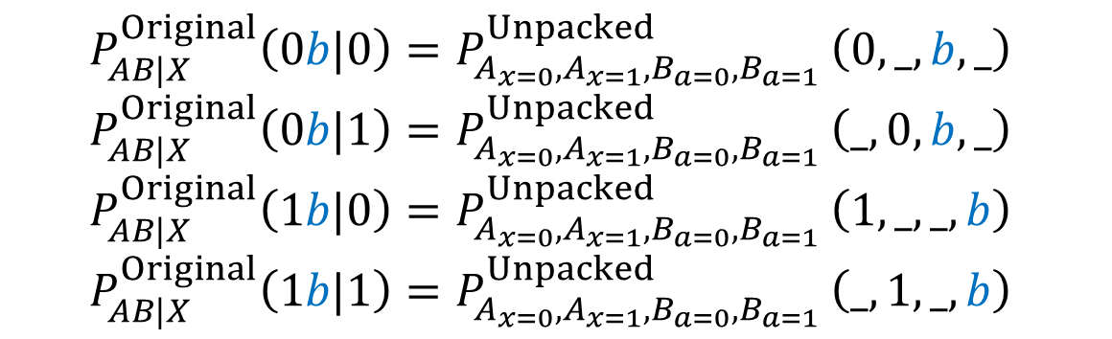

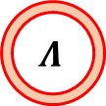
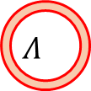

Instrumental Scenario (Unpacking)
Original Graph
$$A_{x=0}^{}$$
$$B_{a=0}^{}$$
$$A$$
$$B$$
$$Λ_{}^{}$$
Unpacked Graph
$$X$$
$$Λ$$
$$A_{x=1}^{}$$
$$B_{a=1}^{}$$
$$P_{AB|X}^{Original}\left(0b|0\right)=P_{A_{x=0},A_{x=1},B_{a=0},B_{a=1} }^{Unpacked}\left(0,_,b,_\right)$$
$$P_{AB|X}^{Original}\left(0b|1\right)=P_{A_{x=0},A_{x=1},B_{a=0},B_{a=1} }^{Unpacked}\left(_,0,b,_\right)$$
$$P_{AB|X}^{Original}\left(1b|0\right)=P_{A_{x=0},A_{x=1},B_{a=0},B_{a=1} }^{Unpacked}\left(1,_,_,b\right)$$
$$P_{AB|X}^{Original}\left(1b|1\right)=P_{A_{x=0},A_{x=1},B_{a=0},B_{a=1} }^{Unpacked}\left(_,1,_,b\right)$$

Slide 58
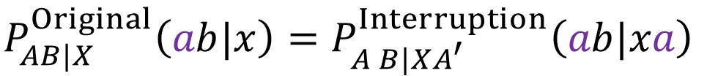
Instrumental Scenario (Interruption)
Original Graph
Interruption Graph
X
A
B
X
A
A’
B
Λ
Λ
Evans: “Graphical methods for inequality constraints in marginalized DAGs” arXiv:1209.2978
$$P_{AB|X}^{Original}\left(ab|x\right)=P_{A B|XA^{′}}^{Interruption}\left(ab|xa\right)$$

Slide 59
Instrumental Scenario (Interruption)
Original Graph
Interruption Graph
X
A
B
X
A
A’
B
$$Ψ_{\text{AB}}^{}$$
$$Ψ_{\text{AB}}^{}$$
Henson, Lal, & Pusey: “Theory-independent limits on correlations from generalised Bayesian networks” arXiv:1405.2572
Quantum-valid Argument
$$P_{AB|X}^{Original}\left(ab|x\right)=P_{A B|XA^{′}}^{Interruption}\left(ab|xa\right)$$

Slide 60
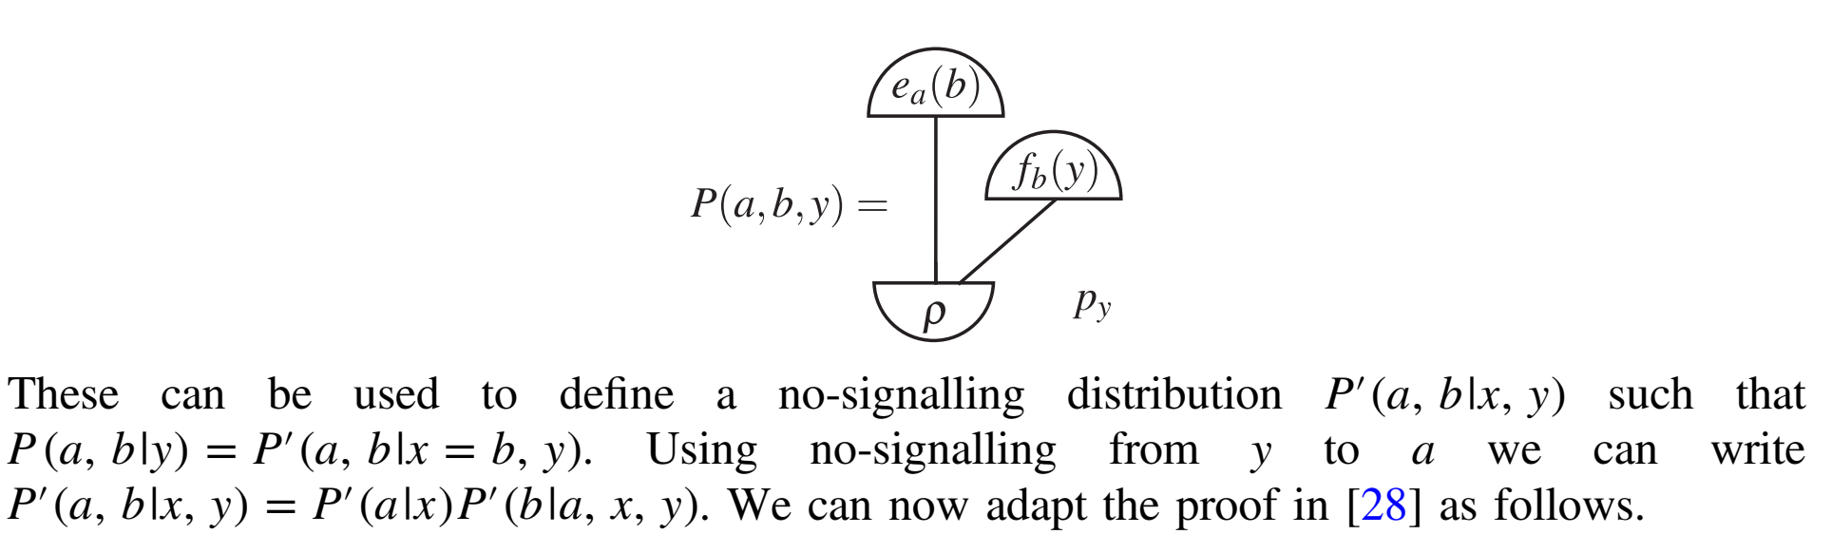
Henson Lal & Pusey arXiv:1405.2572

Slide 61










Bell Scenario (Unpacking)
$$A$$
$$B$$
$$A_{x=0}$$
$$A_{x=1}$$
$$B_{y=0}$$
$$B_{y=1}$$
$$Λ$$
Λ
$$X$$
$$Y$$
$$P_{AB|XY}^{Original}\left(ab|00\right)=P_{A_{x=0},A_{x=1},B_{y=0},B_{y=1} }^{Unpacked}\left(a,_,b,_\right)$$
$$P_{AB|XY}^{Original}\left(ab|01\right)=P_{A_{x=0},A_{x=1},B_{y=0},B_{y=1} }^{Unpacked}\left(a,_,_,b\right)$$
$$P_{AB|XY}^{Original}\left(ab|10\right)=P_{A_{x=0},A_{x=1},B_{y=0},B_{y=1} }^{Unpacked}\left(_,a,b,_\right)$$
$$P_{AB|XY}^{Original}\left(ab|11\right)=P_{A_{x=0},A_{x=1},B_{y=0},B_{y=1} }^{Unpacked}\left(_,a,_,b\right)$$
Bell’s Theorem!

Slide 62













Biconfounding Scenario (Unpacking)
Original Graph
Unpacked Graph
$$A_{b=1}^{}$$
$$C_{b=1}^{}$$
$$A$$
$$C$$
$$B$$
$$A_{b=0}^{}$$
$$B$$
$$C_{b=0}^{}$$
$$Λ_{AB}^{}$$
$$Λ_{BC}^{}$$
$$Λ_{AB}^{}$$
$$Λ_{BC}^{}$$
$$P_{ABC}^{Original}\left(a0c\right)=P_{A_{b=0},A_{b=1},B,C_{b=0},C_{b=1} }^{Unpacked}\left(a,_,0,c,_\right)$$
$$P_{ABC}^{Original}\left(a1c\right)=P_{A_{b=0},A_{b=1},B,C_{b=0},C_{b=1}}^{Unpacked}\left(0,a,1,_,c\right)$$

Slide 63





Biconfounding Scenario (Interruption)
$$B′$$
$$B′′$$
$$A$$
$$C$$
$$B$$
$$A$$
$$B$$
$$C$$
$$Ψ_{\text{AB}}^{}$$
$$Ψ_{\text{BC}}^{}$$
$$Ψ_{\text{AB}}^{}$$
$$Ψ_{\text{BC}}^{}$$
$$P_{ABC}^{Original}\left(abc\right)=P_{ABC|B^{′}B^{′′}}^{Interruption}\left(abc|bb\right)$$
$$P_{ABC}^{}\left(000\right)P_{ABC}^{}\left(101\right)+1≤{\left(1−P_{ABC}^{}\left(000\right)\right)}^{2}+{\left(1−P_{ABC}^{}\left(101\right)\right)}^{2}$$

Slide 64













Biconfounding Scenario (Unpacking+Inflation)
Unpacked Graph (Condensed Notation)
Inflation of Unpacked Graph
$$A$$
$$C$$
$$B$$
$$A_{}^{1}$$
$$B_{}^{1}$$
$$C_{}^{1}$$
$$Λ_{AB}^{}$$
$$Λ_{BC}^{}$$
$$Λ_{AB}^{1}$$
$$Λ_{BC}^{1}$$
$$B_{}^{2}$$
$$P_{A^{1}B^{1}C^{1}}^{Inflation}\left(ab|xy\right)=P_{ABC}^{Unpacked}\left(abc\right)$$
$$Λ_{AB}^{2}$$
$$B_{}^{3}$$
$$Λ_{BC}^{2}$$
$$P_{A^{1}A^{2}B^{1}B^{2}B^{3}B^{4}C^{1}C^{2}}^{Inflation}\left(a^{1}a^{2}b^{1}b^{2}b^{3}b^{4}c^{1}c^{2}\right)$$
$$=P_{A^{1}A^{2}B^{1}B^{2}B^{3}B^{4}C^{1}C^{2}}^{Inflation}\left(a^{2}{a^{1}b}^{3}b^{4}b^{1}b^{2}c^{1}c^{2}\right)$$
$$P_{A^{1}A^{2}B^{1}B^{2}B^{3}B^{4}C^{1}C^{2}}^{Inflation}\left(a^{1}a^{2}b^{1}b^{2}b^{3}b^{4}c^{1}c^{2}\right)$$
$$=P_{A^{1}A^{2}B^{1}B^{2}B^{3}B^{4}C^{1}C^{2}}^{Inflation}\left(a^{1}a^{2}b^{2}b^{1}b^{4}b^{3}c^{2}c^{1}\right)$$
$$A_{}^{2}$$
$$B_{}^{4}$$
$$C_{}^{2}$$

Slide 65

Classical Causal Inference Recommendation
UNPACKING
INFLATION with broadcasting
If $P$passes every inflation test of $G$, then $P$is compatible with $G$!
Navascues & EW: “The Inflation Technique Completely Solves the Classical Inference Problem” arXiv:1707.06476

Slide 66
GPT Causal Inference Recommendation
INTERRUPTION
INFLATION without broadcasting
(For any given causal structure there exists a well-defined hierarchy of broadcast-free inflations.)

Slide 67
Recap
Thus far, the constraints are either just classically valid or GPT-valid.
What about quantum-specific constraints… ?

Slide 68
Quantum Causal Inference Recommendation
INTERRUPTION
QUANTUM INFLATION
Beyond the scope of this talk, defined in terms of Semidefinite Programming
EW et. al.: “Quantum Inflation: A General Approach to Quantum Causal Compatibility” arXiv:1909.10519

Slide 69


Observational Equivalence
Sometimes different causal structures admit the same distributions
A
B
C
A
B
C
X
A
B
X
A
B
Λ
$$Λ_{XA}^{}$$
$$Λ_{AB}^{}$$

Slide 70


Exogenization: precursor to canonical form
Latent variables can pass forward any incoming information (side channels)
Y
X
A
B
X
A
B
Y
$$Λ$$
$$Λ$$
B
C
B
C
A
Λ_{BC}
A
Λ_{AS}
Λ_{ABC}
X
Y
S
Z
X
Y
S
Z

Slide 71




No quantum (or GPT) exogenization!
B
C
B
C
A
$$Ψ_{\text{BC}}^{}$$
A
$$Ψ_{\text{AS}}^{}$$
$$Ψ_{\text{ABC}}^{}$$
X
Y
S
Z
X
Y
S
Z
$$P\left(A,B | X,Y,S\text{=0}\right) \text{can} \text{maximally} \text{violate} \text{the} \text{A}\text{−}\text{B} \text{Bell} \text{inequality}$$
$$P\left(A,B | X,Y,S\text{=}\text{1}\right) \text{can} \text{maximally} \text{violate} \text{the} \text{B}\text{−}\text{C} \text{Bell} \text{inequality}$$
$$\text{Monogomy} \text{of} \text{nonlocality}\text{!}$$

Slide 72
GPT Correlations = Generalization of No-Signalling
“Enveloping Theory” – (Future Proof)
Beyond Bell scenarios, the GPT distributions are constrained by both equalities and inequalities.
The GPT-valid inequalities offer fundamental insight into causality in a nonclassical world.

Slide 73
What is genuinely multipartite, in terms of causal modelling?

Slide 74

Genuine Multipartite Entanglement Definition
$$k\text{−}\text{Partiteness}\left(ρ_{ABC}\right)≤2 \text{if} \text{and} \text{only} \text{if}$$
$$ρ_{ABC}= w_{1}\sum_{λ_{1}}{\left.\left|Ψ_{AB}^{λ_{1}}\right.\right\rangle \left\langle \left.Ψ_{AB}^{λ_{1}}\right|\right.⊗\left.\left|Ψ_{C}^{λ_{1}}\right.\right\rangle \left\langle \left.Ψ_{C}^{λ_{1}}\right|\right.P_{1}\left(λ_{1}\right)} =w_{1} ρ_{AB|C}$$
$$+w_{2}\sum_{λ_{2}}{\left.\left|Ψ_{AC}^{λ_{2}}\right.\right\rangle \left\langle \left.Ψ_{AC}^{λ_{2}}\right|\right.⊗\left.\left|Ψ_{B}^{λ_{2}}\right.\right\rangle \left\langle \left.Ψ_{A}^{λ_{2}}\right|\right.P_{2}\left(λ_{2}\right)} +w_{2} ρ_{AC|B}$$
$$+w_{3}\sum_{λ_{3}}{\left.\left|Ψ_{BC}^{λ_{3}}\right.\right\rangle \left\langle \left.Ψ_{BC}^{λ_{3}}\right|\right.⊗\left.\left|Ψ_{A}^{λ_{3}}\right.\right\rangle \left\langle \left.Ψ_{A}^{λ_{3}}\right|\right.P_{3}\left(λ_{3}\right) +w_{1} ρ_{BC|A} }$$
$$\text{where}{ w}_{i}≥0 \text{and} w_{1}+w_{2}+w_{3}=1$$

Slide 75

Multipartiteness is unstable under Composition
A B C
$$\frac{\left.\left|00\right.\right\rangle +\left.\left|1\right.1\right\rangle }{\sqrt{2}}$$
Isn’t that a bit silly?
This three-party qubit-quarted-qubit state is genuinely 3-partite entangled.

Slide 76

Genuine Multipartite Nonlocality Definition
$$k\text{−}\text{Partiteness}\left(P_{ABC|XYZ}\right)≤2 \text{if} \text{and} \text{only} \text{if}$$
$$P\left(abc | xyz\right)=w_{1}\sum_{λ_{1}}{P_{1}\left(ab | xyλ_{1}\right)P_{1}\left(c | zλ_{1}\right)P_{1}\left(λ_{1}\right)}$$
$$+w_{2}\sum_{λ_{2}}{P_{2}\left(bc | yzλ_{2}\right)P_{2}\left(a | xλ_{2}\right)P_{2}\left(λ_{2}\right)}$$
$$+w_{3}\sum_{λ_{3}}{P_{3}\left(ac | xzλ_{3}\right)P_{3}\left(b | yλ_{3}\right)P_{3}\left(λ_{3}\right)}$$
$$\text{where}{ w}_{i}≥0 \text{and} w_{1}+w_{2}+w_{3}=1$$

Slide 77

Multipartiteness is unstable under Composition
A B C
$$\begin{matrix} & \begin{matrix}\text{x}\text{=0,}\text{a}\text{=0} \\ \text{x}\text{=0,}\text{a}\text{=1}\end{matrix} & \begin{matrix}\text{x}\text{=1,}\text{a}\text{=0} \\ \text{x}\text{=1,}\text{a}\text{=1}\end{matrix} \\ \begin{matrix}\text{y}\text{=0,}\text{b}\text{=0} \\ \text{y}\text{=0,}\text{b}\text{=1}\end{matrix} & \left(\begin{matrix}0.4 & 0.1 \\ 0.1 & 0.4\end{matrix}\right) & \left(\begin{matrix}0.4 & 0.1 \\ 0.1 & 0.4\end{matrix}\right) \\ \begin{matrix}\text{y}\text{=1,}\text{b}\text{=0} \\ \text{y}\text{=1,}\text{b}\text{=1}\end{matrix} & \left(\begin{matrix}0.4 & 0.1 \\ 0.1 & 0.4\end{matrix}\right) & \left(\begin{matrix}0.1 & 0.4 \\ 0.4 & 0.1\end{matrix}\right)\end{matrix}$$
Also awkward, but consistent!
This three-party [(22)(4444)(22)] correlation is genuinely 3-partite nonlocal.

Slide 78

LOSR vs LOCC
If classical communication is free, the teleportation is possible.
Three pairs of singlets can be transformed into the GHZ state with classical communication.
Historically, teleportation was a primary task, so LOCC was the appropriate paradigm. But…
Bell’s Theorem / QKD / RNG: only shared randomness is free!
$$\text{GHZ} \text{State}=\frac{\left.\left|000\right.\right\rangle +\left.\left|1\right.11\right\rangle }{\sqrt{2}}$$
Schmid, Fraser, Kunjwal, Sainz, EW, Spekkens:
“Why standard entanglement theory is inappropriate for the study of Bell scenarios” arXiv:2004.09194

Slide 79
LOCC Entanglement vs LOSR Entanglement
Hardy’s correlation can only be realized using a partially-entangled state.
How can more entanglement fail where less entanglement succeeds??!
Answer: It all comes down to the free operations.
“more” and “less” entangled are artifacts of LOCC terminology.
There are many classes of free operations. LOSR, LOCC, SEP…

Slide 80

Genuine Network Multipartite Entanglement
$$k\text{−}\text{Network}\text{Partiteness}\left(ρ_{ABC…}\right)>k$$
$$\text{if} \text{and} \text{only} \text{if}$$
$$ρ_{ABC…} \text{cannot} \text{be} \text{produced}$$
$$\text{by} \text{a} \text{faithful} \text{causal} \text{structure} \text{involving} \text{only} k\text{−}\text{way} \text{quantum} \text{sources}\text{.}$$
Navascues, EW, Rosset, Pozas-Kerstjens: “Genuine Network Multipartite Entanglement” arXiv:2002.02773
Related: Kraft et. al.: “Quantum entanglement in the triangle network” arXiv:2002.03970

Slide 81




Not Genuinely Network Multipartite Entangled
$$Ψ_{\text{BC}}^{}$$
$$A$$
$$Ψ_{\text{AB}}^{}$$
$$Λ$$
Hybrid graph:
2-way quantum sources supplemented with 3-way classical shared randomness
$$C$$
$$B$$
$$Ψ_{\text{BC}}^{}$$

Slide 82


Triangle-Producible Quantum States
A
B
C
ρ_{AC}
ε_{A}
ε_{B}
ε_{C}
ρ_{AB}
$$Λ$$
ρ_{AC}
$$k\text{−}\text{NetworkPartiteness}\left(ρ_{ABC…}\right)≤2$$
$$\text{if} \text{and} \text{only} \text{if}{ ρ}_{ABC} \text{can} \text{be} \text{realized} \text{by}$$

Slide 83















Ring Inflation for Triangle Producible States
4 SEP (PPT) conditions
$$Ψ_{\text{CA}}^{1}$$
3 LINK conditions
$${ C}_{}^{2}$$
$${ A}_{}^{1}$$
$$ρ_{A^{1}B^{1}A^{2}B^{2}}^{Inflation}=ρ_{A^{1}B^{1}|A^{2}B^{2}}^{Inflation}$$
$$ρ_{B^{1}C^{1}B^{2}C^{2}}^{Inflation}=ρ_{B^{1}C^{1}|B^{2}C^{2}}^{Inflation}$$
$$ρ_{A^{1}C^{1}A^{2}C^{2}}^{Inflation}=ρ_{A^{1}C^{2}|A^{2}C^{1}}^{Inflation}$$
$$ρ_{A^{1}C^{1}B^{2}}^{Inflation}=ρ_{A^{1}{|C}^{1}|B^{2}}^{Inflation}$$
$$Ψ_{\text{BC}}^{2}$$
$$ρ_{A^{1}B^{1}}^{Inflation}=ρ_{AB}^{Original}$$
$$ρ_{B^{1}C^{1}}^{Inflation}=ρ_{BC}^{Original}$$
$$ρ_{C^{1}A^{2}}^{Inflation}=ρ_{CA}^{Original}$$
$$Ψ_{\text{AB}}^{1}$$
$${ B}_{}^{2}$$
$$Λ$$
$${ B}_{}^{1}$$
$$Ψ_{\text{AB}}^{2}$$
$$Ψ_{\text{BC}}^{1}$$
$${ A}_{}^{2}$$
$${ C}_{}^{1}$$
$$Ψ_{\text{CA}}^{2}$$
Cyclic symmetry
1 SYMMETRY CONSTRAINT
$$ρ_{A^{1}B^{1}C^{1}A^{2}B^{2}C^{2}}^{Inflation}\left(a^{1}b^{1}c^{1}a^{2}b^{2}c^{2}\right)=ρ_{A^{1}B^{1}C^{1}A^{2}B^{2}C^{2}}^{Inflation}\left(a^{2}b^{2}c^{2}a^{1}b^{1}c^{1}\right)$$

Slide 84

Genuine Multipartite Nonlocality Definition
$$k\text{−}\text{Partiteness}\left(P_{ABC|XYZ}\right)≤2 \text{if} \text{and} \text{only} \text{if}$$
$$P\left(abc | xyz\right)=w_{1}\sum_{λ_{1}}{P_{1}\left(ab | xyλ_{1}\right)P_{1}\left(c | zλ_{1}\right)P_{1}\left(λ_{1}\right)}$$
$$+w_{2}\sum_{λ_{2}}{P_{2}\left(bc | yzλ_{2}\right)P_{2}\left(a | xλ_{2}\right)P_{2}\left(λ_{2}\right)}$$
$$+w_{3}\sum_{λ_{3}}{P_{3}\left(ac | xzλ_{3}\right)P_{3}\left(b | yλ_{3}\right)P_{3}\left(λ_{3}\right)}$$
$$\text{where}{ w}_{i}≥0 \text{and} w_{1}+w_{2}+w_{3}=1$$

Slide 85


Svetlichny’s Inequality
Svetlichny “Distinguishing three-body from two-body nonseparability by a Bell-type inequality” 10.1103/PhysRevD.35.3066
$$+\left\langle A_{0}B_{0}C_{0}\right\rangle \\ +\left\langle A_{0}B_{0}C_{1}\right\rangle \\ +\left\langle A_{0}B_{1}C_{0}\right\rangle \\ +\left\langle A_{1}B_{0}C_{0}\right\rangle \\ −\left\langle A_{0}B_{1}C_{1}\right\rangle \\ −\left\langle A_{1}B_{1}C_{0}\right\rangle \\ −\left\langle A_{1}B_{0}C_{1}\right\rangle$$
$$−\left\langle A_{1}B_{1}C_{1}\right\rangle \\ ≤4$$
Captures the probability that the tripartite parity coincides with the majority setting.
Maximum value of $4$ if $k\text{−}\text{Partiteness}$< 3.
Maximum value of $8$ in general no-signaling theories
Maximum value of $4\sqrt{2}$ in QM, achieved by sharing a tripartite entangled state, i.e. a 3-way resource.

Slide 86

Genuine Network Multipartite Nonlocality
$$k\text{−}\text{NetworkPartiteness}\left(P_{ABC|XYZ}\right)>2$$
$$\text{if} \text{and} \text{only} \text{if}$$
$$P_{ABC|XYZ} \text{cannot} \text{be} \text{realized}$$
$$\text{by} \text{a} \text{causal} \text{structure} \text{involving} \text{only} k\text{−}\text{way} \text{sources}\text{.}$$
no-signalling
GPT
quantum
EW et. al.: “Bell Quantified: The Resource Theory of Nonclassicality of Common-Cause Boxes” arXiv:1903.06311
Barrett et. al.: “Non-local correlations as an information theoretic resource” quant-ph/0404097
Barrett & Pironio: “Popescu-Rohrlich correlations as a unit of nonlocality” quant-ph/0506180
Chao & Reichardt: “Test to separate quantum theory from non-signaling theories” arXiv:1706.02008
Anshu & Mhalla: “Pseudo-telepathy games and genuine NS k-way nonlocality using graph states” arXiv:1207.2276
************Add Citation******

Slide 87










Nonlocal Width ≤ 2
$$X$$
$${NS}_{AC}$$
$${NS}_{AB}$$
$$A$$
$$Λ$$
$$C$$
$$B$$
$$Z$$
$$Y$$
$${NS}_{BC}$$

Slide 88
Violating Svetlichny’s Inequality with 3 PR boxes
X
COPY
PR-BOX
PR-BOX
XOR
A
B
C
XOR
XOR
PR-BOX
COPY
COPY
Y
Z

Slide 89

Quantum Width (causal proposal)
$$\text{QuantumWidth}\left(P_{ABC|XYZ}\right)>k$$
$$\text{if} \text{and} \text{only} \text{if}$$
$$P_{ABC|XYZ} \text{cannot} \text{be} \text{realized}$$
$$\text{by} \text{a} \text{faithful}\text{∗} \text{causal} \text{structure} \text{involving} \text{only} \text{k}\text{−}\text{way} \text{quantum} \text{sources}\text{.}$$
*faithful meaning not fine tuned, i.e., no causal influences between the wings.
(Resource Theory of the Nonclassicality of Common Causes)
EW et. al.: “Bell Quantified: The Resource Theory of Nonclassicality of Common-Cause Boxes” arXiv:1903.06311

Slide 90







Not Genuinely Network Multipartite Nonlocal
$$X$$
$$Ψ_{\text{CA}}^{}$$
$$A$$
$$Ψ_{\text{AB}}^{}$$
$$Λ$$
$$C$$
$$B$$
$$Z$$
$$Y$$
$$Ψ_{\text{BC}}^{}$$
Acknowledgement to Rob Spekkens & Daniel Brod for clearly articulating hybrid causal structures to me.

Slide 91
Quantum Width ≠ Nonlocality Width ?
Quantum Width allows for quantum sources, and fully general measurements employed at each site.
No-signaling boxes cannot be used for entanglements swapping (no analog of entangled measurements).
Sometimes the Quantum Width of a correlation is strictly less than the Nonlocality Width (NS-box sources)…
Skrzypczyk, Brunner, & Popescu: “Emergence of Quantum Correlations from Non-Locality Swapping” arXiv:0811.2937

Slide 92
















Ring Inflation for Triangle Producible Correlations
$${ Z}_{}^{2}$$
$${ X}_{}^{1}$$
$$Ψ_{\text{CA}}^{1}$$
$${ C}_{}^{2}$$
$${ A}_{}^{1}$$
$$Ψ_{\text{BC}}^{2}$$
$$Ψ_{\text{AB}}^{1}$$
$${ Y}_{}^{2}$$
$${ B}_{}^{2}$$
$$Λ$$
$${ B}_{}^{1}$$
$${ Y}_{}^{1}$$
$$Ψ_{\text{AB}}^{2}$$
$$Ψ_{\text{BC}}^{1}$$
$${ A}_{}^{2}$$
$${ C}_{}^{1}$$
$$Ψ_{\text{CA}}^{2}$$
$${ X}_{}^{2}$$
$${ Z}_{}^{1}$$

Slide 93

Genuine Network Multipartite Nonlocality
GHZ-Mermin pseudotelepathy game
Quantum correlation of
$$\left\langle A_{0}B_{0}C_{1}\right\rangle =\left\langle A_{0}B_{1}C_{0}\right\rangle =\left\langle A_{1}B_{0}C_{0}\right\rangle =−\left\langle A_{1}B_{1}C_{1}\right\rangle =1$$
Quantum realization requires genuine network entanglement, but this correlation can alternatively be realized by wiring PR-boxes together.
$$\left\langle A_{0}B_{0}\right\rangle =1, \left\langle A_{1}B_{1}C_{0}\right\rangle =−\left\langle A_{1}B_{1}C_{1}\right\rangle =\frac{\sqrt{2}}{2}$$
$$\left\langle A_{0}C_{0}\right\rangle =\left\langle A_{0}C_{1}\right\rangle =\left\langle B_{0}C_{0}\right\rangle =\left\langle B_{0}C_{1}\right\rangle =\frac{\sqrt{2}}{2}$$
This correlation requires genuine network entanglement to realize, even allowing for unlimited (beyond quantum) bipartite nonlocality.

Slide 94
Causality Research Summary
The different operational predictions of quantum common causes versus classical common causes is a reflection of the different properties of quantum information versus classical information
Find new forms of nonclassical statistics, beyond Bell’s Theorem
Concepts regarding Bell inequalities can be generalized for other causal problems
Notes:
Note that since HLP, only major advancement is better classical constraining, and slightly better GPT constraints

Slide 95


Automated Diagnosis
[TWEAK IMAGE of Disease model]
In medical diagnosis, a doctor wants to determine the disease causing the symptoms
If a disease causes the symptoms, then treating the disease will reduce the symptoms
Notes:
Ciaran was recruited because of his causal expertise. And his research within Babylon is about what sorts of algorithms will be good for automated diagnoses.

Slide 96
REMINDERS: Take Away Lessons
Classical and quantum causal structures differ in their predictions only in terms of inequality constraints (unpublished)
E. Wolfe et. al. developed techniques to characterize both classical and quantum correlations in arbitrary causal scenarios
Causal approach suggests new concepts of genuine network multipartite entanglement and nonlocality
Research in quantum causal inference encourages students to explore novel ideas at the forefront of data science.
Notes:
Note that since HLP, only major advancement is better classical constraining, and slightly better GPT constraints

Slide 97
Entropic Approach
There are efficient techniques to find entropic inequalities implied by classical causal structures.
There exists a technique to find entropic inequalities implied by quantum causal structures.
But it is presently unclear how to generate violable entropic inequalities.
Weilenmann & Colbeck: “Analysing causal structures with entropy” arXiv:1709.08988
Mikin et. al.: “The entropic approach to causal correlations” arXiv:1706.10270
Chaves, Majenz, & Gross: “Information-Theoretic Implications of Quantum Causal Structures” arXiv:1407.3800

Slide 98
Links for Further Reading
Intro to Inflation Technique
arXiv:1609.00672
Quantum Inflation
arXiv:1909.10519
On LOSR vs LOCC
arXiv:2004.09194
Genuine Network Multipartite Entanglement
arXiv:2002.02773

Slide 99



Water Consumption
Exercise
Health

