Slide 1
Superconducting Radiofrequency research and development at TRIUMF and UVic
Tobias Junginger, Aveen Mahon, Daniel Hedji, Lucas Wallace, Noah Gorgichuk, Oliver Kester, Philipp Kolb, Robert Edward Laxdal, Rogério de Sousa, Ryan McFadden, William Stokes, Md Asaduzzman, Edward Thoeng

Slide 2
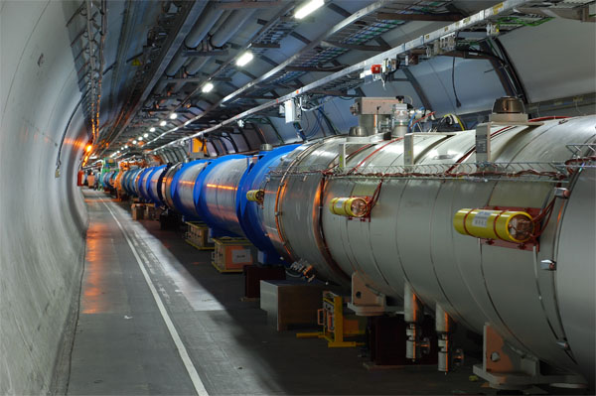
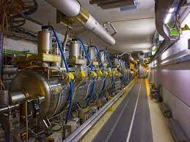
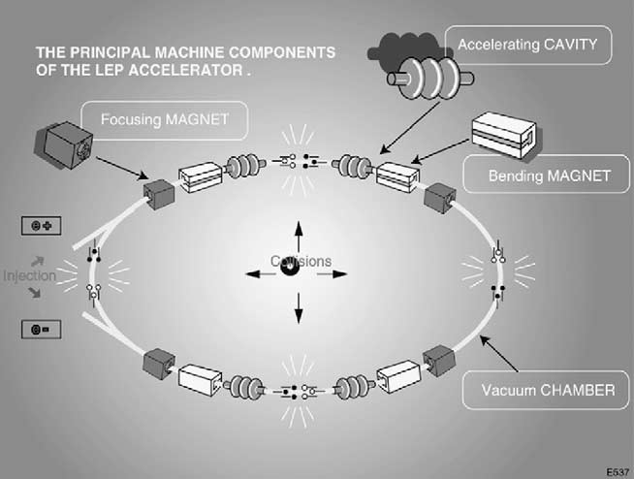
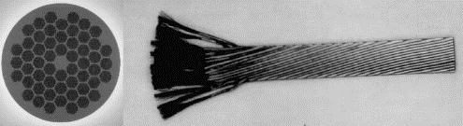
Superconductivity for accelerators
Bending Magnets of the LHC
Superconducting Radiofrequency (SRF) cavities of the LHC
Cross section of wire with
NbTi filaments in a copper matrix
Particle accelerators use superconductors to steer and increase the energy of charged particles

Slide 3



Particle Acceleration with cavities
1. Acceleration with radiofrequency cavities requires synchronization of particles and RF field. Outside of the cavity the approaching particle bunch does not experience the RF field
beam direction
Particle bunch
E
H
2. The particle bunch enters the cavity. The electric field is pointing in the direction of the beam axis → The particle is accelerated
beam direction
Particle bunch
E
H
3. The particle bunch leaves the cavity. The field direction has changed again
beam direction
E
Cavities are used to accelerate particles by an alternating electric field
An oscillating electric field causes an oscillating magnetic field
The cavity confines the electromagnetic fields by surface shielding currents
These currents create losses (heating), which can be reduced by using superconducting materials
H
Particle bunch
Why is niobium the material choice which requires costly helium cooling?
Faraday's law of induction: $∇×H=ε_{0}\frac{∂E}{∂t}$
$$\text{Amp}\text{è}\text{re}\text{′}\text{s} \text{l}aw: ∇×H=J$$
Ohm‘s law: $J$=σE

Slide 4
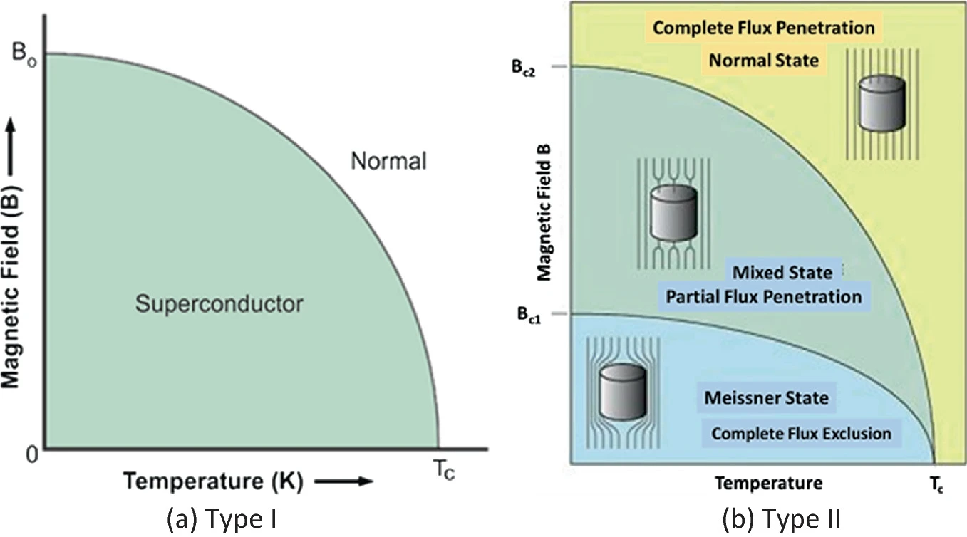
Two types of superconductors
A type II superconductor can split into normal and superconducting areas to lower its energy
Magnetic fields partially enters into the normal conducting areas in the form of flux tubes
Under DC fields flux tubes can be pinned –> no dissipation
  SC magnets are operated between B_{c1} and B_{c2}
Under RF fields flux tubes oscillate –> strong dissipation
  RF cavities are operated in the Meissner state
  For defect free surfaces the Meissner state can persist metastable up the superheating field H_{sh}
B_{c}
Material | Lead | Nb | NbTi | Nb3Sn
B_{c}[T] | 0.07 | 0.2 | 0.2 | 0.52
B_{c1}[T] | - | 0.17 | 0.01 | 0.05
B_{c2}[T] | - | 0.24 | 11 | 28
B_{sh}[T] | 0.08 | 0.24 | 0.16 | 0.44

Slide 5
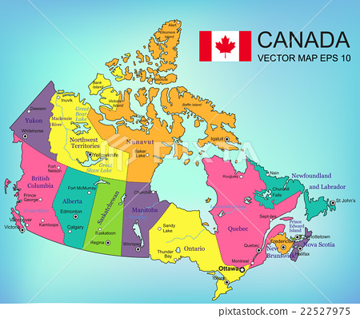
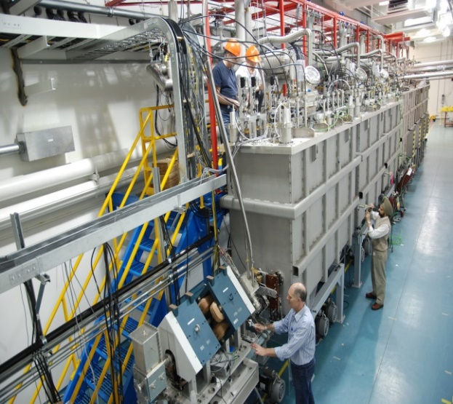
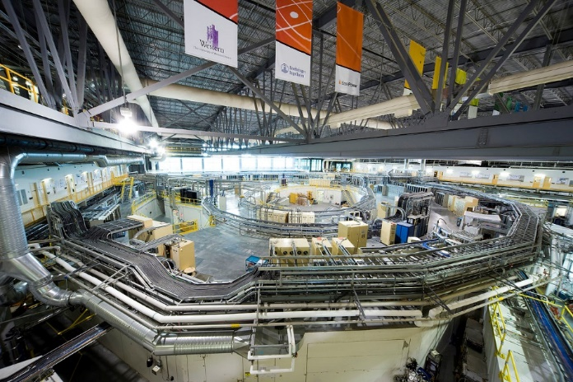
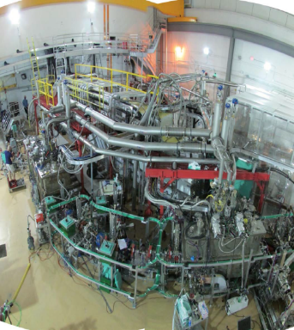
SRF Accelerators in Canada
TRIUMF
Canadian Light Source
ISAC-II
ARIEL e-linac

Slide 6
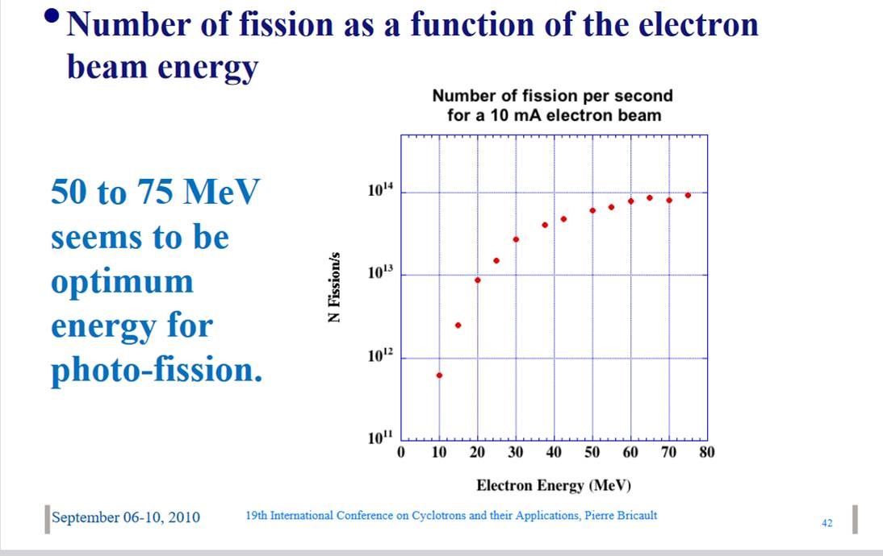
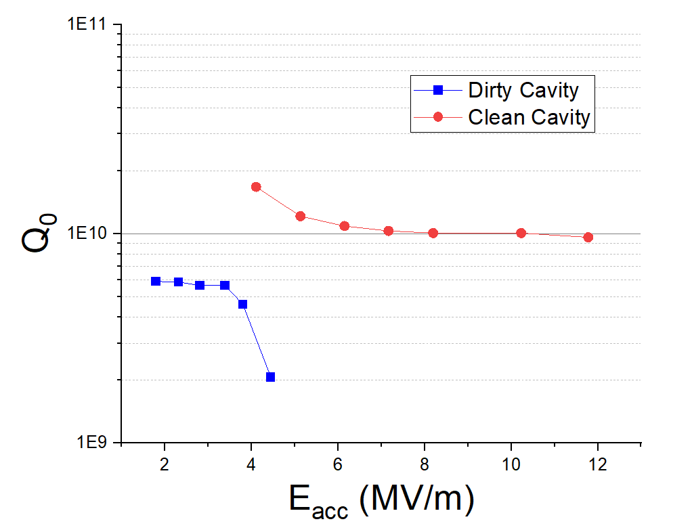
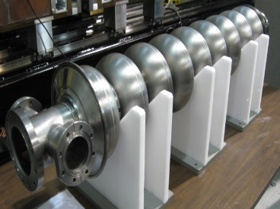
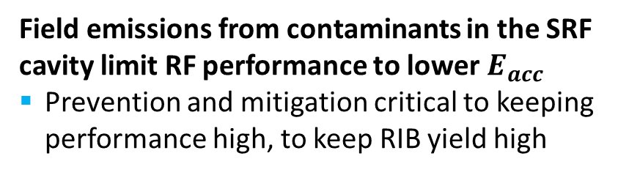


TRIUMF ARIEL e-LINAC - Reliable 30MeV Operation
Stable 30MeV operation is critical for Radioactive Ion Beam (RIB) production:
RIB yield is strongly dependent on beam energy
TRIUMF is operating at 30MeV (3 cavities each delivering 10 MV/m) – at the lower end of the yield curve
Field emissions from contaminants in the SRF cavity limit RF performance to lower $E_{acc}$
Prevention and mitigation critical to keeping performance high, to keep RIB yield high
Clean cavity reaches $E_{acc}>10 MV/m$
Field Emission limits performance to $E_{acc}≈ 4MV/m$

Slide 7

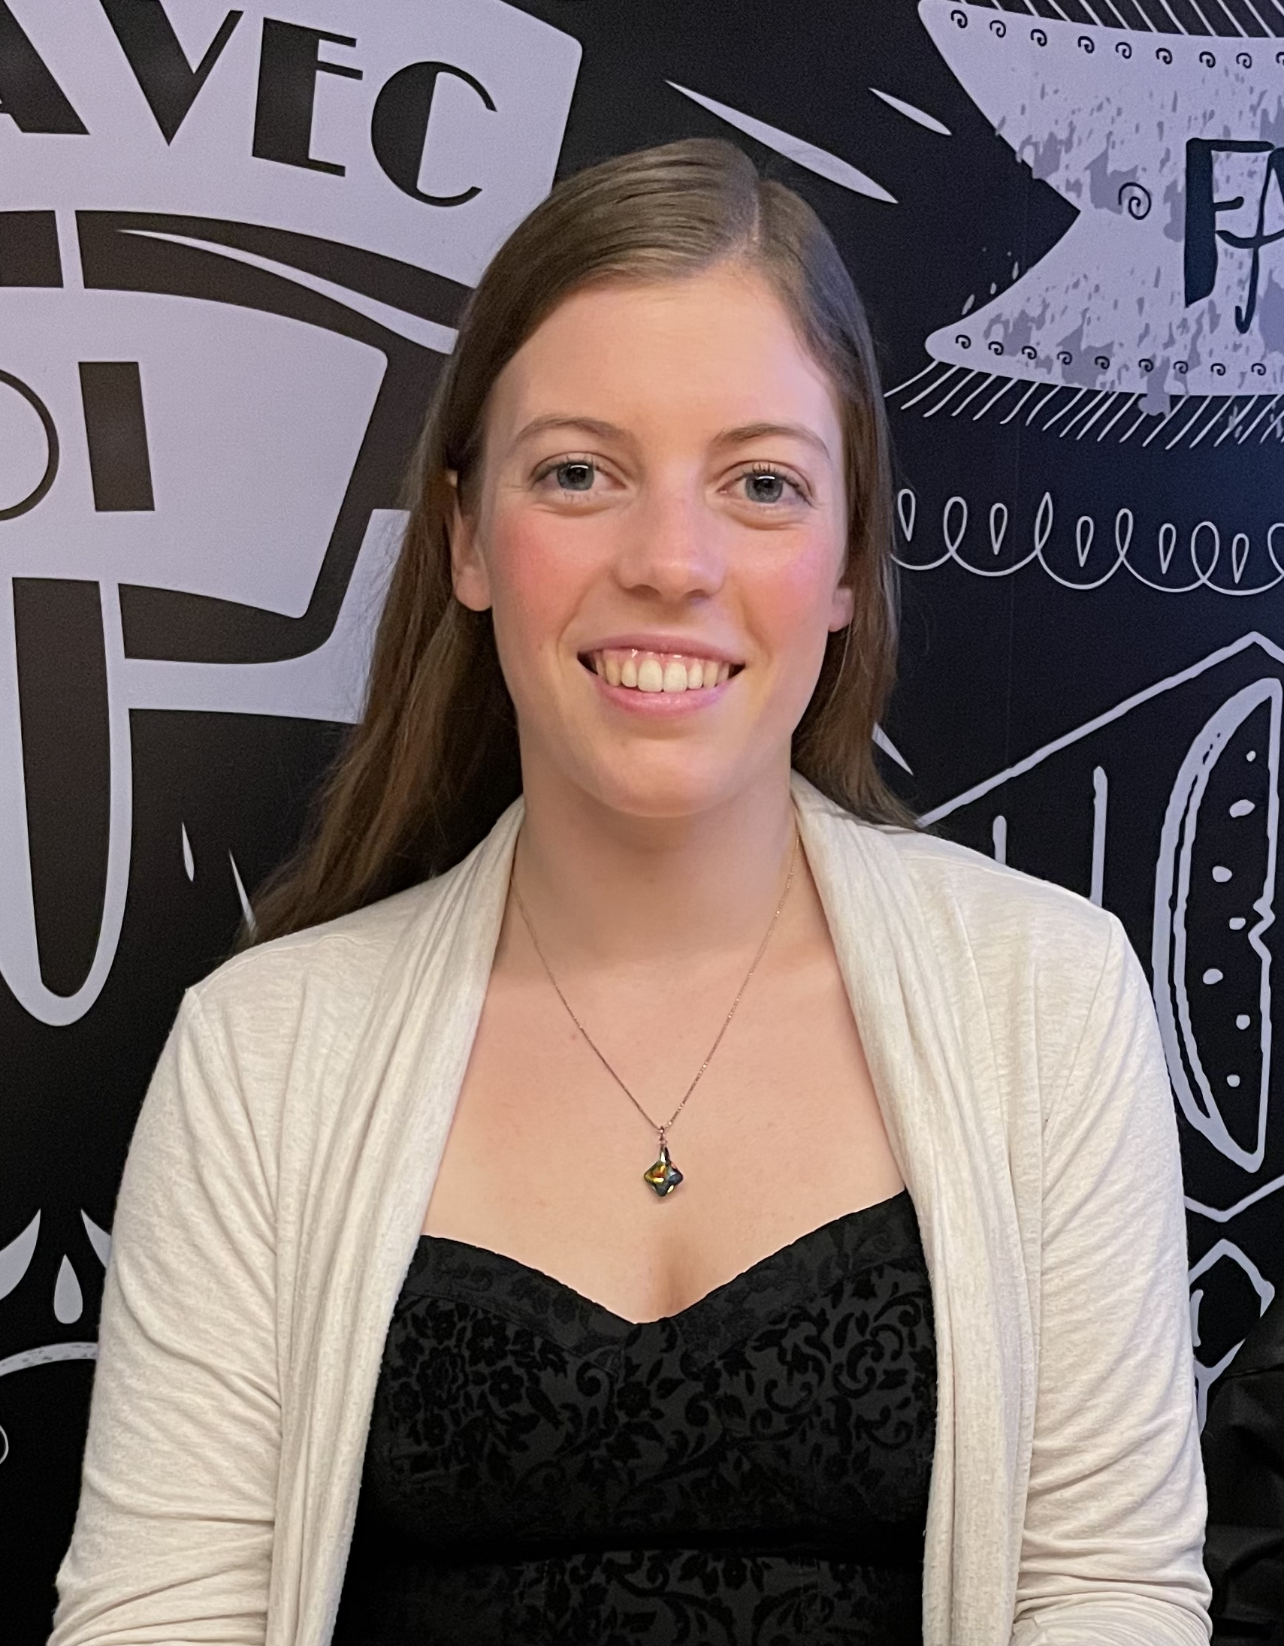
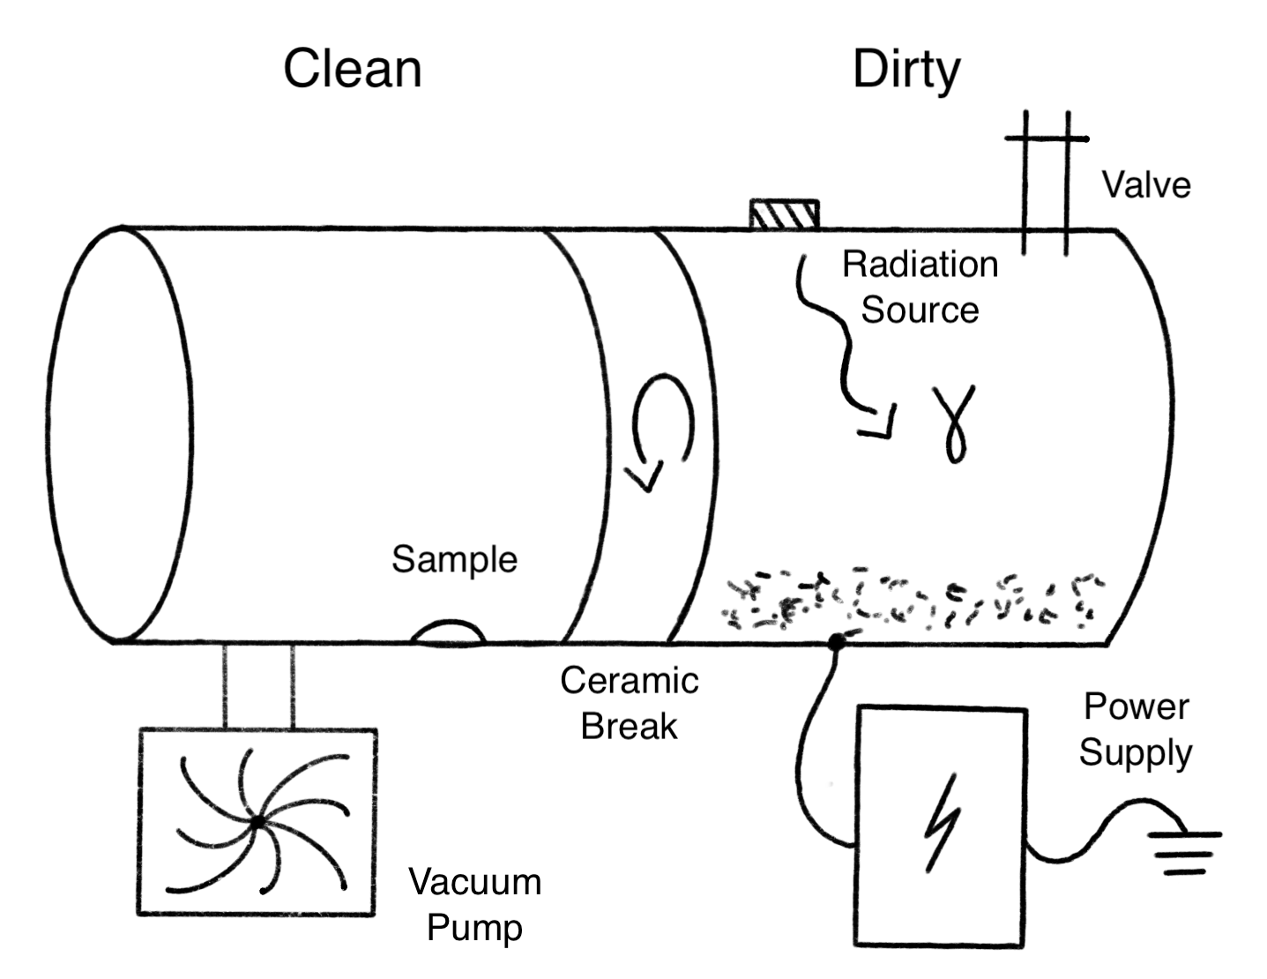
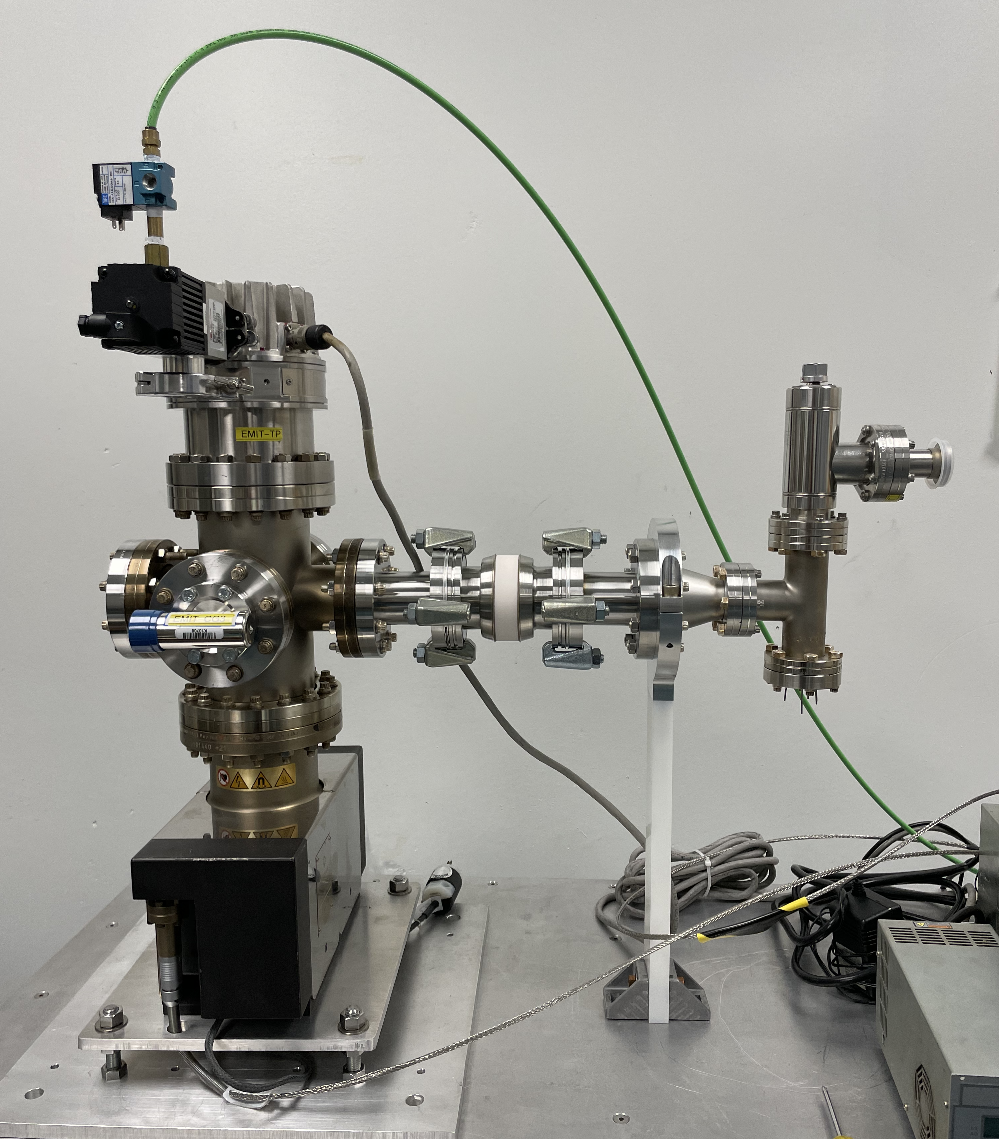
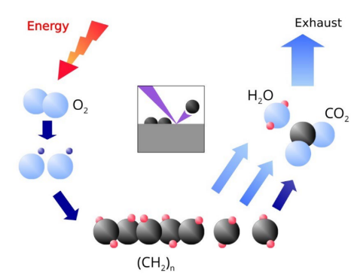
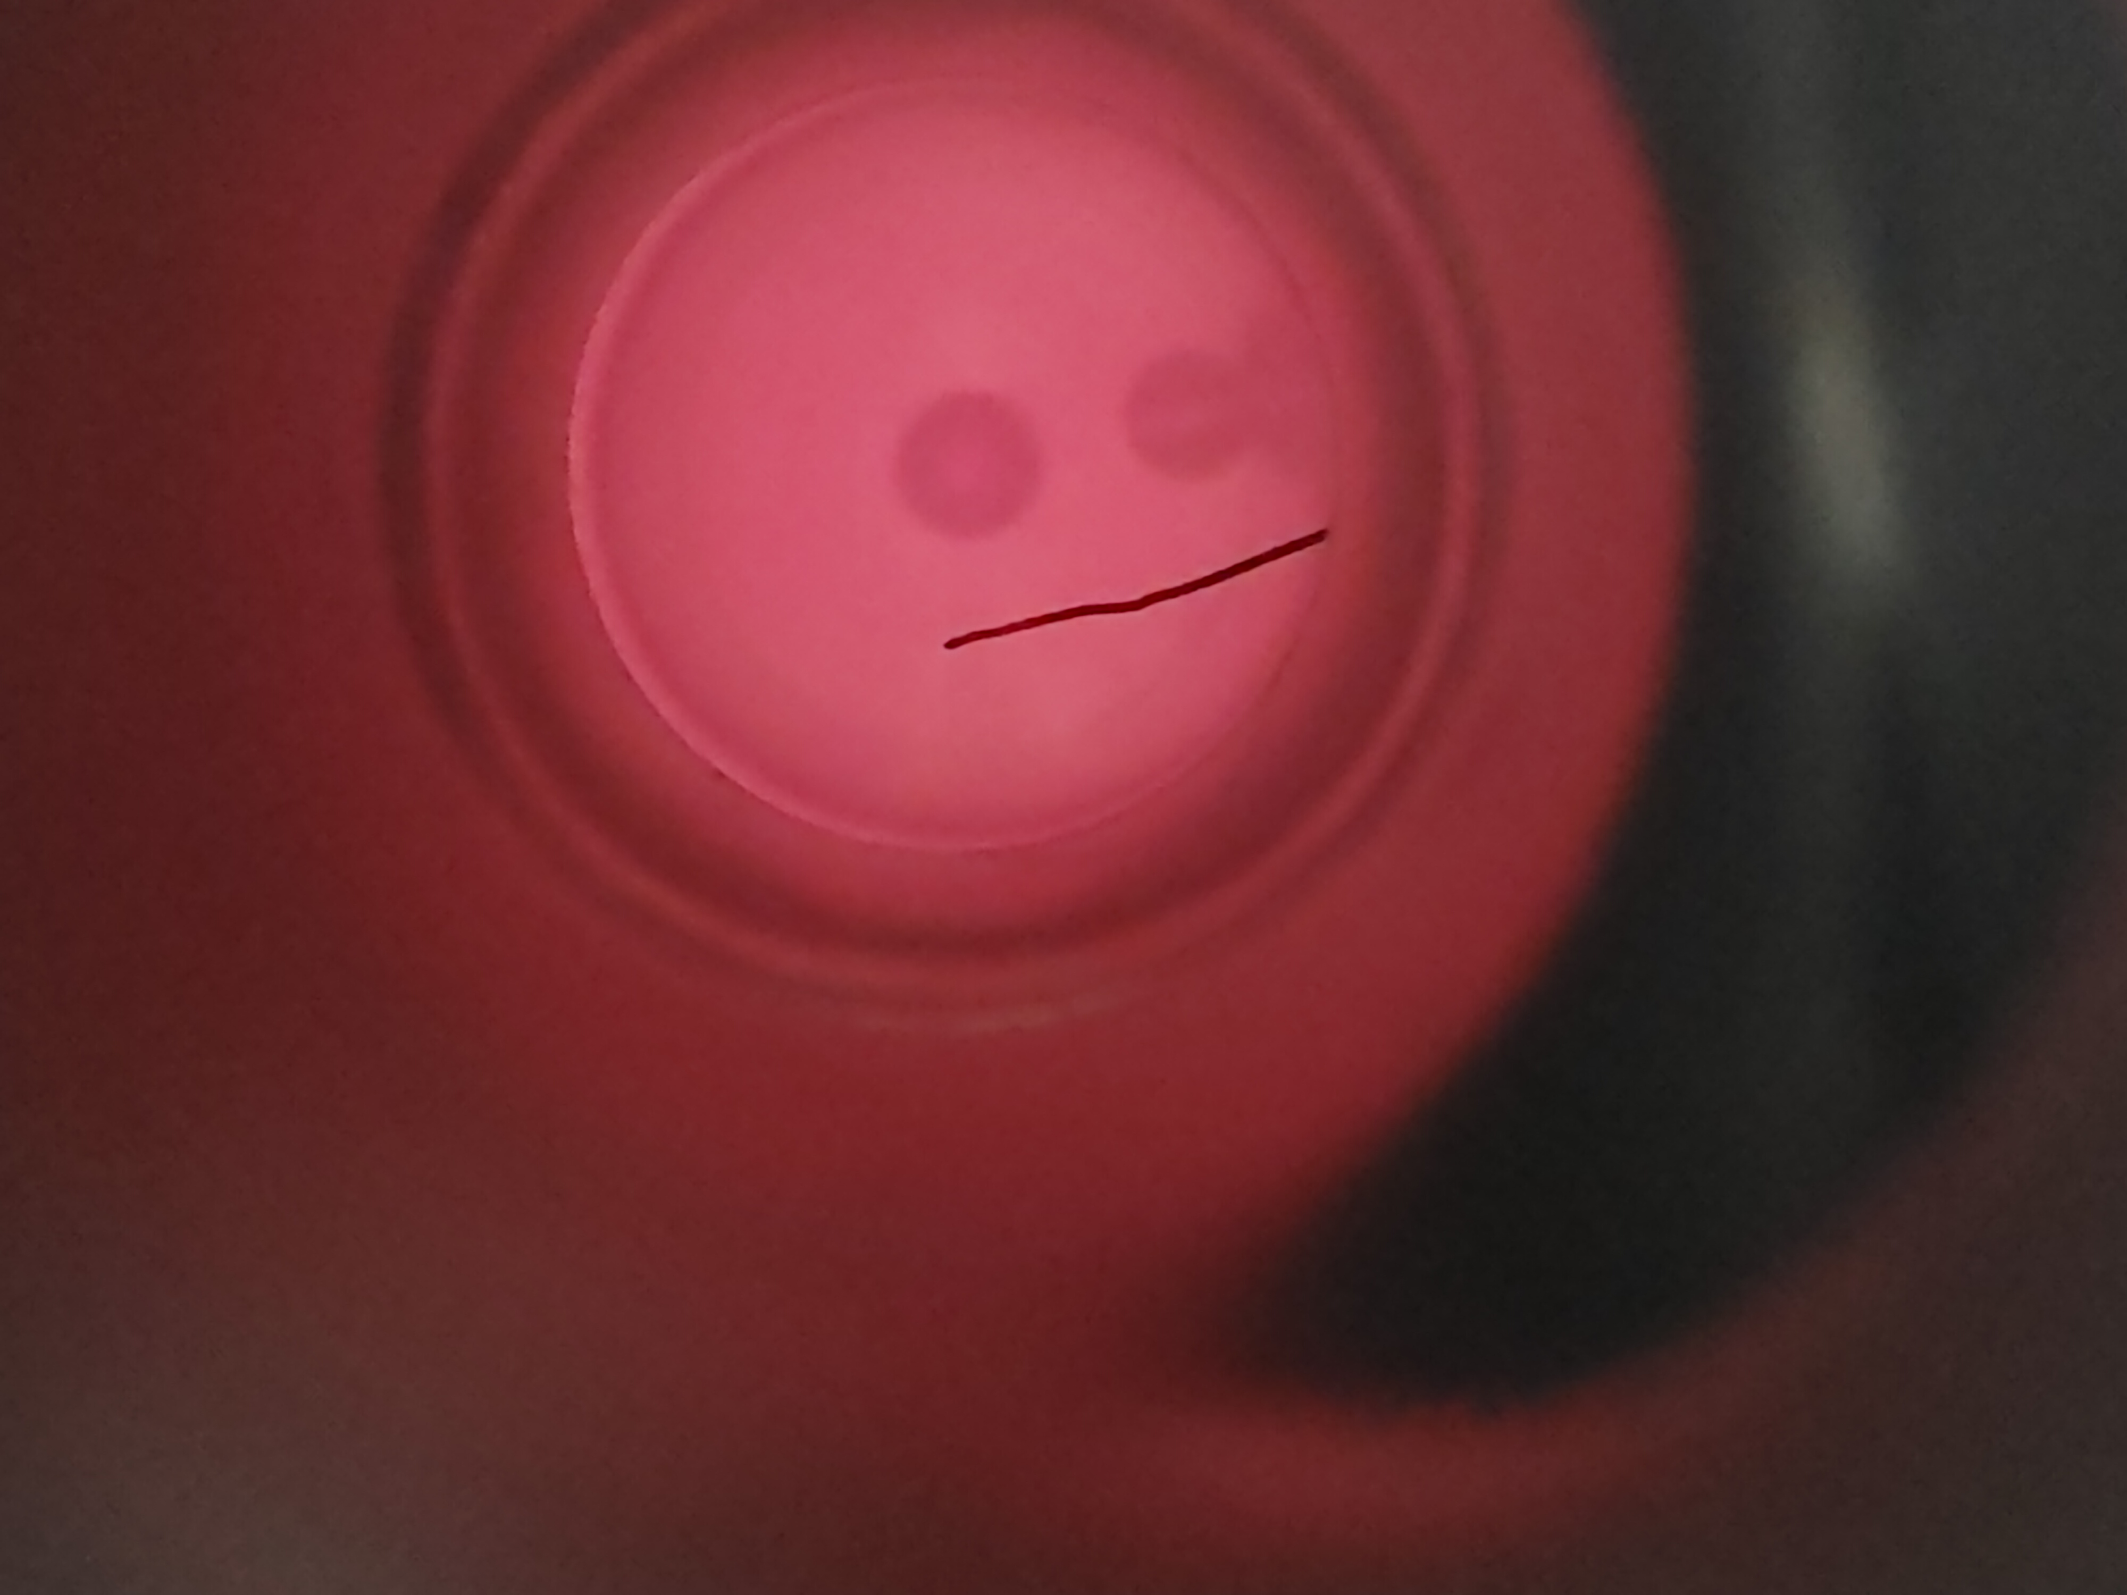
TRIUMF ARIEL e-LINAC - Reliable 30MeV Operation
Plasma cleaning
Current cleaning procedures are done ex-situ (2-3 months).
Plasma cleaning allows for an in-situ cleaning, which reduces cleaning time to ~1 week. MSc project D. Hedji
What if we could avoid contamination in the first place?
Emitters are μm to sub μm sized contaminants → dust
Previous studies indicate that dust migrates and is charged:
  A potential barrier could therefore suppress dust migration and tackle field emission problem at its source.
PhD A. Mahon
PI T. Planche
MSc. D. Hedji
P.I. R.E. Laxdal

Slide 8
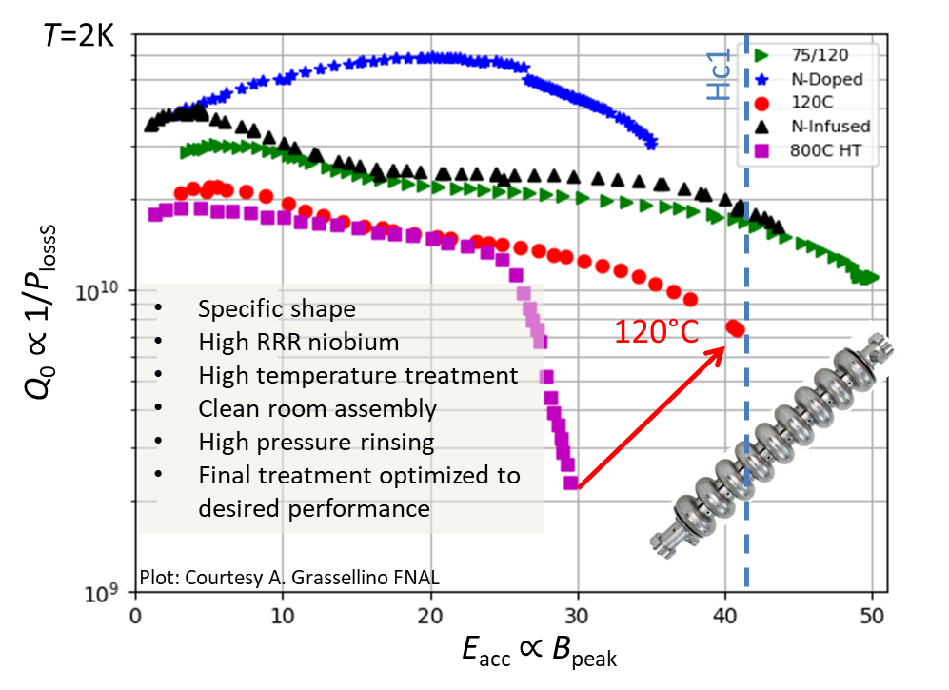
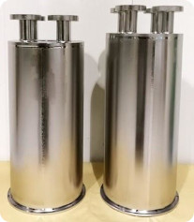
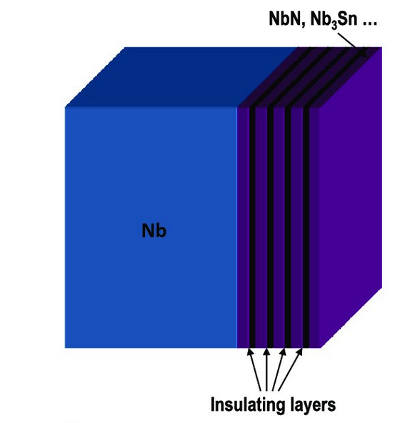
SRF materials research
Current material of choice niobium is reaching fundamental limitations
Subtle changes in heat treatments have significant influence
Surface treatments have only been optimized for electron accelerators (elliptical cavities)
  TRIUMF has dedicated program to optimize co-axial cavities for heavy ion accelerators
Accelerating gradients beyond 50 MV/m require new materials potentially as multilayers
Ultimate limitation H_{sh}
State of the art niobium cavity performance
Co-axial test cavities

Slide 9
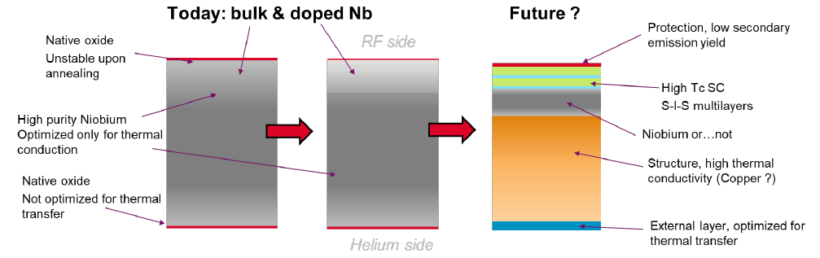
SRF Material of the future

Slide 10
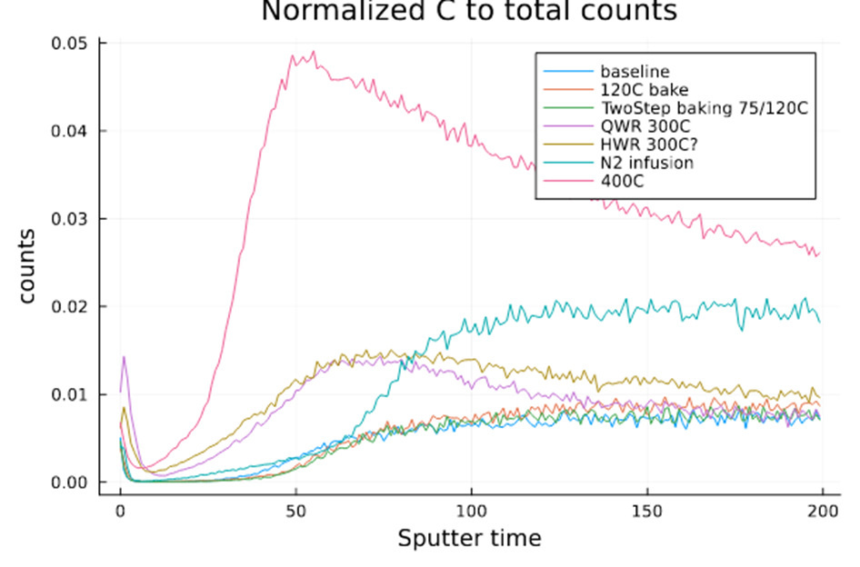
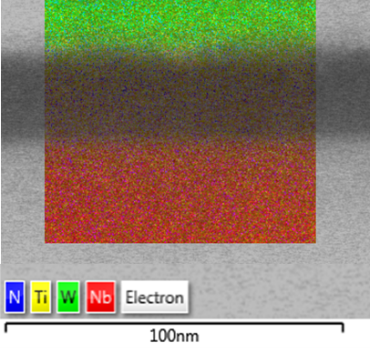
SRF Material Science
SRF material science is about engineering the outermost ~100nm of the material by coating or diffusion
Our research focuses on detecting flux penetration with nanometer resolution and its correlation to material properties
β-NMR (TRIUMF) enables flux penetration measurements with nanometer depth resolution
Transmission electron microscopy (UVic) and secondary ion mass spectroscopy (Surface Science Western) reveal surface structure and elemental composition
R. Laxdal, R. McFadden, E. Thoeng, Md Assaduzzaman, W. Stokes, L. Wallace

Slide 11
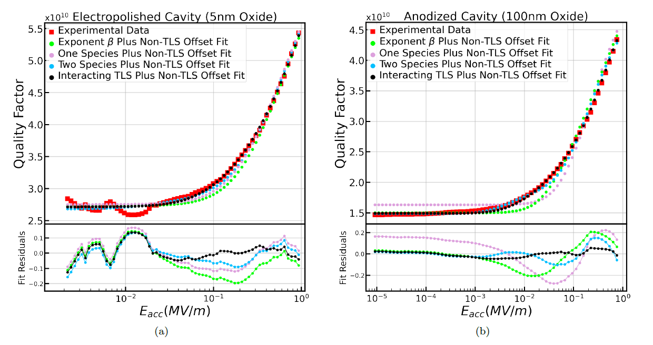
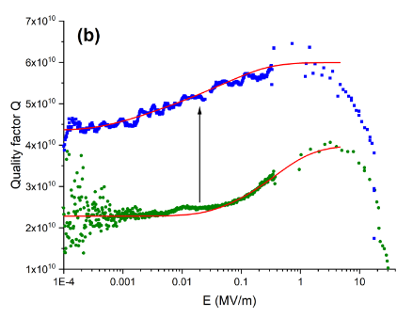
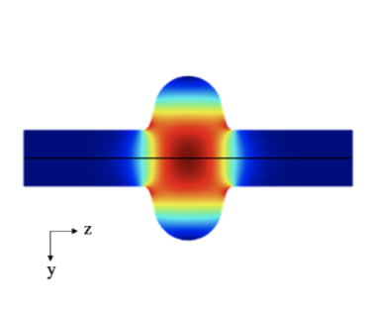
SRF for Quantum Computing
Main mechanism for quantum decoherence in current quantum hardware are defect two level systems (TLS) in oxides
SRF cavities can increase coherence times and be used as a testbed for theoretical models
Re-analysis of literature data provides evidence that the TLSs present in niobium oxide are “atomic-like” (instead of “glass-like”) . Undergrad Project N Gorgichuk
Replacing the oxide with another material can increase coherence times (recent results from CEA Saclay)
Y. Kalboussi et al. APL 124 2024
N Gorgichuk, T Junginger, R de Sousa -
Physical Review Applied 19 (2) 2022

Slide 12
Summary
SRF cavities unlike DC magnets need to be operated in a flux free Meissner state
  Current material of choice for SRF cavities is niobium (largest H_{C1})
    Performance close to fundamental limits in elliptical cavities
  Meissner state can potentially be maintained above H_{c1} using heterostructure coatings
SRF technology is interesting for quantum applications

Slide 13
Backup slides

Slide 14
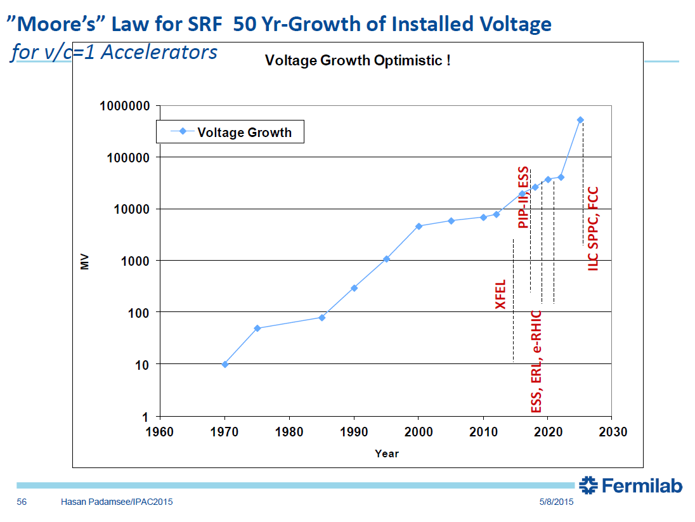
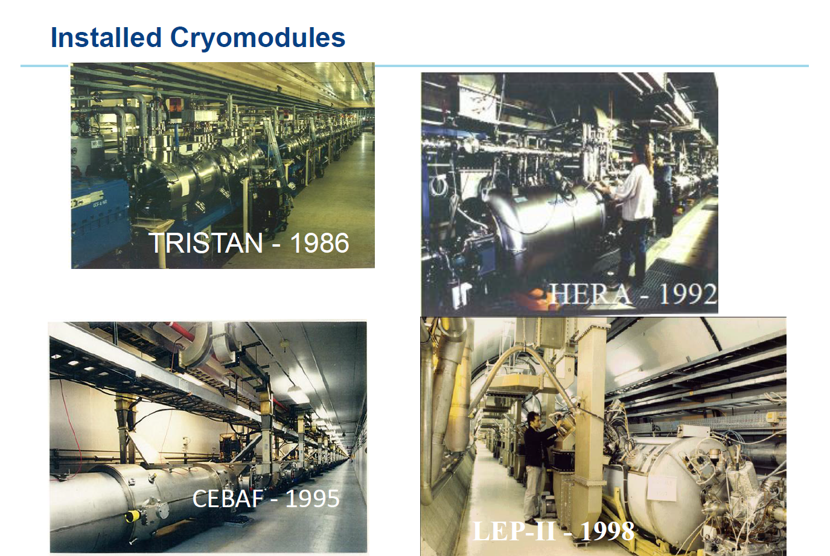
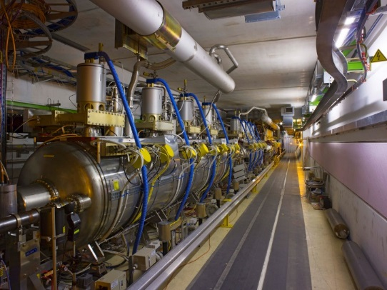
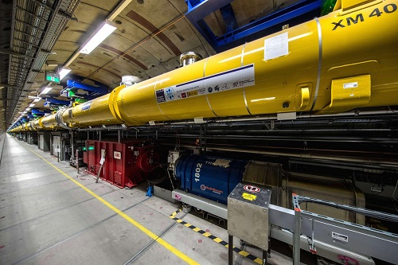

Examples of SRF accelerators
KEK, Japan
DESY, Germany
Jefferson Lab, USA
CERN, Switzerland+France
JLAB, USA
CERN, Switzerland+France
TRIUMF+
Canadian Light Source
LHC, 2008
XFEL, Germany, 2018

Slide 15
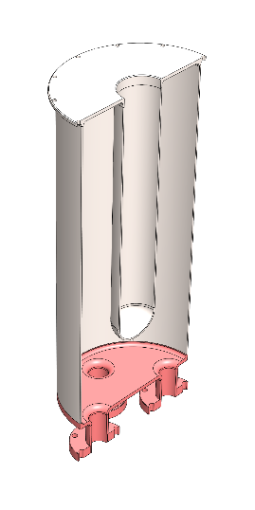
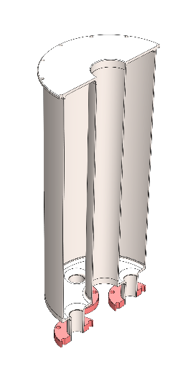
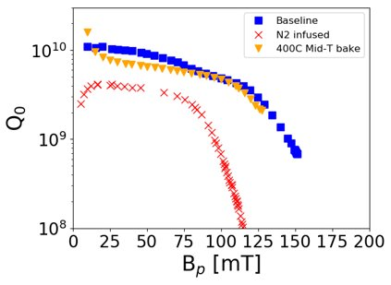
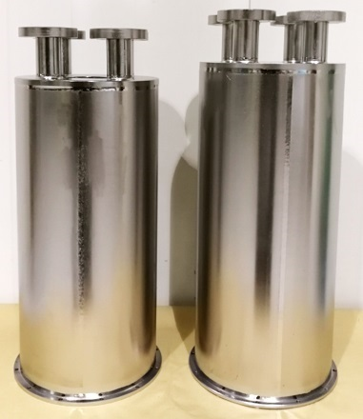
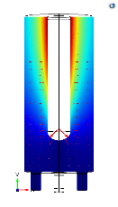
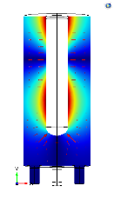
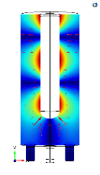
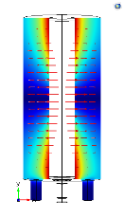
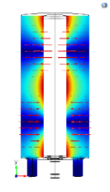
Coaxial Research Cavities at TRIUMF
Most SRF research done on high frequency, high beta, elliptical cavities.
Ion accelerators need low frequency, low beta coaxial cavities.
TRIUMF has dedicated coaxial cavities for fundamental SRF research
PI R. Laxdal, P. Kolb, MSc R. Gregory, MSc. McMullen
QWR
HWR
QWR
217 MHz
T=2K
QWR: Quarter Wave Resonator
HWR: Half Wave Resonator
New baking procedures tried for the first time on coaxial cavities
Encouraging results but below expectation (P. Kolb et al. SRF2021)
P. Kolb et al.
Phys. Rev. Accel. Beams 23, 122001
  Multiple modes (=multiple frequencies)

Slide 16
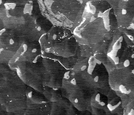
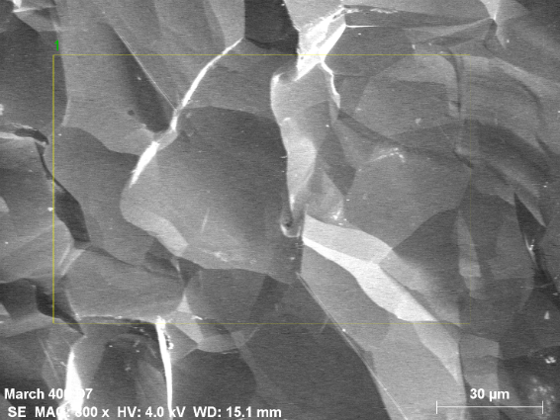
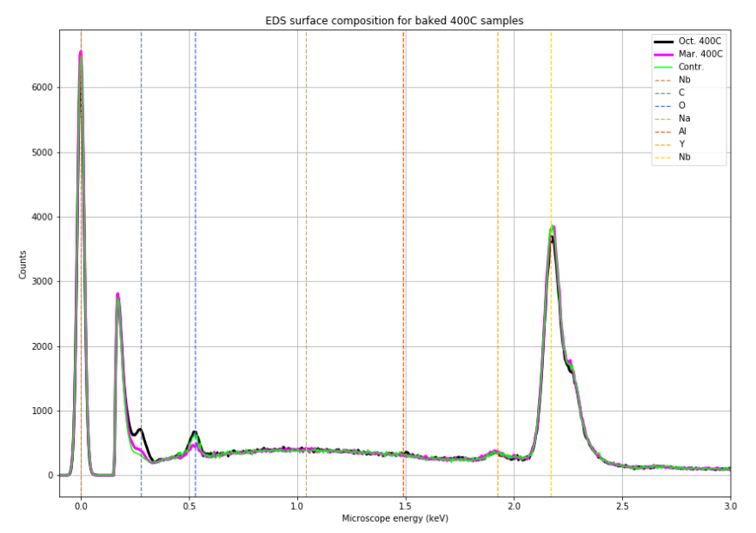
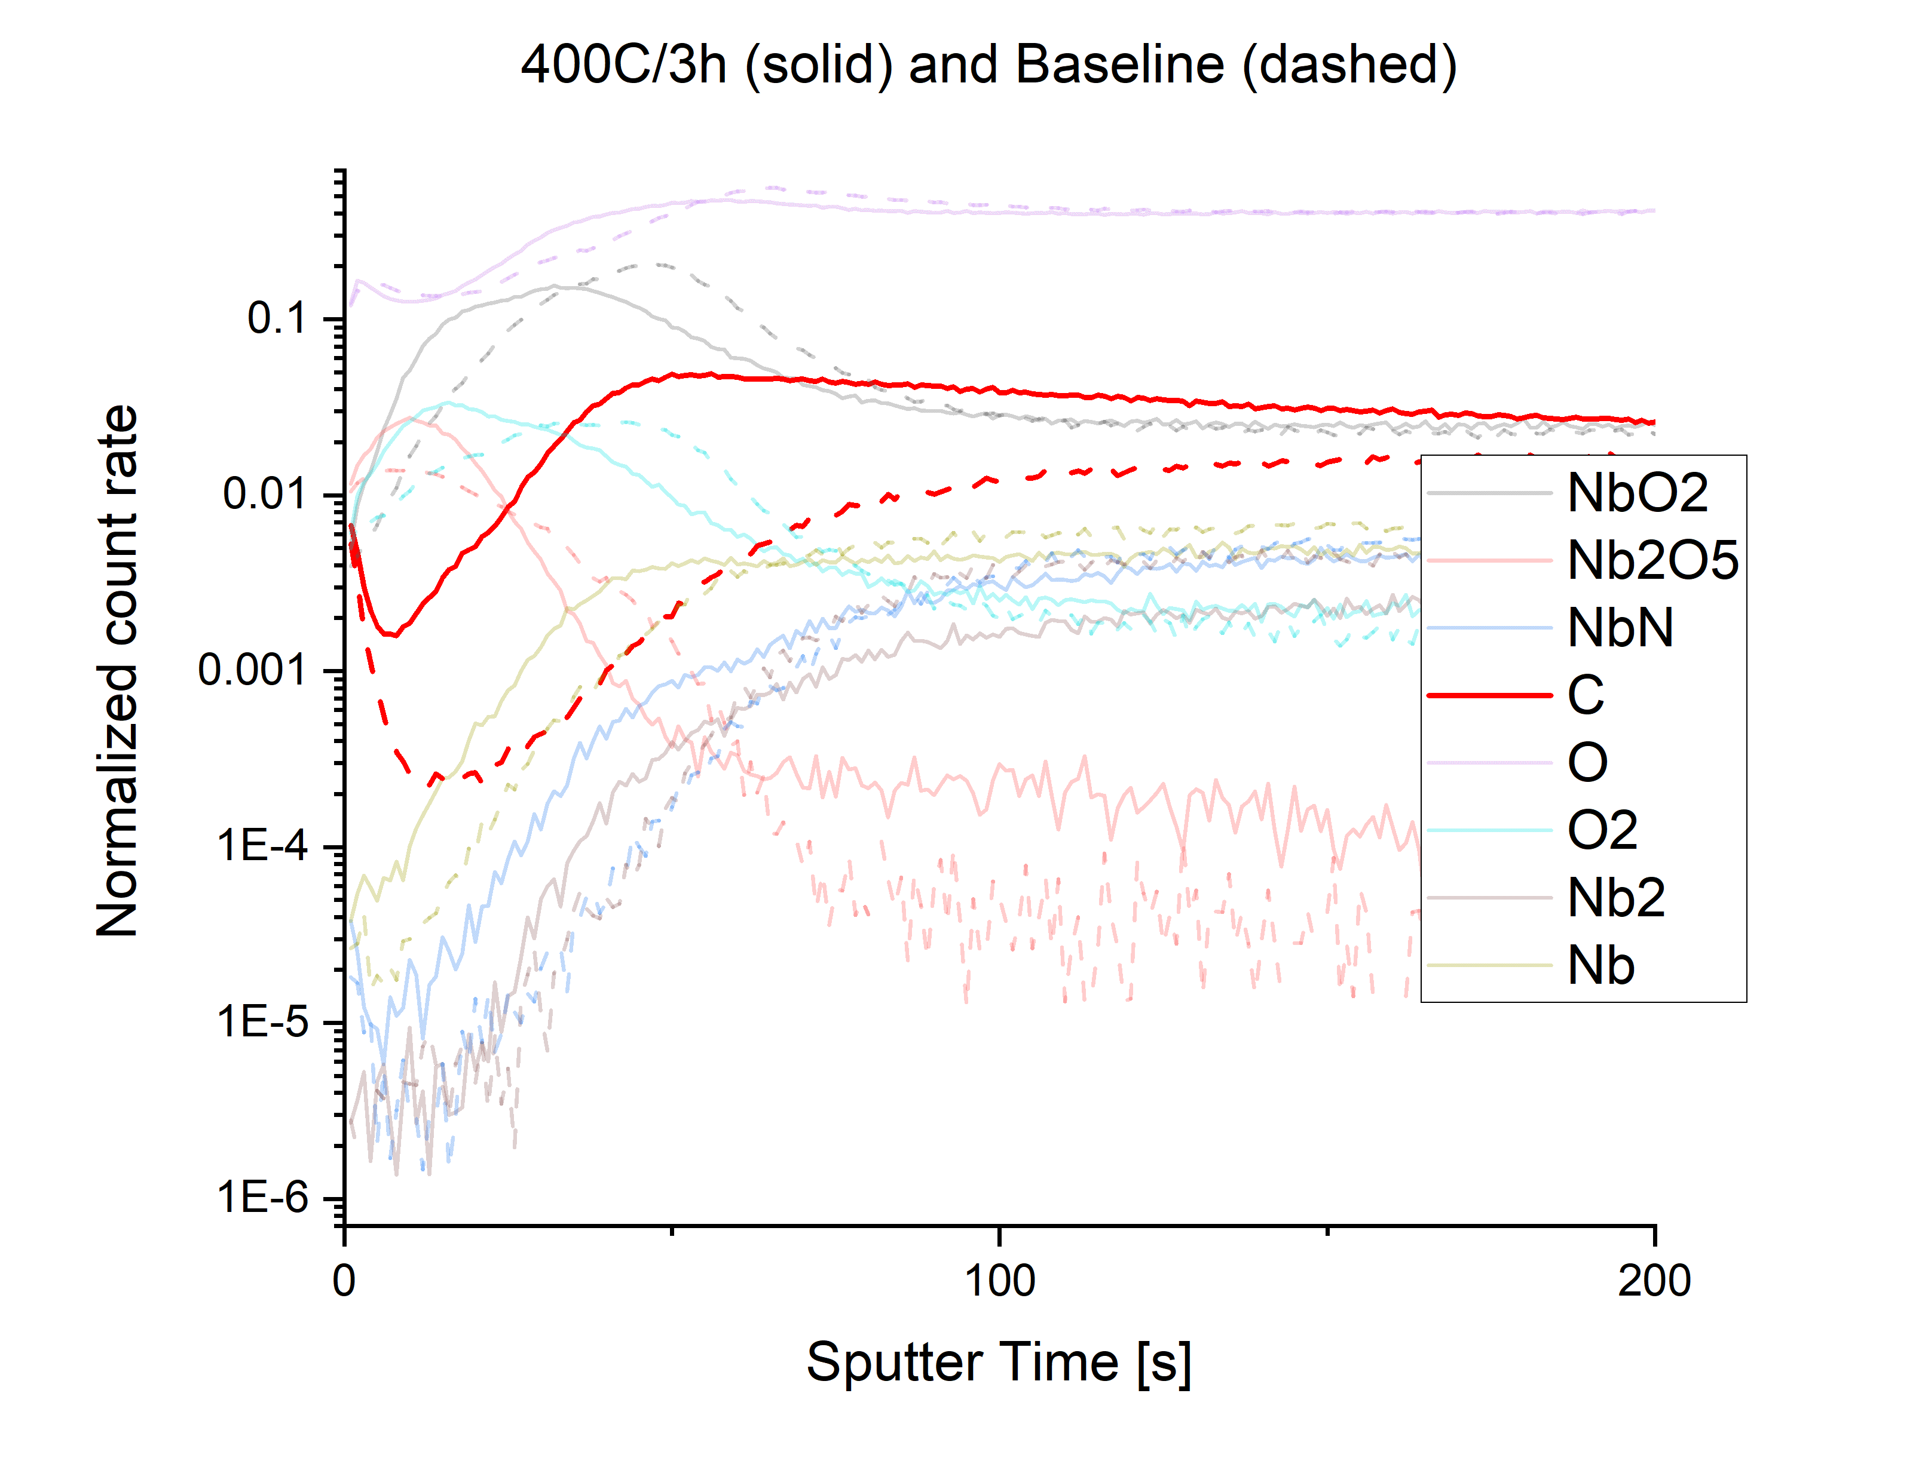
Coaxial Research Cavities at TRIUMF
Several new baking procedures tried for the first time on coaxial cavities
Unlike for traditional procedures there is no material removal (chemistry) after baking. Very clean environments required.
Material analysis with SEM/EDX shows signs of carbon contamination. (Honors thesis project D. Hedji)
TOF-SIMS depth profile shows that carbon contamination is most pronounced in relevant near surface region
400°Cavity Witness Sample
Reference Sample
SEM image before and after furnace cleaning
SEM: scanning electron microscopy, EDX: energy dispersive X-Ray spectroscopy, TOF-SIMS: Time-of-Flight Secondary ion mass spectroscopy

Slide 17

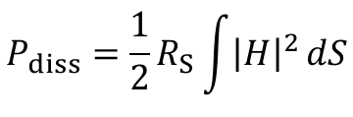

When to use Superconducting Cavities
$$P_{diss}=\frac{1}{2}R_{S}\int{{\left|H\right|}^{2}}dS$$
Dissipated power:
$$H∝E_{acc}$$
Carnot Efficiency of refrigeration cycle:
$$η=\frac{T_{cavity}}{RT−T_{Cavity}}=\frac{4.2K}{300K−4.2K}=0.014$$
E
H
Example: Isac-II CW 141 MHz cavity operated in CW E_{acc}=5 MV/m
In case of SRF systems grid power goes mainly to the cryoplant and the beam, for normal conducting machines mainly in the RF power source
 | Super Conducting | Normal Conducting
R_{S} | ~100nΩ | 3mΩ
P_{diss} | 7 W | 200kW
Grid Power | ≈1kW | ≈400kW
Strongest incentive to use SC cavities is for accelerators operated in CW or at high duty factors

Slide 18


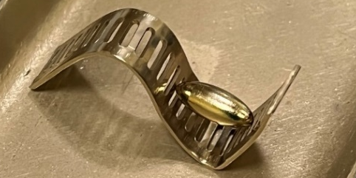
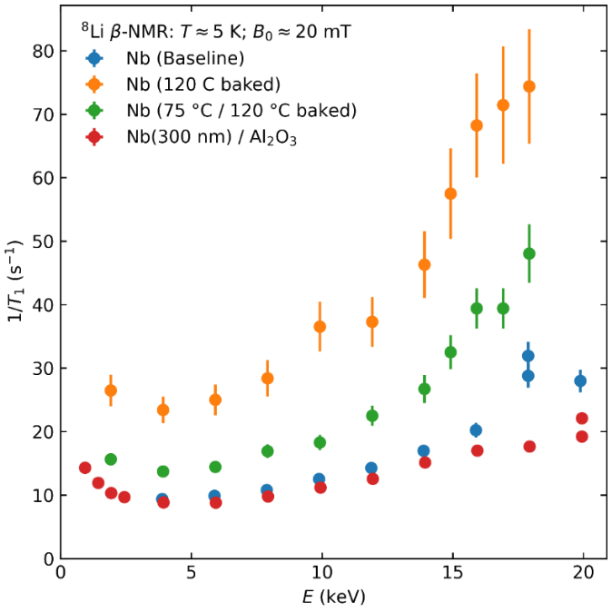
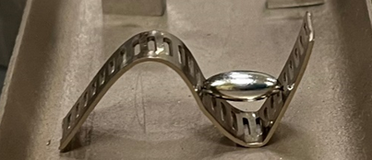
β-NMR + SRF @ TRIUMF
Low energy muon spin rotation is limited to parallel field to about 25mT
SRF cavities operate at 100-200mT
  Steering in higher field difficult due to low muon mass
  Higher mass of 8Li favors betaNMR with 8Li for SRF studies
New high field magnet
R. Laxdal, R. McFadden, PhD E. Thoeng (UBC), PhD Md Assaduzzaman
Low field magnet
Next studies will be on multilayer samples prepared by atomic layer deposition at CEA Saclay
Method is sensitive to changes by surface treatments
(E. Thoeng et al SRF2021)
High parallel field spectrometer. Successfully commissioned in summer 2021

Slide 19
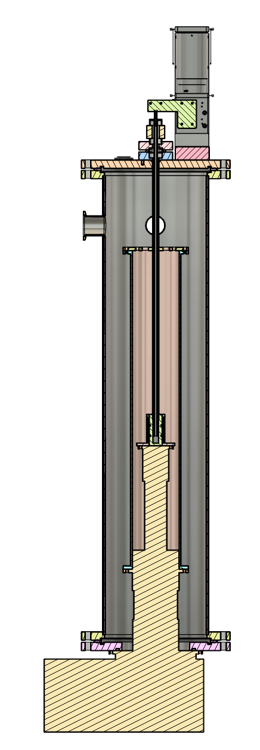
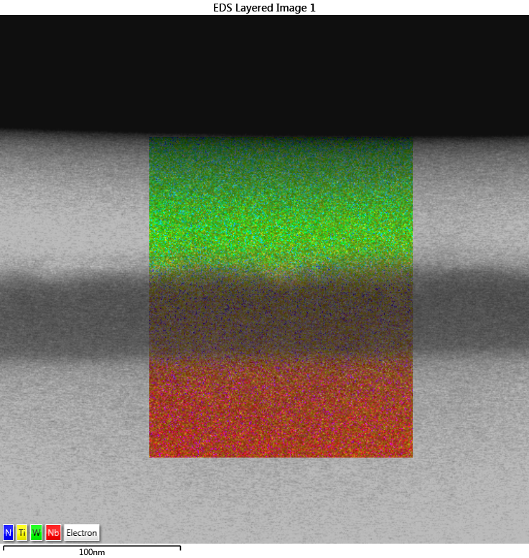
Measurement of the vortex penetration field
β-NMR studies will be coupled with measurements of superconducting bulk and material properties at UVic
Vibrating sample magnetometry can be used to measure the substrate (niobium) vortex penetration field
  Instruments are commercially available but the SRF parameter range (relatively low field at low temperature) favor a dedicated design which can be realized at a fraction of the cost
  Status: Design finalized, construction started (MSc Lucas Wallace)
TEM/EDX map of a NbTiN on Nb sample
BSc Will Stokes

Slide 20

Backup slide

Slide 21


UVic/TRIUMF Accelerator Research
Graduate Program
Currently 14 UVic graduate students in accelerator physics based at TRIUMF (11), UVic (2), D-Pace (1)
Seven adjunct professors, six at TRIUMF, one at D-Pace
Education
One graduate lecture course taught by adjunct faculty at TRIUMF each year and broadcasted nationwide
Undergraduate lecture course, graduate + undergraduate projects offered at UVic
There are no particle accelerators at UVic
Accelerator Research does not necessary require accelerators on site. At UVic we focus on
  Cryocooler based fundamental SRF studies
  Surface and Materiel Science Studies at the Electron Microscopy Facility (A. Blackburn)
  Application of SRF technology to quantum computing (R. de Sousa)
  Beam Dynamics studies for polarized beams in SuperKEKB (M. Roney)
Fundamental SRF studies with purpose built instruments
Beam Simulations
Accelerator Systems Development
Material Science

Slide 22
The superheating field
S. Posen et al. PRL 115, 047001 (2015)
Niobium:
  Close to T_{c} H_{entry}=H_{sh}
  T<<T_{c} usually H_{entry}<H_{sh}
Nb₃Sn:
  Close to T_{c} H_{entry}=H_{sh}
  T<<T_{c} H_{entry}<<H_{sh}
RF heating proportional to H². Close to T_{c} less power is dissipated. Flux entry less likely.
Coherence length of Nb₃Sn smaller than Nb. Flux entry at defects more likely.
The good news is H_{c1} is not a general limitation!

