Slide 1

Comparison Between Ground-based Lidar Measurements from MPLCAN and Simulated Retrievals from the Aerosol Limb Imager
Emily Tracey (Western University)
Landon Rieger (University of Saskatchewan,) Bob Sica (Western University), Victoria Pinnegar (Western University)

Slide 2
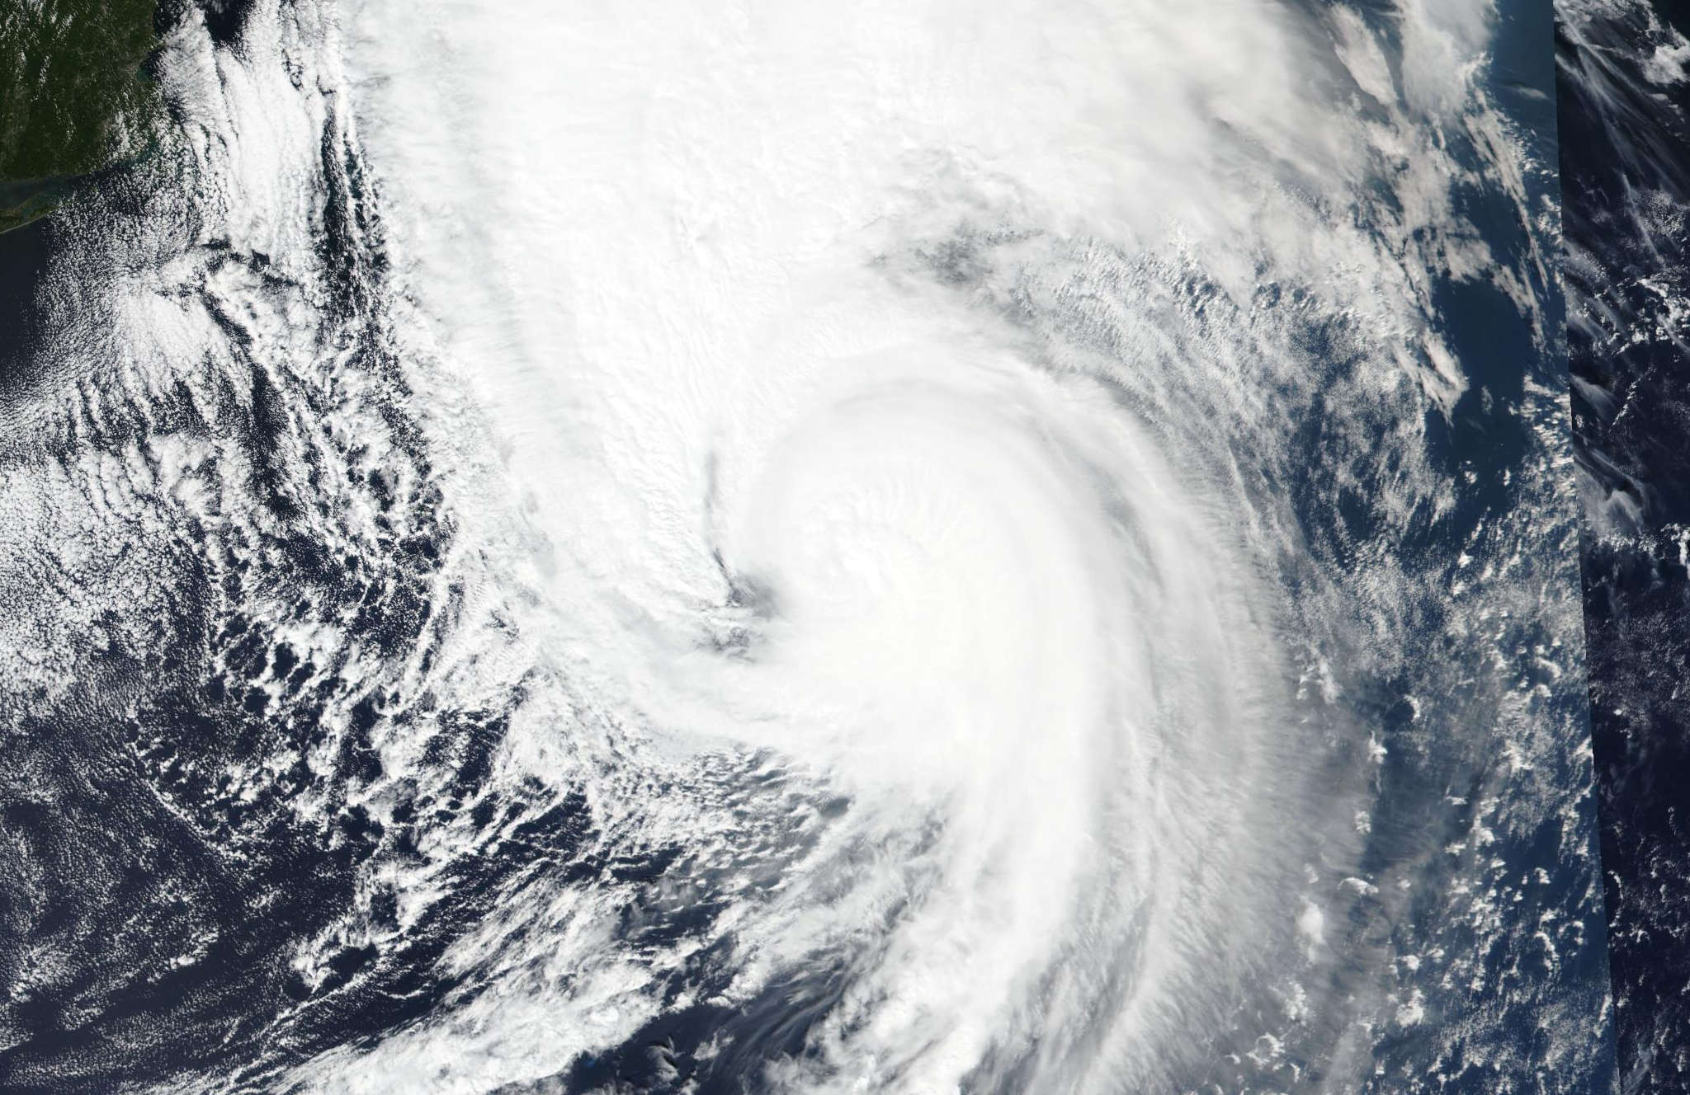
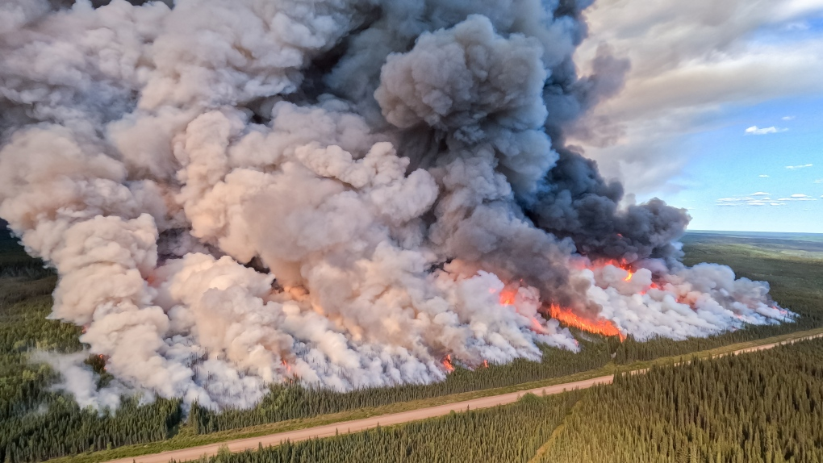
Introduction
There is an increased demand for continuous measurements of the atmosphere as severe weather events become more frequent
Hurricane Fiona [1]
Quebec Wildfires in 2023, the worst Canadian Wildfire season on record[2]
Notes:
Climate change has shown a clear correlation with extreme weather events which have impacted the health and safety of Canadians. One example of this include hurricane Fiona that made landfall in the maritimes in 2022 as the strongest storm on record based on pressure measurements and it also became the costliest weather event in Atlantic Canada history. Canada also had a record breaking number of wildfires last year fueled by warm temperatures and drought conditions. I’m sure almost everyone here received air quality notifications from these fires. Events like these motivate scientists to take continuous mesaurements of Earth’s atmosphere to monitor it as it continuous to change and to more accurately predict the future.
I’m sure we’ve all heard aboutsevere weather events such as hurricane Fiona which made landfall in Atlantic Canada in 2022 and last years record breaking wildfire season that brought poor air quality across the country. These events are become more frequent as they are correlated with climate change. This has lead to a demand for more measurements of our atmosphere and motivates my research.

Slide 3
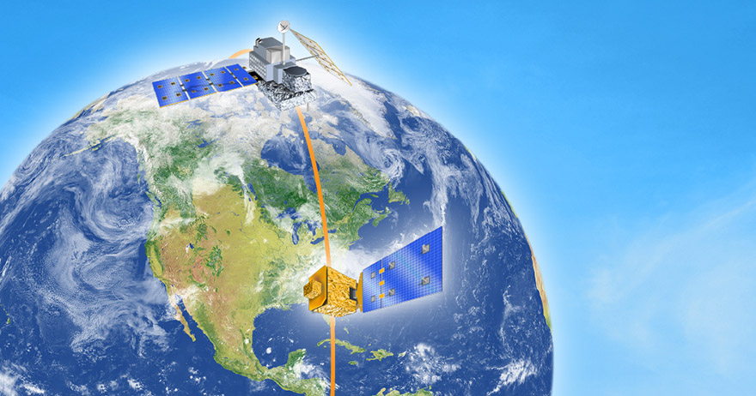
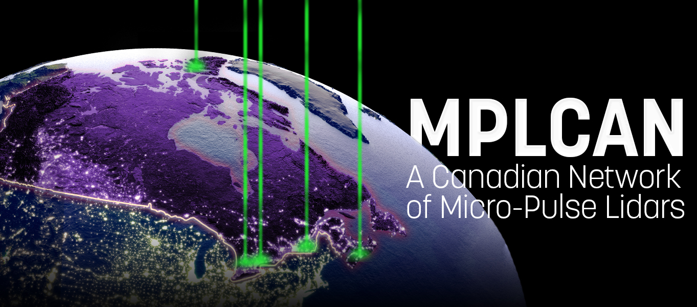
How do we measure our atmosphere?
Remote sensing - acquire information about our atmosphere from the ground or from space by detecting reflected or emitted radiation
Space-based
Ground-based
HAWC satellite mission
Notes:
Remote sensing is a broad term that describes instruments that detect reflected or emitted ration that has passed through the atmosphere to learn about the atmosphere itself. These measurements can be taken from space or from the ground. My project will compare measurements from a satellite in space to measurements from a lidar on the ground. Ground based methods are important to verify and validate space based measuremnts and fill in gaps between missions or in other areas.

Slide 4
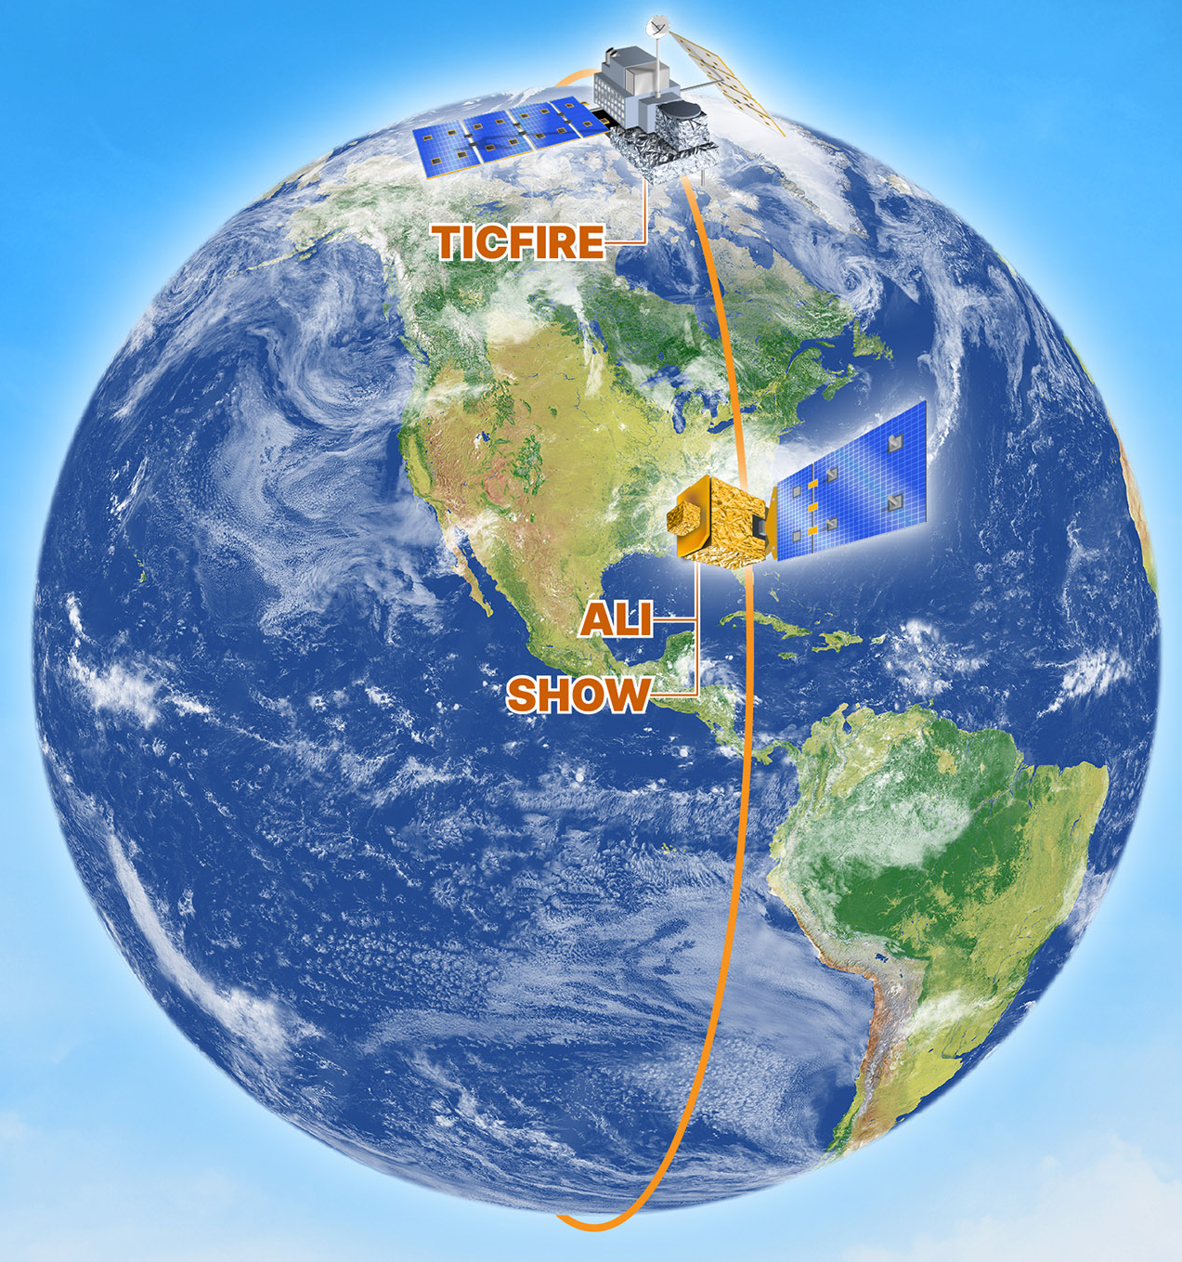
HAWC (High-altitude Aerosols, Water vapour and Clouds) Satellite Mission
HAWC consists of 3 Canadian instruments and a Canadian satellite that will be part of the international NASA-led Atmosphere Observing System (AOS).
The Canadian instruments:
ALI (Aerosol Limb Imager)
SHOW (Spatial Heterodyne Observations of Water)
TICFIRE (Thin Ice Cloud in Far InfraRed Emissions)
Set to fly in 2031
Instruments and satellites involved in HAWC [3]

Slide 5
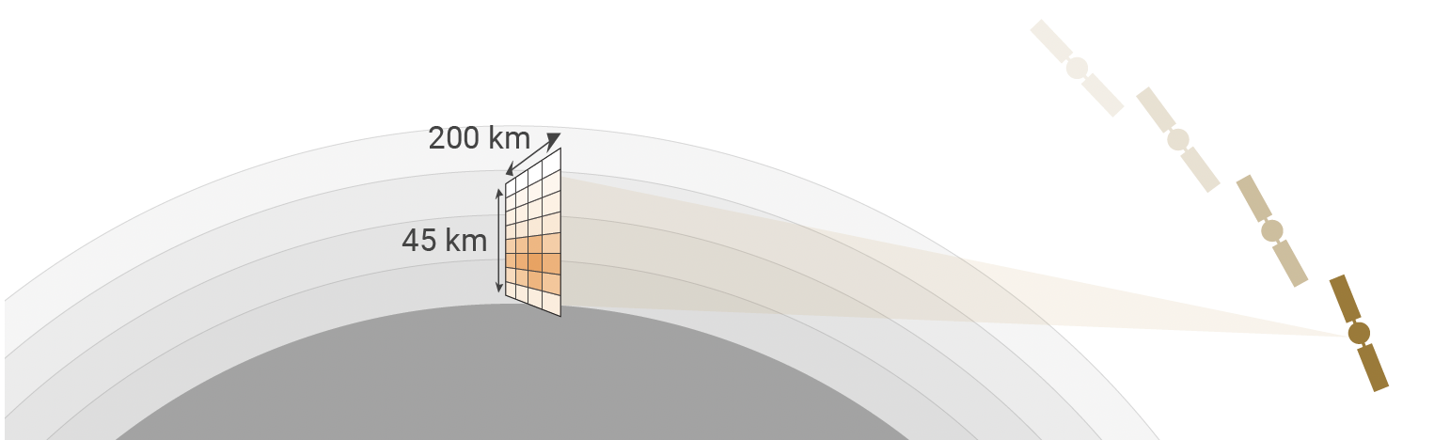
ALI Instrument
Objective: characterize aerosols in the upper troposphere and stratosphere to reduce the large uncertainty in climate forcing due to aerosols
aerosol - particles or droplets suspended in the air. Ex: dust, pollen, smoke
Sun
measures the visible and near infrared spectral region
(600-1500 nm)
45 km
Line of Sight
Illustration of ALI measurement geometry [4]
Notes:
Indirect vs direct cloud adjustments

Slide 6
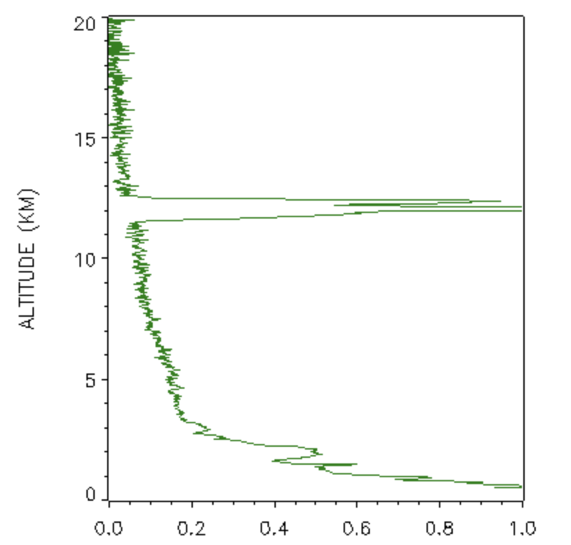
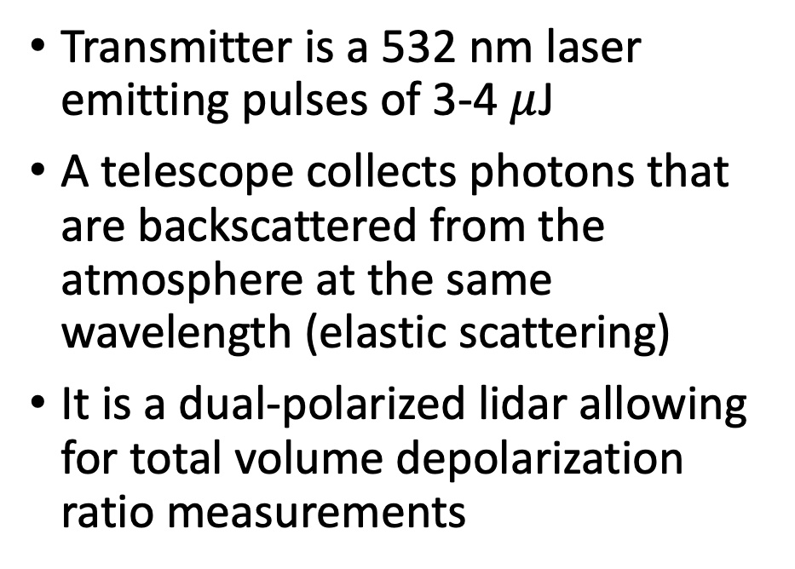
Micro Pulse Lidars (MPLs)
Transmitter is a 532 nm laser emitting pulses of 3-4 $μ$J
A telescope collects photons that are backscattered from the atmosphere at the same wavelength (elastic scattering)
It is a dual-polarized lidar allowing for total volume depolarization ratio measurements
Aerosol or cloud layer
telescope
532 nm laser
detector

Slide 7
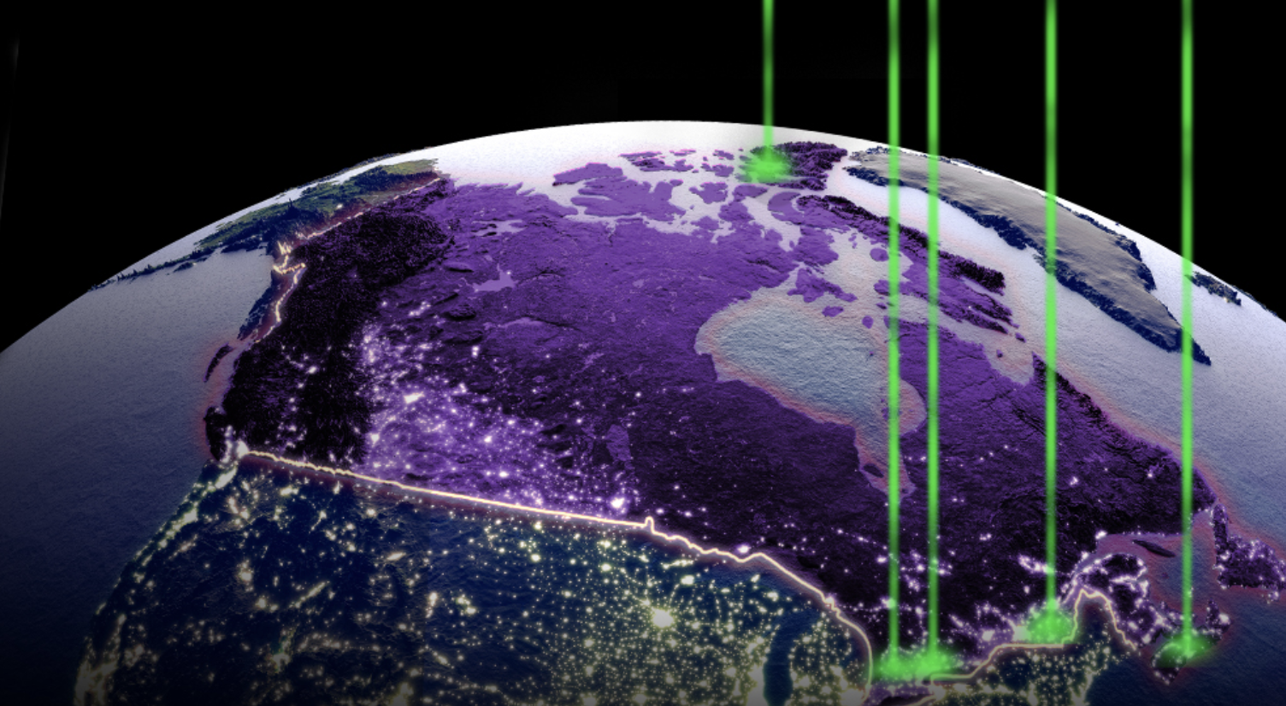
MPLCAN is a network of 5 MPLs across Canada, with 3 new nodes coming online this summer
Notes:
Stony Plain AB, CHARS (Cambridge Bay), Iqaluit

Slide 8
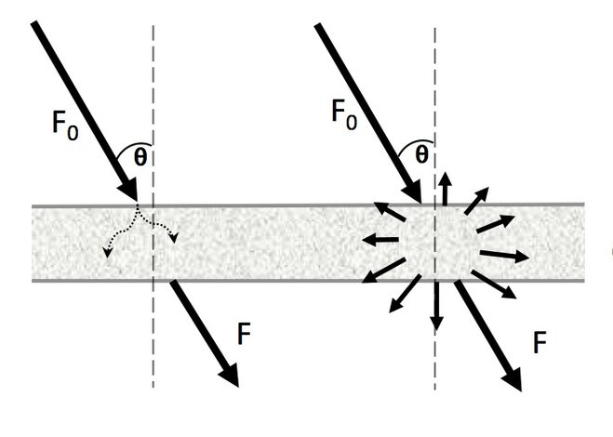
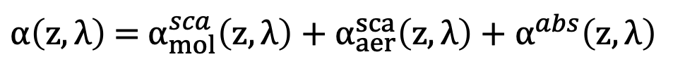
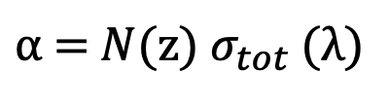
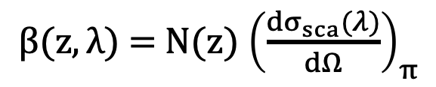
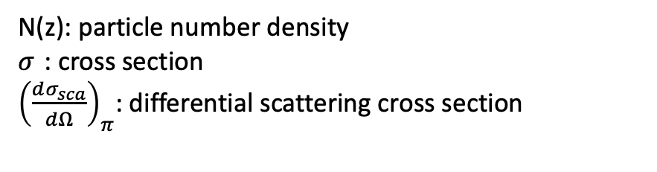
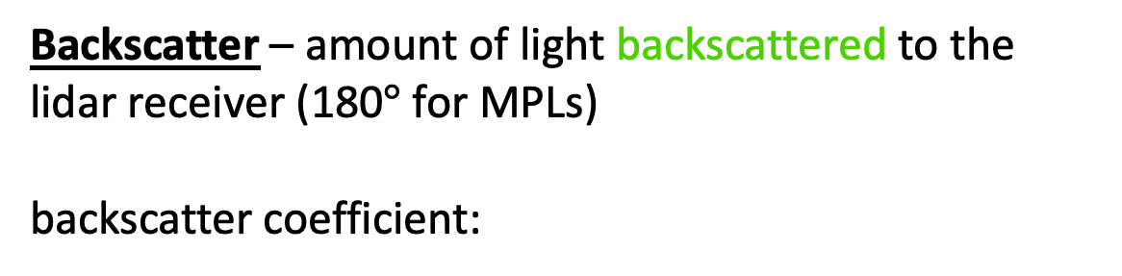
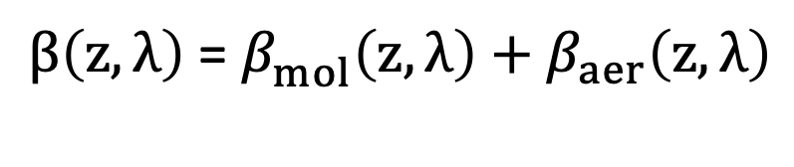
A Little Radiative Transfer
N(z): particle number density
$σ_{ }$: cross section
${\left(\frac{dσ_{sca}}{dΩ}\right)}_{π}$: differential scattering cross section
Extinction – fraction of light lost when transmitted through a medium due to scattering and absorption
Absorption
Scattering
extinction coefficient:
$α$ = $N$(z) ${σ_{tot}}_{ }\text{(}λ\text{)}$
$α\left(z,λ\right)$ = $α_{mol}^{sca}\left(z,λ\right)+α_{aer}^{sca}\left(z,λ\right)+α_{ }^{abs}\left(z,λ\right)$
backscatter
Backscatter – amount of light backscattered to the lidar receiver (180$°$ for MPLs)
backscatter coefficient:
$β(z,λ)$ = $N$(z) ${\left(\frac{dσ_{sca}(λ)}{dΩ}\right)}_{π}$
$β\left(z,λ\right)$ = $β_{mol}^{ }\left(z,λ\right)+β_{aer}^{ }\left(z,λ\right)$

Slide 9
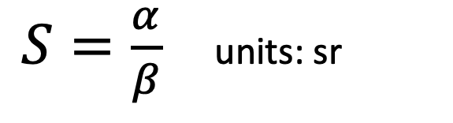
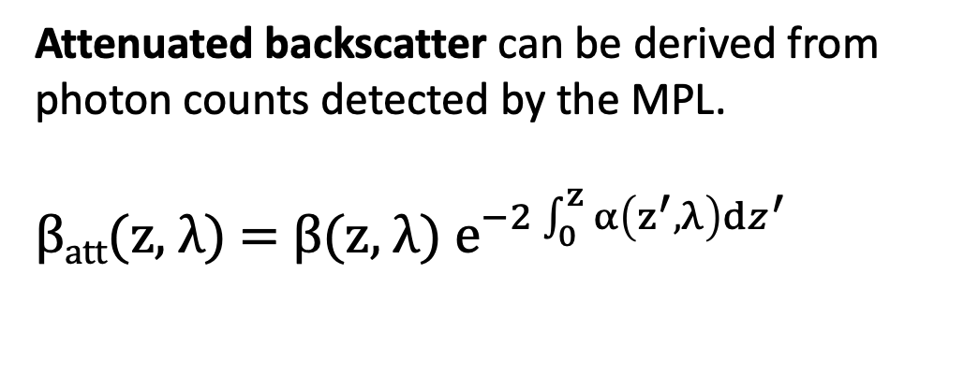
MPL measurements
Attenuated backscatter can be derived from photon counts detected by the MPL.
β_{att}(z, λ) = β(z, λ) $e^{−2\int_{0}^{z}{α\left(z^{′},λ\right)}dz^{′}}$
We cannot separate extinction and backscatter in an elastic lidar measurement without assumption of the lidar ratio:
$S=\frac{α}{β}$ units: sr
ALI measurements
ALI measures limb scattered radiance from the Sun and retrieves:
Aerosol extinction
Aerosol particle size

Slide 10
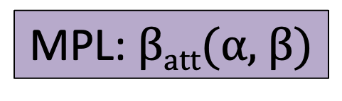
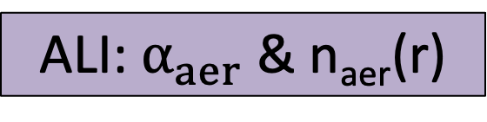
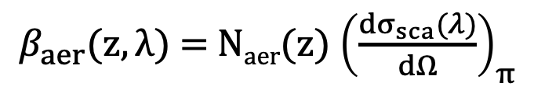
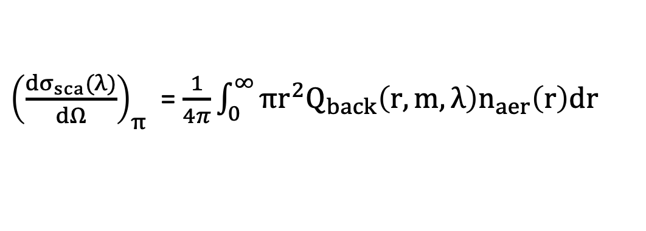
Relating MPL and ALI Measurements
MPL: β_{att}($α$, β)
ALI: $α_{aer}$ & n_{aer}(r)
I convert the ALI retrievals into attenuated backscatter by calculating the aerosol backscatter coefficient for direct comparison with MPLs.
Method 1: assume lidar ratio and use retrieved extinction:
$$β_{aer}=α_{aer}/S$$
Method 2: Use retrieved aerosol size distribution and Mie theory:
Size distribution
$β_{aer}(z,λ)$ = $N$_{aer}(z) ${\left(\frac{dσ_{sca}(λ)}{dΩ}\right)}_{π}$
${\left(\frac{dσ_{sca}(λ)}{dΩ}\right)}_{π}$ = $\frac{1}{4π}\int_{0}^{∞}{πr^{2}Q_{back}\left(r,m,λ\right)n_{aer}\left(r\right)dr}$
Number density
backscattering efficiency

Slide 11
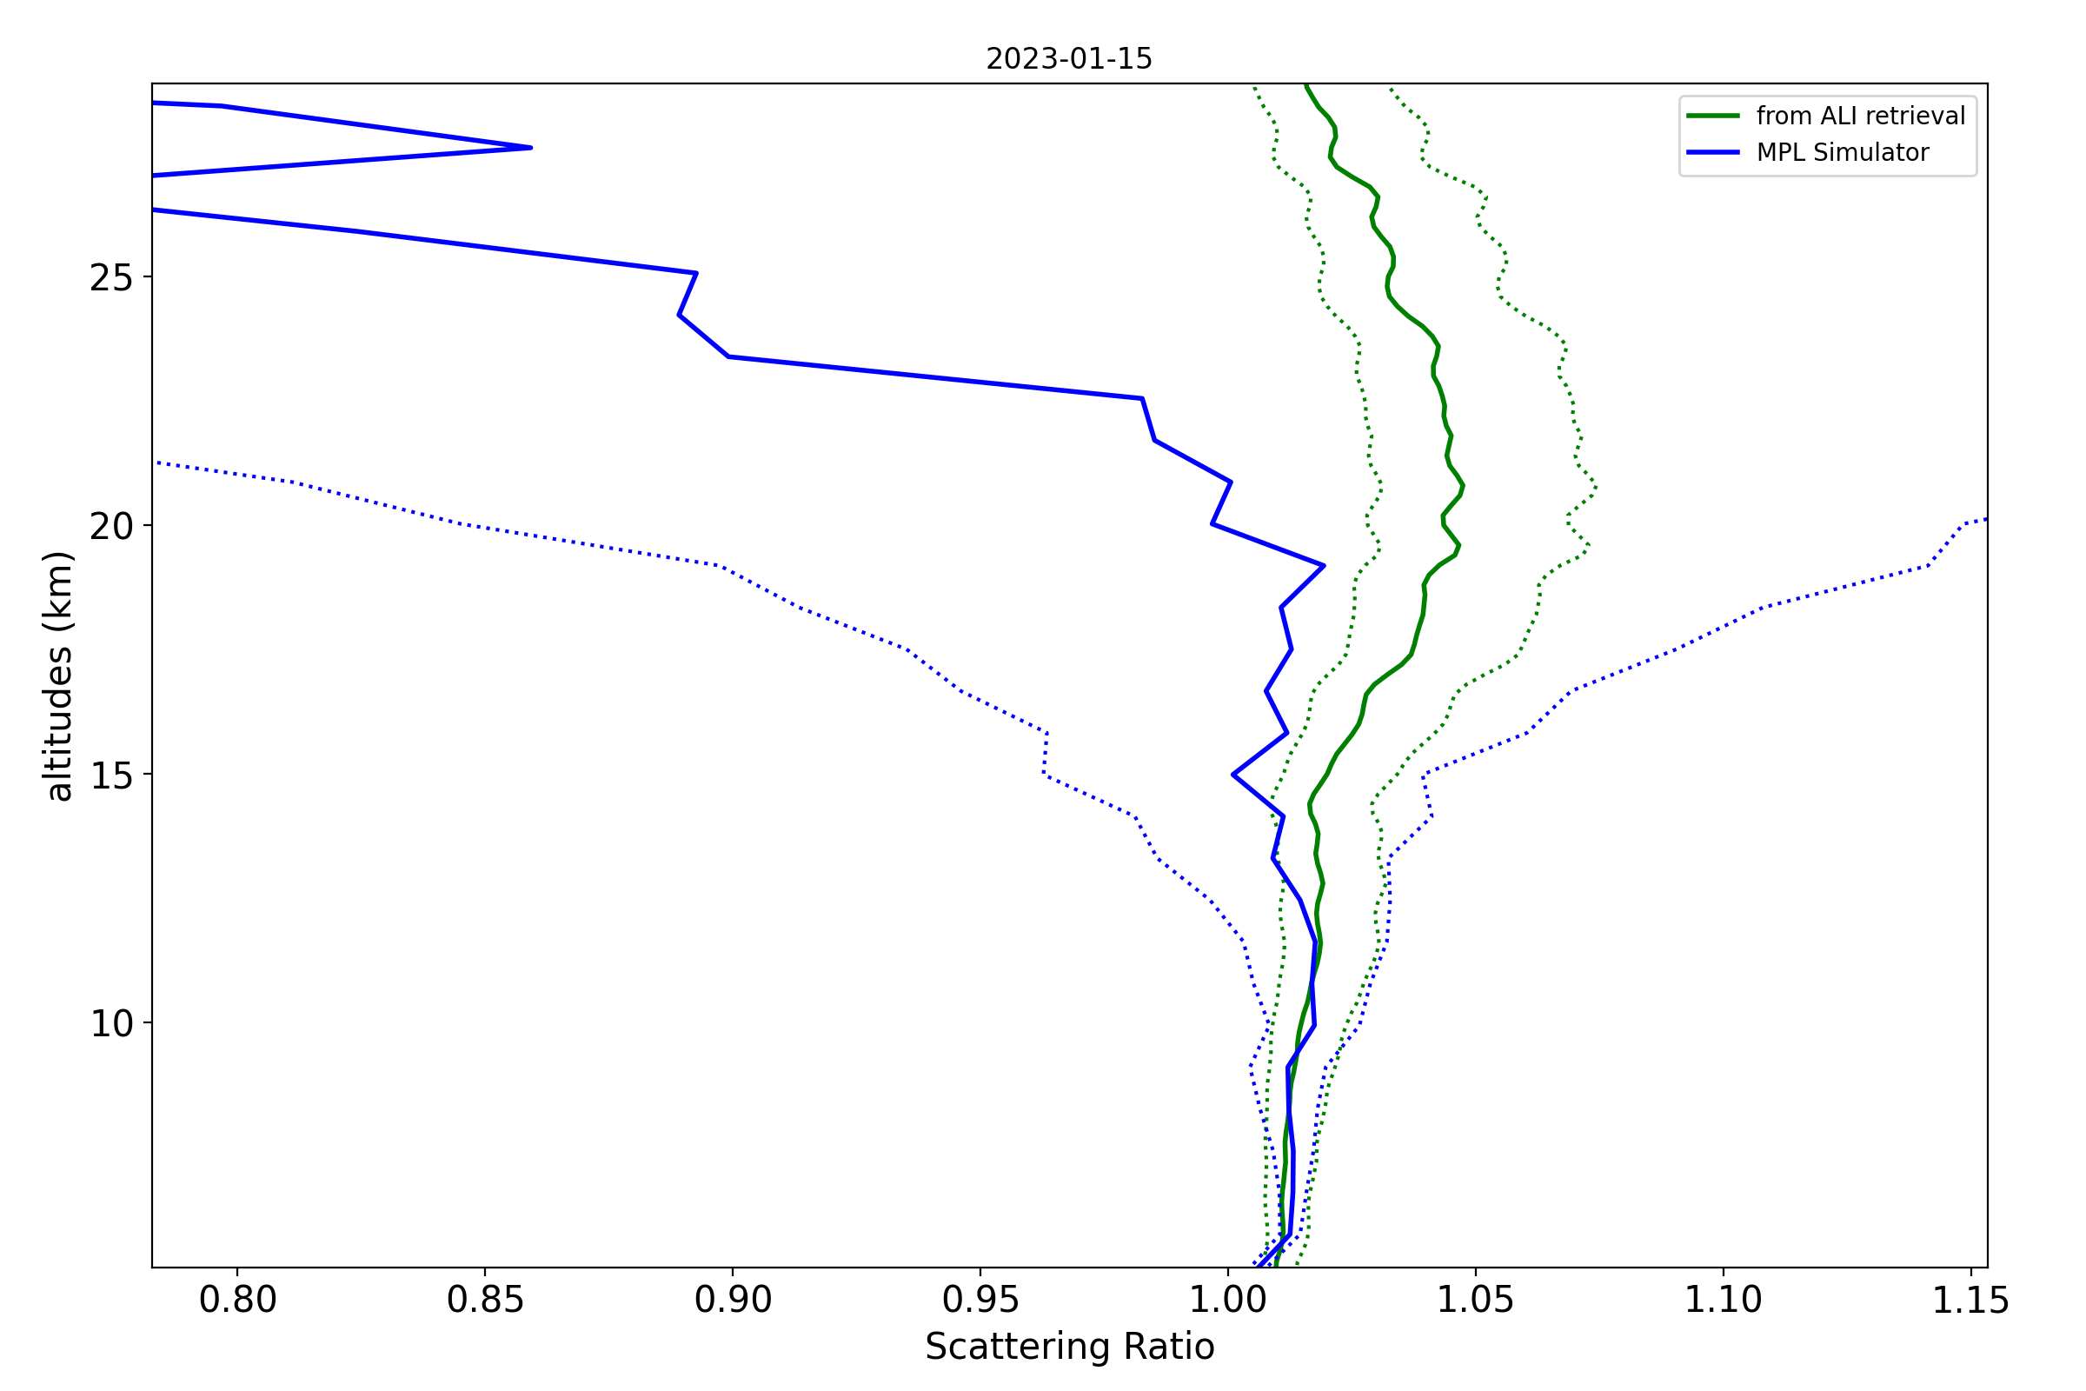

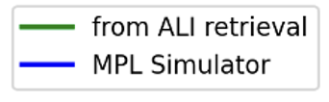
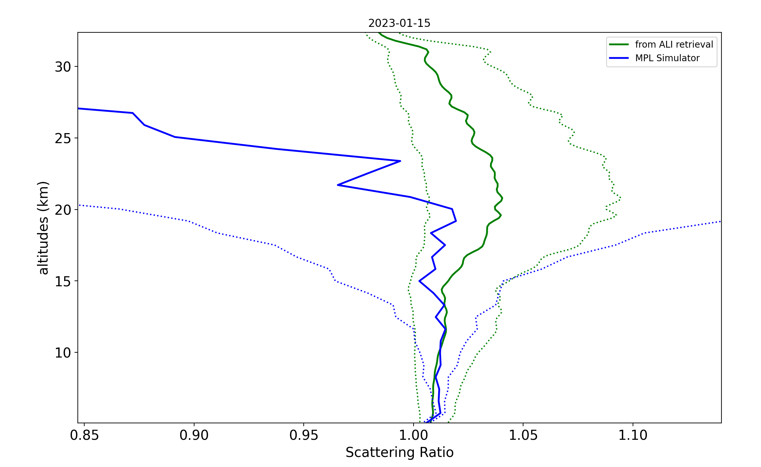


Initial Result Comparing ALI and MPL Simulations
Method 1: Using lidar ratio
Method 2: Using particle size and Mie theory
SNR drops off at about 15 km for these low aerosol loads
Scattering ratio - ratio of total attenuated backscatter to molecular attenuated backscatter
Notes:
To test my methods I am using an ALI simulator developed by researchers at the university of saskatchewas and an MPL simulator that I developed. For this experiment I inputted background stratospheric aerosols into both simulators, so no major aerosols from valcanos or wildfires. To isolate just the aerosol signal, because that is what we care about, im plotting scattering ratio which is the ratio between total attenuated backscatter and just molecular backscatter. The Ali simulator is shown in green with dotted lines as it error bars and the MPL simulator is shown in blue.You can see that they agree quite well until about 15 km which is where the MPL snr drops off since there are so few aerosols present. This was a good test of my methods to see if everything works as expected but MPL is designed for much higher aerosol loads so its not the most realistic example. You can see the uncertainty is incredibly high after 15 km. you can also see comparing the two methods that they agree quite qwell. The uncertainty is higher prom particle size but this is misleading bc lidar raio assumes that we know what is up there.
The MPL simulator appears to agree with the ALI retrieval simulation quite well below 12 km, however the scattering ratio is extremely low compared to its uncertainty so these measurements don’t have much confidence. The MPL is not very good at detecting such low aerosol loads at these higher altitudes, so this is not a realistic case but it shows that the general method is working.
The uncertainty around the lidar ratio assumes that we actually know exactly what the particles are up there and have chosen the right lidar ratio, so really this uncertainty is higher.

Slide 12
Future Work
Run several coincident measurements using various atmospheric models, including higher aerosol loadings that would be more easily detectable by MPLs
Simulate the satellite passing over the MPLCAN during a wildfire smoke event where a pyrocumulonimbus cloud injects smoke into the stratosphere

Slide 13





Acknowledgements
Supervisor: Dr. Bob Sica (Western University)
Colleagues: Victoria Pinnegar and Vasura Jayaweera (Western University)
Collaborator: Landon Rieger (University of Saskatchewan)

Slide 14
References
[1] https://earthobservatory.nasa.gov/images/150392/canada-braces-for-fiona
[2] https://montreal.ctvnews.ca/forest-fire-centre-declares-2023-already-worst-year-ever-for-canadian-wildfires-1.6456879
[2] Gobbi, G. P. (1995). Lidar estimation of stratospheric aerosol properties: Surface, volume, and extinction to backscatter ratio. Journal of Geophysical Research: Atmospheres, 100(D6), 11219–11235. https://doi.org/10.1029/94jd03106
[3] https://www.asc-csa.gc.ca/eng/satellites/hawc/
[4] L. Rieger, Adam Bourassa, Alexis Bourassa, “ALI Instrument and Simulator Report,” Canadian Space Agency, June 21, 2022. [Online]

