Slide 1
Designing a New Proton Beamline for a Low Energy Monoenergetic Neutron Source at RMTL
Department of Mechanical and Materials Engineering
Mayank Mohan Arora, Neha Panchal, Levente Balogh

Slide 2
Script REDUCE TO 12 Mins
DELETE THIS PAGE FROM YOUR PRESENTATION
Background
  RMTL
  NEWS-G
  Sphere
  Why this beam
Beamline
  Vacuum
  Support structure
  Target
  Chamber
  Fast closing valve
  Alignment
  Beam characterisation (View port, quzrtz etc)
Future work
  Collimator
    Design
    Simulations
Notes:
Delete this page

Slide 3
Background

Slide 4
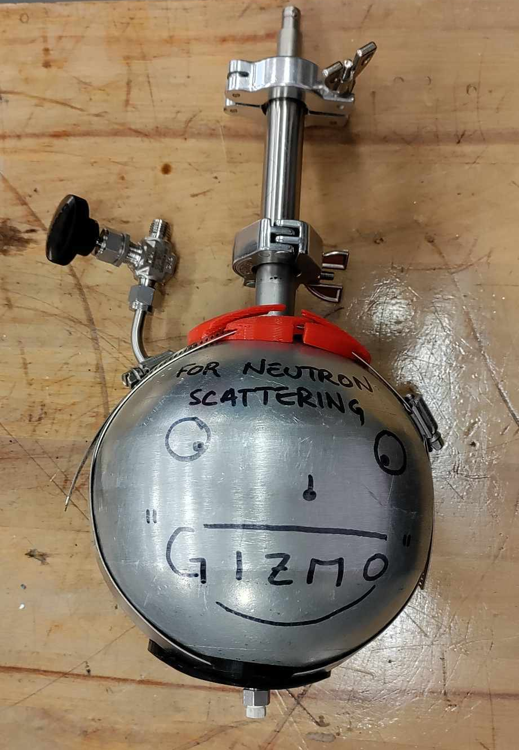
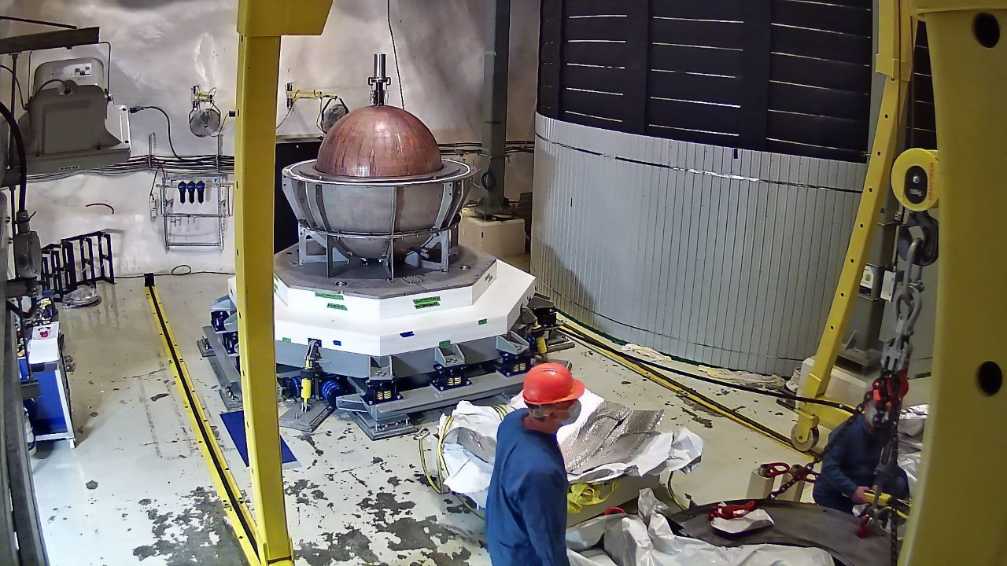
NEWS-G (New Experiments With Spheres – Gas)
A collaboration between 11 universities for dark matter detection.
Spherical Proportional Counter (SPC)
Spherical vessel usually filled with a noble gas
An incoming particle ionizes the gas, generating electrons
Electrons are attracted by a high voltage sensor at the centre, creating a charge which can be measured
Full-Scale SPC at SNOLAB, Sudbury
Small-Scale SPC at Queen’s

Slide 5
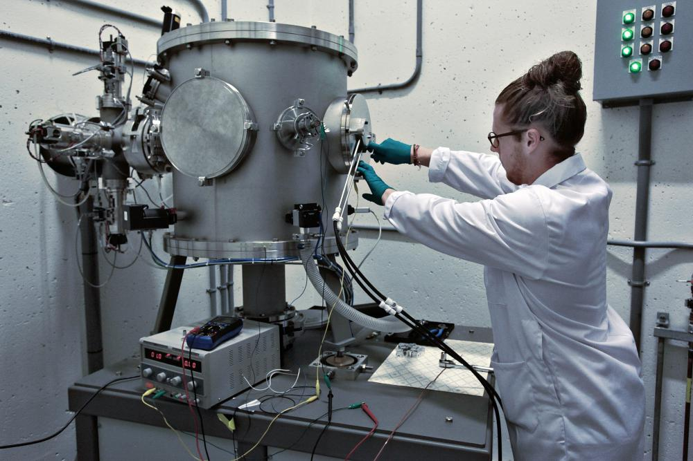
Why make a new beamline?
SPC needs to be calibrated with neutrons
Neutrons behave like hypothetical dark matter particles (theoretically)
Neutrons would only interact with the nuclei of the gas (Which is desirable)
Finding a low energy (10-100 keV) neutron source setup with high intensity is rare
Old chamber is generally used to irradiate samples
Resulted in a lot of gamma radiation when used for SPCs

Slide 6
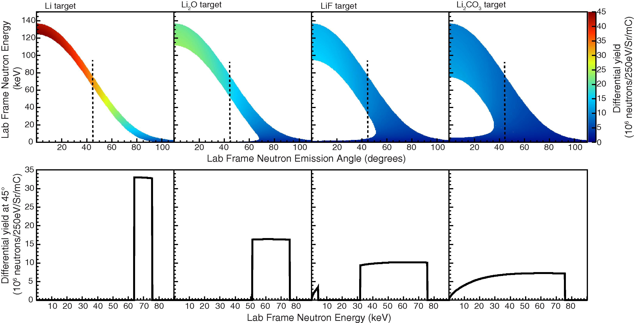
Previous Work: How to get these neutrons?
Lithium Fluoride (LiF) is a good source of Neutrons when bombarded with protons
Calculations done by Joshi et. al [1] show a good yield of neutrons from LiF
Will be using a proton beam energy of around 1.8-2MeV at 20 µA
[1] T.H. Joshi, S. Sangiorgio, V. Mozin, E.B. Norman, P. Sorensen, M. Foxe, G. Bench, A. Bernstein, Design and demonstration of a quasi-monoenergetic neutron source, Nuclear Instruments and Methods in Physics Research Section B: Beam Interactions with Materials and Atoms, Volume 333, 2014, Pages 6-11, ISSN 0168-583X, https://doi.org/10.1016/j.nimb.2014.04.008. (https://www.sciencedirect.com/science/article/pii/S0168583X14005102)
Comparison of differential neutron yields [1]

Slide 7
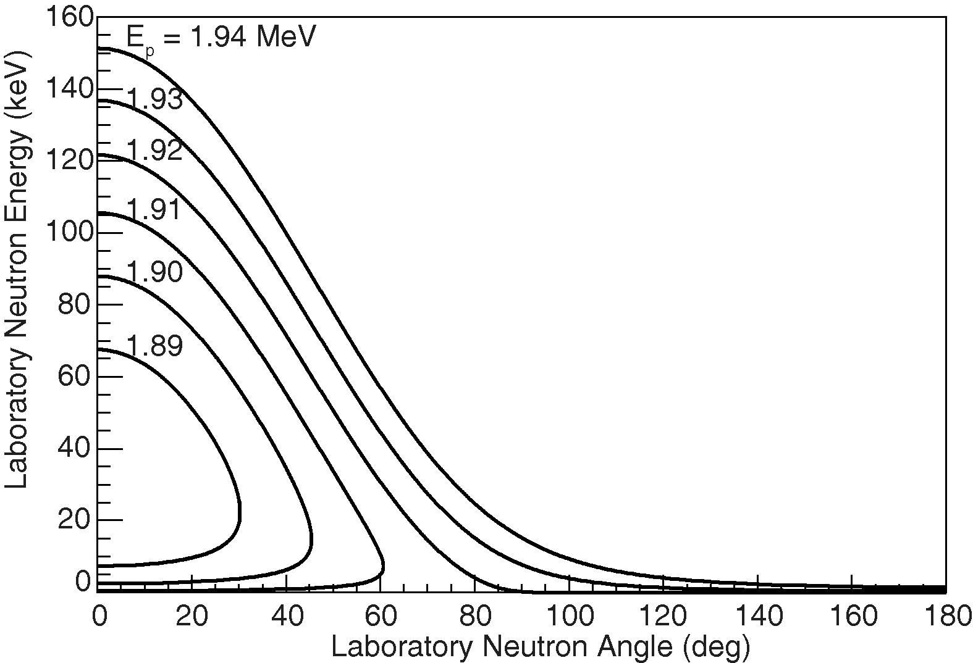
Proton energy contours [1]

Slide 8
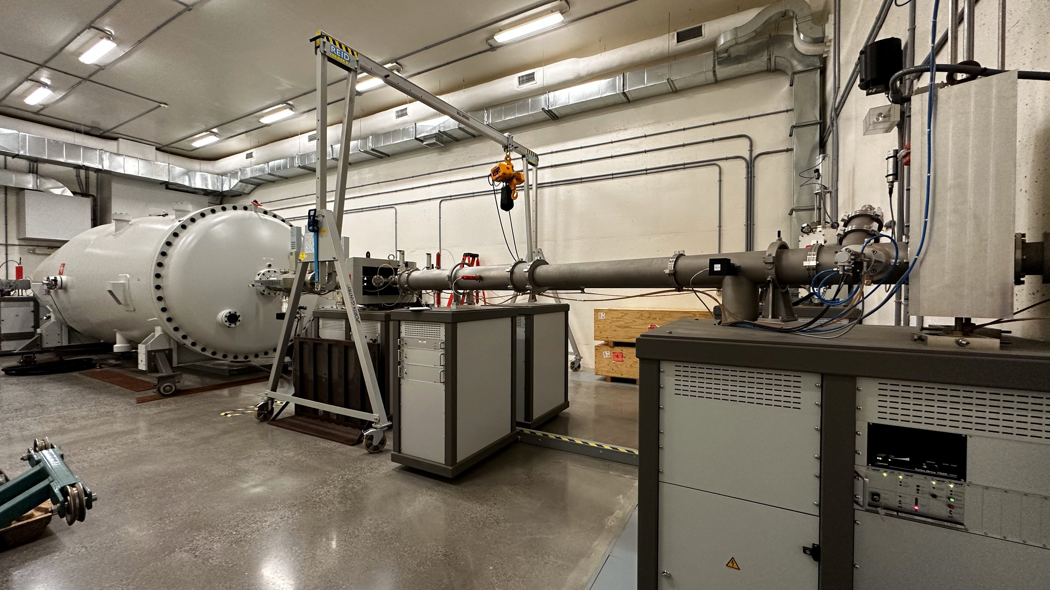
Reactor Materials Testing Lab
Tandem particle accelerator
Can provide up to:
  8MeV and 35 µA of H⁺
  12MeV and greater than 10 µA of He⁺⁺
2 Testing rooms
Operates at a pressure of around 10⁻⁷ mbar

Slide 9
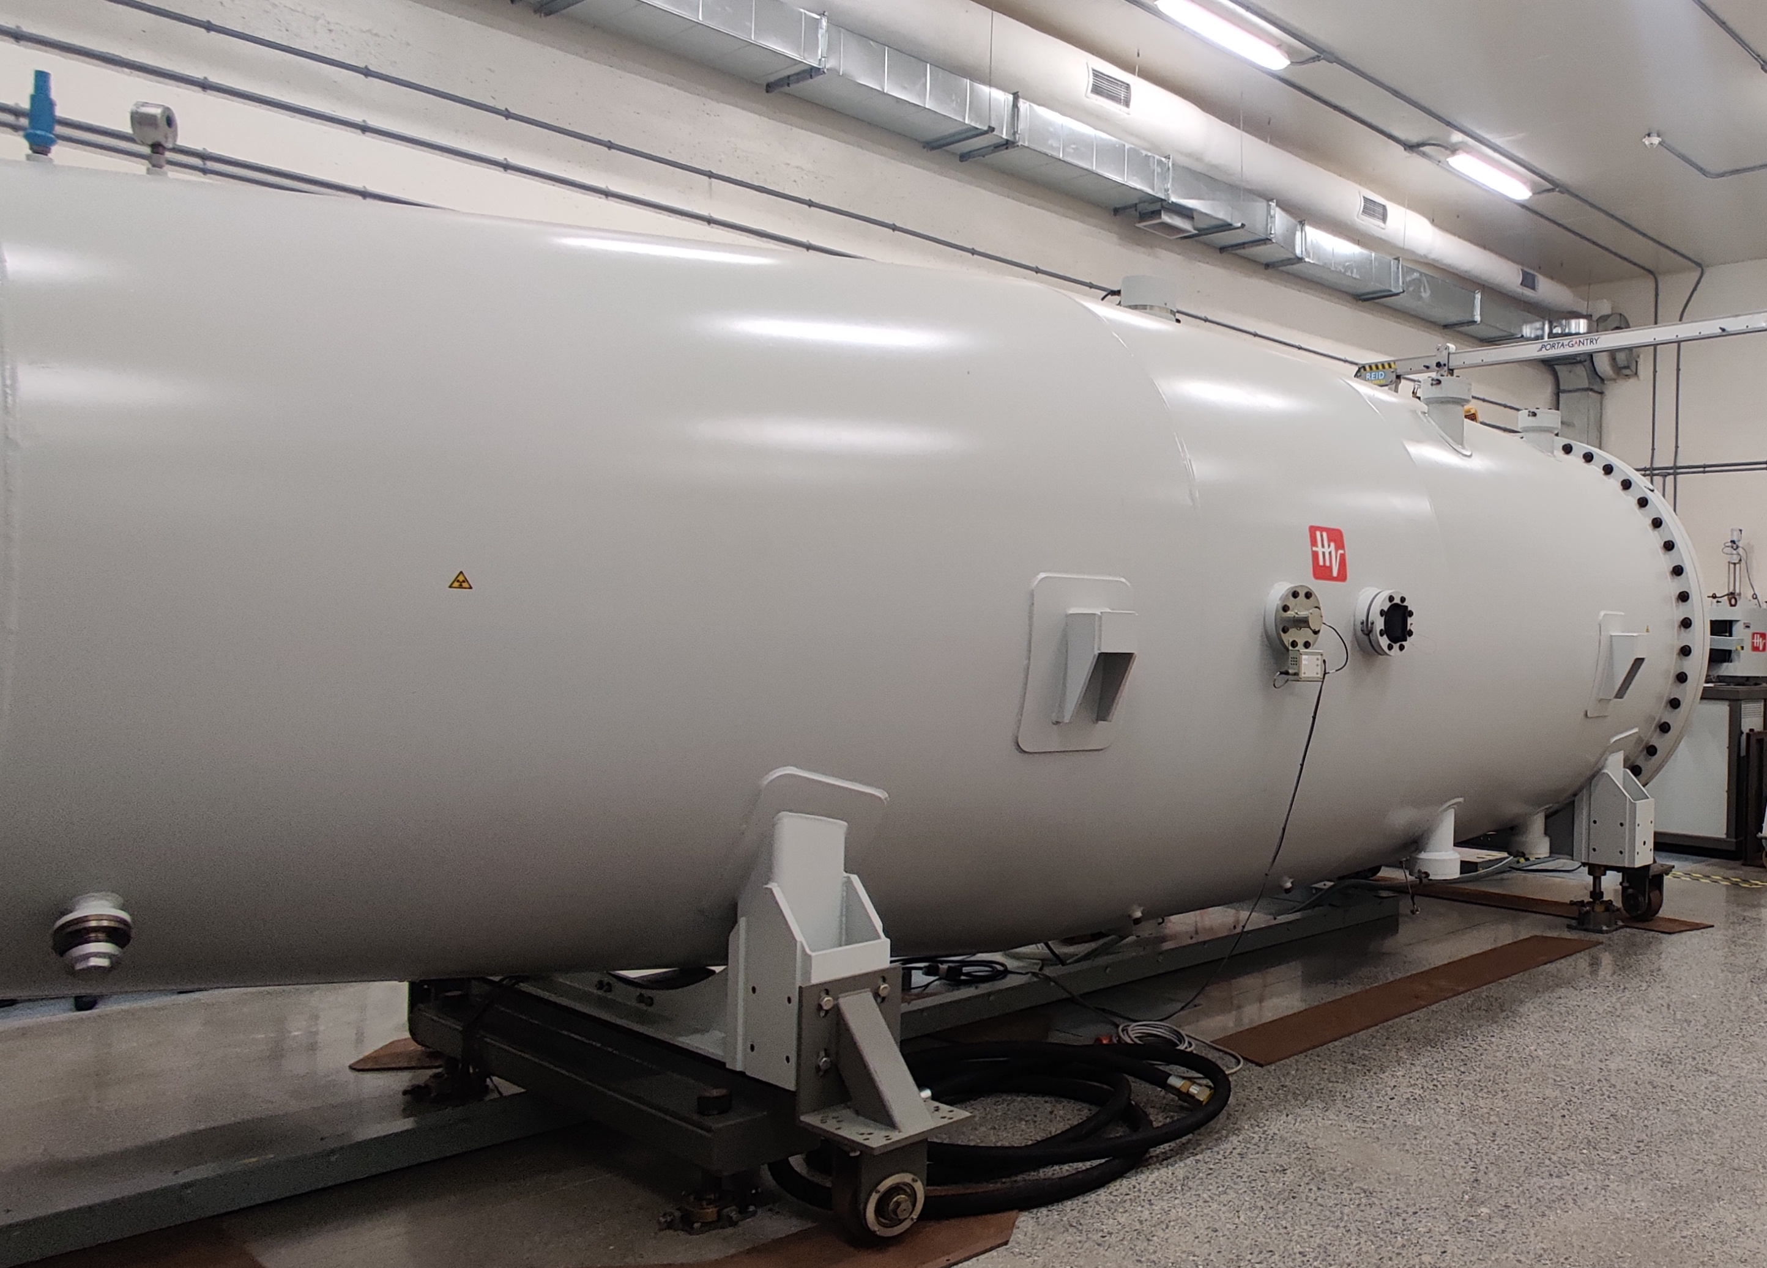
Tandem Accelerator
0V
+4MV
0V
H⁻
Stripper system
(Argon)
H⁺
H⁺ at 8MeV
H⁻

Slide 10
Beamline

Slide 11
Bemaline topics
Design considerations
Finding suitable manufacturers
  Tell about Machine Shop, Kurt Lesker, CCR
  Compare cost, timeline, etc
Support Structures
  Results
Target
  Target design
Thermal analysis
  Setup
  Results

Slide 12
Design Considerations
Minimize gamma radiation
Minimize time to generate vacuum
Maintain a pressure difference of 10⁻⁷mbar and 1013 mbar (Atmosphere)

Slide 13
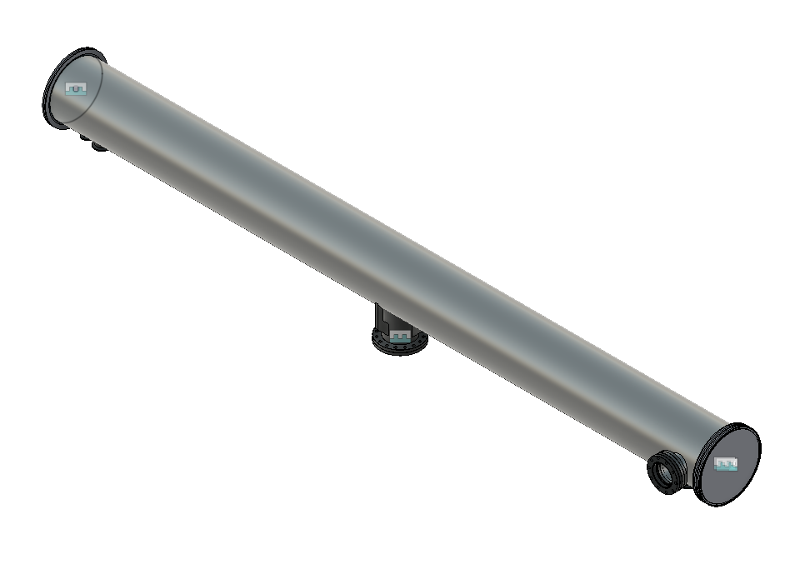
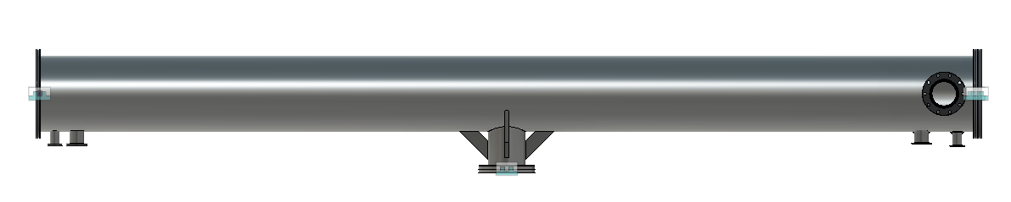
Main Chamber
ISO 200K
8-inch diameter
2.5m length
304L Stainless Steel
SS has small gamma radiation output
Manufactured by Kurt J Lesker Company in 12 weeks

Slide 14
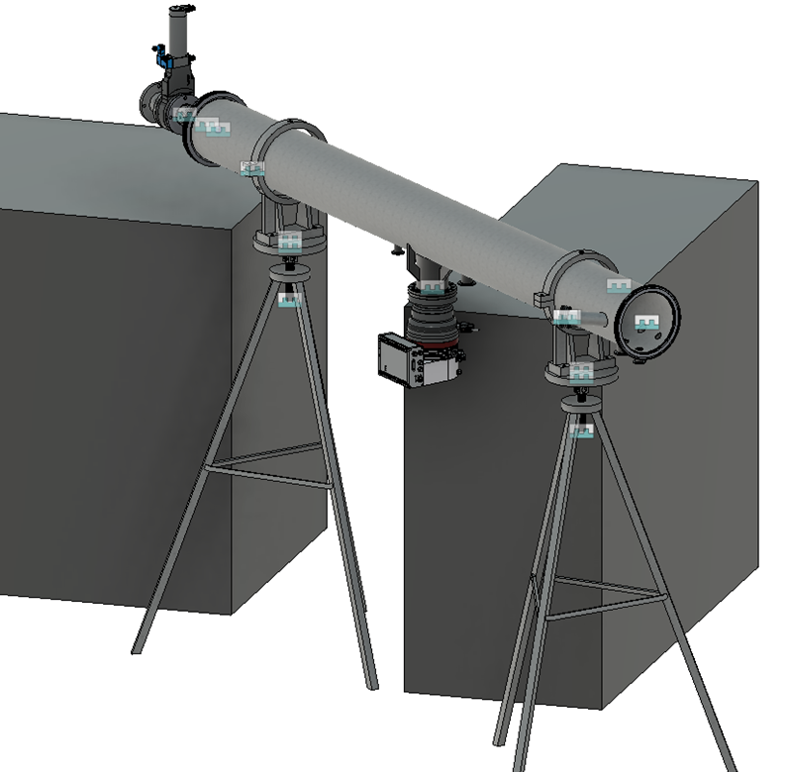
Scale: 1m

Slide 15
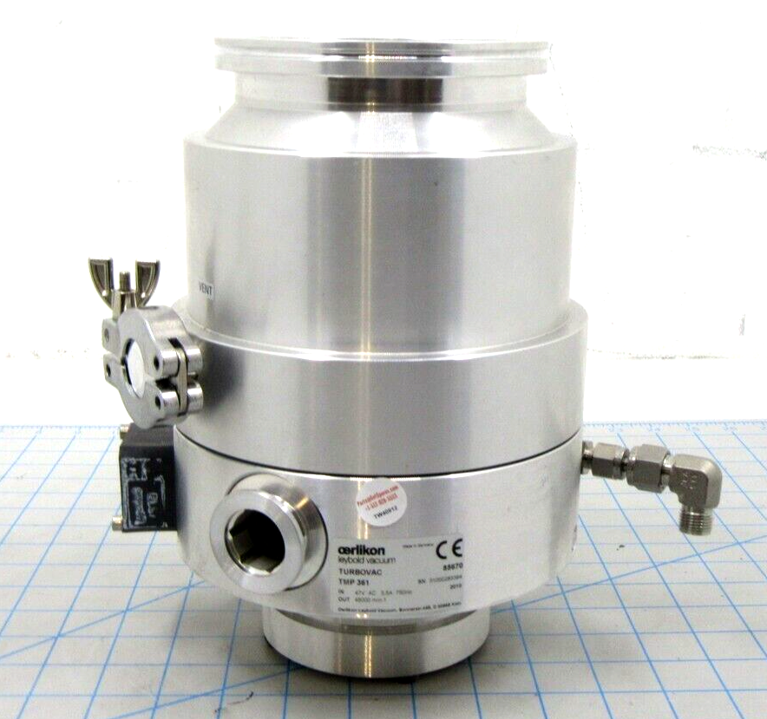
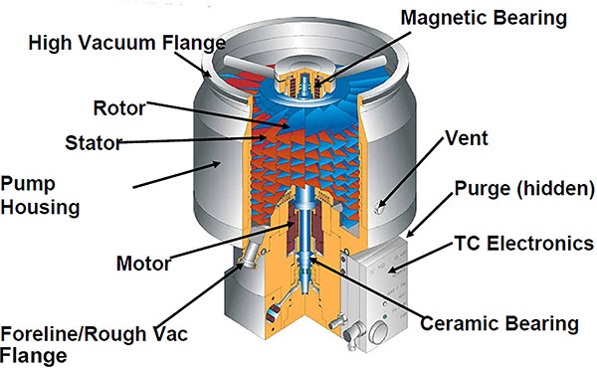
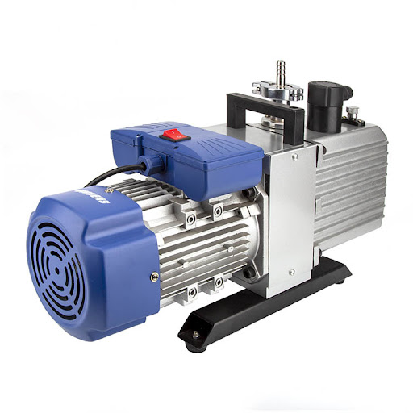
Vacuum System
Required pressure of 10⁻⁷ mbar
Achieved by a combination of a roughing pump and a turbomolecular pump in series
Roughing pump brings down the pressure to 10⁻² mbar
Turbomolecular pump starts after this stage
Turbo-Molecular Pump
Image taken from Kurt J. Lesker Company
Rotary Vane Roughing Pump

Slide 16
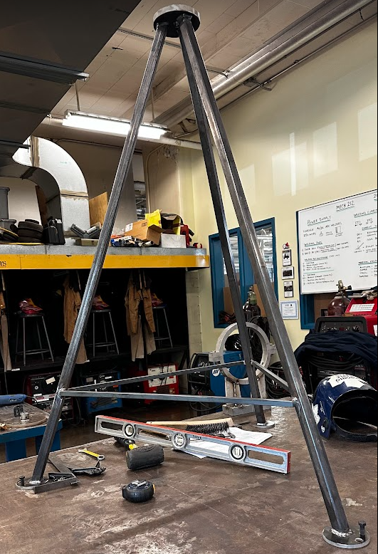
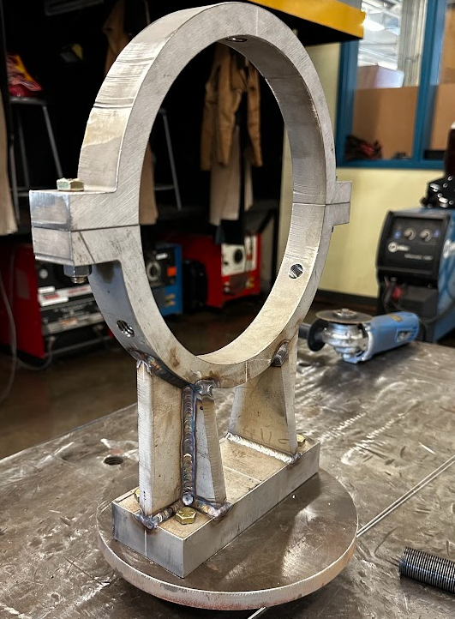
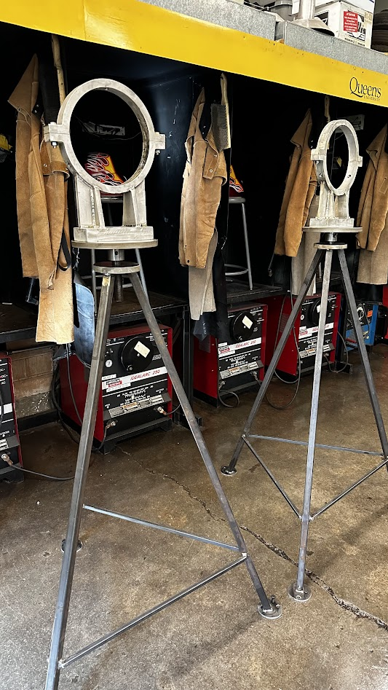
Support Structures:

Slide 17
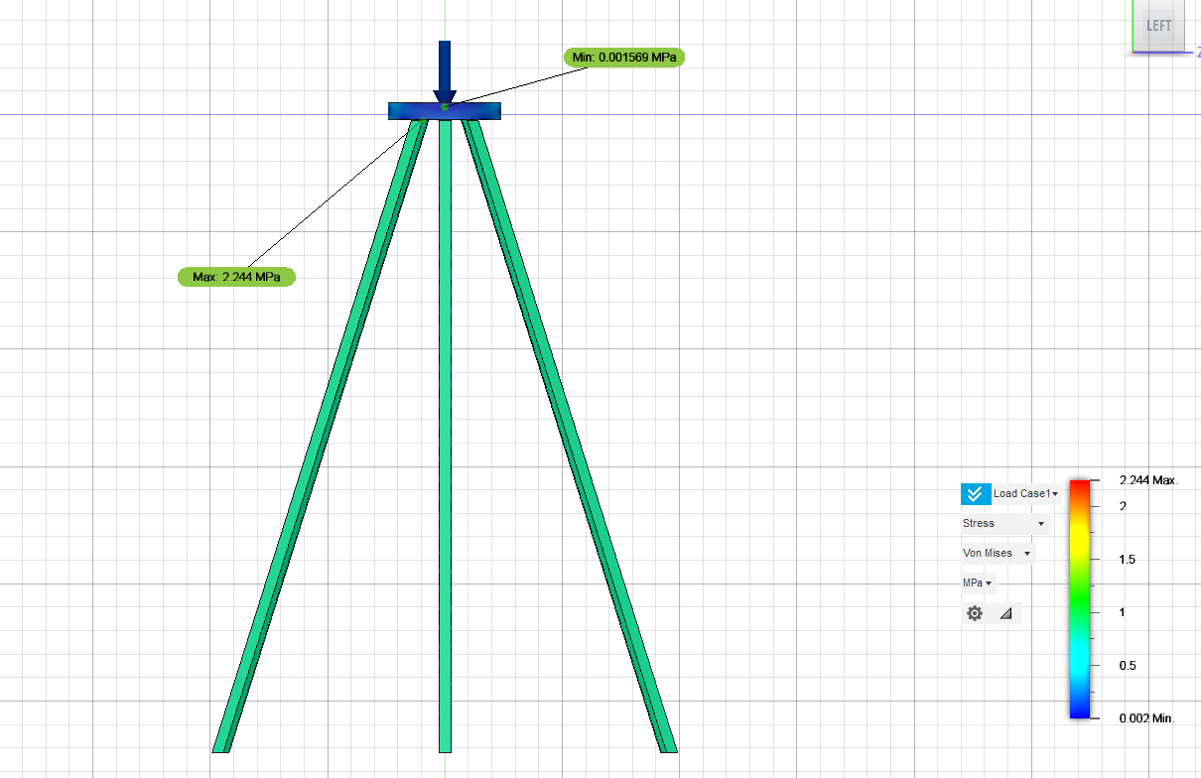
Load Analysis for support structures
A simple static stress study was done on Fusion 360
Even with double the operating load (400N), Maximum Von-Mises Stress is 2.244MPa

Slide 18
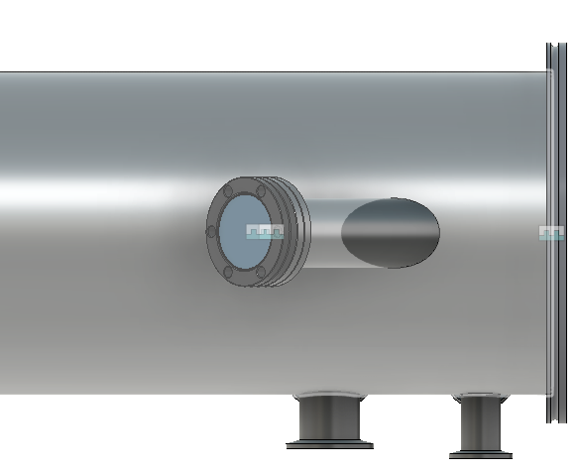
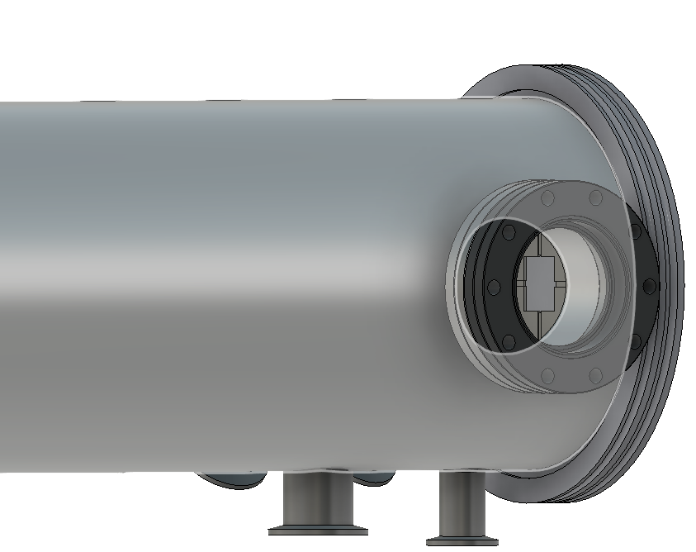
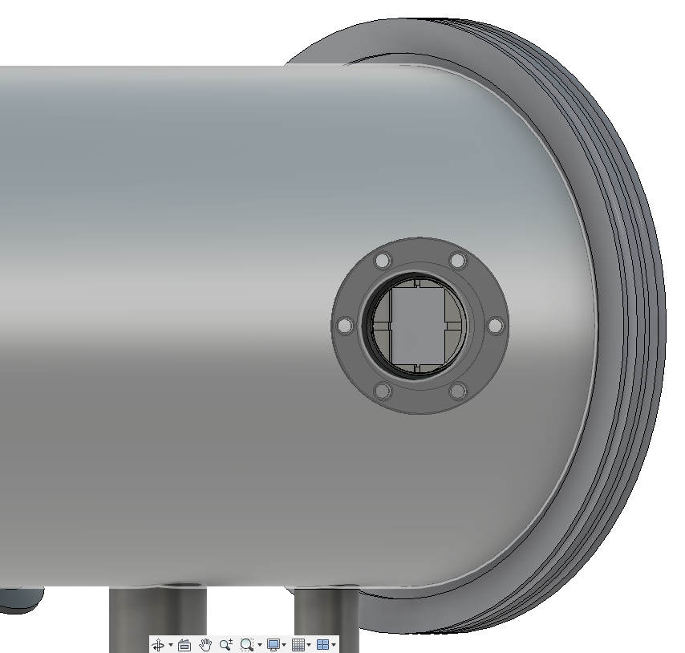
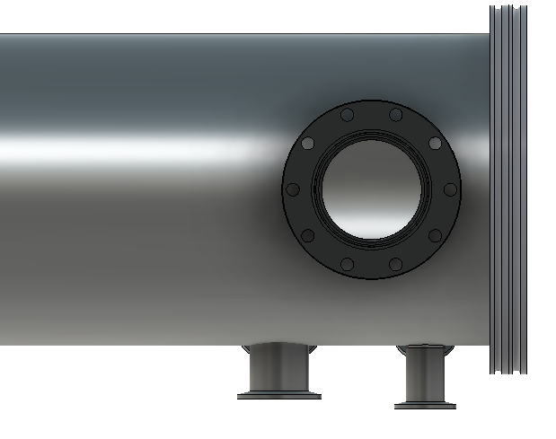
Viewport
Allows to view target in real time
Originally at an angle
Changed to a straight port with a wider diameter
Resulted in a decrease of lead time from 20 weeks to 12 weeks
Old Design
New Design

Slide 19




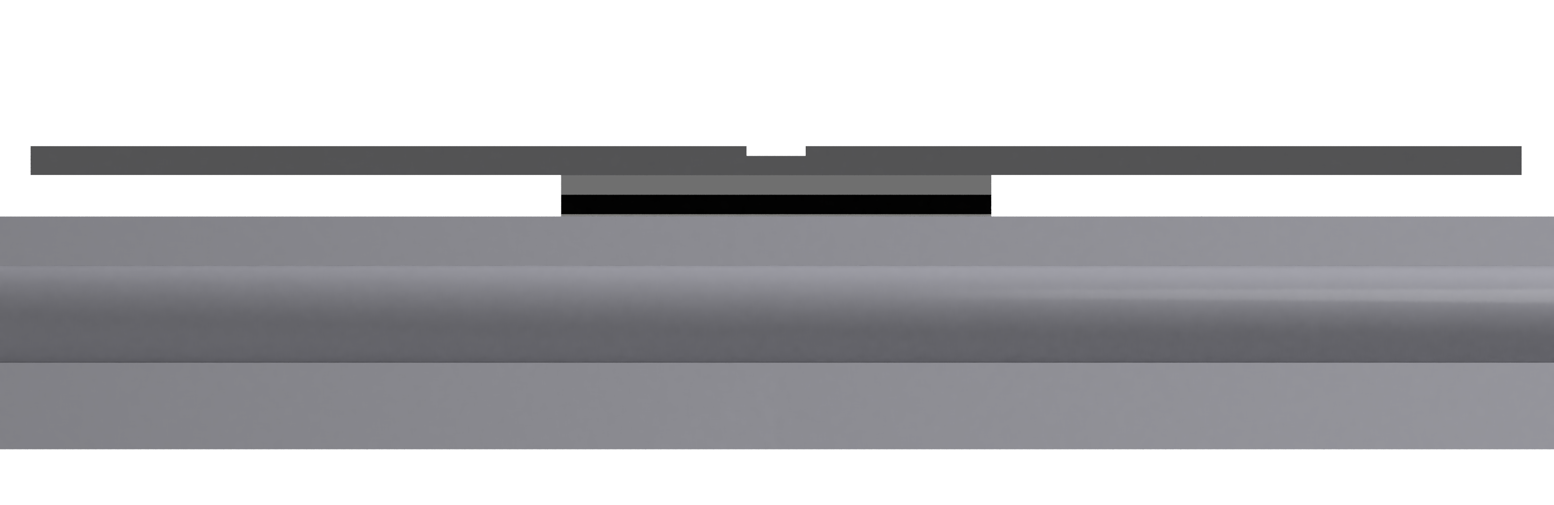
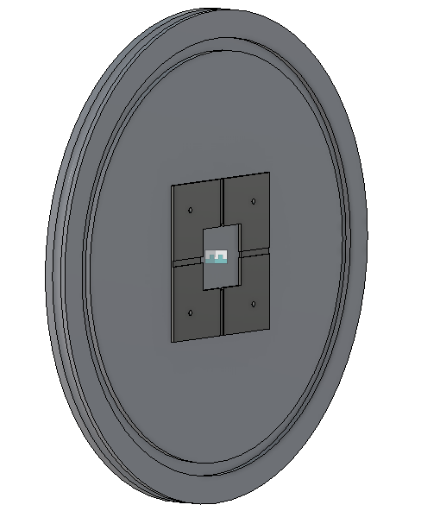
Target
LiF (1 µm) Evaporated on 2mm Tantalum Substrate
Tantalum Hold down plate
1 mm Aluminium Nitride Backing Plate (for thermal conduction, and electrical insulation)
304L SS ISO200K Flange
Target Flange (Side View)

Slide 20
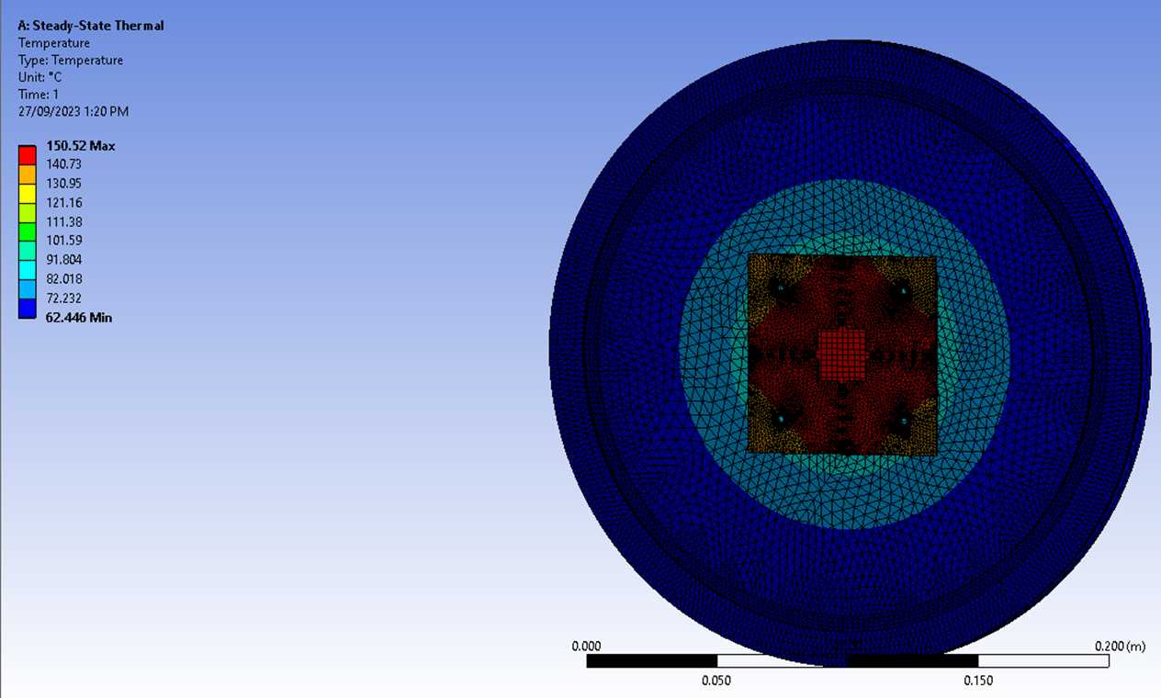
Thermal Analysis
LiF has a melting point of 848°C , however, as it’s only 1μm, proton beam can sputter it off at around 100-200°C
Cooling methods like liquid cooling cannot be implemented
An external fan kept at a distance is the best option
Simulation analysis was done to ensure we do not reach extreme temperatures
With beam properties of 2MeV and 20μA of proton beam, a heat source of 40W was applied on target

Slide 21
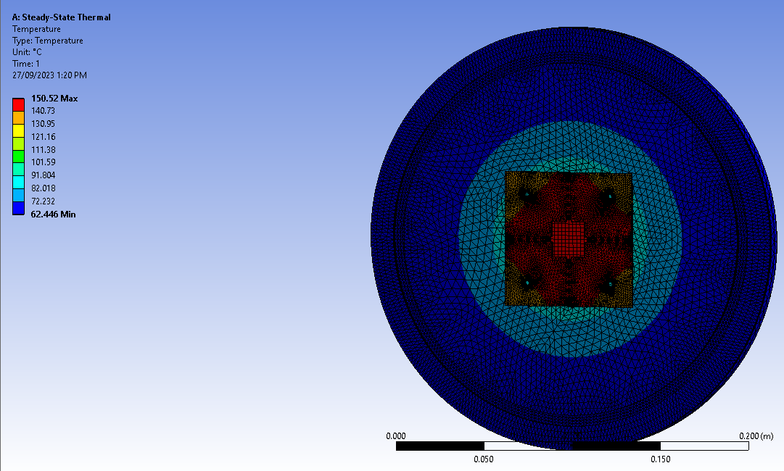
Thermal Analysis
With 2MeV and 20μA of proton beam, a heat source of 40W was applied on target
Only radiation heat transfer was allowed on the “inner” part of flange
Ambient convective heat transfer was applied on the “outside”
Conduction between layers

Slide 22
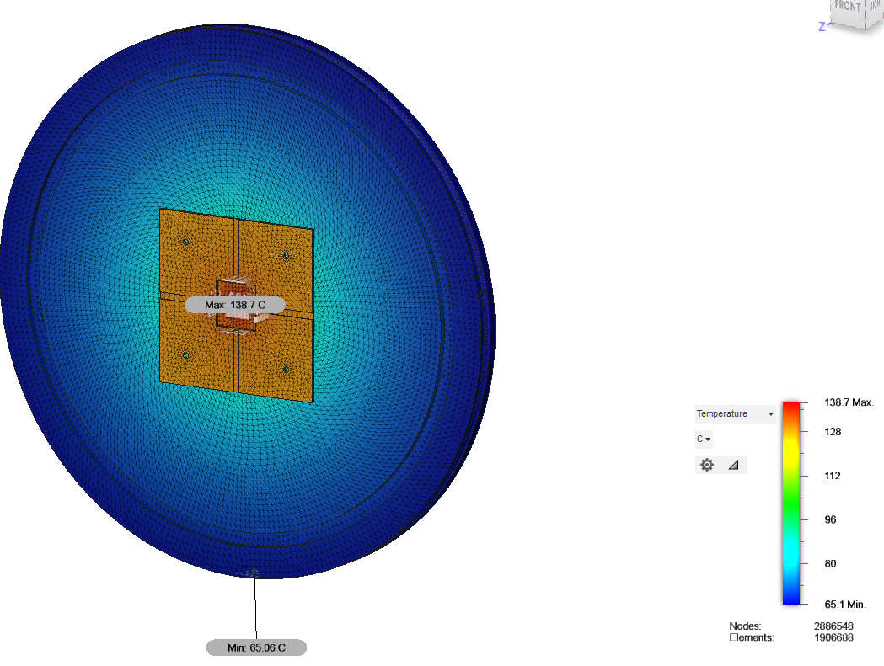
Thermal Analysis: Fusion 360
Results were compared with a similar simulation on Autodesk's Fusion 360
A finer mesh was implemented
Same conditions

Slide 23
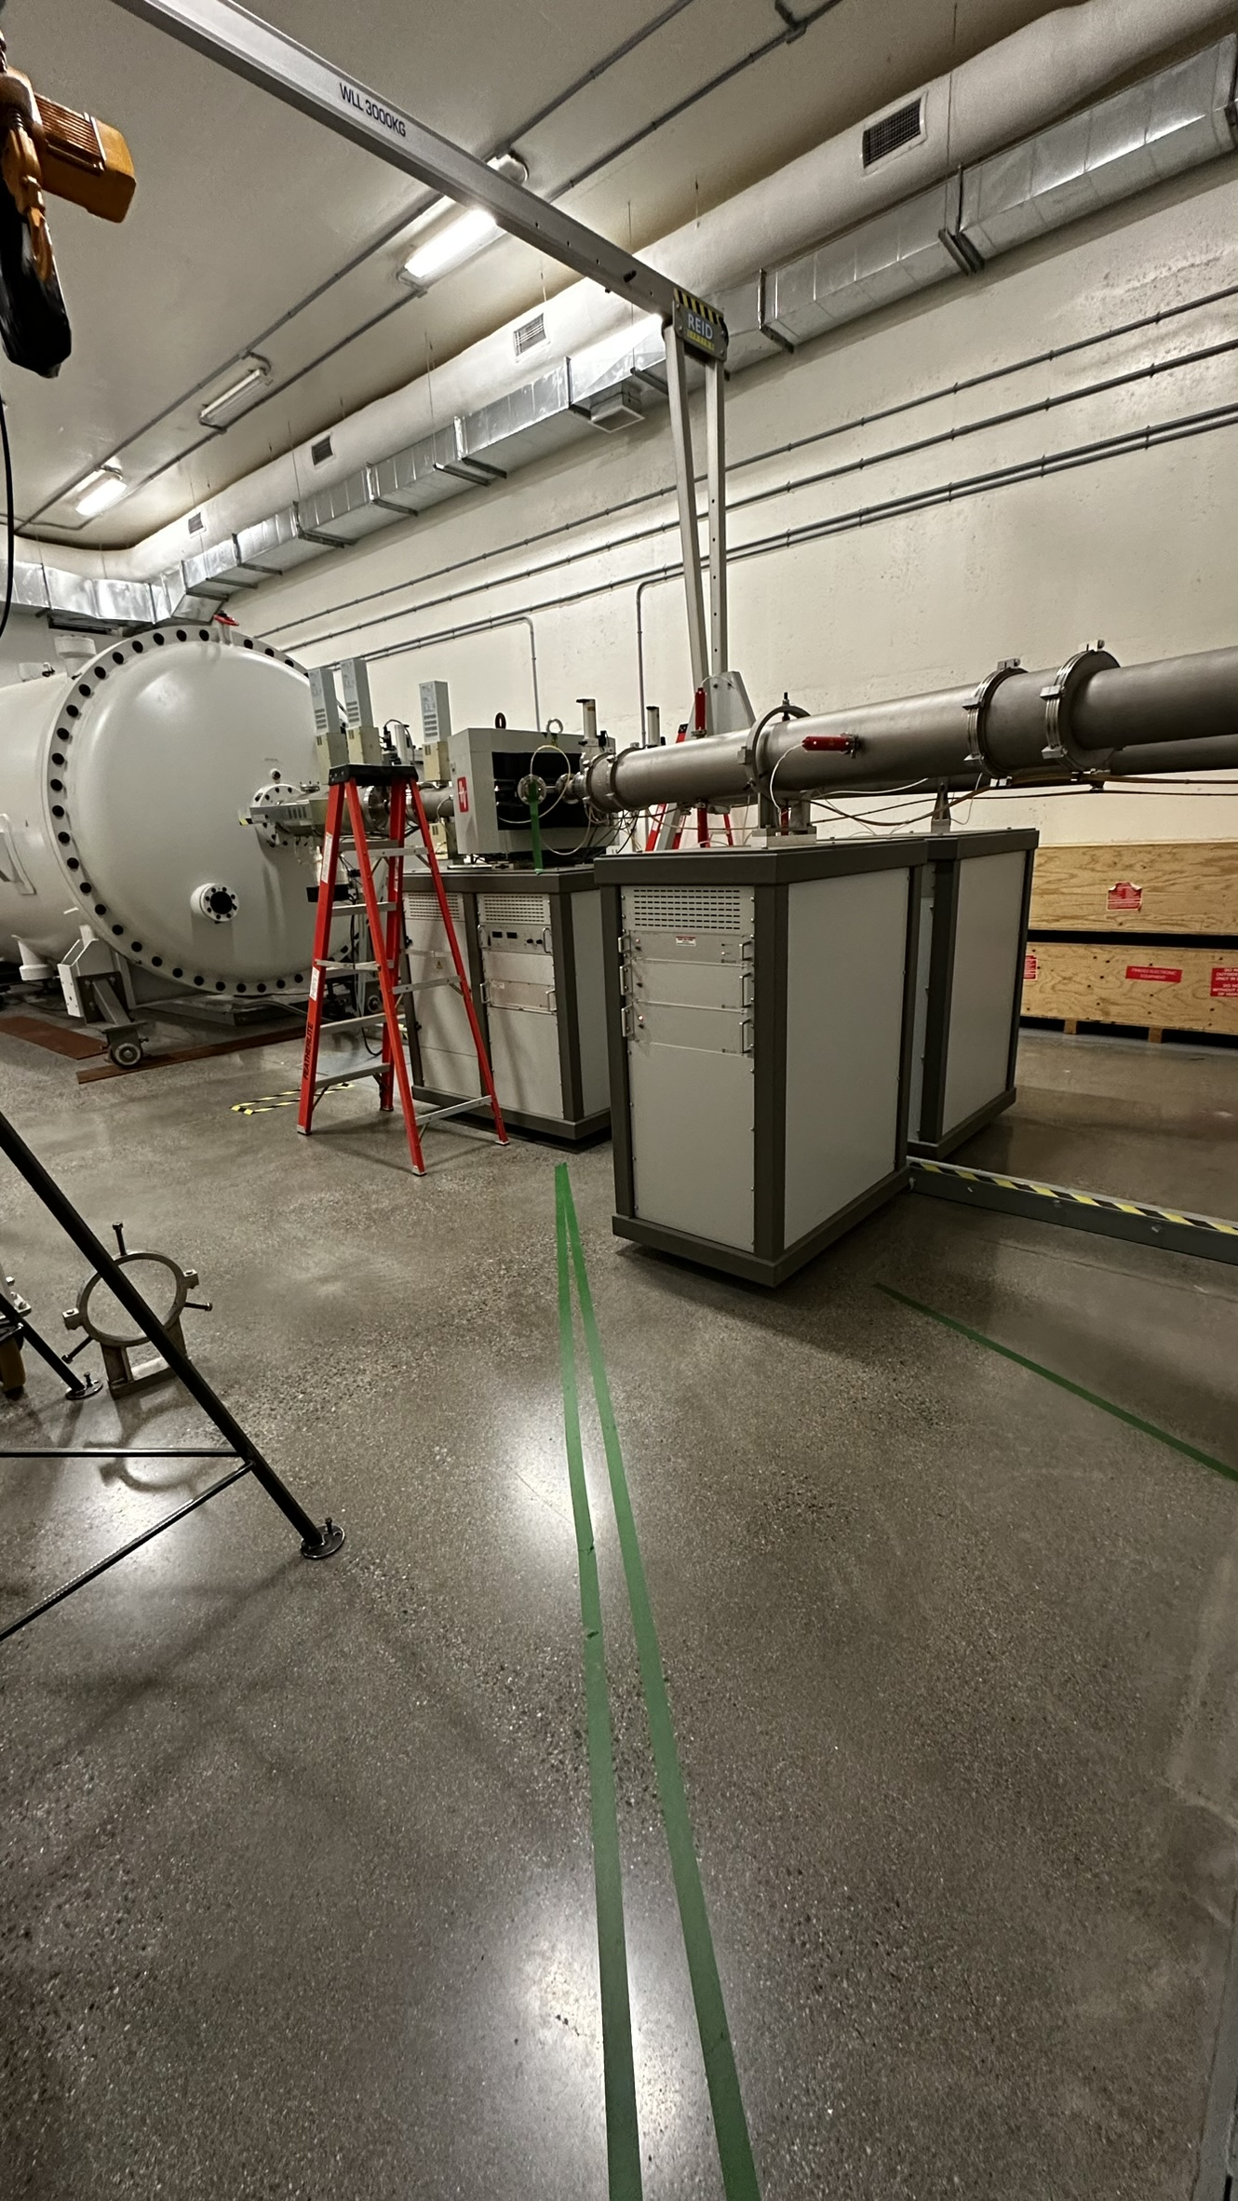
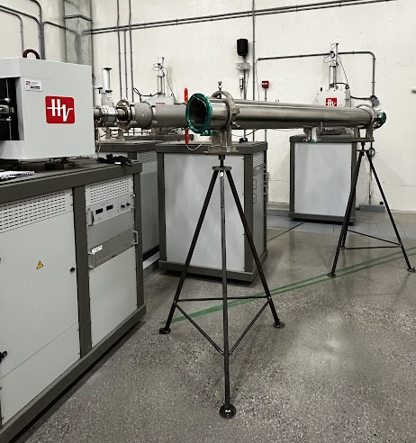
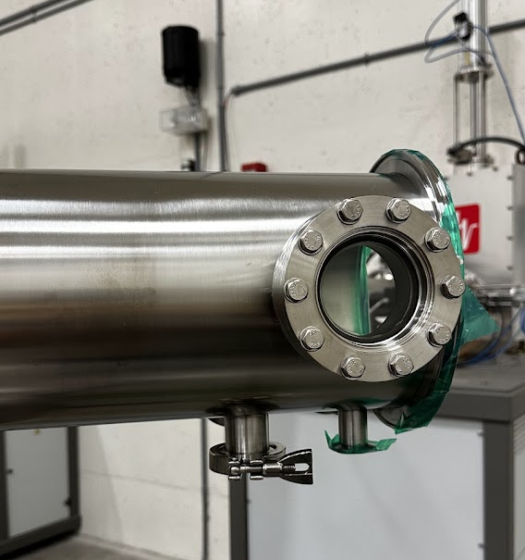
Current State: Assembly Begins
Chamber needs to align precisely
Since the chamber is over 2.5m long, even one degree can result in an error of ~30mm
Confirmed the beam angle to be at 45° using auto-leveling laser

Slide 24
Future Work

Slide 25
Beam Characterisation
The new beamline would need new control settings which are not known yet
Beam will be defocused
Make sure it hits the target by being the right size
Does not overheat

Slide 26
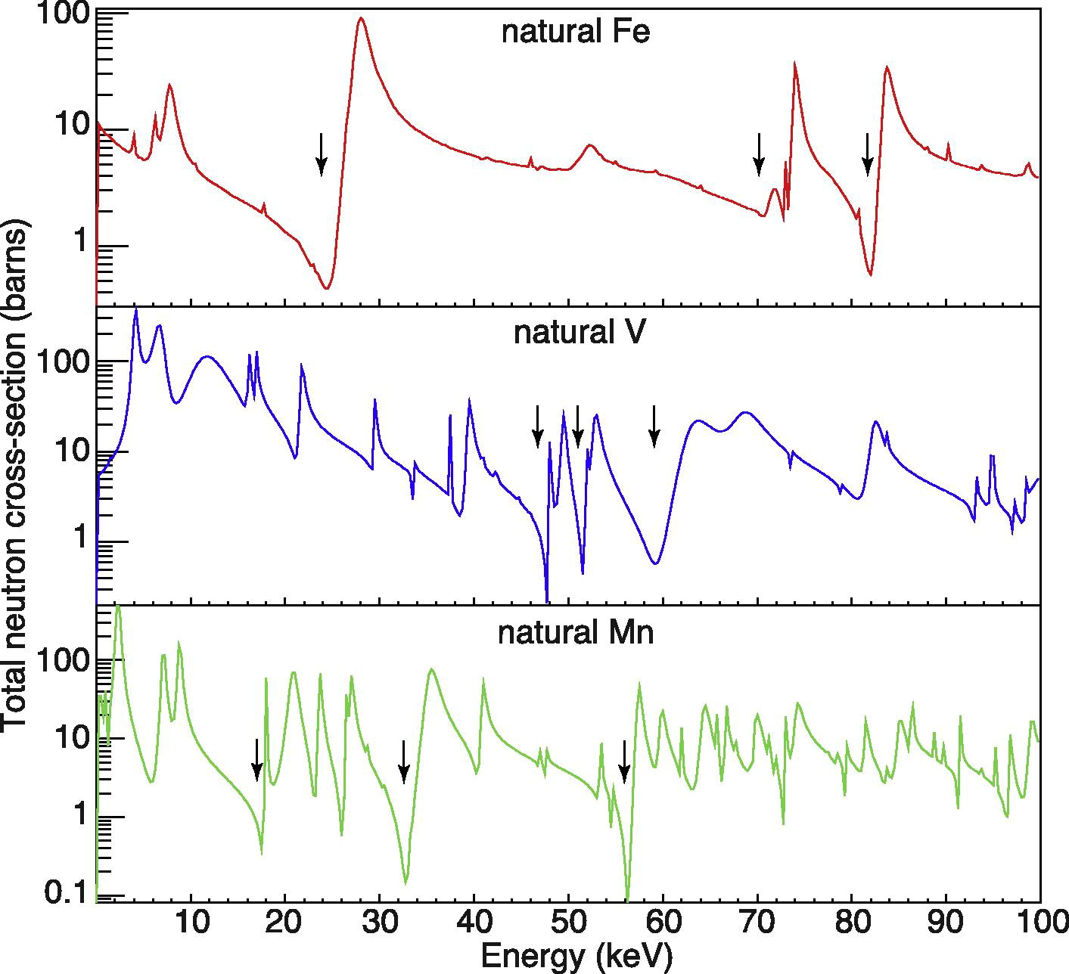
Collimator (Iron Filter)
A beam of monoenergetic neutrons is needed
Iron is capable of “filtering” out neutrons at specific energy levels
Borated-Polyethylene will be used to collimate neutrons
Lead is a good absorber of gamma radiation
Collimator will be designed to rotate from 33°-55° about the target
Simulations using GEANT4 are being done to find the perfect dimensions
Interference Notches [1]
BPE
LEAD
SPC
IRON
BPE
LEAD
Note: 1 barn = 10⁻²⁸m²
Section View of the iron filter
Notes:
Around 20 cm in length and height and 40cm wide

Slide 27
Conclusion
With the extra space we are confident to expect the reduction of gamma radiation
We expect to get a monoenergetic source of low energy neutrons at 24keV
This should help the physics team with their calibration, which can ultimately be implemented at SNOLAB

Slide 28
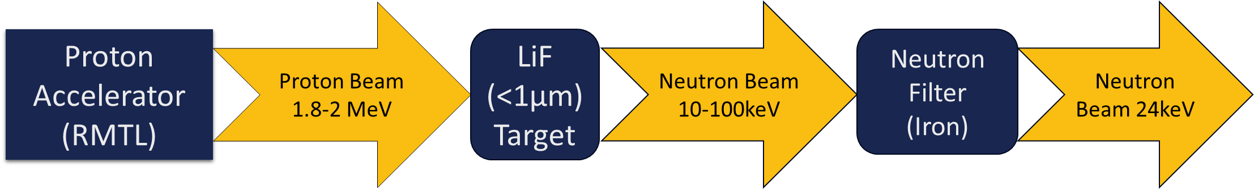
To summarize

Slide 29
References
T.H. Joshi, S. Sangiorgio, V. Mozin, E.B. Norman, P. Sorensen, M. Foxe, G. Bench, A. Bernstein, Design and demonstration of a quasi-monoenergetic neutron source, Nuclear Instruments and Methods in Physics Research Section B: Beam Interactions with Materials and Atoms, Volume 333, 2014, Pages 6-11, ISSN 0168-583X, https://doi.org/10.1016/j.nimb.2014.04.008. (https://www.sciencedirect.com/science/article/pii/S0168583X14005102)

Slide 30


Acknowledgments
The whole team of Reactor Materials Testing Lab
Arthur B. McDonald Institute
My supervisor Dr Levente Balogh

Slide 31
Thank you!
Any questions and/or suggestions?

