Slide 1


Marginally Outer-Trapped Tori in maximally extended Schwarzschild spacetime
at CAP Congress 2024
May 28
Kam To Billy Sievers
Based on: Marginally Outer Trapped Tori in Black Hole Spacetimes,
Booth, Hennigar, Kunduri, Muth, Newhook, Sievers. PRD

Slide 2
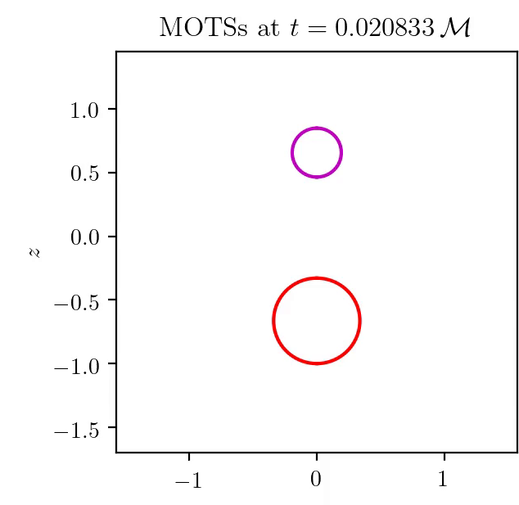
BH Merger
Summary in Booth, Hennigar, Pook-Kolb [PRL, PRD x2], video courtesy of Daniel Pook-Kolb.

Slide 3

Marginally Outer Trapped Surface
(MOTS)
vanishing
outward null expansion
$$r=2M$$

Slide 4
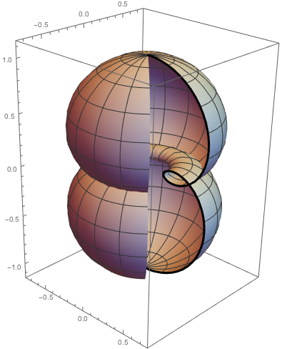
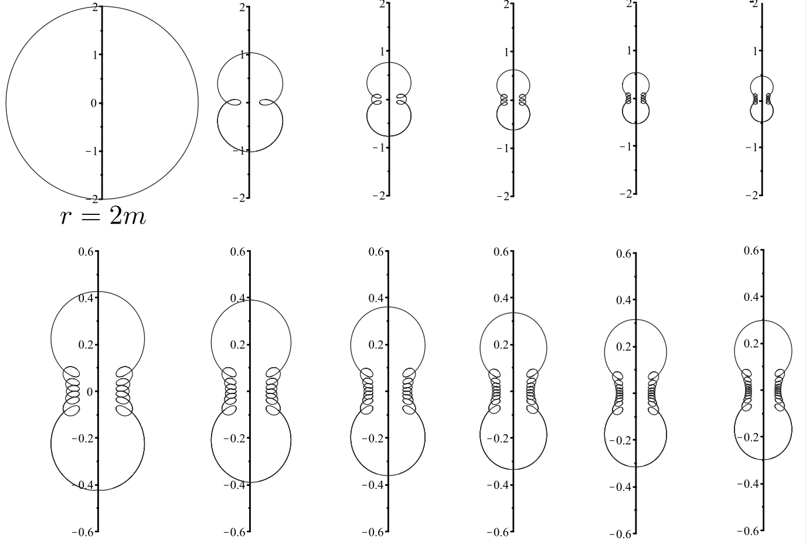
MOTSs in other black holes
Booth, Hennigar, Mondal. PRD
Booth, Hennigar, Newhook, (Sievers). PRD
Booth, Hennigar, Kunduri, Muth, (Sievers). CQG

Slide 5
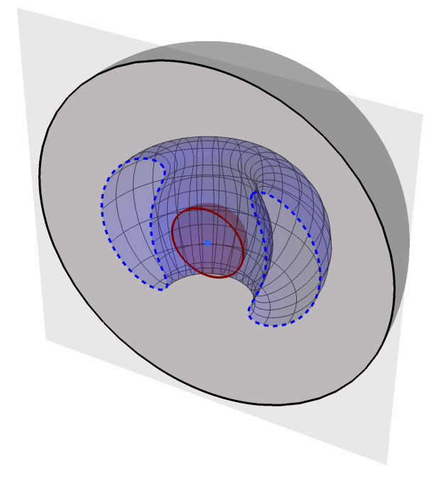
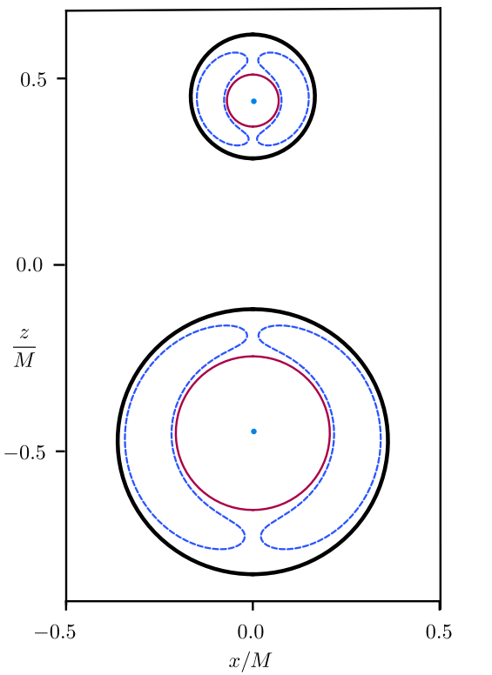
Toroidal MOTSs in Merger
Puncture data is used
Non-time-symmetric hypersurfaces
Toroidal MOTSs are present but not involved in merger process
Figure adapted from Booth, Hennigar, Pook-Kolb. PRD

Slide 6
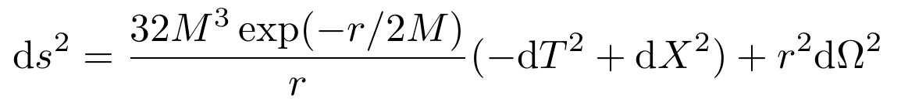


Kruskal-Szekeres extension of Schwarzschild
Certain const. T hypersurfaces are non-time-symmetric and/or exhibit an Einstein-Rosen bridge between two asymptotically flat regions

Slide 7

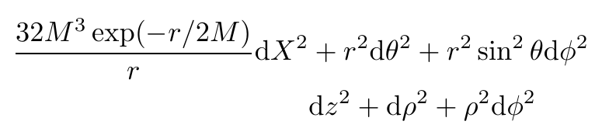
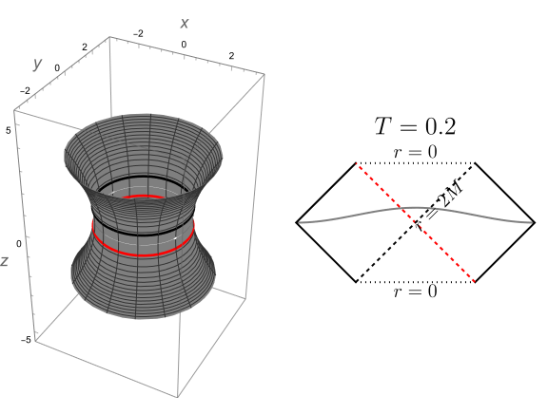


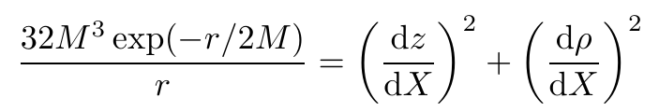
Visualization of const. T slices
  Embed const. T hypersurface in flat
  Black hole interior

Slide 8
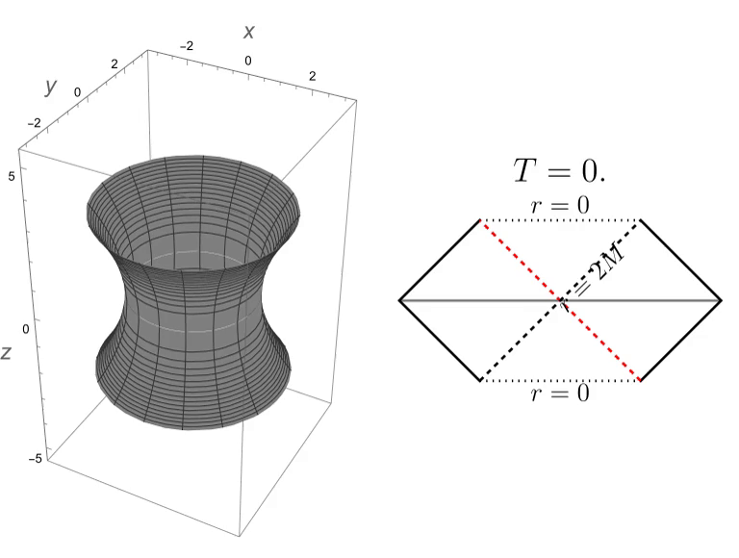
Visualization of each T

Slide 9
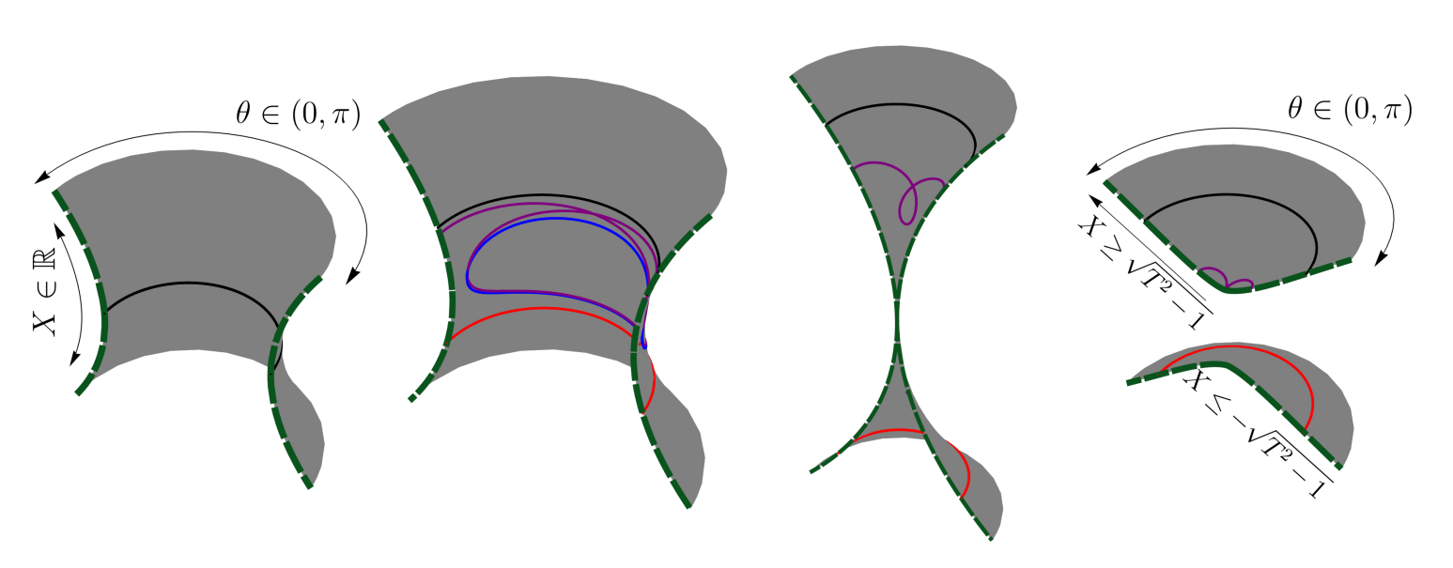
MOTSs in Kruskal-Szekeres

Slide 10
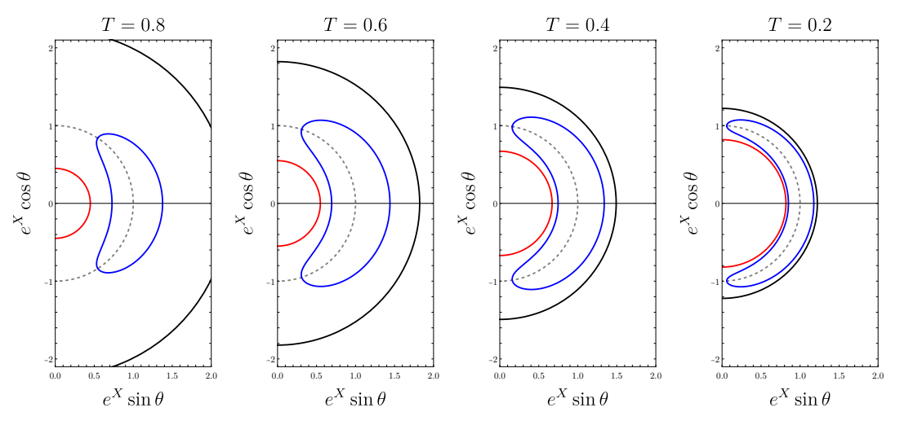
Tori in Kruskal-Szekeres

Slide 11
Conclusion
Marginally outer-trapped tori have been numerically found in the Schwarzschild spacetime — departure from time-symmetry.
Self-intersecting MOTSs persists in these coordinates.
Framework for MOTSs in const. Kruskal-Szekeres time T hypersurfaces developed.

